Slide 1

$π^{+}π^{−}$ production with pion beams: HADES data
Two-pion
Witold Przygoda
HADES Collaboration
23 May 2018, Orsay

Slide 2
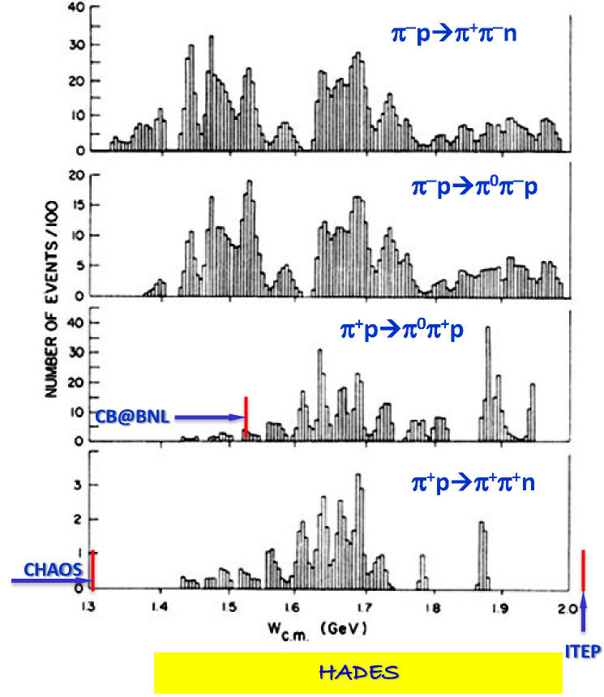
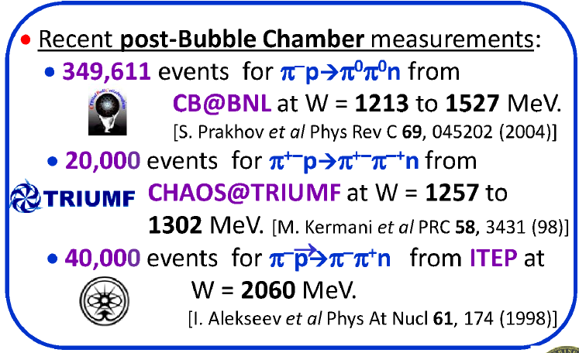

πN→ππN status
most of data 1.3 <√s <2 GeV from
Manley et. al PRD30 (1984) 904
241214 bubble chamber events
analyzed in isobar PWA model
knowledge on N* coupl. to ρN, Δπ, σN
very scarce data base for
pion-nucleon reactions
differential distributions
are even more scarce (or missing)
more recent data do not help for
π⁺π⁻ in 1.3 <√s < 2 GeV region

Slide 3

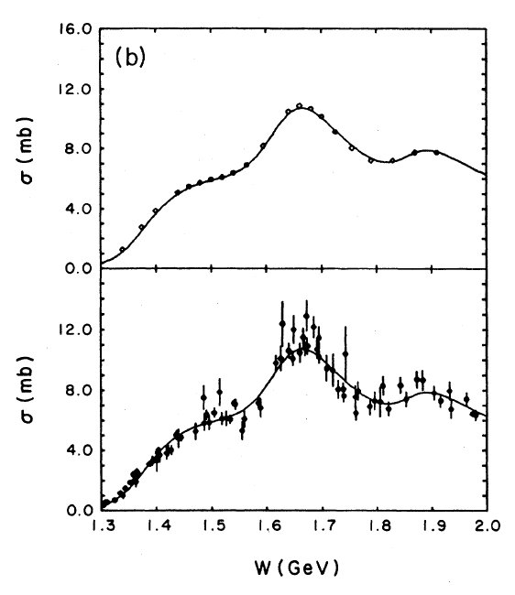
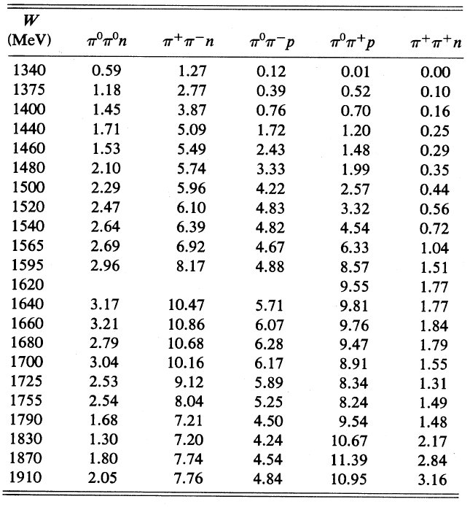

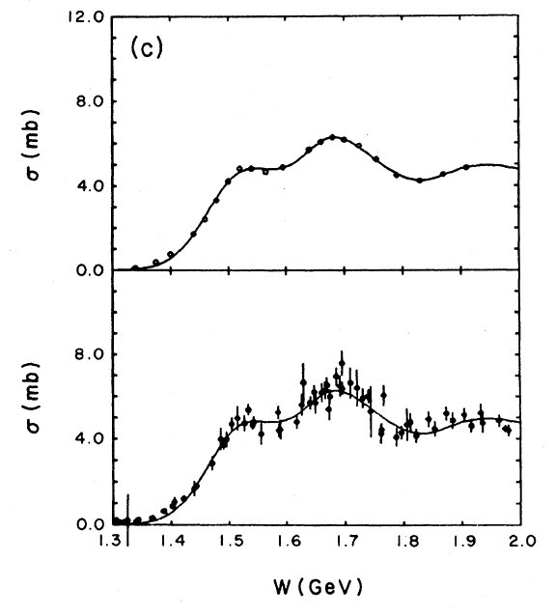
HADES physics for pion beams (2014)
D. M. Manley et al.
Phys. Rev. D 30 (1984) 904

Slide 4
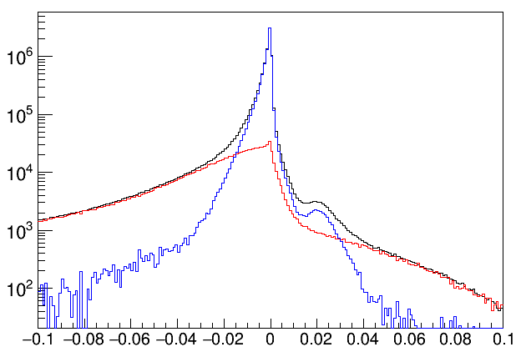
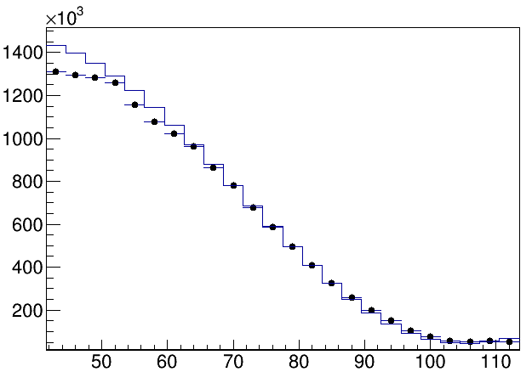
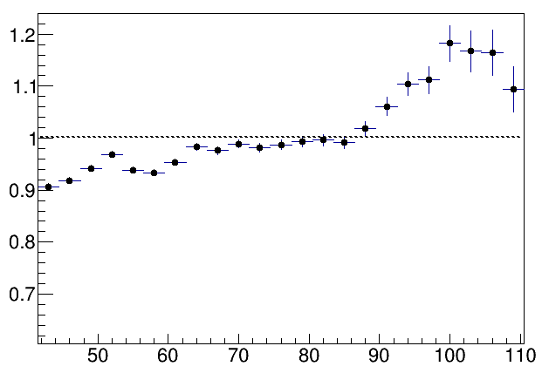
elastic events (C subtr.) | SAID compared
πp miss. mass²
690 MeV/c
690 MeV/c
PE target
p, Carbon
corrected yield
60⁰ < θ_{CM} < 110⁰
MC simulation: acc & eff correction
beam momenta adjusted to measured
(HADES spectrometer) values:
652, 685, 740, 790 MeV/c
corrections for energy loss
obtained scaling used
then in π⁺π–, π⁰π–, e⁺e–
±10%
θ_{CM}
exp normalized to the same area

Slide 5
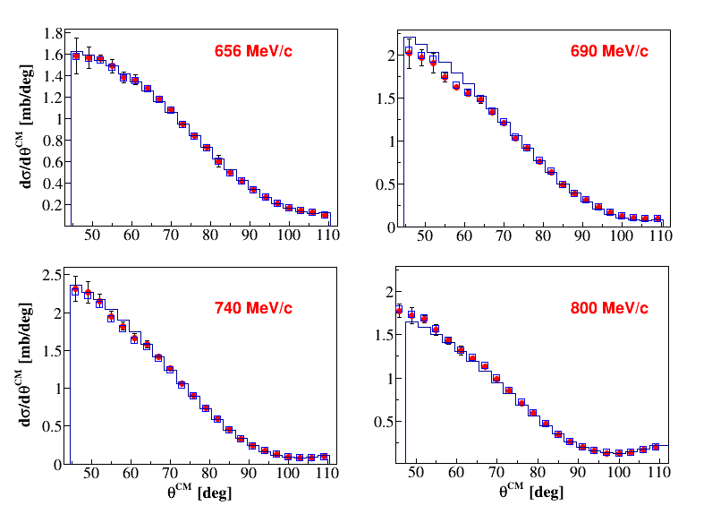
elastic events | results
DATA – mean of sectors, error=RMS
SAID

Slide 6
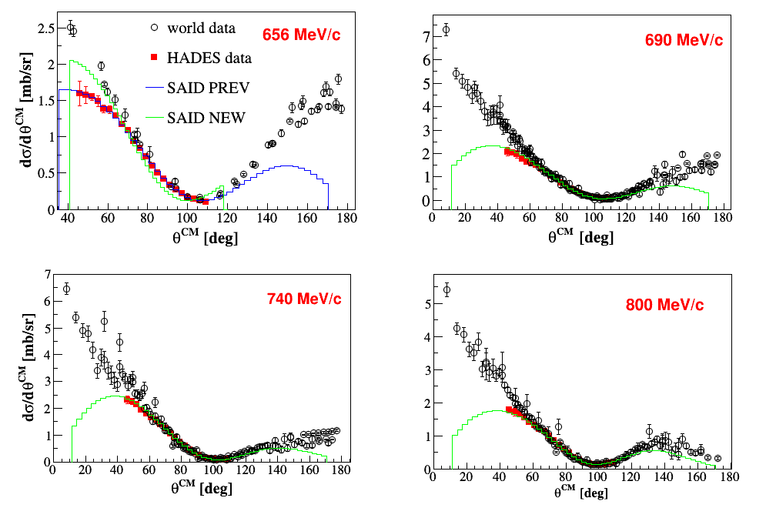
elastic events | SAID database

Slide 7
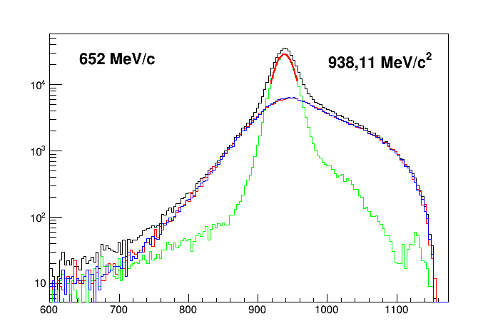
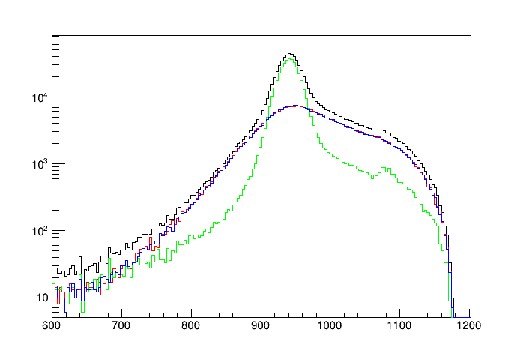
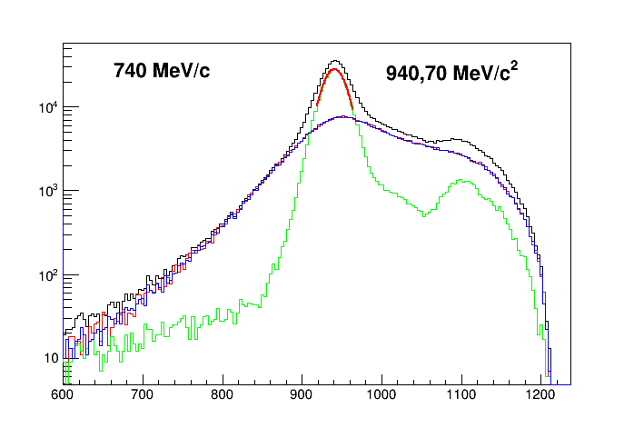
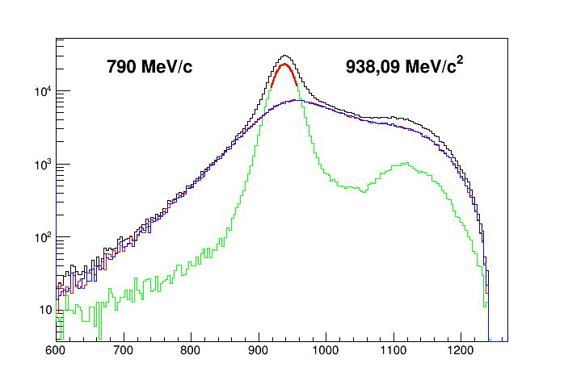
(n π⁺π⁻) events – scaling from elastic
656 MeV/c
690 MeV/c
941,10 MeV/c
748 MeV/c
800 MeV/c
17
π ⁺π – missing mass
π ⁺π – missing mass

Slide 8
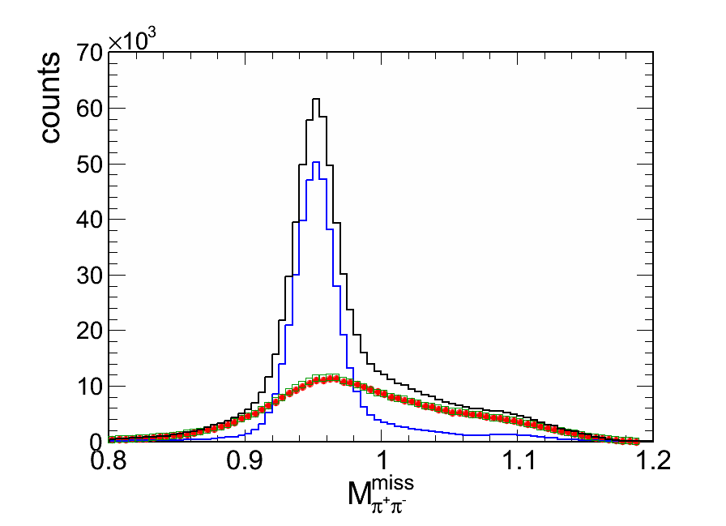
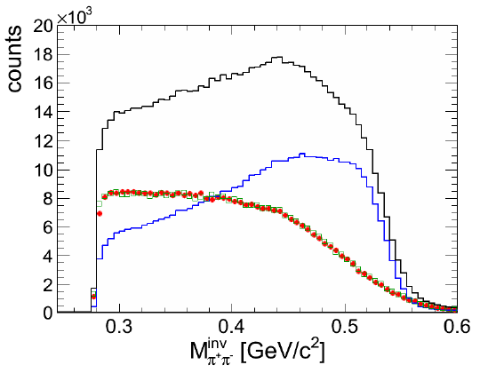
(n π⁺π⁻) – events with signal extracted
690 MeV/c
goal: separate signal (π⁻p)
from background (π⁻C)
based on PE events and C events
relative normalization of PE events
and C events deduced from
π⁻p elastic scattering
black
total PE
red
bg: total C
procedure: event from C correlated
with event from PE based on χ²
( miss. mass + momentum of π⁺, π⁻, n )
( miss. mass + momentum of π⁰, π⁻, p )
blue
signal
PWA done with:
four ππ data samples from HADES
photon- and pion-induced reactions
green
bg: from PE

Slide 9
PWA coupled channel analysis
Notes:
The new data on the π −p → π +π −n (HADES) and γp → π+ π− p (CLAS) reactions are included to the full set of the Bonn-Gatchina data base. The data base has a large number of reactions with two particle final states, the Crystal Ball data on π− p → 2pi0 n and MAMI and CB-ELSA on γp → 2π0 p. All reactions with three body final states are fitted with event-by-event maximum likelihood method.

Slide 10
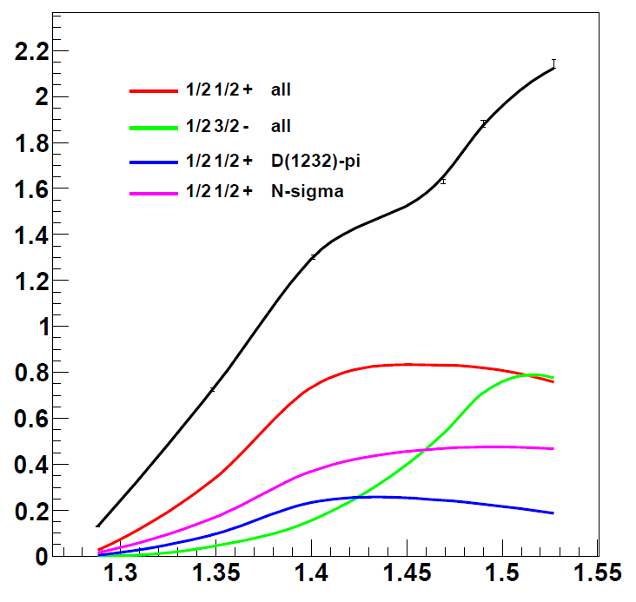



PWA: initial waves
$$π^{−}p → π^{0}π^{0}n$$
$$γp → π^{0}π^{0}p$$
D₁₃(1520)+..
σ [mb]
D₁₃(1520)+..
σ[μb]
P₁₁(1440)+..
P₁₁(1440)+..
F₁₅(1680)+..
MAMI
Crystal Ball
I J^{P}
√s [GeV]
in energy range of 1.45 - 1.55 GeV
in 2-pion production only few resonances
matter: D₁₃(1520), P₁₁(1440)
$$ρ → π^{0}π^{0}$$

Slide 11

PWA: final states
$$π^{−}p → π^{0}π^{0}n$$
$$γp → π^{0}π^{0}p$$
σ [mb]
σ[μb]
√s [GeV]
Dominat channels in 2π⁰ are: Δπ and Nσ (2π⁰ in I = 0)

Slide 12
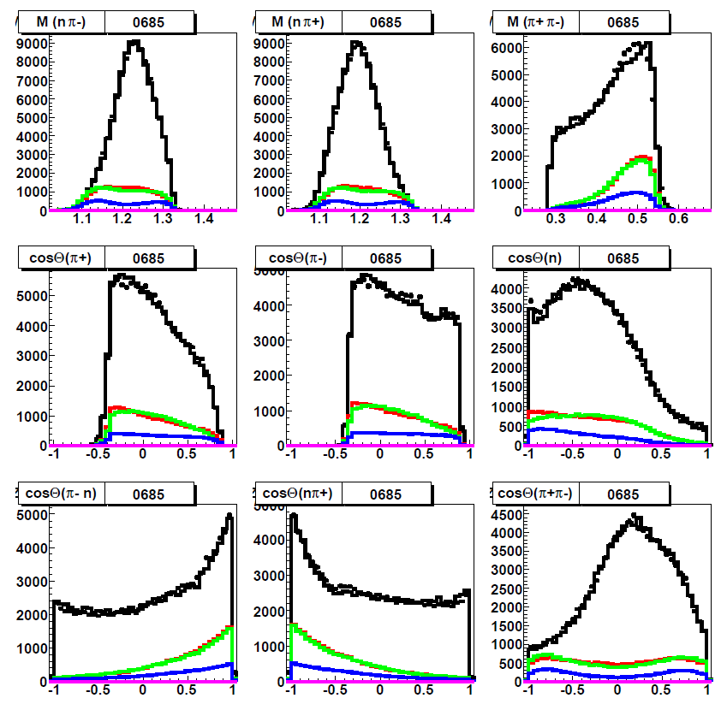
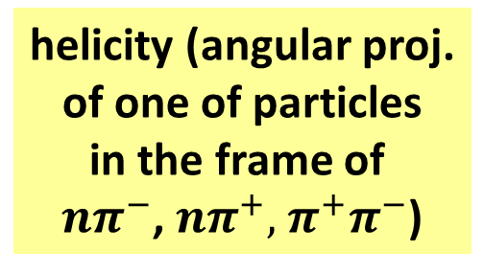
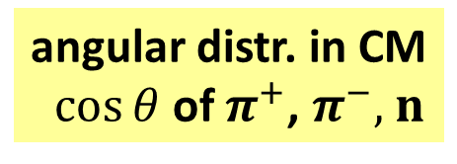
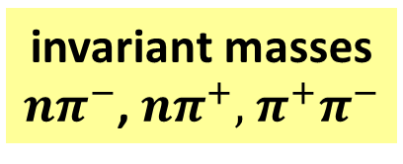
PWA example results (n π⁺π⁻)
in the acceptance
690 MeV/c
invariant masses
$nπ^{−}$, $nπ^{+},$ $π^{+}π^{−}$
ρ – total
ρ – s-channel
ρ – D₁₃(1520)
angular distr. in CM
$\cos{θ}$ of $π^{+}$, $π^{−},$ $n$
helicity (angular proj.
of one of particles
in the frame of
$nπ^{−}$, $nπ^{+},$ $π^{+}π^{−}$)

Slide 13
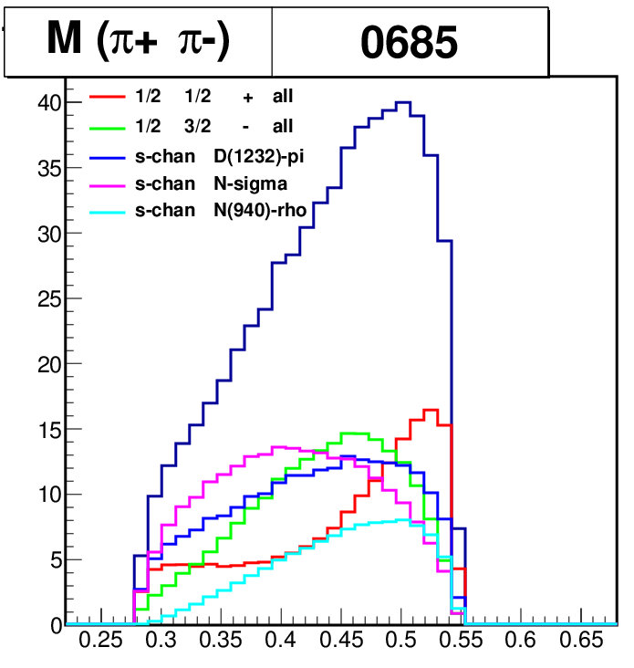
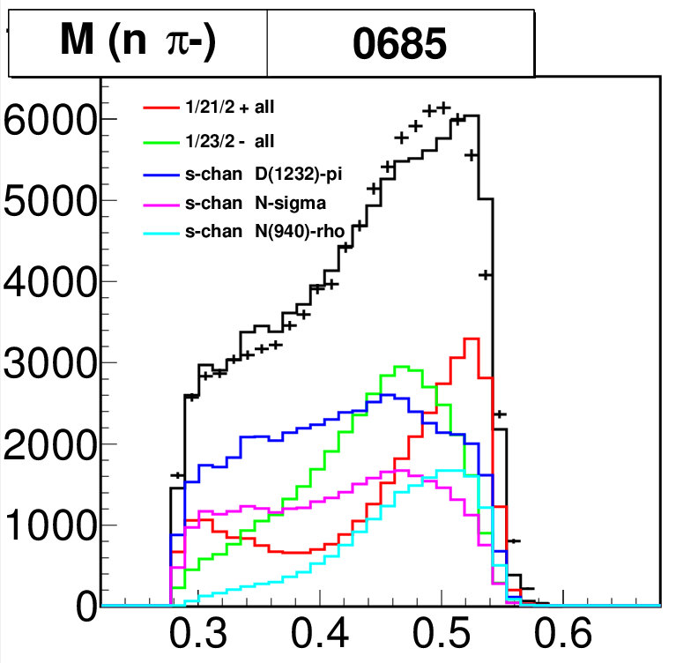
PWA π⁺π⁻ inv. mass – main contributions
Total cross section (from PWA solution)
Inside HADES acceptance:
INPUT: D₁₃(1520), P₁₁(1440)
OUTPUT: Δπ, Nσ, Nρ

Slide 14
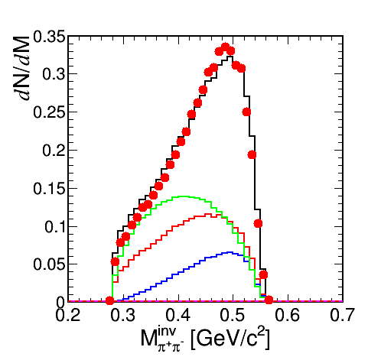
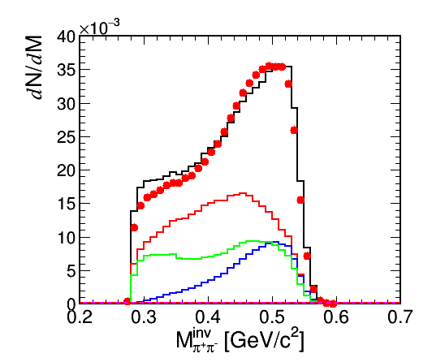
PWA π⁺π⁻ inv. mass – main contributions
Total cross section (from PWA solution)
Inside HADES acceptance:
― Δ(1232)π ― σN(939) ― ρN(939) ‐ ‐ ‐ ρN(u-channel) ― N(1440) π

Slide 15
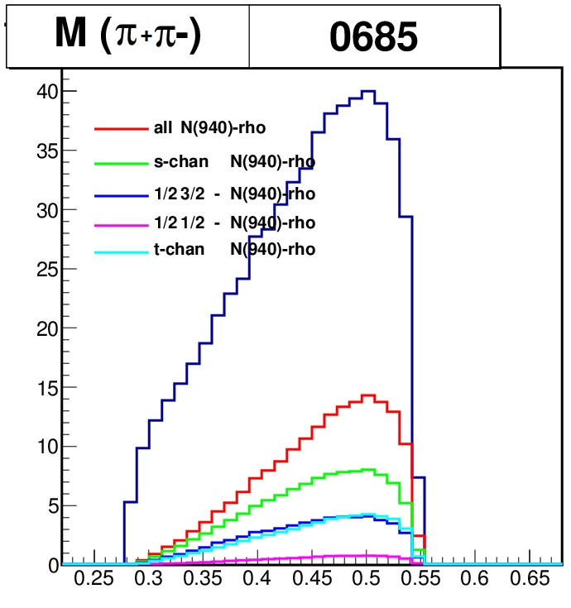
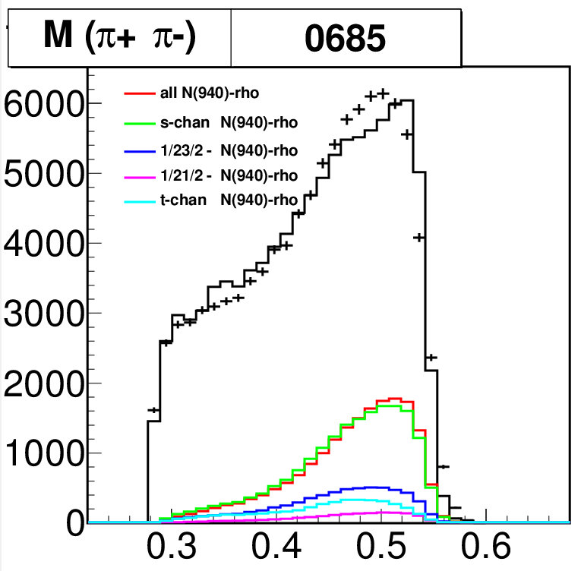
PWA π⁺π⁻ inv. mass – ρ contribution
Total cross section (from PWA solution)
Inside HADES acceptance:
D₁₃(1520)
important non-resonant (t-channel contribution)
Dominated by s-channel
- resonant D₁₃(1520) production
Strong interferences between 1/2- states with
isospin 1/2 and 3/2
FOR DILEPTON ANALYSIS:
N(1520)D₁₃ coupling to ρN: 11%
Total ρN : 1.3 mb (for 690 MeV/c)

Slide 16
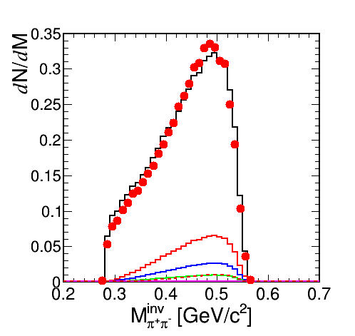
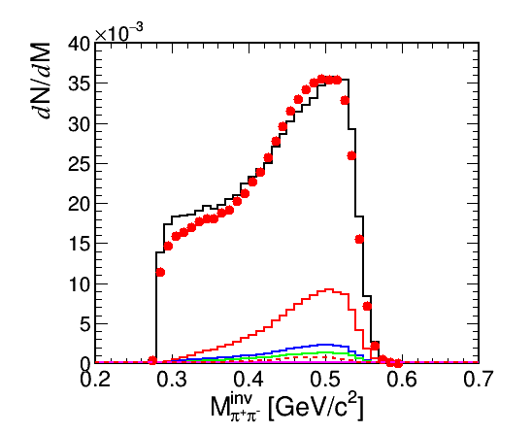
PWA π⁺π⁻ inv. mass – ρ contribution
Total cross section (from PWA solution)
Inside HADES acceptance:
― ρN ― D₁₃ ― S₁₁ ‐ ‐ ‐ ρN(t-channel) ― P₁₁

Slide 17
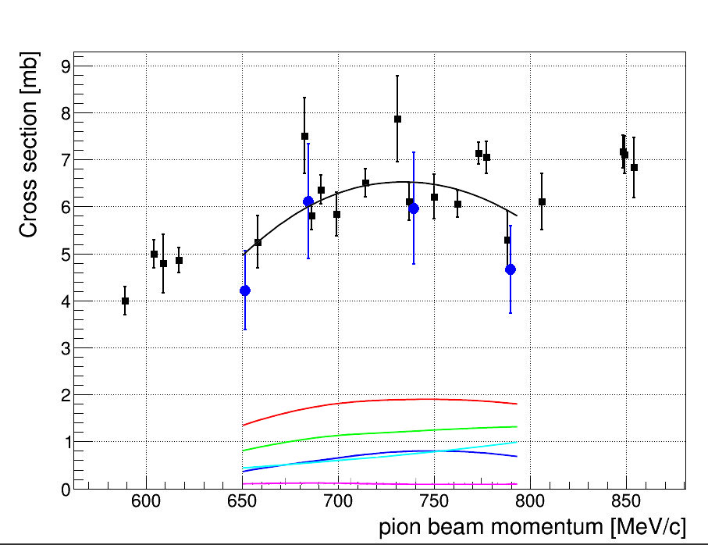
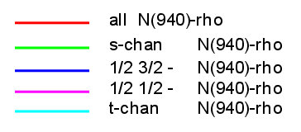

PWA results (n π⁺π⁻) – cross section
$$γp → π^{+}π^{−}p$$
preliminary
(SAPHIR, CLAS)
σ [μb]
…mind the gap!
HADES data are really unique
in this energy range!

Slide 18
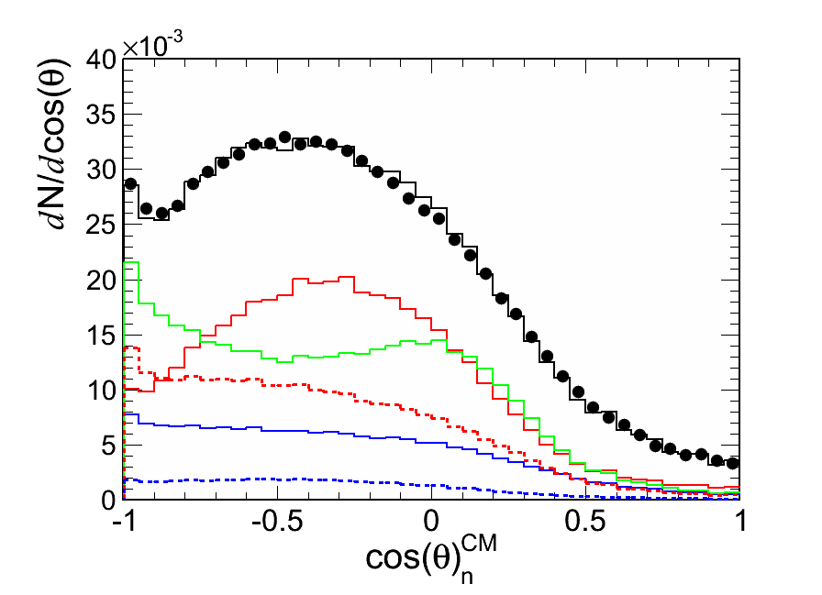
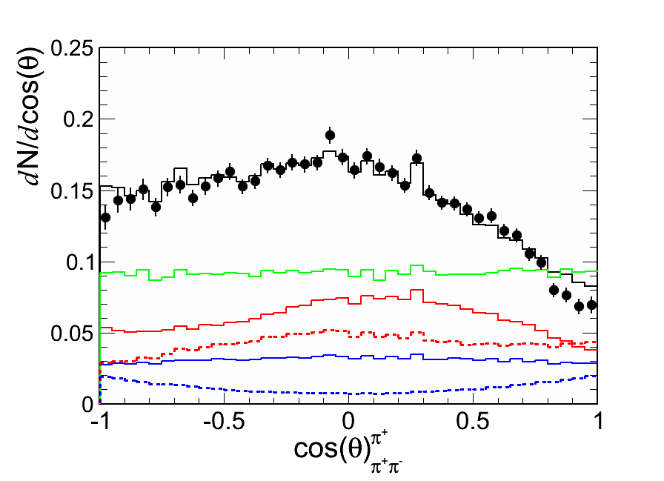
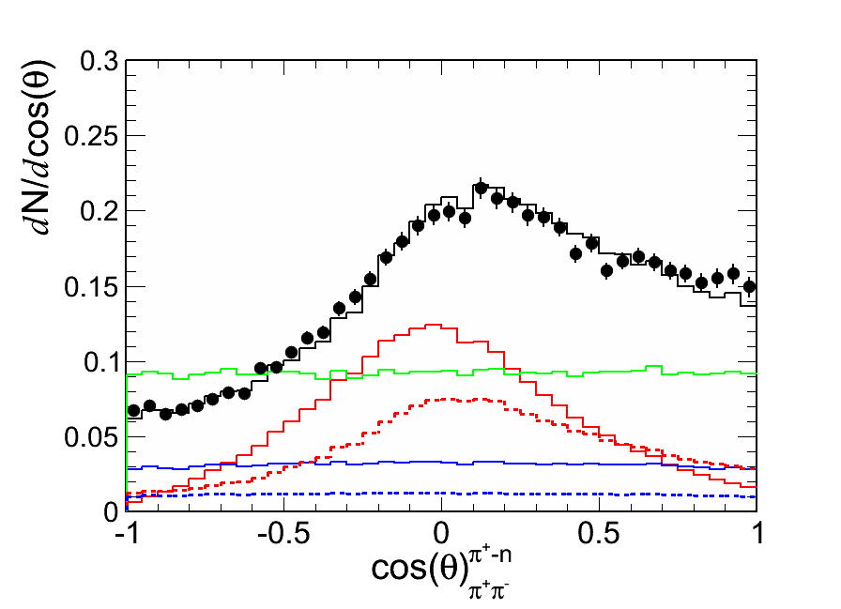
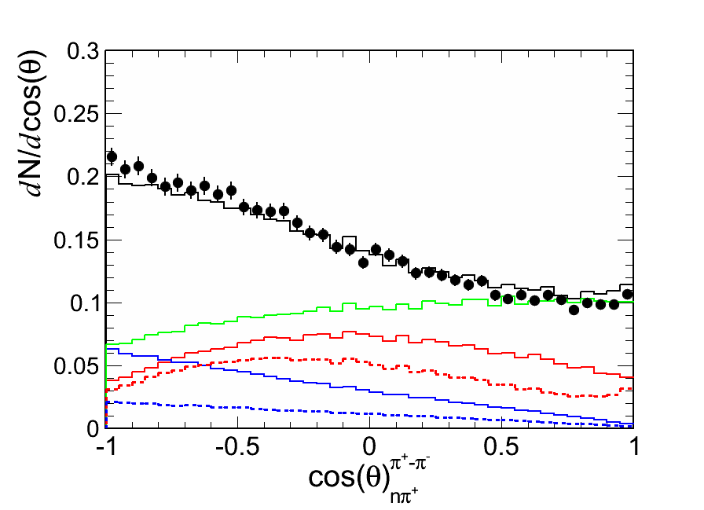
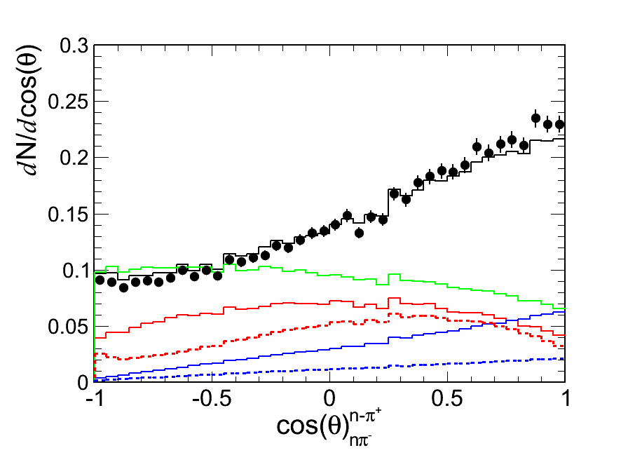
PWA results (n π⁺π⁻) – cross sections
[CS EXP mb] CROSS SECTIONS CALCULATED as a mean from:

Slide 19
PWA results (n π⁺π⁻) – cross sections
*
MOM | CS EXP [mb] | CS PWA
656 | 5.21 | 5.00
690 | 5.48 | 5.89
748 | 5.31 | 6.36
800 | 4.95 | 5.68
*
*
*
*

Slide 20
PWA results (pπ⁻ π⁰) – cross sections
MOM | CS EXP [mb] | CS PWA
656 | 1.64 | 1.46
690 | 2.29 | 2.22
748 | 3.46 | 3.36
800 | 3.03 | 3.34
*
*
*
*

Slide 21
SUMMARY
HADES & pion beam is an unique tool
to understand in details baryon - ρ couplings
Significant off-shell ρ contribution originating from
N(1520)D₁₃ shown by combined PWA and e⁺e⁻ data
Furhter investigation on specific observables (helicity, GJ -> Dalitz plots) necessary in order to prove the conitrbuting channels
Future activity (now and 2018+):
Beam energy scan: continuation and extension to third resonance region
HADES upgrade: electromagnetic calorimeter - neutral final states: η / π / ω
Di-electron measurements : ρR couplings S₁₃(1620), D₃₃(1700), P₁₃(1720)

Slide 22
BACKUP

Slide 23
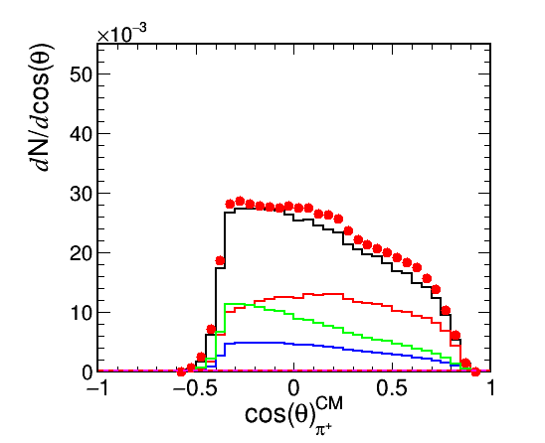
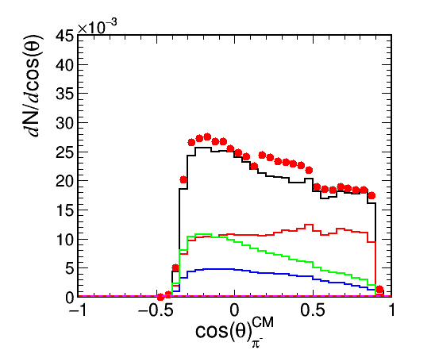
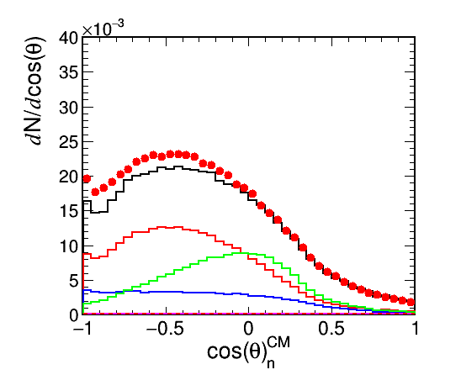
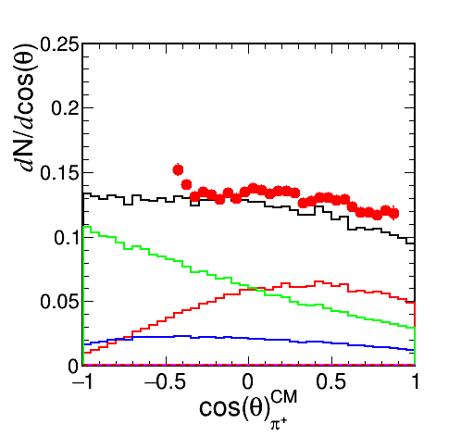
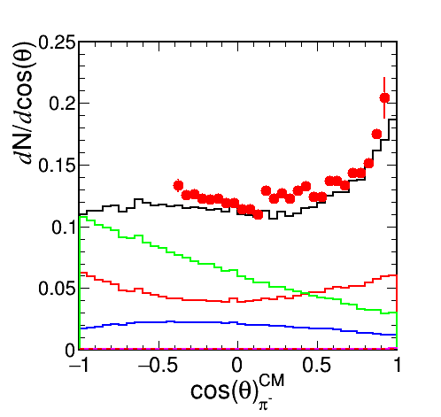
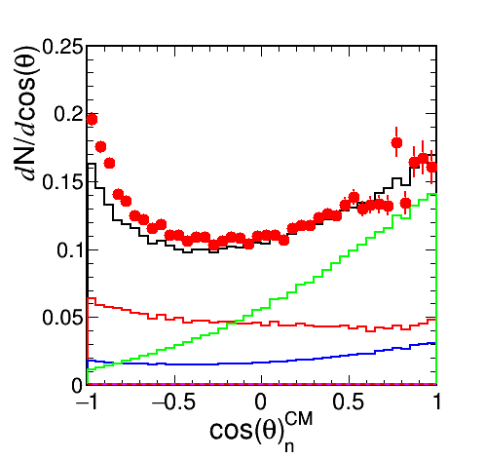
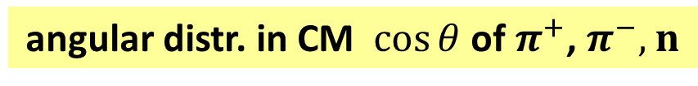
PWA results (n π⁺π⁻)
656 MeV/c
in acceptance
angular distr. in CM $\cos{θ}$ of $π^{+}$, $π^{−},$ $n$
in 4π
― Δ(1232)π ― σN(939) ― ρN(939) ‐ ‐ ‐ ρN(u-channel) ― N(1440) π

Slide 24
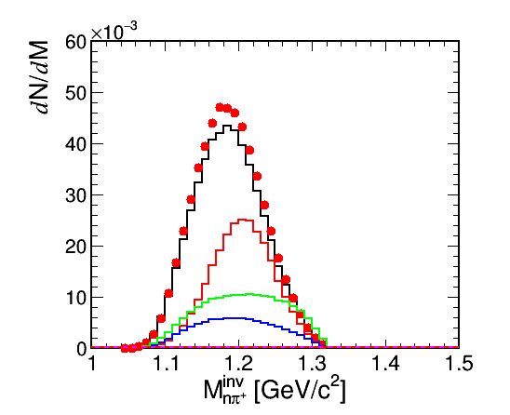
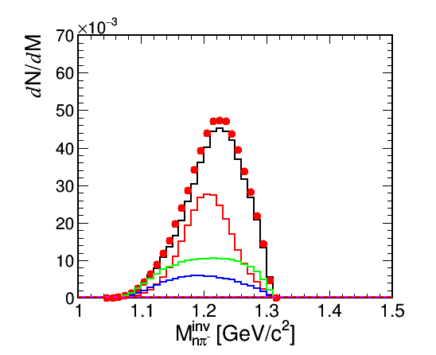
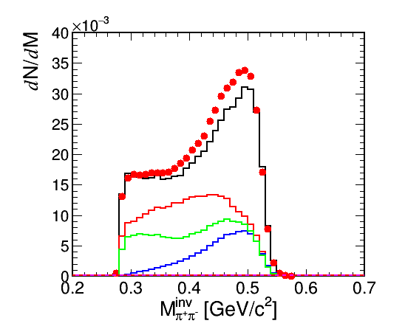
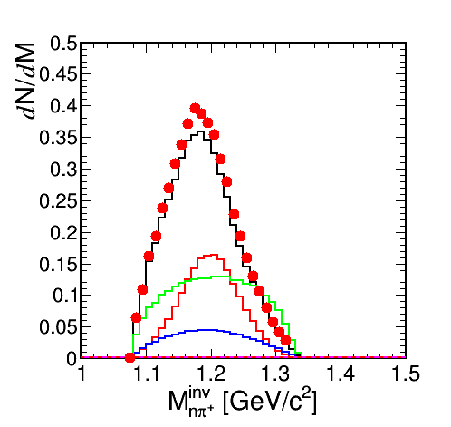
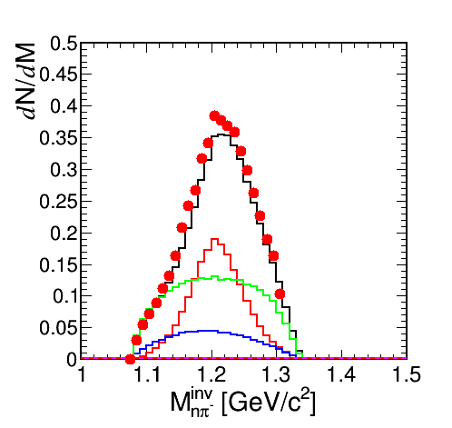
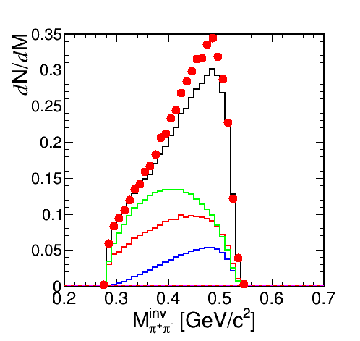
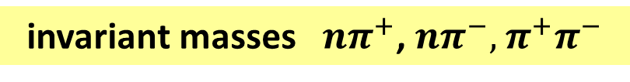
PWA results (n π⁺π⁻)
656 MeV/c
in acceptance
invariant masses$nπ^{+}$, $nπ^{−},$ $π^{+}π^{−}$
in 4π
― Δ(1232)π ― σN(939) ― ρN(939) ‐ ‐ ‐ ρN(u-channel) ― N(1440) π

Slide 25






PWA results (n π⁺π⁻)
656 MeV/c
in acceptance
helicity (angular proj. of one of particles in the frame of $nπ^{+}$, $nπ^{−},$ $π^{+}π^{−}$)
in 4π
― Δ(1232)π ― σN(939) ― ρN(939) ‐ ‐ ‐ ρN(u-channel) ― N(1440) π

Slide 26






PWA results (n π⁺π⁻)
656 MeV/c
in acceptance
Godfired-Jackson frame ( $nπ^{+}$, $nπ^{−},$ $π^{+}π^{−}$)
in 4π
― Δ(1232)π ― σN(939) ― ρN(939) ‐ ‐ ‐ ρN(u-channel) ― N(1440) π

Slide 27






PWA results (n π⁺π⁻)
656 MeV/c
in acceptance
angular distr. in CM $\cos{θ}$ of $π^{+}$, $π^{−},$ $n$
in 4π
― ρN(all) ― D₁₃ ― S₁₁ ‐ ‐ ‐ ρN(t-channel) ― P₁₁

Slide 28






PWA results (n π⁺π⁻)
656 MeV/c
in acceptance
invariant masses$nπ^{+}$, $nπ^{−},$ $π^{+}π^{−}$
in 4π
― ρN(all) ― D₁₃ ― S₁₁ ‐ ‐ ‐ ρN(t-channel) ― P₁₁

Slide 29






PWA results (n π⁺π⁻)
656 MeV/c
in acceptance
helicity (angular proj. of one of particles in the frame of $nπ^{+}$, $nπ^{−},$ $π^{+}π^{−}$)
in 4π
― ρN(all) ― D₁₃ ― S₁₁ ‐ ‐ ‐ ρN(t-channel) ― P₁₁

Slide 30






PWA results (n π⁺π⁻)
656 MeV/c
in acceptance
Godfired-Jackson frame ( $nπ^{+}$, $nπ^{−},$ $π^{+}π^{−}$)
in 4π
― ρN(all) ― D₁₃ ― S₁₁ ‐ ‐ ‐ ρN(t-channel) ― P₁₁

Slide 31






PWA results (n π⁺π⁻)
690 MeV/c
in acceptance
angular distr. in CM $\cos{θ}$ of $π^{+}$, $π^{−},$ $n$
in 4π
― Δ(1232)π ― σN(939) ― ρN(939) ‐ ‐ ‐ ρN(u-channel) ― N(1440) π

Slide 32




PWA results (n π⁺π⁻)
690 MeV/c
in acceptance
invariant masses$nπ^{+}$, $nπ^{−},$ $π^{+}π^{−}$
in 4π
― Δ(1232)π ― σN(939) ― ρN(939) ‐ ‐ ‐ ρN(u-channel) ― N(1440) π

Slide 33






PWA results (n π⁺π⁻)
690 MeV/c
in acceptance
helicity (angular proj. of one of particles in the frame of $nπ^{+}$, $nπ^{−},$ $π^{+}π^{−}$)
in 4π
― Δ(1232)π ― σN(939) ― ρN(939) ‐ ‐ ‐ ρN(u-channel) ― N(1440) π

Slide 34






PWA results (n π⁺π⁻)
690 MeV/c
in acceptance
Godfired-Jackson frame ( $nπ^{+}$, $nπ^{−},$ $π^{+}π^{−}$)
in 4π
― Δ(1232)π ― σN(939) ― ρN(939) ‐ ‐ ‐ ρN(u-channel) ― N(1440) π

Slide 35






PWA results (n π⁺π⁻)
690 MeV/c
in acceptance
angular distr. in CM $\cos{θ}$ of $π^{+}$, $π^{−},$ $n$
in 4π
― σN(939) ― Δ(1232)π ― ρN(939) | ‐ ‐ ‐ N(1520) ‐ ‐ ‐ ρN

Slide 36




PWA results (n π⁺π⁻)
690 MeV/c
in acceptance
invariant masses$nπ^{+}$, $nπ^{−},$ $π^{+}π^{−}$
in 4π
― ρN(all) ― D₁₃ ― S₁₁ ‐ ‐ ‐ ρN(t-channel) ― P₁₁

Slide 37






PWA results (n π⁺π⁻)
690 MeV/c
in acceptance
helicity (angular proj. of one of particles in the frame of $nπ^{+}$, $nπ^{−},$ $π^{+}π^{−}$)
in 4π
― ρN(all) ― D₁₃ ― S₁₁ ‐ ‐ ‐ ρN(t-channel) ― P₁₁

Slide 38






PWA results (n π⁺π⁻)
690 MeV/c
in acceptance
Godfired-Jackson frame ( $nπ^{+}$, $nπ^{−},$ $π^{+}π^{−}$)
in 4π
― ρN(all) ― D₁₃ ― S₁₁ ‐ ‐ ‐ ρN(t-channel) ― P₁₁

Slide 39






PWA results (n π⁺π⁻)
748 MeV/c
in acceptance
angular distr. in CM $\cos{θ}$ of $π^{+}$, $π^{−},$ $n$
in 4π
― ρN(all) ― D₁₃ ― S₁₁ ‐ ‐ ‐ ρN(t-channel) ― P₁₁

Slide 40






PWA results (n π⁺π⁻)
748 MeV/c
in acceptance
invariant masses$nπ^{+}$, $nπ^{−},$ $π^{+}π^{−}$
in 4π
― Δ(1232)π ― σN(939) ― ρN(939) ‐ ‐ ‐ ρN(u-channel) ― N(1440) π

Slide 41






PWA results (n π⁺π⁻)
748 MeV/c
in acceptance
helicity (angular proj. of one of particles in the frame of $nπ^{+}$, $nπ^{−},$ $π^{+}π^{−}$)
in 4π
― Δ(1232)π ― σN(939) ― ρN(939) ‐ ‐ ‐ ρN(u-channel) ― N(1440) π

Slide 42






PWA results (n π⁺π⁻)
748 MeV/c
in acceptance
Godfired-Jackson frame ( $nπ^{+}$, $nπ^{−},$ $π^{+}π^{−}$)
in 4π
― Δ(1232)π ― σN(939) ― ρN(939) ‐ ‐ ‐ ρN(u-channel) ― N(1440) π

Slide 43






PWA results (n π⁺π⁻)
800 MeV/c
in acceptance
angular distr. in CM $\cos{θ}$ of $π^{+}$, $π^{−},$ $n$
in 4π
― Δ(1232)π ― σN(939) ― ρN(939) ‐ ‐ ‐ ρN(u-channel) ― N(1440) π

Slide 44






PWA results (n π⁺π⁻)
800 MeV/c
in acceptance
invariant masses$nπ^{+}$, $nπ^{−},$ $π^{+}π^{−}$
in 4π
― Δ(1232)π ― σN(939) ― ρN(939) ‐ ‐ ‐ ρN(u-channel) ― N(1440) π

Slide 45






PWA results (n π⁺π⁻)
800 MeV/c
in acceptance
helicity (angular proj. of one of particles in the frame of $nπ^{+}$, $nπ^{−},$ $π^{+}π^{−}$)
in 4π
― Δ(1232)π ― σN(939) ― ρN(939) ‐ ‐ ‐ ρN(u-channel) ― N(1440) π

Slide 46






PWA results (n π⁺π⁻)
800 MeV/c
in acceptance
Godfired-Jackson frame ( $nπ^{+}$, $nπ^{−},$ $π^{+}π^{−}$)
in 4π
― Δ(1232)π ― σN(939) ― ρN(939) ‐ ‐ ‐ ρN(u-channel) ― N(1440) π

Slide 47







PWA results (pπ⁻ π⁰)
angular distr. in CM $\cos{θ}$ of $p$, $π^{−}$, $π^{0}$
656 MeV/c
acc
4π
― Δ(1232)π ― σN(939) ― ρN(939) ‐ ‐ ‐ ρN(u-channel) ― N(1440) π

Slide 48







PWA results (pπ⁻ π⁰)
invariant masses$pπ^{−}$, p$π^{0},$ $π^{0}π^{−}$
656 MeV/c
acc
4π
― Δ(1232)π ― σN(939) ― ρN(939) ‐ ‐ ‐ ρN(u-channel) ― N(1440) π

Slide 49






PWA results (pπ⁻ π⁰)
helicity (angular proj. of one of particles in the frame of p$π^{0}$, $pπ^{−},$ $π^{0}π^{−}$)
656 MeV/c
acc
4π
― Δ(1232)π ― σN(939) ― ρN(939) ‐ ‐ ‐ ρN(u-channel) ― N(1440) π

Slide 50






PWA results (pπ⁻ π⁰)
Godfired-Jackson frame ( $pπ^{−}$, p$π^{0},$ $π^{0}π^{−}$)
656 MeV/c
acc
4π
― Δ(1232)π ― σN(939) ― ρN(939) ‐ ‐ ‐ ρN(u-channel) ― N(1440) π

Slide 51






PWA results (pπ⁻ π⁰)
angular distr. in CM $\cos{θ}$ of $p$, $π^{−}$, $π^{0}$
690 MeV/c
acc
4π
― Δ(1232)π ― σN(939) ― ρN(939) ‐ ‐ ‐ ρN(u-channel) ― N(1440) π

Slide 52






PWA results (pπ⁻ π⁰)
invariant masses$pπ^{−}$, p$π^{0},$ $π^{0}π^{−}$
690 MeV/c
acc
4π
― Δ(1232)π ― σN(939) ― ρN(939) ‐ ‐ ‐ ρN(u-channel) ― N(1440) π

Slide 53






PWA results (pπ⁻ π⁰)
helicity (angular proj. of one of particles in the frame of p$π^{0}$, $pπ^{−},$ $π^{0}π^{−}$)
690 MeV/c
acc
4π
― Δ(1232)π ― σN(939) ― ρN(939) ‐ ‐ ‐ ρN(u-channel) ― N(1440) π

Slide 54






PWA results (pπ⁻ π⁰)
Godfired-Jackson frame ( $pπ^{−}$, p$π^{0},$ $π^{0}π^{−}$)
690 MeV/c
acc
4π
― Δ(1232)π ― σN(939) ― ρN(939) ‐ ‐ ‐ ρN(u-channel) ― N(1440) π

Slide 55






PWA results (pπ⁻ π⁰)
invariant masses$pπ^{−}$, p$π^{0},$ $π^{0}π^{−}$
690 MeV/c
acc
4π
― ρN(all) ― D₁₃ ― S₁₁ ‐ ‐ ‐ ρN(t-channel) ― P₁₁

Slide 56






PWA results (pπ⁻ π⁰)
helicity (angular proj. of one of particles in the frame of p$π^{0}$, $pπ^{−},$ $π^{0}π^{−}$)
690 MeV/c
acc
4π
― ρN(all) ― D₁₃ ― S₁₁ ‐ ‐ ‐ ρN(t-channel) ― P₁₁

Slide 57






PWA results (pπ⁻ π⁰)
Godfired-Jackson frame ( $pπ^{−}$, p$π^{0},$ $π^{0}π^{−}$)
690 MeV/c
acc
4π
― ρN(all) ― D₁₃ ― S₁₁ ‐ ‐ ‐ ρN(t-channel) ― P₁₁

Slide 58






PWA results (pπ⁻ π⁰)
angular distr. in CM $\cos{θ}$ of $p$, $π^{−}$, $π^{0}$
748 MeV/c
acc
4π
― Δ(1232)π ― σN(939) ― ρN(939) ‐ ‐ ‐ ρN(u-channel) ― N(1440) π

Slide 59






PWA results (pπ⁻ π⁰)
invariant masses$pπ^{−}$, p$π^{0},$ $π^{0}π^{−}$
748 MeV/c
acc
4π
― Δ(1232)π ― σN(939) ― ρN(939) ‐ ‐ ‐ ρN(u-channel) ― N(1440) π

Slide 60






PWA results (pπ⁻ π⁰)
helicity (angular proj. of one of particles in the frame of p$π^{0}$, $pπ^{−},$ $π^{0}π^{−}$)
748 MeV/c
acc
4π
― Δ(1232)π ― σN(939) ― ρN(939) ‐ ‐ ‐ ρN(u-channel) ― N(1440) π

Slide 61






PWA results (pπ⁻ π⁰)
Godfired-Jackson frame ( $pπ^{−}$, p$π^{0},$ $π^{0}π^{−}$)
748 MeV/c
acc
4π
― Δ(1232)π ― σN(939) ― ρN(939) ‐ ‐ ‐ ρN(u-channel) ― N(1440) π

Slide 62






PWA results (pπ⁻ π⁰)
angular distr. in CM $\cos{θ}$ of $p$, $π^{−}$, $π^{0}$
800 MeV/c
acc
4π
― Δ(1232)π ― σN(939) ― ρN(939) ‐ ‐ ‐ ρN(u-channel) ― N(1440) π

Slide 63






PWA results (pπ⁻ π⁰)
invariant masses$pπ^{−}$, p$π^{0},$ $π^{0}π^{−}$
800 MeV/c
acc
4π
― Δ(1232)π ― σN(939) ― ρN(939) ‐ ‐ ‐ ρN(u-channel) ― N(1440) π

Slide 64






PWA results (pπ⁻ π⁰)
helicity (angular proj. of one of particles in the frame of p$π^{0}$, $pπ^{−},$ $π^{0}π^{−}$)
800 MeV/c
acc
4π
― Δ(1232)π ― σN(939) ― ρN(939) ‐ ‐ ‐ ρN(u-channel) ― N(1440) π

Slide 65






PWA results (pπ⁻ π⁰)
Godfired-Jackson frame ( $pπ^{−}$, p$π^{0},$ $π^{0}π^{−}$)
800 MeV/c
acc
4π
― Δ(1232)π ― σN(939) ― ρN(939) ‐ ‐ ‐ ρN(u-channel) ― N(1440) π

