Slide 1
Development of a
Gaseous Proton-Recoil Detector
for neutron flux measurements between
0.2 and 2 MeV neutron energy
P. Marini, L. Mathieu, M. Aïche, S. Czajkowski, B. Jurado, I. Tsekhanovich
Centre d’Etudes Nucléaires de Bordeaux Gradignan,
CNRS/IN2P3, Université de Bordeaux, FRANCE

Slide 2
I- Context and motivations
Neutron flux measurement
Useful to normalize cross section measurements, for neutron beam line characterization, for dosimetry investigations…
Usually, standard reactions are used : ²³⁵U(n,f), ²³⁸U(n,f), ²³⁷Np(n,f)
These standards are known with an accuracy of few % (from 0.5% to 10%)
An independent measurement
Evaluators require independent measurements
¹H(n,p) reaction is a primary standard known with an accuracy around 0.2% in the MeV region
Especially, its application and detection are completely different from the other standards
(e.g. recoil proton detection VS fission fragments detection)
A real improvement in term of independence

Slide 3
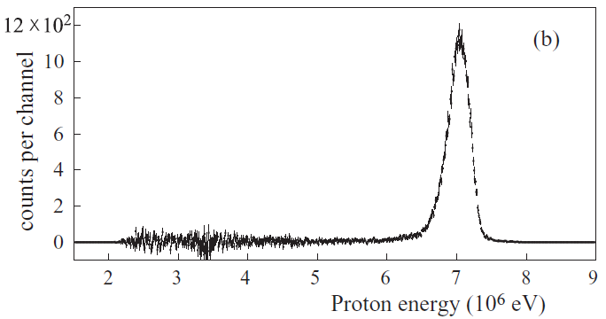
I- Context and motivations
Principle
proton peak (N_{proton})
Experimental setup :
Ta screen
E_{n}
recoil protons
E_{p}
Si
E_{p} ~ E_{n}
neutrons
Well defined efficiency
H-rich foil
E_{p}
E_{p}
Si spectrum after usual background subtraction
Usual background :
The Si detector may see other signals which have to be subtracted
Need for a background measurement (masking H-rich foil)
To obtain a precise neutron flux (ΔN_{proton}~1%), the background has to be small enough

Slide 4
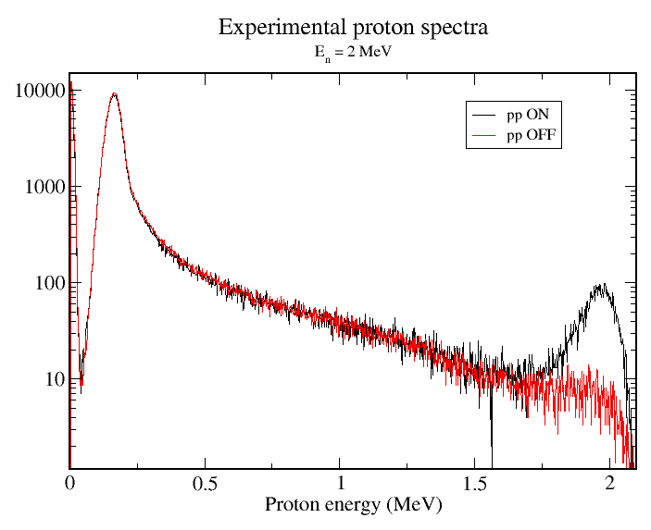
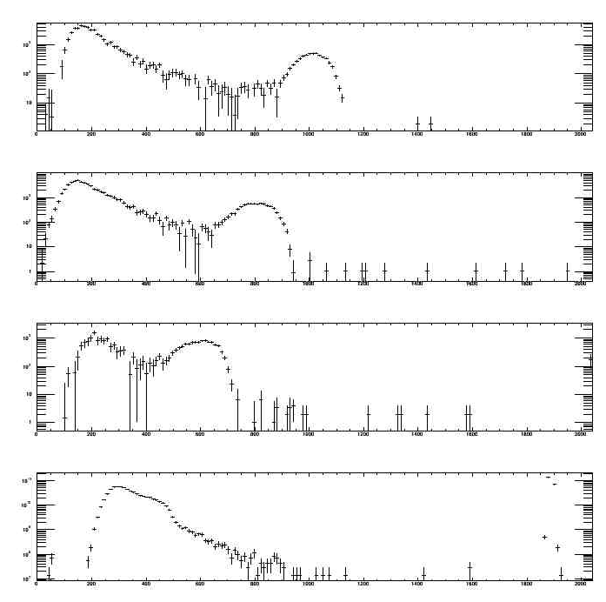
II- Issue at low energy
A tremendous background
At low energy, the background is hundred times higher than the proton peak
E_{n}=1.1MeV
Counts/20keV
E_{n}=0.9MeV
E_{n}=0.7MeV
Non-ideal background subtraction
E_{n}=0.5MeV
Remaining background
Impossible to determine N_{proton} better than 1% below 1 MeV
E_{p}(keV)
P. Marini et al., Nucl. Instr. and Meth. A, 841 (2017)

Slide 5
II- Issue at low energy
Background source
An experiment was carried out @AIFIRA to investigate this background :
- present as soon as the beam is ON
- present even when the Si detector is masked
electrons
less ‘MeV/µm’ but :
. whole Si depth used
. possible tangent tracks
. more multiple events
Emitted by gamma-ray interaction
p
e⁻
Very high signal at few 100 keV (quickly decreasing
with E)
Si
(50 µm)
e⁻
e⁻ flux for a 1 MeV gamma-ray source
(MCNP simulations)

Slide 6
II- Issue at low energy
Background source
An experiment was carried out @AIFIRA to investigate this background :
- present as soon as the beam is ON
- present even when the Si detector is masked
electrons
less ‘MeV/µm’ but :
. whole Si depth used
. possible tangent tracks
. more multiple events
Emitted by gamma-ray interaction
These gamma-rays are mainly produced by (n,γ) reaction on the neutron source material
p
e⁻
Very high signal at few 100 keV (quickly decreasing
with E)
They cannot be avoided
Si
(50 µm)
e⁻

Slide 7
III- A new detector, phase I
Main features
Low sensitivity to electrons: thickness adapted to proton range
Thinner Si detectors:
need to be changed for each energy
sensitive to irradiation
more difficult to calibrate
Gaseous detector:
gas pressure adapted to proton range
- much more complex
Background events rejection
segmented detector to perform track analysis
Well defined efficiency
a collimator is placed inside the detector => two chambers
100% efficiency required for good tracks (“no missed event”)

Slide 8
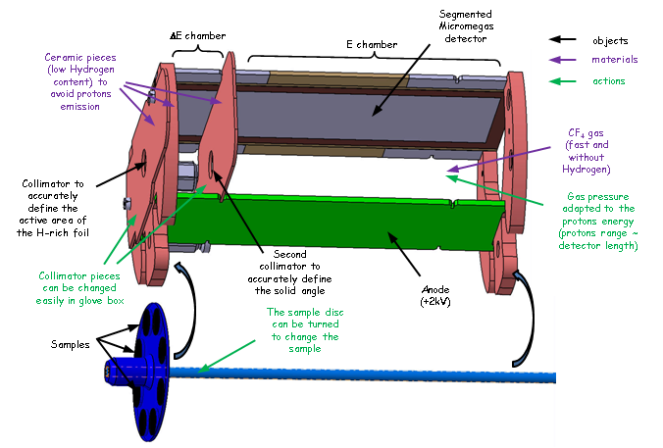
III- A new detector, phase I
The Gaseous Proton Recoil Detector (GPRD)
Constraint :
as low material as possible to avoid interference with cross section measurement (e.g fission)
Designed with track calculations
(nbr e⁻ generated, different E_{n}, different P_{gas})

Slide 9
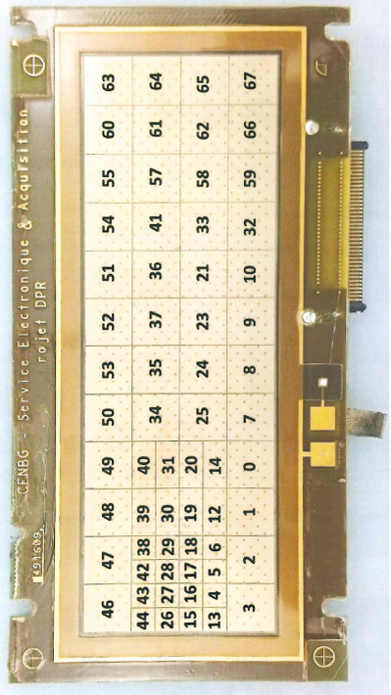
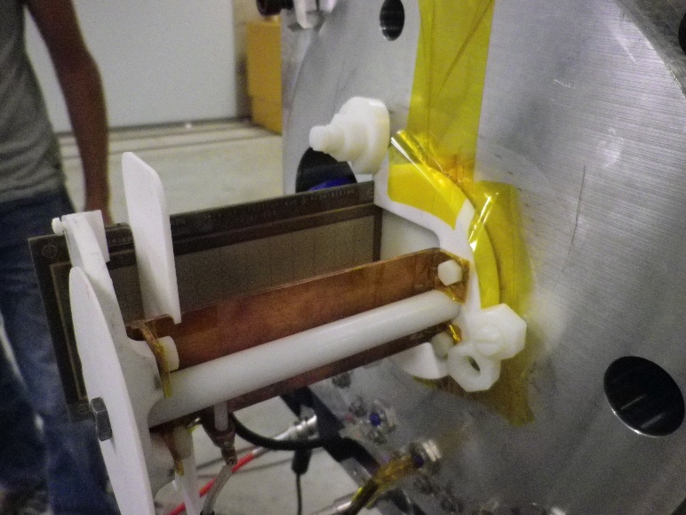
III- A new detector, phase I
The Gaseous Proton Recoil Detector (GPRD)
Segmented detector (CEA/Irfu)
collimators
64 pads
divided in two chambers: ΔE-E
smaller pads in ΔE region (lower e- generation)
E region
H-film
collimators
ΔE region
well defined efficiency (collimated sample)
Picture of the GPRD prototype
(test experiment)
rotating sample disk

Slide 10
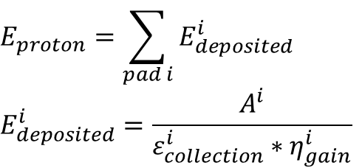
III- A new detector, phase I
Energy calibration
- signal amplitude:
$$E_{proton}=\sum_{pad i}{E_{deposited}^{i}}$$
$$E_{deposited}^{i}=\frac{A^{i}}{ε_{collection}^{i}∗η_{gain}^{i}}$$
Signal amplitude
f(exp.conditions,xyz)
f(gap, gas)
Test on constant energy deposition (very long alpha track) showed a very constant gap
η_{gain} = f(gas)
same for all pads!
Nevertheless, due to ε_{collection}, it is very hard to determine the proton energy via the signal amplitude

Slide 11
III- A new detector, phase I
Energy calibration
- track length:
obtained thanks to the segmentation
proton energy
Issue: smooth end-of-track
energy deposition reconstruction
(thanks to constant η_{gain}, despite ε_{collection})
can we see this ?
Issue: no information on the z-axis
very poor energy resolution

Slide 12

III- A new detector, phase I
Efficiency
collimators
$$ε=ε_{geom}\left(E_{n}\right)∗ε_{intr.}$$
E region
Calculation
(simulation)
H-film
100 % ?
not yet proven
ΔE region
- detector dead time:
a high counting rate could lead to missed events
. the recoil proton counting rate is usually quite low
. OK if there is not a lot of background events

Slide 13

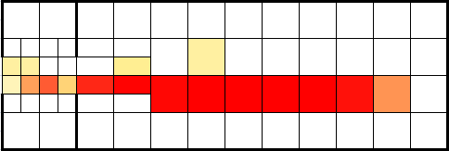
III- A new detector, phase I
Test experiment on the AIFIRA facility in 2016
irradiation with neutrons (E_{n} down to 300 keV)
- same conditions than previous experiments (distance, reaction)
Validations
- track measurement
« straight » tracks using the whole length of the GPRD
pads amplitudes
track for E_{n} = 1 MeV

Slide 14
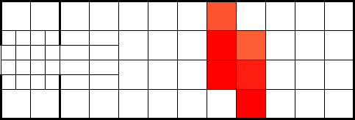
III- A new detector, phase I
Test experiment on the AIFIRA facility in 2016
irradiation with neutrons (E_{n} down to 300 keV)
- same conditions than previous experiments (distance, reaction)
Validations
- track measurement
- very low sensitivity to e- or γ
test without H-film gives no signal
(each pad is not sensitive enough to see signal from background electrons)
only few cosmic rays seen

Slide 15
III- A new detector, phase I
Test experiment on the AIFIRA facility in 2016
irradiation with neutrons (E_{n} down to 300 keV)
- same conditions than previous experiments (distance, reaction)
Validations
- track measurement
- very low sensitivity to e- or γ
- discrimination between direct and scattered neutrons
shorter “ΔE-E” tracks rejected
(protons from neutrons with lower energy / higher angle)

Slide 16
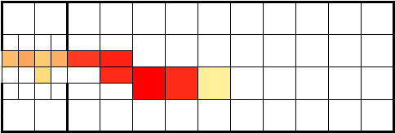
III- A new detector, phase I
Test experiment on the AIFIRA facility in 2016
irradiation with neutrons (E_{n} down to 300 keV)
- same conditions than previous experiments (distance, reaction)
Validations
- track measurement
- very low sensitivity to e- or γ
- discrimination between direct and scattered neutrons
- low detection energy limit: 300 keV (at least)
track for E_{n} = 300 keV
no test carried out below 300 keV

Slide 17
III- A new detector, phase I
Test experiment on the AIFIRA facility in 2016
irradiation with neutrons (E_{n} down to 300 keV)
- same conditions than previous experiments (distance, reaction)
Validations
- track measurement
- very low sensitivity to e- or γ
- discrimination between direct and scattered neutrons
- low detection energy limit: 300 keV (at least)
- general functioning (electronics, acquisition, gas regulation, rotating disk…)
- ε_{intr} = 100% not proven
need a quantitative and accurate experiment

Slide 18
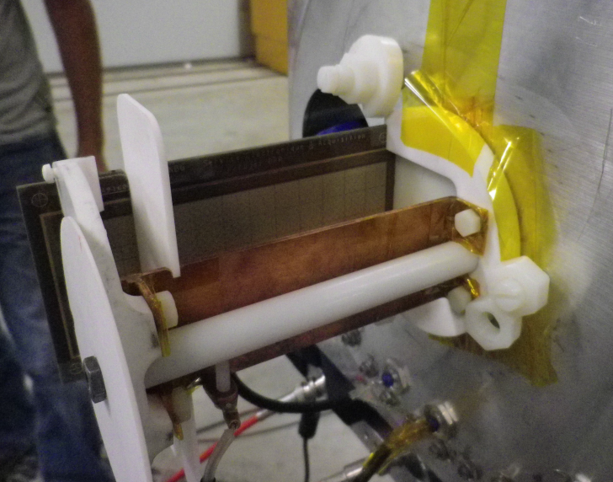
III- A new detector, phase I
Issues
- Static sparks
CF₄ gas at few 10 mbars => Paschen regime
=> drop of the breakdown voltage
removal of some conductive pieces
hence the adhesive !
- Non homogeneous electric field
Weak signal on the side pads
+ perturbation due to the collimator
future addition of a field cage to constraint the electric field

Slide 19
III- A new detector, phase I
Issues
- Signal loss after few minutes of irradiation
grounding some mechanical elements reduce the issue
Charge accumulation on insulators
(from e- coming « from » the beam) => electric field distortion
future addition of a field cage to constraint the electric field

Slide 20
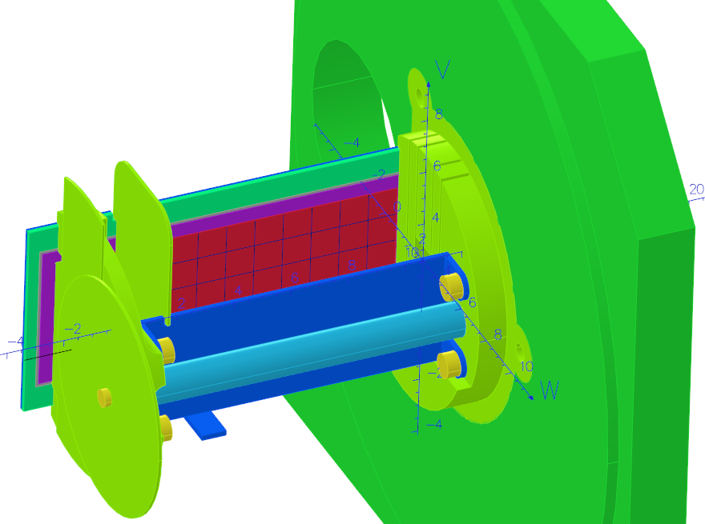
IV- A new detector, phase II
Electric field simulations
With the OPERA code (ex-Tosca)
collimators
micromegas detector
cathode
sample disk

Slide 21
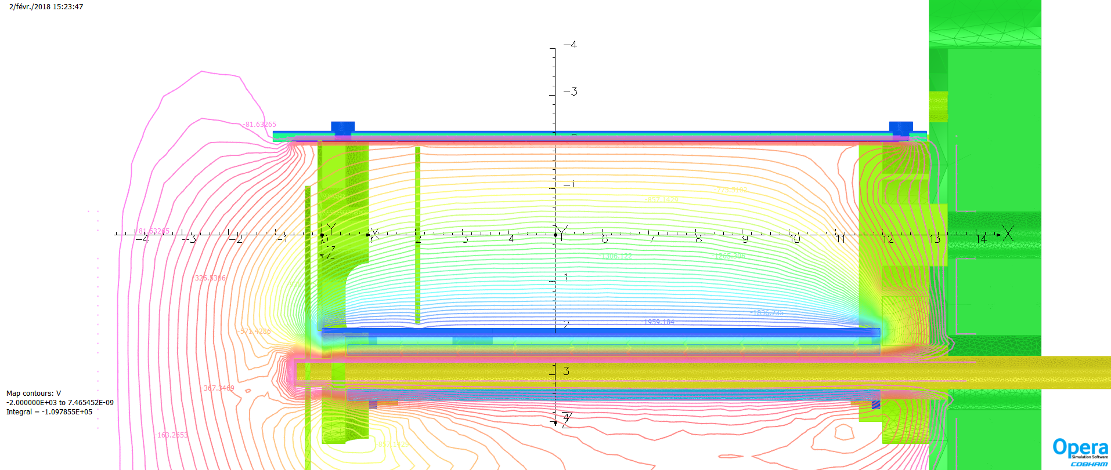
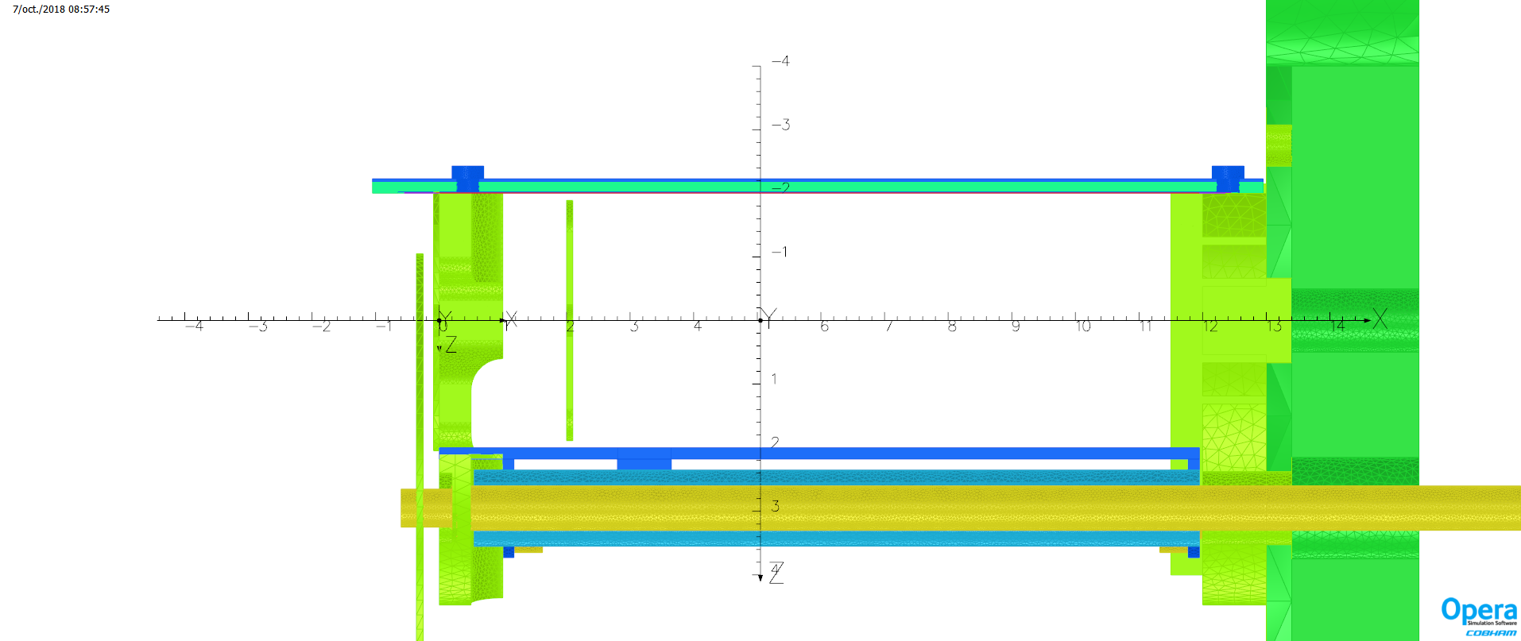
IV- A new detector, phase II
Electric field simulations
With the OPERA code (ex-Tosca)
Equipotential lines :
top view of the GPRD
collimators
micromegas detector
(-500V)
electric field distortion !
aluminum structure
(ground)
ground ring
(ground)
macor structure
sample disk
cathode
motor axis
(-2000V)
(ground)

Slide 22
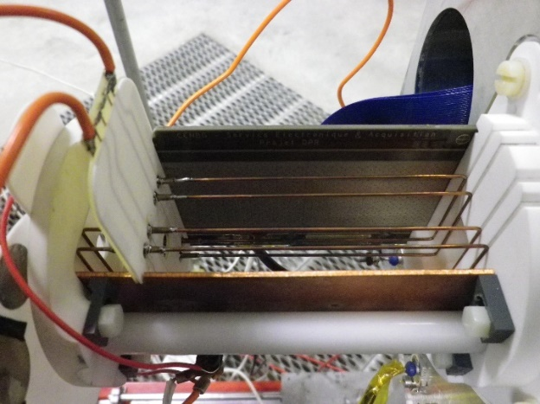
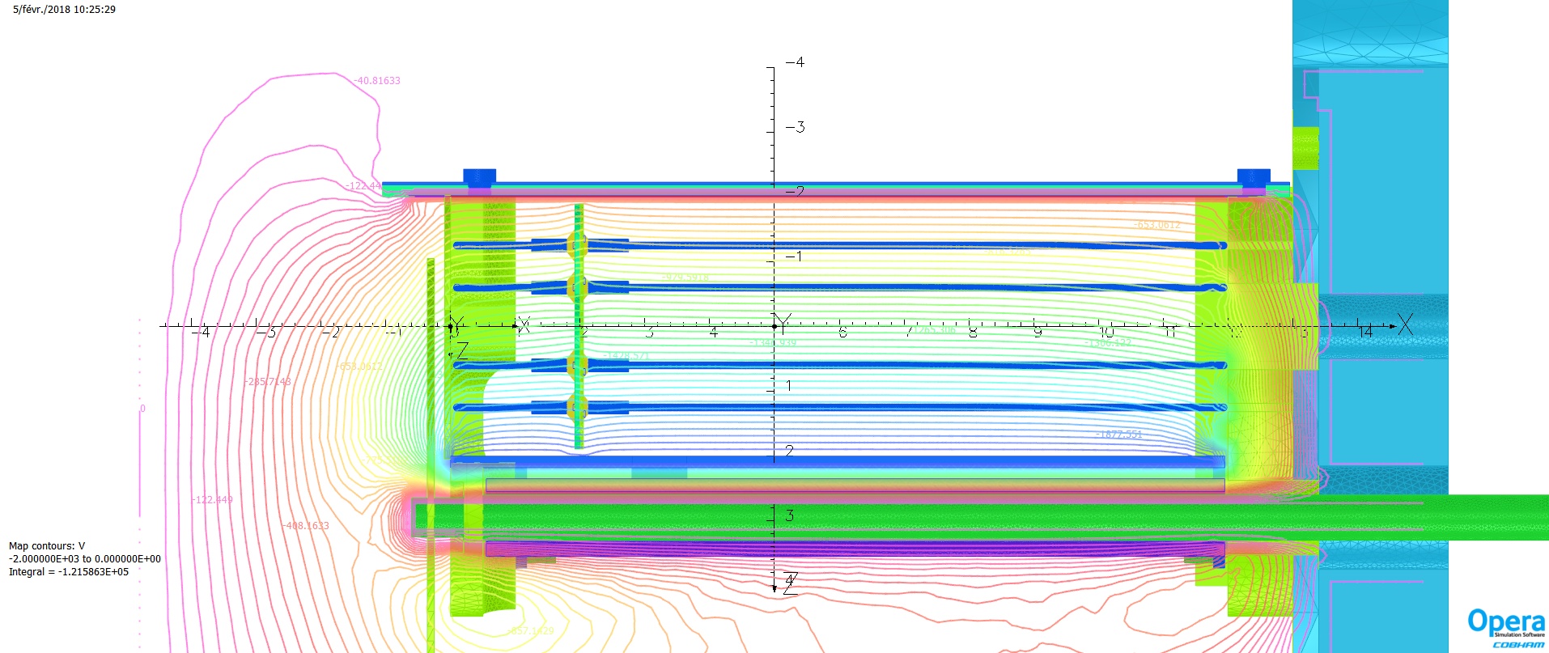
IV- A new detector, phase II
Electric field simulations
field cage
With the OPERA code (ex-Tosca)
Equipotential lines :
much better electric field

Slide 23
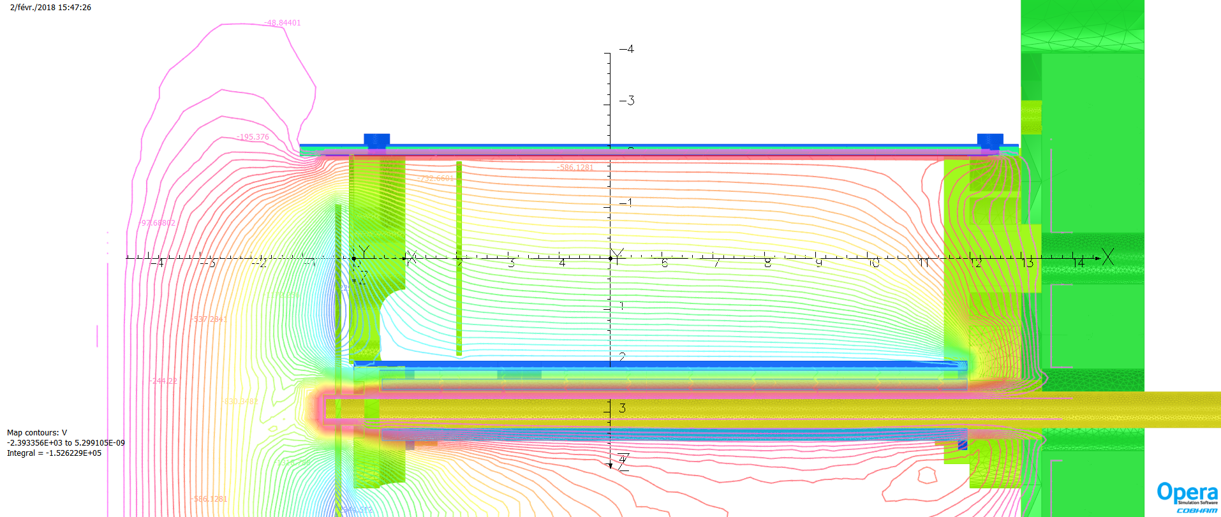
IV- A new detector, phase II
Electric field simulations
With the OPERA code (ex-Tosca)
A static electric charge can be added
top view of the GPRD
strong electric field distortion !
sample disk
(electric charge -2nC)

Slide 24
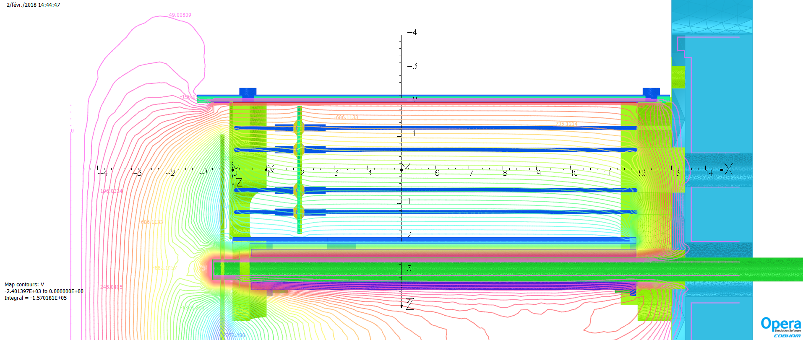
IV- A new detector, phase II
Electric field simulations
With the OPERA code (ex-Tosca)
A static electric charge can be added
top view of the GPRD
weak electric field distortion
sample disk
(electric charge -2nC)

Slide 25
IV- A new detector, phase II
A different gas
With very good insulating properties: 70% N₂ – 30% CO₂
- used in accelerator tank (as is SF₆)
- very cheap
Much slower than CF₄:
no background events
=> a fast gas is not mandatory anymore
P= 40 mbar
ΔV= 1250V
(E_{n} = 0,2 MeV)
P= 200 mbar
ΔV= 1500V
(E_{n} = 1,0 MeV)
P= 60 mbar
ΔV= 1500V
(E_{n} = 0,5 MeV)
P= 500 mbar
ΔV= 1500V
(E_{n} = 1,5 MeV)

Slide 26
IV- A new detector, phase II
Test experiments on the AIFIRA facility in 2018
irradiation with neutrons (E_{n} down to 200 keV)
- same conditions than usual experiments (distance, reaction)
Validations
- good static electric field behavior
no more electron leakage on the side pads (except the last raw)

Slide 27
IV- A new detector, phase II
Test experiments on the AIFIRA facility in 2018
irradiation with neutrons (E_{n} down to 200 keV)
- same conditions than usual experiments (distance, reaction)
Validations
- good static electric field behavior
- good electric field behavior under irradiation
no loss of signal amplitude with irradiation !

Slide 28
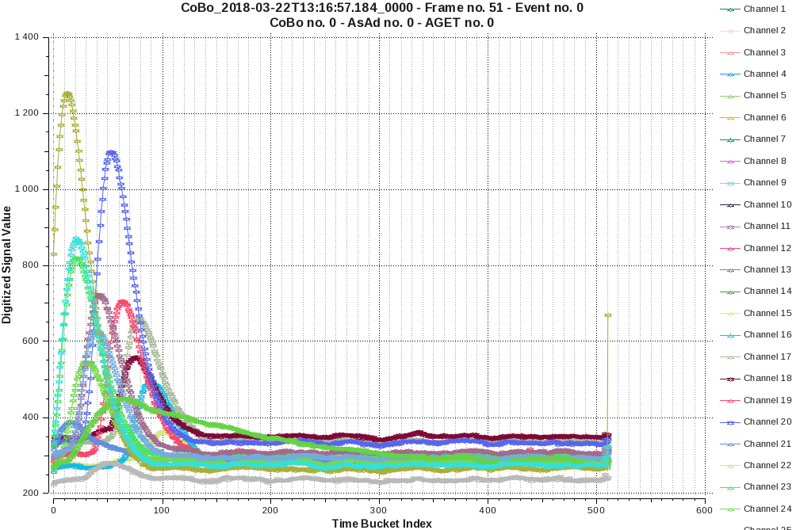
IV- A new detector, phase II
Test experiments on the AIFIRA facility in 2018
irradiation with neutrons (E_{n} down to 200 keV)
- same conditions than usual experiments (distance, reaction)
Validations
- good static electric field behavior
- good electric field behavior under irradiation
- 3D tracks reconstruction
lower drift velocity => significant time difference depending
on z-axis
z-coordinate (cm)
improvement of E_{res} via track length determination

Slide 29
IV- A new detector, phase II
Test experiments on the AIFIRA facility in 2018
irradiation with neutrons (E_{n} down to 200 keV)
- same conditions than usual experiments (distance, reaction)
Validations
- good static electric field behavior
- good electric field behavior under irradiation
- 3D tracks reconstruction
- low detection energy limit: 200 keV (at least)
track for E_{n} = 200 keV
limitation due to the
H-rich sample thickness
(0,5µm max at 200keV)

Slide 30
IV- A new detector, phase II
Test experiments on the AIFIRA facility in 2018
irradiation with neutrons (E_{n} down to 200 keV)
- same conditions than usual experiments (distance, reaction)
Validations
- good static electric field behavior
- good electric field behavior under irradiation
- 3D tracks reconstruction
- low detection energy limit: 200 keV (at least)
- ε_{intr} = 100% not proven
need a quantitative and accurate experiment

Slide 31
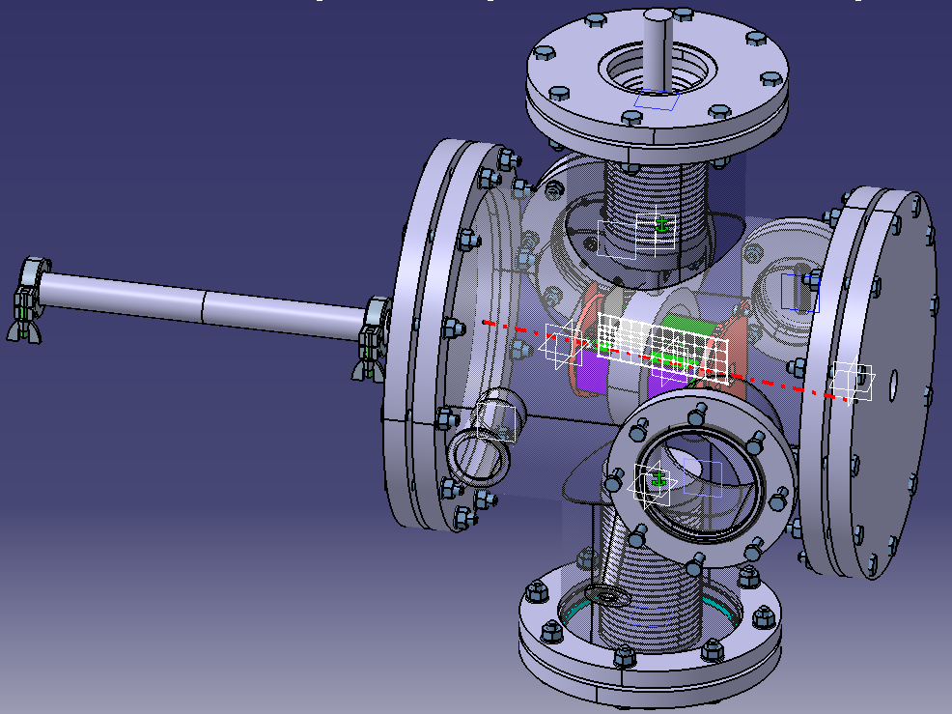
IV- A new detector, phase II
Next experiment
Goals
- better understanding of the detector
- prove ε_{intr} = 100%
- determine the detector rate limit
Direct proton beam experiment
A new chamber has been designed:
direct proton micro beam
(few p/s to few 10 p/s)
GPRD shift in (x;y)
to irradiate different parts
Si detector
to monitor the counting rate

Slide 32
Conclusion
A difficult energy range for recoil proton
very high background due to n->γ->e⁻
prevent an accurate counting of recoil protons
The Gaseous Proton Recoil Detector
built in 2016
designed for a low sensitivity to γ/e⁻ background
test experiments @AIFIRA facility :
. good behaviour under irradiation
. validation of the low sensitivity to background
. track reconstruction
. low energy limit of 200 keV (limited by the thinness of the H-film)
- a direct proton experiment planned to investigate the efficiency
Perspectives : The GPRD will be completed and used to measure the ²⁴²Pu(n,f) cross section below 1 MeV (submitted to EURATOM WP2018)

Slide 33
Thank you for your attention

