Slide 1
Possible contribution à l’ILC
&
Réalisations gpe Laser_Electron_Interaction
Actuellement :
Elec : R. Chiche, D. Jehano, E. Plaige, S. Trochet
Méca : D. Douillet, Y. Peinaud
DEPACC : K. Cassou, K. Dupraz, A. Martens, D. Nutarelli, C. Pascaud, V. Soskov, F. Zomer
Production de rayons X ou gamma
-Imagerie X
-polarimétrie
-’photonique nucléaire’

Slide 2
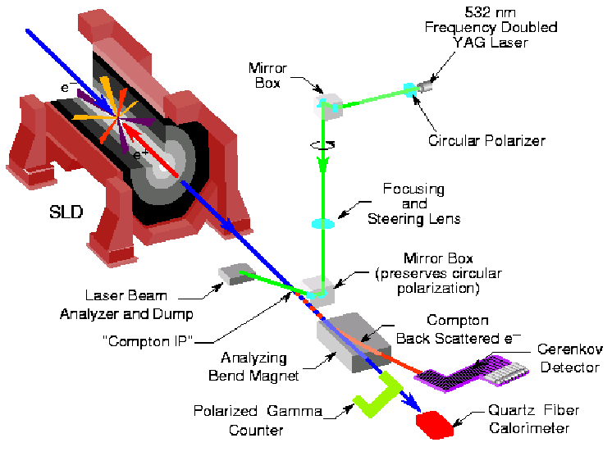
For ILC we could contribute to the electron polarimeter
Early studies in 2000 using the SLAC polarimeter scheme

Slide 3
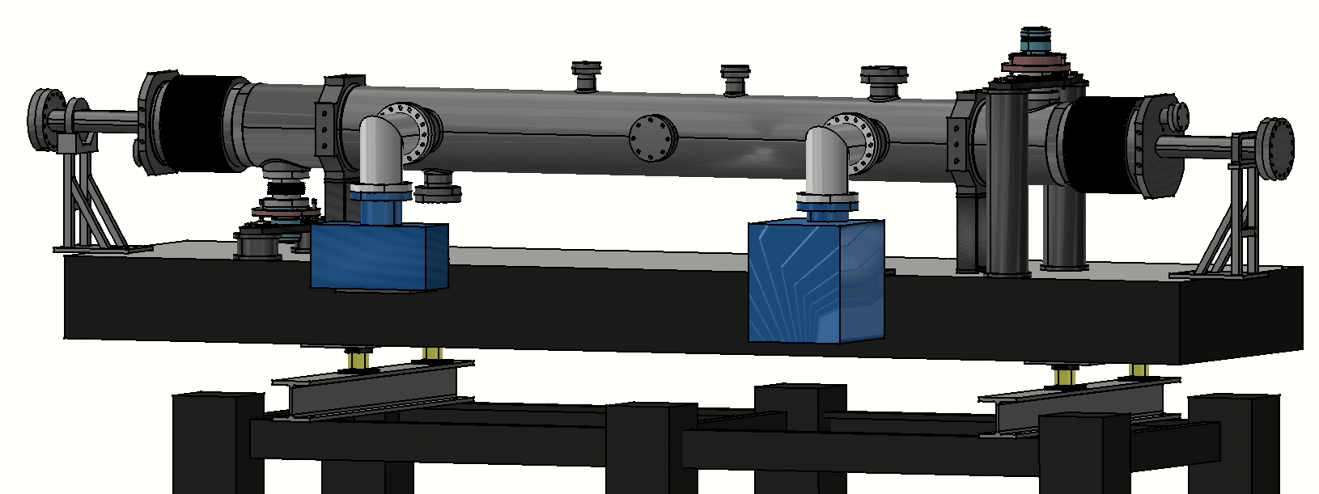
Compton polarimeter at HERA
~2000 DESY / HERA
2 mirror cavity, 2 m long
CW laser beam
Finesse~25000
Issue ➔ laser frequency stabilization
@ 10⁻¹² relative accuracy in accelerator
environment

Slide 4
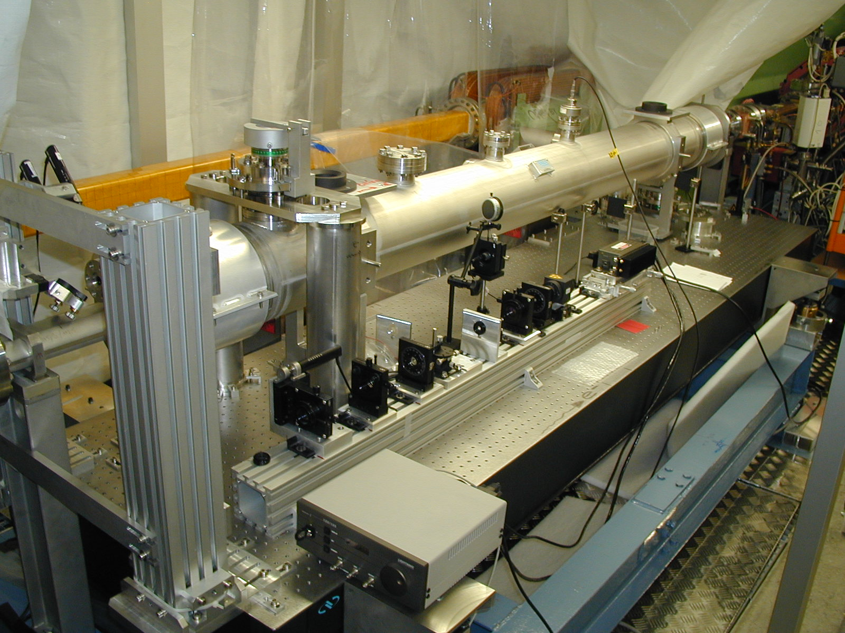
Laser d’alignement
Tube protons

Slide 5
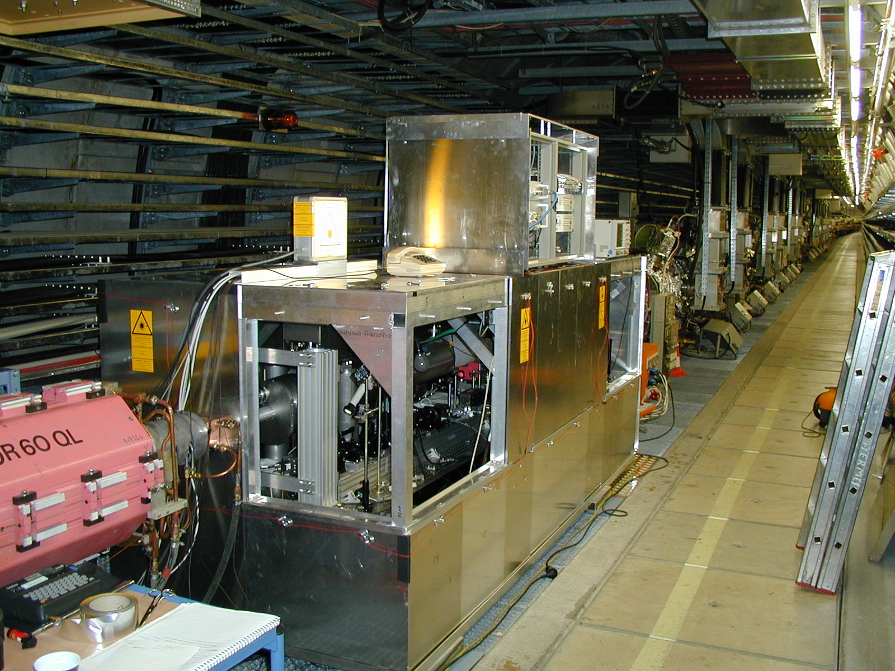
Blindage (3 mm pb) +
isolation thermique
(sandwitch Alu/isolant/Alu)

Slide 6
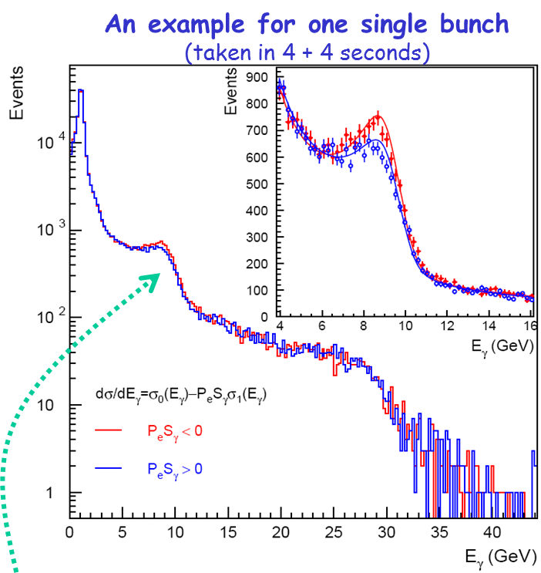
results
An example for one single bunch
(taken in 4 + 4 seconds)
Compton peak & asymmetry measured
Fitted P_{e}: 29.7±2.5_{stat}% (one bunch in 8s)
32.1±1.5_{stat}% (all bunches in 8s)
(TPOL P_{e}: 29.6±1.3_{stat}% (all bunches in 1min)

Slide 7
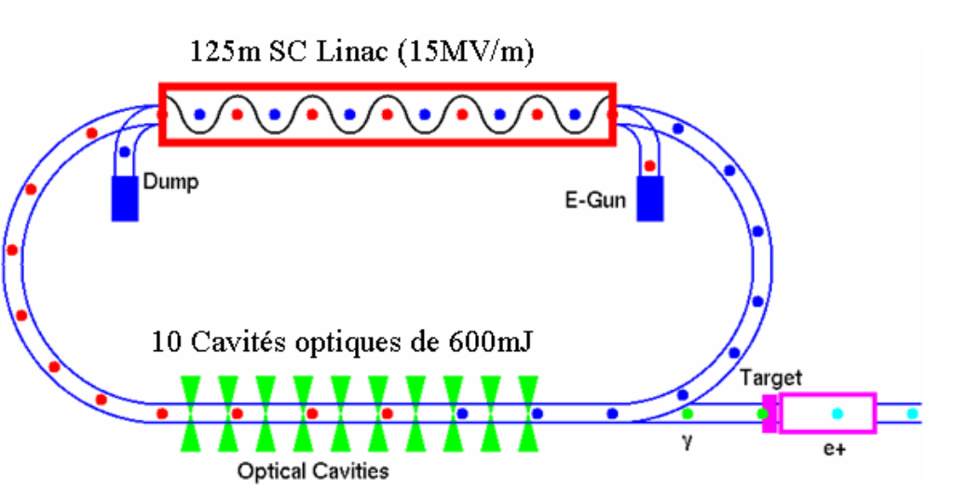
Collaboration with KEK
Optical cavity R&D
Pulsed laser

Slide 8
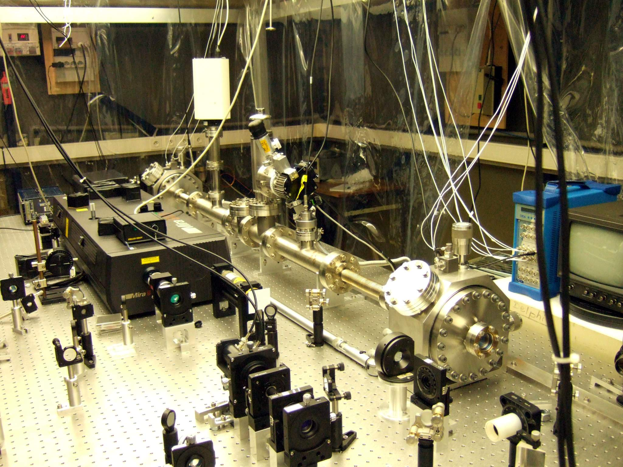
EUROTEV
Contrat européen 2006
Cavité 2 miroirs, finesse 26000,
Pulsed Laser
(Ti:sapph picosecond)

Slide 9
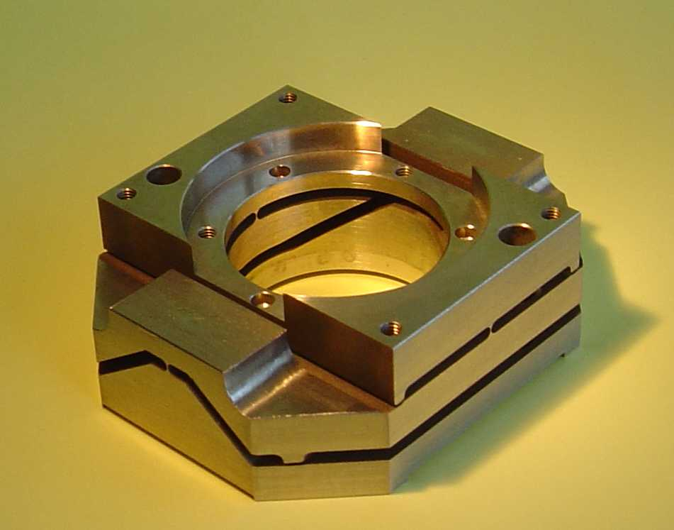
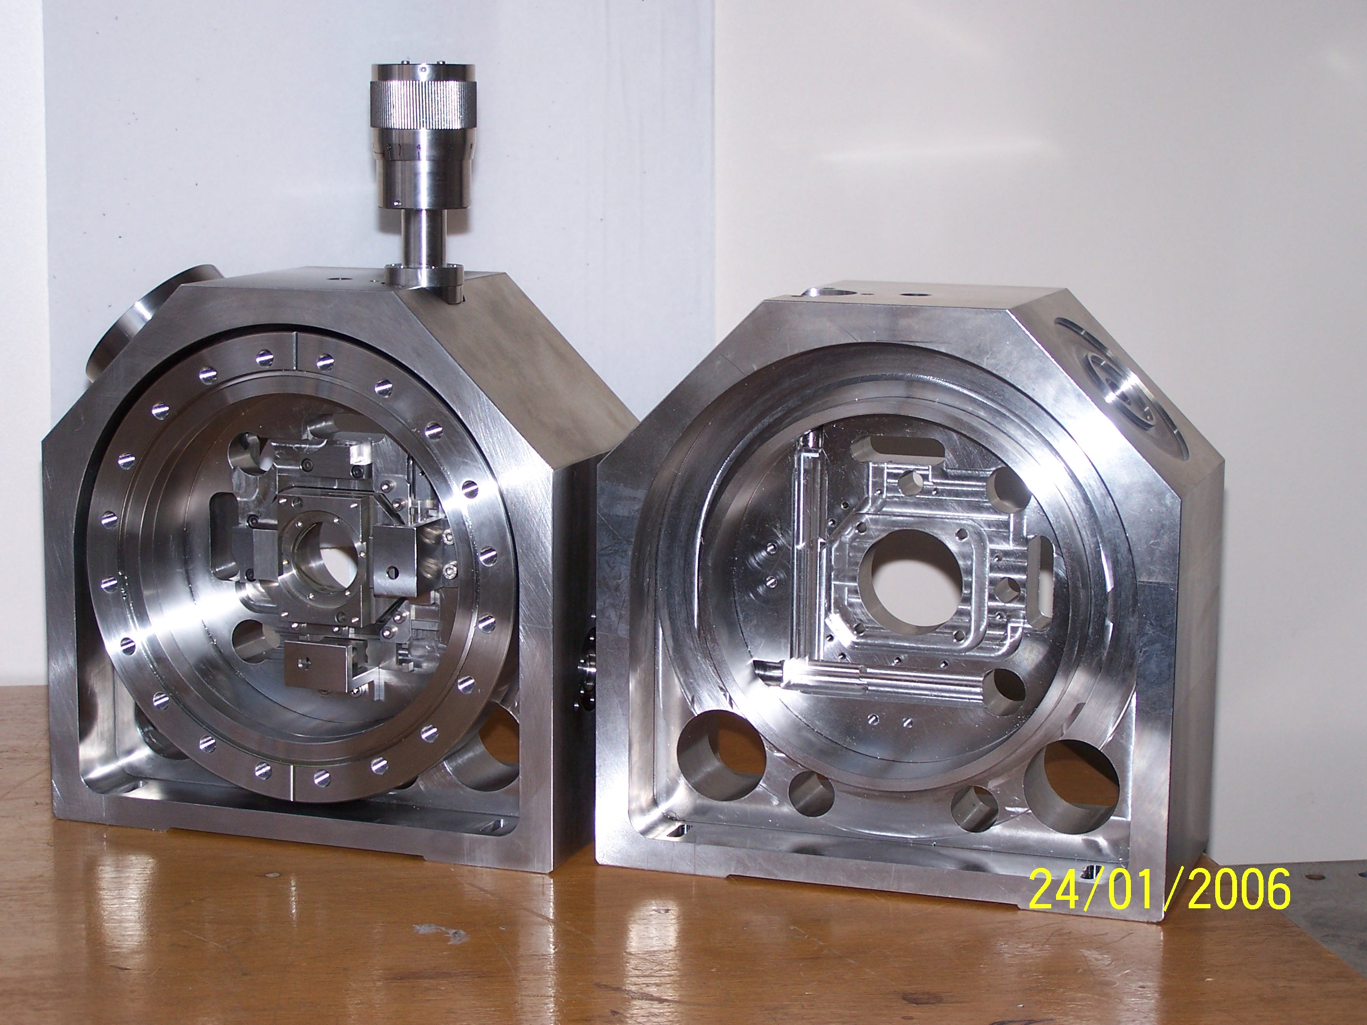
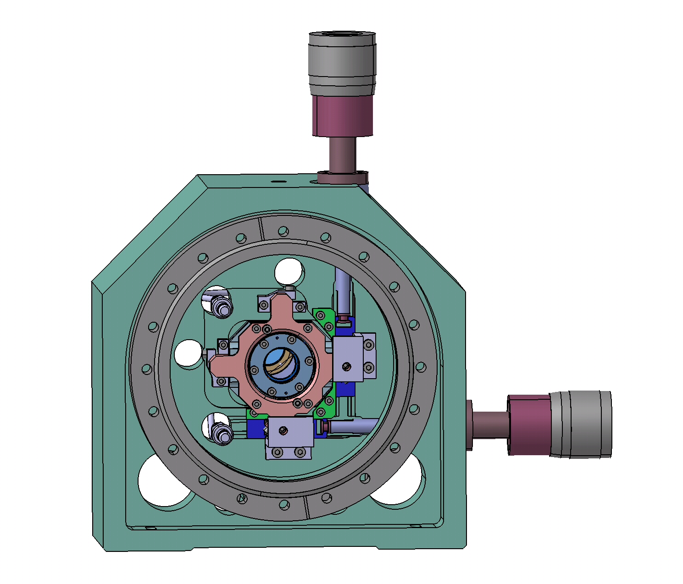
R. Cizeron/LAL

Slide 10
Results

Slide 11
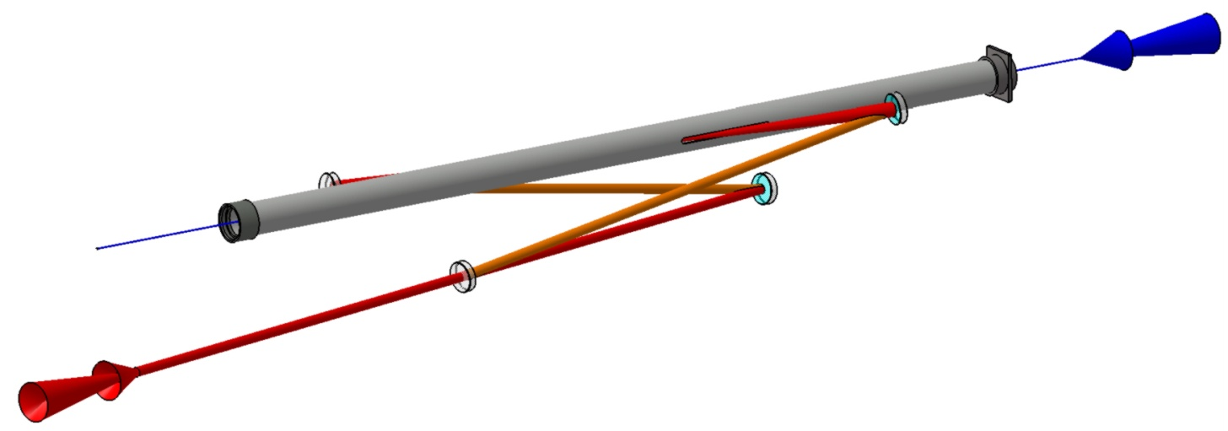
Non planar 4-mirror cavity for ATF
MightyLaser (LAL/KEK/CELIA/LMA)
Contrat ANR
2008-2012
Polarised positron source
Circularely polarized eigen mode
ATF beam pipe: 5mm slit…
2 spherical mirrors
Angle laser / e⁻ beam= 8°
ATF e⁻ beam
laser/beam
Interaction point
Injection laser
2 flat mirrors

Slide 12
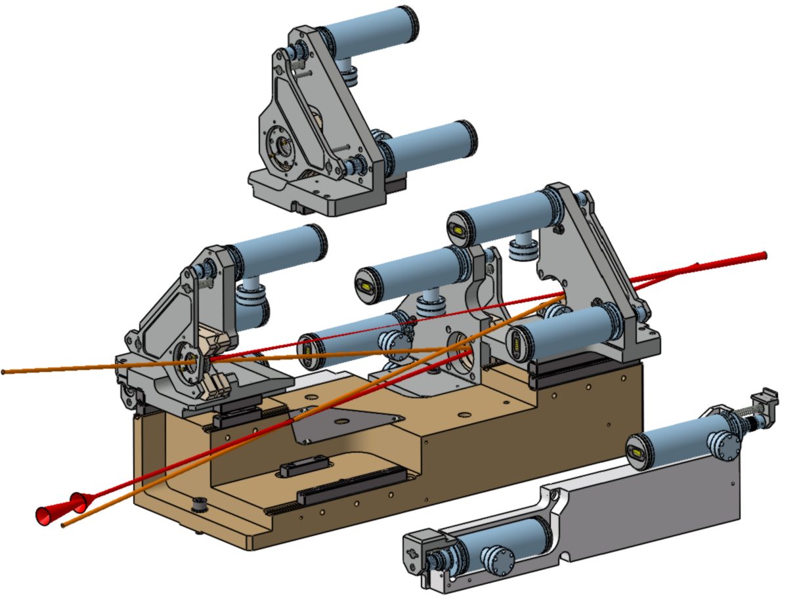
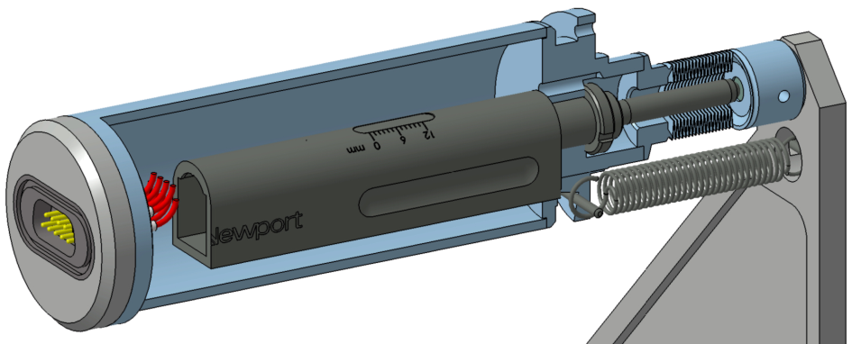
OVERALL DESIGN PRINCIPLE
θx
actuator
Gimbal mounts→ θx θy ± 10 mrad
Encapsulated
commercial
stepper motor
bellow
θy
translation : 3 balls on guide rail and plan
translation Z actuators

Slide 13
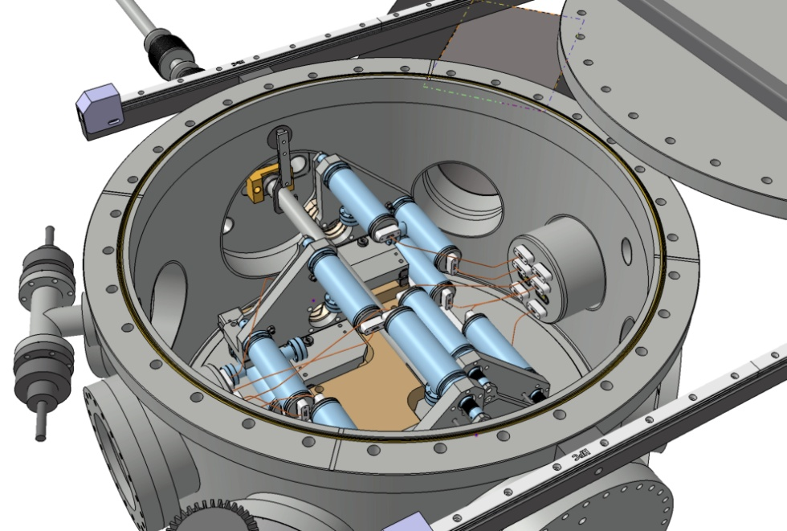
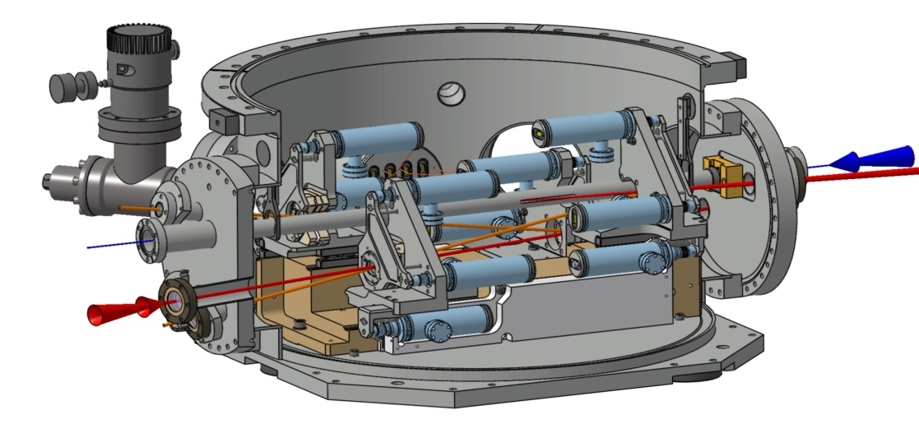
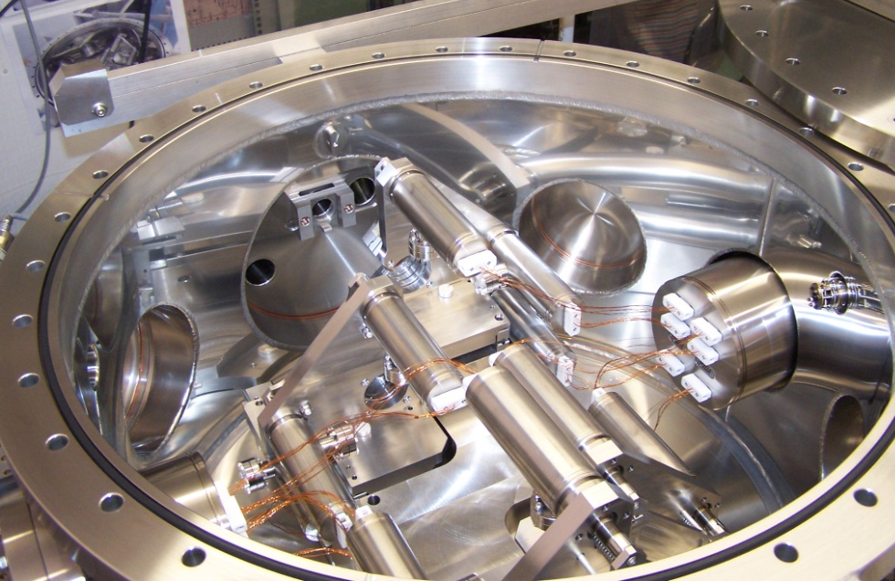
Vacuum vessel for ATF

Slide 14
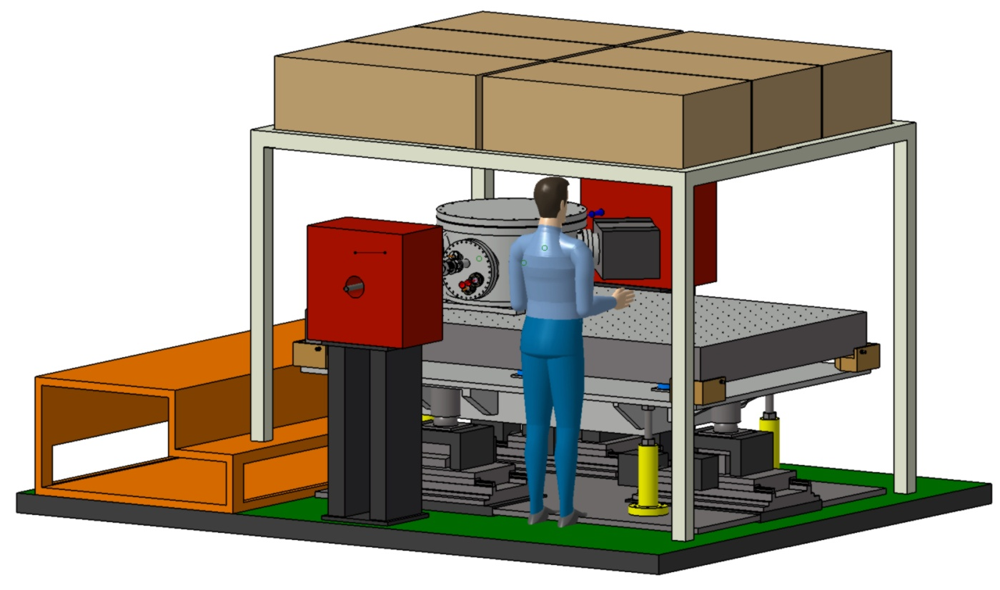
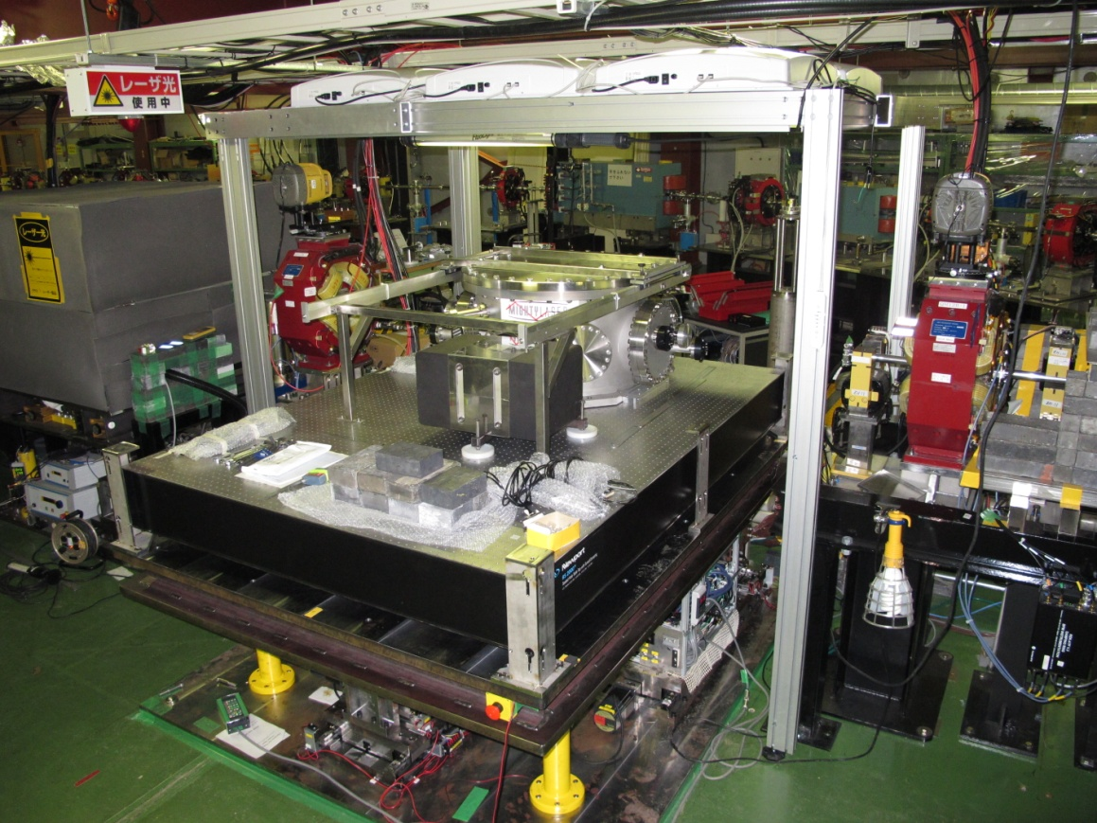
Implementation
at ATF / KEK

Slide 15
Results

Slide 16
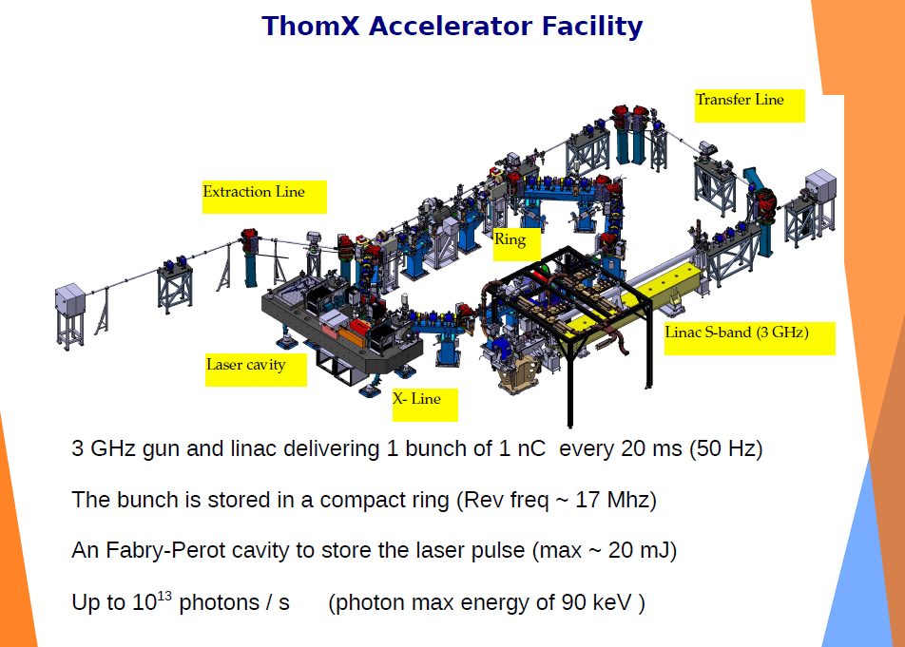

Slide 17
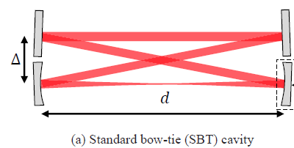
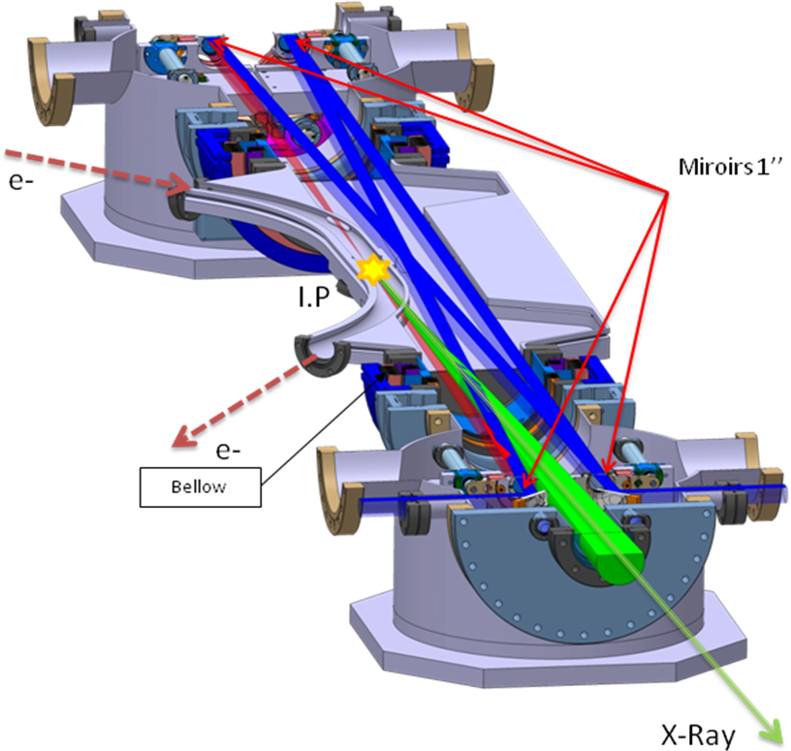
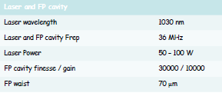
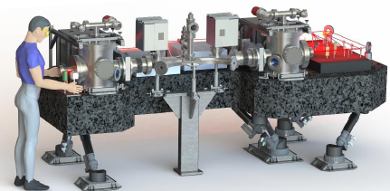
ThomX Optical cavity
Laser oscillator rep. rate & CEP locking
@ Δν/ν ~10⁻¹²

Slide 18
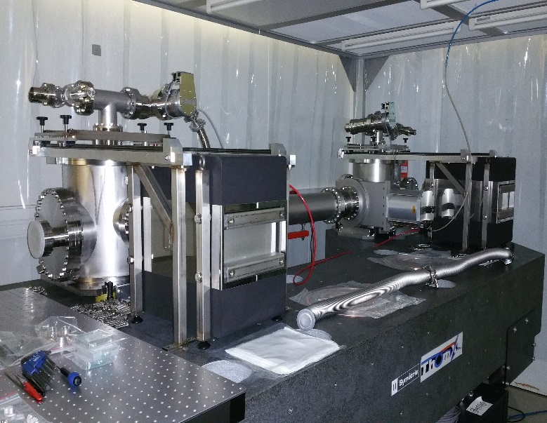
ThomX optical table

Slide 19
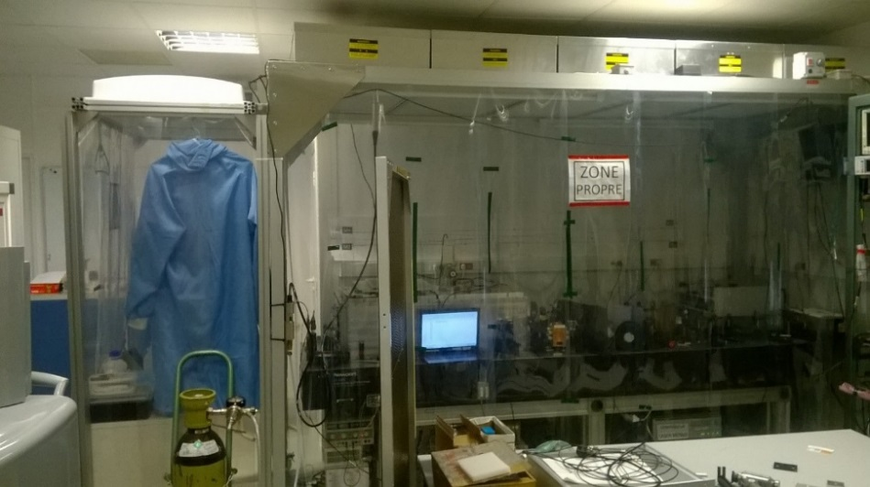
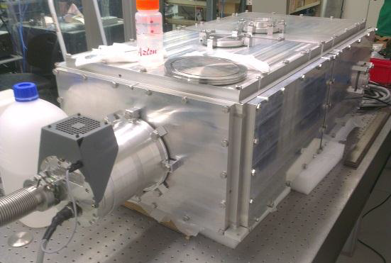
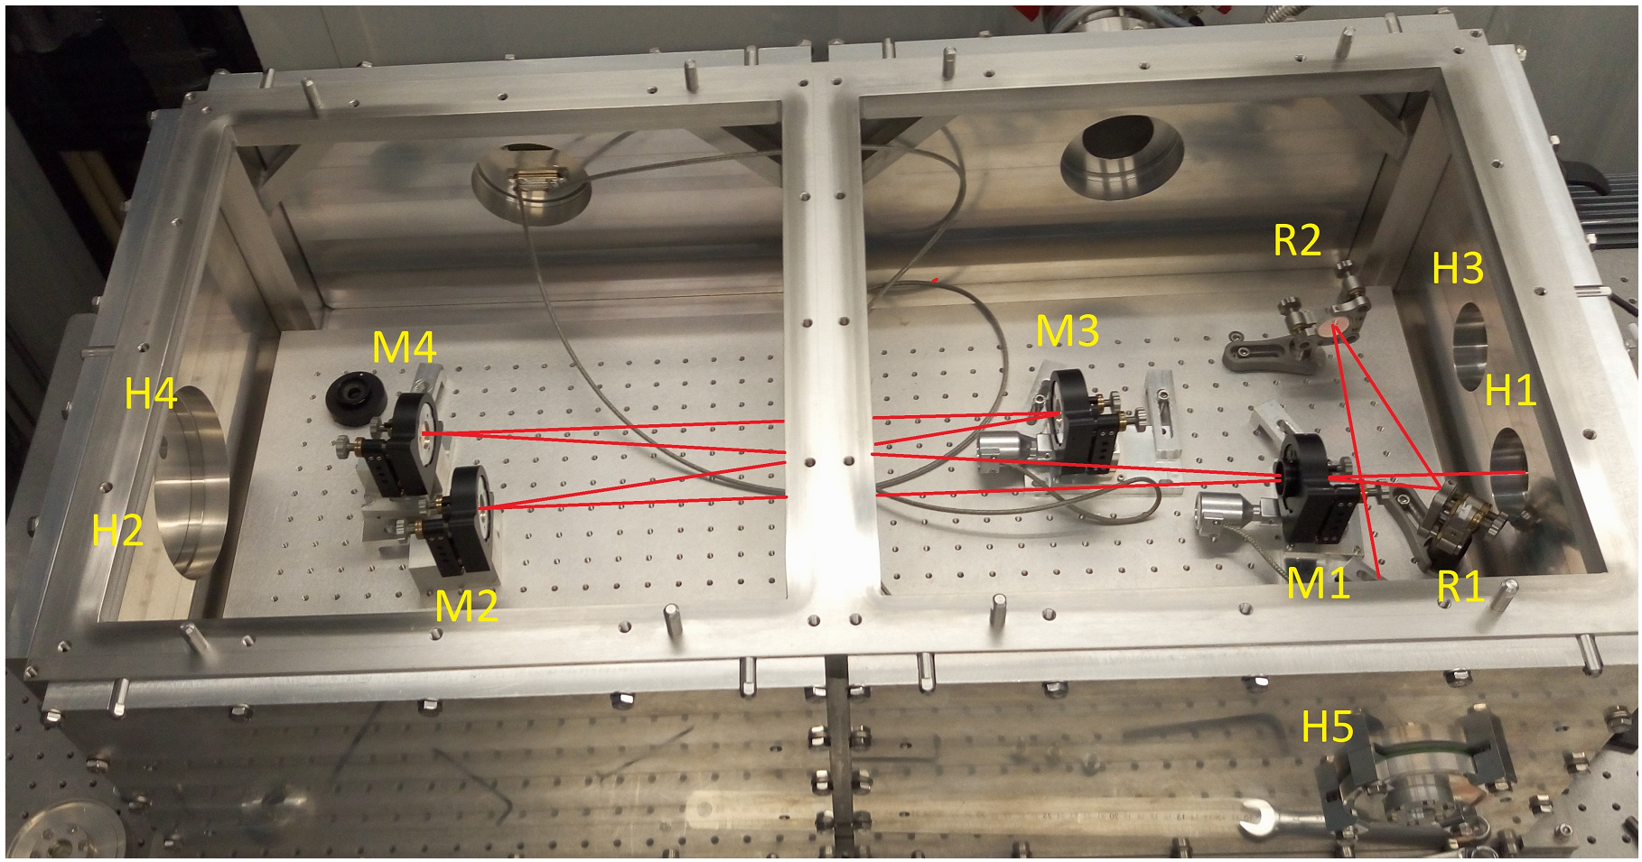
ThomX test cavity
R&D cavity (133 MHz)
Test for ThomX
High average power

Slide 20
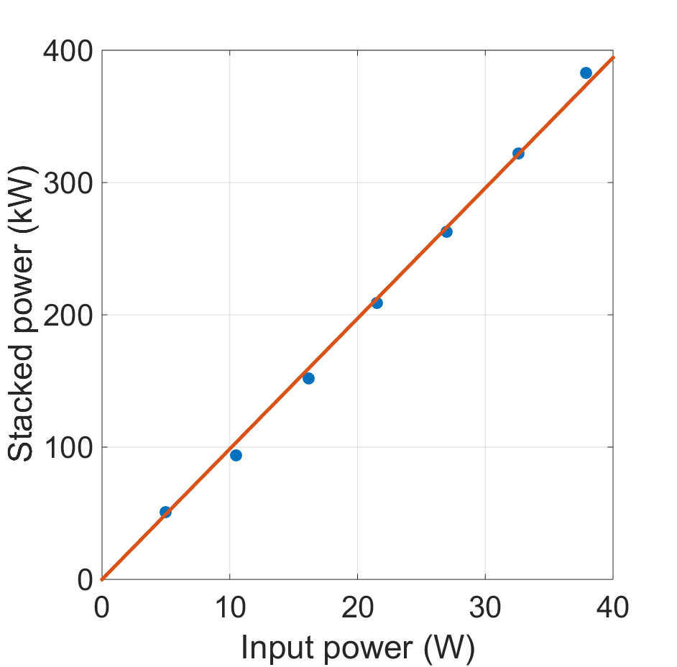
Measured stacked power
Max stable stacked power ~ 383 kW
400 kW during few seconds
Effective enhancement factor ~ 10 000
Spatial coupling ~ 90 %
Thorough re-alignement at every step
Still limited by thermal effects in the
mounts
Mirrors transmission measured
with a calibrated power meter

Slide 21
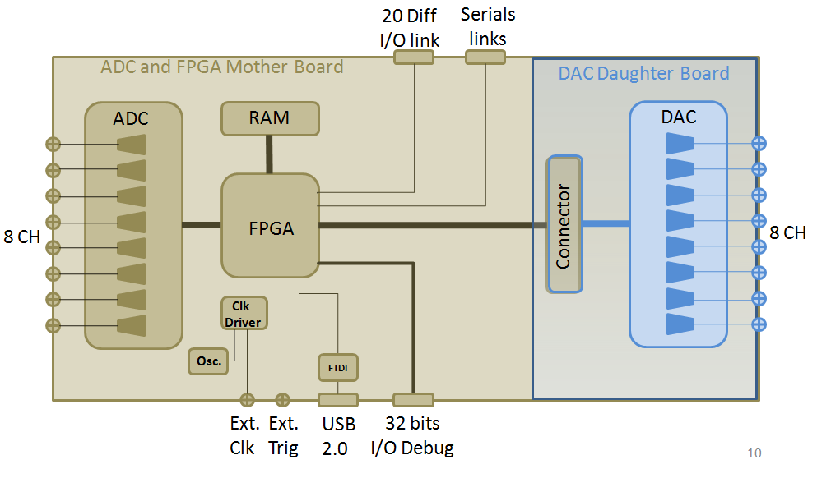
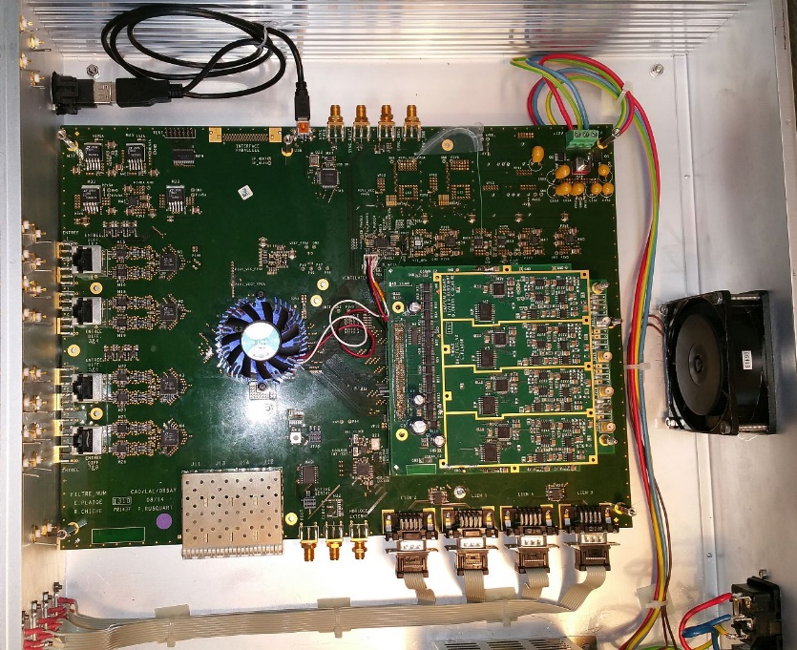
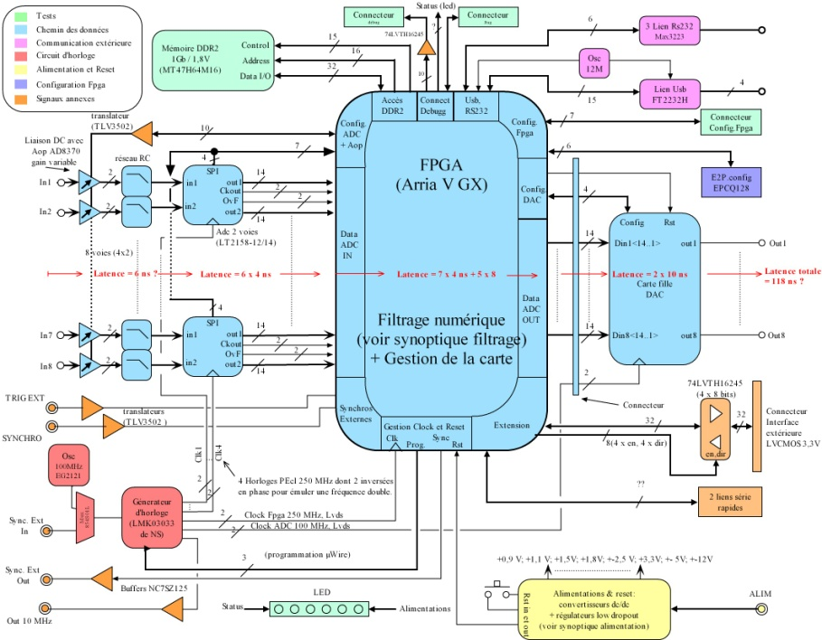
ThomX feedback system
Performances :
8 channels (In and Out)
ADC @ 250 MHz
FPGA @ 250 MHz (DSP) – 500 MHz (Logic)
DAC @ 125 MHz
Global in-out latency (GIOL) ~ 65 ns
Designer : E. Plaige

Slide 22
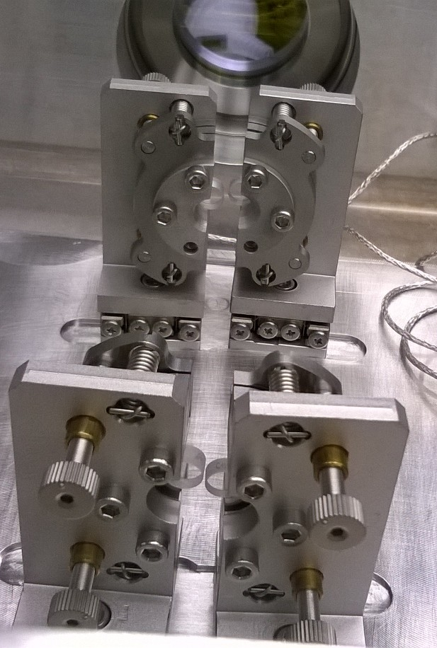
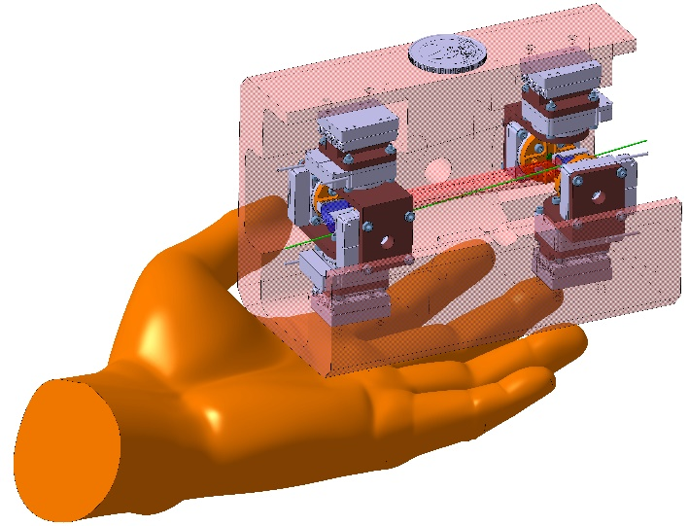
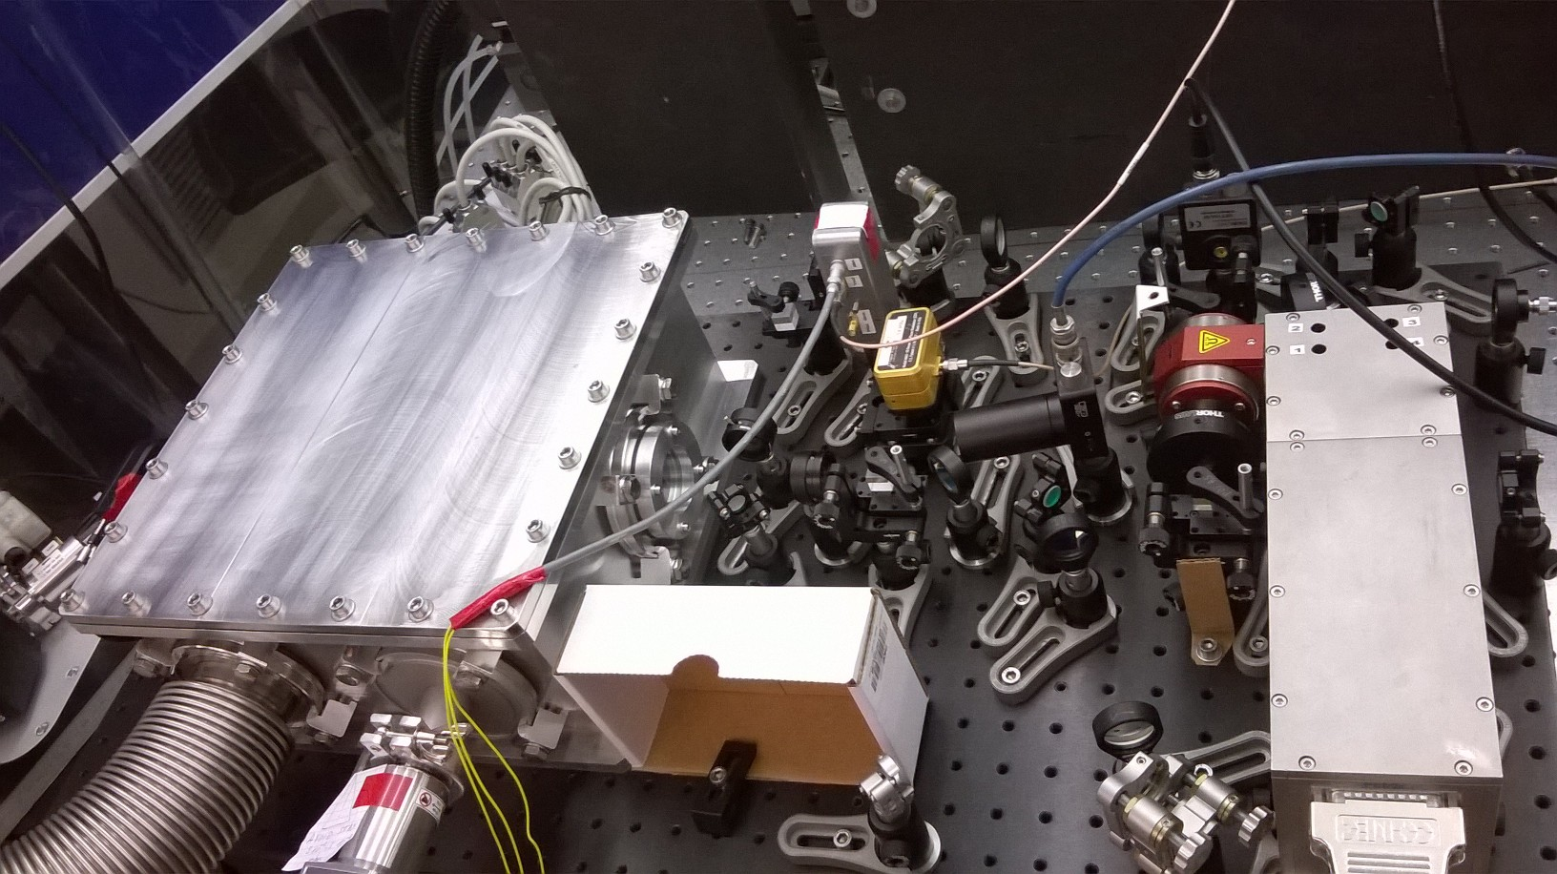
Valo industrielle (LabCom CNRS avec Amplitude)
Cavité optique
miniaturisée
Source Compton & LINAC

Slide 23

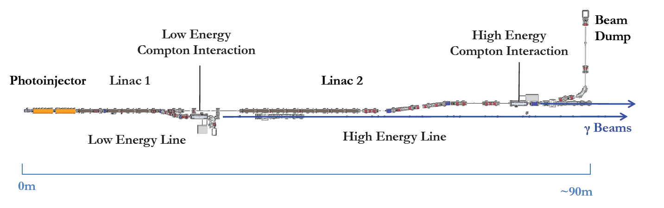




ELI-NP gamma beam source
Extreme Light Infrastructure = Programme de recherche européen
Faisceau
laser
Faisceau
laser
e-
Rayons γ
Défis technologiques :
➔ synchronisation < 500 fs
➔ 32 paquets e- @100Hz
Accélérateur
linéaire
Point
d’interaction
Spécifications du faisceau de rayons gammas:
  Énergies γ (E_{γ}) : 0.2 – 19.5 MeV
  Largeur spectrale relative (ΔE/E) : <0.5%
  Flux : > 10¹⁰ ph/s
  Polarisation linéaire : >95%
Laser 400 mJ
E_{e} ≈ 280 MeV
Laser 200 mJ
E_{e} ≈ 600 MeV
Schéma d’ELI-NP-GBS

Slide 24
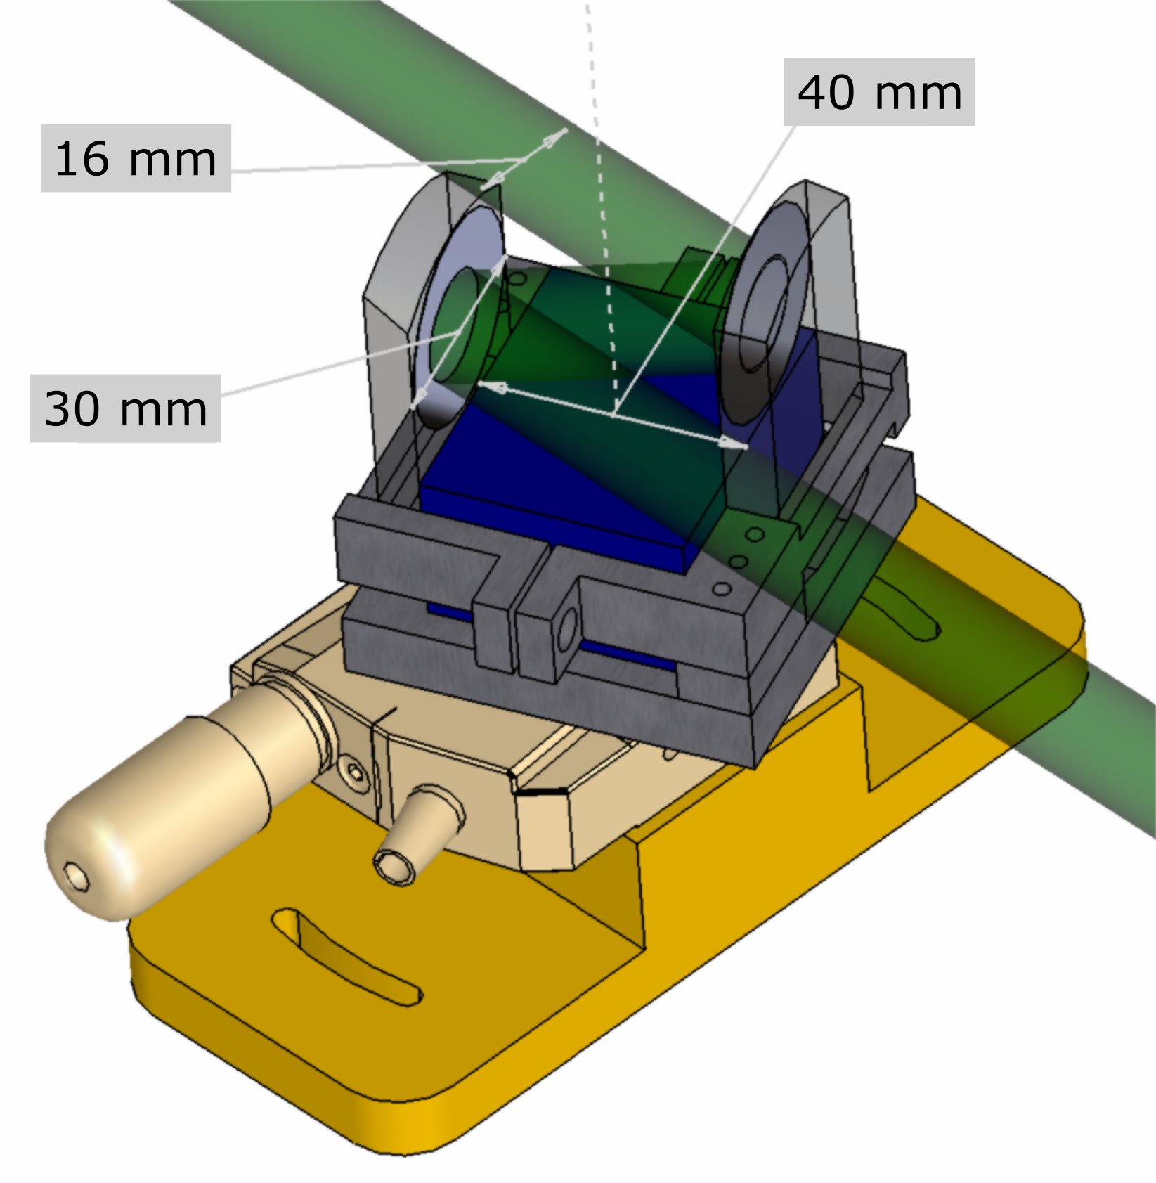
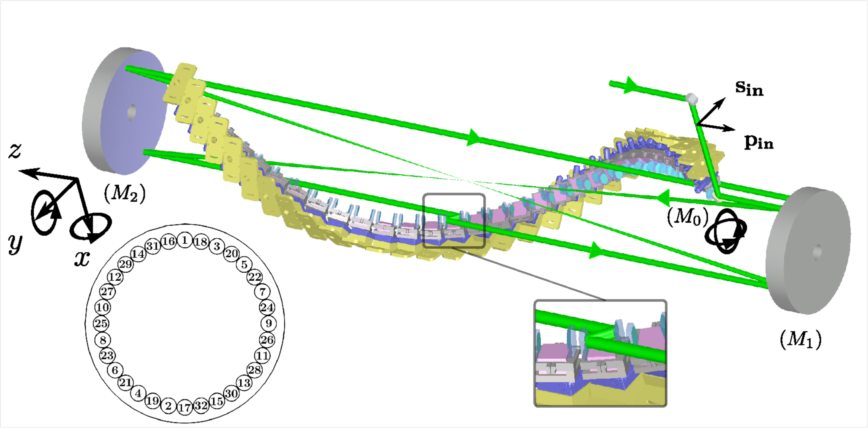
Point d’interaction (recirculateur)
Spécificités :
Unique point d’interaction laser-électrons
Angle de croisement laser-électrons constant (faible largeur spectrale)
Pas d’aberration optique (2 miroirs paraboliques)
32 passages d’une impulsion laser (puissance laser x32)
Faisceau
laser
Faisceau
laser
e-
Rayons γ
Accélérateur
linéaire
Point
d’interaction
2377 mm
380 mm
Schéma du recirculateur

Slide 25
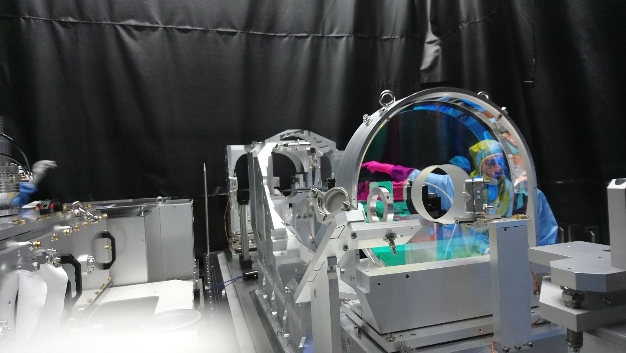
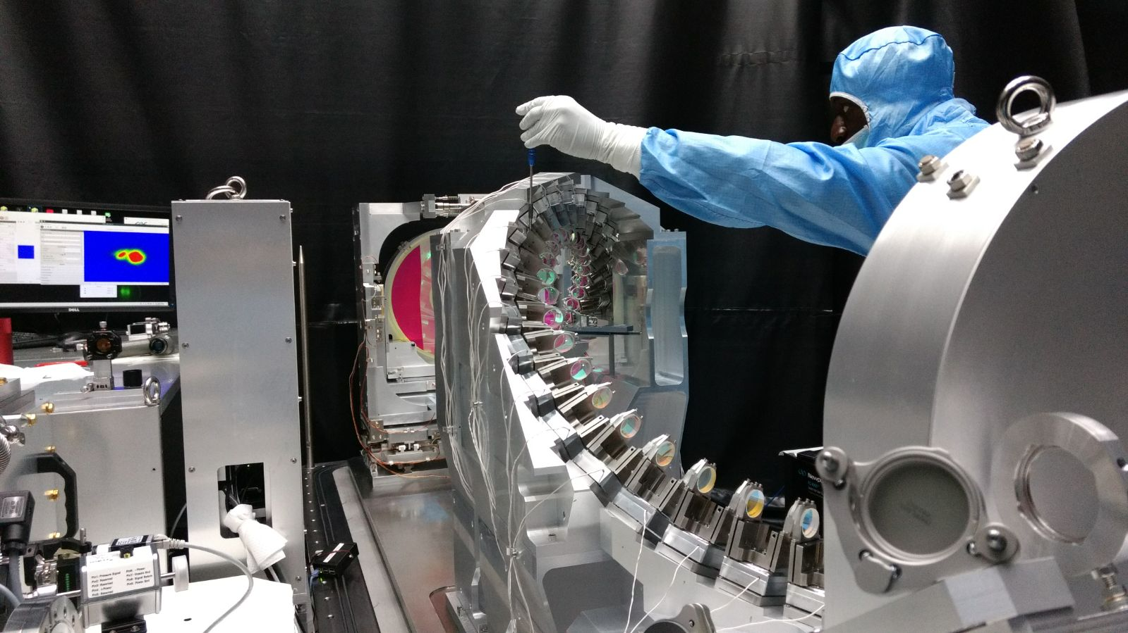
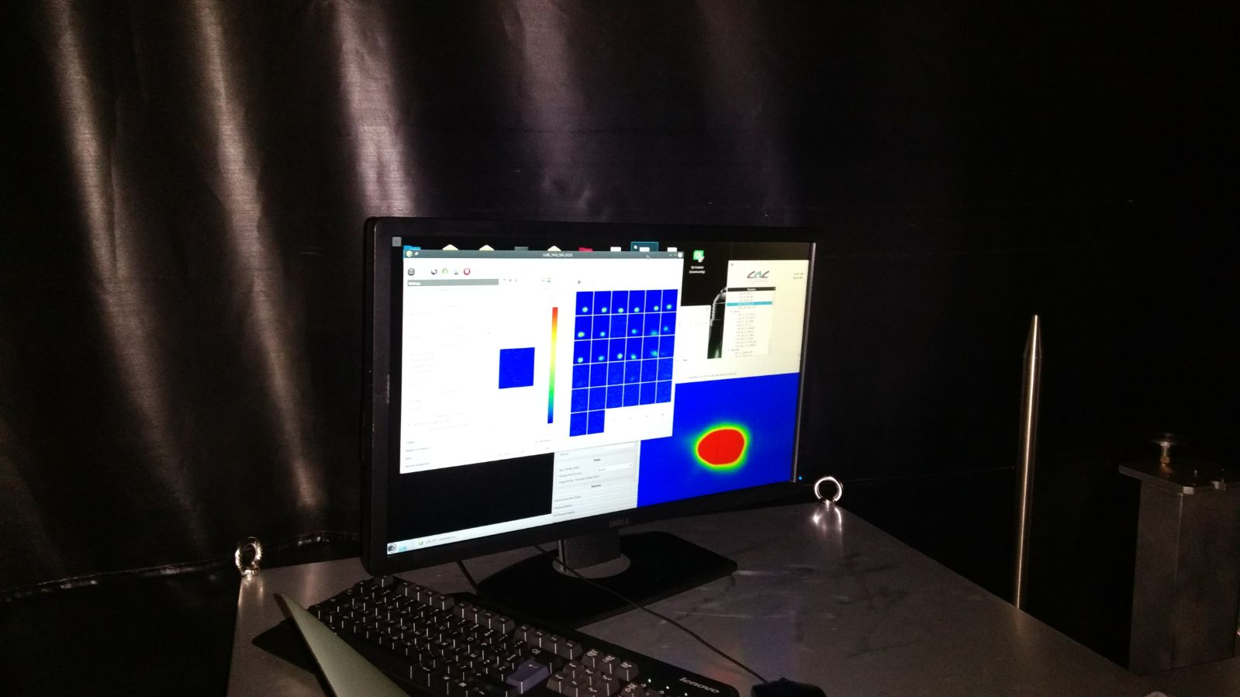
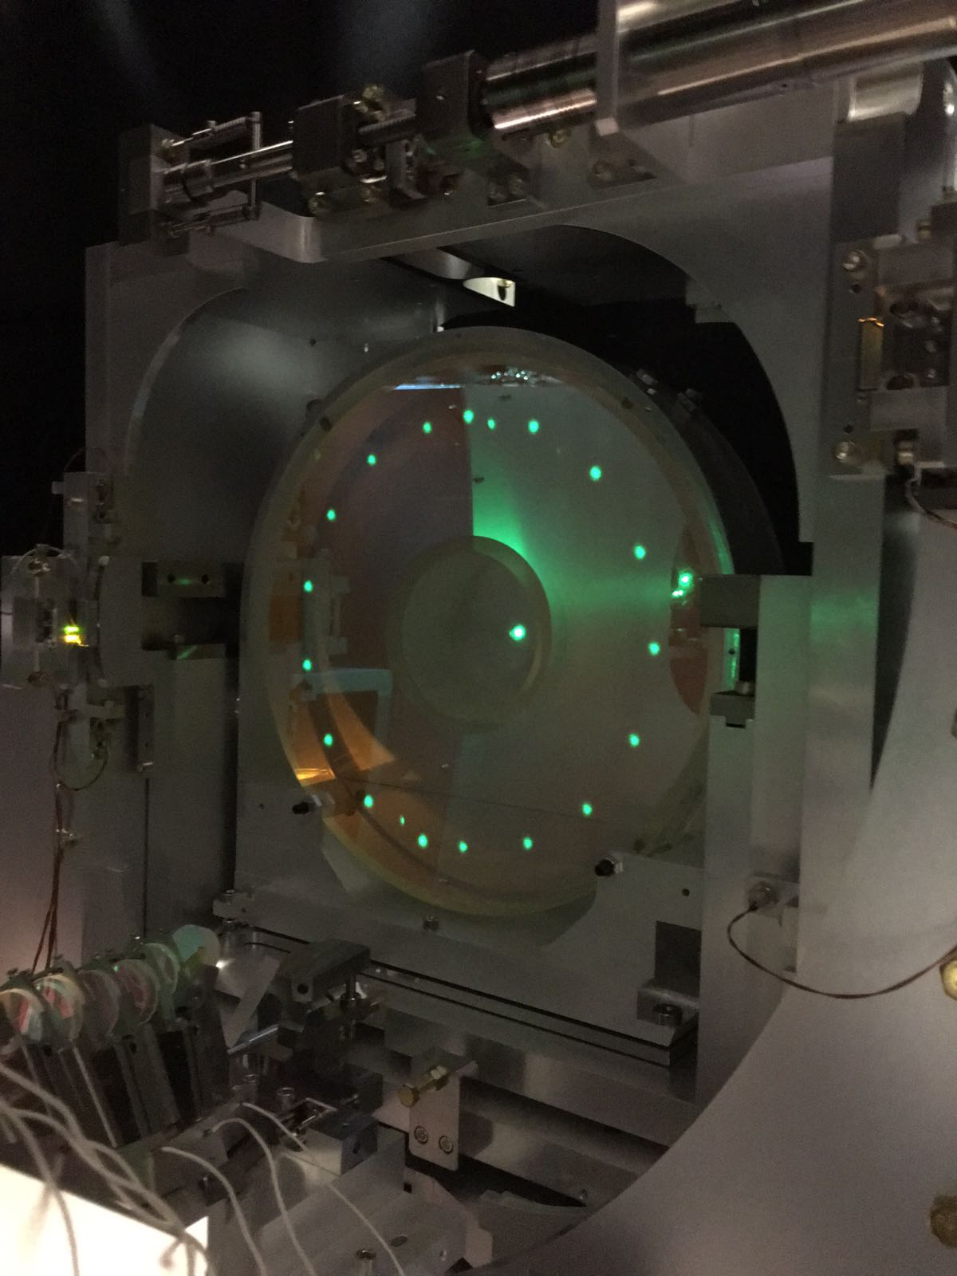
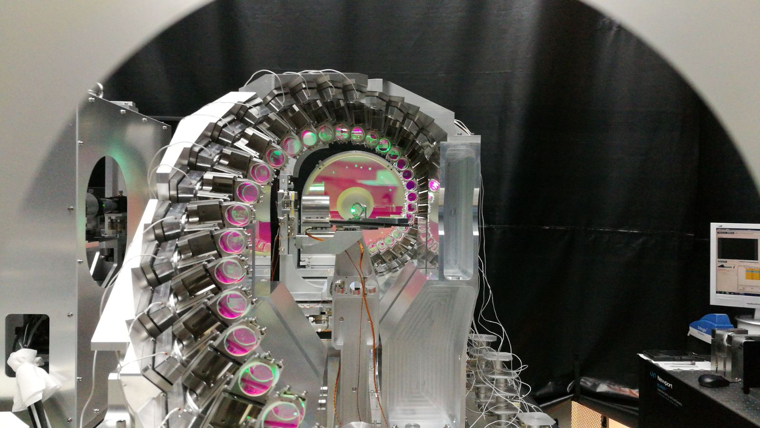

Slide 26
High intensity Laser beam transport lines

Slide 27
For ILC we could contribute to the electron polarimeter
Early studies in 2000 using the SLAC polarimeter scheme

Slide 28
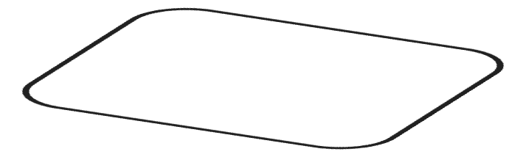
Global architecture
Laser oscillator and fiber amplifier
Amplificateur
Cavité optique
Anneau e_
Oscillator laser
IP
<P> ~ 10 mW
<P> ~ 150 W
<P> ~ 500 kW
Strecher
5 mW
Amp. #1
150 W
Compressor
Amp. #2
Amp. #3
Gain ~ 30000

Slide 29
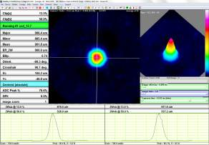
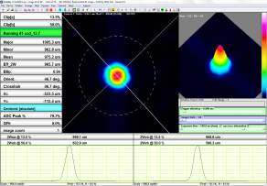
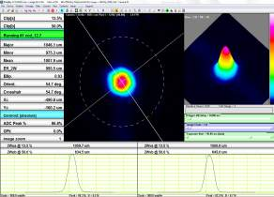
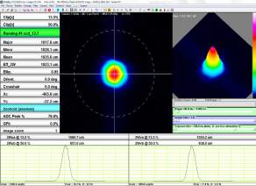
laser system
fiber amplifier : laser beam quality
Beam quality at high power
0A/4W
5A/97W
11A/200W
8A/158W
CELIA Lab.

Slide 30
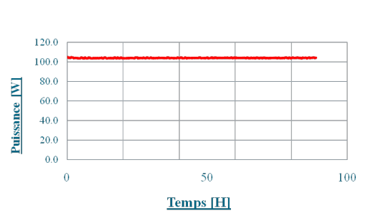
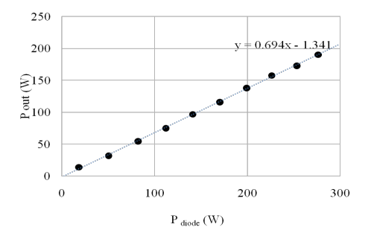
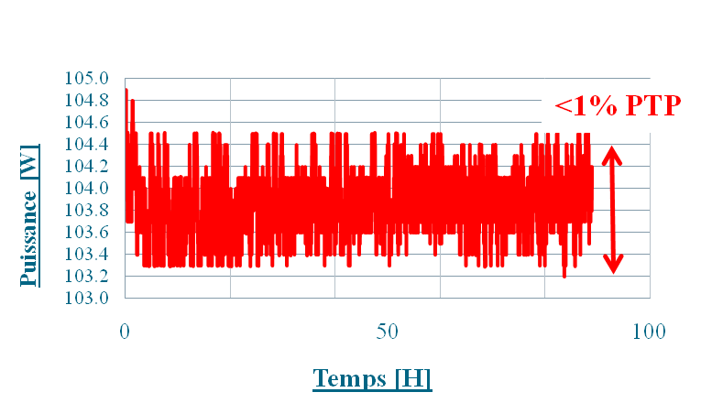
laser system
fiber amplifier
Max power : 210 W
Stability over 90h @ 104 W :
210 W
η=69%
Fiber amplifiers are very efficients
CELIA Lab.

Slide 31
fiber amplifier : Amplified Spontaneous Emission
ASE
CELIA Lab.

