Slide 1
Experimental methods in astroparticle physics
V. Bertin
CPPM

Slide 2
Which are the messengers?
photons
γ
ν
neutrinos
nuclei
p,He,…
The nuclei can interact with the interstellar medium (ISM) ,cosmic microwave background (CMB) and can be deviated bu magnetic fields (galactic and intergalactic)
Photons can be absorbed by the ISM and CMB
Neutrinos are not absorbed and deviated
Gravitational Waves!

Slide 3
Outline
The beginning of astroparticle physics: the discovery of Cosmic Rays
Cosmic rays flux
Direct detection of Cosmic Rays
Cosmic ray showers in the atmosphere and their detection
Gamma rays: direct and indirect detection
Astrophysical neutrinos
Gravitational waves

Slide 4
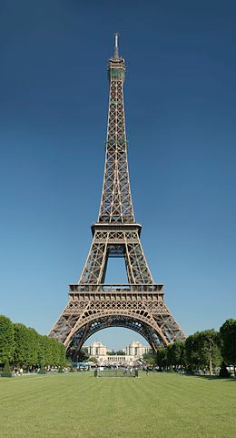
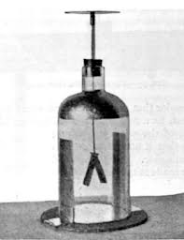
A bit of history: first evidence of CR
3.5 ions/cm³
1910:
Theodor Wulf measured air ionisation as a function of altitude.
The ionisation is larger than expected if the cause is coming only from radioactivity of the ground
300 meters: flux/15
0.4 ions/cm³
electroscope
6 ions/cm³

Slide 5
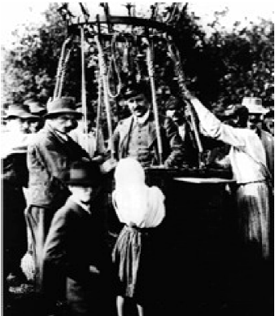
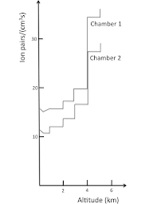
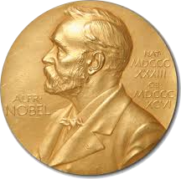
A bit of history: the discovery of CR
1912:
Victor Hess repeated ionisation measurement (using an electroscope) on board a balloon until an altitude of 5200 m
the radiation decreased slowly until 700 m and then increased considerably with height
He concluded that the increase of the ionisation with height was originated by radiation coming from space
Results were confirmed by W. Kolhorster in flights up to 9200 m
V.H. was awarded the Nobel Prize in 1936 for the discovery of cosmic rays

Slide 6
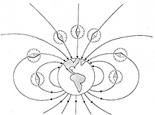
A bit of history:The nature of CR
Long debate on the nature of extraterrestrial radiation:
R.A. Millikan and others believed Cosmic Rays (CR) were photons.
1927: J. Clay finds evidence of CR intensity variation with latitude
1930: Bruno Rossi predicts the “East-West effect”: CR are charged positive particles which are deviated by the geomagnetic field the intensity of CR should be different if they are coming from East or West
1932: Compton verifies Rossi’s prediction with a world-wide campaign
Cosmic Rays are charged particles !

Slide 7
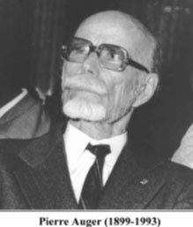
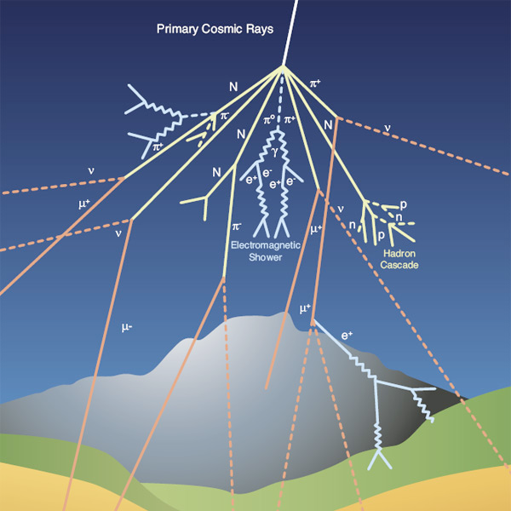
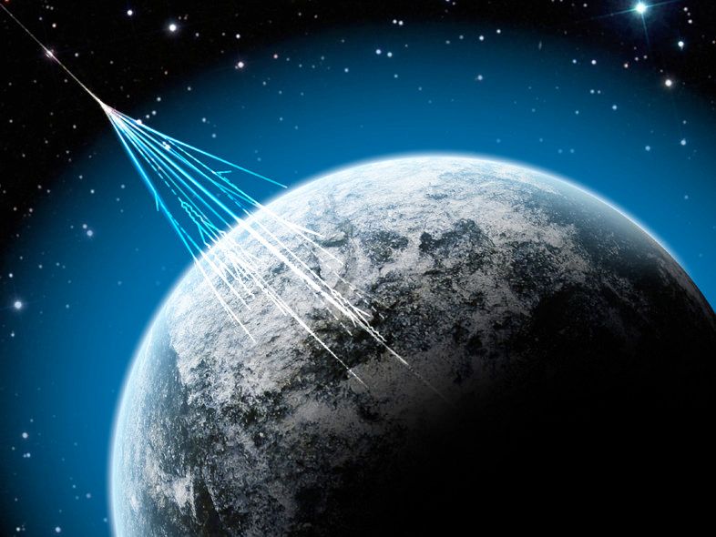
A bit of history: Auger experiment
1938: Pierre Auger demonstrated that group of particles arrive in time coincidence on detectors separated by distances as large as 200 m:
this demonstrated that the particles arriving at the Earth surface are “secondary” particles produced by a common “primary” particle that interacts in the high atmosphere, producing a shower of particles.

Slide 8
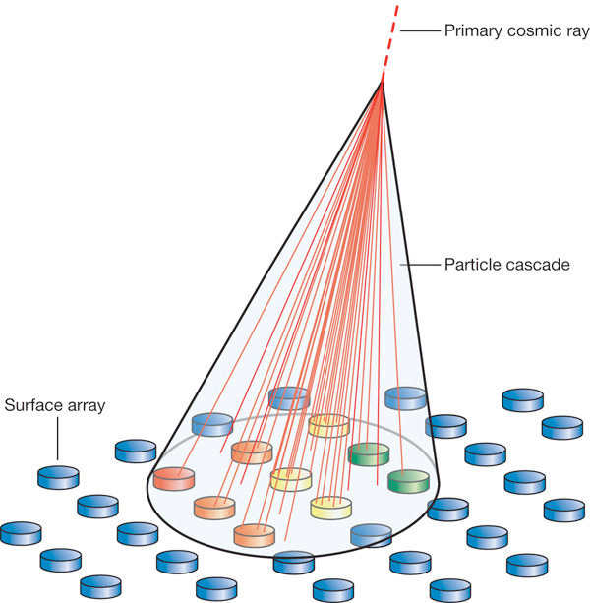
A bit of history: Auger experiment
S(detector)=150 cm²
efficiency counter= 0.003/cm²
Total surface covered = 2x10⁵ cm²
E_primary_min ~100 GeV

Slide 9
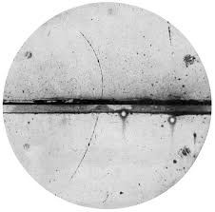
A bit of history: particle physics with CR
Since 1930s experimental techniques for detection and measurement of electric charge, mass, lifetime of particles become more refined.
New particles are discovered in CR:
1932: C. Anderson discovers the positron in a cloud chamber (Nobel Laureate in 1936)
1937: C. Anderson and S. Neddermeyer discover the muon
1947: C. Lattes, G. Occhialini and C. Powell discover the pion using nuclear emulsions
First image of a positron obtained by Anderson
First discoveries in particle in physics using Cosmic Rays!

Slide 10
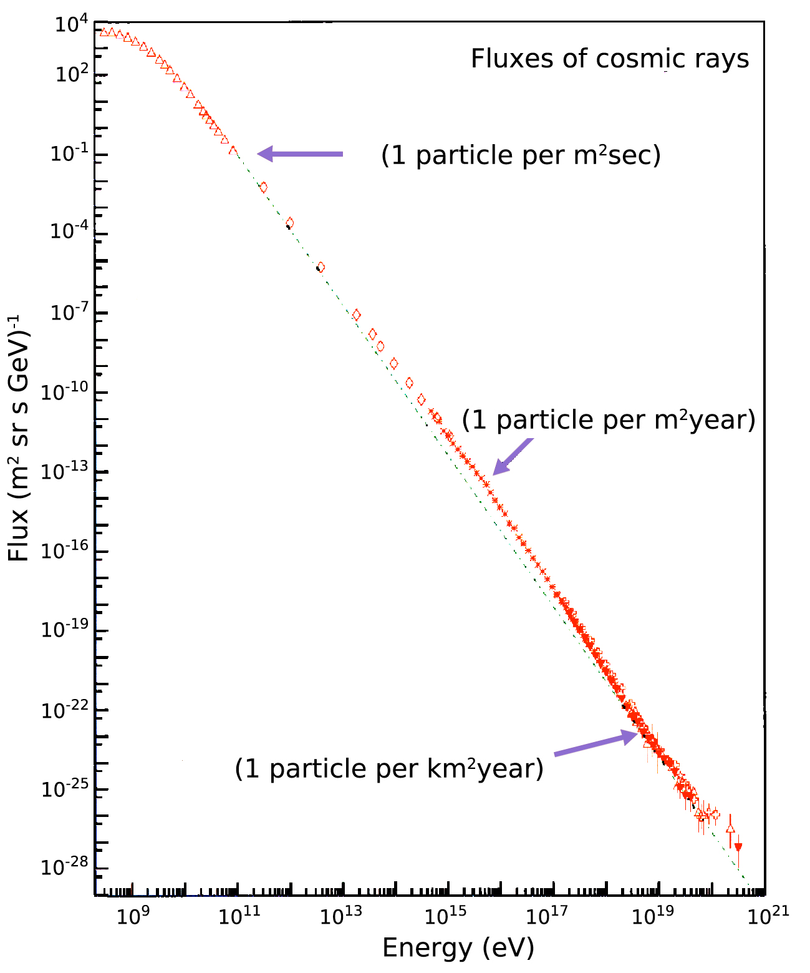
Charged Cosmic rays
Primary charged cosmic rays composition:
89% protons
10% helium nuclei
1% heavier nuclei
99 % nuclei
1% electrons
0.15% photons
Knee
Flux proportional to E^{-2.7} pour E<10¹⁵ eV
How can we detect CR?

Slide 11
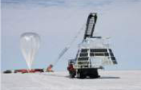
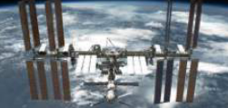
Direct detection
( E<10¹⁵ eV)
Stratospheric balloons, satellites
important to determine the flux and energy of protons, helium and heavier nuclei
- the detector must:
measure the flux
identify particles
measure their energies

Slide 12
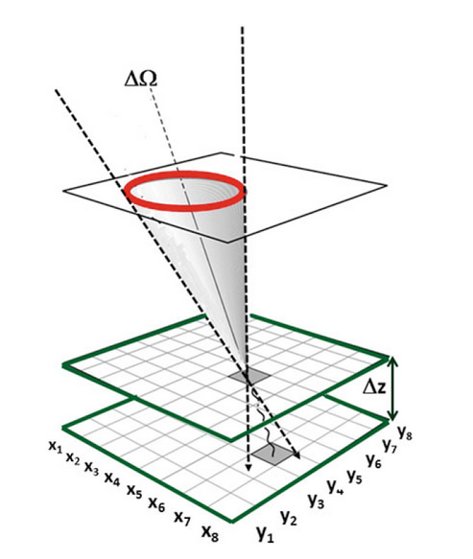
Direct detection
A Toy Telescope for primary Cosmic Rays:
2 layers of counters separated by
each layer measures position (x,y,z), time of crossing the layer (t) and intensity of the signal (I)
trigger logic: coincidence between two layers: to decrease probability of fake signals on the layers
to distinguish between upward (t2-t1>0) and downward (t2-t1 <0) going CR, timing resolution of layers must be of the order of ns (or better) (relativistic particles cover 1 m in 3.3 ns): time-of-flight measurement
A uniform magnetic field can be added between the two layers to allow particle momentum (if |Ze| is known) and sign of the charge measurement.
Detectors with good spatial resolution (tracking systems) in x are required the measure particle deflection due to B: combination of the magnetic field and tracking detectors form a magnetic spectrometer
B
FL

Slide 13
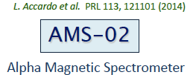
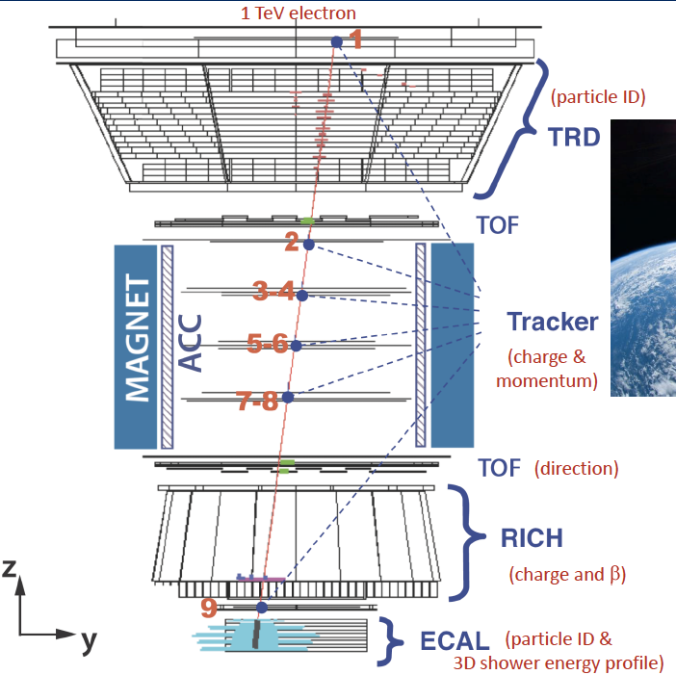
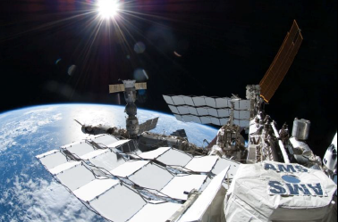
Direct detection: satellites
0.15 ns precision
10 precision
1.2 m
since 2011 : 90 billions of primary CR have been detected
Energy between 0.5-500 GeV
Notes:
ToF serve for trigger for lower detectors , ToF can resolve particles up to 0.98 c velocity . Consists of scintillators
up and down rejection 10-9 ( wrong direction would give wrong assignment to sign-> important for antimatter detection)
TRD provides Gamma factor for protons and electrons of a given energy
in the calorimeter the particle is converted in a shower through absorbers : hadronic if incident particle is proton, nucleus, electromagnetic if incident particle is photon, electron, positron . From shower shape-> distinction proton-positron (10^5)

Slide 14
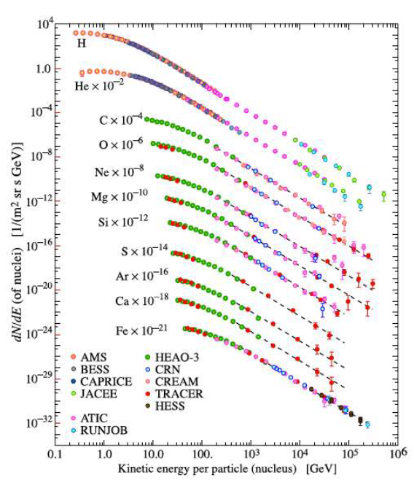
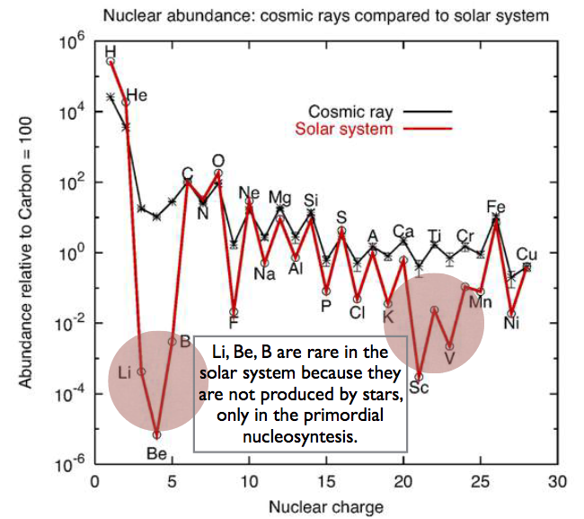
Cosmic rays composition
CR composition similar to Solar one
Li, Be, B are secondary components produced by fragmentation reactions of the heavier C,N and O during the journey of CR in ISM

Slide 15
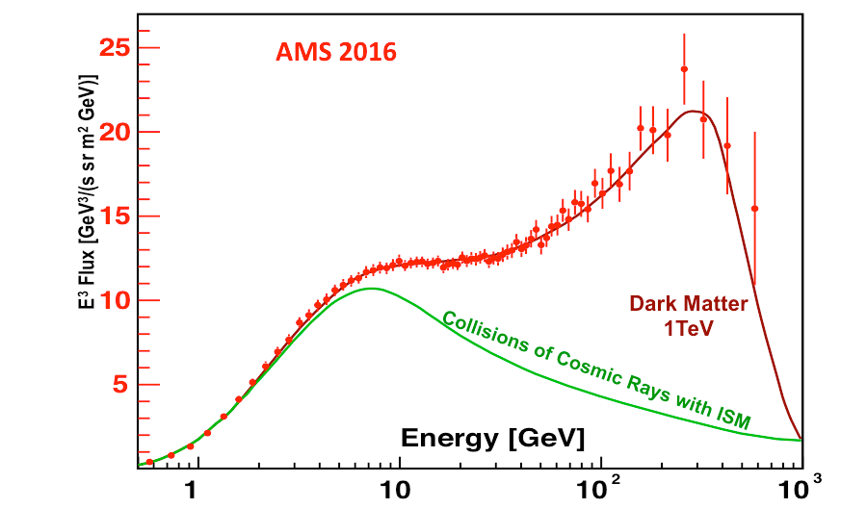
Antimatter measurements by AMS-02
positrons
Possible explanations:
Dark Matter annihilation (Wimp with mass ~ 1 TeV)
positrons created in pulsar wind (nearby pulsars)

Slide 16
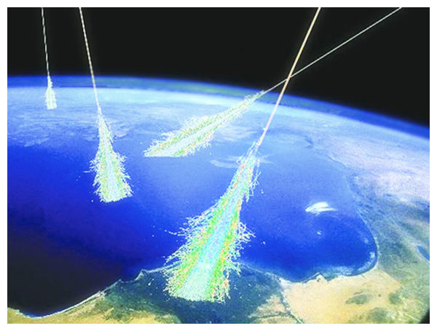
Indirect detection
( E>10¹⁵ eV )
Detectors on ground
to detect higher energy CR, larger detectors are needed (no enough space on satellites or balloons)
CR entering in the atmosphere create showers
by detecting the showers on ground it’s possible to measure direction and energy of CR

Slide 17
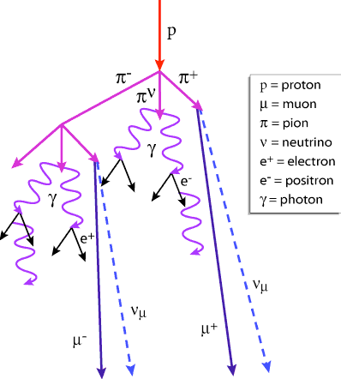
Extensive Air Shower
h ~ 35 km
E0
gamma , e⁻, e⁺ ~ 85% E0
muons ~ 10% E0
hadrons ~ 4% E0
neutrinos ~ 1 % E0
E0 =10¹⁸eV 10¹⁰ particules sur une surface de quelque km²
E0 =10¹⁵eV 10⁶ particules sur une surface 10⁴ m²

Slide 18
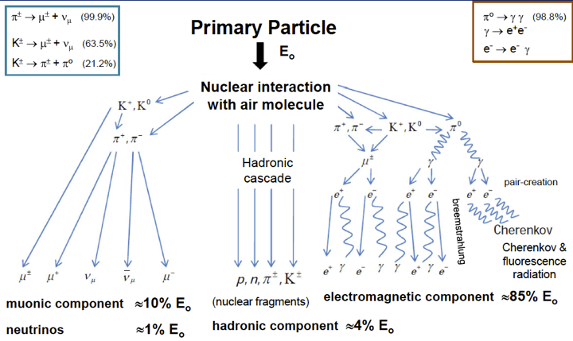
Extensive Air Shower
E0 =10¹⁸eV 10¹⁰ particles on a surface of few km²
E0 =10¹⁵eV 10⁴ particles on a surface of about km²

Slide 19
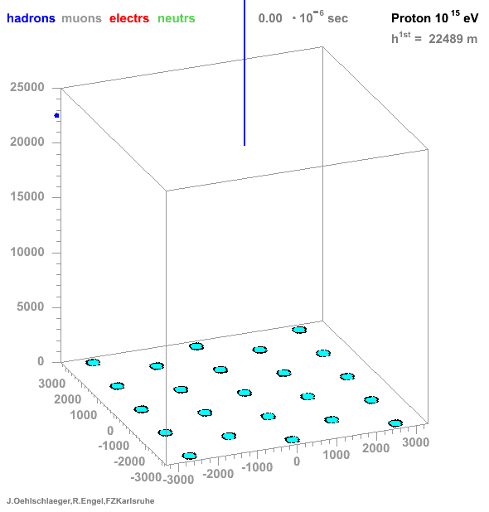
Extensive Air Shower

Slide 20
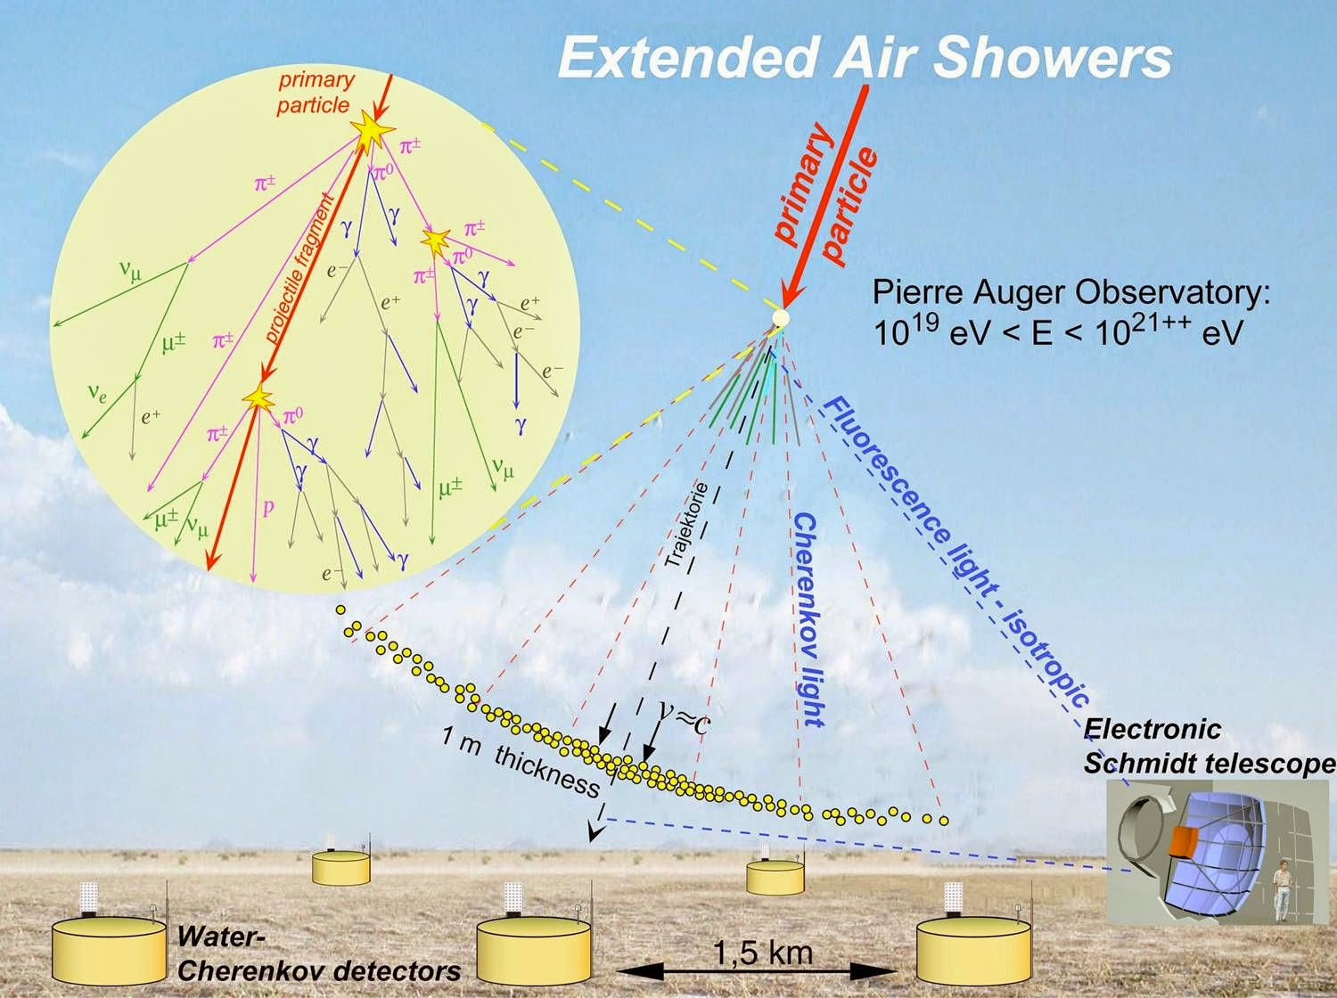
Detection of Air Shower
Surface detector matrix (Cherenkov detectors, scintillators)

Slide 21
Detection techniques

Slide 22
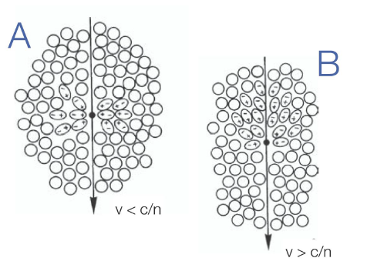
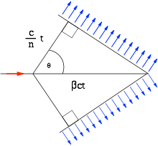
Cherenkov effect
The Cherenkov effect is happening when a charged particle moves at a speed higher than the speed of light in the medium.
v>c/n
n =refractive index
z

Slide 23
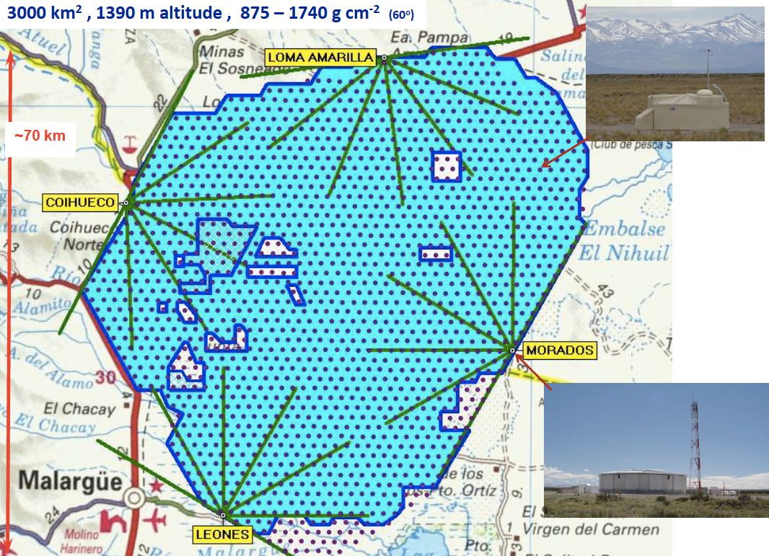
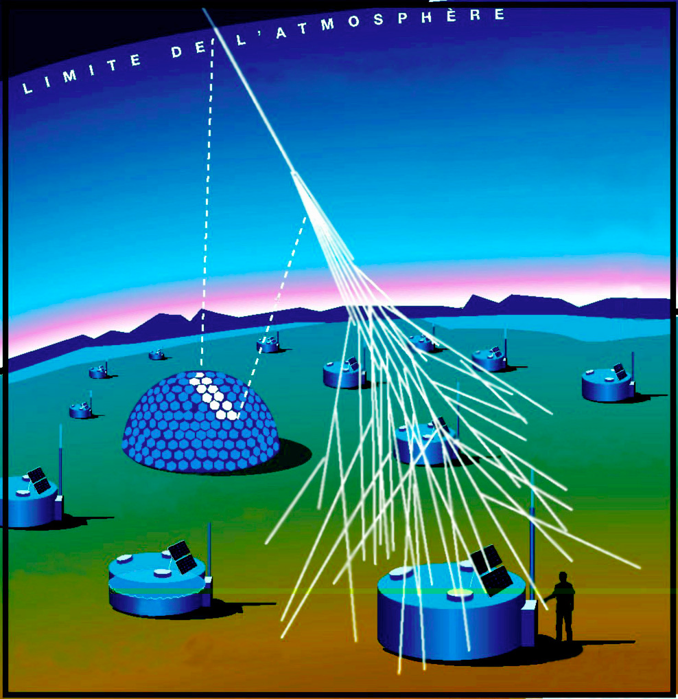
Pierre Auger Observatory
Hybrid observatory:
surface detectors
fluorescence detectors
1600 water tanks at 1.5 km distance de 1.5 km
12 tons of purified water
4 sites for fluorescence
Field of View: 30 deg x 30 deg

Slide 24
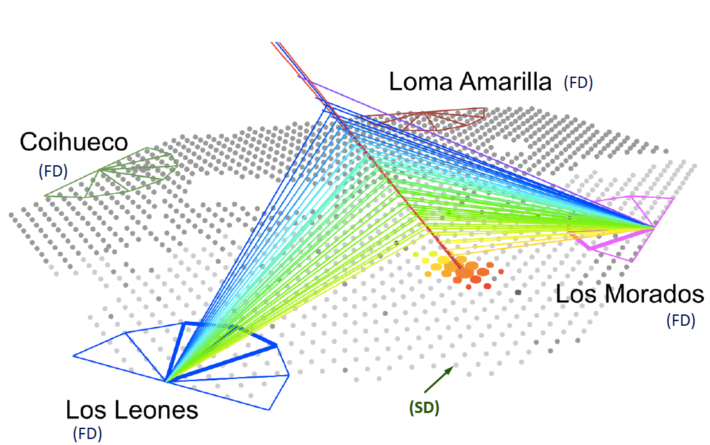
Pierre Auger Observatory
Example of an hybrid event

Slide 25
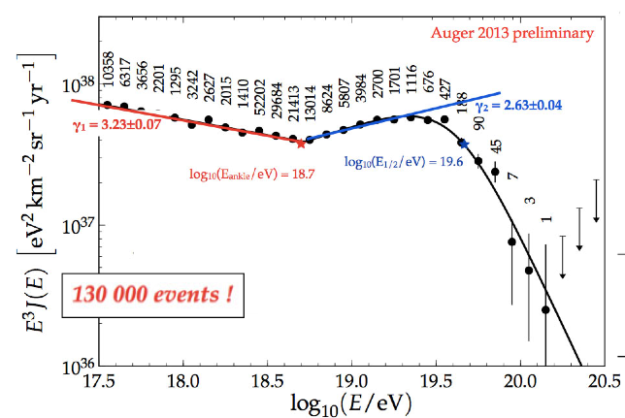
Spectrum of UHECR
ankle
ATTENTION: E³ Flux
what is the nature of this cut?
interaction with CMB?
Maximum acceleration energy in sources?
A cut is visible !!!

Slide 26
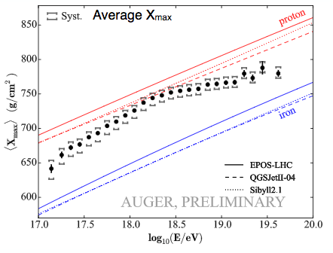
Composition of UHECR
Xmax= depth at which the energy deposit reaches its maximum.
X max is proportional to the logarithm of the mass A of the primary particle.
simulations using proton and Iron primary particles

Slide 27
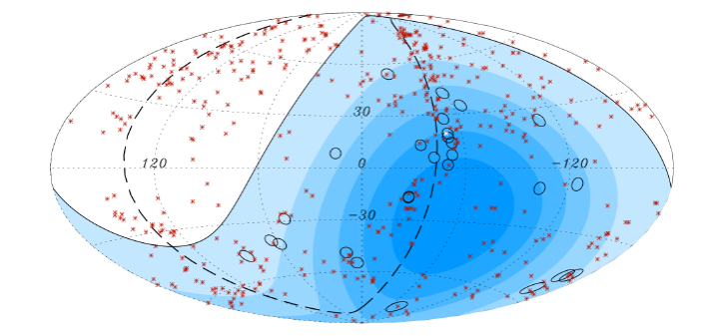
CR anisotropy

Slide 28
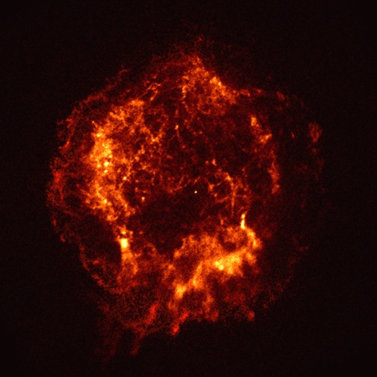
Connection CR-gamma-neutrino
p
ν
π±
p
γ
π⁰
Inverse Compton
(+Bremsstr.)
e±
γ
protons/nuclei
electrons/positrons
radiation fields and matter

Slide 29
Which are the messengers?
γ
photons
neutrinos
ν
nuclei
p,He,…
89% protons
10% helium
1% heavier nuclei (Fe, …)
99 % nuclei
1 % electrons
0.1 % photons
On Earth much less cosmic photons than charged CR
the direction of photons indicates directly the source position

Slide 30
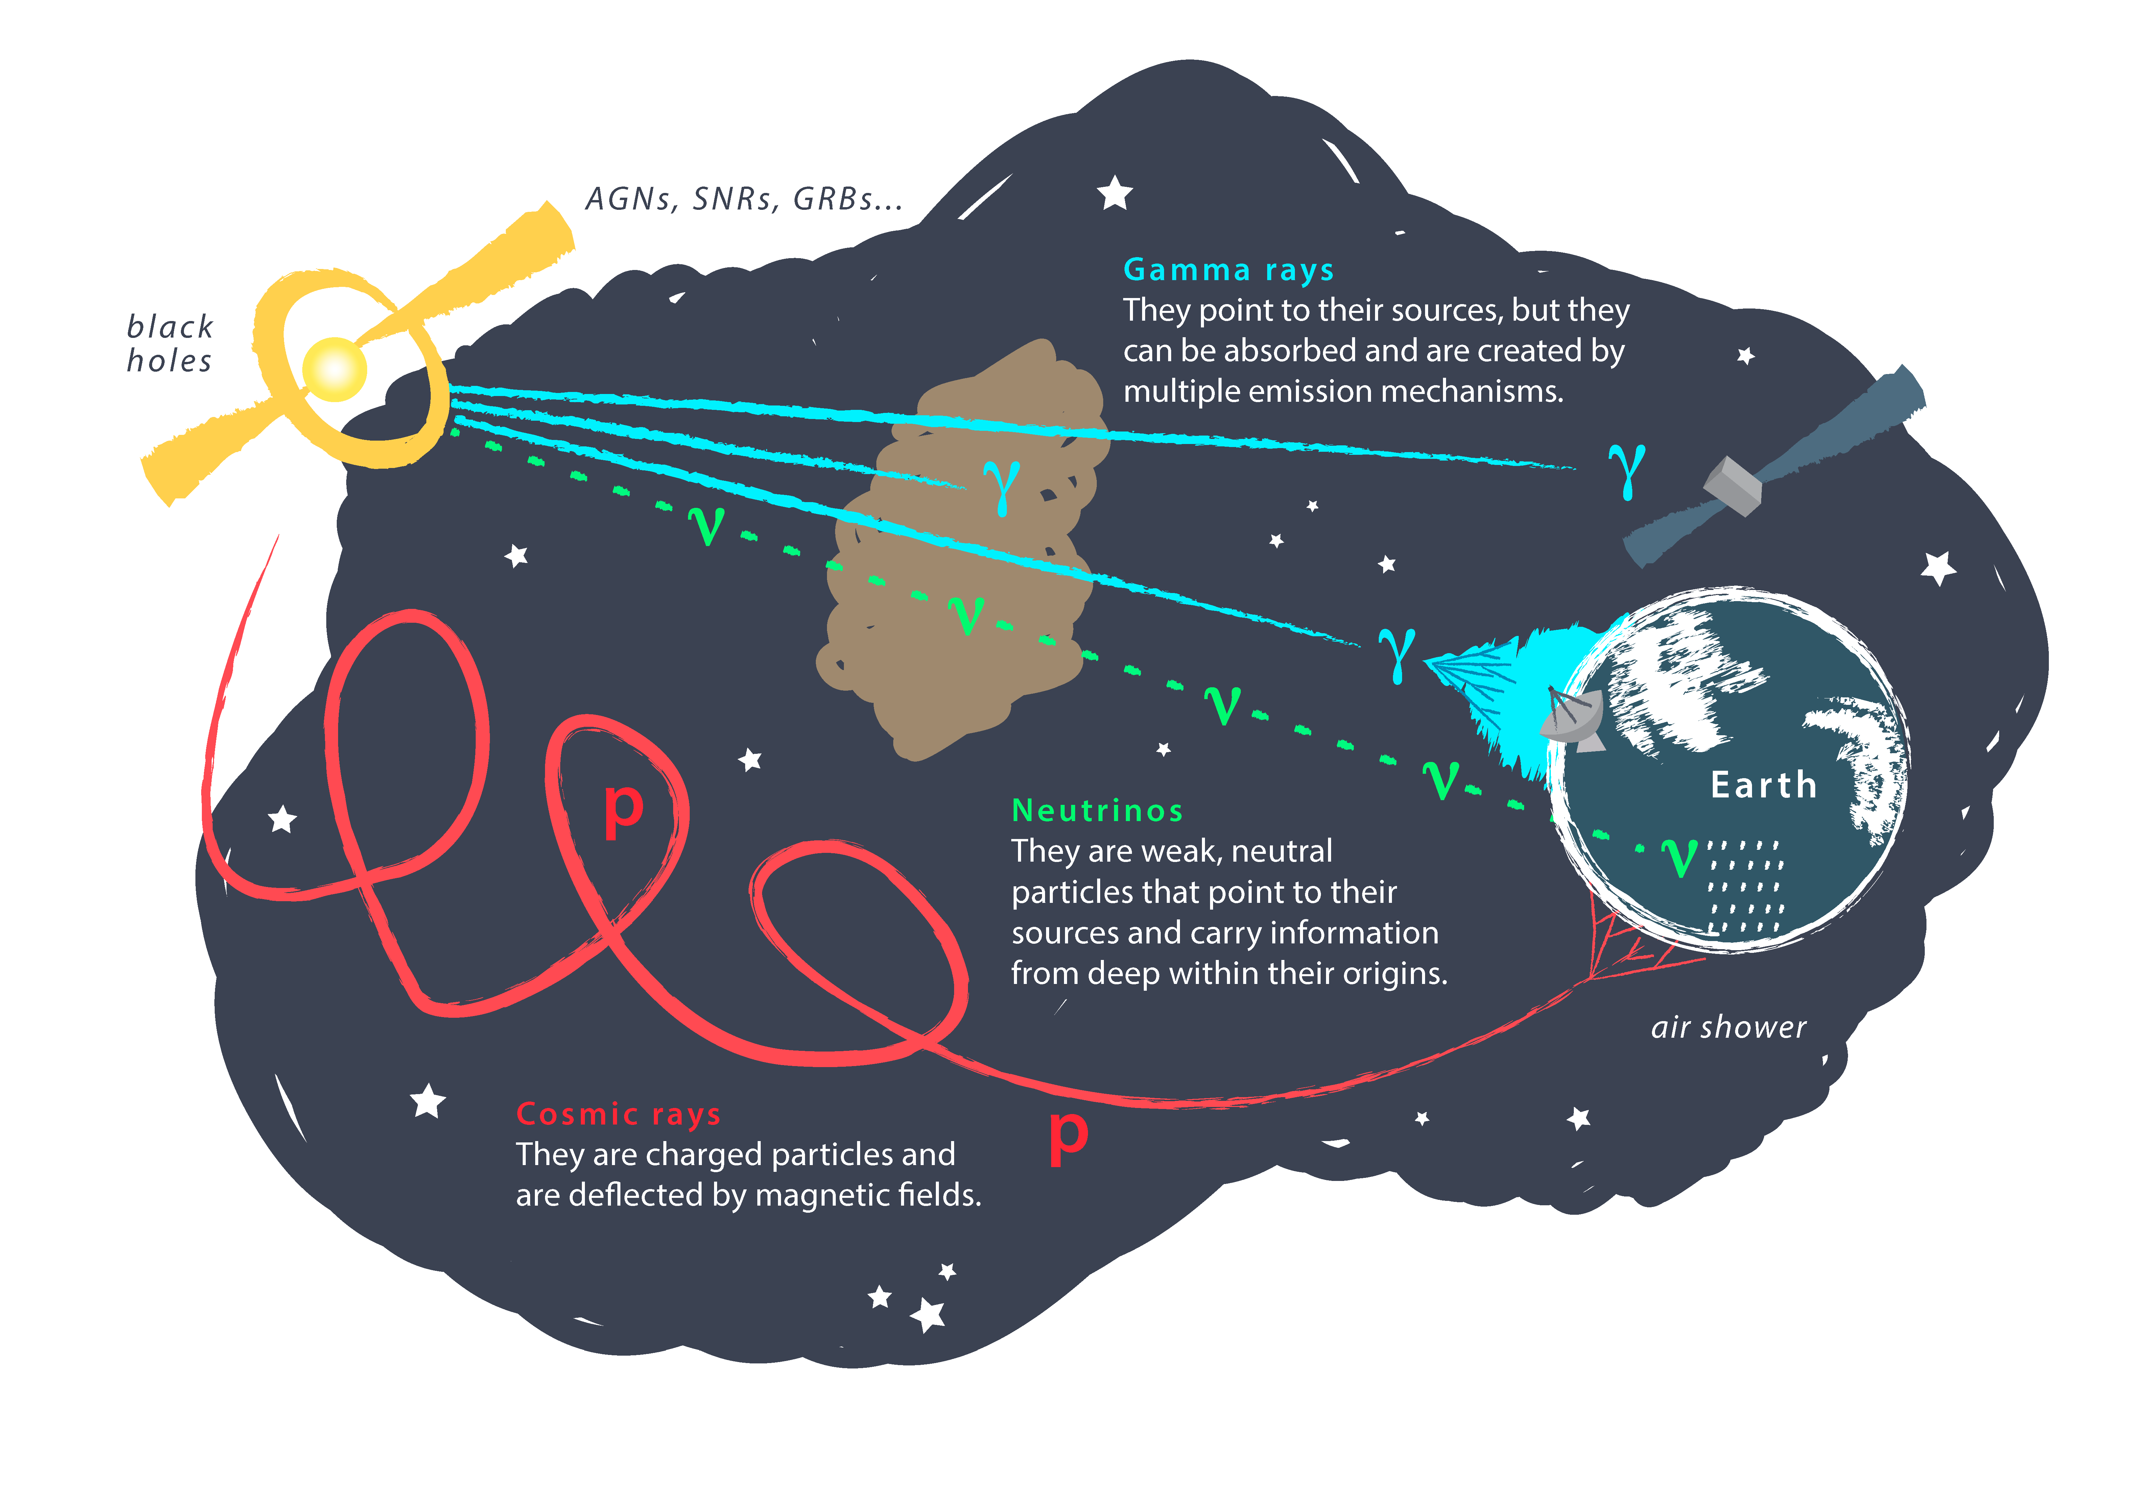
Connection CR-gamma-neutrino

Slide 31
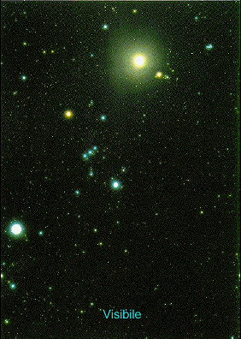
The sky in different wavelengths
Moon
Crab

Slide 32
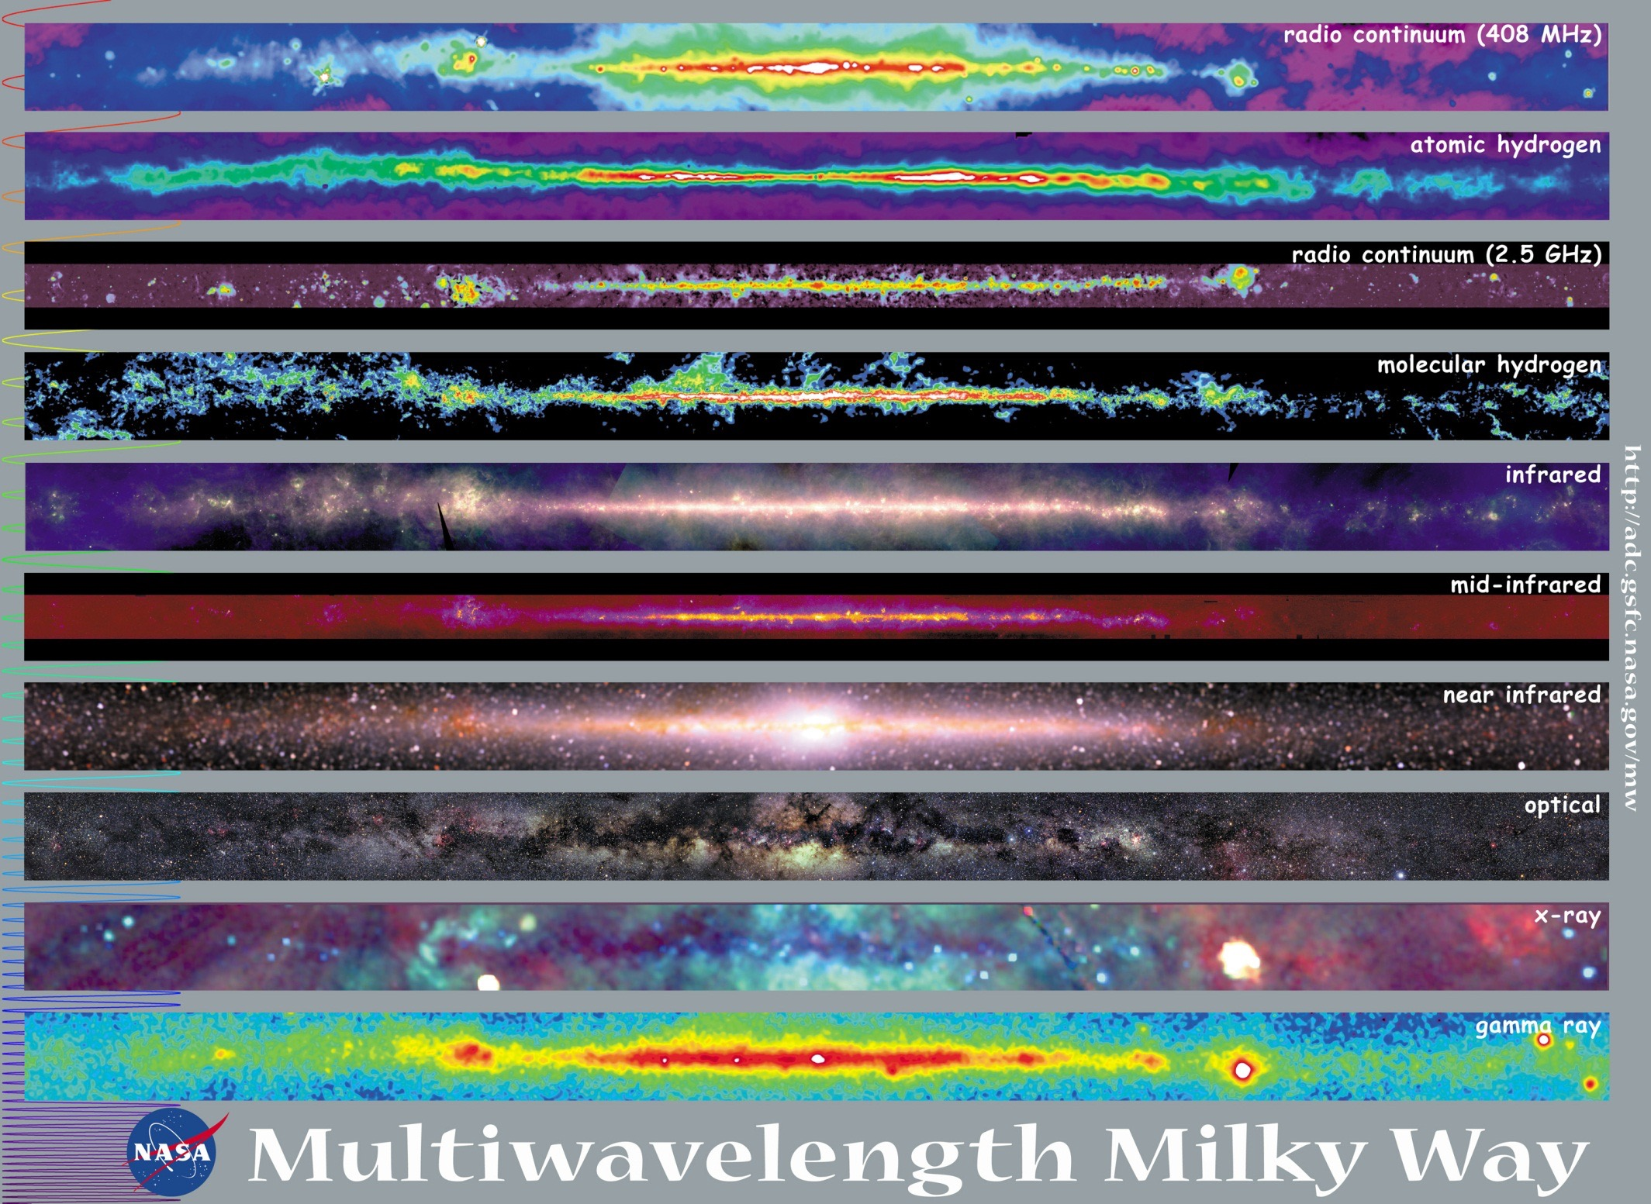

Slide 33
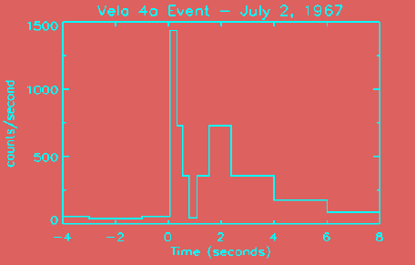
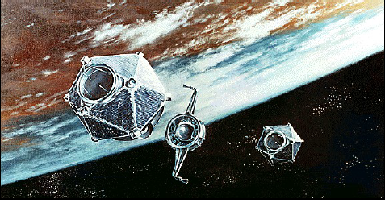
Discovery of cosmic gamma rays
First detection : VELA
3 pairs of satellites launched on 1963-1964-1965
Goal: gamma survey of nuclear bomb tests
1967: detection of a gamma ray burst Detected energy: 0-10 MeV

Slide 34
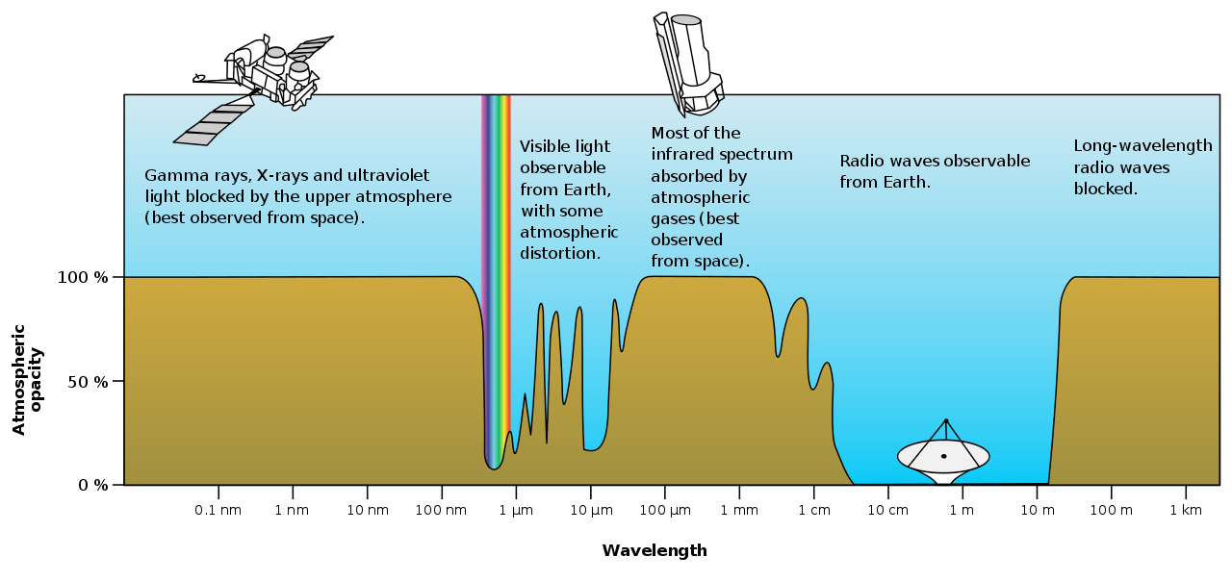
Photons absorption in the atmosphere
10⁴ 10³ 10² 10¹ 1 10⁻¹ 10⁻² 10⁻³ 10⁻⁴ 10⁻⁵ 10⁻⁶ 10⁻⁷ 10⁻⁸ 10⁻⁹
Energy [eV]

Slide 35
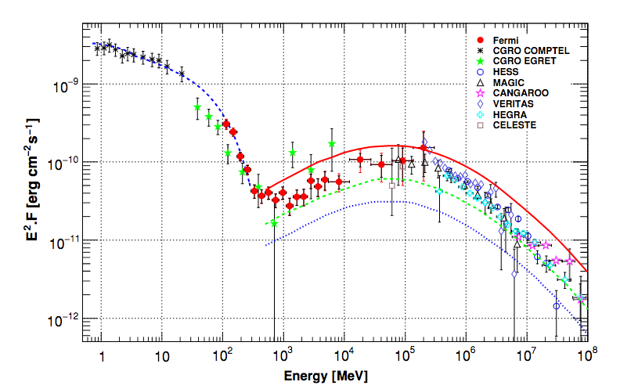
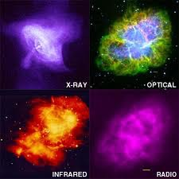
Gamma sources: The Crab nebula: a reference
It is the remnant of a supernova observed in 1054, that was visible during the day for 6 weeks.
A fast rotating neutron star (PULSAR) is what remains of this supernova explosion : diameter of 20 km and rotation period of 30 tours/s.
The x-rays images show the acceleration regions (synchrotron radiation)
Particles are the reaccelerated in the shockwaves with the surrounding gas, producing TeV gamma rays (Inverse Compton mechanism)
synchrotron radiation
Inverse Compton
ATTENTION: E² Flux

Slide 36
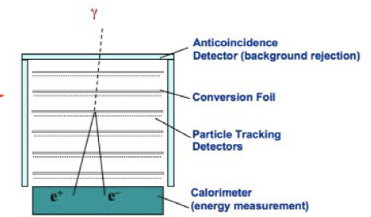
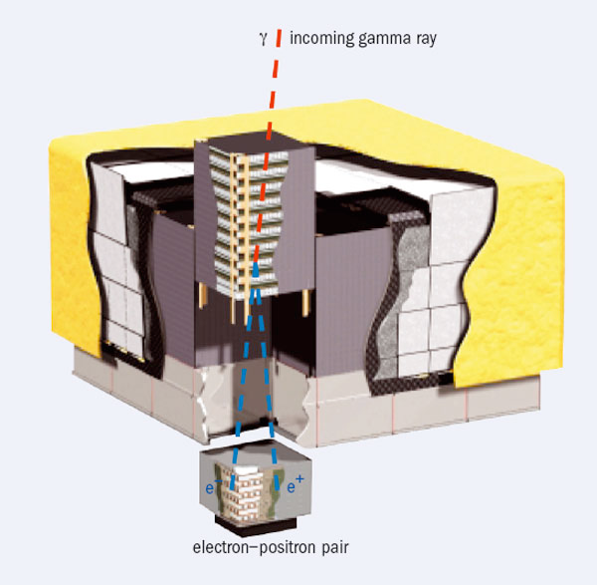
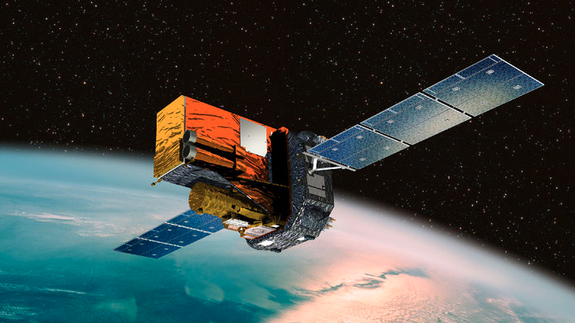
Gamma Direct detection: satellite
For energies below 100 GeV gamma flux can be measured on satellites
FERMI Large Area Telescope: 20 MeV-300 GeV

Slide 37
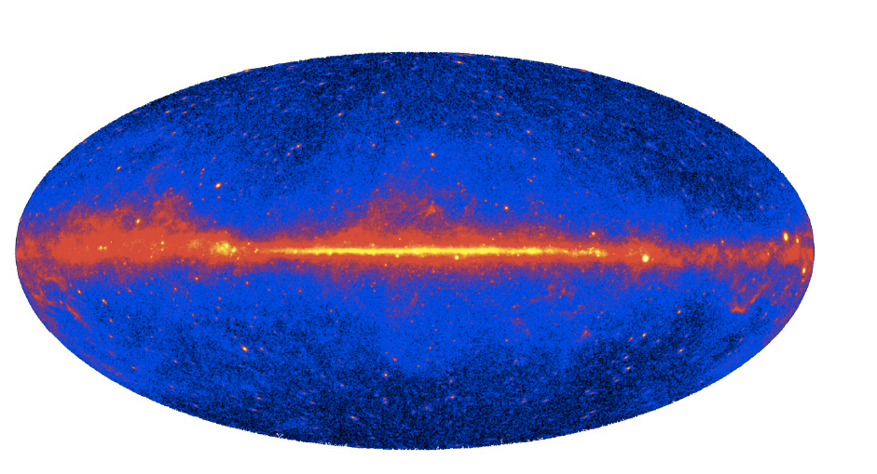
Gamma Astronomy at GeV
1800 sources have been detected: a lot of extragalactic sources
extra-galactic sources
galactic centre
galactic sources
+ diffused emission

Slide 38
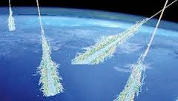
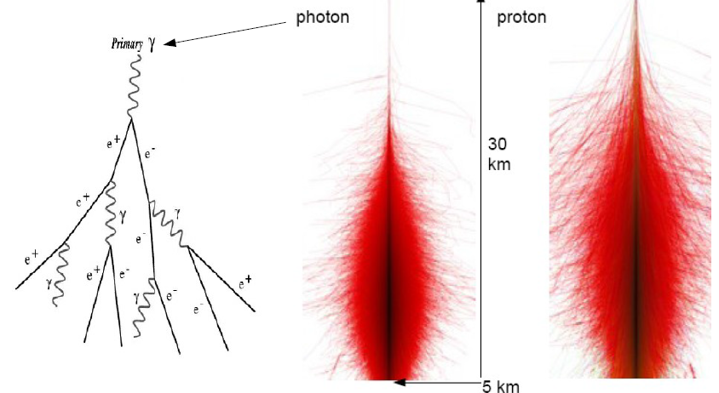
Gamma Indirect detection
For E > 100 GeV gammas are detected through the electromagnetic showers created in the atmosphere
Showers produced by gammas are much more symmetric and thin in respect to showers produced by protons. This characteristics is used to differentiate gammas from protons.

Slide 39
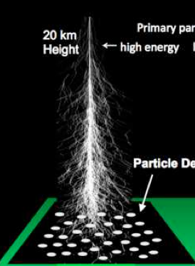
Gamma Indirect detection
Imaging Air Cherenkov Telescopes
Air Shower arrays
high efficiency at E ~ 1-10 TeV
angular resolution ~ 0.1º
hadronic rejection power (>99%)
small Field of View
observations during clear nights
high efficiency at E > 100 TeV
angular resolution ~ 0.2º -1º
hadronic rejection power (~ 50%)
large Field of View
permanent observation
Cherenkov
cone
particle
detectors
optical detector
10 km
~120 m

Slide 40
Gamma Indirect detection
Imaging Air Cherenkov Telescopes (IACT)
See Lecture about CTA this morning !

Slide 41
Which are the messengers?
γ
photons
neutrinos
ν
nuclei
p,He,…
p/A + p/γ → π⁰ + π± + ...
↓ ↓
γ γ ν_{μ} μ
↓ ν_{μ} ν_{e} e
As TeV gammas, neutrinos are produced by hadronic interaction of high energy nuclei and protons in astrophysical sources
If astrophysical neutrinos are detected coming from a source, surely this source has produced cosmic rays (protons, nuclei)
BUT interaction probability in detectors is extremely small
We need HUGE detectors!
Only 1 neutrino over 10 bilions of neutrinos coming from the Sun and traversing the Earth, will interact!!

Slide 42
What are neutrinos?

Slide 43
What are neutrinos?
For details on research on neutrino properties see Lecture on:
ANTARES/KM3NeT (this morning)
SuperNEMO (next week)

Slide 44
Astrophysical sources

Slide 45
How to detect astrophysical neutrinos?
Use the Earth as detector!!
Photon detector matrix
Cherenkov light
(∼42° in water)
neutrino
ν_{µ}
µ
W
muon
N
X
Connection to the shore
neutrino
principal interaction channel: ν_{μ} interacts with matter creating a relativistic muon

Slide 46
Neutrino telescopes in the World
ANTARES & KM3NeT
BAIKAL
See Lecture on ANTARES and KM3NeT this morning !
IceCube

Slide 47
Astrophysical neutrinos exist!
3 yr data: 988 days
Observed : 37 events
Significance 5.7 σ

Slide 48
Are there other cosmic messengers?
Gravitational waves
'ripples' in the fabric of space-time caused by energetic processes in the Universe (collision of black holes, neutron stars etc.)
Albert Einstein predicted the existence of gravitational waves in 1916 in his general theory of relativity.

Slide 49
How can we detect GW?

Slide 50
LIGO interferometer

Slide 51
Discovery of gravitational waves
September 14, 2015
LIGO interferometer for the first time senses distortions in spacetime itself caused by passing gravitational waves generated by two colliding black holes nearly 1.3 billion light years away!

Slide 52
Conclusions
Astroparticle physics is an exiting field between Astrophysics and Particle Physics
we want understand the origin and the role of cosmic relativistic particles
we want to explore the most extreme and energetic events in our universe
using different and new probes we can open new windows on the universe allowing new discoveries and better understanding of the universe

