Slide 1
Formation des Premières Etoiles

Slide 2
Questions préliminaires
Quelle information est pertinente pour comprendre la formation stellaire maintenant et lors de la formation des premières étoiles (pop. III) ?
La fonction initiale de masse (IMF)
Le refroidissement du nuage de gaz à l’origine des étoiles
L’instabilité de Jeans
La fragmentation des étoiles
La détection des premières étoiles

Slide 3
Mass functions
The stellar masses are one of the most important factors in determining their evolution, so when studying a stellar population, we are interested in estimating their masses.
An important information is the number of stars per unit mass which is called a mass function.
We deﬁne the mass function Φ(M) such that Φ(M) dM is the number of stars with masses between M and M + dM.
With this deﬁnition, the total number of stars with masses between M_{low} and M_{up} is:
By deriving both sides, we get:
Φ is the derivative of the number of stars with respect to mass, i.e. the number of stars dN within some mass interval dM.

Slide 4
Total mass of stars between M_{low} and M_{up}
If we are interested in the total mass of stars between M_{low} and M_{up} in a given system rather than the number of such stars, we must integrate Φ times the mass per star. Thus the total mass of stars with masses between M_{low} and M_{up} is:
or equivalently:
ξ (M) gives the number of star per ln(M), rather than per number in mass.
Physical explanation:
  Suppose that Φ(M) = Cte constant: there are as many stars from 1 − 2 M as there are from 2 − 3 M as there are from 3 − 4 M , etc.
  Instead suppose that ξ(M) = Cte: there are equal numbers of stars in intervals that cover an equal range in logarithm, so there would be the same number from 0.1 − 1 M , from 1 − 10 M , from 10 − 100 M , etc.
y = ln(m)
dy/dm = 1/m
dy = dm/m
d[ln(m)] = dm/m

Slide 5

The distribution of initial stellar masses (IMF) might be invariant [hot topic].
If we examine two populations, of galaxies of diﬀerent sizes, then Φ(M) = dN/dM will be diﬀerent because they have diﬀerent numbers of stars. However, they may have the same fraction of their stars in a given mass range.
So, it is generally common to normalize Φ or ξ so that the integral is unity, i.e. to compute a normalization factor for Φ or ξ such that the integrals are equal to 1.
When the mass is normalized, Φ(M) dM and ξ(M) dM give the fraction of stars (fraction by number for Φ and fraction by mass for ξ ) with masses between M and M + dM.
with m_{low}= 0.1M and m_{up} = 120M
In LMC at 165 000 l.y.
  R136a1 : 265 M (?)
  R136a2 : 195 M (?)
ηCarinae : 120 M

Slide 6
The Salpeter Initial Mass Function (IMF)
If we ignore the low-mass flattening of the IMF below ~ 1M, we might assume that the same slope holds over the range M_{min} = 0.1M to M_{max} = 120M.
This is known as the Salpeter IMF: ϕ(M) = ϕ₀ M^{-2.35}
The normalization ϕ₀ (in units of M ) is evaluated by requiring that the integral equals to 1:
In a similar way, we have in terms of mass:

Slide 7
Illustration
So, we will have: ϕ(M) = 0.060 M^{-2.35} and ξ(M) = 0.17 M^{-1.35} for M = 0.1 – 120M
We can estimate the fraction of stars by number and by mass in a given mass range. For instance, what is the fraction of stars by number (1) and by mass (2) more massive than the Sun in a new-born population with a Salpeter IMF?
1)
2)
4.5% of the stars are more massive that the Sun but,
the mass of these stars amounts to 40% of the new-born stars.

Slide 8
Two remarks
The total stellar mass of a system is computed from the following integral:
It shows that most of the stellar mass lies in low-mass stars.
The total luminosity (assuming L = C M^{3.5}) is computed as follows:
which shows that the total stellar luminosity is dominated by the most massive stars.
most of the stellar mass lies in low-mass stars
that the total stellar luminosity is dominated by the most massive stars

Slide 9
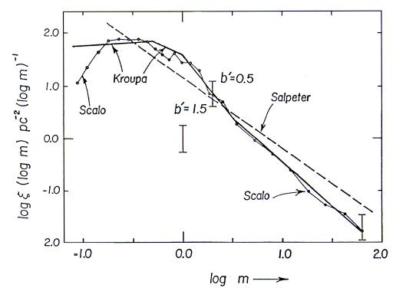
Other more realistic IMFs (mainly for faint stars)
IMF Scalo (1998): ξ(m) = m^{-α}
α = -0.2 ± 0.3 for 0.08 ≤ m/M < 1 M
α = -1.7 ± 0.5 for 1 ≤ m/M < 10 M
α = -1.3 ± 0.5 for 10 ≤ m/M < 100 M
IMF Kroupa 2001: ξ(m) = m^{-α}
[α= 0.3 for m/M < 0.08]
α= 1.3 for 0.08 ≤ m/M <0.5
α= 2.3 for 0.5 ≤ m/M

Slide 10
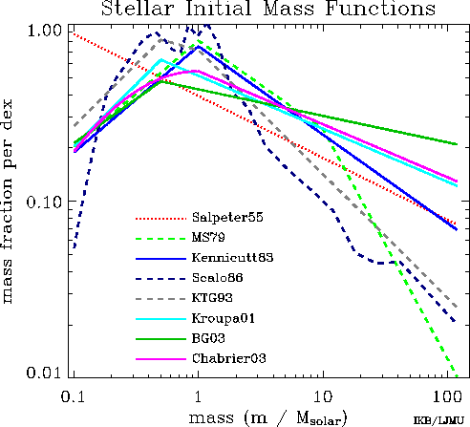
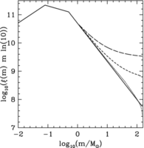
Sample Initial Mass Functions of Stars
There is a general trend
Top-heavy IMF
10

Slide 11
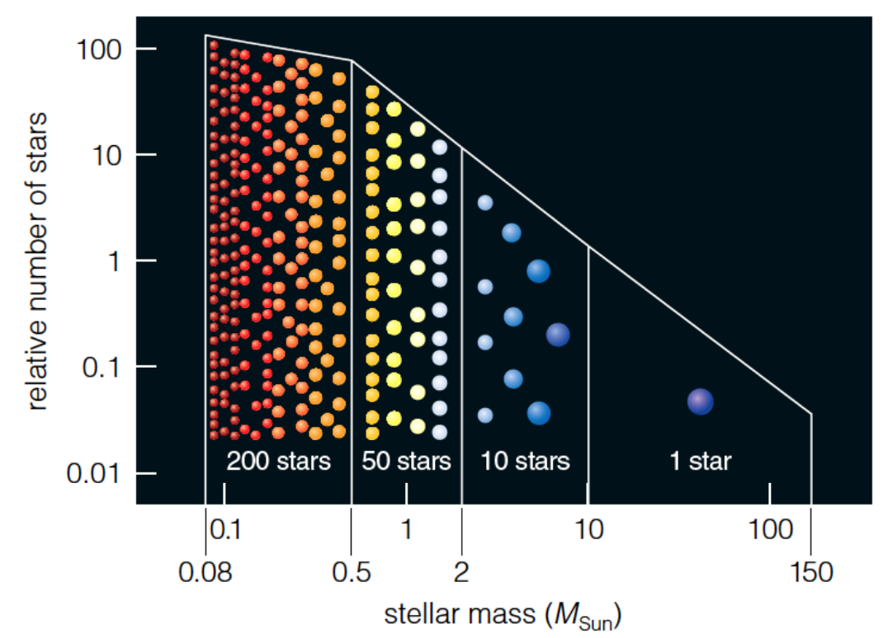

Slide 12
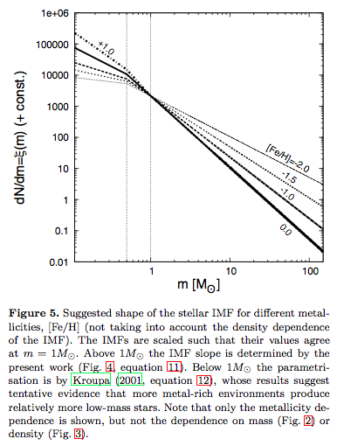
Variabilité de l’IMF ?
Une question important et même cruciale est :
Est-ce que l’IMF est universelle ou bien varie t-elle avec l’environnement, les abondances chimiques (métallicité), le redshift, le taux de formation stellaire, la masse de Jeans, ?
Marks et al. (2012)

Slide 13
Pourquoi l’IMF est-elle si importante ?
Changer l’IMF => changer la masse stellaire (M*) dans un système (p.e. une galaxie)
Changer l’IMF => changer le taux de formation stellaire (SFR = M* / Δt) et donc, tous les paramètres physiques et cosmologiques associés :
  La densité cosmique de formation stellaire = densité de formation stellaire par unité de volume de l’univers en fonction du redshift
Changer l’IMF => changer le nombre de photons ionisants UV, ce qui est important pour la réionisation de l’univers.

Slide 14
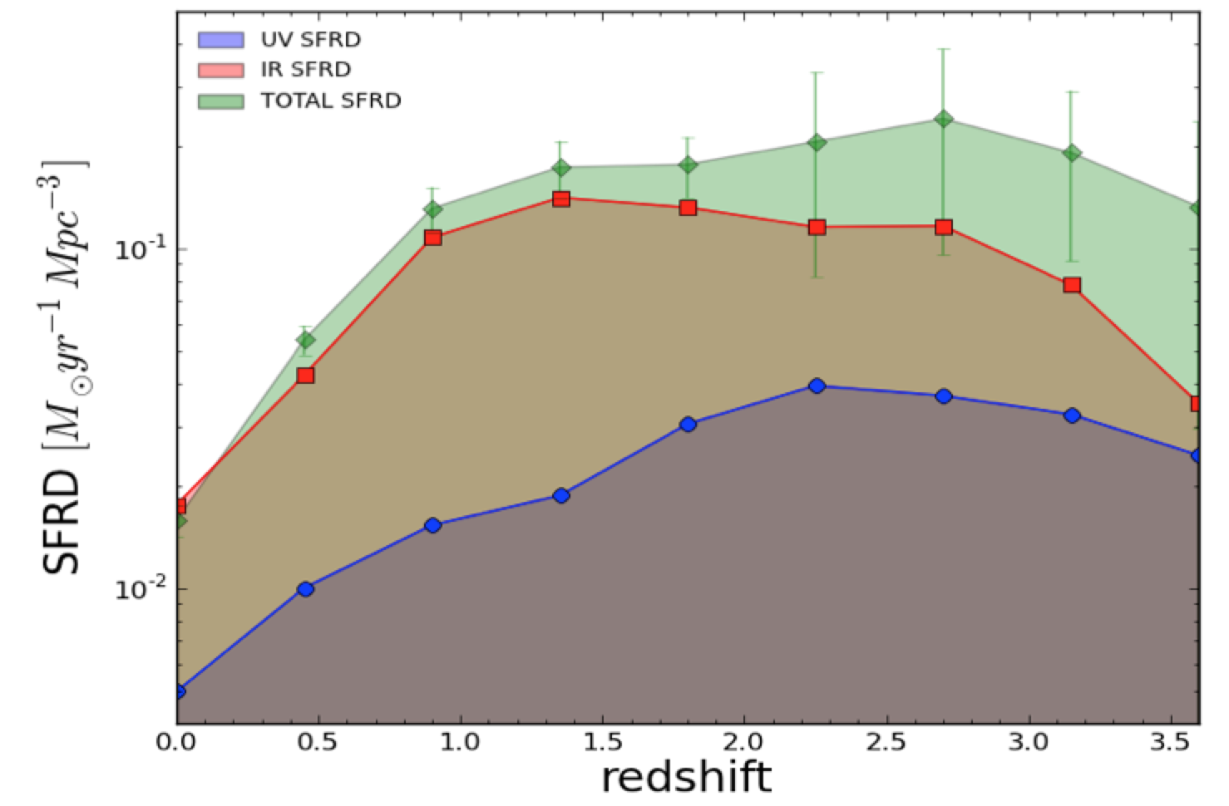
Implication cosmologique de la variation de l’IMF
Evolution of de la densité de formation stellaire cosmique
Burgarella et al. (2013)

Slide 16
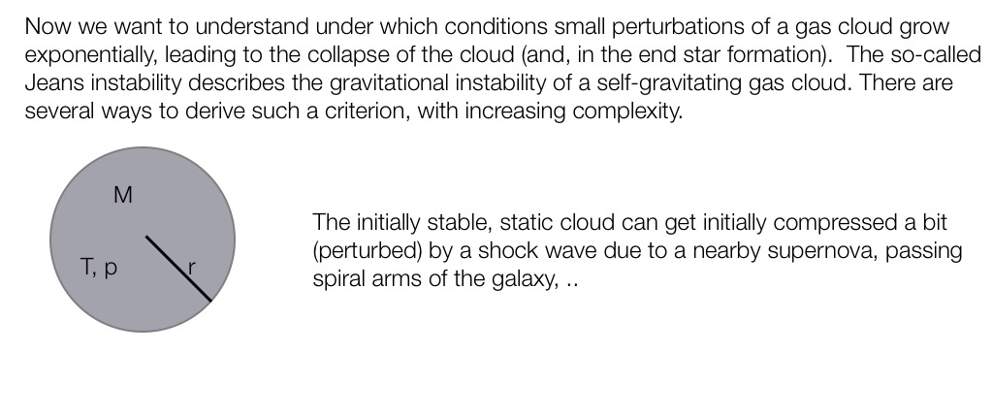
Jeans instability

Slide 17
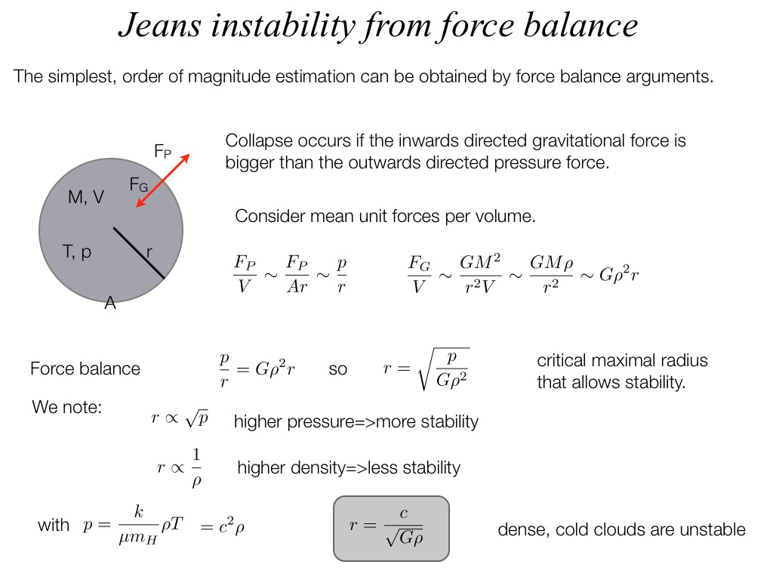
Jeans Instability from force balance

Slide 18
Jeans Instability (from the more precise Virial Theorem Method)
4.89 x 10²¹
[kg]
π
10⁻¹⁹ kg / m³
3.9 pc ≈ 800 000 AU
G = 6.67 x 10⁻¹¹ m³ kg⁻¹ s⁻², k_{B} = 1.38 x 10⁻²³ J K⁻¹ and m_{H} = 1.67 x 10⁻²⁷ kg

Slide 19
Fragmentation
➔



Slide 20
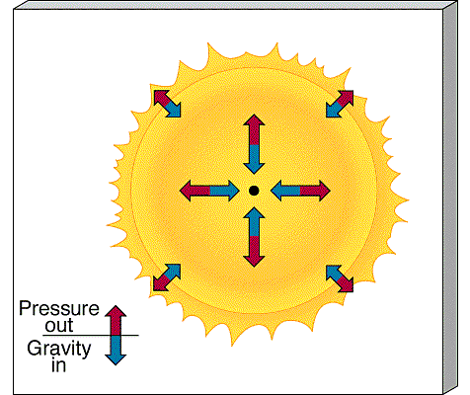
La formation stellaire est gouvernée par deux influences dominantes :
  la gravité
  les échanges thermiques
L’attraction de la gravité contrebalance les mouvements stochastiques du gaz dans les nuages de gaz interstellaires lors de la contraction qui peut durer jusqu’à 100 000 ans et conduira à la formation des étoiles.
Durant la contraction, la densité du gaz croît. Il y a de plus en plus de collisions entre atomes et molécules et la température du gaz augmente.
Cet échauffement est un problème car il peut arrêter la contraction si la chaleur n’est pas efficacement dissipée hos du nuage.

Slide 21
Un processus efficace pour refroidir le gaz est la collision entre molécules.
Lorsque 2 molécules entrent en collision, une partie de l’énergie cinétique est transformée en énergie potentielle. L’énergie est stockée dans la molécule (rotation ou vibration ou en excitant un ou plusieurs électrons).
Cette énergie est ensuite libérée par l’émission d’un photon qui peut s’échapper du nuage en évacuant l’énergie et donc en refroidissant le nuage.
La formation d’un nuage est donc liée à la composition chimique de ce nuage.

Slide 22
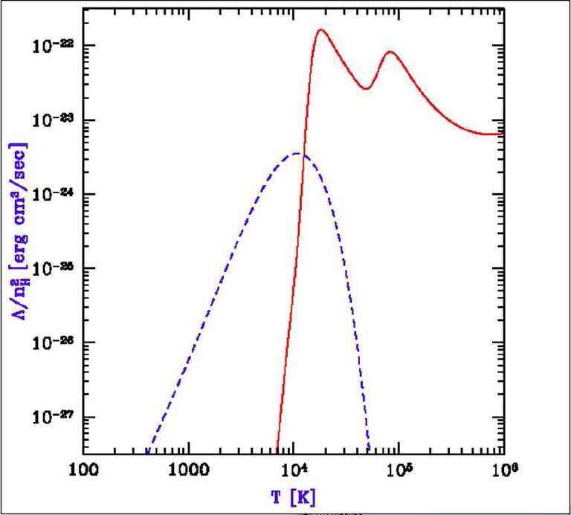
H et He sont, de loin, les éléments les plus abondants dans l’univers.
Mais, H and He sont de mauvais refroidisseurs parce que l’émission de photons n’est pas efficace à faible température de gaz, correspondant aux nuages moléculaires.
Une fraction importante du refroidissement est due à l’eau, au monoxyde de carbone, à l’H et au C moléculaire.
Cooling rate of primordial gas as a function of temperature. The solid line represents the contribution from atomic hydrogen and helium and the dashed line represents the contribution from molecular hydrogen. At temperatures below 10^4 K cooling is provided by H2, which is a poor coolant, but at T> 10^4 K more efficient atomic hydrogen line cooling comes to play. Courtesy: Bromm (2012)
From: http://www.cfa.harvard.edu/swas/science1.html

Slide 23
Simulations numériques

Slide 25
Une physique simplifiée pour les premières étoiles
Uniquement la fusion thermonucléaire primordiale : seulement : only H/D/He -> pas d’éléments lourds -> pas de poussières
On suppose que les conditions initiales suivent une cosmologie ΛCDM (Cold Dark Matter )
Premières étoiles
= ΛCDM + φsique de H/D/He
atomique & moléculaire

Slide 26
Une autre hypothèse importante assumption : l’IMF des étoiles pop III
Quelle est la masse caractéristique ?
dN/dlogM
Quelle loi de puissance ?
Effets de la turbulence?
logM

Slide 27
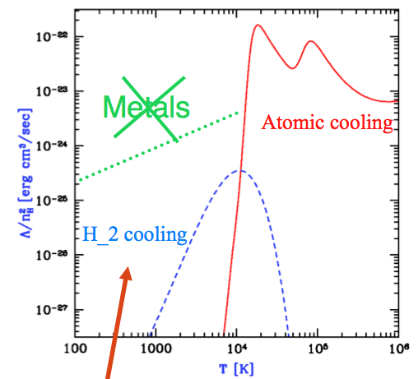
Problème du refroidissement des nuages primordiaux
Contribution de H et He atomiques (ligne continue), et H moléculaire (ligne pointillée).
Refroidissement par H atomique cooling efficace T > 10^4 K.
A plus basse température, refroidissement dû à H₂, qui n’est pas très efficace
C’est le régime où se forment des minihalos (~ 10⁶ M) qui sont probablement à l’origine des premières étoiles.
T_{vir pour pop III}

Slide 28
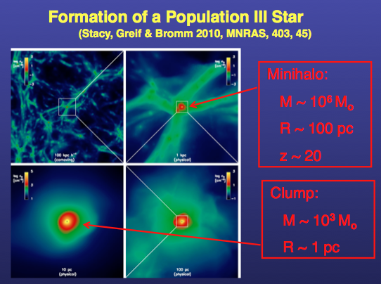
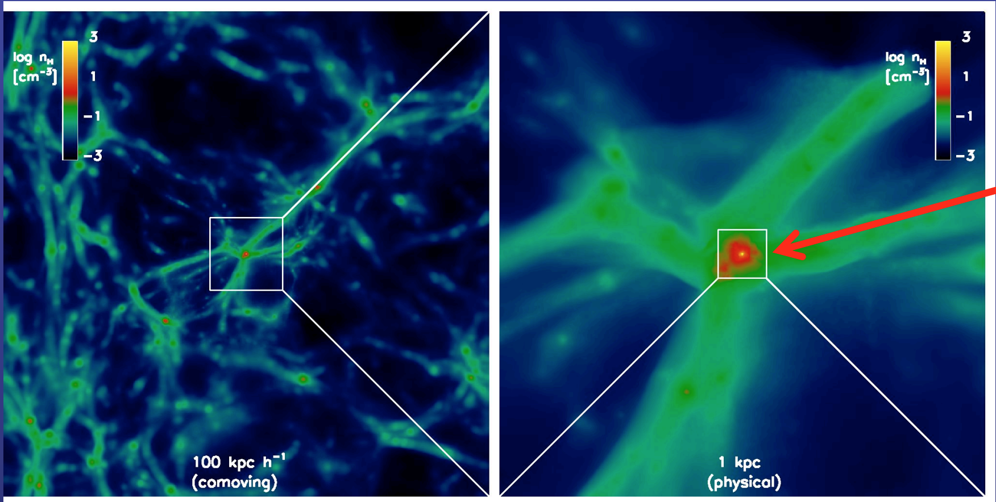
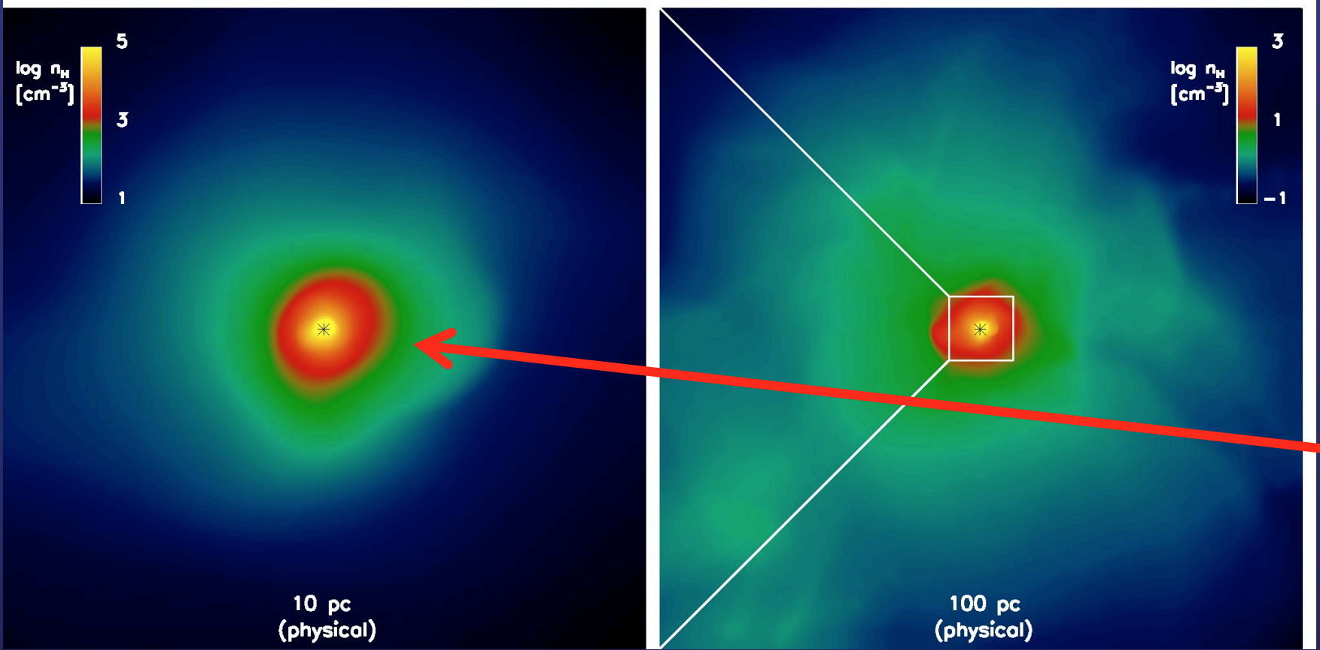

Slide 29
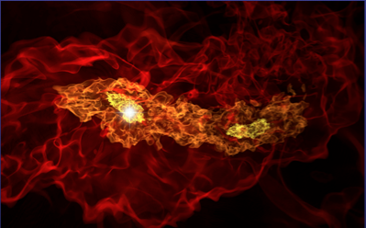
Early POP III binaries
(Turk, Abel & OʼShea 2009, Science, 325, 601)
800 AU
~ 10 M
~ 6 M

Slide 30
Jusqu’à récemment, on pensait que les cœurs de pop III ne pouvaient former qu’1 étoile, parce que la fragmentation n’était pas efficace.
Avec cette hypothèse; l’estimation de la masse finale des étoiles primordiales était basée sur l’équilibre de l’accrétion du gaz avec la pression radiative de la proto-étoile. Ce qui conduisait à des étoiles très massives (plusieurs centaines ou milliers de masses solaires).
Mais, la fragmentation du gaz pourrait s’établir dans les flux turbulents de gaz qui nourrissent les parties centrales des nuages.
En prenant cela en compte, les simulations suggèrent que des étoiles moins massives peuvent se former.

Slide 31
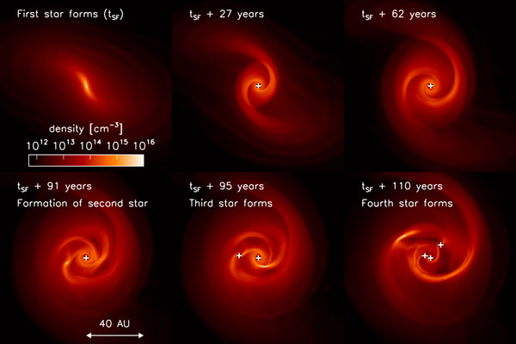
Pop III Star Formation: disk fragmentation (Clark et al. 2010)
Because gas in the early universe did not contain metals, it was thought that primordial stars were solitary massive objects.
But, the accretion disks that formed around the first stars were found to be highly susceptible to fragmentation.
Therefore, instead of forming in isolation, the first stars almost always occur as members of multiple stellar systems, with separations as small as the distance between Earth an the Sun.

Slide 32
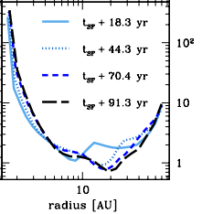
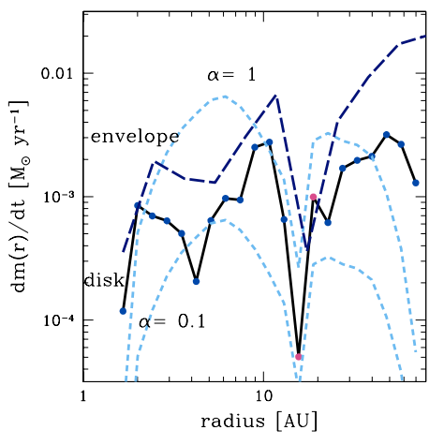
Pop III Star Formation: Disk Fragmentation (Clark et al. 2011)
Q
mass transfer rate through the disk
mass infall rate through spherical shells
Left: the Toomre ‘Q’ parameter provides a measure of the gravitational instability of the disk. For high Q, the disk is stable, while for values around 1, the disk is unstable to fragmentation. As the disk grows, the value of Q remains around 1 in the outer regions, and so the dynamics of the disk is dominated by gravitational instabilities.
Right: the accretion rate through the disk and envelope as a function of radius from the central protostar helps to explain why the disk became so unstable. The accretion rate through the disk is considerably lower than the rate at which material is added to the disk. The system is unable to process the material in the disk quickly enough before more is added from the infalling envelope. As a result, the disk grows in mass, became gravitationally unstable, and ultimately fragments
Notes:
The mass transfer is denoted by the solid black line, while the mass infall rate through spherical shells with the specified radius is shown by the dark blue dashed line

Slide 33
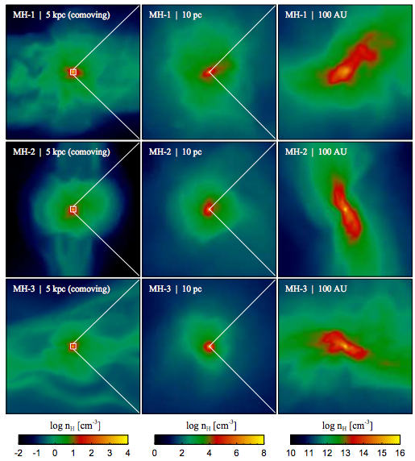
Pop III Star Formation: further evolution (Greif et al. 2011)
The panels show the density-squared weighted number density of H nuclei projected along the line of sight.
The gas virializes on a scale of ~5 kpc, followed by the collapse of the central ~1 pc, where the gas becomes self-gravitating and decouples from the dark matter.
In the ﬁnal stages of the collapse, a fully molecular core on a scale of a few hundred AU forms.

Slide 34
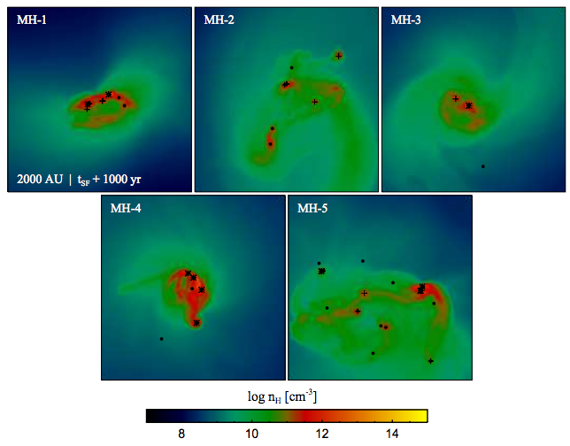
Pop III Star Formation: Further Evolution
(Greif et al. 2011, ApJ, 737, 75)
The central 2000 AU after 1000 yr of fragmentation and accretion.
Black dots, crosses and stars denote protostars with masses below 1 M⊙, between 1 M⊙ and 3 M⊙, and above 3 M⊙.
A relatively rich protostellar cluster with a range of masses has survived in each case. In a few minihalos, low-mass protostars have been ejected out of the central gas cloud, such that they are no longer visible.
In simulation MH-2, two independent clumps have collapsed almost simultaneously and formed their own clusters before eventually merging
Again: gravitationally unstable disks -> multiple stars form
Quite a bit of statistical variation

Slide 35
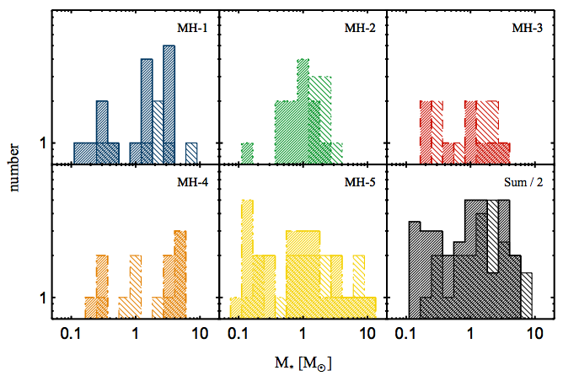
Pop III IMF: Early Situation
(Greif et al. 2011, ApJ, 737, 75)
After t ~ 1000 yr of fragmentation and accretion
A “top-heavy” IMF: dN/dln m ~ m^x (x=0) (cf. Salpeter: x = -1.35)

Slide 36
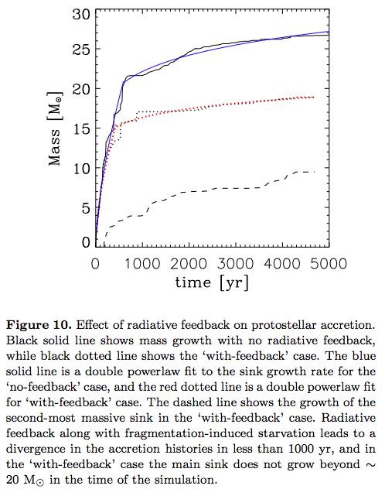
Pop III Star Formation: Radiative Feedback (Stacy et al. arXiv: 1109.3147)
A dominant binary has formed (~ 20 and ~10 M) after ~ 5 000 yr of accretion
Note: Hosokawa et al. 2011 (Science Express): -> find similar result (only in 2D, but with better Radiation-Hydro)

Slide 37
L’IMF des premières étoiles
Simulations numériques par Bromm, Coppi, & Larson (1999, 2002), Abel, Bryan, & Norman (2000, 2002), Nakamura & Umemura (2001, 2002), Yoshida et al. (2006, 2008, OʼShea & Norman (2007), Gao et al. (2007), Clark et al. (2011), Greif et al. (2011)
Résultat -> « Top-heavy » IMF
~ 1 M
~ 10 M
dN/dlogM
Masse caractéristique
IMF Primordiale ?
POP I / II
POP III
logM

Slide 38
Peut-on détecter des étoiles ou galaxies primordiales ?

Slide 39
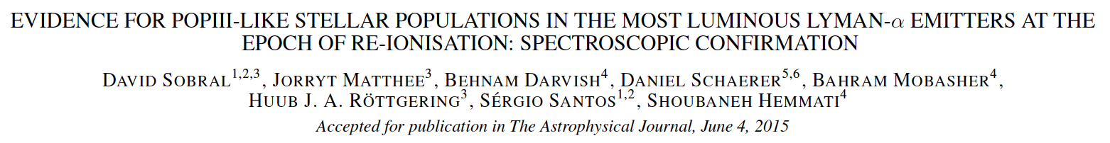
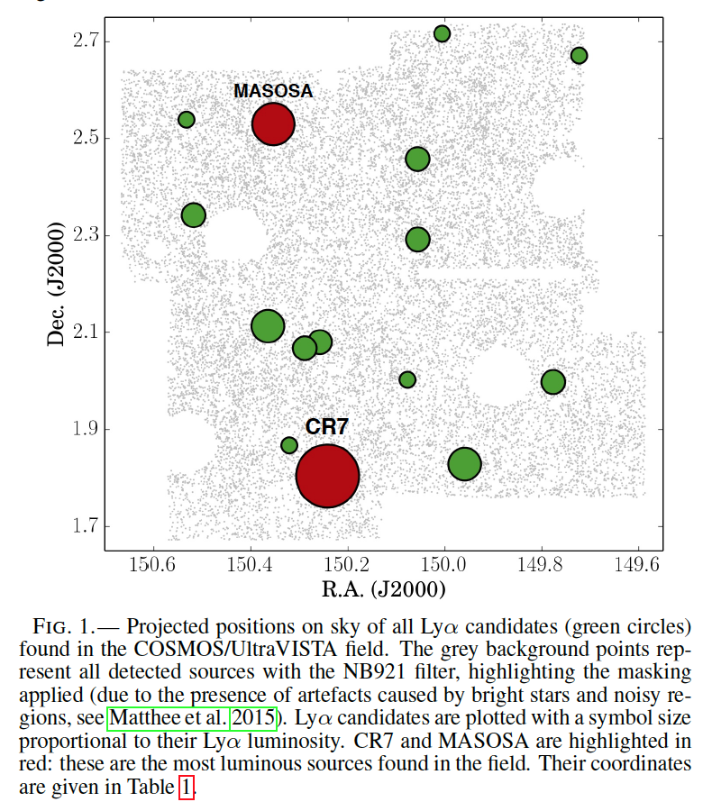

Located in the COSMOS field, an intensely studied patch of sky in the constellation of Sextans, this galaxy is three times brighter than the brightest distant galaxy known up to now. Its nickname was inspired by the Portuguese soccer player Cristiano Ronaldo (also known as CR7).

Slide 40
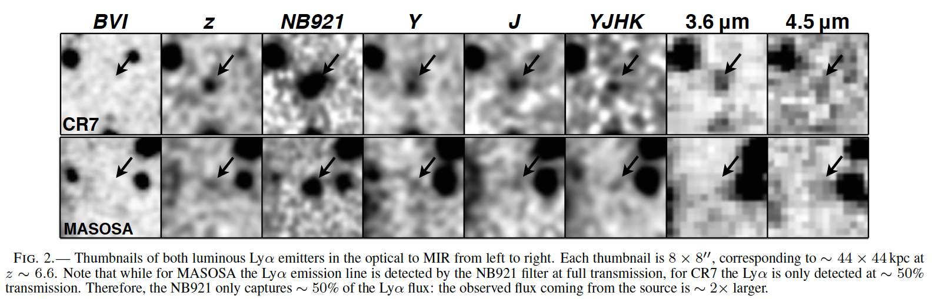

Slide 41
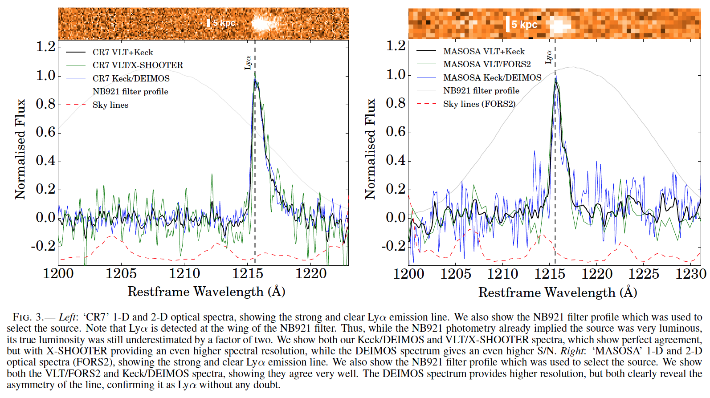

Slide 42
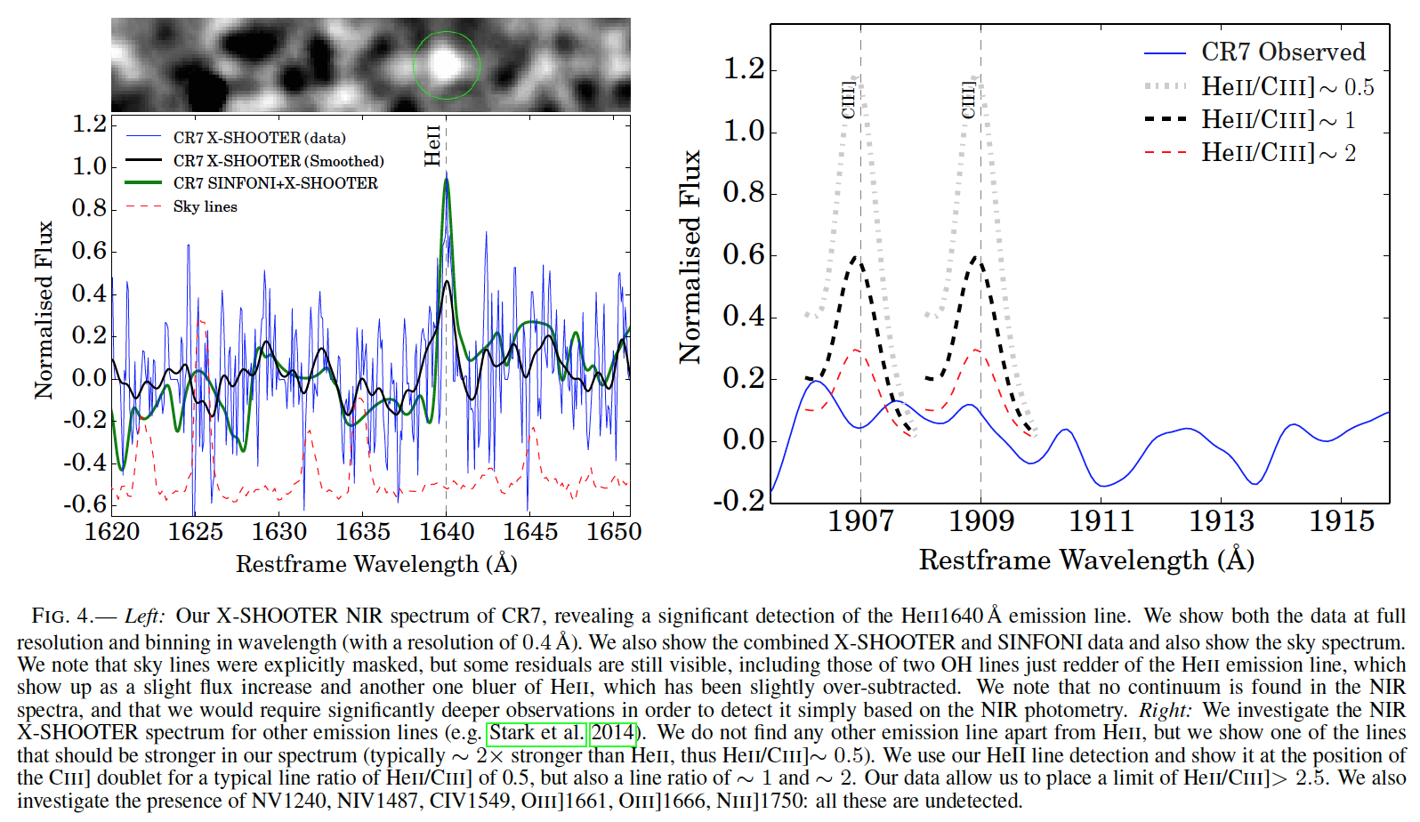

Slide 43
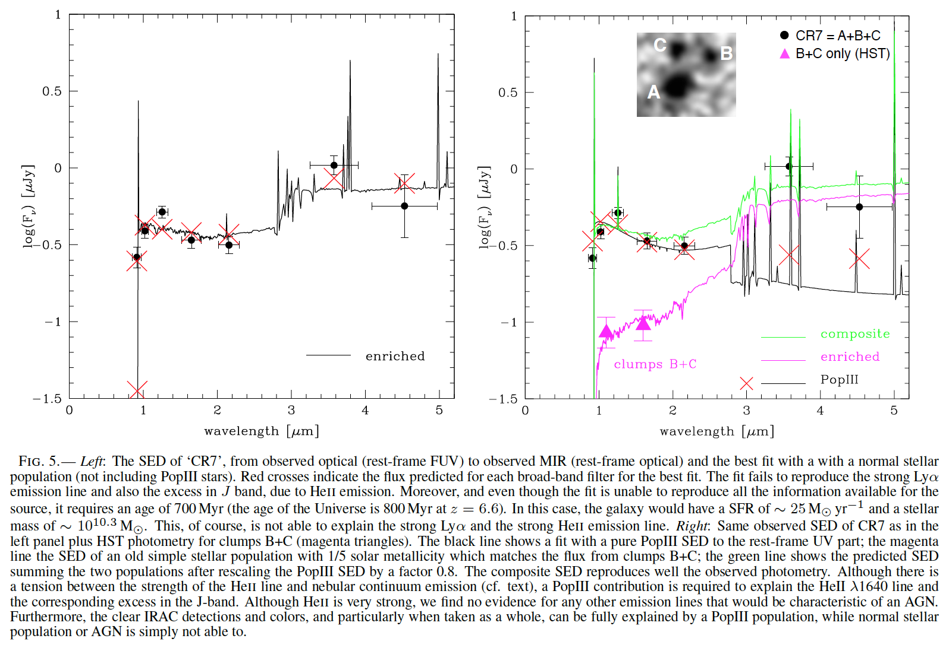

Slide 44
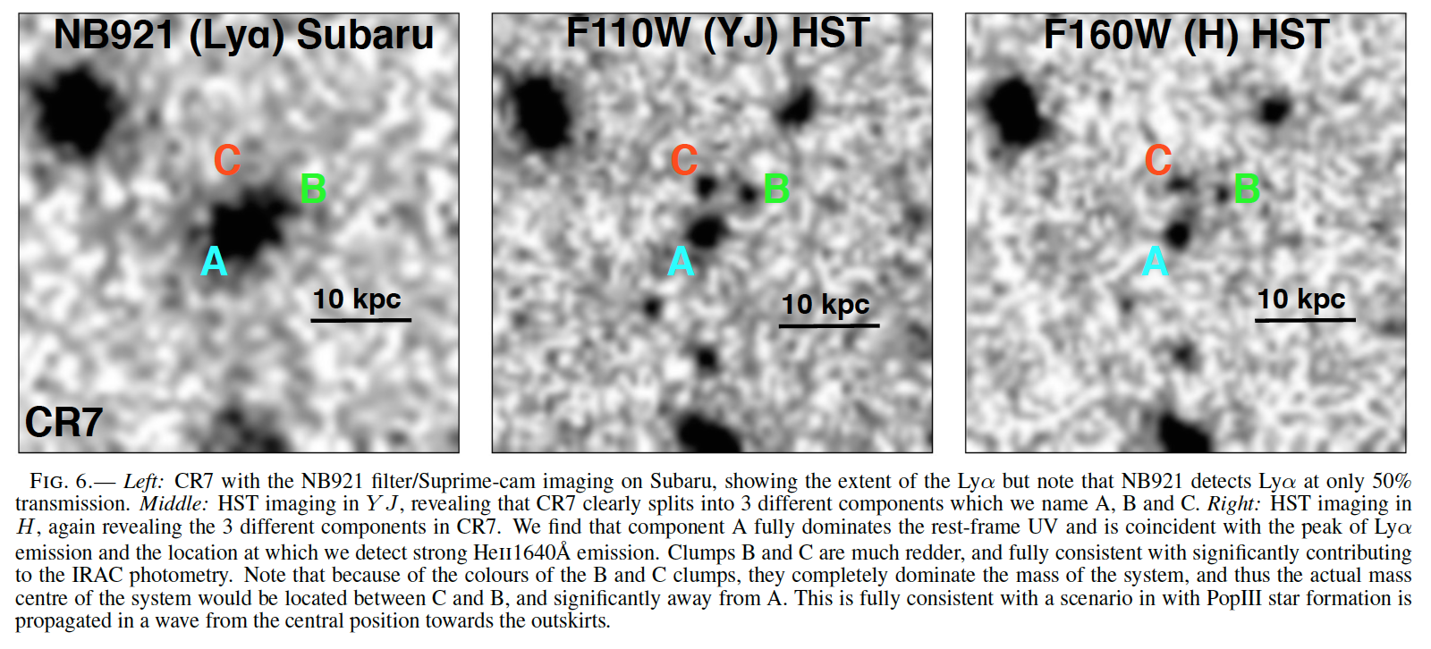

Slide 45
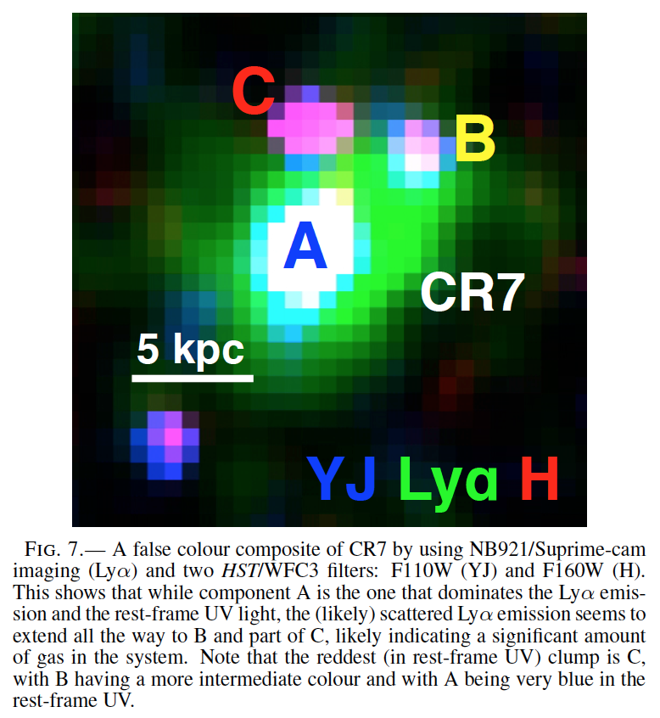
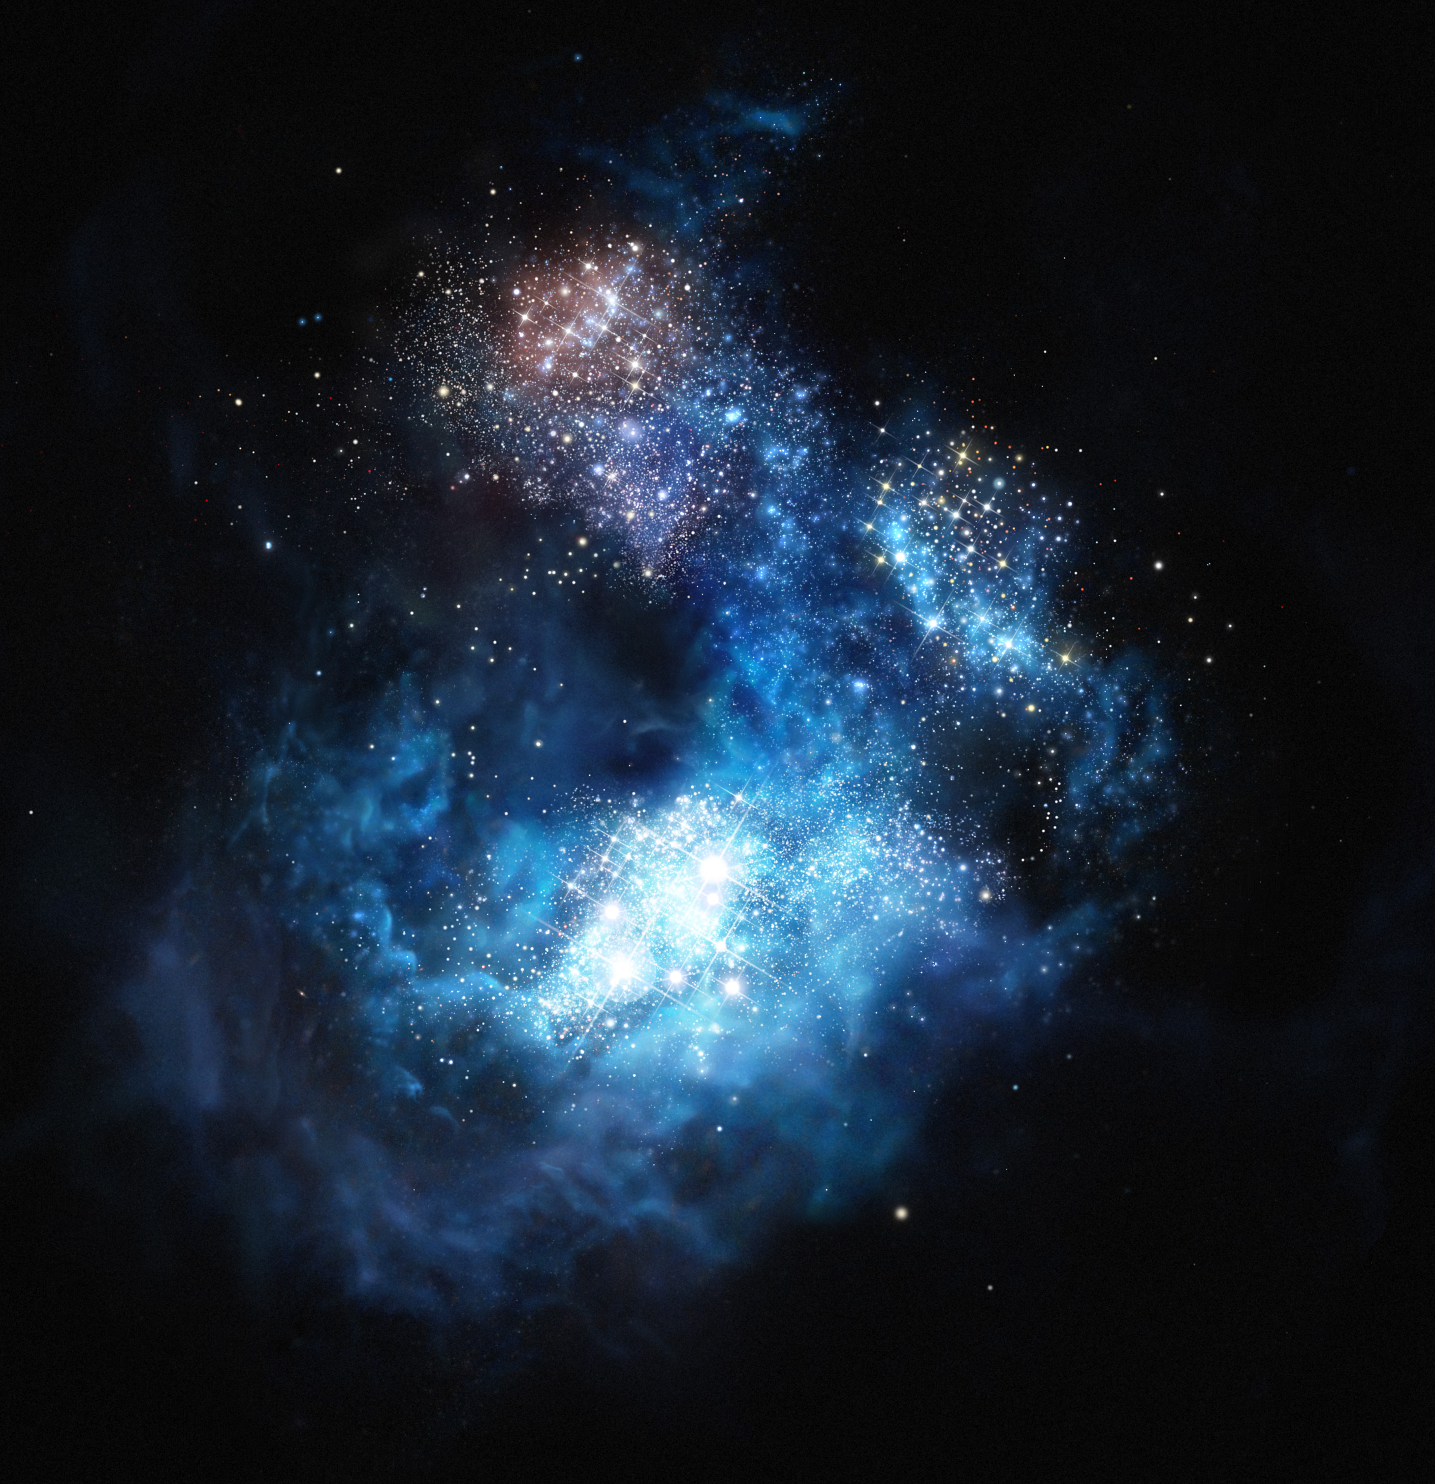
C
B
A

Slide 46
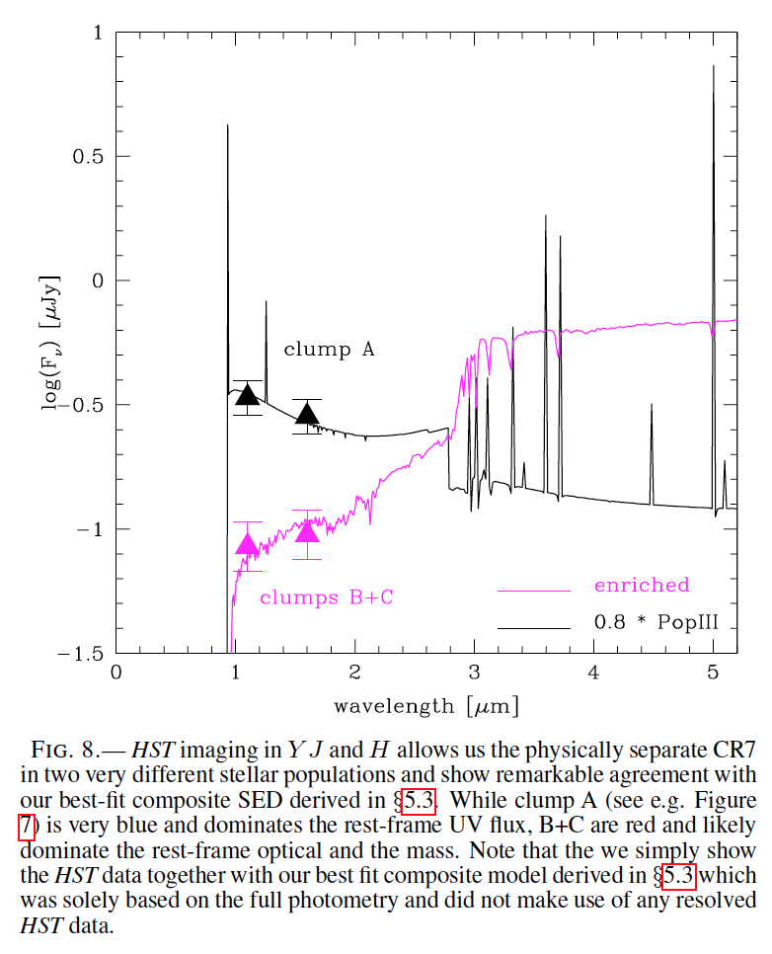

Slide 47
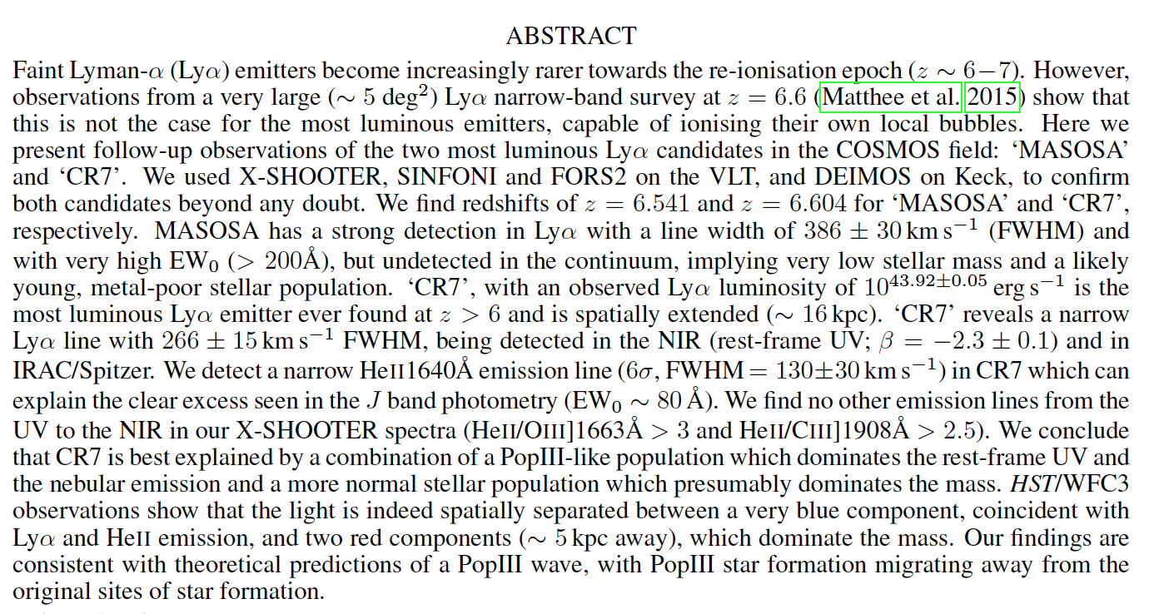

Slide 48
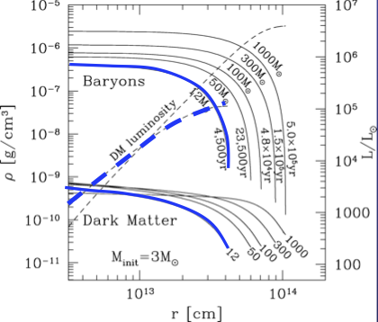
Dark-Matter powered Stars: “Dark Stars” (Spolyar, Freese & Gondolo 2008; Freese et al. 2008; Iocco et al.)
Dark Stars are the very ﬁrst phase of stellar evolution in the history of the universe: the ﬁrst stars to form (typically at redshifts z 10 − 50) might be powered by heating from dark matter (DM) annihilation instead of fusion (if the DM is made of particles which are their own antiparticles).
Any DM particle which is capable of annihilating with itself in such a way as to give the correct relic abundance today will also annihilate wherever the DM density is high.
The ﬁrst protostars and stars are particularly good sites for annihilation because they form at high redshifts and in the high density centers of DM haloes.
DM annihilation provides a powerful heat source in the ﬁrst stars.
Self-annihilating WIMP DM heats stellar interior
=> A red supergiant (~ 1 000 R) Pop III?

Slide 49
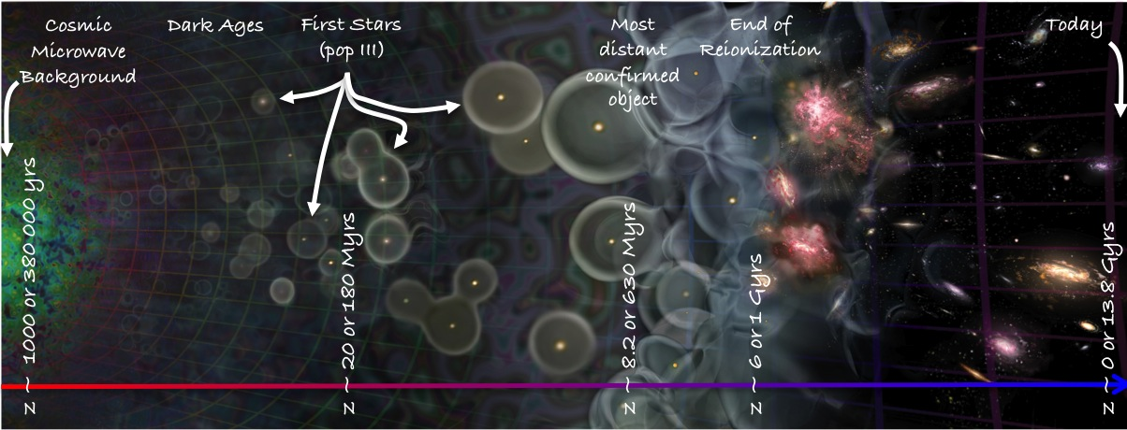
Universe’s Timeline

