Slide 1
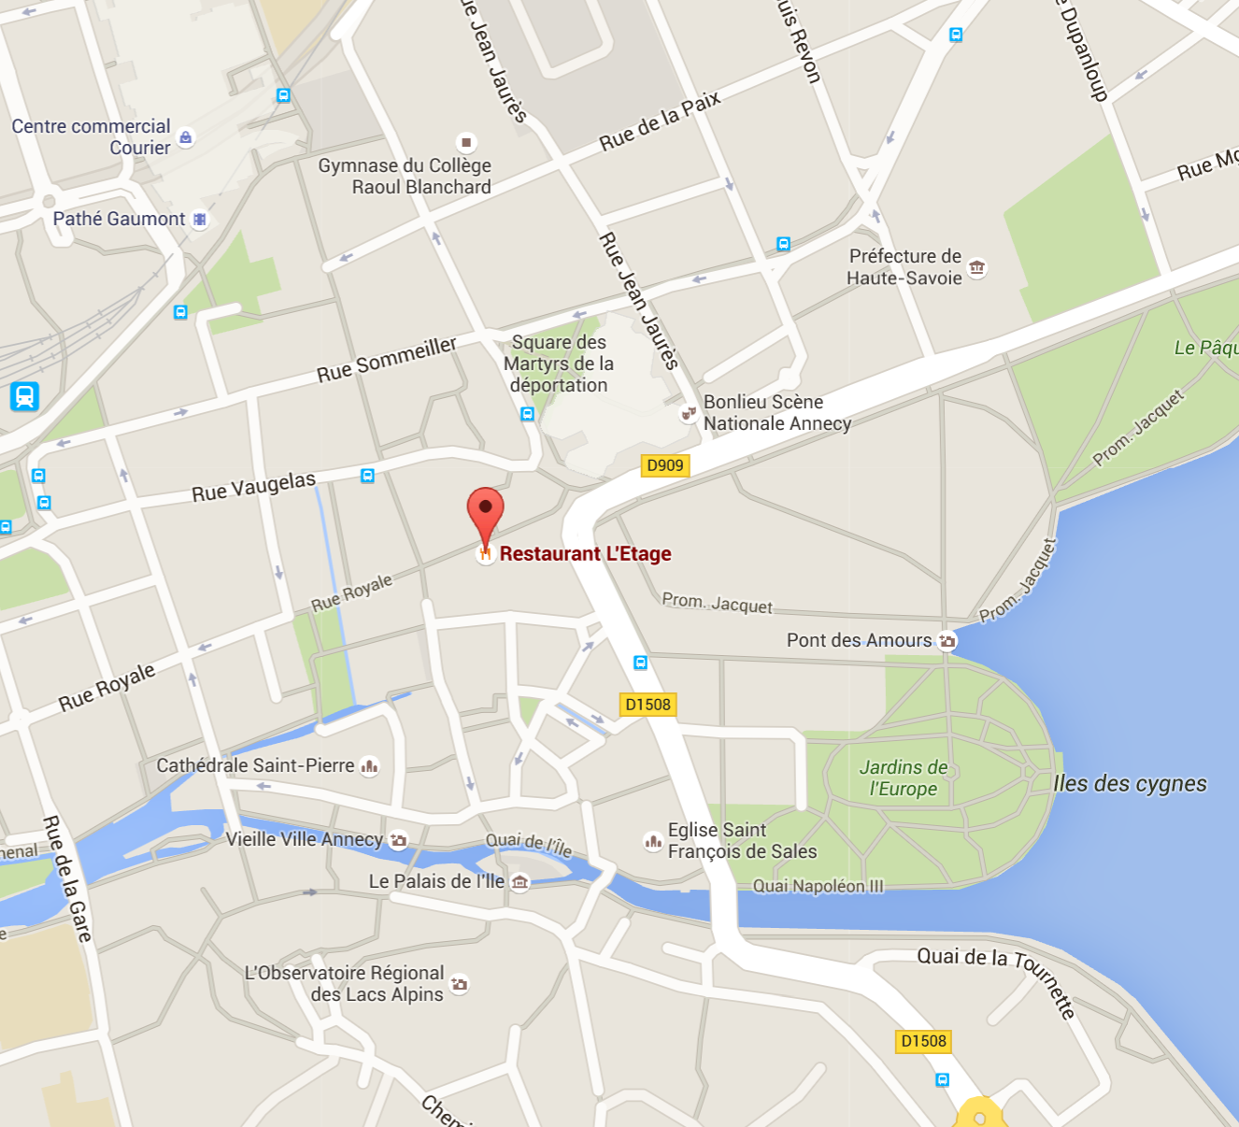
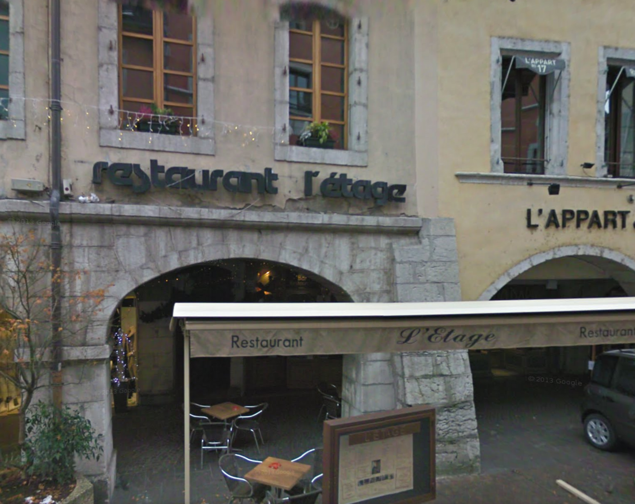
This evening’s restaurant
L’Etage, rue royale/rue du Pâquier, ~ 20h00

Slide 2
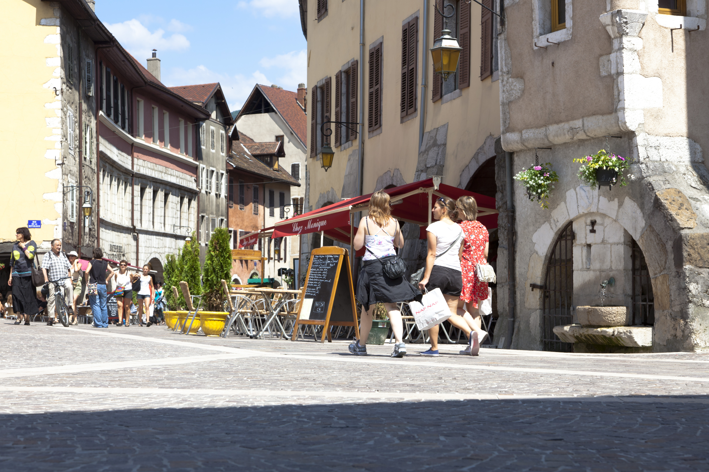
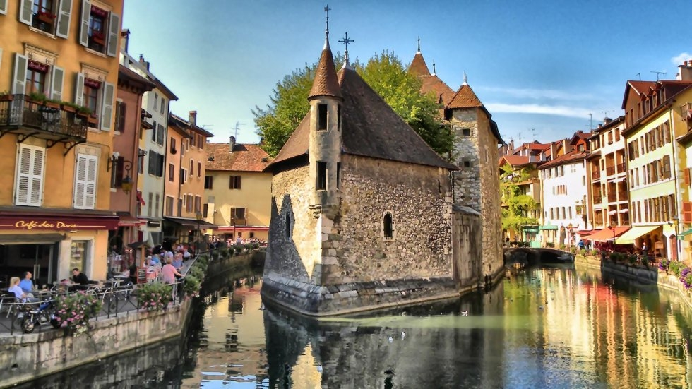
The historical city centre
There are guided tours (but not on Sunday! ☹)

Slide 3
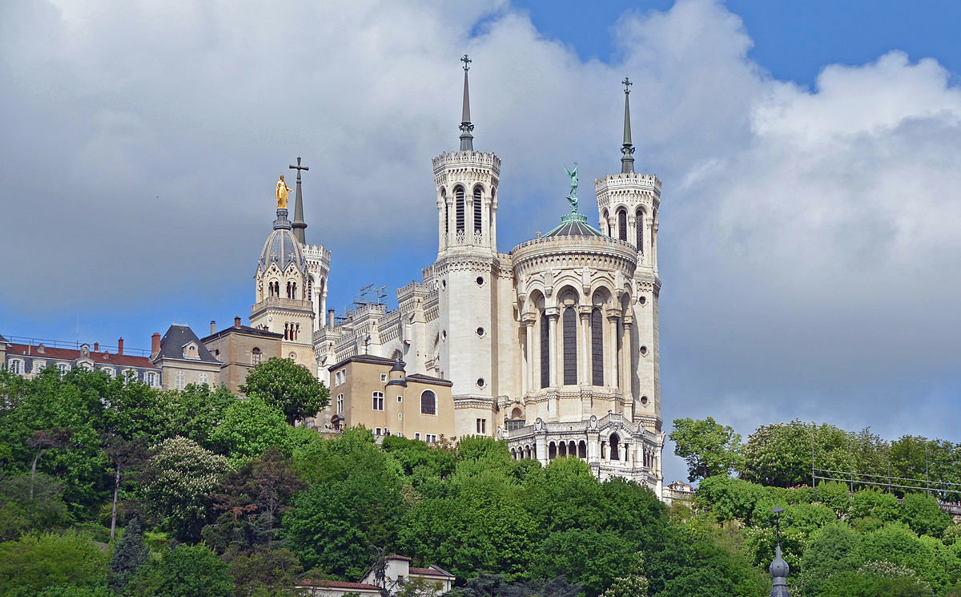
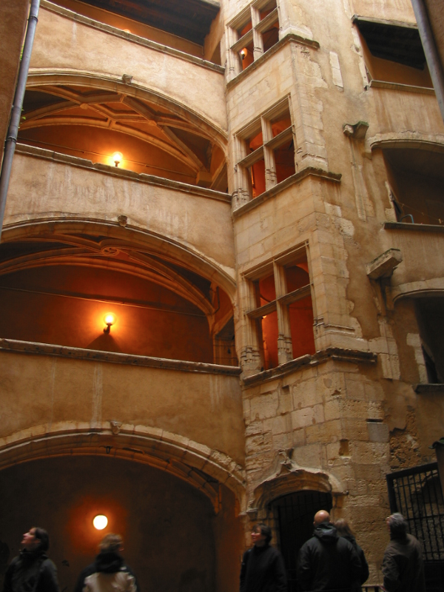
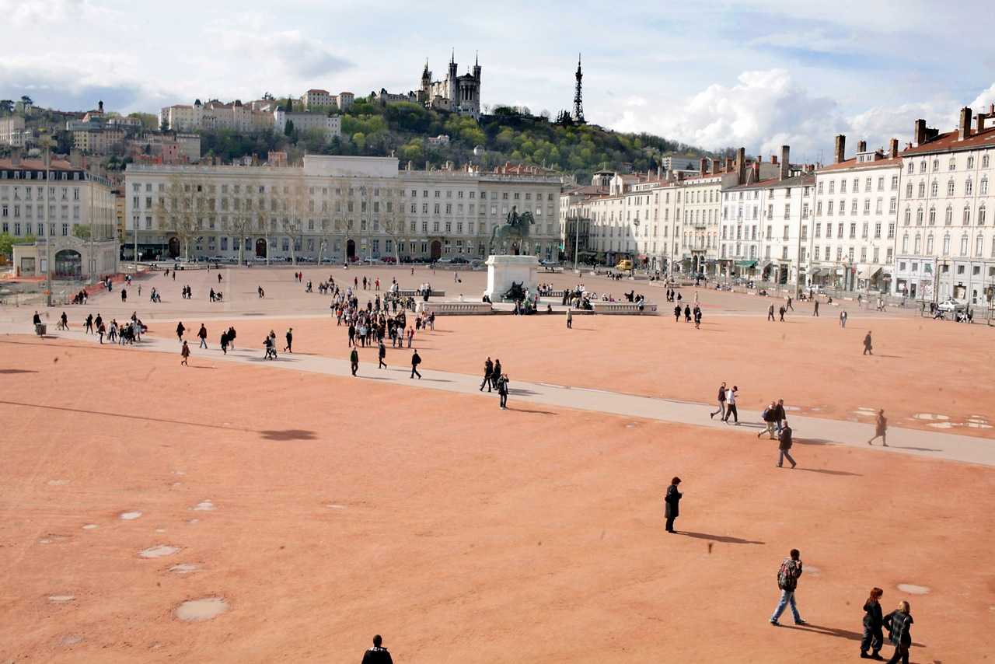
Lyon
2 h away by train
Beautiful old town

Slide 4
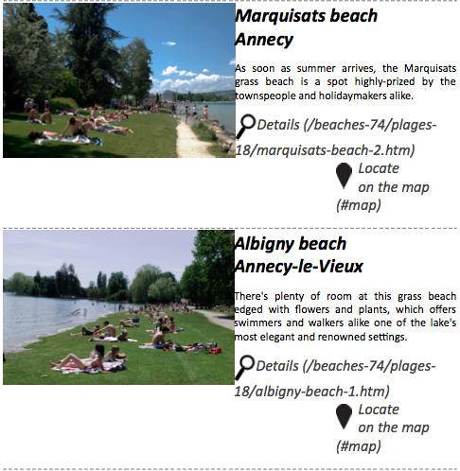
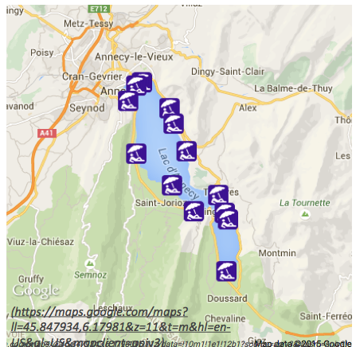
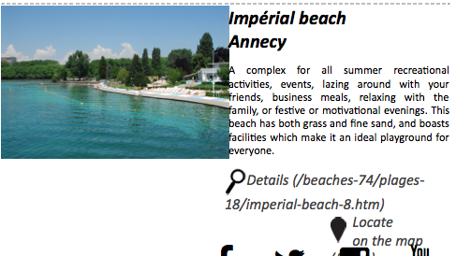
http://en.lac-annecy.com/beaches-74.htm
Free entrance
Free entrance
Not Free entrance

Slide 5
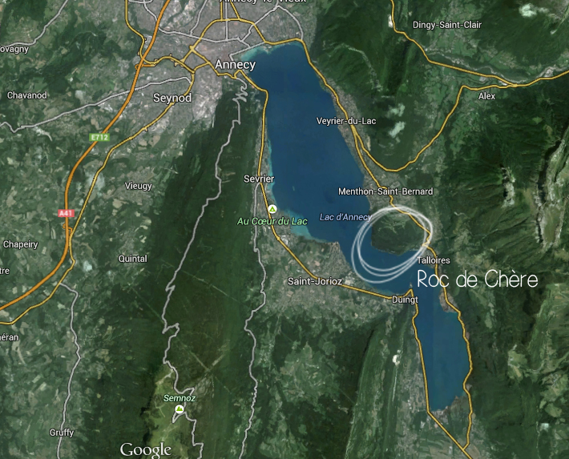
Le roc de chère

Slide 6
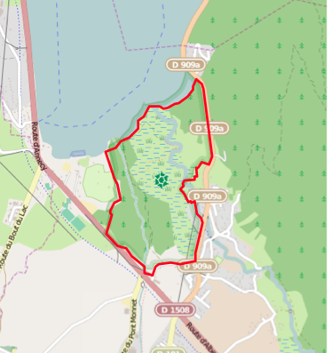
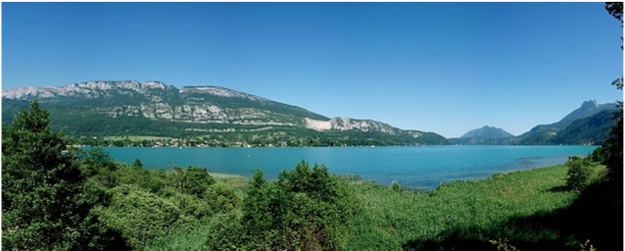
Réserve naturelle du Bout-du-Lac
http://www.ville-doussard.fr/marais
http://www.savoie-mont-blanc.com/
Magazine/Activites-et-detente/Rando/6-balades-insolites-La-reserve-du-bout-du-lac-a-Doussard

Slide 7
Mountains! (BE CAREFUL! & shoes!)

Slide 8
Hiking/rambling : Mount Veyrier
~2 h to get to the top from the lake side, depending on your legs! ~same time to go down.

Slide 9
Some views from mount Veyrier

Slide 10
Hiking/rumbling : Mount Veyrier

Slide 11
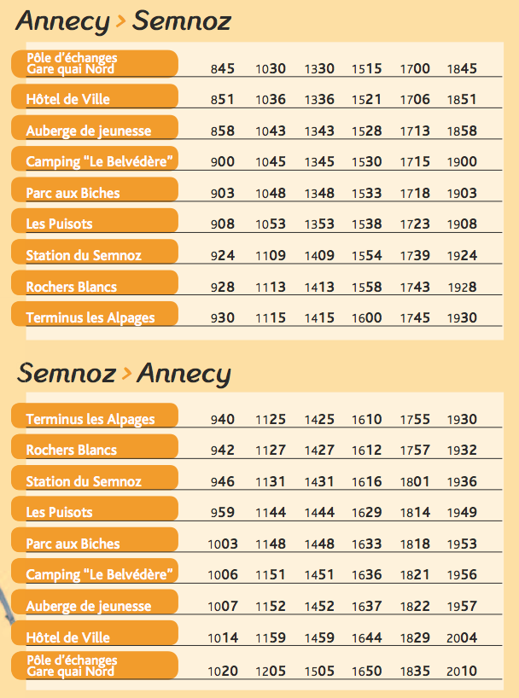
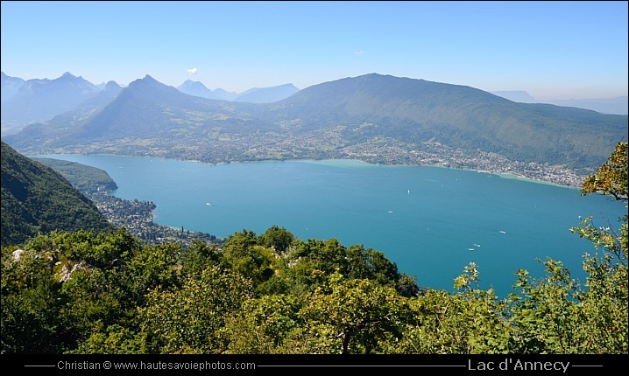
Mount Semnoz
There are buses that go to the top of the mount Semnoz
http://www.sibra.fr/sites/sibra.fr/files/flyer_ligne_dete_2015-web.pdf

Slide 12
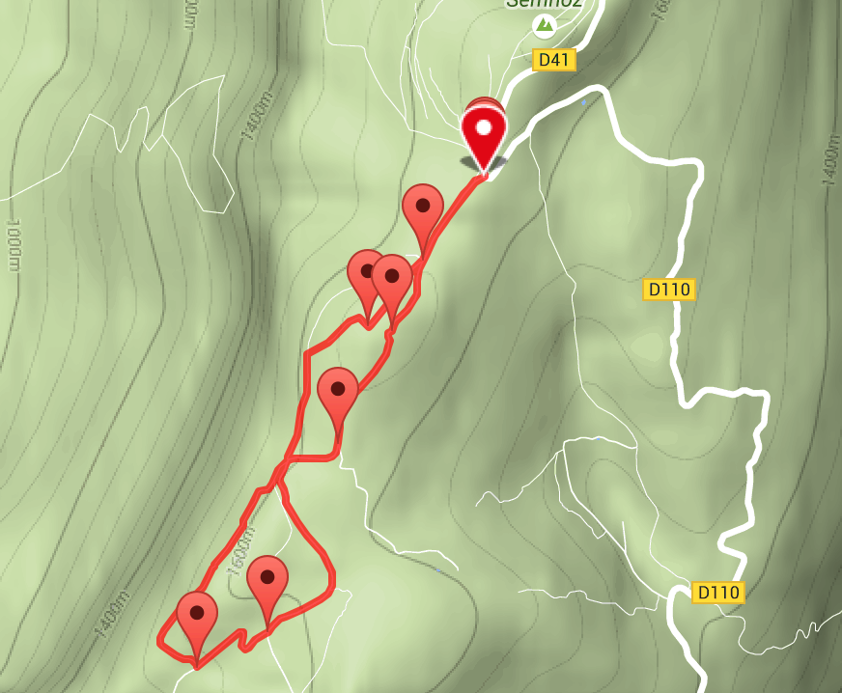
Mount Semnoz
The top of the
mount Semnoz
is a plateau, and
there are trails
http://www.savoie-mont-blanc.com/offre/fiche/itineraire-de-randonnee-le-plateau-du-semnoz/331197

