Slide 1
GRASPA
Giovanni LAMANNA
19 July 2018

Slide 2
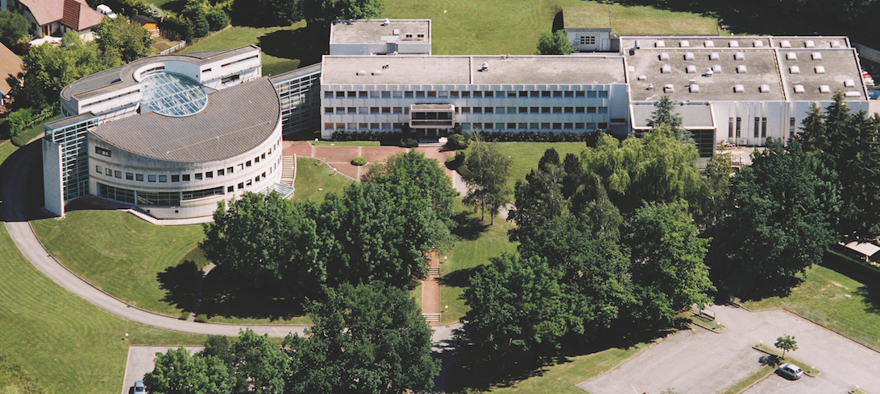
Fundamental research in Annecy
Created in 1976, LAPP is one of the 20 laboratories of the CNRS National Institute for Nuclear and Particle Physics (IN2P3).
Research domain:
Combination of the experimental investigations of the two extremes, from the largest-scale structures in the observable Universe to the most fundamental particles (particle and astroparticle physics).
Frontier technologies in different fields: mechanics, electronics, computer science, scientific software and e-infrastructures. …
LAPP was born 42 years ago by the wish of CNRS scientists to have a French laboratory close to CERN.
More than 150 researchers, engineers, technicians, administrative personnel, students..
LAPP hosts the Data and Computing Centre MUST (also WLCG Tier2) and has a Theory Laboratory (LAPTh) within its premises.

Slide 3
Fundamental research in Annecy
Creating LAPP in 1976 was a bold but successful challenge.
80’s : LAPP participates to important experiments at CERN, such as UA1 that enabled the W and Z bosons discovery [Nobel Prize 1984]
90’s : LAPP expands and diversifies its activities
  LEP (e+e-) experiments at CERN - the Standard Model is tested with great accuracy
  Astroparticle Physics field:
  gravitational waves (Virgo), high energy cosmic rays (AMS)
  on diverse sites: Switzerland, Italy, USA, Namibia, Japan, Spain, in Space (ISS)
During the past 42 years we contributed to some of the most striking global results in Particle and Astroparticle Physics.
LAPP is associated to important discoveries:
  Z and W bosons (1983)
  Higgs boson (2012)
  Neutrinos oscillation
  Gravitational waves (2015)

Slide 4
Particle physics
ATLAS
LHCb
Neutrinos
At LHC, CERN
At LHC, CERN
Matter-antimatter asymmetry
Neutrino properties: oscillation, 4th family, matter-antimatter asymmetry
Search for new physics
Higgs boson discovery, 2012
STEREO, SuperNEMO and WA105/DUNE
Search for new physics

Slide 5
Astroparticle physics
AMS
HESS & CTA
Virgo
Search for dark matter and antimatter in the Universe
Search for dark-matter
Gravitational waves detection
LSST
Dark matter and dark energy studies
On the ISS
Telescopes in Namibia, Chili, La Palma
Study of high energy cosmic rays sources
Interferometer installed in Pisa, Italie
General relativity, gravitational astronomy
Chili

