Slide 1
Status and perspectives of
gaseous photon detectors ^{(*)}
S. Dalla Torre
(*) for Cherenkov imaging counters

Slide 2
OUTLINE
gaseous PDs for RICHes, I generation - photoconverting vapours
gaseous PDs for RICHes, II generation – MWPCs with solid state CsI PC
gaseous PDs for RICHes, III generation – closed geometry gaseous PDs
gaseous PDs with sensitivity in the visible range
non traditional PCs
conclusions

Slide 3
OUTLINE
gaseous PDs for RICHes, I generation - photoconverting vapours
gaseous PDs for RICHes, II generation – MWPCs with solid state CsI PC
gaseous PDs for RICHes, III generation – closed geometry gaseous PDs
gaseous PDs with sensitivity in the visible range
non traditional PCs
conclusions

Slide 4
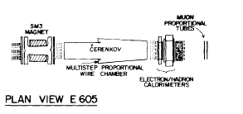
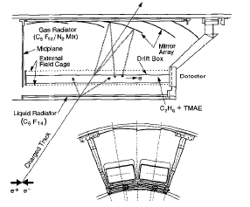
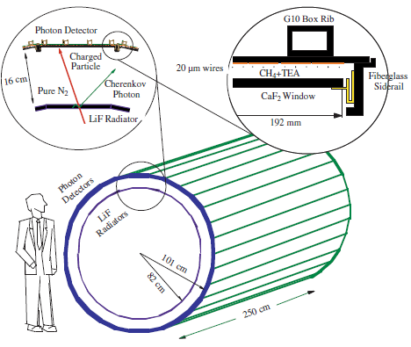
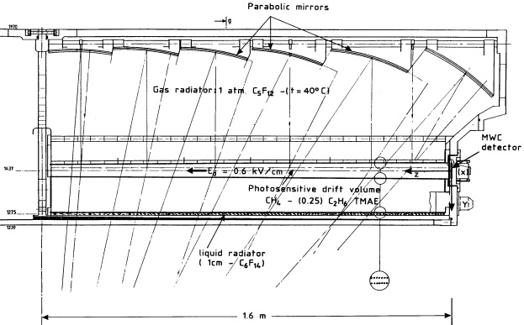
GASEOUS PDs, THE PAST
Gaseous photon detectors, the first generation: converting vapours
OMEGA
E605
SLD - CRID
DELPHI
TMAE
(Tetrakis-Dimethylamine-Ethylene)
CLEO III
TEA (Tri-Ethyl-Amine)

Slide 5
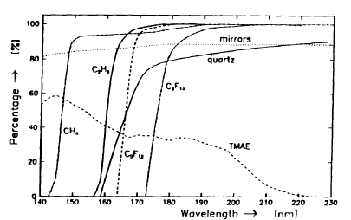
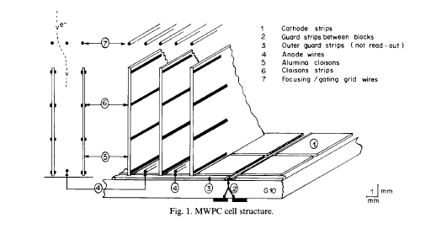
GASEOUS PDs, THE PAST
TMAE
TMAE
DELPHI barrel RICH
Photosensitive volume:
5 cm thick
QE,
NIMA 323 (1992) 351
thick photosensitive volume (slow photon
detectors, parallax error)
heating and temperature control
(T _bubbling <T_operation)
photon feed-back from amplification region
(protections)
chemically extremely reactive
cloisons
Anode wire
DELPHI barrel RICH, NIMA 273 (1988) 247

Slide 6
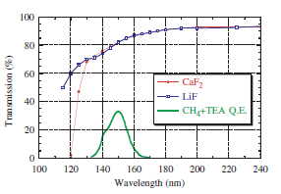
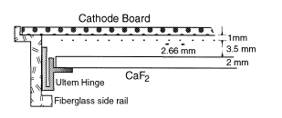
GASEOUS PDs, THE PAST
TEA
NIMA 554 (2005) 147
CLEO III, NIMA 441 (2000) 374
technical challenges of the far UV domain
large chromatic dispersion in far UV region:
  Proximity focusing (the Chromatic dispersion is not the major resolution limitation)
  He, a radiator gas with extremely reduced chromatic dispersion

Slide 7
GASEOUS PHOTON DETECTOS, WHY ?
In spite of critical aspects and technical challenges,
gaseous photon detectors offer:
operation in magnetic field
the most effective solution for what concerns the cost of large detector area application
minimum material budget when the photon detectors have to seat in the experiment acceptance
second generation of gaseous photon detectors

Slide 8
OUTLINE
gaseous PDs for RICHes, I generation - photoconverting vapours
gaseous PDs for RICHes, II generation – MWPCs with solid state CsI PC
gaseous PDs for RICHes, III generation – closed geometry gaseous PDs
gaseous PDs with sensitivity in the visible range
non traditional PCs
conclusions

Slide 9
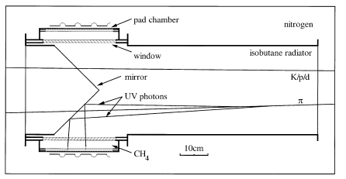
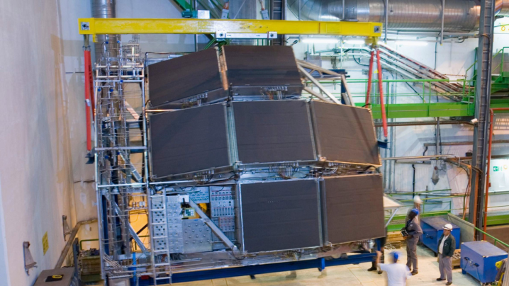
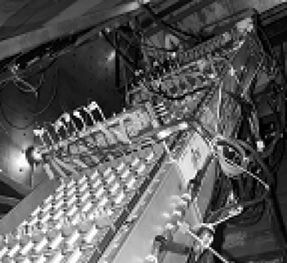
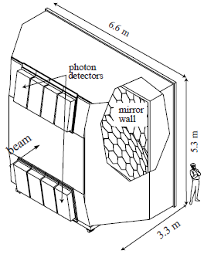
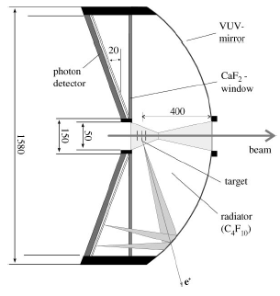
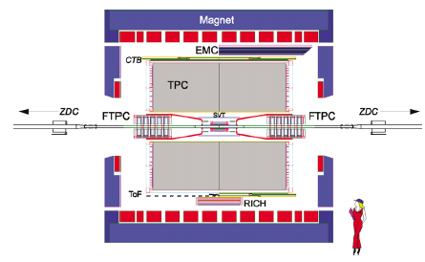
GASEOUS PDs, THE PRESENT
MWPCs with solid state photocathode (the RD26 effort)
ALICE-HMPID
CsI area > 10 m²
TIC, NA44
JLAB-HALL A
A solid state photocathode exposed to
a gaseous atmosphere in an effective PD:
a success !
COMPASS,
RICH-1
CsI area > 5 m²
STAR
HADES

Slide 10
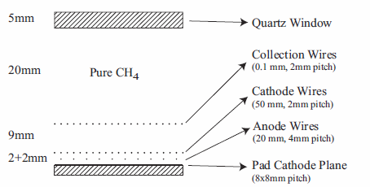
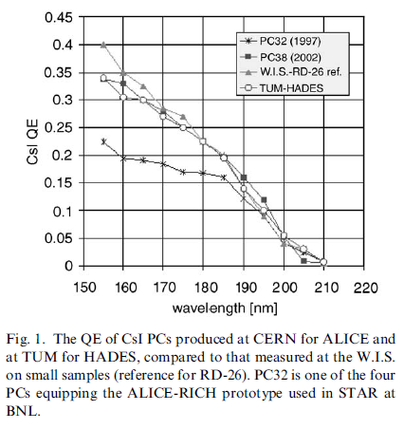
GASEOUS PDs, THE PRESENT
Structure of the PDs
@ 2 kV (typical):
E (CsI surface) ~ 7 kV/cm
Photocathode - the most robust
one in gaseous atmosphere: CsI
COMPASS,
RICH-1 PDs
The best quartz cuts here
P. Abbon et al, NIM A 577 (2007) 455.
A. Di Mauro, NIM A 525 (2004) 173.

Slide 11
PCs, WHICH CONFIGURATION ?
Reflective versus semi-transparent photocathodes
REFLECTIVE - larger photoelectron collection :
  Semitransparent photocathode - the application of a thin metallic film, which absorbs photons, on the entrance window is required
  the probability of photoelectron absorption is lower in a reflective photocathode than in a semitransparent one as the conversion probability is the highest at the entrance surface of the photo-converter
the thickness of the photo-converter layer is non critical in the reflective configuration, contrary to the semitransparent one:
this aspects is very relevant for large area detectors

Slide 12
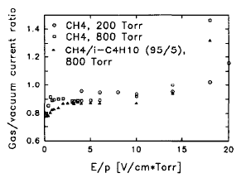
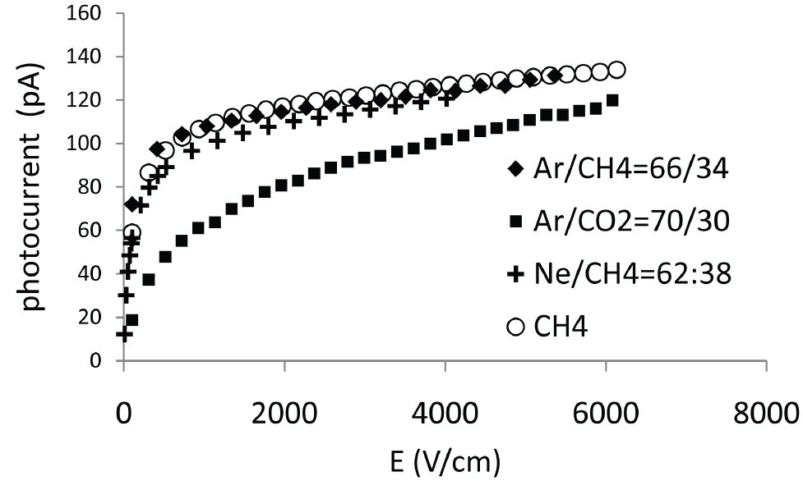
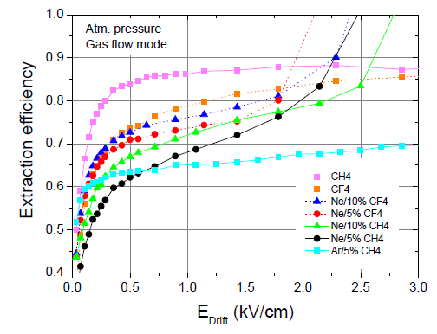
PHOTOELECTRON EXTRACTION
Photoelectron extraction from a CsI film, the role of gas and E
VACUUM
Breskin et al.,
NIM A 367 (1995) 342
M. Alexeev et al., NIM A (2010) in press
C. D. R. Azevedo et al., 2010 JINST 5 P01002

Slide 13
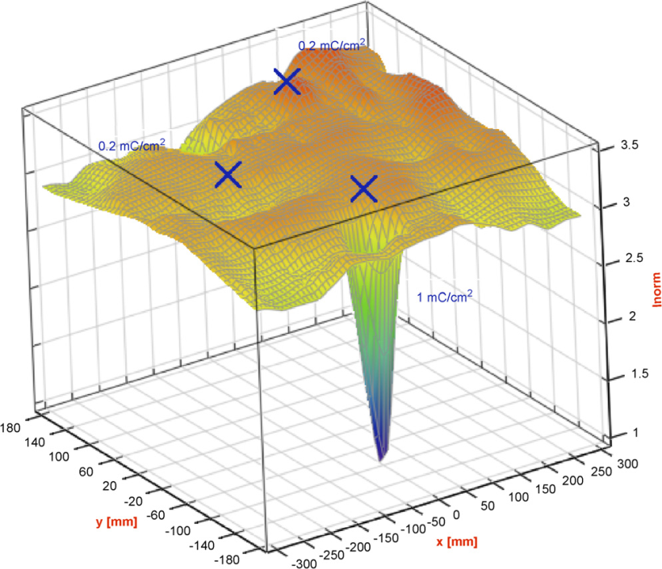
GASEOUS PDs, THE PRESENT
MWPCs with CsI photocathode, the limits
Severe recovery time (~ 1 d) after detector trips
  Ion accumulation at the photocathode moderate gain:<10⁵
Feedback pulses (effective gain: <1/2)
  Ion and photopns feedback from the multiplication process not fast
Aging after integrating a few mC / cm²
  Ion bombardment of the photocathode
0.2 mC/cm²
MWPCs → slow signal formation
  + low gain → “slow” electronics (signal
  integration, low noise level)
  Gassiplex FE : integration time ~ 0.5 μs, time res> 1 μs
  APV (COMPASS RICH-1 upgrade) : resolution ~ 400 ns
  → Detector memory, i.e. not adequate for high rates
1 mC/cm²
H. Hoedlmoser et al., NIM A 574 (2007) 28.

Slide 14
OUTLINE
gaseous PDs for RICHes, I generation - photoconverting vapours
gaseous PDs for RICHes, II generation – MWPCs with solid state CsI PC
gaseous PDs for RICHes, III generation – closed geometry gaseous PDs
gaseous PDs with sensitivity in the visible range
non traditional PCs
conclusions

Slide 15
TOWARDS THE FUTURE
TWO REQUESTS
Reduced photon and Ion BackFlow (IBF)
  Reduced aging
  High gain → high photoelectron detection efficiency
Intrinsically fast gaseous detectors (signal due to electron motion)
  Short integration time
  High rate environments
MICROPATTERN GASEOUS DETECTORS

Slide 16
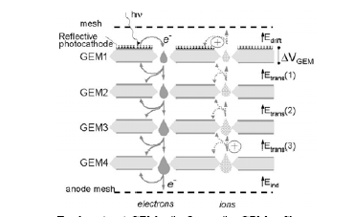
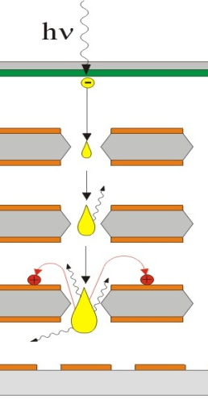
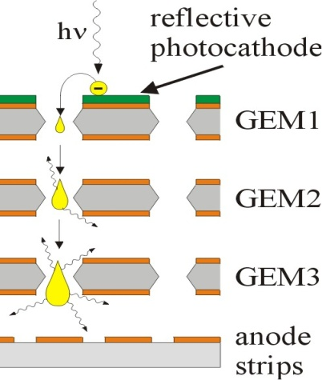
ION (& photon) BLOCKING GEOMETRIES
First developments …
GEM-based PDs
No photon feedback!
Semi-transparent PC
ion avalanche
Reflective PC
e⁻ avalanche
A. Breskin and R. Chechwik, NIM A 595 (2008) 116

Slide 17
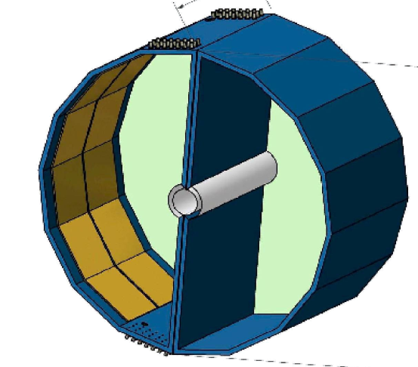
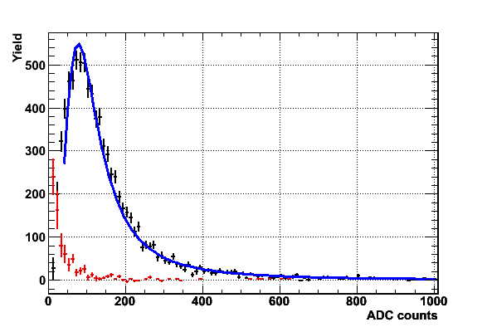
ION (& photon) BLOCKING GEOMETRIES
B≈0
… and applications:
PHENIX HBD,
a threshold Cherenkov counter
(window-less)
Central message for any similar application
Reversed bias cuts the MIP signal !
Aspects non exportable to imaging devices:
detection of >> 1 photon per pad: low gain (5000)
non negligible noise level (~20% single photon signal)
detect photons with λ down to ~110 nm: chromaticity !
Cherenkov
blobs
Transparent mesh 90%
e⁻
e⁺
HV
CsI
~ 1 m
MIP
Standard Bias
Reverse Bias
A. Milov et al. J. Phys. G34, S701 2007
I. Tserruya, RICH2010

Slide 18
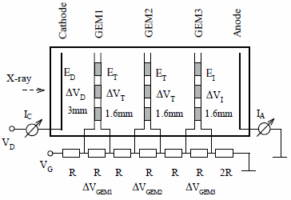
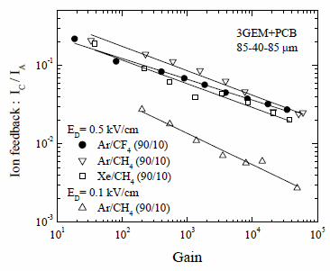
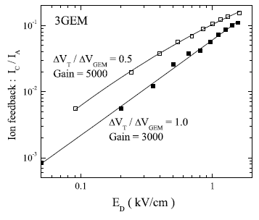
GEM-based PDs and IBF
rich literature about IFB in GEM-based detectors
I_{C}
I_{top1}
strong dependence from gain and E_{DRIFT}
poor dependence from pressure and gas type
E ~ 1 kV/cm needed for good photoelectron extraction
E_{D} = 0.5 kV/cm
I_{bottom3}
10⁻³ 10⁻² 10⁻¹
10⁻³ 10⁻² 10⁻¹
I_{A}
E_{D} = 0.1 kV/cm
The same for reflective PCs :
small and reversed E_{D} is needed
A. Bondar et al., NIMA 496 (2003) 325
IBF: a few % level in
effective GEM-based
photon detectors
A. Breskin et al., NIMA 478 (2002) 225d

Slide 19
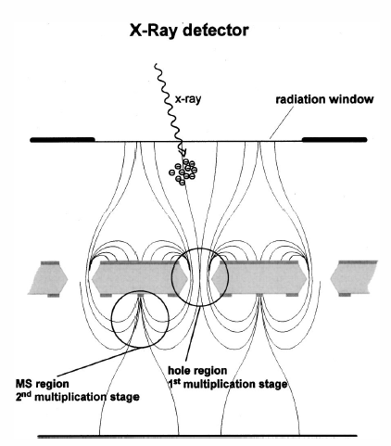
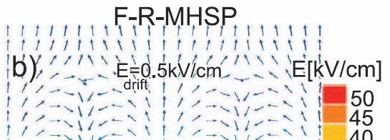
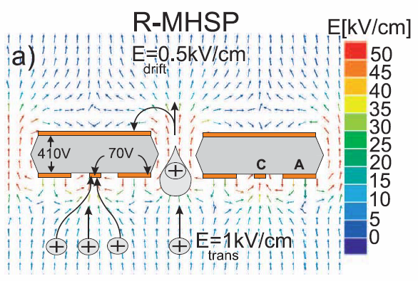
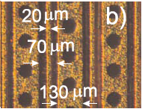
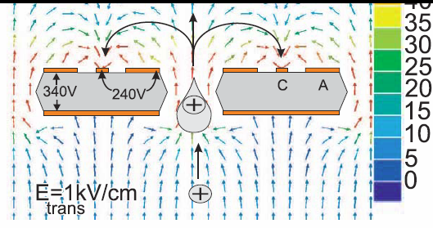
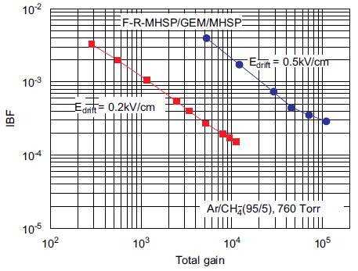
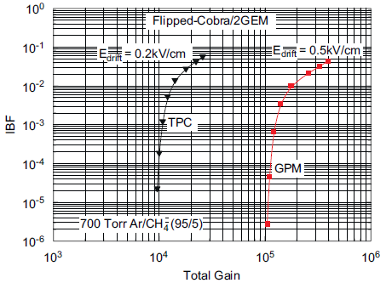
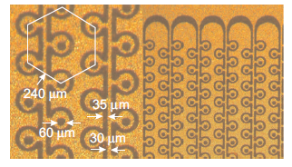
OVERCOMING IBF
More complex geometries needed: Micro-Hole & Strip Plate (MHSP), COBRA
MHSP
J.F.C.A. Veloso et al.,
Rev.Sc. Instr. 71 (2000) 2371
A.V. Lyashenko et al.,
JINST 2 (2007) P08004
COBRA
A.V. Lyashenko et al.,
NIMA 598 (2009) 116
A.V. Lyashenko et al.,
NIMA 598 (2009) 116

Slide 20
GEM-based PDs and GAIN
GEM-based PDs in laboratory studies
  for single photoelectron detection, they have been operated at gains > 10⁵ (see, for instance, the plots of the previous slides)
GEM-based detectors in experiments
  Always a MIP flux and small rates of heavily ionizing fragments crossing the detectors (even when the detectors are used as photon detectors)
  PHENIX HBD: gain ~ 5000 (I. Tserruya, RICH2010)
  GEM trackers
    At COMPASS: G ~ 8000
    (B. Ketzer, private comm.)
    At LHCb: G ~ 8000-9000
    (G. Bencivenni, private comm.)
    At TOTEM: G ~ 8000-10000
    (G. Catanesi, private comm.)
In experiments, small chances
to operate GEM-based PDs at gains > 10⁴

Slide 21
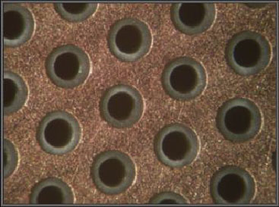
THGEM-based PDs, why ?
PCB technology, thus:
robust
mechanically self supporting
industrial production of large size
boards
economic
Comparing to GEMs
Geometrical dimensions X ~10
  But e⁻ motion/multiplic. properties do not!
  Larger holes: dipole fields and
  external fields are strongly coupled
About gain:
Large gains are easily obtained (rim !)
About PCB geometrical dimensions:
Hole diameter : 0.2 – 1 mm
Pitch : 0.5 – 5 mm
Thickness : 0.4 – 3 mm
RIM
introduced in // by different groups:
L. Periale et al., NIM A478 (2002) 377.
P. Jeanneret, PhD thesis, Neuchatel U., 2001.
P.S. Barbeau et al, IEEE NS50 (2003) 1285
R. Chechik et al, .NIMA 535 (2004) 303

Slide 22
ABOUT THE RIM
X-ray measurements
NOTE: two different scales
THGEM
& RIM
RIM: 100 μm
RIM: 10 μm
RIM: 100 μm
Effective gain
RIM: 10 μm
Effective gain
NO RIM
NO RIM
E_{DRIFT} (kV/cm)
zoom
E_{DRIFT} (kV/cm)
RIM: 100 μm
NO RIM
Energy resolution (%)
RIM: 10 μm
E_{DRIFT} (kV/cm)
S. Dalla Torre et al.,
IEEE – NSS 2008 , Dresden 19-25/10/2008

Slide 23
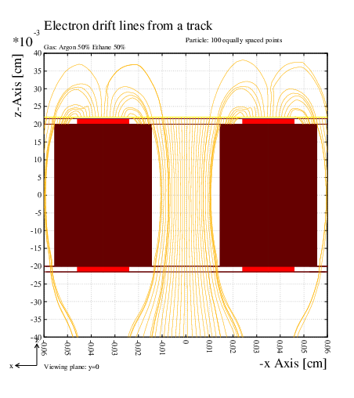
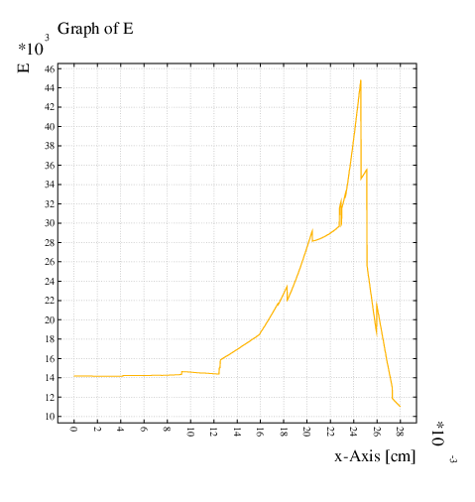
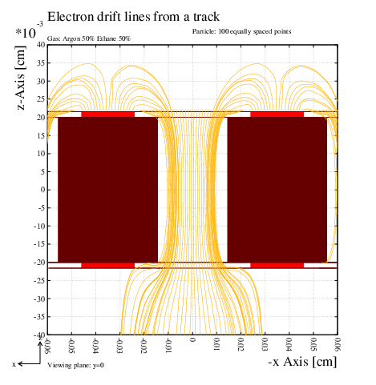
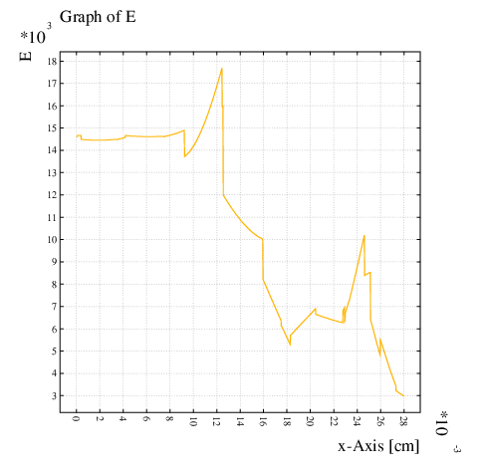
CAN WE SIMULATE THE RIM ROLE ?
An illustration of the unkown (M.Alfonsi and G. Croci, private comm.)
NO CHARGE ON THE RIM
E field
Is it possible to understand the charging up via simulation?
It has been done for standard GEMs: a lengthy iterative procedure to simulate the time dependent process
M Alfonsi, G. Croci, R. Veenhof et al., not yet published
[studies in the context of the RD51 effort to provide adequate simulation tools for MPGDs ]
hole
rim
NEGATIVE CH. ON TOP RIM
POSITIVE CH. ON BOTTOM RIM
E field
hole
rim

Slide 24
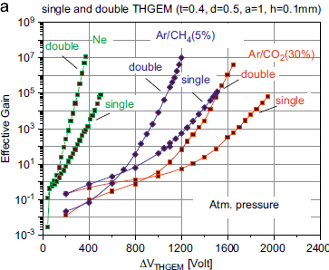
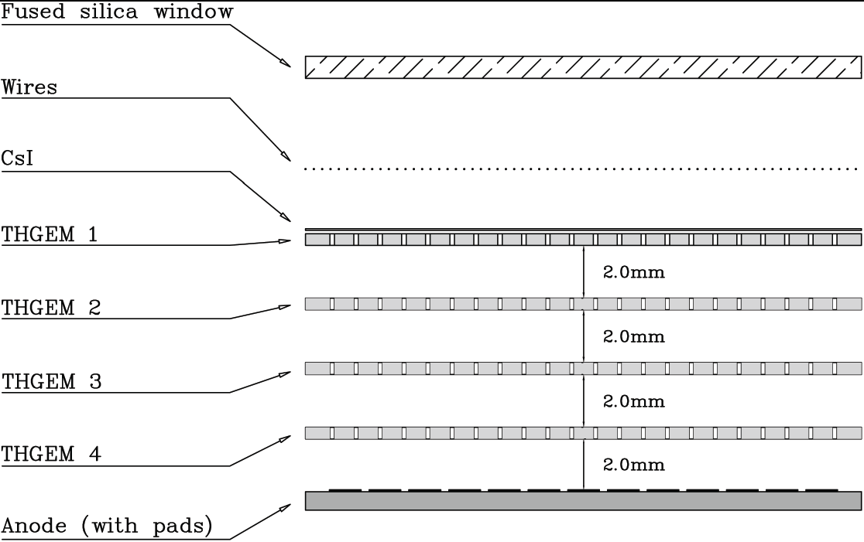
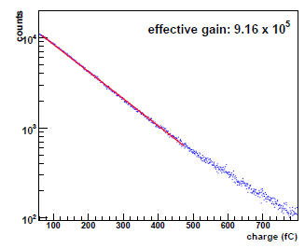
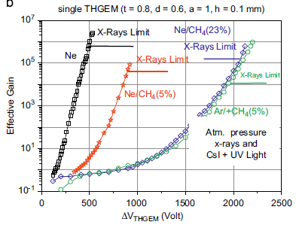
THGEM GAIN & RIM
employing large rim (100 μm)
minimum rim (<10 μm)
Single photons
THGEMs
Dim: 0.4 mm
Pitch: 0.8 mm
Thickn.: 0.4mm
A. Breskin et al., NIMA (2010) in press
Single photons
M. Alexeev et al.,
JINST 5 (2010) P08009
see S. Levorato’s talk
Gain limited to ~10⁵ in test beam:
MORE WORK REQUIRED

Slide 25
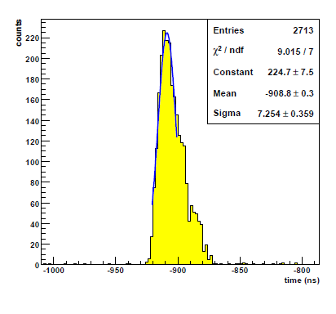
More about THGEM
Fast device
Triple THGEM
detecting single photons
High rate device
Irradiation:
8.9 KeV X-ray
I (pA)
0 1000 2000
single THGEMno RIM
0 20 40 60 80 100 120
Rate (kHz / mm²)
M. Alexeev et al.,
JINST 5 (2010) P08009
see S. Levorato’s talk

Slide 26
PHOTOELECTRON EXTRACTION
y
photoelectron trajectories from
a THGEM photocathode, simulation,
multiplication switched off
thickness 0.6 mm, diam. 0.4 mm, pitch: 0.8 mm, ΔV = 1500 V
x
x cross-section
field above the THGEM
E = 0
E = - 500 V
E = 500 V
photoelectron lost
(not entering
the holes)
photoelectron lost
( filed too low
for extraction)
see S. Levorato’s talk

Slide 27
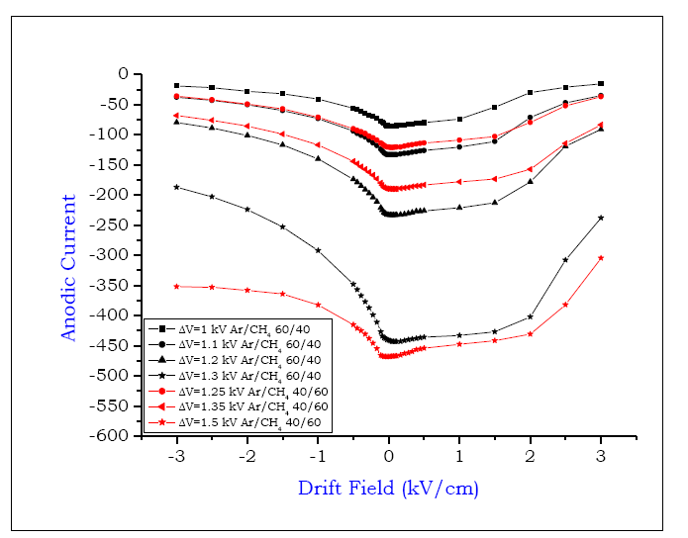
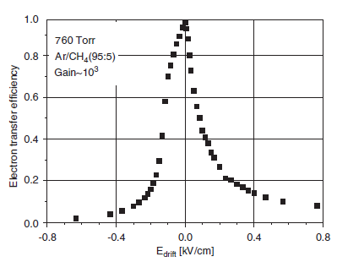
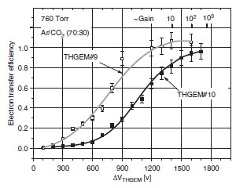
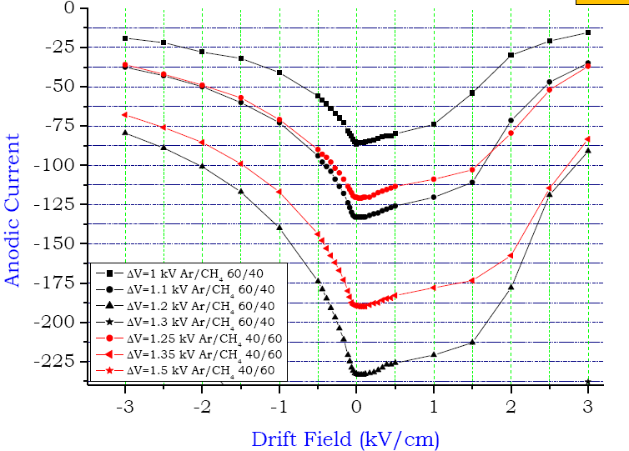
PHOTOELECTRON EXTRACTION 5/5
Counting mode technique
Ar/CH₄: 40/60; 60/40
ΔV =
1kV
1.1, 1.2
1.25, 1.3
1.35
1.5
Anodic current
ZOOM
external electric field applied
Active
area: 54 %
Active
area: 77 %
S. Dalla Torre et al.,
TIPP09 - Tsukuba,
Japan 11-17/3/2009
C. Shalem et al., NIMA 558 (2006) 475

Slide 28
ESTRACTION EFFICENCY vs ACTIVE AREA
Conflicting requirements → high ΔV
In this example:
E_{z} ~ 700 V/cm
Active area: 78 %
pitch: 0.8 mm;
diameter: 0.4 mm;
thickness; 0.6 mm,
no rim
ΔV = 1500 V
E_{z} on top surface
E_{z} on top surface
Hole edge

Slide 29
IFB IN THGEM-based PDs
THGEMs
Dim: 0.4 mm
Pitch: 0.8 mm
Thickn.: 0.4mm
typical charge sharing
0%
Drift
When the effective gain is 10⁶ →
~ 500000 ions/(detected photon) back to the photocathode
a factor 10 less is needed
Scanning ΔV_{1,2,3},E_{transfer}, E_{induction}
results in a few % variation of the IFB→
a different architecture is needed
26%
THGEM 1
1%
5%
THGEM 2
4%
68%
THGEM 3
49%
Induction
47%
anode
F.Tessarotto et al., MPGD2009, 12-15 June 2009,
Kolympari, Crete, Greece

Slide 30




COBRA THGEMs
Extension of the THGEM-Cobra concept (J.Veloso et al., MPGD2009, 12-15 June 2009, Kolympari, Crete, Greece )
Geometrical limitations from the PCB technology (pist thickness); minimum pitch 1mm → less robust against discharges
A wire implementation (S. Levorato’s talk)
see S. Levorato’s talk

Slide 31



LARGE SIZE THGEMs
600 x 600 mm²
~600,000 holes/piece, 0.001 € / hole
Ø: 0.4, pitch: 0.8, thickness: 0.6 mm
rim: 5 μm (micro-etching)
Ni-Au coating

Slide 32
OUTLINE
gaseous PDs for RICHes, I generation - photoconverting vapours
gaseous PDs for RICHes, II generation – MWPCs with solid state CsI PC
gaseous PDs for RICHes, III generation – closed geometry gaseous PDs
gaseous PDs with sensitivity in the visible range
non traditional PCs
conclusions

Slide 33

GASEOUS DETECTORS FOR VISIBLE LIGHT
photocathodes for visible light
  Chemical reactivity (gas purity better than ppm level needed →
  UHV materials and sealed detectors)
  PC stability under ion bombardment - work function lower than CsI one
  K-Cs-Sb aging in the few μC/mm²
  Na-K-Sb range ~ CsI (mC/cm²)
A.Breskin et al.,
NIMA 553 (2005) 46
F-R-MHSP,
IBF: 3 x 10 ⁻⁴
K-Cs-Sb vs CsI
Doulble GEM,
IBF: ~ 10 ⁻²
A.V.Lyashenko et al., 2009 JINST 4 P07005

Slide 34





GASEOUS DETECTORS FOR VISIBLE LIGHT
the GEM-like approach the MicroMega approach
Multiple GEM
sealed
K-Cs-Sb
Double MM, Ni mesh
recent past now
Pulsed ion gating
K-Cs-Sb - Continuous
mode, not a sealed PD
R.Chechik
et al., NIMA
502 (2003) 195
IBF : <2.5×10⁻³
Gain < 10⁴
Non adequate
for single photons
Vacuum, 20%
Breskin et al.,
NIMA 553 (2005) 46
A.V.Lyashenko et al.,
2009 JINST 4 P07005
Ar (90%)+CH₄ (10%)
12% (stable) after 1.5 y
Poor compatibility of bialkali and GEM material ?
Extremely poor QE of the bialkali PC:the material of the GEM
chemically
reacts with the bialkali metals
F. Tokanai et al., NIMA 610 (2009) 164
F. Tokanai et al., NIMA 610 (2009) 164

Slide 35






GASEOUS DETECTORS FOR VISIBLE LIGHT
The Capillary Plate (CP) approach
Pyrex CP
better bialkali compatibility
than lead glass
300 μm
V. Peskov et al., NIMA 433 (1999) 492
F. Tokanai et al., NIMA 610 (2009) 164
MCP coupled to Micromegas
Inclined to reduce more the IBF
(tested with CsI)
In collaboration with HAMAMATSU
Glass PC Imaging properties
X-ray studies simulating configurations with
semitransparent PC, reflective PC
Resolution:
~ 100 μm
F. Tokanai et al., NIMA 610 (2010) in press
J.Va’vra and T. Sumiyoshi, NIMA, 435 (2004) 334
Next step: coupling with a bialkali PC

Slide 36
OUTLINE
gaseous PDs for RICHes, I generation - photoconverting vapours
gaseous PDs for RICHes, II generation – MWPCs with solid state CsI PC
gaseous PDs for RICHes, III generation – closed geometry gaseous PDs
gaseous PDs with sensitivity in the visible range
non traditional PCs
conclusions

Slide 37



C NanoTube PCs ?
an example :
MWCNTs
QE Measurement
Absorbance in a wide spectral range
with a peak at 200 nm
Turbomolecular Pump
Deuterium Lamp
PMT
Monochromator
Vacuum Pumps
Photocathode in MWPC or NIST photodiode
Collimator
Can the work
function be lowered ?
Still a long way to go …
MWPC - VACUUM
anodic wires
photocathode
A.Valentini,
private communication
R&D in the context of
the INFN SINPHONIA experiment
and the HP2-W17 activity

Slide 38
SUMMARY / CONCLUSIONS
PHOTON DETECTORS
  since the beginning a central question for Cherenkov imaging counters
GASEOUS PHOTON DETECTORS
  Still no other approach to instrument large surfaces at affordable costs
MPGD-BASED PHOTON DETECTORS
  The handle to overcome the limitations of open geometry gaseous PDs
  R&D in the context of MPGDs: dedicated developments needed for photon detection
  Work in progress - these detectors are really needed !
GASEOUS PHOTON DETECTORS for photons in the visible range
  When ? Will they be cheap ?

Slide 39
SPARE SLIDES

Slide 40


RETHGEM
Resistive THGEMs
Introduced to obtain spark-protected detectors
High gains (up to ~ 10⁵ with single layer)
Technological breakthrough: screen printing technology opening the way large size and massive production
Rate limitations – with the improved Strip-RETGEM up to 400 Hz/cm²
J.M.Bidault et al., NP (PS) 158 (2006) 199
C. Agos et al., 2008 JINST 3 P02012
RETGEM, Production technique
S-RETGEM, Production technique
C. Agos et al., 2008 JINST 3 P02012
V.Peskov et al., NIMA 610 (2009) 169

Slide 41


GASEOUS PDs, THE PRESENT
MWPCs with CsI photocathode, the limits
Severe recovery time (~ 1 d) after detector trips
Feedback pulses moderate gain:<10⁵
  Ion feedback and photons from the multiplication process (effective gain: <1/2)
Aging after integrating a few mC / cm² not particularly fast
  Ion bombardment of the photocathode
0.2 mC/cm²
1 mC/cm²
Proof of the CsI film degradation
thanks to an accident (COMPASS RICH-1),
chamber contaminated by air:
water absorption is largely enhanced
where the ion bombardment has been
more intense
H. Hoedlmoser et al., NIM A 574 (2007) 28.

Slide 42

GASEOUS PDs, THE PRESENT
MWPCs with CsI photocathode, more about signals
Amplitude spectra:
total gain: < 10⁵
MWPCs → slow signal formation
  + low gain → “slow” electronics (signal integration, low noise level)
  Gassiplex FE : integration time ~ 0.5 μs, time res> 1 μs detector memory,
  APV (COMPASS RICH-1 upgrade) : resolution ~ 400 ns i.e. not adequate for high rates
INCREASING GAIN

Slide 43

GEM-based PDs and GAIN
GEM-based PDs in laboratory studies
  for single photoelectron detection, they have been operated at gains > 10⁵ (see, for instance, the plots of the previous slides)
GEM-based detectors in experiments
  Always a MIP flux and small rates of heavily ionizing fragments crossing the detectors (even when the detectors are used as photon detectors)
  PHENIX HBD: gain ~ 5000 (I. Tserruya, RICH2010)
  GEM trackers
    At COMPASS: G ~ 8000
    (B. Ketzer, private comm.)
    At LHCb: G ~ 8000-9000
    (G. Bencivenni, private comm.)
    At TOTEM: G ~ 8000-10000
    (G. Catanesi, private comm.)
→ In experiments, small chances
to operate GEM-based PDs at gains > 10⁴
S. Bachmann et al.,
NIMA 479 (2002) 294

Slide 44


PHOTOELECTRON EXTRACTION
“ the ETE includes also the extraction efficiency from the PC into the gas “
Counting mode technique
Ar:CH₄ = 95 : 5
THGEM
Tick 0.4 mm
diam. 0.3 mm
Pitch 0.7 mm
Rim: 0.1 mm
Active area: 54 %
Normaliz.
E=3 kV/cm
Active
area: 54 %
Active
area: 77 %
C. Shalem et al., NIMA 558 (2006) 475

Slide 45
PHOTOELECTRON EXTRACTION 5/5
Anodic current in a THGEM detector versus
the external electric field applied ,
a measurement
ZOOM
Ar/CH₄: 40/60; 60/40
ΔV =
1kV
1.1, 1.2
1.25, 1.3
1.35
1.5
The behaviour predicted by the
simulation is confirmed!
A clear suggestion to optimise
the detector design
S. Dalla Torre et al.,
TIPP09 - Tsukuba, Japan 11-17/3/2009

Slide 46


COBRA THGEMs
Extension of the THGEM-Cobra concept (J.Veloso et al., MPGD2009, 12-15 June 2009, Kolympari, Crete, Greece )
Geometrical limitations from the PCB technology (pist thickness); minimum pitch 1mm → less robust against discharges
A wire implementation (S. Levorato’s talk)
1.2 mm
(pists all > 100 μm)
see S. Levorato’s talk

Slide 47


ABOUT THE RIM
RIM - analogous to the
GEM conical hole profile
THGEM
& RIM
RIM: 100 μm
RIM: 10 μm
NO RIM
zoom
same HV
2006
2007
S. Dalla Torre et al.,
IEEE – NSS 2008 , Dresden 19-25/10/2008

Slide 48
MORE ABOUT THE RIM
NOTE: two different scales
X-ray measurements
RIM: 10 μm
RIM: 100 μm
RIM: 100 μm
Effective gain
NO RIM
Effective gain
Energy resolution (%)
NO RIM
RIM: 10 μm
E_{DRIFT} (kV/cm)
E_{DRIFT} (kV/cm)
the charge accumulation at the dielectric surface
that allows to obtain much larger gains
makes it difficult to have complete charge
collection
Diam (mm) | Pitch (mm) | Rim (μm) | Thick (mm)
0.3 | 0.7 | 0 | 0.4
0.3 | 0.7 | 10 | 0.4
0.3 | 0.7 | 100 | 0.4
S. Dalla Torre et al.,
IEEE – NSS 2008 , Dresden 19-25/10/2008

