Slide 1
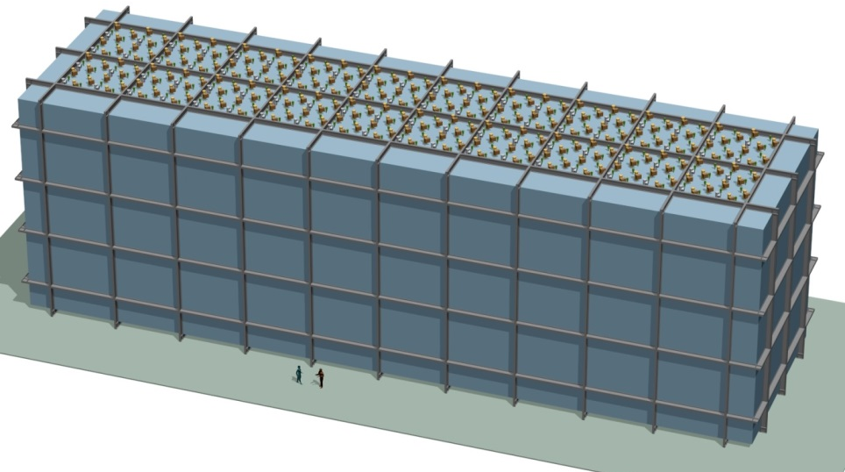
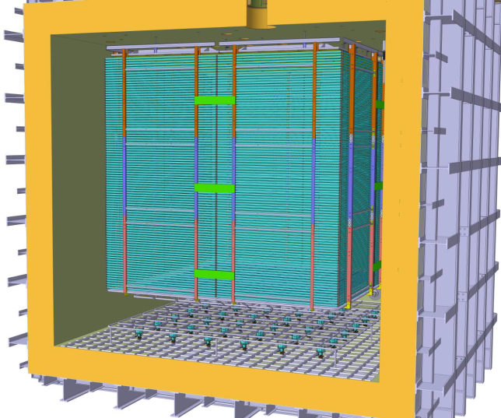
IN2P3 activities in DUNE
Dario Autiero, IPNL Lyon
LAL, 23/1/2018
DUNE
10 kton module
WA105
Dual-Phase ProtoDUNE

Slide 2
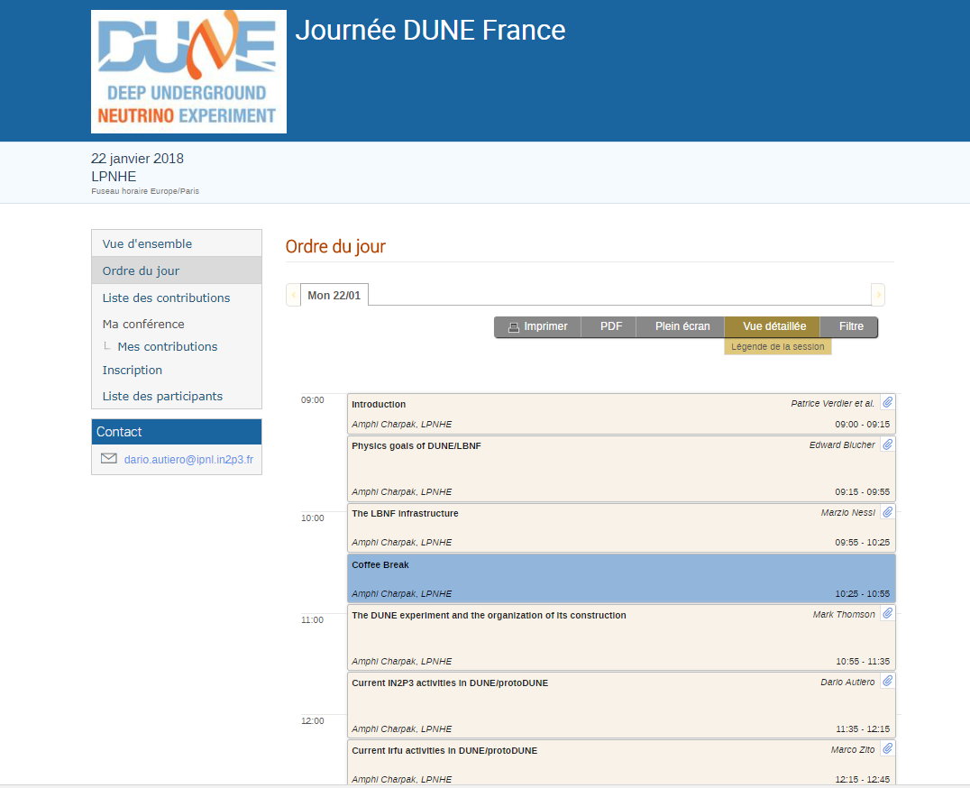

Slide 3
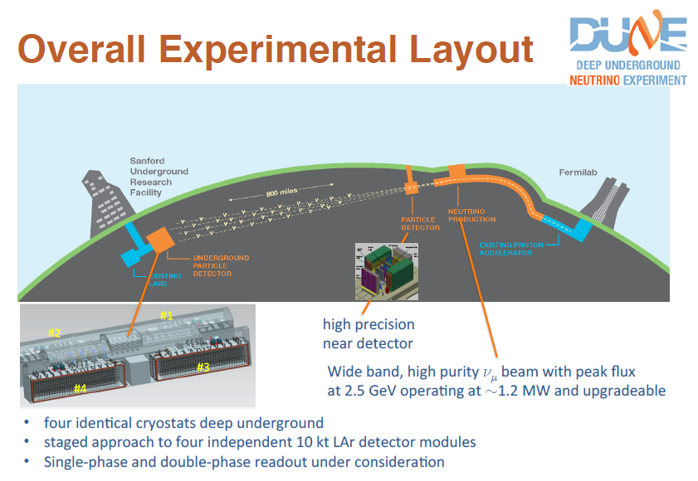
1.2 – 2.4 MW
40 kton FD mass
Operation since 2026

Slide 4
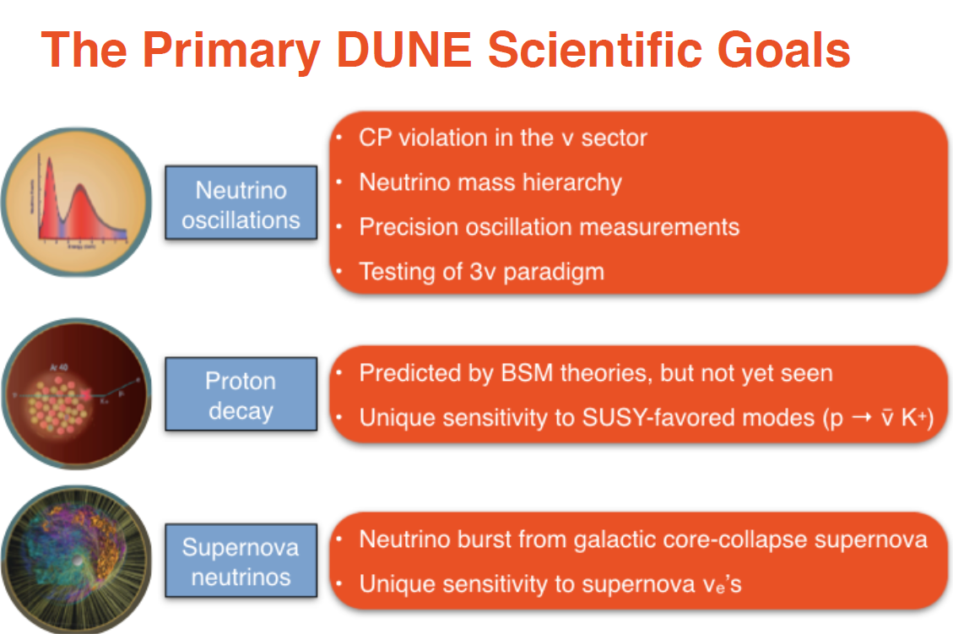

Slide 5
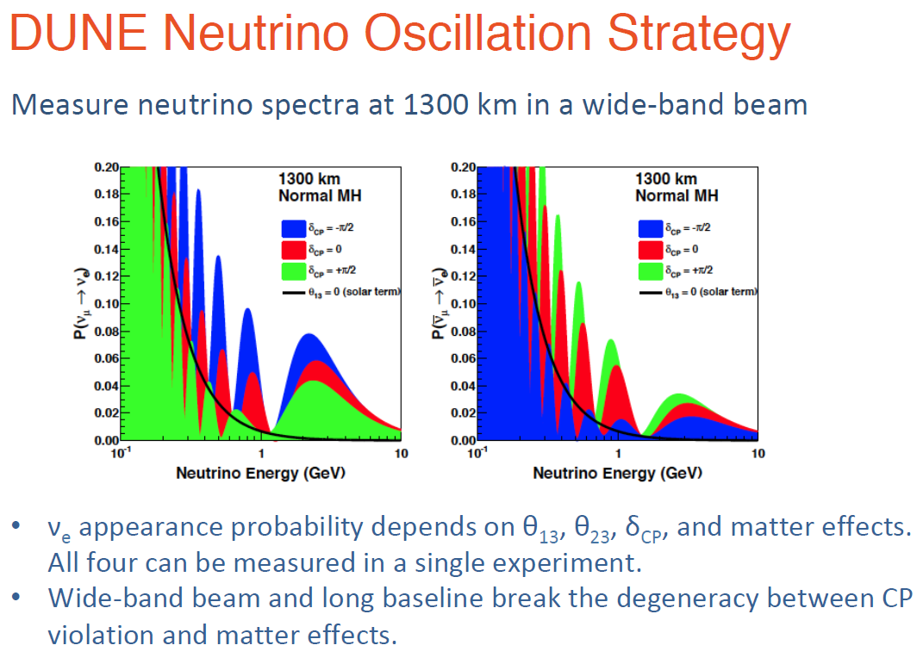

Slide 6
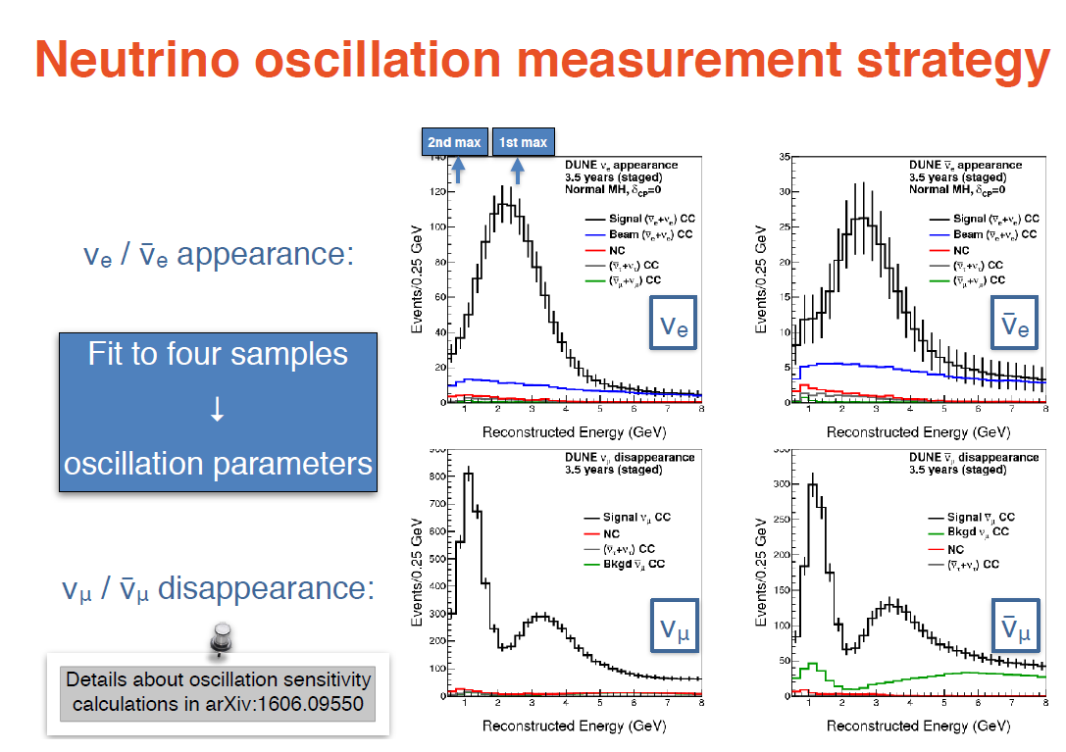

Slide 7
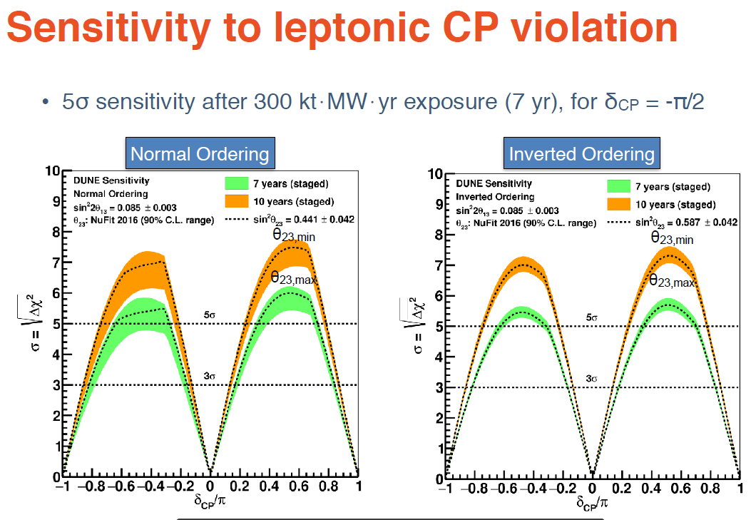

Slide 8
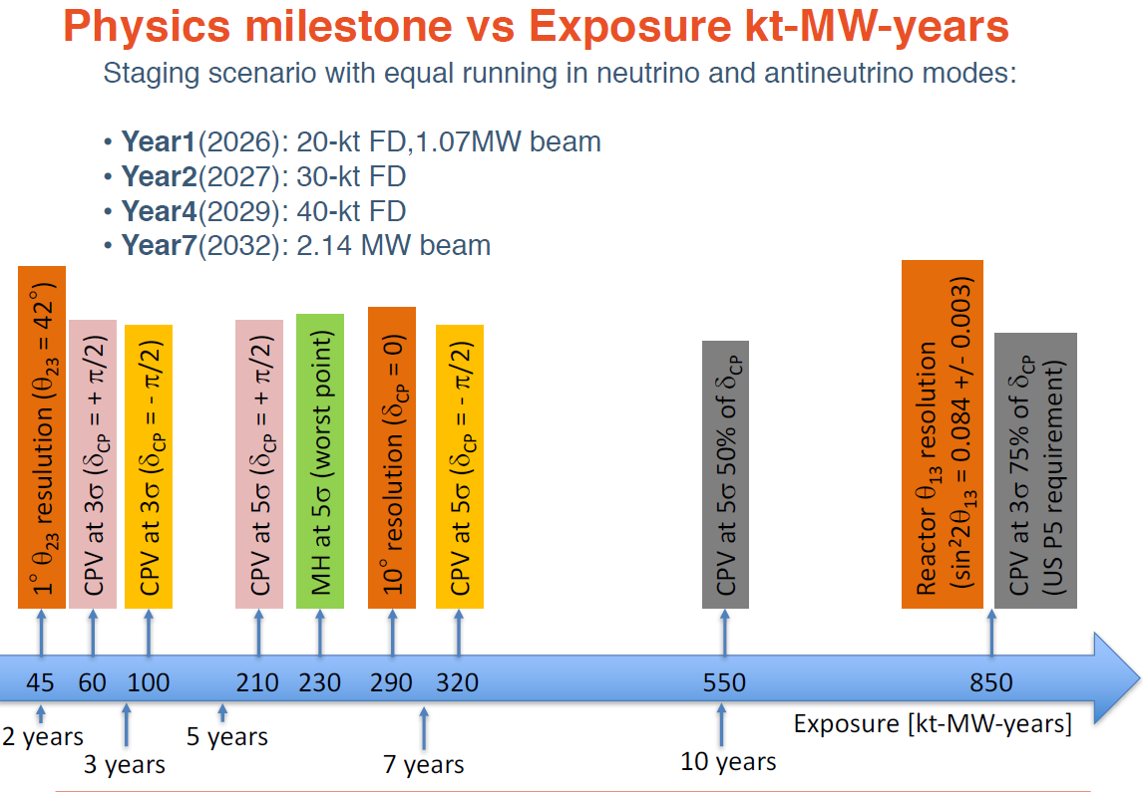

Slide 9
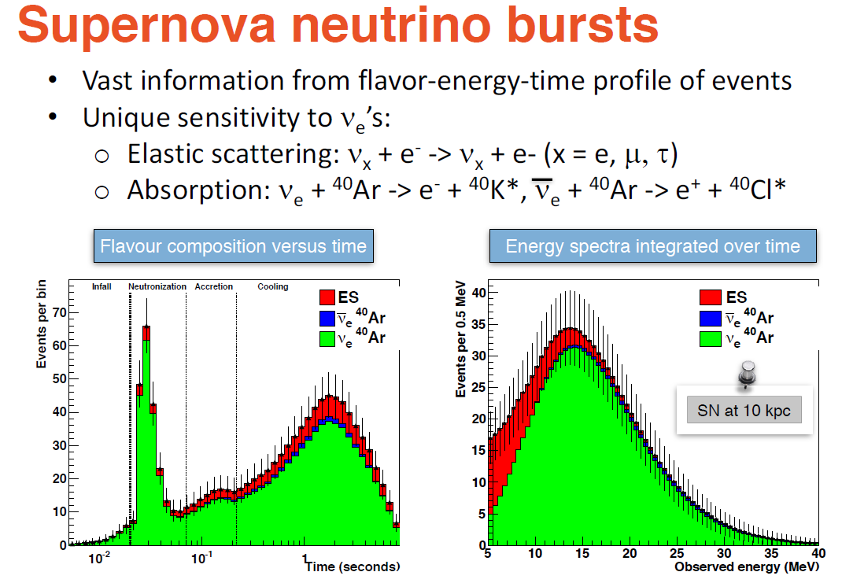

Slide 10
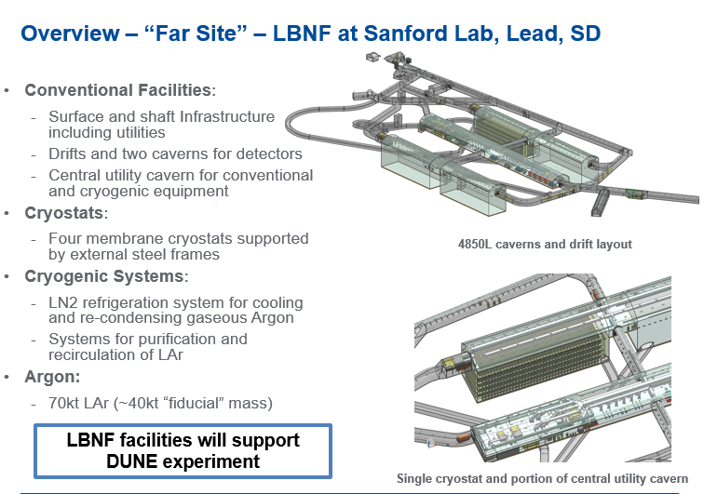

Slide 11
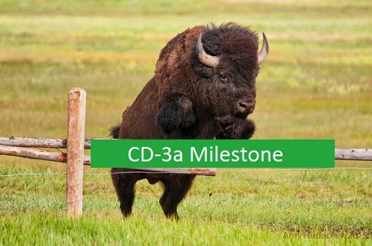
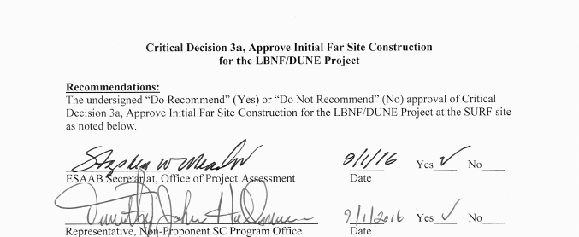
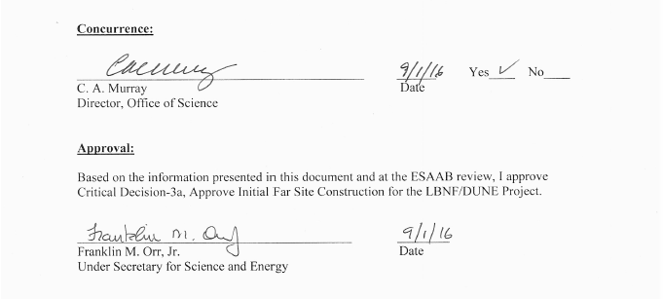
LBNF CD-3a – Approval of Initial Far Site Construction
On September 1st 2016, DOE Under Sec’ty for Science and Energy approved the CD-3a milestone
Paves the way to start ~$300M in construction at far site in FY17
Signifies DOE's strong commitment to move the project forward, solidify international partnerships, and position DUNE to rapidly pursue its science objectives.

Slide 12
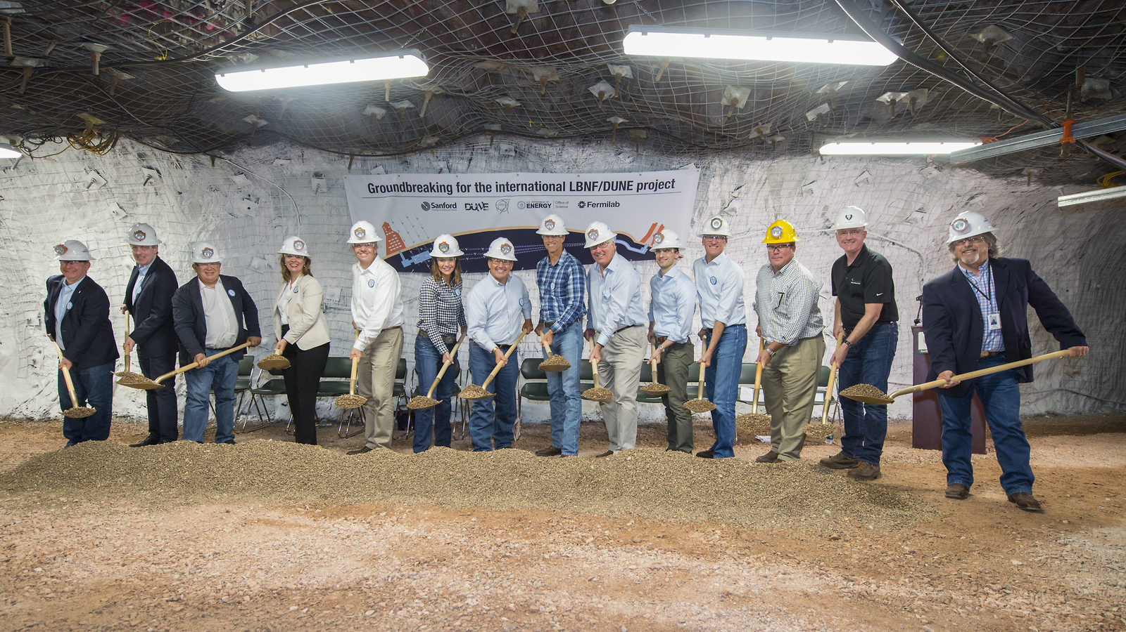
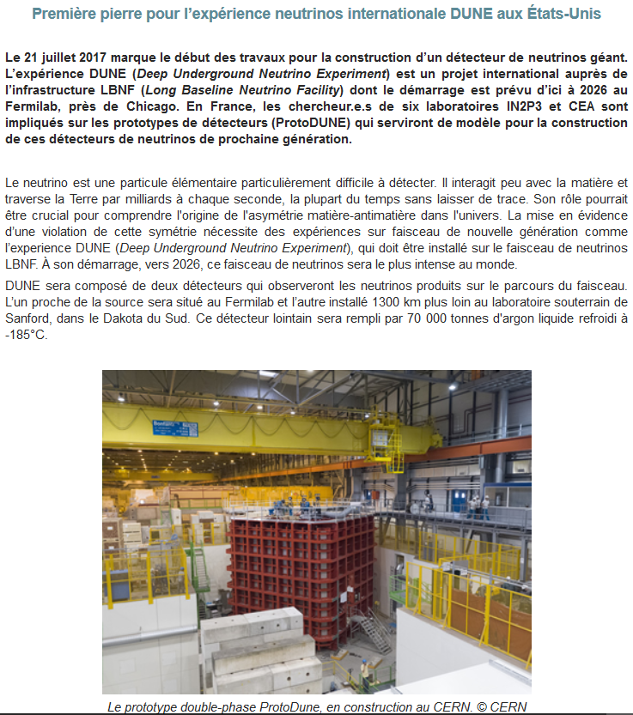
LBNF Groundbreaking 21/7/2017
→ Start of civil engineering works for LBNF
http://www.in2p3.fr/recherche/actualites/2017/nouvelle_experience_dune.html
http://news.fnal.gov/2017/07/construction-begins-international-mega-science-experiment-understand-neutrinos/

Slide 13
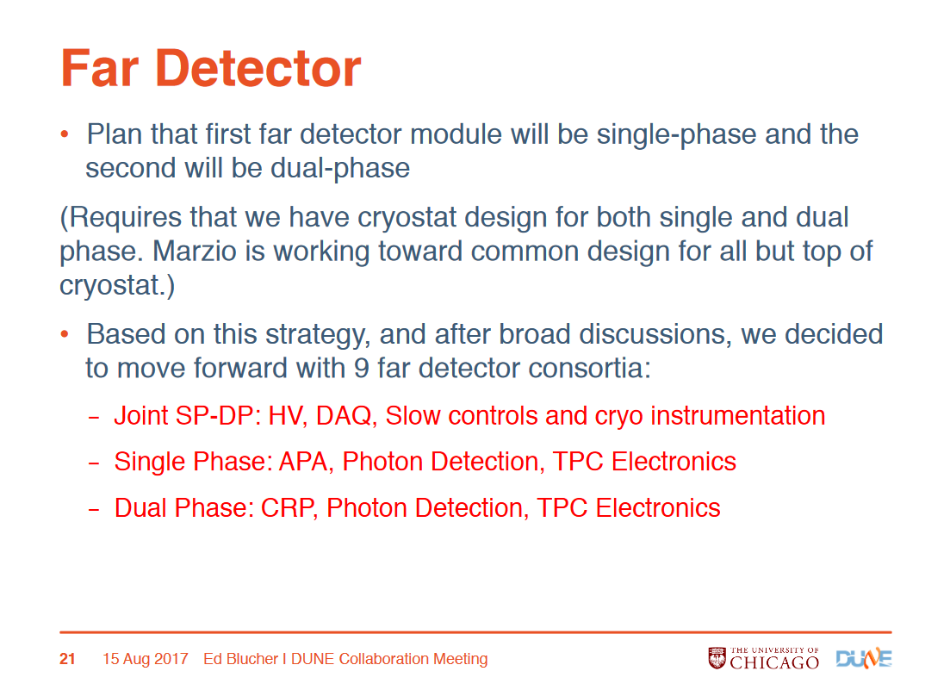
Creation of FD consortia July-August

Slide 14
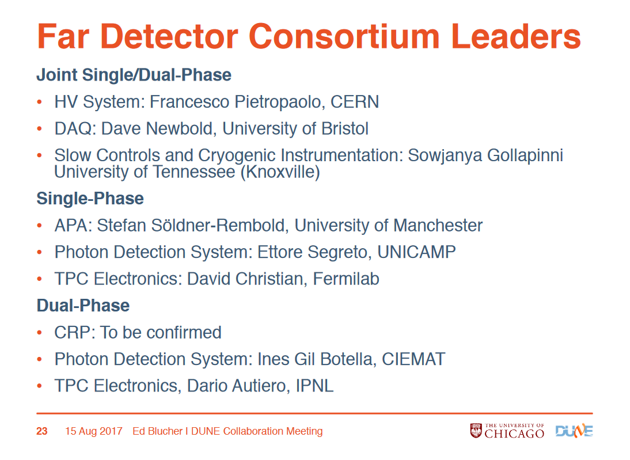

Slide 15
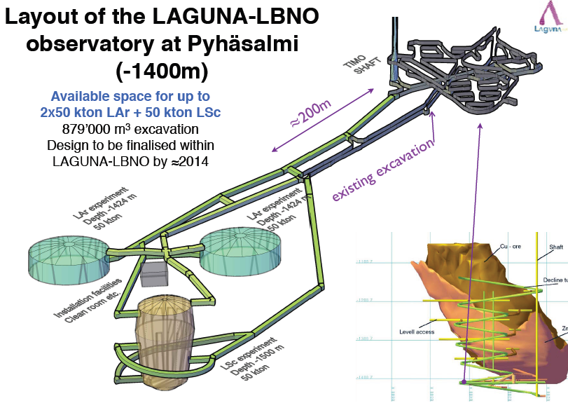
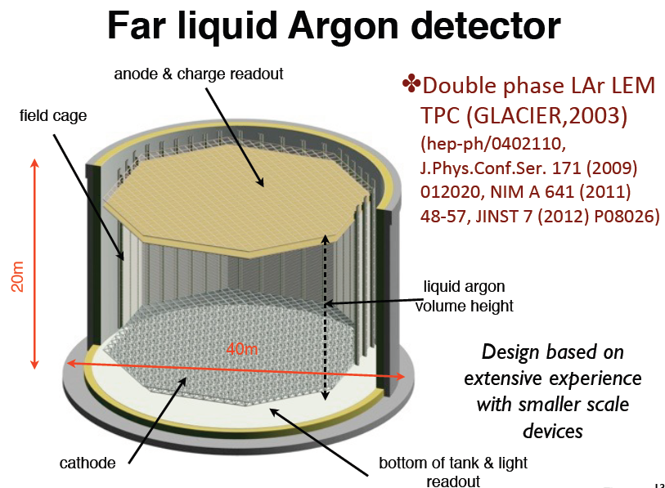
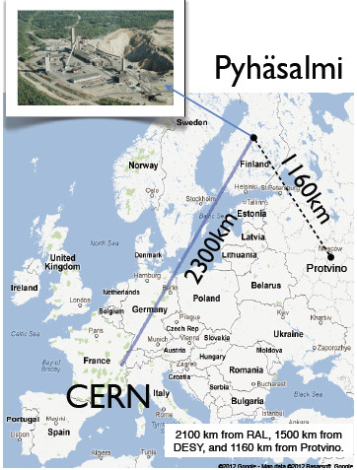
LAGUNA-LBNO Design Study:
2 EU programs: 2008-2011/2011-2014
~17 Meur investment
Completed August 2014
Prototyping activity for dual-phase since 2003
LBNO EOI June 2012 (CERN to Pyhasalmi)
http://cdsweb.cern.ch/record/1457543
224 physicists, 52 institutions
Physics program:
Determination of neutrino mass hierarchy
Search for CP violation
Proton decay
Atmospheric and supernovae neutrinos
LBNO Phase I:
20 kton
dual-phase LAr TPC

Slide 16
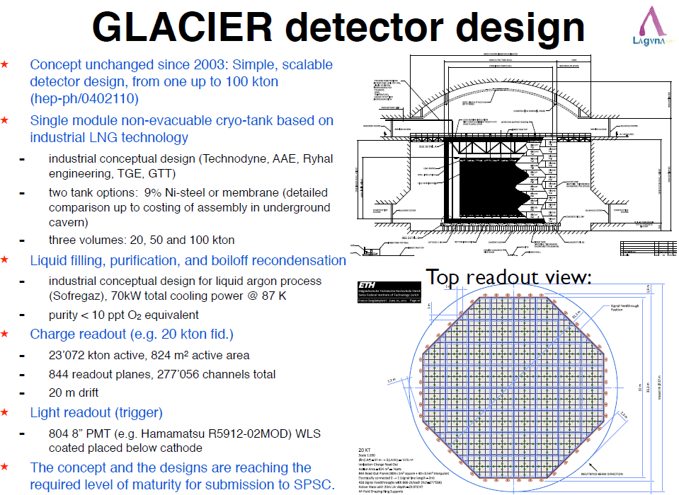
Technical aspects finalized in the LAGUNA-LBNO study as deliverables in view of
Building an affordable LAr underground detector → August 2014

Slide 17

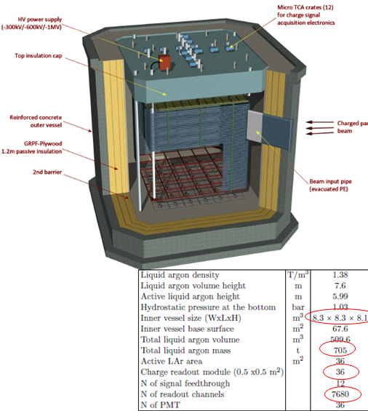
The LBNO-DEMO/WA105 experiment at CERN (approved in 2013)
→ 1/20 of 20 kton LBNO detector
6x6x6m³ active volume, 300 ton , 7680 readout channels, LAr TPC (double phase+2-D collection anode): DLAr
Exposure to charged hadrons, muons and electrons beams (0.5-20(10) GeV/c)
Full-scale demonstrator of all innovative LAGUNA-LBNO technologies for a large LAr detector:
LNG tank construction technique (with non evacuated vessel)
Purification system
Long drift
HV system 300-600 KV, large hanging field cage
Large area double-phase charge readout
Accessible FE and cheap readout electronics
Long term stability of UV light readout
Assess performance in reconstructing hadronic showers (most demanding task in neutrino interactions):
Measurements in hadronic and electromagnetic calorimetry and PID performance
Full-scale software development, simulation and reconstruction to be validated and improved
Installation in the CERN NA EHN1 extension, data taking in 2018
→ Fundamental step for the construction of a large LAr detector

Slide 18

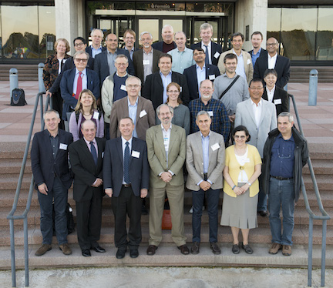
Joint USA-Europe initiative for a common long-baseline experiment (E)LBNF
based on the liquid argon TPC technology
Very quick developments since July 2014:
Top priority of the USA P5 committee (HEP strategy in the USA) May 2014
→ Reformulation of the program
APPEC Meeting on Neutrino Infrastructures Paris June 2014
August 2014: creation of an Interim International Executive Board (IIEB) for LBNF chaired by the Fermilab Director N. Lockyer
→ gathering the collaboration (ELBNF LOI)
January 2015: Presentation of the LOI to the FNAL PAC (LBNF (facility) + ELBNF (experiment): 40 kton at Homestake (1300 km from FNAL), 1.2 MW beam upgradable to 2.4 MW, first 10 kton module in 2021, excavation works start in 2017
March 2015: Election of the two co-Spokesperson and choice of the final name for ELBNF: DUNE

Slide 19
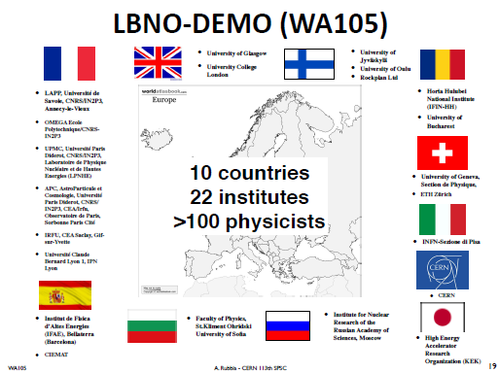
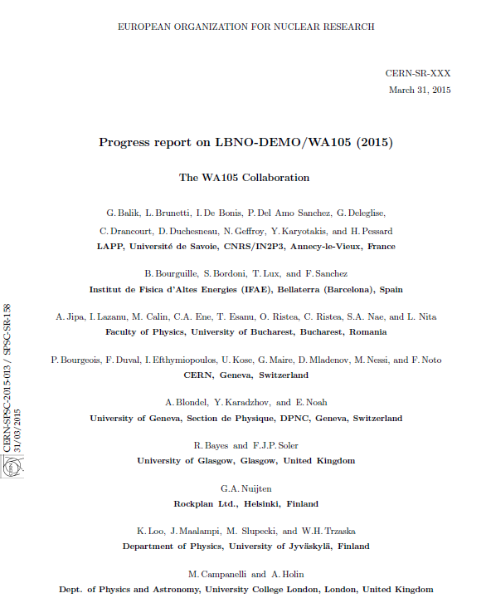
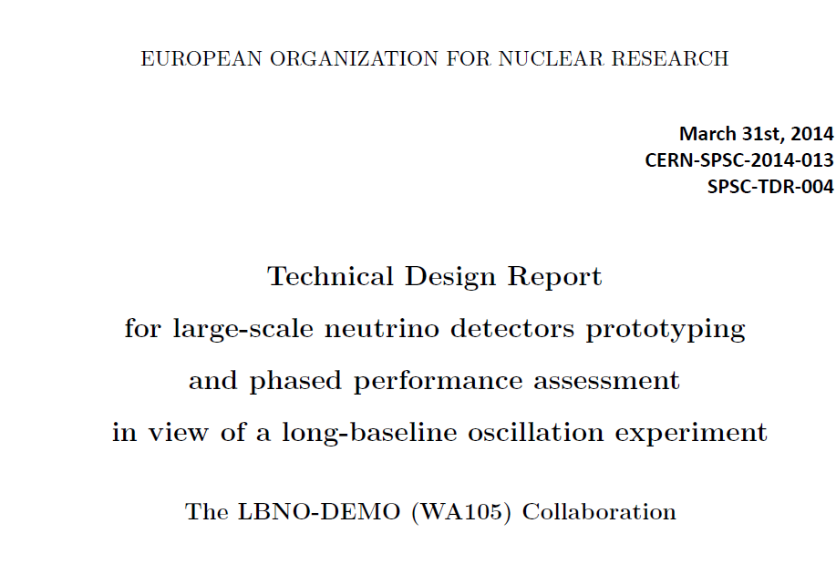
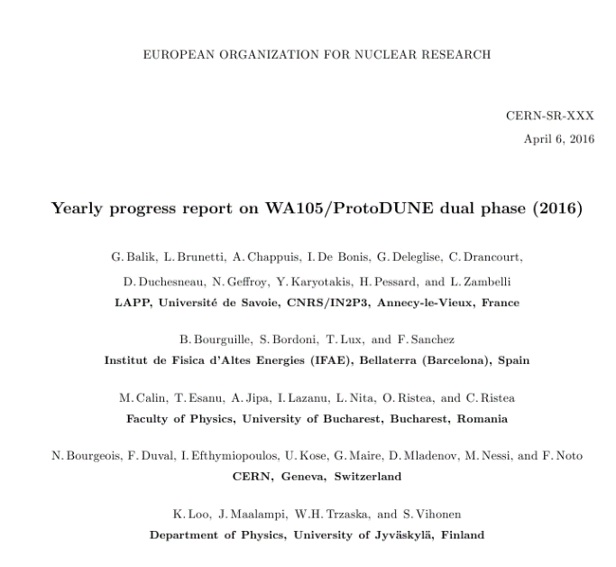
WA105 Technical Design Report:
History of Dual-Phase ProtoDUNE / WA105
2015 Annual SPSC progress report 31st March 2015 SPSC-SR-158
Project started in 2013 (CERN RB approval) following the submission of LBNO Expression of Interest
Collaborators from 10 countries
and 22 institutes
DUNE CDR, July 2015: WA105 and Dual-phase
10 kton design
WA105 project MOU fully signed, December 2015
Integration in the DUNE project as ProtoDUNE-DP
December 2015; EOI call for ProtoDUNEs, January 2016
2016 Annual SPSC progress report, April 7th 2016
CERN-SPSC-2016-017
SPSC-SR-184
Systematic LBNC reviews since beginning of 2016
TDR:
submitted on 31st March 2014
CERN-SPSC-2014-013
SPSC-TDR-004(2014)
2017 Annual SPSC progress report, April 4th 2017
CERN-SPSC-2017-011
SPSC-SR-206
19
Technical Design Review April 2017

Slide 20
Strong involvement of IN2P3 groups in DUNE (physics, computing, detector developments, coordination) past/present roles:
D.Autiero member of the DUNE Executive Committee, Consortium leader for DP-electronics , ProtoDUNE-DP co-coordinator
D. Duchesneau member of Speakers Committee, ProtoDUNE-DP co-coordinator, technical lead in the DP photon detection consortium
S. Galymov deputy coordinator of detector optimization task-force
Y. Karyotakis co-coordinator of joint SP-DP beamline instrumentation WG
T. Patzak co-coordinator of LBL WG, chair of Speakers Committee,
E. Pennacchio, ProtoDUNE-DP Computing Liaison
A. Tonazzo co-coordinator of atmospheric neutrinos WG
Hardware responsibilities in WA105/ProtoDUNE-DP (WA105 MOU signed in 2015)
APC+OMEGA+LAPP: light readout electronics
IPNL: Front-end analog cryogenic electronics, digital electronics, DAQ, online computing
LAPP: Charge Readout Planes hanging system, Charge Readout Planes mechanical frames design, beam instrumentation
LPNHE cathode HV feedthrough

Slide 21
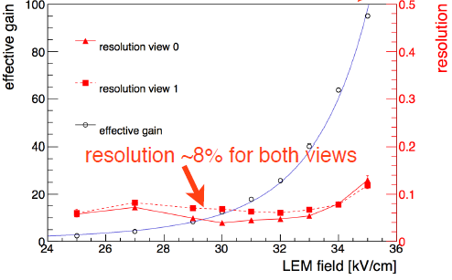
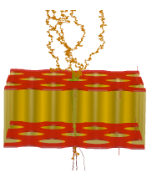
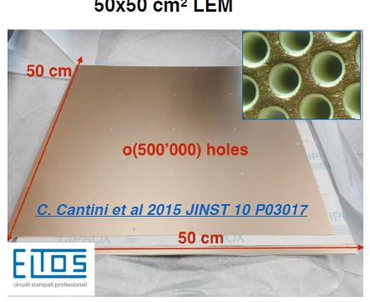
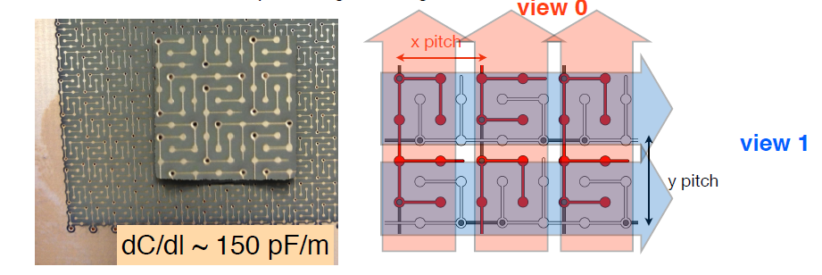
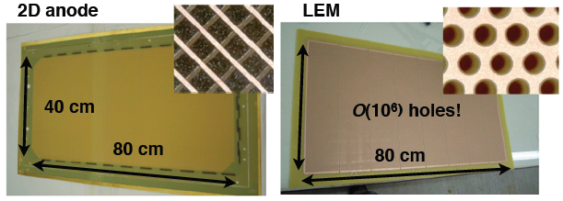
Dual-phase readout:
Long drift, high S/N: extraction of electrons from the liquid and multiplication with avalanches in pure argon with micro-pattern detectors like LEM (Large Electron Multipliers)
Tunable gain (~20 minimum), two symmetric collection views, coupling to cold electronics
Anode 0V
2 mm
Collection field 5 kV/cm
LEM (1mm)
25-35 kV/cm
GAr
Extraction field 2 kV/cm
1 cm
Grid
LAr
Drift field 0.5-1 kV/cm
500 um holes
800 um pitch
Anode PCB

Slide 22
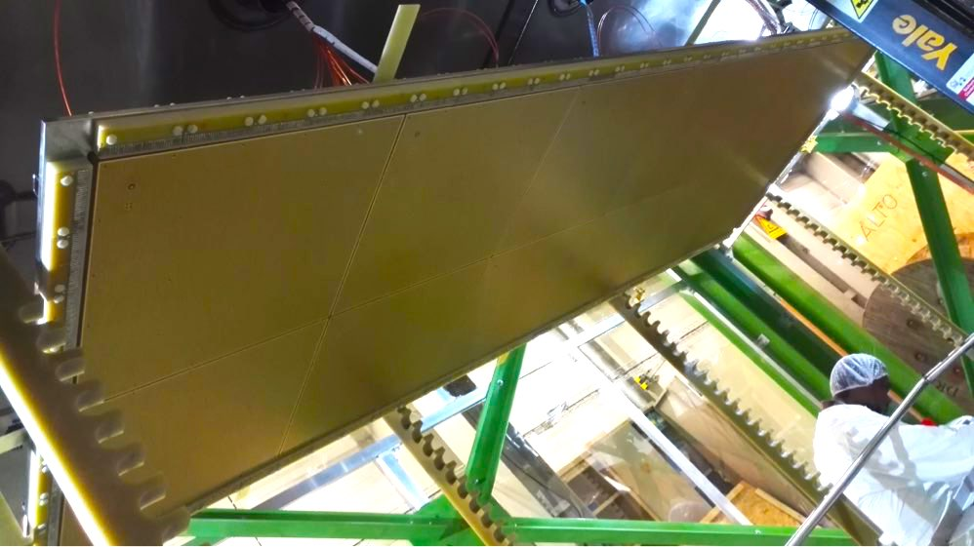
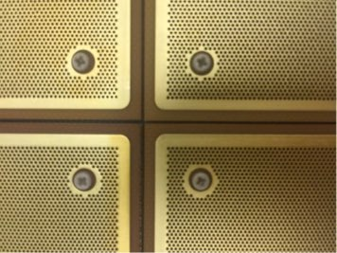

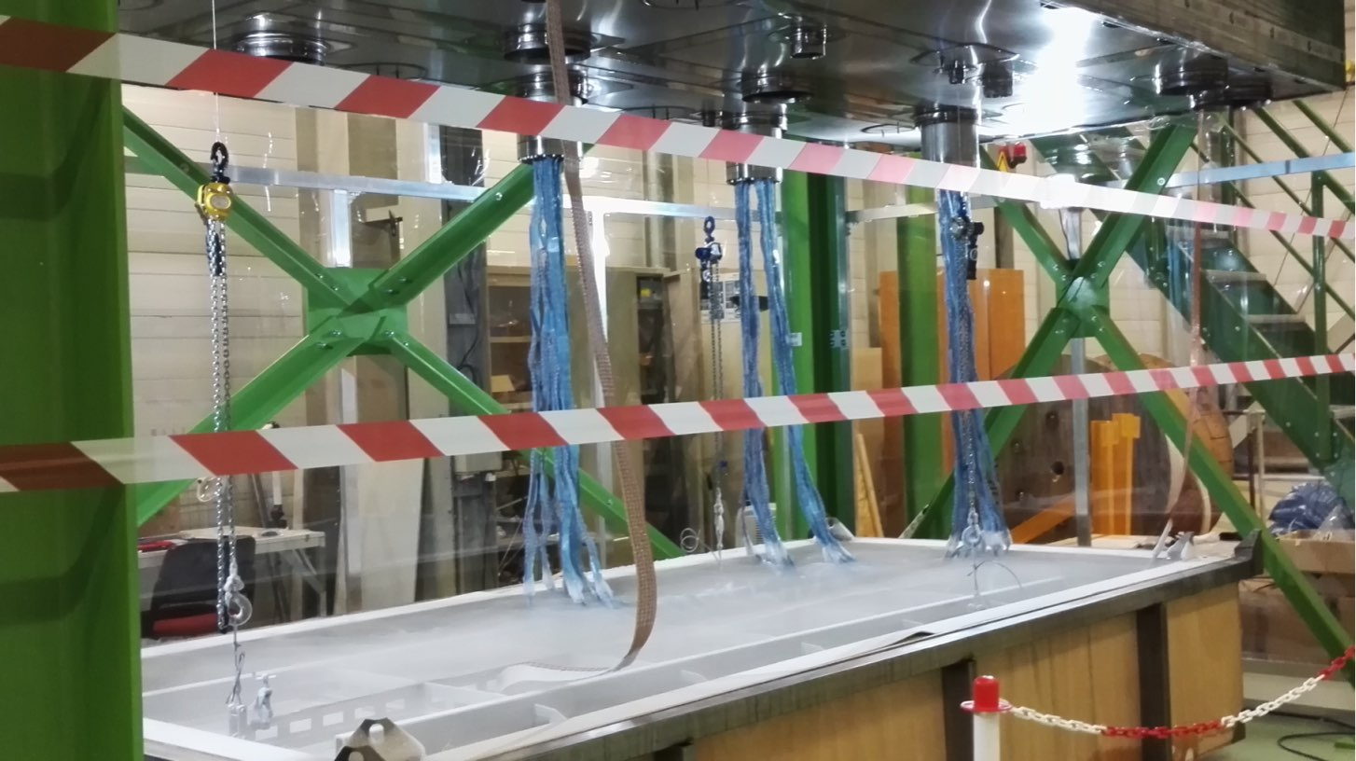
3x1x1 CRP in May 2016 and cold bath test with photogrammetry:
Active area
50 cm
50 cm

Slide 23
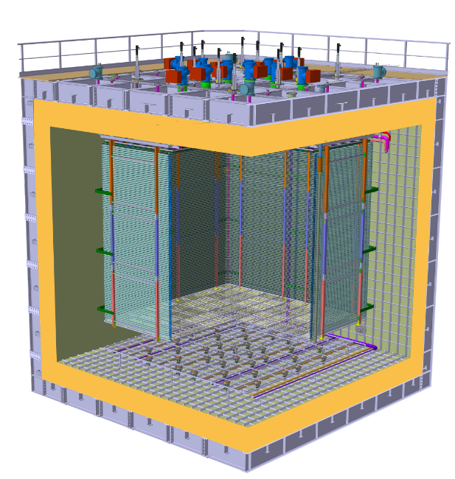
Detector–Cryostat integration
Finalization by the end of November 2016 of executive design of: CRPs, field-cage and cathode
ProtoDUNE-DP Technical Design Review on April 24th-25th
https://indico.cern.ch/event/617300/
4 Charge Readout Planes
6 m
Field Cage (common structural elements with SP)
Cathode
6 m
36 cryogenic photomultipliers Hamamatsu R5912-02mod with TPB coating

Slide 24
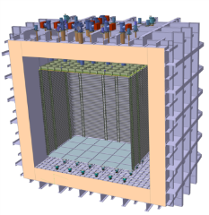
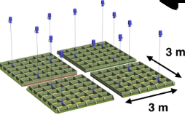
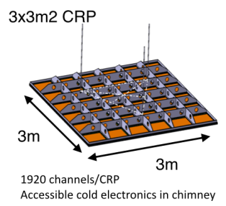
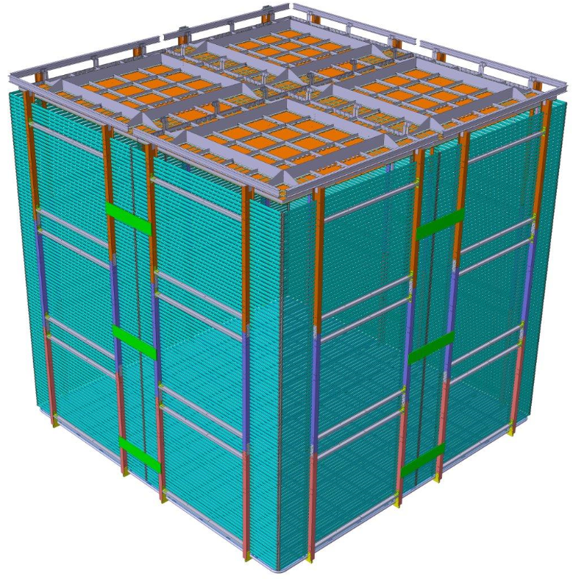
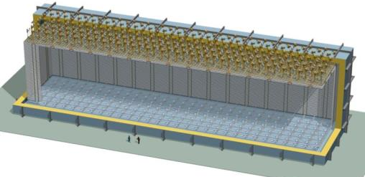
The Dual-Phase ProtoDUNE/WA105 6x6x6 m³ detector is built out of the same 3x3m² Charge Readout Plane units (CRP) foreseen for the 10 kton Dual-Phase DUNE Far Detector (same QA/QC and installation chains)
WA105: 4 CRP
10 kton: 80 CRP
6 m
12 m
6 m
6 m
60 m
24

Slide 25
Dual phase liquid argon TPC
6x6x6 m³ active volume
ProtoDUNE-DP at CERN
Event size: drift window of
7680 channels x 10000 samples ⇒ 146.8 MB
X and Y charge collection strips
3.125 mm pitch, 3 m long →7680 readout channels
Segmented anode
in gas phase with
dual phase amplification
3 m
E=0.5-1.0 kV/cm
Drift coordinate
6 m = 4 ms
sampling 2.5 MHz
(400 ns), 12 bits
10000 samples
per drift window
LAr volume
Drift
dE/dx → ionization
Prompt UV
light
6 m
6 m
Cathode
Photomultipliers
25

Slide 26
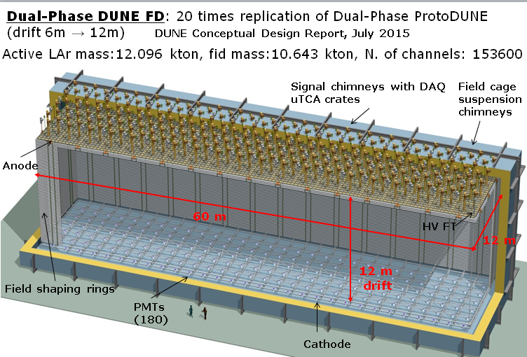
Dual-phase 10 kton FD module
80 CRP units
60 field shaping rings
240 signal FT chimneys
240 suspension chimneys
~1000 PMTs
153600 readout channels
Advantages of double-phase design:
Anode with 2 collection (X, Y) views (no induction views), no ambiguities
Strips pitch 3.125 mm, 3 m length
Tunable gain in gas phase (20-100), high S/N ratio for m.i.p. > 100, <100 KeV threshold, min. purity requirement 3ms → operative margins vs purity, noise
Long drift projective geometry: reduced number of readout channels
No materials in the active volume
Accessible and replaceable cryogenic FE electronics, high bandwidth low cost external uTCA digital electronics

Slide 27
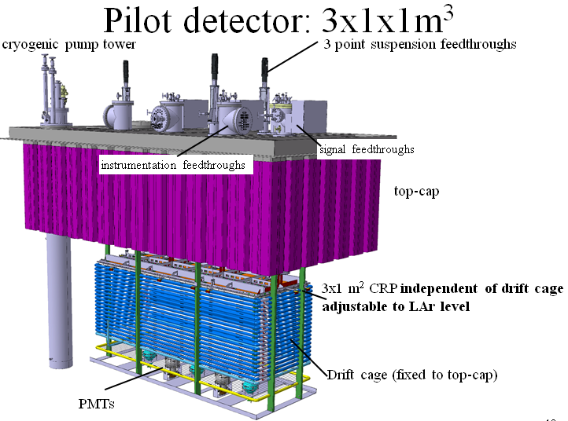
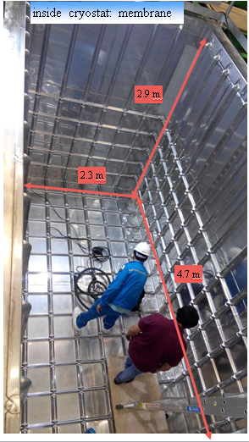
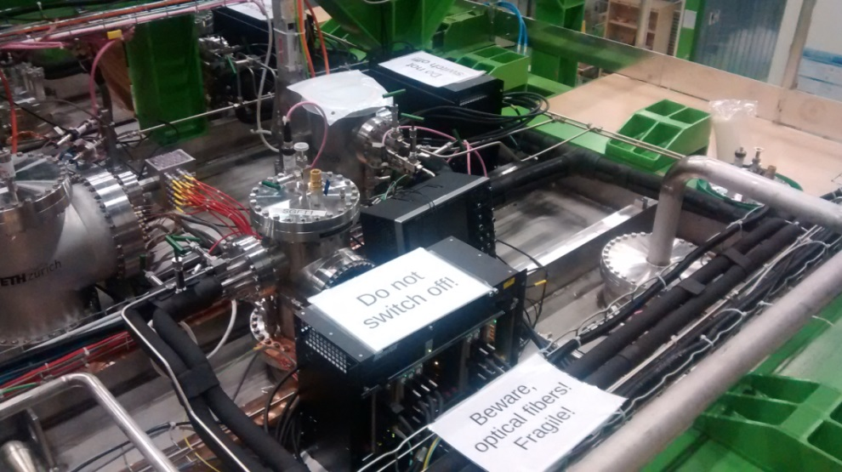
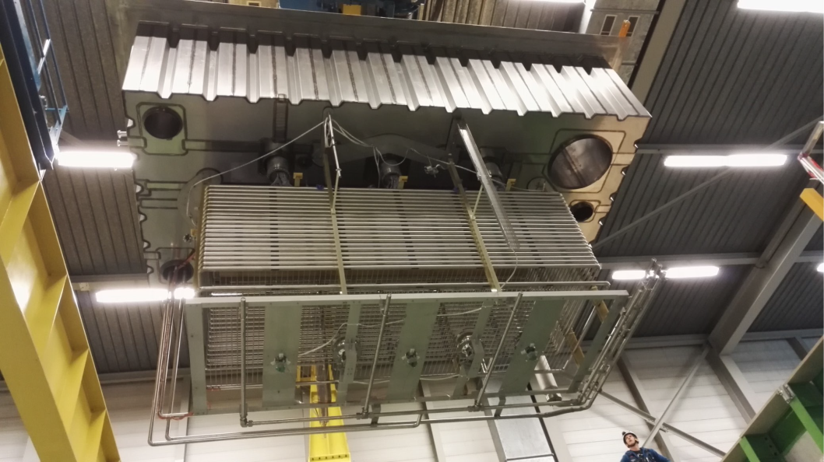
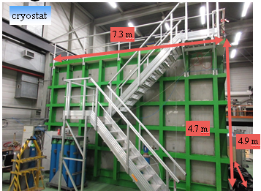
Detector installation completed during the fall 2016

Slide 28
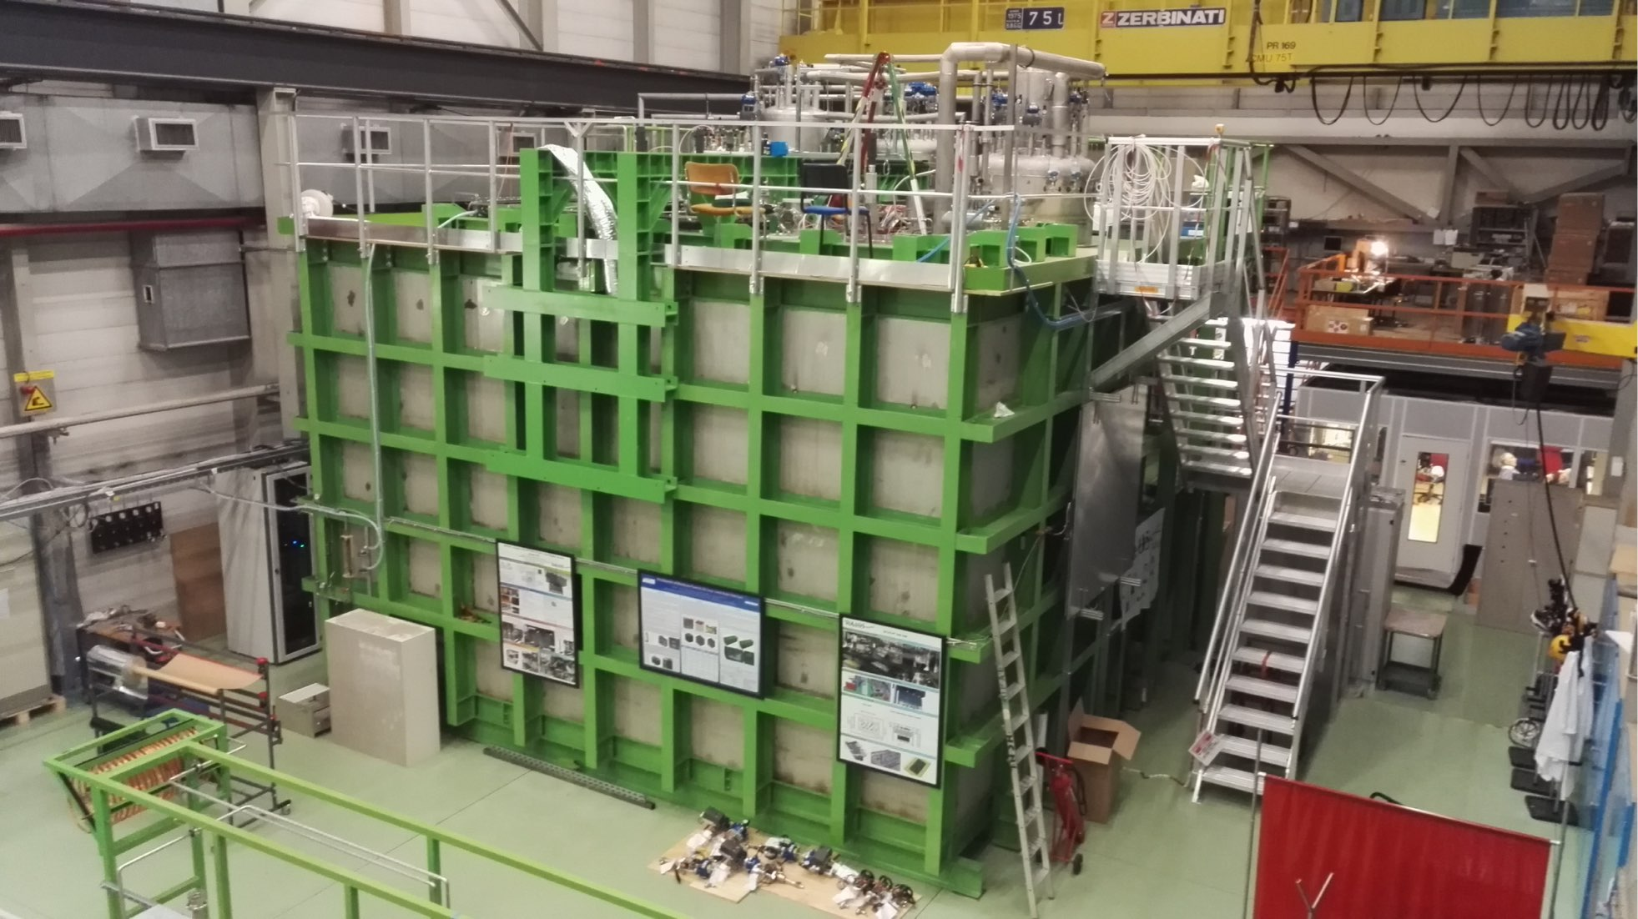
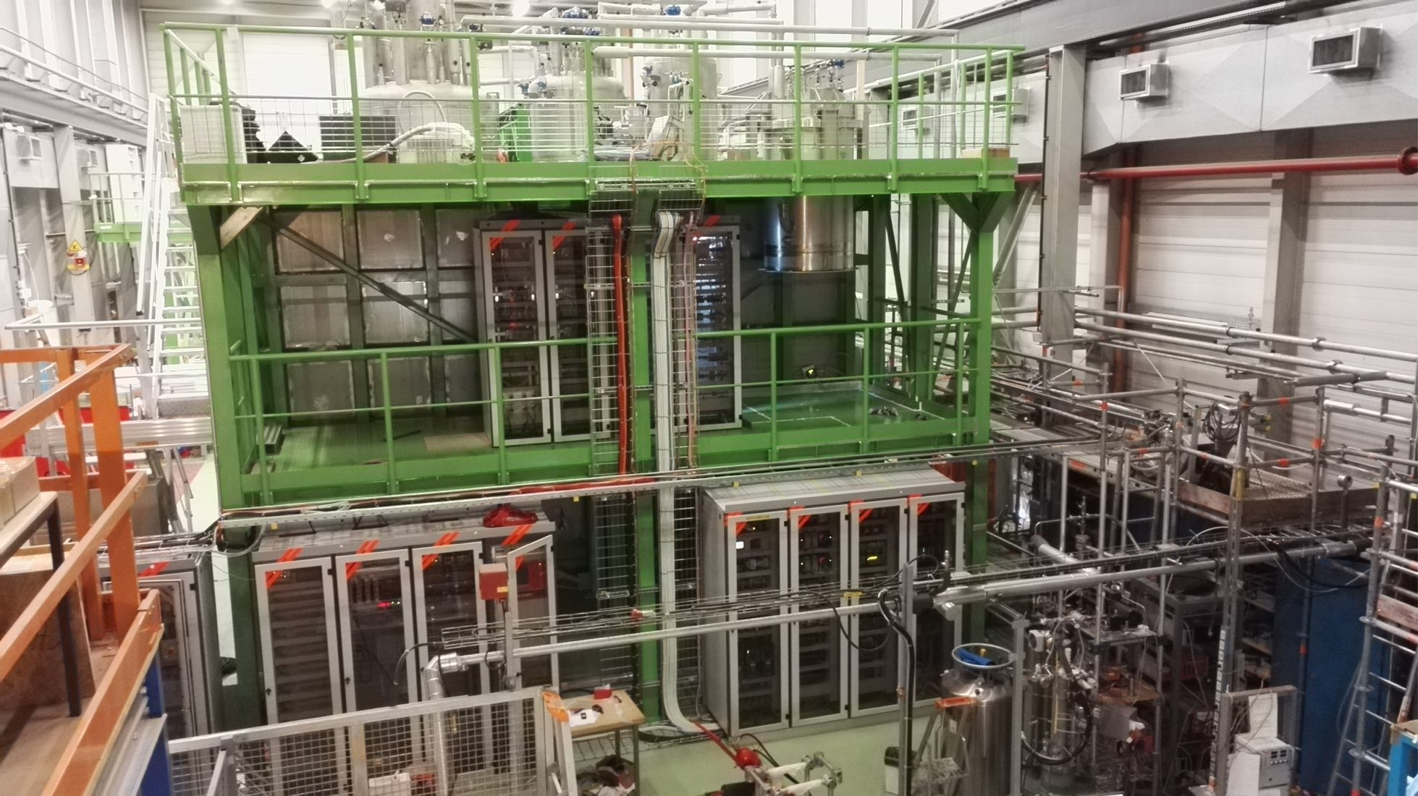
3x1x1 detector installation completed by in the fall 2016
Cryostat: first prototype of GTT membrane cryostat with steel structure for DUNE
Detector operation after cryogenic commissioning: June-November 2017

Slide 29


Gas purity evolution during purging (open and closed loop) and cool-down:
→ oxygen, nitrogen and moisture under control; no evidence for large outgassing or leaks
Liquid purity estimated with charge attenuation along reconstructed tracks > 7 ms lifetime
(original goal > 3 ms)

Slide 30


3x1x1 cosmic ray events:
All data available at CERN and FERMILAB and reconstructed with LARSoft

Slide 31







ProtoDUNE-DP accessible cold front-end electronics and uTCA DAQ system 7680 ch
(IPNL)
Full accessibility provided by the double-phase charge readout at the top of the detector
Digital electronics at warm on the tank deck:
Architecture based on uTCA standard
1 crate/signal chimney, 640 channels/crate
→ 12 uTCA crates, 10 AMC cards/crate, 64 ch/card
Cryogenic ASIC amplifiers (CMOS 0.35um) 16ch externally accessible:
Working at 110K at the bottom of the signal chimneys
Cards fixed to a plug accessible from outside
→Short cables capacitance, low noise at low T
Warm
FE cards mounted on insertion blades
ASICs 16 ch.
(CMOS 0.35 um)
uTCA crate
Cold
CRP
Signal chimney
31

Slide 32


Cost effective and fully accessible cold front-end electronics and DAQ
Ongoing R&D since 2006→ entered in production phase for 6x6x6 (7680 readout channels)
ASIC (CMOS 0.35 um) 16 ch. amplifiers working at
~110 K to profit from minimal noise conditions:
FE electronics inside chimneys, cards fixed to a plug accessible from outside
Distance cards-CRP<50 cm
Dynamic range 40 mips, (1200 fC) (LEM gain =20)
1300 e- ENC @250 pF, <100 keV sensitivity
Single and double-slope versions
Power consumption <18 mW/ch
Produced at the end of 2015 in 700 units (entire 6x6x6)
DAQ in warm zone on the tank deck:
Architecture based on uTCA standard
Local processors replaced by virtual processors emulated in low cost FPGAs (NIOS)
Integration of the time distribution chain (improved PTP)
Bittware S5-PCIe-HQ 10 Gbe backend with OPENCL and high computing power in FPGAs
Production of uTCA cards started at the end of 2015, pre-batch to be deployed on 3x1x1
ASIC 16 ch.
(CMOS 0.35 um)
Large scalability (150k channels for 10kton) at low costs

Slide 33




Cold front-end electronics
ASIC under testing
Accessible via chimneys without opening of the TPC cryostat and shielded from digital electronics
R&D on cryogenic ASIC since 2006 (9 versions produced 6 for SP and 3 adapted to DP dynamics)
Preamplifier ASIC final version (3 dual phase versions produced): 16 channels, Double slope gain with “kink” at 400 fC, 1200 fC dynamic range
Full production of 700 chips performed in Sep. 2015 (covers fully 7680 ch required for 6x6x6), acceptance batch of 25 circuit tested in Jan 2016 → good performance measured
Design and production of 64 ch front-end cards completed as well as operation tests in the 3x1x1 chimneys
Measured ENC as a function of C_{det}
Anode capacitance is 150 pF/m ➔ 450 pF for a 3x3m² module: expected noise = 1600 ENC
For LEM equivalent gain of 20 (10 per each view)
S/N ~ 100 for 1MIP signal

Slide 34

Charge readout AMC:
Components:
X8 ADC AD9257 14 bits, x2 Dual port memories IDT70V3339, ALTERA Cyclone V with NIOS
Features:
64 channels, 2.5 MHz sampling, 12 bits output, lossless Huffman-like compression (factor 10), 10 Gbit/s connectivity. Interface with the White-Rabbit and trigger timestamps transmission via dedicated lines and protocol on the uTCA backplane
DAQ in protoDUNE-DP based on transmitting drift windows on the basis of external triggers
Working mode foreseen for DUNE: continuous streaming
10 cards/crate → 640 channels/crate on a 10 Gbit/s optical link to DAQ back-end

Slide 35




Analog cryogenic FE:
Full production 700 chips of cryogenic ASIC amplifiers procured at the beginning of 2016
64 channels FE cards with 4 cryogenic ASIC amplifiers designed and tested in the spring 2016
First batch of 20 cards (1280 channels) produced for the 3x1x1 operation, operational
Production of remaining 100 cards for 6x6x6 on 2017 budget
Digitization cards:
uTCA 64 channels AMC digitization cards (2.5 MHz, 12 bits output, 10 GbE connectivity)
20 cards produced by September 2016 to equip the 3x1x1, operational
Production of remaining 100 cards for the 6x6x6 on the 2017 budget
(main card components ADCs, FPGAs, IDT memories, already purchased in 2015 for the entire 6x6x6 production)
White Rabbit timing/trigger distribution system:
Components produced in 2016 for the entire 6x6x6, system operational on the 3x1x1

Slide 36

Global uTCA DAQ architecture for ProtoDUNE-DP
integrated with « White Rabbit » (WR) Time and Trigger distribution network
+ White Rabbit slaves nodes in uTCA crates +
WR system (time source, GM, trigger system, slaves)

Slide 37

6x6x6: 12 uTCA crates (120 AMCs, 7680 readout channels)
3x1x1: 4 uTCA crates (20 AMCs, 1280 readout channels) Operational since fall 2016
Event builder, network, GPS/White Rabbit GM,
WR Trigger PC
Signal Chimneys and uTCA crates

Slide 38

DAQ system of 3x1x1

Slide 39



White Rabbit trigger time-stamping PC (SPEC + FMC-DIO)
White Rabbit Grand-Master
GPS unit
White Rabbit uTCA slave node based on WRLEN developed and produced for entire 6x6x6
Other components of the chain (GPS receiver, WR grandmaster, SPEC+ FMC-DIO + 13 WRLEN ) available commercially

Slide 40

How a crates was looking like before VHDCI signals cabling to the warm flange
WR uTCA slave
card node with WRLEN mezzanine
MCH
AMC 64 channels
digitization cards
10 Gbit/s data link
White Rabbit optical link

Slide 41




Top cap picture with uTCA crates cabled to signal chimneys
Run control with 20 AMCs
Automatic data processing on online storage/processing farm for purity and gain analysis + data transfer on EOS
Stable system, noise conditions 1.5-1.7 ADC counts RMS

Slide 42

Typical event signature for ground surface Liquid Ar TPC operation
For each beam trigger we can have on average 70 cosmics overlapped on the
drift window after the trigger (these cosmics may have interacted with the detector in the
4 ms before the trigger and in the 4 ms after the trigger → chopped tracks, “belt conveyor” effect
Example of cosmics only event
(in one of the views)

Slide 43


Electronics for the Light readout (APC-OMEGA-LAPP)
36 cryogenic photomultipliers Hamamatsu R5912-02mod at the bottom of the tank 1 PMT/1m²
Development (APC-OMEGA) of the trigger card mezzanine based on the PARISROC2 ASIC.
→ Mezzanine cards tested and produced
Finalization in progress of uTCA light readout digitization boards (APC+LAPP) based on Bittware S4AM (the same card as used in the charge readout demonstrator made at IPNL in 2015),
9 read channels/uTCA board,
Foreseen for the 10 kton: full integration of trigger mezzanine card on final uTCA card derived from the final charge readout card to get the timing information from WR and send data to DAQ

Slide 44

During spills it is needed a continuous digitization of the light in the +-4 ms around the trigger time (the light signal is instantaneous and keeps memory of the real arrival time of the cosmics)
→ Sampling can be coarse up to 400 ns just to correlate to charge readout
→ Sum 16 samples at 40MHz to get an effective 2.5 MHz sampling like for the charge readout
The LRO card has to know spill/out of spill
Out of spill it can define self-triggering light triggers when “n” PMTs are over a certain threshold and transmit its
time-stamp over the WR

Slide 45


Online processing and storage facility: internal bandwidth 20 GB/s, 1 PB storage, 384 cores: key element for online analysis (removal of cosmics, purity, gain, events filtering)
Smaller test scale system of online storage/processing already installed and operative for 3x1x1 since last fall
→ Useful to perform tests to finalize the architecture of final online storage/processing facility.
C.R. stands for Counting Room

Slide 46


Slide 47


High bandwidth (20GBytes/s) distributed EOS file system for the online storage facility
Storage servers recovered from CCIN2P3: 20 machines + 5 spares, installed at CERN on September 10th (DELL R510, 72 TB per machine) up to 1.44 PB total disk space for 20 machines, 10 Gbit/s connectivity for each storage server.
Infrastructure: DAQ rooms (back-end nodes/storage servers, racks, cooling, power), Counting rooms → already made available by the Neutrino Platform
DAQ/online storage and processing facility network architecture:
Designed in collaboration with Neutrino Platform and IT, Neutrino Platform procured the 40 Gbit/s
DAQ switch and 10 Gbit/s router
Connectivity to central EOS storage at IT division:
40 Gb/s link for ProtoDUNE-DP
Online computing farm:
→ Procured by Neutrino Platform. ~1k cores installed in June in a dedicated room at EHN1
12 racks, 10 Gbit/s connectivity per rack

Slide 48



High voltage system for the drift field:
300 KV HV power supply already available
HV feedthrough (with LPHNE contribution) already built and tested (nominal field of 6x6x6) at 300 kV in a dedicated LAr cryostat and deployed on 3x1x1 detector where it will operate at lower field
The achievement of 300 kV is an important milestone and world record.
300 kV HV feedthrough→
Test setup of HV feedthrough

Slide 49


Charge Readout Plane (CRP) suspension system and frame design (LAPP)
CRP hanging system feedthrough and motorization (subsample already installed on 3x1x1 for its CRP hanging) for adjustment of LEM readout plane with respect to the LAr level
← 3 suspension points per CRP

Slide 50



3x3 m² CRPs integrating the LEM-anode sandwiches (50x50 cm²) and their suspension feedthroughs (CRP specific to dual-phase technology: critical item)
→ Invar frame + decoupling mechanisms in assembly in order to ensure planarity conditions +-0.5 mm (gravity, temperature gradient) over the 3x3 m² surface which incorporates composite materials and ensure minimal dead space in between CRPs
CRP mechanical structure design:
→ campaign of cold bath tests + photogrammetry on differential effects in thermal contraction, design of decoupling mechanism

Slide 51






Thermal decoupling supports of G10 frame on invar frame
Integration of the grid of submerged extraction wires in the frame minimizing dead space in between CRPs. Tests for the wires system design
Tooling, assembly and installation procedures defined, Hall 185 equipment →
CRP assembly animation:
https://youtu.be/jcnJjlU-Cyc
Suspension feedthroughs
CRPs

Slide 52





Oct. 2017: full size model of invar frame
4 Charge Readout Planes to be assembled in the clean room in Hall 185 and then moved to the cryostat clean room buffer
Preparation of CRP assembly in Hall 185
Grid mounting tooling

Slide 53




Completion in November 2017 of cryostat + inner cryogenics.
Leak tests completed and start of detector installation

Slide 54




Start of field cage assembly activity (December 2017)
All material in hand at CERN. 8 out of 9 sub-modules assembled in few days; one sub-module left out to train technicians
Installation sequence for full panel successfully tested.
Parts of 2 modules installed and placed in final position in cryostat ~1 day with four people
Electric and mechanical connection of adjacent panels for straight and bent ends fully tested

Slide 56
Envisaged contributions to 10kton modules construction (in the framework of the FD DP-Electronics consortium presently involving 3 IN2P3, 3 Japanese and 1 US institution )
In line with the continuation of the protoDUNE-DP activities on a 10 kton module:
FE cryogenic for charge readout
Digital electronics for charge and light digitization and readout based on integrated uTCA design and time distribution system
Groups involved on the digital electronics have also a strong commitment in the DAQ consortium in order to interface the FE electronics and contribute to the DAQ development. →The DAQ consortium will organize the DP back-end to handle the very large data flow from FE in order to digest and analyze it on real time and issue global triggers for beam events, cosmic events + proton decay and SN burst events (DAQ is a big challenge)

Slide 57



Components for a 10 kton dual-phase module, DUNE baseline: two DP modules
(list based on current 6x6x6 design prior to further optimization and channels density increase)
Total number of charge readout channels: 153600
(+light readout channels ~1k)
Cryogenic ASICs (16 ch): 9600
Cryogenic FE cards (64 ch): 2400
AMC cards (64 ch): 2400
uTCA White Rabbit cards: 240
uTCA crates (including MCH,PU,FU): 240
10 Gbe optical links to backend: 240
VHDCI cables (32 ch) 4800
White Rabbit switches (18 ports): 16

Slide 58

Light Readout system (example assuming similar photodetectors coverage as in ProtoDUNE-DP)

Slide 59
Envisaged contributions to 10kton modules construction (in the framework of the FD consortia)
In line with the continuation of the protoDUNE-DP activities on a 10 kton module:
FE cryogenic electronics for charge readout
Digital electronics for charge and light digitization and readout based on integrated uTCA design and time distribution system
Groups involved on the digital electronics have also a strong commitment in the DAQ consortium in order to interface the FE electronics and contribute to the DAQ development. The DAQ consortium will organize the DP back-end to handle the very large data flow from FE in order to digest and analyze it on real time and issue global triggers for beam events, cosmic events + proton decay and SN burst events (DAQ is a big challenge)
CRP mechanics and motorization
+ …
Plus naturally strong involvement in Physics and Computing activities
Next steps → ProtoDUNE-DP operation and TDR completion in 2019

Slide 60
Conclusions:
The IN2P3 groups have a long-standing involvement in the physics program explored by DUNE and in the related detector developments, first with the LAGUNA-LBNO design study and then within DUNE.
They have contributed to DUNE since its birth, they are providing important contributions to ProtoDUNE-DP and they are fully integrated in the current DUNE activities and organization.
We are looking forward to providing hardware contributions to the DUNE FD and have already integrated the activity of the consortia in view of the FD TDR
We can build up on the current experience and involvement in order to have new IN2P3 groups joining. The contribution to DUNE will be a huge task under all its aspects. We very much look forward to have new IN2P3 groups interested in this physics in joining us in DUNE and reinforcing the IN2P3 contribution.

Slide 63
Dual-Phase electronics Consortium includes:
The analog cryogenic FE
The uTCA digitization system for charge readout
The uTCA digitization system for light readout
The White-Rabbit time distribution system
This hardware which has been produced for ProtoDUNE-DP is very much the same we plan to build for the 10 kton DP modules→ it has been designed explicitly having in mind that goal. It has been already operating on the 3x1x1 detector since the fall last year
The system is completely scalable and based on industrial technologies (uTCA, fast Ethernet network) and benefits of evolution of the market in terms of costs and performance. Some small differences with respect to the present system could be implemented such as the use of 40 Gbit/s links instead of 10 Gbit/s depending on the channel density per crate (possible factor x2)
In addition for ProtoDUNE-DP we built the back-end system and online storage/processing facility. The experience with the design and operation of this system can be useful/inspirational for the design of the common DUNE DAQ system
The groups in the DP Electronics Consortium are committed also to the DAQ Consortium in order to work on the DAQ so that it is correctly interfaced with the FE and to bring the experience from the ProtoDUNE-DP back-end design

Slide 64

For those who are not familiar with the DP electronics/DAQ this detailed document summarizes the features of the system and also addresses the aspects on the interfaces and the possible DAQ architecture
General description of the DP-FE electronics
Details on the PD-DP timing/trigger system
ProtoDUNE-DP FE electronics and DAQ installation for the 3x1x1 detector in hall 182
ProtoDUNE-DP FE electronics scaled to a 10 kton DP module
ProtoDUNE-DP back-end system and possible evolution at the 10 kton scale
General assumptions on the DAQ back-end for the 10 kton detector
Interfaces between the DP-FE electronics and the DAQ and data rates
https://indico.fnal.gov/event/15366/session/2/contribution/26/material/slides/0.pdf

Slide 65
PD-DP back-end vs 10 kton DAQ
protoDUNE-DP DAQ/back-end:
a) external triggers not generated by the charge readout itself (triggers from: beam counters, large area cosmic ray counters or light readout system) defining events corresponding to a drift window
b) very large data volume to be written continuously on disk (all drift windows at 100 Hz rate during the spills without zero suppression and using lossless compression)
c) data quality online-analysis (aimed at measuring the LAr purity and the detector gain) performed with batch jobs on the processing farm on cosmics overlapping beam events, each job corresponding to a multi-event file written on disk.
DAQ for 10 kton DP module: several similarities in the architecture and some differences related to new aspects related to the specific operation mode of the 10 kton detector (proton decay an SN neutrino searches):
a) Continuous trigger-less, non zero-suppressed, loss-less compressed data streaming from the AMC cards to the event builders situated in the DAQ system. The AMC cards operating in ProtoDUNE-DP function by dumping from their internal dual-port memories the drift windows corresponding to the time-stamps of the external triggers but they are already capable of working in a continuous sampling mode, as foreseen for the 10 kton operation.
b) Charge triggers to be generated by the data analysis on the events builders, this is a main difference with respect to the ProtoDUNE-DP working mode and it will require to implement the proper algorithms at the level of the event building farm.
c) Smaller data volume to be written on disk, just for the selected events (beam events, cosmic rays and proton decay candidates, SN burst candidates)
d) Necessity of keeping a sliding 10s window on the event builders for SN events searches
e) Different requirements on the online analysis: smaller rate of events, mainly cosmics

Slide 67



Input x8 10 Gbit/s from uTCA crates in two network cards with 4 inputs/card (total occupancy 6 Gb/s for the 8 links)
EVTB L1
x2 L1 event building PCs:
DELL R730, 256 GB RAM
x2 Intel X710 Quad Port 10Gbit/s
x1 Ethernet Mellanox Connect X3, Double port, 40Gbit/s, DA/QSFP
Task in ProtoDUNE-DP DAQ: put together data from the uTCA crates for the same drift widow corresponding to half of the detector → Two L1 EVTBs
Output x2 40 Gbit/s
x4 L2 event building PCs:
DELL R630, 128 GB RAM RDIMM
x1 Ethernet Mellanox Connect X3, Double port, 40Gb, DA/QSFP
Task in ProtoDUNE-DP DAQ: put together events halves in single events and assemble multi-events files to be written on EOS → 4 LV2 units working in parallel
I/O x2 40 Gbit/s
EVTB L2
Interconnectivity via Brocade ITX7750-26Q switch, 26 ports at 40 Gbit/s

Slide 68
Scalability considerations:
The PD-DP back-end architecture is perfectly scalable (in terms of number of channels and performance). The technology is completely based on commercial components which will become cheaper and more performant in 3-4 years. This architecture of the EVB layers can be modified by including also the online charge analysis and can support the 10 s sliding window for SN bust searches. There is flexibility with respect to the software implementation. Present machines could already fit the needs for the 10kton.
DP has high signal to noise (>100) which makes it very suitable to look for de-excitation photons in SN events
The whole system was thought since the beginning to perform software triggers at the level of the EVTB building farm and to handle the 10s sliding window buffering and analysis for SN burst searches
The system can provide high quality data without zero suppression. This is an essential feature for rare events. The final data flow on disk is not a problem.
The present EVTB hardware/network scaled by a factor 20 to the 10 kton module is ~1Meur (based on present costs x 20 with no price reduction for larger quantity)
The DAQ can be organized in ROI corresponding to PD-DP like architectures (20 ROI), each L1 EVTB can be used to define a smaller ROI (8 crates)
More details about rates and implementation in the next slides

Slide 69
Interface from uTCA to DAQ:
DP charge readout (baseline configuration with 240 uTCA crates):
240 ethernet optical links at 10 Gbit/s (or less links, 120, at 40 Gbit/s)
1 link/crate, 640 readout channels/crate, 12 bits, 2.5 MHz sampling, loss-less compression with factor 10 compression
Compressed data rate per link 1.79 Gbit/s
Data rate per LV1 EVTB: 14.32 Gbit/s
Total data rate: 430 Gbit/s
DP light readout (example corresponding to the same photocoverage as in PD-DP):
5 ethernet optical links at 10 Gbit/s
1 link/crate, 9 cards per crate (16 channels/card) → 144 channels/crate
14 bits, 2.5 MHz sampling continuous streaming → 4.7 Gbit/s per link
Total data rate: 23.5 Gbit/s
Some special runs with 40 MHz sampling to study the time profile (purity) in self triggering mode (for instance selecting 20 uS windows after the trigger)
LRO local triggers can be propagated via the network or the White-Rabbit.

Slide 70
Expectations from the DAQ system:
The DAQ system, common to both single and dual phase, is expected to be a network based DAQ system capable of:
a) Collecting this high bandwidth data volume coming from the data links of the FE crates
b) Putting together the data streams from different crates in Regions Of Interest (ROIs) or over the entire detector volume
c) Processing this data flow by an online trigger farm in order to select relevant events to be recorded on disk: neutrino beam, and off-beam events.
d) Producing charge readout triggers independently on the light readout triggers and beam spill information. In particular, triggers over a sliding timing window of about 10 seconds may be issued by the trigger farm for the search of SN neutrinos based on the presence of low energy depositions, in order to dump on disk the entire content of the SN trigger sliding time window.
It is assumed that the DAQ system will be constituted by a set of event building/trigger machines, high performance network elements, an online computing farm and a high bandwidth distributed storage system based on an array of storage servers operating in parallel.

Slide 71
Possible architecture:
10 kton DP readout architecture organized in 20 ROI, each similar to the PD-DP back-end architecture
Triggers searched on EVTB L1 on sliding windows of 10 s
Combination with beam data and with light data to define the window T0 and select streams
Decompression + keeping compressed data in memory for further writing on disk from LV2
Definition of streams output streams: beam, cosmics/proton decay, SB burst
For beam/cosmics → dump in the event format one drift window
Charge readout data:
0.43 Gbytes compressed per event if all ROIs dumped
22 Mbytes compressed per event for one ROI (reasonable choice for beam and cosmic events)
→ Writing of multi-events files organized on EOS by LV2 EVBs, size ~6 GB/file
SN burst searches:
Each L1 EVTB can look continuously at the 10s sliding window, can send trigger signals over the network to a general supervisor
Criteria applied: compactness of the energy deposition, threshold, some channels excluded in order to define a fiducial volume to shield from environmental radioactivity also by detector elements.
Supervisor can order the dump on disk of the EVTBs windows if a certain number of candidate energy depositions is found from the EVTBs. It is possible to put in communication in this scheme also parts of different 10 kton modules
Decide to dump on disk compressed data for selected ROIs or the entire 10 kton detector if it is the entire DP 10 kton module this corresponds to 536 GB compressed data (about 100 files from LV2)

Slide 72
The IN2P3 can give a very visible and qualified contribution on the TCP electronics for a 10 kton module including several aspects:
Analog electronics
Digital electronics for charge and light readout
Timing
DAQ
We have already a successful hardware model for the electronics on which we can build up to provide a strong contribution. There is a lot of work which can be shared among different institutions for:
Production and test of the analog and digital cards O(5000) units
The signal chimneys (see talk on mechanics)
The implementation of the analog system grounding and calibration
The implementation of the network and uTCA architecture
Integration, cabling/installation commissioning
The activities in the DAQ consortium in order to interface the FE electronics and contribute to the DAQ development close to offline. The DAQ consortium will organize the DP back-end architecture to handle the very large data flow from FE in order to digest and analyze it on real time and issue global triggers for beam events, cosmic events + proton decay and SN burst events (DAQ is a big challenge)

