Slide 1


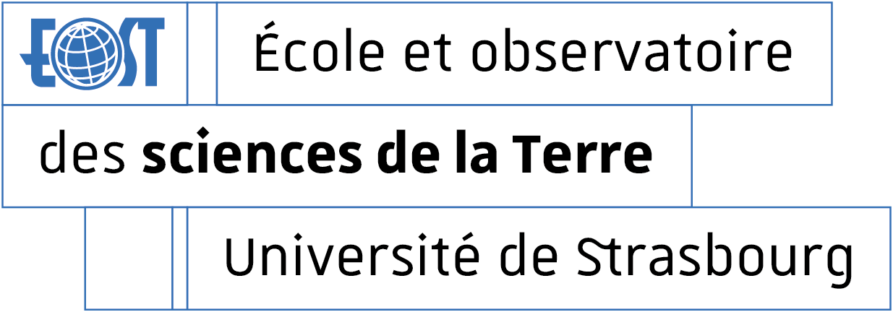

Monitoring of time-gravity changes using superconducting gravimeters
SG - Superconducting Gravimetry
Séverine Rosat
Institut de Physique du Globe de Strasbourg; UMR 7516, Université de Strasbourg/EOST, CNRS

Slide 2
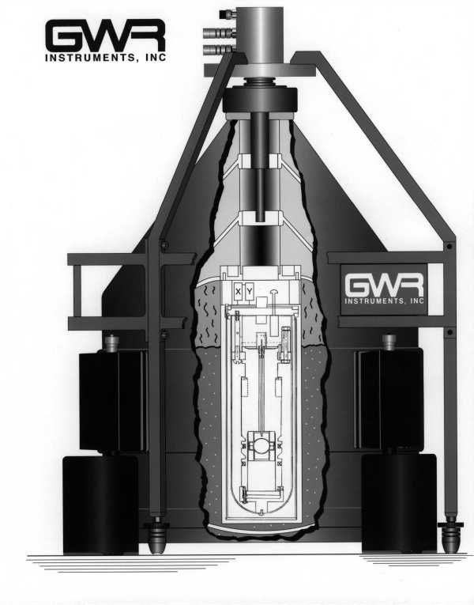
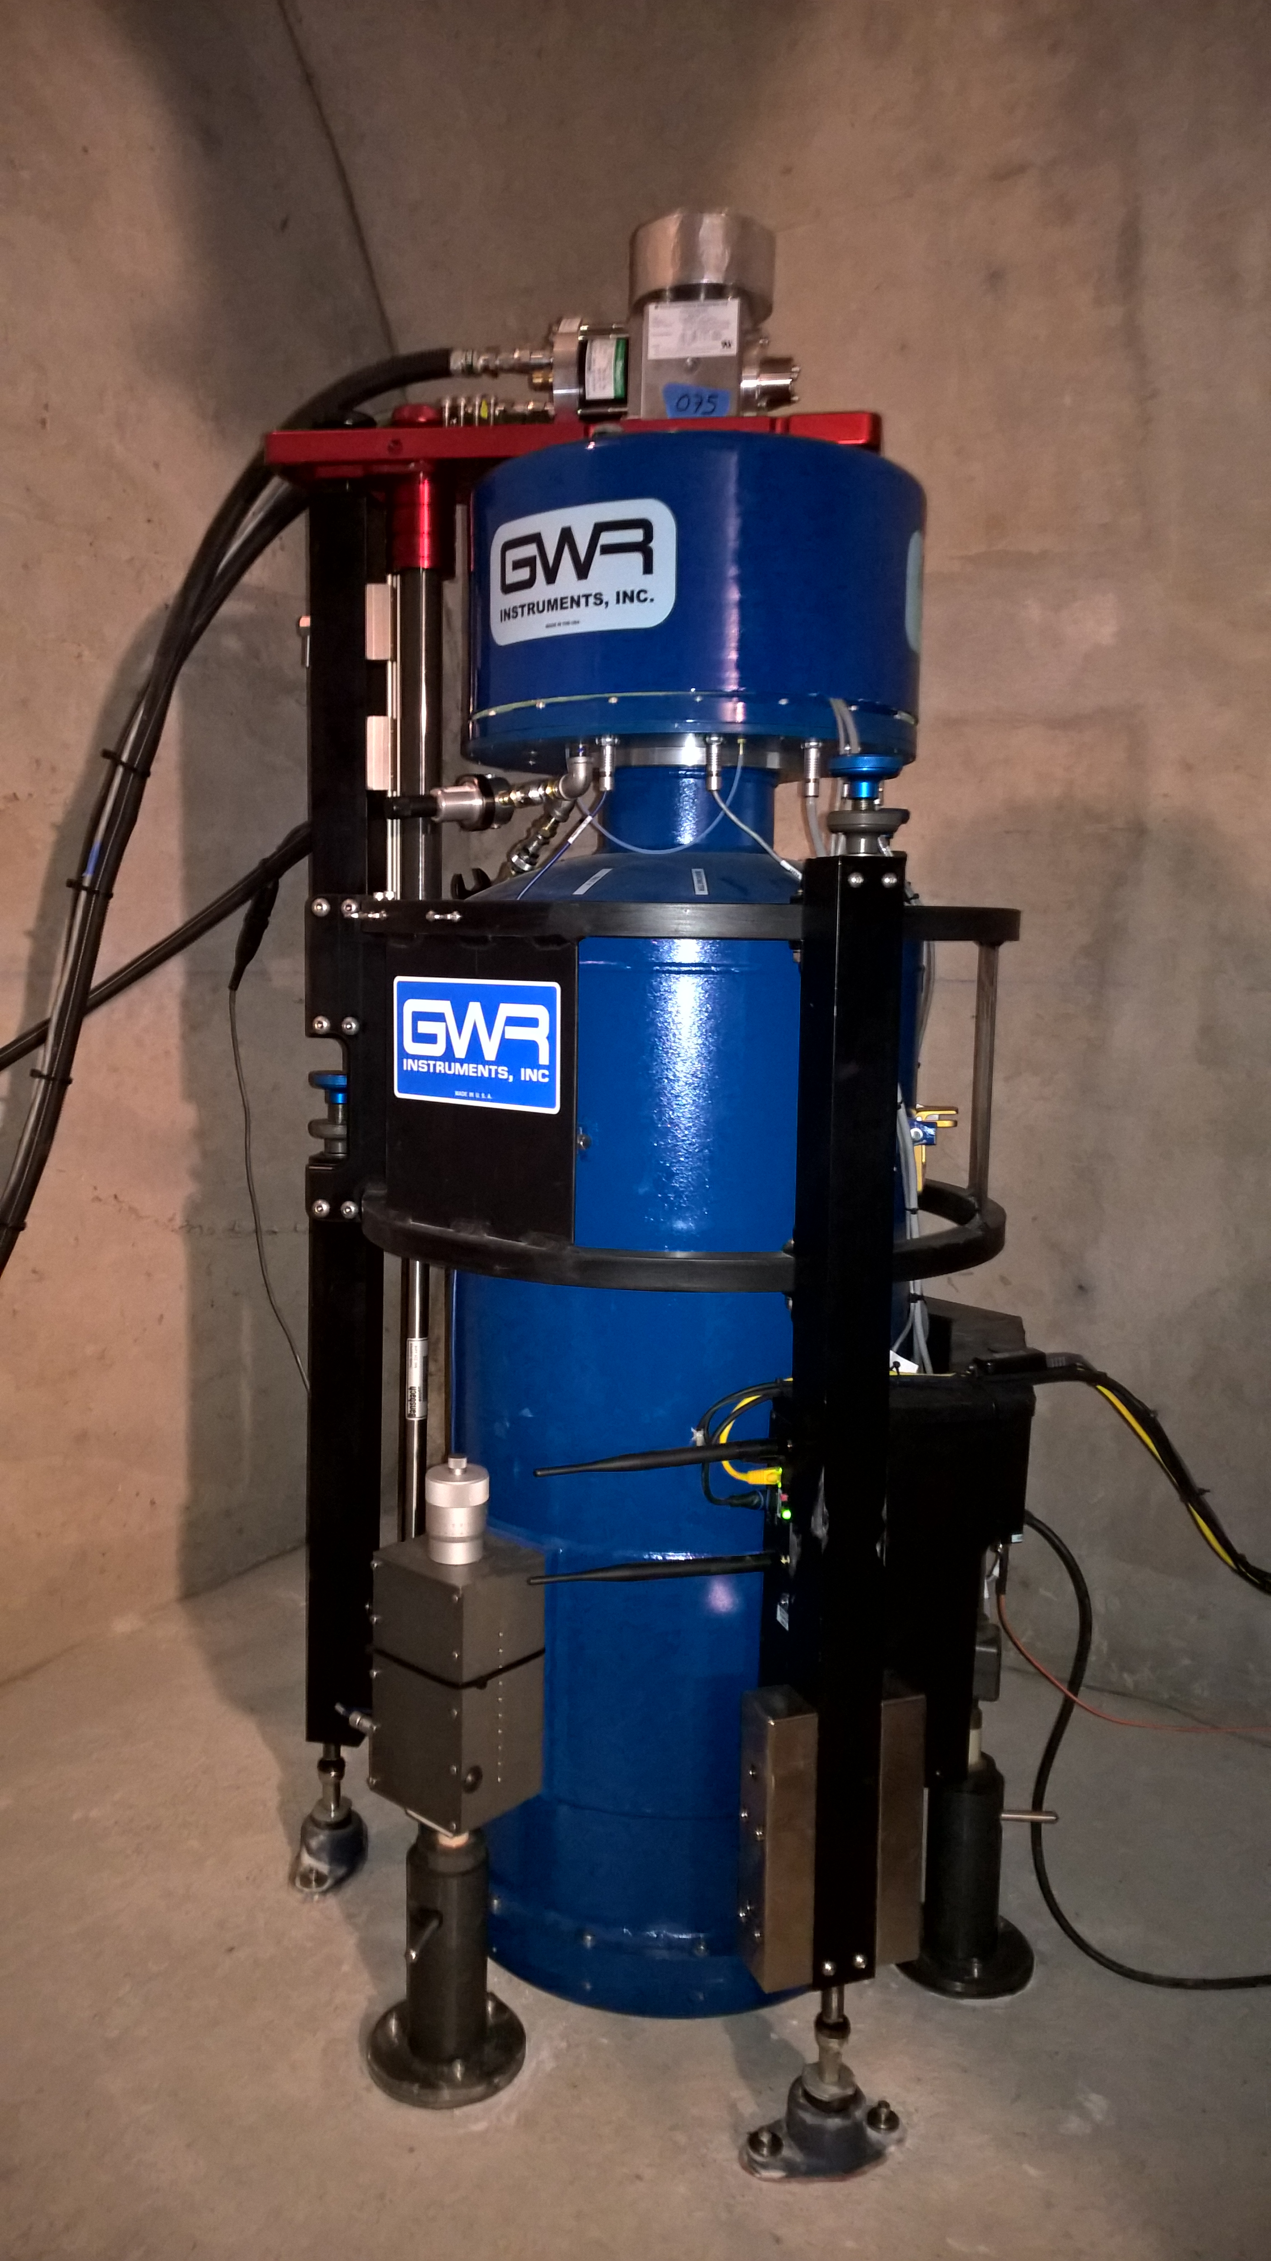
Superconducting gravimetEr: SENSOR
Components of the SG sensor (GWR Instruments, Inc.)
Liquid He (4.2 K)
Cryogenic dewar
The levitation force is produced by the interaction between the magnetic field from the coils and the currents induced on the surface of the superconducting sphere.
Magnetic feedback → very low instrumental drift
(a few µGal/year, where 1 µGal ~ 10⁻⁸ m/s²)
Very high sensitivity at the nanogal level (~ 10⁻¹² g)

Slide 3
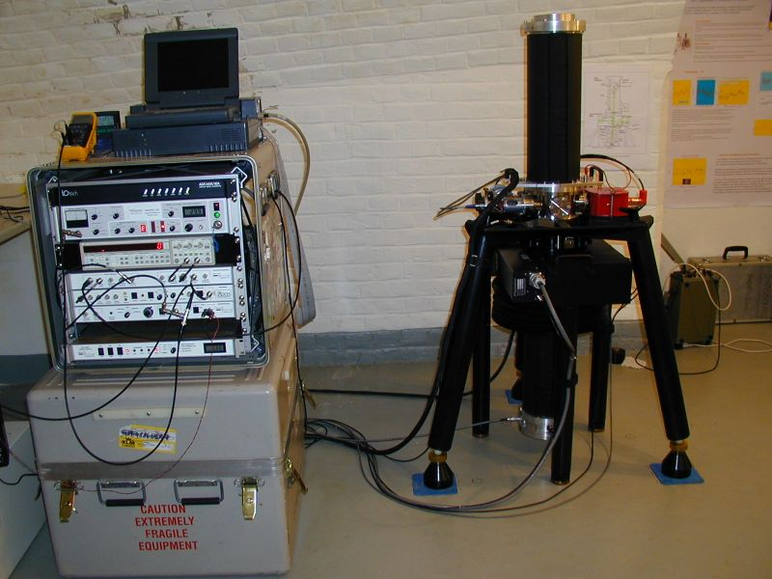
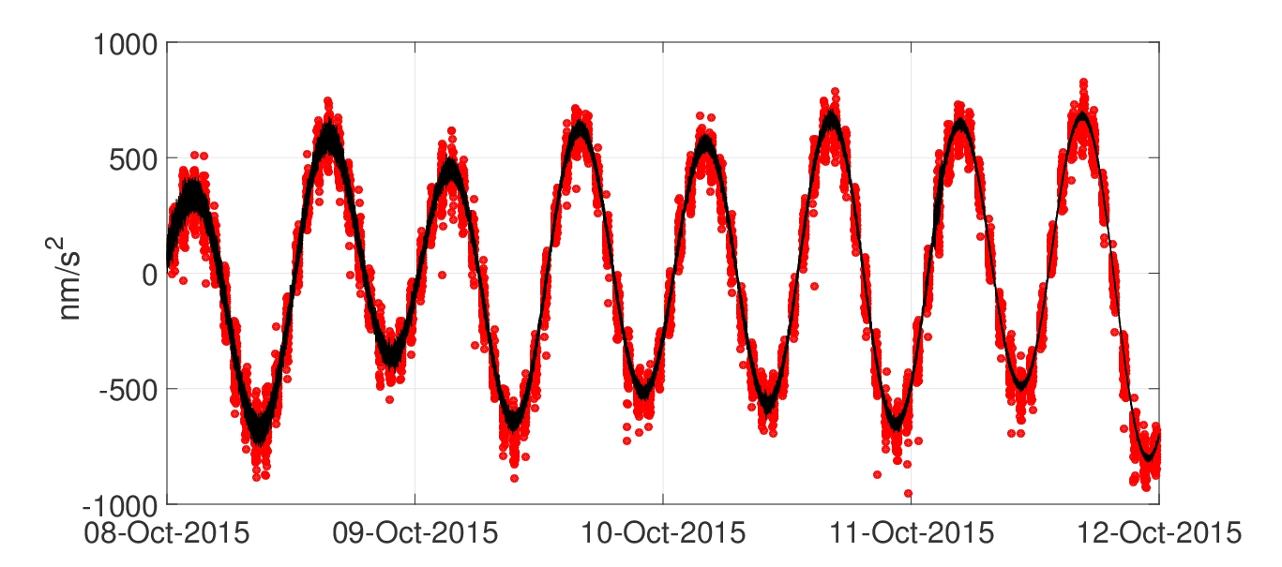
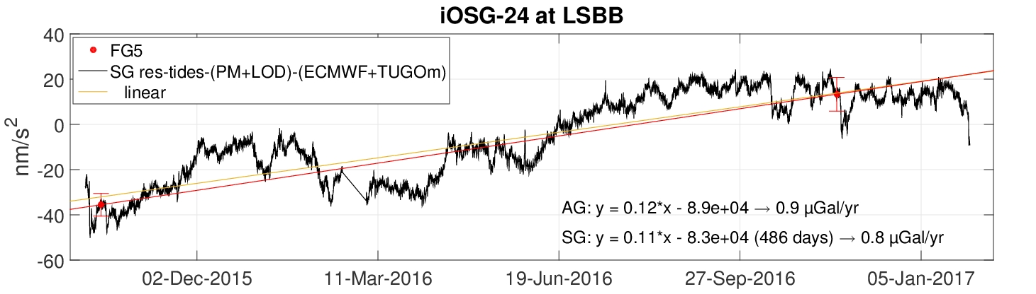
Superconducting gravimetEr: calibration and instrumental drift
→ Using absolute values of gravity
Example of iOSG-24 with FG5#206
least-squares adjustment
Scale factor = -451 ± 3 nm/s²/V (relative error of 0.7 %)
Very small instrumental drift ~ 0.8 µGal/year

Slide 4
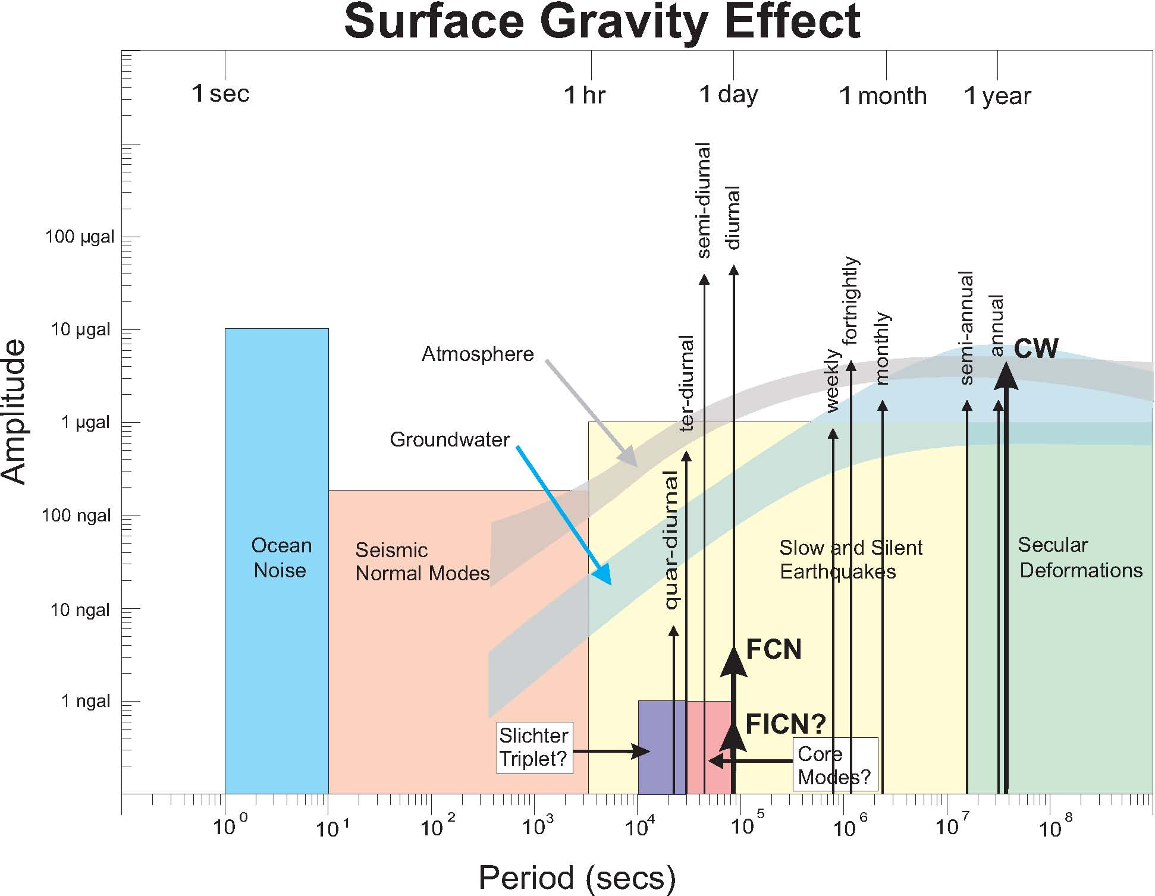
SPECTRUM OF TIME-VARYING GRAVITY CHANGES
1 µm/s²
100 nm/s²
~10⁻⁹g
10 nm/s²
1 nm/s²
0.1 nm/s²
~10⁻¹²g
0.01 nm/s²
Hinderer, Crossley and Warburton, 2007

Slide 5
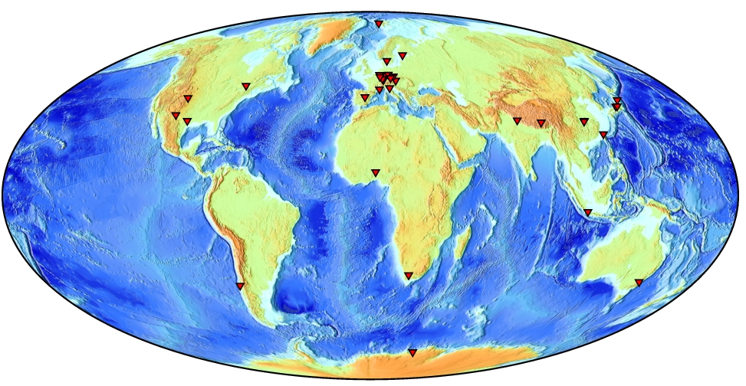
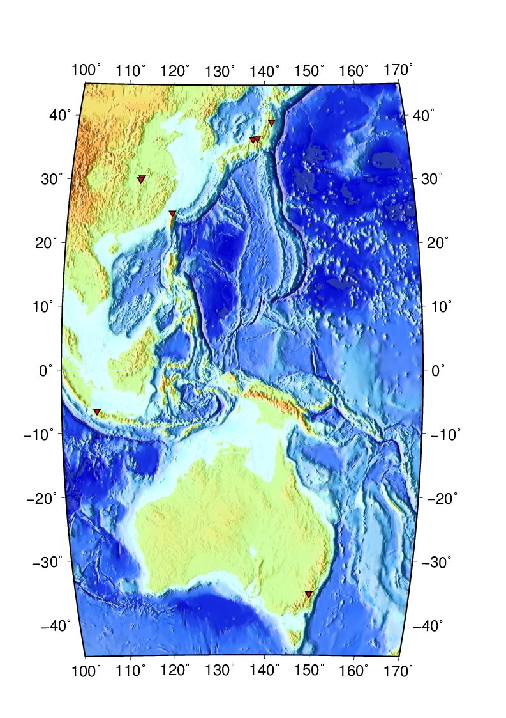
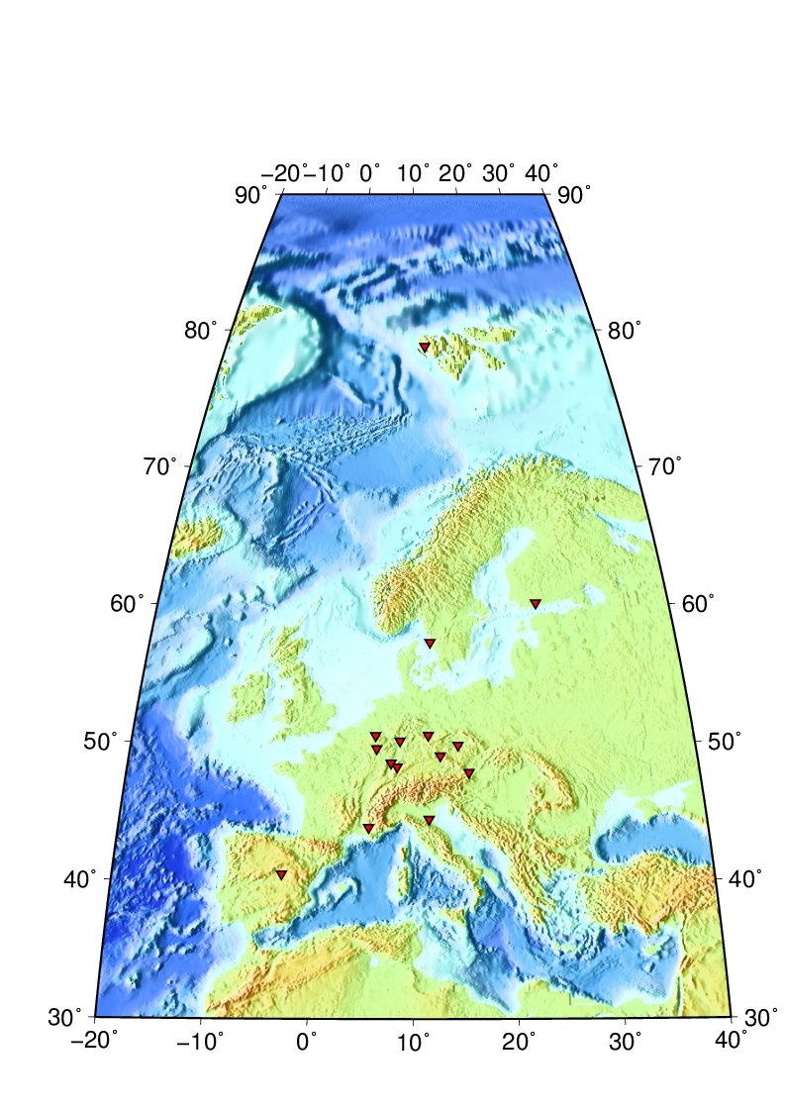
Superconducting gravimetEr NETWORK
International Geodynamics and Earth Tide Service (IGETS)
http://igets.u-strasbg.fr/
~ 30 SGs worldwide

Slide 6
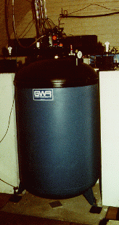
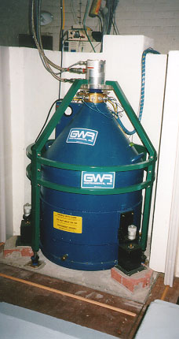
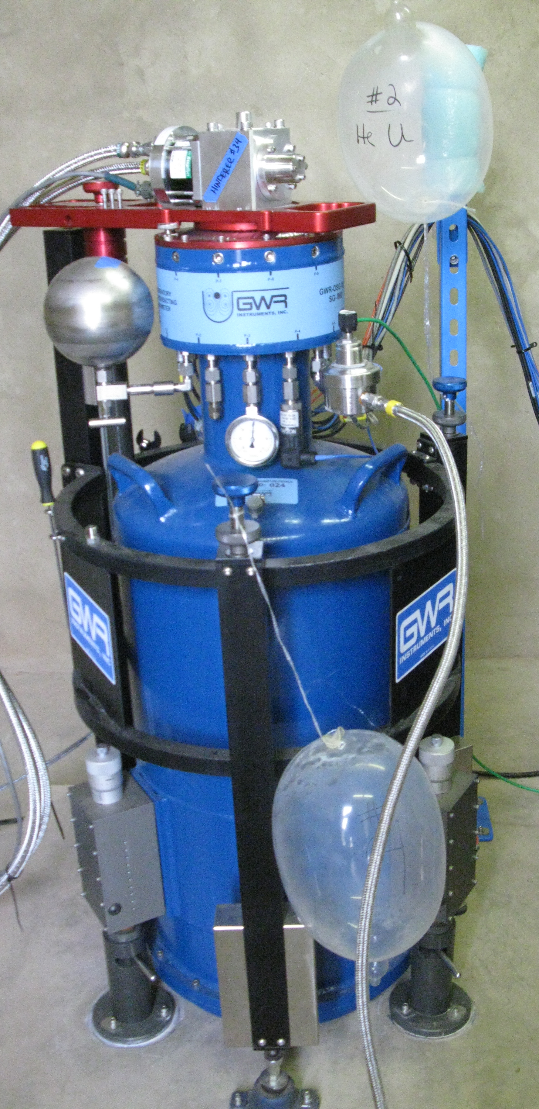
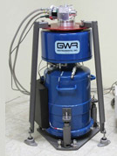
Superconducting gravimetEr
Size, difficulty of installation and price
Field SG
Early commercial model TT instruments
~1981 - 1994
200 L dewar
Compact SG
1994 - 2002
125 L dewar
Observatory SG
2003 - 2012
42 L dewar
iOSG
Since 2012
35 L dewar
iGrav
Since 2012
16 L dewar
Niobium sphere: 2.54 cm diameter, mass ~4.3g
GWR Instruments, Inc.

Slide 7
Today’s Superconducting gravimetErs
Observatory SG
iOSG
Super stable: Drift rate < 0.5 µGal/month ; Scale factor constant to < 0.01 % over decades
Super precise: 0.1 nanoGal (10⁻³ nm/s²) resolution in frequency domain; < 0.3 nm/s² resolution in the time domain for 2 minute averaging
Super low noise: < 1 (nm/s²)²/Hz in seismic band (1 to 8 mHz)
GWR Instruments, Inc.
Field SG
iGrav
Super stable: Drift rate < 0.5 µGal/month ; Scale factor constant to better than 1 part in 10⁴ for years
Super precise: 1 nanoGal (10⁻² nm/s²) in frequency domain; 0.05 µGal in the time domain for 1 minute averaging
Super low noise: 0.3 µGal/(Hz)½ ~ 1 (nm/s²)²/Hz in seismic band
Smaller and cheaper (~ 250 k€)
GWR Instruments, Inc.

Slide 8
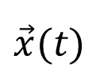

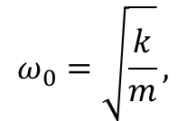


Superconducting gravimetEr
SG as a damped harmonic oscillator:
→ Brownian noise given by:
Damping constant proportional to velocity
From magnetic gradient (between upper and lower coils)
x: relative displacement of the sphere wrt its equilibrium position
k
$$x_{0}$$
b
m
$$\vec{x}(t)$$
$$\vec{F}(t)$$
$$ω_{0}=\sqrt{\frac{k}{m}},$$
$$Q=\frac{\sqrt{km}}{b}$$
where ω₀ is the natural frequency of the oscillator, Q its quality factor and m is the mass of the oscillating sphere (Warburton et al., 2010); k_{B} is the Boltzmann constant and T the temperature.
Increase mass of levitated sphere → decrease noise due to Brownian motion
(as long as field at surface of sphere remains << critical value)

Slide 9
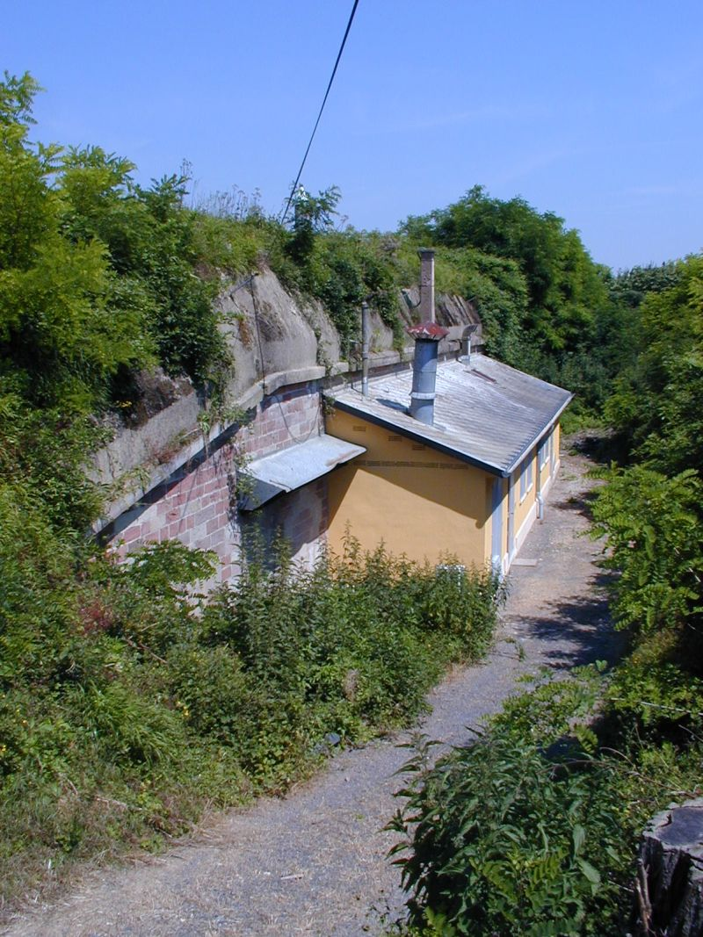
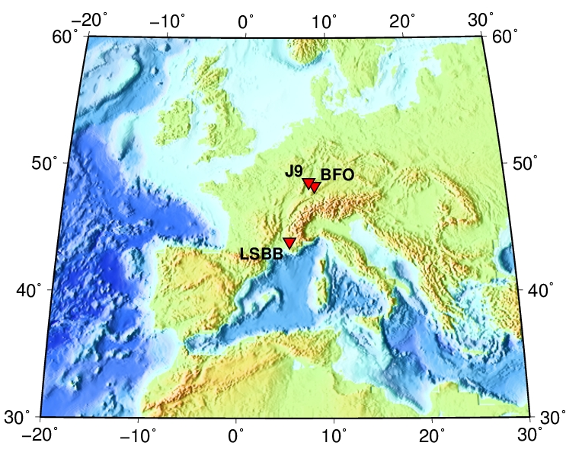
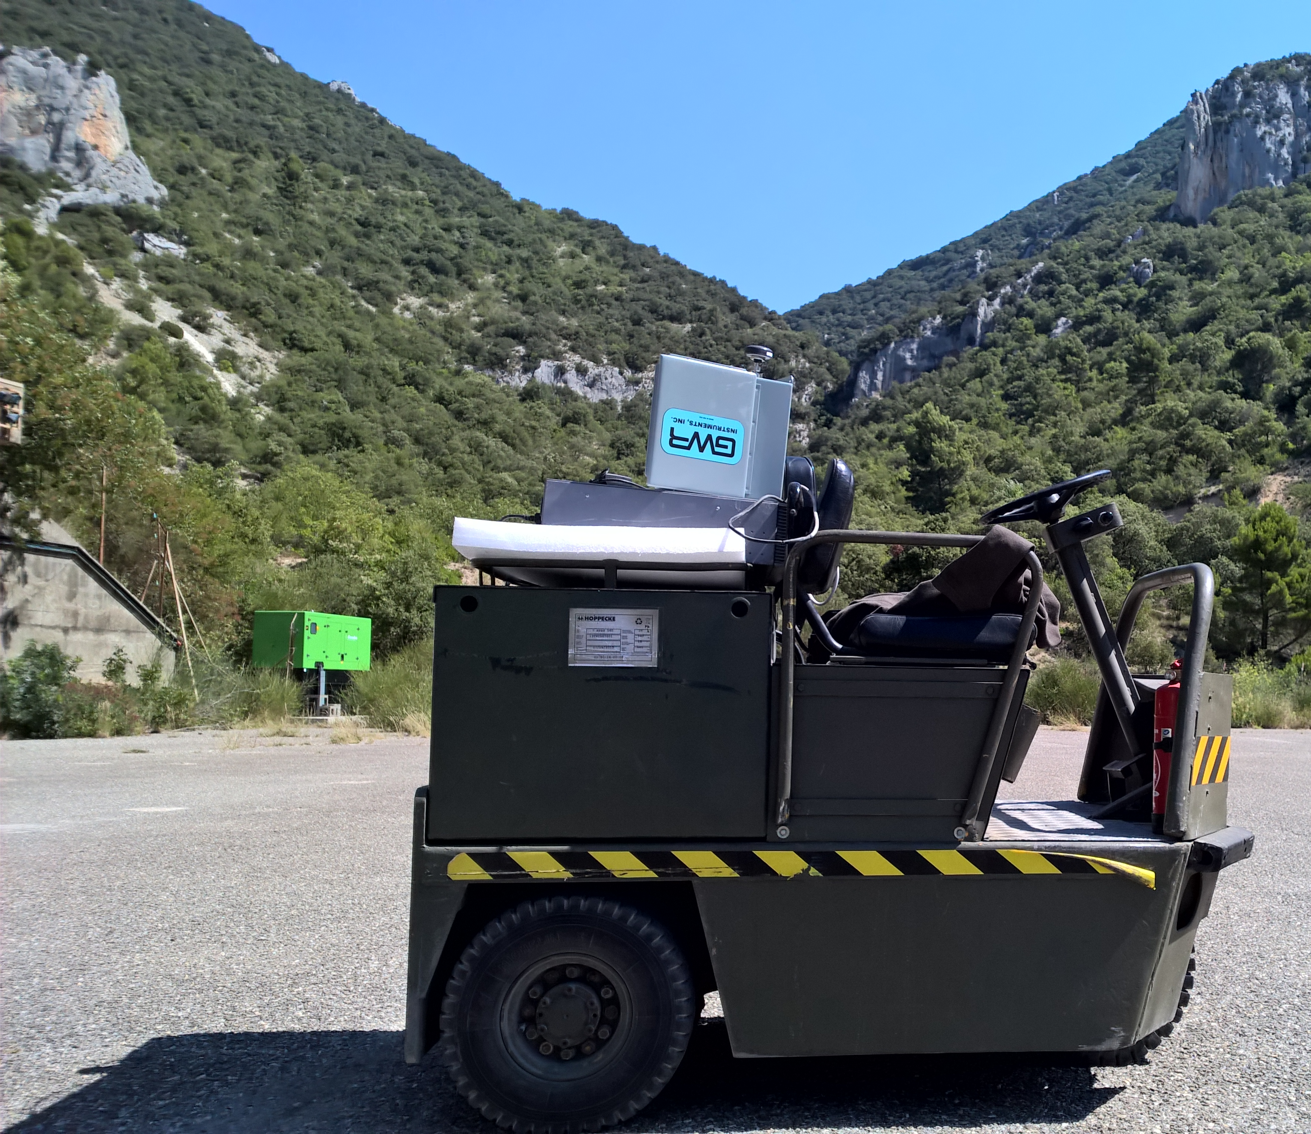
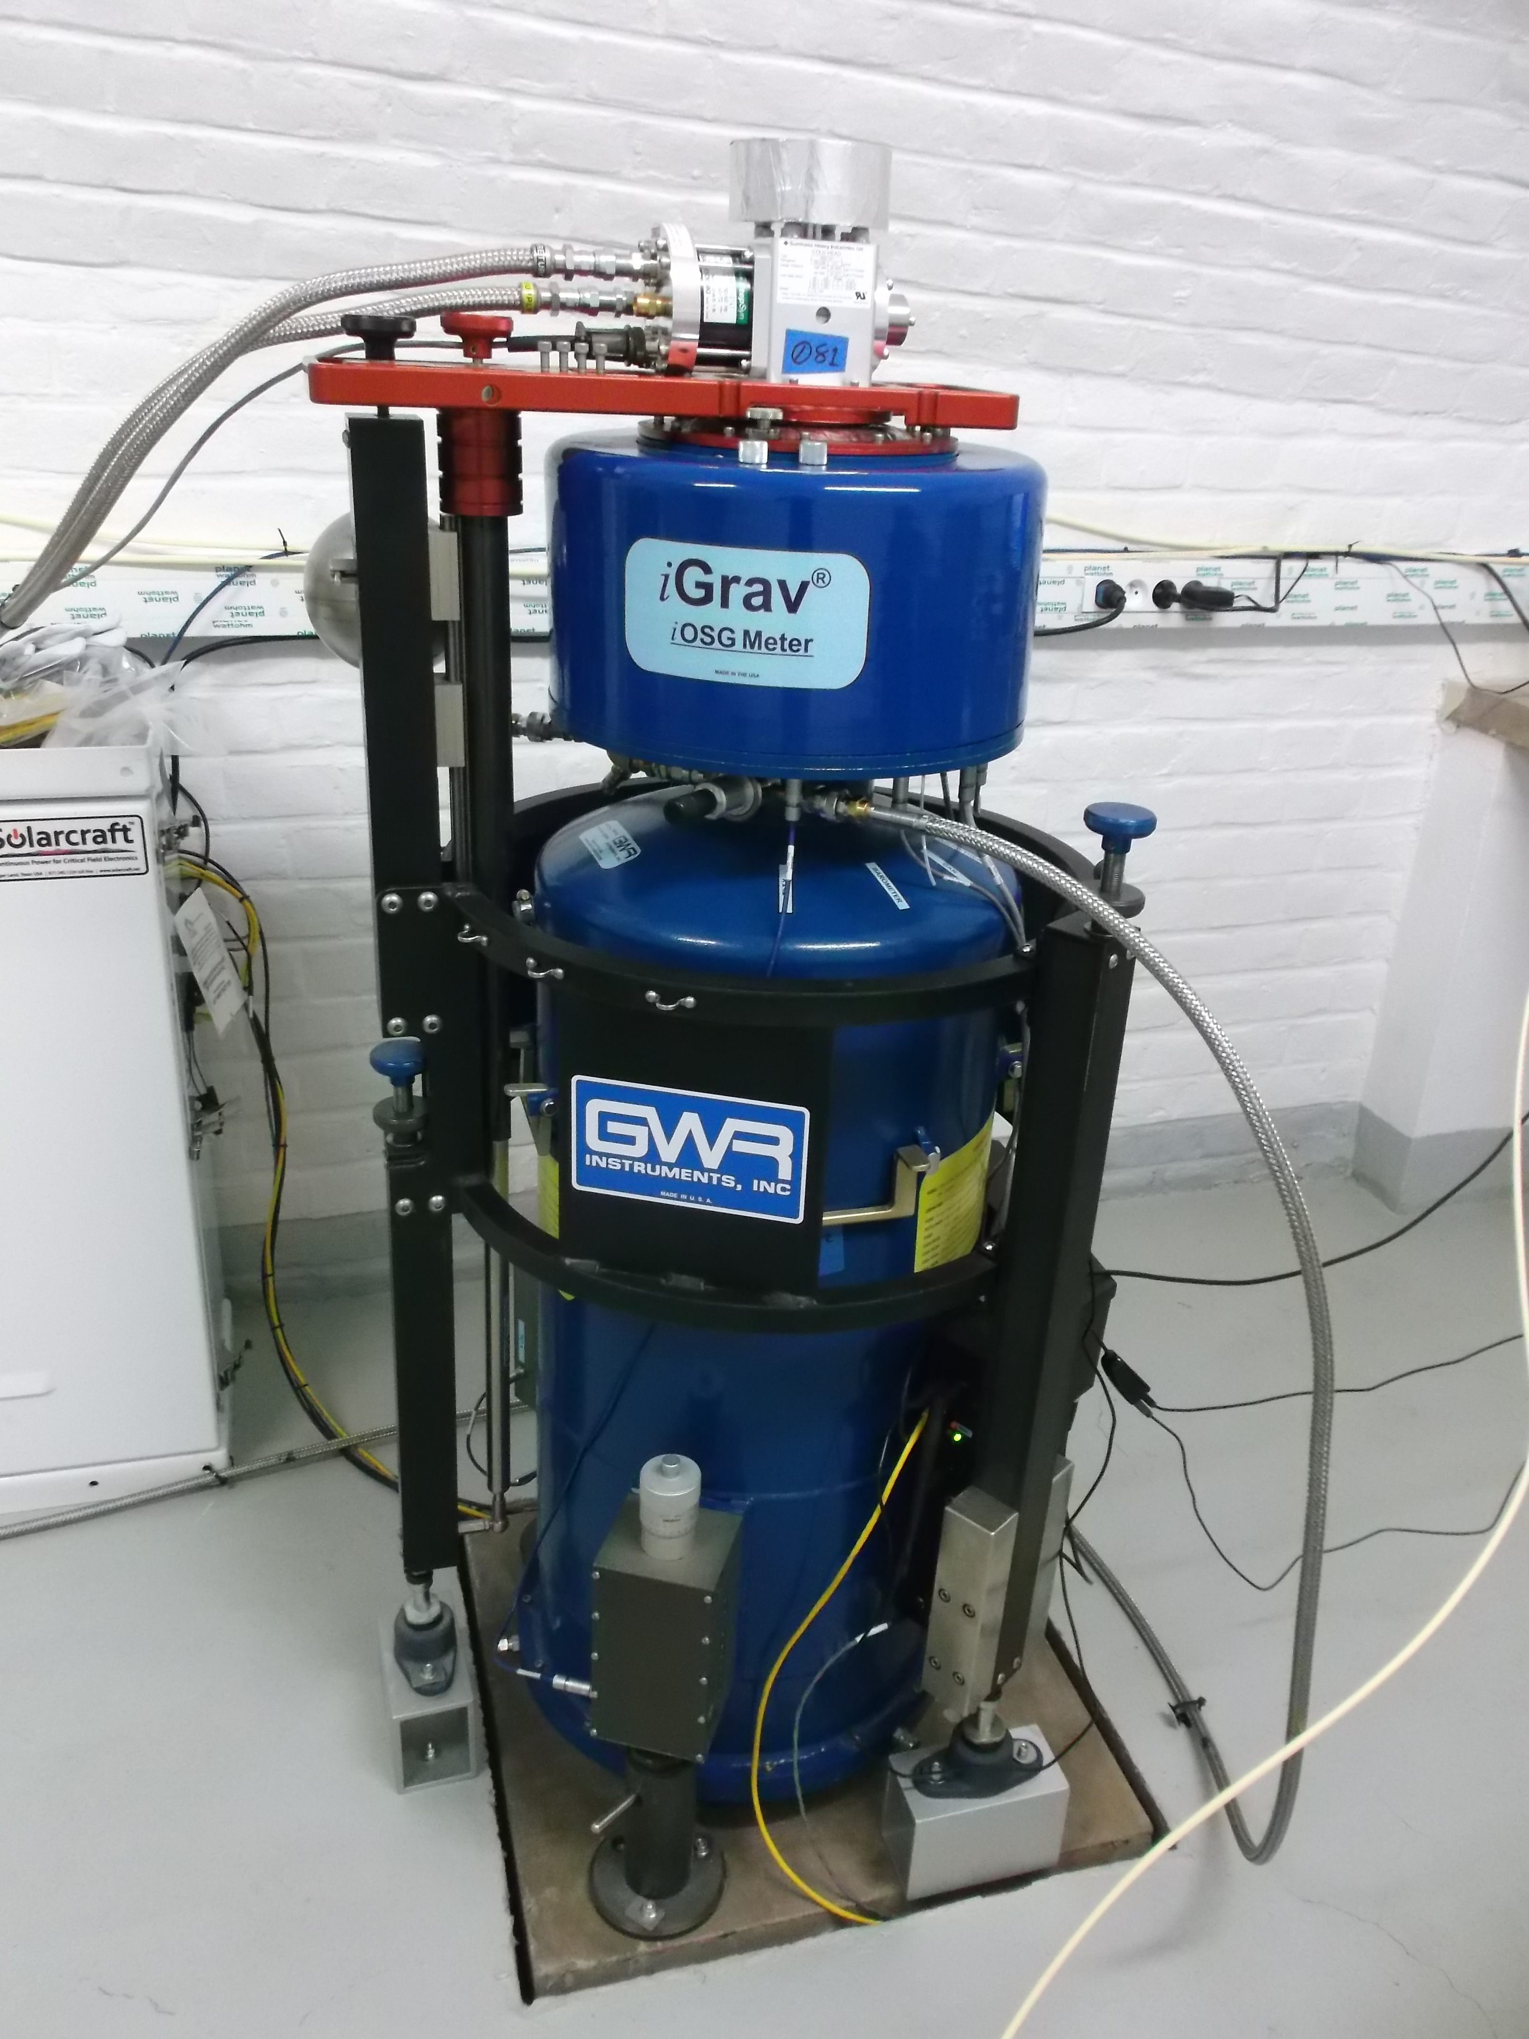
Superconducting gravimetEr
Strasbourg, J9
2 iOSGs
+ prototype OSG-56 (BFO)
BFO
Dual-sphere
Since Oct. 2009
OSG056
Rustrel, LSBB
Mass of the levitating sphere
~17.7g for iOSG (ex. at LSBB and J9)
Since Feb. 2016
iOSG-23
RESIF
Since July 2015
iOSG-24
MIGA

Slide 10
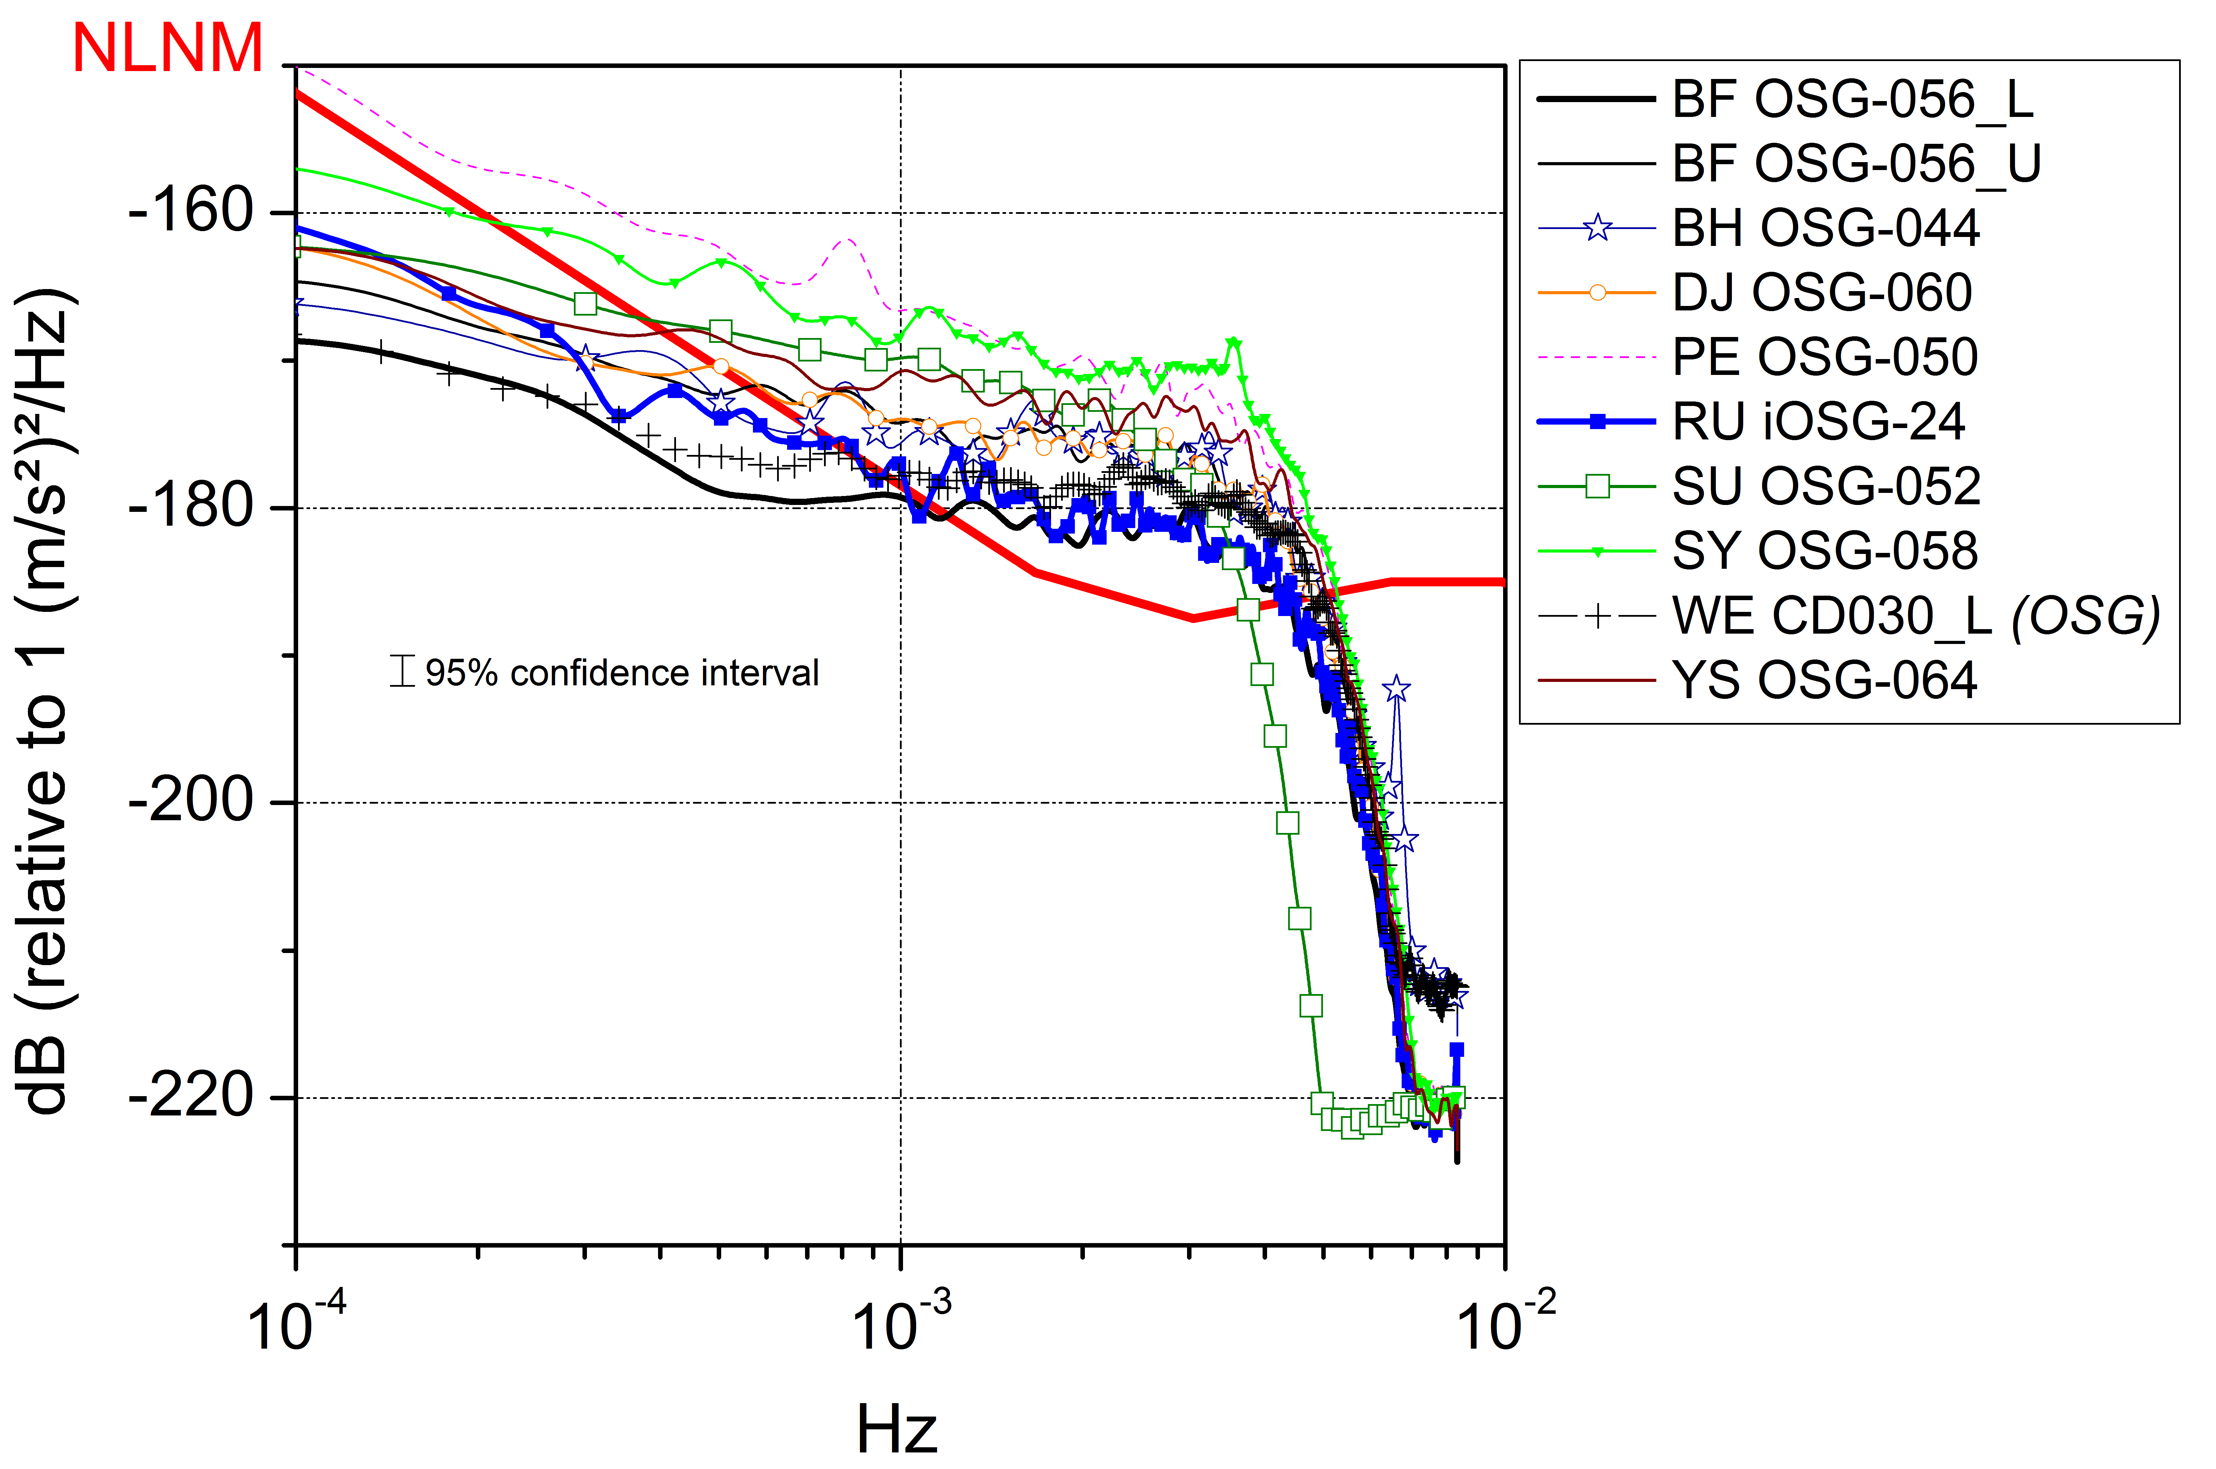
SEISMIC NOISE LEVELS: iOSGs VS. SGs (5 QUIETEST DAYS)
Heavier sphere
Rosat et al. 2016
New Low Noise Model of Peterson (1993) = seismological noise model
iOSG-24 (and OSG-56_L) → lowest noise level in the seismic band
(Modified from Rosat & Hinderer 2011)

Slide 11
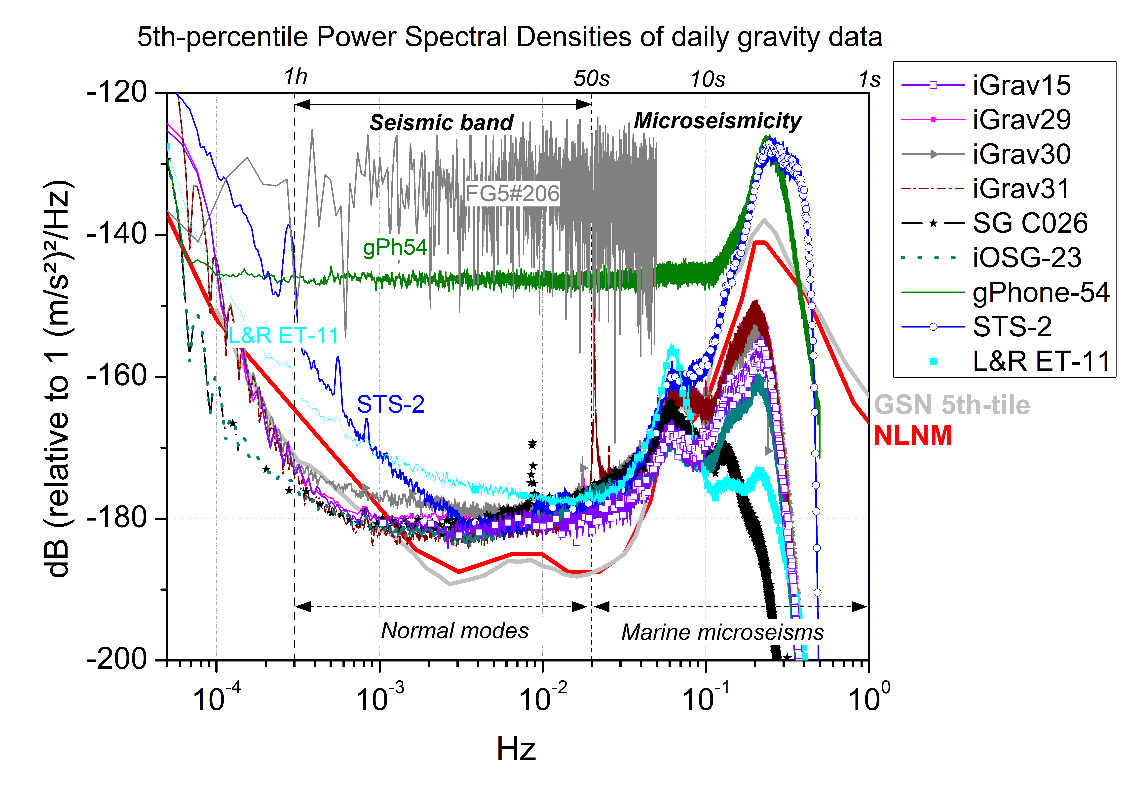
Seismic noise levels at j9: SG vs. other instruments
1 (nm/s²)²/Hz
FG5: absolute ballistic gravimeter
gPhone-54, CG5, L&R ET-11: relative spring gravimeters
Rosat et al. 2018, soumis

Slide 12
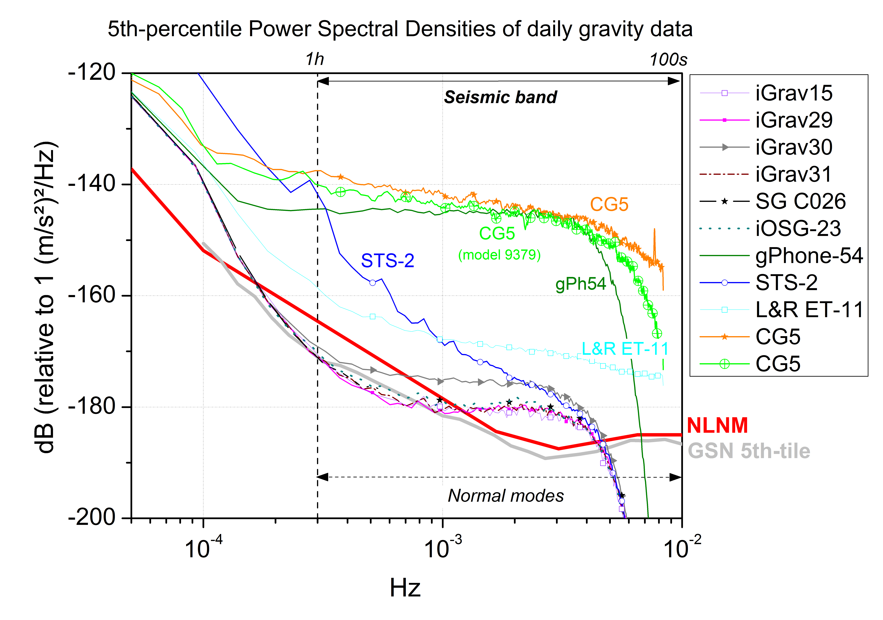
Seismic noise levels at j9: SG vs. other instruments
gPhone-54, CG5, L&R ET-11: relative spring gravimeters
Rosat et al. 2018, soumis

Slide 13
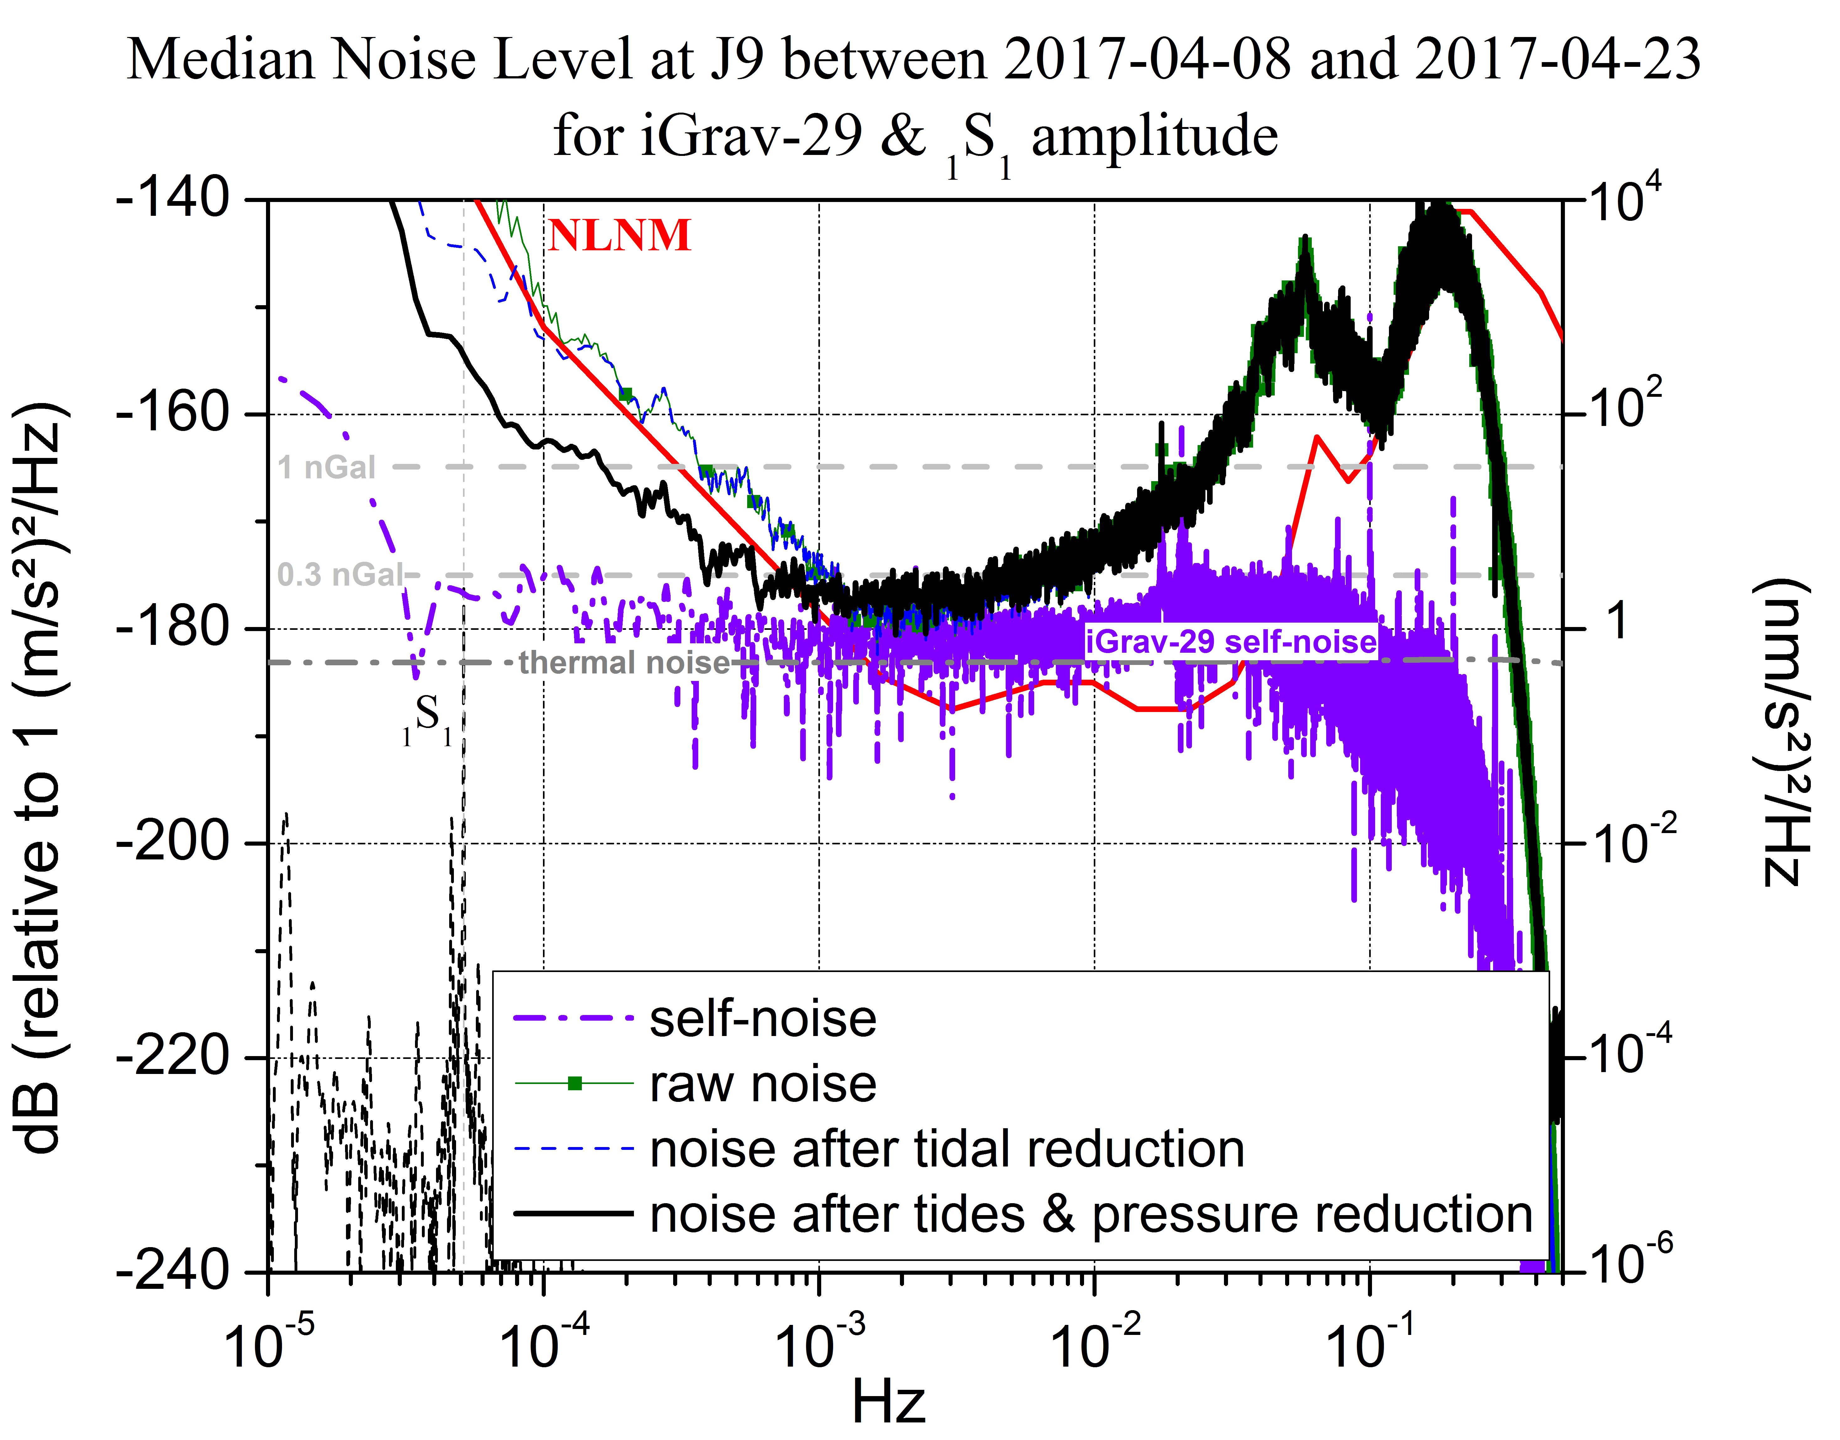
self-noise extracted from a 3-channel correlation analysis
[Sleeman et al. 2006]
~0.1 nGal
₁S₁: inner core Slichter mode
Rosat et al. 2018, soumis

Slide 14
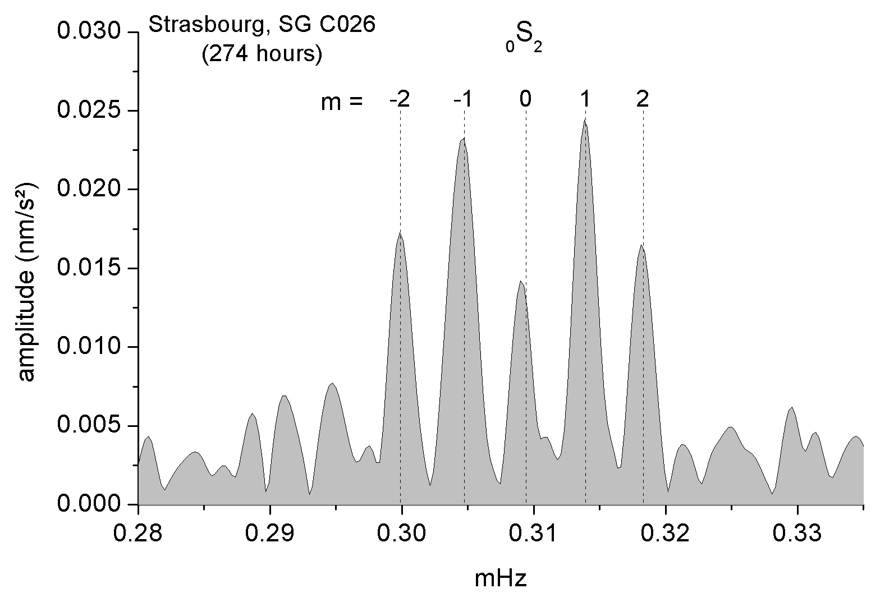
Superconducting gravimetEr: seismic modes
Ex: High-resolution frequency analysis after the 2001 M_{w} 8.4 Peru earthquake
1 nGal
0.5 nGal
Rosat et al. 2003, GRL

Slide 15
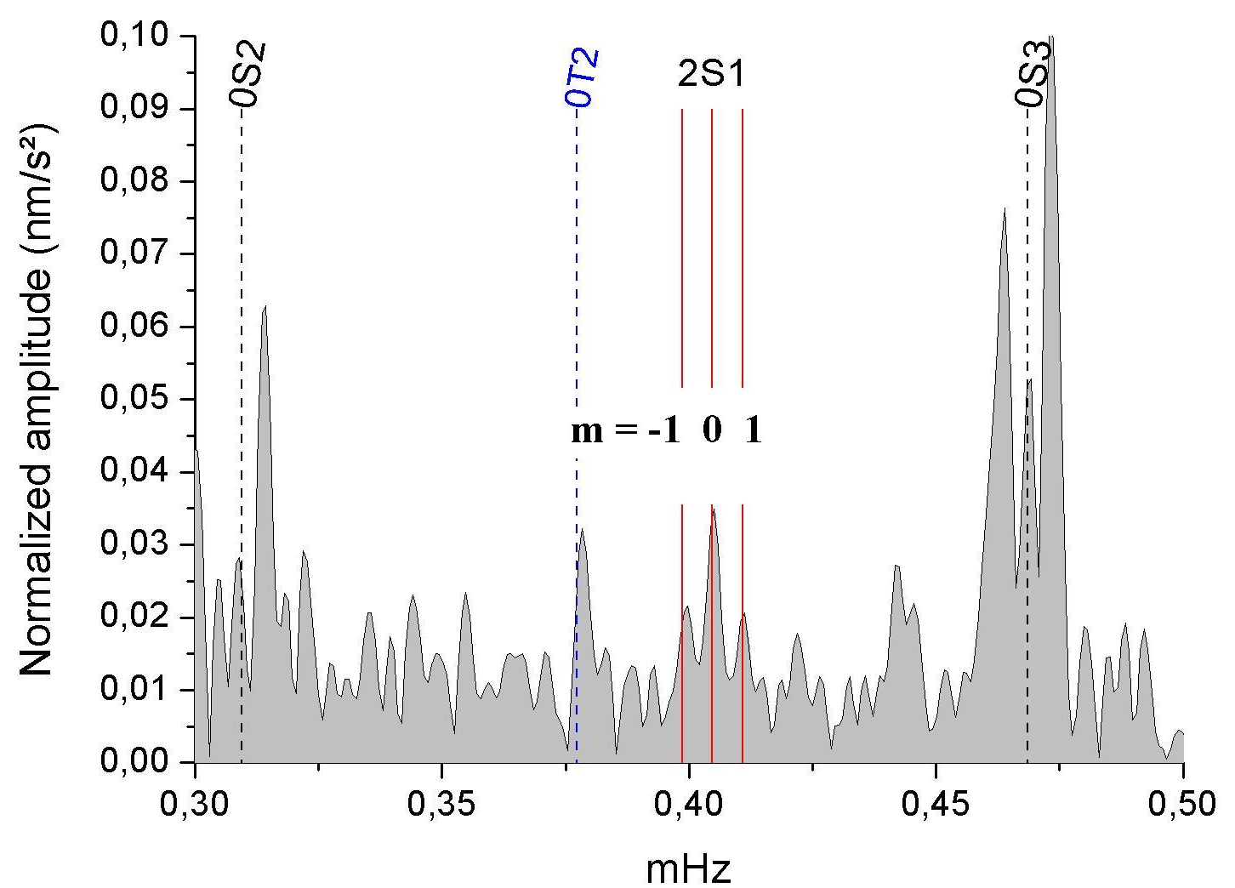
Superconducting gravimetEr: seismic modes
Ex: 1st detection of ₂S₁ mode after the 2001 M_{w} 8.4 Peru earthquake
1 nGal
Rosat et al. 2003, GRL

Slide 16
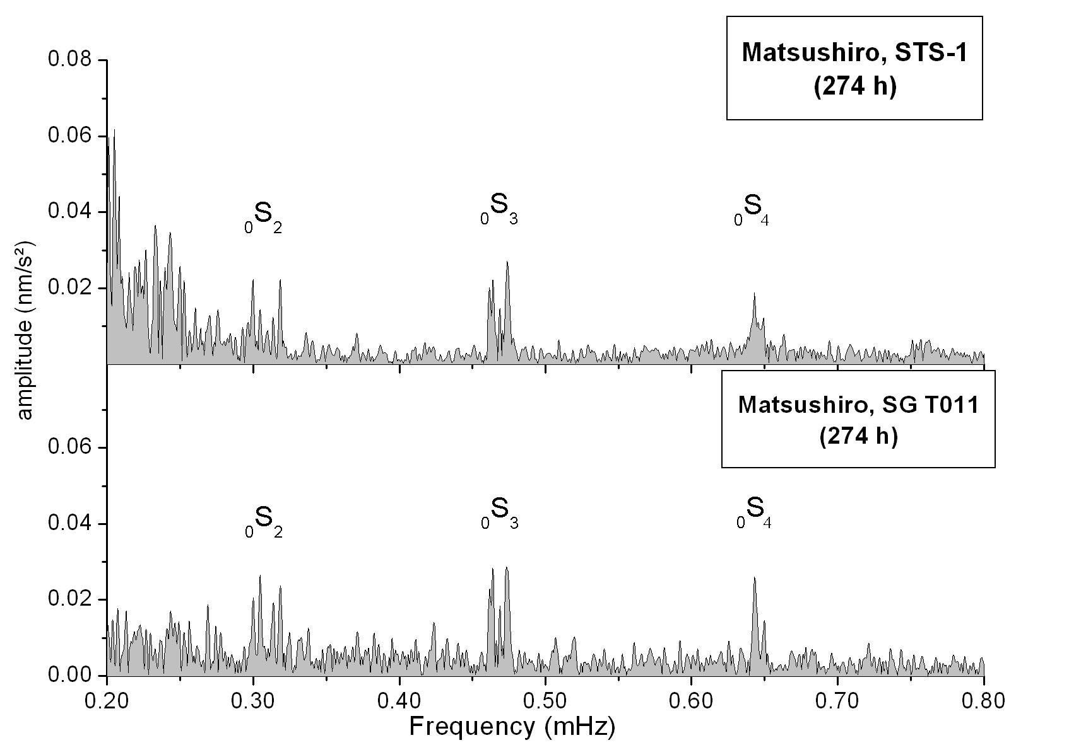
Superconducting gravimetEr: seismic modes
Ex: STS-1 vs. SG after the 2001 M_{w} 8.4 Peru earthquake
1 nGal
1 nGal

Slide 17
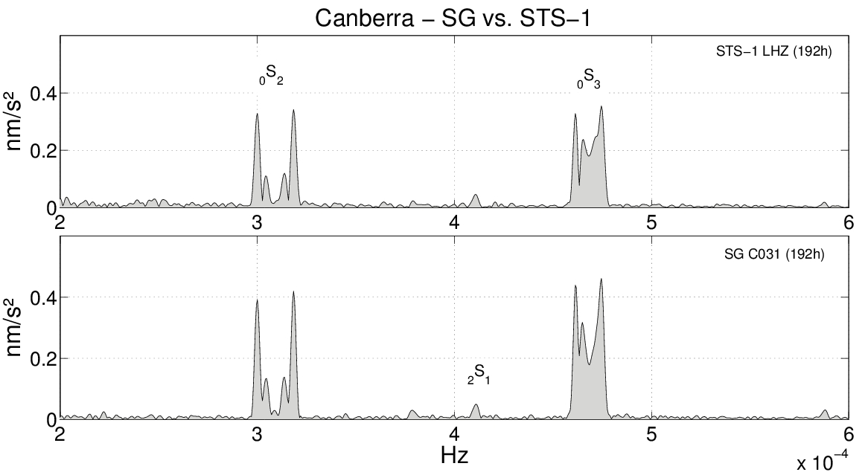
Superconducting gravimetEr: seismic modes
Ex: STS-1 vs. SG after the 2004 M_{w} 9.1 Sumatra-Andaman earthquake

Slide 18
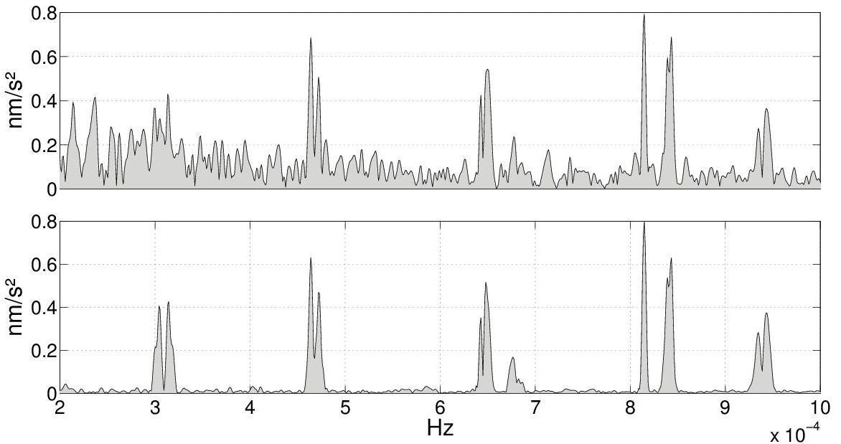
Superconducting gravimetEr: seismic modes
Ex: STS-1 vs. SG after the 2011 M_{w} 9.0 Tohoku earthquake
Sutherland (South-Africa)
STS-1
SG

Slide 19
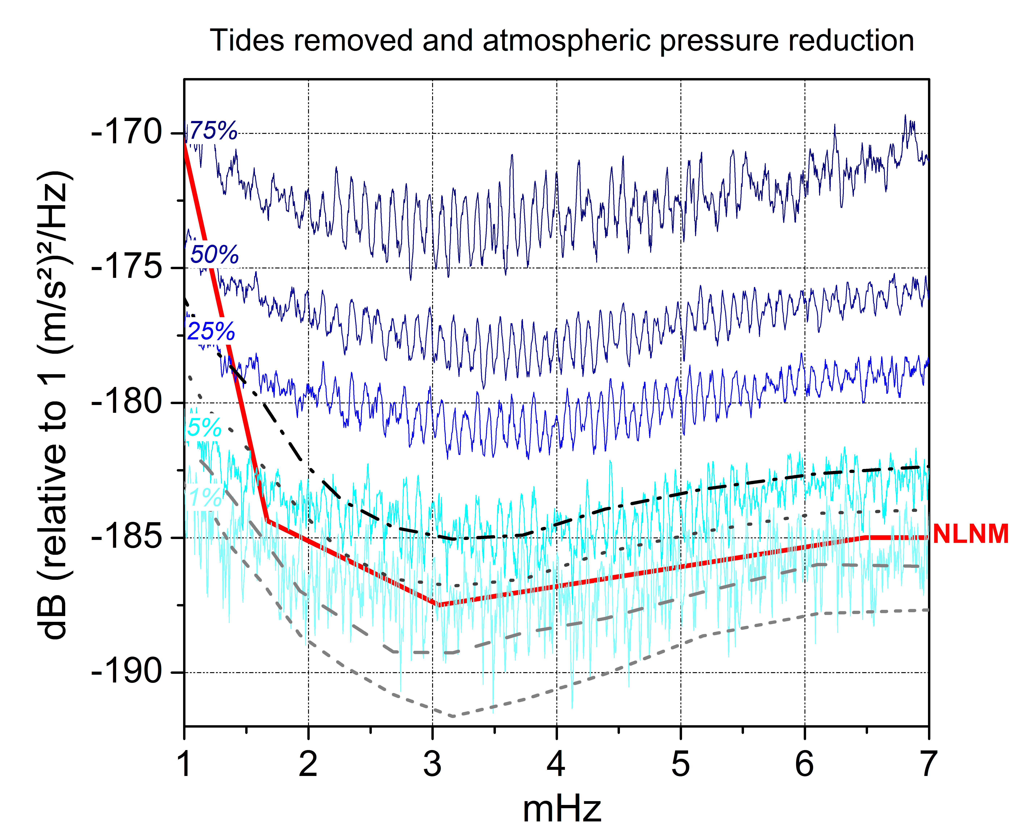
Superconducting gravimetEr: hum
Ex: iOSG-24 at LSBB

Slide 20
conclusion
SGs:
Perform better than long-period seismometers at frequencies lower than 1 mHz
Have a linear response to local atmospheric pressure changes → better noise reduction than STS-1
Resolution close to 0.1 nGal at seismic frequencies
Application to gravity-based earthquake early warning:
Successful detection after 2011 Tohoku EQ (Montagner et al. 2015) but some difficulties for future early warning system:
Poor geographical coverage of SGs
Signal to be detected is small and transient → needs to be separated from other possible disturbances

Slide 21
Thank you
Severine.Rosat@unistra.fr

Slide 22
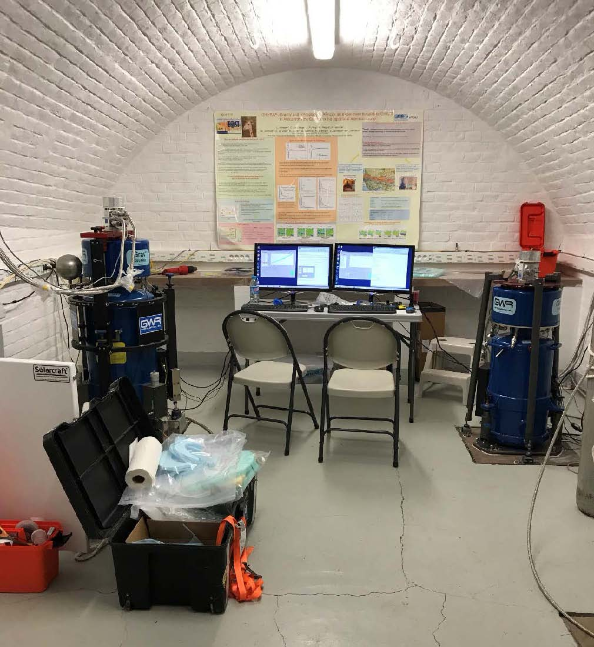
Superconducting gravimetErs
Strasbourg, J9
iOSG23 and iGrav30 parallely recording

Slide 23
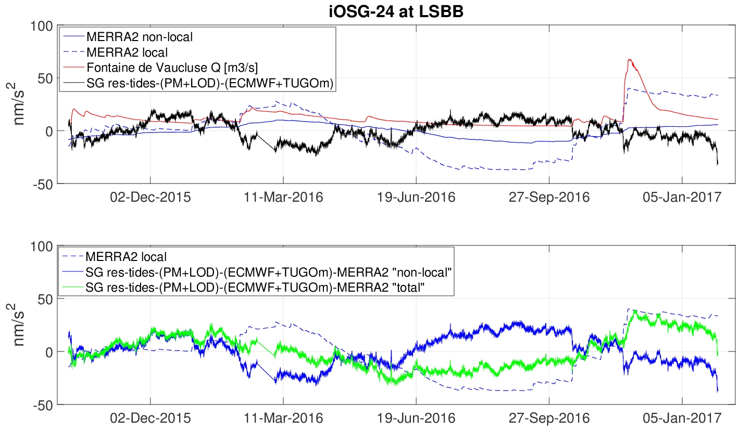
Superconducting gravimetEr
Hydrological effect on iOSG-24 using MERRA2 hydrological model
SG residuals after removing tides, polar motion and atmospheric pressure effects
SG residuals after removing the total hydrological effect
Local hydrological effect anti-correlated with SG residuals

Slide 24
Superconducting gravimetEr: seismic noise level
Statistical Noise levels of some worldwide SGs
New Low Noise Model of Peterson (1993) = seismological noise model
Rosat et al. 2016

