Slide 1


Local gravity gradient noise
(Newtonian Noise)
Donatella Fiorucciª, Jan Harms^{b}, Matteo Barsugliaª
ªAstroparticule et Cosmologie (APC)
^{b} Gran Sasso Science Institute (GSSI)
EGRAAL Meeting 10/01/2018

Slide 2
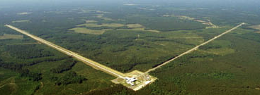
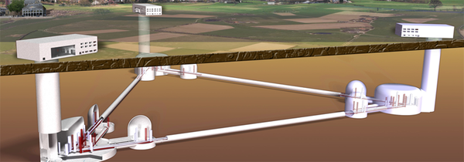
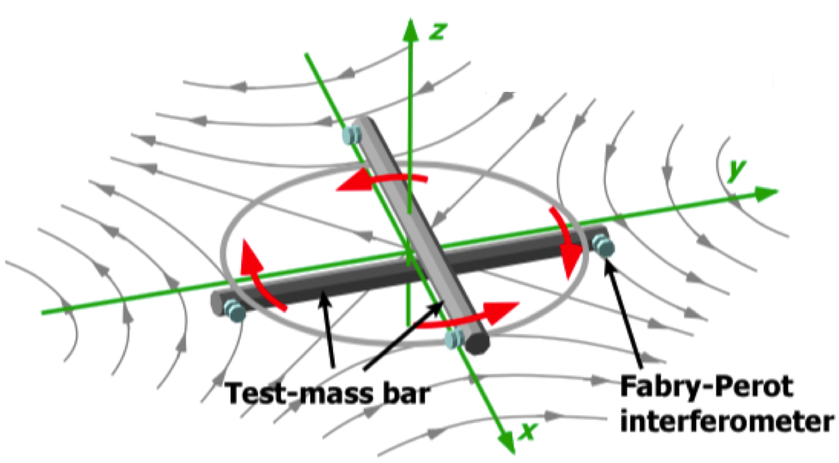
Newtonian Noise frequency range in different detectors
Frequency range
≈ 10Hz – 20Hz
aLIGO, AdVirgo, KAGRA
Einstein Telescope (ET)
Cosmic Explorer (CE)
Frequency range
≈ 1Hz – 20Hz
Torsion bar antennas (TOBA, TORPEDO) and other low frequency detectors (atom interferometers, surconducting gradiometers)
Frequency range
≈ 10 mHz-1Hz
EGRAAL Meeting 10/01/2018

Slide 3
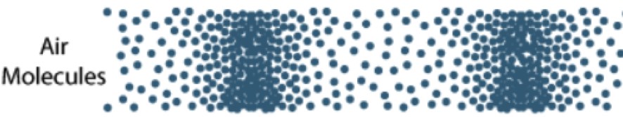
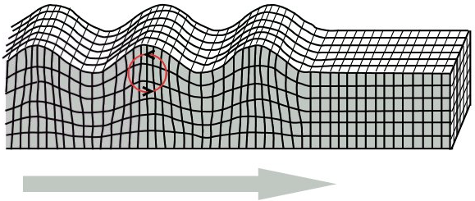
Newtonian Noise (NN)
δT
Infrasound waves ^{1, 2, 3}
v(t)
r(t)
Temperature fluctuations ^{2, 3}
m
Seismic waves ^{1,} ²
¹ Saulson Phys. Rev. D 30, 732, ² J. Harms Terrestrial Gravity Fluctuations,
³ Creigthon CQG. 25 (2008) 125011, C.Cafaro, S. A. Ali arXiv:0906.4844 [gr-qc]

Slide 4
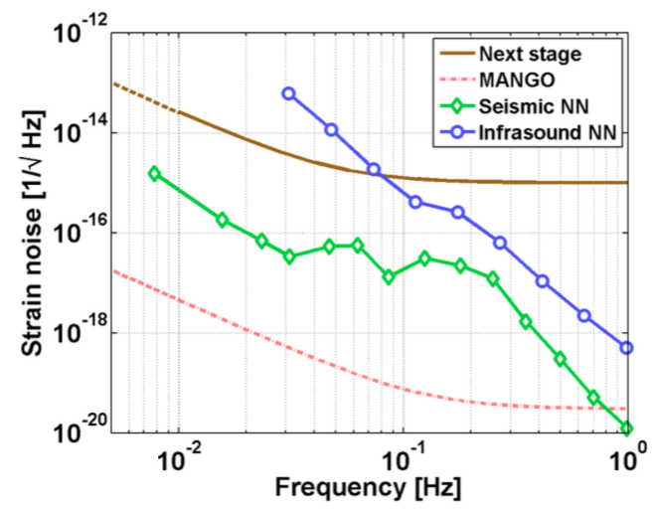
Infrasound vs seismic NN
*
Seismic NN does not limit the target sensitivity of the next-generation gradiometers
*
EGRAAL Meeting 10/01/2018
Harms et al. Phys. Rev. D 88 (2013)

Slide 5
Atmospheric NN
Infrasound NN
- Model
- Measurement of pressure fluctuations at the Advanced Virgo (AdV) site
- AdV infrasound NN
- ET infrasound NN
- Torsion bar antenna infrasound NN
NN due to temperature fluctuations
- Model
- Laser interferometers (ET case)
- Torsion bar antenna
EGRAAL Meeting 10/01/2018

Slide 6
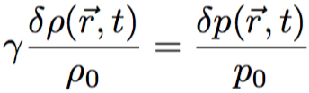




Infrasound NN modeling
Equation 1 Relation between pressure and density perturbations
Equation 2 Gravity potential perturbation
*
Measurement of pressure fluctuations at infrasound frequencies
Eq. 2 is used to derive the infrasound NN both for laser interferometers and for TOBA.
* Harms, Living Rev. Relativ. (2015)
EGRAAL Meeting 10/01/2018

Slide 7
Infrasound NN modeling
Laser interferometer
Test mass building modeling for laser interferometers on Earth
Test mass cavity modeling for underground laser interferometers
The exterior and interior pressure fluctuations are assumed to be incoherent.
EGRAAL Meeting 10/01/2018

Slide 8
Infrasound NN modeling
TOBA
TOBA on Earth, z₀ = 0
TOBA underground, z₀ < 0
Building effect neglected: the cavity or building hosting the detector is much smaller than the length of infrasound waves.
EGRAAL Meeting 10/01/2018

Slide 9
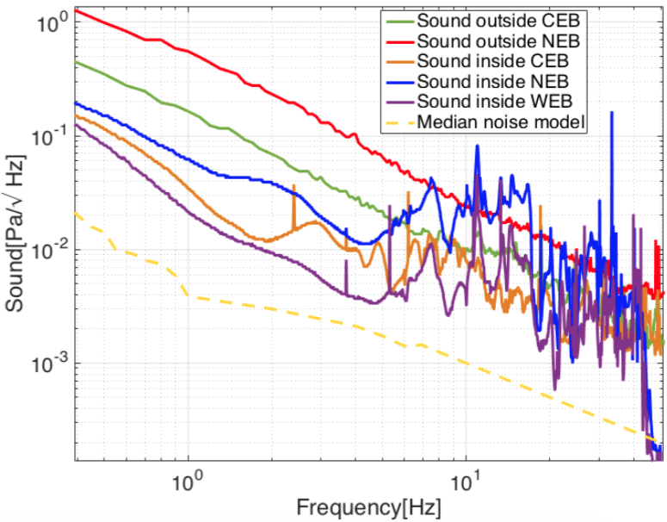
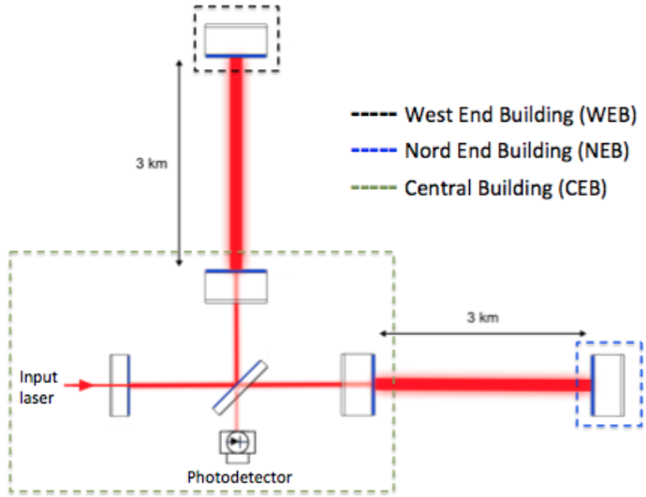
Measurements of pressure spectra at the AdV site
*
Simplified scheme of AdV.
Solid lines: sound spectra measured at the AdV site. Dashed yellow line: pressure fluctuation median noise model presented in Geophys. Res. Lett.32, L09803.
*I. Fiori, D.Fiorucci, J.Harms, F.Paoletti
EGRAAL Meeting 10/01/2018

Slide 10
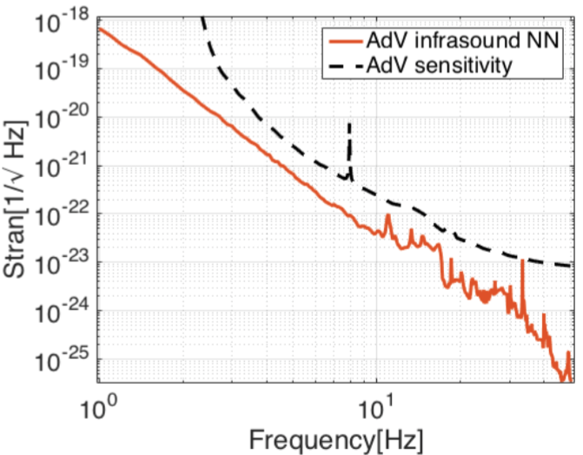
AdV infrasound NN
Estimate of the AdV infrasound NN, by using sound spectra recorded at the AdV site.
EGRAAL Meeting 10/01/2018

Slide 11
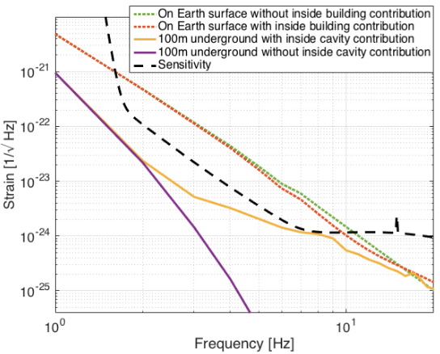
Infrasound NN for an ET-like detector
Infrasound NN for an ET like laser interferometer using the pressure fluctuation median noise model presented in Geophys. Res. Lett.32, L09803.
EGRAAL Meeting 10/01/2018

Slide 12
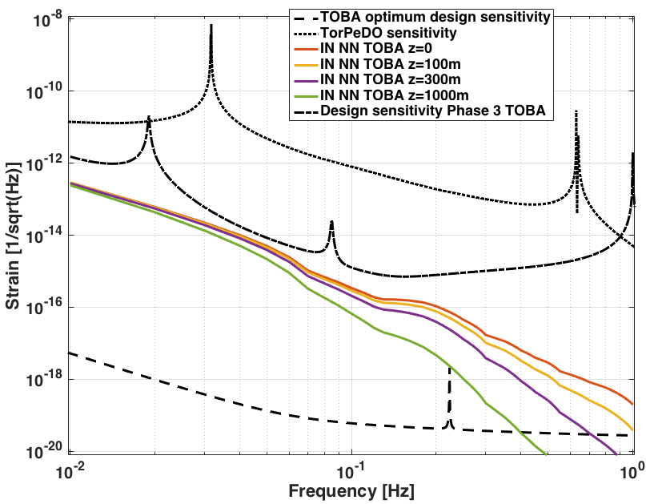
TOBA infrasound NN
TOBA infrasound NN for different detector depth using the pressure fluctuation median noise model presented in Geophys. Res. Lett.32, L09803.
EGRAAL Meeting 10/01/2018

Slide 13
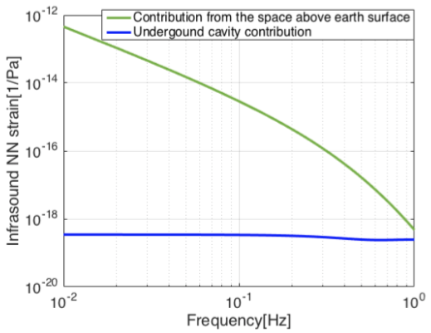
TOBA infrasound NN - Cavity/building effect
Contributions to the infrasound NN of a TOBA detector located 300 m beneath the earth surface. Blue line: contribution due to the space inside the underground cavity housing the detector. Green line: contribution of the space above the earth surface.
EGRAAL Meeting 10/01/2018

Slide 14
Atmospheric NN
Infrasound NN
- Model
- Measurement of pressure fluctuations at the Advanced Virgo (AdV) site
- AdV infrasound NN
- ET infrasound NN
- Torsion bar antenna infrasound NN
NN due to temperature fluctuations
- Model
- Laser interferometer (ET case)
- Torsion bar antennas
EGRAAL Meeting 10/01/2018

Slide 15
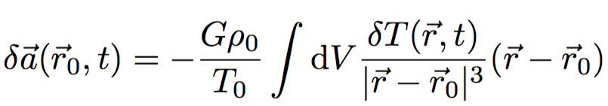
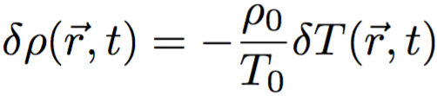
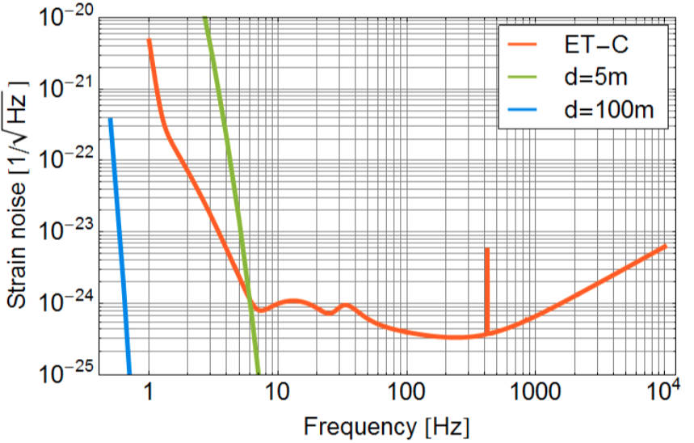
Temperature fluctuation NN-ET
*
Uniform airflow 20 m/s
⬥ credit: Jan Harms
* Harms, Living Rev. Relativ. (2015)
EGRAAL Meeting 10/01/2018

Slide 16
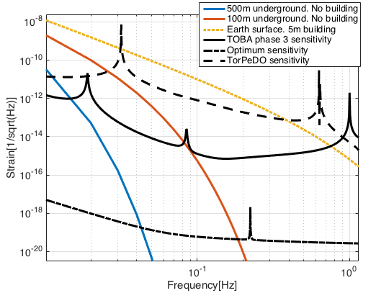
Temperature fluctuation NN-TOBA
TOBA orientation
y
Wind speed, v=10m/s, along the x axis
x
Turbulent mixing theory breaks down at f ≤ few tens of mHz ¹
Gravimeter data show that this noise is overestimated by few orders of magnitude at
10mHz ²
Validity of the model for
10 mHz < f < hundreds of mHz must be checked
Model should be ok (but simplified) for f ≥ 1 Hz.
Preliminary!
Probably
overestimated
Warning!
¹ Kukharets, V.P. and Nalbandyan, H.G. Izv., Atmos. Ocean. Phys., 42, (2006)
² Hinderer, Crossley, Warburton, Gravimetric Methods, 2007 Elsevier B.V.

Slide 17
Conclusion and Perspectives
Infrasound NN
Pressure fluctuations variate significantly with location, time and season. It is important to characterize the detector sites in terms of pressure fluctuations.
Characterization of the AdV site in terms of pressure fluctuations and infrasound NN level.
For an ET-like detector the Infrasound NN is strongly suppressed, when going underground. However the attenuation can be significantly spoiled by the internal contribution of the test mass cavity.
TOBA infrasound NN is below the next stage sensitivity and a few orders of magnitude above the sensitivity required for gravitational-wave detection. This allows the exploitation for geophysical applications.
TOBA NN from Temperature fluctuations
Check and improve the model.
Strongly attenuated when going underground.
EGRAAL Meeting 10/01/2018

