Slide 1



Workshop on future instruments for gravity-based earthquake early warning
January 10th 2018
Elasto-gravitational signals preceding direct seismic waves:
Status of observations and modelling
Martin Vallée
With contributions from :
Jean Paul Ampuero, Kévin Juhel, Pascal Bernard, Jean-Paul Montagner, Matteo Barsuglia

Slide 2
Context
Gravitational perturbations due to mass redistribution associated with tectonic processes :
Static (final) gravitational perturbations:
  Known solution for shear or tensile faults in half-space
  [Okubo et al., 1992]
  Observed by Earth gravimeters [2003 Tokachi earthquake, Imanishi et al., 2004] and space gravimetry [static gravitational changes of the 2011 Tohoku earthquake detected by GRACE, e.g. Matsuo &Heki, 2011]
Dynamic gravitational perturbations :
  Such perturbations also occur immediately after an earthquake :
    The Earth masses are perturbed, both at the source location and at the places affected by the transient dilatant/compressive elastic waves
    These perturbations propagate at the speed of light… even if their signature is small, the quiet period before the P-wave arrival may allow to observe them

Slide 3
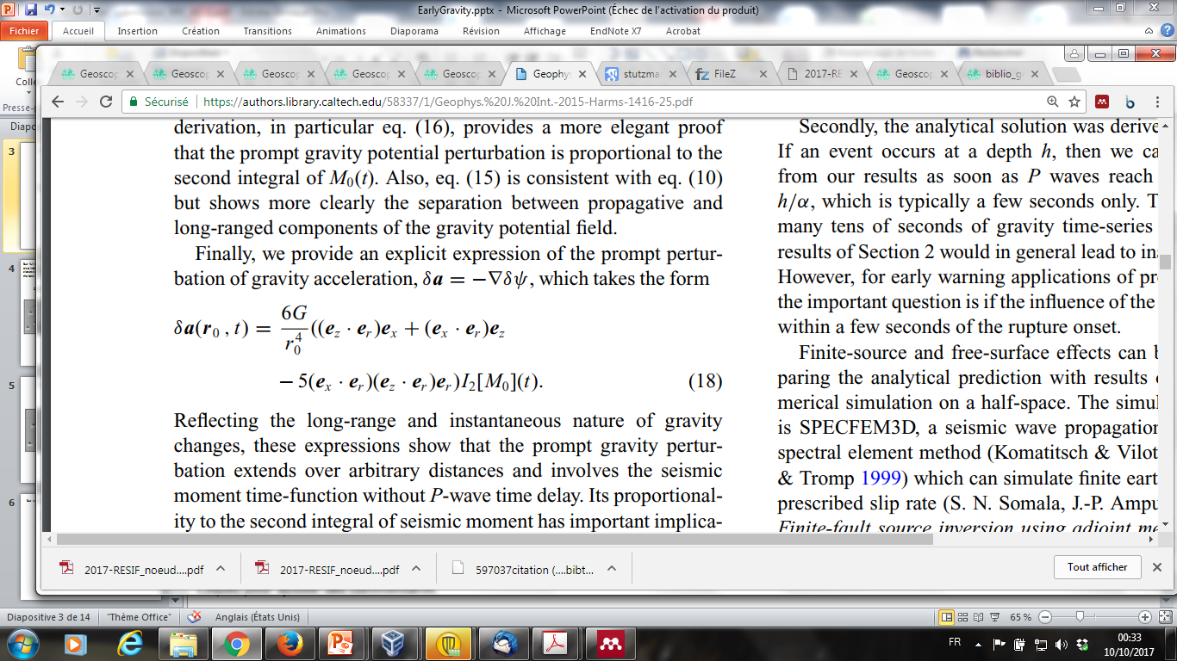
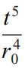
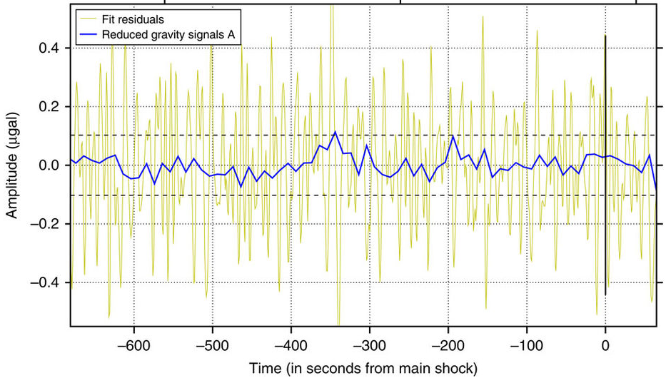
Analytical solution for pre-P gravitational perturbations in full space [Harms et al., 2015]:
Δg
Eq
Radiation pattern
2nd integral of the moment time function
Large earthquakes (with rapidly increasing moment) offer the best potential
Δg
When the earthquake is in its development phase (M₀ ~ t³) :
~
First detection of a perturbation [Montagner et al., 2016] for the 2011 Tohoku earthquake
Kamioka gravimeter in Japan, about 500km from the earthquake

Slide 4
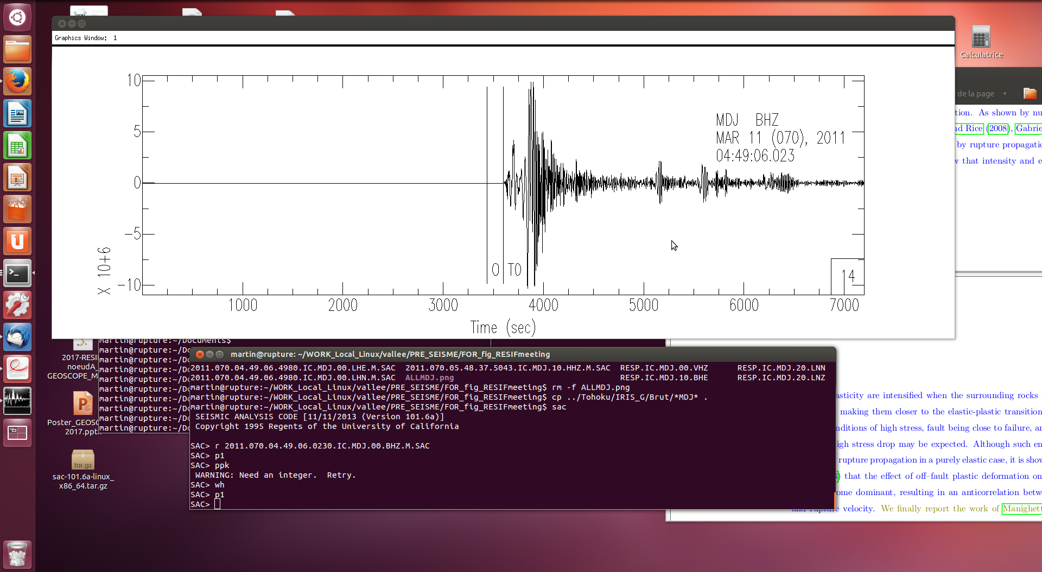
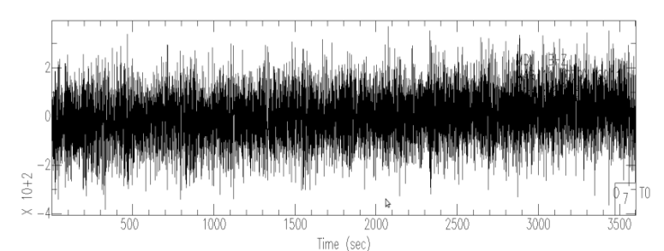
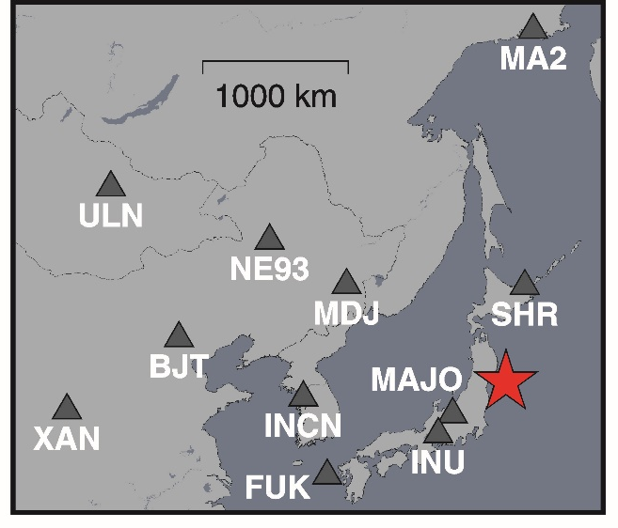
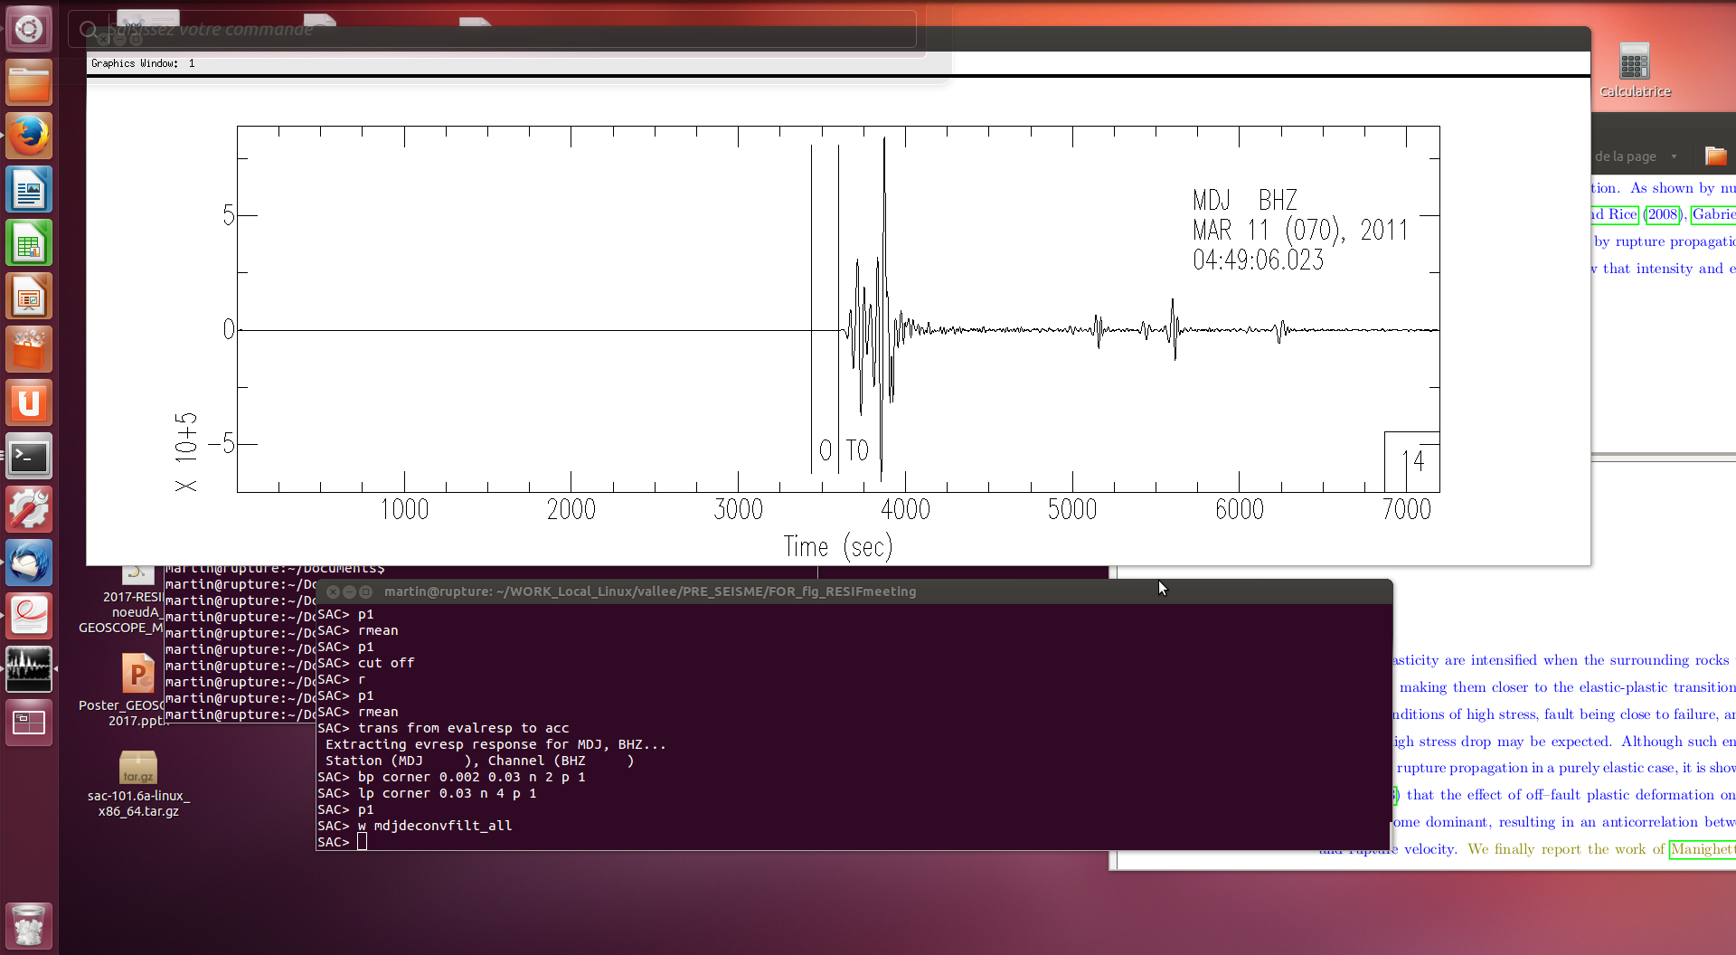
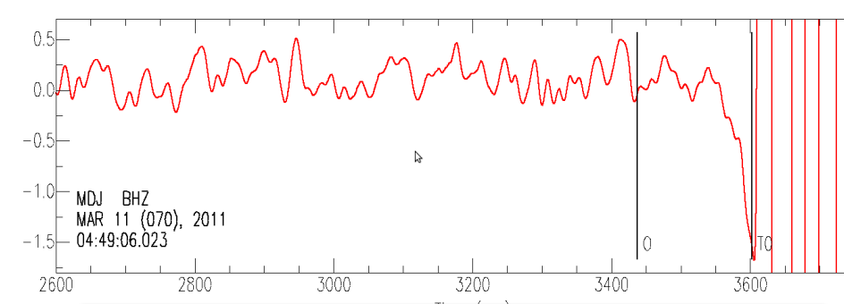
Full space theory indicates that the closest distances do not provide the best observation potential.
Let’s look also further away :
Raw velocity signal
O: origin time
T_{P} : P arrival time
T_{P}
Zoom on the pre-P arrival time (scale /25000)
Deconvolution from the response to acceleration
(nm/s²)
Bandpass filtered between 0.002Hz and 0.03Hz
Observations of the signal recorded at the MDJ seismic broadband station (IC network), located ~1300km from the earthquake
T_{P}
Zoom on the pre-P arrival time (scale 1:600000)
~ -1.6nm/s² pre-P signal
T_{P}

Slide 5
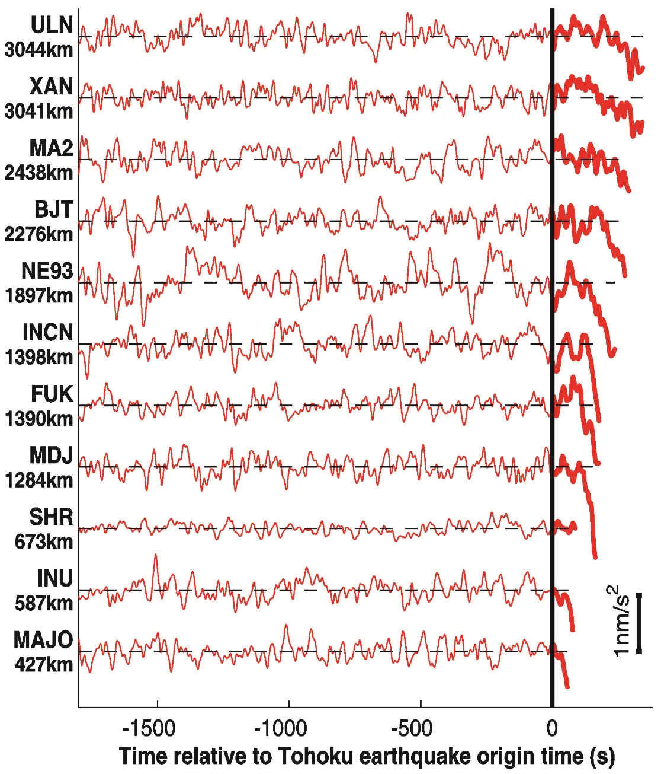

With seismometers, such a tiny signal requires excellent stations to be recorded
After retrieving all the available broadband stations (IRIS), map of all the stations able to detect the signal, based on a Signal-to-Noise ratio criterion
Most of the stations are FDSN stations (IRIS or GEOSCOPE) known for their high quality
Some stations from F-NET (Japan) are also included
Vallée et al., Science, 2017

Slide 6
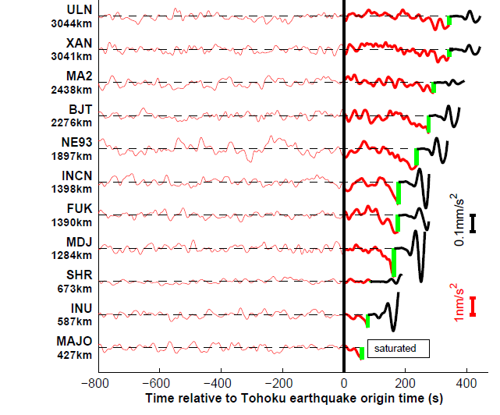
Green tick : P wave arrival
Relative amplitudes between the pre-P and the post-P signals
Pre-P signals are 10⁵ to 10⁶ smaller

Slide 7
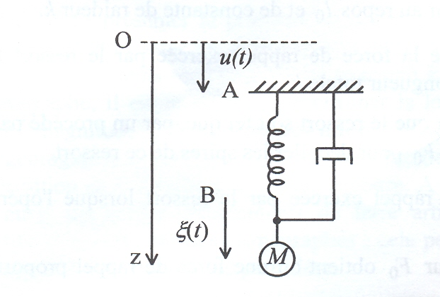
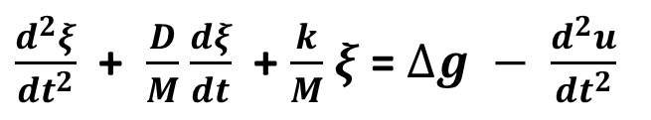
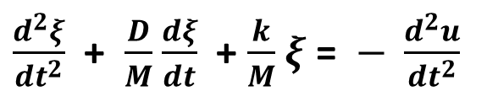
But what are exactly these signals that we observe ?
What do we expect to record with a ground-attached seismometer (or gravimeter) ?
Without gravitational changes, gravity only controls the equilibrium position of the mass, and we have :
$\frac{d^{2}ξ}{{dt}^{2}}$ + $\frac{D}{M}$ $\frac{dξ}{dt}$ + $\frac{k}{M}$ $ξ$ = $− \frac{d^{2}u}{{dt}^{2}}$
(1)
With Δg, (1) is simply modified as :
$\frac{d^{2}ξ}{{dt}^{2}}$ + $\frac{D}{M}$ $\frac{dξ}{dt}$ + $\frac{k}{M}$ $ξ$ = $∆g − \frac{d^{2}u}{{dt}^{2}}$
(2)
A seismometer is therefore a seismo-gravimeter, which records, after correction from the instrumental response, the difference between the ground acceleration and the gravitational perturbations

Slide 8
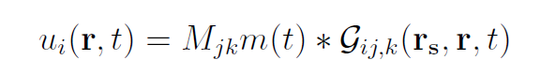
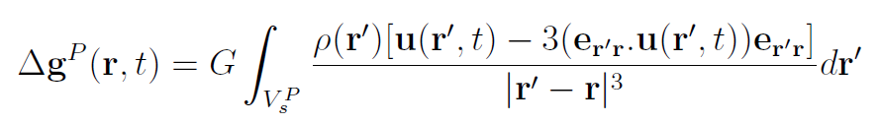
How to compute Δg ?
Let us consider an earthquake in r_{s}, starting at t=0, and generating elastic waves, with the fastest (P) one arriving at T_{P} at the station in r₀
At a given time t (0<t<TP), transient elastic displacements affect the volume V_{s}^{P} around the source
r₀
r_{s}
These displacements can be calculated in every point r of V_{s}^{P} (use of AXITRA method, moment tensor version) with :
V_{s}^{P}
The pre-P gravitational perturbation is controlled by an integral over V_{s}^{P} of the form (Dahlen & Tromp 1998):
Pre-P gravitational change Δg
But note that there is a gravitational perturbation not only at r₀, but everywhere in the medium

Slide 9
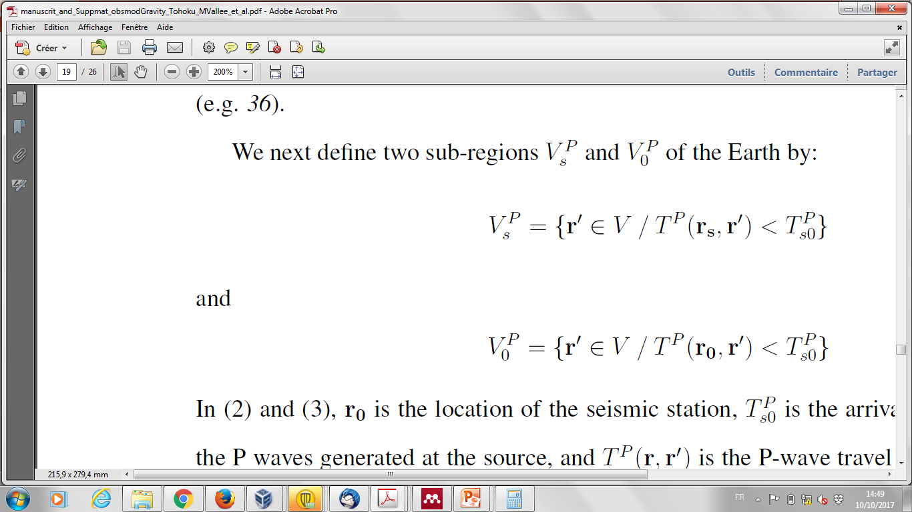
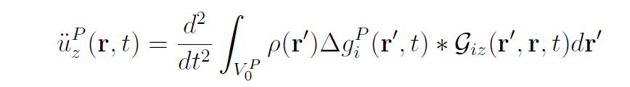
Δg is also a body force acting in the whole medium, which will cause the station to move EVEN BEFORE the arrival to the direct P wave. This can be seen as a try of the Earth to elastically re-equilibrate after the gravitational perturbations.
Concretely, all the gravitational perturbations occurring in the volume V₀^{P} defined by
can generate elastic waves arriving before the hypocentral P arrival at the station
T_{P} }
r₀
r_{s}
V₀^{P}
This gravitational-induced acceleration can be computed with the integral
AXITRA method (single force)

Slide 10
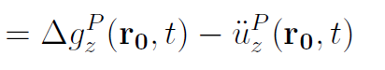
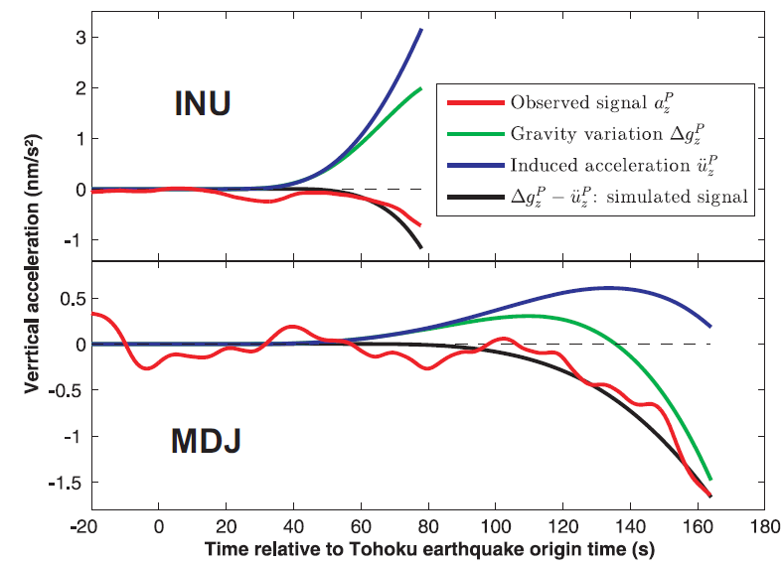
We now have all the ingredients to compute the prompt vertical acceleration recorded by the broadband seismometers
Data & simulations at INU (GEOSCOPE, G) and MDJ (IRIS-China, IC)
Vallée et al., Science, 2017
Remark : at INU station, the recorded signal is negative while the gravitational perturbation is positive : the signal is dominated by the induced acceleration

Slide 11
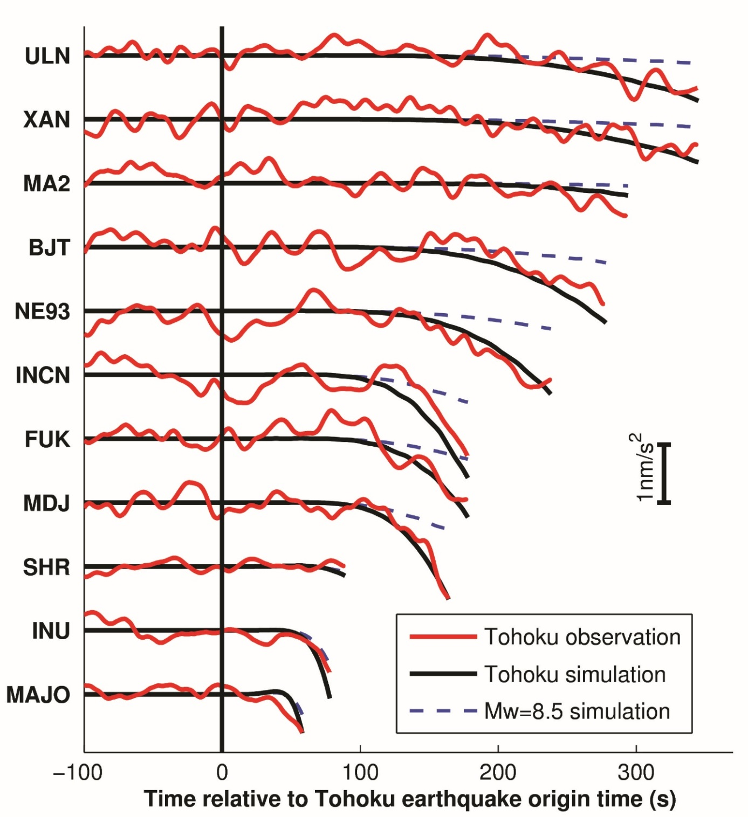

Complete simulation at all stations
Good agreement between observed and modeled signals
Strong sensitivity to earthquake magnitude
[A smaller Tohoku-type earthquake (Mw <8.5) would not have been detected]
Vallée et al., Science, 2017

Slide 12
Conclusions
The signal preceding direct seismic waves is today measurable with high-quality broadband seismometers in case of very large earthquakes
This signal results from elasto-gravitational effects and can be modelled with a 3-stage procedure:
    Elastic displacements in the medium
    Induced gravitational perturbation
    Induced ground acceleration
These observations, besides being original and physically modelled by a new procedure, also have a great potential for an early determination of the earthquake magnitude, in the minutes following a very large earthquake
  Such a potential for early magnitude determination should even more motivate instrumental developments to increase the range of magnitude where these signals can be measured

Slide 14
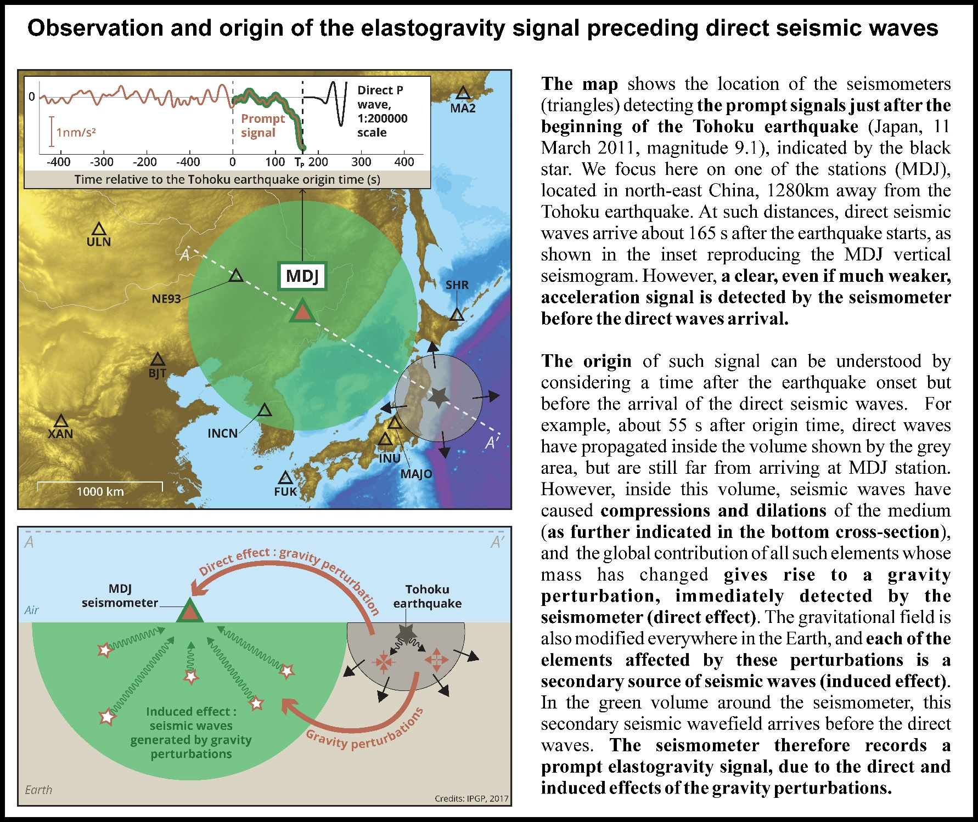

Slide 15
We now have all the ingredients to compute the prompt vertical acceleration recorded by the broadband seismometers
More practical information :
Propagation
  Intensive use of the AXITRA (Cotton and Coutant, 1997) method
  Introduction of Earth flattening formulas (Muller, 1977) to correct for sphericity (some stations are thousands of kilometers away from the Tohoku earthquake)
  Use of the PREM model in the mantle combined with a crust thickness of 40 km
Source
  Global CMT parameters for the source coordinates, origin time, moment tensor (strike, dip, rake = 203°, 10°, 88°)
  isosceles triangular GCMT moment rate function (140 s duration) with GCMT seismic moment (M₀ = 5.31 10²²N.m).

Slide 16
The infinite homogeneous medium
A nice configuration to test the validity and accuracy of the approach, as we theoretically know in this case that there is an exact cancellation between the gravity perturbation and the induced acceleration.
Such a cancellation is very well reproduced by the numerical simulation.

Slide 17
Alternative approaches ?
Normal modes
Normal modes can theoretically model such signals more directly because self-gravitation can be intrisically included.
This theoretical advantage however comes with the drawback of modeling the waves at the global scale (and not around the earthquake as the 3-stage-AXITRA method does)
Results should not be different when frequencies are not too low
(> 0.001-0.002Hz)
Analytical derivations
Offer efficient and insightful computation of the gravity perturbations, both in full-space and half-space models.
These approaches have been explored in detail in the PhD of Kévin Juhel

Slide 18
WEST
EAST
MDJ
Tohoku earthquake
Earth surface
T₁
div u > 0
Depth
div u < 0
T₂
Understanding the sign change of the vertical gravity perturbation at MDJ station

