Slide 1




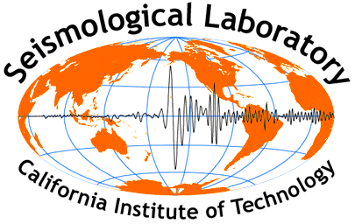





Workshop on future Instruments for gravity-based earthquake early warning
M. Barsuglia (APC), J.-P. Montagner (IPGP)
K. Juhel (IPGP/APC), D. Fiorucci (APC)
P. Bernard, E. Clévédé, P. Lognonné, M. Vallée (IPG Paris)
E. Chassande-Mottin (APC),
J.-P. Ampuero (Caltech), J. Harms (INFN, Italy), B. F. Whiting (U. Florida)

Slide 2
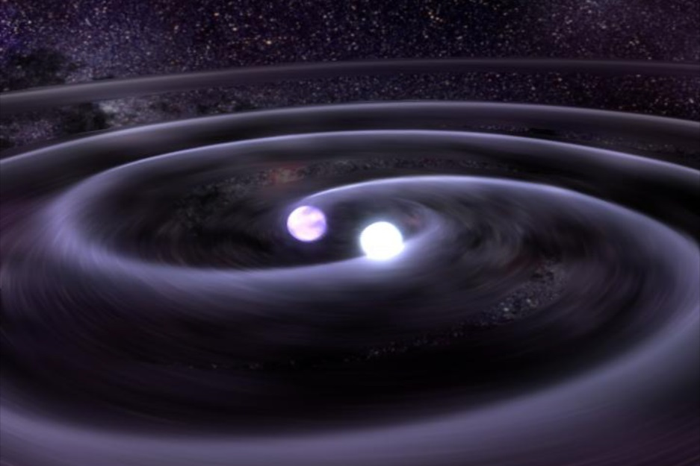
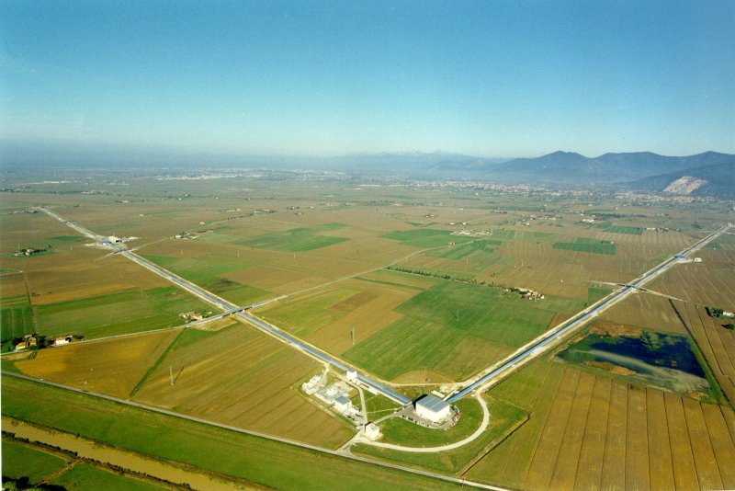
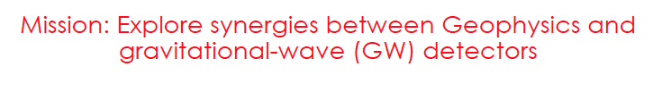
LABEX UnivEarthS geophysics and GW detectors
Fall 2011
VIRGO

Slide 3
History- Motivation
NORMAL MODE THEORY
filtered at 100s
Offset
offset related to the source mass redistribution
(Clévédé & Lognonné, personal communication, 2012)
Notes:
At teleseismic distances this signal is too small to be detected. We looked for gravity data close big earthquakes.

Slide 4
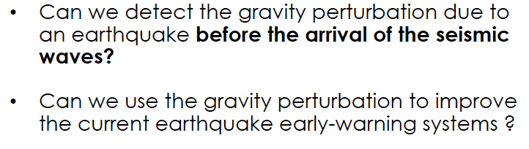
LABEX UnivEarthS
Matteo Barsuglia, Eric Chassande-Mottin APC
Jan Harms, Caltech, INFN
Jean-Paul Ampuero, Caltech
Bernard Whiting, U. Florida
Pascal Bernard,
Kevin Juhel, PhD, Donatella Fiorucci, Post-doc
Martin Vallée, IPGP
Current Project (+ E-GRAAL)
VIRGO

Slide 5
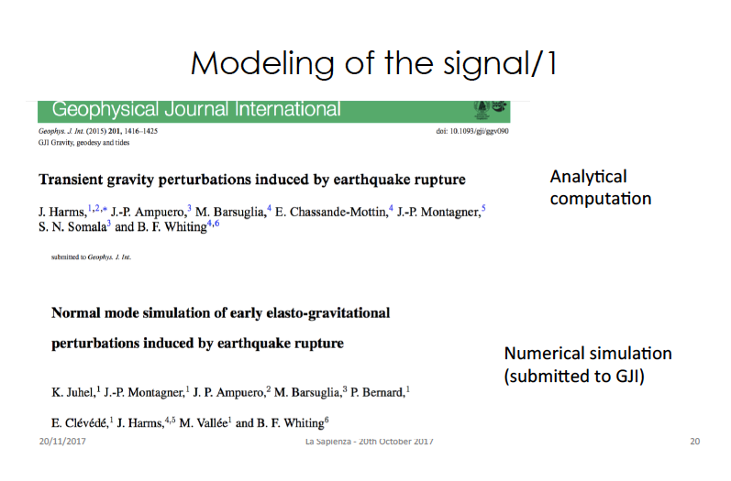

Slide 6
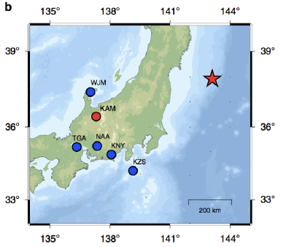
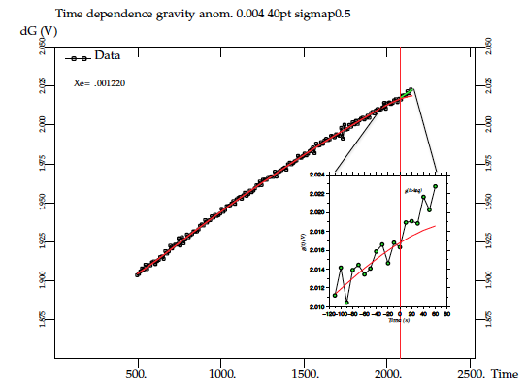
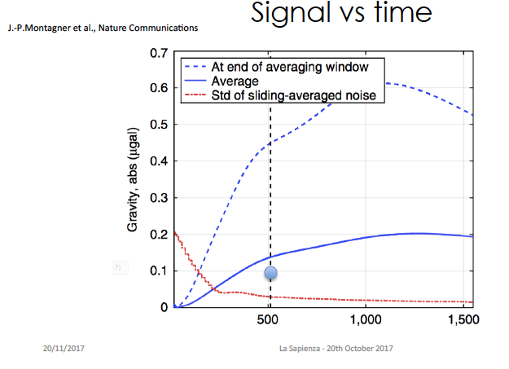
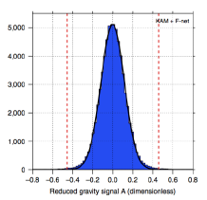
First act
Detection of a gravity signal for the 2011 Tohoku earthquake in Japan
VIRGO
Superconducting
Gravimeter
KAMIOKA
+VBB seismic stations
Montagner et al., Nature Com., 2016

Slide 7
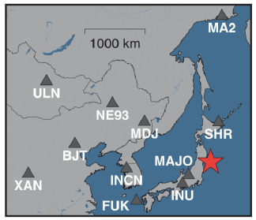
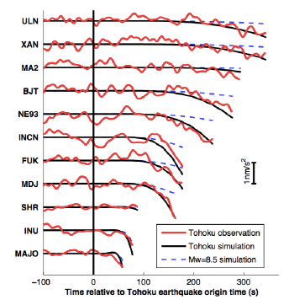
Second act
Detection of a gravity signal for the 2011 Japan-Tohoku earthquake in East Asia
Vallée et al., Science, 2017

Slide 8
Workshop on future Instruments for gravity-based earthquake early warning
Need for new instruments
-State-of-the-art
Martin Vallée, Kevin Juhel, Donatella Fiorucci
Séverine Rosat, Isabelle Panet
New avenues of research
Ho-Jung Paik, Masaki Ando, Brad Sigmolen
Jo van den Brend, Fiodor Sorrentino, Rémi Geiger

