Slide 1
GRETINA Detectors
Status and failures
Chris Campbell
Thanks to Dirk Weisshaar,
Shaofei Zhu, and Heather Crawford

Slide 2
GRETA/GRETINA detector design
Radiall connector
LN₂ cooled
~100K
Preamplifier
housing
Warm FET for
segments
Liquid cooling
(for preamplifier)
Two crystal geometries (A and B-type)
FWHM at 1.3MeV: central < 2.35 keV
segments <2.5 keV
Four 36-fold
segmented
HPGe detectors
Cold FET for
central contacts

Slide 3
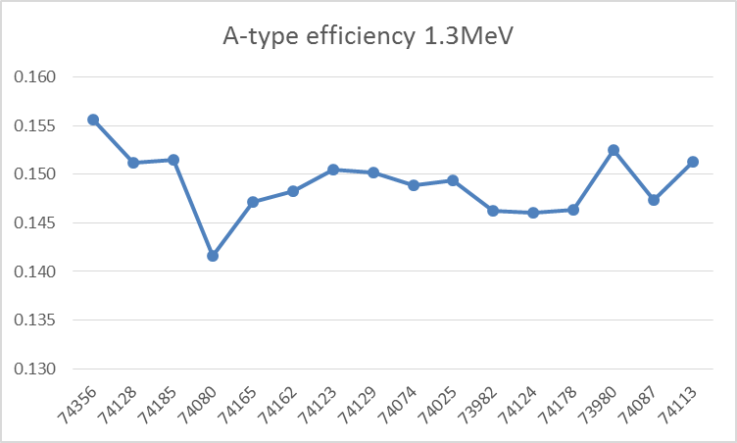
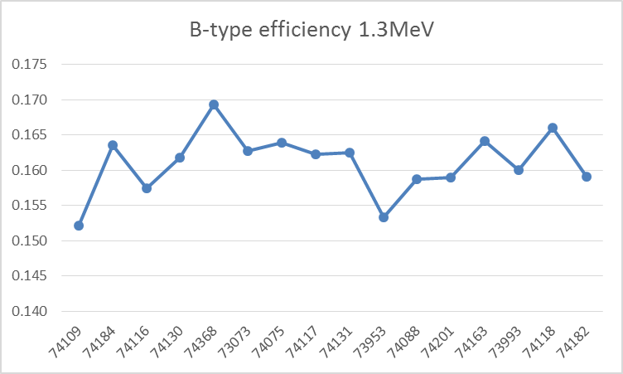
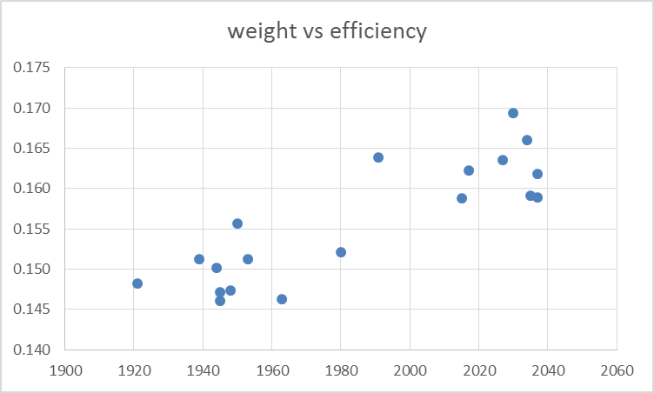
Efficiency
Absolute efficiency at 1.3MeV with
source put at nominal target position
(17.8 cm from endcap).
Measured mean values for 16 crystals:
A-type: 0.149(5)%
B-type: 0.161(5)%
Efficiency [%]
GRETA spec: > 0.14%
crystal s/n
Efficiency [%]
GRETA spec: > 0.15%
crystal s/n
crystal mass in [g]

Slide 4
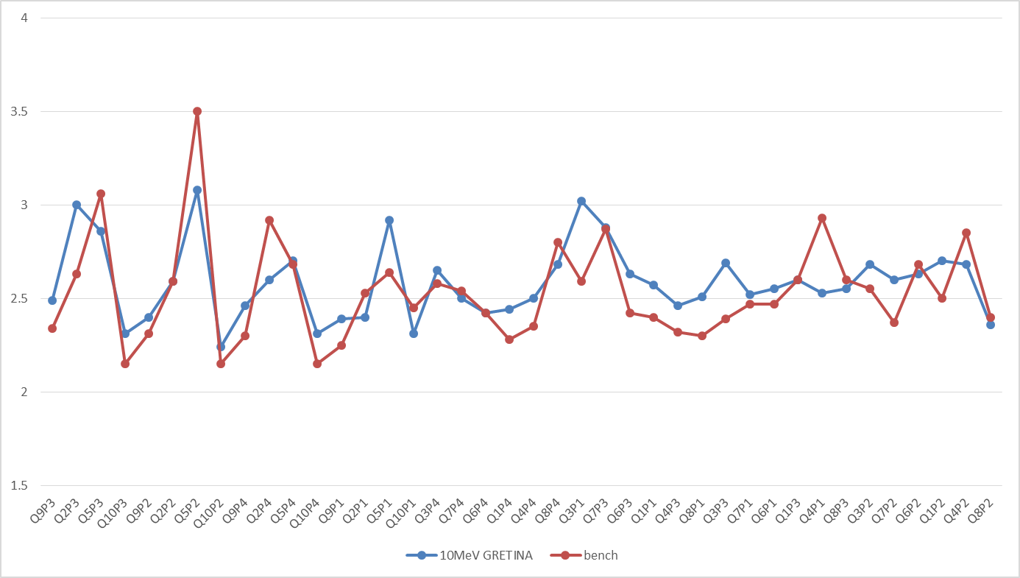
Detector resolution in real life*
* after detectors saw their fair share of radiation damage
FWHM of GRETINA detectors measured recently
Leakage current
Blue: measured few weeks ago in array
Red: measured ‘on the bench’ when detector arrived
for campaign (after ANL campaign, no annealing performed)
microphonic
Central contact FWHM at 1.3MeV in [keV]
‘worse’ resolution mostly
because of neutron damage
‘new’ detectors

Slide 5
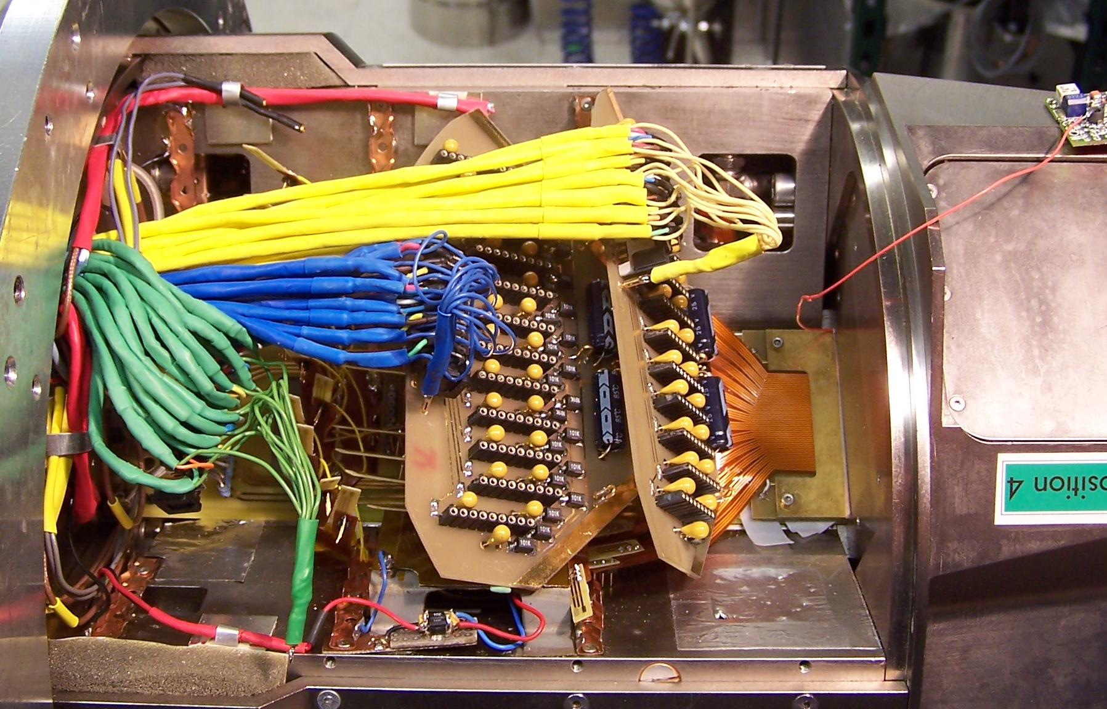
We can (almost) fix anything on our own
Preamplifier
housing
(e.g. short in
motherboard)
Remove endcap:
Change cold FET
Swap broken capsules
Radiall connector
(e.g. changing damaged pins)
Reliability:
At NSCL 37 out of 40 experiments were carried out without a single missing crystal. (3 with ONE dead central contact FET)
Change blown warm FET

Slide 6
Detector temperature over 3 years
LBNL
NSCL
ANL
pumped
pumped
Preamp off
(xmas)
Measurement with RGA confirmed He in detector module’s cryostat vacuum
Do we need Basis to track temperature???

Slide 7
Failures after annealing
In 2012 all GRETINA quad systems got annealed at 100ºC for 40-60 hours.
Status after annealing in 2012 after LBNL :
Q4 P2: ε2 short connection
Q6 P4: leakage through α4 for HV>4700V. At HV = 4500V ΔE 2.5keV
Q7 P3: leakage through α1, ΔE 3.1keV
………………………
In 2013 all GRETINA quad systems got annealed at 105ºC for 100 hours.
(increase from 100ºC to 105ºC in agreement with Canberra)
After this annealing, leakage current on 5 crystals.
Q2 P1: ΔE 6keV, leak α5 Q3 P1: unusable, leak β3 Q5 P2: ΔE 5keV, leak ε2
Q6 P4: ΔE 4keV, leak α4&5 Q7 P3: ΔE 3.1keV, leak α1
Q2 P1, Q3 P1, Q5 P2, and Q6 P4 were sent for repair to Canberra.
Q7 P3 performance is unchanged and was therefore not sent for repair.
Note: No annealing cycle was performed since 2013

Slide 8
Core FET Failures
Detector Position | Crystal SN | 2012 | 2013 | 2014 | 2015 | 2016 | 2017
Q1Pos1 | 73953 | -- | -- | -- | -- | -- | 11/28
Q1Pos3 | 73993 | -- | -- | -- | -- | -- | 11/28
Q1Pos4 | 74025 | -- | -- | -- | -- | -- | 11/28
Q5Pos1 | 74117 | -- | -- | 12/4 | 7/6 | -- | 11/13
Q5Pos3 | 74130 | -- | -- | -- | -- | -- | 11/15
Q5Pos4 | 74129 | -- | -- | -- | -- | -- | 11/13
Q6Pos2 | 74178 | 4/12 | -- | -- | 9/14 | -- | 11/13
Q6Pos3 | 74131 | -- | 10/7 | -- | 9/14 | -- | 11/13
Q7Pos3 | 74182 | -- | -- | -- | 7/24 | -- | 12/21
Q8Pos4 | 74165 | -- | -- | -- | -- | 2/ | --

Slide 9
Recent Example
Failure Circumstances
  Q1 @ full bias [P2 disconcected] …
  Next morning, Q1 P1,3,4 CC signals were gone (FETs dead). Some segments on Q1 P1&4 were also lost.
Repair/Recovery
  Quad was removed from array, and pumped on while being warmed up
  Cold FETs were changed
  Detector was outgassed at 85°C for 100 hours, and then cooled down
  Segments checked and dead FETs replaced

Slide 10
Details
Correlated failures
  Q1 P1,3,4
  Q5 P1,3,4 Time between failures
  Q6 P2,3 Time between failures
  Q5,6 first failure within 30 min. of full bias
Q7P3
  At full bias for at least 12 hours before it died
  Detector had been fully biased for several days in the array, and was biased down to allow removal of other modules from the frame
Q8P4 [Feb. 2016]
  Installed in array and operating a full bias voltage for some weeks
  CC signal disappeared while mounted and operational in array

Slide 11
Status today
GRETINA @ FMA
  11 Quads operational
  43 of 44 crystals working
    1 Core preamplifier failed, will be replaced following current FMA campaign
  5 crystals each with a single missing segment
    Only one due to problem in the capsule
    Others missing due to Radiall connector and cabling problems

Slide 12
Future modules
GRETINA Q12 ordered
  May 2018 scheduled delivery
  Electronics purchased and installed in DAQ
GRETA Request For Proposal (RFP) expected soon

Slide 13
END

Slide 14
Summary
The GRETA/GRETINA detector module is a solid piece of hardware!
High reliability, good maintainability
Close interaction with detector manufacturer ensured and ensures a
high-quality detector system
Close working relation was developed with the AGATA project, also in terms
of detector technology, ensuring that GRETA will get state-of-the-art technology
Technical concerns were identified, addressed, and solved (microphonics, x-talk, rise time)
or strategies how to solve are in place (annealing, He-permeation)
The current detector design and performance is a result from our ‘lessons learned’
experience during the GRETINA project
Continuing with the current detector design for GRETA ensures the absence of any
technical risks in the ‘Detector Systems’ box WBS 1.02

Slide 15
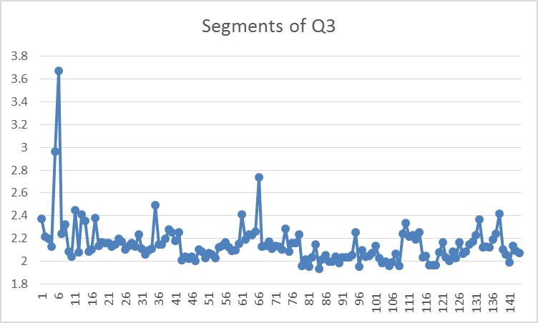
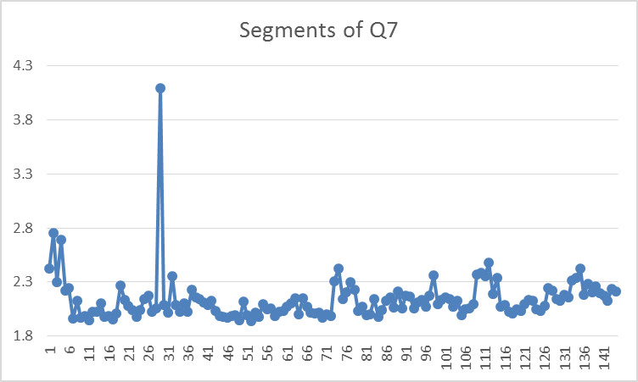
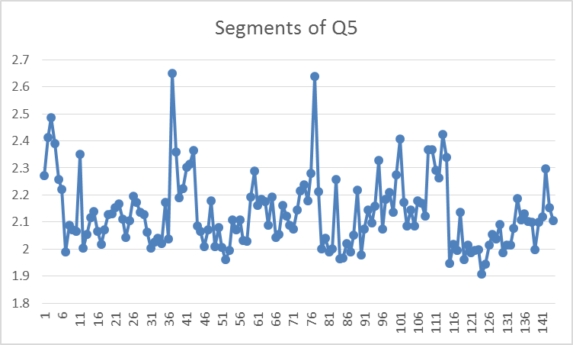
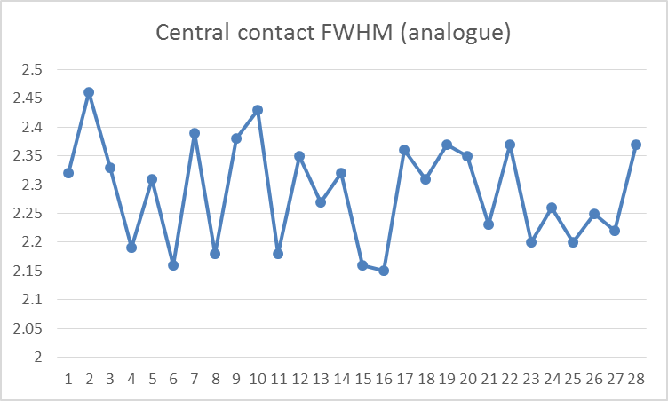
Energy Resolution measured at acceptance
microphonics
Mean 2.15keV
microphonics
Mean 2.14keV
Mean 2.13keV
Mean 2.29keV

Slide 16
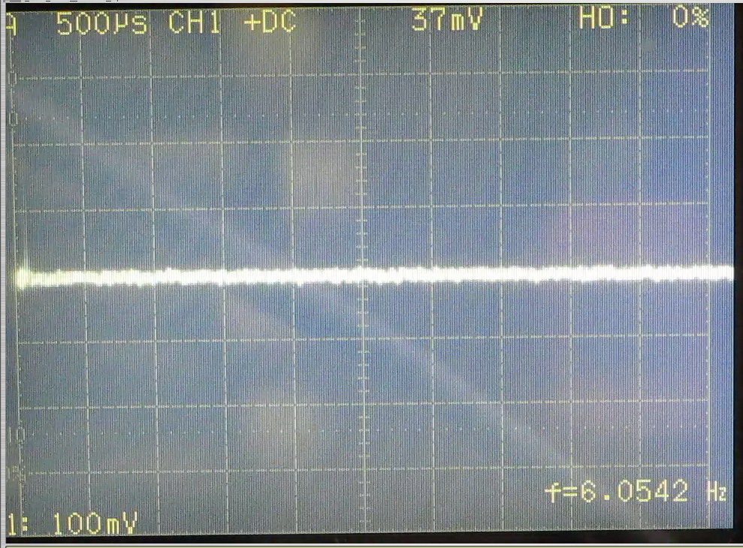
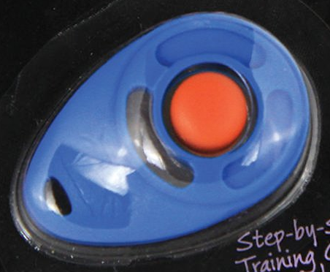
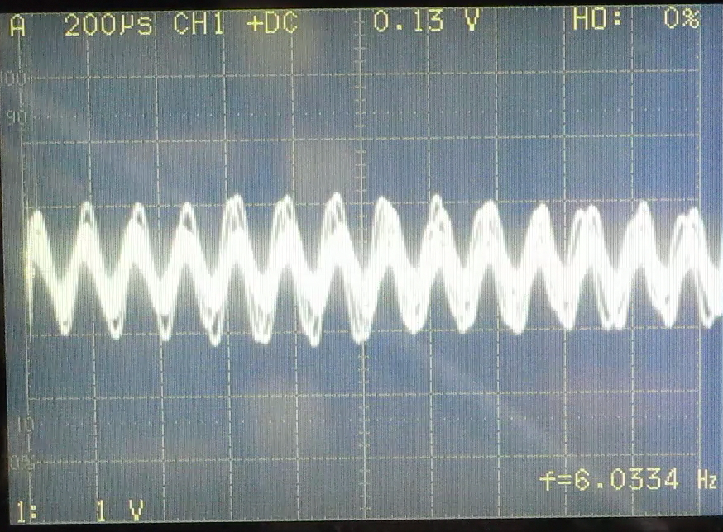
Microphonics seen during acceptance
Clicker on a segment w/o response
Clicker test:
Detector response (shaped signal, 6μs) while
using a clicker in 25 cm distance from detector
Clicker on a microphonic segment
(this segment does 3keV at ambient noise)

Slide 17
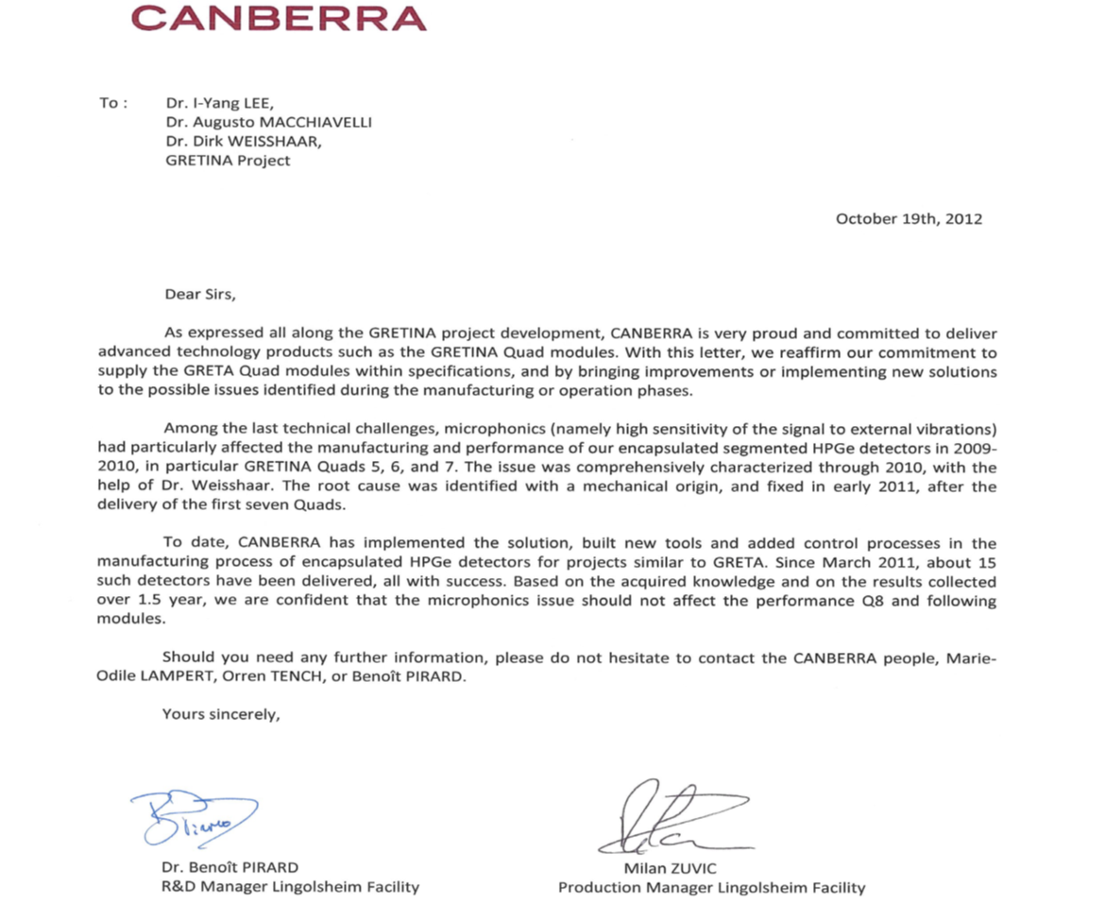
Microphonics after 7th GRETINA quad
After negotiations about the
microphonics with the vendor
we got finally this letter as a
conclusion of the matter.
Indeed, since then all capsules
(but one in recent Q10) delivered
did NOT show those microphonics
anymore.
“…microphonics issue should
not affect the performance Q8
and following modules.”

