Slide 1
Status of the ENSAR2 JRA2 - PSeGe
A.Gadea (IFIC-Valencia) for the PSeGe Collaboration

Slide 2
ENSAR2 (project number: 654002) is the integrating activity for European nuclear scientists who are performing research in three of these major subfields: Nuclear Structure, Nuclear Reactions and Applications of Nuclear Science.
Its core aim is to provide access to eleven of the complementary world-class large-scale facilities: GANIL-SPIRAL2 (F), INFN (LNL & LNS) (I),CERN-ISOLDE (CH), JYFL (FI), ALTO (F), GSI (D), KVI-CART (NL), NLC (IFJ PAN-Krakow & HIL-Warsaw) (PL), IFIN-HH/ELI-NP (RO) and to the theoretical physics facility: ECT* (I).
It provides as well Network and Joint Research Activities funding.
ENSAR2 started on March 1st, 2016. It will last 4 years
ENSAR2 is funded by the European Commission within its HORIZON2020 Programme under the specific programme 'Infrastructures'.

Slide 3
JRA2 – PSeGe R&D on Position-Sensitive Germanium Detectors for Nuclear Structure and Applications.
Andres.Gadea@ific.uv.es, Daniel.R.Napoli@lnl.infn.it, Peter.Reiter@ikp.uni-koeln.de http://psege.lnl.infn.it
The present project is contributing to the R&D of detector technology for position-sensitive HPGe detector arrays. R&D on key areas as detector technology. The work of the JRA2 is proceedings according to plan.
Participants:
IFIC-CSIC: personnel funds for Task3
INFN-LNL: personnel funds for Task 1
Uni. Cologne: personnel funds for Task 1
GSI: personnel funds for Task 2
Uni. Liverpool: networking funds for Task 4
CNRS: networking funds for Task 4
Task 2: R&D on novel Ge-detector geometries for ultimate position resolution and efficiency
Modeling and simulation of electrical-field distributions, evaluation of the 3D position resolution obtainable, production of a prototype detector in cooperation with the industrial partner, experimental determination of the performance figures with the produced prototype.
Task 3: R&D on segmented p-type coaxial detectors
R&D on basic properties of the dopants producing high hole-barrier n-contacts, evaluation of the barrier and study of segmentation with these materials.
Associated partners:
KTH &University of Uppsala, Sweden, ELI-NP, Romania, University of Milan, Italy, STFC, UK, University of Salamanca & University of Valencia, Spain, CEA-Saclay, France
Task 1: New technologies on passivation and segmentation
R&D of segmented contacts in HPGe detectors and of the passivation of the boundary regions between contacts, charge collection and electric-field exploration via 2D scans.
Task 4: Demonstration of imaging applications and associated detector technologies
4.1: Demonstration of imaging applications
4.2: Detector encapsulation techniques
4.3: R&D on associated Detector technologies
4.4: PSA and neutron-gamma discrimination

Slide 4
Status (I)
Task 1: New technologies on passivation and segmentation
Contract assigned to INFN ongoing (Walter Rainiero) since 3/11/2016
Done the first test of implantation of Boron in planar detectors to produce new contact technologies
Now working in the preparation of a coaxial detector from a raw Ge-HP crystal in order to check the new contact technology in quasi-coaxial detectors.
The contract for a post doc position in IKP-Cologne is assigned (Herbert Hess) starting from 1.12.2016. Funds will be used until 31.8.2018
Work on the new encapsulation technique at IKP-Cologne.
Cryostat development is ongoing for new detector prototypes in collaboration between IKP-Cologne and INFN.

Slide 5
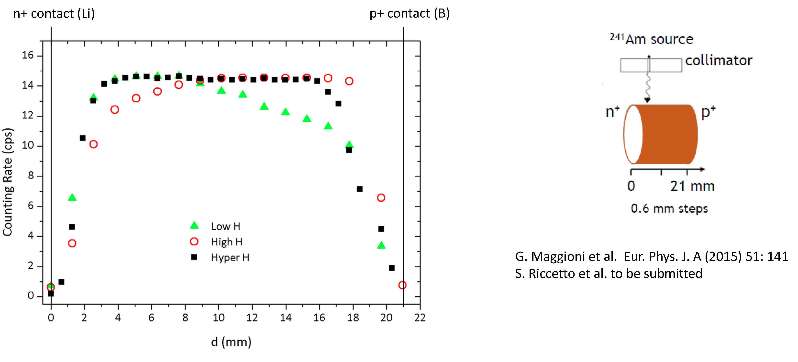
Activities ongoing:
V.Boldrini et al: Characterization of thermally induced shallow defects in HPGe.Thermally-induced defects and contamination in candidates for HPGe doping techniques.
W.Raniero et al: Preparation of segmented coaxial detector prototypes with new pasivation techniques.
F. Sgarbossa et al.: Investigation of P Monolayer Doping in Germanium
New Hydride Passivation Techniques

Slide 6
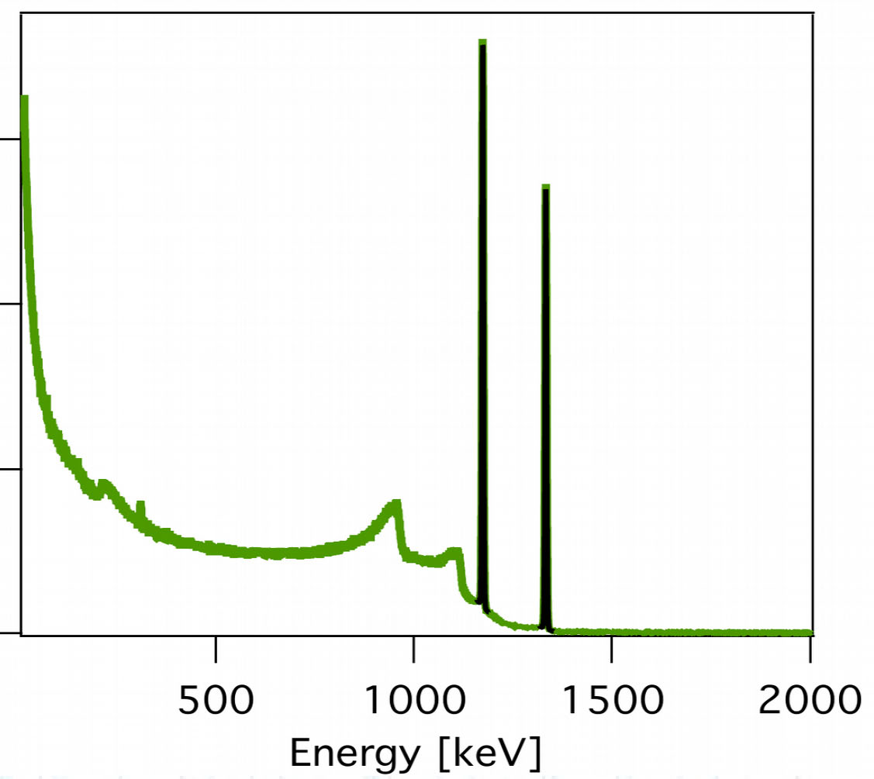
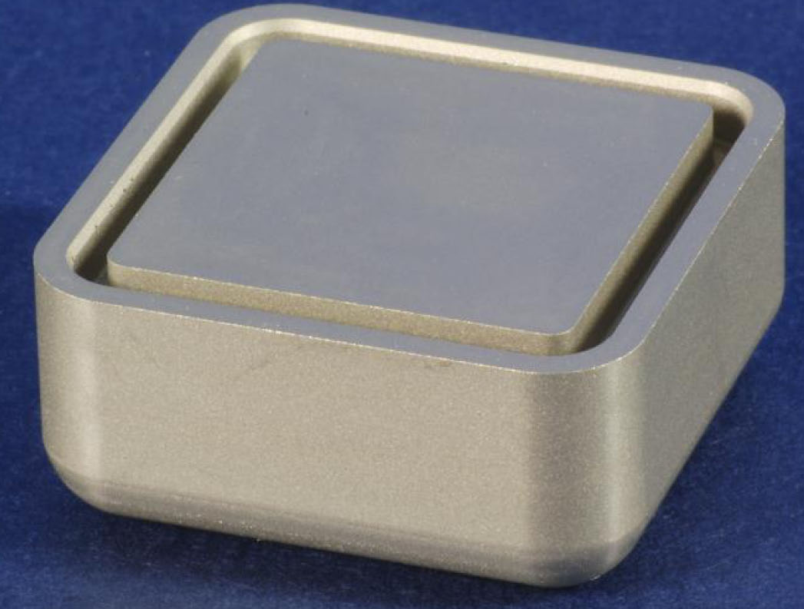
Status (II)
Task 2: R&D on novel Ge-detector geometries for ultimate position resolution and efficiency
Contract on-going (Tugba Arici)
Proceeding with the prototype of quasiplanar geometry for position sensitive Ge detectors. First prototype is now been characterized.

Slide 7
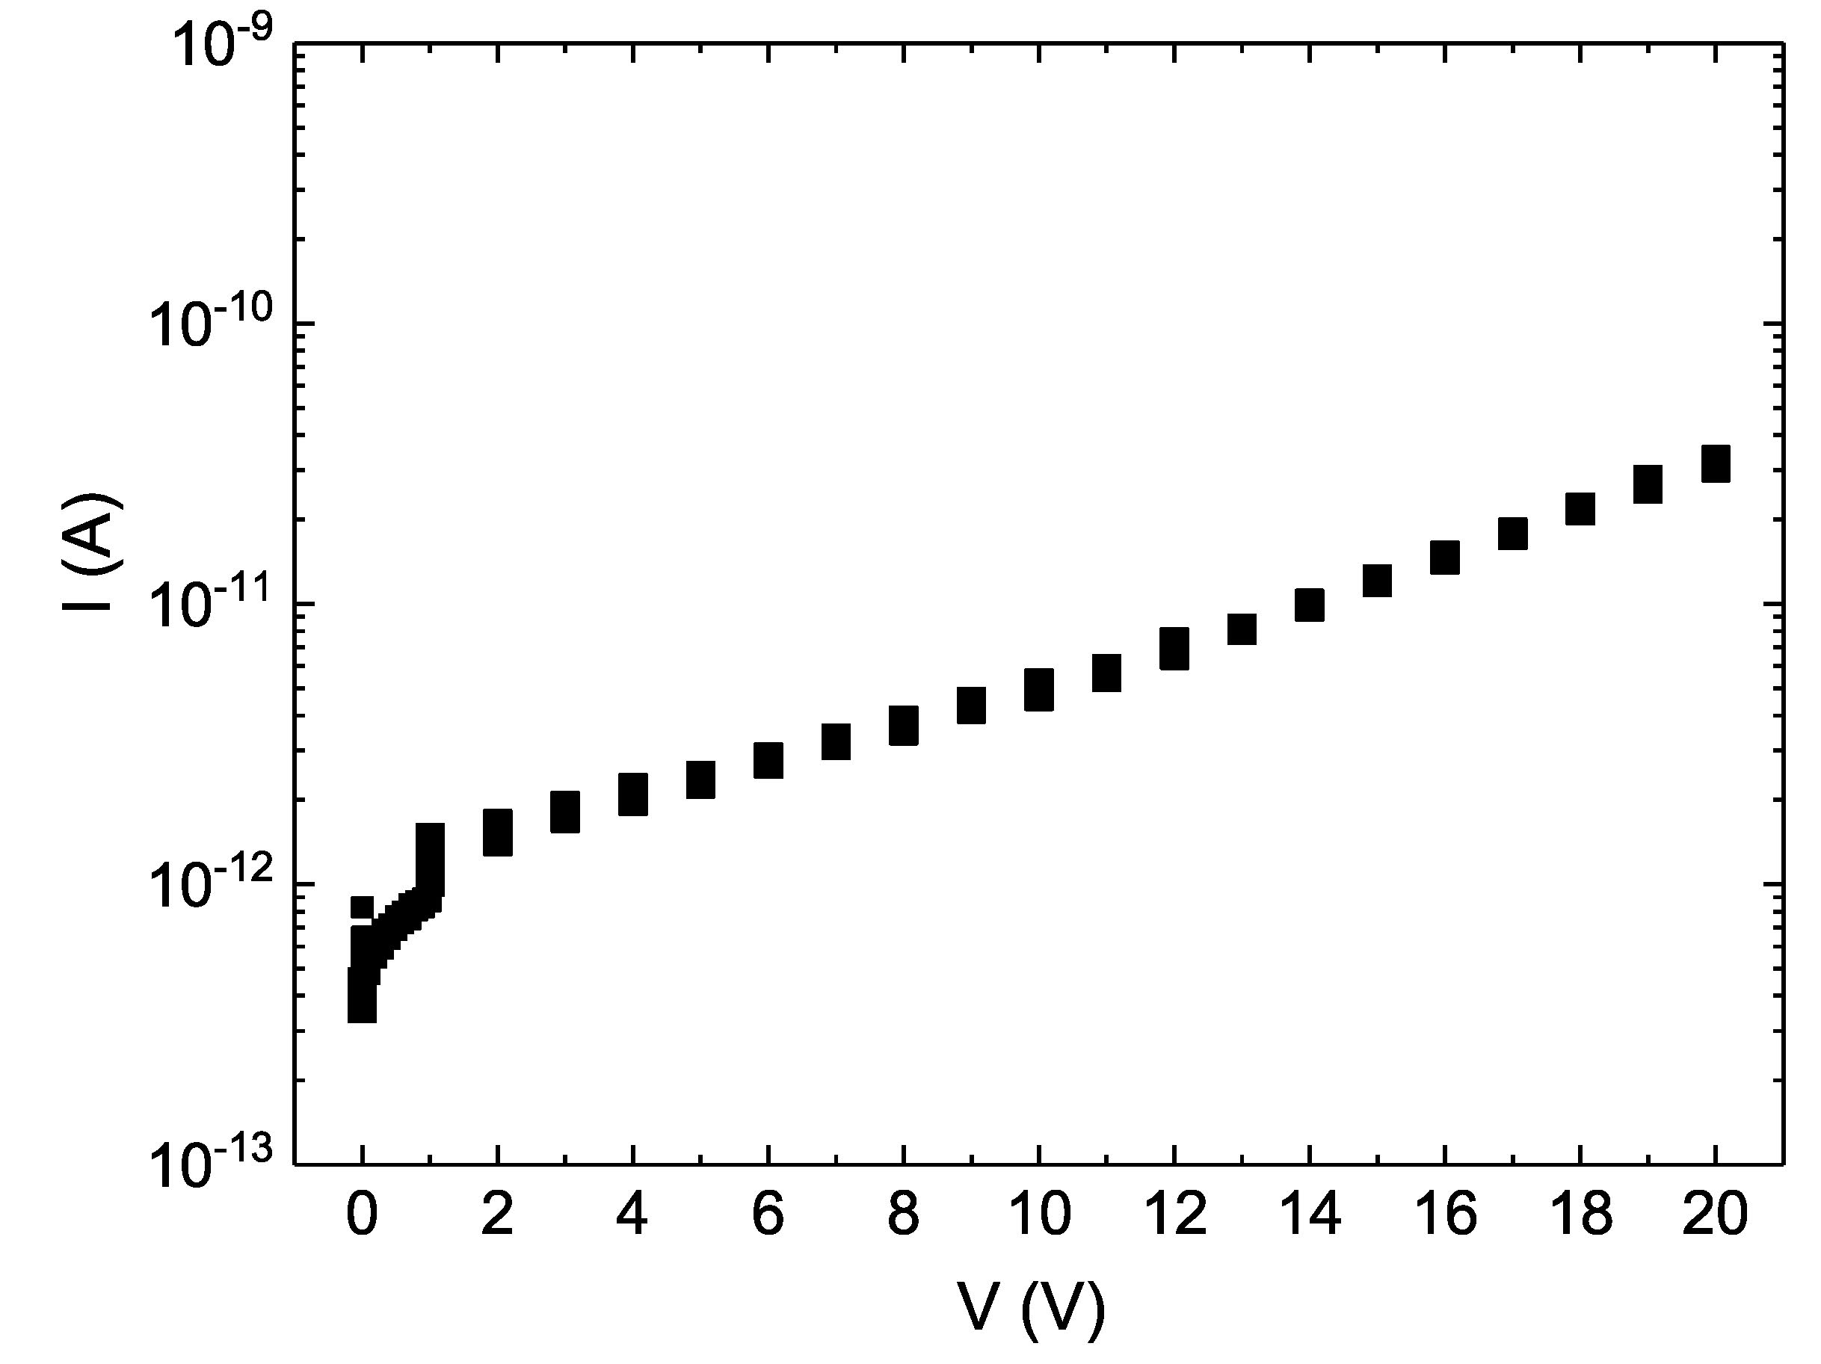
Status (II)
Task 3: R&D on segmented p-type coaxial detectors
Test on the use of Phosphorous for dopant diffusion and activation for the junction formation done, not good results. Now Sb as dopant being tested.
Collaboration established with the Micro electronics group of the University of Padova, Italy
Ongoing contract for a pre-doctoral collaborator Stefano Bertoldo.
Diode Prototype
1cm², 2mm thick
Under test
n contact Sb
P contact B

Slide 8
Status (III)
Task 4: Demonstration of imaging applications and associated detector technologies
Done the 1st and the 2nd workshops on Detector R&D, Applications and associated technologies.3rd being organized
Training sessions on advanced detector technology organized.
Collaboration on-going on Position Sensitive Ge Detector Imaging applications.
IKP-Cologne is contributing to the developments with the work of a master student (Rouven Hirsch) working on gamma ray imaging with two different position sensitive HPGe detectors: a cylindrical coaxial detector, and tapered AGATA detector both 36 fold segmented. This work performed in collaboration with University of Liverpool.

Slide 9
Summary:
The PSeGe activity is progressing timely in several fronts.
Prototypes in Task 1, i.e. new pasivation techniques, Task 2, i.e. new geometries, and Task 3, i.e. p-type contacts, exist or are being produced.
Promising p-type contacts based on Sb.
Networking funds allow the organization of the workshops and training visits to the Laboratories with Ge detectors experts.

