Slide 1
Characterization of an n-type Segmented Inverted Coaxial Point Contact (ICPC) Detector
Heather Crawford (LBNL)
Second AGATA-GRETINA Collaboration Meeting, CSNSM Orsay Campus, CNRS France -- April 4-6,2018

Slide 2
Outline
Overview of the n-type Segmented Inverted Coaxial HPGe Point Contact Detector
Energy resolution from the point contact
  Drift time corrections
  Azimuthal angle reconstruction
Full position (r and z) reconstruction
In-beam characterization work
Next steps…

Slide 3

Outline
Overview of the n-type Segmented Inverted Coaxial HPGe Point Contact Detector
Energy resolution from the point contact
  Drift time corrections
  Azimuthal angle reconstruction
Full position (r and z) reconstruction
In-beam characterization work
Next steps…
Marco Salathe

Slide 4
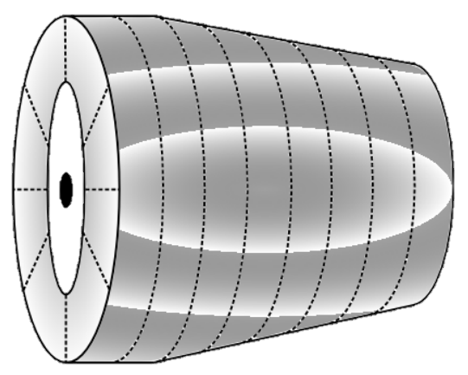
Inverted Coaxial HPGe Point Contact Detector
Novel, large-volume gamma-ray tracking detector combining electrode segmentation and point-contact technology
Combines benefits of segmented (GRETA/AGATA) and point contact (Majorana/GERDA) detector technologies
Strong variation in charge drift time and highly localized point contact weighting potential allows direct identification of number of interactions
Signal shape at point contact allows precise determination of charge arrival time
Segmentation of outer contacts provides determination of interaction time
Knowledge of drift time allows precise determination of interaction position from segments signals
  Predicted position resolution approximately σ ~ 0.2mm
  Factor 3 -4 better than predicted for GRETINA
Vetter et al., NIMA 452, 223 (2000). | Cooper et al., NIMA 665, 25 (2011).

Slide 5
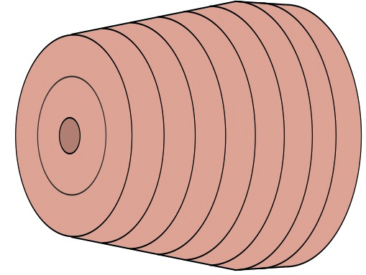
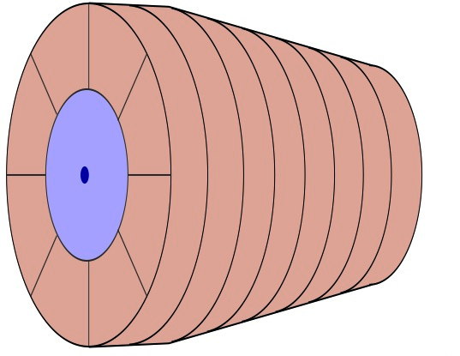
n-Type ICPC Prototype Detector
Produced by Canberra France for David Radford (ORNL)
7 cm rear diameter; 8 cm length; 10 degree taper over 6 cm of length
20 individual segments
  Point contact (full volume electrode) on the back
  8 wedges surrounding the point contact
  8 longitudinal slices on the sides
  2 concentric circular electrodes on the front
  1 contact in the bore hole (front)
Cooper et al., NIMA 665, 25 (2011).

Slide 6
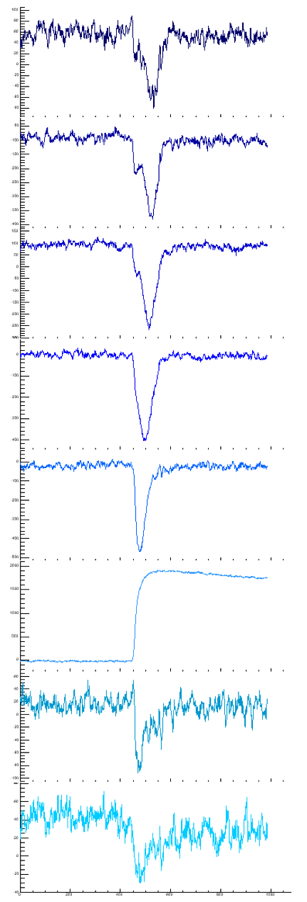
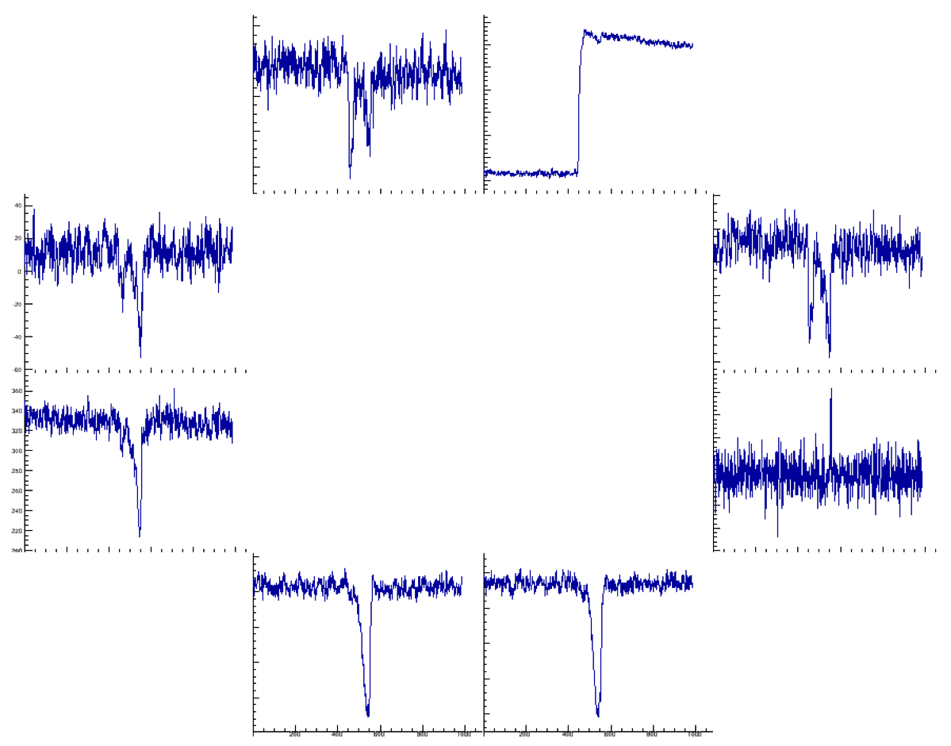
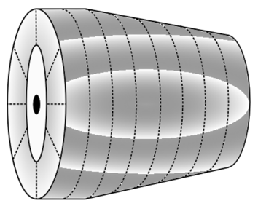
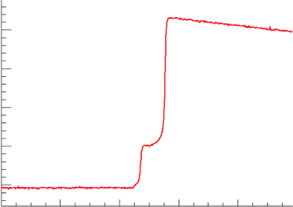

A representative event…
⁶⁰Co
Individual event data shows power of slow-drift combined with segmentation
Along z (vertical), slices clearly show drift of charge from first interaction point toward PC
Second hit (back) is located by wedge signals (net + neighbours)
Drift time (segment time --> PC time) refines z information

Slide 7
Charge Trapping in the n-type ICPC
For n-type material electron trapping is significant even at standard impurity levels (without damage)
Large variation in drift times, paths and the associated trapping strongly degrades the resolution (and peak shape)
Can ‘HPGe resolution’ be recovered?
Salathe et al., NIMA 868, 19 (2017).

Slide 8
Charge Trapping: Drift Time Correction
To a first approximation, charge trapping increases linearly with drift time
Division of data into (100ns) drift-time slices and calculation of centroid provides first linear correction
Salathe et al., NIMA 868, 19 (2017).

Slide 9
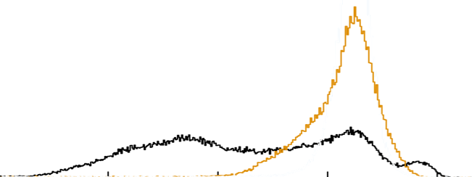
Charge Trapping: Drift Time Correction
Simple linear correction works well at low drift-times, i.e. close to the PC where electrons are ultimately collected
Divergence at long drift-times shows clear dependence of resolution on other parameters
Salathe et al., NIMA 868, 19 (2017).

Slide 10
Charge Trapping: Azimuthal Angle Effect
Beyond drift-time -- an approximate proxy for depth (z) -- other obvious parameters are radius and azimuthal angle
Strong variation in the amount of trapping is clearly observed at different azimuthal angles
Salathe et al., NIMA 868, 19 (2017).

Slide 11
Azimuthal Angle Reconstruction: Building a Basis
An experimental basis for azimuthal angle reconstruction was built
A ring of collimated vertical ¹³⁷Cs measurements were taken in the detector at a radius of 24 mm, with 2.5 degree spacing
Photopeak events satisfying A/E cut were averaged to build a basis at each angle, considering on the rear 8 wedge segments
Salathe et al., NIMA 868, 19 (2017).

Slide 12
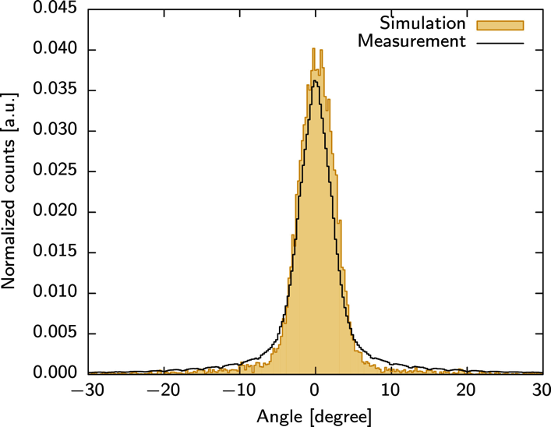
Azimuthal Angle Reconstruction
A fit of individual events to the available basis signals, using a χ² minimization, and then a linear interpolation between grid points allows reliable azimuthal angle determination
Salathe et al., NIMA 868, 19 (2017).

Slide 13
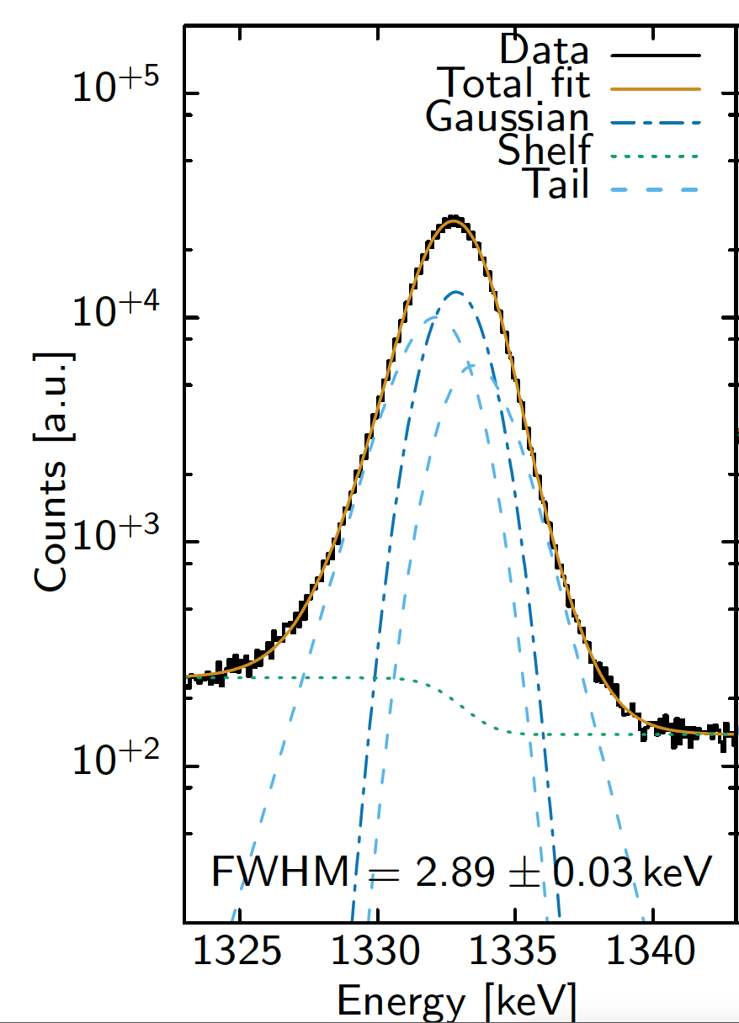

Charge Trapping: Drift and Angle Correction
Uncollimated ⁶⁰Co measurement (from the crystal front) shows performance of angle-drift time correction
For single-site events, now at ~2.9 keV at 1332 keV with these corrections
Salathe et al., NIMA 868, 19 (2017).

Slide 14
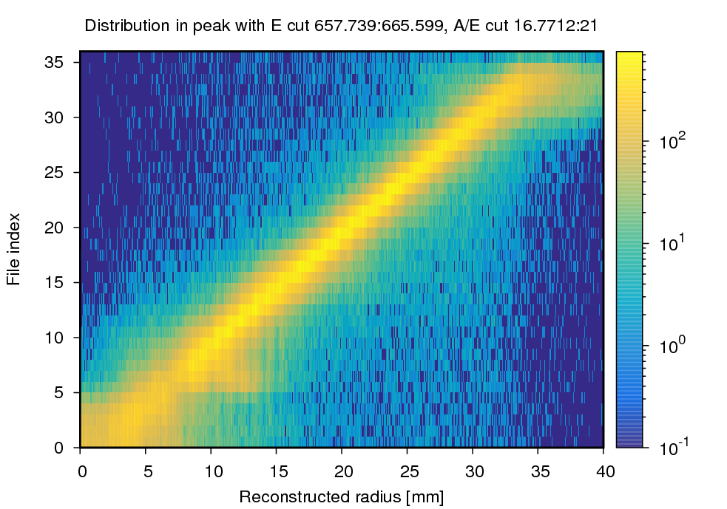
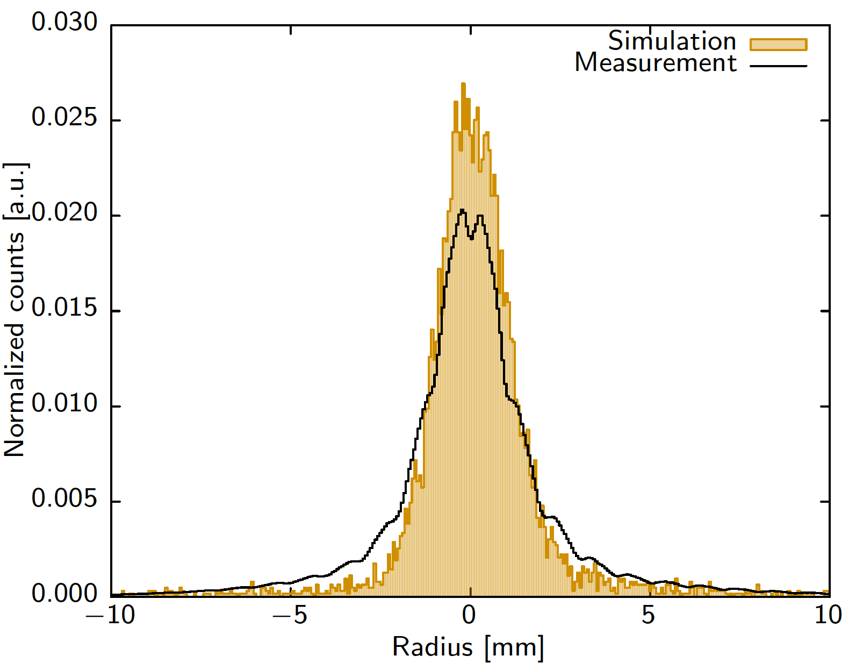
Radial Position Reconstruction
45°
Radial reconstruction is performed following 𝜑 determination
Signals from the front and longitudinal segments included in bases indexed by observed net segment, 𝜑 and drift time
Least-squares χ² minimization and interpolation between basis points determines r position
Good performance achieved with (at this point) single iteration of fitting step, except in region very near point contact (r = 0)

Slide 15
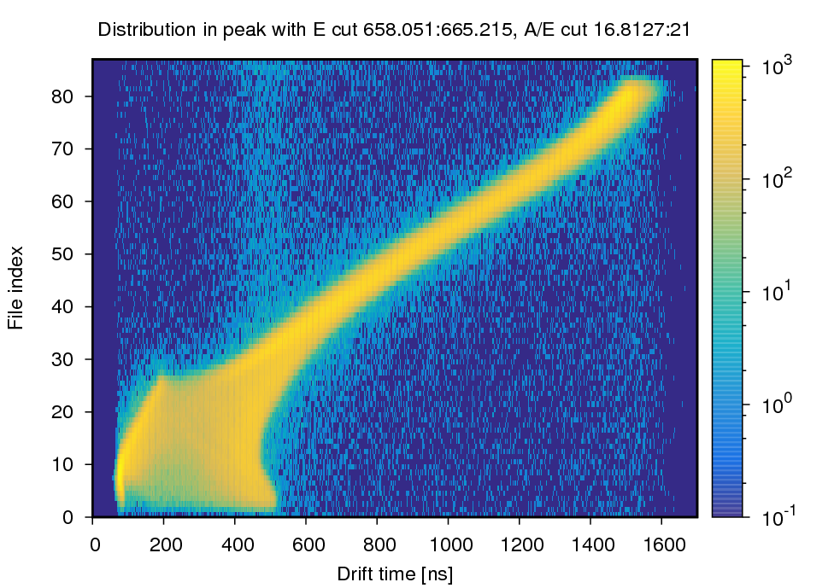
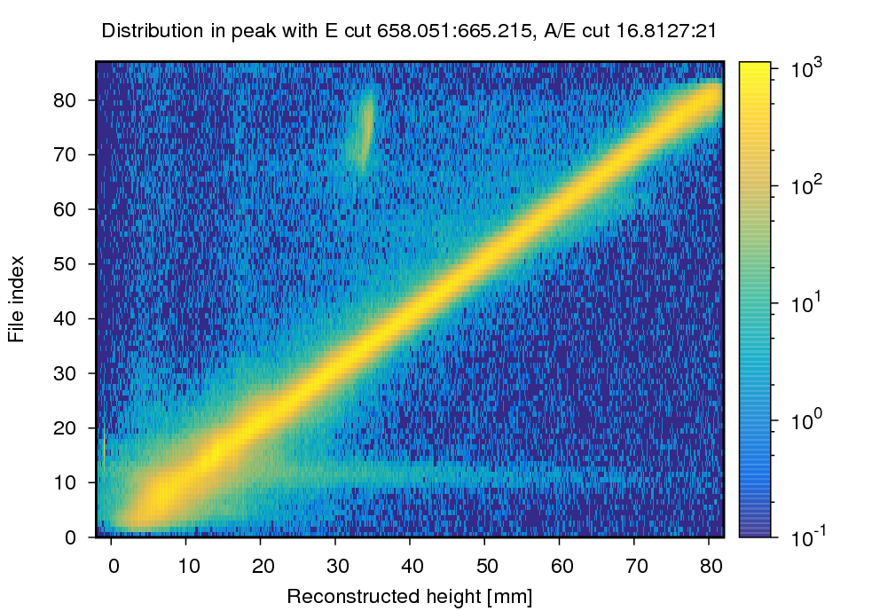
Depth (z) Reconstruction
With 𝜑 and r reconstruction, determination of z is ‘simply’ a look-up table to map drift time to depth
Challenges near the PC arise due to double-valued z vs drift time relationship

Slide 16
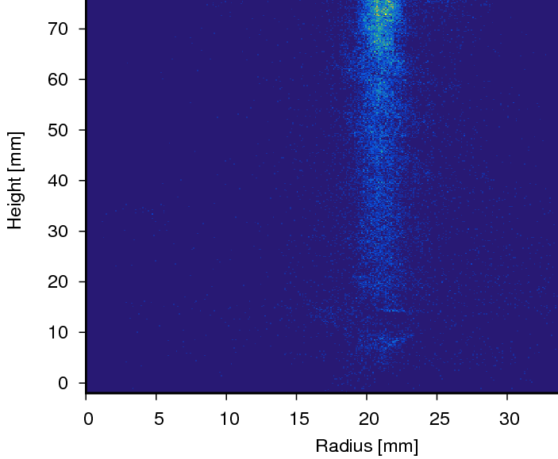
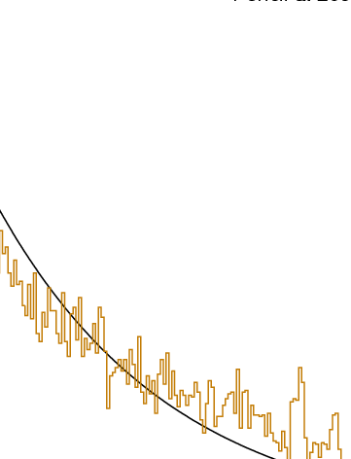
Pencil Beams: Attenuation in HPGe
Overall position reconstruction approach is well-understood
Performance for single-site interactions is good – better than 0.5° in 𝜑, of order 1 mm in r, z from scanning results through most of crystal volume
Single pencil beam shows r with σ of ~ 1.2-1.3 mm;
z profile matches well attenuation length in Ge

Slide 17
In-Beam Test of Position Resolution
⁸⁴Kr(¹²C, 4n)⁹²Mo – ⁸⁴Kr at 395 MeV onto 45μg/cm² C target
⁹²Mo residues recoil at v/c ~ 0.09
Doppler broadening is dominated by effective position resolution (opening angle)
Placement of detector within ~6cm (at 90°) of target position allows measurement of position resolution with precision < 0.5 mm

Slide 18
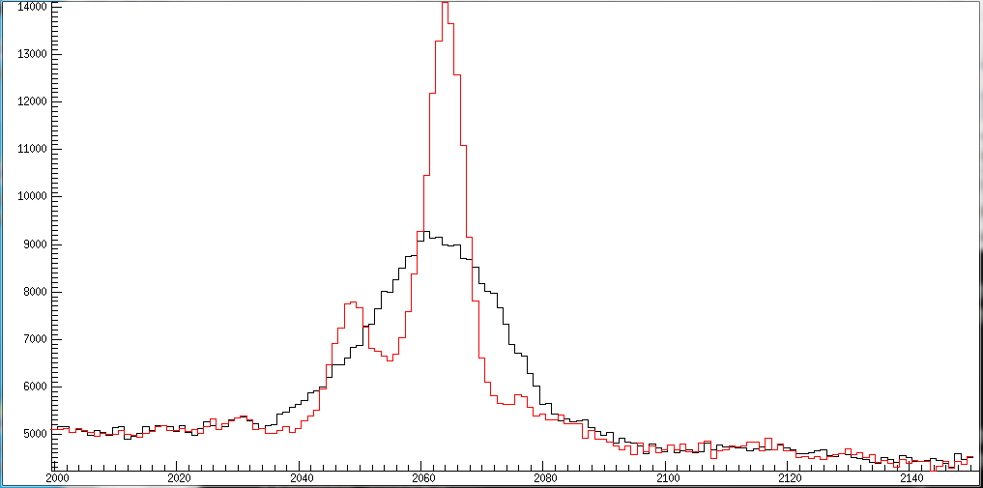
In-Beam Test of Position Resolution
⁸⁴Kr(¹²C, 4n)⁹²Mo – ⁸⁴Kr at 395 MeV onto 45μg/cm² C target
⁹²Mo residues recoil at v/c ~ 0.09
Doppler broadening is dominated by effective position resolution (opening angle)
Placement of detector within ~6cm (at 90°) of target position allows measurement of position resolution with precision < 0.5 mm
Corrected by
Crystal position – 26 keV
Position from tracking – 8 keV
Measurement performed for GRETINA engineering run – at 18 cm distance, σ = 2 mm in GRETINA translates to ~ 8keV FWHM for 2 MeV peak(s)

Slide 19
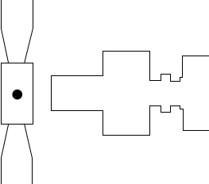
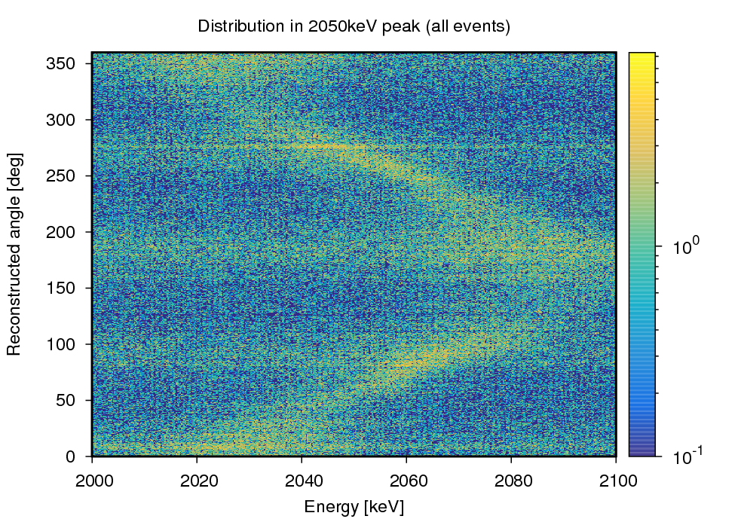
How Does It Look?
Point contact data nicely shows Doppler shift as a function of angle
φ ~ 180°
Beam

Slide 20
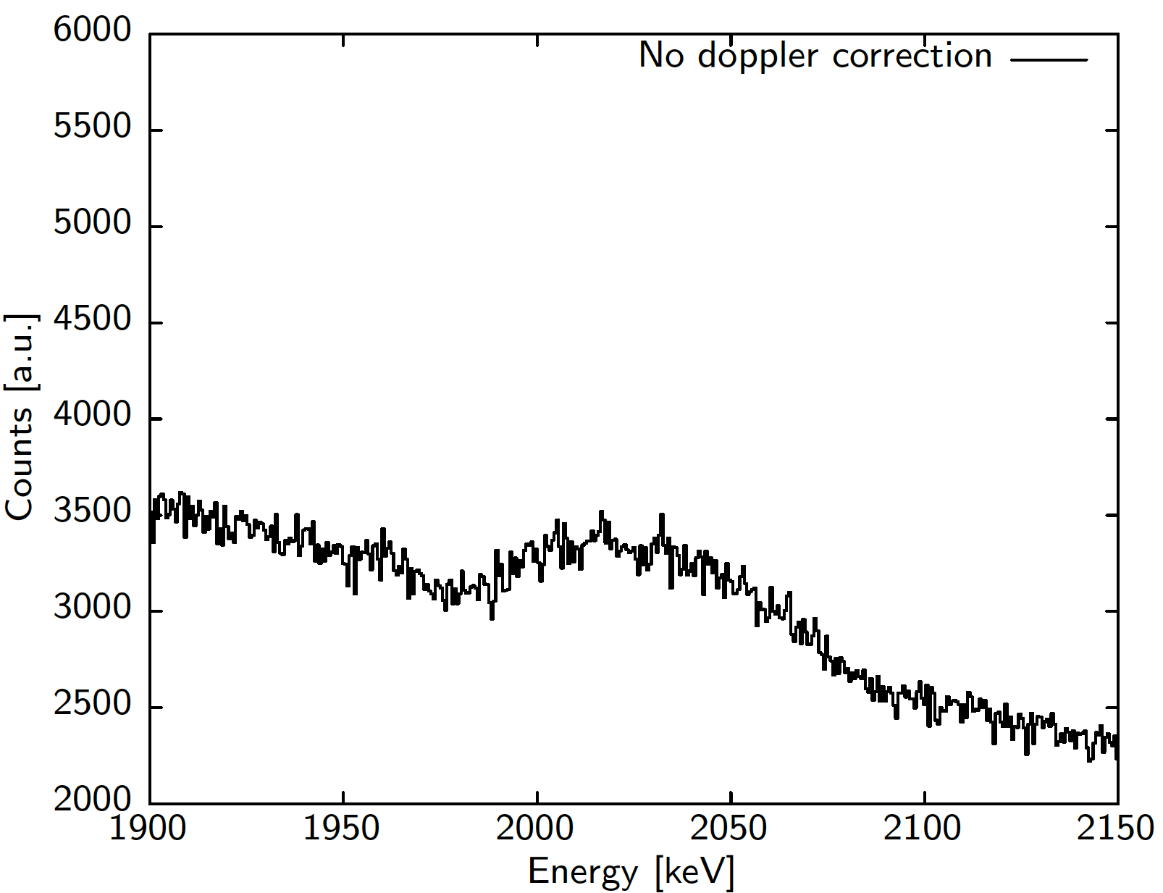
How Does It Look?
Point contact data nicely shows Doppler shift as a function of angle
φ ~ 180°
Beam

Slide 21
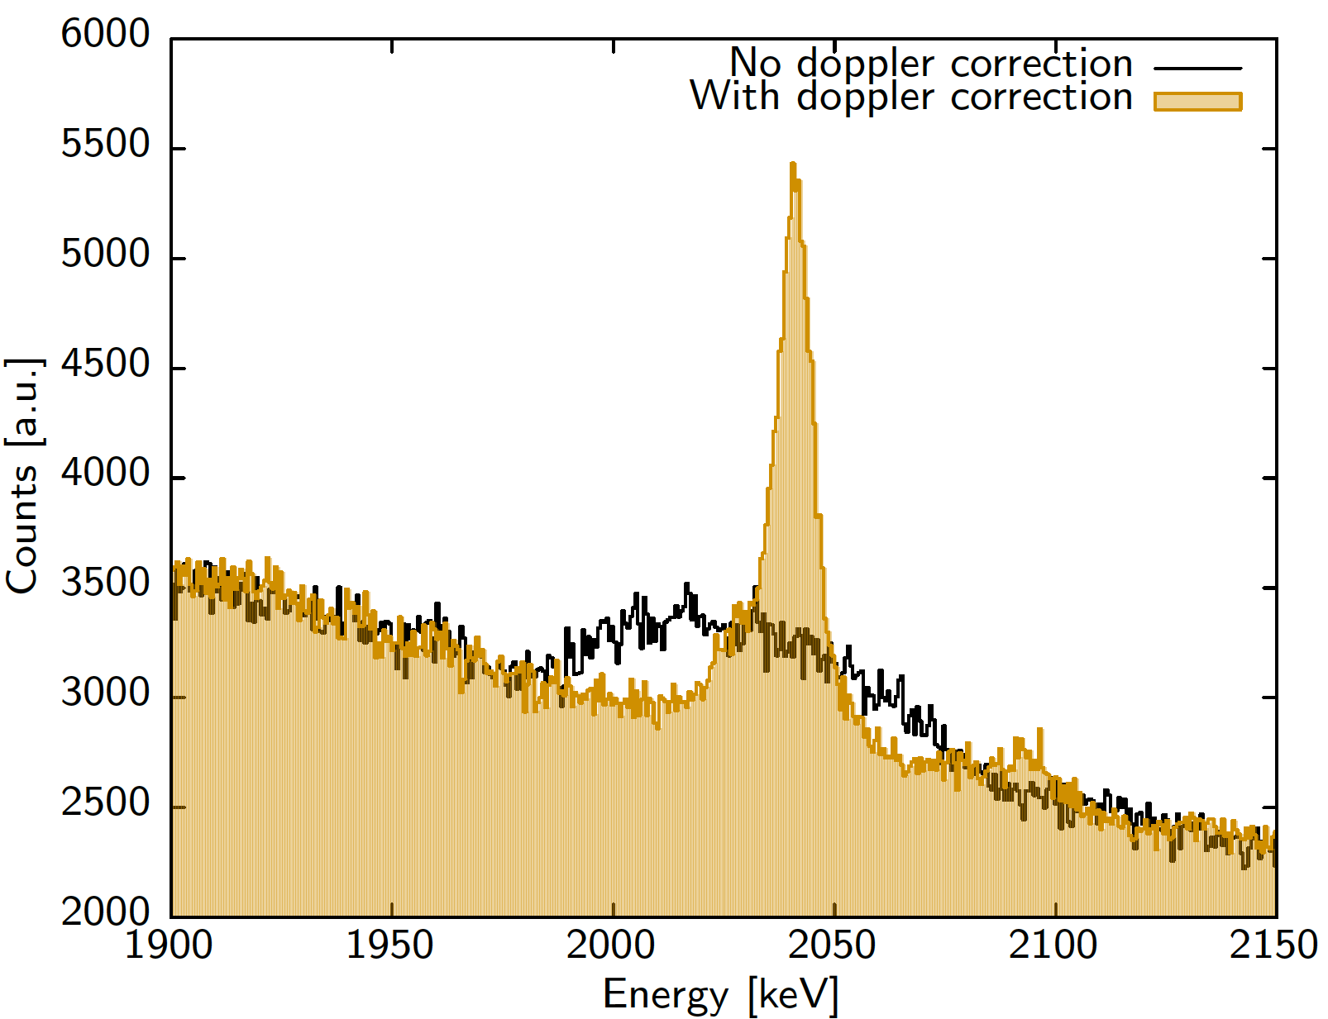
How Does It Look?
Point contact data nicely shows Doppler shift as a function of angle
Reconstruction for single-site events gives ~ 9 keV FWHM for ICPC
Based on simulations, this corresponds to σ_{x,y,z} ~ 1.5 mm
φ ~ 180°
Beam

Slide 22
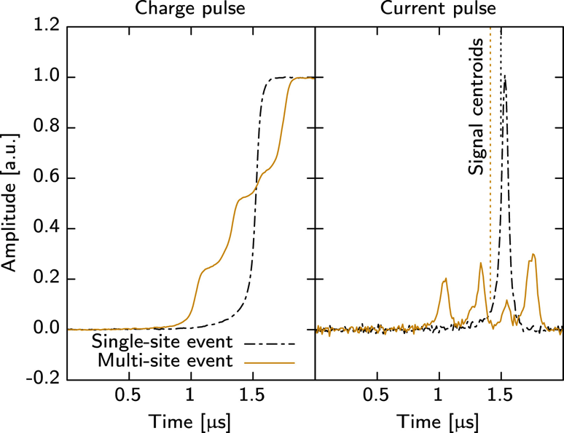
Next Steps Toward Full Signal Decomposition
Main effort to date has been on single-site events (A/E cut, and segment multiplicity = 1)
Next steps are to extend position reconstruction to include (a) charge sharing events and (b) multi-site events
  Number of interactions will be constrained by point contact signal
  and number of net charge segments
  Maintain azimuthal, and then r reconstruction approach, but iterate over solution(s) as multiple interactions are added
  Add PC signal to the basis as additional constraint on χ² fit

Slide 23
Summary
n-type segmented ICPC prototype characterization measurements have been underway at LBNL for last 2 years
Energy resolution after correction for position of interaction (primarily drift time and 𝜑) has reached 2.9 keV at 1332 keV – resolution is recovered
Full position (𝜑, r and z) reconstruction for single-site events has been achieved with promising first results
Next steps toward complete signal decomposition are understood – in-beam polarization data has been taken as a test data set (compared directly with clovers)
Next steps – neutron damage! Stay tuned…

Slide 24
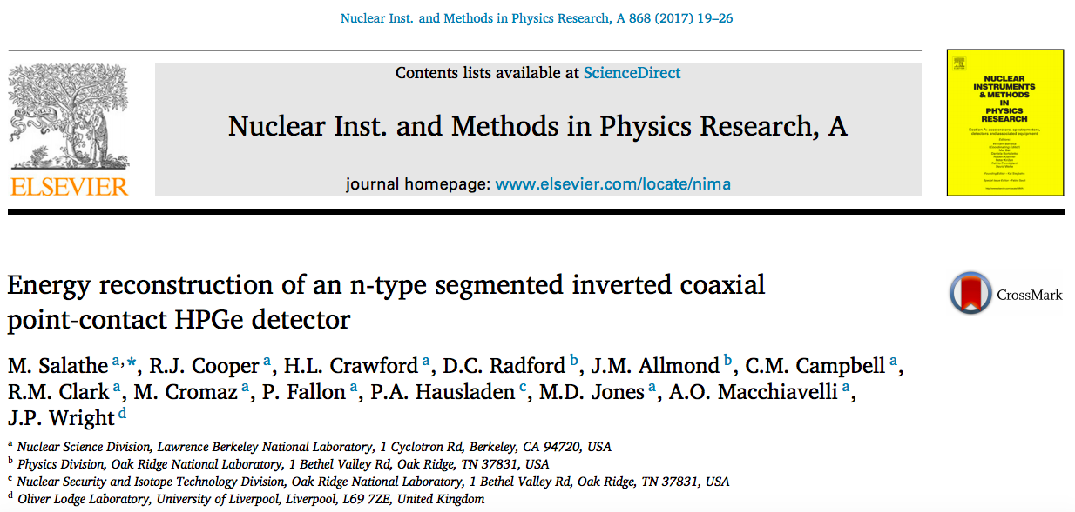
Acknowledgements
Special thanks:
Marco Salathe, Ren Cooper and David Radford (ORNL)
Thank you!

Slide 25
Backup

Slide 26
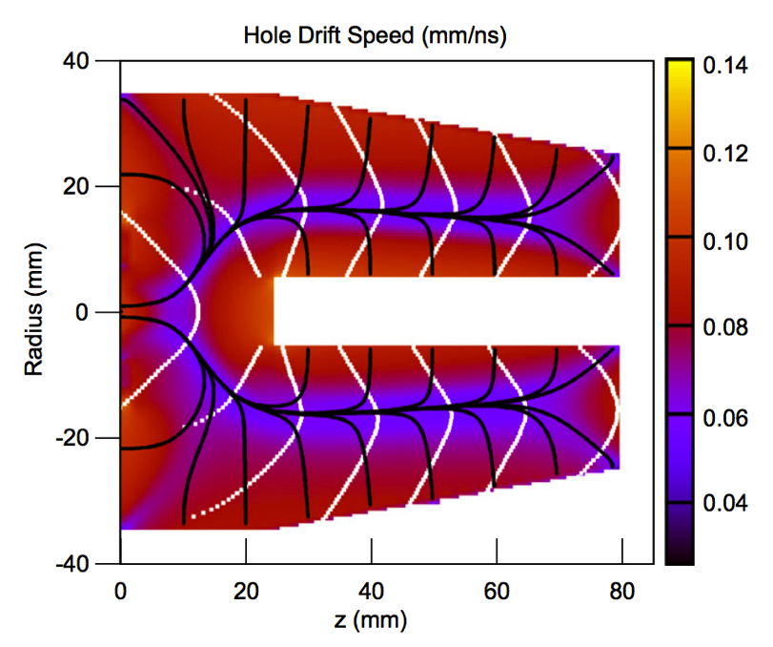
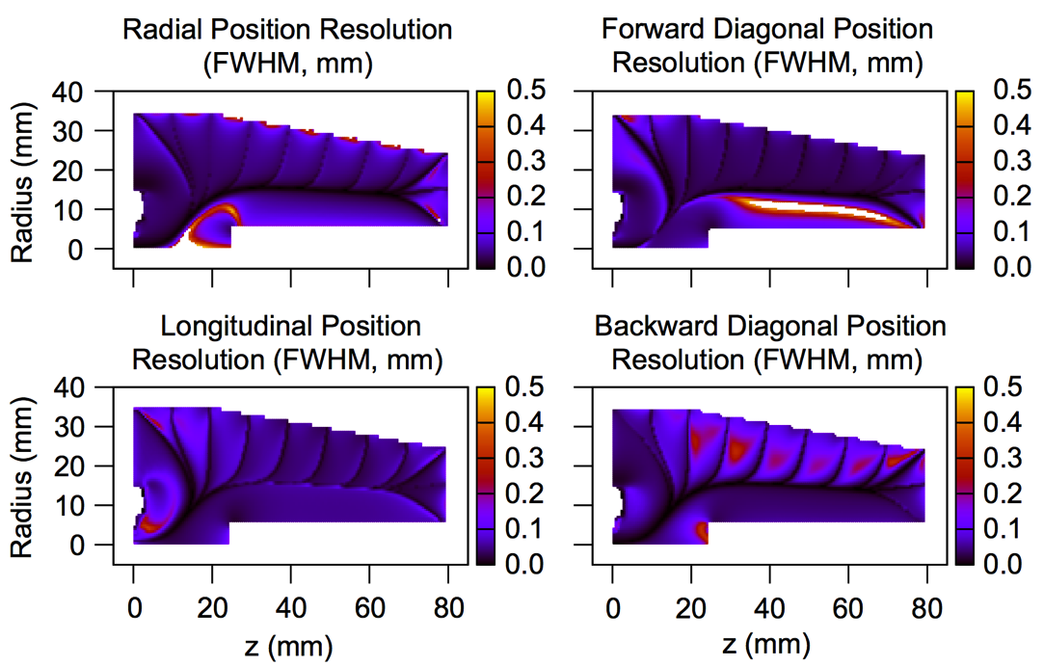
Inverted Coaxial HPGe Point Contact Detector
Field, weighting potential and signal generation calculations have shown the potential performance gains for such a geometry
Cooper et al., NIMA 665, 25 (2011).

Slide 27
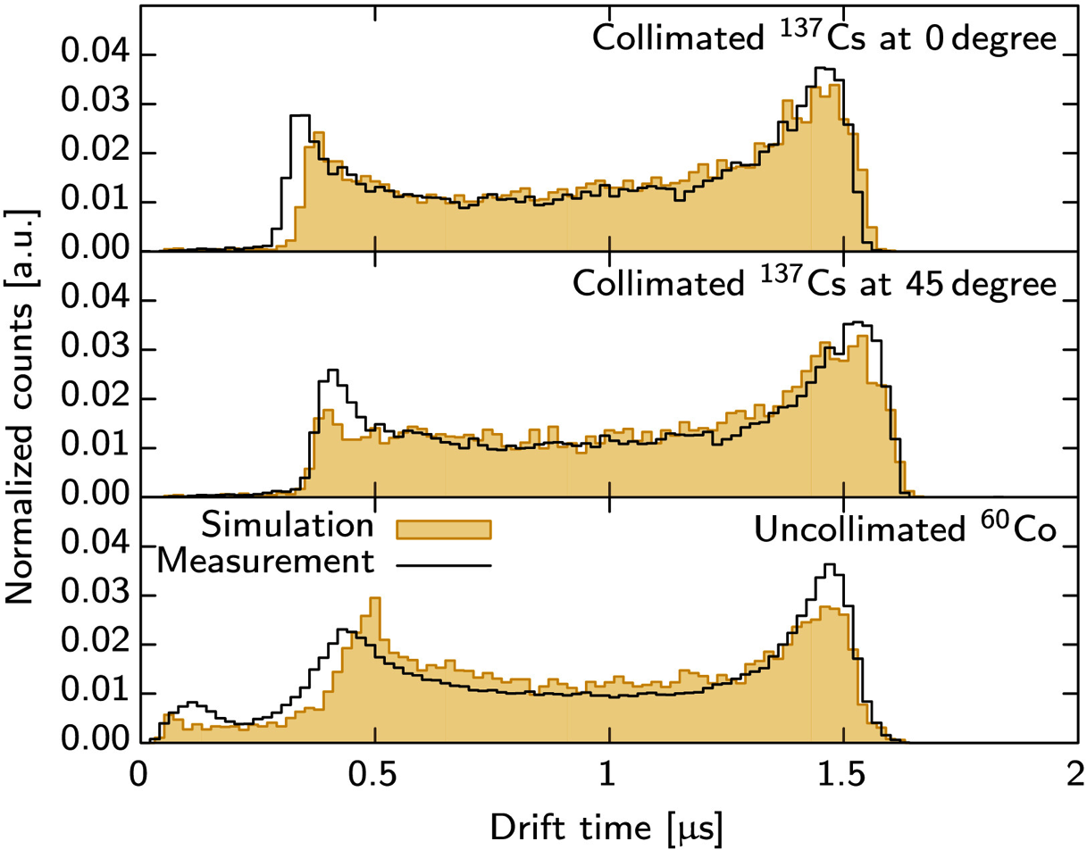
Drift Time – Simulation vs. Experiment

Slide 28
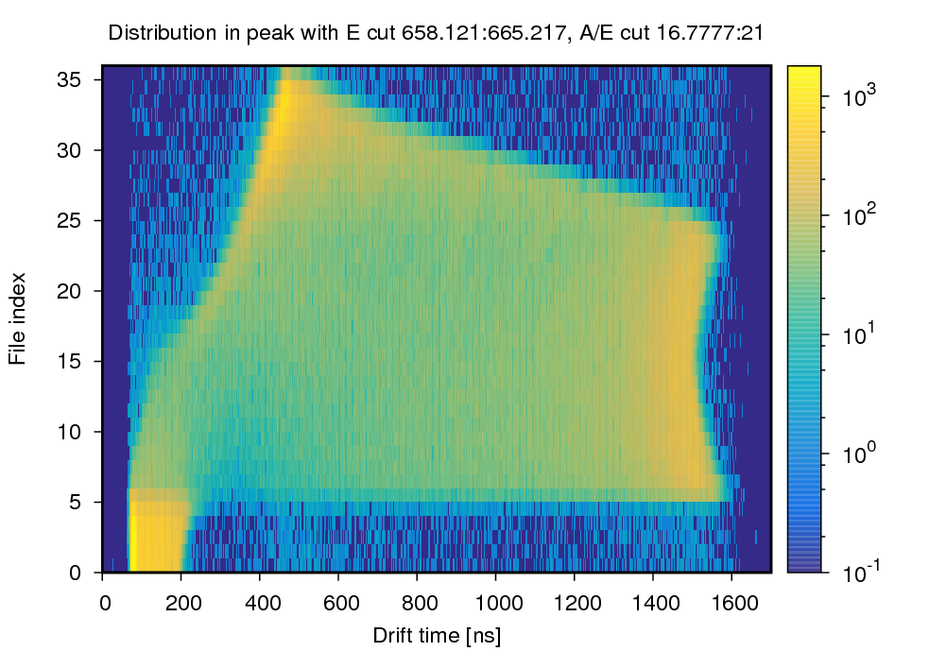
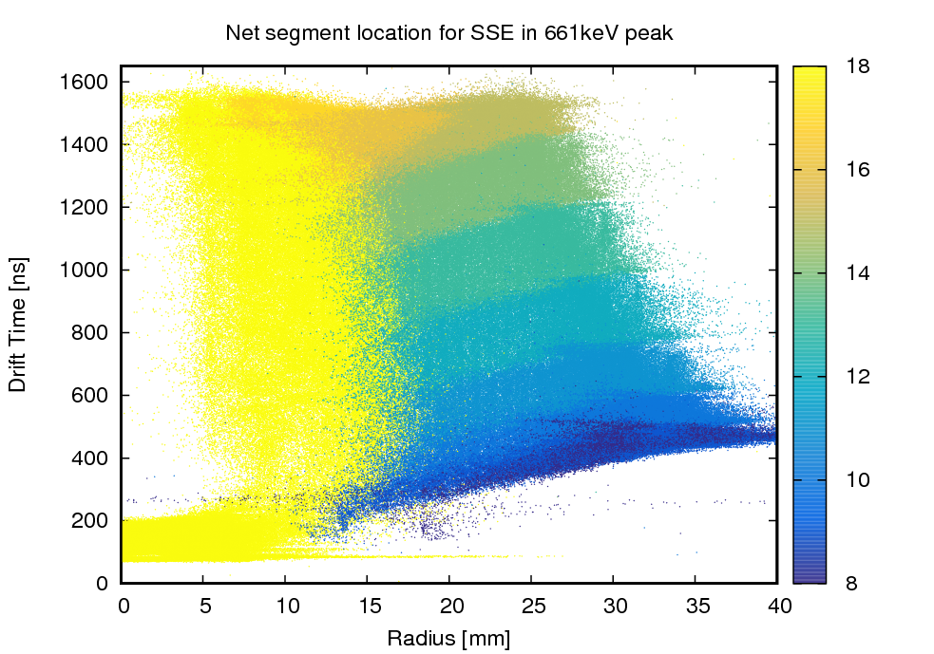
Radial Position Reconstruction
Collimated ¹³⁷Cs scans from the center to the outside of the crystal at specific angles were used to build up the r basis
Signals from the front and longitudinal segments included; basis was built indexed by observed net segment, 𝜑 and drift time
0°

Slide 29
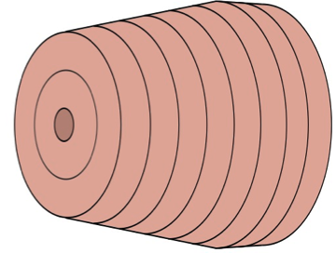
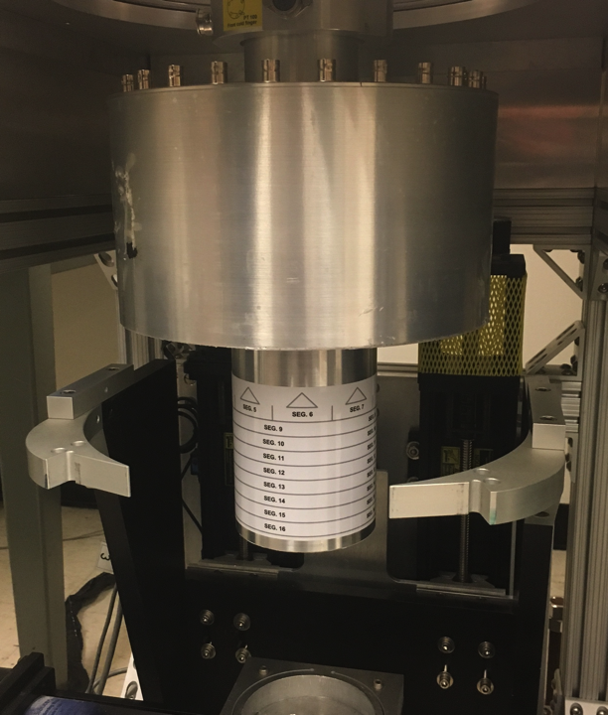
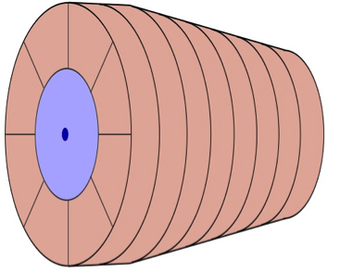
n-Type ICPC Prototype Detector @ LBNL
Supported by LDRD funding at LBNL, prototype was moved from ORNL to LBNL (88” cyclotron) for characterization work
GRETINA scanning table and infrastructure, capabilities for in-beam testing have allowed a thorough investigation of the detector
Cooper et al., NIMA 665, 25 (2011).

