Slide 1
GRETA Electronics and requirements
Chris Campbell
Thanks to Thorsten Stezelberger (LBNL engineer) and
GRETINA Electronics working group + Mike Carpenter

Slide 2
Outline
GRETA Working Group Workshop - Focus on Electronics, Auxiliary Detectors and Facility Interfaces - Nov 30 – Dec. 1, 2017
Discussion of problems – ADC issues
Physics inputs/requirements to GRETA Electronics (Engineers)
  Spectrum requirements
  Trigger requirements
GRETA Electronics Systems
Initial design considerations – ADC quality and cooling

Slide 3
GRETINA lessons: ADC linearity (and fidelity)
Linearity effects
  Shifts peak positions relative to linear (typically asymmetric sawtooth residuals)
  Can produce peak shoulder or doublet (for some, not all peaks)
  At higher rates, peaks shift with baseline (becomes complicated)
    Broadens peaks, can cause doublets or tails to high or low energy
  ADC STEP scale problem >>> Smaller spectrum effects from smaller kev/ch
Fidelity
  Issues beyond static ADC channel width variation
  Observed time-structure to some problems
  Energy resolution at rate depends on Pole-Zero math accurately describing the waveform
    Signal = sum of exponentials
Must TEST ADC thoroughly!
  signal=expectation, exhaustive pulser tests, and real preamp signals at varying rates

Slide 4
GRETA needs
Select best ADC for GRETA use case
  Requires testing (my problem)
  Knowledge of REQUIREMENTS (community input)
In the absence of a perfect, economical, low-power ADC,
  Choices, tradeoffs, mitigation of problems, maximize physics reach
  All ADCs will have some nonlinearity
  The effect on the spectrum will scale with gain/range, i.e. keV/ch or total MeV
Spectrum nonlinearity ~ (ADC step nonlinearity) * (energy range)
The #1 question I have for testing ADC & building Digitizers:
  What energy range(s) are actually needed and why?

Slide 5
How to chose ADC range and preamp reset ?
Biggest gamma-ray to observe <= your physics
Energy deposition distribution and rate <= your physics + background
  Need gamma spectrum emitted or energy spectrum measured
  Need rates
  Energy deposited + Rates + Statistical simulation >>> predicted baseline distribution
Protons (light charged particles)
  Observed at S800
  Bigger issue at HRS – forward angles populated
  10’s MeV deposited in core and one-few segments
Which mitigation strategies will work for various cases
Do all energies need “best” obtainable resolution?
  If someone studies a 12MeV gamma, do they care if the resolution degraded?
  How much degradation is acceptable?

Slide 6
Related: ADC Overflow
Overflow depends on both past gamma tails and current gamma amplitude
Sources
  Many gammas (e.g. 1 MeV) stack-up in a short time period (τ_{preamp} = 50 μs)
  One high energy gamma, >10MeV
  One high energy particle
Mitigation Strategies
  Wait => dead time Overflow time + Filter restart/recovery
  Segment sums
  Time-over-threshold
  Resistive preamp + pulsed reset

Slide 7
ADC Non-Linearity Mitigation Strategies
Channel-scale issue => maximize channels per keV, Minimize Range
Tailor to signal polarity
  Gretina has +/- 10MeV segment ADCs
  One might change that to -2MeV to 10MeV, reducing non-linearity by 40% in energy
Have multiple ADC ranges for same signal
  Buffer Amp copies signal faithfully
  Telescoping Ranges as in Gretina: 2.5, 5, 10, 30 MeV
  Stacking Ranges
    Shifted ranges with small overlap
    Each ADC covers same energy delta
    E.g. 0-10, 9-19, 18-28 MeV

Slide 8
ADC Non-Linearity Mitigation Strategies
Calibration of ADC step heights
  Depends on static vs. dynamic effects
  Depends on stability of non-linearity as a function of conditions and reset
  Perhaps correct some subset of similar, large-problem channels
  Must be done at 100MHz, or in parallel to energy filter, on FPGA
Imposed signal
  Think Dither or Gatti slider
  Adding a known, varying signal in analog and subtracting it in digital
  Depends on distribution of non-linearities and added signal quality
Offset signal
  Conditionally subtract an offset in analog to allow expanded effective range for ADC

Slide 9
Physics requirements

Slide 10
High resolution spectrum requirements
Required Range: 0-10 MeV
Resolution at 1kHz incident rate
  @ 0.060 MeV <= 1.8keV
  @ 1.33 MeV <= 2.5keV
Resolution at 50kHz incident rate
  @ 1.33 MeV <= 3.5keV
Rate performance
  Core >= 50kHz / crystal
  Segments >= 10kHz / segment

Slide 11
Fast beam spectrum requirements
Required Range: 0-15 MeV (for Doppler shift, E_{rest}<10MeV)
Resolution requirement relaxed by (0.5% * E_{gamma}) added in quadrature
Additional Preamp issue: charged particles (10’s-100’s MeV)
  Core and front segments
Additional channel to cover Full core preamp output range
System Calibration / linearity verification must be tractable!

Slide 12
Excess ADC ranges needed
Core:
  50kHz/crystal with an <E>=0.75 MeV
  Result in preamp baseline shifts of +/-5MeV
Segments:
  Observe opposite-polarity induced signals
  Estimate : -2MeV

Slide 13
Trigger Requirements – Fast trigger
Generate a fast trigger based on crystal multiplicity within 500ns of gamma-rays interacting with the detector with a 100keV threshold placed on each crystal. (This latency is acceptable for all currently known applications and auxiliary detectors.)
The walk associated with the discriminator employed on individual channels used to construct the fast trigger should be < 600 ns to allow for all prompt gamma-rays to contribute to the fast multiplicity calculations assuming a threshold set at 100 keV for individual channels.
Additional fast trigger requirements have been requested for fast beam experiments:
  2 level trigger – read out all crystals above threshold X if a multiplicity requirement is met with threshold set to Y.
  Upper level discriminator for multiplicity determination (veto charged particles)
  Multiple crystal multiplicity triggers based on patterns e.g. front multiplicity >= X and/or back multiplicity >= Y

Slide 14
Trigger Requirements – Slow triggers, counters
Slower Triggers will be constructed which can be overlapped with each other and/or with external triggers from other detector systems. These triggers will include:
  CFD multiplicity (eliminate walk and provide tighter coincidence window)
  Total Energy sum of central contacts
  Hit pattern multiplicity
  Delayed multiplicity
  Additional algorithms may be required such as those suggested for fast triggers.
  Not all trigger algorithms need to be available simultaneously.
Trigger information should be recorded with each GRETA channel including , (i) the trigger condition satisfied for the triggered channel and (ii) timestamp when triggers(s) was satisfied
Trigger counters indicating both raw and accepted trigger rates will be provided.

Slide 15
Trigger Requirements – General
The trigger system will be able to generate at least 480,000 triggers/sec.
The trigger and timing systems will be able to accommodate up to four ancillary DAQ systems providing both trigger capabilities and clock synchronization.
A buffer of at least 20μsec will be available in the digitizer to provide overlap triggering between GRETA and other delayed triggers e.g from RMS, FMA).

Slide 16
Trigger Requirements – External DAQs
External triggers from ancillary devices can both trigger GRETA and be overlapped with other external triggers as well as the GRETA internal triggers.
Back-compatibility to GRETINA/MyRIAD systems, which are used by numerous auxiliary devices.
Timing outputs needed: 100MHz GRETA clock; downsampled GRETA clock, NIM signal for timestamp reset signal
Record within GRETA external clocks up to 1GHz from outside systems (number) as well as the ability to synchronize the clock at their fundamental frequencies.
Provide nanosecond timing relative to an external clock or detector (i.e. accelerator RF)

Slide 17
Other Requirements
An equivalent to ‘Bank 29’ is requested with 10++ channels of digitizers synced within the GRETA system to natively incorporate external signals
GRETA digitizers, possibly in a different form factor, which could be used by other detection systems.

Slide 18

GRETA
Electronics Systems: Digitizer and Signal Filter Board
Thorsten Stezelberger
Level 3 Manager – GRETA Electronics Systems – LBNL Scope
Engineering Division
Lawrence Berkeley National Laboratory

Slide 19
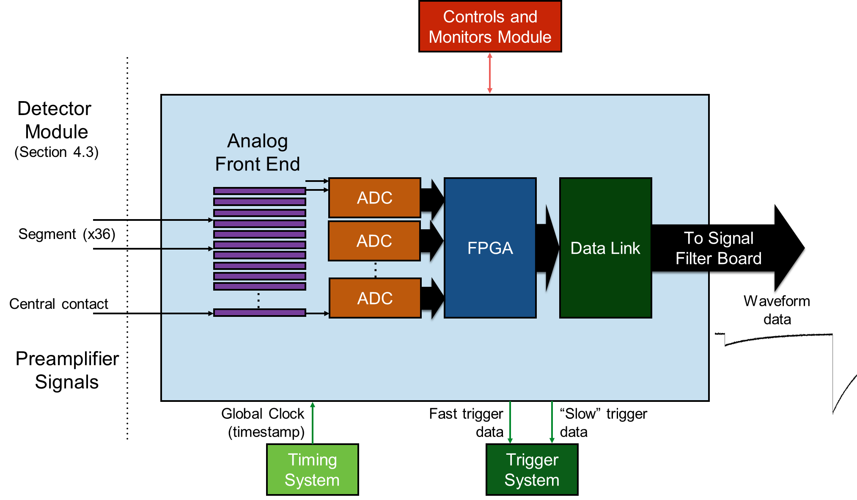
The Digitization

Slide 20
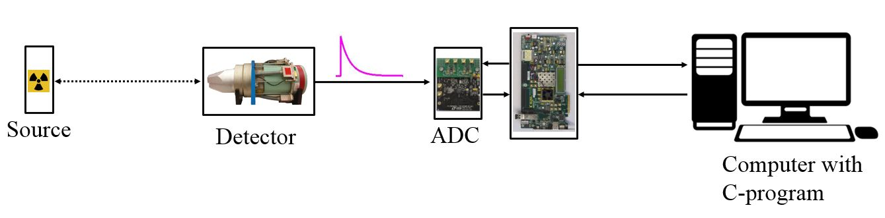
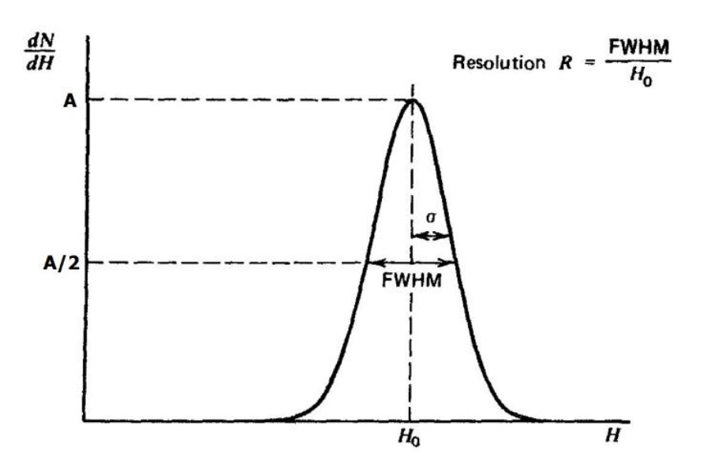
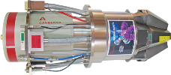
The ADC test setup
Signal Generation
  Source + Detector (shown)
  Pulse Generator
Data Collection
  ADC Board
  FPGA Board
  ADC Data streamed over 10GbE to Computer
Data Analysis
  Offline using MATLAB

Slide 21
Preliminary DNL Test Results
AD9655
AD9655
DNL pattern is not reproducible
LTC2194
DNL pattern is reproducible
Both shown modern ADCs have improved DNL over the GRETINA ADC
LTC2194
Current GRETINA ADC AD6645

Slide 22
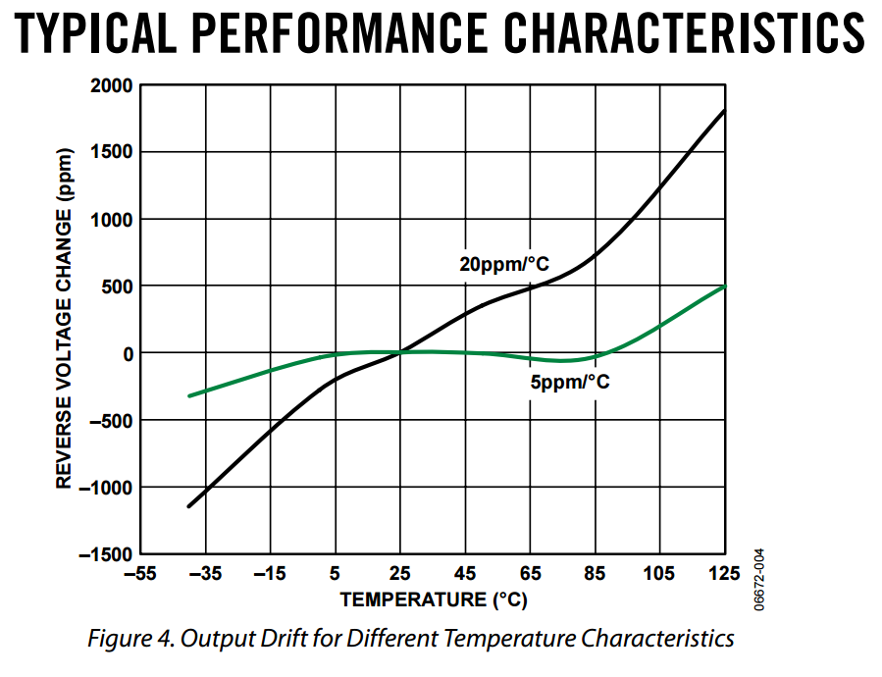
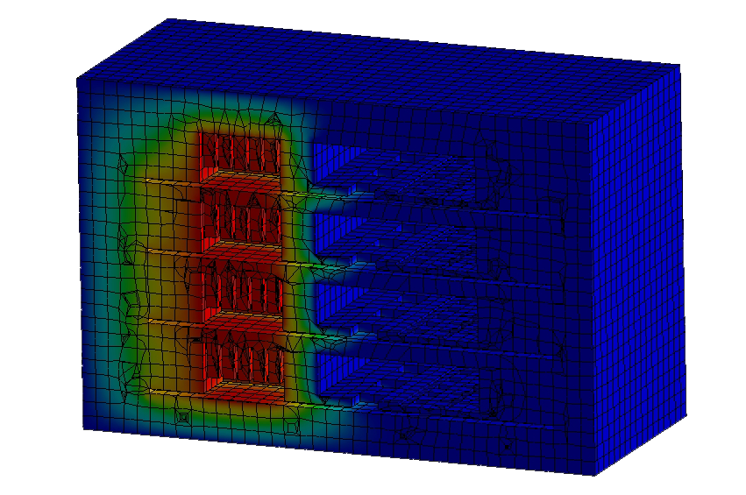
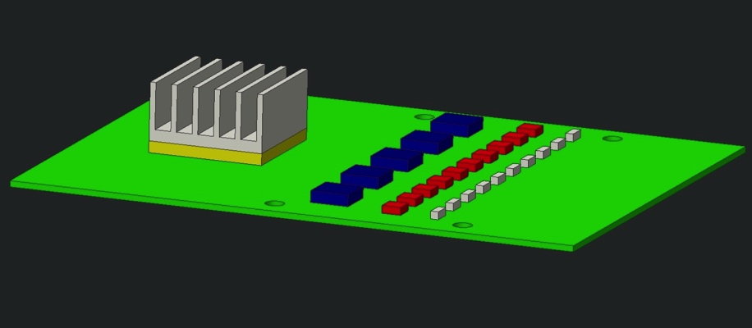
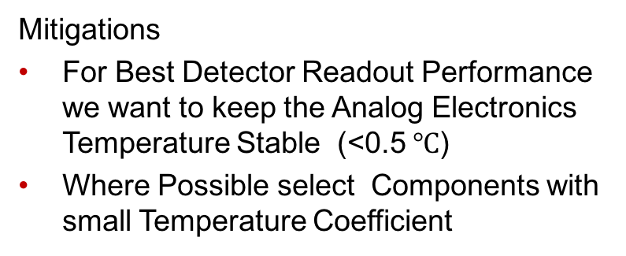
The Digitizer Module Cooling And Temperature Control
The Digitizer Module will be compact
Cooling and Thermal Stability will be important
Analog Components have a Temperature Coefficient
Temperature Coefficient changes the performance (mainly Gain)
Mitigations
For Best Detector Readout Performance we want to keep the Analog Electronics Temperature Stable (<0.5 $℃$)
Where Possible select Components with small Temperature Coefficient
Temperature Characteristics of a
Analog Devices ADR1581 Voltage Reference
(This Device was selected at random as example)
Initial static and transient thermal simulations have been performed

Slide 23
END

Slide 25
CDR numbers meaning for spectroscopy
Dynamic range “up to 25MeV”
  Preamplifier voltage output range in which signals could be measured
Final energy spectrum: 0.3 keV/channel, 0-10 MeV
Integral non-linearity [INL](<= 0.01%) >>> 10000keV*0.01% = 1keV
  Up to +/-1 keV deviation anywhere in 0-10MeV spectrum
Differential non-linearity [DNL](<= 1%) >>> 0.3 keV/ch *1%=0.003keV/ch
  Channel width may vary up to 1% >>> counts vary <= 1% systematic
Relation INL<->DNL >>> 1keV/(0.003keV/ch) = 333ch
  1keV max calibration deviation (INL) must occur slowly due to DNL
  1keV variation takes at least 333 channels >>> 333ch * 0.3keV/ch = 100keV
INL and DNL set limits, not average behavior. Multiple deviations could occur in spectrum with or without a pattern
Effective requirement, <=2.5keV FWHM @1.33MeV (at rate)
  Also constrains INL condition

Slide 26
GRETA
Electronics Systems: Digitizer and Signal Filter Board
Thorsten Stezelberger
Level 3 Manager – GRETA Electronics Systems – LBNL Scope
Engineering Division
Lawrence Berkeley National Laboratory

Slide 27
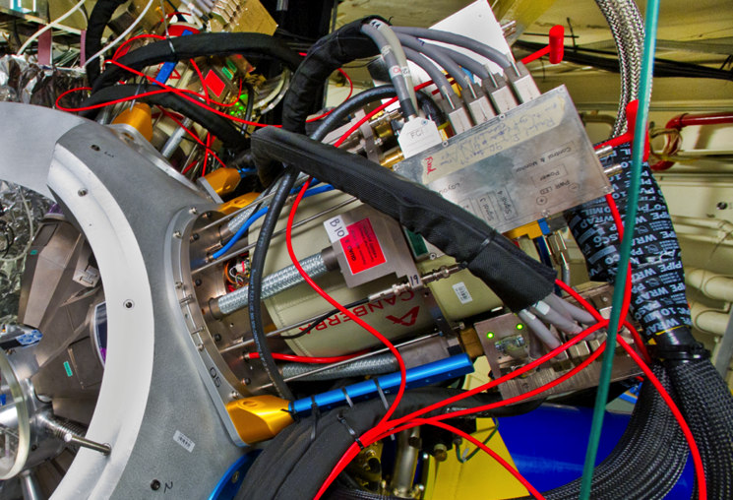
The Motivations driving the Architecture
Provide Digitization of the Detector signals as close as possible to the Detector (36 Segment + 1 Central Contact)
Allow for Digitizer change without removing services to the crystal
Data Transfer to Computing System
  At least 4000 Validated Events/Crystal/s
  32MByte/Crystal/s
Upgradeable Digital Signal Processing
Utilize new components and technologies
Simplify Cabling

Slide 28
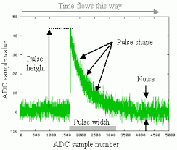
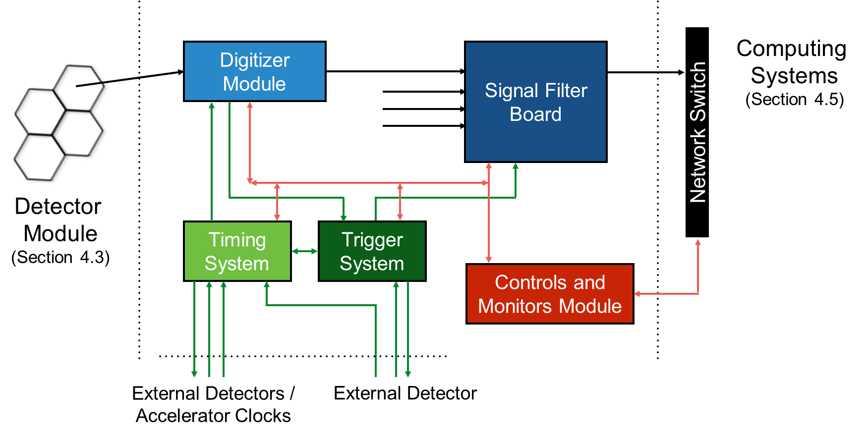
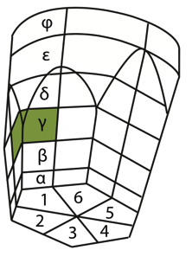
The GRETA Electronics Block Diagram
The Following Slides will follow the Data Flow from the Detector to the Computing System
The Description is for one Crystal. GRETA will have 120 Crystals

Slide 29
The Detector Interface

Slide 30
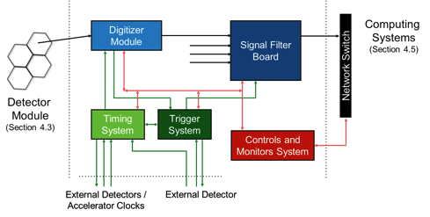
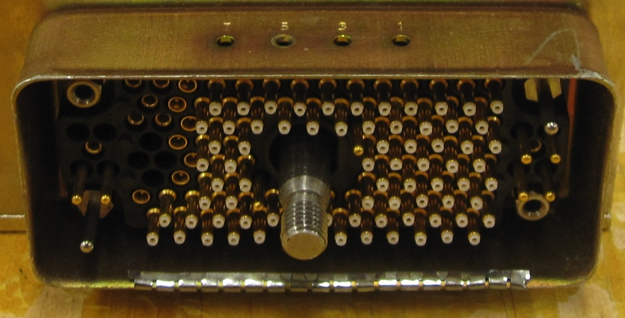
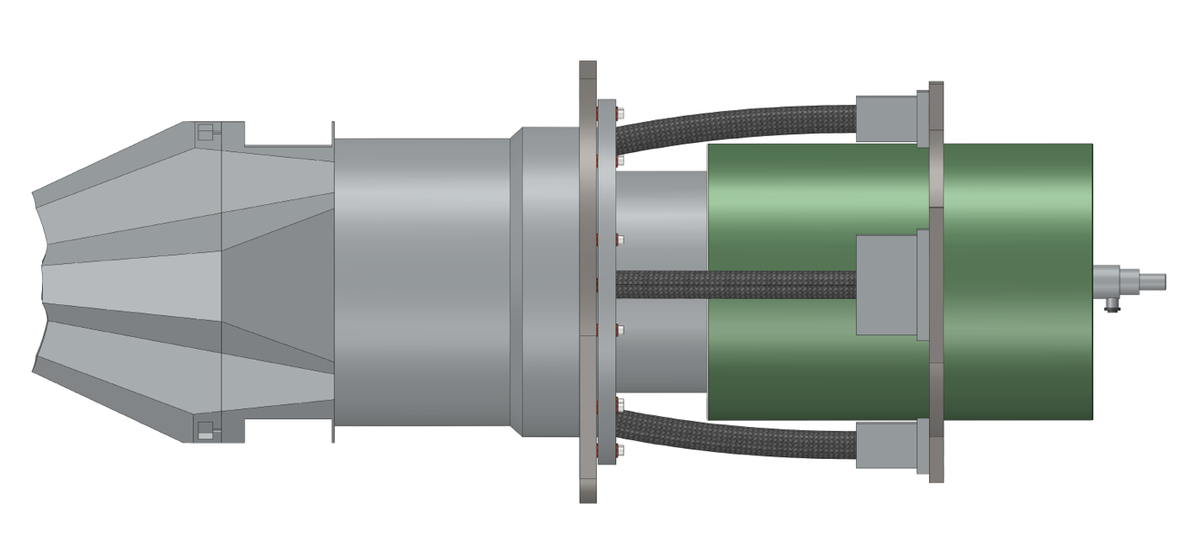
The Detector Interface Box
Power crystal without Digitizer Module
  Useful during acceptance tests
  Swap Digitizer Module without Biasing Down The Crystal
Can stay on the Detector
Detector Interface Box
Digitizer Module
Detector Power Cable

Slide 31
The Functions of the Interface Box
Bring Power to the Crystal/Detector
Interface to Temperature Interlock
Interface to Temperature sensors in the Quad Detector
Pass the Crystal Signals to the ADC Module
Pass test signals from ADC Module to detector test segments
Provide interface to probe detector signal using a scope

Slide 32
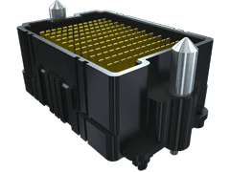
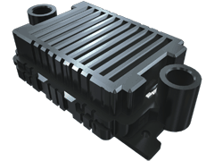
Potential Detector Interface Box to Digitizer Module connector
Connector Properties
  PCB Mount
  Rugged / Durability
  High Density / Differential Pins
  Low Crosstalk
  Low Cost
Candidate for the Connector
  Samtec HDAF HDAM series
➔ We have a candidate and will research and select a connector at design time

Slide 33
The Digitizer

Slide 34
The Digitizer Module
36+1 Crystal Signals to Digitize
Simple / Small FPGA
  Timestamp and Send Waveform data
  Simple Filters to generate Trigger data

Slide 35
The Digitizer Module Functions
Analog Frontend for 36+1 Crystal Segment Signals
  Termination and Buffering
  Anti Aliasing Filter
  ADC driver
Digitize 36+1 Crystal Signals
  Digitize Synchronous
  >= 100 MS/s (from GRETINA)
  >= 14 bit (from GRETINA)
Timestamp ADC Data
Operate synchronous to global clock
Package ADC data and transmit to Signal Filter Board
Generate Trigger Data
  Intended for trigger system to make trigger decisions
  Fast Trigger Data is simple with short latency for external detectors
  Slow Trigger Data can include more. e.g.:
    Initial energy estimate
    Map of segments over threshold
    First Segment over threshold

Slide 36
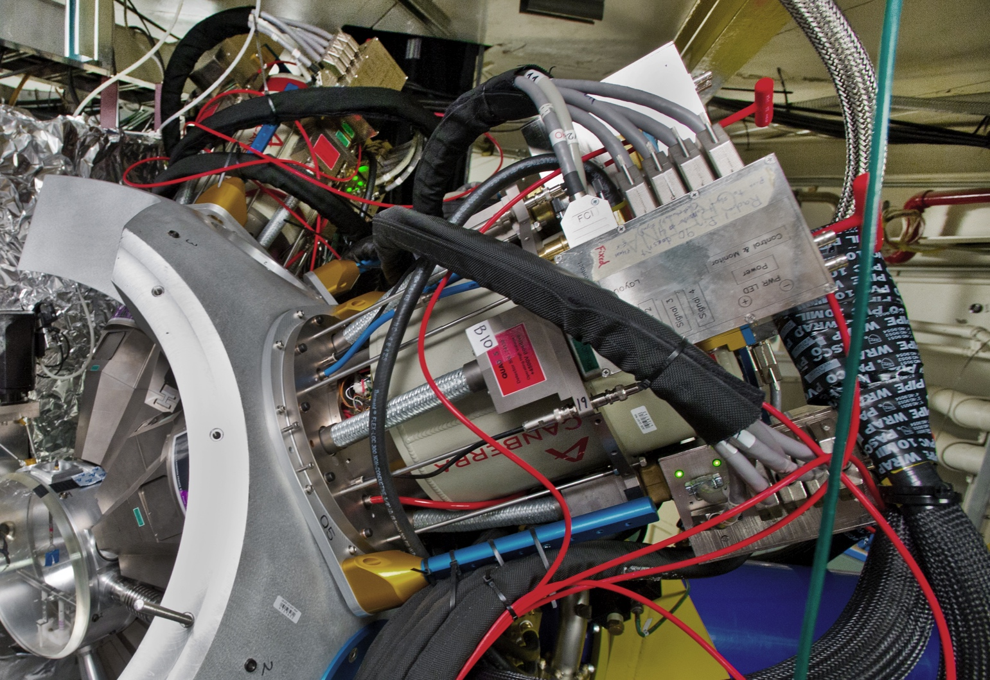
The Digitizer Module’s Location
Digitizer Modules will be located at current “Radiall Box” location
“Radiall Box”
GRETINA Detector with “Radiall Box”

Slide 37
The Digitization

Slide 38
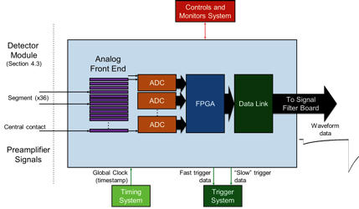
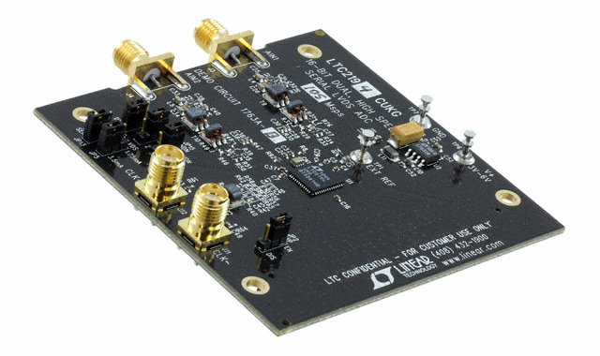
The ADC for GRETA
Requirements for Candidates
(Based on GRETINA experience)
>= 14 bit (Up to 25MeV)
>= 100MSamples/s
Low power
Package Size
We identified 3 Candidates
(16 bit / 100MSamples/s)
  AD9655
  AD9653
  LTC2194
We compared the ADCs
  One of the ADCs looks promising (LTC2194)
➔ We will monitor the market for new ADCs and make the final decision at design time
LTC2194 Evaluation Board

Slide 39
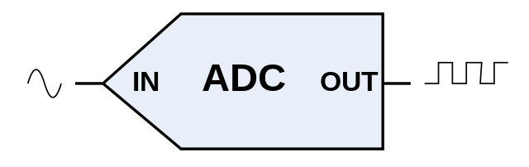
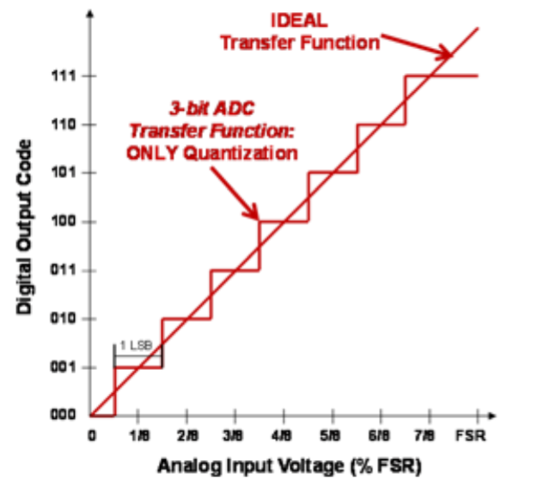
The Envisioned ADC Characterization Tests
Datasheets do not provide all the Information we need
Tests
Differential Non-Linearity (DNL)
Integral Non-Linearity (INL)
Crosstalk
Noise
Temperature stability
Memory effects
Physics related data analysis
  Overshoot
  Radioactive Source

Slide 40
The ADC test setup
Signal Generation
  Source + Detector (shown)
  Pulse Generator
Data Collection
  ADC Board
  FPGA Board
  ADC Data streamed over 10GbE to Computer
Data Analysis
  Offline using MATLAB

Slide 41
Preliminary DNL Test Results
AD9655
AD9655
DNL pattern is not reproducible
LTC2194
DNL pattern is reproducible
Both shown modern ADCs have improved DNL over the GRETINA ADC
LTC2194
Current GRETINA ADC AD6645

Slide 42
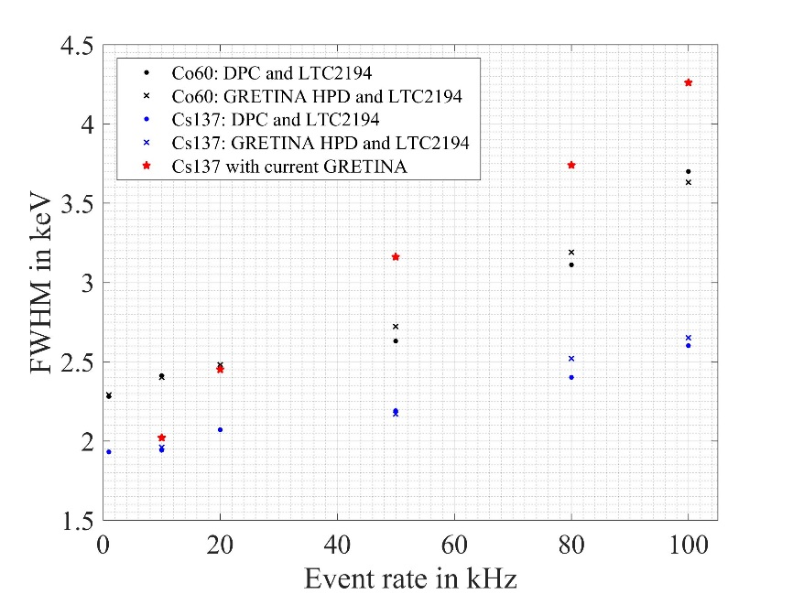
Preliminary LTC2194 Performance Results
Co60
HPD : Single Pole Correction: 2.75 KeV
DPC : Double Pole Correction: 2.65 KeV

Slide 43
The Digitizer Module Cooling And Temperature Control
The Digitizer Module will be compact
Cooling and Thermal Stability will be important
Analog Components have a Temperature Coefficient
Temperature Coefficient changes the performance (mainly Gain)
Temperature Characteristics of a
Analog Devices ADR1581 Voltage Reference
(This Device was selected at random as example)
Mitigations
For Best Detector Readout Performance we want to keep the Analog Electronics Temperature Stable
Where Possible select Components with small Temperature Coefficient
A. Hodgkinson (C3-3)

Slide 44
The ADC Data Transfer

Slide 45
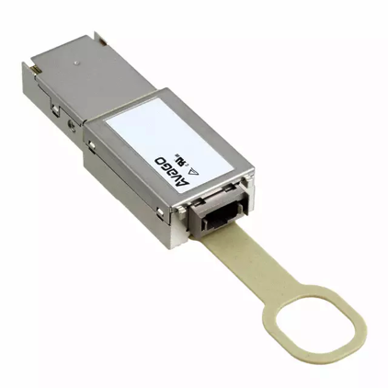
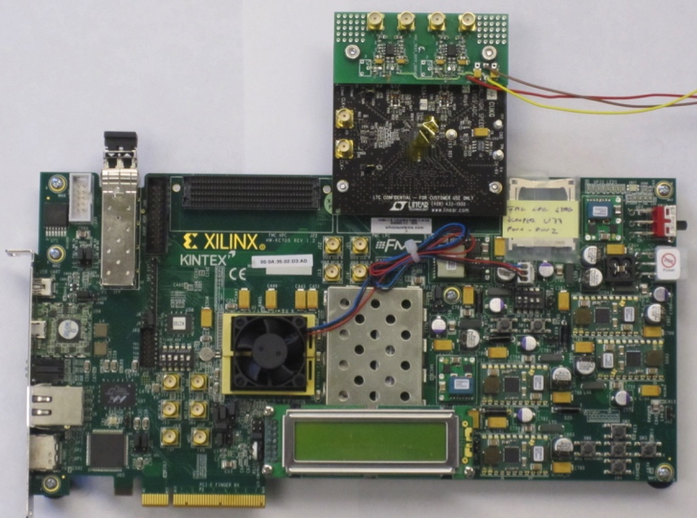
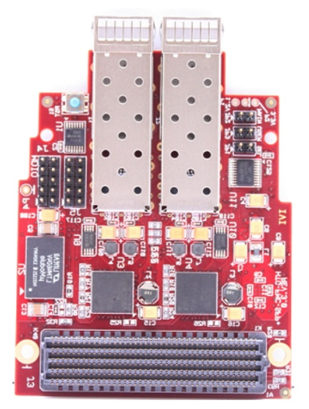
The Fiber Link from the Digitizer Module to the Signal Filter Board
Stream ADC data from Digitizer Module to Filter Board
  ~64Gbit/s between Boards
  Standard Networking Hardware is readily available
    100Gbit/s
We used Data Streaming before
  GRETINA Test for real-time filtering on CPUs
  GRETA ADC Characterization
The use of Fiber makes grounding easier
The use of Fiber is easier to route

Slide 46
The Digital Signal Processing

Slide 47
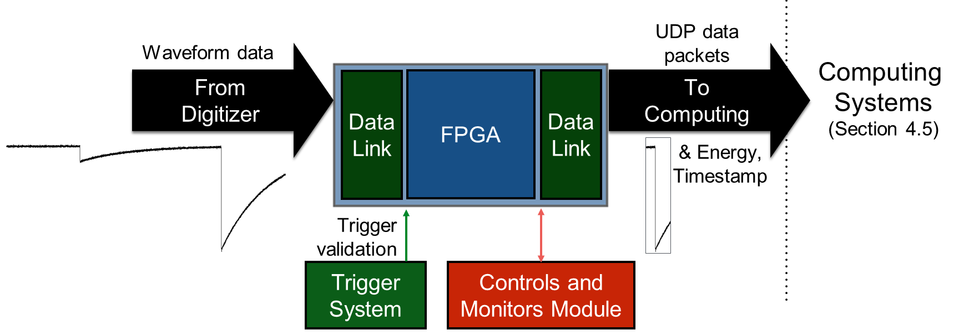
The GRETA Signal Filter Board
Digital Only Board
Commercial FPGA Boards Possible
Compute Filters for all ADC data steams
  Event Time
  Event Energy
Package “Validated” Events and transmit to Computing System

Slide 48
Signal Filter Board Functions
Digital Only Board
  Commercial Of The Shelf (COTS) options are possible
Receive streamed ADC Waveform Data from Digitizer Module
Digital Signal Processing based on existing GRETINA Firmware code
  Find signals using LED
  Compute Energy
  Code will be ported to take advantage of new FPGA Architectures
Real-time processing
  The Signal Filter Board can run asynchronous as long as it keeps up with Digitizer Module
Assemble signals selected by the Trigger System and transmit them to Computing
  Waveform
  Timestamp
  Energy

Slide 49
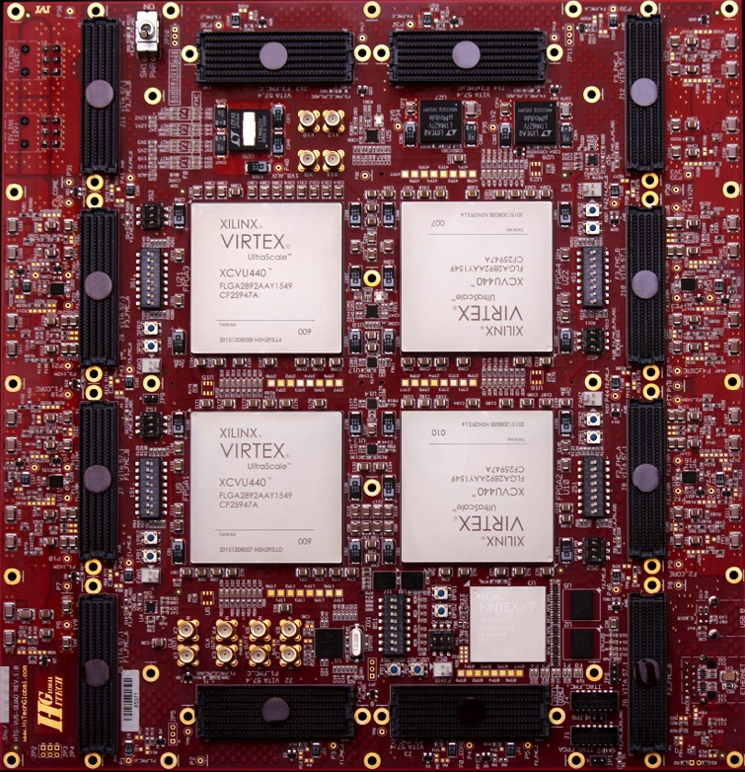
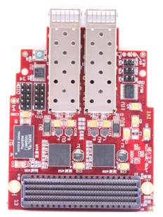
A Commercial Of The Shelf Signal Filter Board
Leverage Commercial Products
  Various Manufacturers offer powerful FPGA Board with Fiber Interfaces
Interfaces
  Digitizer Module
  Computing System
  Trigger System
  Slow Controls
Fiber Optics Interface Modules
Available FPGA Board
➔ We will research commercial FPGA Boards during the design phase

Slide 50
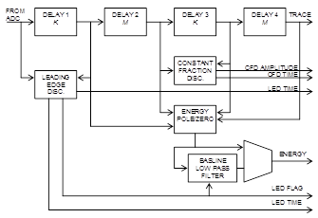
The GRETA Filter Algorithms
The GRETA Filter Algorithms are built on GRETINA Signal Processing
  LED Leading Edge Discriminator
  Trapezoidal Filter
  Pole-Zero Cancelation
  Baseline Restoration
  Energy Determination
We intend to take advantage of the capabilities in modern FPGAs in the implementation of the Filter Algorithms

Slide 51

Data Transfer to Computing
Use Standard Interfaces
  10 Gigabit Ethernet
    10GBASE-SR
  UDP protocol
  Work with Computing on Data Format
Signal Filter Board will Push Data to the Computing Nodes
Capable to handle the required
  ~32MByte/Crystal/s
Flow Control Schemes exist
  Details will be worked out at design time
ADC Characterization Setup with 10GbE

