Slide 1
GRETINA (+GRETA) Rate Performance
Chris Campbell
Thanks to Mario, Shaofei, Heather, Torben

Slide 2
What is Rate Performance?
What is Rate?
  Front end rate : gammas per second per crystal
  Event Readout rate : trigger-validate gamma events per second per crystal
  Decomp(osition) rate : processed rate of gamma events per crystal
Performance axes/dimensions impacted by rate
  Front end rate
    Preamp Baseline (ADC range)
    Energy resolution (Integration time / pile-up losses)
  Event rate
    System stability
    Data flow + Processing
    Position resolution: Doppler resolution + Peak-to-Total ratio
What is the Front end Rate?? What does it really mean?

Slide 3
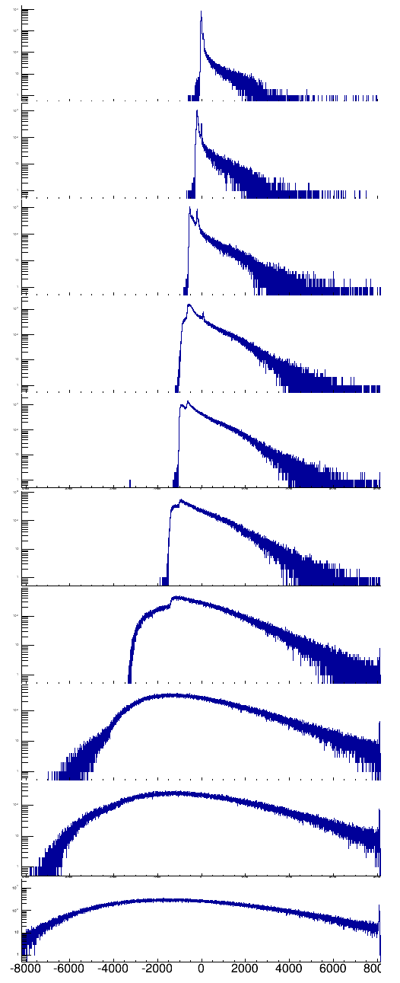
Baselines vs. Rate
1 kHz
2.6 kHz
4.3 kHz
6.9 kHz
12 kHz
19 kHz
32 kHz
53 kHz
74 kHz
97 kHz
Rate from 60Co
<E> ~ 700keV
Baseline before gamma pulses plotted
Baseline range
-5.5MeV to 5.5MeV

Slide 4
GRETINA + FMA, push rate limits
Goals :
  50kHz /crystal front end rate, acceptable resolution
  >=2 kHz / crystal Readout+Decomp rate, acceptable position resolution
Readout+Processing chain: FPGA->VME->IOC->Ethernet->Decomp
GRETINA Crystal (triggered)event limit: 1100 Hz
Trigger validation window improved
Enabled by Downsampled Readout
  2 samples @ 100MHz added before writing trace on FPGA
  Decomp changes to fit downsampled data (Mario)

Slide 5
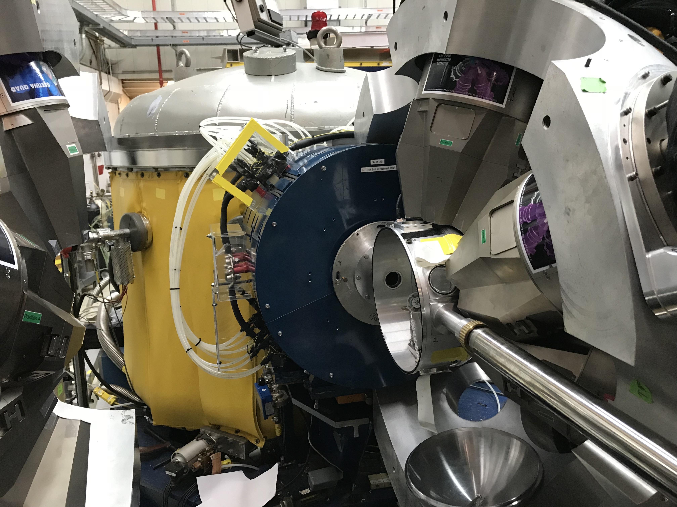

Slide 6
Downsampled data from the current experiment at FMA/Argonne
Mario has added core slope correction to Preprocessing
  More study needed to measure improvement and study noise sensitivity

Slide 7
Old/New Rate Limitations
Data rate < 20 MB/sec VME + IOC
  1100 events/sec (100MHz) => 17.6 MB/sec
  2300 events/sec (50MHz) => 16.6 MB/sec
Sort and send IOC
  < 1100 events/sec (100MHz)
  < 2300 events/sec (50MHz)
Decompose signal Cluster CPUs
  43 crystals
  At ~2300 events/sec/crystal (50MHz)
  Cluster: 84 nodes, 1256 cores
  Average 95% CPU
All limitations with ~10% of each other, well-matched

Slide 8
IOC Limits apply to MAX crystal in array

Slide 9
Energy resolution (2μsec Integration time)

Slide 10
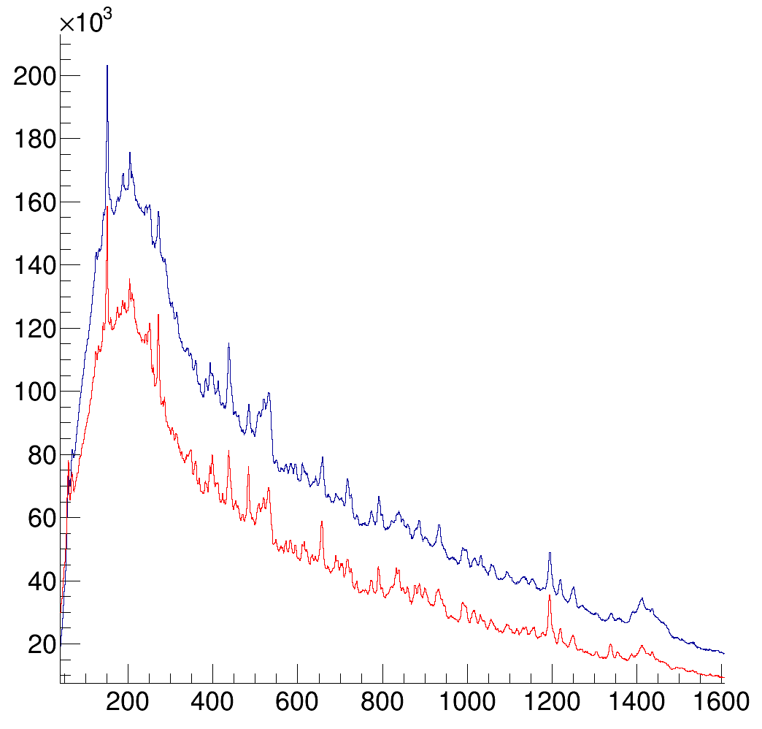
Position performance
Doppler correction performance maintained at high rate
Interaction point distributions unchanged
Decomp failures similar across rates
P/T consistent at low and high rates
P/T degraded ~10% by downsampling in offline tests

Slide 11
Decomposed throughput linear with rate

Slide 12
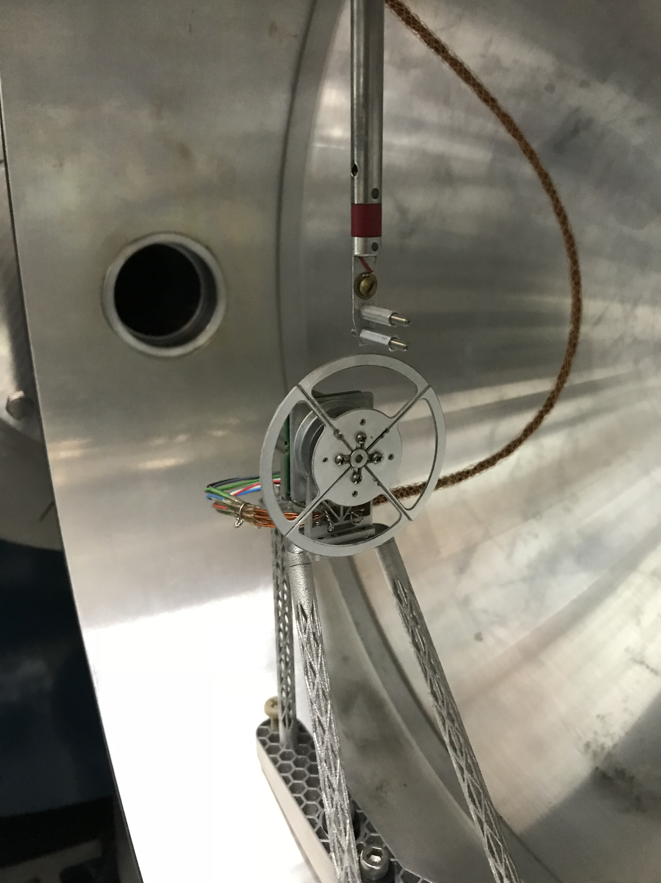
What is the rate in a real experiment?
Real experiments have multiple variations of rate
  Across crystal
  Over time
  Various time scales

Slide 16
Gated by
TS modulus
The rate variation in the data is NOT an FMA/DAQ/Trigger effect
The true gamma rate is varying over this 0.4 second timescale
Time between gamma hits (microseconds)

Slide 17
What Front-end rate?
(-10,+25%) rate variation among crystals relative to array average
~20% of ~40μsec periodic beam sweep for wheel spokes
  If rate is prompt and not activation/decays, rate should drop dramatically
  Maybe true rate is ~120% x observed rate
~40% rate variation of Periodic (0.4sec) nature, possibly beam?
  Maybe true rate covers (60%,140%) x observed rate
Energy Resolution and Pileup fraction are integrating over these variations of instantaneous rate.

Slide 18
GRETA rate requirements

Slide 19
Decomposition Rate Sets Scale of GRETA Computing
Signal decomposition is a online process - interaction point data required to monitor/debug experiments - Need to keep up!
It is the most computationally intensive aspect of array
Cores required:
  Number of crystals - 120
  Rate (/ crystal, post trigger) - 4 kHz
  Time / crystal event - 10 ms / core (2016 Xeon)
  Implies 4800 core cluster (40 cores / crystal)

Slide 20
Data Rates In/Out of Cluster
Input bandwidth:
  event size - trace (mode 3) - (single crystal) - 8kB
  input bandwidth/crystal from filter boards - 4 kHz * 8kB = 32 MB/s/crystal
  aggregate bandwidth (switch fabric, link between electronics room & cluster) - 32 MB/s * 120 = 3.8 GB/s
Output bandwidth:
  event size - interaction points (mode 2) - 512 bytes
  output bandwidth - 512 bytes * 4 kHz = 2 MB/s/crystal
  aggregate output bandwidth (mode 2) = 240 MB/s

