Slide 1
GRETINA Simulations
Heather Crawford (LBNL)
for Lew Riley et al. (Ursinus College)
Second AGATA-GRETINA Collaboration Meeting, CSNSM Orsay Campus, CRNS France – April 4-6, 2018

Slide 2
UCGretina Geant4 Simulation
The basics

Slide 3
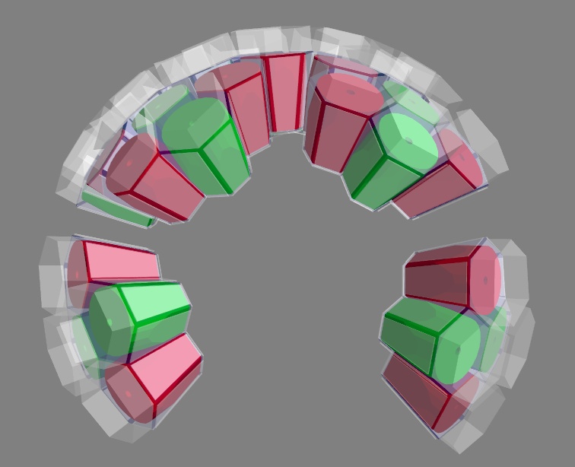
GRETINA/GRETA Geometry
…adopted from the AGATA simulation code

Slide 4
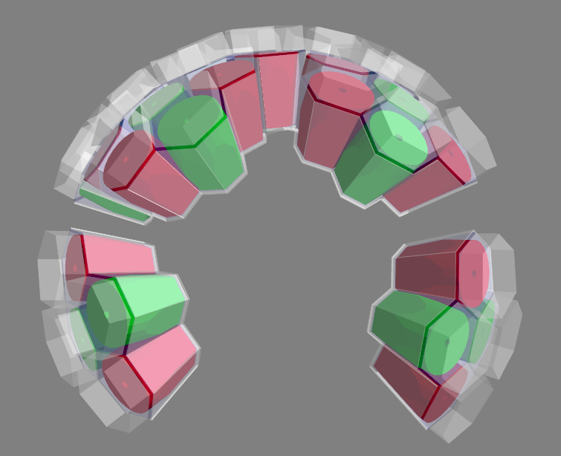
GRETINA/GRETA Geometry
…with modified (closed) capsules…
... dead layers:
1.5 mm back plane, 3.5 mm coaxial ...

Slide 5
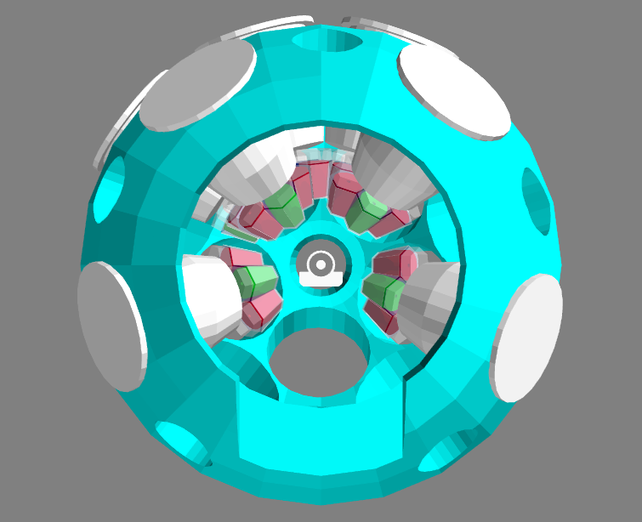
GRETINA/GRETA Geometry
…and additional dead material

Slide 6
Ion Tracking, Reactions, and Gamma Decay
Beam/Beam-Like Reaction Product (GenericIon Class)
  Incoming kinetic energy
    Option 1: Mean KE and dp/p
    Option 2: User-supplied incoming KE distribution
  Relativistic 2-body reaction kinematics
  Decay scheme
    Option 1: Single transition
    Option 2: User-supplied partial level scheme
Gamma decay in flight
  Level lifetimes
  Gamma-ray angular distributions

Slide 7
Gamma Ray Scattering
Raw data: "hits" depositing energy in active detector volumes
  Primary particles (emitted gamma rays)
  Secondary particles (scattered electrons, scattered gammas, pairs)
Interaction points: consolidated hits
  Consolidate multiple hits in each segment
  User-specified "packing resolution”
  IP positions: barycenters of consolidated hits

Slide 8
Output
Decomposed gamma-ray packets (Mode 2 data, Type 1)
S800 physics data packets (Type 9)
Emitted gamma-ray packets (Type 11)
  Number of emitted gammas
  Full-energy flag (multiplicity 1, full energy in one crystal)
  For each emitted gamma:
    Energy
    Emission position (x, y, z)
    Emission direction (theta, phi)
    Source beta
User sorting / post-processing code must fold in thresholds, energy & position resolution

Slide 9
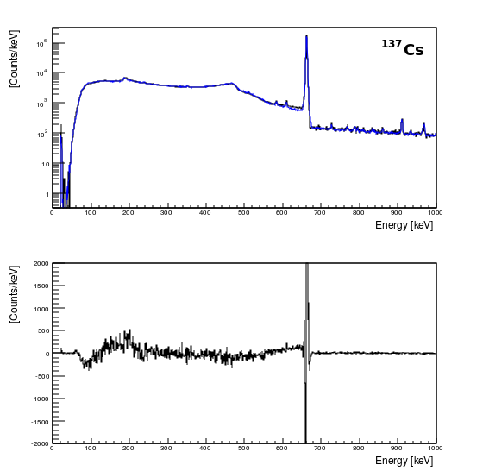


Performance: Stationary Sources
Threshold response:
Resolution response:
Fit: p1*(simulation)
+ p2*(measured room background)

Slide 10

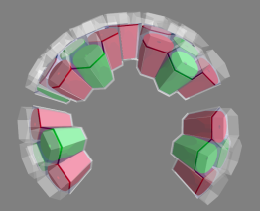
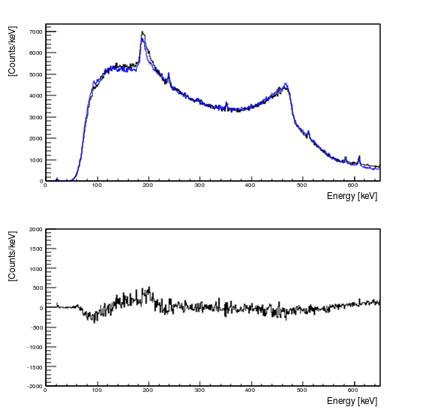
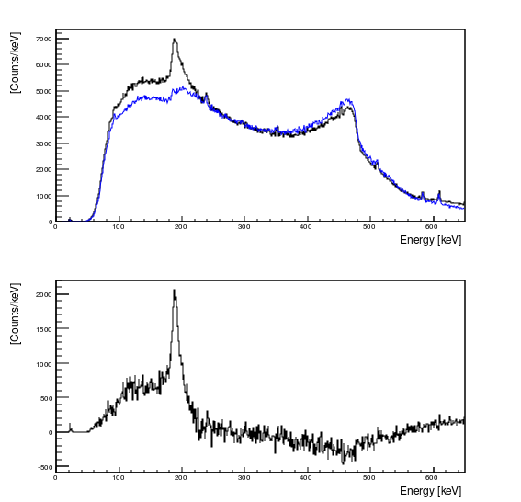
Performance: Dead Material and Stationary Sources

Slide 11
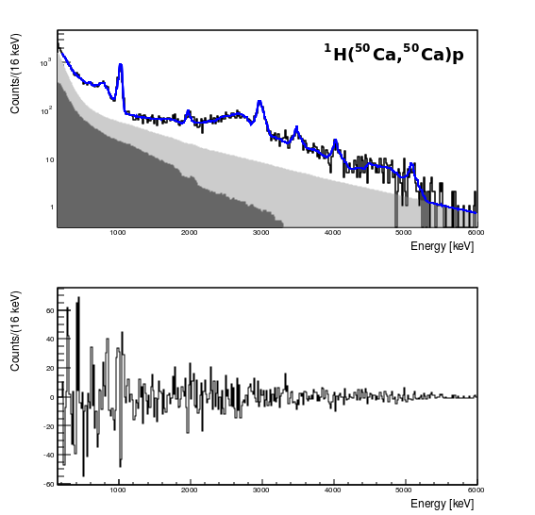
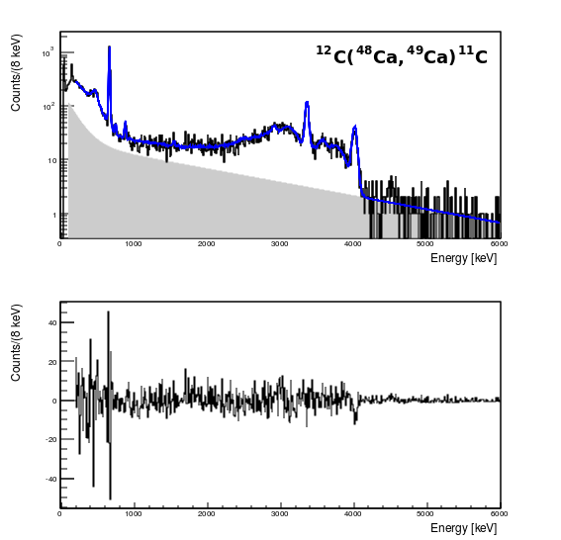
In-Beam Performance
L. Riley et al.
A. Gade et al.
Inverse-kinematics (p,p’)
30 mm LH Target ~10 pps
Inverse-kinematics pickup
10ps lifetimes, angular distributions included

Slide 12
Issues/ Future Work
Evaluate Addback and Tracking
  Determine packing resolution empirically (hit multiplicity?)
  How to handle background in source measurements?
Efficiencies
  Efficiency below 300 keV (currently too efficient)
  Non-physical coaxial dead layer ⟹ improve through measurement
Dead material (low-energy backscattering)
  GRETINA: improve preamp/dewar model
  Additional materials?

Slide 13
Issues/ Future Work
Evaluate Addback and Tracking
  Determine packing resolution empirically (hit multiplicity?)
  How to handle background in source measurements?
Efficiencies
  Efficiency below 300 keV (currently too efficient)
  Non-physical coaxial dead layer ⟹ improve through measurement
Dead material (low-energy backscattering)
  GRETINA: improve preamp/dewar model
  Additional materials?

Slide 14
UCGretina Geant4 Simulation
Refining Geometries with Data

Slide 15
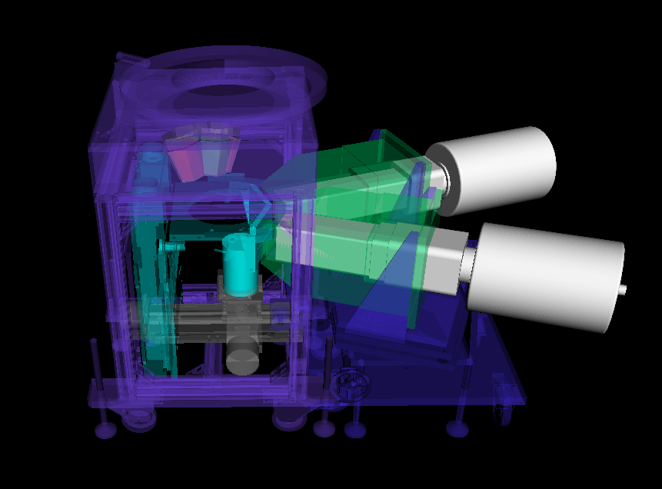
Coincidence & Pencil Beam Scanning Simulations
Complete LBNL scanning table assembly, including coincidence scanning clovers, etc. has been implemented into UCGretina
Directly provides a mechanism for confirming expected distributions of scanning data
  Extent of coincidence “points” resulting from finite collimation
  Depth profile of pencil beams
Collimated measurements can be used with simulation to constrain detector parameter inputs to the simulation

Slide 16
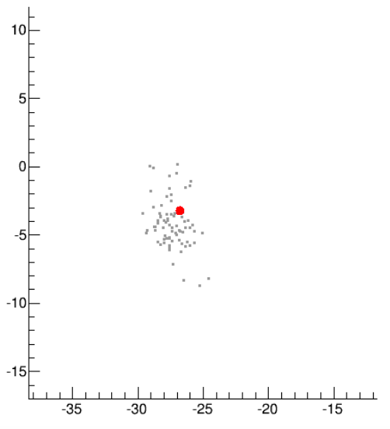
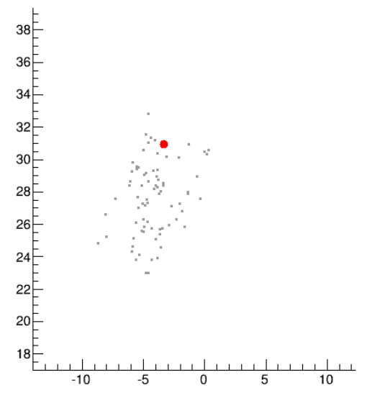
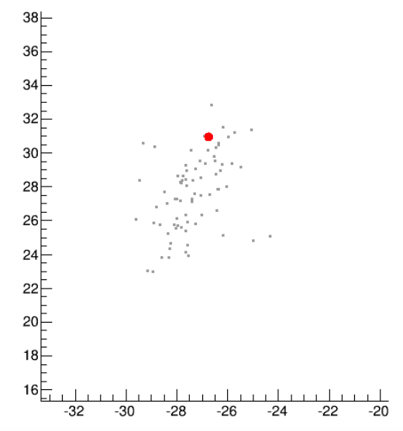
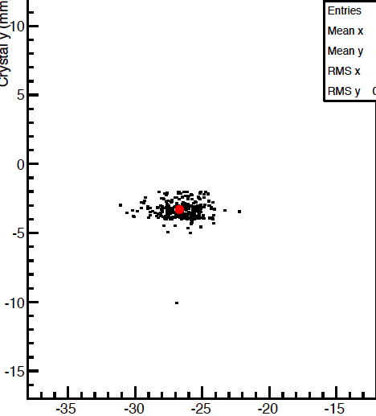
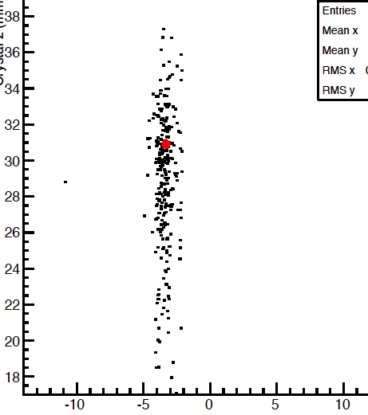
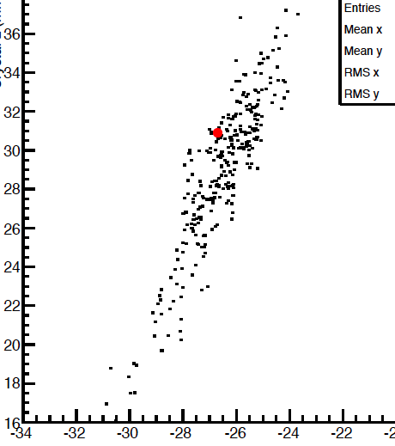
Coincidence Scanning and Table Limitations
X [mm]
Z [mm]
Z [mm]
Data
X [mm]
Z [mm]
Z [mm]
Simulation
Y [mm]
X [mm]
Y [mm]

Slide 17
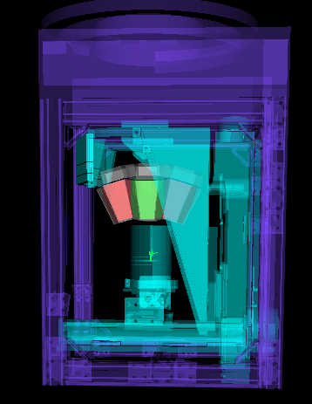
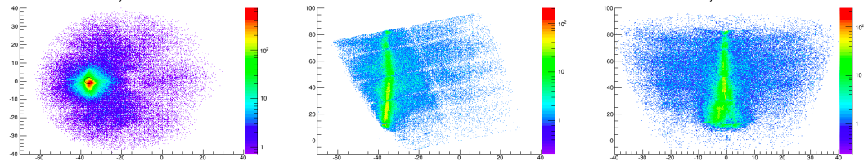
Pencil Beams and Coaxial Dead Layer
Series of pencil beam measurements (¹³⁷Cs) were taken during scanning campaign of 2015 using Q4P4
Without any inclusion of signal decomposition, using only singles efficiencies, systematic scanning provides data to constrain dead layer thicknesses
XY
YZ
XZ

Slide 18
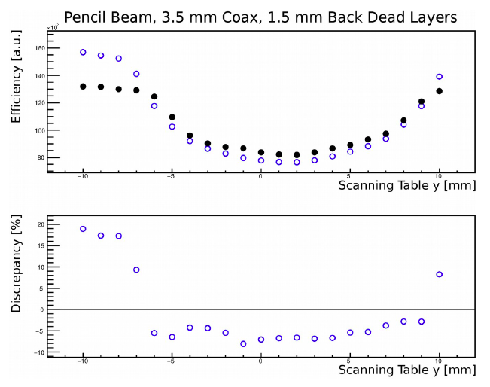
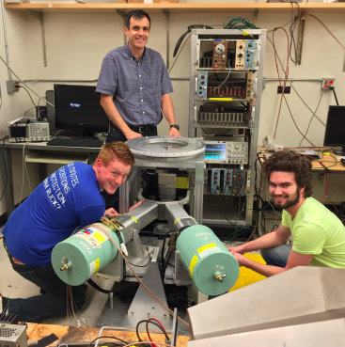
Pencil Beams and Coaxial Dead Layers
Prof. Lew Riley, Sean Gregory and Ethan Haldeman

Slide 19
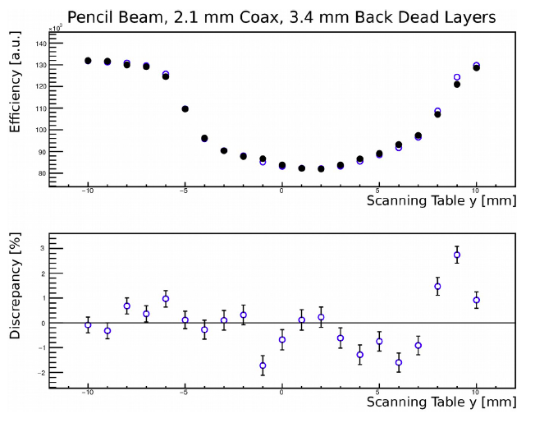
Pencil Beams and Coaxial Dead Layers
Prof. Lew Riley, Sean Gregory and Ethan Haldeman

Slide 20
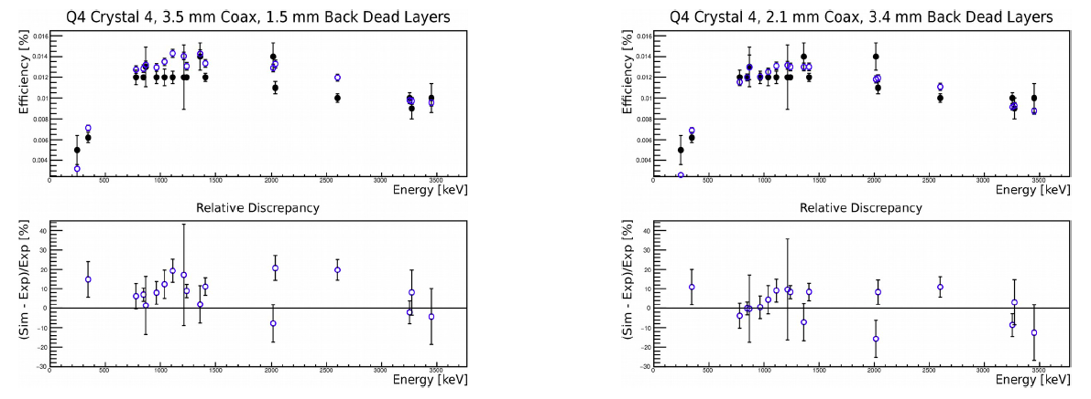
Detector Rear Dead Layers
Efficiency measurements, requiring a signal in the rear layer (rear 1.2cm) of the crystals can be compared to simulation, analyzed in the same way
Shape of efficiency curve proves sensitive to rear dead-layer thickness

Slide 21
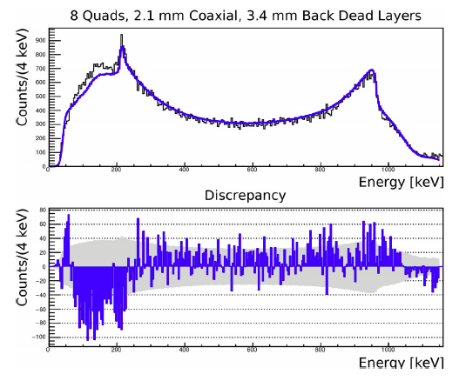
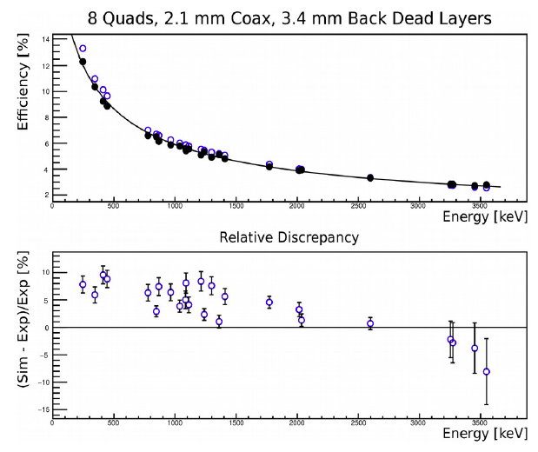
Still Under Development…
Scanning data provides a rigid comparison point for determining dead layers in specific regions of the crystal
Changes (more physical dead layer values) cause discrepancy in overall efficiency, detector response ⟹ iterations required

Slide 22
Still Under Development…
Scanning data provides a rigid comparison point for determining dead layers in specific regions of the crystal
Changes (more physical dead layer values) cause discrepancy in overall efficiency, detector response ⟹ iterations required
Additional pencil beam scanning along the coaxial bore, and perpendicular at a range of effective z has been done to validate dead layer thicknesses
Segment-by-segment efficiencies may provide even more insight (beyond the rear segments)

Slide 23
“Enhanced” Simulation

Slide 24
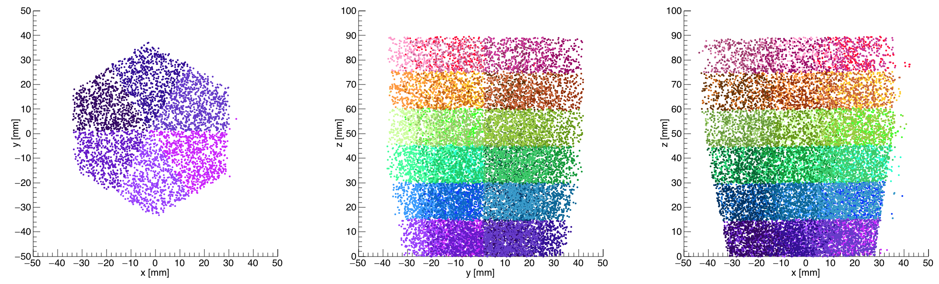
Toward a More Realistic Description
Geant4 includes realistic crystal geometries but does not have the correct segmentation
Introduces challenges in accurately applying concepts such as position resolution etc. – realistic description would require us to maintain the definition of net segment correctly

Slide 25
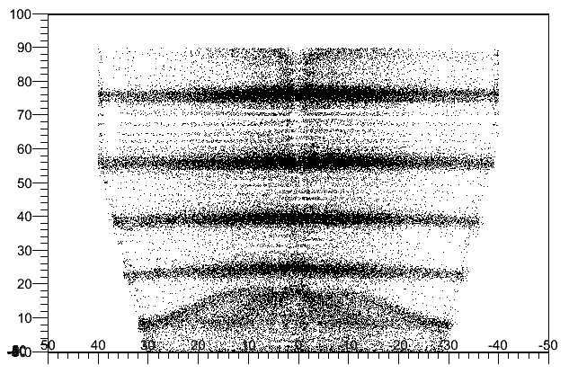
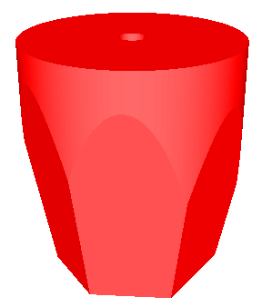
Improving Segment Boundary Descriptions
Geant4 includes realistic crystal geometries but does not have correct segmentation
We use the basis grid points to define the correct segmentation in Z (as a function of X, Y) and phi
Directly reproduce detector crystal geometry (A and B type) in ROOT, to constantly check that no operation puts interaction points outside the physical crystal volume

Slide 26
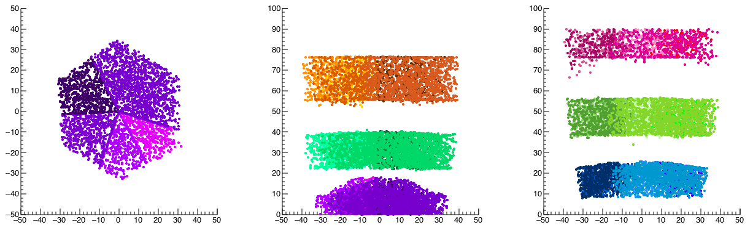
Improving Segment Boundary Descriptions
5% of points were removed (out of bounds)
49% of segments were modified

Slide 27
Segment Efficiencies

Slide 28
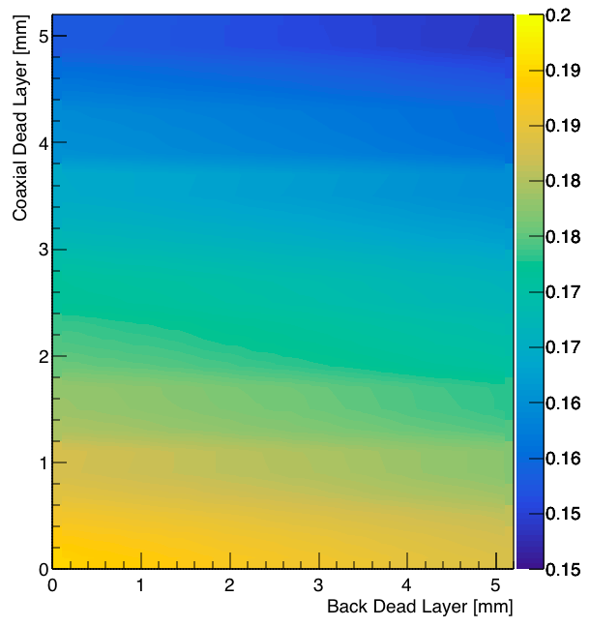
Total Crystal Efficiency
Total efficiency for B-type crystals – average 0.161(5)
Can define contour to reproduce total efficiency – back vs. coaxial dead layer
Consistent with large dead layers array optimization suggested

Slide 29
Segment Efficiency (% of CC)

Slide 30
“Standard” Simulation
1.5 mm back dead layer + 3.5 mm coaxial dead layer
Flat segment slices at 8, 14, 16, 18 and 20

Slide 31
Remapped Simulation
1.5 mm back dead layer + 3.5 mm coaxial dead layer
Mapped to realistic segment boundaries (all changes to layer #)
Shape of distribution for segment efficiencies correct

Slide 32
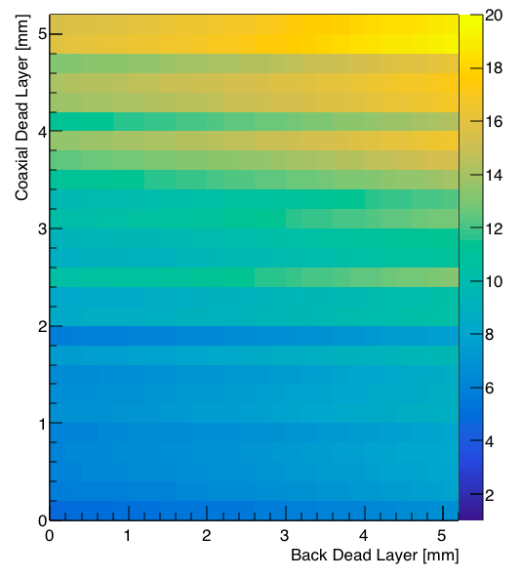
Remapped Simulation
Vary dead layers and optimize χ² of difference in segment-by-segment relative efficiencies
Best “fit” for lower dead layers (coaxial and back)

Slide 33
Still Under Development…
There is no consistent description of overall crystal efficiency and segment partial efficiencies – for both crystal geometries A and B
Suggestive of additional losses – outer surface area effective dead layer?

Slide 34
Still Under Development…
There is no consistent description of overall crystal efficiency and segment partial efficiencies – for both crystal geometries A and B
Suggestive of additional losses – outer surface area effective dead layer?

Slide 35
Still Under Development…
There is no consistent description of overall crystal efficiency and segment partial efficiencies – for both crystal geometries A and B
Suggestive of additional losses – outer surface area effective dead layer?
Exploring addition of outer surface dead layer – combine optimizing segment and total efficiencies to fit crystal-by-crystal for most accurate description

Slide 36
Summary

Slide 37
GRETINA Simulation Status Summary
UCGretina Geant4 simulation package has become an all-inclusive package for both physics analysis and GRETINA performance benchmarking
  Includes capabilities for in-beam and source simulation, with dead material included for good reproduction of overall spectral shape, and source efficiencies
Detailed scanning measurements are continuing to refine the subtleties of detector geometry
More “realistic” simulations are reached by post-processing of Geant4 outputs
  Realistic segments and energy-dependent smearing provide path forward to better agreement with P/T and polarization
  Method to investigate partial energy loss near boundaries etc.

Slide 38
Acknowledgements
Thank you to
Lew Riley (Ursinus College)

Slide 39
Thank you!

Slide 40


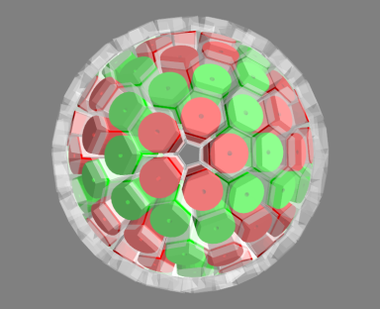
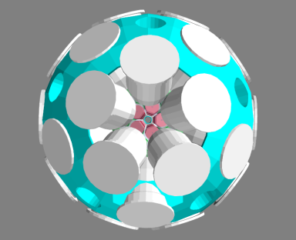
GRETINA ⟹ GRETA
@ 1.33 MeV
85/5 keV thresholds
P/T
efficiency
Crystals
Calorimeter
Crystals
Calorimeter
22%
40%
4.5%
6.7%
20%
38%
4.4%
6.6%
18%
48%
19%
35%
17%
45%
19%
34%

Slide 41
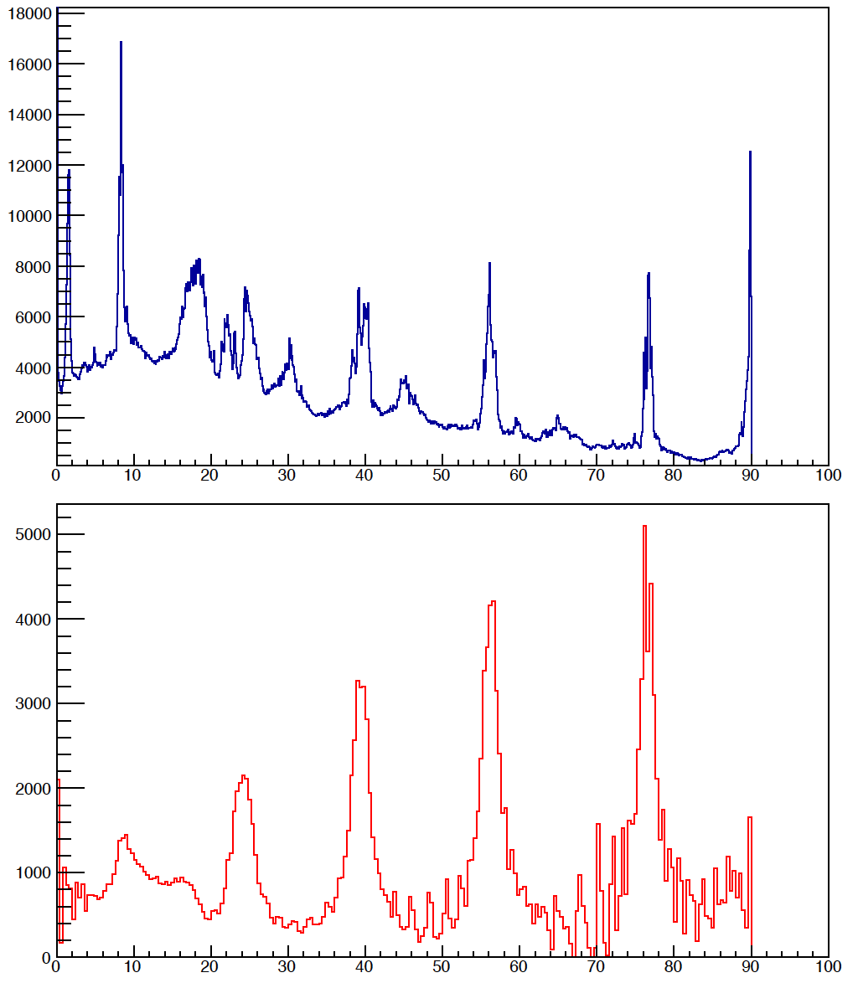
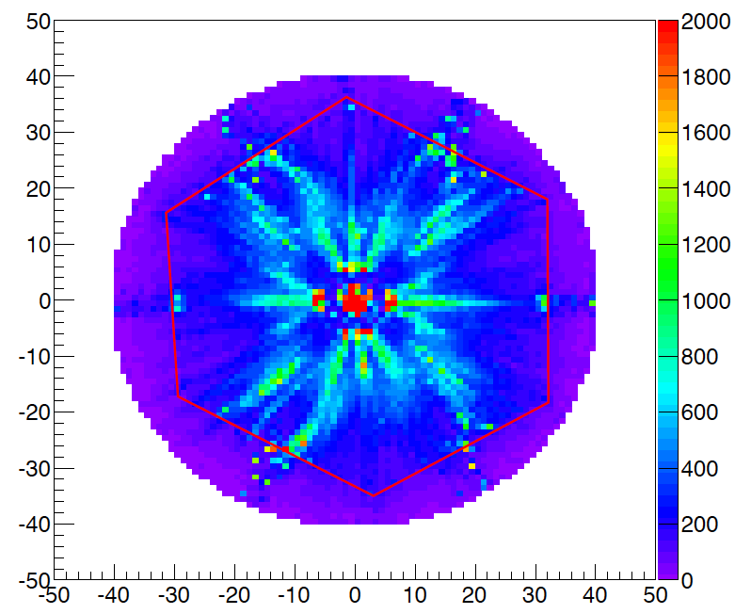
Decomposition Basis and Errors
Data
Similarity in basis point distributions and data (x,y,z) distributions suggests using density of grid points to weight likelihood for altered interaction point positions
Counts
Basis
Crystal y (mm)
Counts
Crystal x (mm)
Crystal z (mm)

Slide 42
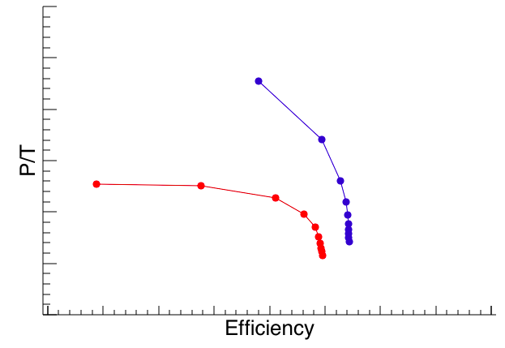
Getting Closer to Experimental P/T
Including the position resolution smearing (here with σ as a function of energy), P/T vs. ε curves become shallower ⟹ closer to data curves

Slide 43
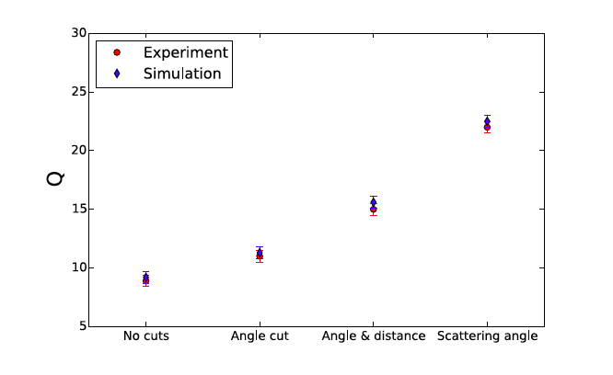
Polarization Summary: More Realistic Simulation

Slide 44
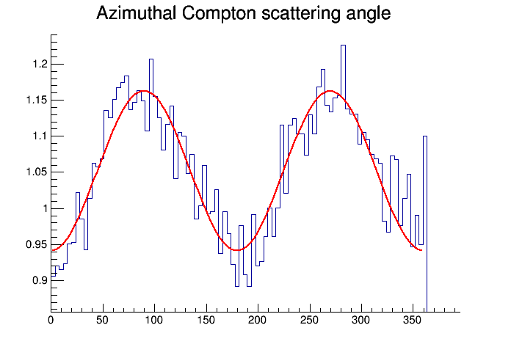
Polarization: Angle Cut
Normalized intensity
Q = 11%
Angle φ [degrees]

Slide 45
Polarization: Angle & Distance Cuts
Normalized intensity
Q = 16%
Angle φ [degrees]
Distance between interaction points > 20mm

Slide 46
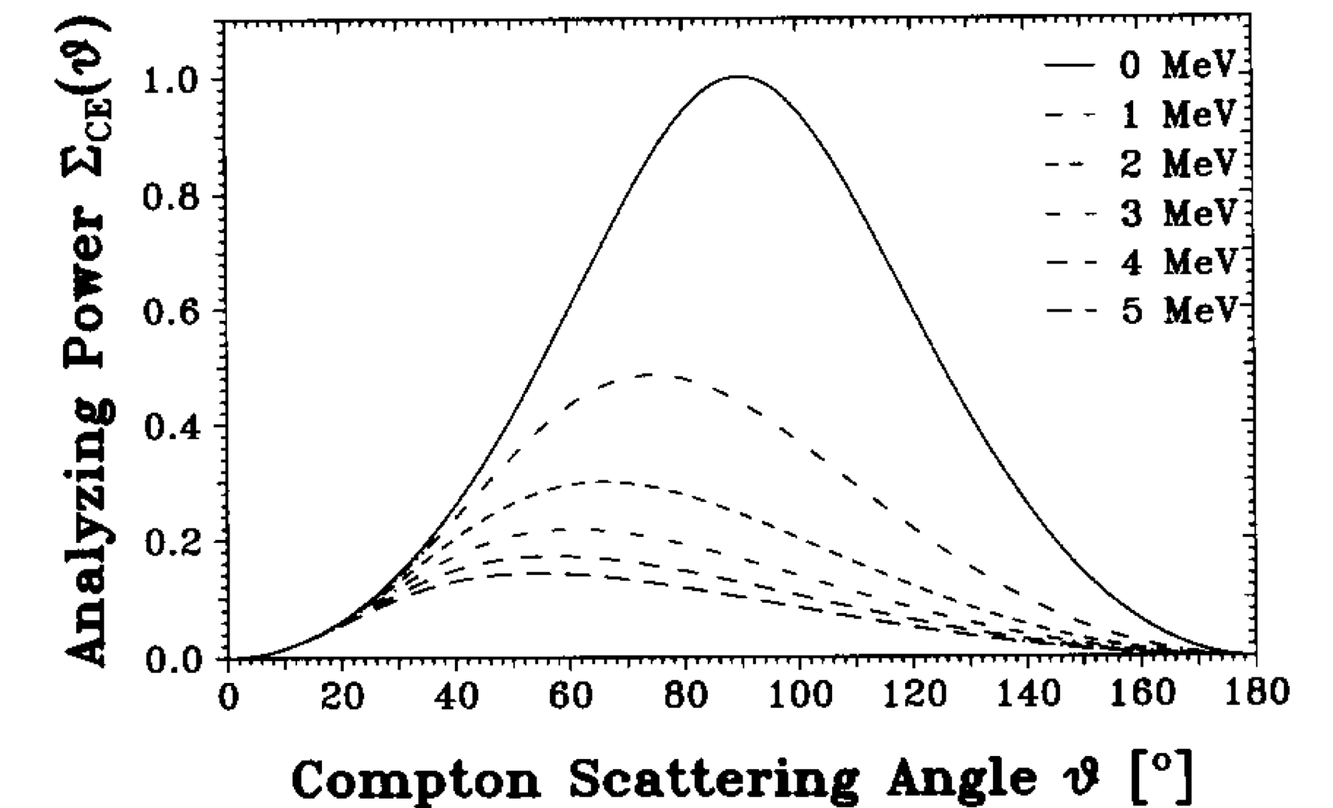

Polarization: Analyzing Power
Q = 25%

Slide 47
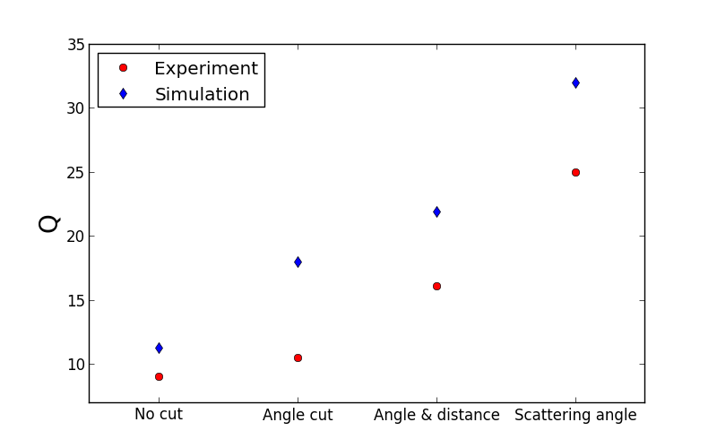
Polarization Summary: “Ideal” Simulation

Slide 48
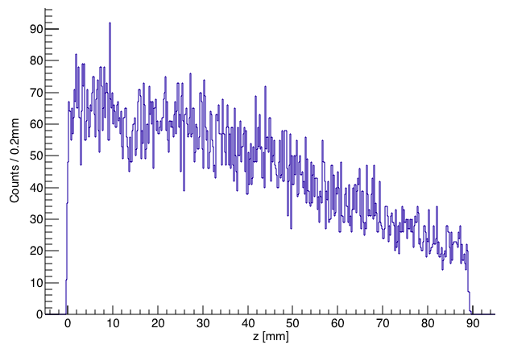
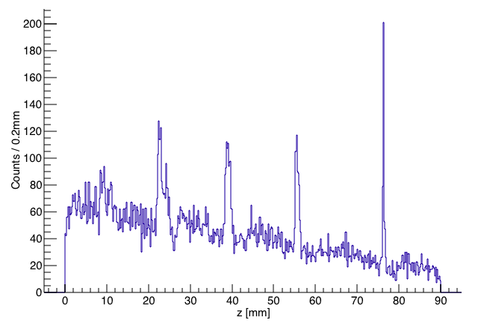
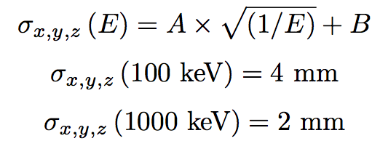
Converging Toward Data
‘Smeared’ Simulation
‘Raw’ Simulation
With realistic segments, interaction point distributions naturally move toward reproducing data more readily
Application of an energy-dependent position resolution smearing to the simulated data, while requiring no change to the segment ID naturally results in “clumping” of lower-energy points near segment boundaries
Data
z [mm]

Slide 49
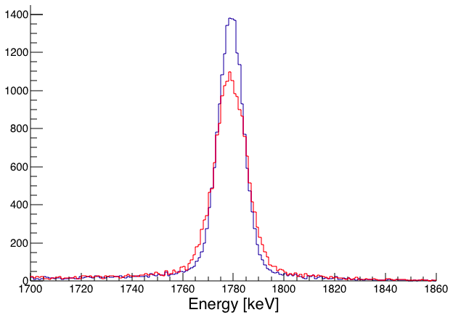
Converging Toward Data
²⁸Si at 0.4c
‘Smeared’ Simulation
‘Raw’ Simulation

Slide 50
Polarization and Simulation
⟹ Preliminary

Slide 51
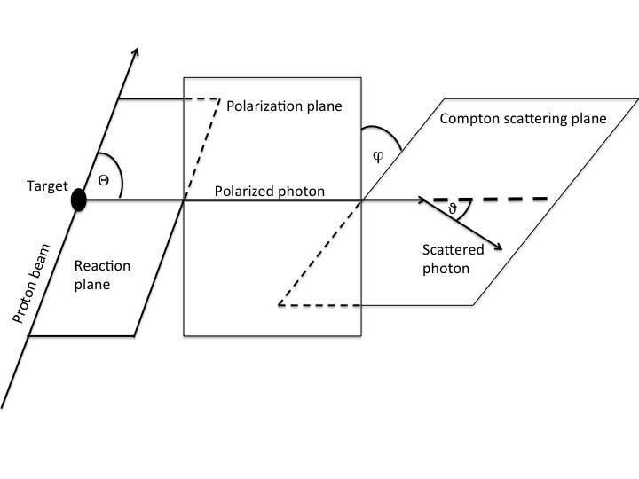
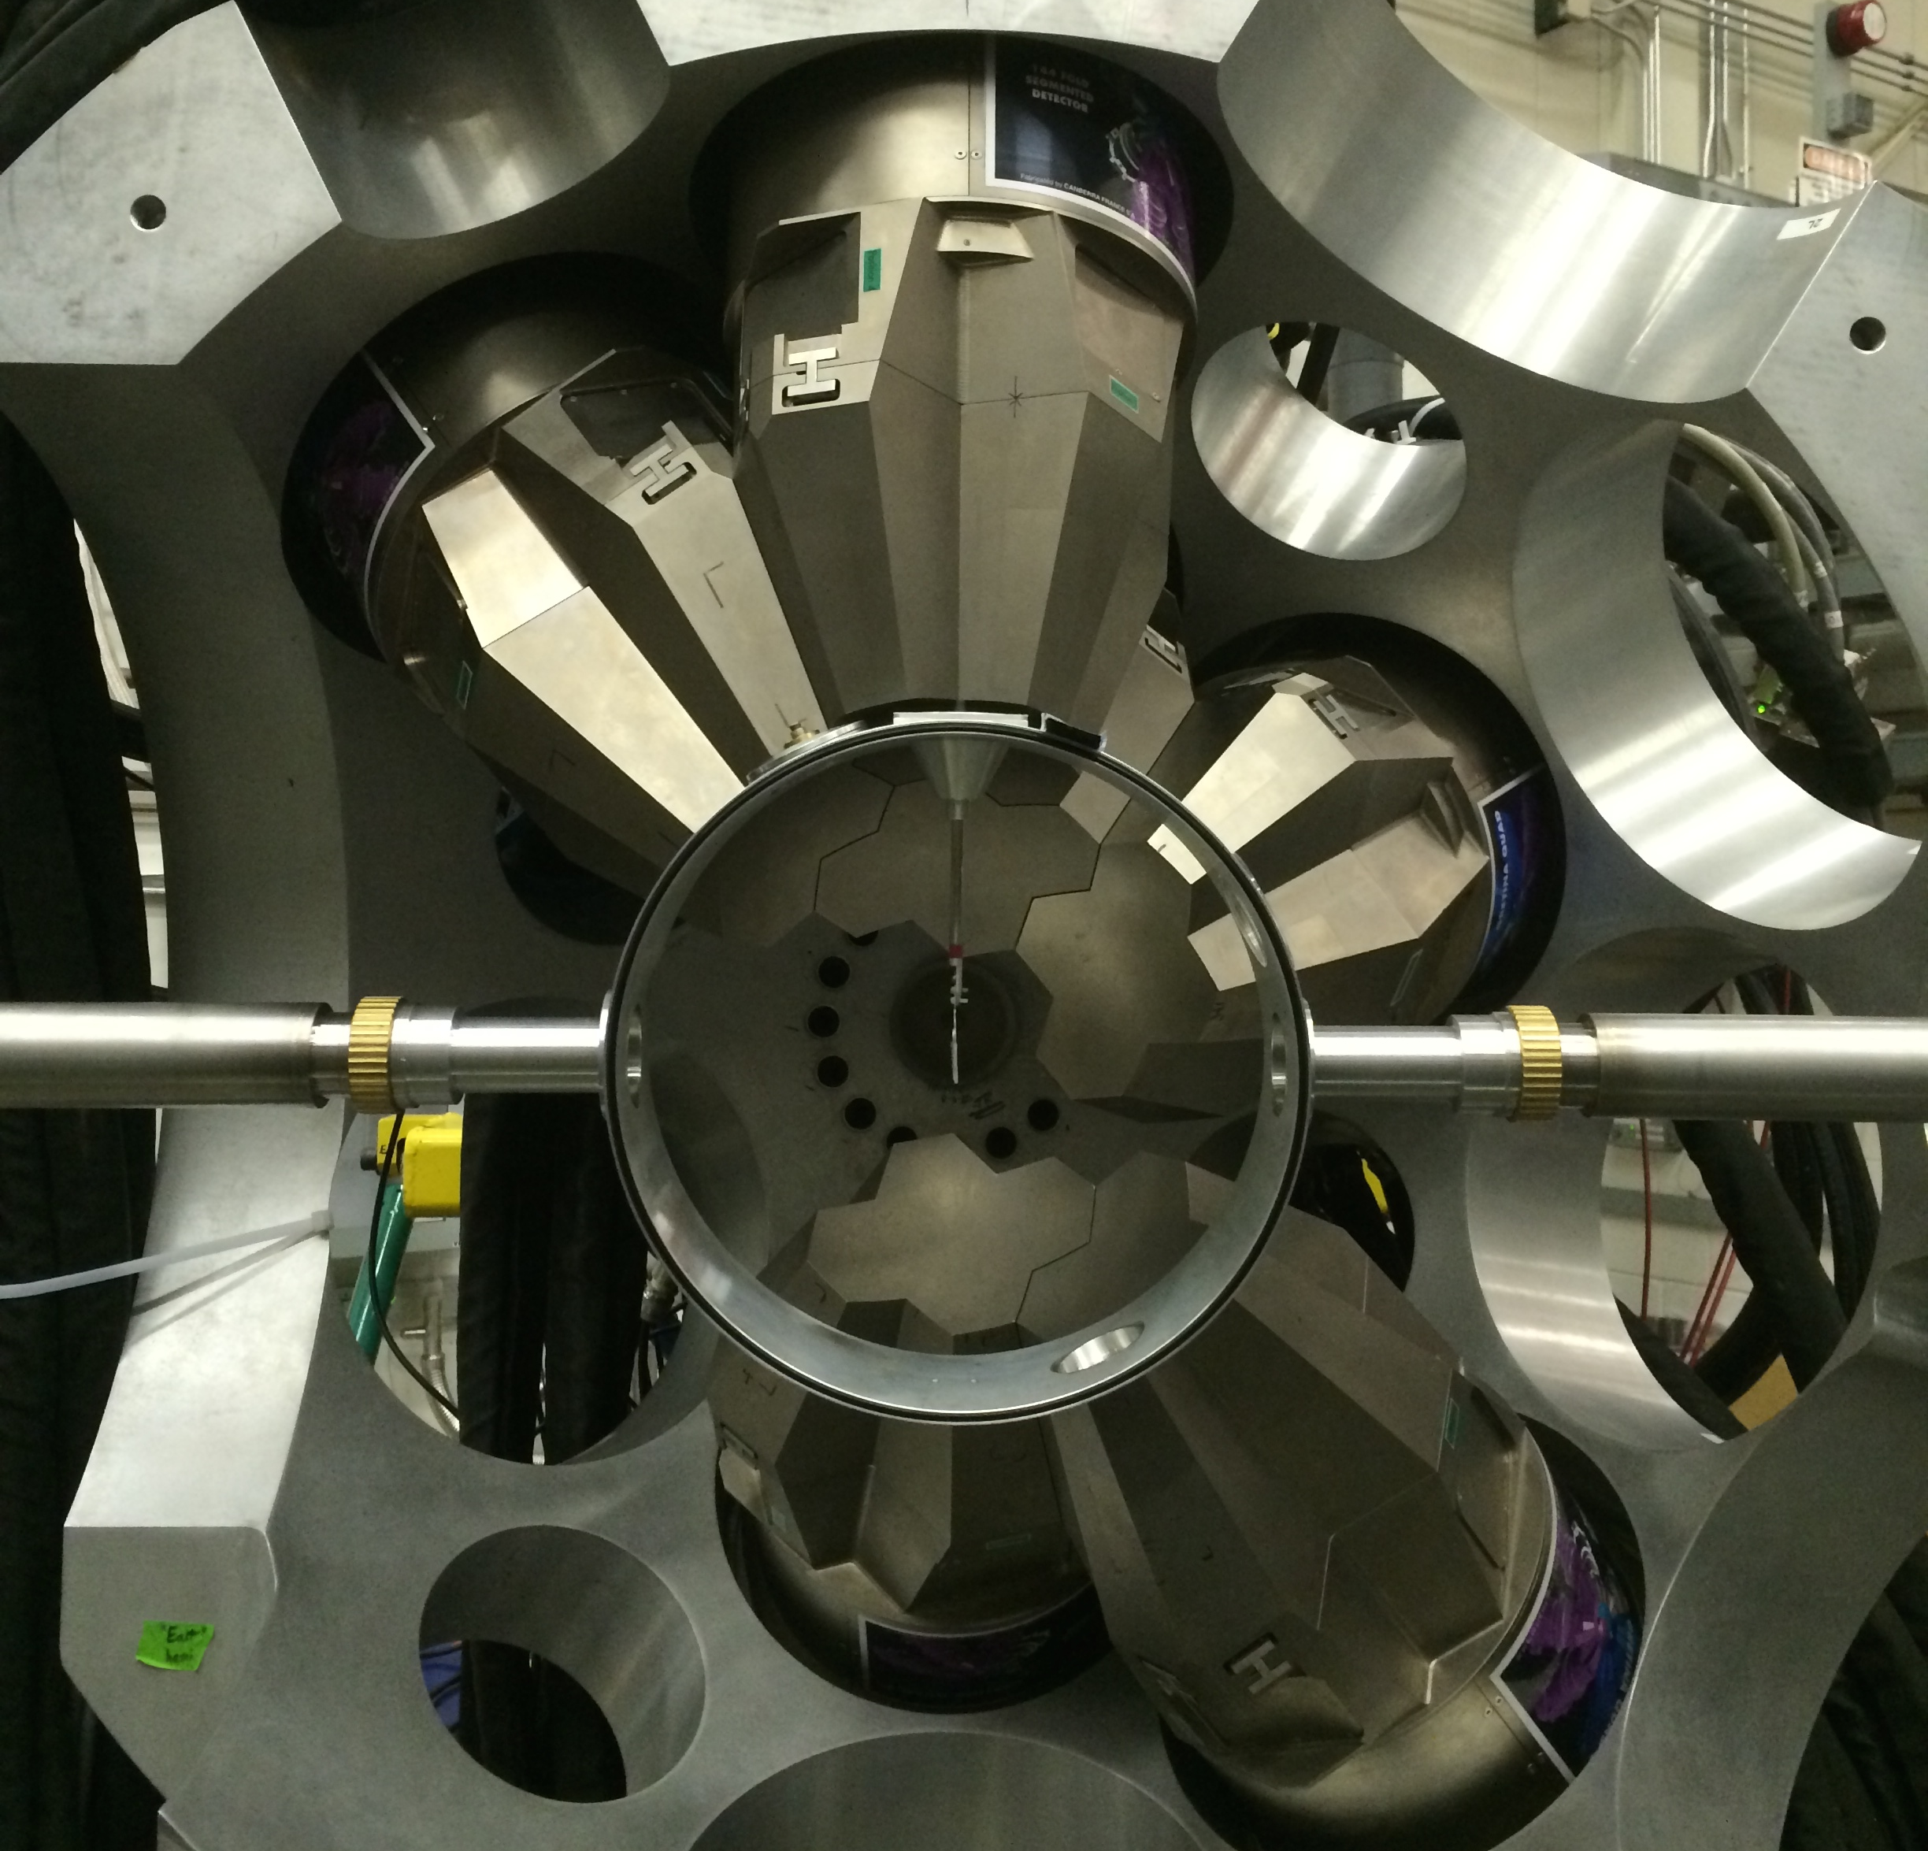
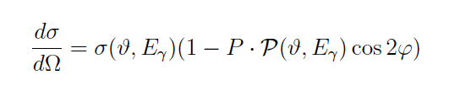
Polarization In-Beam Test: GRETINA @ ANL
2⁺
1369keV
²⁴Mg(p, p’γ)²⁴Mg
0⁺

Slide 52
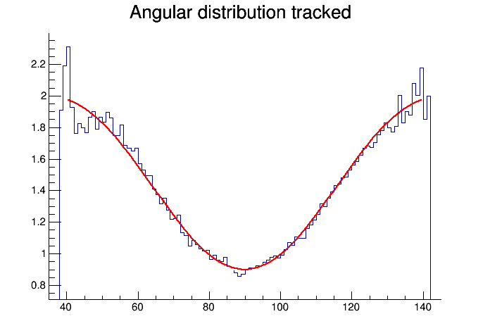
Polarization In-Beam Test: GRETINA @ ANL
A₂ = 0.53(2) A₄= -0.36(4)
Normalized intensity
²⁴Mg E_{γ}=1.37MeV
⁶⁰Co E_{γ}=1.33MeV
Angle θ [degrees]
P(90)= 0.96

Slide 53
Polarization
Normalized intensity
Q = 9% - no data cuts
Angle φ [degrees]

Slide 54
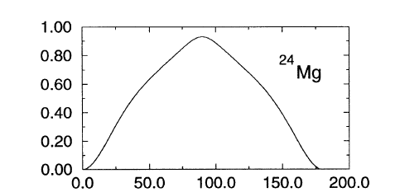


Polarization as a Function of Angle

Slide 55
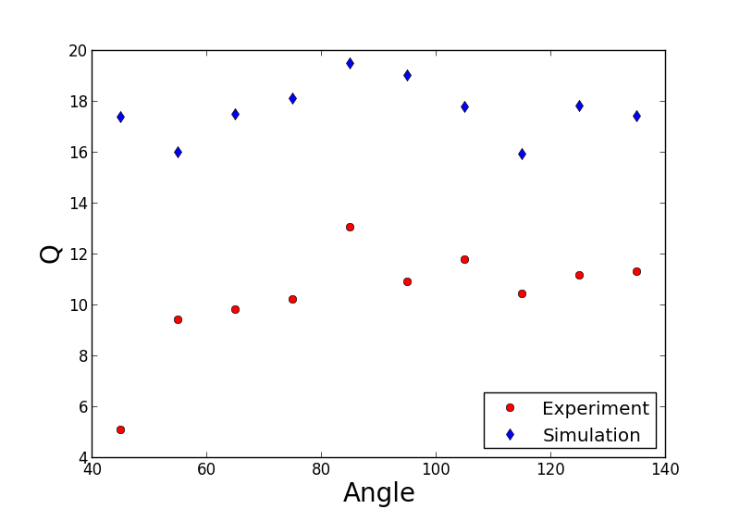
Polarization as a Function of Angle

