Slide 1

GRETINA Polarization Notes
Michael David Jones
Nuclear Science Division
Lawrence Berkeley National Laboratory
This material is based upon work supported by the U.S. Department of Energy,
Office of Science, Office of Nuclear Physics under Contract No. DE-AC02-05CH11231.

Slide 2
Polarization Recipe
Use tracked data (X,Y,Z) to get 1st and 2nd interaction point.
Define reaction-plane as v1 x Z = n1
3. Gate on photopeak and measure v1 x v2 = n2
  Compton Phi is dot product of two planes’ normal vectors: n1 * n2
  Correct for Compton background
4. Same procedure with SOURCE data at similar energy.
  At present, I do NOT account for different attenuation within Ge.
5. Normalize DATA with SOURCE spectrum
  This corrects for “PHI efficiency”
May cut on scattering angle (v1*v2) within Ge, and distance between interactions
  Also cut on [70-110] deg (LAB FRAME) for peak asymmetry

Slide 3
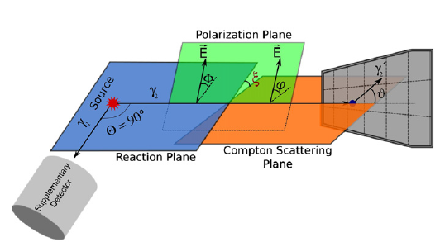
Definitions
Z x v1
v1 x v2
v2
v1
Z-hat
Reaction Plane: z x v1 = n1
Compton Plane: v1 x v2 = n2
Compton PHI: n1 * n2 = cos(PHI)

Slide 4
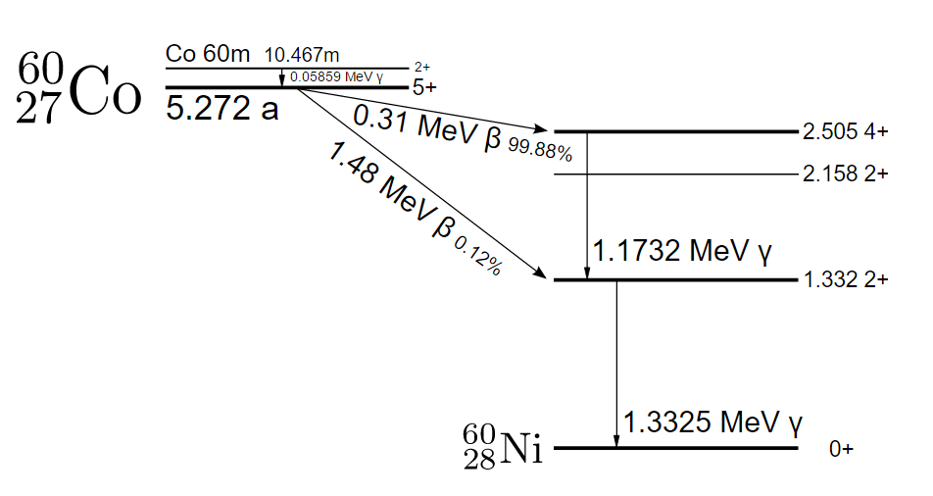
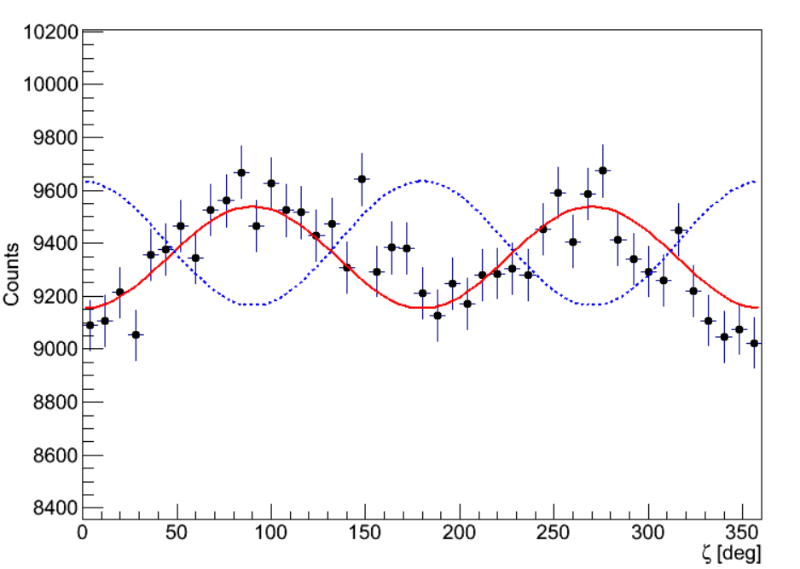
Side Note
This can also be done with g-g cascades from ⁶⁰Co using one photon as the beam axis:
(You normalize with randomly generated reaction plane mixed with data)
⁶⁰Ni: 1173 keV (E2)

Slide 5
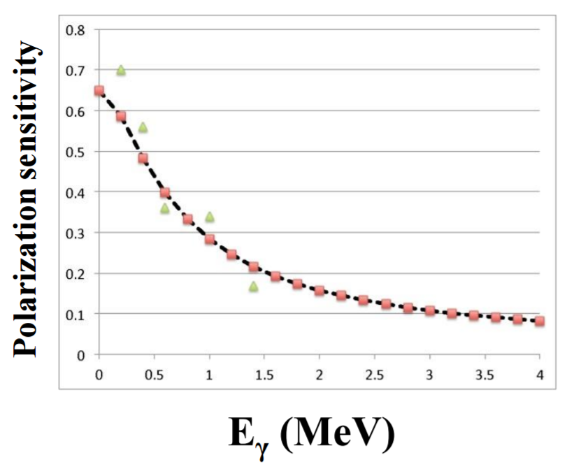

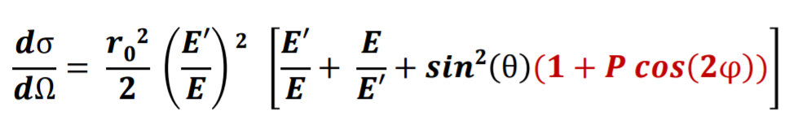
Angular Distributions & Polarization
B. Alikhani et al. NIM A 675 (2012) 144-154
Z-axis
Use Z-axis for reaction plane.
1st and 2nd interaction point give Compton plane.
Possible thanks to tracking!

Slide 6


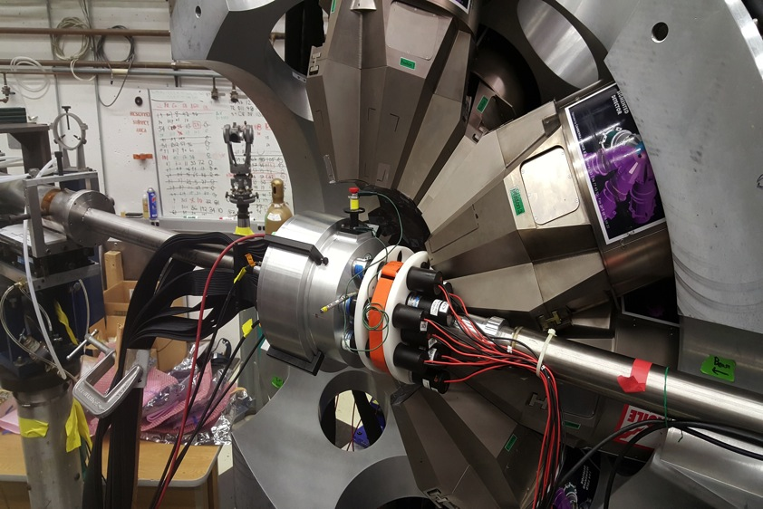
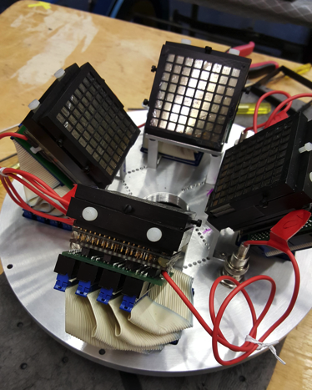
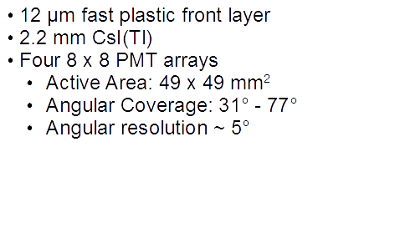
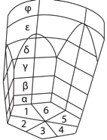

Experiment at ANL
⁵⁶Fe(p,p’) at 16 MeV
D.G. Sarantites et. al. NIMA Vol. 790, pg 42-56 (2015)

Slide 7
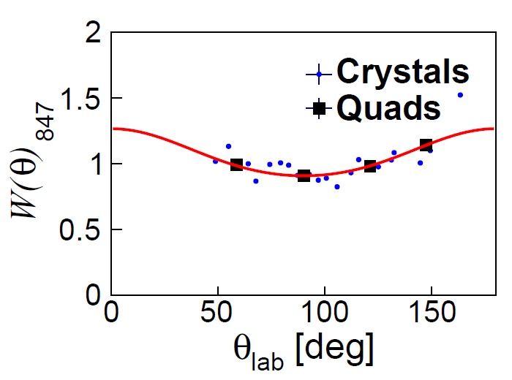
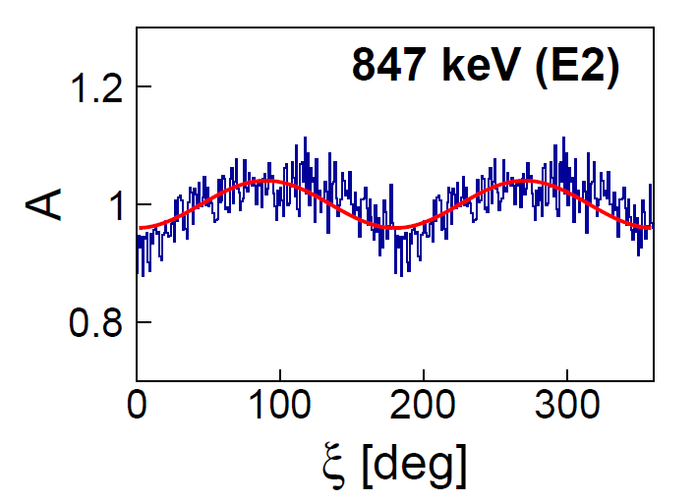
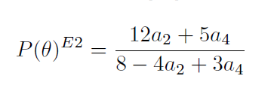
Angular Distributions & Polarization
⁵⁶Fe, 847 keV, E2
Angular distribution gives polarization, which agrees with measurement:
A_{ang} = -0.059(18)
A_{pol} = -0.05(1)

Slide 8
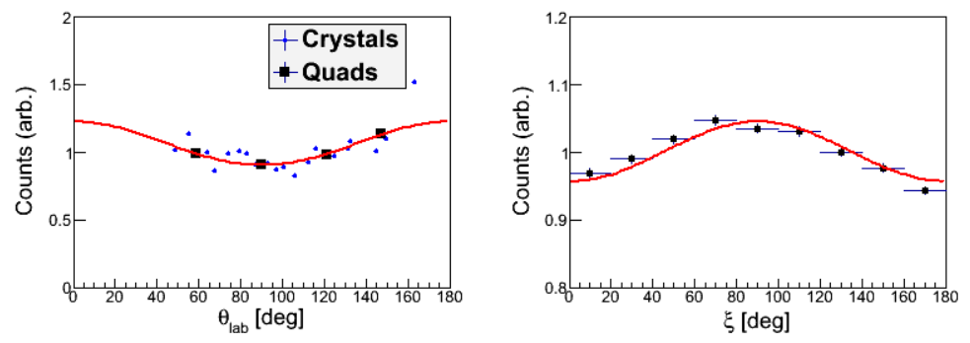
847 keV, E2 (2⁺ → 0⁺)
⁵⁶Fe
a₂ = 0.22(5)
a₄ = 0.02(5)
A_{pol} = -0.05(1)

Slide 9
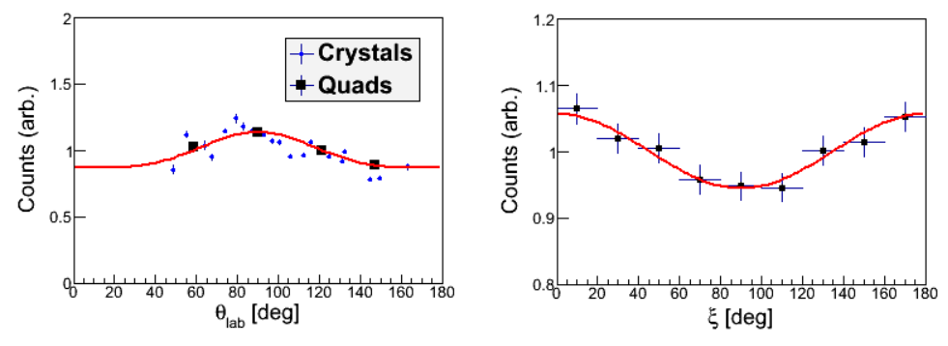
476 keV, M1 (7/2⁻ → 5/2⁻)
⁵⁵Fe
a₂ = -0.20(5)
a₄ = 0.07(5)
A_{pol} = -0.06(1)
*Uncertainties are approximate based on the (5) from the 847 fluctuation and its normalization

Slide 10
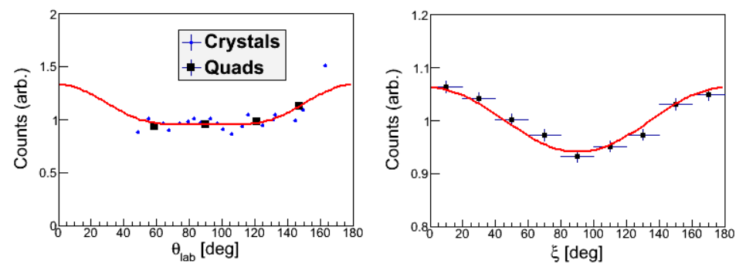
931 keV, M1 + E2 (5/2⁻ → 3/2⁻)
⁵⁵Fe
a₂ = 0.21(5)*
a₄ = 0.09(5)*
A_{pol} = 0.04(1)
*Uncertainties are approximate based on the (5) from the 847 fluctuation and its normalization

Slide 11
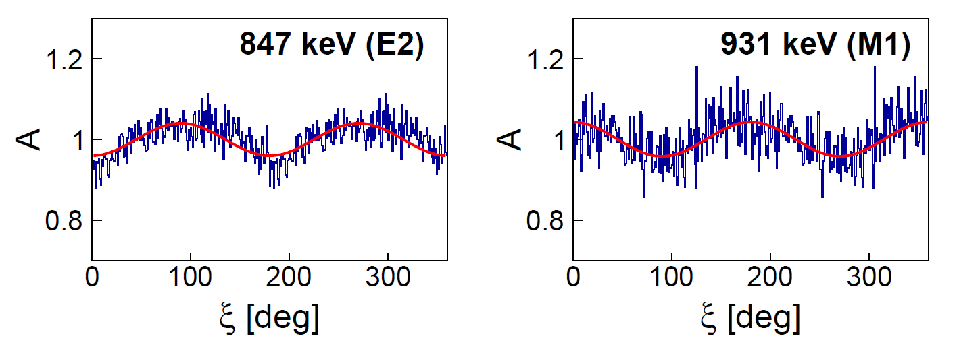

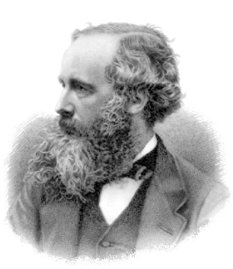
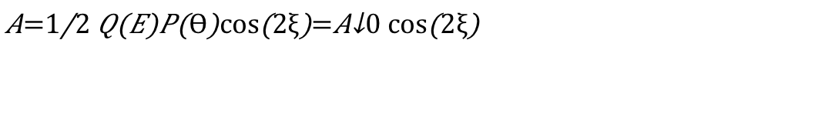
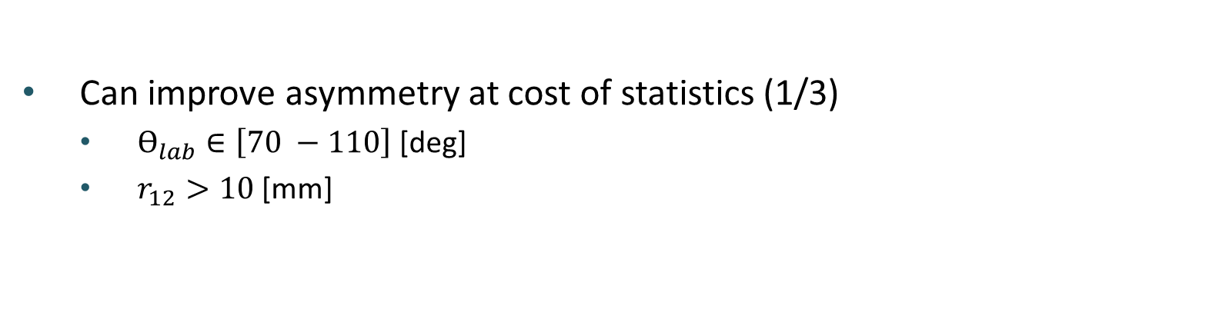
Polarization
Can improve asymmetry at cost of statistics (1/3)
  $Ѳ_{lab}∈\left[70 −110\right]$[deg]
  $r_{12}>10$[mm]
⁵⁶Fe, 847, E2
⁵⁵Fe, 931, M1+E2
$$A=\frac{1}{2}Q\left(E\right)P\left(Ѳ\right)cos\left(2ξ\right)=A_{0}cos\left(2ξ\right)$$

Slide 12
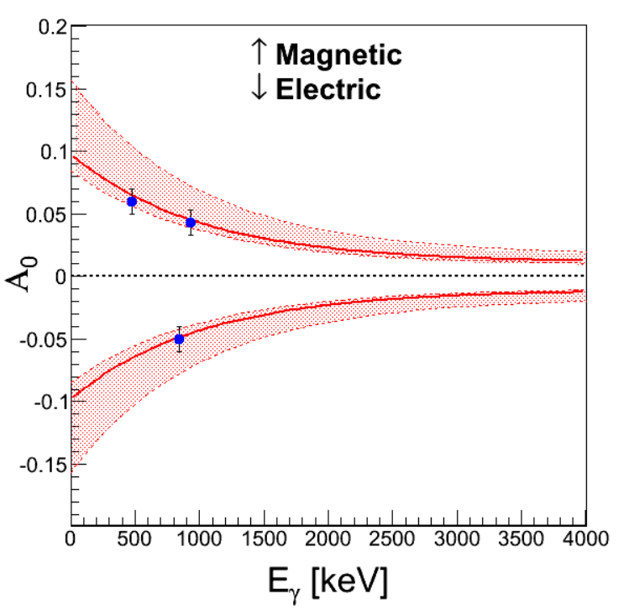
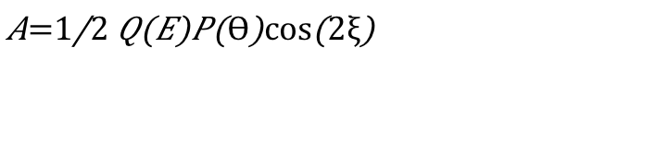

Analyzing Power
Alignment constrained by (p,p’) angular
distributions: (red band)
$$P =0.37(11)$$
Analyzing Power can be pinned down by
measuring several energies (red line)
$$A=\frac{1}{2}Q\left(E\right)P\left(Ѳ\right)cos\left(2ξ\right)$$

Slide 13
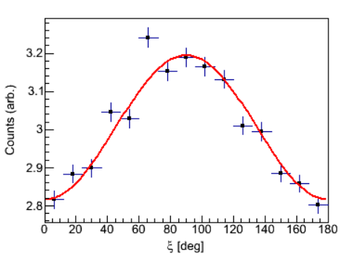
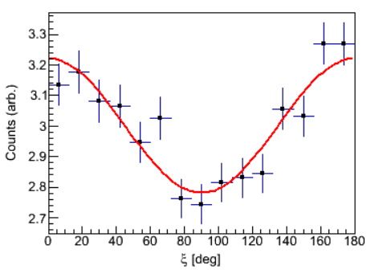


Polarization
Can improve asymmetry at cost of statistics (1/3)
  $Ѳ_{lab}∈\left[70 −110\right]$[deg]
  $r_{12}>10$[mm]
⁵⁶Fe, 847, E2
⁵⁵Fe, 931, M1+E2
$$R \sim A_{0}[1+ A_{1}cos\left(2ξ\right)]$$
$$A_{1}=PQ$$
Cuts double asymmetry from ~3% to 6%

Slide 14
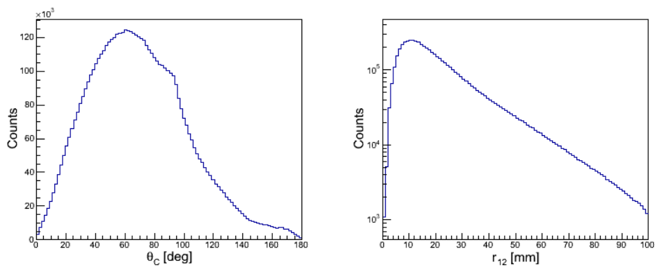





846 (2+)
Test sensitivity with first excited state of 56Fe
Compton angle and relative distance (r₁₂)
$$z−axis$$
$$θ_{c}$$
$$θ_{lab}$$
$$r_{12}$$
$$γ_{1}$$

Slide 15
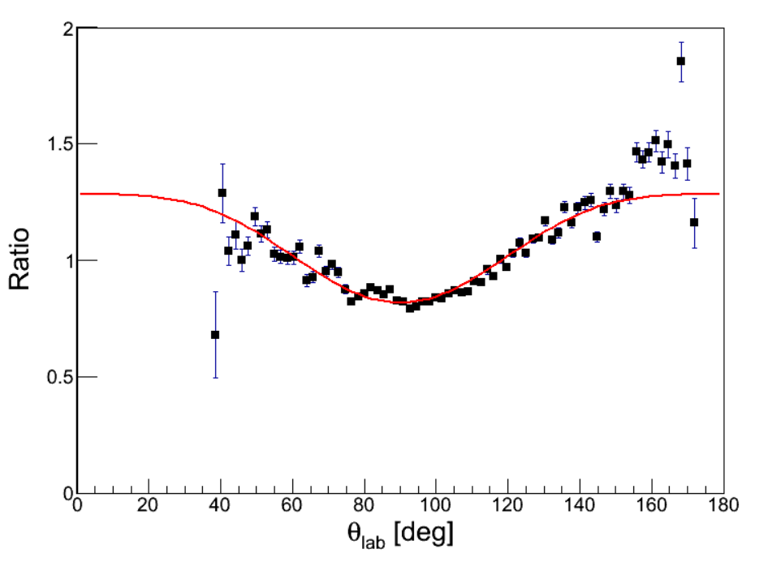
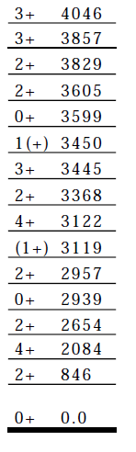

Angular Distributions
Angular distribution of 846 (E2) relative to 2598 (M1 + E2)
Can normalize with source data as well (¹⁵²Eu, ⁶⁰Co).
$$R= \frac{I(847,θ)}{I(2598,θ)}$$
Multipole character accessible!
⁵⁶Fe

