Slide 1
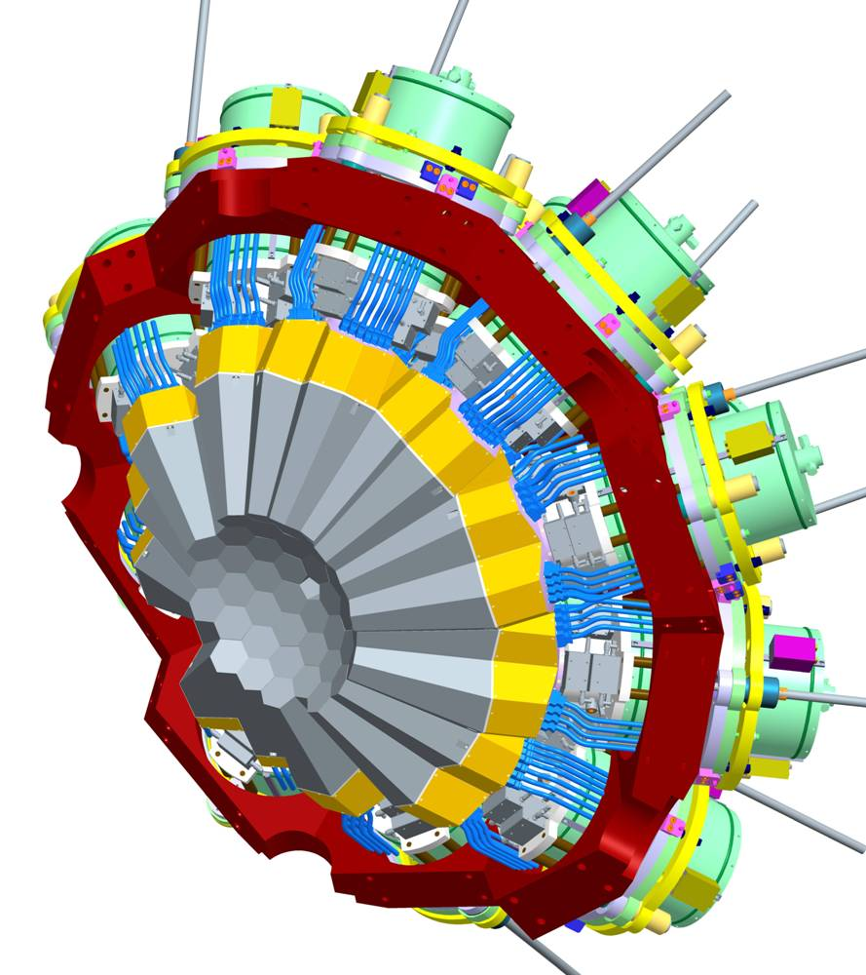
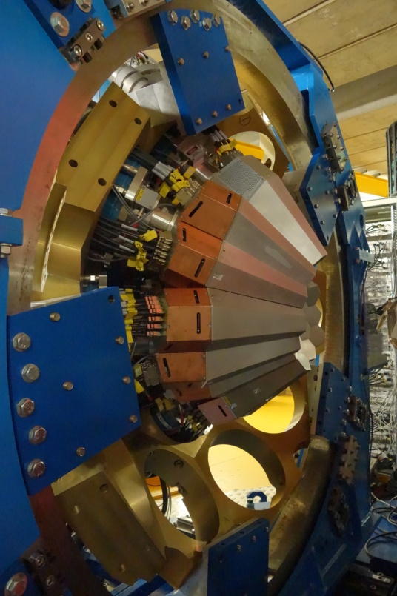
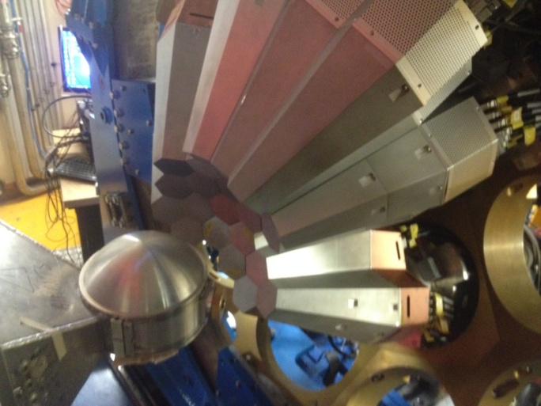



AGATA Project Review
Andres Gadea (IFIC-CSIC, Spain)
on behalf of the AGATA Collaboration
2nd AGATA-GRETINA tracking arrays collaboration meeting
4th- 6th April 2018
Notes:
Introduction
Overview of the system
Physics outcomes from this meeting important
define physics case
experimental constraints
range of experiments
key experiments demonstrator/full array
meeting
Key design parameters Before too late
120/180 decision

Slide 2

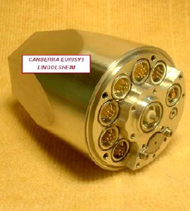
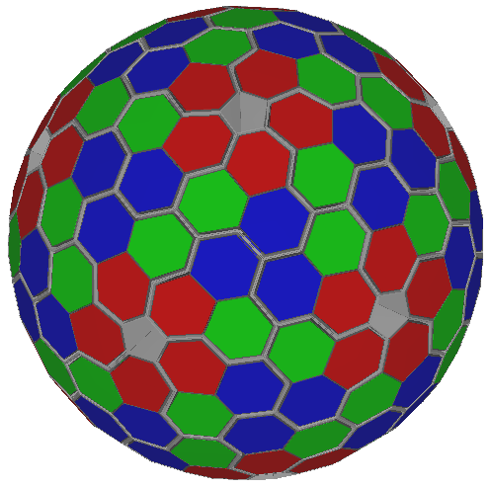
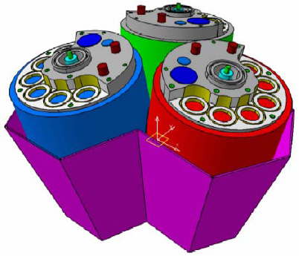
AGATA
(Advanced GAmma Tracking Array)
Encapsulation
180 hexagonal crystals: 3 shapes
3 fold clusters (cold FET): 60 all equal
Inner radius (Ge): 23.5 cm
Amount of germanium: 362 kg
Solid angle coverage: ~82 %
36-fold segmentation 6480 segments
Crystal singles rate ~50 kHz
Efficiency (Mγ=1): Conc. Des. 43% (~25%)
Peak/Total (Mγ=1): Conc. Des. 58% (~50%)
Geodesic Tiling: 180 hexagons
+ 12 Pentagons
AGATA Collaboration NIM A 668 (2012) 26
6660 high-resolution digital electronics channels
High throughput DAQ / Capability to record sampled pulses
Pulse Shape Analysis → position sensitive operation mode
γ-ray tracking algorithms → maximum efficiency and P/T
Sophisticated Detector and Mechanical infrastructures.

Slide 3
The AGATA Phase 1
2009-(2015) 2020
Phase 1 of AGATA (>1π)→ 60 crystals
MoU ongoing, ~85 % achieved, Extended until 2020
Available Triple and Double clusters
The first “real” tracking sub-array
AGATA 1π
To be used at RIB and High Intensity Stable beam facilities
Coupled to spectrometers, trackers, neutron and LCP arrays…
β = 0 β = 0.5

Slide 4
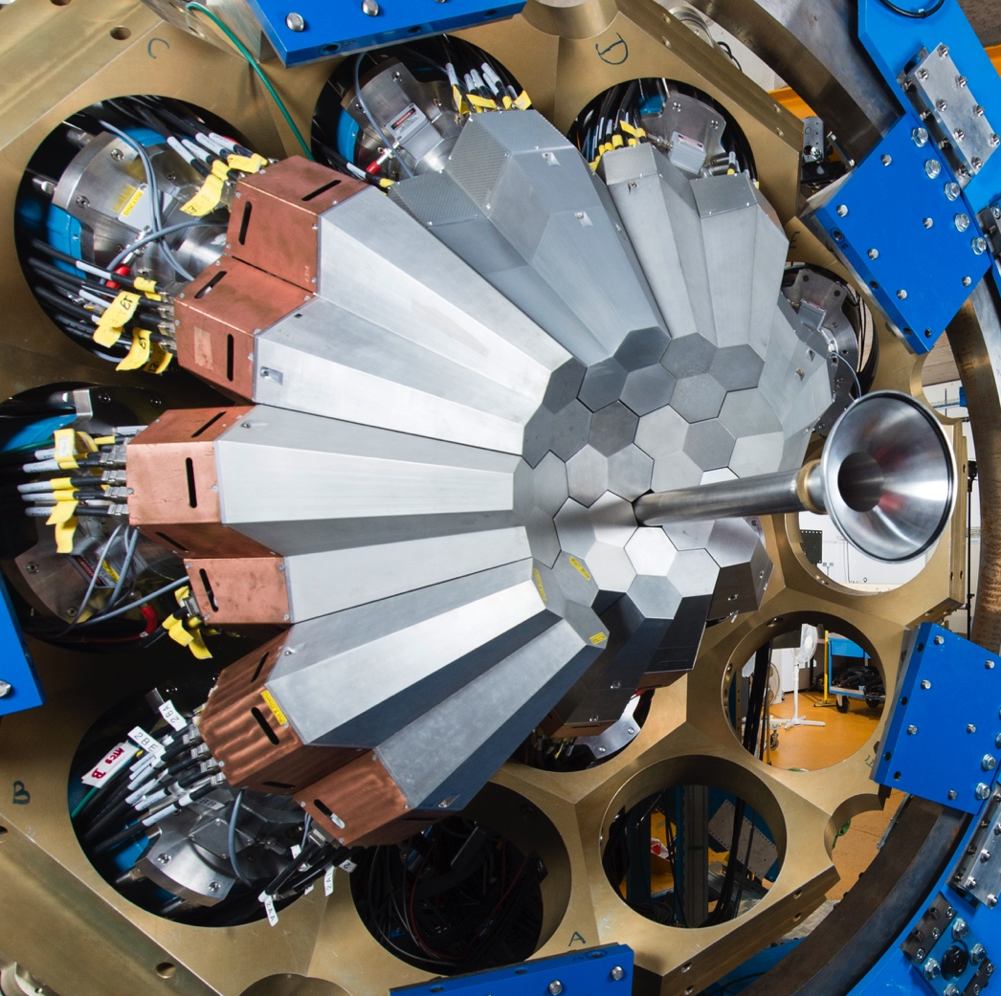
The AGATA Phase 1
2009-(2015) 2020
Phase 1 of AGATA (>1π)→ 60 crystals
MoU ongoing, ~85 % achieved, extended until 2020
Available Triple and Double clusters
The first “real” tracking sub-array
AGATA 1π
To be used at RIB and High Intensity Stable beam facilities
Coupled to spectrometers, trackers, neutron and LCP arrays…
β = 0 β = 0.5

Slide 5
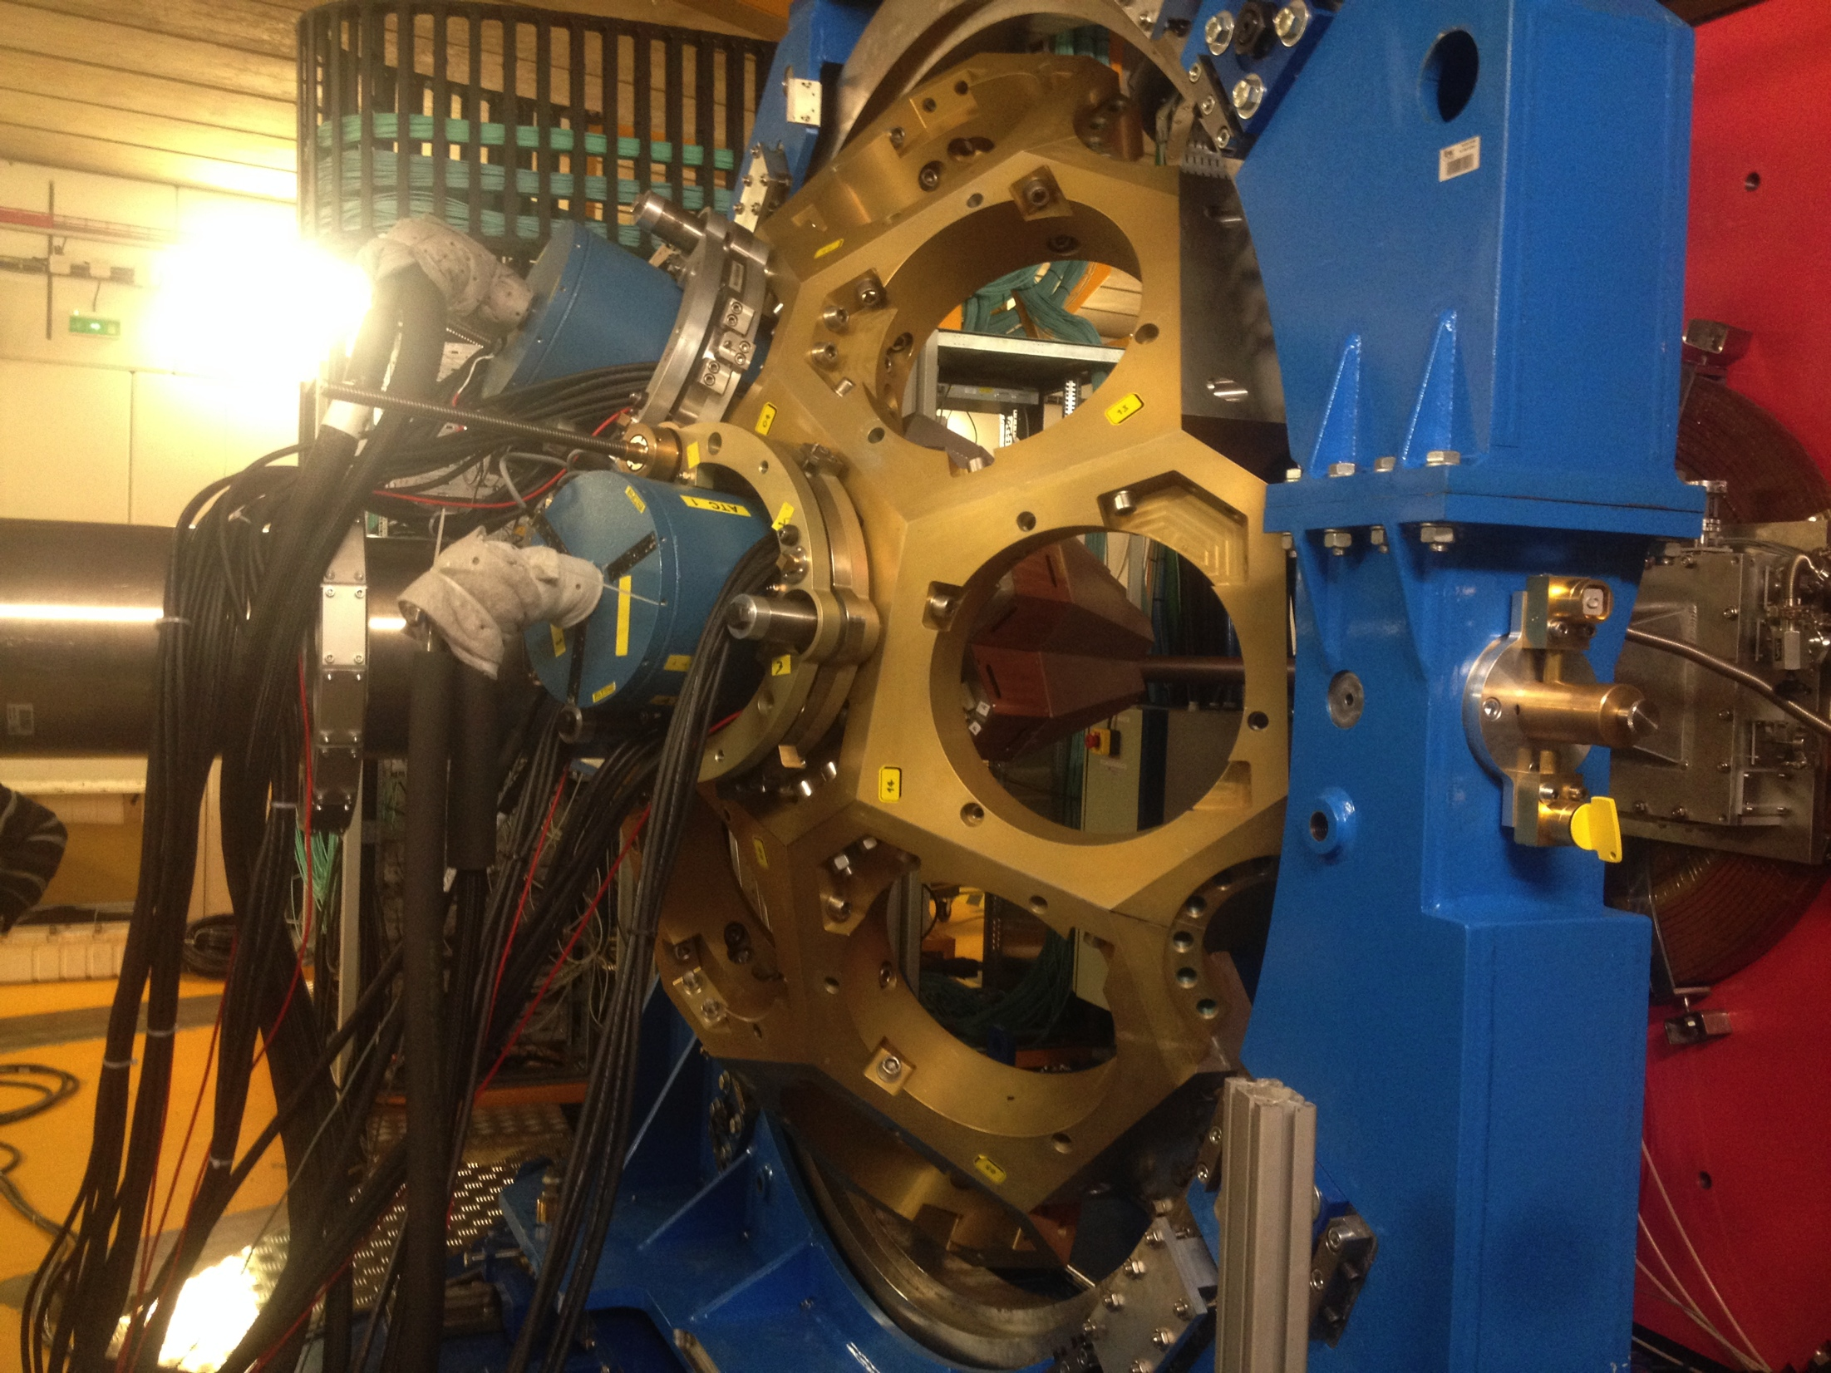
AGATA infrastructures at GANIL (2015-2020): up to 1π

Slide 6
AGATA Subsystems/Tasks
Highly Segmented HPGe Detectors Building Triple (Double) Clusters
Synchronized Digital Electronics and Trigger System
Control, High Throughput Data Acquisition and Storage
Detector and mechanical Infrastructures
PSA, Tracking and Integrated Data Analysis
Simulations, Performance, Commissioning

Slide 7
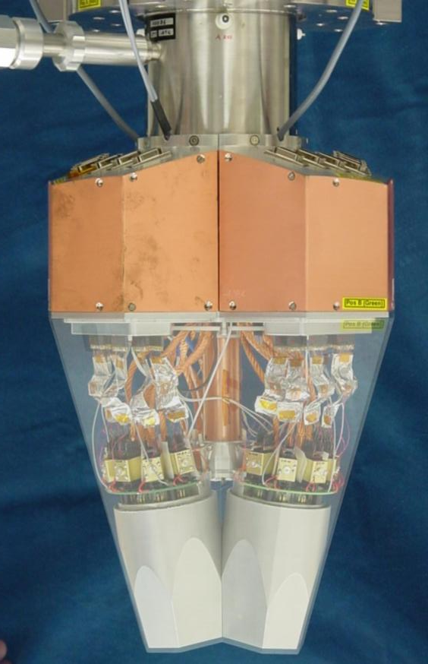
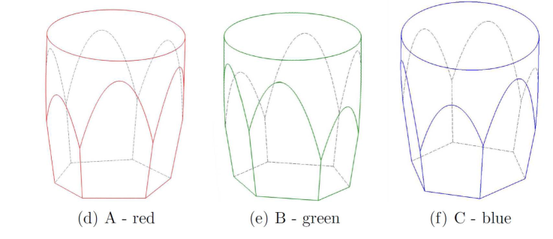
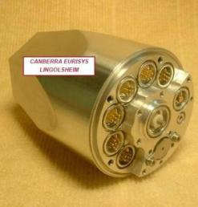
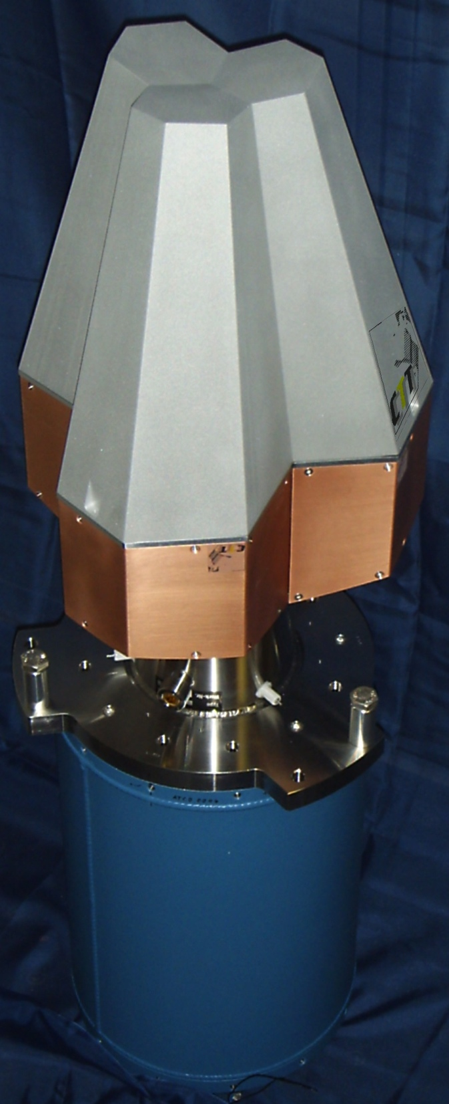
AGATA Detectors & Cryostats
AGATA capsules procured at Canberra/Mirion-Lingolsheim. AGATA Crysostat provided by CTT (Spin-off of IKP-Köln)
Detectors mounted and maintain within the collaboration.
Cold FET technology for all signals
FWHM @ 1332 keV
Core: 2.35 keV
Segments: 2.10 keV
80 mm
90 mm
Cold FET for all signals
6x6 segmented
A. Wiens NIM A 618 (2010) 223
D. Lersch NIM A 640(2011) 133
AGATA capsules by Canberra-Lingolsheim
111 high resolution spectroscopy channels
Mounted on Triple & Double cryostats
47 detectors delivered / 51 funded (45 is 1π)
Aiming 35 capsules setup in 2018 / ~45 2019
R&D on encapsulation and detector technology ongoing EU ENSAR2 JRA.
AGATA Triple Cryostat by CTT
IKP-Köln, Uni. Liverpool, IRFU-Saclay, INFN-LNL, IFIC, Uni. Salamanca

Slide 8



AGATA Detectors & Cryostats
(See Herbert contribution)
A001 - A015 Delivered, A015 CAT, A005 failing
47 AGATA
capsules delivered
B001 - B016 Delivered, B009,10,15 failing
C001 - C016 Delivered, C001,13 failing
3 Repairs Delivery Scheduled in April, 2 new failures under repair
4 New Capsules Being Ordered Finland (1), Hungary (3) for 2019
Expected 35 capsules setup in 2018, ~45 (1π) in 2019
Agreement with DEGAS (DESPEC) 4 detectors procured
Detector Clusters Mounting and Maintenance performed by the collaboration IKP, IRFU, GANIL and IPHC
11 Triple Cryostats + 1 Double Cryostat available
2 Triple cryostat under repairing / maintenance
1 Triple cryostat ordered, delivery late 2018
1 Triple Cryostat and parts ordered by Hungary and Finland (2019)
And :
New encapsulation technique, develop by IKP-Cologne, now in use
R&D detector technology ongoing ENSAR2 JRA –Report on Thursday
IKP-Köln, Uni. Liverpool, CEA IRFU-Saclay, GANIL, IPHC-Strasbourg

Slide 9
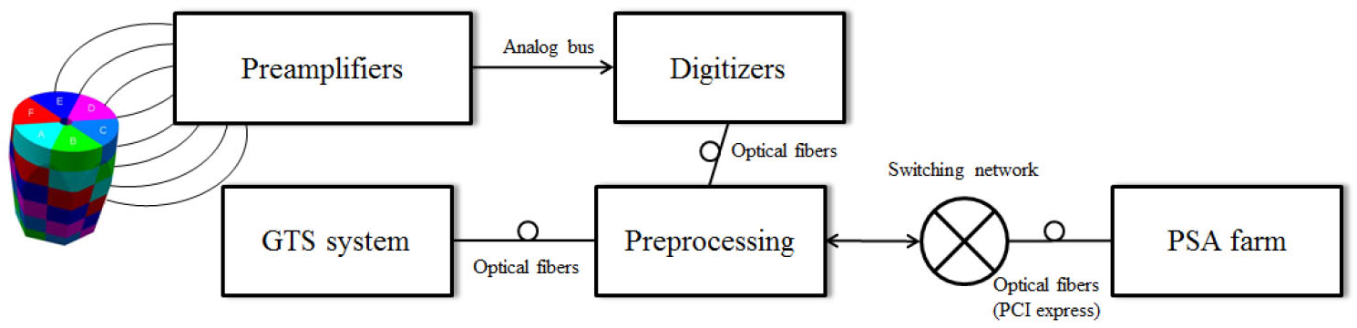
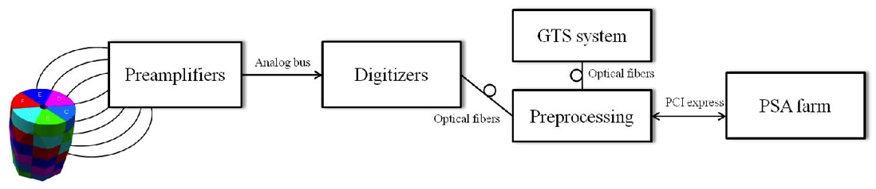
AGATA Electronics Phase 0
DIGITIZER
SEGMENT CORE GTS MEZZANINES
200 MB/s/seg
7
ATCA
AGATA Electronics Phase 1
3 DIGITIZERS
4
PCIe
Reduction of Optical Fibers and PCIe Interfaces, Comparable Performance
With new read-out software by D.Bazzacco and DCOD (X.Gave and CSNSM)
DAQ, up to 12 kHz / Channel with on-line PSA (See Emmanuel contribution)
IPHC Strasbourg Uni.Liverpool STFC Daresbury IPNO, CSNSM-Orsay INFN-Padova
INFN-Milano INFN-Padova INFN-LNL IFIC-Valencia ETSE-Uni-Valencia

Slide 10
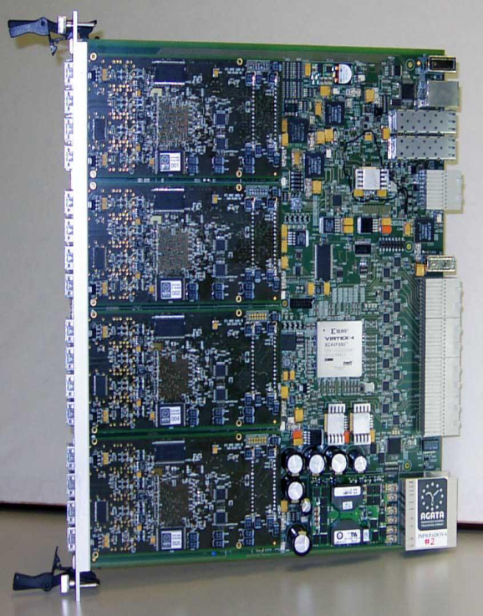
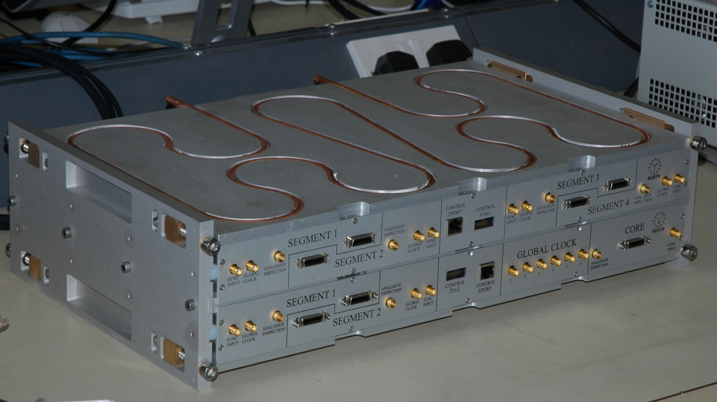
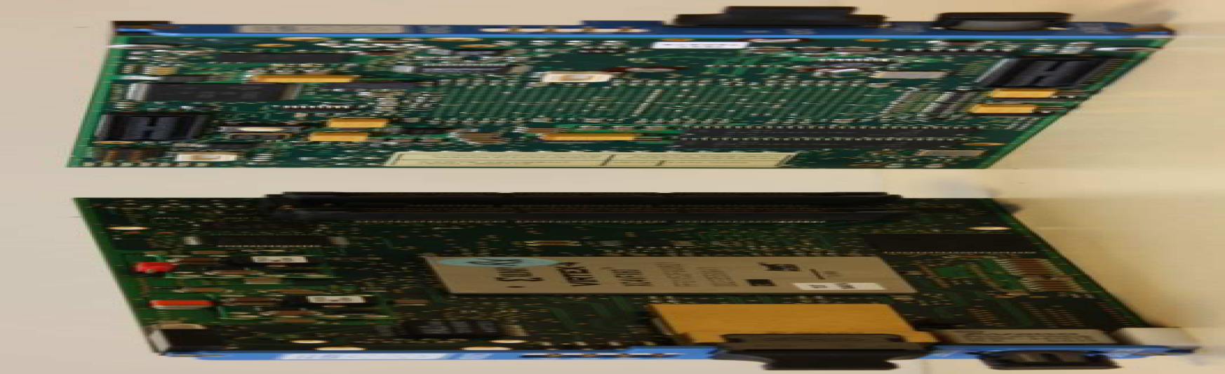
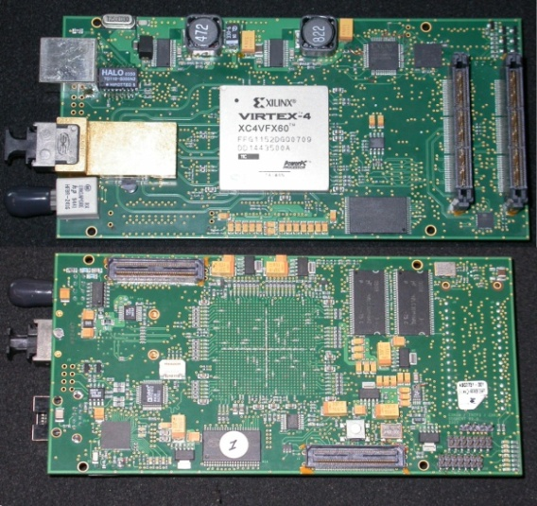
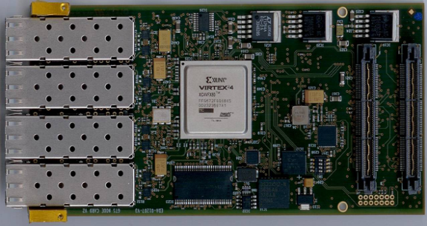
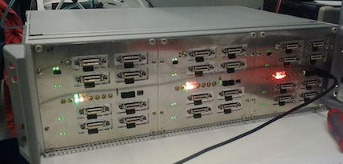
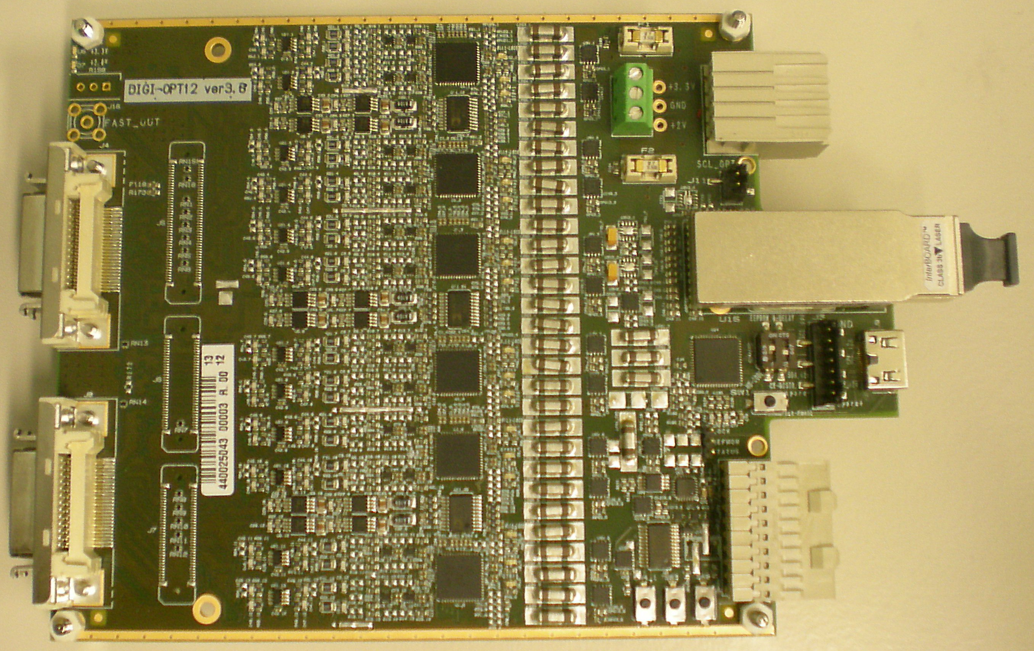
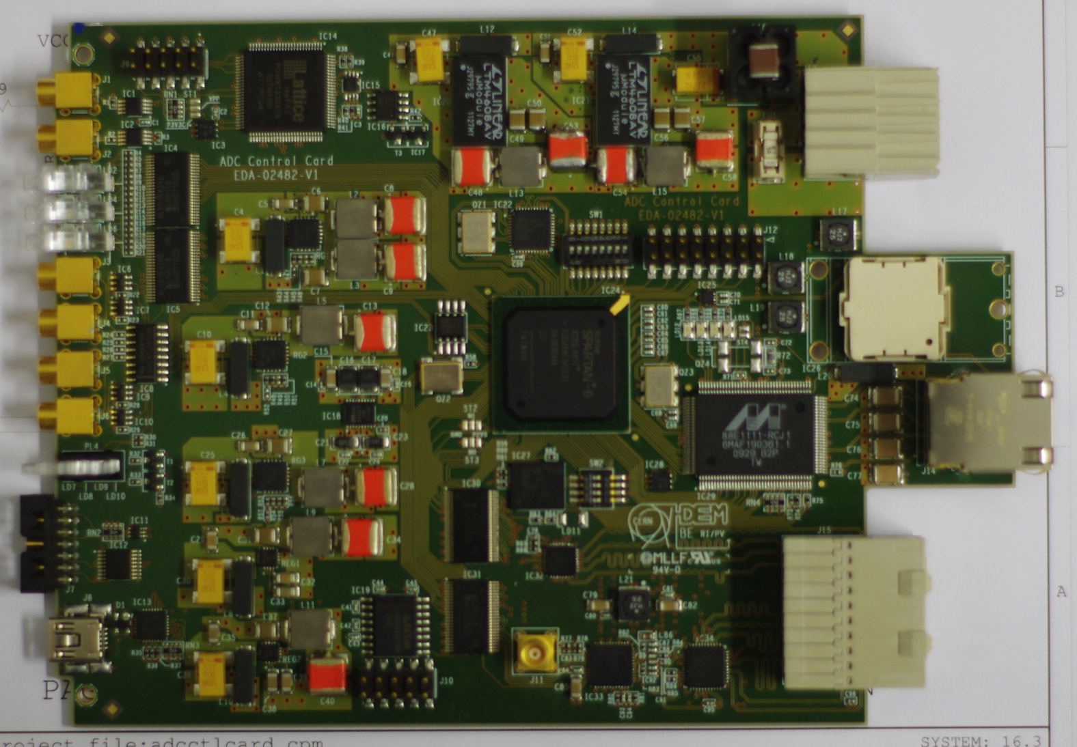
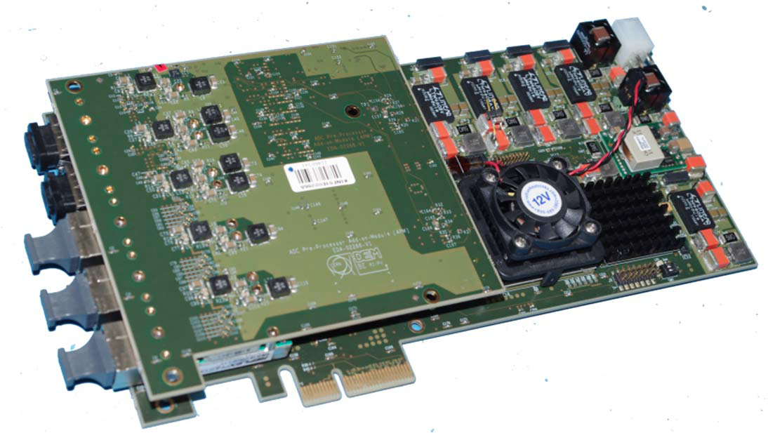
AGATA Electronics Phase 0
DIGITIZER
SEGMENT CORE GTS MEZZANINES
ATCA CARRIER
24 channels available and working from 2 productions
AGATA Electronics Phase 1
3 DIGITIZERS
ADC Card
Control Card
GGP Card
12 channels available and working
Second production of 14/15 channels ongoing. Delivery expected after summer 2018 (1π + Spares)
IPHC Strasbourg Uni.Liverpool STFC Daresbury IPNO, CSNSM-Orsay INFN-Padova
INFN-Milano INFN-Padova INFN-LNL IFIC-Valencia ETSE-Uni-Valencia

Slide 11
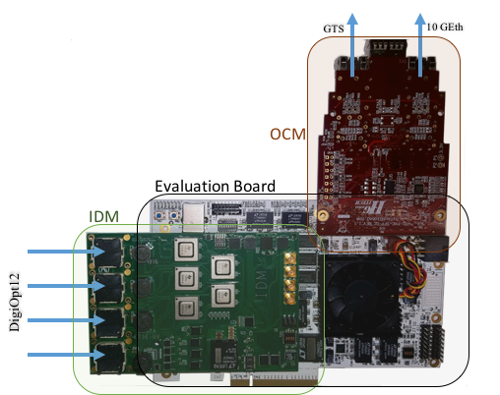
R&D on Mid-Term Electronics
(See Vicente contribution)
Encouraged a medium term (Phase 2) electronics R&D. Goal: low costs, higher processing capability and with Ethernet readout.
DIGITIZER based on the DIGIOPT12 (INFN-Milano)
Pre-processing to be tested on a Xilinx Kintex-7 evaluation board with the main processing FPGA. Input Data Module (IDM), Ethernet readout module (STARE) and GTS interface are plug-in cards.
Firmware improving the processing and
read-out capabilities
INFN-Milano, CSNSM-Orsay, IPHC-Strasbourg, STFC-Daresbury, IFIC & ETSE-Valencia

Slide 12
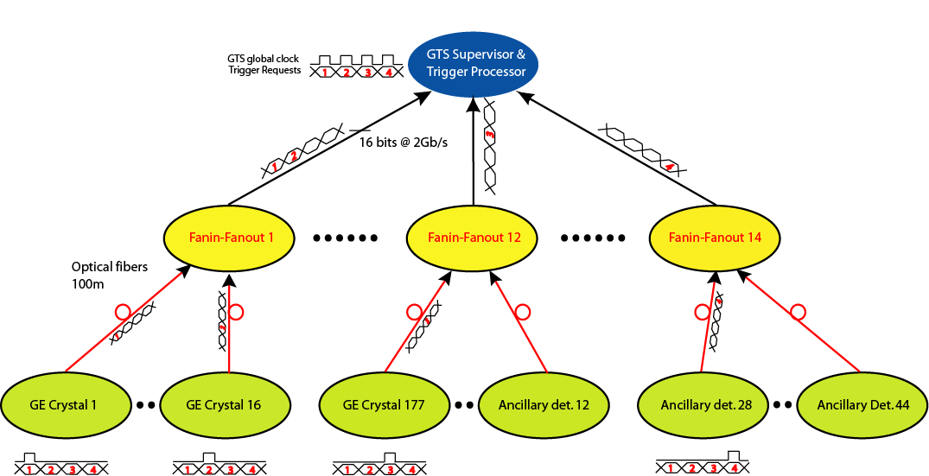
GTS Trigger & Synchronization
Structure
Early AGATA GTS Trigger Processor limited to 40 TR (channels).
The EXOGAM2 GTS Trigger Processor, (GANIL), necessary for 2018 campaign,
commissioned. Now control
by IPbus done at IPHC
GTS Trigger decisions are based in the topological & time informations
Partition 1
Partition 2 …
INFN-Padova, GANIL-Caen, IPHC-Strasbourg

Slide 13
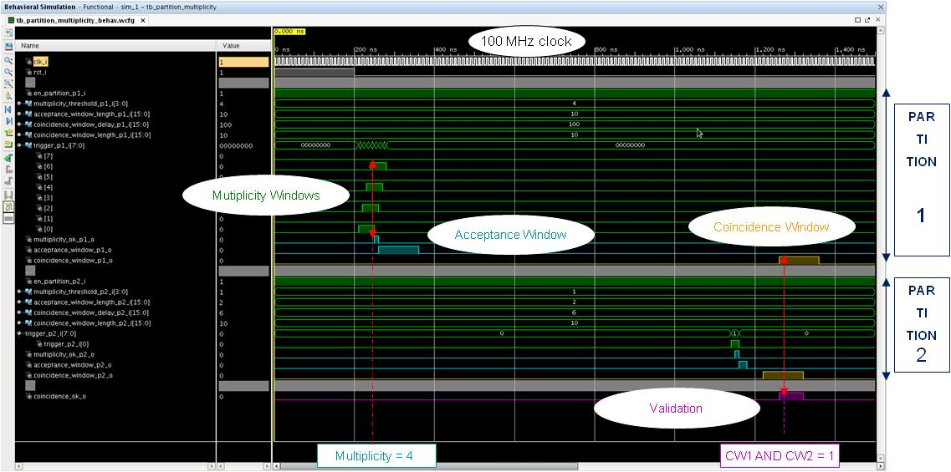
NUMEXO2 / GANIL GTS Trigger Processor
AGATA looking forward to have a Hardware and a Software Trigger Levels
Courtesy of M.Tripon and the GANIL collaborators
GANIL-Caen, IPHC-Strasbourg, CSNSM

Slide 14
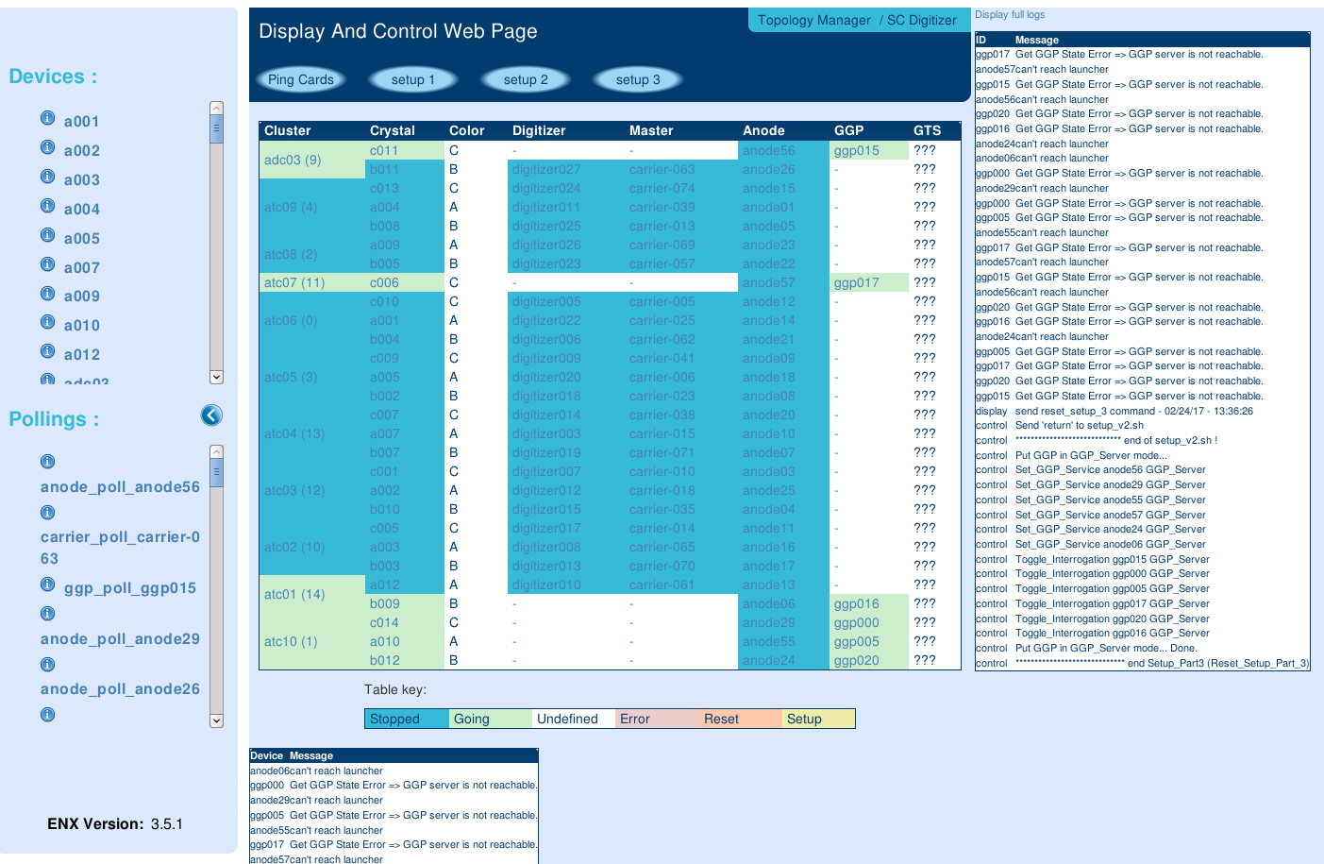
AGATA Data Flow NARVAL at GANIL
(See Xavier, Eric and Amel Contributions)
DAQ Hardware:
Installed for >35 and upgrade to 45 channels ongoing
CEPH diskserver upgraded performance and storage capability.
DAQ Software:
Upgrade of the system to DCOD Completed.
Now PSA data bases uploaded very fast as
a feature of DCOD.
Data Integrity checked with source runs.
Better buffer management that translates to higher PSA processing capability.
GEC, RCC and Topology Manager:
Global Electronic Control and Topology Manager upgraded
General AGATA display and control produced. Electronics status included. Ongoing the modification of the RCC and TM in order to control DCOD with the RCC.
CSNSM-Orsay, GANIL, IPN-Lyon, IPN-Orsay, INFN-LNL, IFJ-PAN-Crakow,

Slide 15
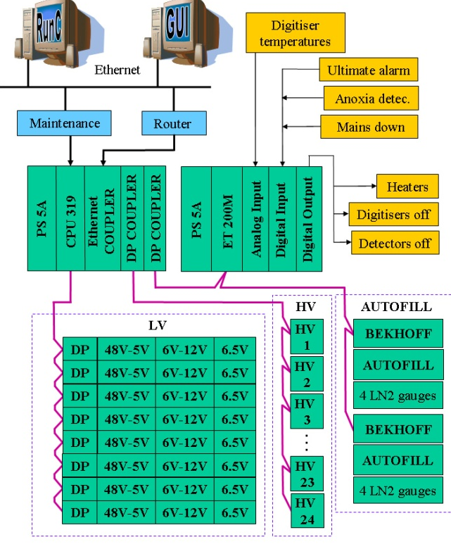
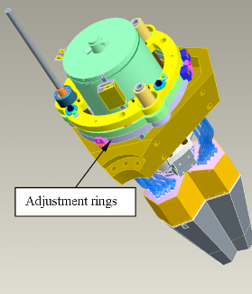
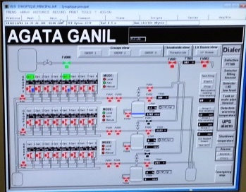
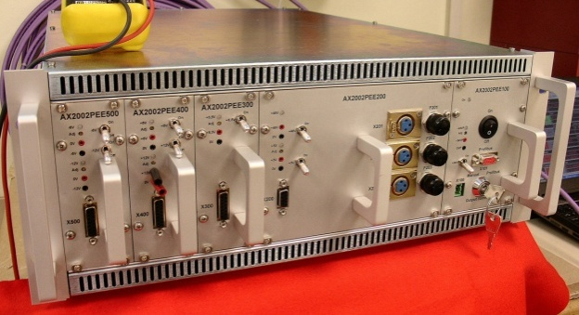
Infrastructure: Detector Support & Mechanical
LVPS, Patch boxes, HV System, Autofill system, Data and Power Supply Cabling, Mechanics etc… Ready for the 45 detector system (1π)
Phase 2: newly Infrastructures compatible with all Host-labs. Increased mobility. Optimizing Mechanics and PS.
CEA Saclay, INFN-Padova, INFN-Milano, GSI, CSNSM-Orsay
STFC-Daresbury, IPHC-Strasbourg, GANIL, INFN-LNL, JYFL-Jyvaskyla,

Slide 16

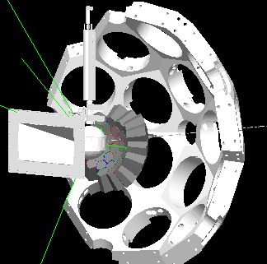
Simulations, Experimental Commissioning and Performance
AGATA Performance:
Aiming to finalize the publication of the performance source test done at GANIL.
Understanding the issues comparing measured and simulated efficiencies.
Analysis of efficiency mismatch with in-beam experiments with high multiplicity
AGATA Simulations: (See Joa contribution)
AGATA Code (AC) still maintained: http://npg.dl.ac.uk/svn/agata
New simulations performed about efficiency and P/T, to be compared to GSI and GANIL Data, including dead layers.
On-going more realistic implementation of the detector geometry and the discussion on the effect of the segmentation and the fields due to the
segmentation and pasivated zones.
Experimental Commissioning
Necessary the commissioning of AGATA coupled with
complementary instrumentation: NEDA + DIAMAN, MUGAST,
VAMOS-GFM.
INFN-Padova, GANIL, CSNSM-Orsay, STFC, Uni. Liverpool, IFIC, ILL

Slide 17
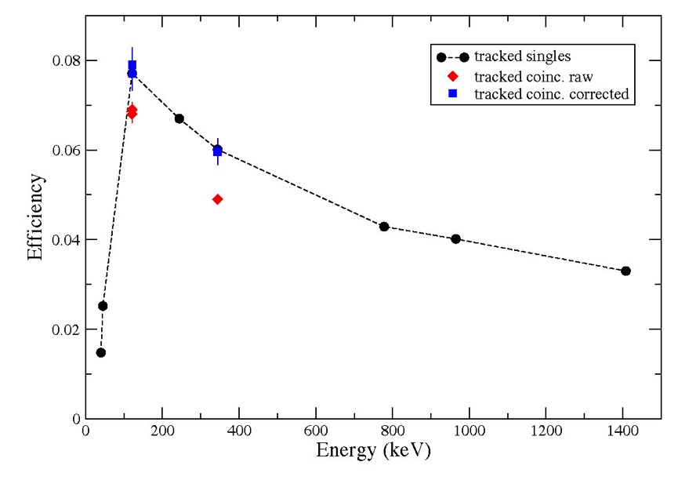
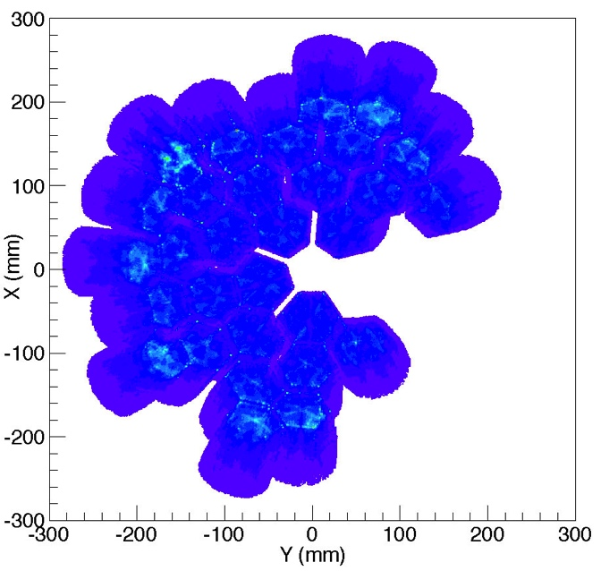
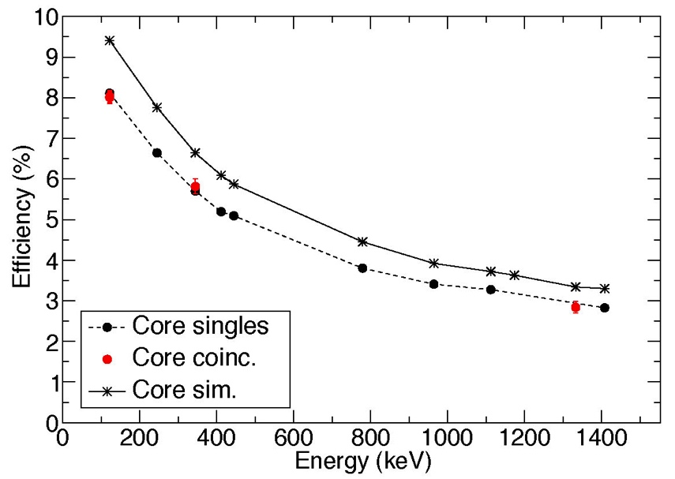
AGATA Performance measurements
AGATA Performance Measurements Run at GANIL in 2016 for detailed evaluation of the AGATA Performance and comparison with simulations.
Tracking efficiency &P/T
Depends on tracking parameters
29 Capsules
Set-up
Preliminary (A.Lopez-Mertens)
Preliminary (R.Perez)
Estimated Efficiency for 1π set-up Eγ=1MeV tracked ~6% and with AGATA at nominal position: 23.5 cm target-detector distance.
Agreement with simulations (M.Labiche)
GANIL, CSNSM-Orsay, IFIC, INFN-Padova, ILL-Grenoble

Slide 18
AGATA PSA & Data Analysis
Pulse Shape Analysis and Detector Characterization ( see Andy contribution)
ADL work ongoing at Uni.Liverpool and IKP-Cologne..
AGATA and GRETINA now collaborating on signal decomposing algorithms with multiple interaction in a segment PSA
Tracking (see Waely contribution):
Discussion on-going with the PSA team the tracking on AGATA and the impact of position uniformity on the algorithm performance.
Planed to include the position determination inaccuracy in the tracking procedure.
Orsay Forward Tracking (OFT) algorithm: New version for single interactions.
Data Analysis
Watchers and analysis software provided by the team
The “Cubix” software is now available. Cubix is an adaptable spectroscopy analysis tool based on Root and developed by G. Macquart, J. Dudouet.
Successful hands-on Data Analysis schools organized by GANIL.
Data Flow & Data Analysis Working Groups prepared a document that allows AGATA users to run an experiment and perform the data analysis in a coherent manner.
Uni. Liverpool, IPN-Lyon, GANIL, CSNSM-Orsay, INFN-Padova, IRFU-Saclay, TU-Munich

Slide 19
Outlook for the present phase of AGATA:
AGATA is in the last 3 years of the Phase 1 MoU (up to 60 detectors 4/3π of the full array).
The goals for this period are:
  To continue the procurement of detectors –already 51 in 2019–
  To complete to 45 (1π), on the electronics, detectors and DAQ, the GANIL set-up.
  To Complete the R&D on Electronics that will serve beyond 45 detectors in the set-up and for a good part of Phase 2
  To complete the detector technology R&D on the framework of the PSeGe ENSAR2 JRA
  Improvements on Tracking, characterization and PSA –in collaboration with the GRETINA colleagues-
  R&D to extend beyond 1π the detector infrastructures –LVPS, Autofill, Cabling- and the mechanical infrastructures.
  To improve realistic simulation of AGATA –in collaboration with the GRETINA colleagues-.
  To realize performance measurements and comparison with simulations.
  To couple Electronics, DAQ and Data analysis with the complementary instrumentation to be coupled with AGATA, i.e. MUGAST, VAMOS- GFM, etc…

Slide 20
Outlook for AGATA Phase 2:
AGATA, is identified as a key instrument for the European RIB facilities and supported in the NuPECC LRP.
The AGATA collaboration is planning to propose the construction of AGATA 4π in the period 2021-2030.
Host Laboratories for Phase 2: FAIR/NUSTAR-HISPEC (in flight RIBs), GANIL/SPIRAL, LNL/SPES and HIE-ISOLDE (ISOL RIBs), JYFL (High intensity stable beams)
Upgraded sub-systems: Detectors, Electronics, DAQ, Infrastructures, and Performance: PSA, Tracking etc… Increasing mobility.
Goals:
  To maximize the outcome of the experiments in European RIB and high intensity stable beams facilities providing outstanding sensibility array. Maximum efficiency and P/T
  Optimizing the measurement angular distribution, polarization, lifetimes, etc…
  Possibility to split AGATA in 2 (or more) sub-arrays when the coupling with complementary instrumentation limits to 2π the installation of AGATA. Parallel campaigns in two Host Laboratories.

Slide 21


Summary:
Subsystems of AGATA with no major issues. expected 35 detectors at GANIL in 2018 and ~45 for the 2019 campaign
Infrastructure ready for 45 detectors, i.e. AGATA 1π
Electronics: 35 + spare channels installed and working. New batch of electronics under production 10 + 4 Spare channels. Estimated that will be available by spring 2018
Installed upgraded NARVAL to the DCOD version. Large Improvements in DAQ, GEC and Topology Manager.
Upgraded CEPH disk server for the 45 capsules setup.
Improvements on simulations, performance determination, on PSA, Tracking and Data analysis
Phase 2 being defined: full AGATA, more compatibility between host Laboratories, easier mobility.
Thank You!
Supported by MINECO, Spain
Grant n. FPA2014-57196-C5

Slide 22

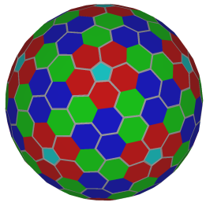











The AGATA Collaboration
>40 Institutions
>350 Collaborators
Bulgaria: Univ. Sofia
Finland: Univ. Jyväskylä
France: GANIL Caen, IPN Lyon, CSNSM Orsay, IPN Orsay,
CEA-DSM-DAPNIA Saclay, IPHC Strasbourg, LPSC Grenoble
Germany: GSI Darmstadt, TU Darmstadt, Univ. zu Köln, TU München
Hungary: ATOMKI Debrecen
Italy: INFN-LNL, INFN and Univ. Padova, Milano, Firenze, Genova, Napoli
Poland: NINP and IFJ Krakow, SINS Swierk, HIL & IEP Warsaw
Spain: IFIC, ETSE-UVEG Valencia, IEM-CSIC, UAM Madrid, USAL Salamanca
Sweden: Univ. Göteborg, Lund Univ., KTH Stockholm, Uppsala Univ.
Turkey: Univ. Ankara, Univ. Istanbul, Technical Univ. Istanbul
UK: Univ. Brighton, CLRC Daresbury, Univ. Edinburgh, Univ. Liverpool,
Univ. Manchester, Univ. West of Scotland, Univ. Surrey, Univ. York

