Slide 1
Storage Analysis with SPARK
14/02/2018
Osman AIDEL

Slide 2
Data storage services at CC-IN2P3
 | Type | Servers | Size
Dcache | Distributed File system | 165 | 9 PiB
xROOTD | Distributed File system | 44 | 2,5 PiB
iRODS | Distributed File system
GPFS | Distributed File system | 165 | 9 PiB
PBS | Distributed File system | 11 | 110 TiB
Database | Database | 20 | 60 TiB
TSM | Tape
HPSS | Tape | 29 | 27PiB
Million of millions of datafiles are stored in different storage systems.
Each storage system is monitored independently

Slide 3
Storage needs
Monitoring and reporting tools are developped by experts.
Experts spend time to develop their own report from different data source (database, JSON, CSV …)
How to identify files no more used ?
Which user has reached its quota ?
Experts tools do not match necessarly with a group / management / support view. So additionnal tools are necessary to satisfy all views.
Management view : How many PBytes we need to buy next year ?
Support view : How to lead files without owner ?
How to make sure CC is compliant with Data Management Plan ?
Group view : How to cleanup data as the quota limit reached ?
How to analyze/report all storage systems in a unified way for all views ?
We need a solution able to :
Extract any data from one or more storage system.
Transform the source data. This step involves cleaning, modifying and filtering the source data using some rules
Load transformed data to a destination data source. The destination can be a database or file.
Query easily tranformed data

Slide 4
Technology watch
Since the Hadoop ecosystem birth, many tools have been developped which could answer to our needs:
Impala
SPARK SQL
Presto
Apache Drill
SPARK is deployed at CERN, Paris-university (LAL), NERSC ...
The solution we explored at CC is Spark SQL :
It provides a unified abstraction for processing data from an heterogeneous of data sources (Oracle, Mongodb, CSV …)
It offers differents API to process/analyze data ( SQL, HiveQL, SCALA,JAVA, Python,R)
It allows to perform join operation across different data sources.
For example, you can join a CSV file with a PostgreSQL table.
Data can be loaded into different destination data source (Parquet, ORC, Cassandra …) depending on the need.
Note this work is still in progress and is not in production.

Slide 5
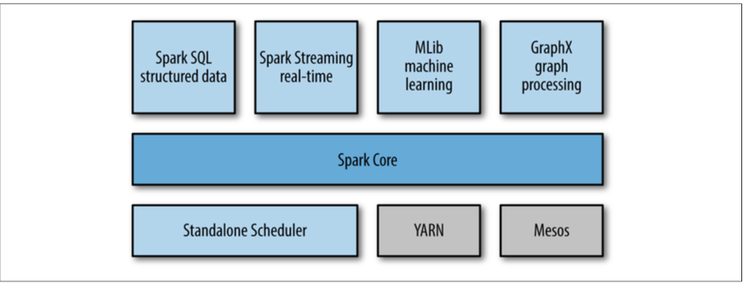
What is Apache Spark ?
Cluster computing platform
Very speed : 10 times faster than Hadoop
Wide range of workload in a unified framework
High availability
Core concept : RDD (Matei’s research paper)
Best suited for batch applications that apply the same operation to all elements of a dataset.

Slide 6
What is SPARK ?
SPARK
Data
Source:
HDFS
NFS
DB
…
Worker 1
Executor
Task
block
Worker 2
Destination:
Database
Files
…
R
D
D
Executor
Task
block
Worker …
Executor
Task
block
Worker 10
Executor
Task
block

Slide 7
SPARK SQL
Spark SQL is a Spark library that runs on top of Spark.
Spark SQL is more than just about providing SQL interface to Spark, it intergates a SQL engine.
Spark SQL API provides functions for selecting columns, filtering rows, aggregating columns, joining datasets, and other common data processing and analytic tasks
Spark SQL is usable with Nosql database, Relational database or file formats as such CSV, JSON, Parquet, ORC and avro.
Spark SQL is compatible with Hive.
Spark is interfaceable with notebook such as Jupyter/Zeppelin

Slide 8
GPFS report
To evaluate SPARK, we limited our use case to GPFS. A report is already generated by GPFS experts and the challenge is to do the same with SPARK.
Identification of GPFS metrics
total /average file size by group / group-user / on GPFS
Number of blocks by group / group-user on GPFS
Number of files / directories / links bygroup / group-user / GPFS
Files less accessed
…

Slide 9
GPFS report
Inode list in GPFS : all-gpfs-file.csv.bz2
Uncompressed file around 90GBytes
Description
579 940 350 rows
36 110 461 directories
15 682 448 links
528 147 441 files

Slide 10
GPFS report
Each inode corresponds to a row.
File structure : CSV schema
|-- NbBlocks: long (nullable = true)
|-- Mode: long (nullable = true) -> 197 distinct values
|-- HardLink: long (nullable = true) -> 1612 distinct values
|-- UID: long (nullable = true) -> 2025 distinct values
|-- GID: long (nullable = true) -> 167 distinct values
|-- Size: long (nullable = true)
|-- LastUpdate: long (nullable = true)
|-- LastRead: long (nullable = true)
|-- LastUpdateMetaData: long (nullable = true)
|-- FileName: string (nullable = true)

Slide 11
GPFS report
SPARK
Worker 1
Executor
Task
block
Avro or Parquet file
GPFS metadata:
580 Millions of rows
R
D
D
Worker 2
Executor
Destination:
MongoDB
Task
block
Worker …
Executor
block
{
"group" : "40778:276",
"values" : {
"lmtime" : 1434027899,
"nnafiles" : 10982,
"blocks" : 466870688,
"ndirs" : 12128,
"bytes" : NumberLong("467229634996"),
"latime" : 1459462182,
"nnadirs" : 0,
"nabytes" : NumberLong("9569299790"),
"hlinkedfiles" : 0,
"nlinks" : 67,
"nfiles" : 512992,
"nablocks" : 9574496
}
}
Task
Worker 9
Executor
Task
block

Slide 12
GPFS report
Avro versus Parquet
Partitioned by GID
9 nodes :
24 vcores
32G de RAM
secondes
Parquet is very interesting when we need to apply many aggregation operations
Contrarely to Avro.
According to our test, Avro is more interesting when you select many columns.

Slide 13
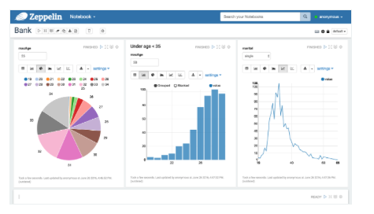
Perspectives
We need to automatize the data processing so that experts , support and groups can interact with storage metrics by using a simple query SQL.
Notebooks as Jupyter/ zeppelin might be a good interface for reporting. Zeppeling provide a graphic interface easy to use (angularJS)

