Slide 1
CC-IN2P3 machine room furbishing
X. Canehan

Slide 2
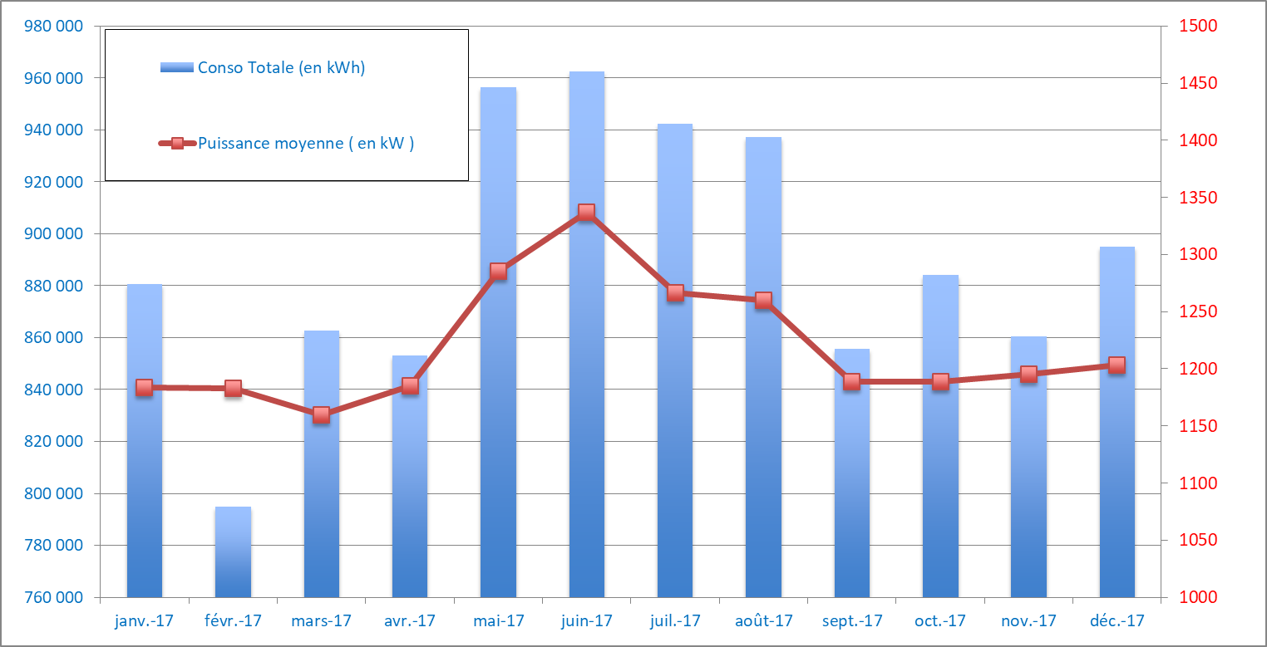
Power and Energy
Mean Power per month around 1.2 MW last year
  Peak above 1.5 MW
Not that much easy consumption gains left
  Getting rid of ineffective servers
  Virtualization
  Infrastructure upgrades
    Cooling Group: Speed Variation Upgrade
Energy (kWh)
Mean Power (kW)
2017 Consumption analysis, Stéphane Lepers
Energy cost will raise in 2018

Slide 3
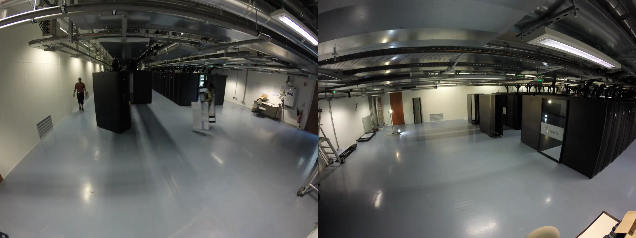
2017 evolutions – Vil2 1st phase at max hosting capacity
Vil-2 first 2 rows at max capacity: 61 racks
  400 kW max aisle A/B, low redundancy (single UPS path)
  600 kW max aisle C/D, highest redundancy (dual UPS paths)
    Single distribution path for cooling

Slide 4
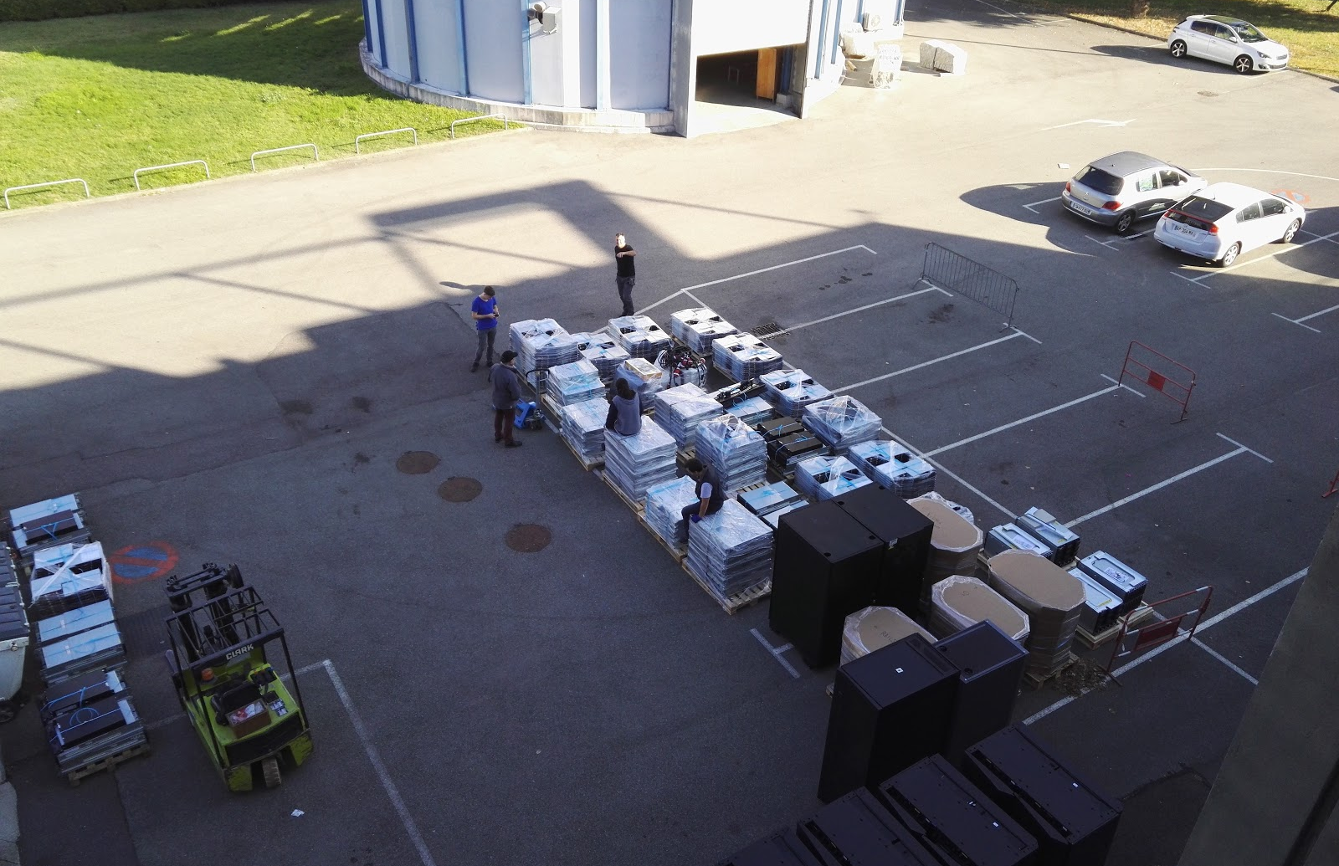
2017 – IT Waste Management
Getting rid of tons of used hardware
  19 tons 2016
  7 tons 2017
Best practices
  Extending HW life
  Re-Using
  Recycling
Contractor with agreements in regards of environmental laws. Hardware is deconstructed, converted to new raw materials, avoiding burying as much as possible.

Slide 5
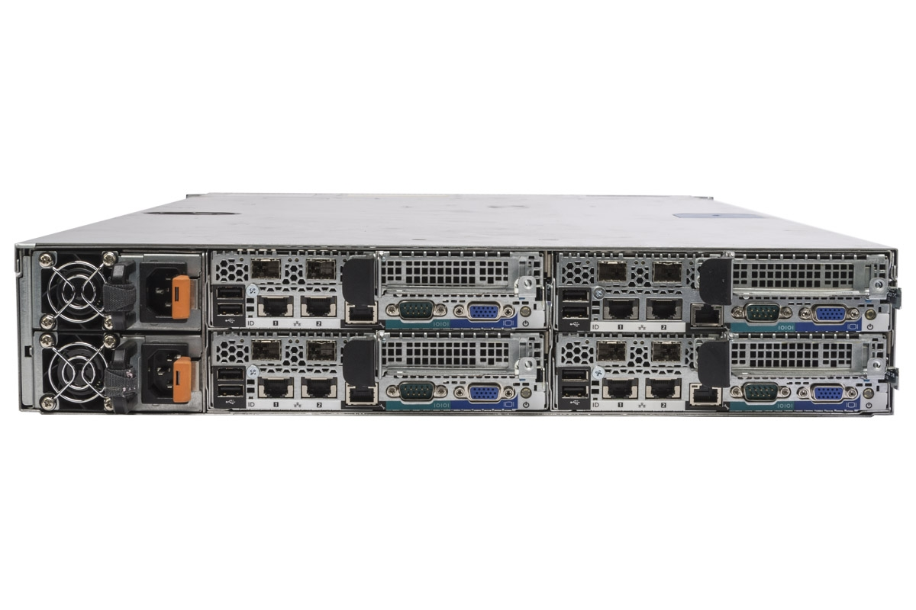
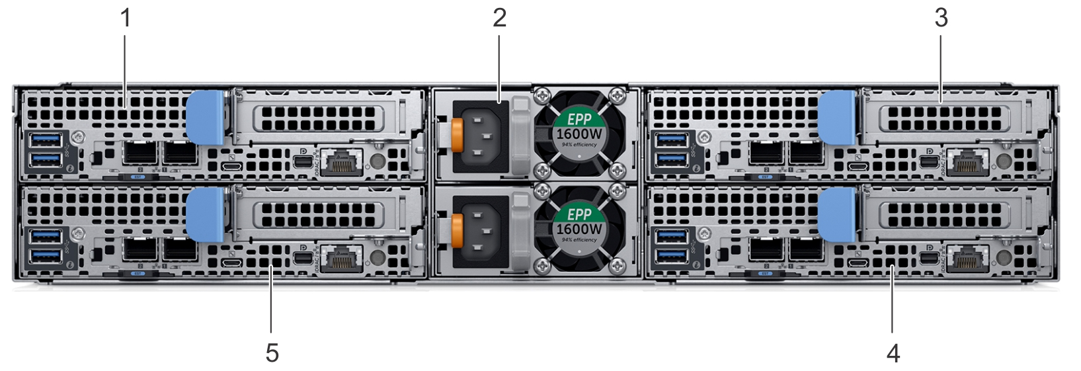
2018 – Form factor and Power Supply Unit Issues
Computing node PSU position changes
  Reconsidering PDU: position in rack and geometry
1600 W
centered
Power unit sizing changes, leading to probable power socket change: 10A to 16A => PDU evolution
Power distribution and power density per rack will change: infrastructure must adapt

Slide 6
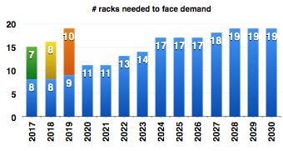
2018 – Need for more racks
Vil-1 refurbishing is expensive
  Power distribution (from wall TD to rack centered)
  CRAC or CRAH systems
  Cooling generation driven to max
  Raised floor detailed check needed
  Mean power per rack below our target
Converting our IT needs in
rack number: we must
extend Vil-2 capacity
Reserve is enough for 2018

Slide 7
2018 – Vil-2 expansion plans
Tier3 grade new aisles
Upgrading existing redundant power lines
  +600 kW shared by both new aisles at start
  Aiming at 600 kW per line next
Adding cold generation and distribution
  Setting 2 new aisles
  Upgrading C/D if possible
  Overall redundancy assured with previous installation
  Redundancy in a single aisle assured by 30 kW CRAH against 15 kW IT load, connected 101

