Slide 1
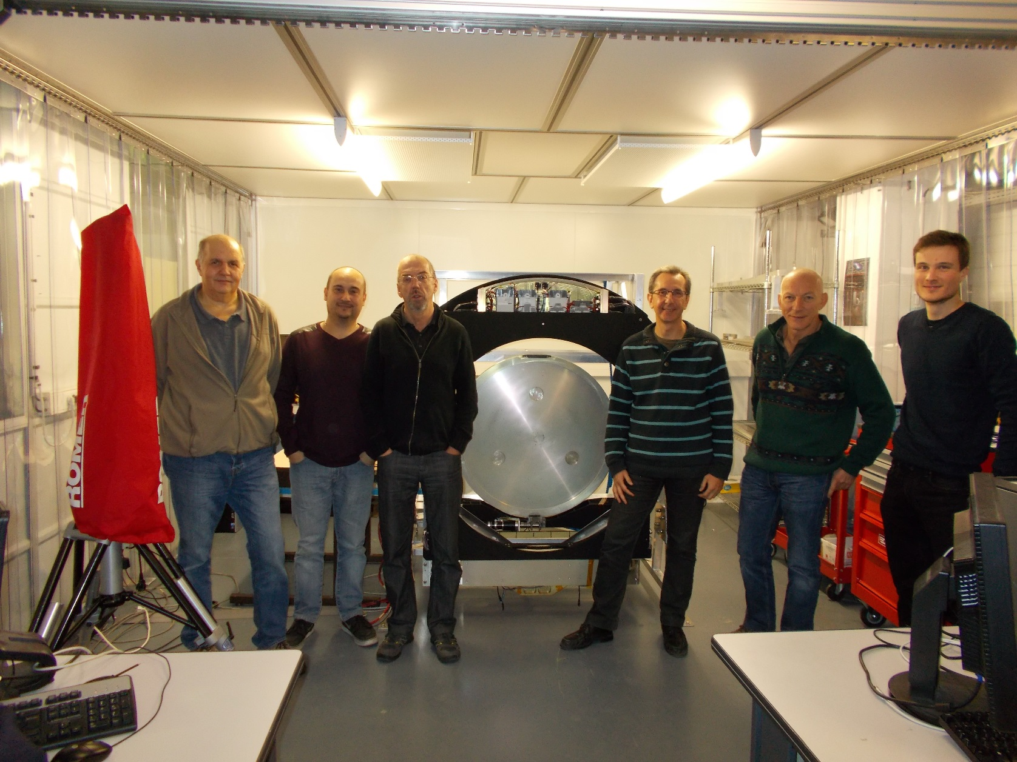

Slide 2
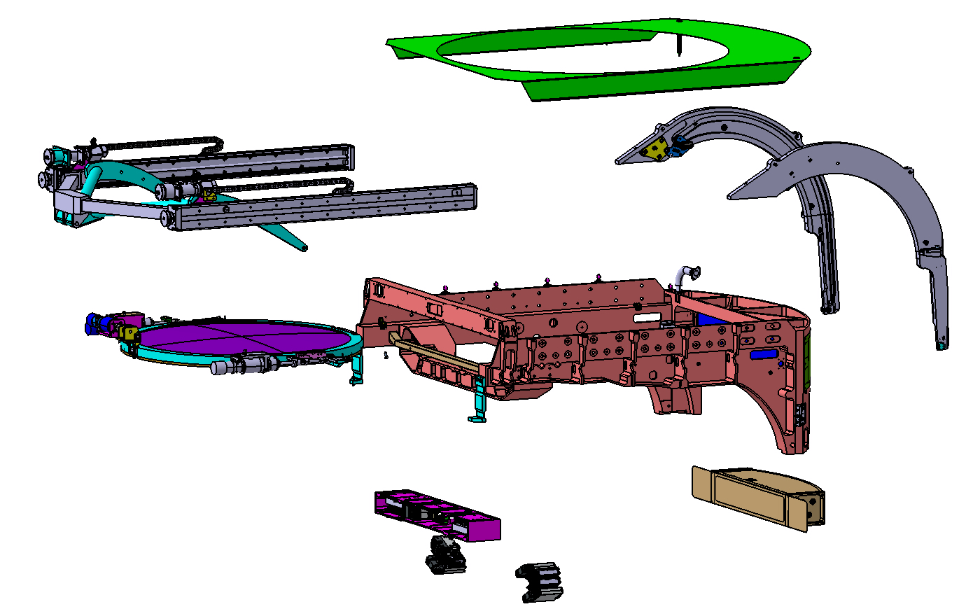
Final Auto Changer : Procurement Status
Driving System:
Linear Rail : OK
Yoke : OK
Motors : OK
Transmission
Linkage
Power chains
Encoders
Baffle :
Guiding System:
Guiding Rail : OK
Trucks
Structure:
Main Structure : OK
Interfaces
External Cover
Filter Interfaces : OK
On-Line Clamp System:
Motors : OK
Supports
Transmission
Clamp
Sensors
Hardware Control Unit:
Controllers : OK
Safety PLC : OK
Other Elect components
Boxes
Connectors
Cooling devices
2

Slide 3
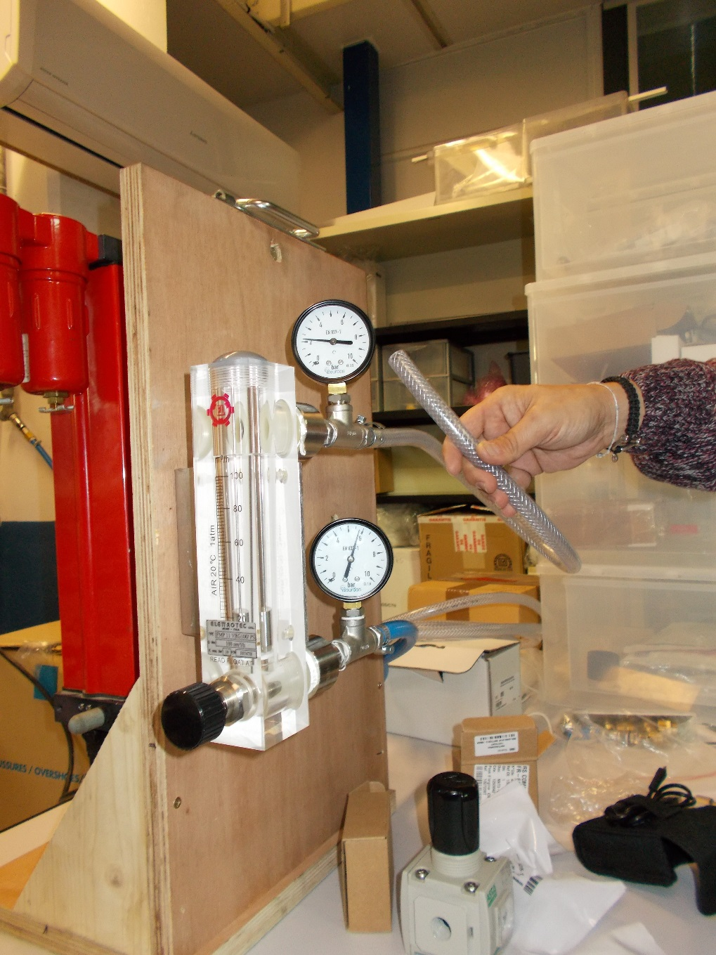
Electrical Box Cooling
Air Comprimé du Labo
Assécheur d’air mobile
Débitmètre
Réducteur de pression

Slide 4
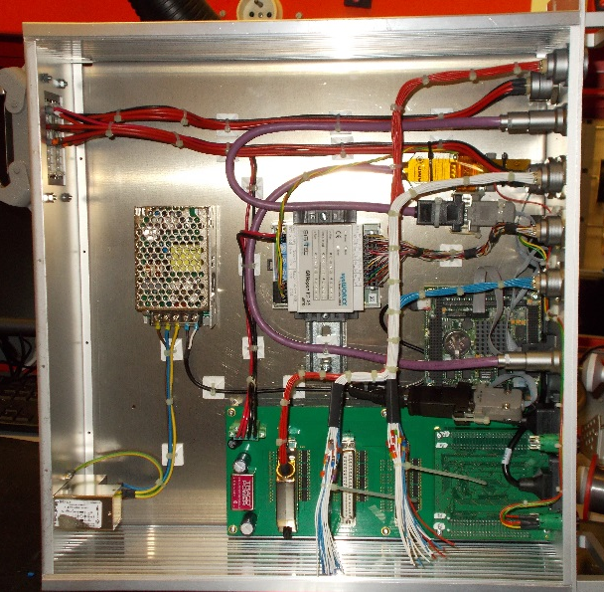
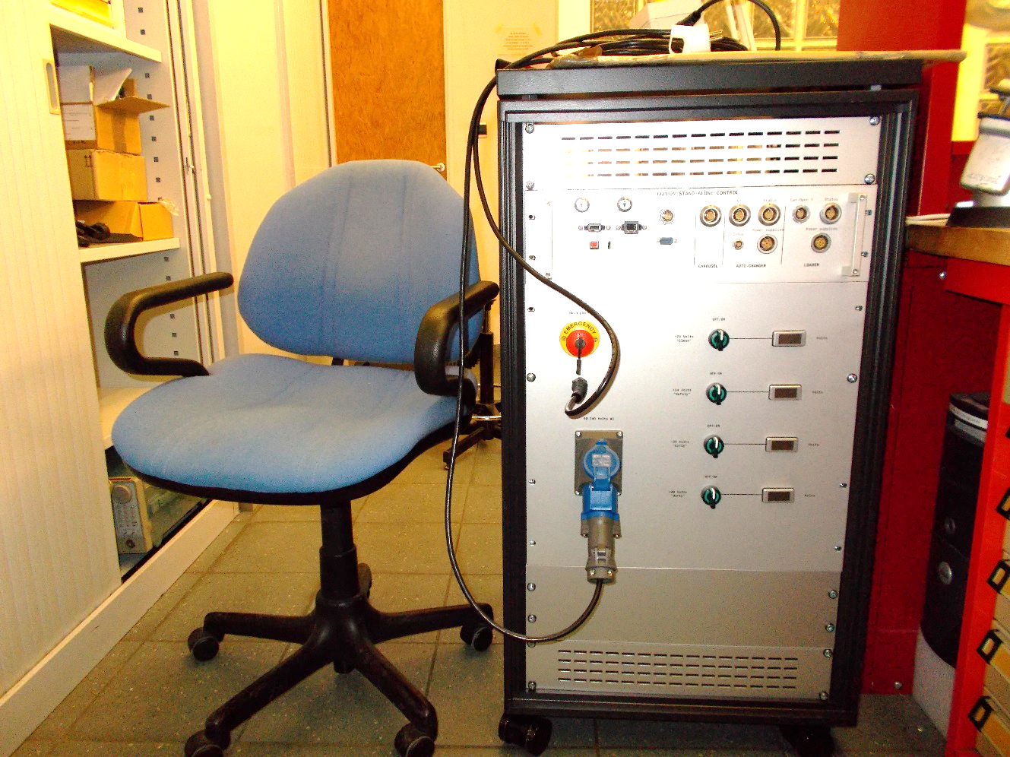
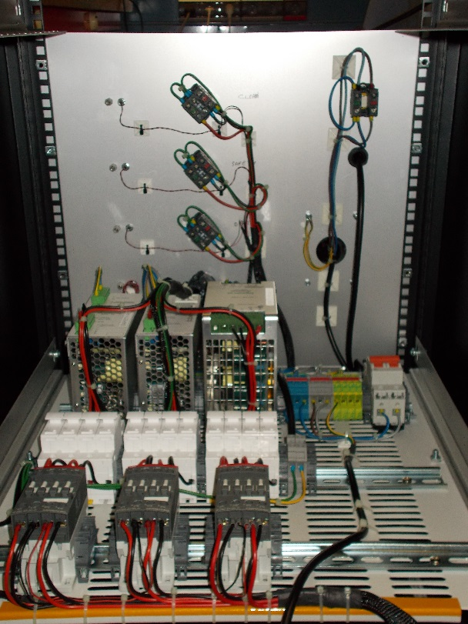
Electrical Command Bay

Slide 5
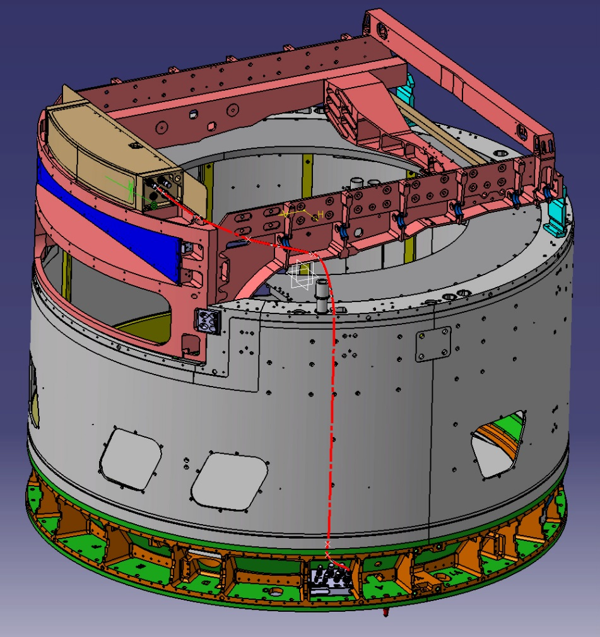
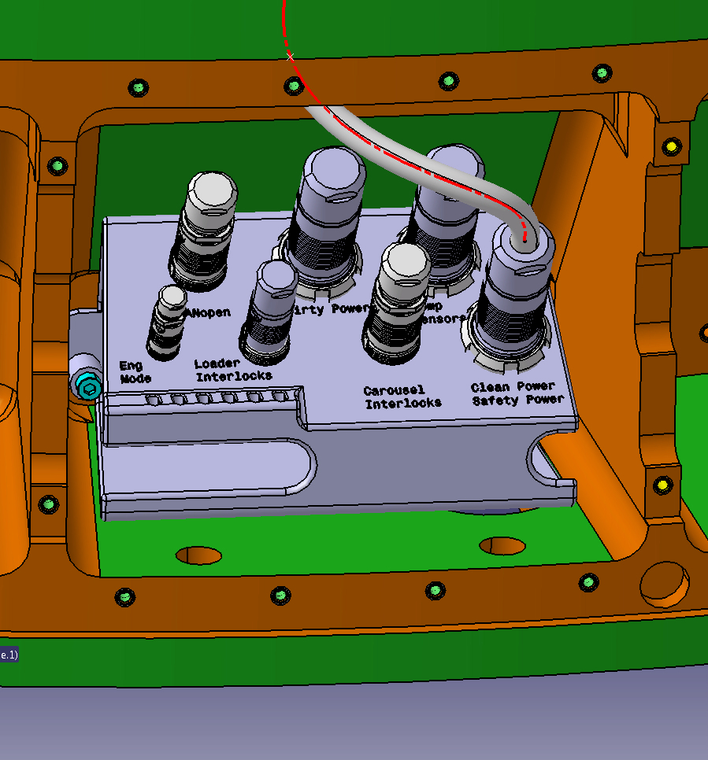
Camera Connection

Slide 6
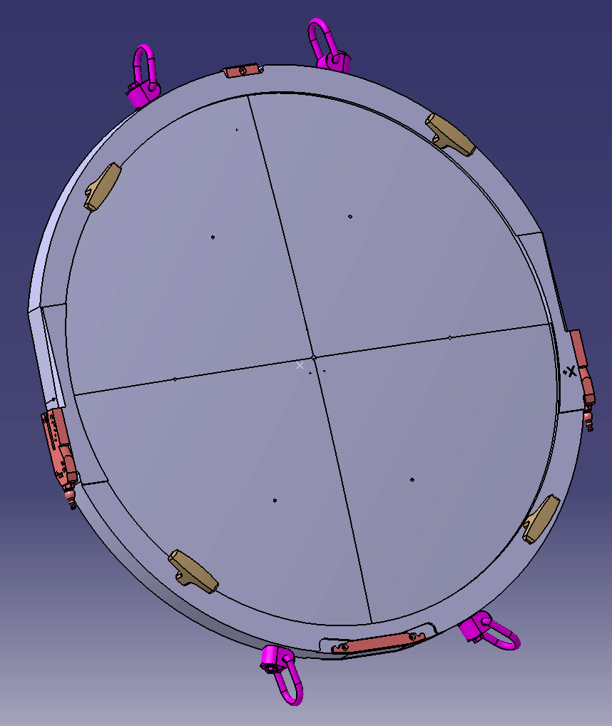
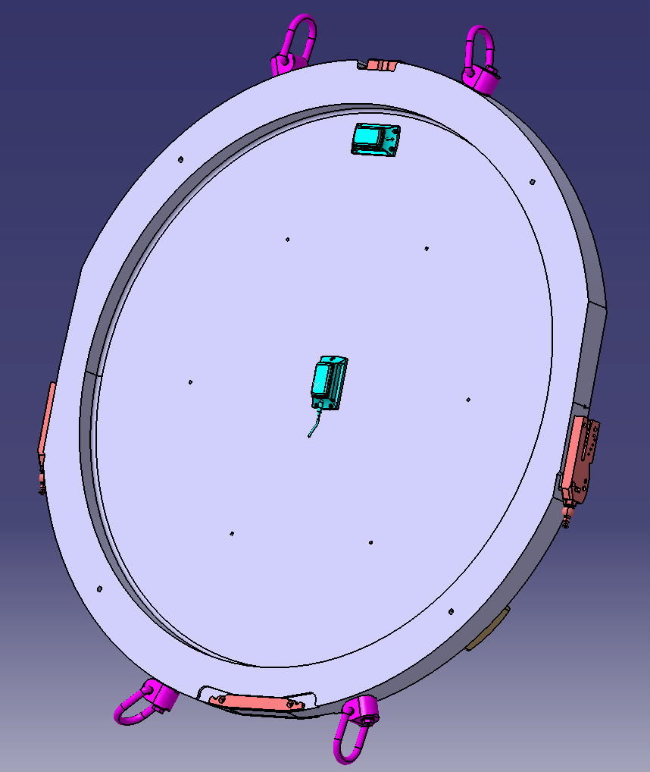
New Dummy Filters

