Slide 1
Integration Modeling to Decipher a Fuel Cycle
Romarie Morales, David Vermillion, Matthew Oster, Jereme Haack, Peter Yee, Katherine Arneson, Kassandra Guajardo, Jackson Chin
Ryan Goldhahn, Braden Soper, Siddharth Manay*, Paul Whitney*
PNNL, LLNL
PNNL-SA-136210

Slide 2
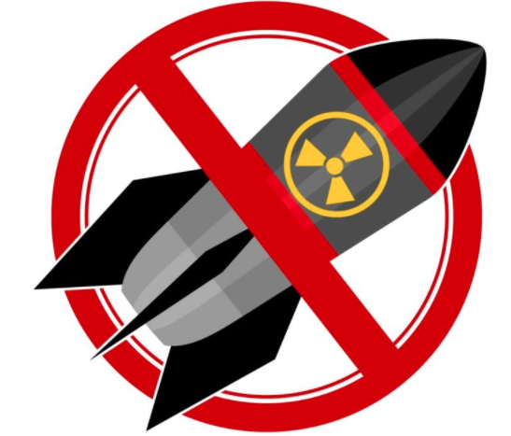
Motivation
Uranium can be split into parts to produce energy.
consider fissile (used to produce nuclear weapons).
Requires Mining and Milling, Conversion, and Enrichment
Plutonium can also be used to produce energy and nuclear weapons
Treaty signatories could clandestinely develop nuclear weapons programs that evade early detection
1997: IAEA comprehensive safeguards
Verifying correctness and completeness that all nuclear technology is used exclusively for peaceful purposes
Image:https://futureoflife.org/2017/06/30/moving-closer-world-without-nuclear-weapons/
PNNL-SA-136210

Slide 3
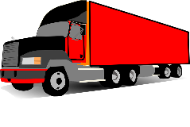
MIRS will demonstrate facility inference from sparse remote sensing clues.
Determine purpose and production information of facilities of interest.
Is it making a material of interest?
How much? When?
Observables can be sparse.
MIRS two-part approach.
Computationally Model the workings of connected facilities.
Infer which model matches the observations.
MIRS develops methods determine more information about unknown facilities - compared to using sensors in isolation.
Model of facility network
Stochastic integration of observables
PNNL-SA-136210

Slide 4
Schematic for a general manufacturing unit
Source Term
Resources
Resource holding
Output holding
Input holding
Source Term
Input(s)
Output(s)
Sink
Term
Production Process
Waste holding
Software representation of manufacturing unit developed
These can be combined to represent different scenarios
Waste
Sink
Term
PNNL-SA-136210

Slide 5
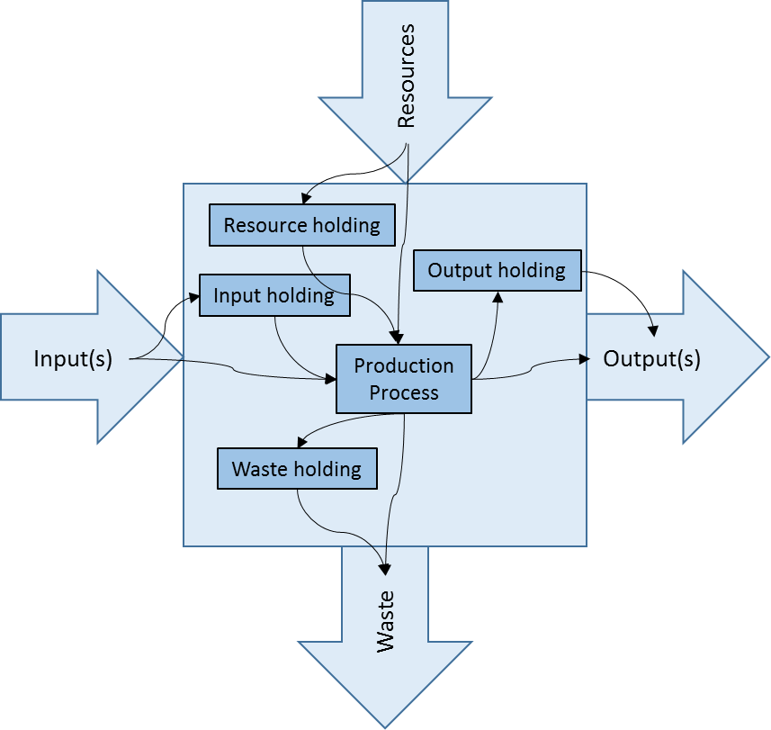
Fa
Computational Experiments
Construct facilities for scenarios, then generate associated sensor outputs. A machine learning (ML) approach uses sensor outputs as training data for an ML algorithm. The ML algorithm is evaluated to see 1) can the scenarios be distinguished, and 2) which features (sensors) are critical for distinguishing the scenarios.
Assessing connections
F1
F2
F3
Is the third facility in a sequence connected?
Inside Facilities F1, F2, …
vs
F1
F2
F6
Diversion Detection
F1
F2
F3
F6
vs
Is material from F2 going to F6?
F1
F2
F3
F6
PNNL-SA-136210

Slide 6
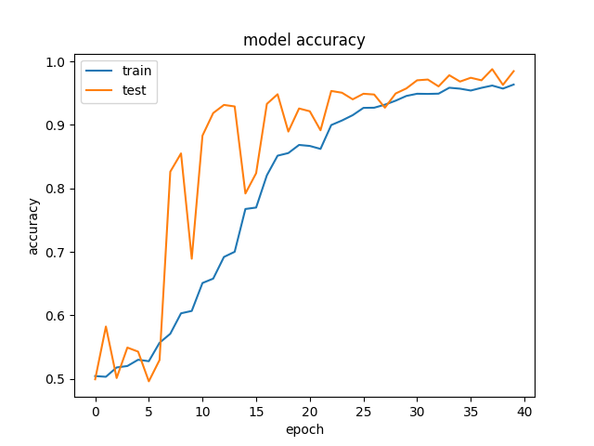
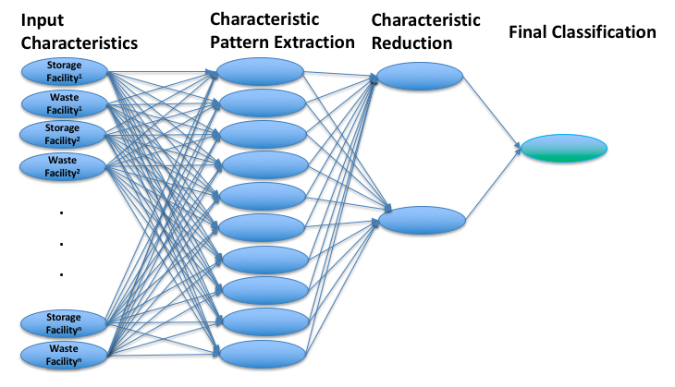
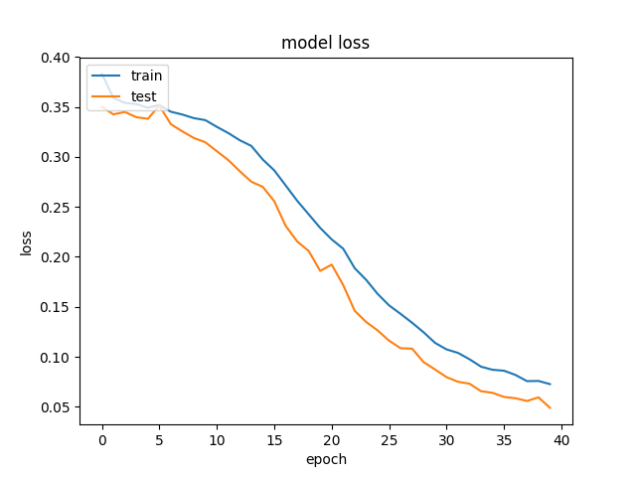
Deep Learning Approach
We designed a convolutional neural network (CNN) model aimed at classifying whether or not a particular simulated facility scenario was
mis-reporting (1) or not (0).
We used the model characteristics as initial input, via linear regression we do a pattern extraction, reduction, and final classification of the facilities.
Model accuracy plot to the top, and model loss to the bottom. As we increase the number of epochs the accuracy of the classification increases to over 0.98
PNNL-SA-136210

Slide 7
Cyclus Software
Agent based nuclear fuel cycle simulator that can track uranium material movement from one facility to another.
Open source software that can be run using python.
With the use of this software we are able to do our forward model and include tracking material (uranium isotope) information
We tailored the Cyclus software to address two particular scenarios that will reflect realistic deterrence cases:
PNNL-SA-136210

Slide 8
Scenario 1
The first scenario covers deterrence coming from a declared Conversion facility and sending (Natural Uranium) material to an undeclared enrichment facility. Then the undeclared Enrichment facility sends high enriched uranium (HEU) to a final facility.
PNNL-SA-136210

Slide 9
Scenario 1: Diversion of Natural Uranium
Declared
1
Mine/Mill
2
Conversion
3
Enrichment
4
Fuel Fab
5
Power
Yellowcake
Nat. U.
LEU
LEU Fuel
Nat. U.
6
Enrichment
7
Weapons
HEU
Undeclared
PNNL-SA-136210

Slide 10
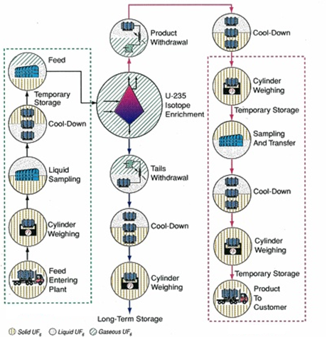
Uranium Enrichment Facility Model
Feed Inventory Levels
Initial feed cylinders onsite
Max feed cylinder capacity
Measured in kgU/month
Cascade Halls
Single ideal cascade
Technology agnostic
SWU to meet demand
Declared: 4% ²³⁵U
Undeclared: 90% ²³⁵U
Tails Assay
Declared: 0.3% ²³⁵U
Undeclared: 0.1% ²³⁵U
PNNL-SA-136210

Slide 11
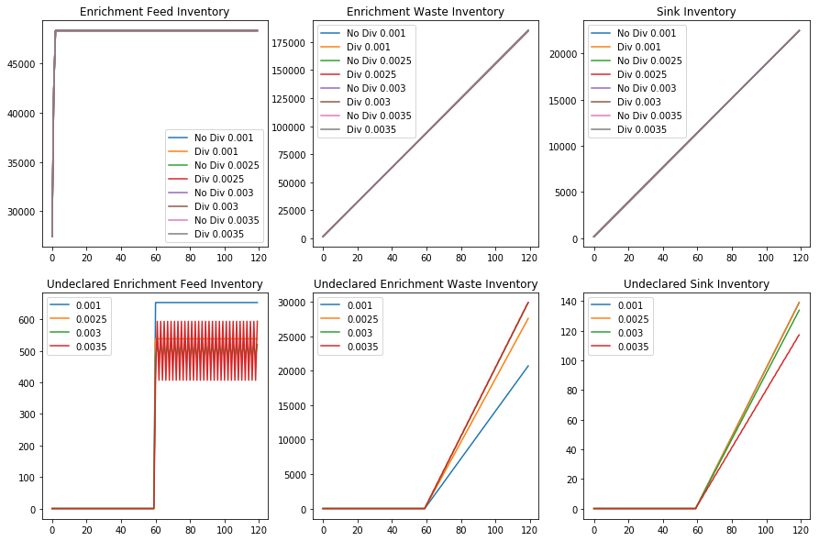
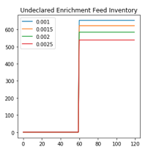
Scenario 1
Scenario 1
Facility: Clandestine Enrichment
Parameters: Tails from .001 to .0035 in
Observation:
Varying the Clandestine waste (tails) does not affect the declared enrichment inventory.
The undeclared waste (tails) is directly proportional to the parameter.
The undeclared sink is inversely proportional to the parameter.
The undeclared enrichment feed inventory bounces from about 400 to 600 on the y-axis on 0.0035.
Behavior of Undeclared Enrichment facility stays level on tails ranging from 0.001 to 0.0025
PNNL-SA-136210

Slide 12
Scenario 2
The second scenario considers the case of deterrence from a declared Enrichment facility to an Undeclared Enrichment facility. The low enriched Uranium (LEU) obtained and transformed is then sent to the final facility.
PNNL-SA-136210

Slide 13
Scenario 2: Diversion of Low-Enriched Uranium
Declared
1
Mine/Mill
2
Conversion
3
Enrichment
4
Fuel Fab
5
Power
Yellowcake
Nat. U.
LEU
LEU Fuel
LEU
6
Enrichment
7
Weapons
HEU
Undeclared
PNNL-SA-136210

Slide 14
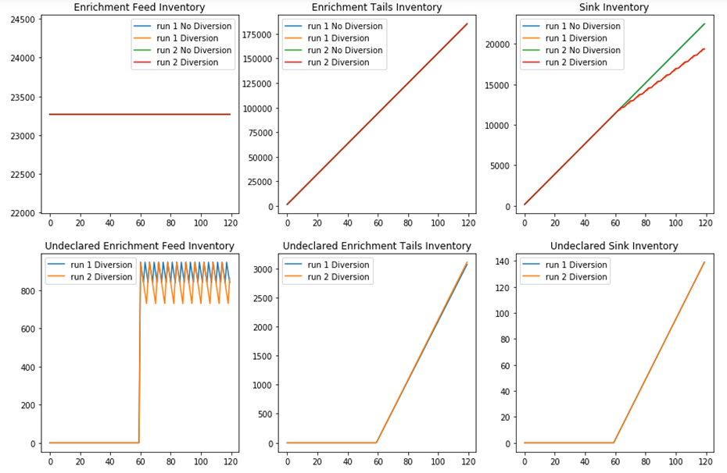
Scenario 2:
Scenario 2
Facility: Clandestine Enrichment
Parameters: Tails assay to 0.0015 (Run 2) from 0.001 (Run 1).
Observations:
The enrichment feed inventory is at about 23,250.
The sink inventory appears to be repeating from an increasing slope and then being constant from 60 to 120 months.
In the undeclared enrichment feed inventory, the variation caused the graph to bounce from about 700 to 950.
Note: A small difference in the declared enrichment tails inventory.
Scenario 2:
PNNL-SA-136210

Slide 15
Status
We implemented computational modeling and inference methods to integrate sparse remote sensing information across a manufacturing chain to draw stronger inferences about the activities at unknown facilities.
Multiple inference approaches provided initial classification power. However, they were only tested in a few particular scenarios.
More tests need to be conducted in order to estimate performance accuracy.
More complex processes with additional raw material and waste inputs/outputs, remotely observable signatures, and variable production rates need to be included.
Results should also be obtained using real data sets from current Nuclear facilities.
PNNL-SA-136210

Slide 16
Questions
PNNL-SA-136210

Slide 17
Parameters:
Archetype | Parameter | Value
Source | Throughput | Varies
Declared Enrichment | Tails Assay | 0.003
 | Initial Feed Inventory | 12500
 | Maximum Feed Inventory | 50000
 | SWU Capacity | 1000
Undeclared Enrichment | Tails Assay | 0.001
 | Initial Feed Inventory | 1000
 | Maximum Feed Inventory | 1000
 | SWU Capacity | 1000
Declared Sink | Throughput | 3697.5
Undeclared Sink | Throughput | 2.3
PNNL-SA-136210

