Slide 1



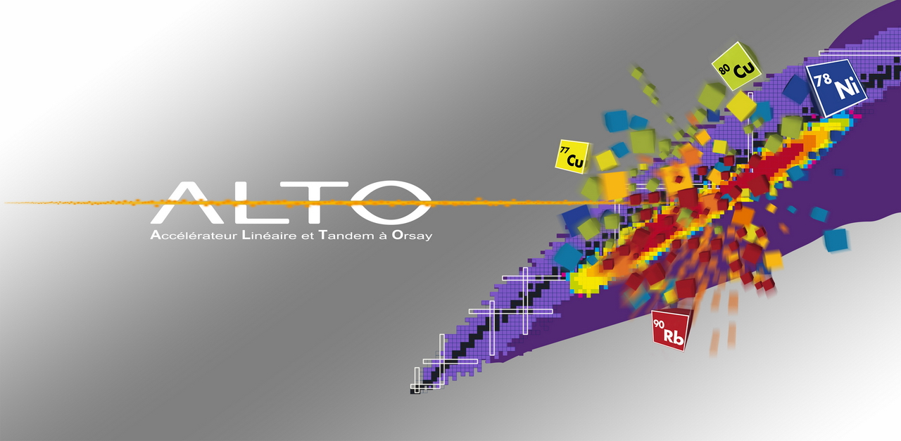
Status of ALTO
and recent results
Fadi Ibrahim– IPN Orsay

Slide 2

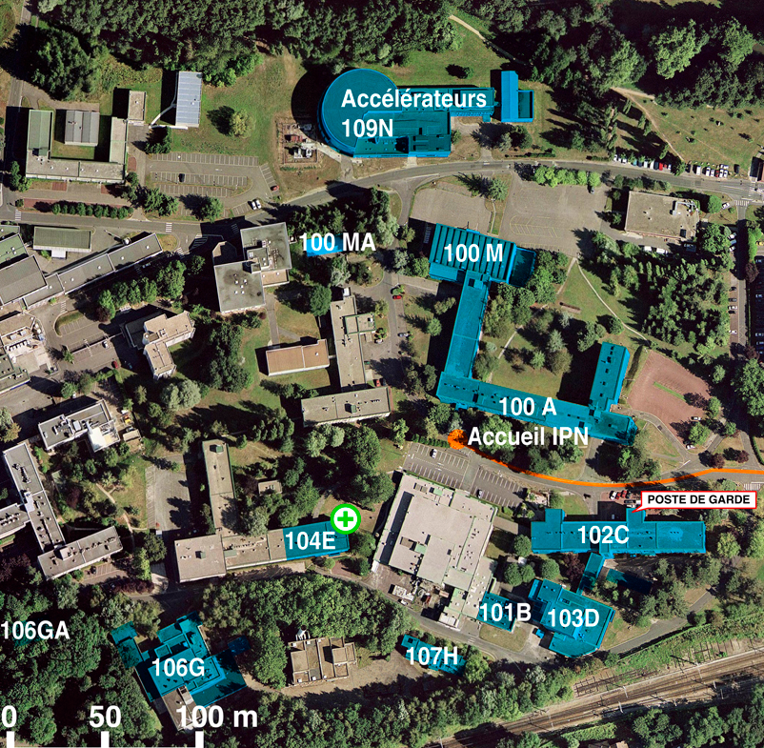


Notes:
2

Slide 3
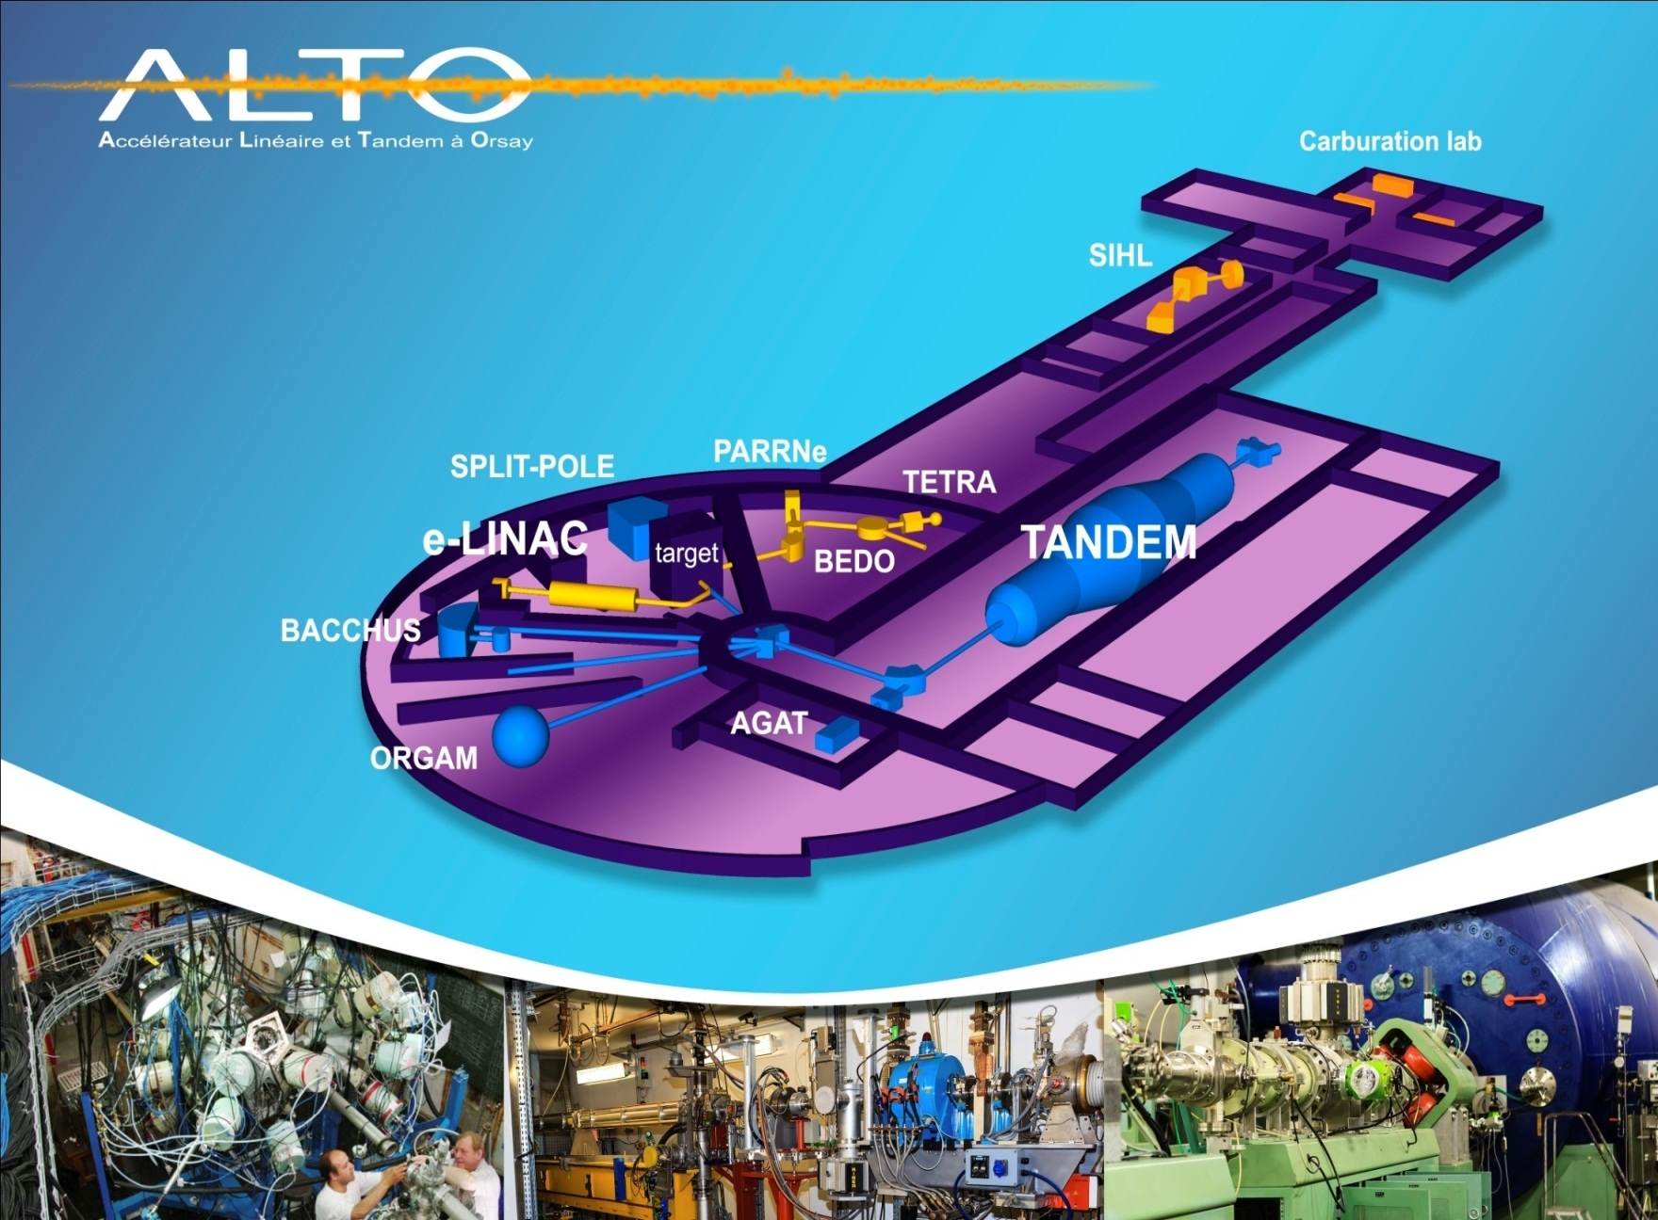
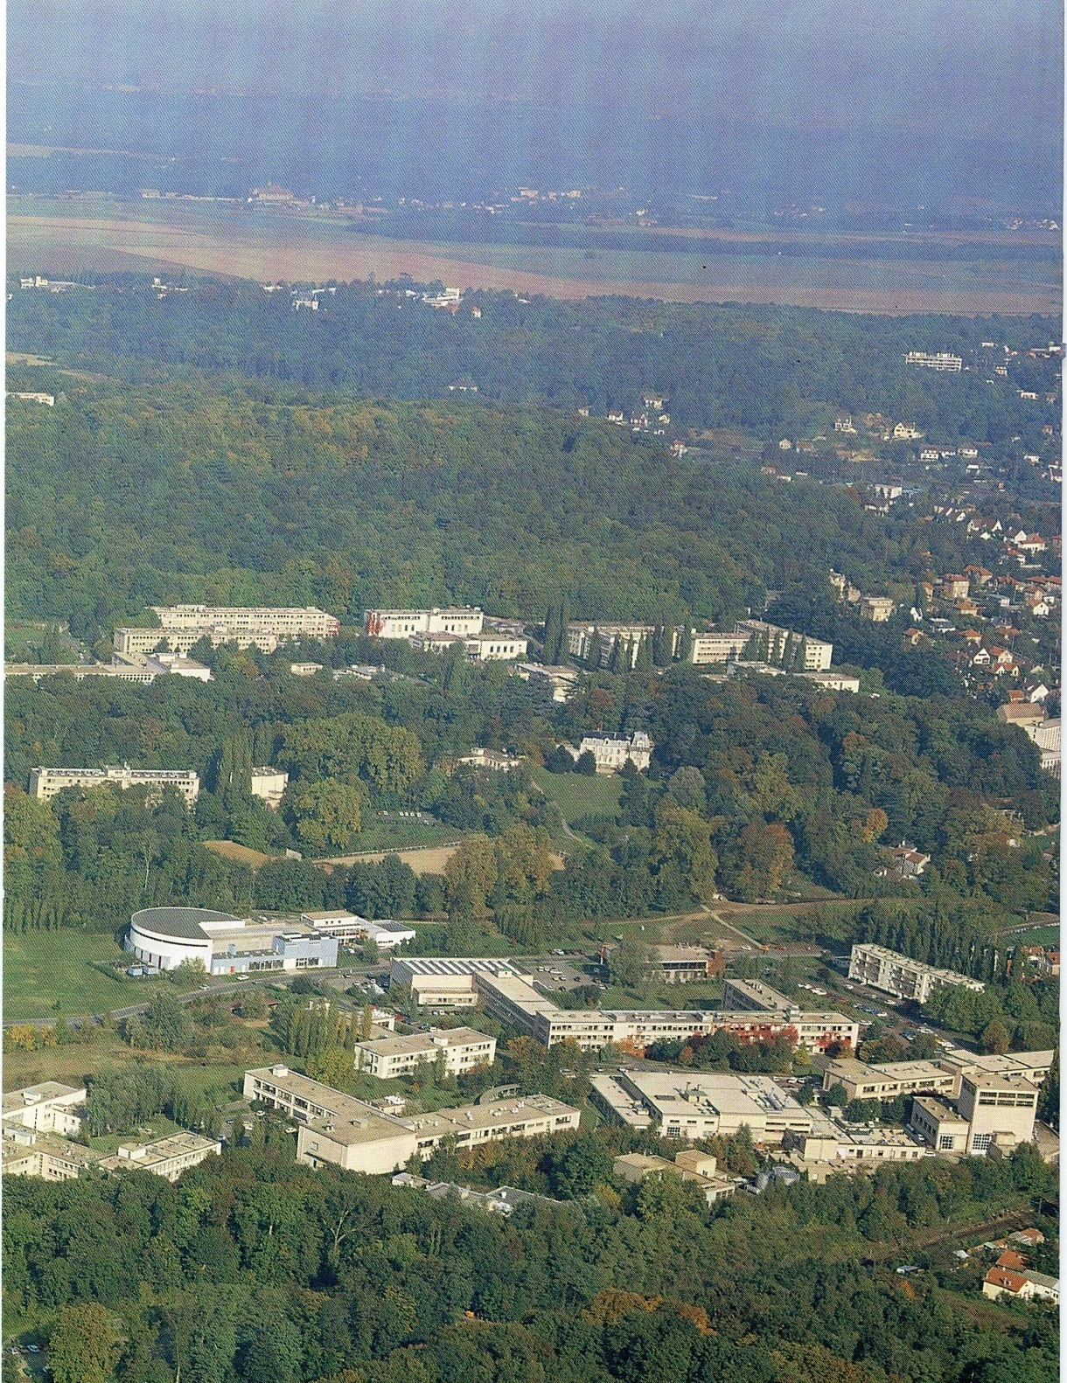
Tandem building
Institut de Physique Nucléaire
Campus of the Paris Sud University Orsay (France)

Slide 4
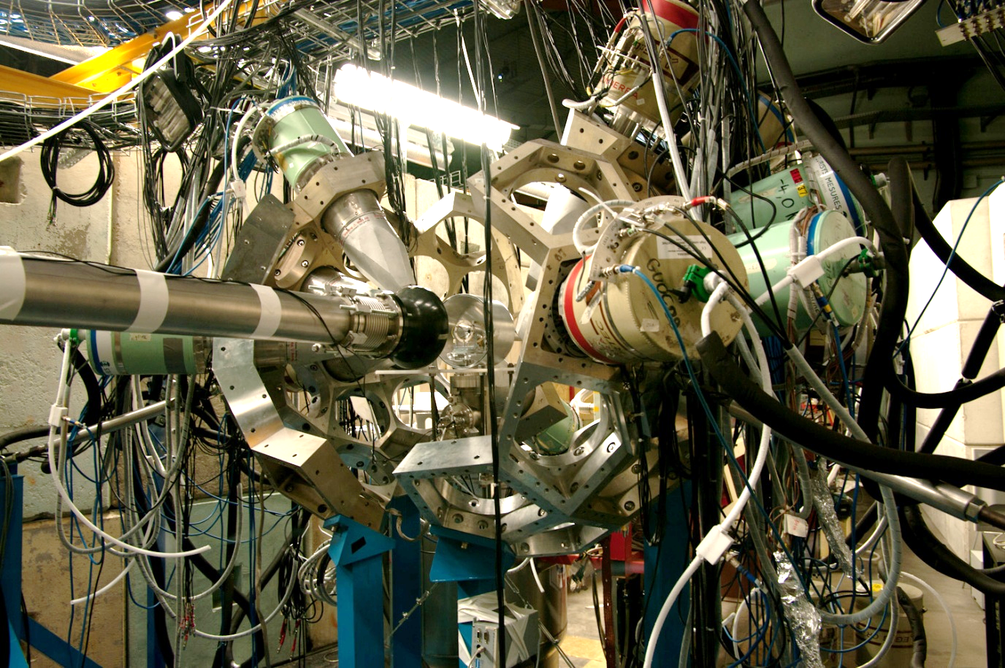

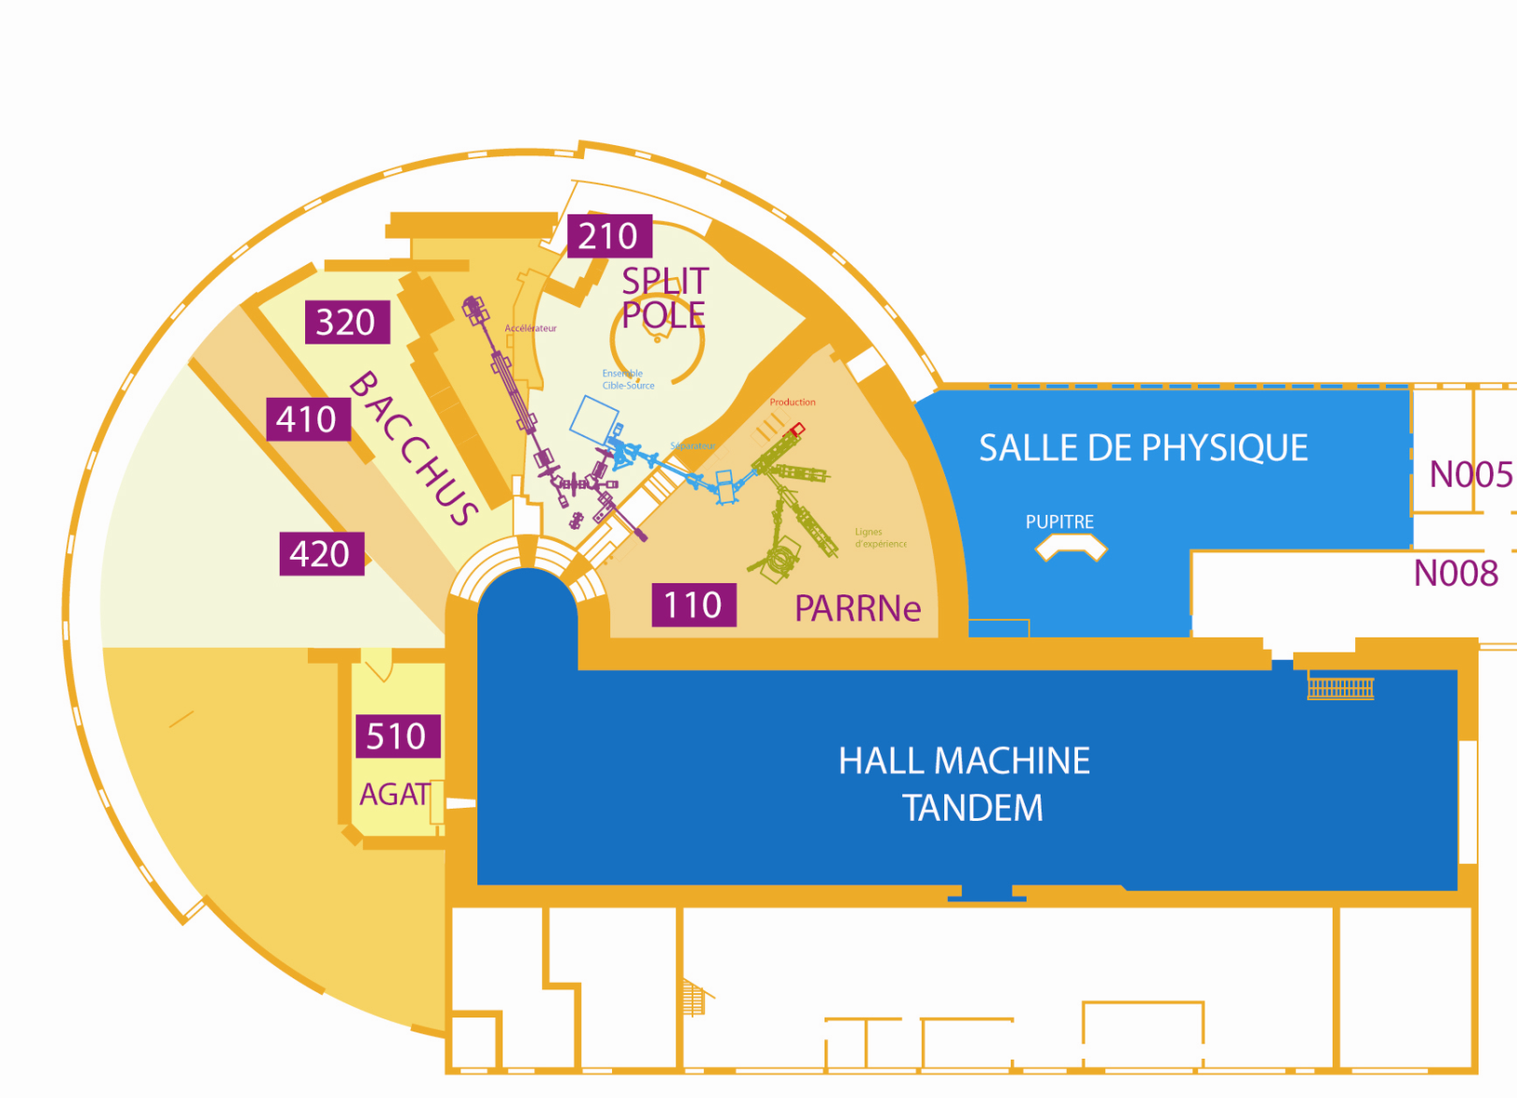
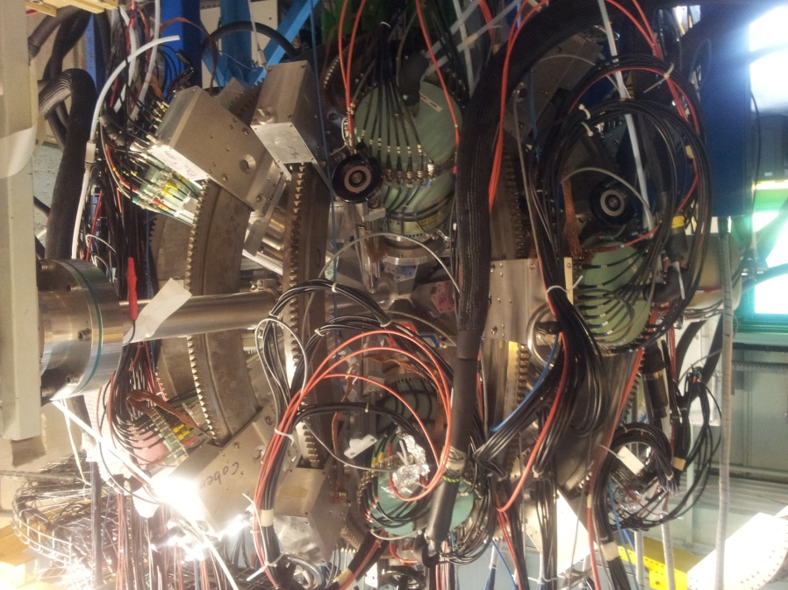
ALTO general layout
γ-spectroscopy
Bacchus
Split-Pole
spectrometer
ISOL
production cave
ORGAM
ISOL
experimental cave
(~100 m²)
ISOL installation
e LINAC
MINORCA
Radioactive beam lines
Stable beam w/o spectrometer
cluster,
molecular &
droplets beams
Stable beam with spectrometer

Slide 5

The ALTO PAC
Richard Casten Yale, USA, Chair
Dimiter Balabanski ELI-NP, Romania
Emmanuel Balanzat CIMAP/GANIL, France
Marcella Grasso IPN Orsay, France
Stéphane Grévy Bordeaux-Gradignan, France
Adam Maj IFJ PAN Kraków, Poland
Paddy Regan Univ. Surrey, UK
Peter Reiter Univ. Koeln, Germany
Berta Rubio CSIC-Univ. Valencia, Spain
Jean-Charles Thomas GANIL, France
Christina Trautmann GSI, Darmstadt, Germany
Aurora Tumino Kore Univ. Enna & LNS-INFN Catania, Italy
ALTO is an Infrastructure supported by the European Community through the ENSAR2 contract in the framework of H2020-INFRAIA-1-2014-2015, for the period from
March 1st, 2016 to February 29th, 2020.

Slide 6
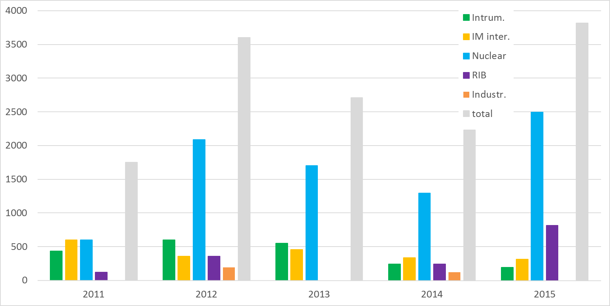
Beam-time and users (2011 – 2015)
2011 2012 2013 2014 2015
Users ~120 ~240 200 135 246
Beam-time 1752 h 3600 h 2712 h 2232 h 3816 h
219 UT 450 UT 339 UT 279 UT 477 UT

Slide 7
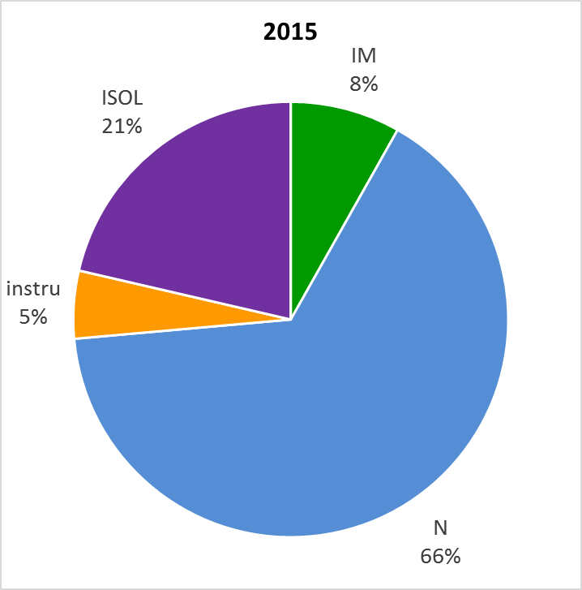
2015 run
2015 – record beam time,
limited by the number of
operators available
High percentage of stable and
radioactive nuclear physics
experiments
Split Pole – 2 campaigns
RIB – 2 campaigns
True parallel operation of stable and radioactive beams over several weeks
34 days of RIB in two campaigns

Slide 8
FAISCEAUX
RADIOACTIFS à ALTO

Slide 9
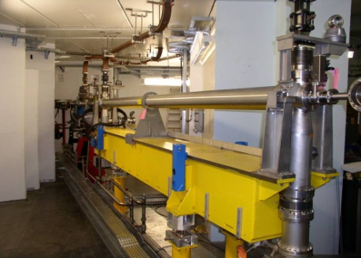
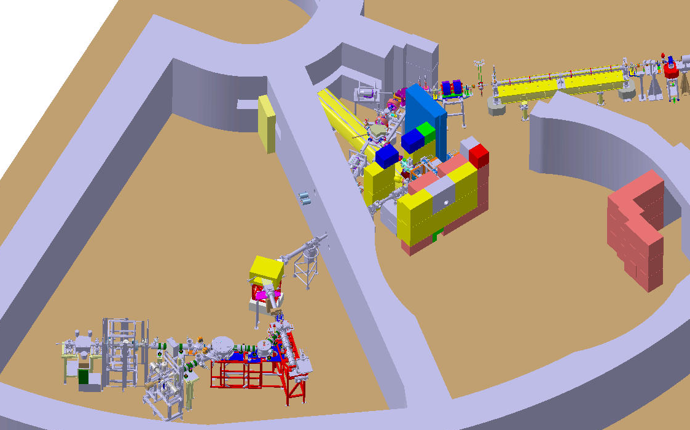
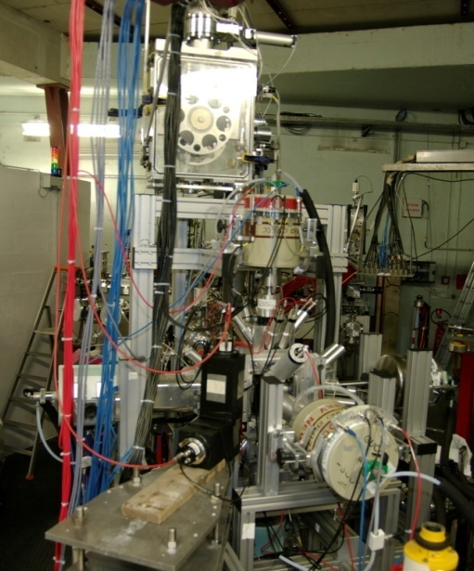
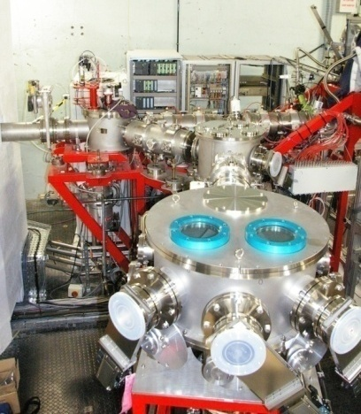
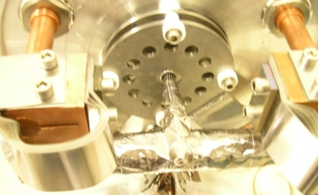
The ISOL installation based on photo-fission: the first of its kind in the world
e-LINAC
10 µA 50MeV
(former 1st section of the LEP injector)
BEDO
beta decay spectroscopy
secondary
beam lines
TIS vault
~10^11 fissions/s
POLAREX
nuclear orientation on line
PARRNe
mass separator
Target Ion-source ensemble
kicker - bender
identification station

Slide 10
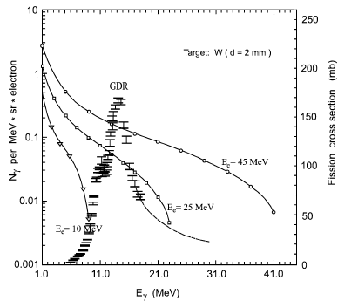
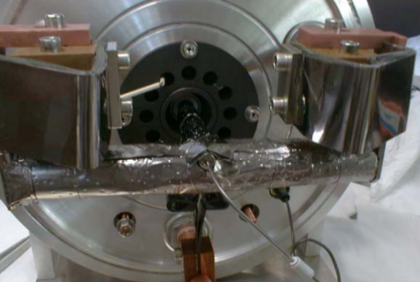

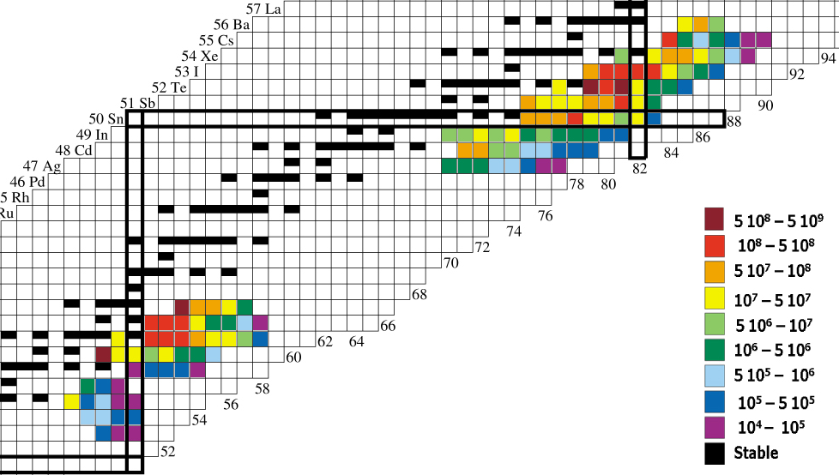
ALTO – RIB production
First operational RIB facility based on photo-fission
Y. Oganessian et al., NPA 701 (2002) 87c
standard ISOLDE target
∅ = 14 mm; L = 200 mm
ρ = 3.2 g/cm³; T ≤ 2100º C
→ Yields for 10 µA,
50 MeV e⁻ beam
(10¹¹ fissions/s)

Slide 11
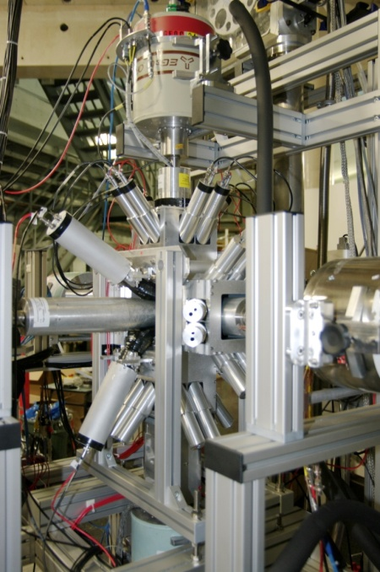
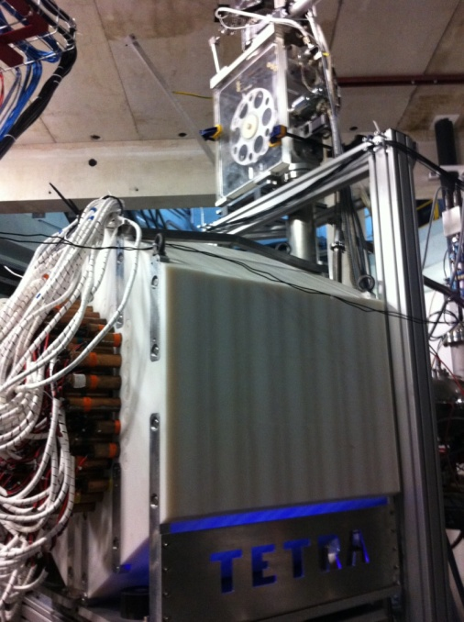
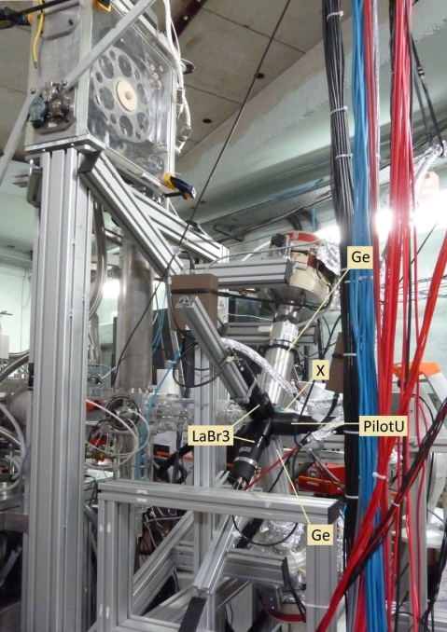

Progress in the RIB instrumentation (so far)
3 modes, 3 commissioning's, 3 physics results
BEDO setup
in gamma mode
4 small EXOGAM clovers
BEDO setup
in neutron mode
Dubna neutron detector TETRA
BEDO setup
fast timing mode
LaBr3
IPN, coll. CSNSM, IPHC
IPN, coll. JINR (Russia), IPHC
IPN, coll. CSNSM, TANDAR (Argentina), INRNE (Bulgaria)
PhD: A. Etilé (CSNSM)
PRC 91, 064317 (2015)
PhD: D. Testov (IPN)
NIM A815, 96 (2016)
M.A.Cardona, D.Hojman, B.Roussière, I.Deloncle et al.
to be submitted

Slide 12
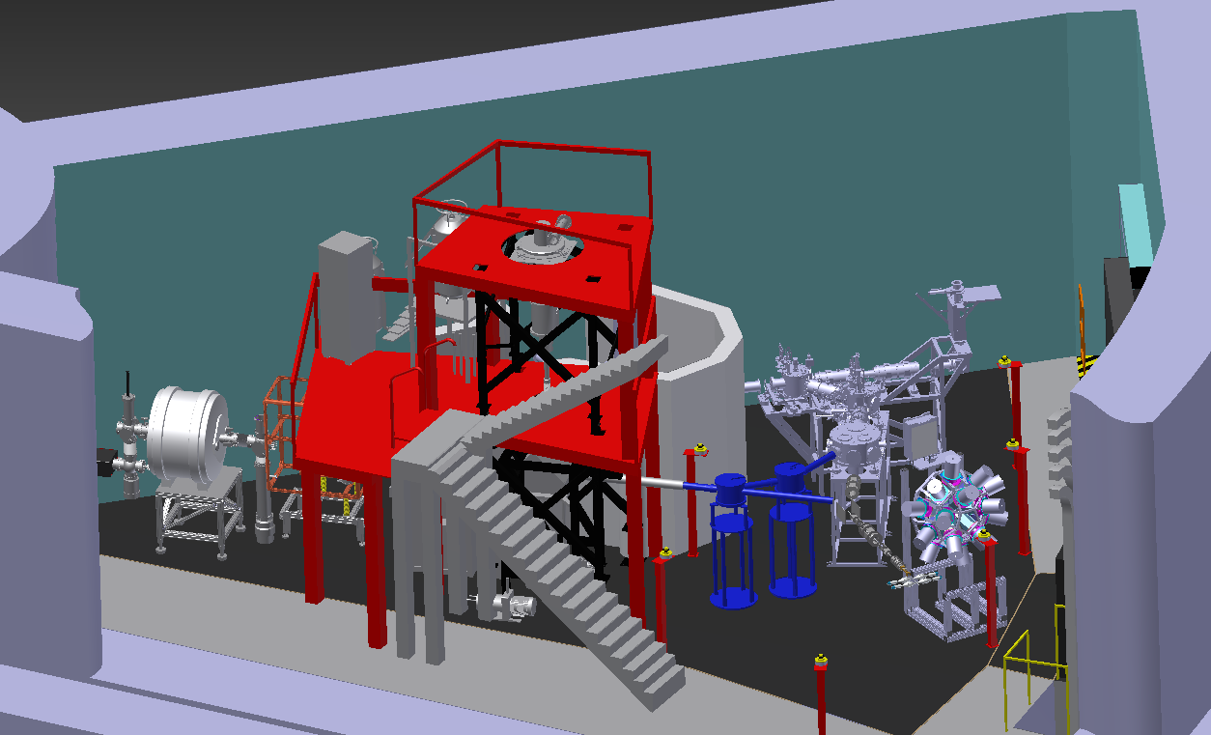
Present RIB setups and near-future projects
Parrne mass separator
Identification station
TETRA
(existing)
TAS
(existing)
MLL Trap
(project)
BEDO
(existing)
POLAREX
(project)
Mass
measurements
LINO
(project)
LTNO
(³He/⁴He)
Laser-Induced nuclear
orientation (µ,Q, J^{p})

Slide 13
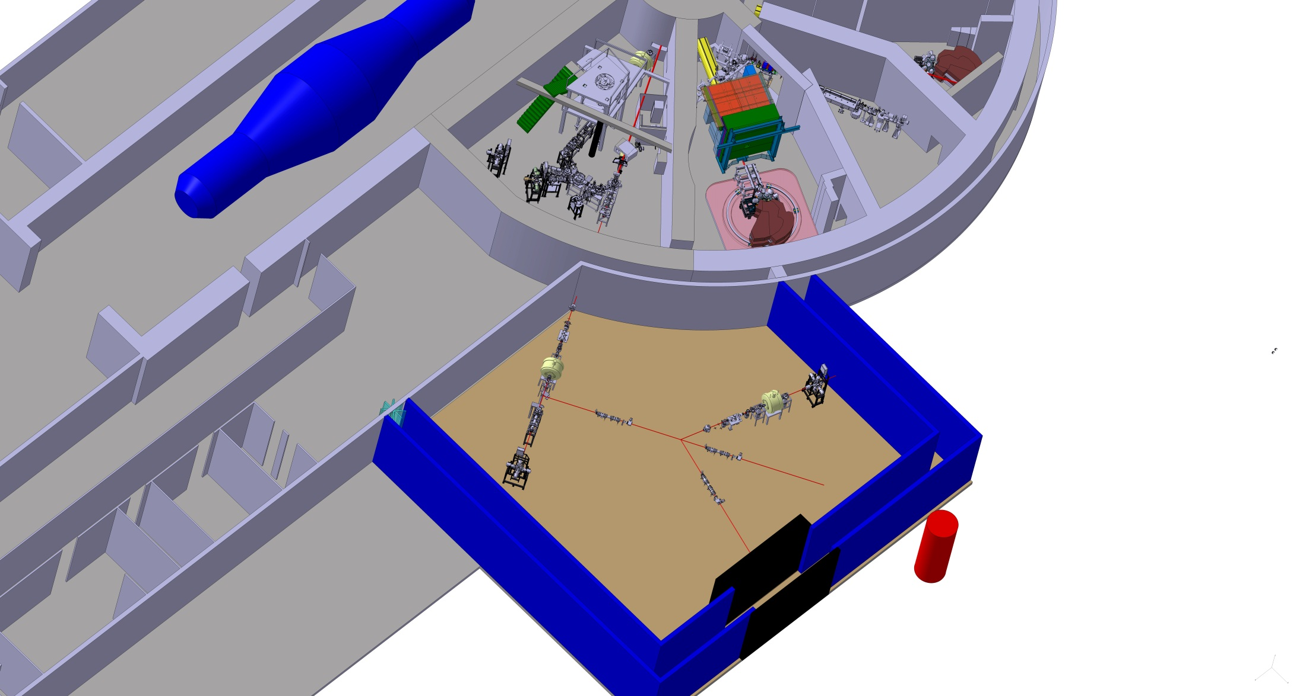
The future extension : PALTO
Platform Assisted by Laser and Traps at Orsay
Progress in the instrumentation of the secondary beam lines
Nuclear orientation on line: the POLAREX project at ALTO

Slide 14
FAISCEAUX
STABLES à ALTO

Slide 15
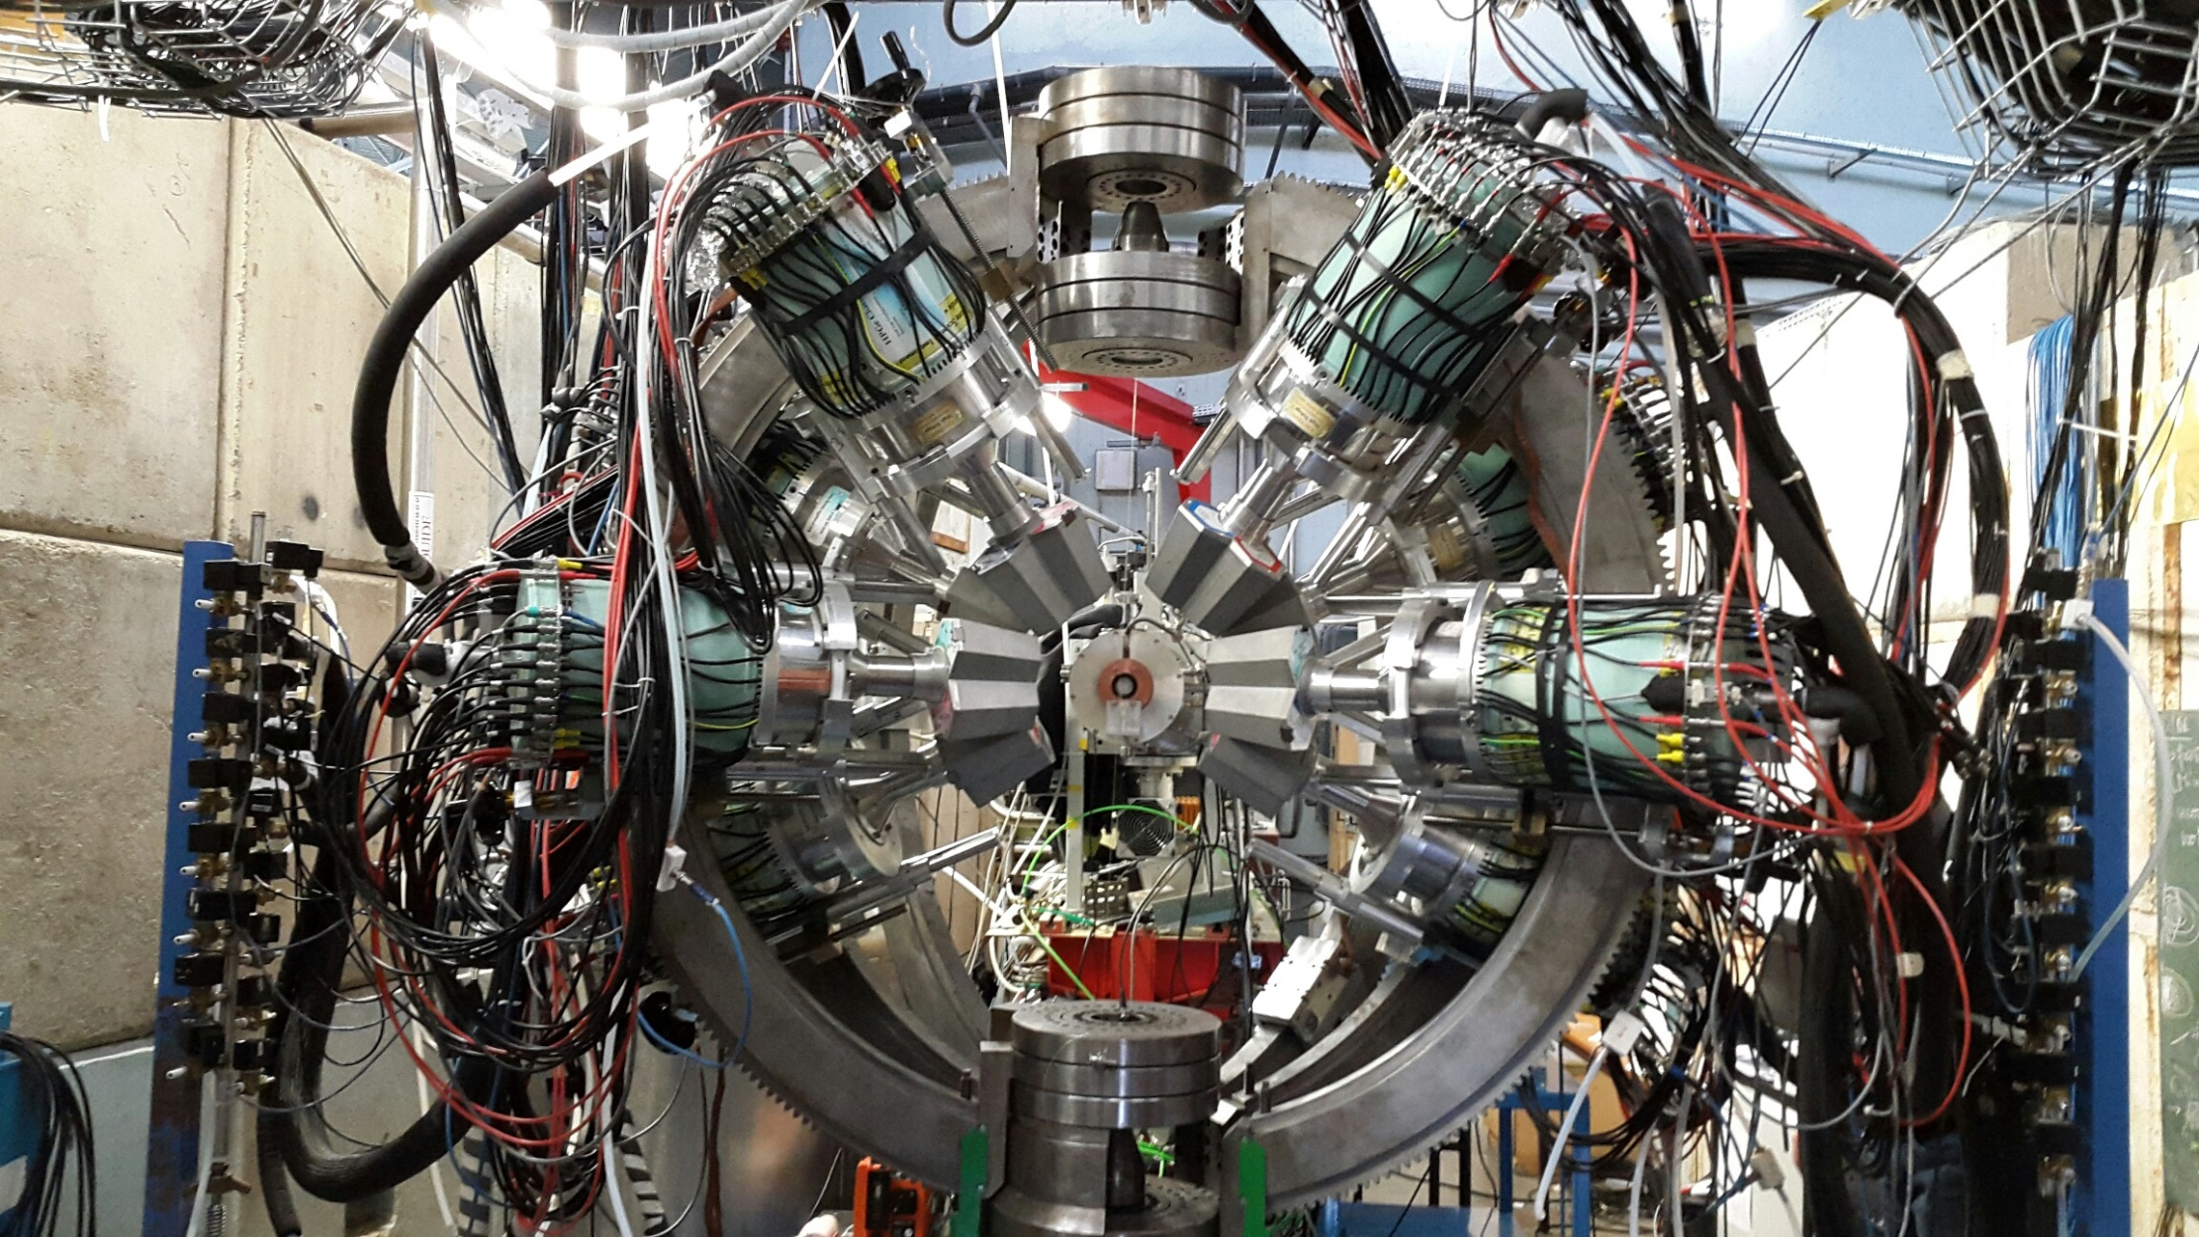
LES INTRUMENTS : SPECTROSCOPIE GAMMA

Slide 16
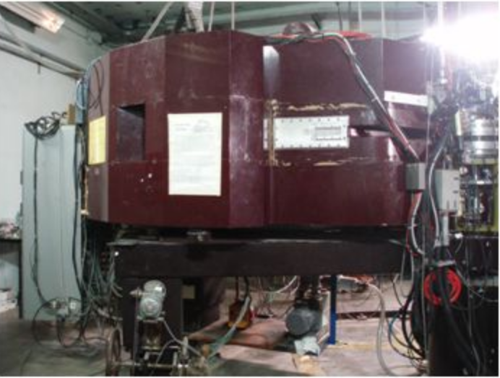
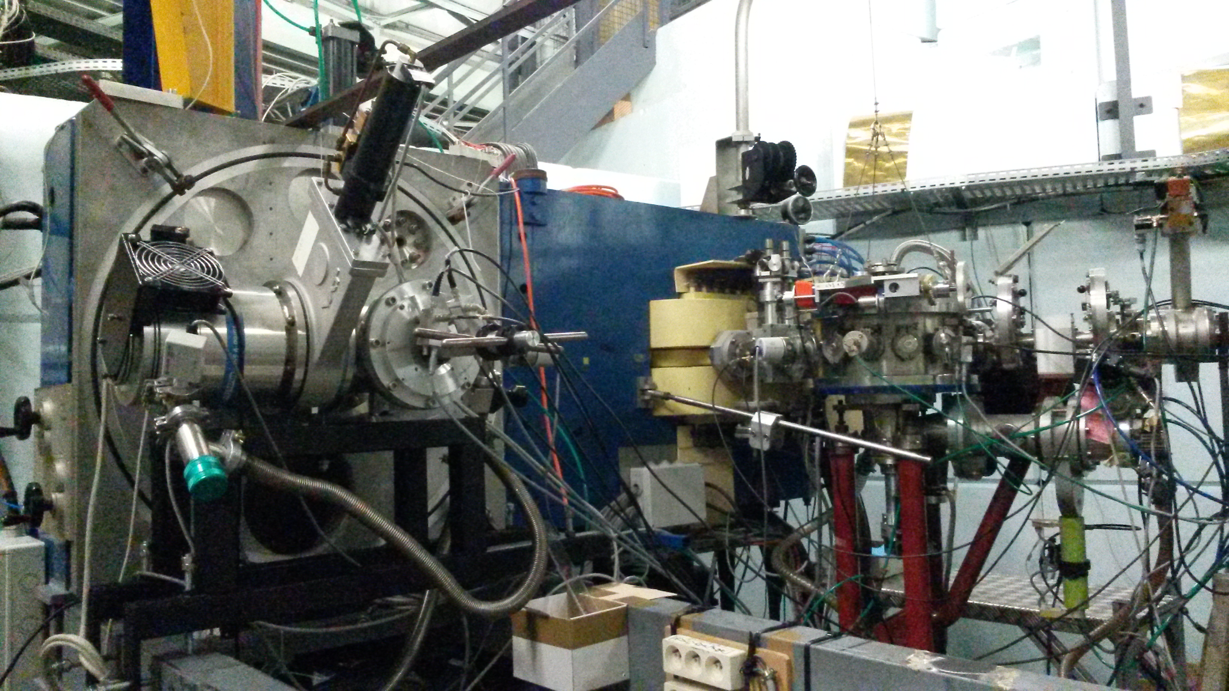
LES INTRUMENTS : LES SPECTROMETRES
Spectromètre
SPLIT POLE :
Ions légers
Spectromètre
BACCHUS:
Ions lourds

Slide 17

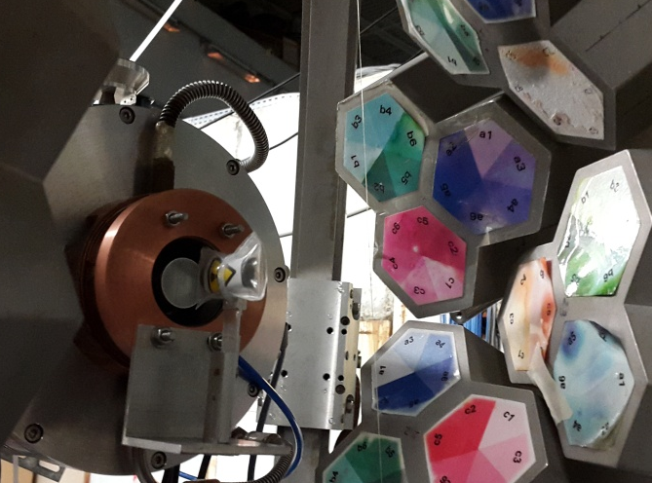
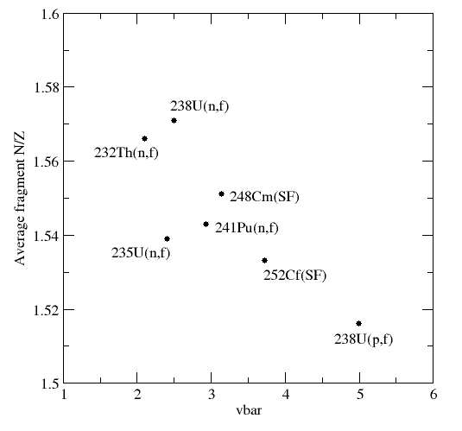
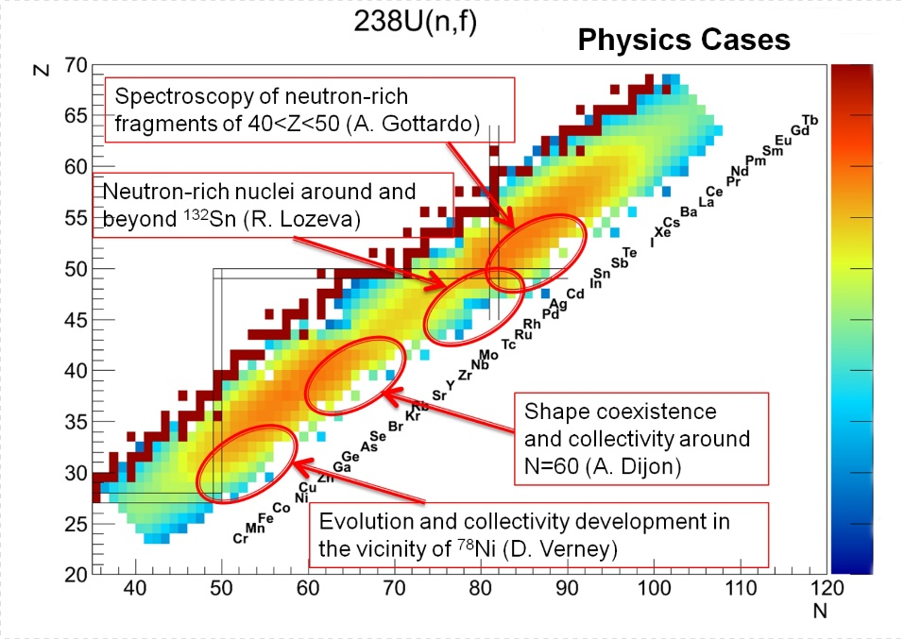
Lithium Inverse Cinematics ORsay NEutron source
Sample
+MINORCA
H target
γ
n-induced fission of ²³⁸U
n
n
n
n
TIPS – tagging of
isomer partners
100nA ⁷Li
13-17 MeV
γ
10⁷ n/s/cm²
LICORNE
Exoticity
EXILL
SF
J. Wilson, M. Lebois et al.
Testing ground for NFS@SPIRAL2

Slide 18
LISTE DES FAISCEAUX à ALTO

Slide 19
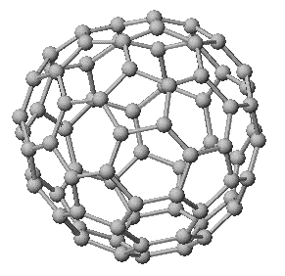
Du proton à l’or
Si au dessus de la barrière coulombienne : du proton à l’iode
Du micro ampère pour les légers aux dizaines de nA pour les
Lourds
Faisceau d’électrons jusqu’à 50 MeV 10uA
Flux de neutrons mono énergétique :
Jusqu’à 4 MeV, flux 10⁷ n/s/cm2
Faisceaux d’agrégats
C60 jusqu’à 50 MeV
Faisceaux radioactifs :
Tous les fragments de fissions séparés à partir de 10¹¹ fissions/s

