Slide 1
Calorimeter technology
E. Auffray, O. Buzanov, A. Golutvin, Yu. Guz, M. Korzhik, A. Schopper, P. Shatalov, E. Shmanin, V. Vasiliev

Slide 2
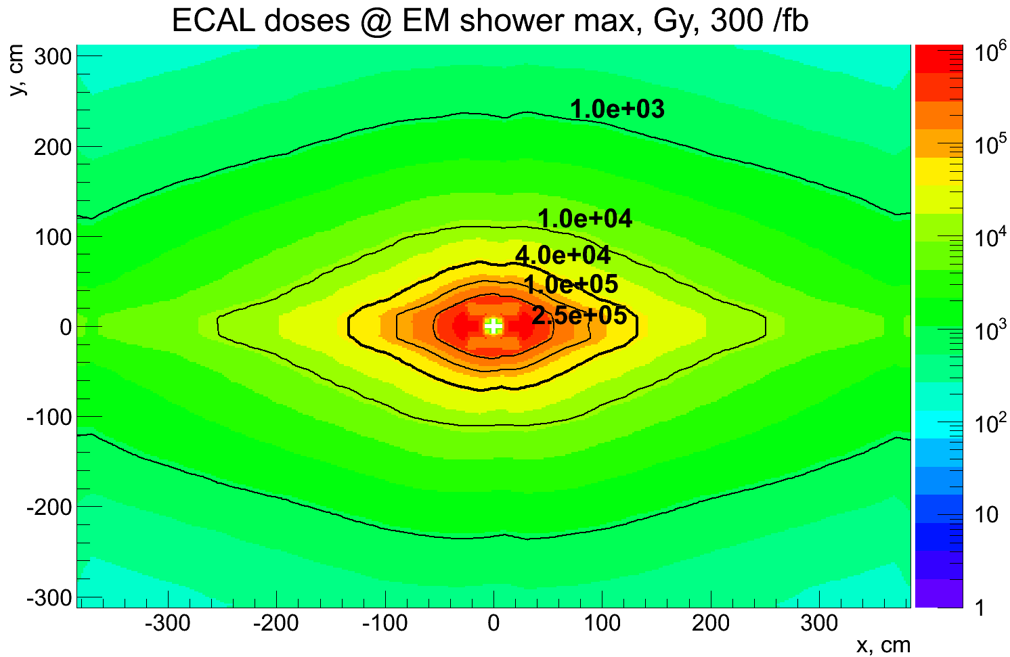
ECAL centre - requirements
Plastic scintillator based Shashlik technology (present ECAL): works till 30-50 kGy.
Periphery: can be shashlik (necessary granularity to be evaluated by MC)
Central cells (150-250 modules):
radiation hard active medium
  inorganic scintillators
radiation hard photo detectors
  cooling ?
small cell size
  4·10³² → 4x4 cm²
  2·10³⁴ → ??? (waiting for MC)
  Molière radius should match (?)
LHCb Preliminary
up to ~1 MGy in the centre (no safety factor) (Matthias Karacson, preliminary).
Neutrons: up to few·10¹⁵/cm² 1 MeV neq
+ need to perform precise timing measurements for EM showers for the whole ECAL surface

Slide 3
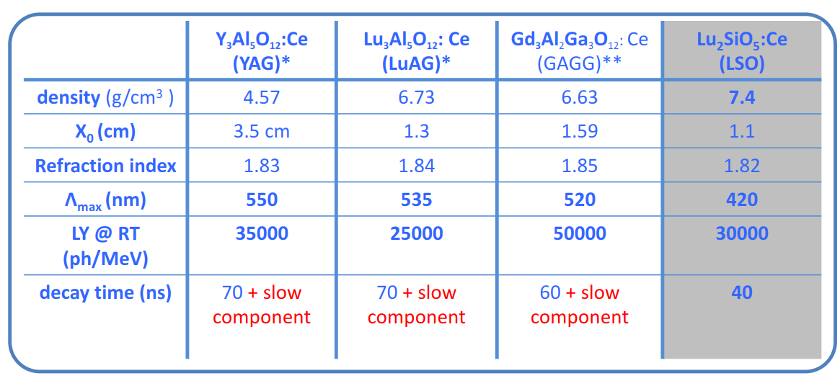
radiation hard crystal scintillators
Crystals with orthosilicate and garnet structure are proven to be radiation hard.
Scintillation: doping with Ce (~1%).
Very fast rise time, relatively slow decay time
E.Auffray, Upgrade Ib/II calorimeter meeting, 23-Feb-2018

Slide 4
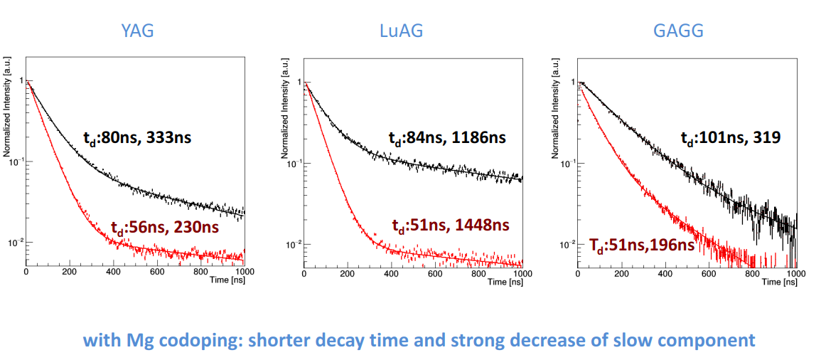
radiation hard crystal scintillators
Codoping: allows to improve the scintillation properties of garnets (decay time).
E.Auffray, Upgrade Ib/II calorimeter meeting, 23-Feb-2018

Slide 5
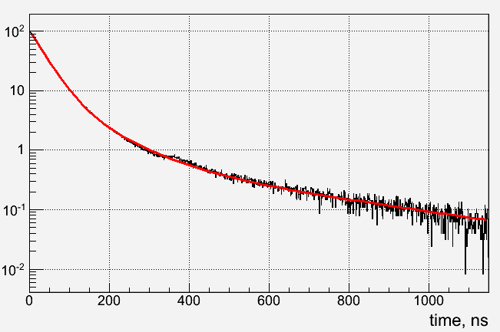
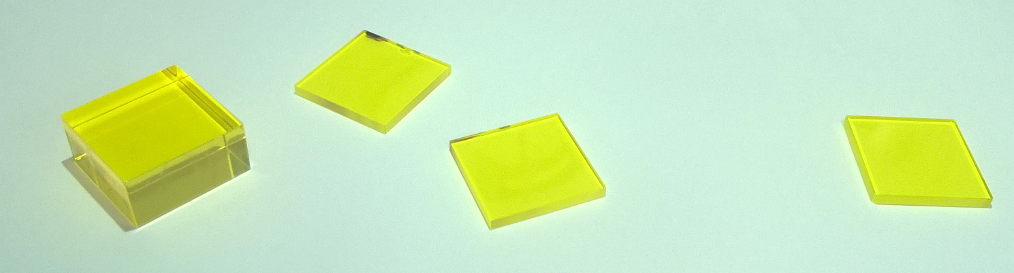
radiation hard crystal scintillators
  One of promising candidates is a multi-doped GAGG:Ce, with Mg and Ti
  4 samples received from FOMOS (Moscow) for our tests
  20x20x10 mm³ – 1 pc
  20x20x2 mm³ – 3 pc
  Irradiation tests were performed at the IRRAD facility @PS CERN
36 ns: 74%
101 ns: 26%
left not
irradiated
irradiated
  Measurements:
  Scintillation signal shape (for non irradiated )
  Transparency before and after irradiation
  γ-spectroscopy (by RP div.)

Slide 6
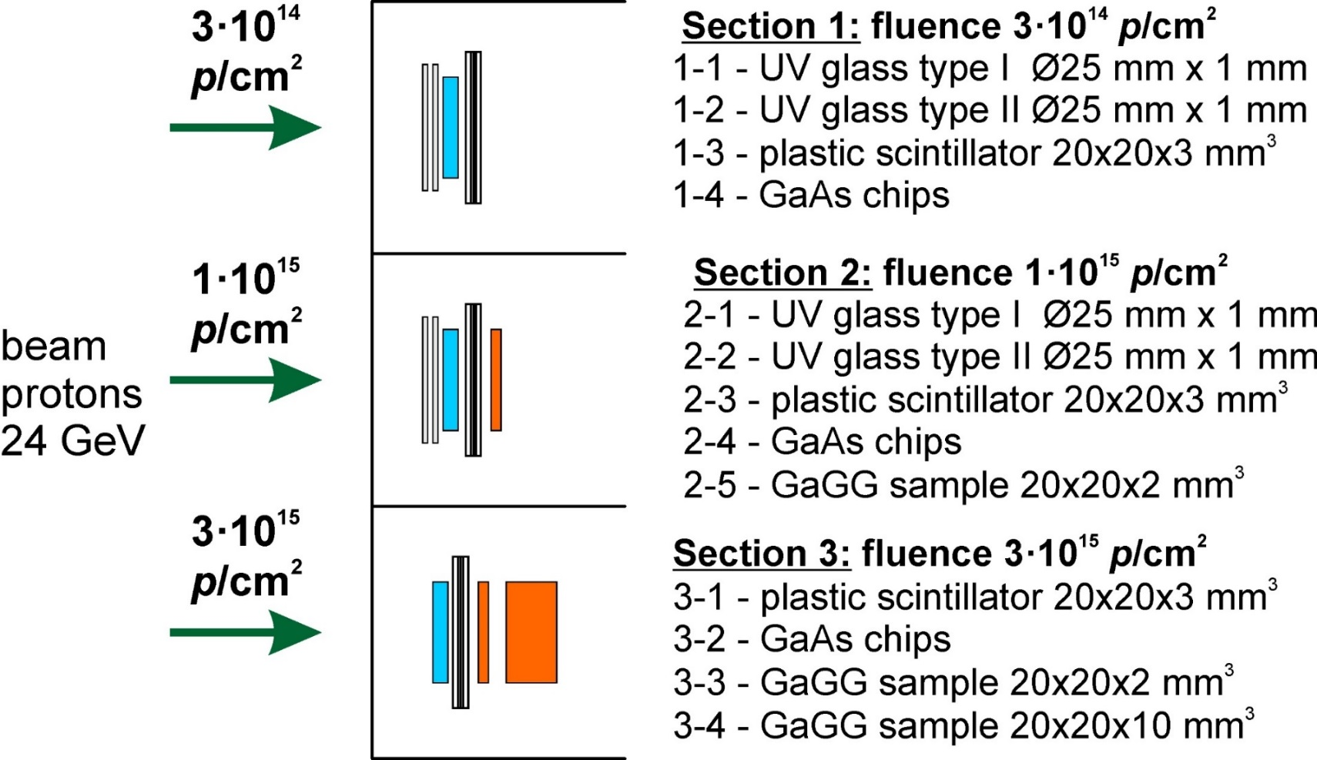
Irradiation at IRRAD @ PS, Nov 17 – Dec 4, 2017
Actual Requested
+ Al foil dosimeters in each section
(Al foils)
4.92∙10¹⁴
1.26∙10¹⁵
37 Mrad
in GAGG
3.08∙10¹⁵
91 Mrad
in GAGG

Slide 7
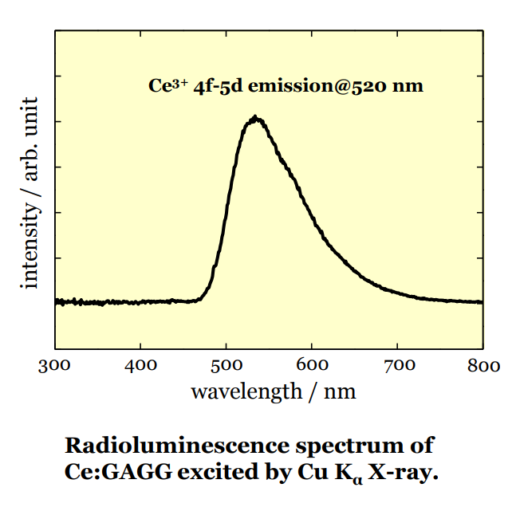
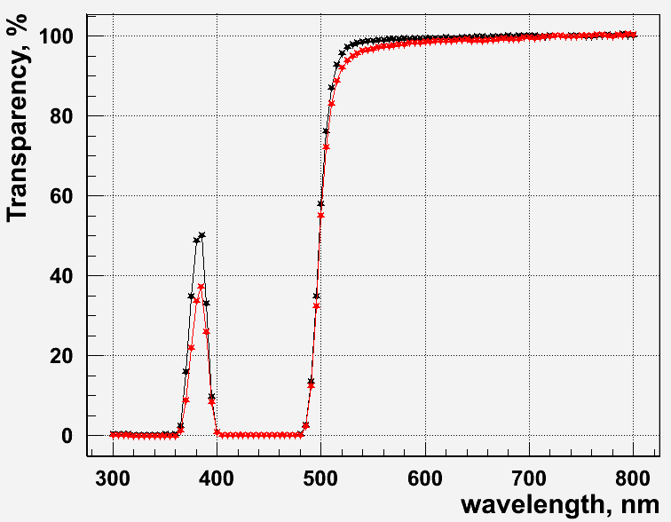
Transparency degradation - I
1 cm thick sample
before irradiation
after irradiation
(3.08∙10¹⁵ p/cm²)
At important
wavelengths:
-3.6% @520nm
-2.5% @540nm
-1.8% @560nm
The transparency degradation @ λ>480 nm measured with the 1 cm sample. For both 2mm thick samples, the degradation cannot be measured reliably.

Slide 8
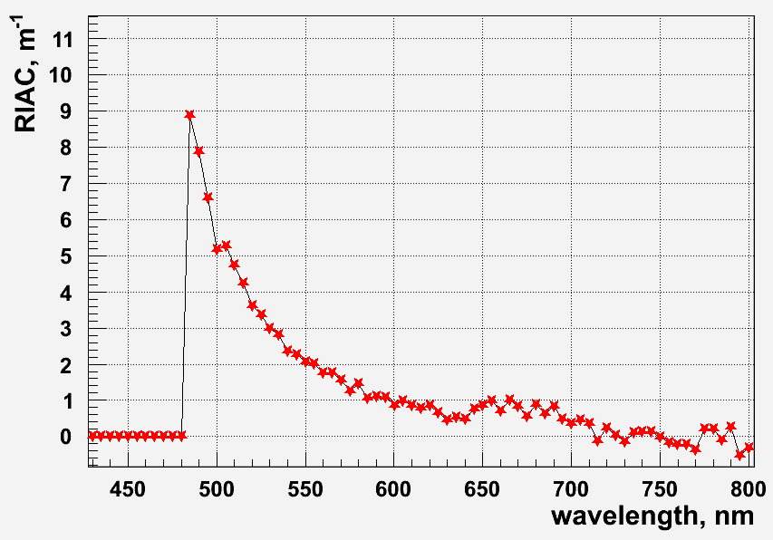
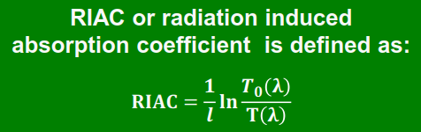
Transparency degradation - II
1 cm thick sample
(3.08∙10¹⁵ p/cm²)
At important
wavelengths:
RIAC=3.6 m⁻¹@520nm
2.5 m⁻¹@540nm
1.8 m⁻¹@560nm
The transparency degradation @ λ>480 nm was measured with the 1 cm thick sample. For both 2mm thick samples, the degradation is not well measurable.
Very good result compared to other inorganic scintillators!
    Do we need separate run of neutron irradiation?

Slide 9
Induced activity
  γ-spectroscopy by RP division (N. Riggaz) (data for the 20x20x10 mm³ shown).
Radio luminescence
Isotopes | (Bq /Unit)
Be-7 | 7.23E+05
Na-22 | 1.96E+04
Sc-46 | 7.52E+04
V-48 | 4.39E+04
Cr-51 | 1.63E+05
Mn-54 | 4.95E+04
Co-56 | 3.54E+04
Co-57 | 5.54E+04
Co-58 | 1.85E+05
Fe-59 | 3.31E+04
Co-60 | 8.51E+03
Zn-65 | 1.88E+05
Zn-72 | 1.55E+04
Isotopes | (Bq /Unit)
As-74 | 1.14E+04
Se-75 | 3.13E+04
Rb-83 | 6.43E+04
Rb-84 | 1.73E+04
Sr-85 | 6.84E+04
Y-88 | 3.20E+04
Zr-88 | 8.59E+04
Ag-105 | 7.93E+04
Sn-113 | 1.35E+05
Te-121 | 9.49E+04
Xe-127 | 1.89E+05
Ba-131 | 5.64E+04
Ce-139 | 1.97E+05
Isotopes | (Bq /Unit)
Pm-143 | 1.04E+05
Pm-144 | 2.50E+04
Eu-146 | 6.96E+04
Gd-146 | 6.89E+04
Eu-147 | 2.81E+05
Eu-148 | 2.34E+05
Pm-148m | 3.54E+04
Eu-149 | 4.08E+05
Gd-149 | 2.85E+04
Gd-151 | 2.75E+05
Gd-153 | 2.58E+05
Eu-156 | 1.13E+05
Activation level after the irradiation to these doses (370 & 910 kGy) is quite high (see ←).
Radio luminescence in irradiated scintillator occurs as scintillations caused by the decays of the generated isotopes.
the signal/noise ratio depends on particular calorimeter design and data taking profile
first rough estimations: the ratio of MIP signal to radio luminescence noise is >~ 1000 in 25 - 100 ns gate
the work on Fluka simulation is ongoing
  Decent agreement with Fluka (M. Korzhik et al).

Slide 10
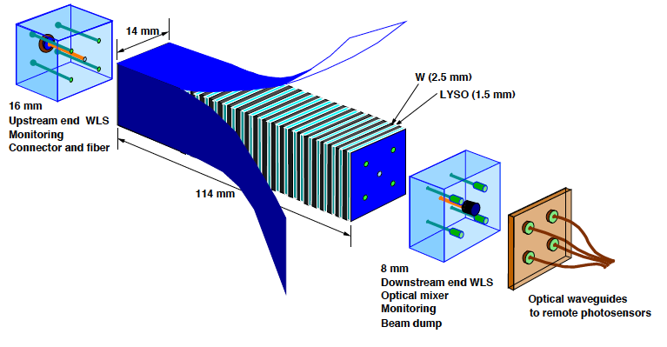
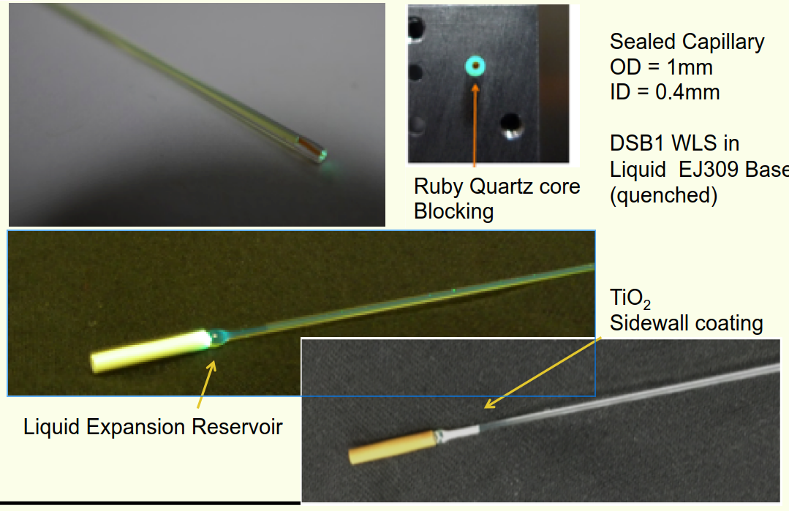
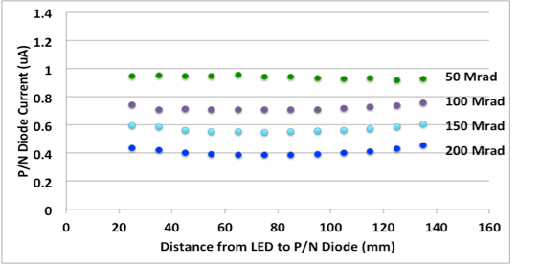
possible ECAL technologies - I
PoS(ICHEP2016)239
Shashlik
Originally consists of LYSO and W
layers and WLS filled capillaries.
Other crystals can be used, WLS should match
R. Ruchti, CPAD2016, Caltech, 2016
The light yield is moderate because of WLS
Pros:
good radiation hardness (small light path in crystal)
low Molière radius achievable (13 mm @GAAG:W=1:1)
reasonable resolution
Cons:
complexity of production

Slide 11
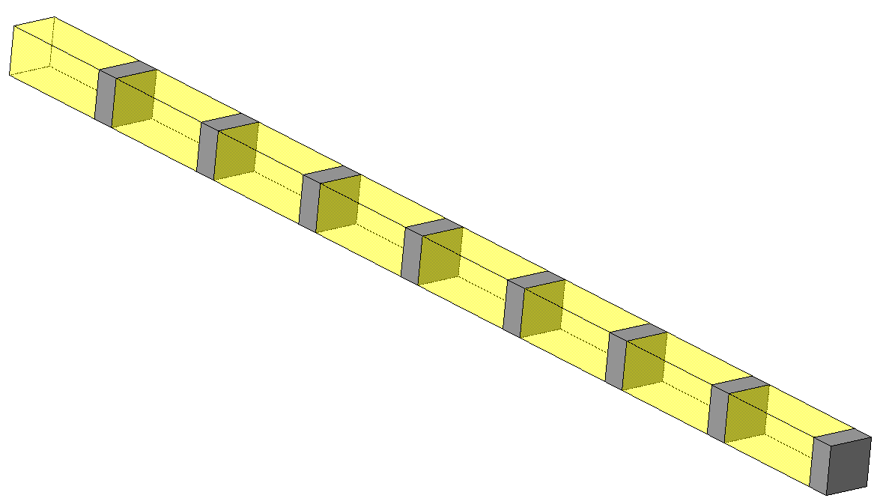
possible ECAL technologies
Homogeneous calorimeter
With longitudinal segmentation as an option.
beam
Fixed Molière radius (e.g., 20 mm for GAGG)
  but performance benefits from longitudinal segmentation
with longitudinal segmentation:
  either need photo detectors which are rad hard at room temperature
    GaAs photo diodes may be a good candidate, studies are ongoing
  or cool down the whole detector
scintillator
Photo detectors
Pros:
perfect if all components are available
timing measurement at ~ shower max – insensitive to shower longitudinal fluctuations
radiation hardness improves with increasing longitudinal segmentation
Cons:
may need cooling of the whole detector -> not easy to integrate into the ECAL centre

Slide 12
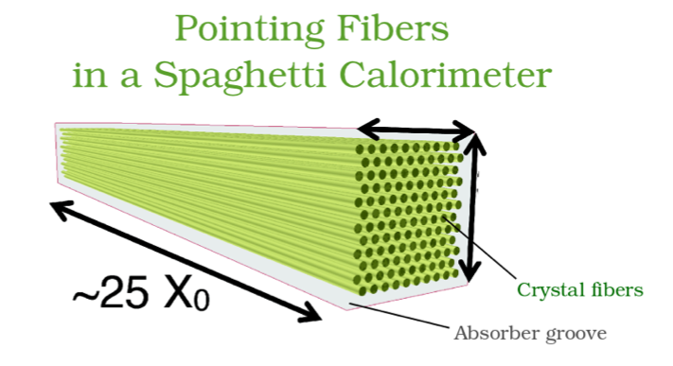
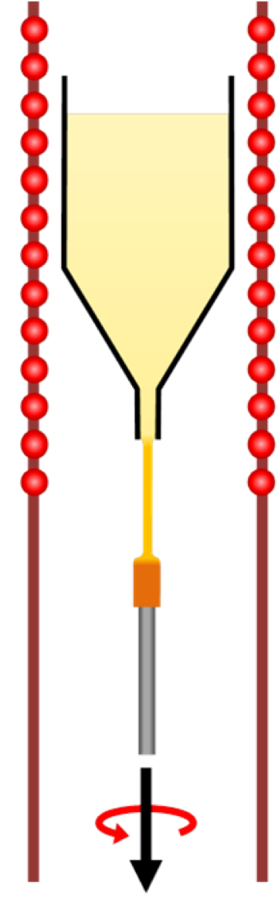
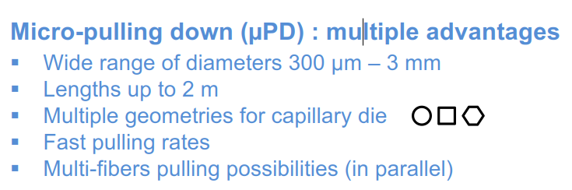
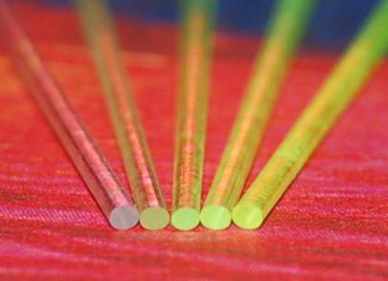
possible ECAL technologies
Crystal Spacal
can be cheaper than other designs
smaller Molière radius possible
but: radiation tolerance can be worse
(long light path)
can be mitigated by double side readout
E.Auffray, Upgrade Ib/II calorimeter meeting, 23-Feb-2018

Slide 13
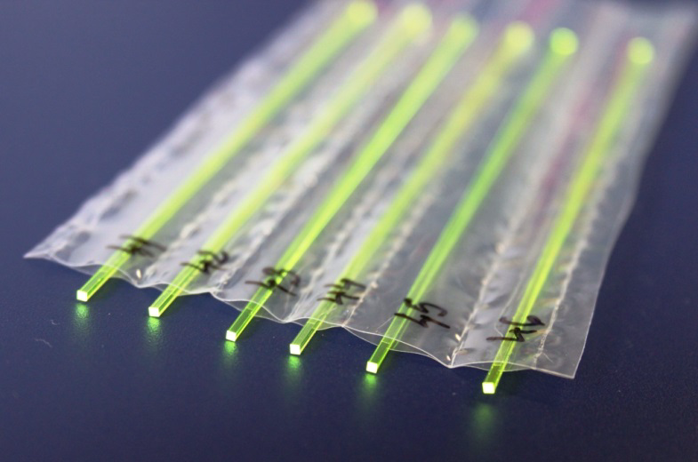
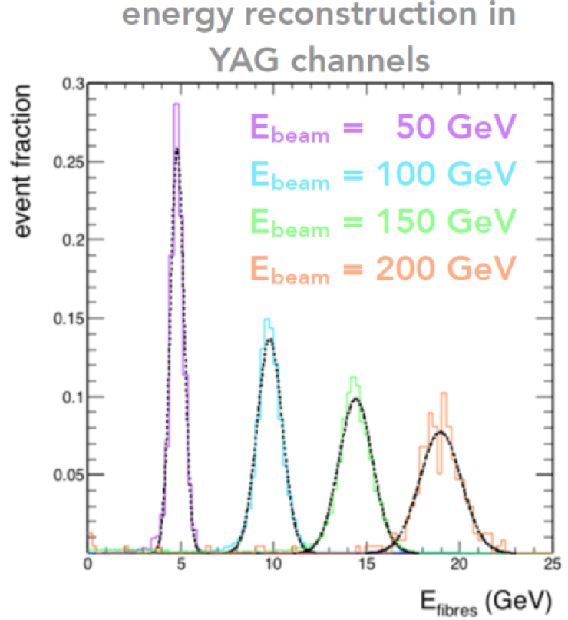
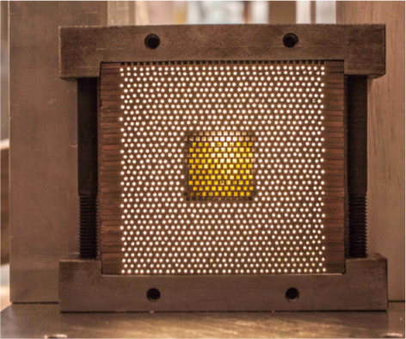
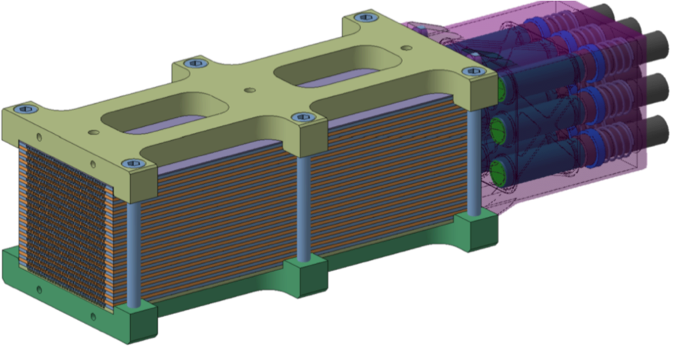
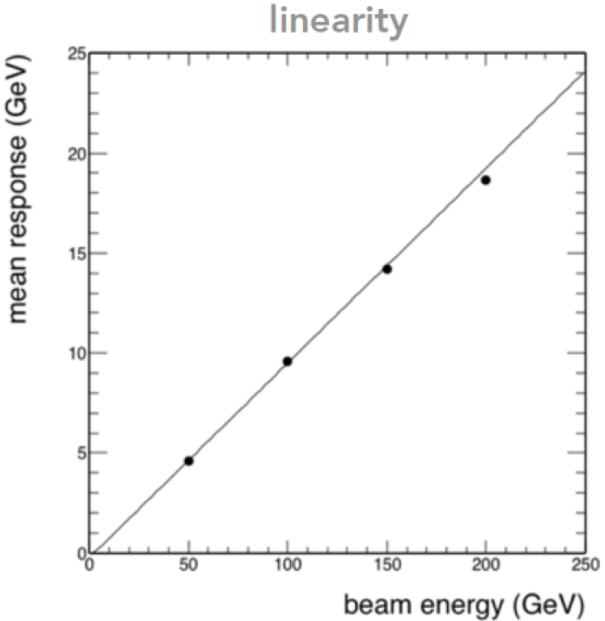
possible ECAL technologies
Crystal Spacal
YAG:Ce square fibers
in a 0,75W/0.25Cu Absorber
60*60*200mm3, ~ 1200 holes
Equivalent of 3*3 PWO crystals
N. Siegrist, H. Gerwig, CERN
E.Auffray, Upgrade Ib/II calorimeter meeting, 23-Feb-2018

Slide 14
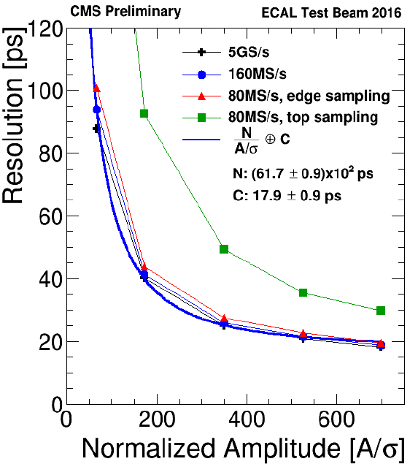
Time measurements
Two options:
either build a dedicated timing layer
  either separate detector (preshower)
  or silicon layers embedded into the ECAL structure
or perform the timing measurements with ECAL itself if possible
CMS PbWO₄ ECAL module has
demonstrated very good time resolution
(~20 ps) at the test beam
To be checked with Shashlik (asap) and Crystal modules (when prototype is available).
Need electronics with sampling rate >100 MS/s at least
For good time resolution, it may require to use semiconductor photo detectors, no PMTs

Slide 15
Conclusions
  The central part of ECAL can be done on the basis of crystal scintillators; plastic scintillator based Shashlik (present design) at the periphery
  There are several technologies and several rad hard crystal scintillators which can be used for the central part.
  Samples of GAGG:Ce (Mg, Ti) scintillator were received and tested
    very promising results!
  next steps:
    work on technology choice and prototype design for the central module (GAGG)
      do we need neutron irradiation of GAGG?
    timing measurements with Shashlik (and new prototypes)

Slide 16
Acknowledgements
  We are greatly indebted to:
  the IRRAD team – for all the work of irradiation and dosimetry;
  Nicolas Riggaz (RP) – for gamma spectroscopy of the samples
  Sasha Singovsky (CMS) – for the great help in the measurements
  Yuri Musienko (CMS), Matthias Karacson (LHCb) – for many fruitful discussions.

