Slide 1
JINR – Sigmaphi collaboration Performance through turnkey systems JINR day in France Jean Luc Lancelot

Slide 2
Sigmaphi presentation
4 examples of contracts with JINR
Conclusions

Slide 3
Equipments for particle accelerators

Slide 4
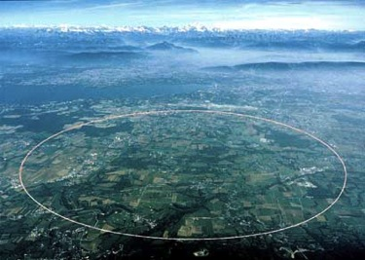
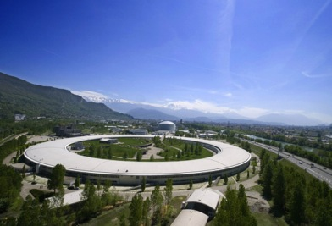
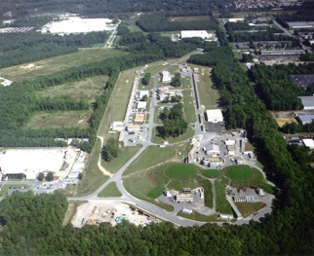
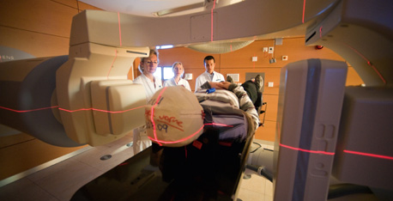
2 main sectors
Physics research labs
CERN-LHC ESRF Jefferson Lab
Hadrontherapy centers manufacturers

Slide 5
Sigmaphi Magnets, Brittany
Sigmaphi Electronics, Alsace
Sigmaphi China
Sigmaphi Japan
30 M€, 90% export, 180 people

Slide 6
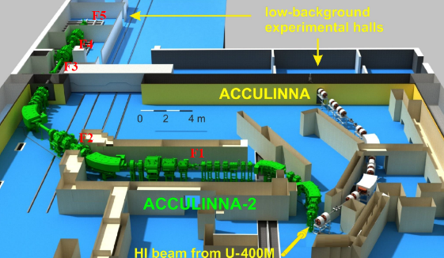
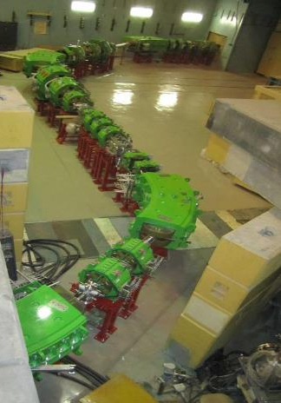
Acculina 2 beamline
70m long heavy ion beamline – optical review, magnets, power supplies, vacuum, installation and alignment

Slide 7
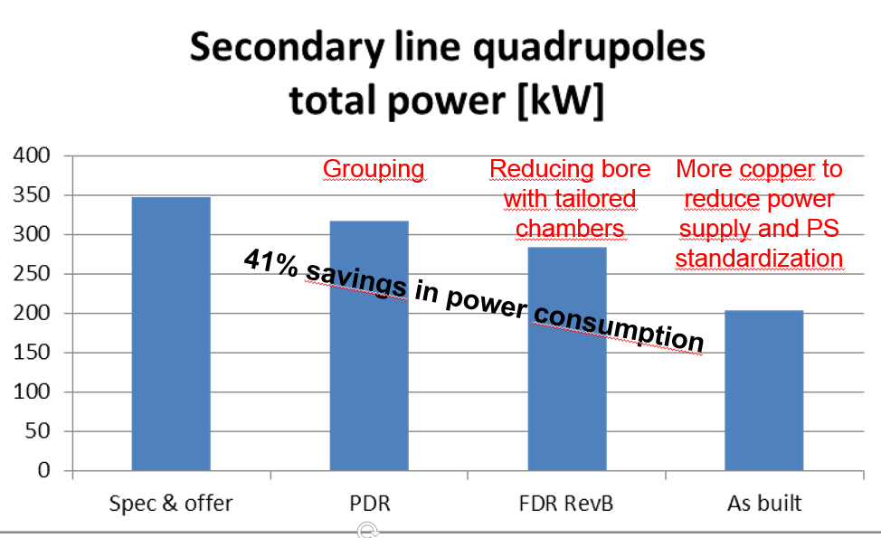
Leaving room is essential to optimization

Slide 8
Gas filled separator
Magnets, power supplies, differential vacuum beam dump, installation
Delivered early 2018

Slide 9
Nica Nuclotron to Collider beamline
330m beamline, magnets, power supply, vacuum, diagnostics, control command, installation – Project started 2017, delivery 2019

Slide 10
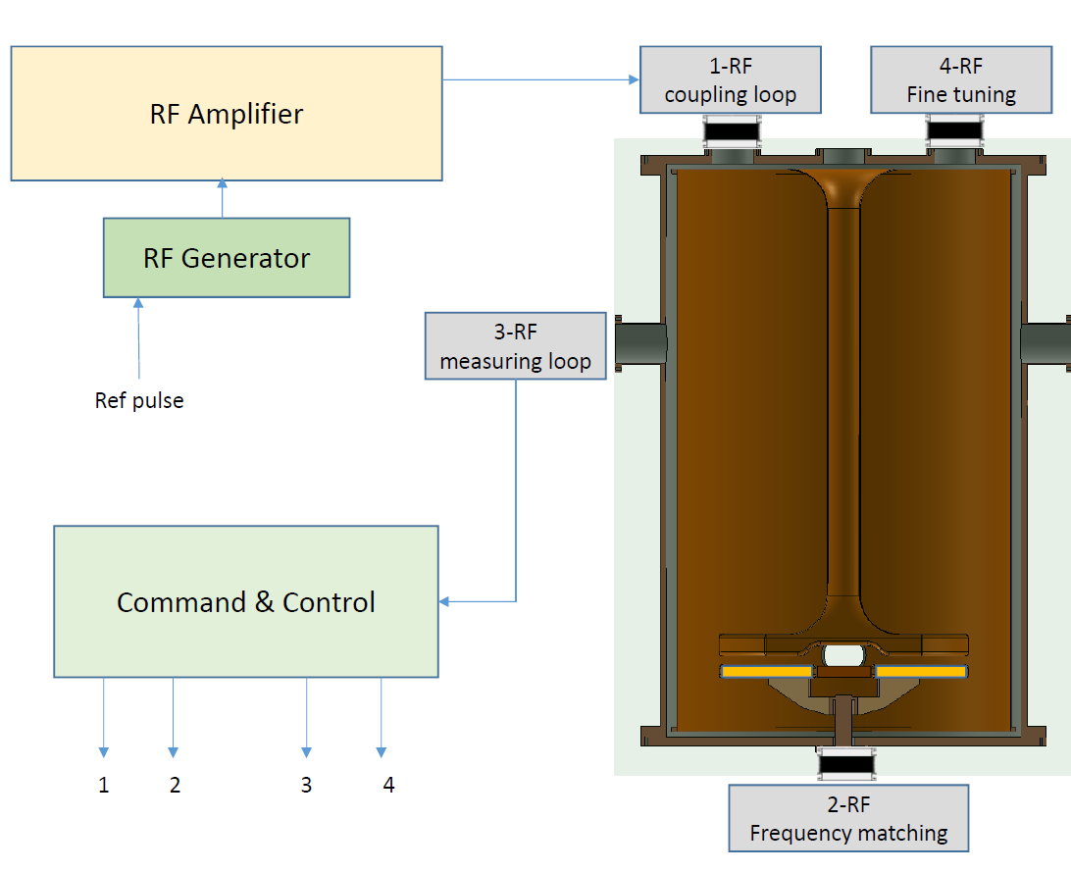
RF Kicker
Time of flight based deflector
14,5 – 20 MHz, 70 mm gap700 mm 120 mm wide long electrodes Contract signed Jan 2017, delivery December 2018

Slide 11
Comments
JINR is our biggest customer for turnkey systems
Quality of technical exchanges is really top level, common goals, going to the essential, letting as much room to manoeuvre as possible
Quality of human relationship is excellent
Administration is very efficient and reactive
This is key to smooth contracts, optimized and performing systems
One only problem: some french banks

