Slide 1
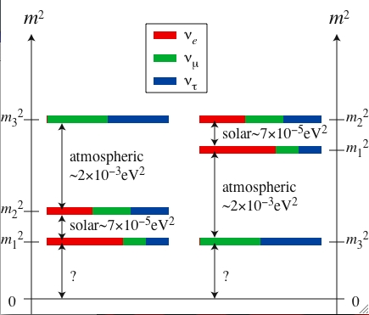
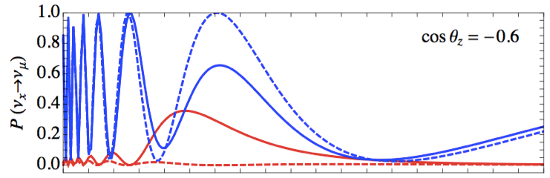
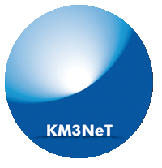
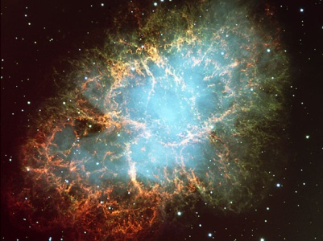
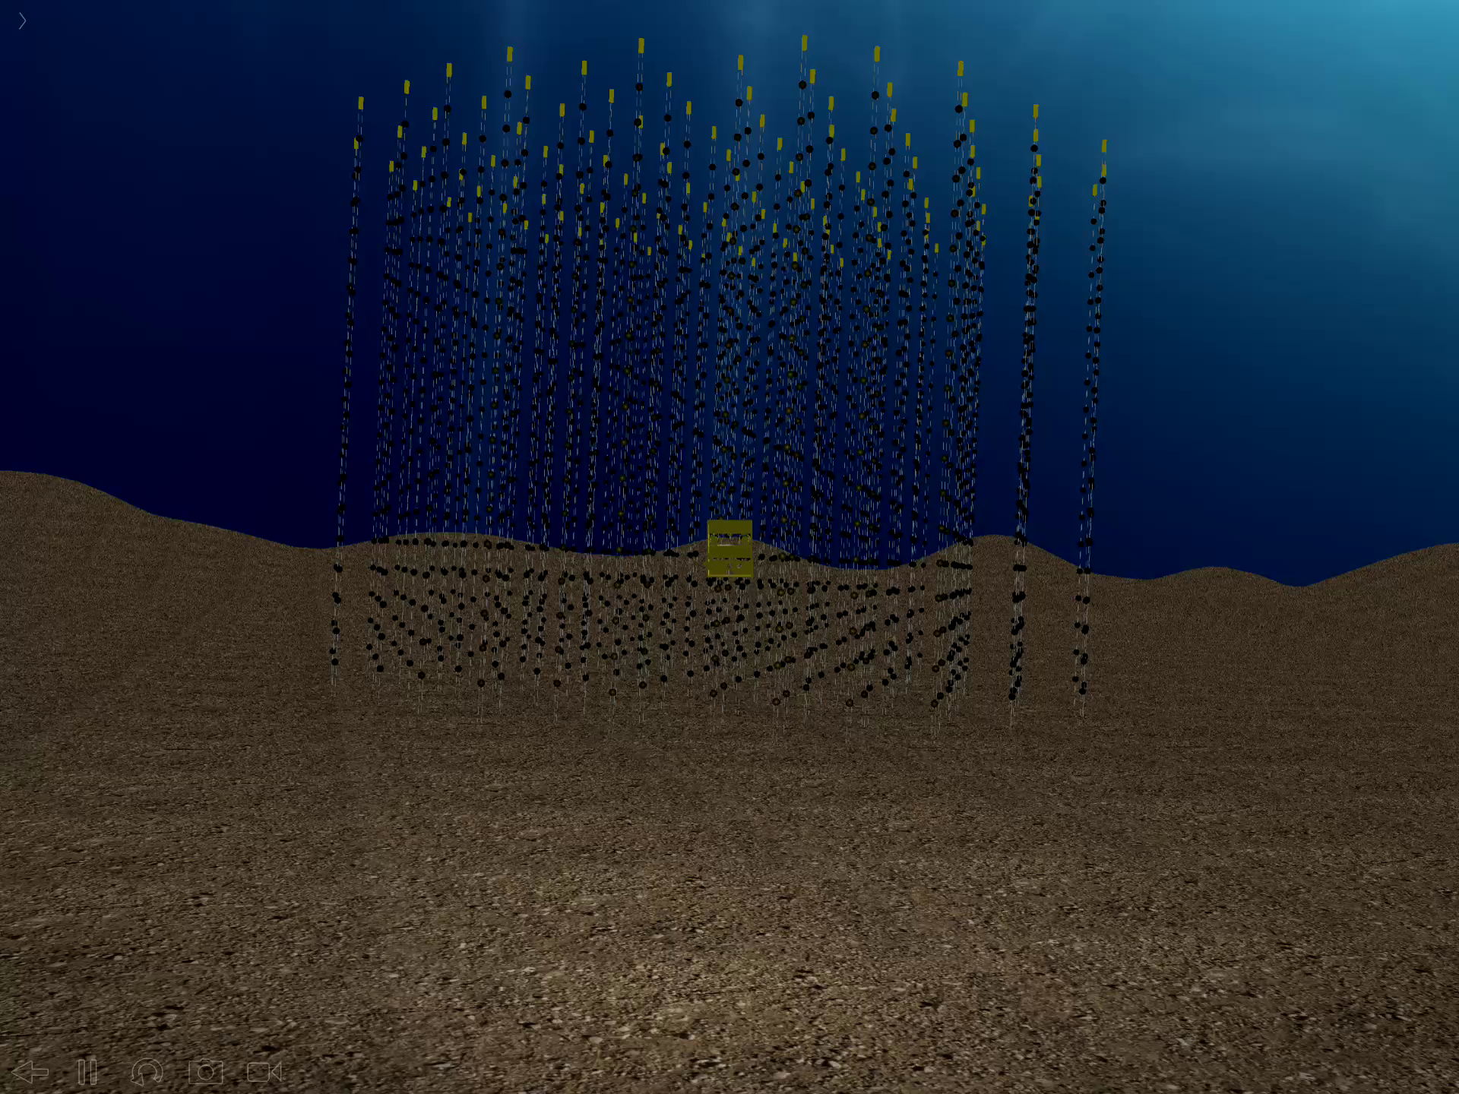
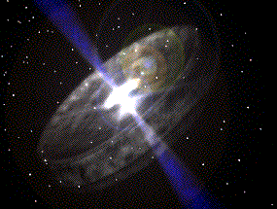
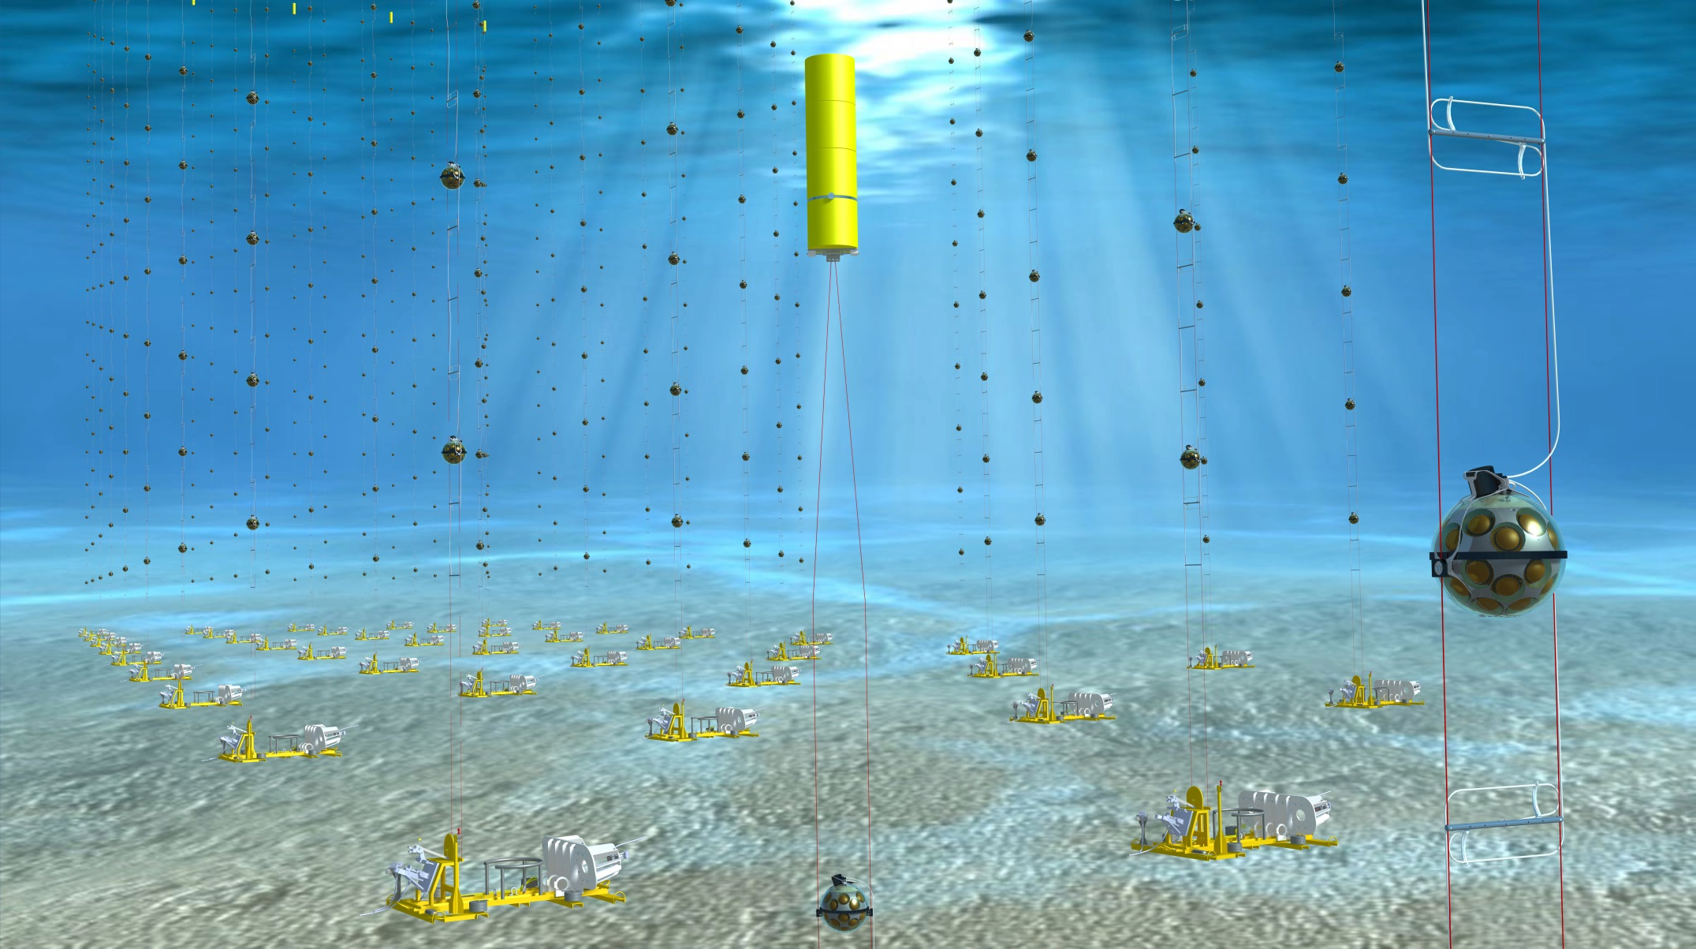

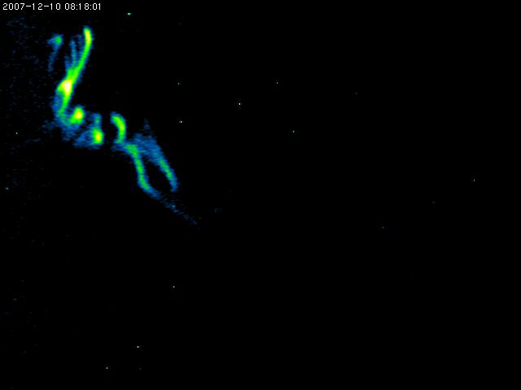
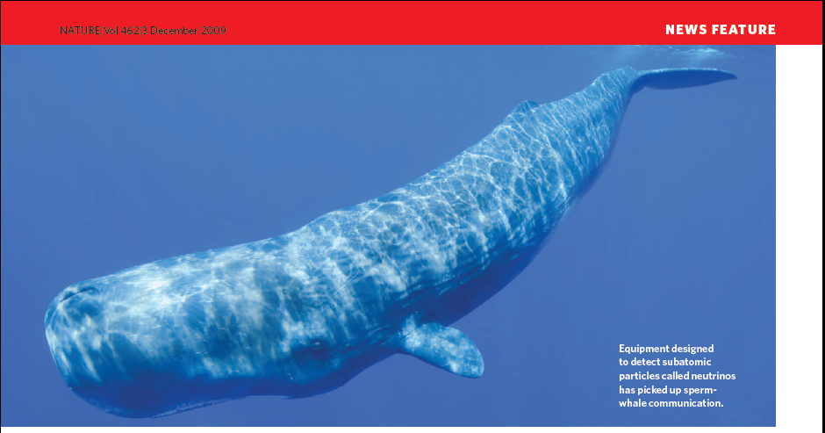
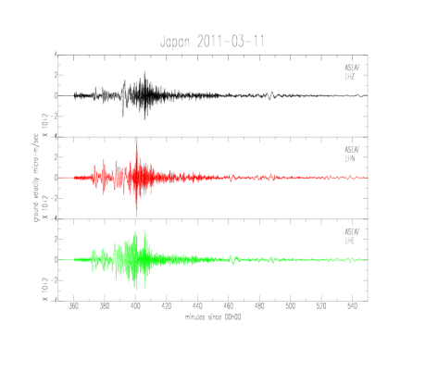
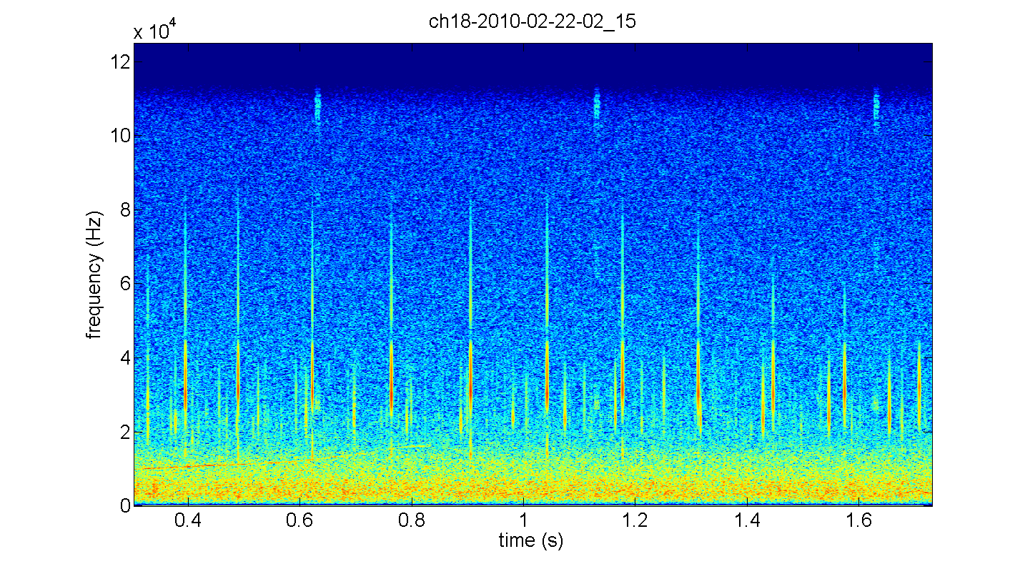
0.5
KM3NeT/ORCA:
Oscillation Research in the Abyss
JINR Day
15/2/18
Paschal Coyle
Centre de Physique des
Particules de Marseille

Slide 2




Large Volume Neutrino Telescopes
ANTARES & KM3NeT
BAIKAL GVD
IceCube

Slide 3
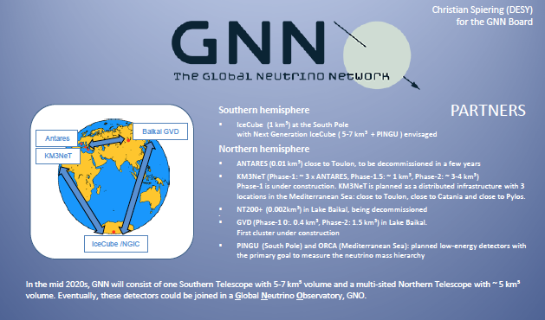
BAIKAL
“Eventually, these detectors could be in a Global Neutrino Observatory, GNO”

Slide 4
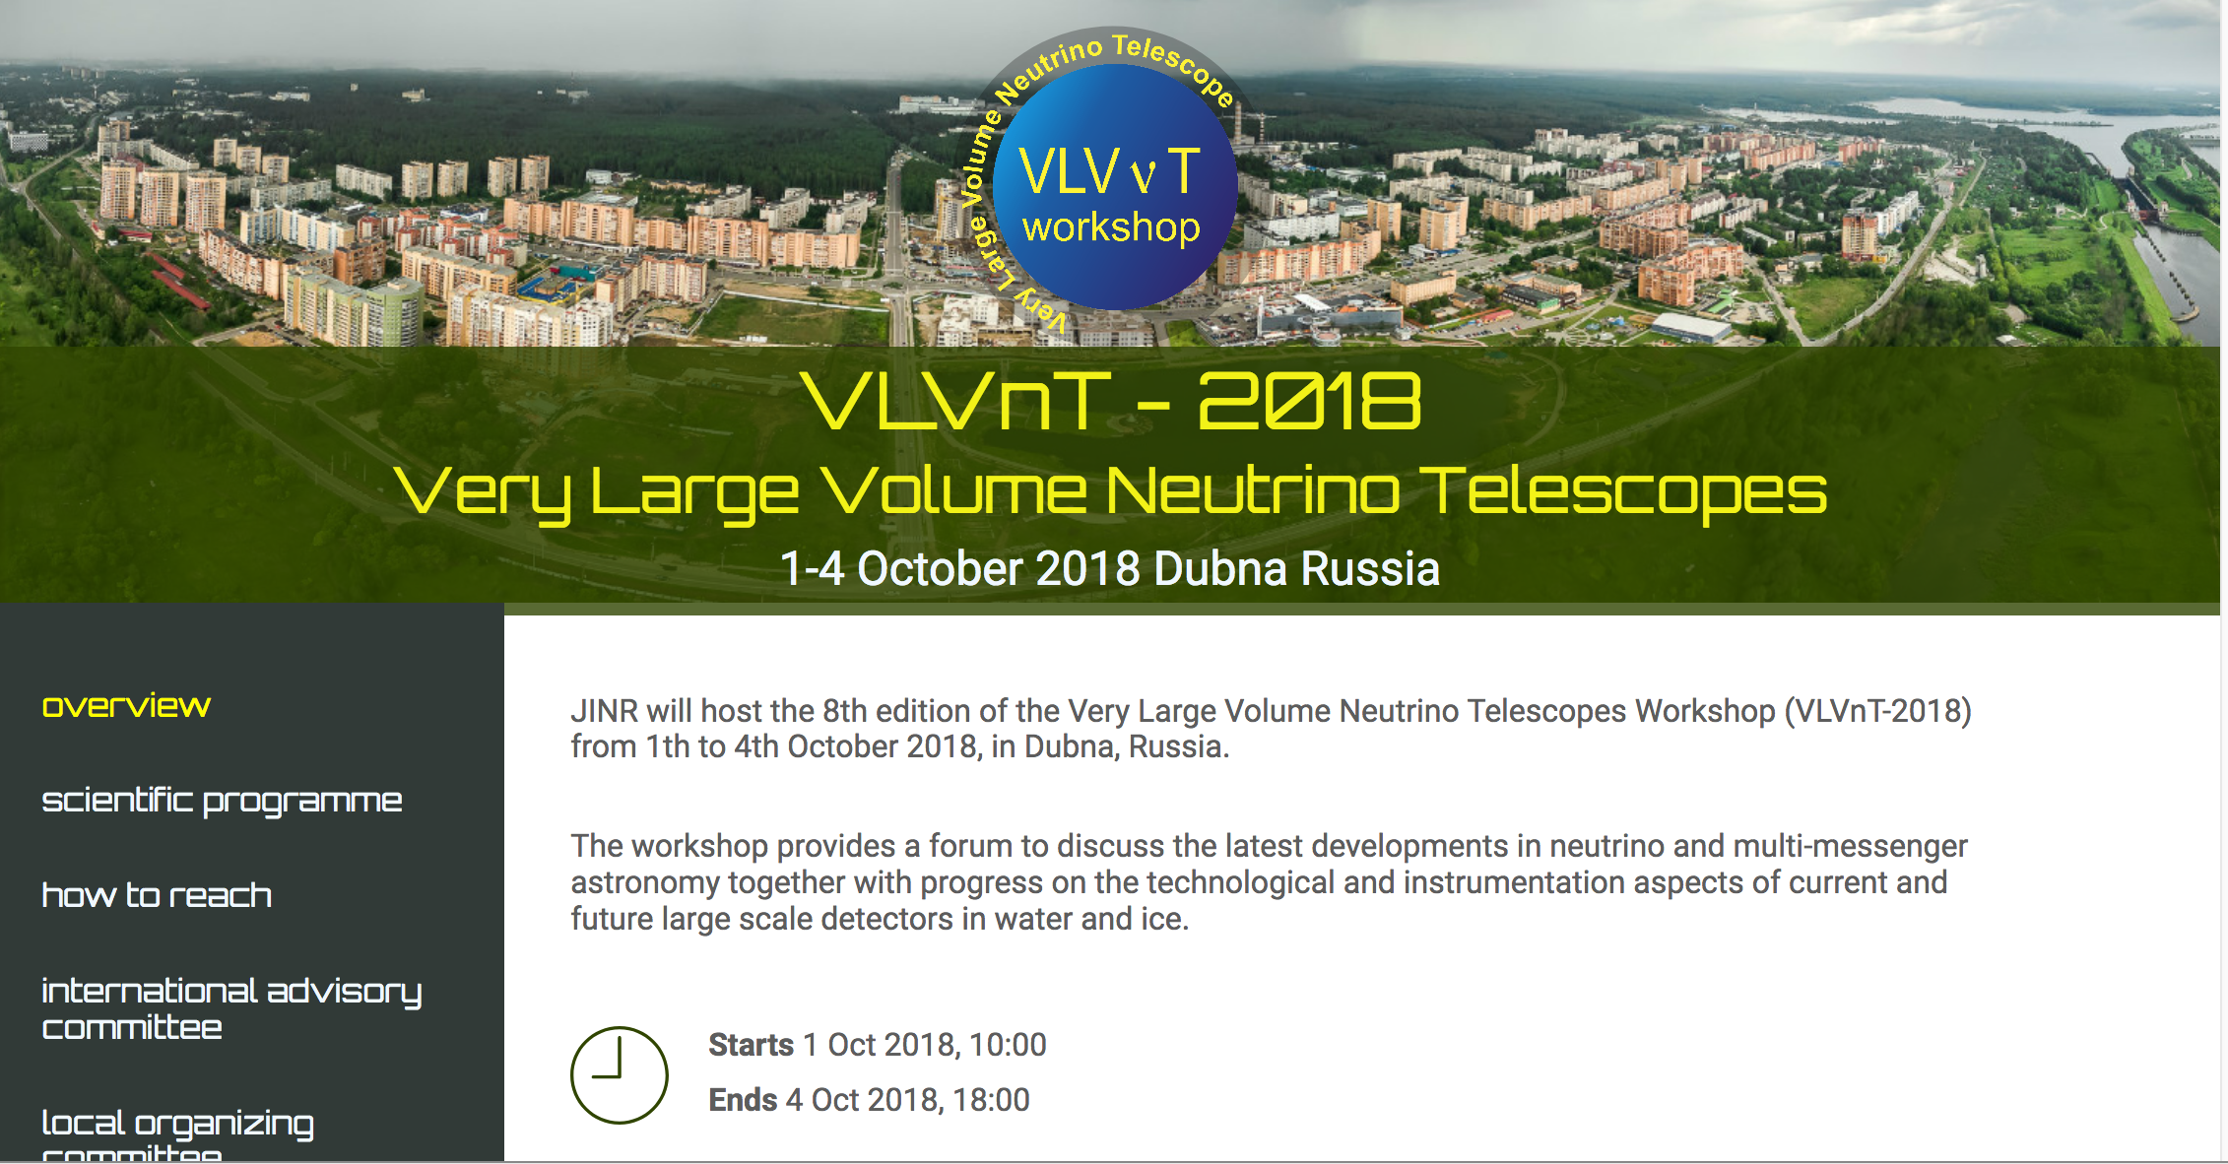


Slide 5
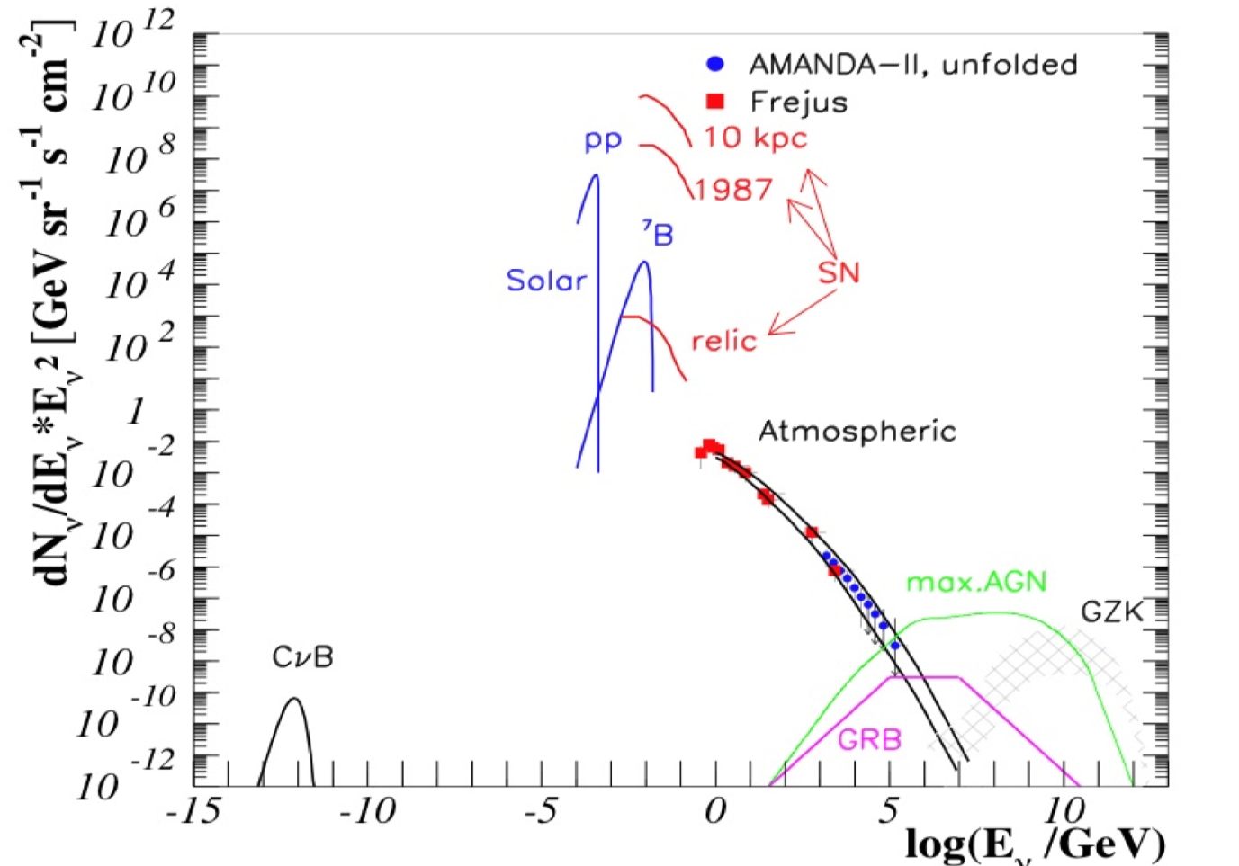
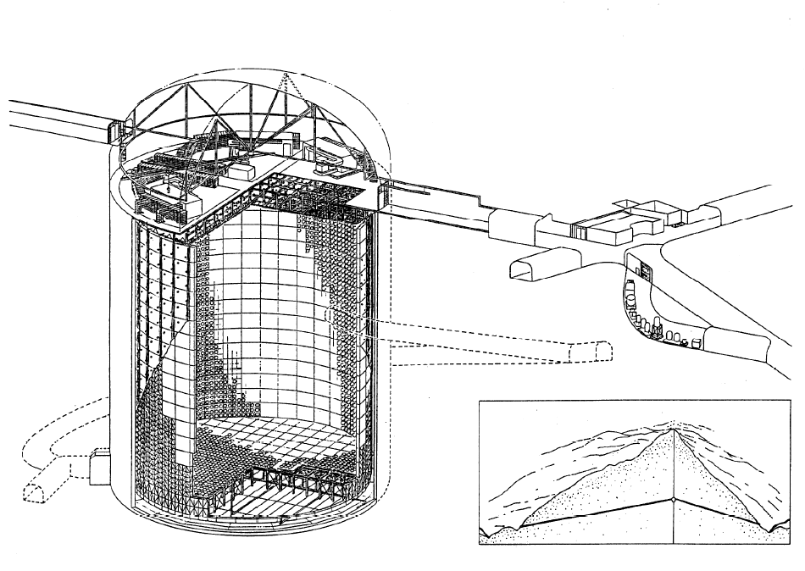
Neutrino Fluxes: MeV to PeV
High energy neutrinos:
Small cross-sections
Need large detectors
for wide energy range
ARCA
^{BAIKAL}
41 m
ORCA
ANTARES
SuperK

Slide 6

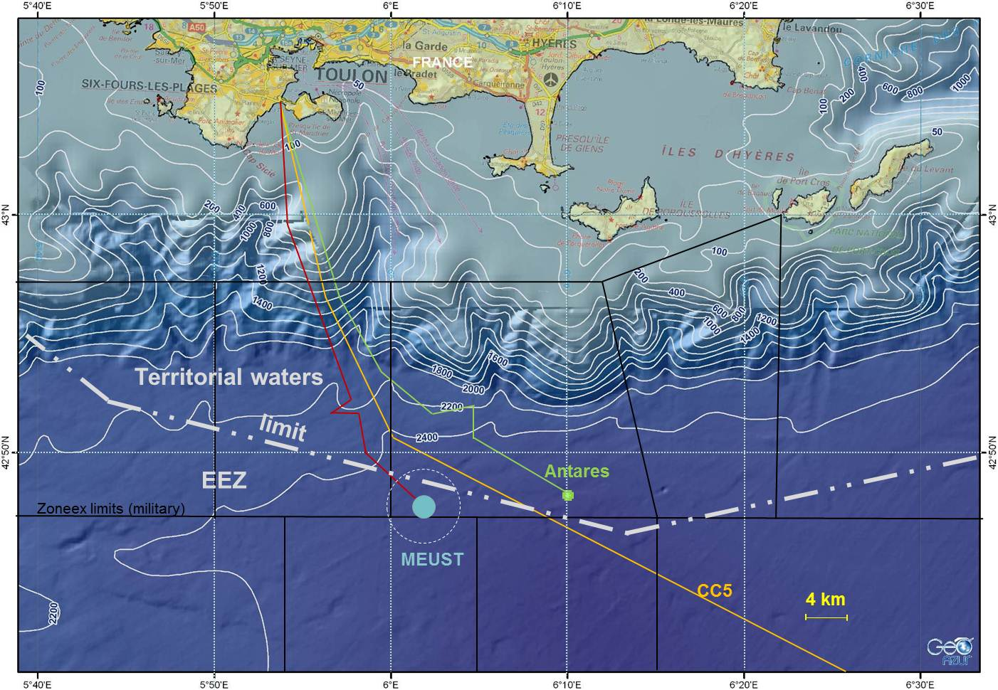
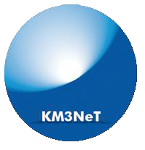
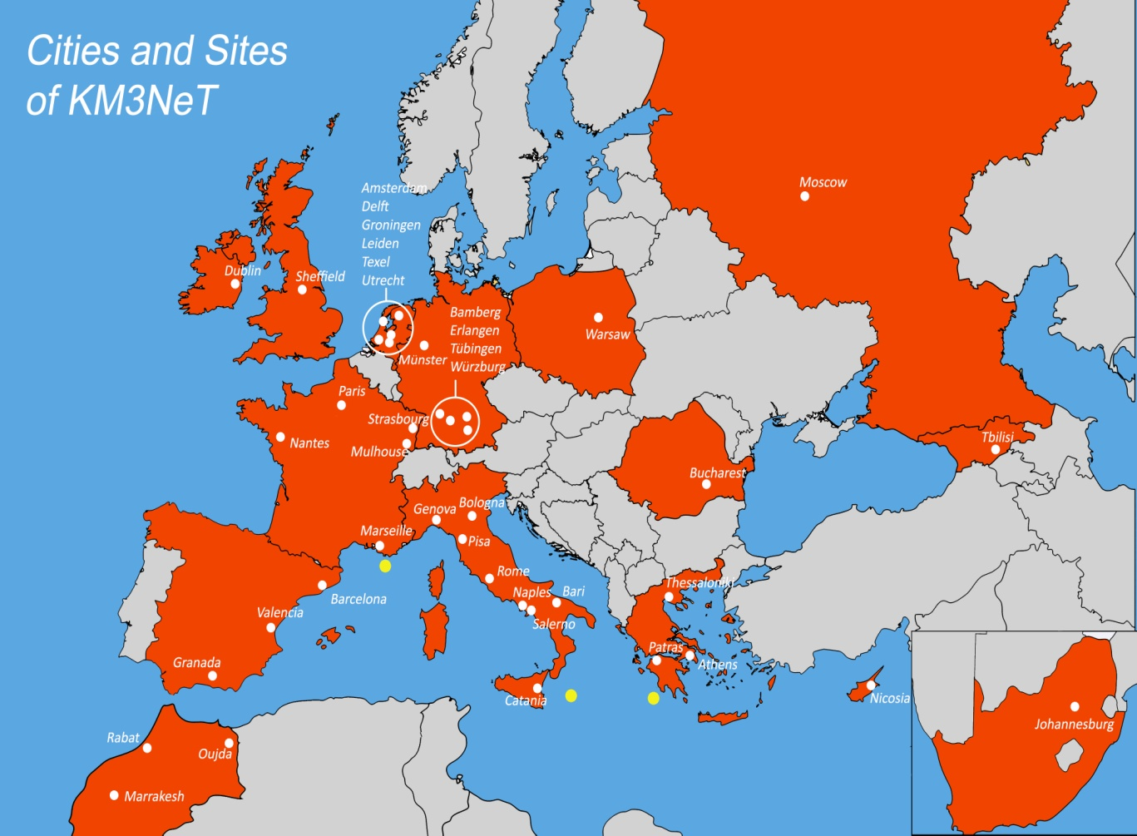
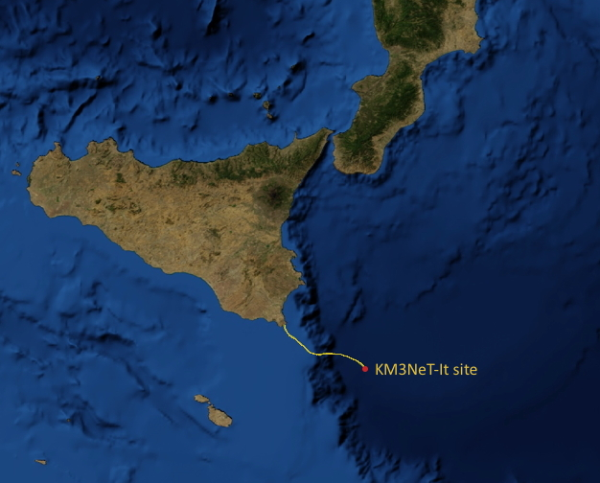

KM3NeT
Multi-site, deep-sea infrastructure
Selected by ESFRI roadmap
Single collaboration, Single technology
ORCA
>240 people
55 institutes / 41 cities
15 countries
2475m
Oscillation Research
with Cosmics In the Abyss
3500m
ARCA
Astroparticle Research
with Cosmics In the Abyss
Bari
Naples

Slide 7

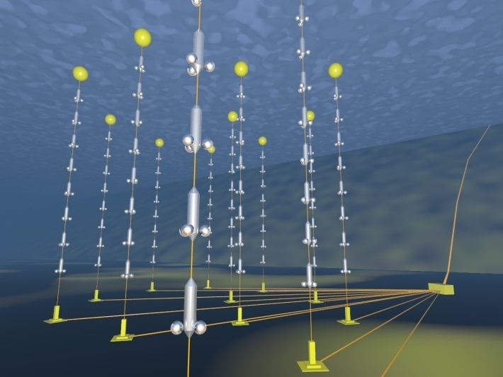

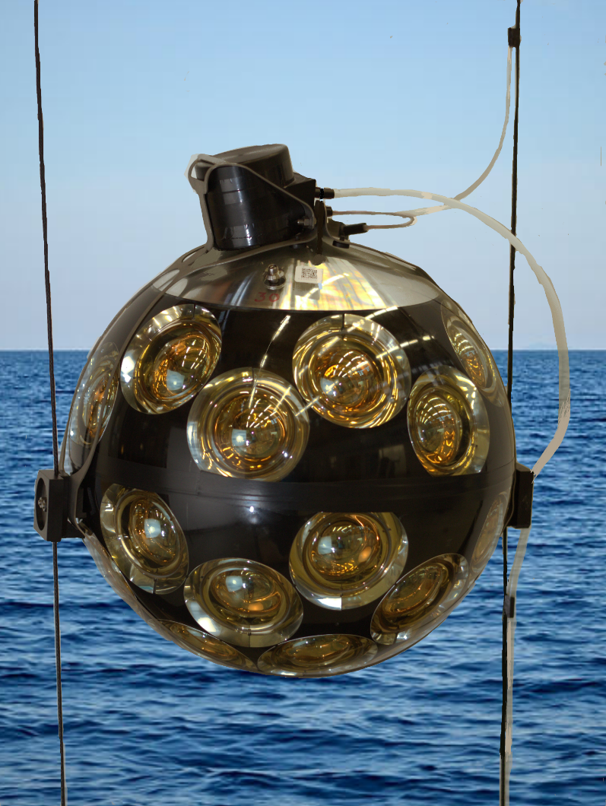
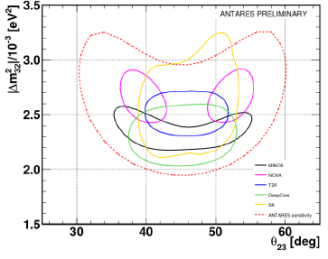
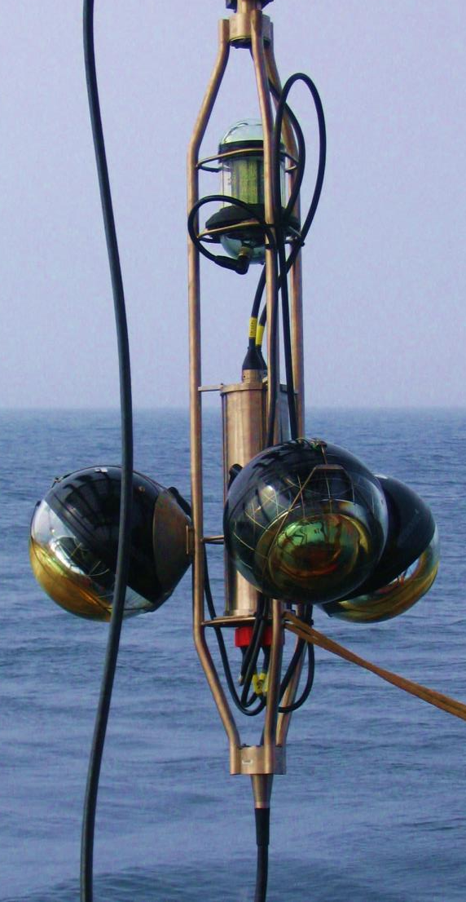
ANTARES -> KM3NeT 2.0
12 lines, 900 OMs
3 Building Blocks (3*115 lines, ~3*2000 OMs)
31 x 3” PMTs
Uniform angular coverage
Directional information
Digital photon counting
Reduced ageing

Slide 8
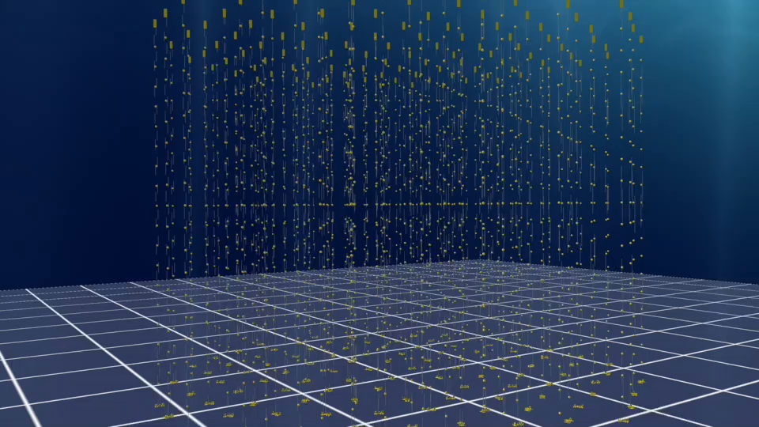
Principle of Detection

Slide 9
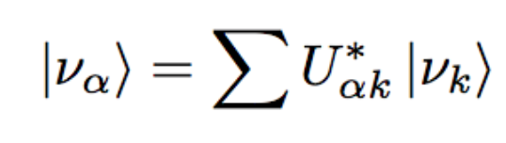
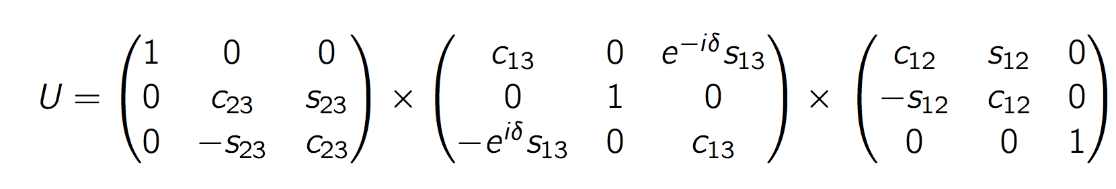
Neutrinos
Neutrino oscillations
Flavour states
Mass states
PMNS Matrix
Atmospheric
Accelerator
Reactor
Accelerator
Solar
Reactor
Neutrino mass hierarchy?
Octant of sin θ₂₃?
CP violation?
Majorana/Dirac?
Absolute masses?
Normal Inverted

Slide 10

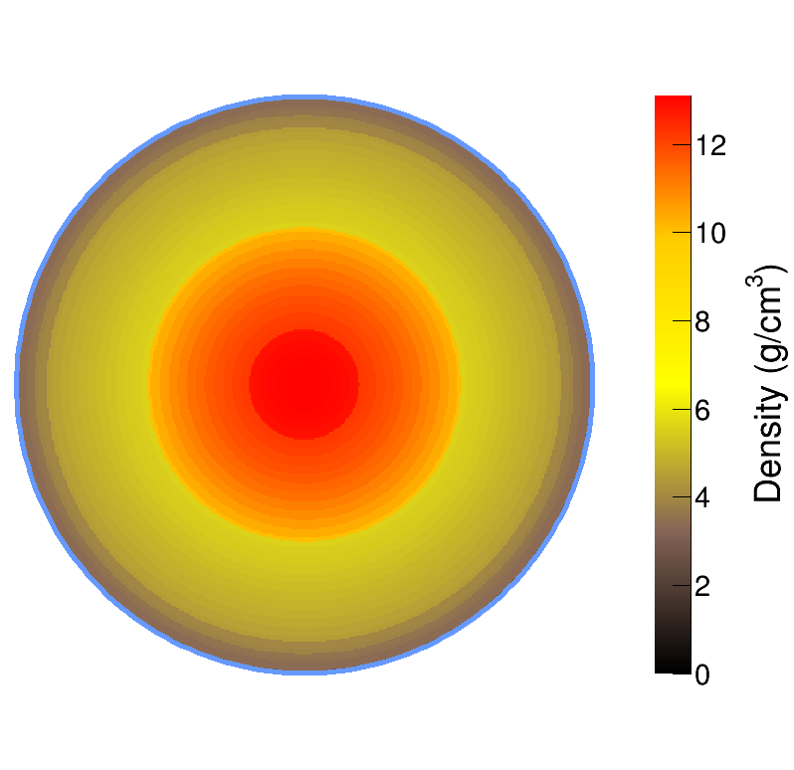
Mass Hierarchy with Atmospheric Neutrinos
A ¨free beam¨ of known composition (ν_{e}, ν_{μ})
A ¨free cavern¨ of known/uniform composition
Wide range of baselines and energies
P(νμ → νμ) for θ=130º
Oscillation pattern distorted by
matter effects in core and mantle
Maximum difference IH  NH for resonance in Earth mantle:
θ=130° (7645 km) and E_{ν} = 7 GeV
1
IH
NH
0.5
νμ
νe
0
1
5
10
Eν [GeV]

Slide 11
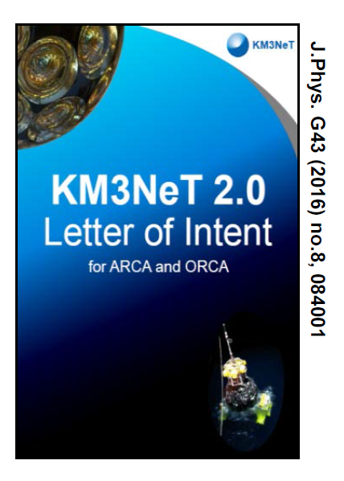
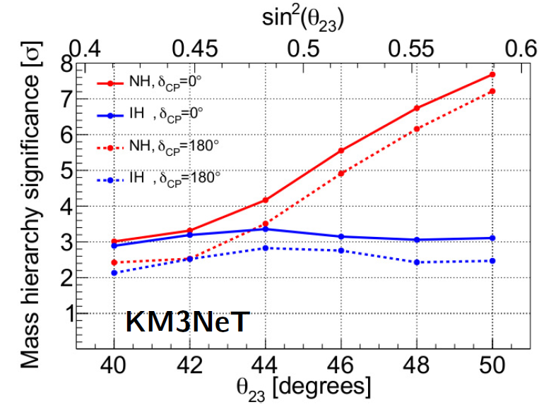
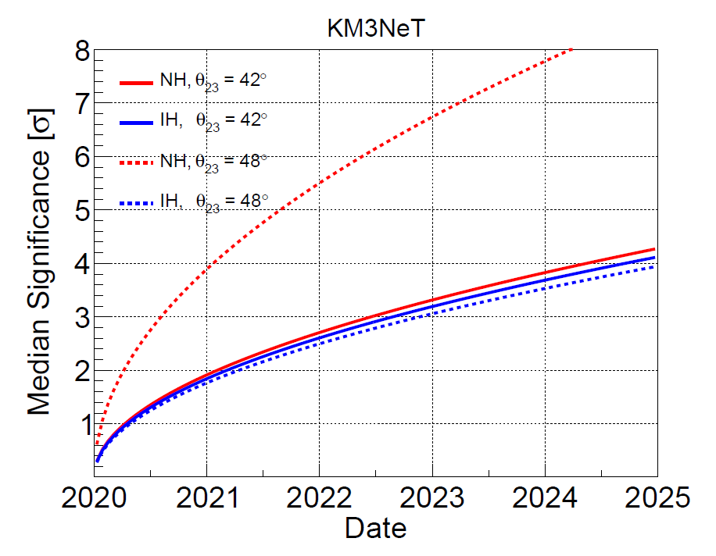
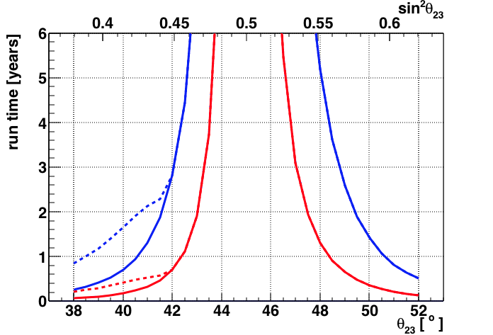
LOI: ORCA Oscillations and NMH
KM3NeT 2.0: Letter of Intent
http://dx.doi.org/10.1088/0954-3899/43/8/084001
J. Phys. G: Nucl. Part. Phys. 43 (2016) 084001
3 yrs
Time to measure octant
MINOS
T2K
NOVA
dotted=
true H
not
known
1σ, 2σ
1σ contours

Slide 12
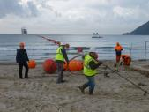
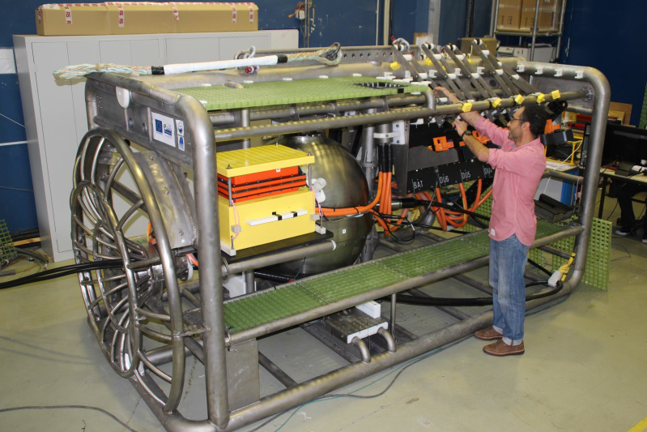
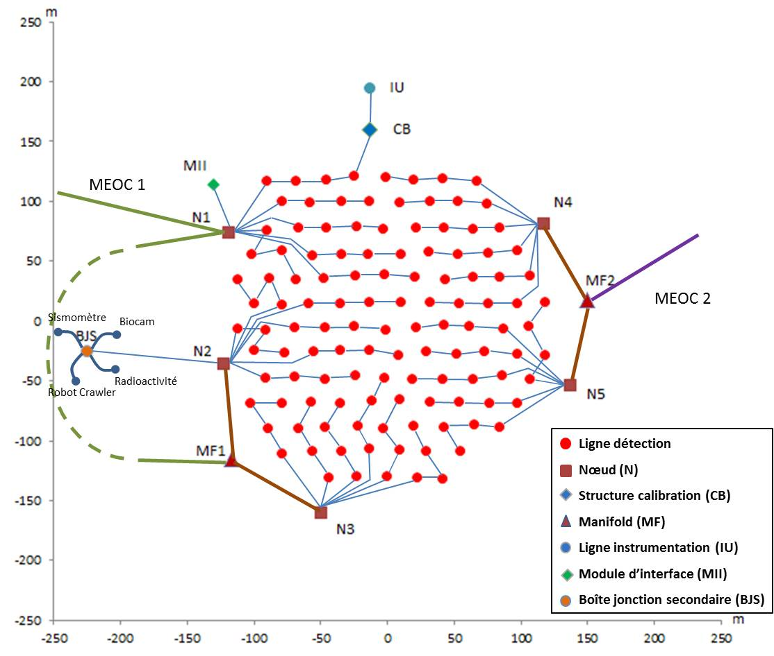
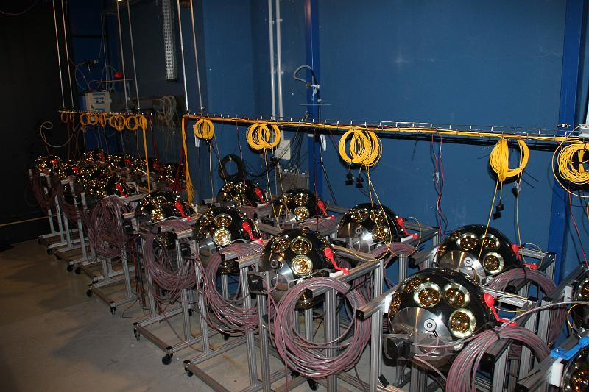
ORCA Seafloor Network
MEOC: Dec 2015, July 2017
Phase 1: 7 string array at KM3NeT-France site
to demonstrate technology/detection
methods in the GeV range
Phase 2: Deploy 1 building block (115 strings)
1st node: May 2015, Sept 2016
Albatross
ANTARES
cable
1st ORCA string: Sept 2017

Slide 13
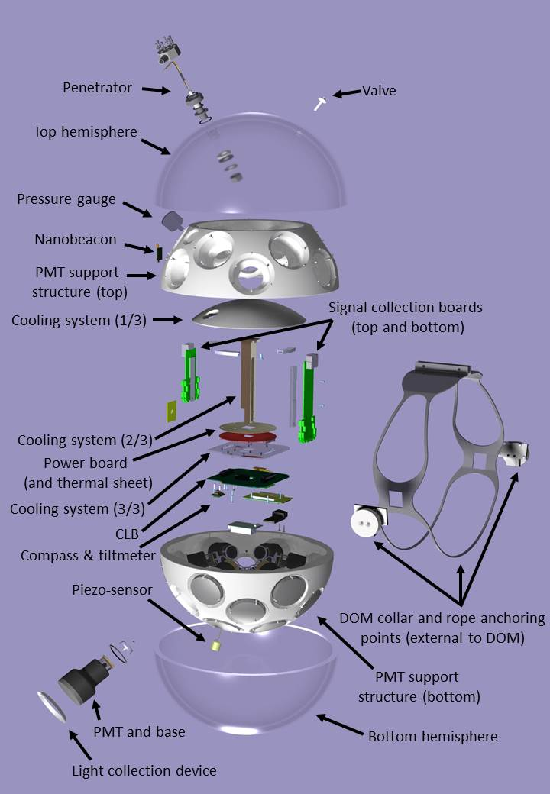

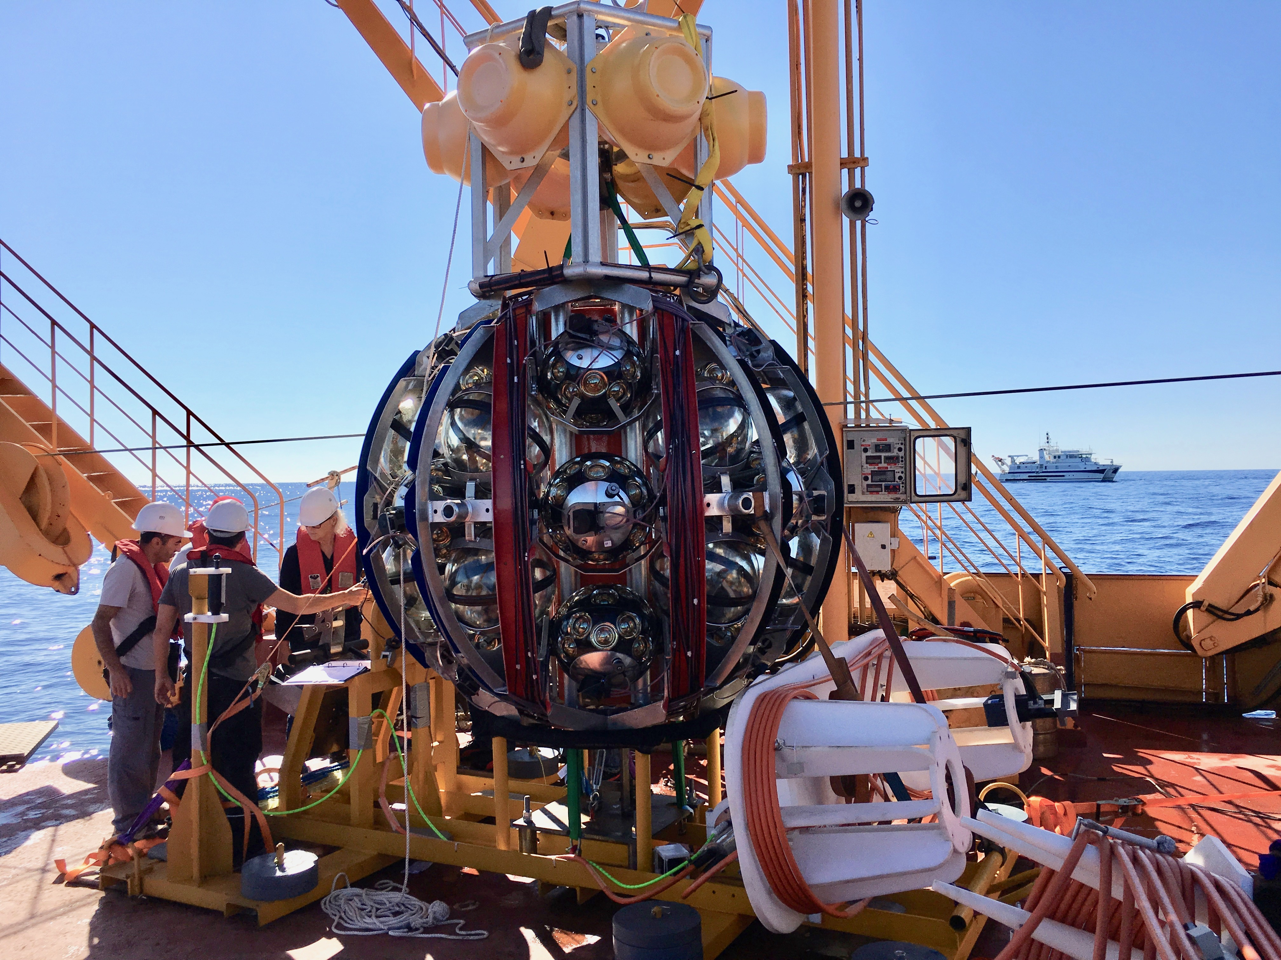
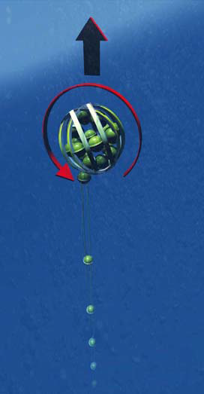

KM3NeT String
Digital Optical Module
String
Deployment Vehicle
~ 800 or 200 m
All data to shore
Gbit/s on optical fibre
Hybrid White Rabbit
LED flasher & acoustic piezo
Tiltmeter/compass
2 dyneema ropes
Oil filled PVC tube
Low drag
Low cost
Rapid deployment
Multiple strings/sea campaign
Autonomous/ROV unfurling
Reuseable

Slide 14
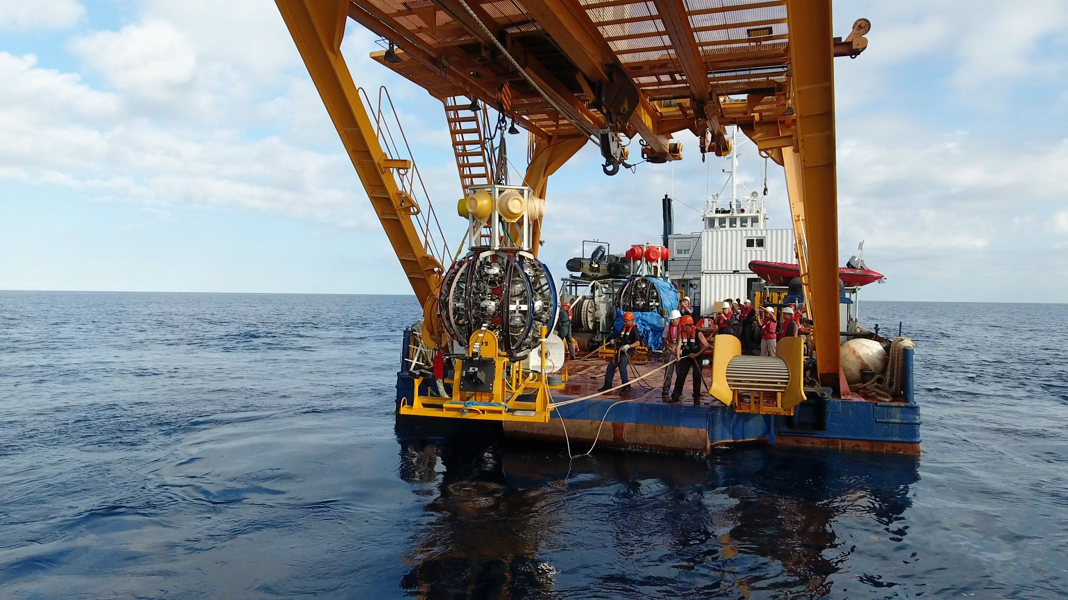
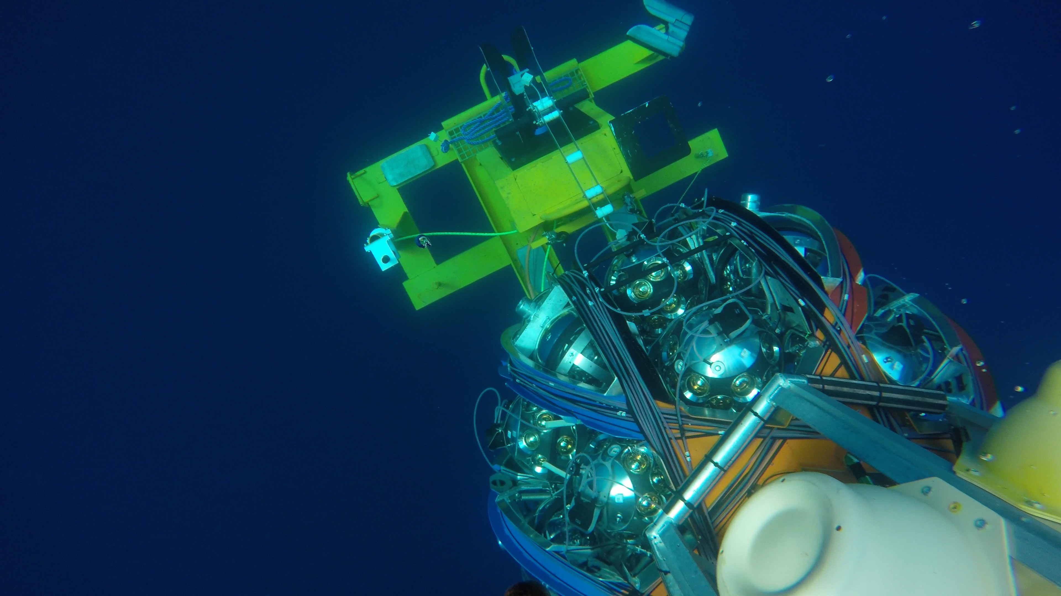
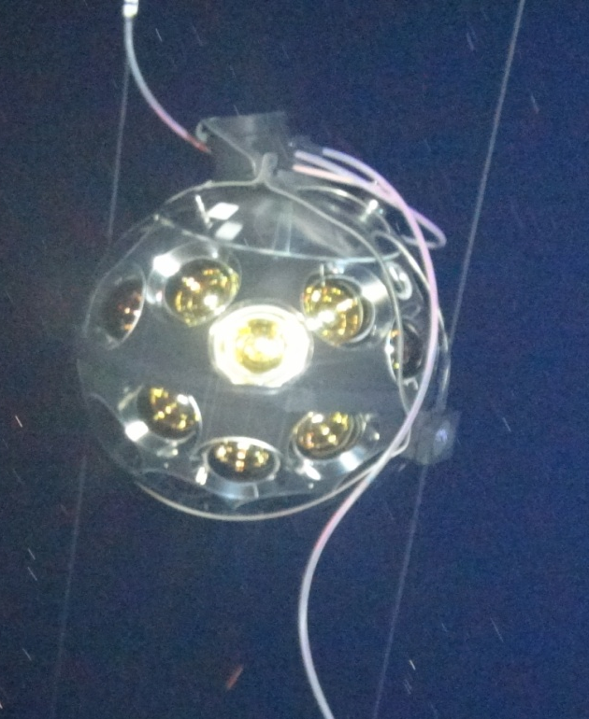
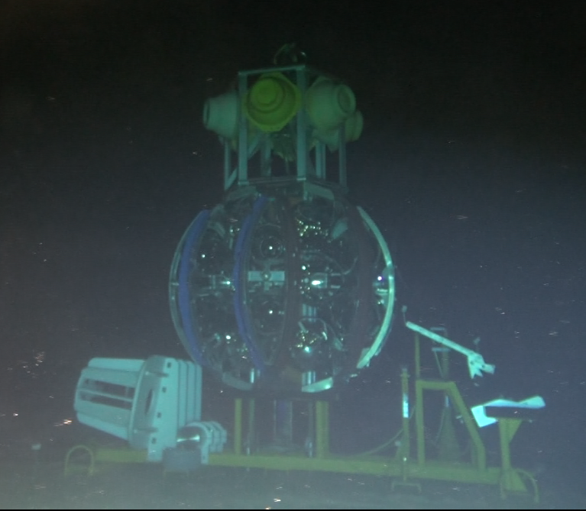
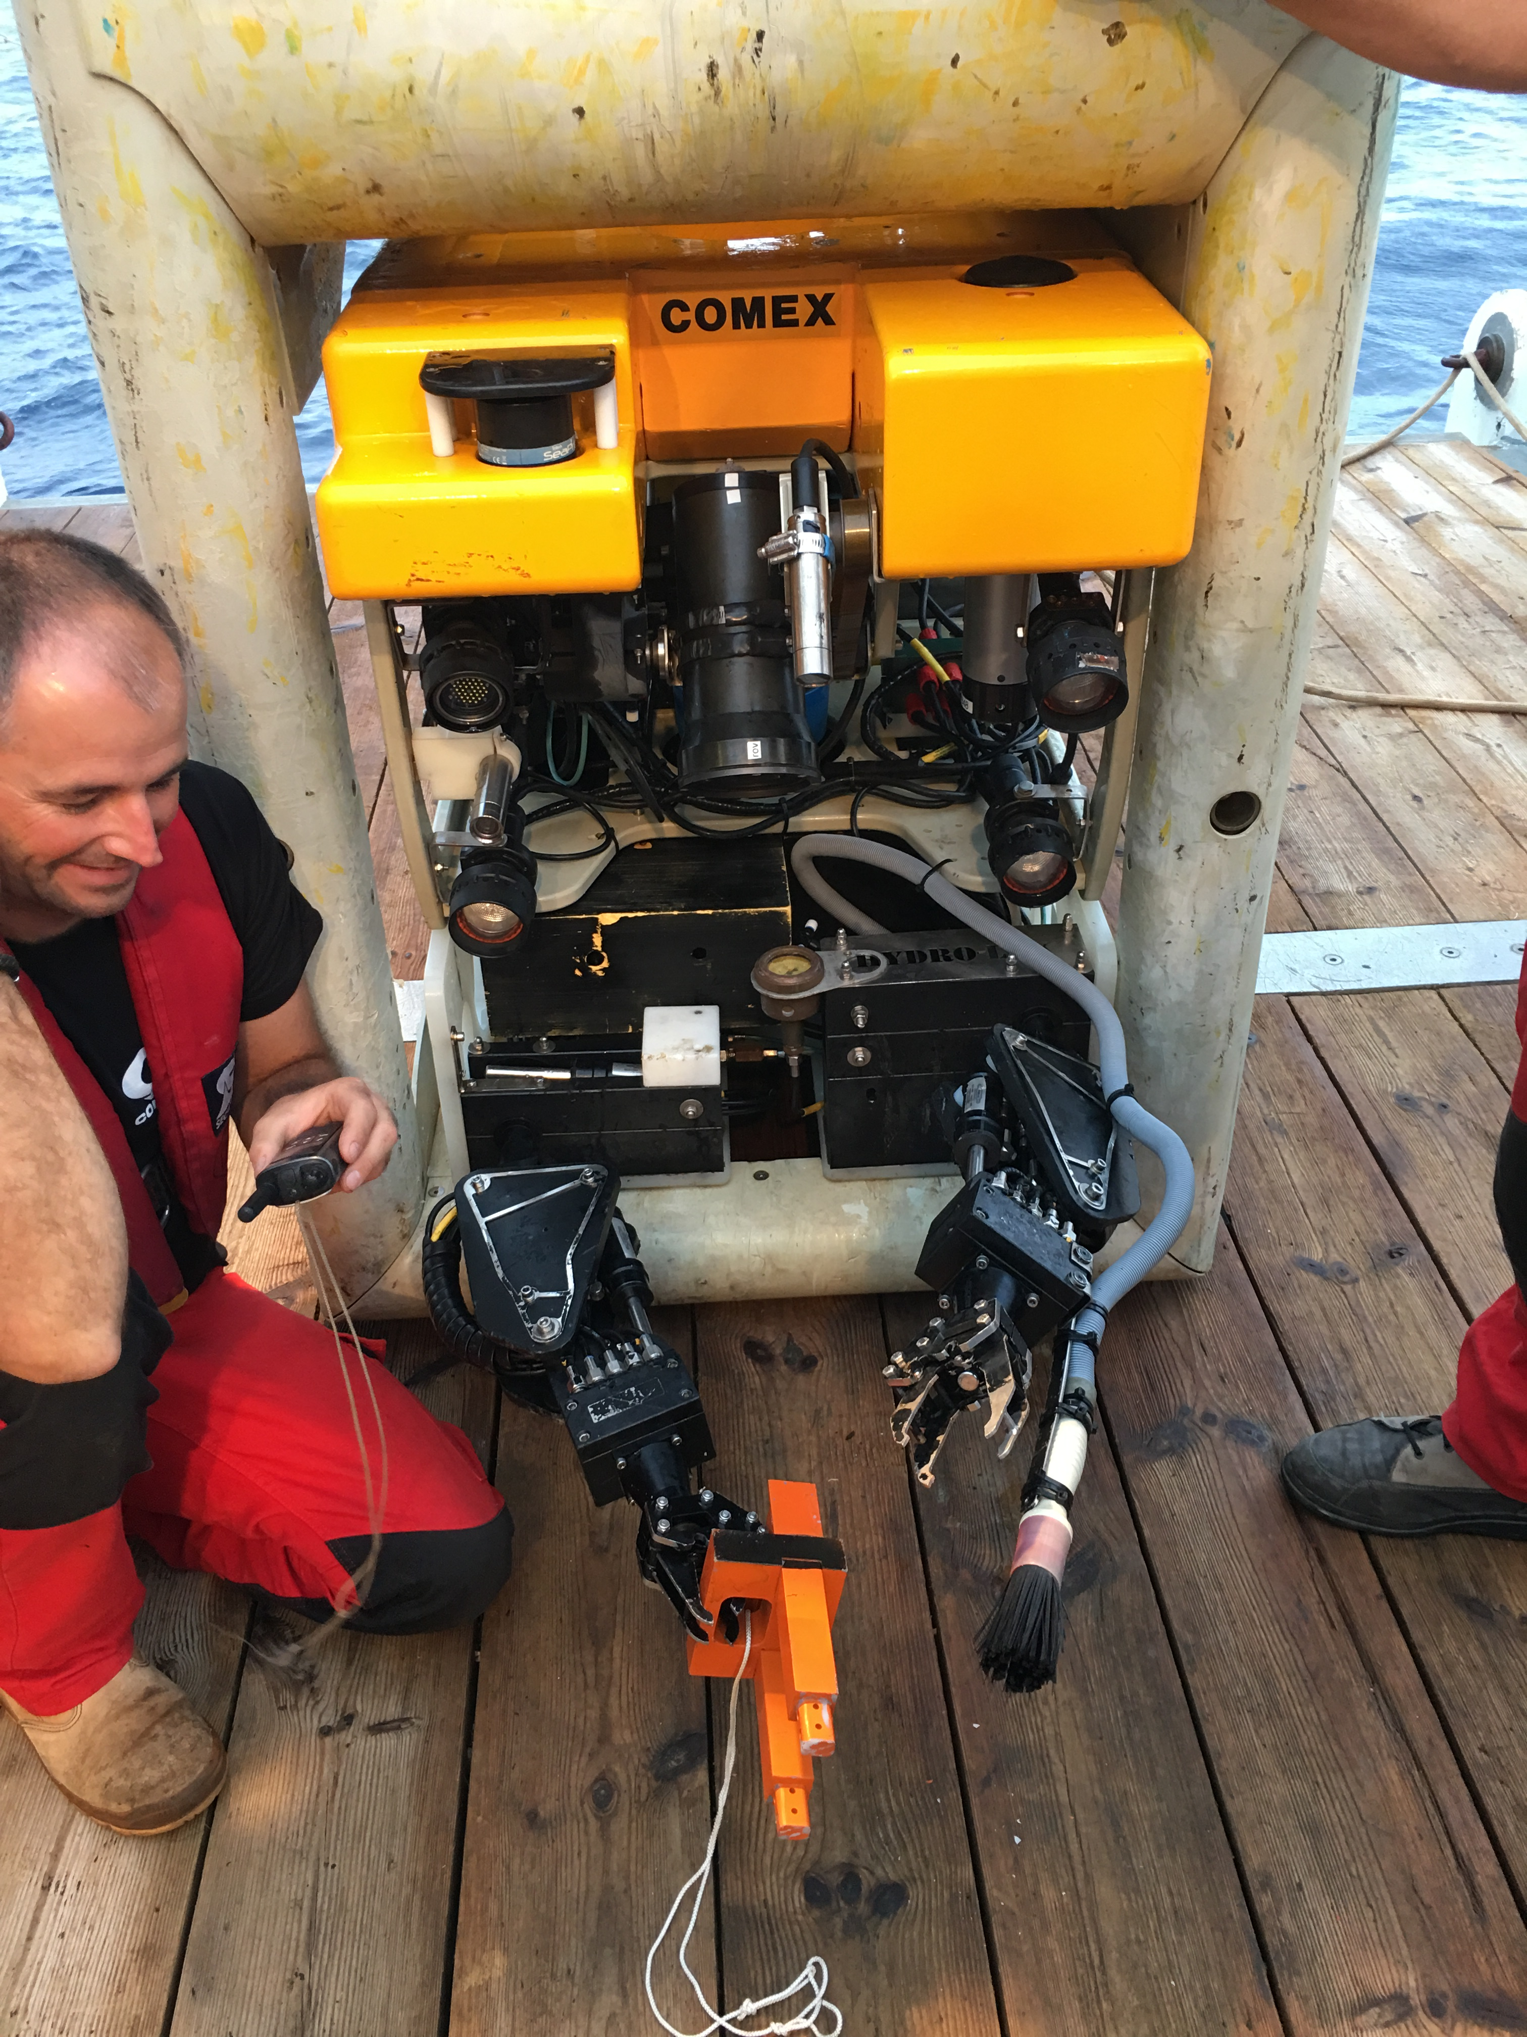
First String Connection (22 Sept 2017)
https://www.youtube.com/watch?v=omlFkdCkbYk

Slide 15
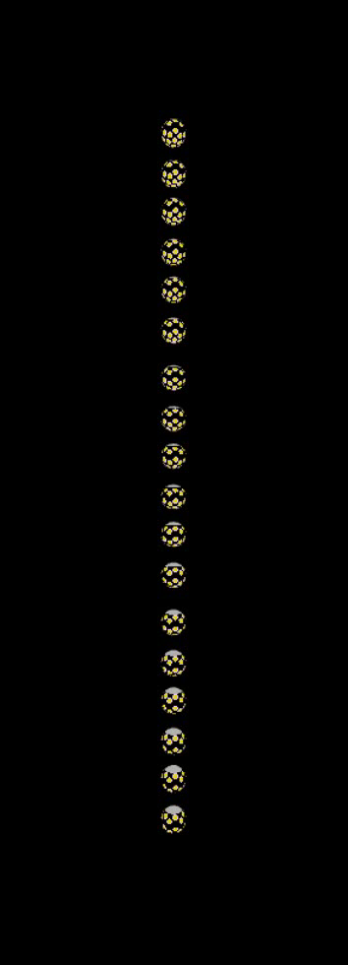
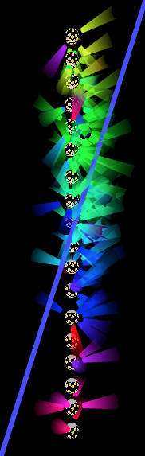
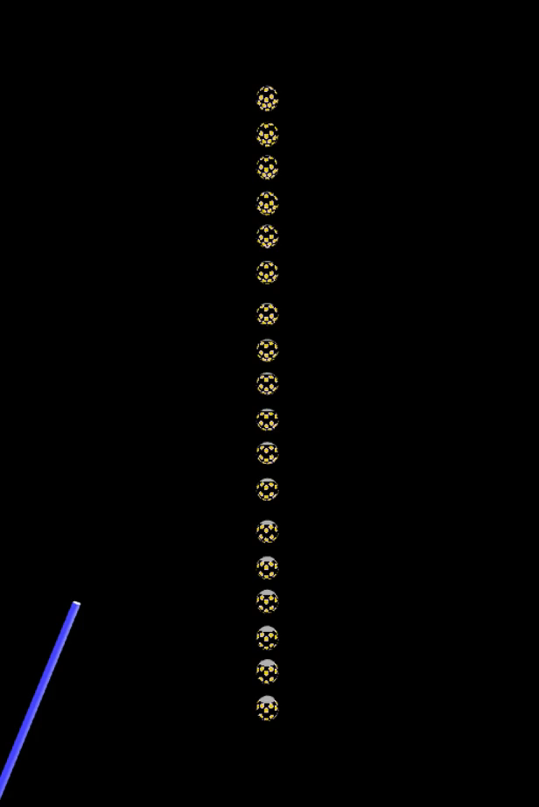
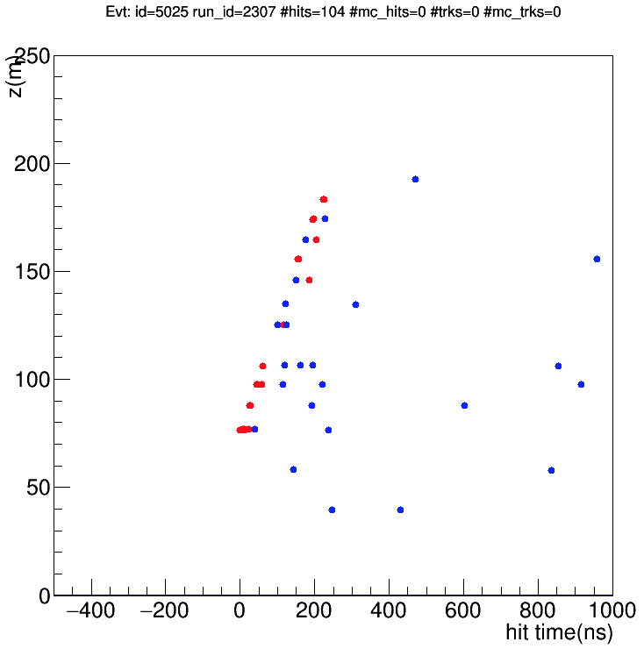
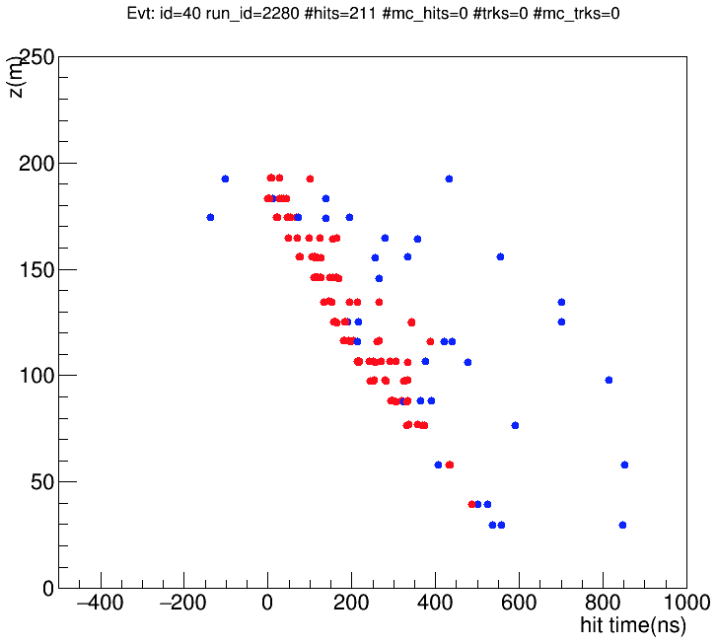
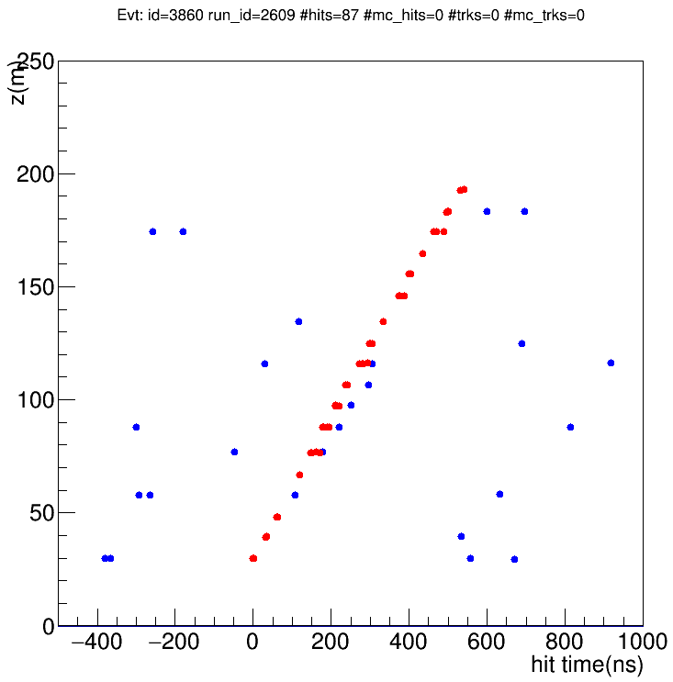
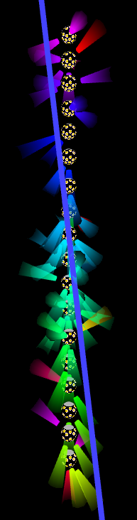
ORCA First Light
Atmospheric Muon Bundle
Neutrino Candidates

Slide 16




ORCA1: Data vs Simulation

Slide 17


Protvino to ORCA (P2O)
U70 accelerator in Protvino (Moscow),
E=70 GeV, 15 kW
Measurement of CP-violation (and NMH)
ν_{e} appearance at L = 2600 km
Target energy range: 3-8 GeV
12° angle, near detector@ -60m
Accelerator upgrade needed:
Moderate intensity option 90 kW
  New ion injection scheme (H⁻) : x3
  Double cycling frequency : 9s → 4.5s : x2
OMEGA Project 450 kW
  New Linac LU-400
  New booster 3.5 GeV
Beam dump
Target hall
Near detector
Notes:
The above figure shows the precision with which theta23 can be measured by
ORCA. Note that a 2 degree prior has been included, so this does not include a
determination of the octant.

Slide 18





Protvino to ORCA (P2O): prelim. study
δ_{CP}
270°
90°
90°
270°
Mass Hierarchy
ORCA detector + 1 (5) years with 450 (90) kW
Better than 5σ for all combination of parameters
0.45 MW-years
NH
IH
CP Violation
Sensitivity of measuring non-zero CP,
i.e. δ_{CP} different from 0° AND 180°
After 3 (15) years non CP-violation excluded for 35% of δ_{CP} values at about 3σ with 450 (90) kW
Already comparable sensitivity to DUNE with
current ORCA performance (w/o optimisation)
1.35 MW-years
NH, neutrino beam
Notes:
The above figure shows the precision with which theta23 can be measured by
ORCA. Note that a 2 degree prior has been included, so this does not include a
determination of the octant.

Slide 19

Outlook
KM3NeT: phased construction of a next-generation neutrino telescope
Developed novel and performant multi-PMT technology interest from IC-Gen2, CHIPs, NuPrism, HyperK, …
ARCA-high energy:
  unprecedented angular resolution/multi-flavour astronomy
  investigation of diffuse flux and point-like sources
ORCA-low energy:
  1st Node +1st string operated (115 by end of 2020)
  NMH at 3 sigma level in 3 years (IH, NH/first octant)
  Much quicker if NH/second octant
  Competitive measurements of Δm²₃₂ and sin²θ₂₃, tau appearance, sterile neutrinos, NSI, DM, tomography,…
P2O
  Protvino beam to ORCA
  NMH at 5 sigma in 1 year
  CP violation at 3 sigma in 6 years
  Super-Orca?

Slide 20





ORCA NMH Experimental Signature
θ_{Z}
Both muon- and electron-channels contribute to hierarchy asymmetry
Electron channel more robust against detector resolution effects
(N_{IH}-N_{NH})/N_{NH}
ν_{μ}
ν_{μ}
ORCA E,θ
resolutions
ν_{e}
ν_{e}

Slide 21


ORCA Tau Neutrino Appearance
ν_{τ} appearance tests PMNS unitarity
and BSM theories
30% deviations allowed by world data
≈3k ν_{τ} CC events/year with full ORCA
Rate constrained within ≈10% in 1 year
Preliminary
1σ, 2σ, 3σ, 5σ

Slide 22



Effective mass
SuperK: 50 kt
ORCA
4000 kt @ 5 GeV
8000 kt @ 10 GeV
DUNE: 40 kt

Slide 23





ORCA Junction Box Deployment (29 Sept 2016)

Slide 24
Neutrino Signatures
atmospheric muon
μ±
μ±
neutrino or
charged lepton
⁽⁻⁻⁾
^{ν}_{x}
⁽⁻⁻⁾
^{νμ}
muon neutrino, CC only
(track reconstruction)
all neutrino flavours, CC & NC
(shower reconstruction)

Slide 25



ORCA Post LoI: Sterile, NSI, Tomography
Non-Standard Interactions
Sterile Neutrinos
Earth Tomography
10 year sensitivity (w systematics)
Mantle
NH
IH
Outer
core
Good sensitivity in U_{τ4} mixing
Factor of two better sensitivity
cf current limits from SK and IC
after only 1 year of data taking
ORCA sensitive to NSI effects
≈10% of the Fermi int.
Direct bounds are more than
10x larger in some cases
ORCA improves over current
atmospheric scale bounds
ORCA is sensitive to N_{e}
geophysics measure ρ_{m}
1σ stat.+ syst. Uncertainty:
5% in the whole mantle
6% in the whole outer core

Slide 26

ORCA Post LoI: DM, SN, Tau Appearance
Dark Matter
ORCA 3 years, track+showers
Competitive for Spin Dependent coupling
Expect excellent sensitivity for GC above 1 TeV
SuperNovae
10 MeV anti-nu e from core-collapse SN
Excess of DOMs where 6-10 PMTs fire together
>80% of all Galactic SN with single building block
Implemented SN trigger on ORCA1
Tau Appearance
Next slide…
Preliminary
1σ, 2σ, 3σ, 5σ

Slide 27

Comparison of LBL Projects
Energy versus baseline
1st Min P(ν_{μ}→ν_{μ})
1st Max P(ν_{μ}→ν_{e})
Matter resonance
P2O
4-5GeV
DUNE
2.4GeV
NOvA
1.6GeV
P2O
NOvA
T2K
HyperK
0.6GeV
DUNE
T2K
HyperK
Daya Bay (2km)
4.0 MeV

Slide 28
KM3NeT Building Block
ARCA/ORCA
115 strings
18 DOMs / string
31 PMTs / DOM
Total: 64k*3¨ PMTs
115 lines, 20m spaced,
18 DOMs/line 9m spaced
450 m
20/90 m
9/36 m
~200/800 m
 | ORCA | ARCA
String spacing | 23 m | 90 m
OM spacing | 9 m | 36 m
Depth | 2470 m | 3500 m
Instrumented mass | 8 Mton | 0.6*2 Gton
~210/1000 m

Slide 29


Comparison of LBL Projects
Main Signal : Appearance of ν_{e} : P(ν_{μ}→ν_{e})
CPV and mass hierarchy degenerate
DUNE
P2O
T2K
HyperK
NOvA
Normal
hierarchy
Inverted
hierarchy

