Slide 1
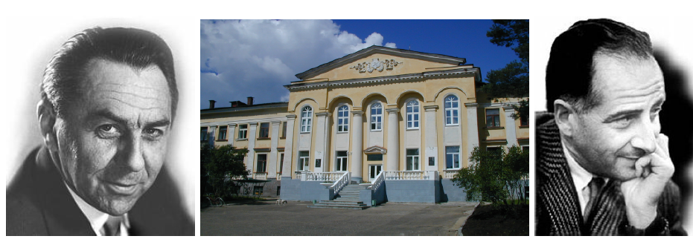
Dzhelepov Laboratory of Nuclear Problems
The Founding Fathers:
Venedict Dzhelepov
Bruno Pontecorvo
Evgeny Yakushev
JINR Day in France, 15.02.2018

Slide 2
Main directions of research in the Laboratory
Neutrino Physics and Astrophysics — 50%
Particle Physics of (super)-high energy — 25%
Development of new detectors, applied research. Medicine — 25%

Slide 3
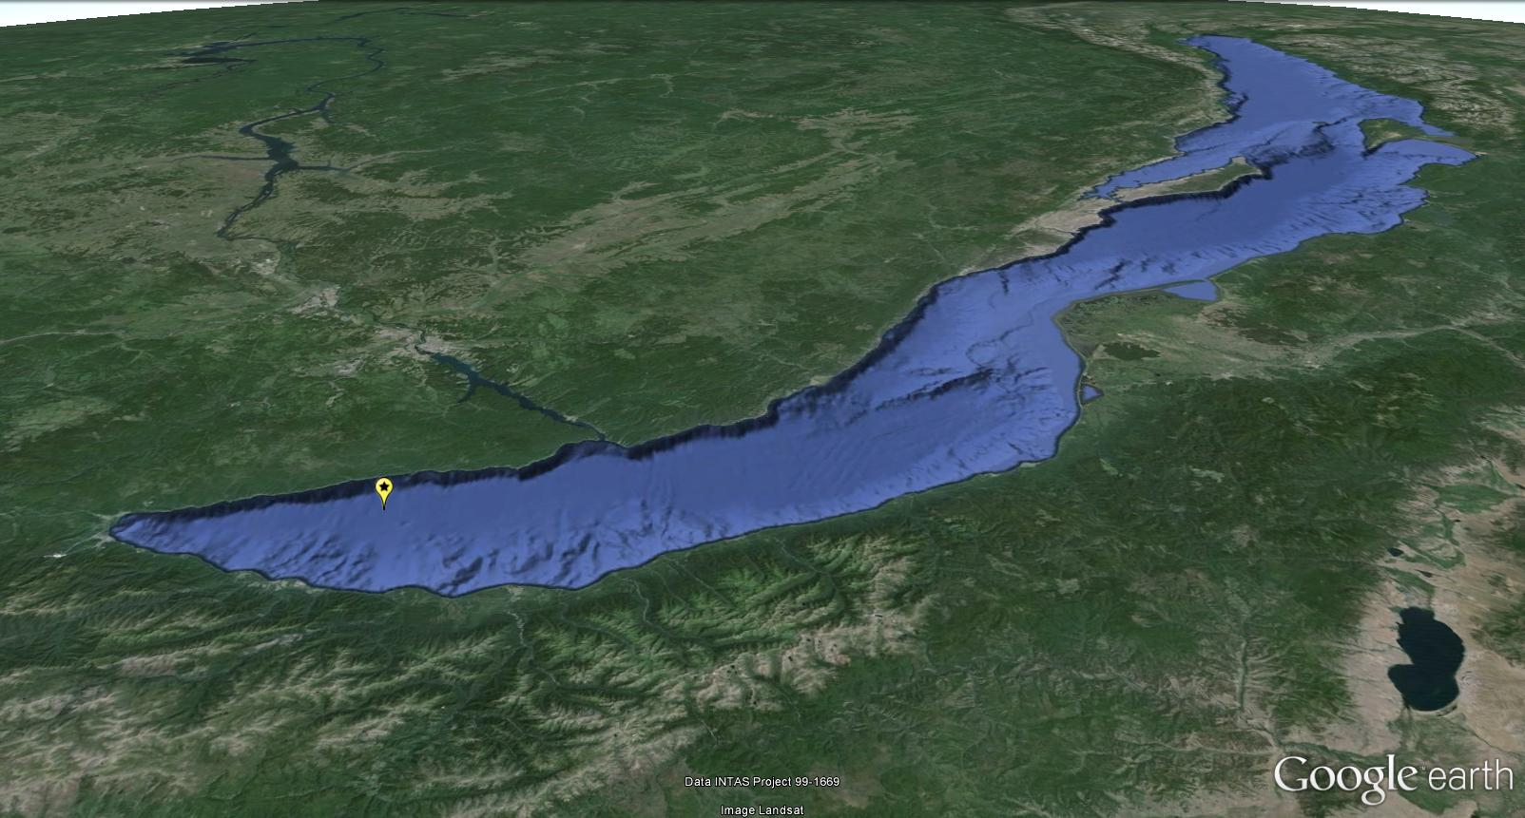
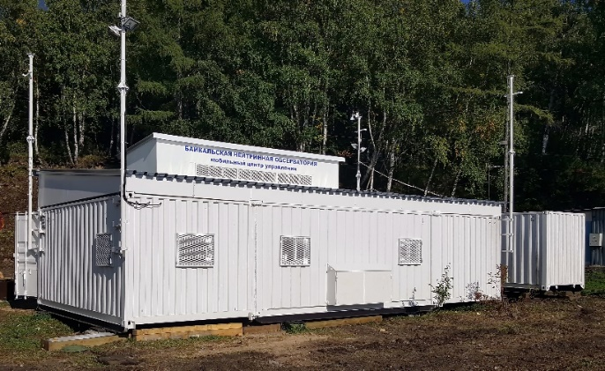
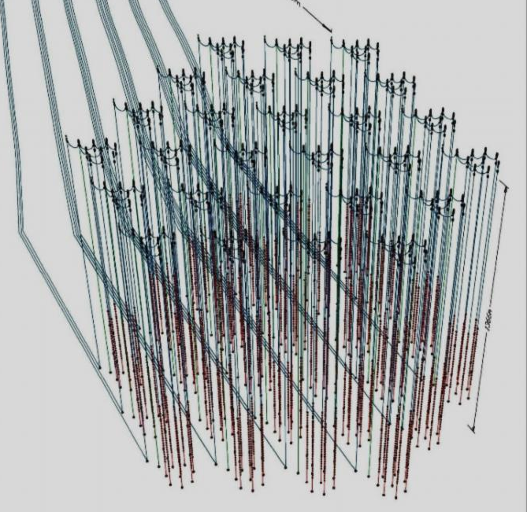
Experiment Baikal
Gigaton Volume Detector
A couple of years ago IceCube saw nothing, and GVD on Baikal was almost not needed. Today the IceCube sees galactic neutrinos, but not very good. The GVD on Baikal is urgently needed! It is a long-term project with a clear and strong prospects. Its discoveries are waiting for us (V.Rubakov, 16.12.2013).
104º25’ E; 51º46’ N

Slide 4
North hemisphere biggest neutrino detector is building by ~ 65 physicists and engineers from
Institute for Nuclear Research, Moscow, Russia.
Joint Institute for Nuclear Research, Dubna, Russia.
Irkutsk State University, Irkutsk, Russia.
Skobeltsyn Institute of Nuclear Physics MSU, Moscow, Russia.
Nizhny Novgorod State Technical University, Russia.
Saint Petersburg State Marine University, Russia.
Institute of Experimental and Applied Physics, Czech Technical University, Prague, Czech Republic.
Comenius University, Bratislava, Slovakia.
EvoLogics GmbH, Berlin, Germany.

Slide 5
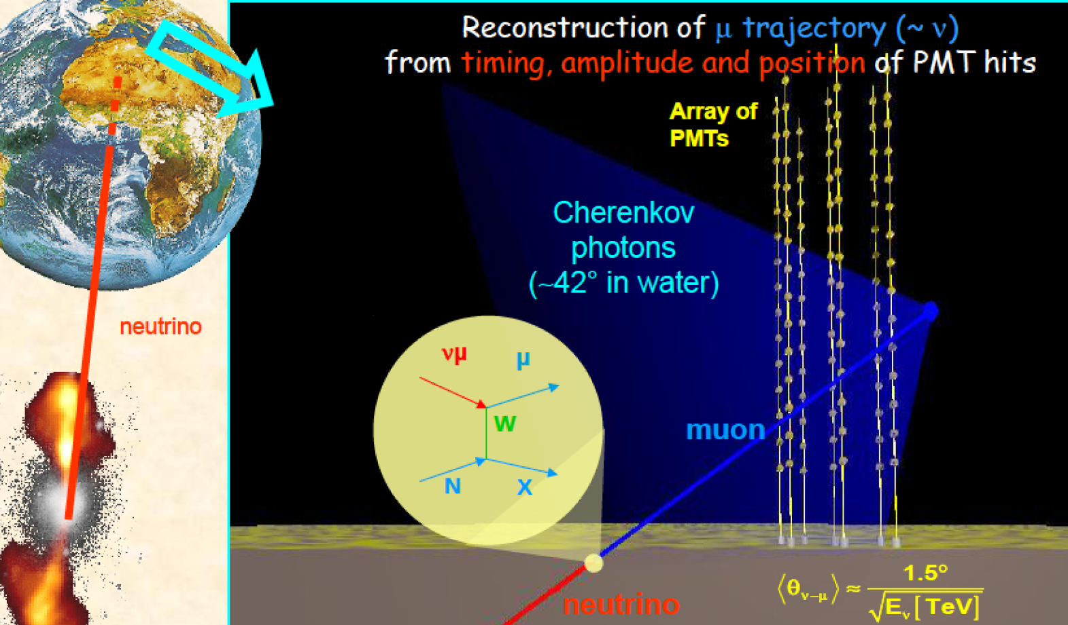
Detection Principle – M. Markov 1960

Slide 6
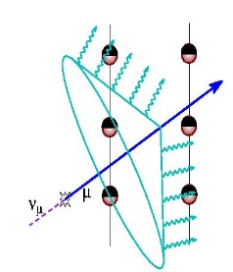
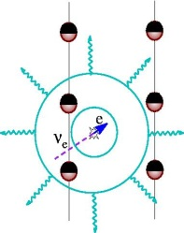
Detection Principle – M. Markov 1960
Telescope (E,Ω)
Energy, direction,
flavour
Target
muon (ν_{μ})
muon
cascade
ν_{e}:ν_{μ}:ν_{τ}
water,
ice
output
Physics (σ_{E},σ_{Ω})
input
cascade
(ν_{e},ν_{μ},ν_{τ})
Arrival times & amplitudes,
PMTs position and orientation
Flux
From local
sources,
diffuse flux
Detection
modes
muons,
cascades
Environment
properties
absorption, scattering,
light background –
⁴⁰K, bioluminescence
Background
downward going atm. muons,
atm. neutrinos

Slide 7
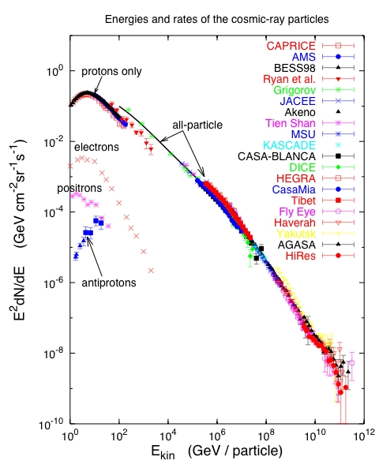
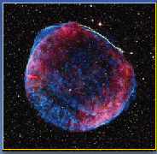
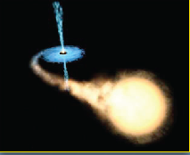
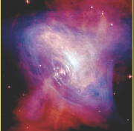
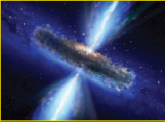
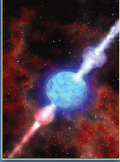
Cosmic Rays / 100 yr. observations
Galactic: TeV – PeV – EeV?
SNR
Microquasars
Pulsars
Extra-Galactic: PeV – EeV ->
Galactic
AGN
GRB
Extra-Galactic
Energy spectrum !
Mass composition !
Sources location ?

Slide 8
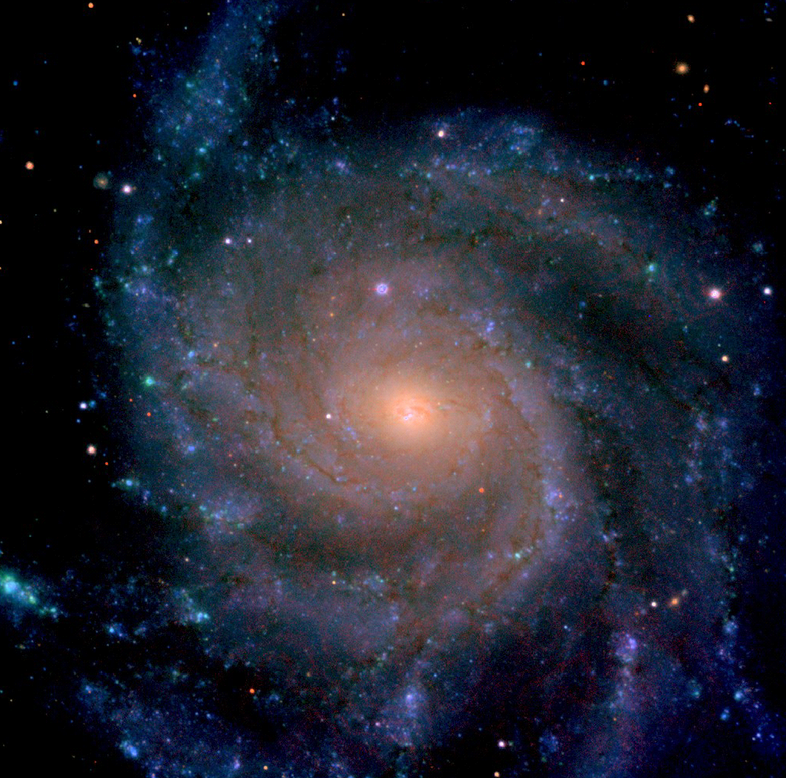
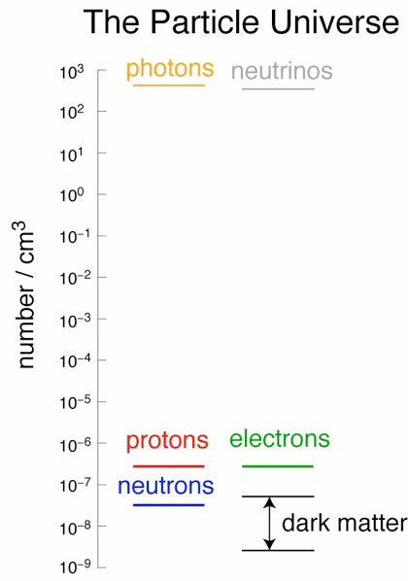
Universe
~5%
NORMAL MATTER
~25%
DARK
MATTER
DARK ENERGY
(local)
DARK ENERGY
~70%
DARK ENERGY
DARK ENERGY

Slide 9
Neutrino fluxes
Born in astrophysical objects.
Travel in straight lines - not suffer
from magnetic fields.
Universe is transparent for neutrinos.
Galactic
E.-Galactic

Slide 10
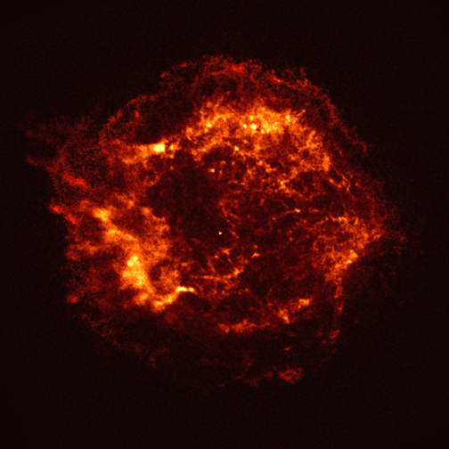
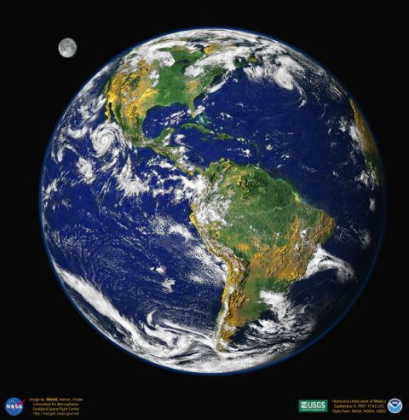
Neutrino telescopes brings an important information complementary to the traditional optic and radio telescopes.
Physics:
- Investigate Galactic and extragalactic neutrino “point sources”
- Diffuse neutrino flux – energy spectrum, local and global anisotropy, flavor content
Dark matter – indirect search
Exotic particles – monopoles, Q-balls, nuclearites, …
Charged particles
γ,ν

Slide 11
Gigaton Volume Detector (GVD) in Lake Baikal
km³-scale 3D-array of photo sensors
flexible structure allowing an upgrade and/or a rearrangement of the main building blocks (clusters)
high sensitivity and resolution of neutrino energy, direction and flavor content

Slide 12
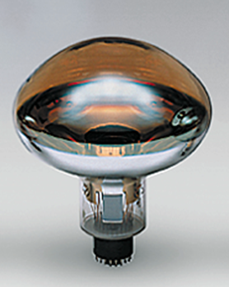
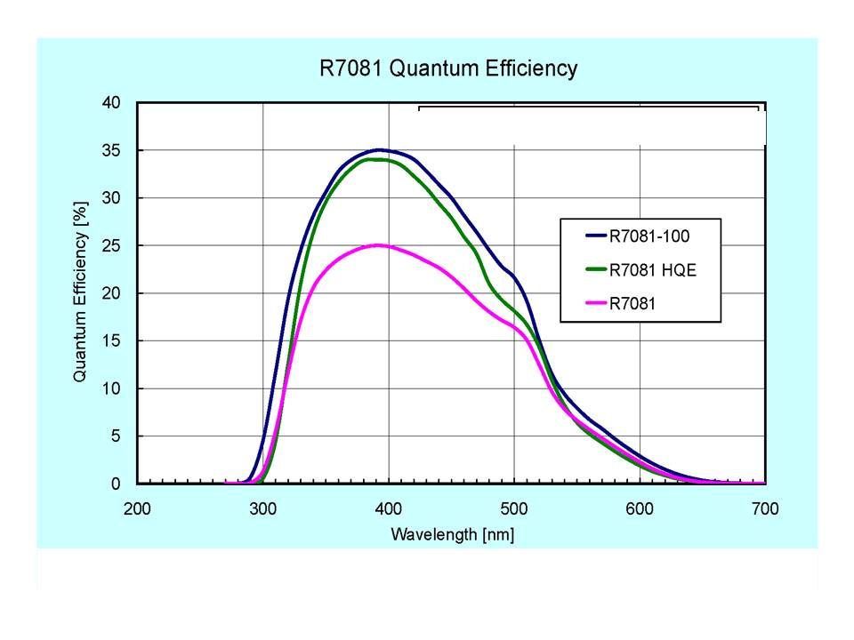
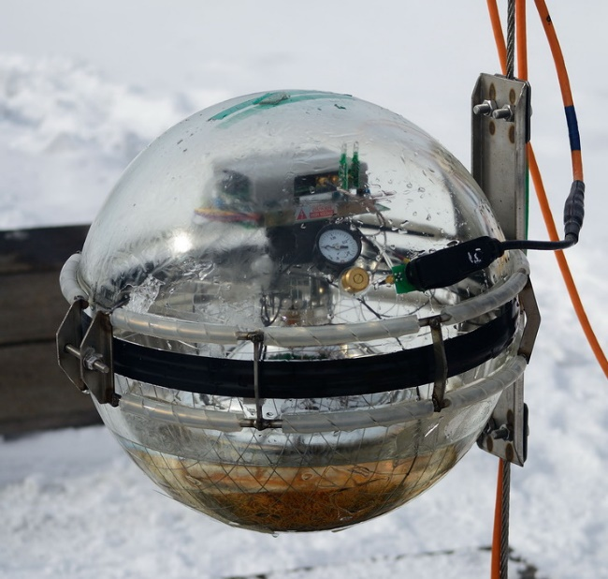
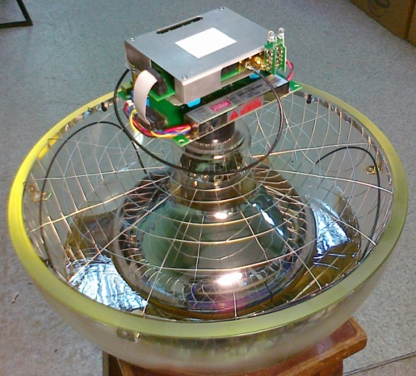
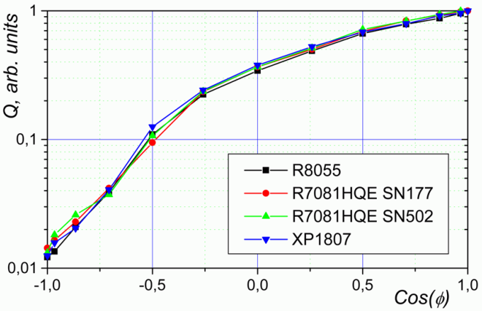
Optical module
Φ220 mm
Quantum efficiency
R7081-100 Hamamatsu
D=10 inch. SBA photocathode QE ≈ 35% @ 400nm; Gain ~10⁷, dark current ~8 kHz
Angular sensitivity
OM electronics
Mu-metal cage
PMT
Optical gel
Glass pressure-resistant
sphere VETROVEX (17”)

Slide 13
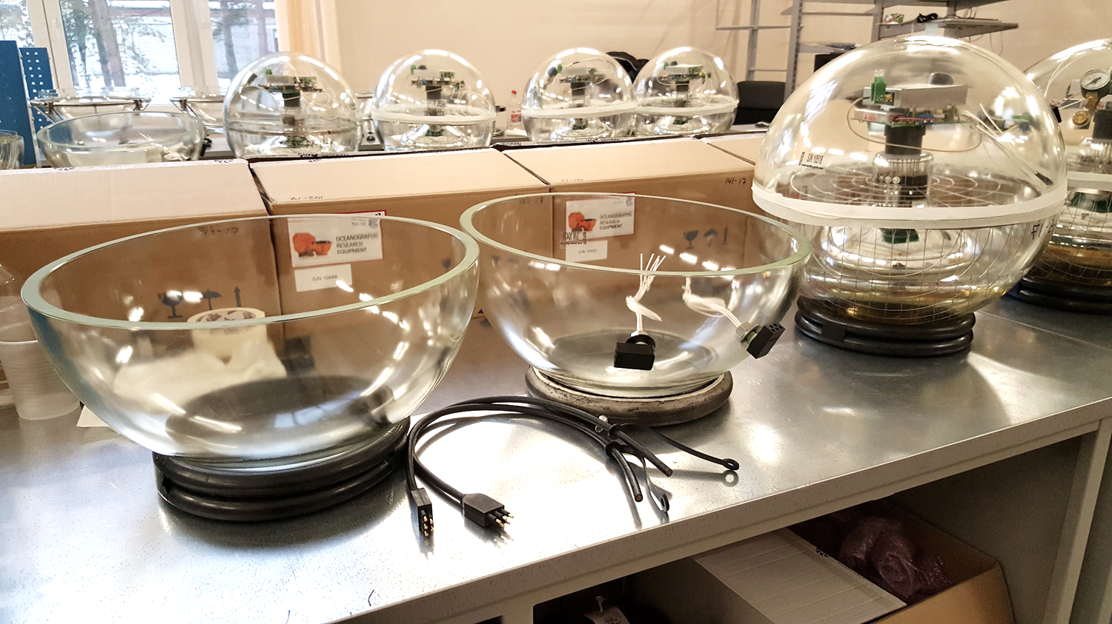
Optical modules assemble
Production rate in 2017 (including testing) was up to 6 OM/day
Notes:
В прошлом сезоне в период с 21 сентября 2016 года по 10 марта
2017 года в сборочных помещениях ЛЯП ОИЯИ было изготовлено
и протестировано 305 оптических модулей. Сборка проводилась
преимущественно двумя сотрудниками. Собранные оптические
модули были поставлены двумя партиями в город Байкальск в
начале февраля и начале марта 2017 года.

Slide 14
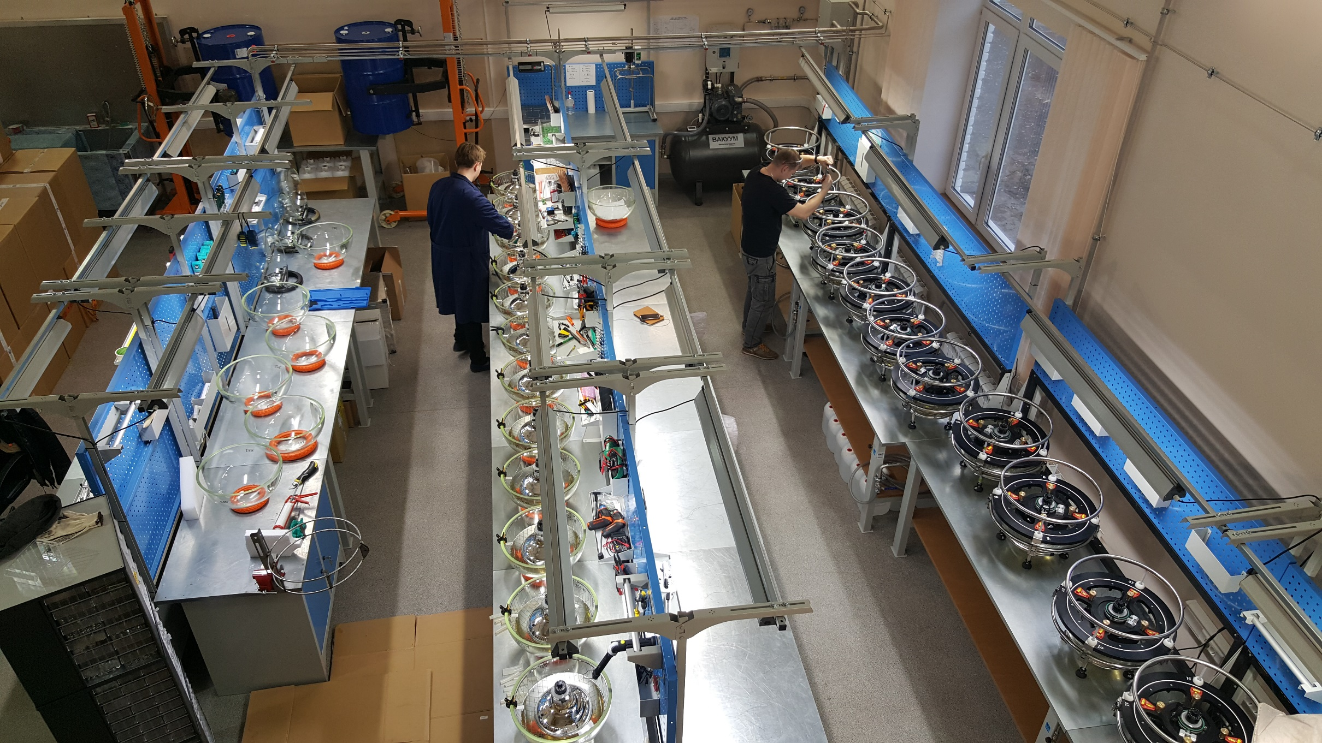
The optical modules production facility
The facility allows to produce and test up to 12 OM per day
This year we need to produce and send to the site 600 OM up to end of February

Slide 15
The site
Site:
1370 m maximum depth
Distance to shore ~4 km
No high luminosity bursts from biology.
No K⁴⁰ background.
Location: 104º25’ E; 51º46’ N
Shore station
36 km
Baikal’sk
Workshop&Storage facilities
Baikal water
Abs.Length: 22 ± 2 m Scatt.Length: 30-50 m

Slide 16
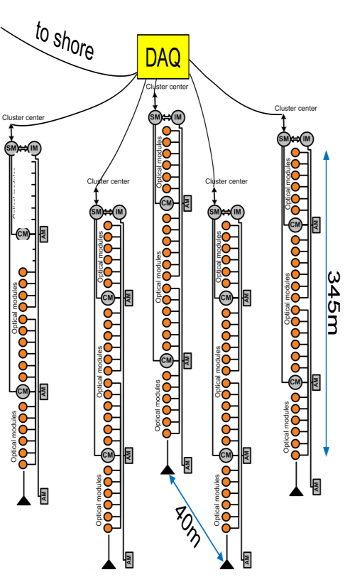
Previous stages of the first cluster “DUBNA”
2012
3 strings (36 OMs),
First full-scale GVD string
Launch: April 2012 yr.
2013
3 full-scale strings (72 OMs)
Section electronics updated
Launch: April 2013
2014
5 strings (120 OMs)
Launch: April 2014
DAQ
DAQ
DAQ
DAQ
DAQ

Slide 17
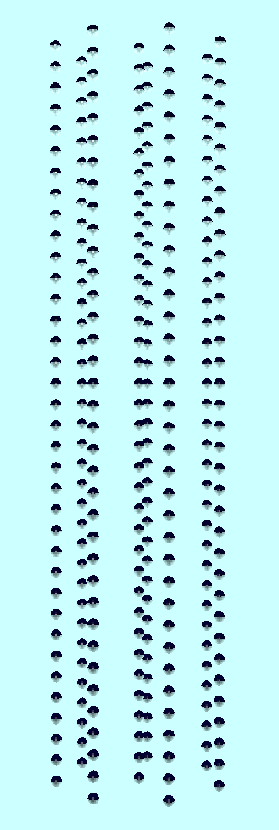
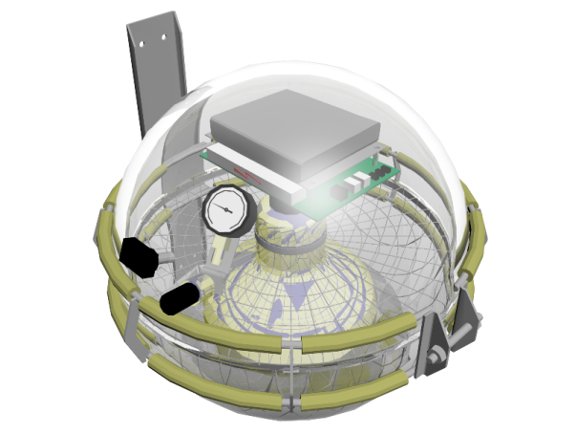
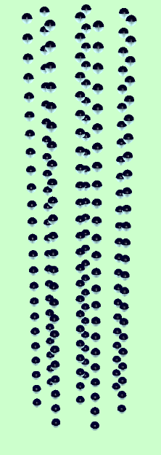
BAIKAL-GVD-1
2304 light sensors
combined in 8 clusters
of vertical strings at
750 – 1300 m depths.
Detection volume 0.4km³
Deployment plan for expedition 2018
April 2017
Taking data
April 2016
Taking data
300 m
“Dubna”
Demonstration
Cluster
~600 m
~1 km
120 m

Slide 18
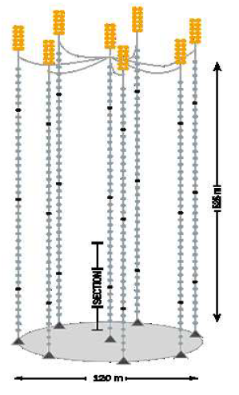
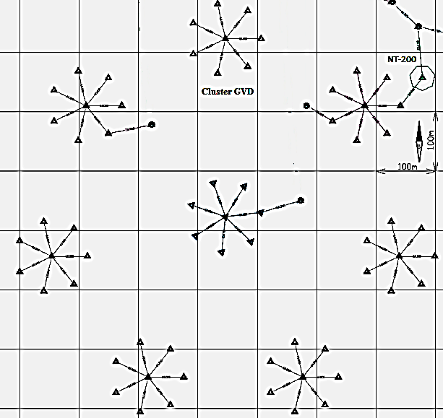
Baikal-GVD : phase 1 (up to 2020)
525 m
Optical module
PMT: R7081-100
120 m
700 m
String: 36 OMs
Cluster: 8 strings
GVD-1: 8 clusters
 | GVD-1
OMs | 2304
Clusters (8 Strings) | 8
Depths, m | 750 – 1275
Eff. Volume (E_{SH} > 100 ТeV) | 0.4 km³
Directional resolution
Cascades: 3° – 5°
Muons: 0.25° - 0.5°

Slide 19
1 cluster = 8 strings = 1 event (> 100TeV, cascade)/year
2017 | 2018 | 2019 | 2020
2 clusters (deployed) | 4 clusters | 6 clusters | 8 clusters

Slide 20
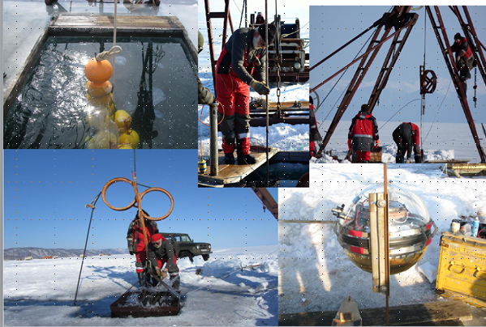
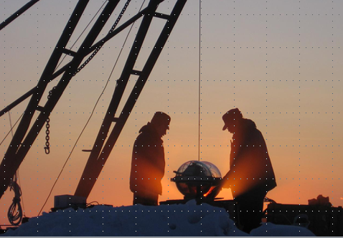
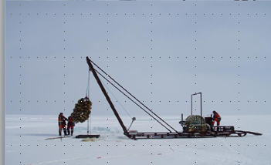
Assembling the detector
Detector deployment from the ice.
Deployment period:~20 February … ~10 April

Slide 21
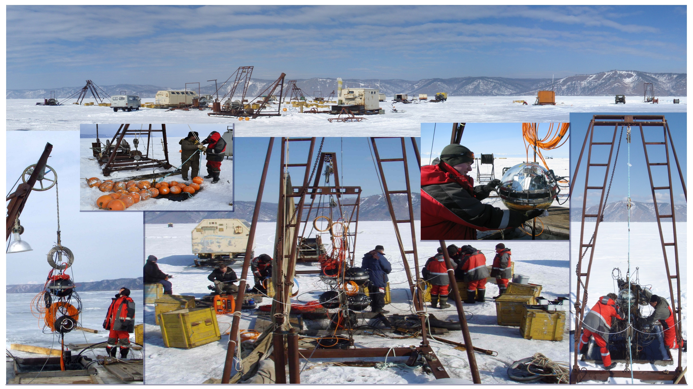

Slide 22
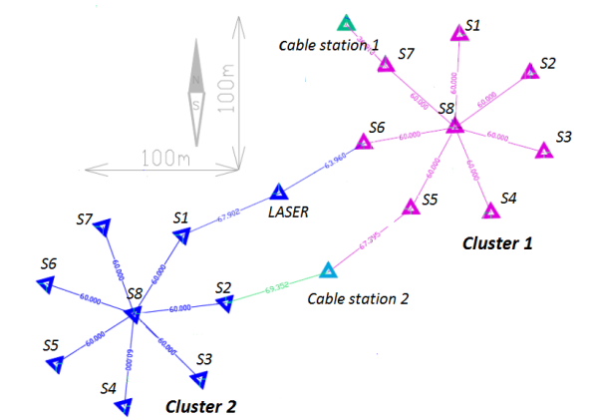
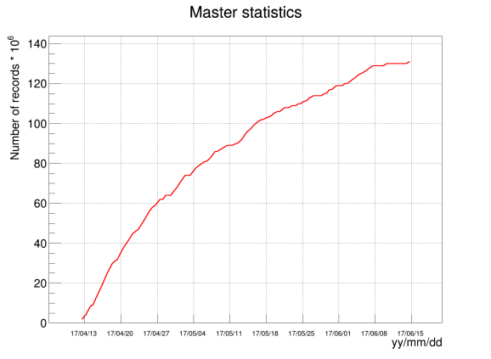
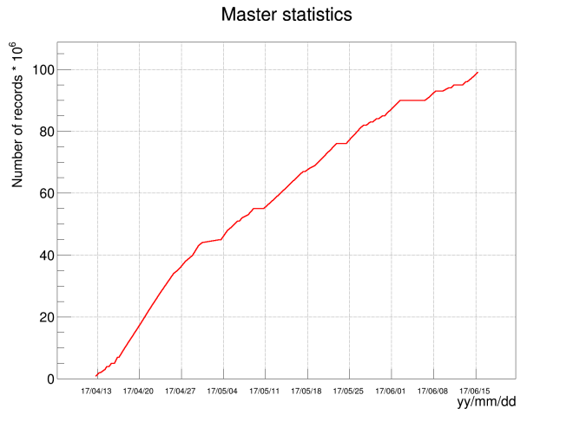
Detector operation -2017
13 April – 15 Jun 2017
Cluster 1
Eff. Vol. (E > 10² TeV) ~0.1 km³
Cluster 2
 | Full time | Eff., % | Event
Cluster-1 | 64d 7h | 84.4 | 1.87×10⁸
Cluster-2 | 64d 0h | 87.6 | 1.45×10⁸
Notes:
This figure shows the present layout of the Baikal installation. Distance between clusters is 250 meters.
New laser calibration source was installed between clusters.
Detector is under operation from 13 April 2017. These figure show accumulative number of events for two clusters.
The efficiency of the detector operation was about 85%. Eff. Volume for cascade ~0.1 cub. km.

Slide 23
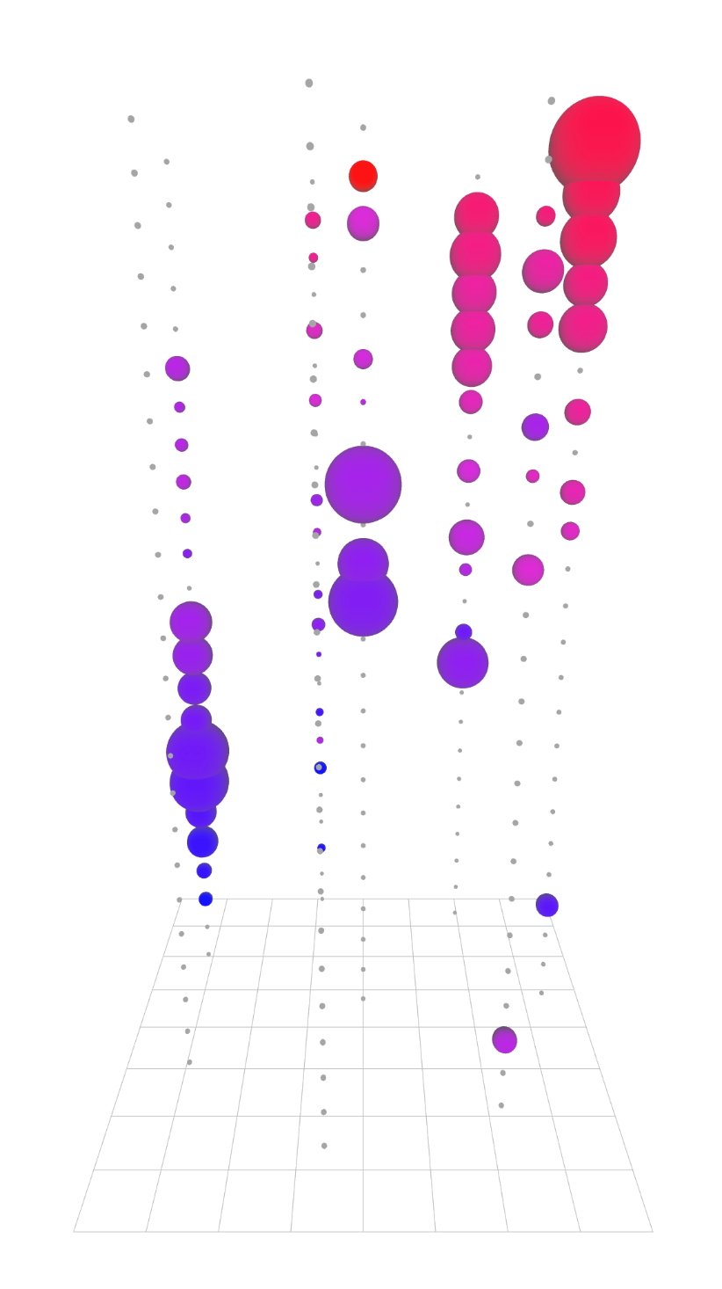
“Dubna” cluster event
Run#229; event 1734
Charge
325 m
Time
$$μ$$
80 m

Slide 24
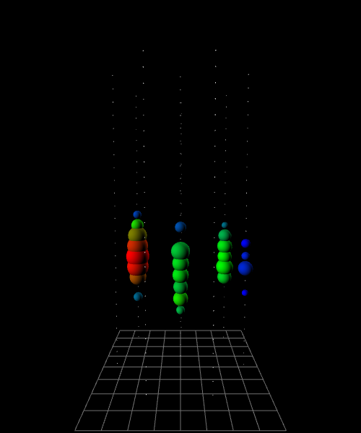
E = 158 TeV, θ = 59°, ρ = 73 m, z = -62 m
γ
ν
≈shower

Slide 25
Conclusions and outlooks
The Baikal-GVD experiment is one of the foundations of JINR/DzLNP neutrino program;
In the north hemisphere the Baikal-GVD is the biggest neutrino detector;
An excellent angular resolution provides key information about interesting high energy neutrino sources;
1 IceCube like event per 1 cluster per year is expected;
First results soon!

