Slide 1
JINR-France symposium
February 15th, 2018, Paris
Sergey Dmitriev
Flerov Laboratory of Nuclear Reactions

Slide 2
FLNR’s BASIC DIRECTIONS of RESEARCH
1. Heavy and superheavy nuclei:
synthesis and study of properties of superheavy elements;
chemistry of new elements;
fusion-fission and multi-nucleon transfer reactions;
nuclear- , mass-, & laser-spectrometry of SH nuclei.
2. Light exotic nuclei:
properties and structure of light exotic nuclei;
reactions with exotic nuclei.
3. Radiation effects and physical groundwork of nanotechnology.
Notes:
2

Slide 3
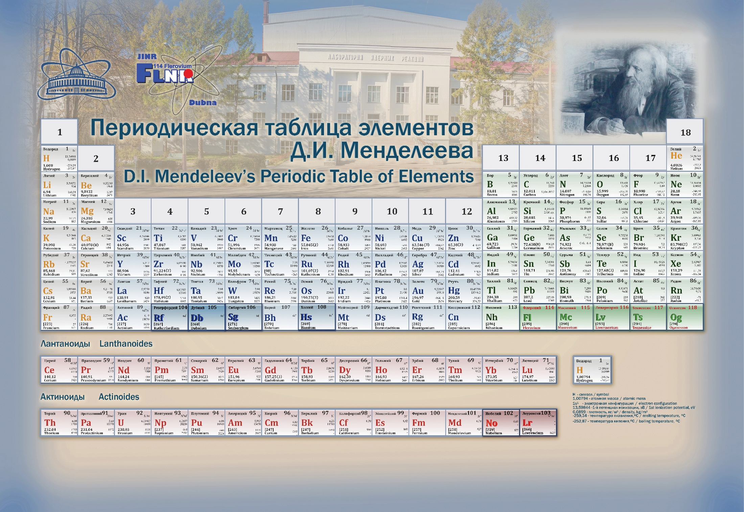

Slide 4
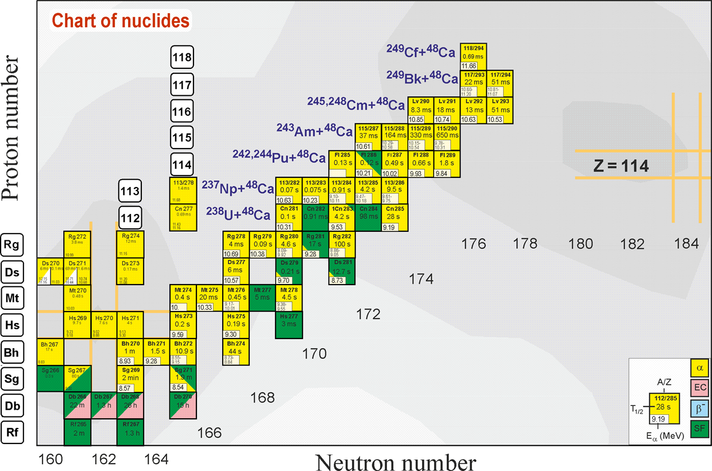
Region of superheavy nuclei

Slide 5
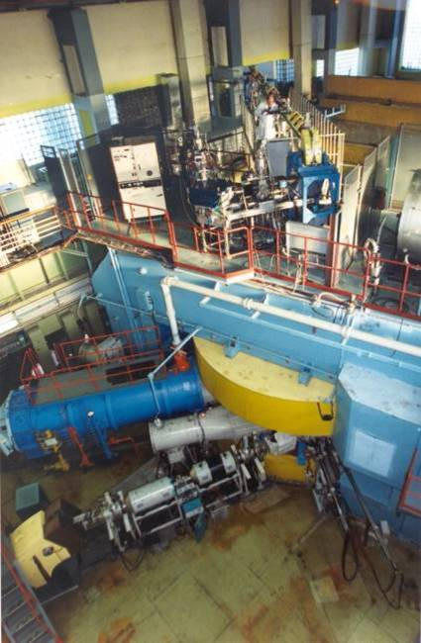
U400 CYCLOTRON
stand-alone & post-accelerator
Ion | Ion energy [MeV/A] | Output intensity
⁴ He ¹⁺ | - | -
⁶ He ¹⁺ | 11 | 3⋅10⁷ pps
⁸ He ¹⁺ | 7.9 | -
¹⁶ O ²⁺ | 5.7; 7.9 | 5 pμA
¹⁸O³⁺ | 7.8; 10.5; 15.8 | 4.4 pμA
⁴⁰ Ar ⁴⁺ | 3.8; 5.1 * | 1.7 pμA
⁴⁸ Ca ⁵⁺ | 3.7; 5.3 * | 1.2 pμA
⁴⁸Ca⁹⁺ | 8.9; 11; 17.7 * | 1 pμA
⁵⁰ Ti ⁵⁺ | 3.6; 5.1 * | 0.4 pμA
⁵⁸ Fe ⁶⁺ | 3.8; 5.4 * | 0.7 pμA
⁸⁴Kr⁸⁺ | 3.1; 4.4 * | 0.3 pμA
¹³⁶Xe¹⁴⁺ | 3.3; 4.6; 6.9 * | 0.08 pμA
¹⁶⁰Gd¹⁹⁺ | 5.5 | 0.01 pμA
²⁰⁹Bi¹⁹⁺ | 3.4 | 0.01 pμA
New heavy isotopes
Fusion-fission
Nuclear spectroscopy
SHE chemistry
Multi nucleon transfer reactions;
Reactions with exotic nuclei
Structure of light exotic nuclei;

Slide 6
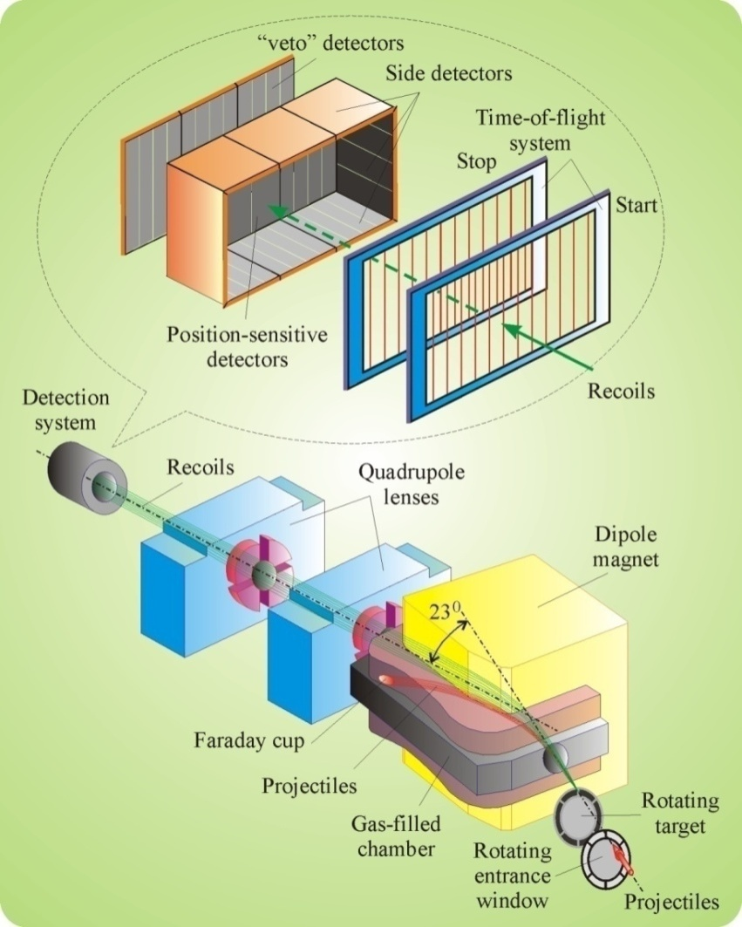
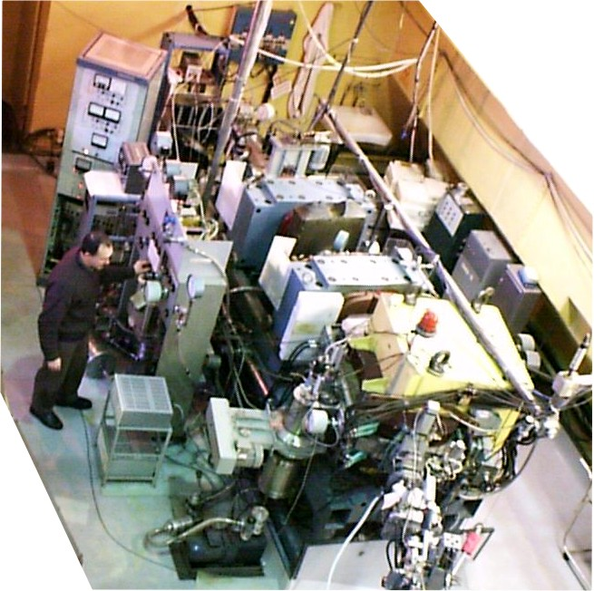
Dubna gas-filled recoil separator

Slide 7
We associate our future in continuing and development of ongoing researches in the field of super heavy elements physics and chemistry with the created SHE factory.

Slide 8
Superheavy Elements (SHE) Factory – the Goals
Experiments at the extremely low (σ<100 fb) cross sections:
Synthesis of new SHE in reactions with ⁵⁰Ti, ⁵⁴Cr ...;
Synthesis of new isotopes of SHE;
Study of decay properties of SHE;
Study of excitation functions.
Experiments requiring high statistics:
Nuclear spectroscopy of SHE;
Precise mass measurements;
Study of chemical properties of SHE.

Slide 9
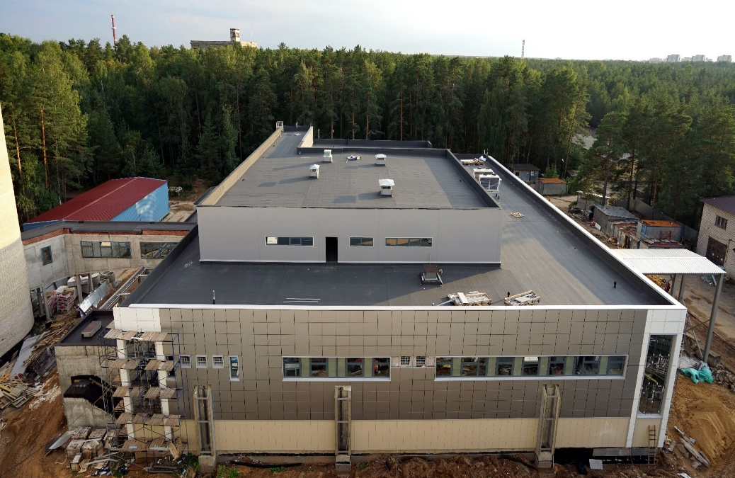
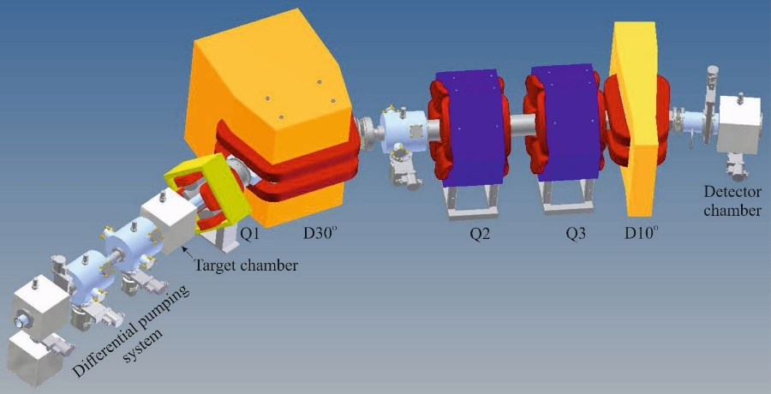
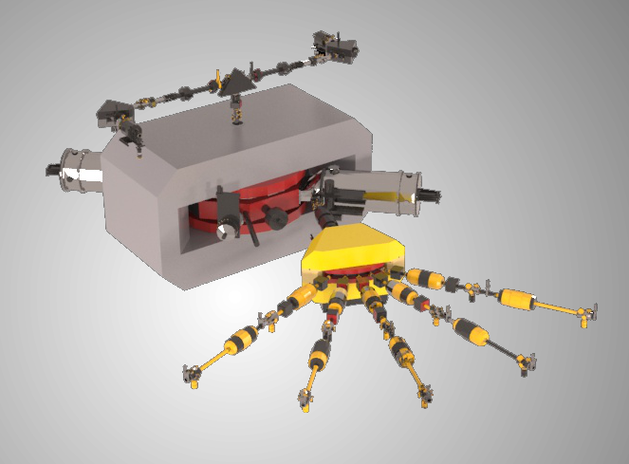
SHE Factory
SHE Factory Building
High-current cyclotron DC-280
New facilities:
New gas-filled separator
Preseparator
SHELS
Etc.
Notes:
The project of the SHE factory includes three principal components: i) high current accelerator, ii) new experimental hall and iii) a number of the next generation facilities.

Slide 10
DC-280 cyclotron – stand-alone SHE factory
DC280 (expected) E=4÷8 MeV/A
Ion | Ion energy [MeV/A] | Output intensity
⁷Li | 4 | 1×10¹⁴
¹⁸O | 8 | 1×10¹⁴
⁴⁰Ar | 5 | 6×10¹³
⁴⁸Ca | 5 | 0,6-1,2×10¹⁴
⁵⁴Cr | 5 | 2×10¹³
⁵⁸Fe | 5 | 1×10¹³
¹²⁴Sn | 5 | 2×10¹²
¹³⁶Xe | 5 | 1×10¹⁴
²³⁸U | 7 | 5×10¹⁰
Synthesis and study of properties of superheavy elements.
Search for new reactions for SHE-synthesis.
Chemistry of new elements.

Slide 11
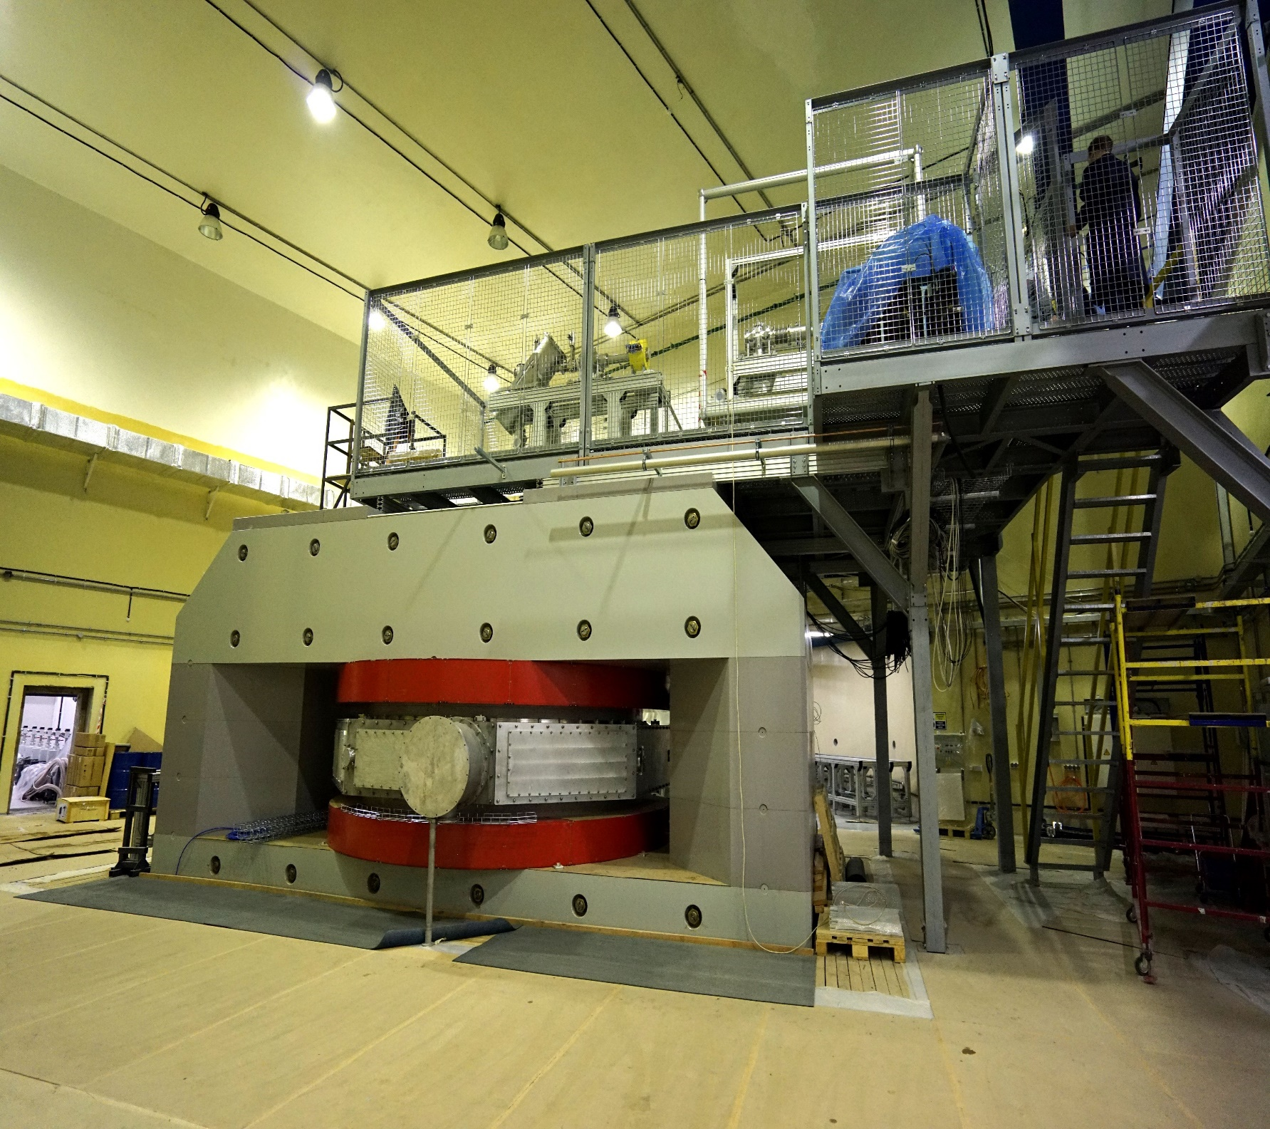

Slide 12
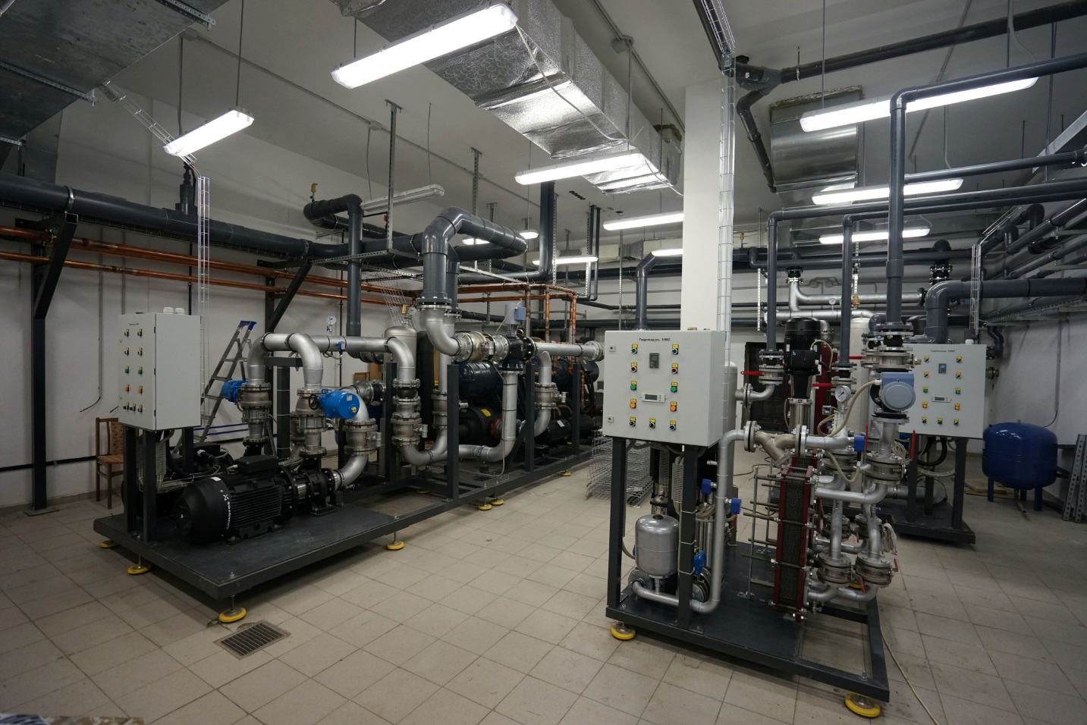
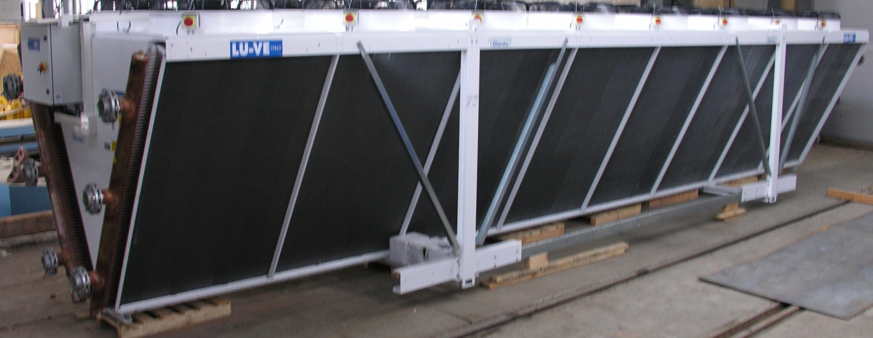
Water cooling system
The water cooling system was developed at the FLNR (equipment suppliers: Russia, Italy, Germany)

Slide 13
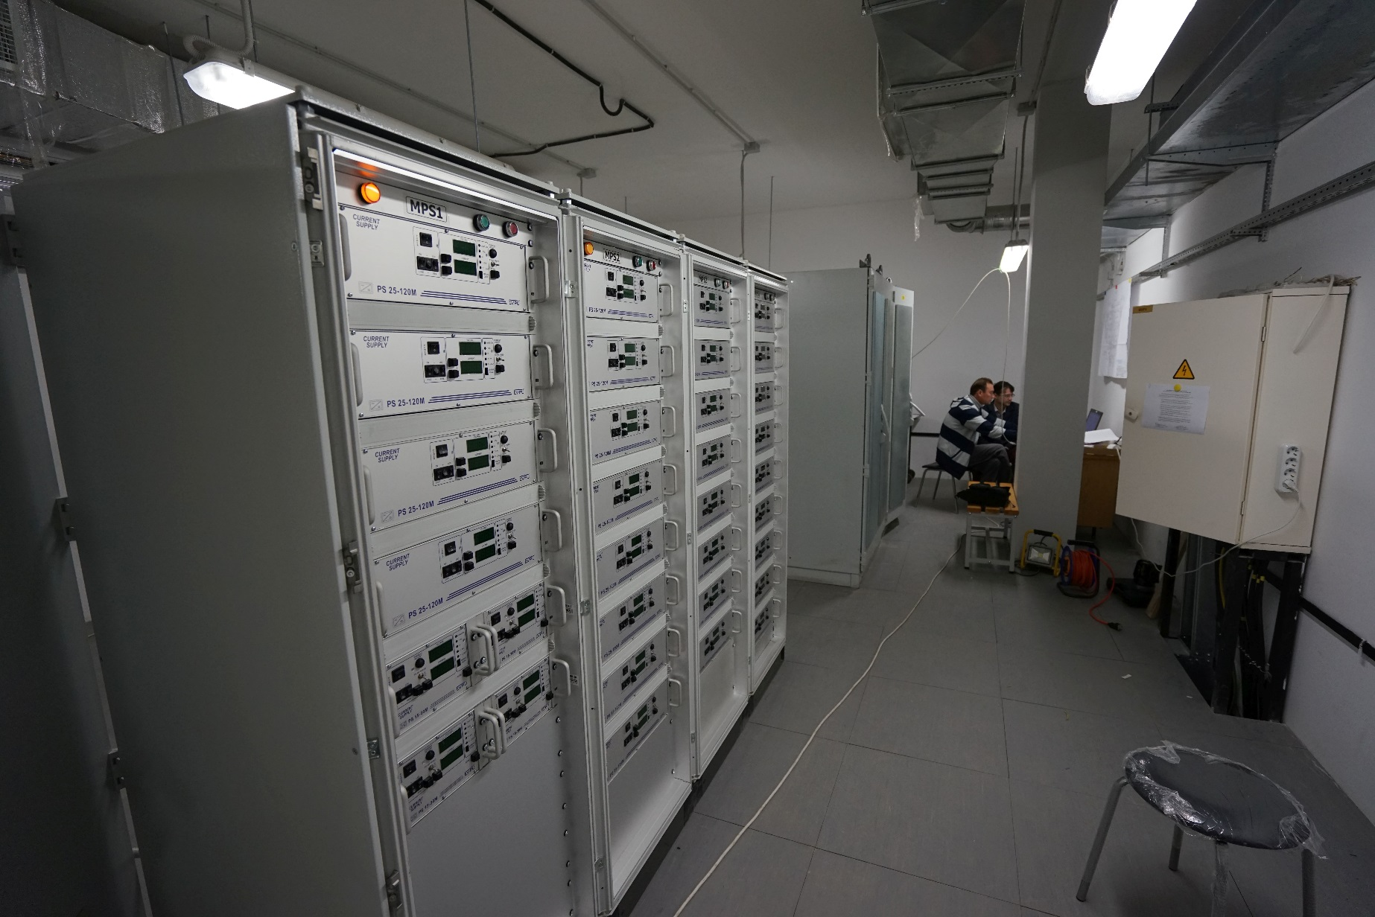
Control system
The control system based on FLNR developments and LabVIEW

Slide 14
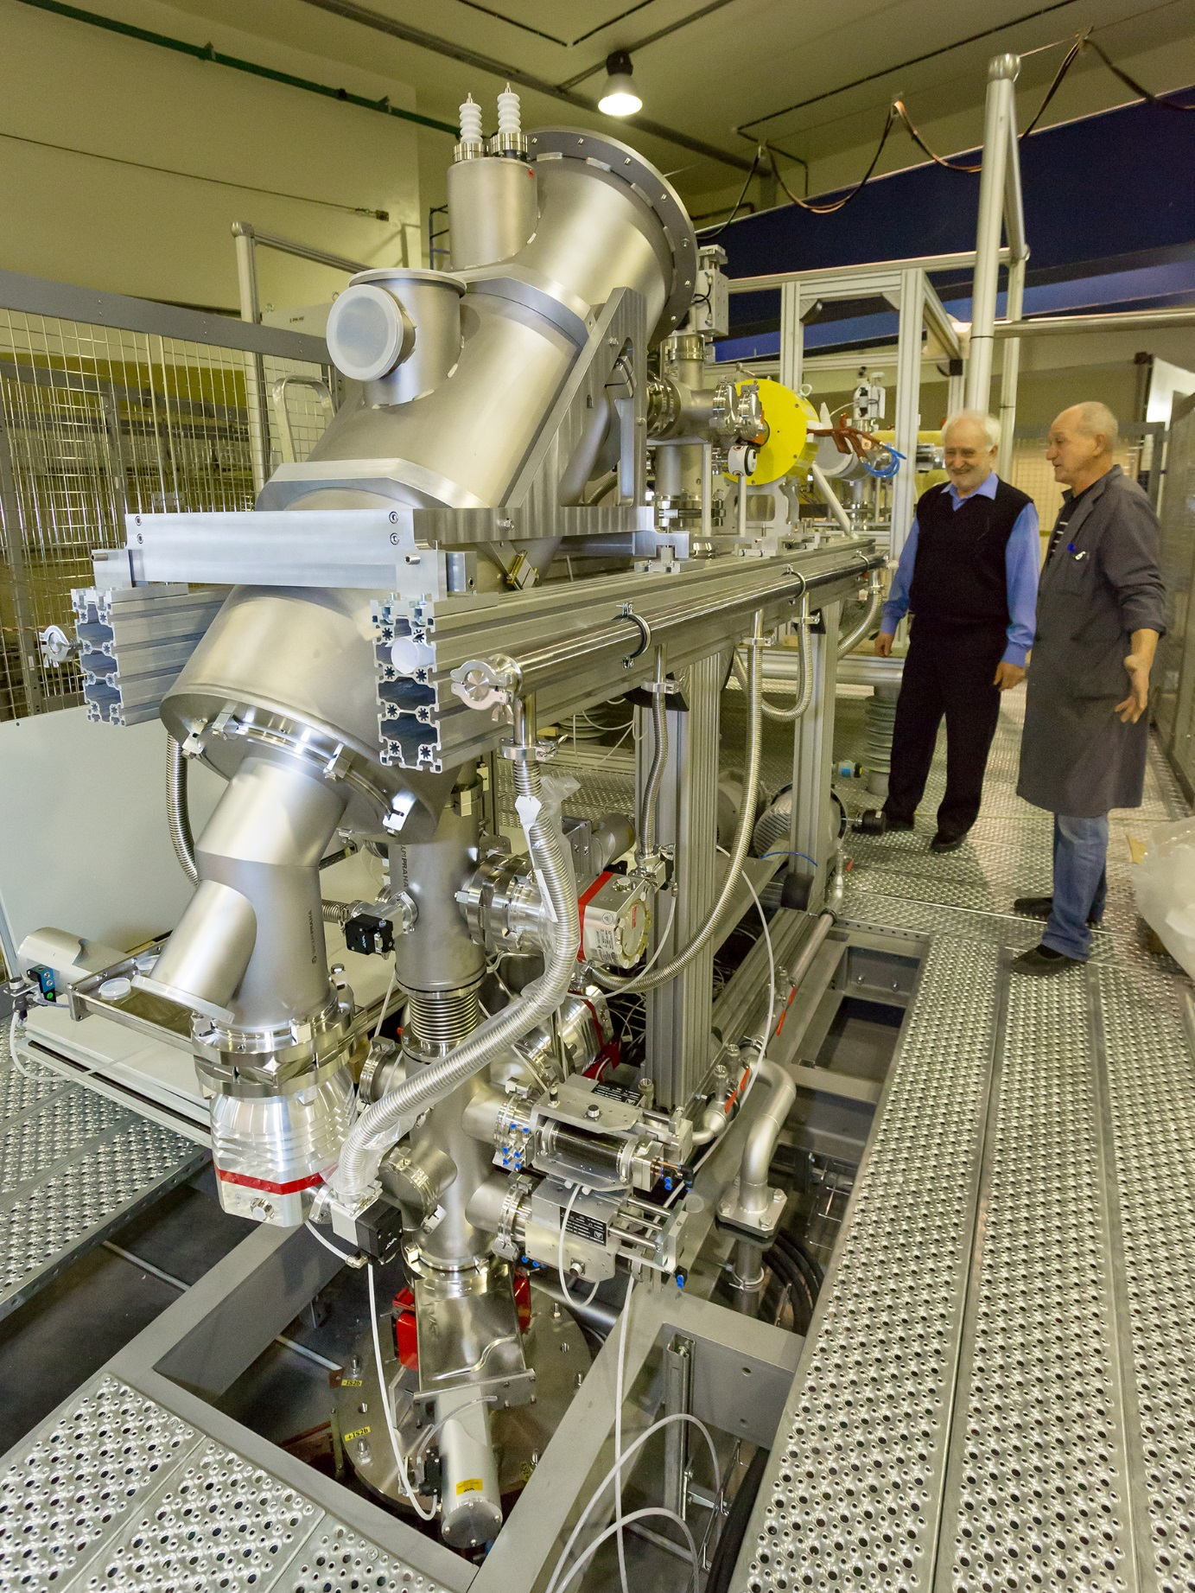

Slide 15
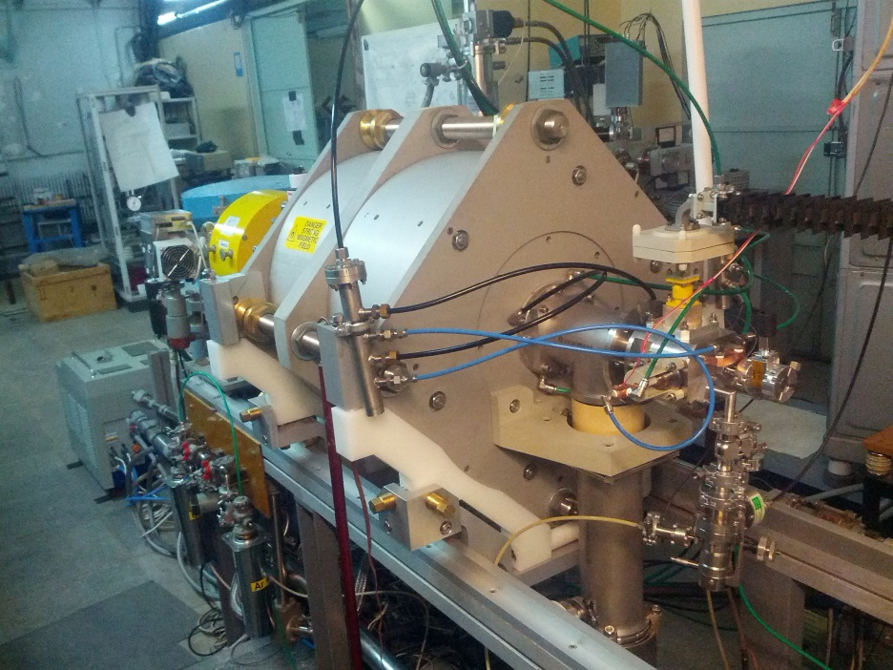
DECRIS-PM at the test bench

Slide 16
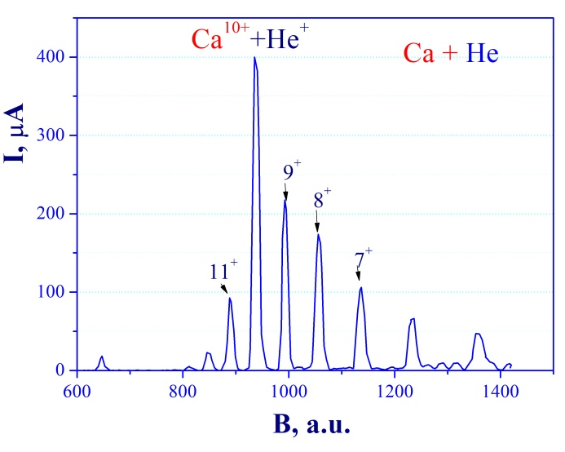
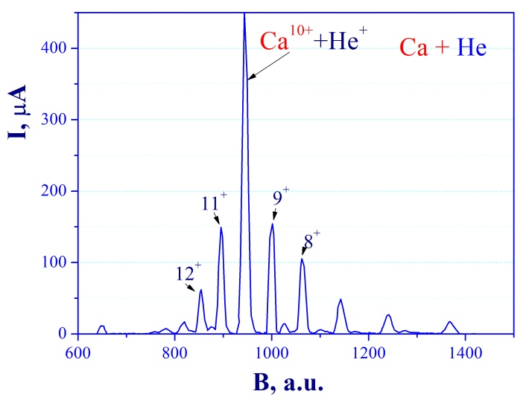
Ca charge state spectra
Ca⁹⁺ =210 µA
Ca¹¹⁺ =150 µA

Slide 17
Expected beam parameters of the DC-280
ION | Z | Beam Intensity from ECR |  | HV platform N | Efficiency of acceleration | Expected beam intensities of (4÷8) MeV/n ions on targets pps
 |  | eμA | pps
20Ne | 3 | 150 | 3.10¹⁴ | 1 | 50% | 1.5·10¹⁴
40Ar | 7 | 300 | 3.10¹⁴ | 1 | 50% | 1.5·10¹⁴
48Са | 7/8 | 160 | 1.10¹⁴ | 1 | 50% | 6.2·10¹³
⁵⁰Ti | 8/9 | 75 | 5.10¹³ | 1 | 50% | 3.1.10¹³
⁵⁴Cr | 9 | 125 | 8.10¹³ | 1 | 50% | 4.10¹³
58Fe | 9/10 | 125 | 8.10¹³ | 1 | 50% | 4·10¹³
64Ni | 10/11 | 125 | 8.10¹³ | 1 | 50% | 4·10¹³
70Zn | 11/12 | 100 | 5.10¹³ | 1 | 50% | 2,5.10¹³
136Хе | 22/23 | 150 | 4.10¹³ | 1 | 50% | 2·10¹³

Slide 18
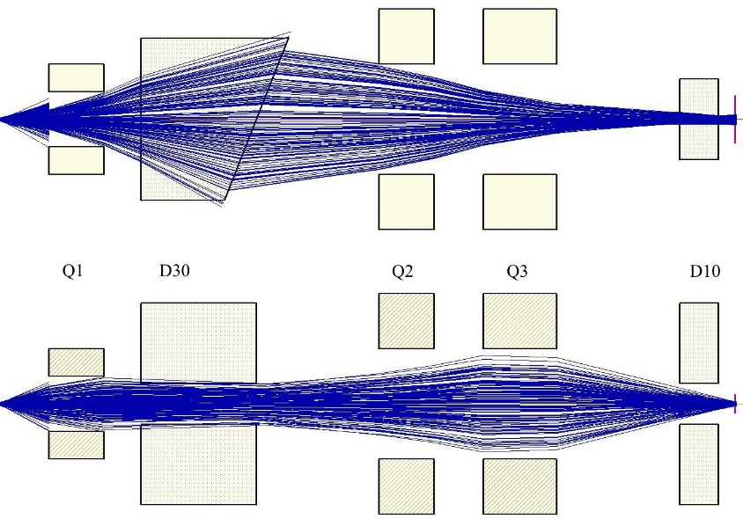
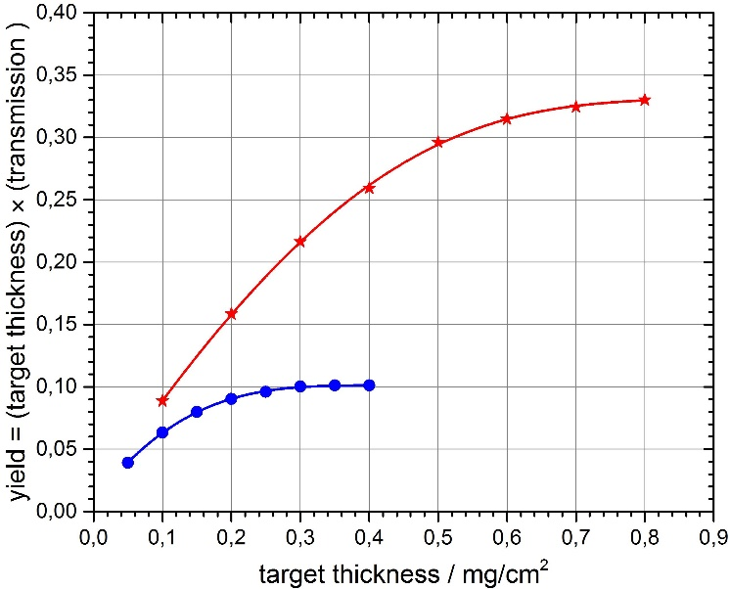
New FLNR gas-filled separator (contracted)
Technical Design
Report No 412923
Reaction | Transmission
²⁴⁴Pu(⁴⁸Ca,3n)²⁸⁹114 | 60 %
²⁴⁴Pu(⁵⁸Fe,4n)²⁹⁸120 | 75 %

Slide 19
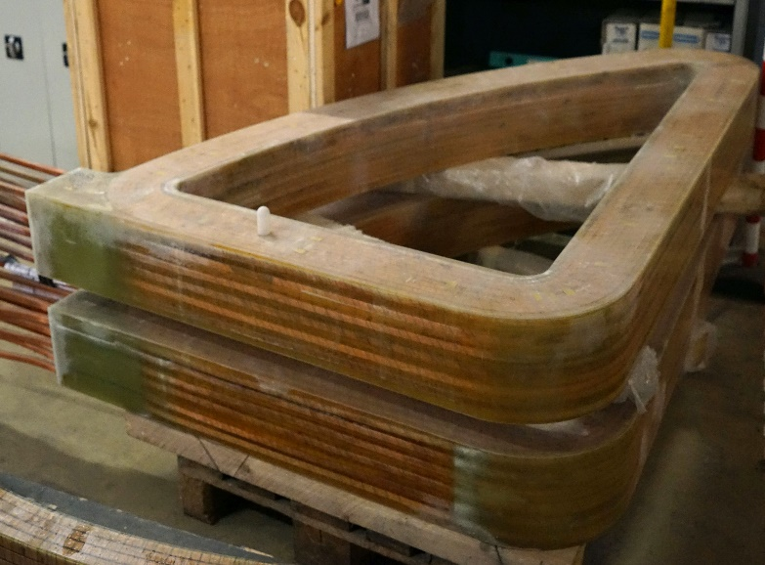
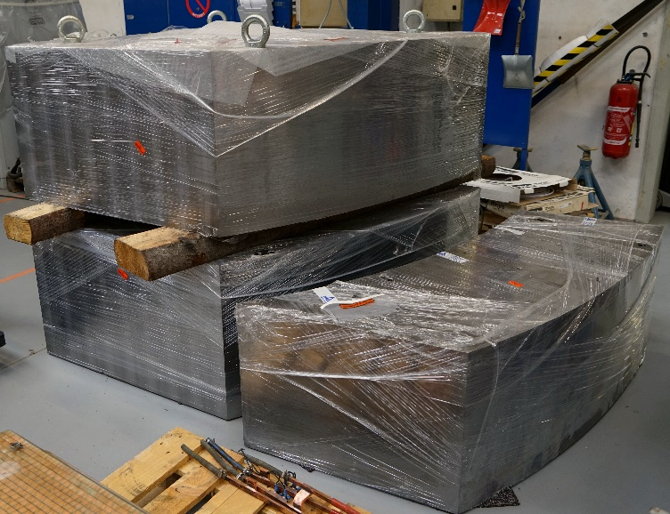
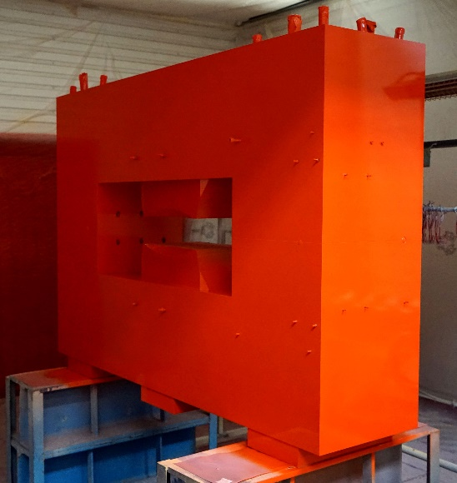
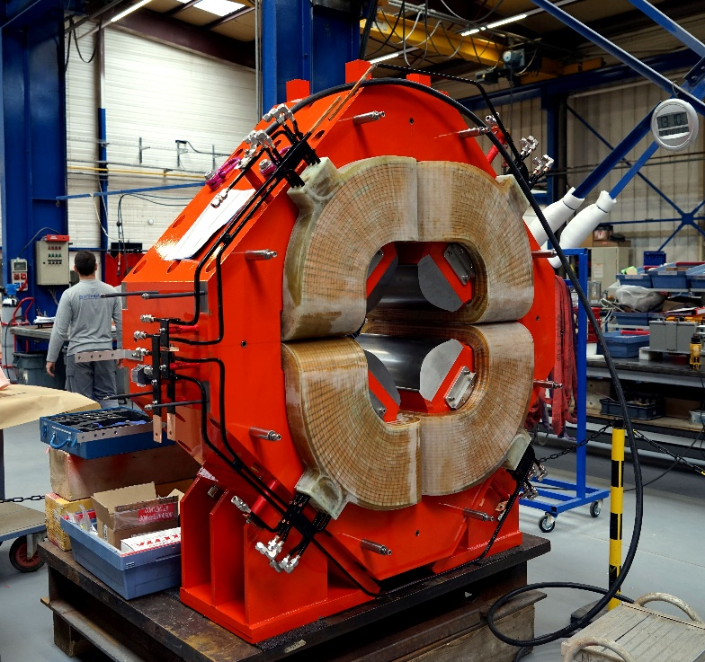
Gas-Filled Separator GFS-2
DC-280
Parts of the main analyzing 30º magnet
Additional 10º magnet
All parts have been manufactured;
Delivery – November , 2017;
Installation Dec. 2017 - Jan 2018
commissioning – Jan –June/ July 2018
Onset of first-day experiments ⁴⁸Ca+ ²⁴³Am –
- Sept.-Nov. 2018;
Focusing quadrupole

Slide 20
Gas-phase chemistry with elements
112, 113 and 114
Are elements 112, 113 and 114 volatile metals?
How do relativistic effects influence the chemistry of E112, E113 and of E114?
Chemistry of elements 115-118 ?

Slide 21
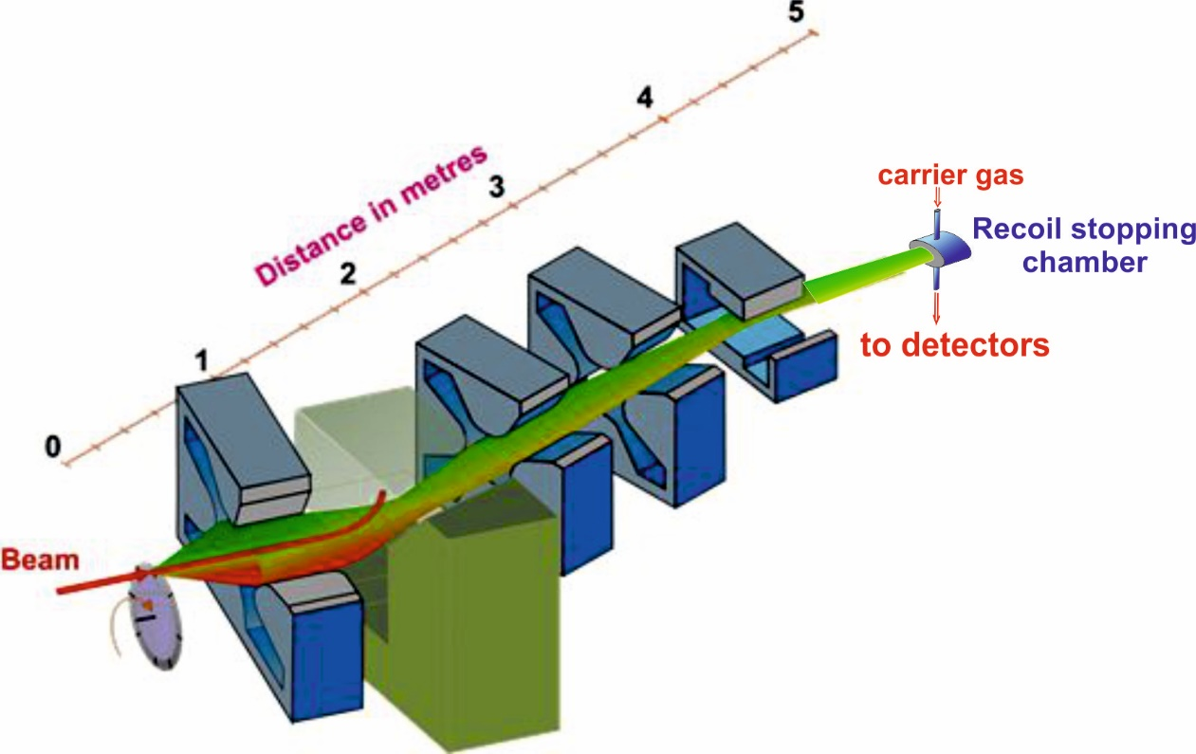
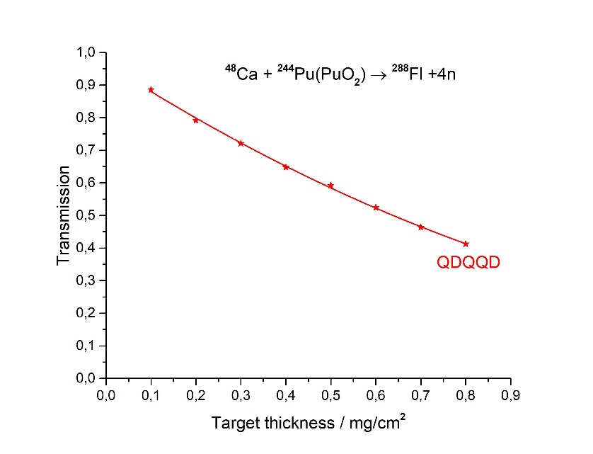
Gas-filled pre-separator GFS-3
(Q_{V}D_{H}Q_{H}Q_{V}D)
Reaction | Transmission
²⁴⁴Pu(⁴⁸Ca,4n)²⁸⁹114 | 60 %
²⁴⁴Pu(⁵⁸Fe,4n)²⁹⁸120 | 75 %

Slide 22
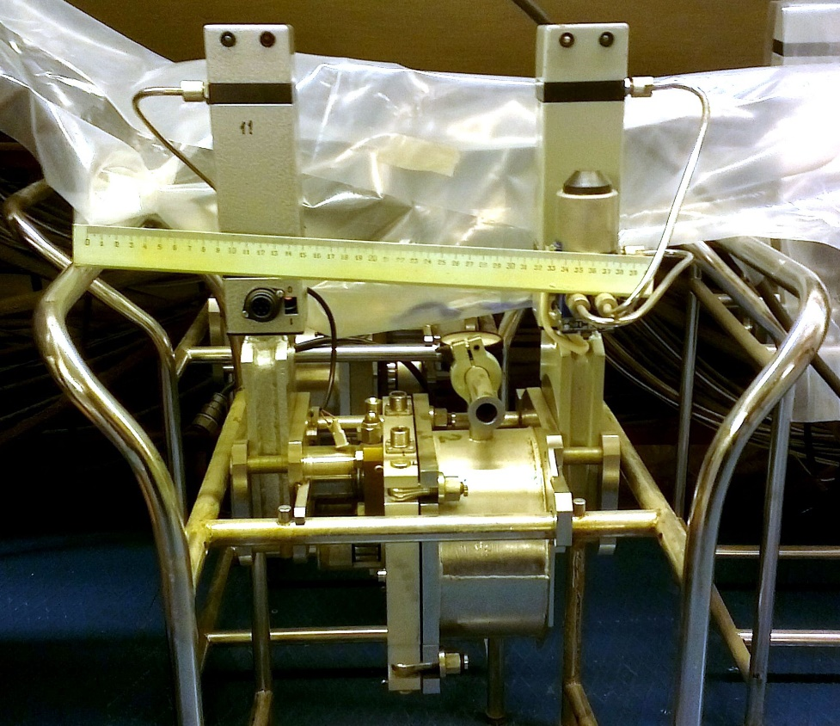
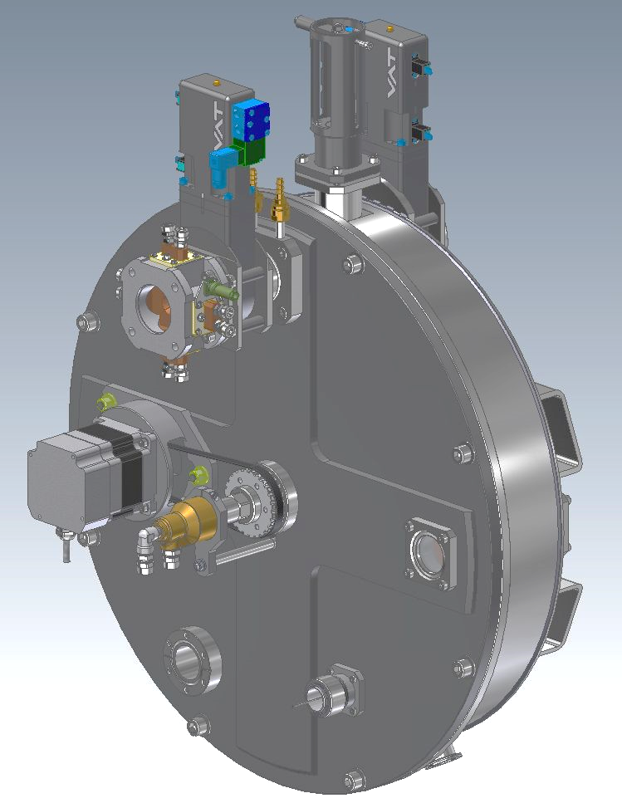
Target block design
old
new
Ø = 120 mm, 1500 r.p.m. synchronous
Beam wobbler or scanner,
Segmented beam diafragm
Is in use at GFS, SHELS, MASHA
Ø = 150mm, 1500 r.p.m. synchronous,
e-beam & optical diagnostic,
water cooling

Slide 23
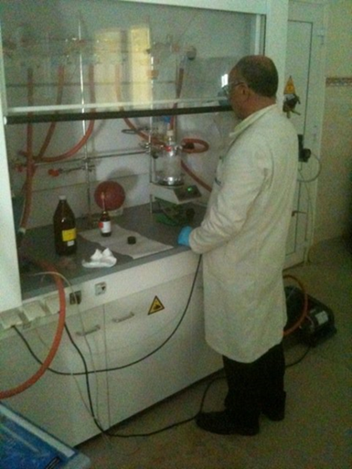
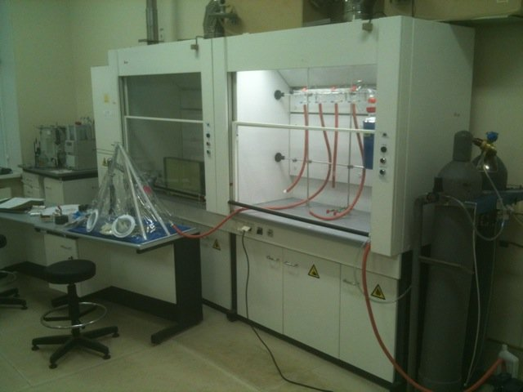
Development of ⁵⁰Ti beam using MIVOC method
Synthesis of (trimethyl)pentamethyl-cyclopentadienyl titanium
TiCl₄ + (CH₃)₅C₅Si(CH₃)₃ Cp*TiCl₃ + 3CH₃Li Cp*Ti(CH₃)₃
Benoit Gall, Zouhair Asfari
Institut Pluridisciplinaire Hubert Curien, IN2P3-CNRS, Université of Strasbourg, France
The first step of synthesis was performed at IPHC, the final step at FLNR.
Chemistry laboratory

Slide 24
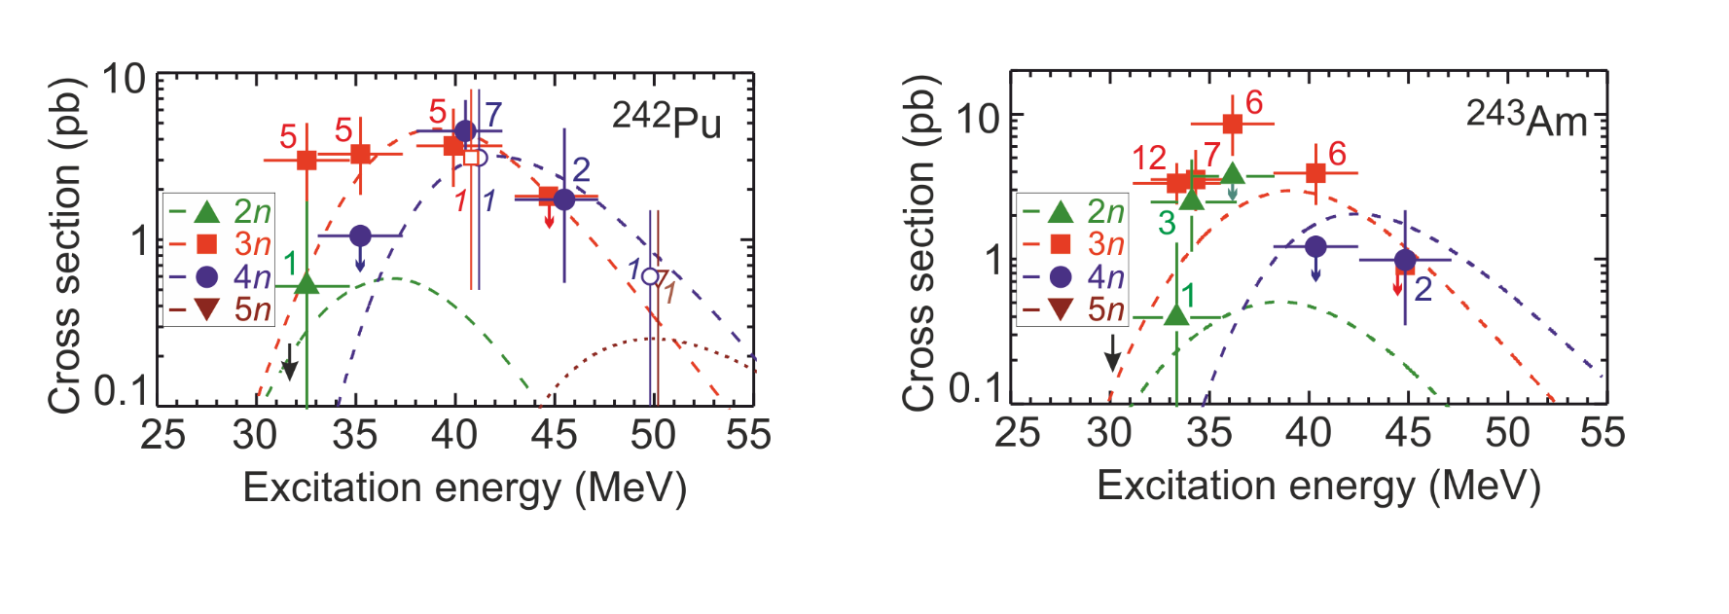
First-day experiments at SHE Factory
Aims of the experiments:
Test of functionalities of all the systems of new accelerator and new gas-filled recoil separator
Accumulate additional statistics for the chosen reactions
Chosen reactions: ⁴⁸Ca+²⁴³Am and ⁴⁸Ca+²⁴²Pu
Enough material to prepare the targets
Relatively large cross sections and, thus, optimum candidates for spectroscopic experiments
Well-studied in previous experiments. Good for testing of the accelerator complex
⁴⁸Ca+²⁴²Pu
Existing experimental data
⁴⁸Ca+²⁴³Am

Slide 25
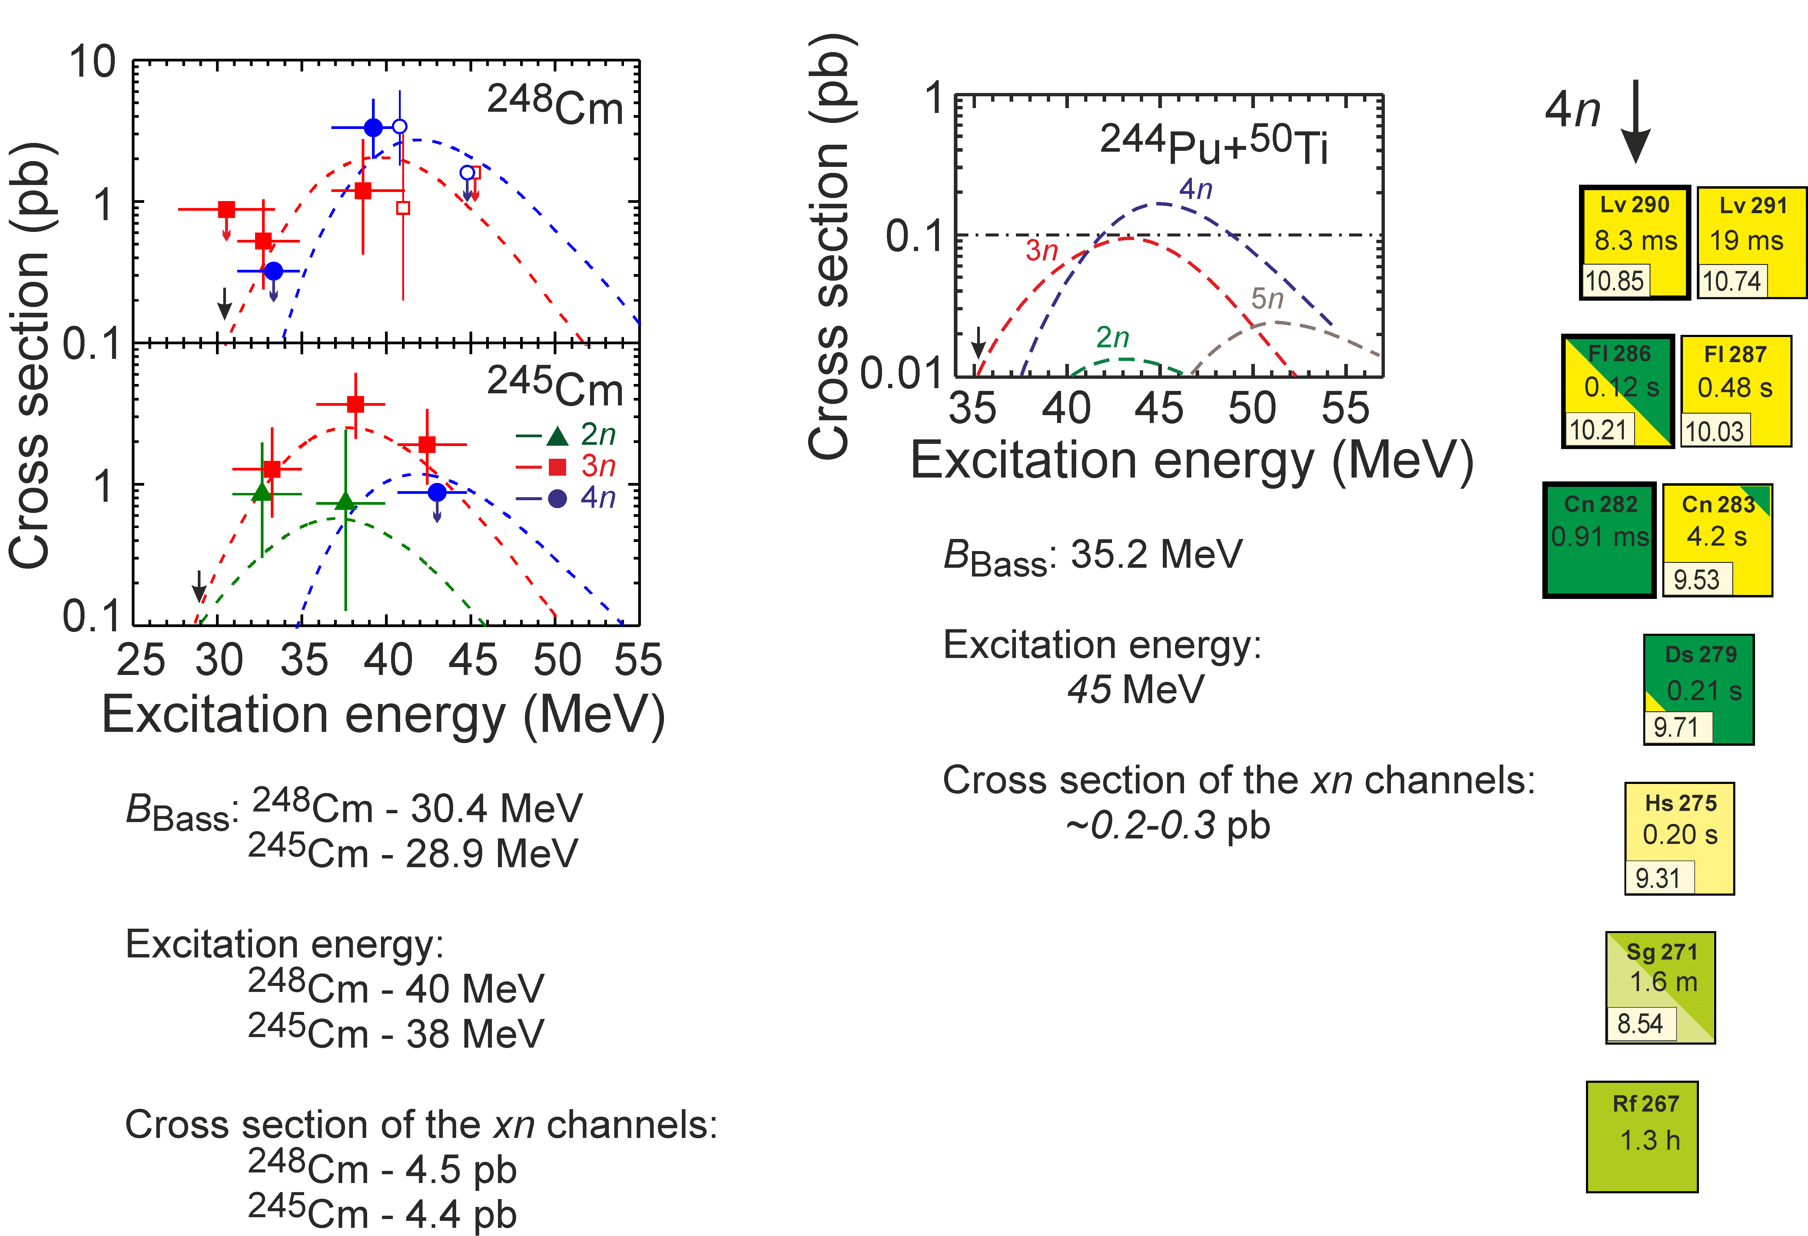
From ⁴⁸Ca to ⁵⁰Ti
Test reactions: ²⁴⁶Cm+⁴⁸Ca ²⁹⁴Lv* ²⁴⁴Pu+⁵⁰Ti ²⁹⁴Lv*
V. Zagrebaev and W. Greiner

Slide 26
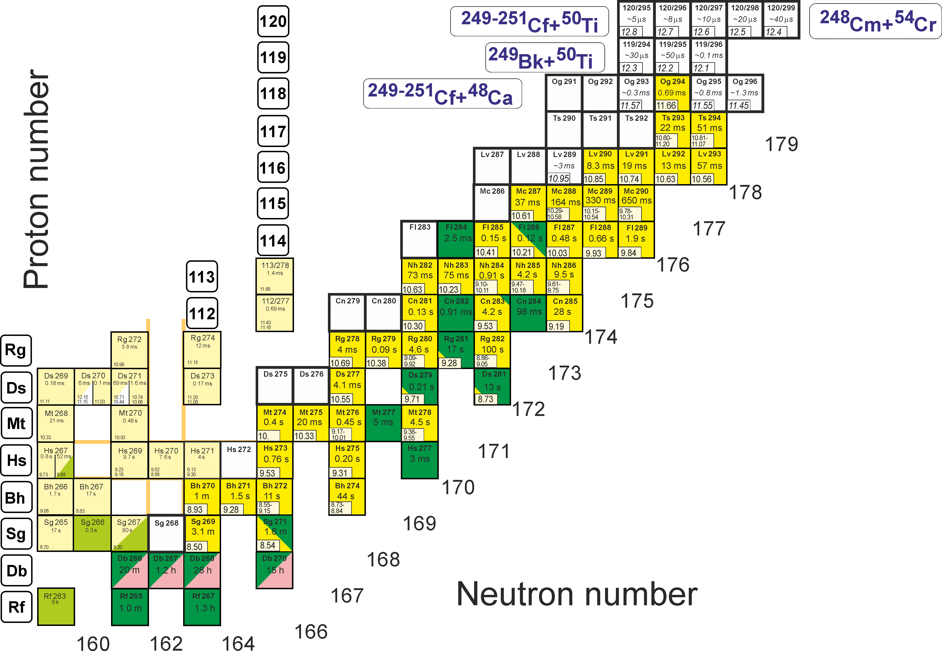
First experiments at SHE Factory
Synthesis of new elements 119 and 120

Slide 27
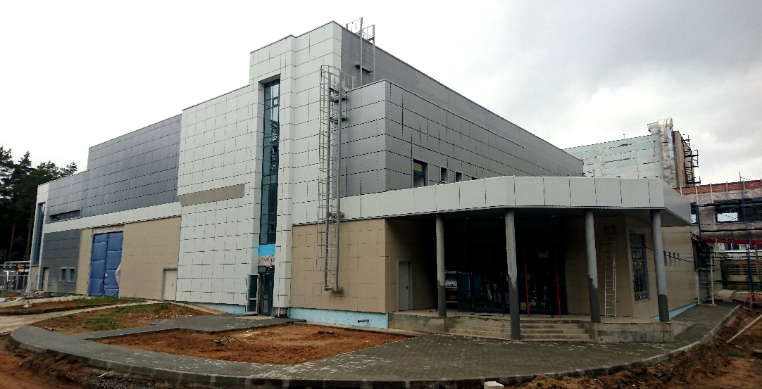
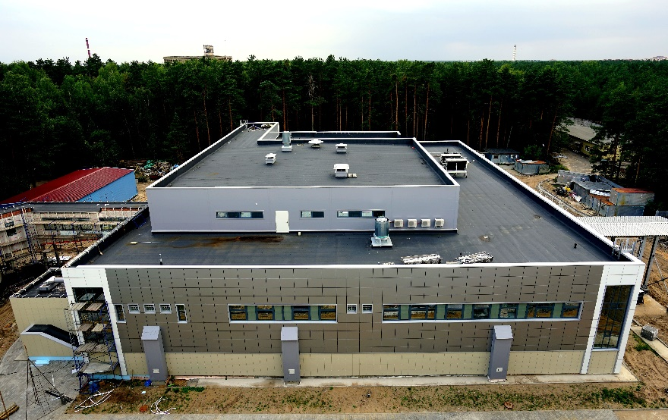
Superheavy Element Factory
time schedule
DC-280
SHE Factory Building: Completion - Dec 2017; commissioning - Jan – April 2018
DC-280 cyclotron: Assembling – Dec 2017; commissioning – Jan - April 2018
Gas-Filled Separator: Installation – Dec 2017; commissioning – Jan - July 2018
Onset of first-day experiments – Sept-Nov 2018

Slide 28
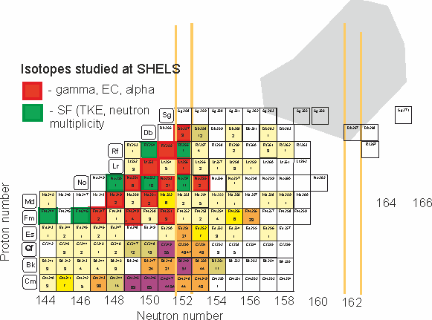
α-, β-, and γ-spectroscopy of heavy nuclei
Present status of research (January 2018)
CSNSM,
Orsay Campus, France
K. Hauschild, A. Lopez-Martens,
R. Chakma, Blaise Retailleau.
IPHC,
Strasbourg, France
O. Dorvaux, B. Gall, F. Dechery,
H. Faure, Z. Asfari, P. Chauveau
GANIL,
Caen, France
J. Piot , Ch. Stodel, D. Ackermann,
H. Savajols, L. Caceres

Slide 29
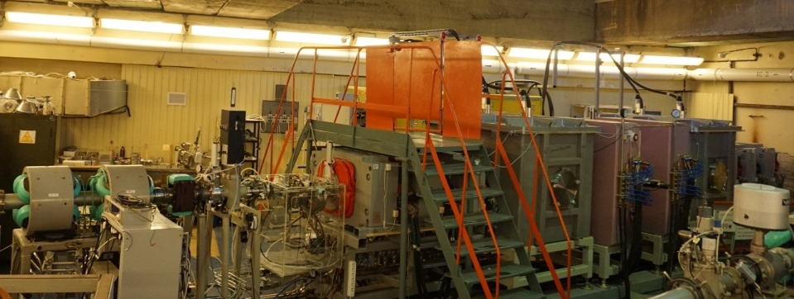
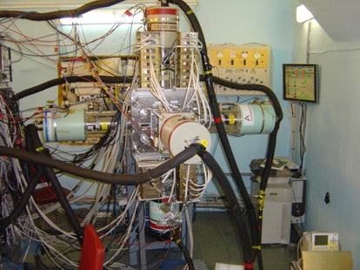
α-, β-, and γ-spectroscopy of heavy nuclei at FLNR JINR
Present status of research (January 2018)
SHELS separator (velocity filter)
U400 heavy ion cyclotron
²²Ne ~ 2 pμA
⁴⁸Ca ~ 1 pμA
⁵⁰Ti ~ 0.5 pμA,
Heavy (Z>100) nuclei
of interest
GABRIELA detector set up (α,β,γ and SF)
Detailed spectroscopy studies of the transfermium isotopes
^{244,246,147,249,251}Fm, ^{249,251}Md, ^{250,251,252,253,254,255}No, ^{253,255}Lr,
^{254,255,256,257}Rf, ²⁵⁷Db

Slide 30

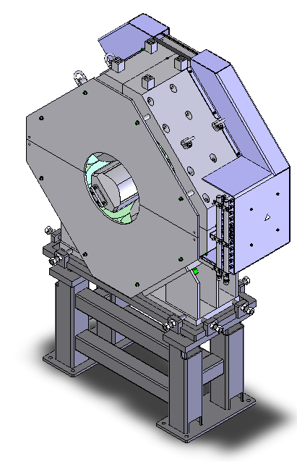
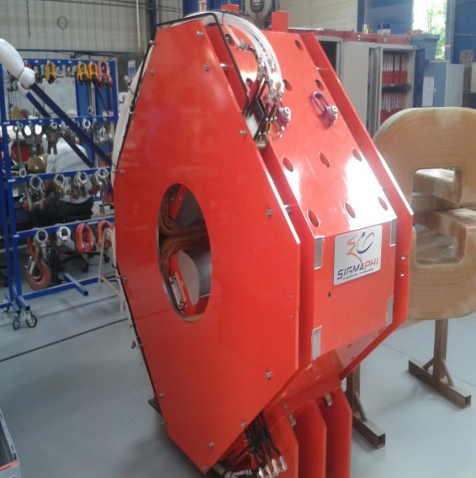
Modernization of experimental set up
SHELS 2018
SHELS 2021
3 super wide aperture (300 mm) quadrupole lenses
for first triplet – increase of transmission for slow ERs
for asymmetric combinations by factor of 1.5

Slide 31
Plans for years 2018 – 2023:
Spectroscopy study of the ²⁵⁷Rf (complete fusion reaction ⁵⁰Ti + ²⁰⁸Pb → ²⁵⁸Rf*)
(model experiment for spectroscopy of element 114)
Spectroscopy study of the ²⁶⁰Sg, ²⁶¹Sg (complete fusion reaction ⁵⁴Cr + ²⁰⁸Pb → ²⁶²Sg*)
Study of SF of the ²⁵⁴Rf (complete fusion reaction ⁵⁰Ti + ²⁰⁶Pb → ²⁵⁴Rf + 2n)
Study of SF of the ²⁶⁰Sg (complete fusion reaction ⁵⁴Cr + ²⁰⁸Pb → ²⁶⁰Sg + 2n)
Study of SF of the ²⁶⁰Rf (complete fusion reaction ²²Ne + ²⁴²Pu → ²⁶⁰Rf + 4n)
Spectroscopy study of the ²⁵⁹Rf (complete fusion reaction ²²Ne + ²⁴²Pu → ²⁵⁹Rf + 5n)
Spectroscopy study of the ²⁶⁵Sg, ²⁶⁶Sg (complete fusion reaction ²²Ne + ²⁴⁸Cm → ^{266,265}Sg + 4,5n)
Experiment for spectroscopy of element 115 (complete fusion reaction ⁴⁸Ca + ²⁴³Am → ²⁸⁸115 + 3n)
Experiment for spectroscopy of element 114 (complete fusion reaction ⁴⁸Ca + ²⁴²Pu → ²⁸⁷Fl + 3n)

Slide 32
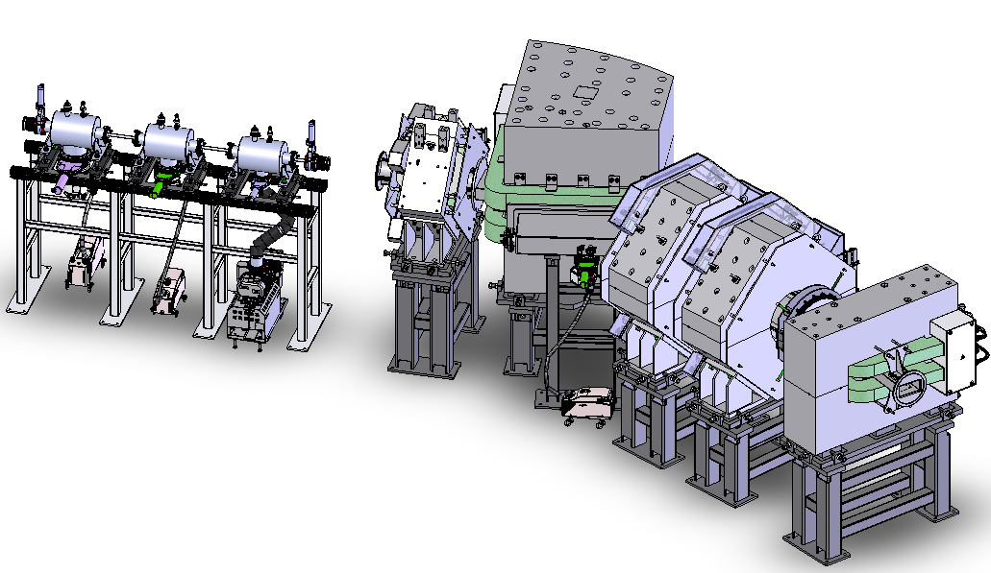
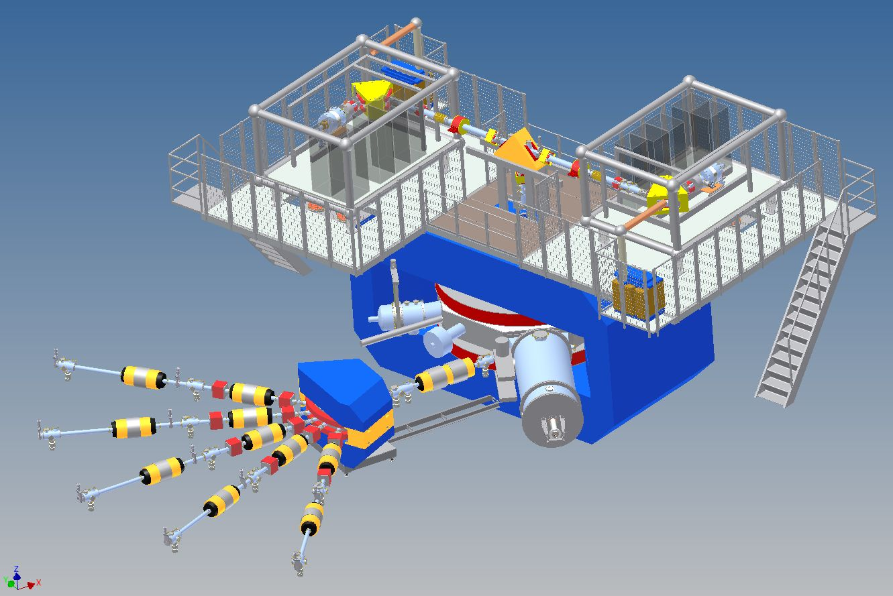
α-, β-, and γ-spectroscopy of heavy nuclei at FLNR JINR
Future perspectives of research (2022 - 2023)
Gas filled separator
DC280 heavy ion cyclotron
²²Ne ~ 20 pμA
⁴⁸Ca ~ 10 pμA
⁵⁰Ti ~ 5 pμA,
Heavy (Z>100) nuclei
of interest
GABRIELA 2020 detector set up (α,β,γ and SF)
Detailed spectroscopy studies of the SHE isotopes
^{287,289}Fl, ^{287,288}Mc, ²⁹³Lv

Slide 33
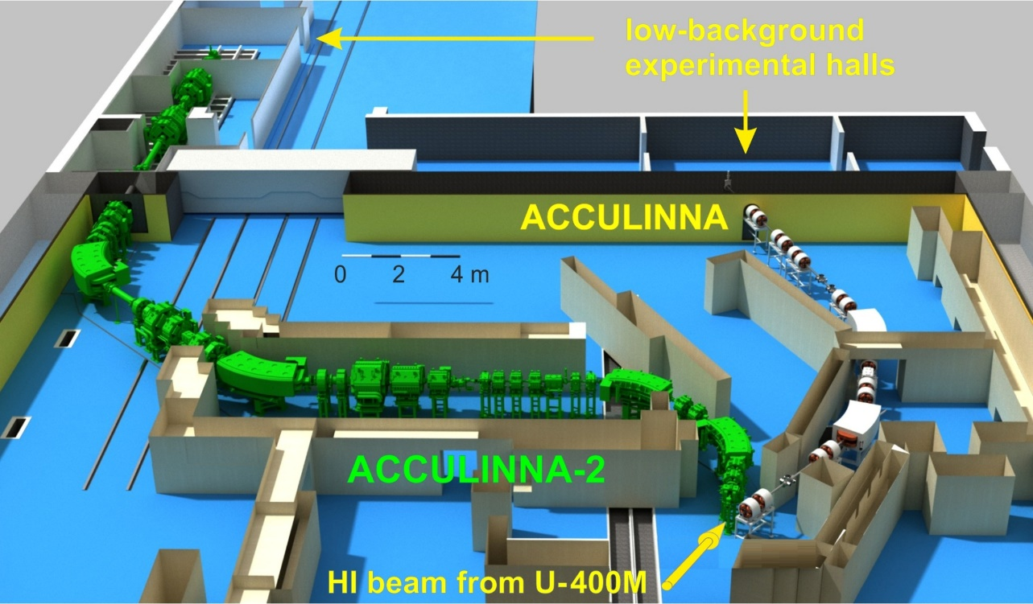
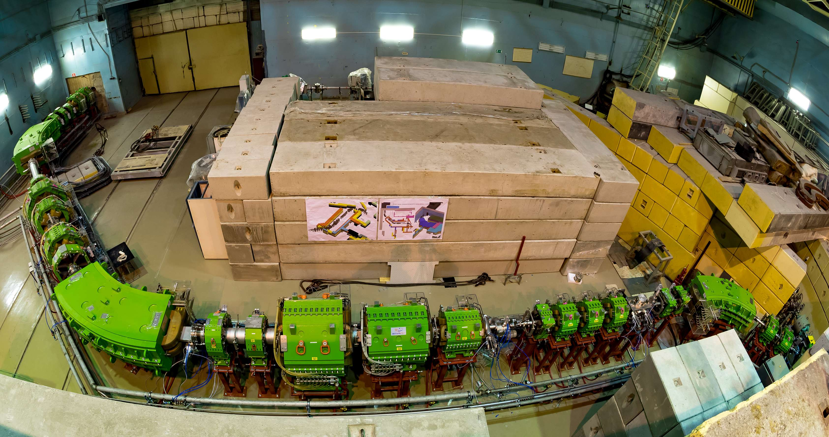
Setup layout
&
Today status
F5
F4
F3
total length F0-F5 ~53m
39 magnetic elements
F2
F1
F3
F0
6 m
F2
F1
F0

Slide 34
ACCULINNA-2 fragment separator commissioned in 2017 is now ready for day-one experiments.
The first-priority experimental program with RIBs is focused on ⁶He+d scattering, beta-delayed exotic decays of ¹¹Be and ^{5,7}H study.
Day-two experiment (with RF-kicker and zero angle spectrometer) will be aimed on ²⁶S observation in (p,t) reaction with ²⁸S.

Slide 35
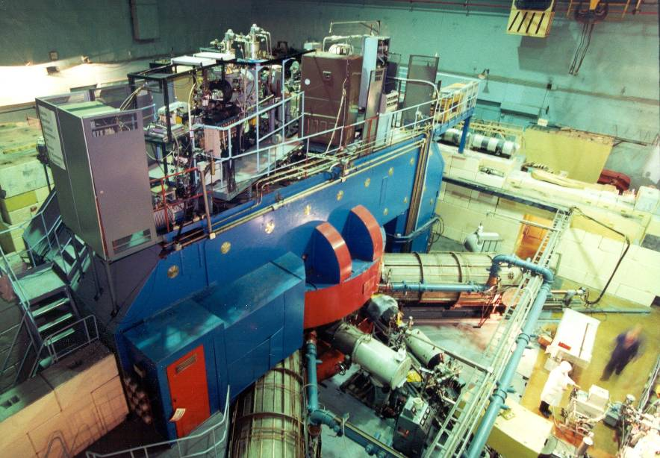
U400M CYCLOTRON
stand-alone & driving accelerator
U400M E=30 ÷ 50 MeV/A E=4.5 ÷ 9 MeV/A
Ion | Ion energy [MeV/A] | Output intensity
⁷Li | 35 | 6×10¹³
¹⁸O | 33 | 1×10¹³
⁴⁰Ar | 40 | 1×10¹²
⁴⁸Ca | 5 | 6×10¹²
⁵⁴Cr | 5 | 3×10¹²
⁵⁸Fe | 5 | 3×10¹²
¹²⁴Sn | 5 | 2×10¹¹
¹³⁶Xe | 5 | 4×10¹¹
²³⁸U | 7 | 2×10¹⁰
Properties and structure of light exotic nuclei;
Astrophysics;
Reactions with exotic nuclei;
Light neutron-rich nuclei;
Deep inelastic scattering;
Producing of RIBs.
Notes:
35

Slide 36
U400R CYCLOTRON
stand-alone & post-accelerator
U400R (expected)
Ion | Ion energy [MeV/A] | Output intensity
⁶He | 2.8 ÷ 14 | 10⁸
⁸He | 1.6 ÷ 8 | 10⁵
⁷Li | 2-17 | 1×10¹⁴
¹⁶O | 6,4 -27 | 1×10¹⁴
⁴⁰Ar | 1-5,1 | 6×10¹³
⁴⁸Ca | 1,6-11 | 1.5×10¹³
⁵⁰Ti | 4,1-21 | 6×10¹²
⁵⁸Fe | 1,2-7,5 | 6×10¹²
⁸⁴Kr | 0,8-3,5 | 2×10¹²
¹³²Xe | 0,8-3,5 | 3×10¹²
²³⁸U | 1,5- 8 | 5×10¹¹
Fusion-fission;
Quasi-fission;
Nuclear spectroscopy;
New heavy isotopes;
Multi nucleon transfer reactions;
SHE chemistry;
Reactions with exotic nuclei;
Structure of light exotic nuclei;

Slide 37
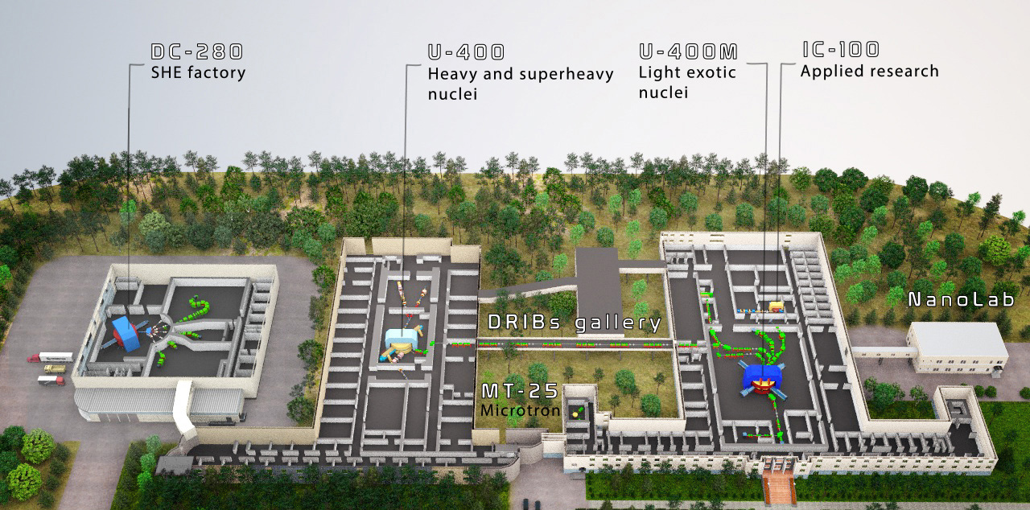

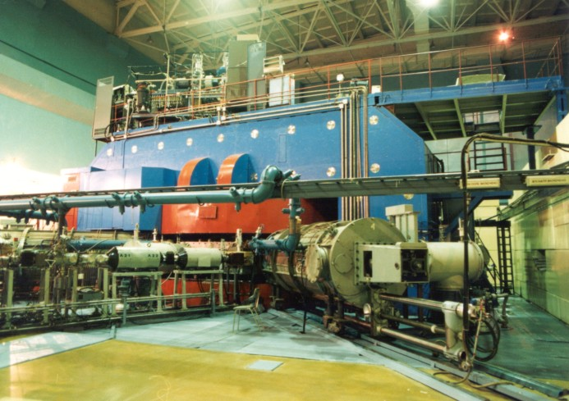

Slide 38
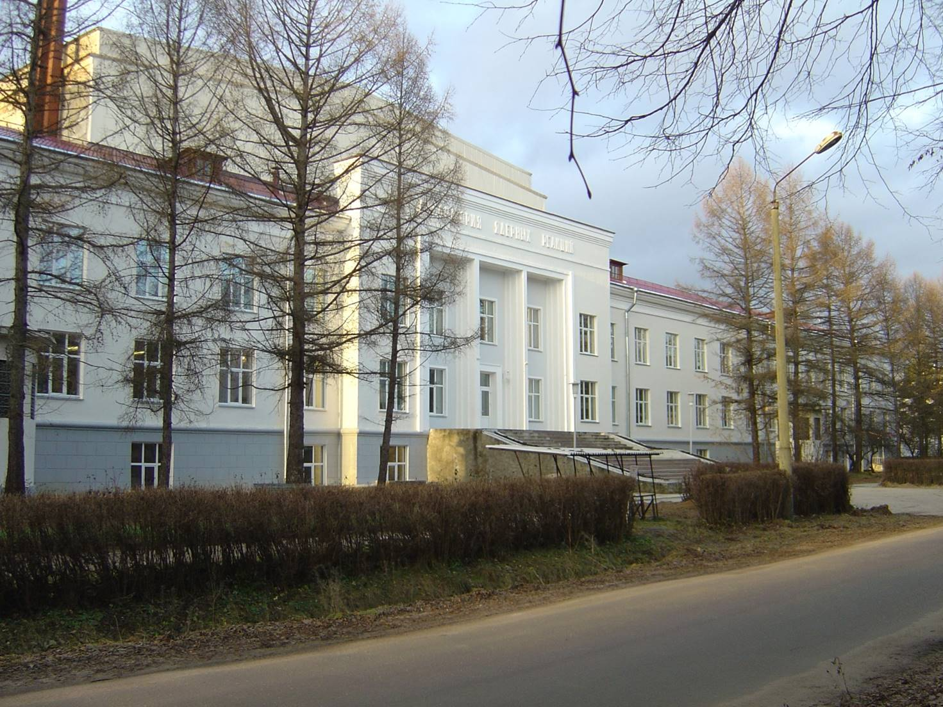
THANK YOU
FOR YOUR
ATTENTION !
Flerov Laboratory of Nuclear Reactions (JINR)

Slide 39
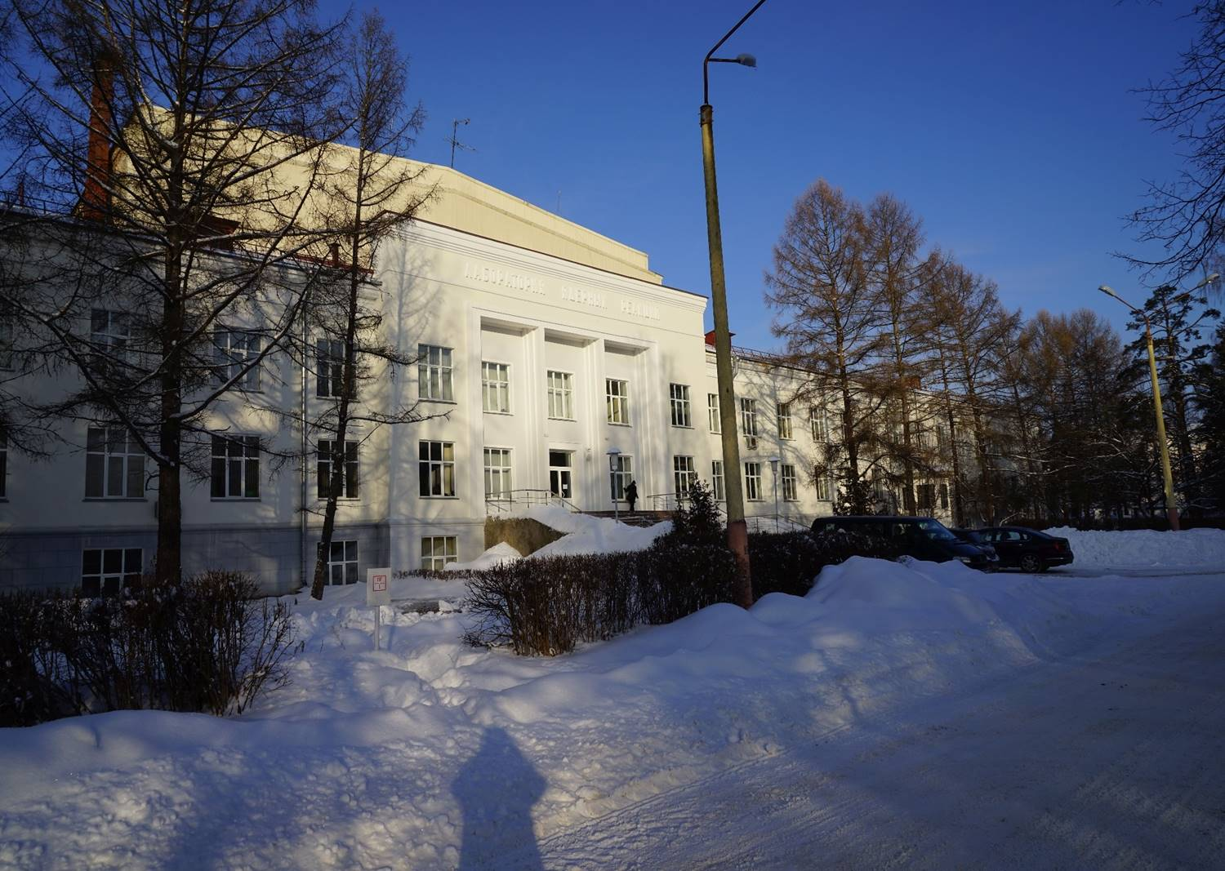
THANK YOU
FOR YOUR
ATTENTION !
Flerov Laboratory of Nuclear Reactions (JINR)

