Slide 1
Particle physics at LAPP
Edwige Tournefier
Novembre 2nd 2017

Slide 2
Your visit today at LAPP
10.00 – 10.15 a.m.: LAPP and particle physics (Edwige Tournefier)
10.15 – 11.45 a.m.: visit (4 groups)
  Gravitational waves (Loïc Rolland, Dimitri Estevez)
  Gamma astronomy (Vincent Poireau, David Sanchez)
  Neutrinos (Anne Chappuis)
  Research and development for new detectors (Maximilien Chefdeville)
  ATLAS at LAPP (Nareï Lorenzo Martinez, Jessica Leveque)
11.45 – 12.15 a.m.: Cosmology (Dominique Boutigny)
12.15 – 12.30 a.m.: Questions and answers
 | Group 1 (Myriam) | Group 2 (Henri) | Group 3 (Caroline) | Group 4 (Alix)
10.15 – 10.45 a.m | Gravitational waves Gamma astronomy | Gravitational waves Gamma astronomy | Detectors | Neutrinos
10.45 – 11.15 a.m | Detectors | LAPP in ATLAS + Valorisation | Neutrinos | Gravitational waves Gamma astronomy
11.15 – 11.45 a.m | LAPP in ATLAS + Valorisation | Neutrinos | Gravitational waves Gamma astronomy | Detectors

Slide 3
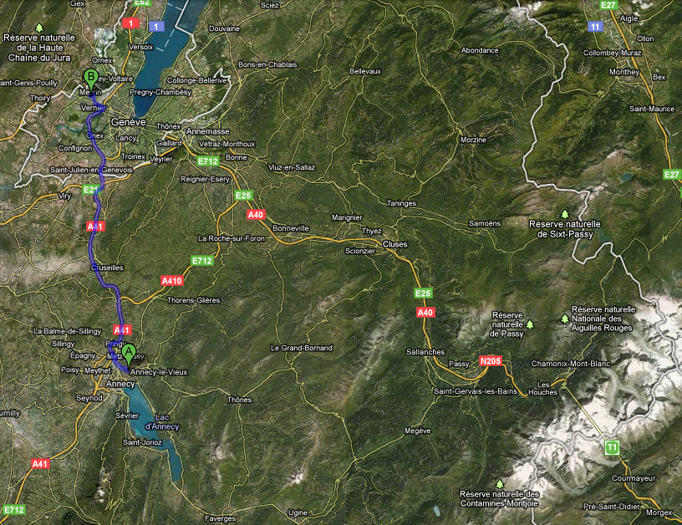
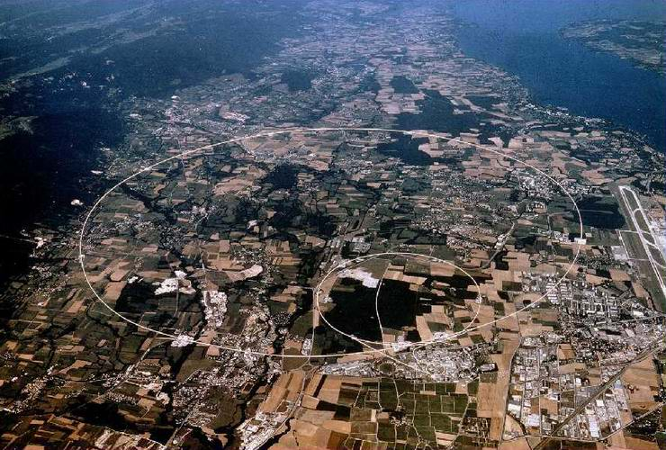
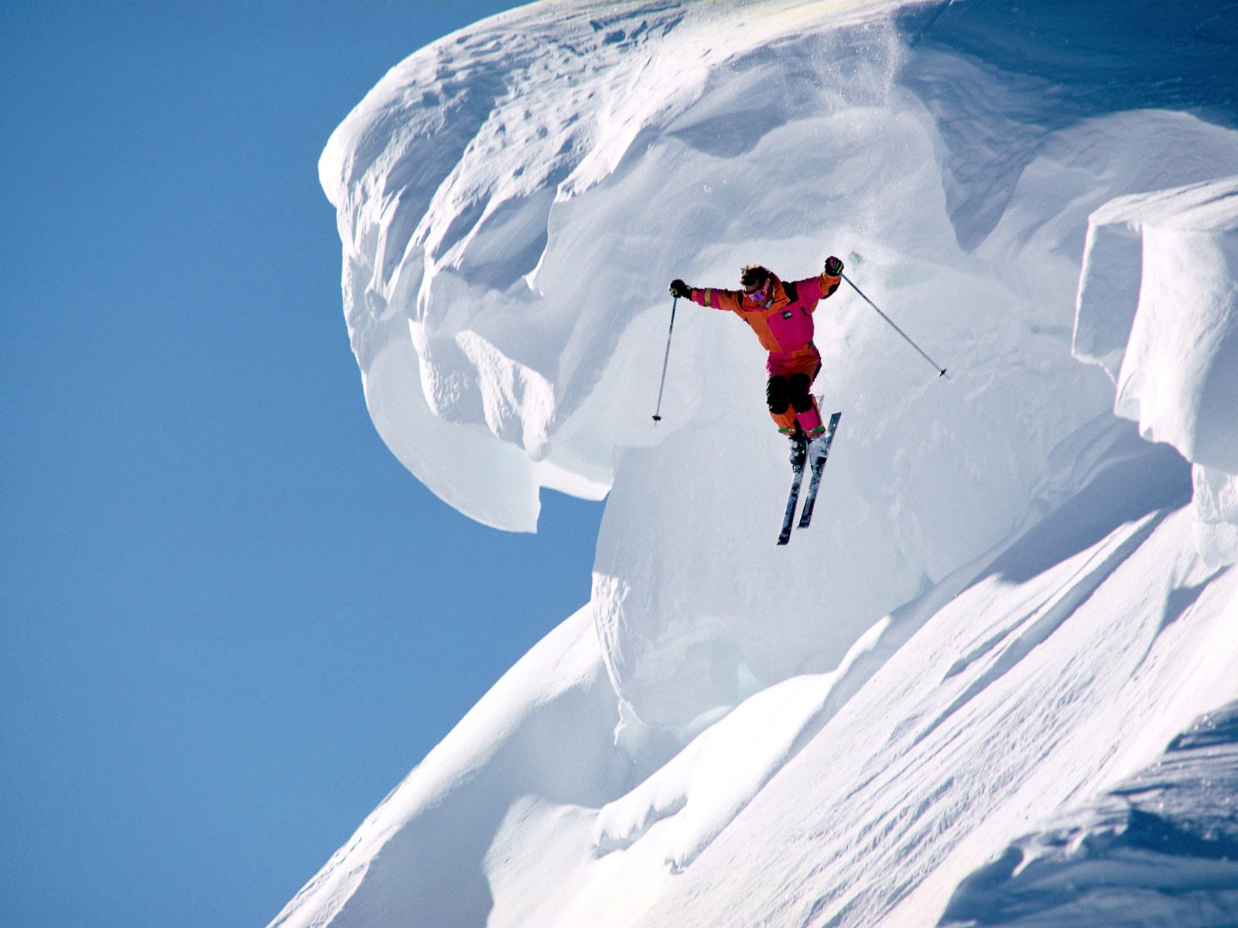
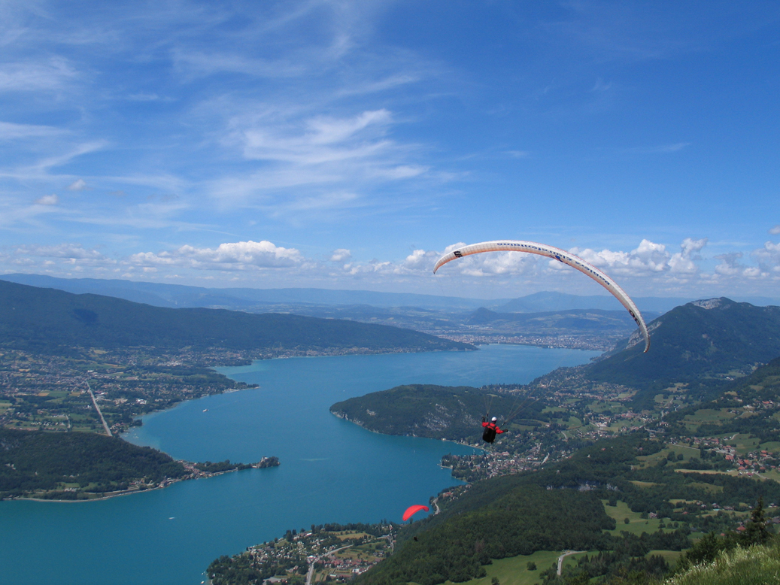
CERN
What is particle physics?
LAPP’s experiments
Who works at LAPP
MT. BIANCO
ANNECY
2

Slide 4
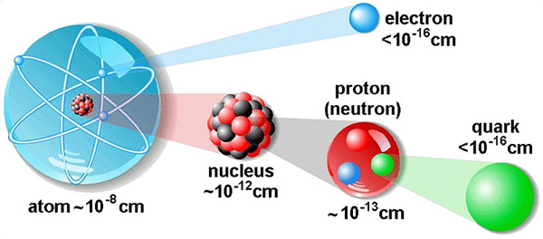
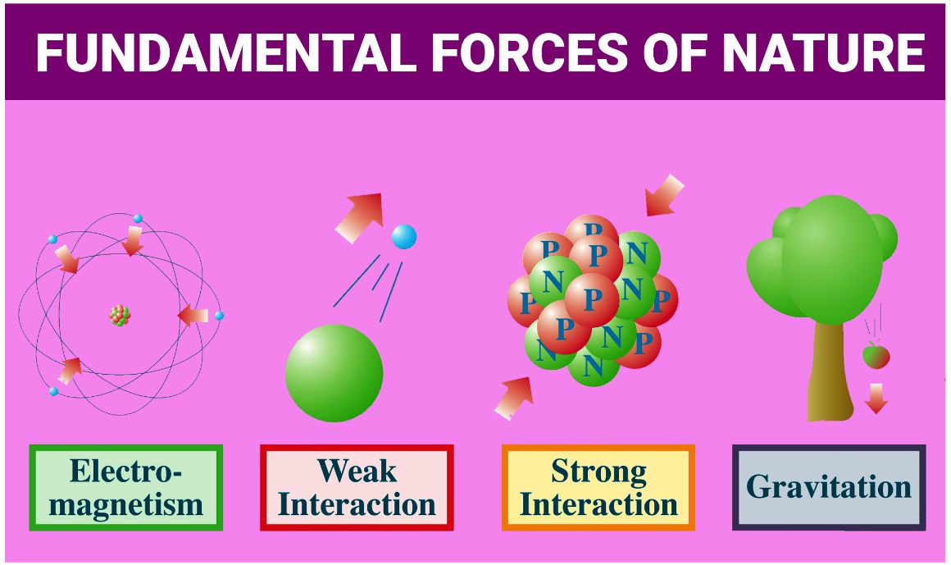
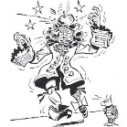
Particle physics
Particle physics studies the elementary constituents of matter and the forces responsible for their interaction

Slide 5
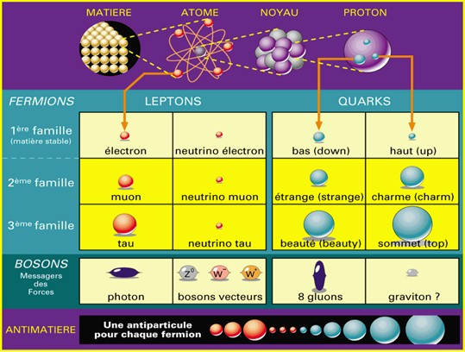
The Model Standard of particle physics
Ordinary matter
Messengers of forces
(bosons)
Higgs boson
H
The mass

Slide 6

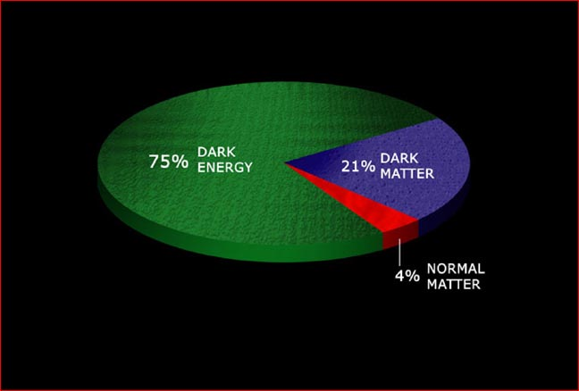
Some puzzles
Where does the mass of particles come from? The Higgs boson (2012)!
What is dark matter made of?
Why does the Universe expansion accelerate?
  Dark energy?
Why is the Universe only made of matter?
Can we build a quantum theory of gravitation?
  And unify all the forces?

Slide 7
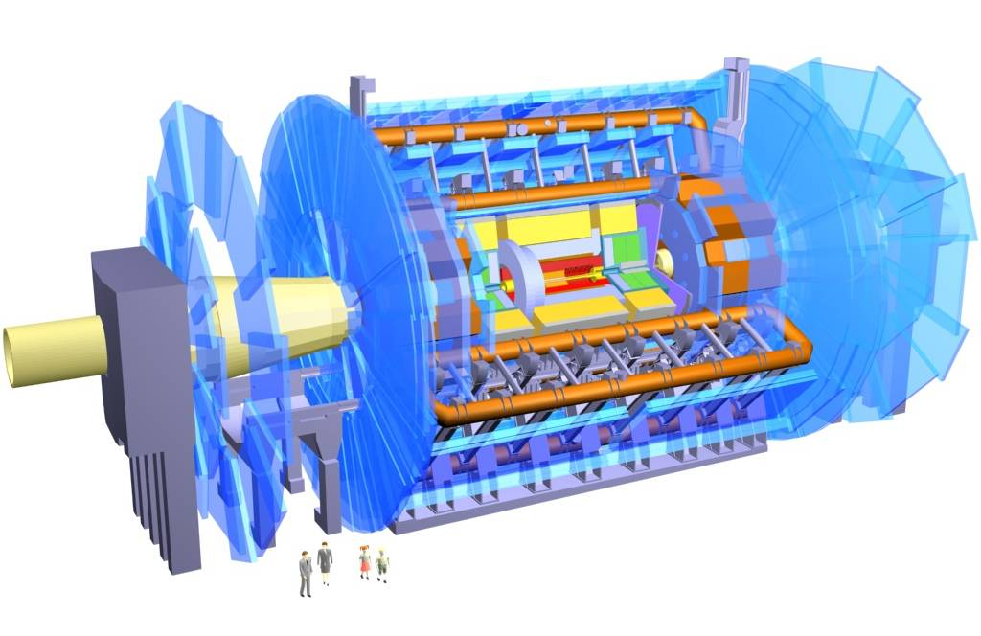
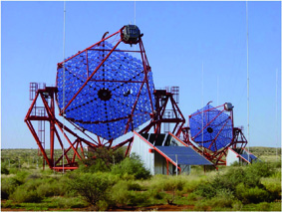
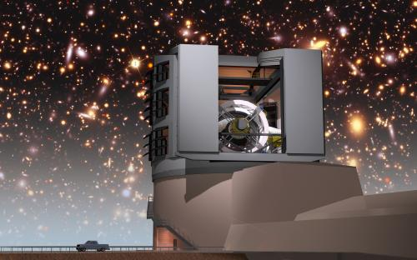
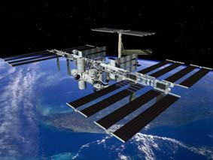
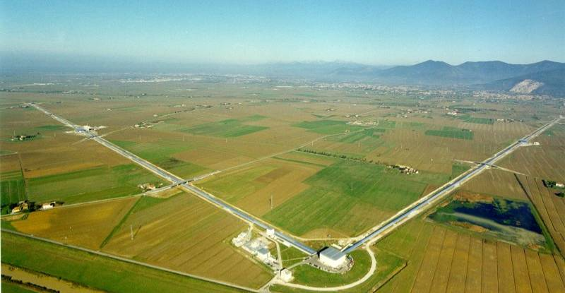
LAPP’s experiments
Study of elementary particles and forces with experiments at accelerators (LHC,…):
  New particles, matter/anti-matter asymmetry
  Study properties of known particles: neutrinos, Higgs,…
Study the content of the Universe and its history with telescopes or experiments in space:
  Astroparticles, cosmology (dark matter, dark energy)
  Gravitational waves

Slide 8
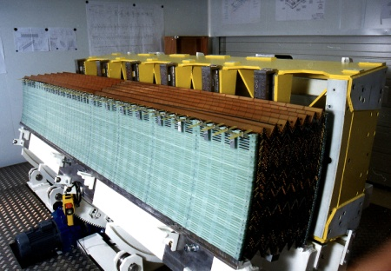
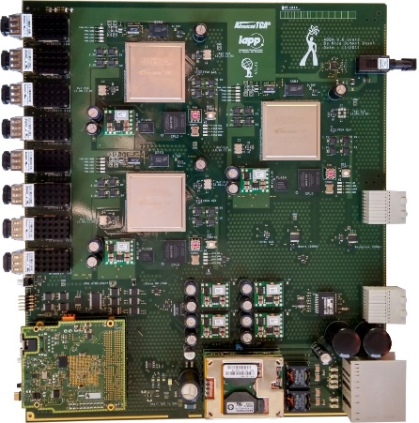
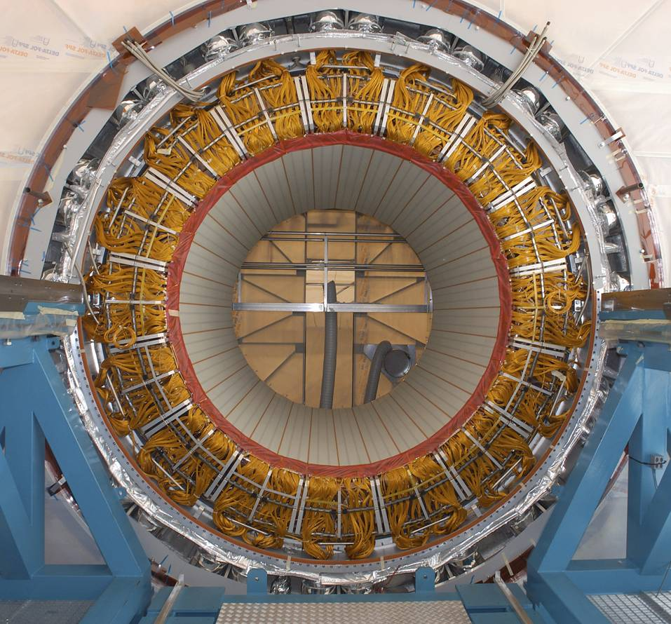
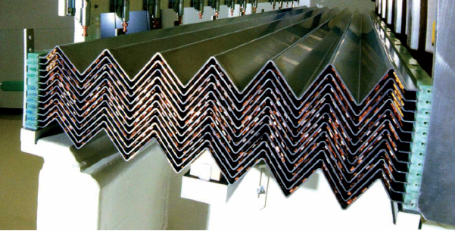
ATLAS and LHCb at LHC
⇒ looking for new particles
⇒ understanding the differences between matter and anti-matter
See the ATLAS presentation
Construction of the ATLAS calorimeter at LAPP

Slide 9
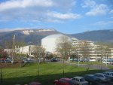
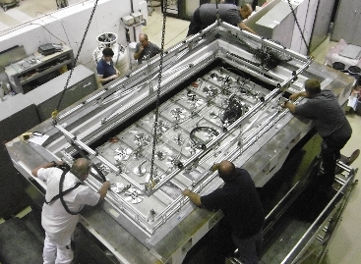
The neutrino experiments
Trying to understand the mysteries of neutrinos:
- mass: SuperNEMO in the Frejus tunnel
- is there a 4th family: STEREO at the ILL reactor in Grenoble
- neutrino/antineutrino properties: WA105/DUNE
See the neutrinos presentation

Slide 10
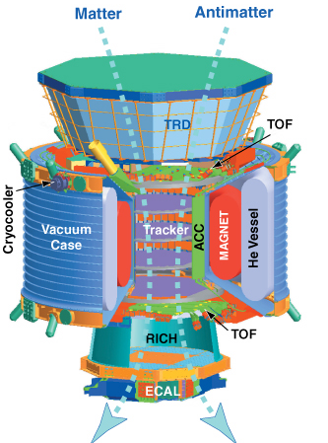
AMS on the ISS
Detection of e-/e+, protons,… from space
⇒ Looking for dark matter and antimatter in the Universe
AMS on the ISS
Assembling AMS at LAPP

Slide 11
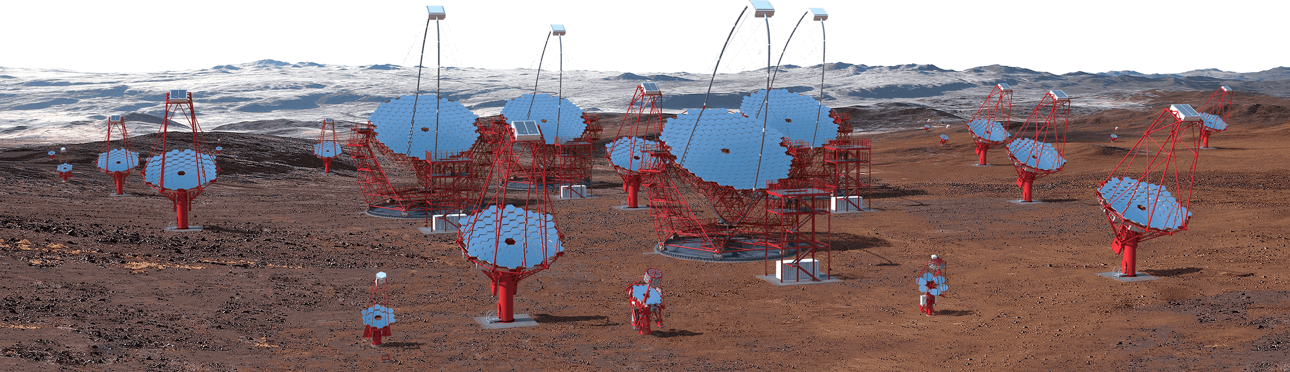
HESS in Namibia and CTA in Chile and La Palma
Detection of cosmic rays
dark matter
study of cosmic rays sources
See the gamma astronomy presentation

Slide 12
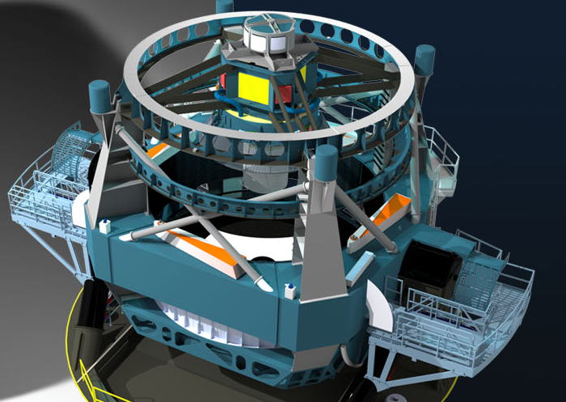
LSST in construction in Chile
⇒ Understanding dark matter and dark energy
See the presentation on cosmology

Slide 13

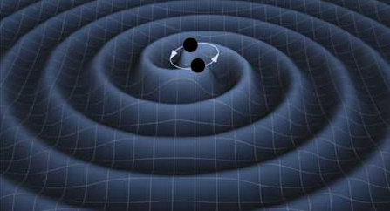
Virgo in Pisa
Looking for gravitational waves
  Study of general relativity
  Tool to study our Universe
2017
See the gravitational waves presentation

Slide 14
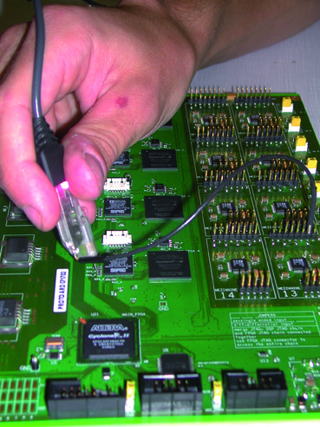
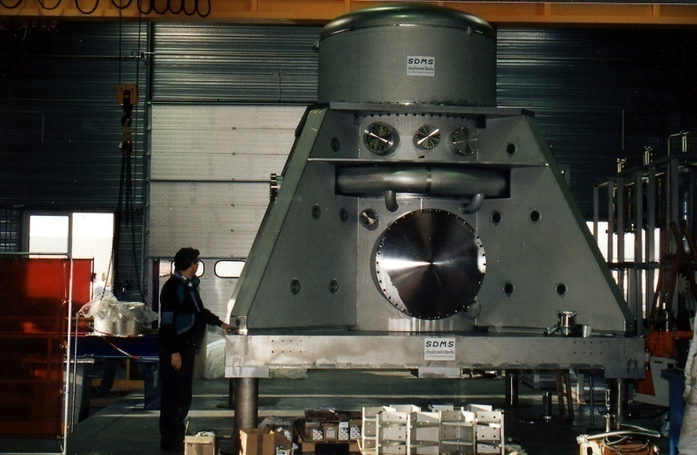
Who works at LAPP
Experimentalists (~40) : researchers, professors,...
  within large collaborations they conceive, build experiments and analyse and interpret their data
Students (~20): PhD or internship
Engineers and technicians (~80) in electronics, mechanics, computing
  they realize the detectors
Administratives (~10)
  for placing orders, communication, planning, management,…

Slide 15

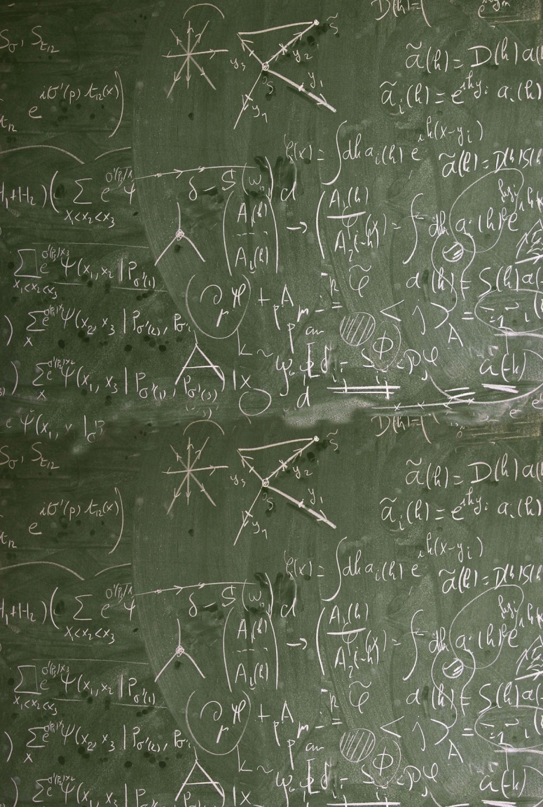
And next door: the LAPTh
In this building, the LAPTh is a theoretical physics laboratory (particle physics, cosmology,…)
theorists predict effects that experimentalists try to measure
or the other way: they try to explain our measurements

Slide 16
Enjoy your visit!

Slide 17
