Slide 1
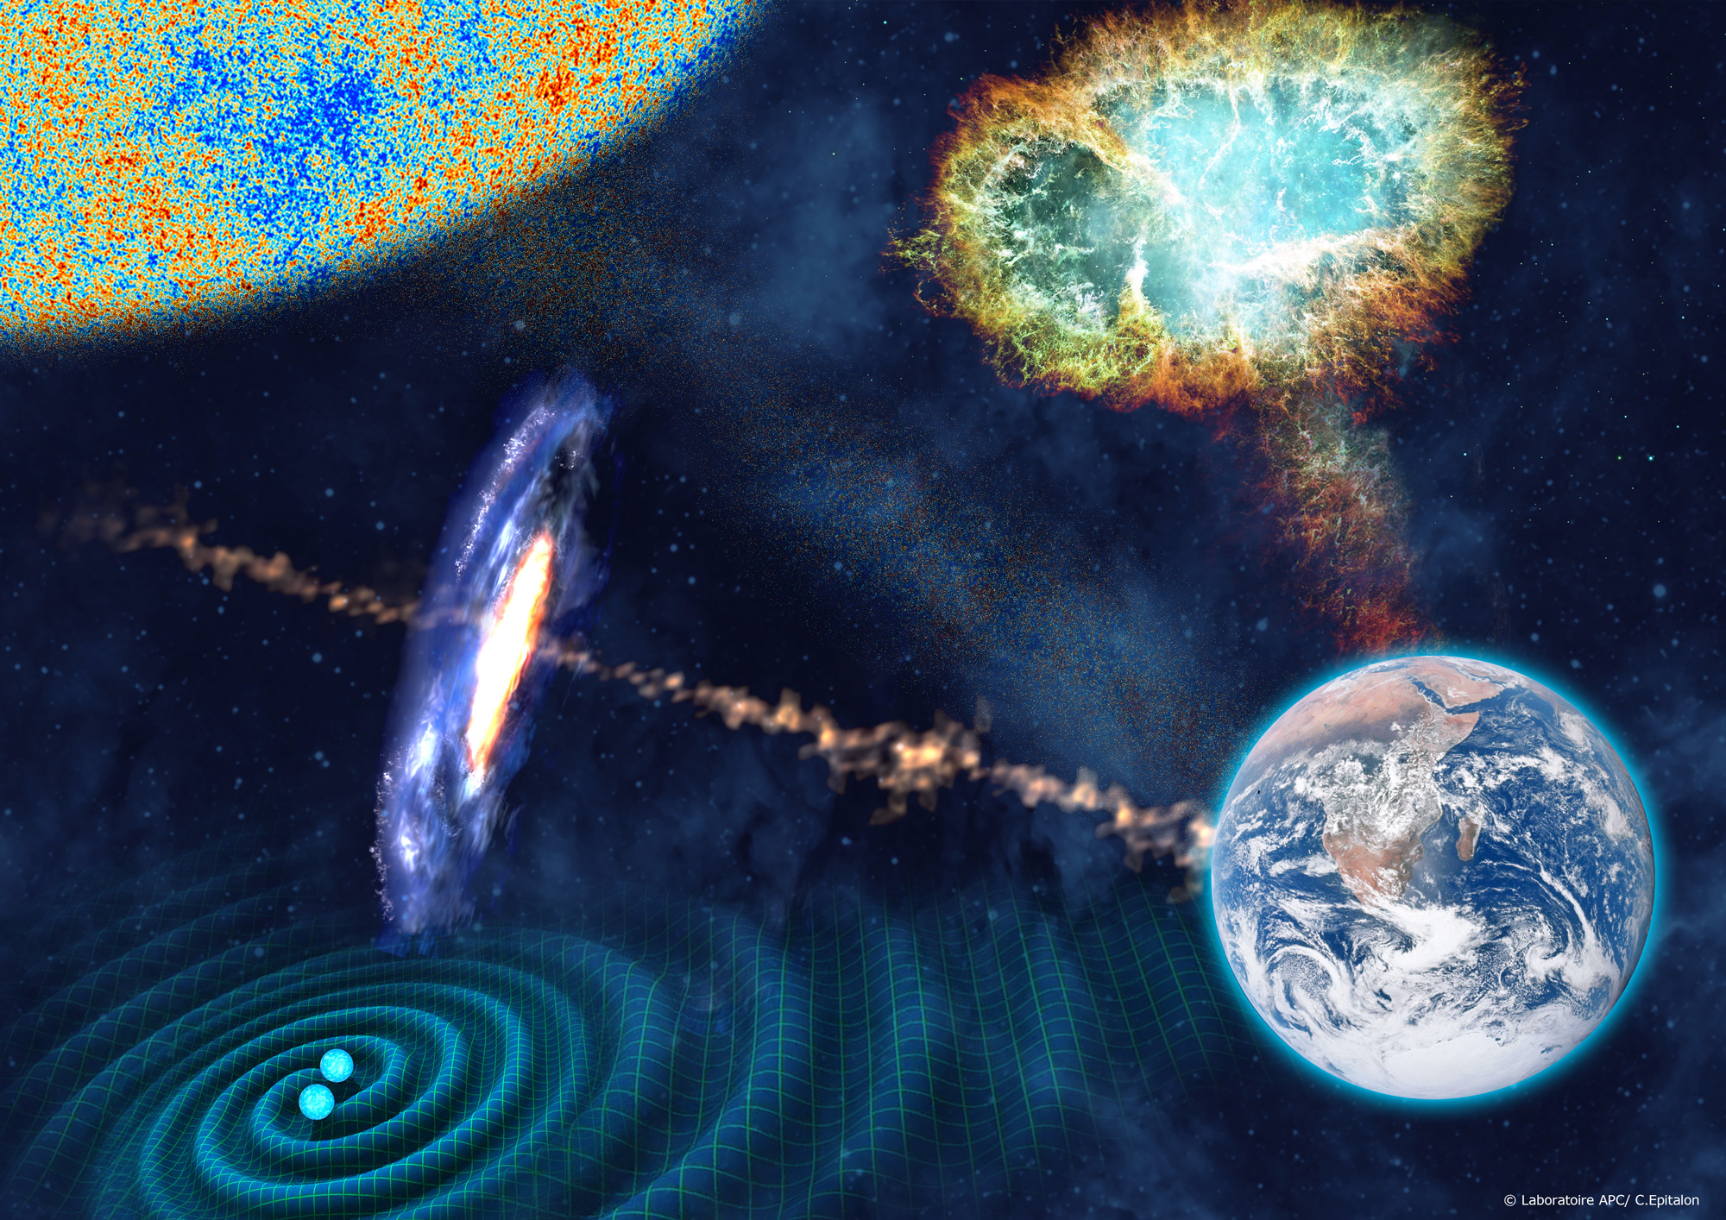
Laboratoire Astroparticule et Cosmologie (APC)
UMR 7164
IN2P3, Univ. Paris Diderot, CEA, Observatoire de Paris
Stavros Katsanevas
Créé en 2005

Slide 2
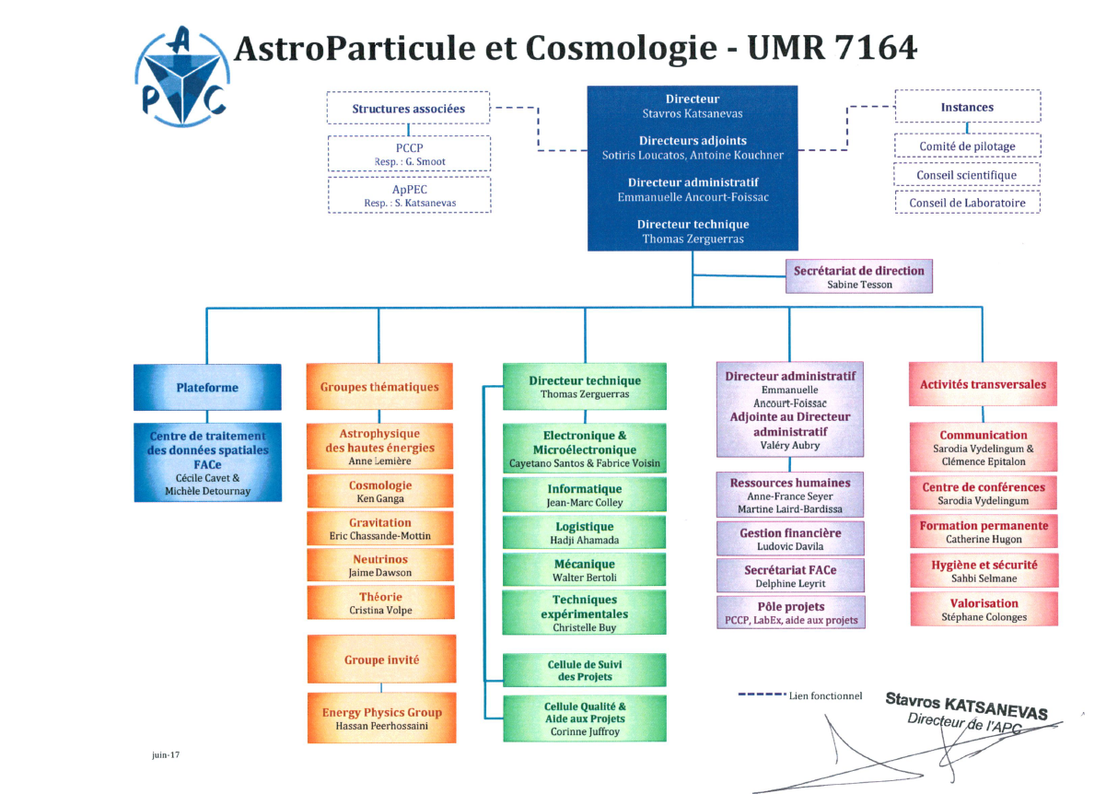
UnivEarths
M. Chaussidon, S.Katsanevas

Slide 3
Laboratory composition

Slide 4
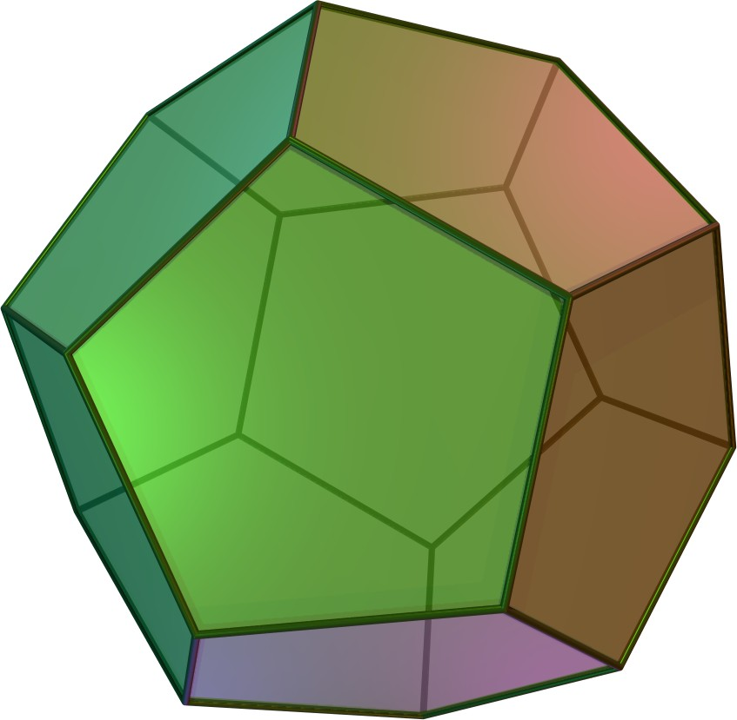
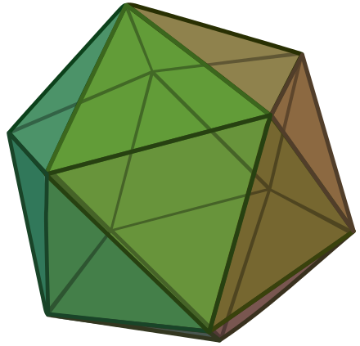
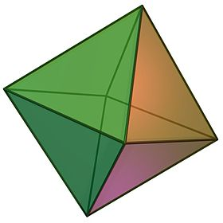
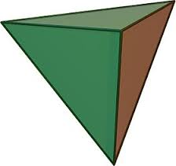
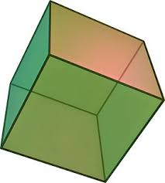
5 APC Groups
A « sudden » convergence
Cosmology
direct/indirect mesure
of ν mass
Feedback
Astrophysique Hautes Energies
PBH,Hubble
Phase Transitions
High Energy Astrophysics
Neutrino
Dark matter
Gravitation
PBH/DM/Snae
Multimessanger
Gravitation
Cosmologie
cosmology | 31
gravitation | 14
HEA | 38
Neutrinos | 29
Theory | 33
Theory
Cosmology/Gravitation/HEA
Ground-Space

Slide 5
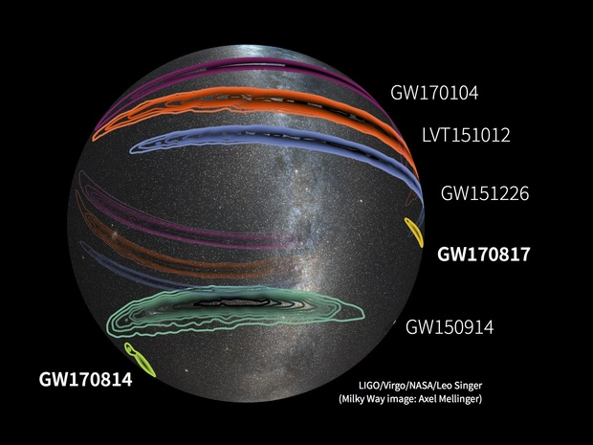
Gravitational Waves
Ground-Space complementarity @APC
LISA advVIRGO

Slide 6
Gravitational waves
A well defined roadmap : advVirgo+ and LISA
Highlights of APC contributions
  advVIRGO
    Beam adaptation telescopes
    Leadership in comissioning and analysis groups
    Organisation responsibility of many seminal papers since 2015
    Interdisciplinarity with Geosciences
  LISA
    Introduction and leadership of French participation to LISA (since 2004)
    Tests and data analysis for LISAPathfinder
Future perspectives and short term milestones
  advVIRGO
    Preparation of O3
    Analysis implication in multimessenger physics (ASTERICS)
    R&D for advVirgo+ : Laguerre-Gauss , FDS
    Interdisciplinary studies with Geoscience
  LISA
    Phase A LISA
    Responsibility of Data Processing Centre
    Participation in AIT/AIV
    LOT , scattered light R&D

Slide 7
SWOT
Gravitational Waves
Forces | Weaknesses
Ground-Space Complementarity High Visibility Role in LISA-France | Manpower group advVIRGO Loss of P.Binetruy
Opportunities | Threats
Start of Multimessenger Astronomy APC scientific environment Interdisciplinarity with Geosciences | Loss of FACe expertise for LISA

Slide 8
Gravitational-wave astronomy: an emerging field...
A “sudden” new convergence
Cosmology
Measurement of cosmological parameters
Primordial Black Holes
CMB Polarisation
Cosmologial phase transitions
Theory
Gravitation
Modified Gravity tests
Cosmic strings,
mass of the graviton
primordial GW backgrounds
High-energy
astrophysics
& neutrinos
Multimessenger Astronomy
Understanding of Violent phenomena
Tests of fundamental laws

Slide 9
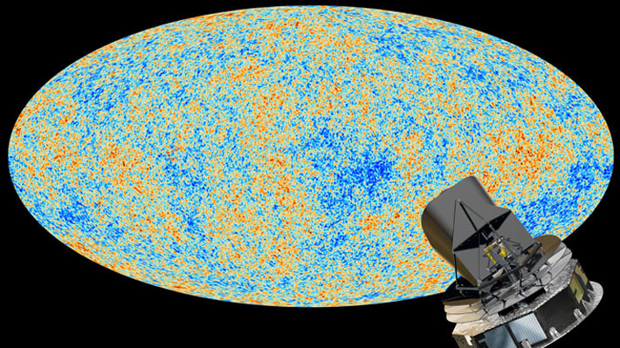
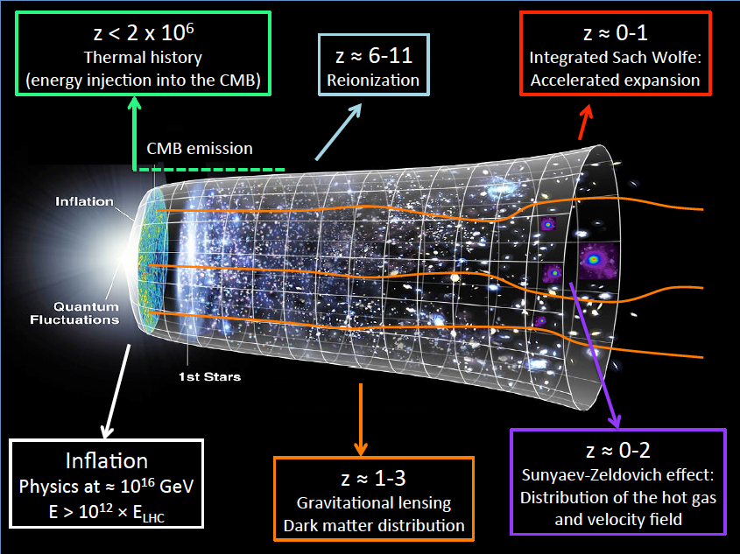
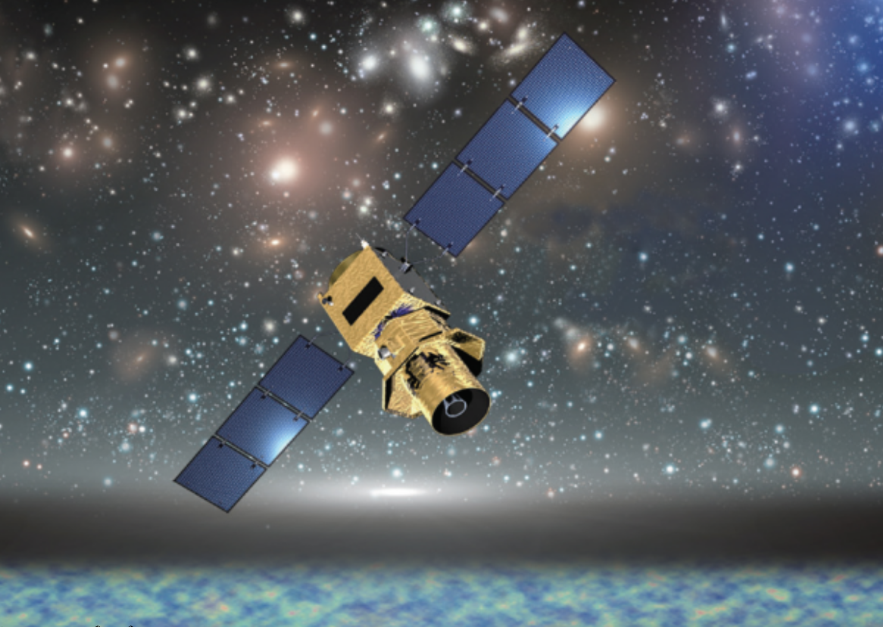
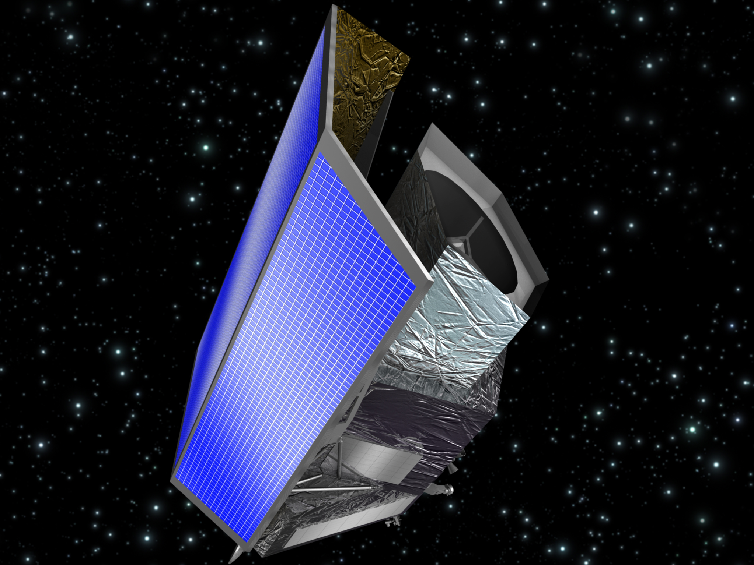
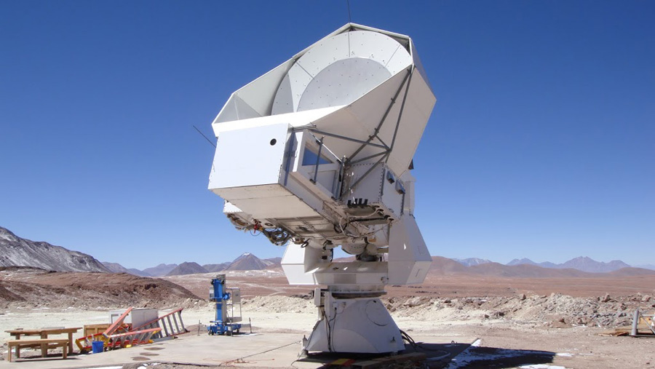
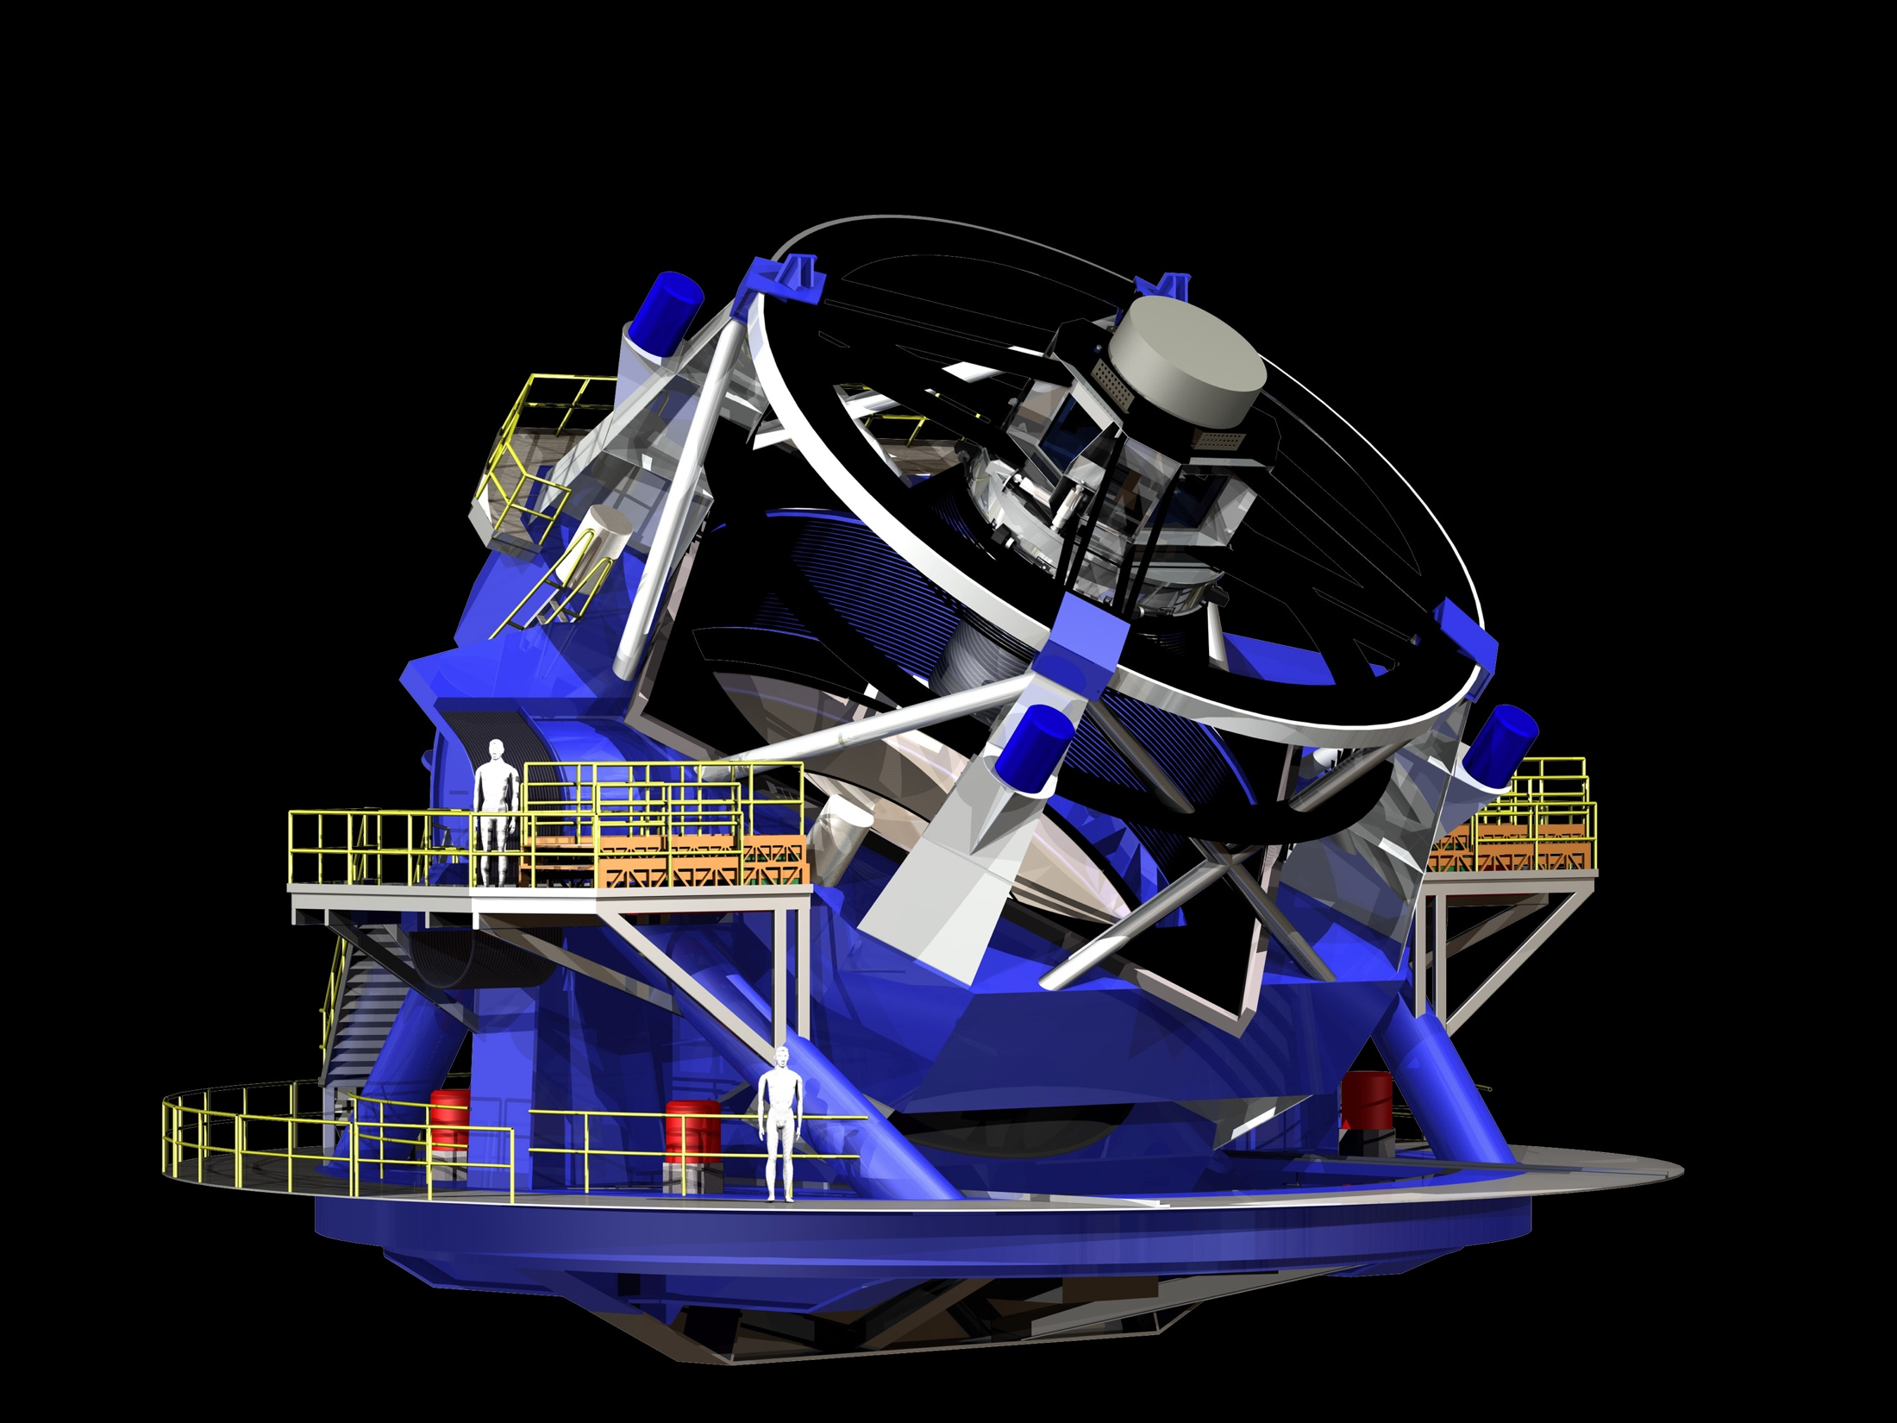
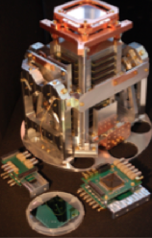
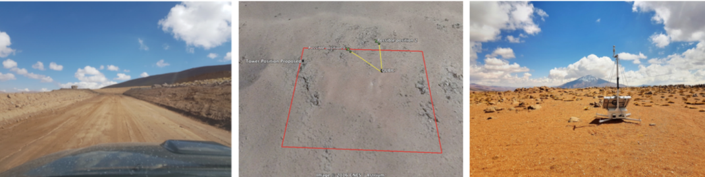
Cosmology
Ground-Space and « near »-« far » complementarity @APC
LiteBird
Euclid
Simons Array
QUBIC
LSST
A well defined roadmap for dark energy
Uncertainties in the European roadmap for CMB on ground and space (CMB-E4,CORE)

Slide 10
Cosmology
Well defined roadmap for dark energy
Roadmap under construction for CMB
Highlights of our contributions
  Planck contributions to construction/analysis (leadership in key papers 2018)
  Leadership in seminal publications in eBOSS, Polarbear
  TES test readout and multiplexing ASIC
  LSST control and command soft
  EUCLID Platform CODEEN
  Responsibility of SGS Euclid
Future perspectives and short term milestones
  CMB
    G2-G3: Technical demonstrator QUBIC in 2018 and full deployment in Argentina in 2019 (technical milestone)
    G3: Participation in Simons Array
    G4:
      Ground: organisation of European CMB community (CMB-E4)
      Space: leadership in European post CORE process (ESA, LiteBird)
  Dark Energy
    Finish LSST-EUCLID contributions by 2019
    LSST-EUCLID exchange of data
    Mass of neutrino analysis cosmology vs ground measurement

Slide 11
SWOT
Cosmology
Forces | Weaknesses
CMB Detector and Readout expertise Data analysis expertise LSST Control and command EUCLID Pipeline software and SGS | DE analysis effort not yet at fulll speed although better than in other french labs CMB: recent losses of key instrumentalist personnel
Opportunities | Threats
Forthcoming LSST-Euclid agreement Large-survey– CMB complementarity Leadership in many European efforts High visibility at non-European efforts (e. Simons array, Litebird) | Not well defined status of QUBIC No clear European roadmap for CMB, uncertainty encourages dispersion

Slide 12
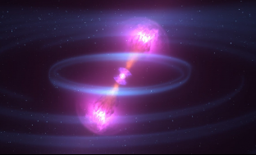
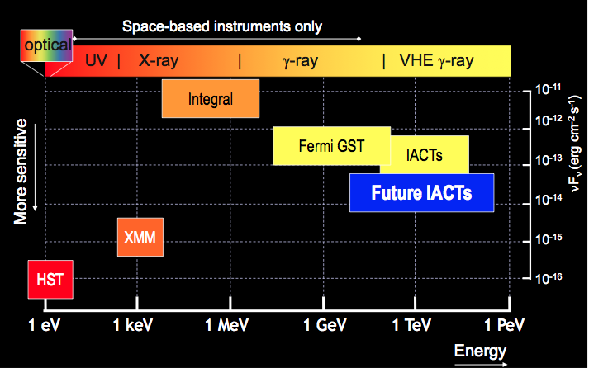
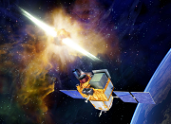
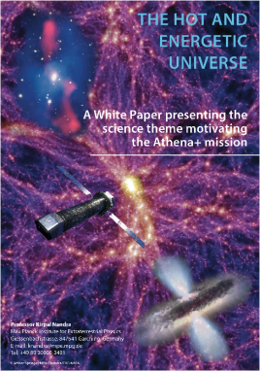
High Energy Astrophysics
UHECR
1 EeV 1 ZeV
CTA
SVOM
ATHENA
KM3Net
∂
∂

Slide 13
High energy Astrophysics
Space : A rich program (SVOM/ATHENA)
Ground : 2 large ESFRI infrastructures CTA/KM3NeT
Highlights of our contributions
  Multi-wavelength studies of AGNs and Galactic Center
  Multimessenger studies of GW
  AHE theoretical studies and simulation
  TARANIS Leadership in XGRE integration (flight model in 2018)
  SVOM : coded mask
  ATHENA Responsibility of WFEE ASIC (end of phase A 2019)
  HESS : papers on legacy, galactic centre, Vela pulsar, link FERMI
  CTA : timing distribution and PHP software
  ANTARES Spokemanship, GW followup
  EUSO : PDM Integration , technical project manager SPB and mini-Euso
  R&D Compton DSSSD detectors
Future perspectives and short term milestones
  TARANIS Deliver flight model in 2018
  Min-EUSO 1 PDM on ISS, launch end 2018
  SVOM flight model in 2019
  ATHENA ASIC WFEE @TRL6 , end of phase A in 2019
  CTA/KM3NEt: Tics, PHP demonstrators, calibration prototype
  EUSO SPB2, K-EUSO, POEMMA discussions and selection

Slide 14
High Energy Astrophysics
SWOT
Strengths | Weaknesses
Ground-Space complementarity Space Quality procedures Large GW followup exeprtise | Unbalanced ratio of engineers and researchers (inverse on ground and space) Role of low energy γ , not yet well understood by our agencies
Opportunities | Threats
Multimessenger Astronomy | TARANIS construction uncertainties EUSO roadmap uncertainties

Slide 15
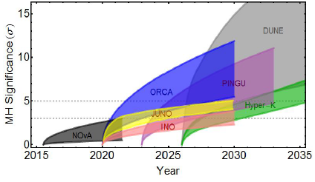
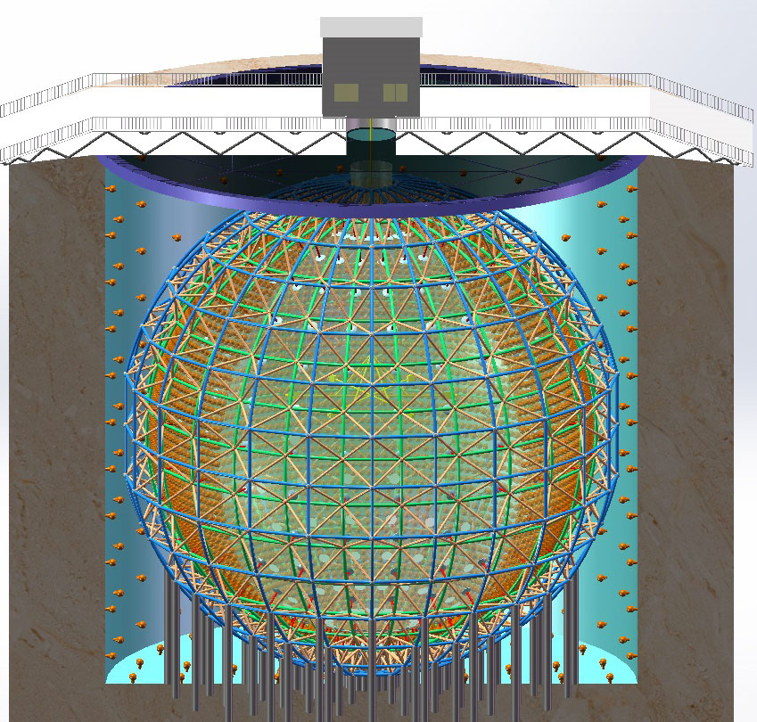
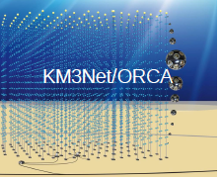
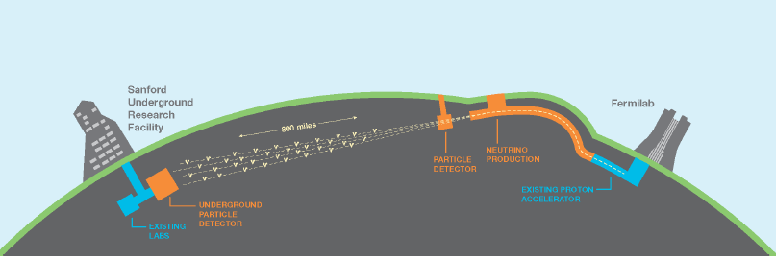
Neutrinos (invisibles I)
Reactor, accelerator and cosmic
10²⁴
10²⁰
CMB
10¹⁶
10¹²
solar
10⁸
Supernova
Flux (cm⁻² s⁻¹ MeV⁻¹)
Géological
10⁴
Reactors
10⁰
Atmospheric
10⁻⁴
10⁻⁸
Energy(eV)
Cosmic
10⁻¹²
DCHOOZ/JUNO
CeSOX
DUNE/ORCA
KM3NEt/ARCA
10⁻⁶
10⁻³
1
10³
10⁶
10⁹
10¹²
10¹⁵
10¹⁸
μeV meV eV keV MeV GeV TeV PeV EeV
3 techniques:H₂O/Liq Scint/Liq Ar

Slide 16
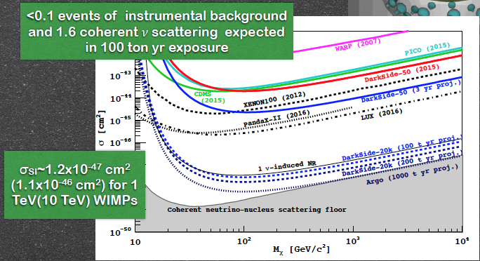
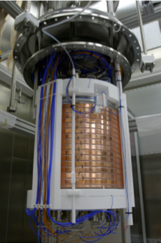
Dark matter (invisibles II)
Liq Argon: Dark-Side➔Ds-20k ➔Argo
Dark Side

Slide 17
Neutrinos and Dark matter
APC contributions and prospectives
Highlights of our contributions
  DCHOOZ : Spokesmanship, mechanics, analysis
  JUNO : The idea of multicalorimetry, DACQ card X-ROC
  WA105/DUNE, Global convergence role, Physics coordination, PM DACQ card
  KM3Net, NH/IH mass analysis, interdisciplinarity with Geosciences
  Borexino/CeSOX, DarkSide detailed simulation
  R&D Darkside directionality ARIS
  R&D LIQUIDO , chair Blaise Pascal Suekane
  Interdisciplinarity Geoneutrinos, Muonic tomography
Future perspectives and short term milestones
  DCHOOZ , final results and decomissioning in 2018
  WA105 Start of data taking in 2018-2019
  JUNO/WA105/DarkSide CATIROC electronics card (synergies)
  R&D advances LIQUIDO, ARIS
  Deployment of ARCHE (muography)

Slide 18
Neutrinos and dark matter
SWOT
Strengths | Weaknesses
Expertise Liquid scintillators Electronics card expertise Simulation Visible responsibilities | Small number of researchers per project ( except KM3NEt) Insufficient manpower in electronics engineers
Opportunities | Threats
Synergy of measurements of neutrino mass hierarchy in neutrino and with cosmology Good position in Argon Global collaboration for Dark matter Interdisciplinarity with Geosciences | Budget ORCA and DUNE Liquid Argon for DM not yet a national priority

Slide 19
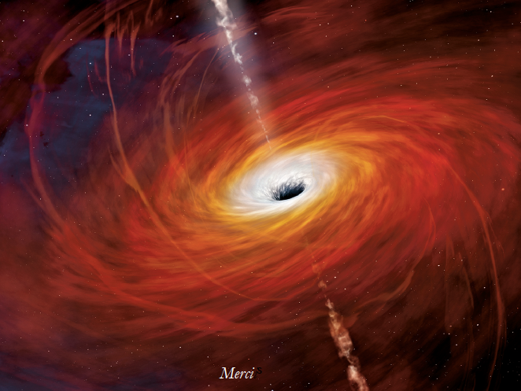
Theory
Cosmology, Gravity, String Theory (1ERC senior) :
- Inflation, dark energy and cosmological perturbations
- Topological defects
- General relativity, modified gravity theories
- Gravitational waves
- Duality, Holography
Astroparticle physics and neutrino:
- Neutrino physics and astrophysics
- MHD and propagation simulations
- Cosmic rays
Quantum Field Theory (QFT) :
- Non-abelian gauge theories and deconfinement,
- QFT in curved geometries,

Slide 20
Theory
SWOT
Strengths | Weaknesses
Good internal organisation International Visibility APC very active meeting place, international insertion Among largest theory groups in IN2P3 | The phenomenological bridge although in good progress needs further strengthening given the opportunities
Opportunities | Threats
New environment after GW discovery Multi-messenger context | Not enough career opportunities of promotion for our Maitres de Conference

Slide 21
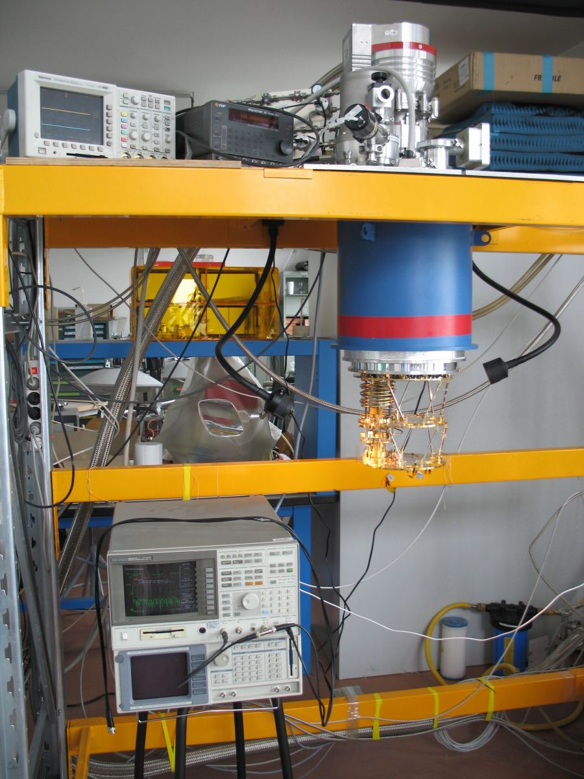
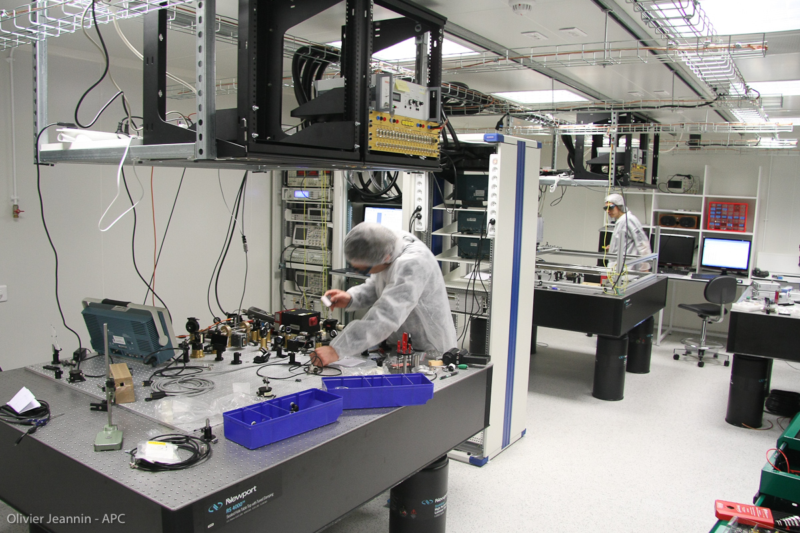
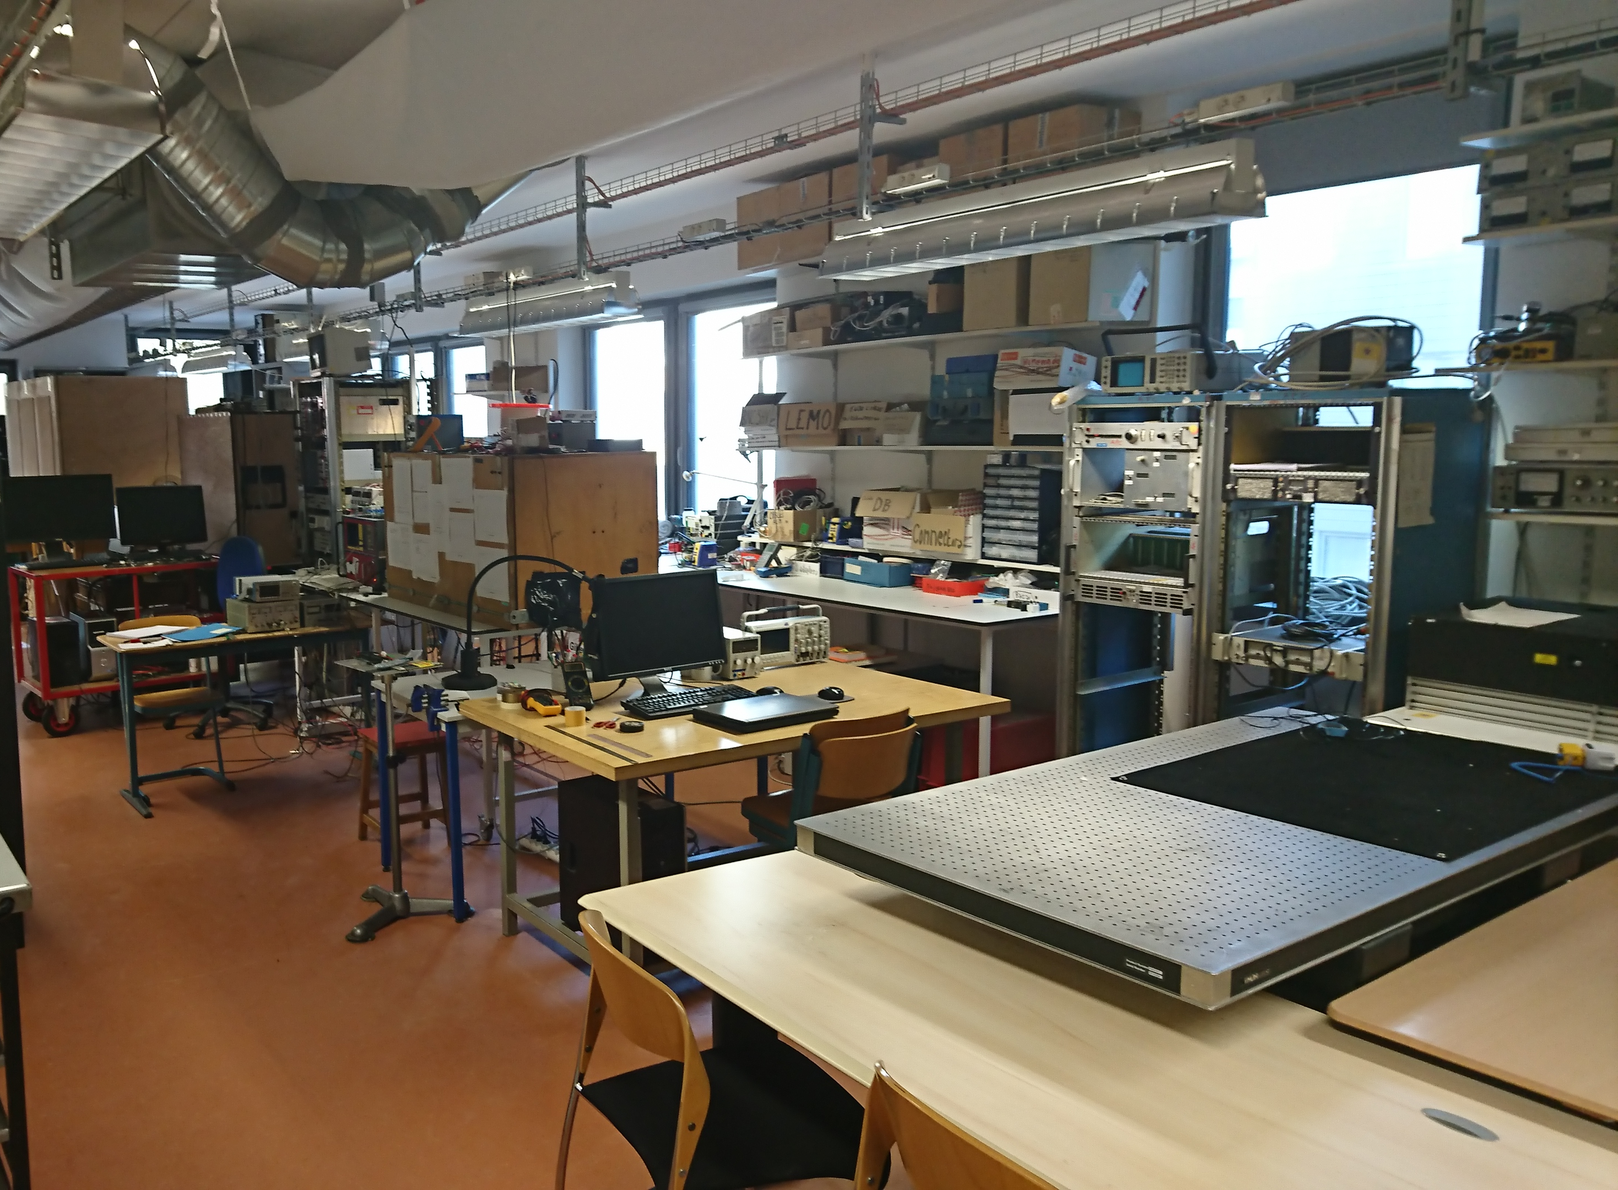
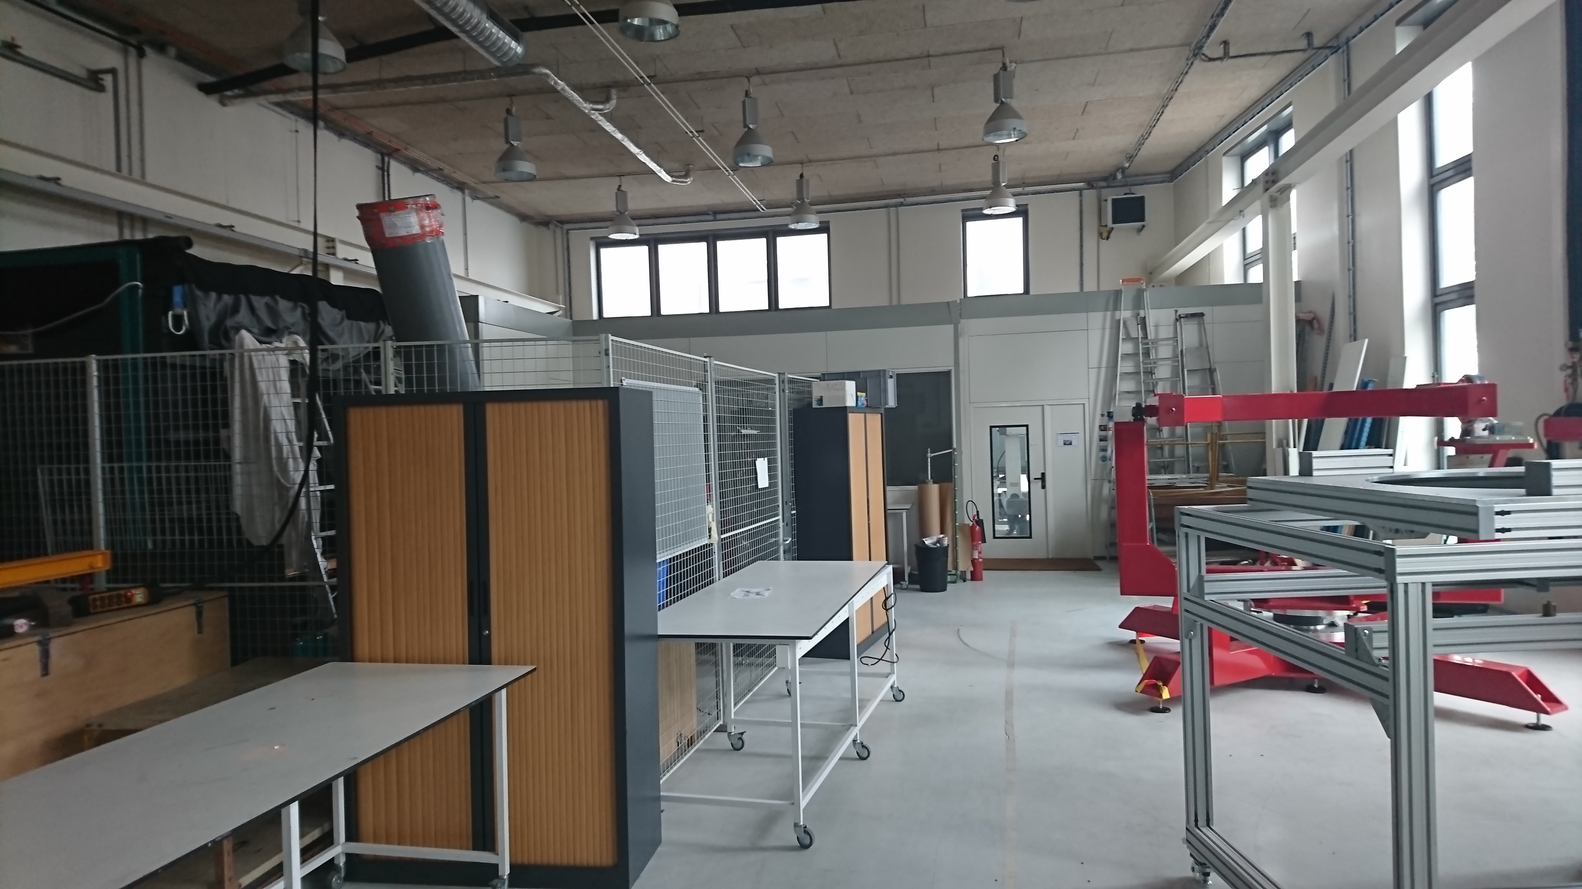
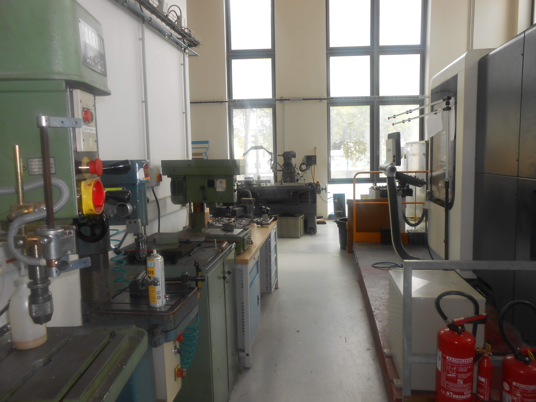
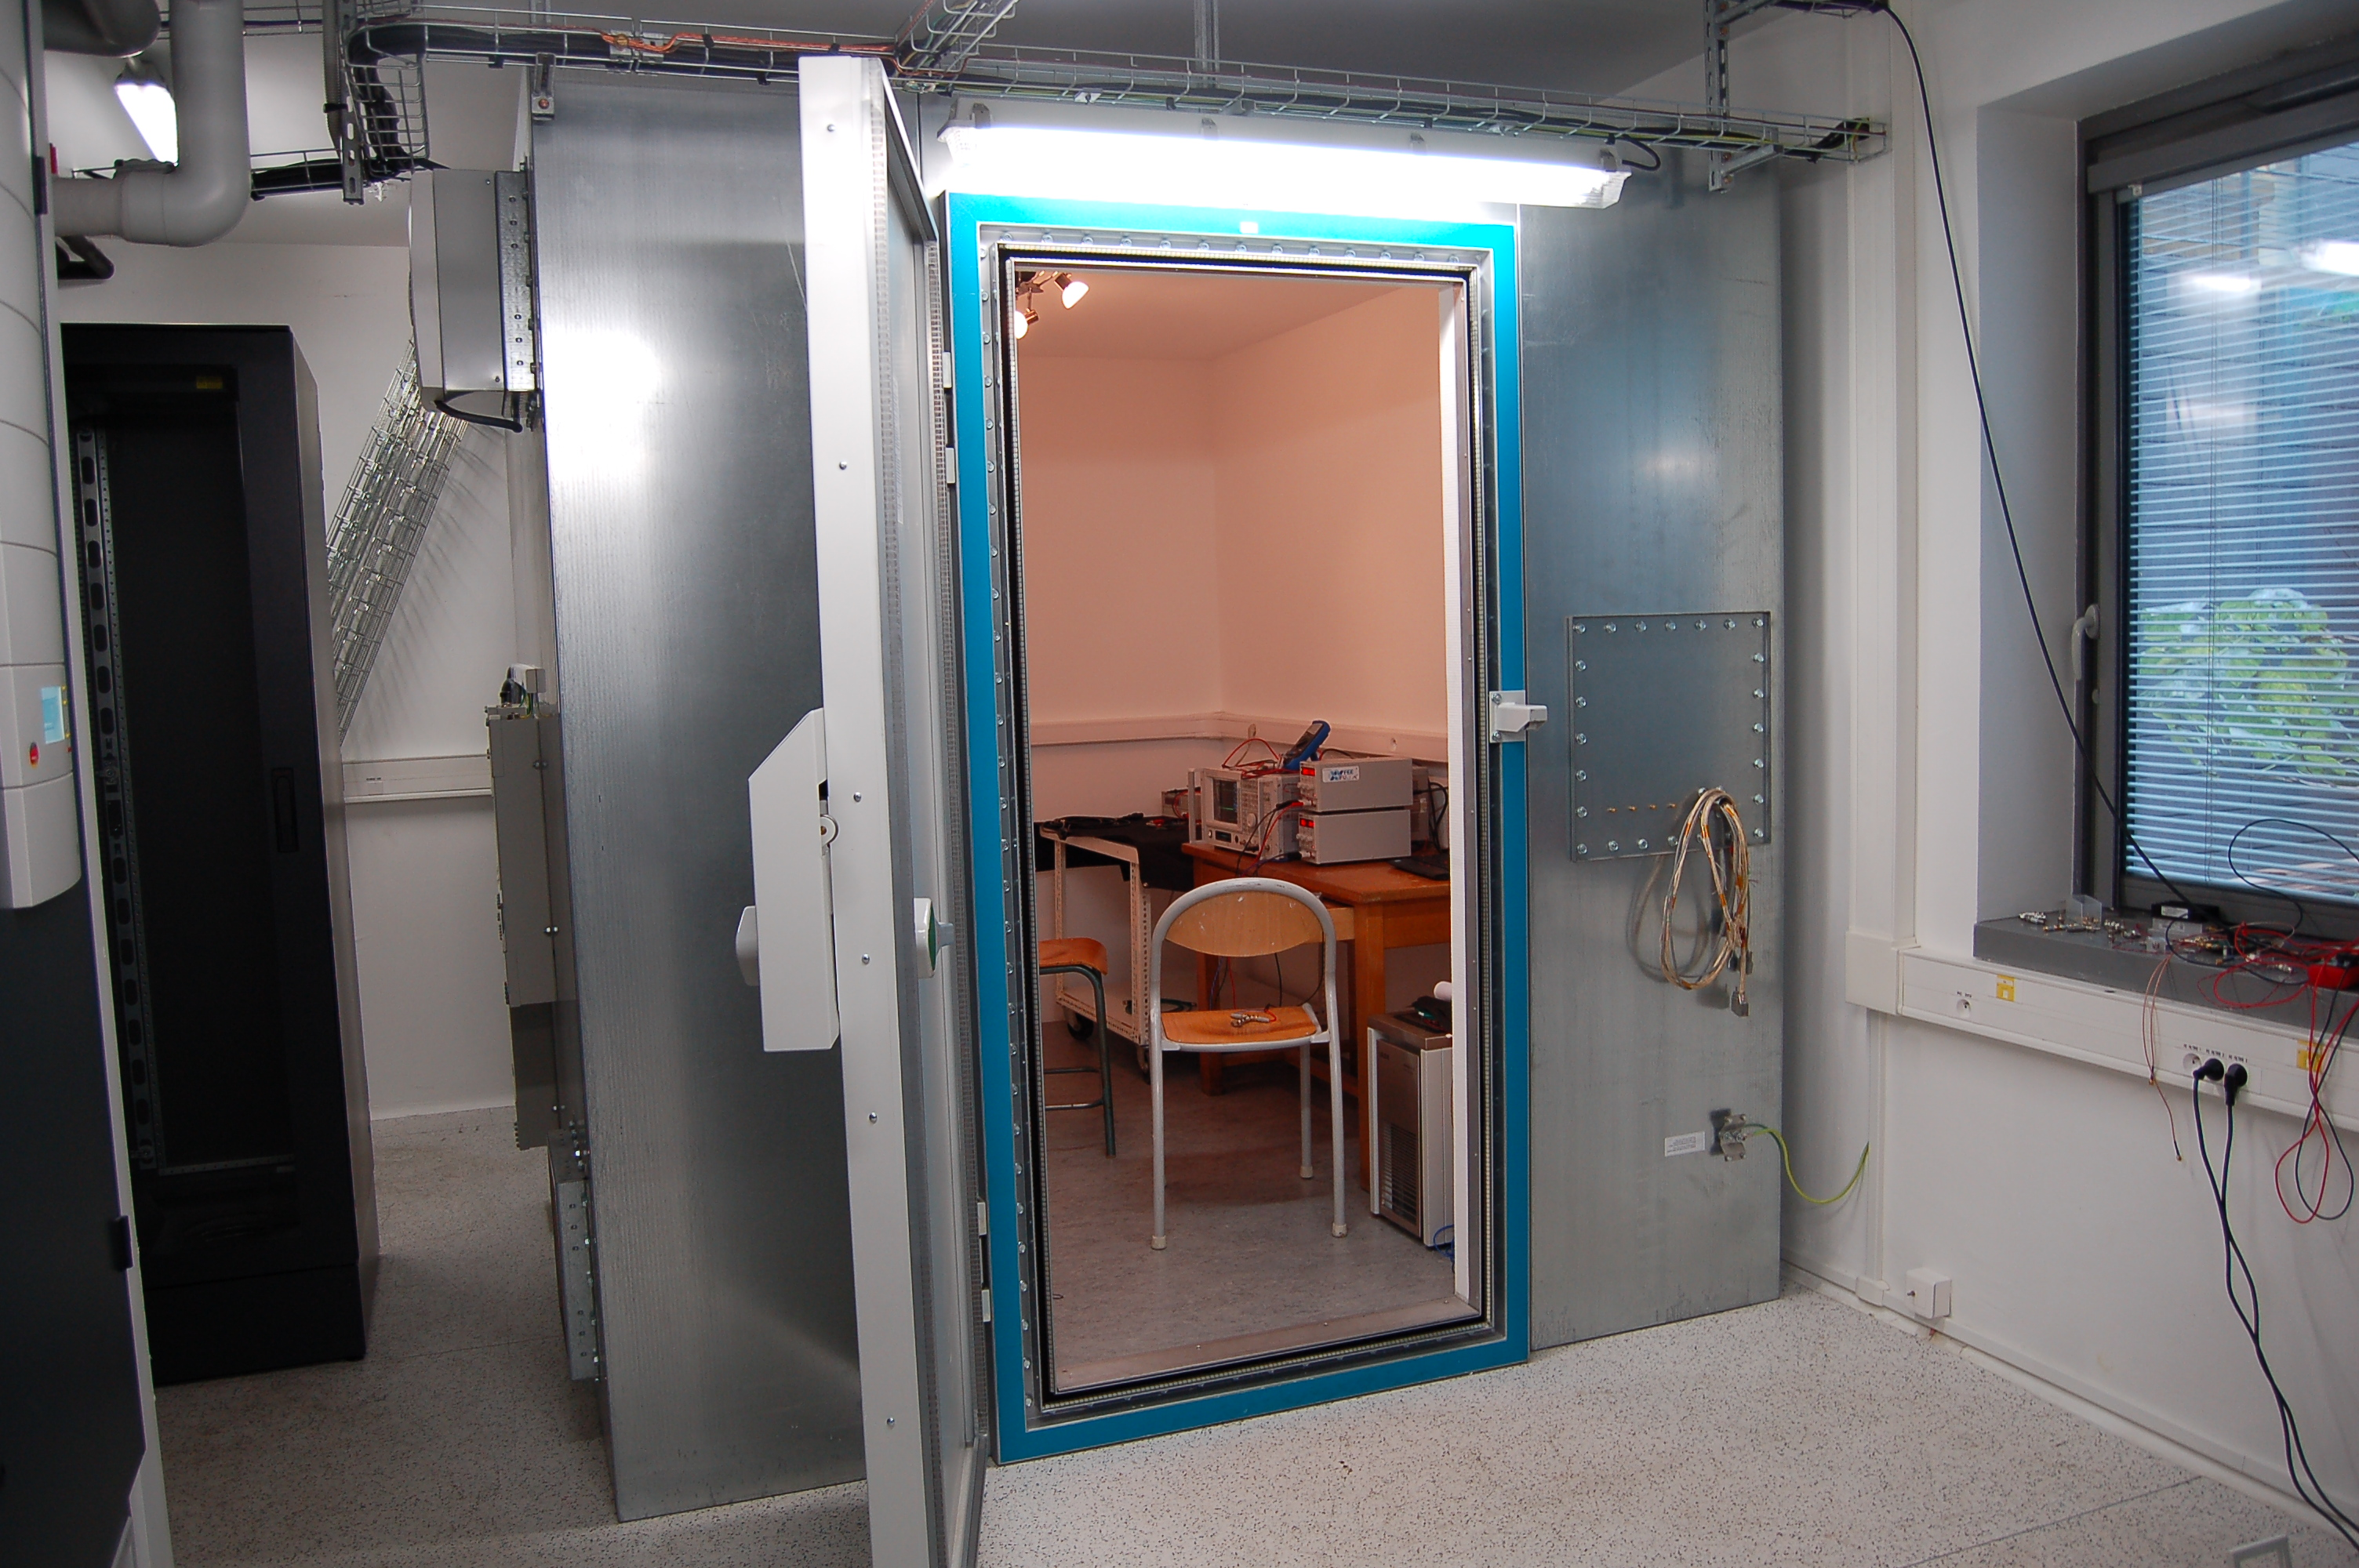
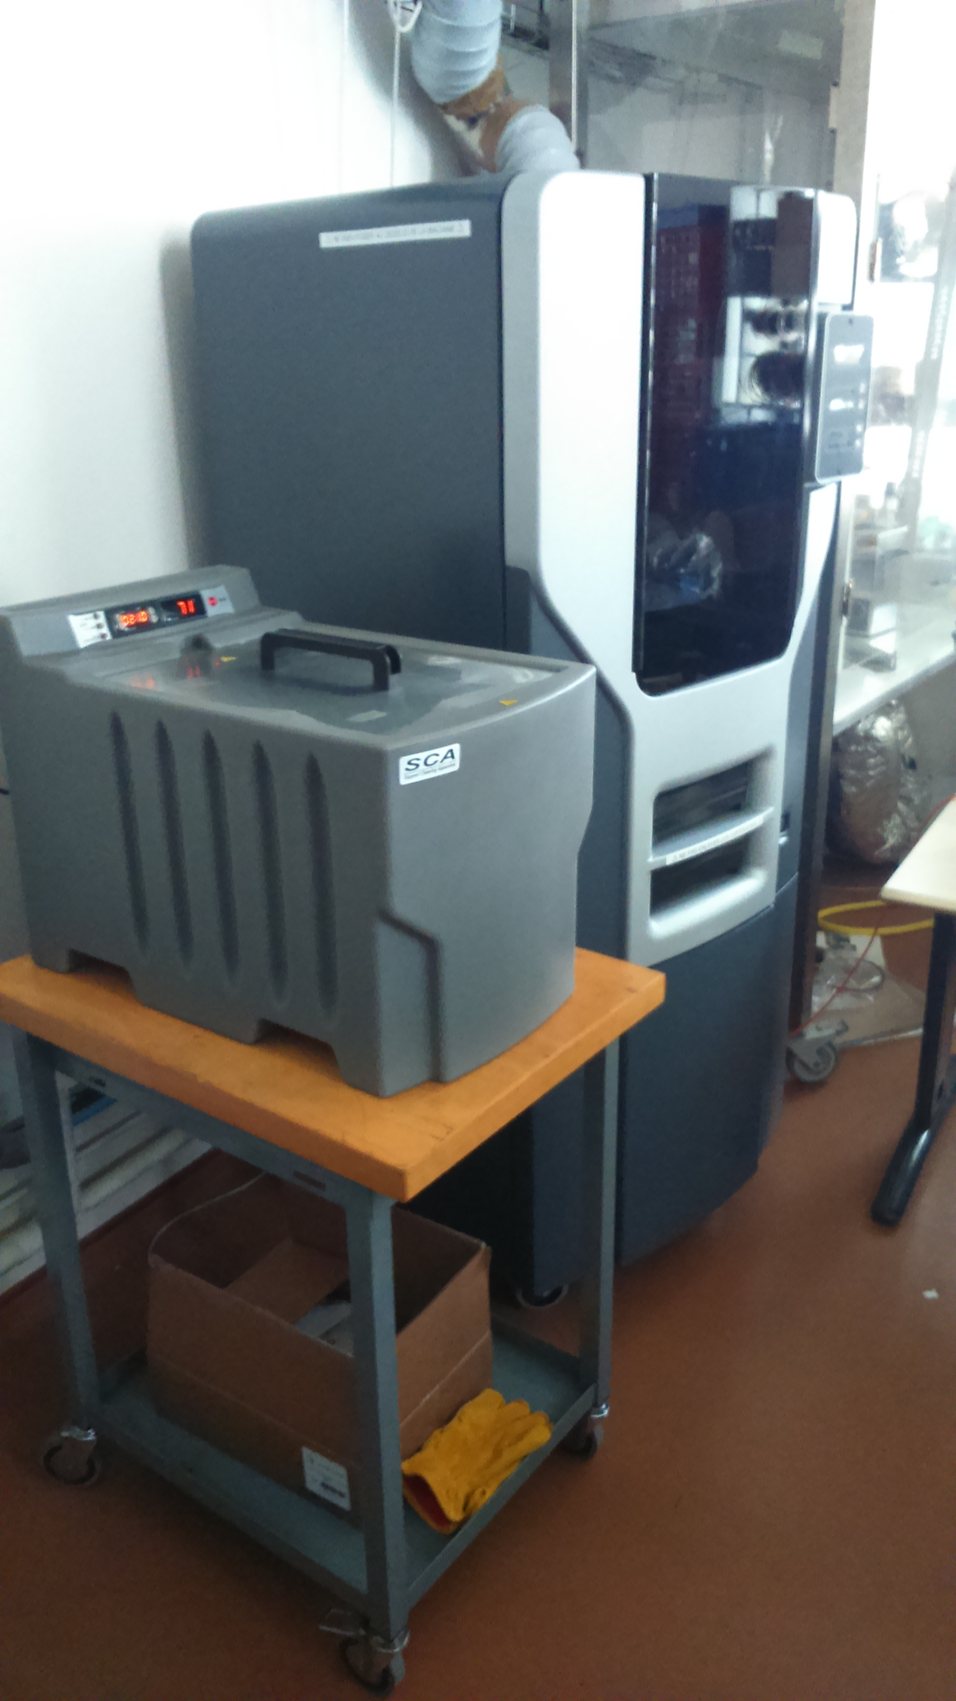
Technical labs
Salle blanche
ISO8 (128m²):
Salle intégration
Salle LISA
Salle VIRGO
Laboratoire Millimétrique:
Cryostat à dilution 100mK
(Oxford Instrument)
(Puissance de refroidissement :
160µW @100mK,
Pas de fluide cryogénique)
Laboratoire Photodétection
Atelier mécanique
Hall de montage
Salle bas bruit (37,5 m²) avec cage de Faraday pour tests de composants et circuits
électroniques (0.1mHz et 10Hz)
Imprimante 3D Stratasys Fortus FDM250mc
(thermoplastique ABS stable)

Slide 22
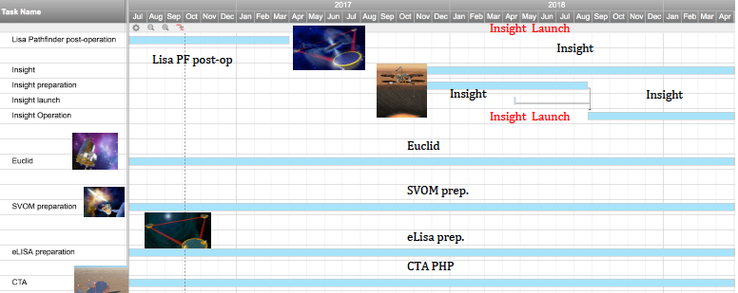
FACe (François Arago center)
Data Science Platform
APC data analysis center for space missions (since 2010).
  650 CPU, 40 TB, team of 10 agents
  Offices, meeting rooms, video-conference rooms, computing room, CDF.
  Location: Biopark but moving to Condorcet and IPGP in 2018
  Strong link with the CC-IN2P3.
Achievements, exemples of activities and projects
PLANCK Sky model , and QUBIC preparation
EUCLID Collaboration platform CODEEN, LSST Slow Control software
CTA Proposal Handling Platform,
VIRGO Mutimessenger studies: ASTERICS (I3, EU), INTEGRAL Follow-up GW ,
MHD computing
Future
  LISA Phase A and DPC
  SVOM ➔ ÉCLAIR pipeline et quick look

Slide 23
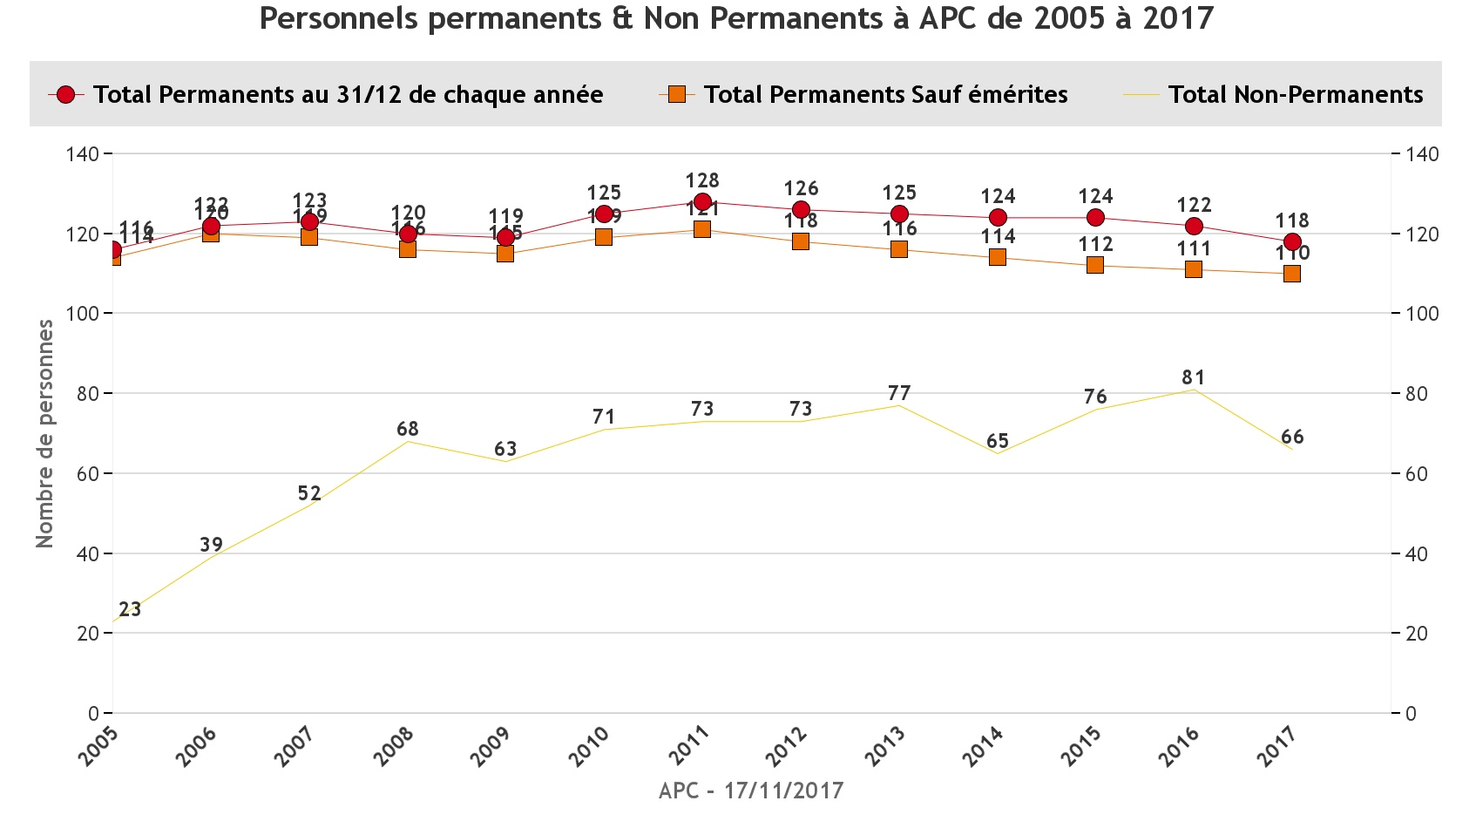
Permanent personnel overall stability

Slide 24
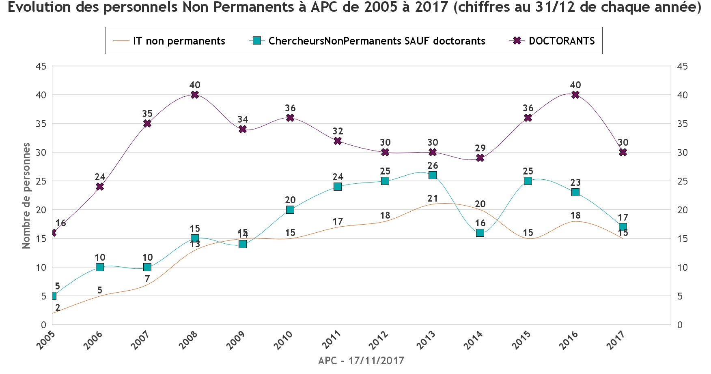
Doctorates , postdocs and non-permanent engineers
Temporary, epochal diminution ?

Slide 25
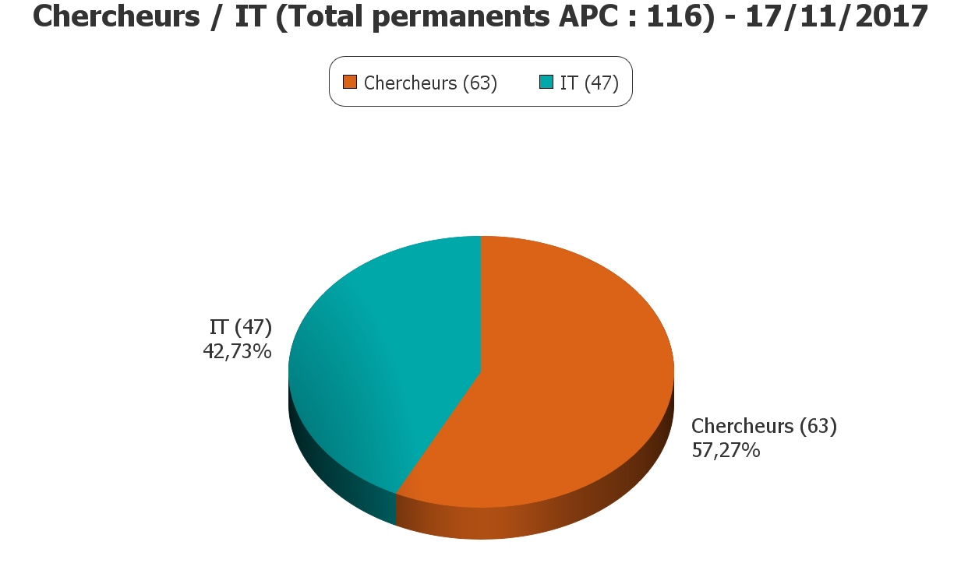
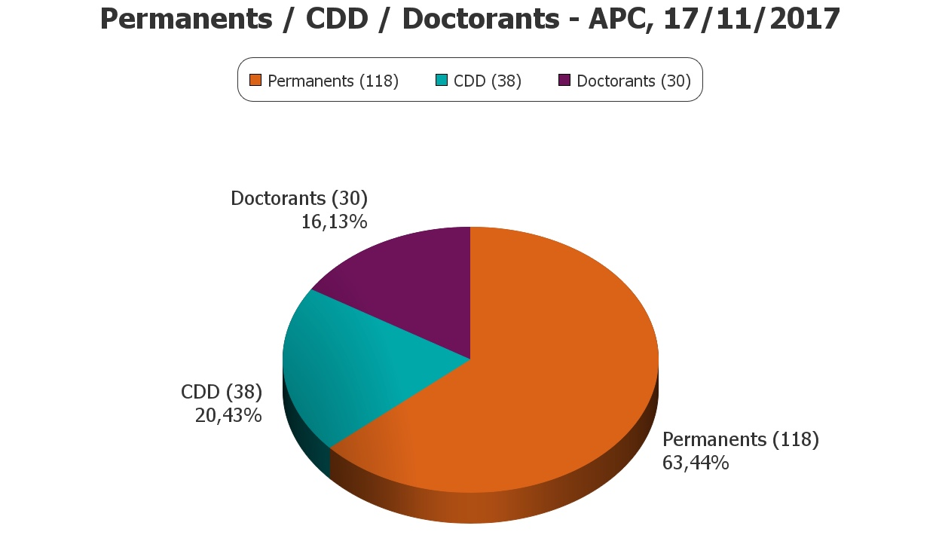
The smallest ratio of engineers to researchers in permanent stuff
And the highest ratio of non-permanent to permanent in IN2P3

Slide 26
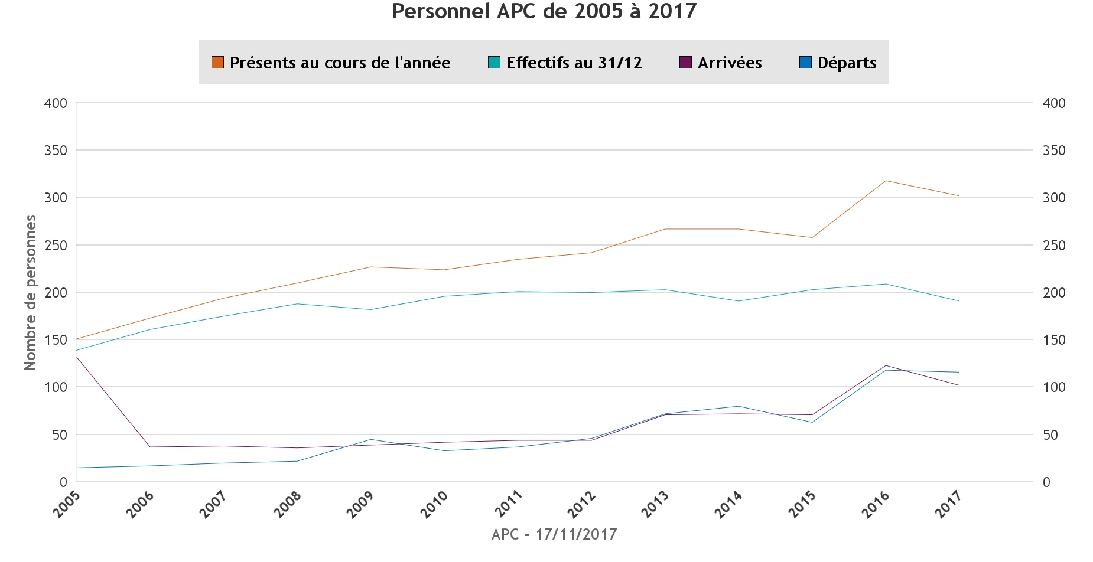
A very large annual turnover (over 100)

Slide 27
Budget evolution
In 2016
21% subventions d’Etat
79% ressources propres
A large variety of sources

Slide 28
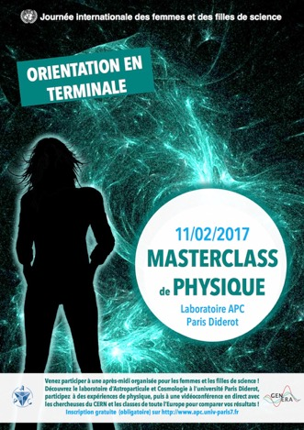
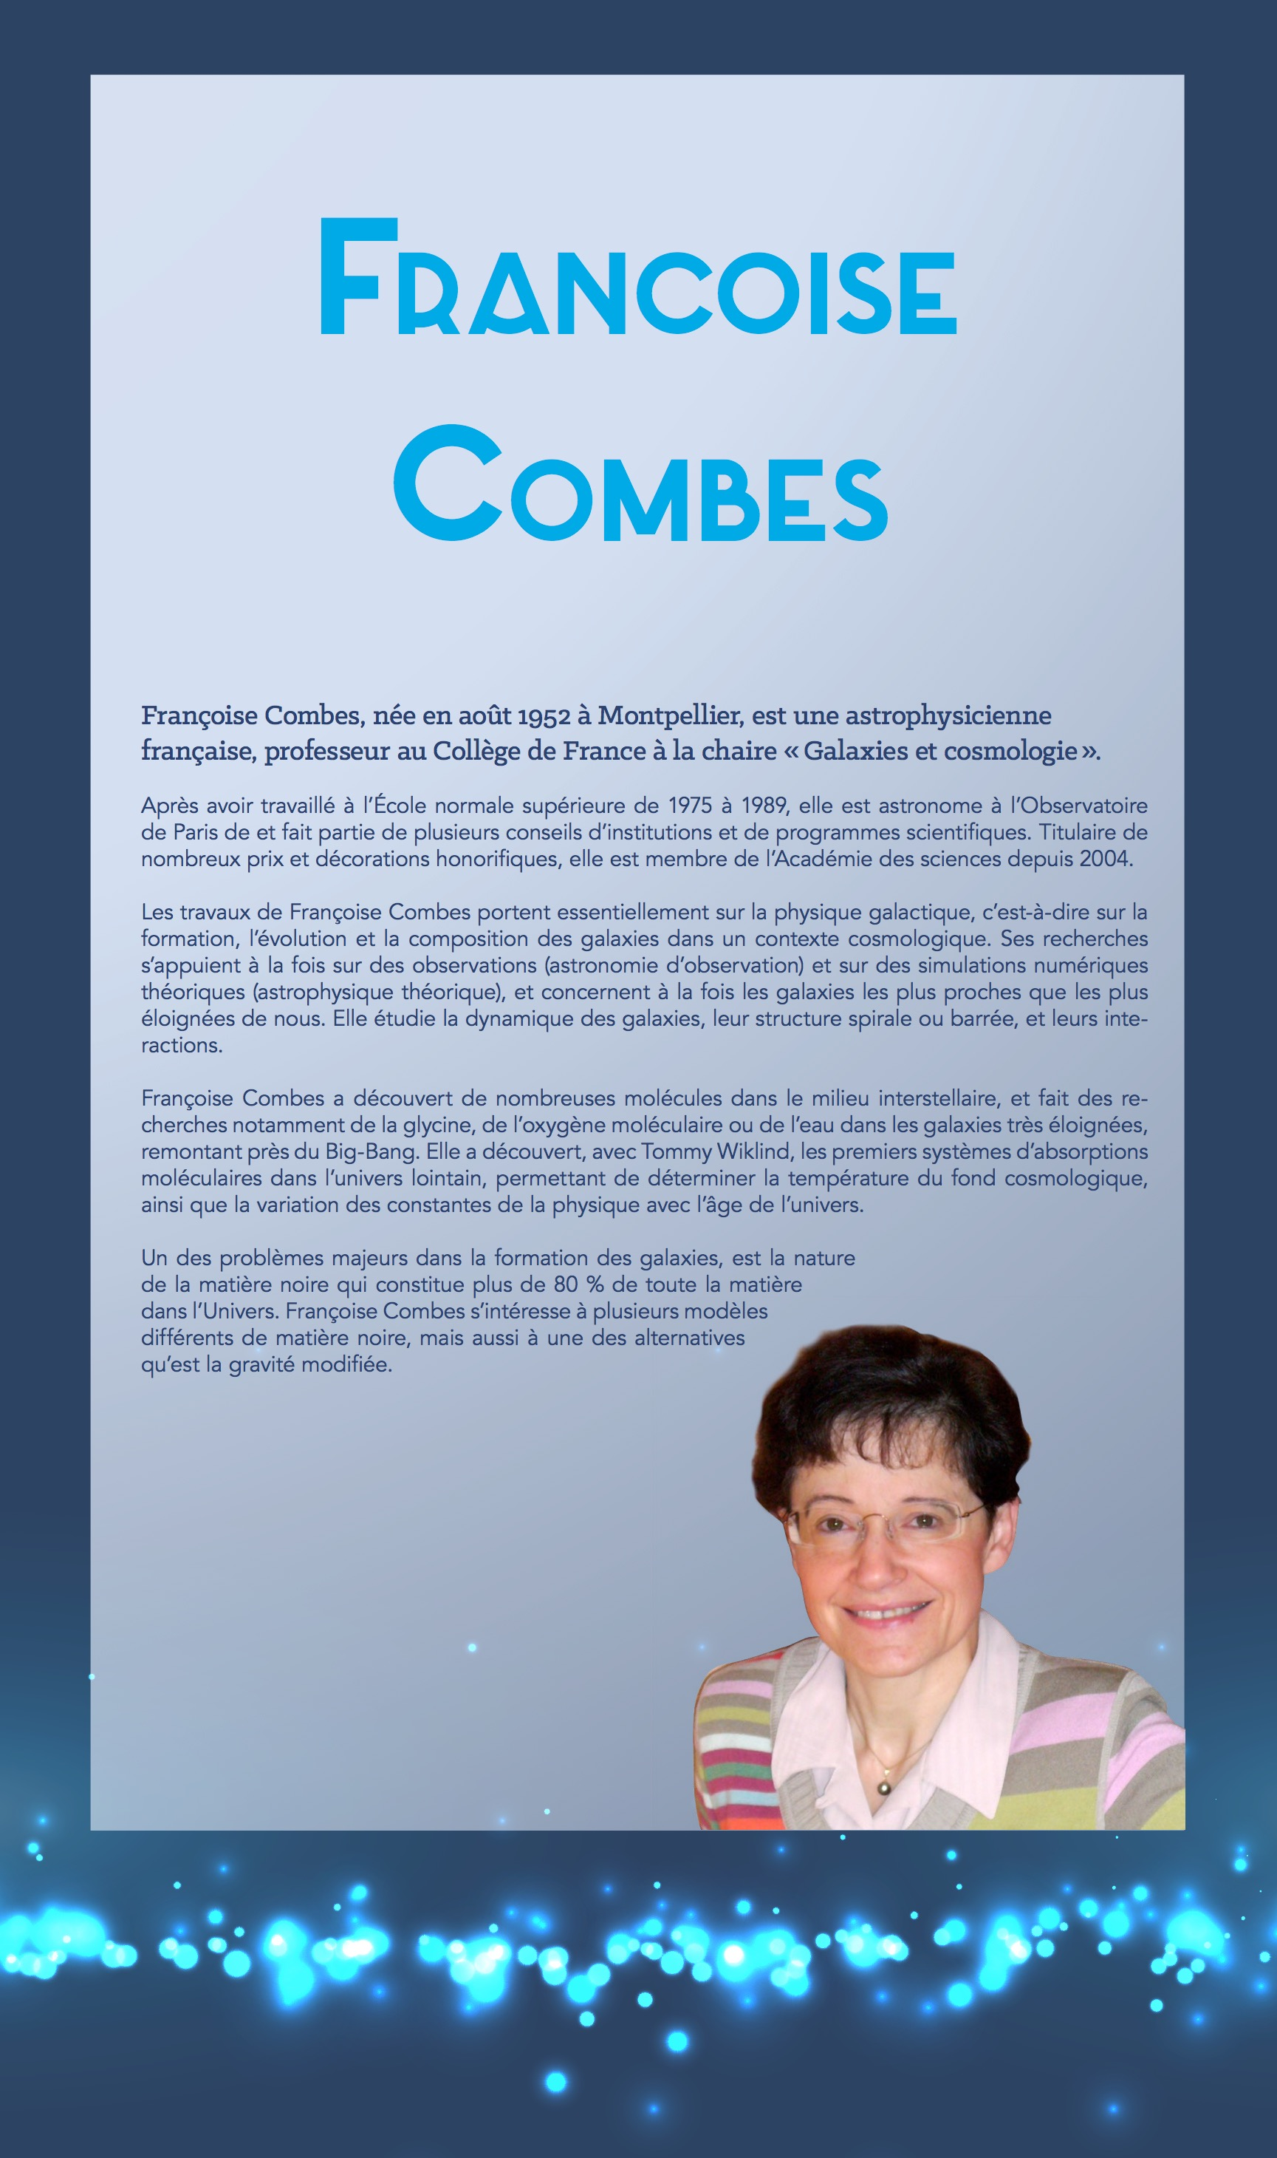
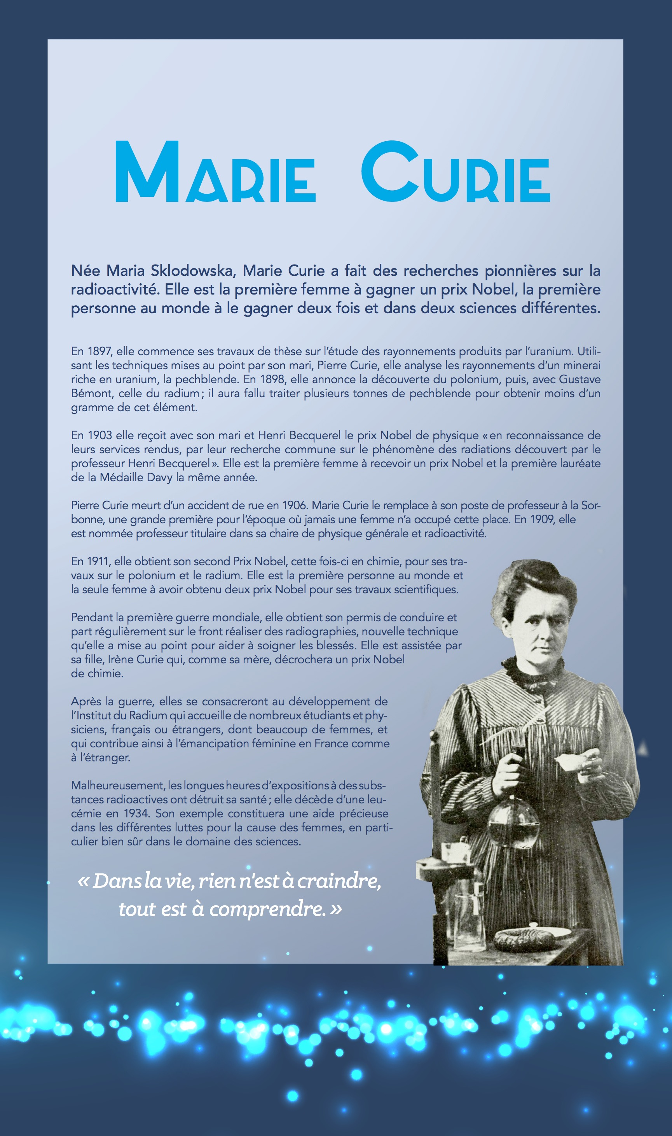
Gender issues
GENERA:
implementation at APC
Actions towards students, role models
  Masterclass on UN day of women in science (11/02/2016)
  Intervention at Summer School for undergraduate students (16/07/2017)
  Discussion session at High School Teachers’ school EPhyD (31/08/2017)
  Exhibit ”Physique de femmes” at Fête de la Science 2017
2) Encourage women to apply
  L’Oréal-Unesco Prize (E. Capocasa and V. Domcke, 2016)
  Nominations of group and service leaders
  ➔ 50% Women of group/srevice leaders at APC
EU funded in the frame of H2020-GERI-2014-1
2015-2018, 3.34 Mio Euro funding
14 beneficiaries from 11 countries
Objectives: assess the status of gender issues and GEPs, support organisations in implementing
Shall establish a long-term perspective beyond project lifetime (network, monitoring)

Slide 29
Three key associated structures
Labex
Univearths
Paris Centre for Cosmological Physics
Interdisciplinarity with Geosciences
Educationand R&D
European Roadmap
APPEC

Slide 30
Astro-geo science emerging synergy
(or revival of an older alliance)
The geosphere, a direct object of study of the geosciences, is both the target and the detecting medium for astroparticle observatories,
They both deal with complex natural systems at a much larger scale than the human, deploy large sensor networks in sometimes hostile environments (sea, desert, underground, space);
Use long series of precise observations acquired over a range of time scales;
Extreme dating is a discovery instrument;
They finally use advanced sensors and a large data manipulation and worldwide networking, including the distribution of alerts.
Seismology
    Seismic precursors using gravitational wave technology
    Ocean floor seismology (standard, acoustic)
Muon Imaging
    Volcano muon tomography
    Archaeology, prospection
Neutrino Imaging
    Geoneutrinos
    Earth Neutrino radiography
Deep ocean
    Parameter monitoring and bioimaging
  Space
    Space weather (Nano satellites, Taranis, EUSO)
APPEC-APC centre organises a pan-European meeting
of agencies and Pis by mid-2018

Slide 31
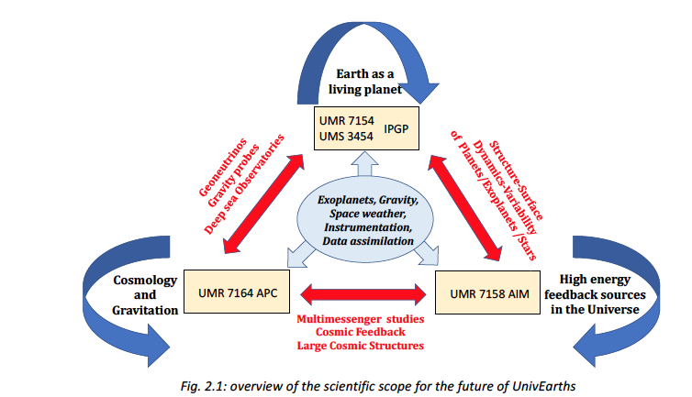
A strategic alliance
The interdisciplinarity with Geosciences Labex Univearths+
EUR EPU (AIM,APC,IPGP) Not retained
Data Plateforme DANTE (APC, IPGP) retained

Slide 32
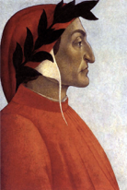
From FACe to Project DANTE
Context:
  CNRS formally asked APC to move out from Biopark
  APC together with its LabEx UnivEarthS partners IPGP submitted the proposal DANTE to the regional call SESAME of 2017: obtained 2 years funding
DANTE a center (APC-IPGP) of innovative and multidisciplinary expertise, could become key centre of P2IDS (Paris Interdisciplinary Institute for Data Sciences)
FACe team keeps its autonomous expertise on APC subjects
Key infrastructure challenge of 2018 for APC
  Personnel and CDF exchange with UMR SHPERE moving to Olympe des Gouges
  Budget of restitution of offices : 309 k€
  Machine mouvement budget : 210 KE (SESAME, PR, CS)

Slide 33

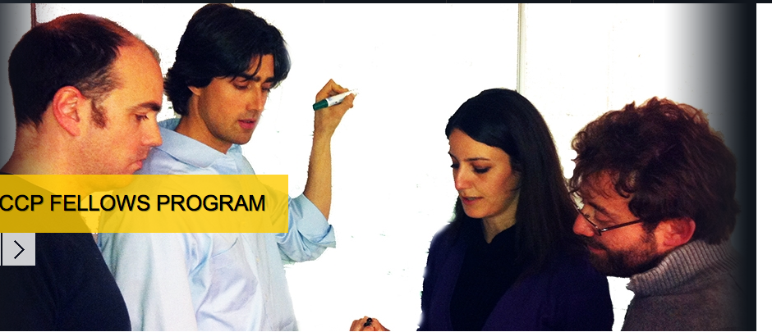
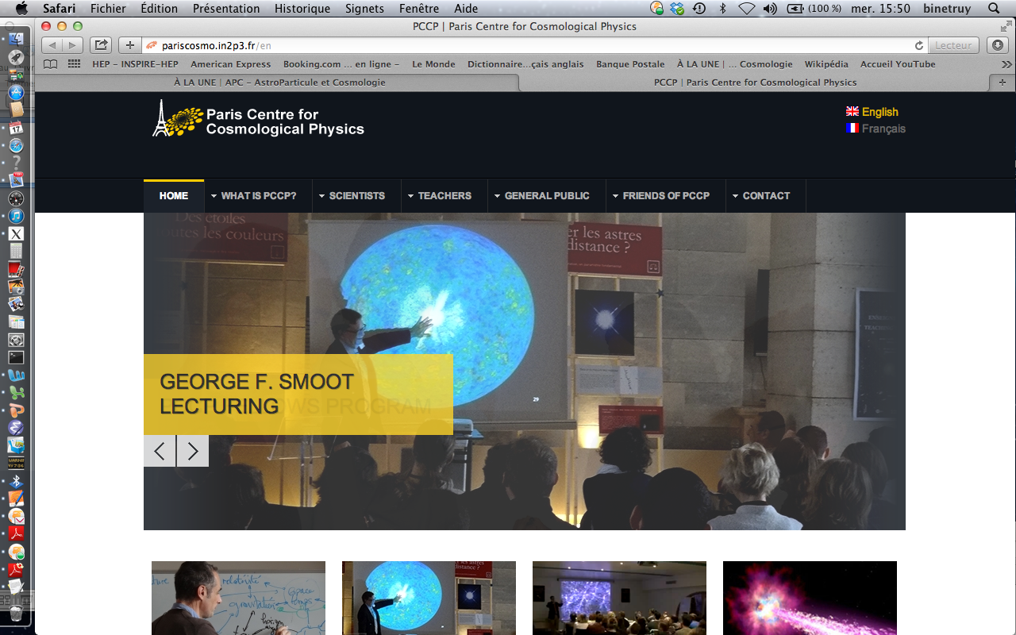
∂
Paris Center for Cosmological Physics
APC ,GEPI, LPNHE, LPTENS, LuTH
Foundation « Physics of the Universe »
Chair G. Smoot, Interim Director S. Katsanevas (replacing P. Binetruy)
A fellows program
Current focus: R&D on cryogenic detectors (TES/KIDS)
Education and Outreach
  « Teaching the Universe »
  MOOC Gravity (P. Binetry + G. Smoot, subscription 100.000 followers)
A Conference program
Art and Science Univers 2.0 (Foundation Carasso)
International Donators (Kazhakstan)

Slide 34
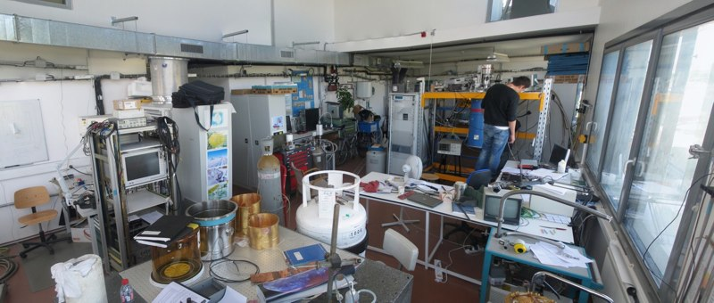
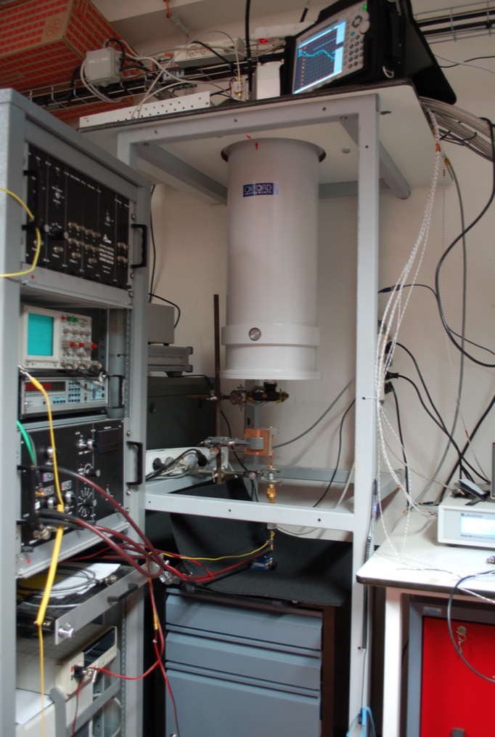
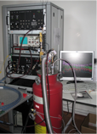
APC mm lab (strong connection with PCCP)
Permanents: Fabrice Voisin (10%), Damien Prêle (10%), Jean-Pierre Thermeau (40%), Steve Torchinsky (50%), Michel Piat (50%)
Postdoc: Maria Salatino
PhD student: Alessandro Traini
Support of technical services
A new instrumentalist under recruitment with Univearths funds
Dilution 20mK
⁴He/³He system 280mK
mm cryo deepstick 4K

Slide 35
R&D BSD (B-mode Superconducting Detectors)
Labo: APC (leader), C2N (ex-IEF), CSNSM, IAS, IN, GEPI, LPSC, L2E, IRAP
Fundings: ANR, CNRS, CNES, ESA
Sensitivity:
Transition Edge Sensor arrays
  Superconducting NbSi
  SiGe ASIC at 4K: TDM 128->1
  Application to QUBIC
Kinetic Inductance Detectors (KIDs)
  Polarisation sensitive KIDs
  Visible + NIR KIDs (GEPI)
Immunity to systematic effects
Planar superconducting microwave devices
  Nb based
  Antennas and filters
  Multi-chroic architecture
  Use of radio architectures in the incoherent detection field
Perspectives: QUBIC, LiteBird, CORE, CMB-E4

Slide 36



TESs developments
Lab | Responsibilities
APC | Coordination, architecture definition, cold readout, TES tests
CSNSM | NbSi, solid state physics
C2N | Microfabrication
IRAP | Warm electronics
QUBIC filled TES array
SiGe ASIC
Readout for QUBIC:
  Cryogenic SiGe ASIC
  TDM 128 -> 1:
  first in the world
C fiber signal on QUBIC TESs

Slide 37



Polarisation sensitive KIDs
Dual-color antenna-coupled LEKID
  Single slot antenna
  2 filters and 2 LEKIDs
    140GHz and 160GHz
    10% bandwidth
  Under test
Sample made at GEPI

Slide 38

APPEC
  APPEC functional centre
  Mandate of APC Functional centre
Organize Scientific Advisory Committee
  April 2016 APPEC town meeting
  S.K central editor of the European Roadmap
Interdisciplinary issues
Recent Highlights
Global Neutrino Meetings (2014,2015,2016)
European Coordination CMB (2015,2016, 2017)
Planned
Interdisciplinary efforts with Geosciences (2018)

Slide 39
Institutional insertion
Target University
P5-P7-IPGP
Federation (IN2P3)
APC-LLR-LPNHE
University evolution
Disciplinary federation
APC considered a key asset of P7 and Target University
Regional federation
S.K
Coordinator of pole Exact sciences and Technology and
Coordinator of the project Paris Interdisciplinary Institute of Data Sciences
Dim-ACAV
Coordinator OdP

Slide 40

International Insertion, beyond APPEC
U. Of Chicago
A new brother institution
Astrocent in Warsaw
UMI Paris- Bay-Area
G. Smoot, S. Perlmutter
Japan
LIA
KAVLI-IPMU
KITP Helmholz Allianz
APC-Hambourg-Oxford
Solvay Institute
LIA Argentina

Slide 41
AstroCeNT:
Particle Astrophysics Science and Technology Centre
The prime objective of AstroCeNT will be to develop a future oriented research and development (R&D) programme in science and technology in the area of ultra-sensitive detectors and sensors as well as large data set collection and analysis tools
The international strategic partner of AstroCeNT will be the Laboratory of Astroparticle and Cosmology (APC) — a world-class scientific institute based in Paris.
The main scientific field of the Agenda will initially be focused on two areas:
  Gravitational wave astronomy and
  Dark matter
The main three science-driven technological themes initially proposed for AstroCeNT are:
  Silicon Photo Multiplier based systems;
  seismic sensors;
  data acquisition and large data set processing

Slide 42
6 questions from our HCERES evaluation committee:
How can you tell if a group is spread too thin to be effective, and how are priorities set and accepted? Can you please give examples of activities that groups decided not to pursue and how that worked?
  Context
    Evolution from APC contributions “en amont et en aval” to key infrastructure contributions
    The importance of our space involvement, key attractor of resources
  2 Evaluation Instruments
    CSP evaluations and Scientific Council. Too close and too far ? Need an intermediate instance, a discussion in our Biennale March 2017, postponed for the new direction
    During the first Biennale of APC, complaints that our FTE did not previously conserve unitarity, this is clearly not the case anymore
6 Projects stopped or downscaled to individual contributions since 2014
  SKA and PTA, (lead to discontent of key researchers) , Xshooter, Borexino, R&D Gamma-cube (despite funds from InnovSATT), and downscaled eBOSS participation (lead to loss of a key researcher)
4 New projects since 2014 (in fact continuation of our expertise in new context):
  SVOM (mask expertise from SimbolX),
  ATHENA (follow-up of our expertise in space ASICs),
  Dark Side (Borexino expertise)
  DUNO (continuation of DCHOOZ expertise)
1 Transmutation LAGUNA ➔ WA105/DUNE
1 R&D project in CSP process: LIQUIDO
By 2019, many programs end, near 40% reduction, but key involvements in the remaining
Good time distribution, but no significant R&D due to lack of resources

Slide 43

A precise evolution of technical forces
CSP and CQP

Slide 44
∂
Roadmap
Projet | 2016 | 2017 |  | 2018 | 2019 | 2020 | 2021
Planck | Operation | Fin
LPF |  | Fin
Antares |  |  |  | Fin
Integral |  |  |  | Fin?
EUSO-balloon/ISS |  |  |  | Fin |  | K-EUSO? | POEMMA?
DCHOOZ |  |  |  | Fin
HESS |  |  |  |  |  | Fin
eBOSS | Analysis |  |  |  |  | Fin
Taranis | AIT/AIV |  | Launch |  |  | Fin
WA105 | Construction |  |  |  |  | Fin
QUBIC | Construction |  |  |  |  | CMB-E4?
advVIRGO | Comissioning/analyse |  |  |  |  |  | advVI+
Darkside/SOX |  |  |  |  |  | DS20k
Polarbear/Simons array
CMB-space | Proposals |  |  |  |  | Litebird?
CTA | Phase CDE |  |  |  |  | First light partial
KM3Net | Phase CDE |  |  |  |  | First light partial
EUCLID | Phase CDE |  |  |  |  |  | Launch
LSST | Phase CDE |  |  |  |  |  | First light
SVOM | Phase BCDE |  |  |  |  |  | Launch
JUNO | Phase BCDE |  |  |  |  |  | Operation
DUNE | Phase BCDE
ATHENA | Phase BCDE
LISA | Phase ABCDE
2017 24 projects in operation and construction
2020 15 projects in operation and construction?

Slide 45
6 questions from our HCERES evaluation committee:
The agreements and connections with international groups are admirable and impressive. Could you please list some specific results or opportunities that are a consequence of these
  UMI Berkeley, many synergies from CMB detectors (BCCP-PCCP), to data science (BIDS-P2IDS), science: Polarbear, LSST, discussions for gravitation ?
  LIA Japan, Litebird, Neutrino, dark matter
  LIA Argentina, CMB deployment in Salta
  Chicago, UHECR, Labex Univearths
  Astrocent, building synergies
  KIT, Hambourg-Oxford, Solvay, essentially theoretical interactions

Slide 46

European Strategy for Astroparticle Physics (2017)
Two emergent characteristics of the present era :
We are at the edge of multi-messenger detections involving high energy photons, neutrinos, high-energy charged particles and gravitational waves, that will give us a deeper understanding of violent phenomena regulating structure formation in the Universe as well as eventually hints for new laws of physics .
The visible Universe from the CMB to the present started to provide comparable constraints to the standard models of cosmology (inflation, dark energy) and particle physics (neutrino, dark matter).

Slide 47



6 questions from our HCERES evaluation committee:
3. What connections are foreseen with the upcoming European Strategy for Particle Physics?
Large scale multi-messenger infrastructures:
  CTA/KM3Net, advVirgo➔ET, upgrade Auger
Medium scale Dark Matter and neutrino experiments
  DM (DS-20k), Neutrinoless-2beta
Synergies with astronomy particle physics and cosmology
  Neutrino DUNE , HK
  Cosmology DE : LSST/EUCLID
  Cosmology CMB roadmap: G4 on ground and space

Slide 48











Multi-messenger
Universe
LISAPF
TARANIS
SVOM
ATHENA
INTEGRAL
CTA
EUSO ballon
EUSO LDB-ISS
LISA
KMN3NEt
HESS
advVIRGO
ANTARES
2018
2020
2022
2024
2026
2028
2030
2032

Slide 49



Mesure of the Universe
(Cosmology, DM,neutrinos)
EUCLID
PolarBear/Simons Array
LiteBird
Planck
LSST
QUBIC
DoubleChooz
Dark Side
JUNO
DUNE
2018
2019
2020
2021
2022
2025
2030
2032

Slide 50
6 questions from our HCERES evaluation committee:
FACe : The François Arago Center is presented as a platform to host DPC (Data Processing Centers) or DAC (Data Access Centers) for space missions or ground based projects with heavy computing needs. Please show how this platform is organized and the workforce needed to operate it. If the workforce is shared with the IT department, how is this managed?
PCCP: What are the organizational and financial relations between The Paris Center for Cosmological Physics (PCCP) and APC? Is there coordination between the PCCP scientific program and the APC physics group (Cosmology, Theory …)?
The Energy Physics Group has recently joined the laboratory. The scientific activity of this is clearly of high level and with high societal impact. However, It is not a priori obvious that APC would offer the best development environment to this research activity. In addition, many of the research themes of this group are rather managed by departments of the CNRS (or CEA) which are not the ones which are the “tutelle” of APC. Would you please further explain the strategy for welcoming this new group at APC?

Slide 51
Key scientific short and medium term objectives
Prepare O3 / Virgo and phase A of LISA
Finish the Technical Demonstrator and the first module of QUBIC
Leadership participation to a European ground / space roadmap for CMB
Fulfil obligations to Euclid and LSST, increase APC weight to analysis
Advancing the construction of major CTA / KM3Net infrastructures
Finish our technical implication to TARANIS
Continue the tradition of low energy photons in space, persuade agencies of it renewed role, until the coming of SVOM / ATHENA who will have a rich multi-messenger potential
Measure mass hierarchy and neutrino CP violation in a complementary way (DUNE / JUNO / ORCA)
Defend th erole of Liquid Argon techniques in DM search in French context
Exploit the synergies between multi-messenger domains and cosmology
Continue to develop
  Interdisciplinarity with the geosciences (UnivEarths)
  Innovative education techniques (PCCP)
  Data science (FACe and DANTE)
  European and international links (APPEC, LIAs and UMIs)

Slide 52
SWOT, APC
Forces | Weaknesses
Very proactive researchers and engineers Leadership in IN2P3 in search of new resources (from ANR to EU) Adaptation to a new funding environment Recognition as a space laboratory Technical and data-science expertise High Visibility in the University envt. International recognition | Differential ratios researchers/engineers per project, in general lack of technical forces (among the smallest IN2P3 ratios) Administration HR fragility, given the multiplicity of the funding sources Large CDD turnover Not anymore dedicated European project manager, communication officer
Opportunities | Threats
Start of GW and Multi-messenger Astronomy Unique APC group structure in the current scientific context Interdisciplinarity with Geosciences | Tight schedule for FACe relocation Fragility to loss of key expertise

