Slide 1
LCG-France Project Status
Fabio Hernandez
Frédérique Chollet
Fairouz Malek
Réunion Sites LCG-France
Annecy, May 18-19 2009

Slide 2
Contents
LCG-France contribution to WLCG
Ongoing work
Progress since last meeting
Questions

Slide 3
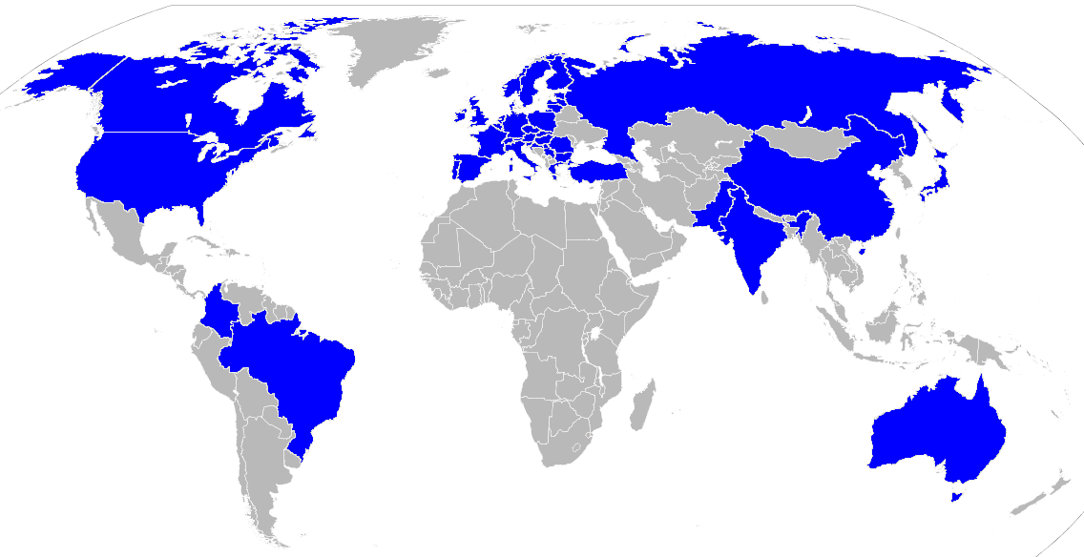
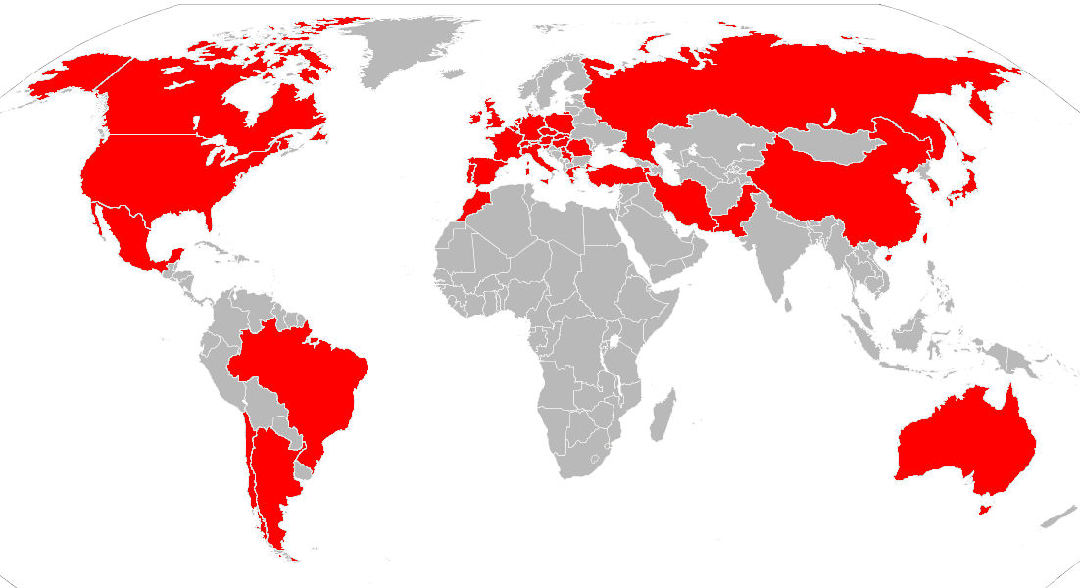
Global infrastructure
Location of sites connected to a grid infrastructure which provided CPU resources to LHC experiments in 2008 (43 countries)
Users currently registered in LHC VOs have certificates issued by authorities in these countries
Source: EGEE Accounting Portal

Slide 4
Actual contribution: CPU All sites
43 countries contribute CPU to the LHC experiments
Top 10 countries crontribute 85% of CPU
Source: EGEE Accounting Portal

Slide 5
Actual contribution: CPU All sites (cont.)
Role | Site | ALICE | ATLAS | CMS | LHCb
Tier-1 | IN2P3-CC | ✓ | ✓ | ✓ | ✓
Tier-2 | IN2P3-CC-T2 | ✓ | ✓ | ✓ | ✓
 | GRIF | ✓ | ✓ | ✓ | ✓
 | IN2P3-LPC | ✓ | ✓ |  | ✓
 | IN2P3-IRES | ✓ |  | ✓
 | IN2P3-LAPP |  | ✓ |  | ✓
 | IN2P3-SUBATECH | ✓
Tier-3 | IN2P3-CPPM |  | ✓ |  | ✓
 | IN2P3-IPNL | ✓ |  | ✓
 | IN2P3-LPSC | ✓ | ✓
Source: EGEE Accounting Portal

Slide 6
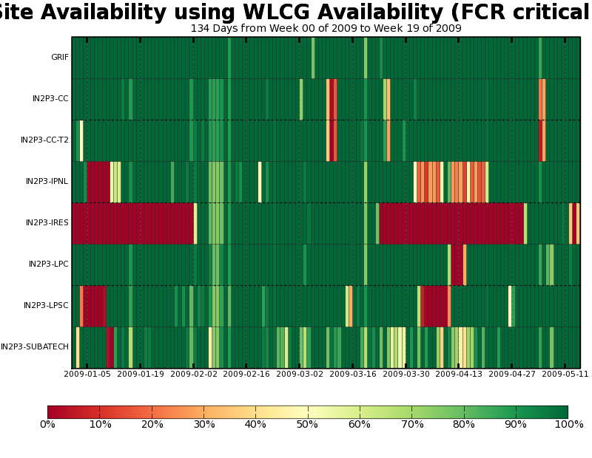
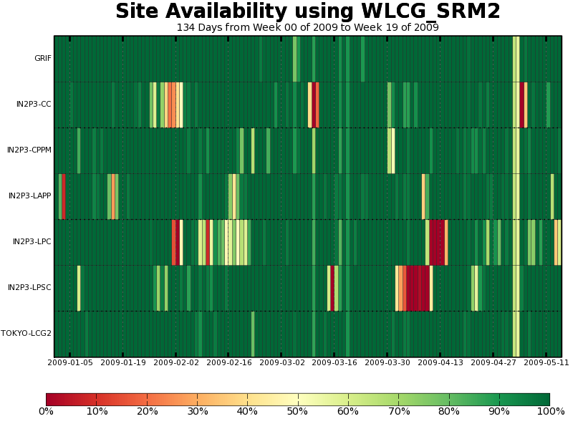
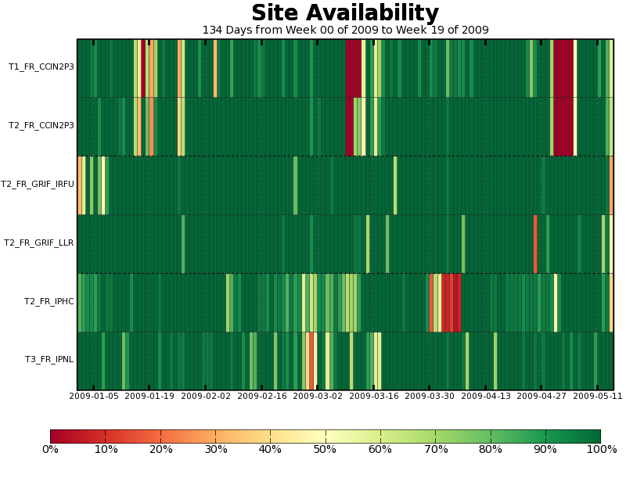
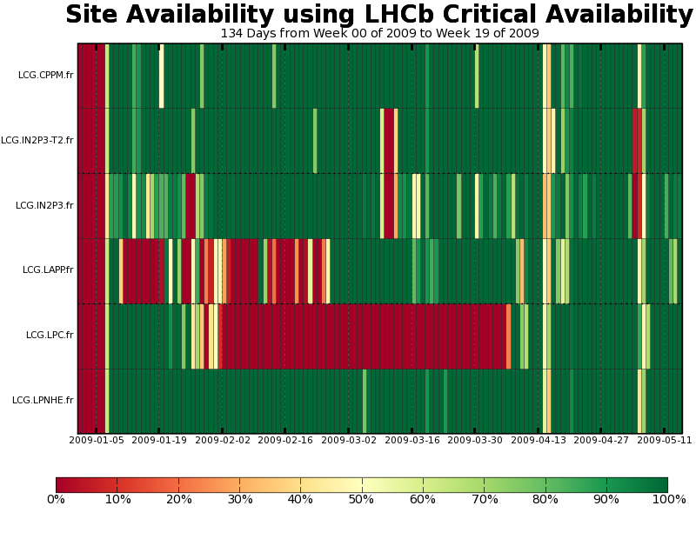
ALICE
ATLAS
LHCb
CMS

Slide 7
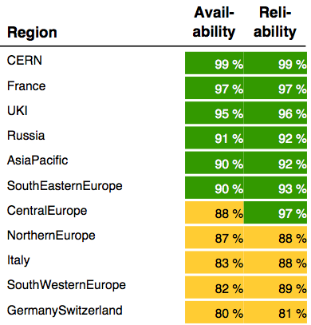
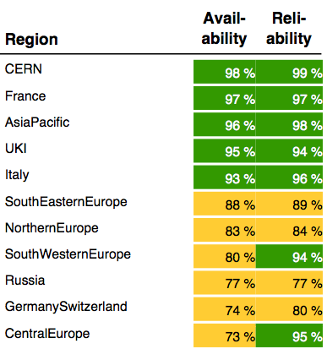
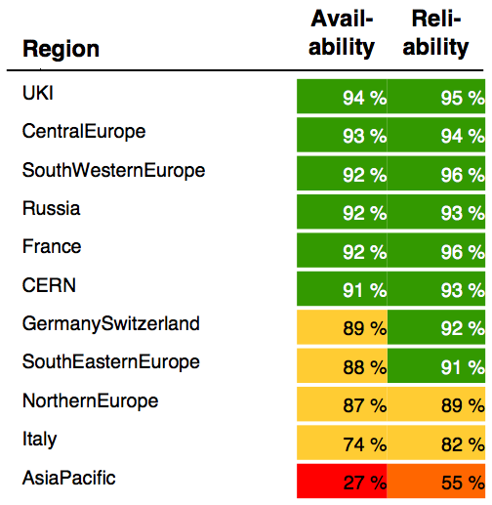
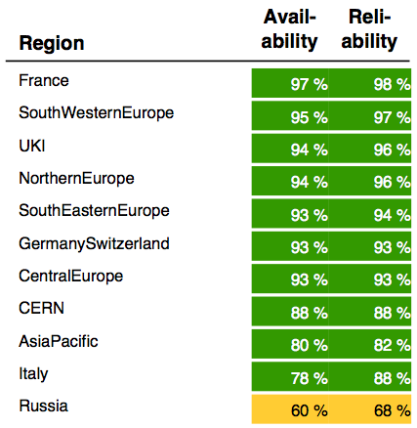
Availability & Reliability – EGEE Regions
Jan 09
Feb 09
Mar 09
Apr 09
Source: https://edms.cern.ch/document/963325

Slide 8
Availability & Reliability – EGEE France
Ces chiffres paraissent suspects pour certains sites
(Phy.CPU = Log.CPU)
Apr 09
Source: https://edms.cern.ch/document/963325

Slide 9
Calendrier
Source: Ian Bird, WLCG Workshop, Prague, 21-22/03/2009

Slide 10
WLCG - Ongoing work
User-level accounting
Improving monitoring tools for various users
Experiments & sites
Automated collection of and reporting on installed CPU and storage capacity
Initial deployment of Scientific Linux v5 for worker nodes, for validation purposes
Bulk CPU capacity not expected running SL5 before September 2009
Switch to new CPU unit SPEC-HEP 2006
https://hepix.caspur.it/benchmarks/doku.php?id=homepage
Virtualization
STEP’09

Slide 11
Progress since previous meeting
Core of a dedicated farm for end-user analysis in place and tests started (CC)
Pilot testing or early adopters of some services at several sites
WMS (GRIF), CREAM CE (Subatech), glexec & SCAS (CC), …
Several software and hardware updates
FTS, VO boxes, WMS, CEs, …

Slide 12
Project Management
Contribution of LCG-France to the funding of the tier-2s and tier-3s: on time
Risk analysis: belated
Quarterly all-sites meetings: first experience seems worth to continue

Slide 13
Concerns
Connectivity of LAPP to the national network, before LHC starts
Infrastructure of tier-1
Performance of the access to mass storage at tier-1
Yet to demonstrate that it can cope with requirements by LHC experiments
Stability of the storage components
Requirements for data analysis not yet understood
Lack of sufficient regulation mechanisms
Inter-site data transfering
Different activities by the same experiment within a single site

Slide 14
This meeting
Update on tier-1 activities and infrastructure
Updates on some other sites
Experiments
Transition to the French NGI
organization and day-to-day operations
Updates on working groups
accounting and monitoring
Connectivity update
WAN and LANs
LHC data analysis

Slide 15
More Information
LCG-France website http://lcg.in2p3.fr
Agendas
http://indico.in2p3.fr/categoryDisplay.py?categId=59

Slide 16
Questions
?

