Slide 1
Are you ready to speak English?
No! Mercy! Mercy!

Slide 2
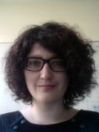
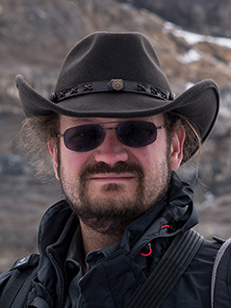
Participants of the video conference
Students from:
Colmar (France)
Erlangen (Germany)
Hamburg (Germany)
Bonn (Germany)
Moderators at CERN:
Rosa Simoniello
Steffen Schaepe

Slide 3
Outlines of the video conference

Slide 4
How is your pronunciation?
Oh my God!!

Slide 5
What does LHC mean?
L
H
C

Slide 6
What does LHC mean?
Large
Hadron
Collider

Slide 7
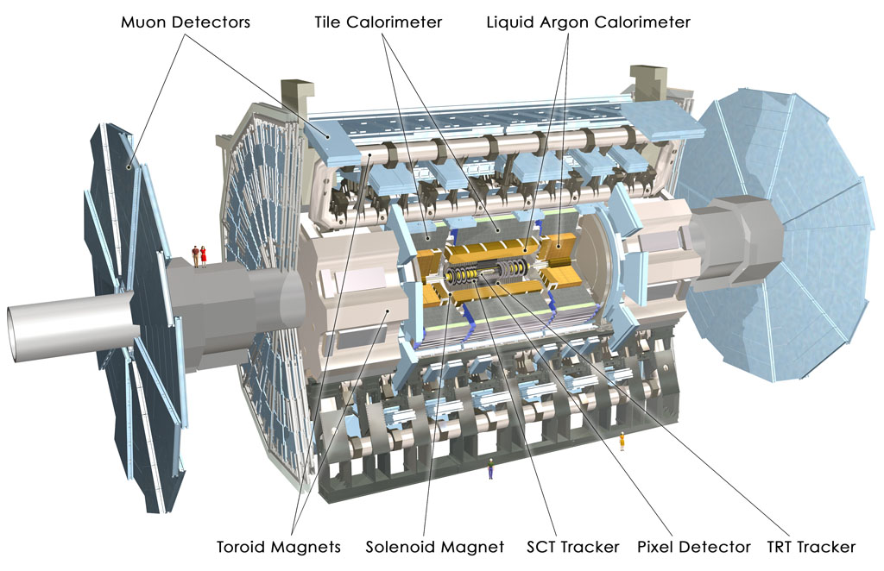
What is the name of this detector?

Slide 8
What is the name of this detector?
ATLAS

Slide 9
Can you pronounce the name of these particles?
Electron
Muon
Lepton
W
Proton
Higgs boson

Slide 10
Can you pronounce these technical words?
Calorimeter
Tracker
Missing energy
Background
Signal

Slide 11
Do you like multiple choice questions?
Damned!!

Slide 12
The proton beams …….. in the center of the ATLAS detector.
Crash
Collide
Merge
Kiss

Slide 13
The proton beams …….. in the center of the ATLAS detector.
Crash
Collide
Merge
Kiss

Slide 14
The W+ boson …….. into one electron and one anti-neutrino.
Merges
Splits
Breaks
Decays

Slide 15
The W+ boson …….. into one electron and one anti-neutrino.
Merges
Splits
Breaks
Decays

Slide 16
What is the mass of the Higgs boson?
125 GeV
91 GeV
14 TeV
511 keV

Slide 17
What is the mass of the Higgs boson?
125 GeV
91 GeV
14 TeV
511 keV

Slide 18
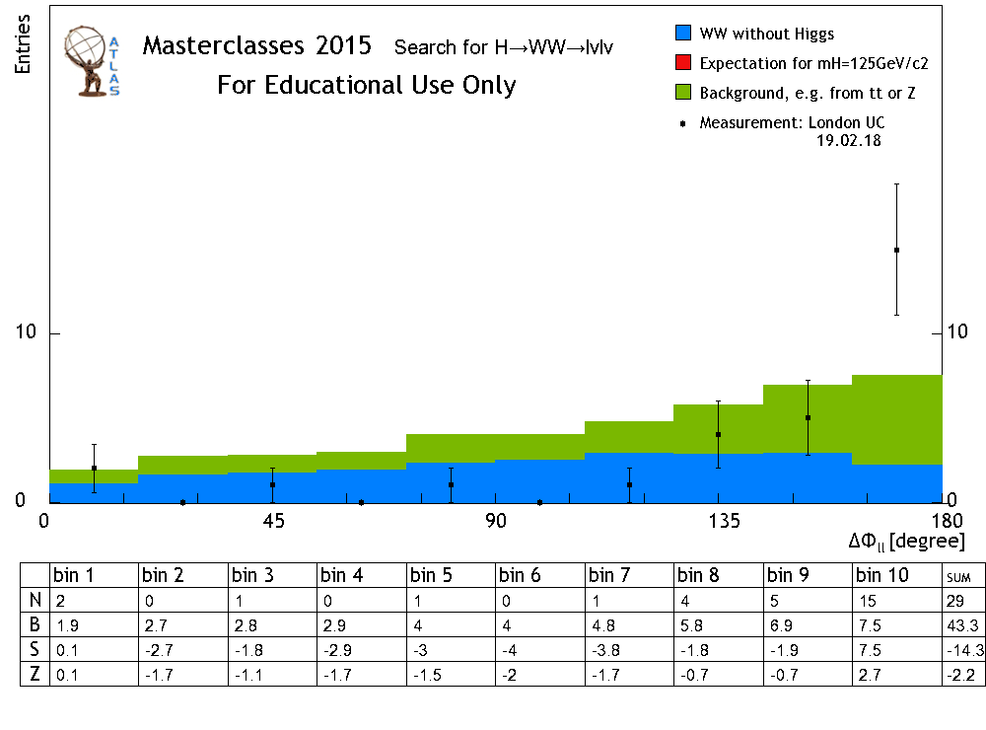
This is the …….. what we get.
drawing
graphics
plot
Smurf
Jul

Slide 19
This is the …….. what we get.
drawing
graphics
plot
Smurf
Jul

Slide 20
For getting an accurate measure, I need a lot of …………
luck
Smurfs
events
steroids
statistics

Slide 21
For getting an accurate measure, I need a lot of …………
luck
Smurfs
events
steroids
statistics

Slide 22
More questions?
ZZZZZZZZZZ

Slide 23
What is the favourite moment of your day?

Slide 24
Do you like listening Jul?

Slide 25
Are you sure to like listening Jul?

