Slide 1
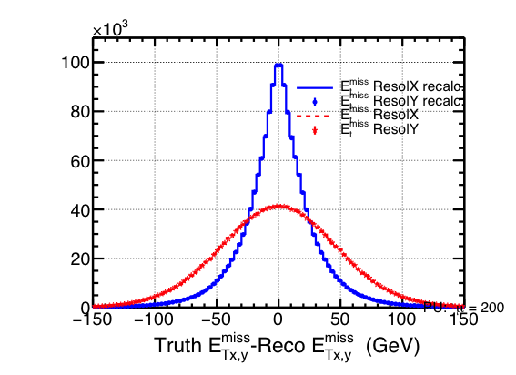
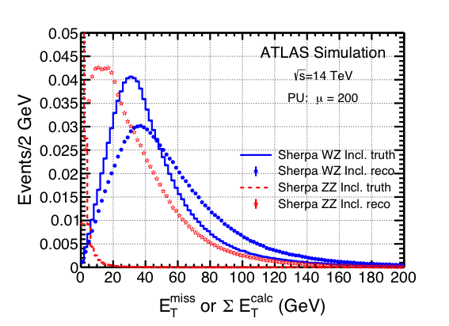
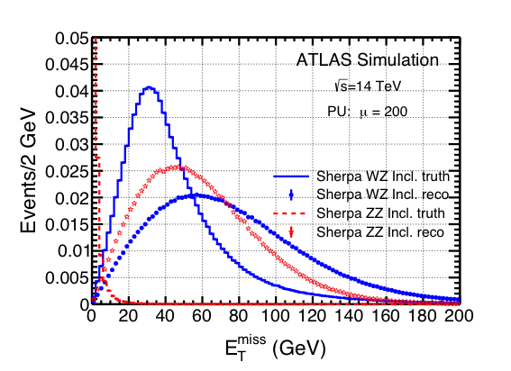
E_{T}^{miss} distributions
E_{t}^{hard} ~ E_{T}^{mis}
E_{T}^{hard} is recomputed using the reco
jets “Track Confirmed”, p_{T}^{jet} > 30 GeV
and the reco leptons, p_{T}^{lept} > 5 GeV
E_{t}^{had} & E_{t}^{mis}
resolution
E_{T}^{hard}= - | Σ p_{T}^{jet} + Σ p_{T}^{lept}|
This improves the E_{T}^{miss} resolution
(but the distribution is not gaussian
anymore)

Slide 2
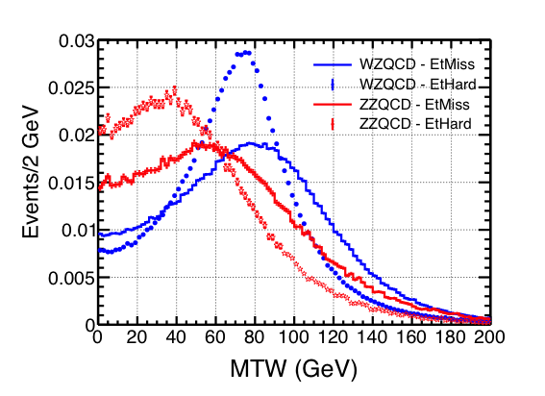
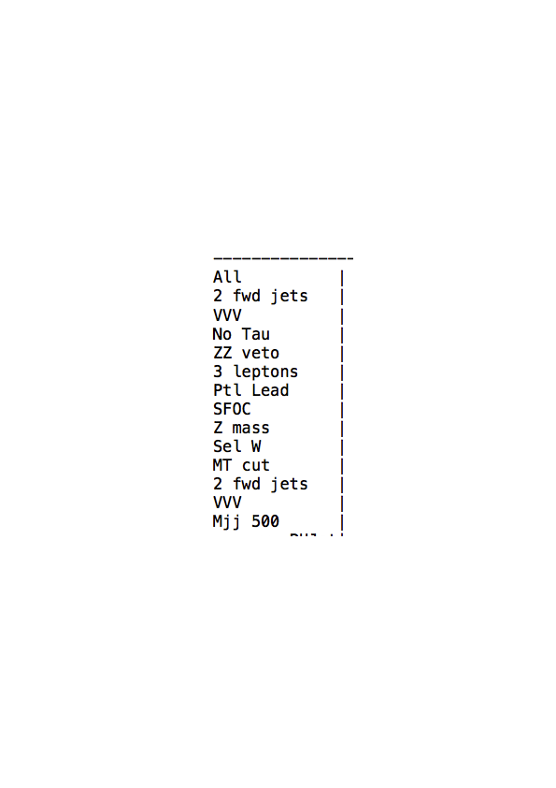
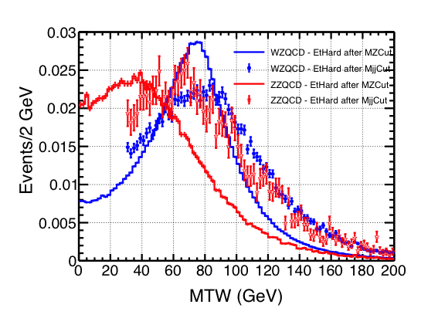
< 4 Basic
= 3 Zlept
?

