Slide 1

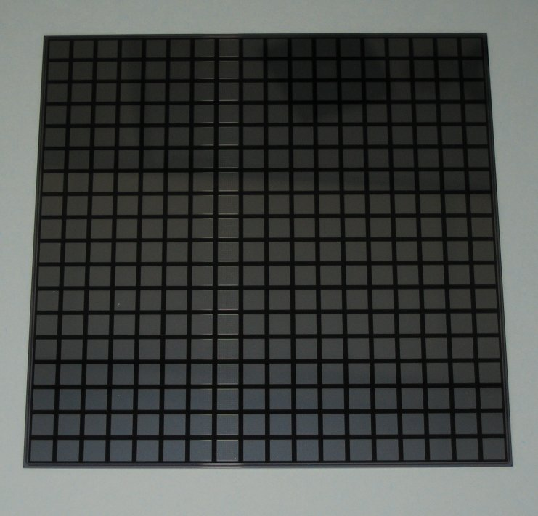
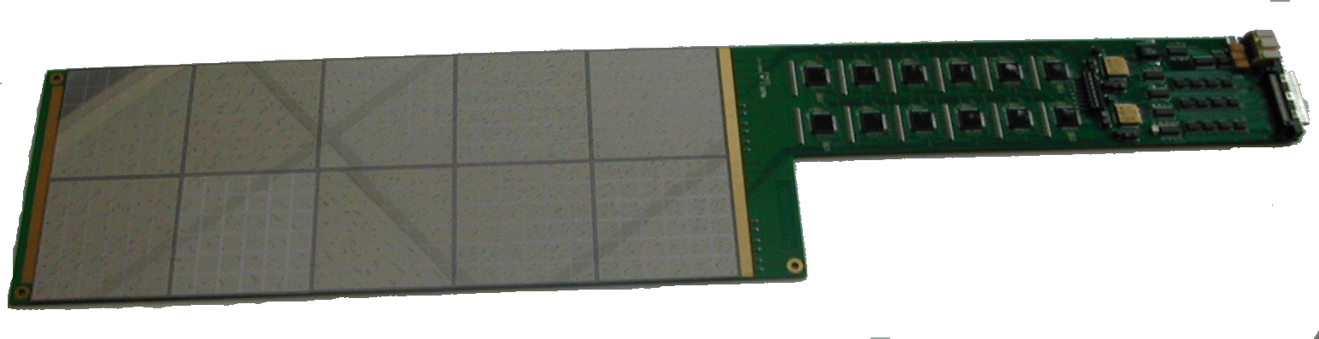


FKPPL technical activities
CALICE Si-W ECAL
Rémi CORNAT
remi.cornat@in2p3.fr

Slide 2
Overview
Front end board
  See presentation from Pr. CHAI & Christophe de la Taille
  New design FEV7, some simplifications
Bounding of Chips
  Inside a groove, horizontal wires
Silicon wafers
  New size and pixel number
  Crosstalk issue (“square events”)

Slide 3

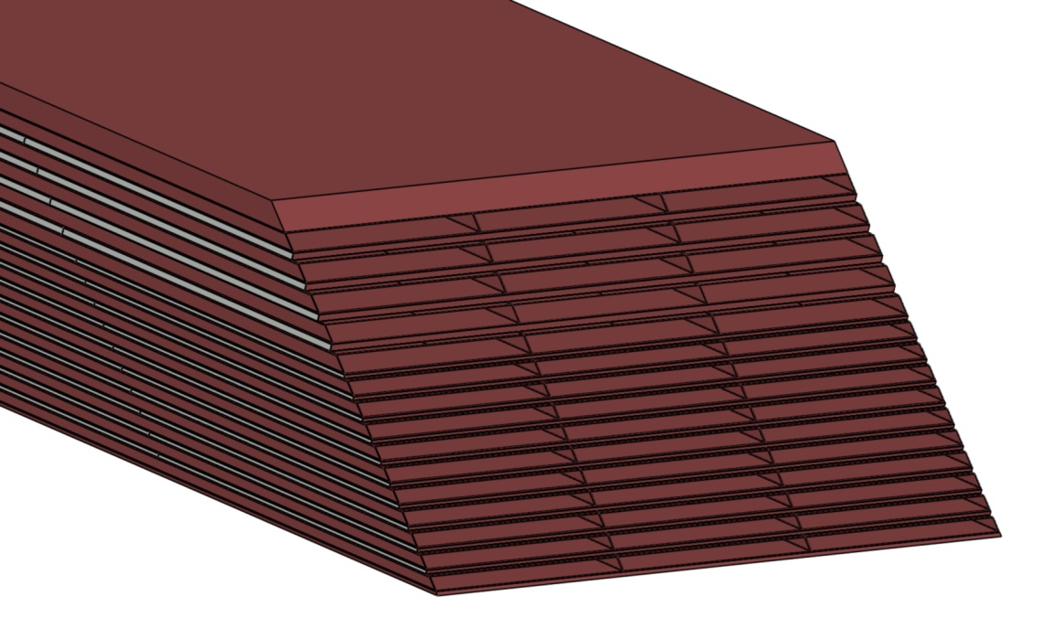
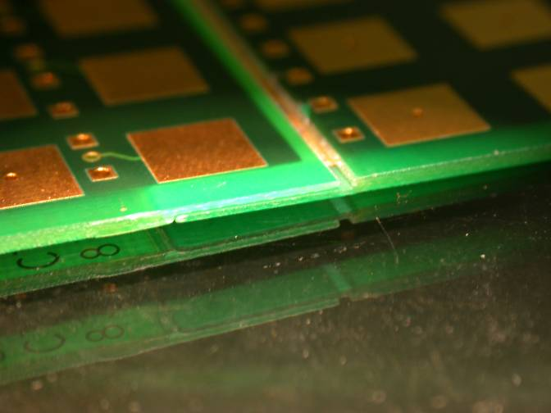
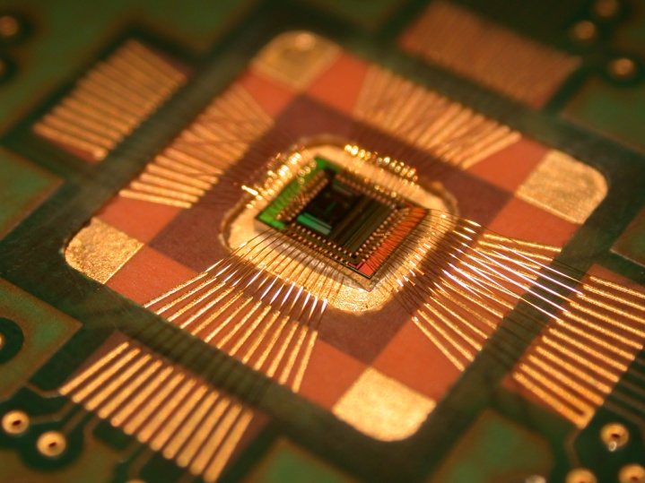
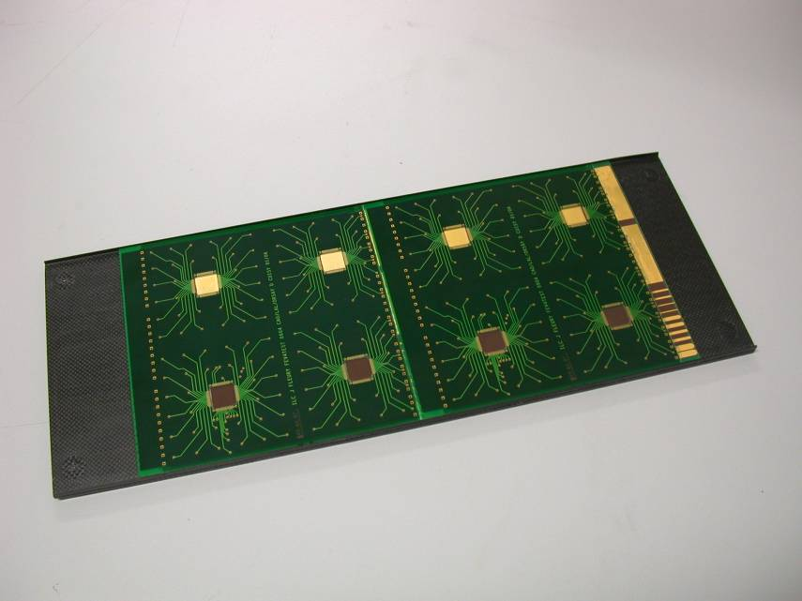
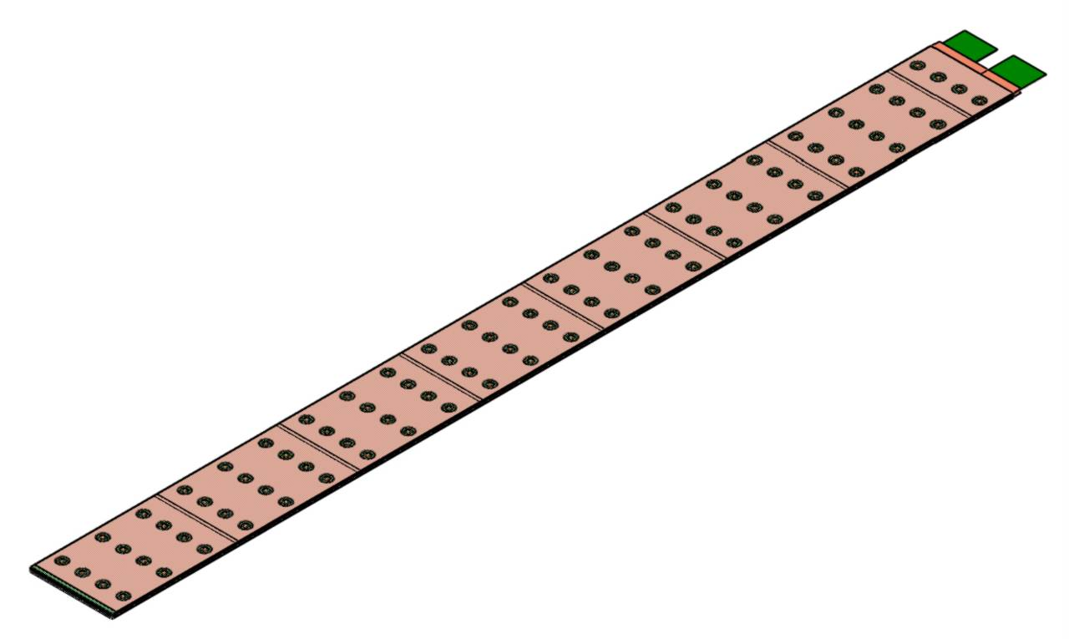
ECAL detector slab
Carbon fiber Alveolar Structure
Slightly relaxed mechanical constraints : ILD + 0.4 mm
182×9.4 mm
182×7.3 mm
Connection between 2 A.S.U.
“end” PCB
Chip embedded
7 A.S.U.
Short sample
A long SLAB and a tower made up of short SLABs (30 layers)

Slide 4
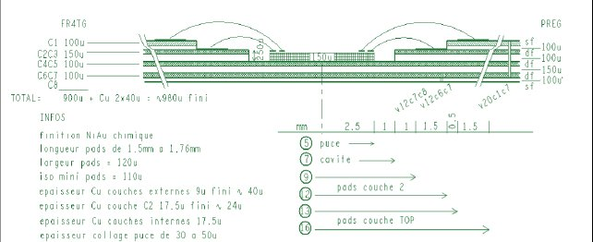
Front end board (reminder)
Complex PCB and manufacturing process as well
Many tries with French manufacturers
Problems with resin between the two assembled PCBs
Clean-up needed but it degrades the coating of bonding pads
Many hope from our Korean colleagues to fix this PCB

Slide 5
Front end board (FEV7, FEV++)
Simpler chip integration but strong requirements on signal integrity
Overall PCB should be slightly simpler
Could be re-routed to be compliant with available tehchnology

Slide 6
Silicon wafers overview
Technology
  Low cost (3000 m2 for an ILC detector)
  Very common process, few number of steps
  PIN diode, reverse bias
CALICE physics prototype
  Various sensors were tested including Korean ones (finally not included in the prototype)
  500 nm, 6x6 cm², 36 pads
  Square events : understood to come from guard rings
  Dead Space
At LLR we are searching for new design techniques
  Reducing crosstalk due to the GR
    Segmented guard rings to avoid square events
  Lowering Dead space (at the border)

Slide 7
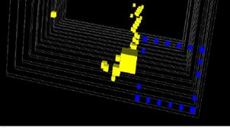
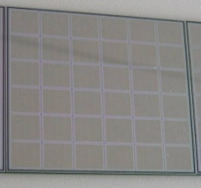
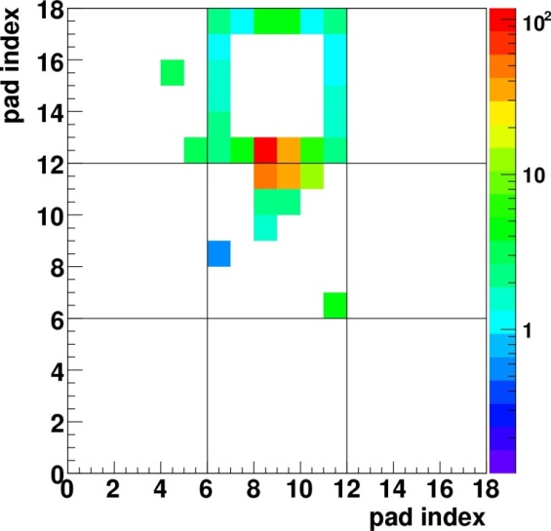
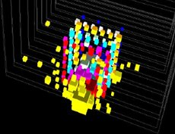
Sensors : crosstalk
When a particle (>100 MIPs) hit the floating guard-rings…
Unbiased guard-rings act as a pad all around the sensor
Definitely confusing for clustering and reconstruction
The square shape corresponds to the guard-rings location
Guard-rings are mandatory to avoid breakdown = need to find a turnaround which meet the cost requirements

Slide 8
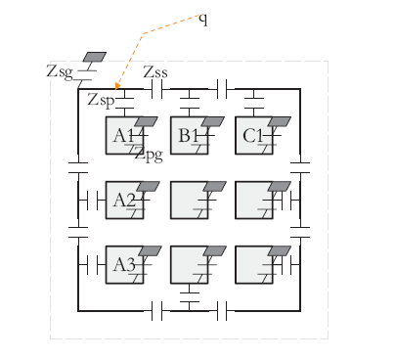

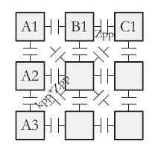
Analytic model of the crosstalk
Couplings are modeled with quadripoles filters
the number of segment Nseg appears
Continuous
1 cm
3 mm
Guard-rings only
Measurement electronics
Crosstalk
Charge injector
Includes the whole measurement chain (band pass filter)
Additional electrical simulations (SPICE)
including the pixel to pixel crosstalk

Slide 9
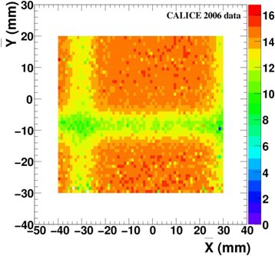
Sensors : dead space
Guard rings + spacing between sensors degrade the efficiency of the charge collection
9 cm large sensors : less dead space
“edgeless” sensor ?

Slide 10
Sensors : next step
e.g. : Hamamatsu design
  New size ordered: 300 nm, 9x9 cm², 256 pads
  Sold as having no guard rings (thus no square events)
  Have guard rings ! External charge injection shows square events…
  Large dead space (1.2 mm)
  Behavior with glue checked over 8 months : OK
  Cost of prototypes: 70 k€ = 40 wafers, not enough for EUDET
A new version of sensor from Korea would be helpful
  Feedback from the physics prototype
  Control of the cost
  Ideas for the guard-rings
  Meeting last week at Daegu (CALICE week) : new design could be envisaged

Slide 11
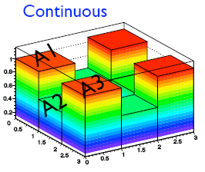
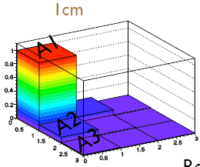
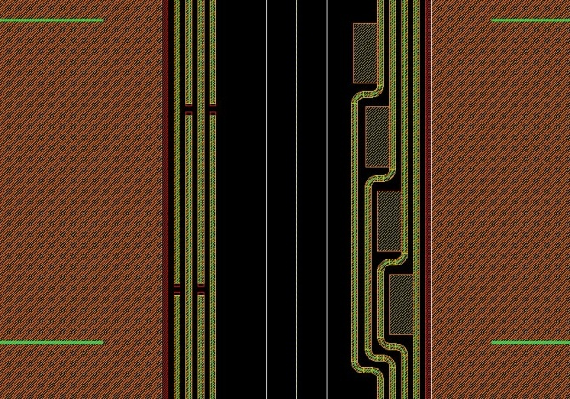
Under study at LLR :
Segmented guard rings
Should avoid the signal propagation along the border of the wafer
Idea tested thanks to PCBs and test bench at LPC (CALOR’08, NSS-MIC’08 talk)
  Segmented topology helps to prevent SqEvt
Prototype wafers are being manufactured (LLR made layout)
  Current leackage can now be measured
  Together with crosstalk
First 8 wafers were measured at LPC
Other version from Korea ?

Slide 12
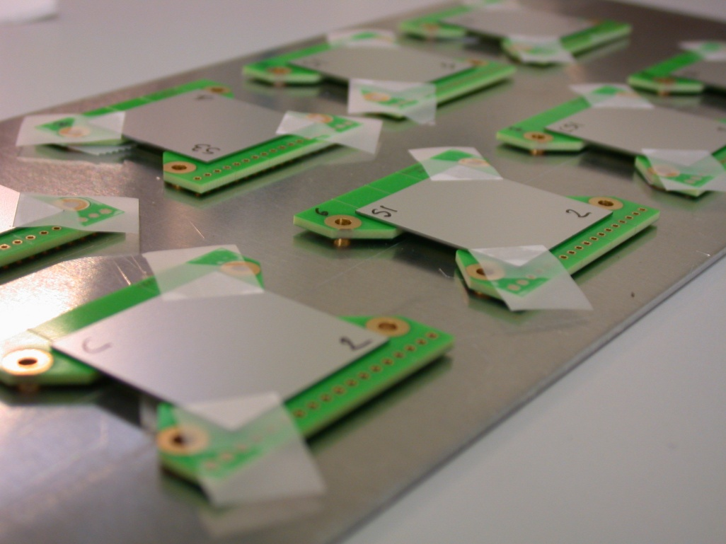
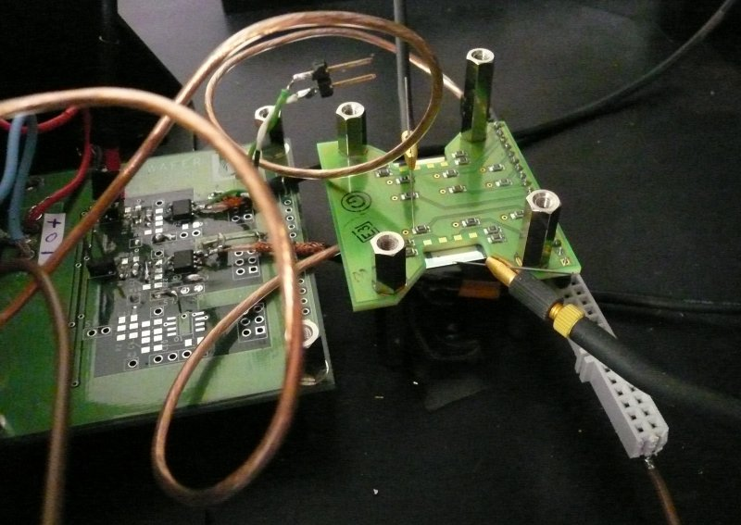
Segmented guard rings prototypes
Glued on PCB supports
Measured with signal injection and charge amplifiers

Slide 13



Segmented guard rings prototypes preliminary measurements results
The segmentation of guard rings clearly contributes to the lowering of crosstalk along the edge of the wafers
I(V) characteristics are not standard
Breakdown occurs early, in a 100-300 V range (non segmented: >500 V)
BUT: no optimizations were done on the layout
  Further investigations are needed
  Not the only solution (see next slide)
Continuous
1 cm segments
3 mm segments

Slide 14
Layout: Some optimizations
3D sensors : lower Vbias, internal current flow, low sensibility to edge effects : can be ~edgeless (100 um)
Cut through edge
same technology as for 3D but used only at the edge
no saw cuts, 3D edges
4-side abuttable ~no dead space, Deep trench etch, n doped polysilicon fill provides edge doping
Trenches + saw cut : cost of trenching, post processing of every sensors, bad control of current.
Dry etching cut
Current terminating ring
two rings but biased : thin contact needed, gluing not applicable
edge width less than ½ wafer thickness
Double sided GR
Doped edges
Punch-through biasing
Biased GR
Segmented GR : need further tests
Integration ☹
For Vertex detectors
Cost
Integration ☹
Crosstalk + ~edgeless ☺ (300 um)
Integration ☹
edge ☹ (800 um)

Slide 15
Front end board
The sensors could have pads to bias the GR in order to avoid crosstalk (if necessary)
  FEV7 to be adapted for bounding (holes)
  Prototype for a definitive solution (additional cost) if segmented/other do not work
FLCPHY3 should be used for crosstalk measurements
  Instead of Op. Amp.
  Upgrade of test bench at LPC
  measurements with laser or beam

Slide 16
Summary
Plenty of issues to work on together
In particular the silicon sensors
Optimization of guard rings to avoid the crosstalk
and lower the dead space
Would require other meetings
What about a PhD student ?
Use of 8 inches raw wafers ?
Have to be checked according mechanical constraints and dead space

