Slide 1
Nuclear Structure and Reactions: Building Together for the Future
9 October 2017 GANIL
Marcella Grasso
From dilute matter to the equilibrium point in the energy-density-functional theory

Slide 2
Present collaborators along this research line:
ENSAR2, JRA TheoS (Theoretical Support for Nuclear Facilities in Europe), Task: Development of suitable effective interactions in mean-field and BMF theories
Laboratoire Internationale LIA COLL-AGAIN
J. Bonnard, A. Boulet,,U. van Kolck, D. Lacroix, O. Vasseur, J. Yang (IPN Orsay)
G. Colò, X. Roca-Maza (Univ. of Milano)

Slide 3
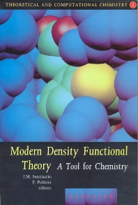
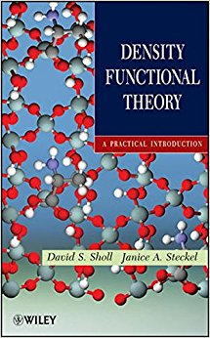
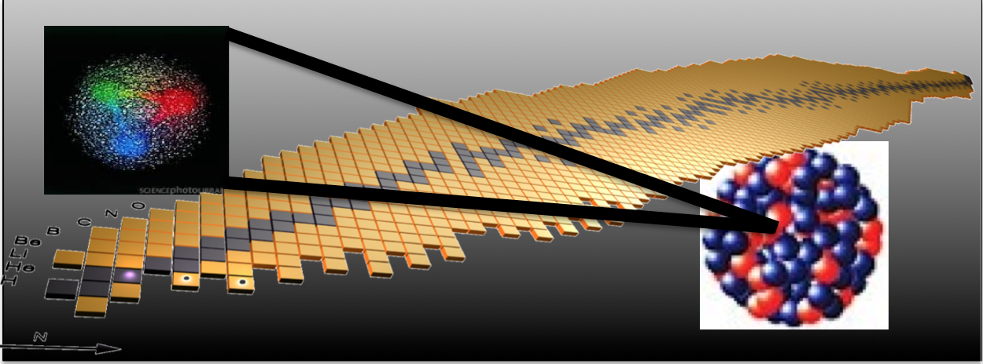
Density Functional Theory in chemistry and solid state physics
Mean-field models and beyond
Nuclear many-body problem with effective interactions
Double counting …
Work on EDF designed for beyond-mean-field models Nuclear matter
Bridging with EFT/ ab initio
Energy Density Functional
(EDF) theory (functionals derived in most cases from effective phenomenological interactions)
… since several decades

Slide 4
OUTLINE
Perturbative many-body problem (beyond mean field)
Work on EDF designed for beyond-mean-field models
Divergences, instabilities, double counting -> bridging with EFT -> regularization procedures and parameters adjustment (around the saturation density)
◆ Introduction of new functionals: very low-density nuclear matter ->
New functionals designed to correctly reproduce ALSO the low-density behavior, bridging with EFT/ ab initio
YGLO functional (resumed formula from EFT)
Lee-Yang inspired functional (density-dependent scattering length)
Resumed formula for the unitary limit
… Towards a power counting in EDF theories

Slide 5
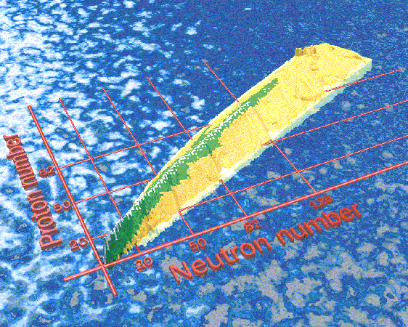
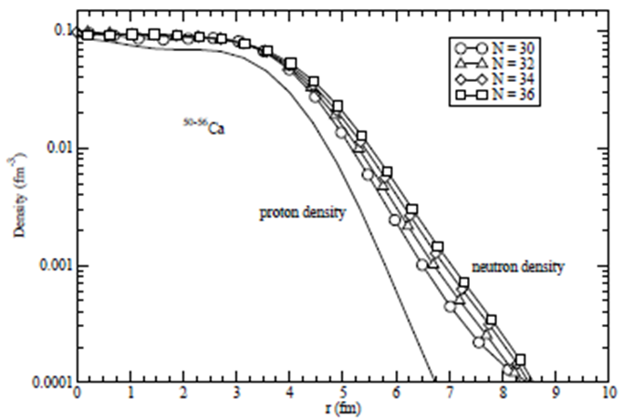
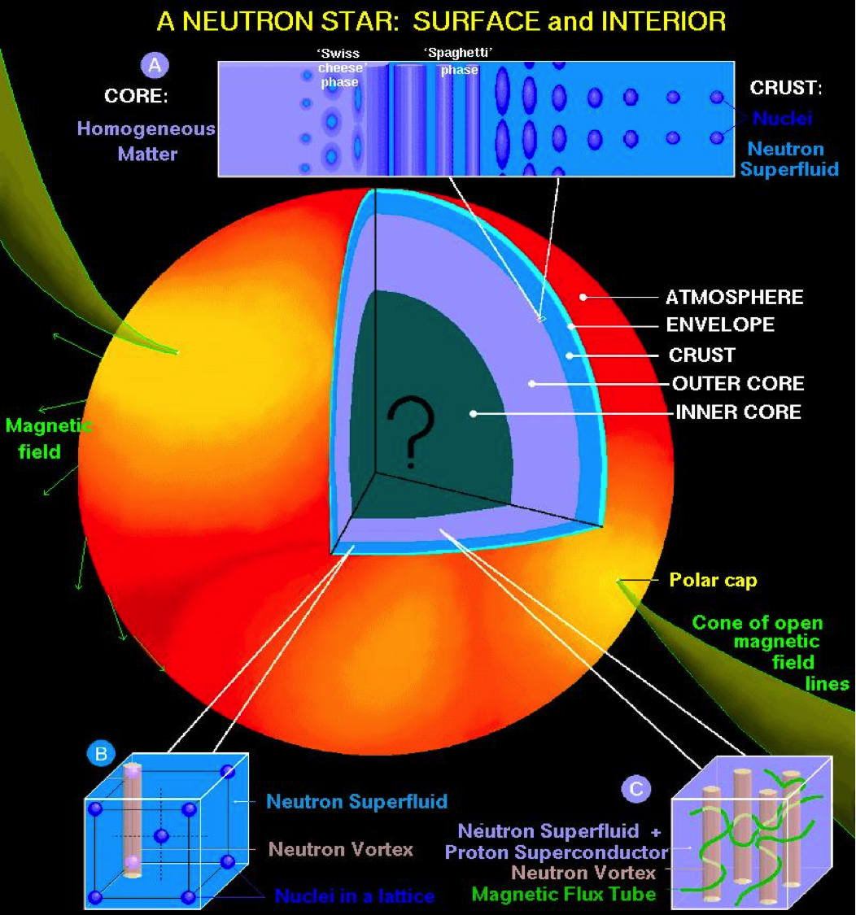
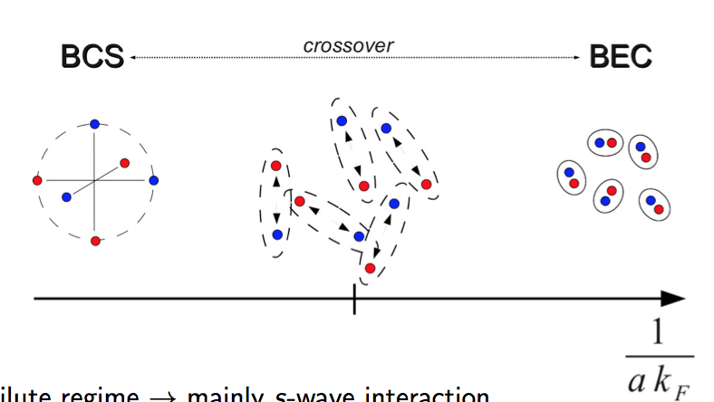
Properties of matter: relevant for constraining energy density functionals
Neutron-rich matter and pure neutron matter -> physics of isospin asymmetric systems
Very low-density neutron matter
Surface properties of neutron-rich nuclei with a diffuse density.
Outer crust of neutron stars
Analogy with ultracold atomic gases at unitarity (large scattering length)

Slide 6
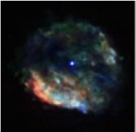
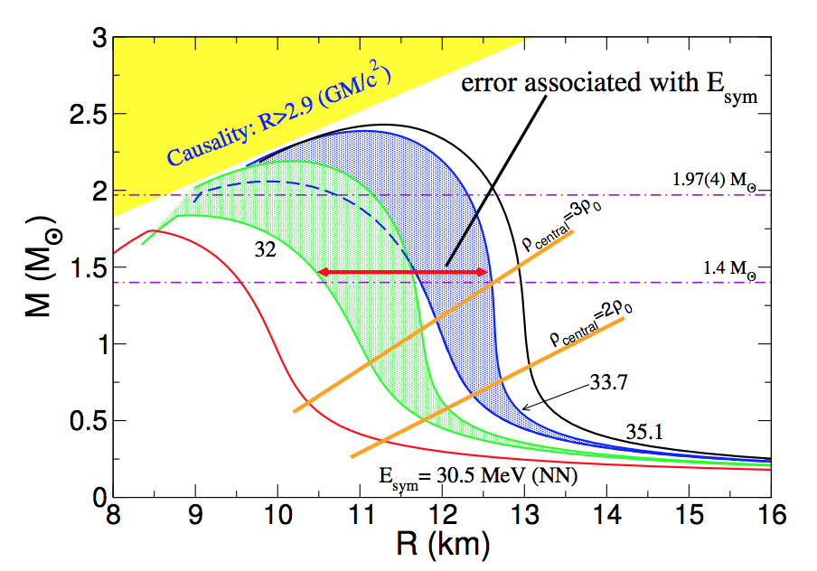
Properties of matter: relevant for constraining energy density functionals
Around the saturation point and beyond.
The structure of neutron stars may be calculated by solving the Tolmann-Oppenheimer-Volkoff equations.
Pressure (first derivative of the EOS) enters in such equations. The total radius is provided by the point where the pressure vanishes:
neutron star mass/radius,
symmetry energy and its density dependence

Slide 7
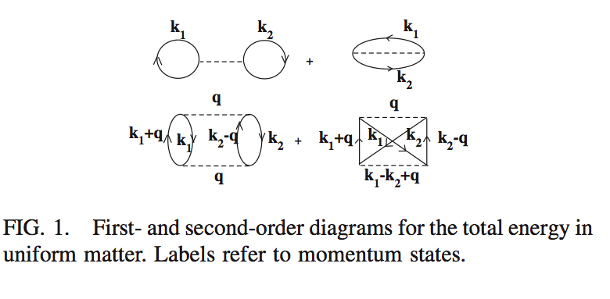
Moghrabi, Grasso, Colo’, Van Giai, PRL 105, 262501 (2010)
First application to finite nuclei: Brenna et al. PRC 90, 044316 (2014)
⬥ Yang, Grasso, Roca-Maza, et al., PRC 94, 034311 (2016)
⬥ Grasso, Lacroix, van Kolck, Invited Comment, Phys. Scr. 91, 063005 (2016)
Equation of state of nuclear matter with a Skyrme-type interaction.
The perturbative many-body problem:
First order
Second order
k_{F} = (3/2 π² ρ) ^{1/3} SM
k_{F} = k_{N} = (3π² ρ) ^{1/3} NM
k_{F} -> Fermi momentum
This second-order contribution diverges ->
For ex. the square of the Skyrme t₀ term has a k_{F}⁴ dependence and is the sum of a finite part plus a term linearly dependent on the cutoff (on the transferred momentum q) -> REGULARIZATION

Slide 8
Skyrme interaction for matter (no spin orbit at the mean-field level)
Spin-exchange operator

Slide 9
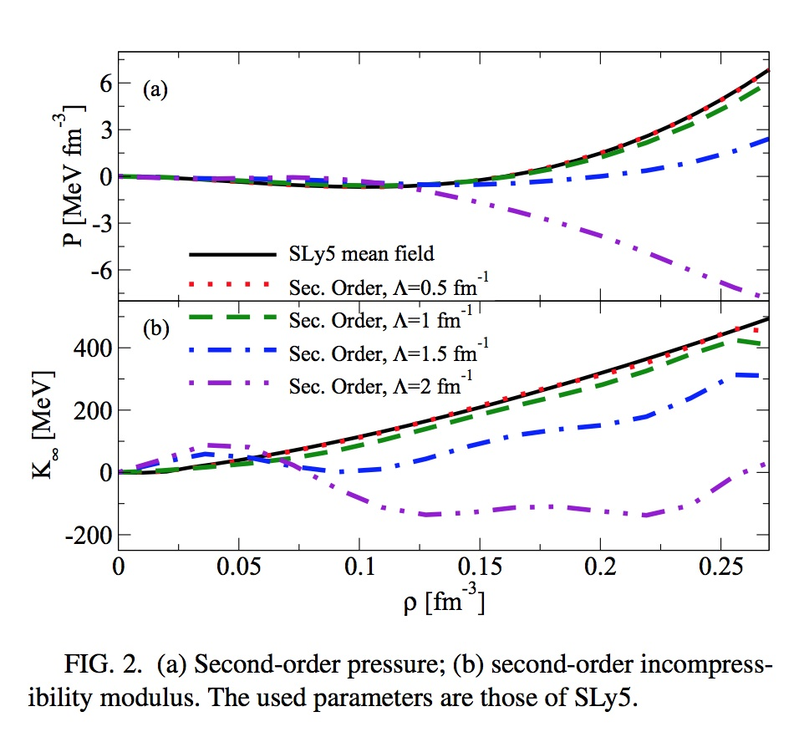
Double counting and ultraviolet divergence (pressure and incompressibility)
PRESSURE
INCOMPR.
Yang, Grasso, Roca-Maza, et al, PRC 94, 034311 (2016)

Slide 10
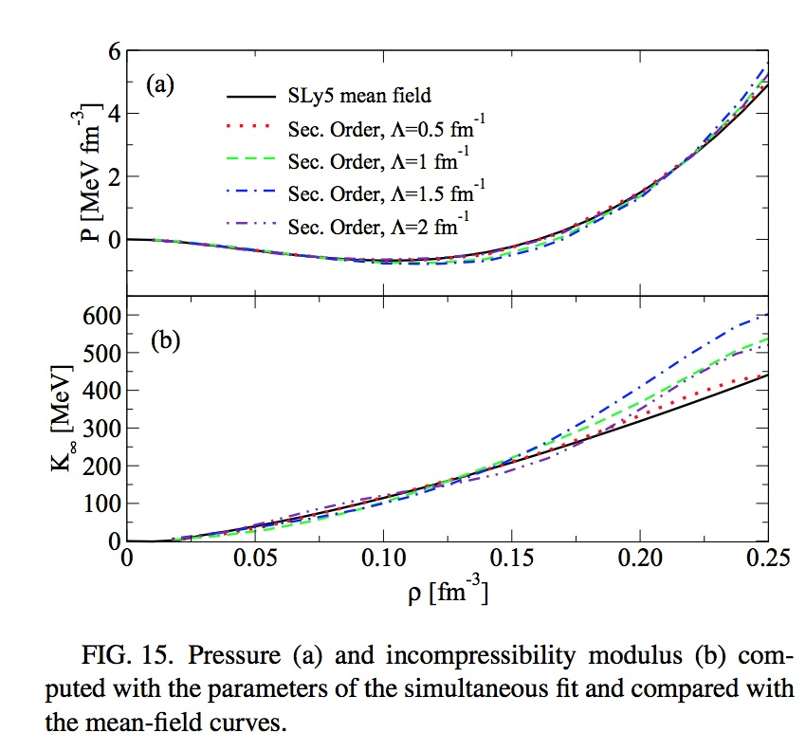
Pressure and incompressibility (not entering in the fit)
PRESSURE
INCOMPRESSIBILITY:
BENCHMARK: 229.9 MeV
Max deviation: 25 MeV
Yang, Grasso, Roca-Maza, et al, PRC 94, 034311 (2016)

Slide 11
Low-density regime … at leading order

Slide 12
Low-density for neutron matter (EFT satisfies this regime -> Hammer, Furnstahl, NPA 678, 277 (2000)) Lee-Yang expansion in (ak_{N}). Low-density EOS
Lee and Yang, Phys. Rev. 105, 1119 (1957)
a -> neutron-neutron scattering length, -18.9 fm
k_{N} -> neutron Fermi momentum = (3π² ρ)^{1/3}
α = 1/3
What about the mean-field Skyrme EOS?
Skyrme term | kN dependence in the EOS
t ₀ | k_{N}³
t ₃ | k_{N}^{3α+3}
t ₁ and t ₂ | k_{N}⁵

Slide 13
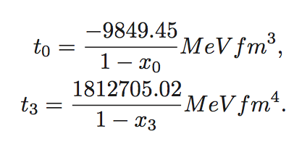
We have to constrain the parameters in the following way:

Slide 14
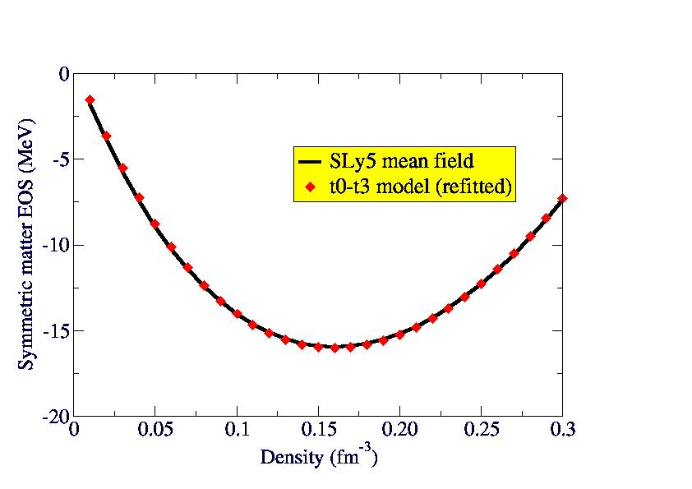
It is possible to constrain the low-density behavior of neutron matter, with α=1/3, and to adjust x0 and x3 for reproducing a reasonable EOS for symmetric matter (at ordinary densities)
But the EOS of neutron matter is completely wrong at ordinary scales of densities
Yang, Grasso, Lacroix, PRC 94 , 031301(R) (2016)

Slide 15
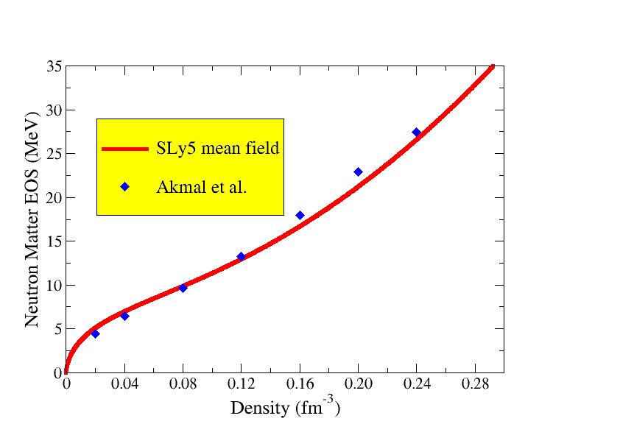
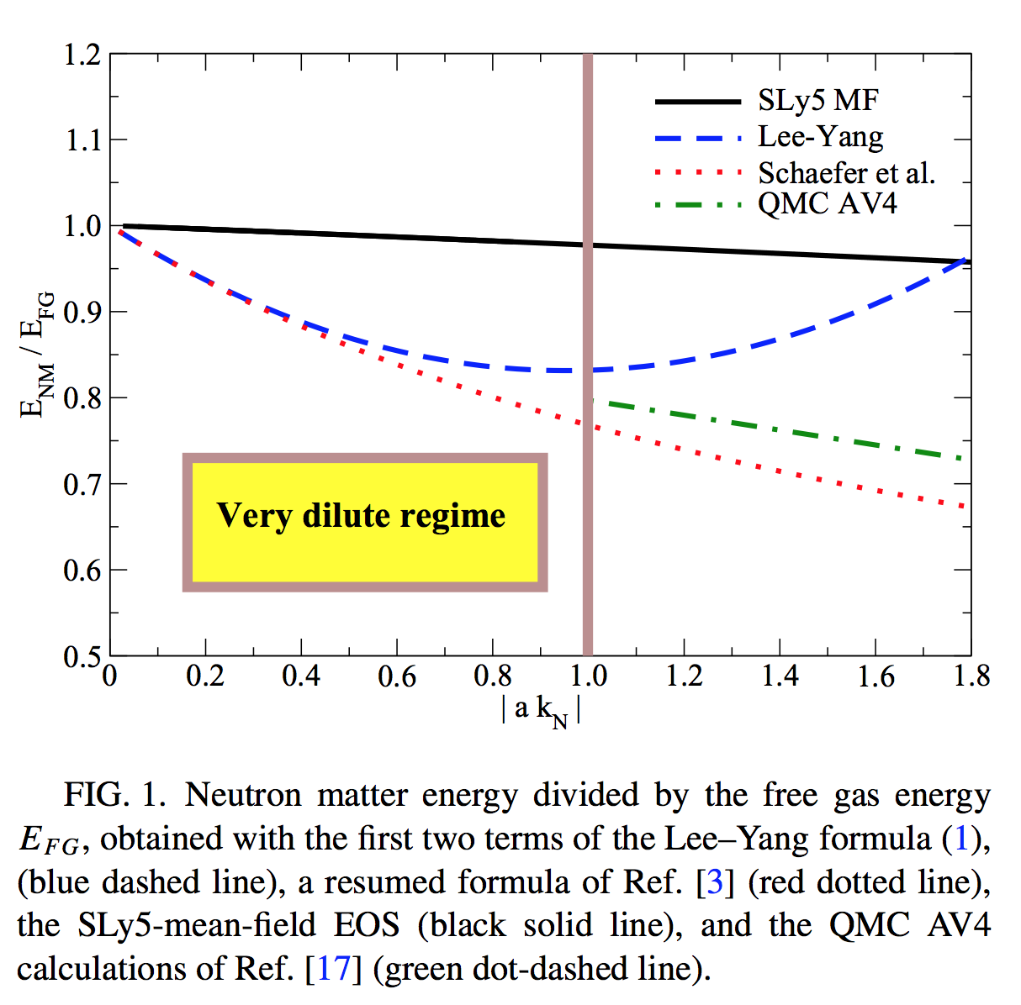
Neutron matter at ‘usual’ density scales. Example of Lyon-Saclay forces adjusted on the neutron EOS
Low-density regime
SLy5 -> Chabanat et al. NPA 627, 710 (1997); 635, 231 (1998), 643, 441 (1998)
Akmal et al. -> PRC 58, 1804 (1998)
Neutron matter energy divided by the free gas energy

Slide 16
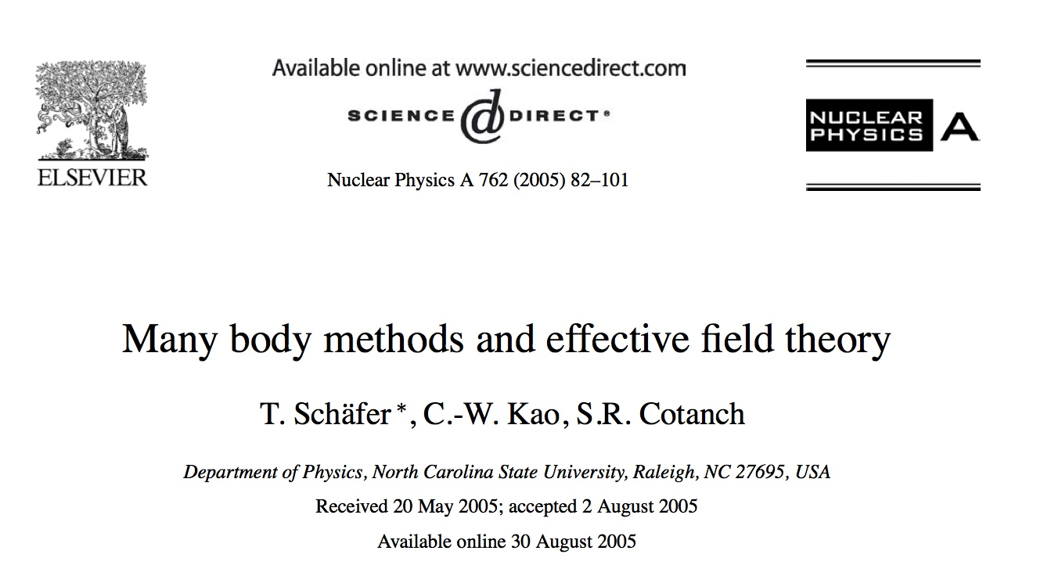
The second-order contribution has the required k_{F}⁴ term
… but only second order is not enough (if one wants to keep the correct value of the scattering length)
Resummation techniques
Steele, arXiv: nucl-th/0010066v2
Kaiser, NPA 860, 41 (2011)
Schaefer, NPA 762, 82 (2005)
Effective field theories capable of describing systems with anomalously large scattering lengths require summing an infinite number of Feynman diagrams at leading order …

Slide 17
Guided by:
The fact that the second-order t₀ contribution leads to the correct dependence on the Fermi momentum in neutron matter;
The resumed formulae;
Good properties of Skyrme functionals
A hybrid functional, YGLO (Yang, Grasso, Lacroix, Orsay):
Matching the low-density limit with the Lee-Yang expansion of the energy (at leading order)
Beta = 1 - > symmetric matter
Beta =0 -> neutron matter

Slide 18
YGLO functional: Inspired by resumed expressions (resumed functional) (EFT)
EOS for symmetric and neutron matter:
Constrained by the first two terms of Lee Yang formula (scattering length)
Mimic velocity- and density-dependent terms
Resumed expression
Other parameters adjusted on QMC results at extremely low densities and on Friedman et al. or Akmal et al. EOSs at higher densities
Yang, Grasso, Lacroix, PRC 94 , 031301(R) (2016)

Slide 19
B and R are fixed by imposing to recover the Lee-Yang formula (the analog for symmetric matter may be found in Fetter-Walecka book)

Slide 20
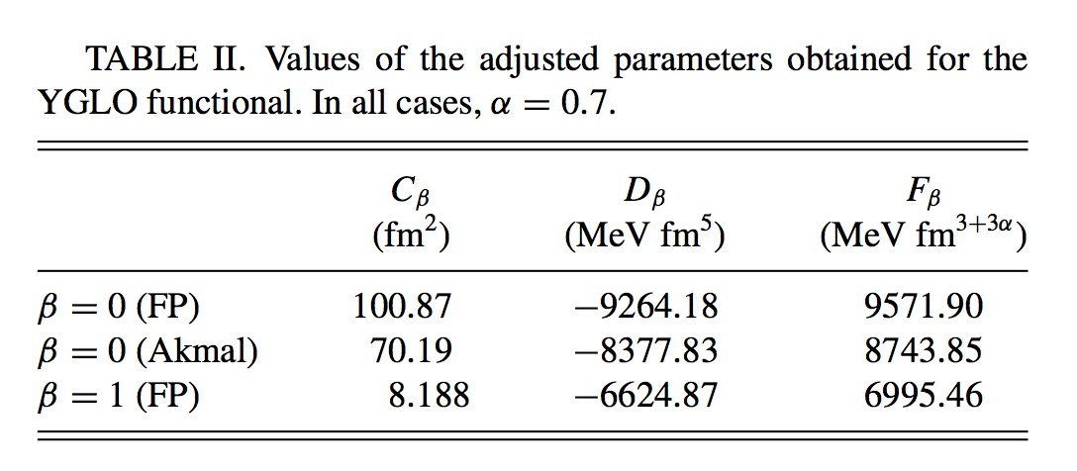
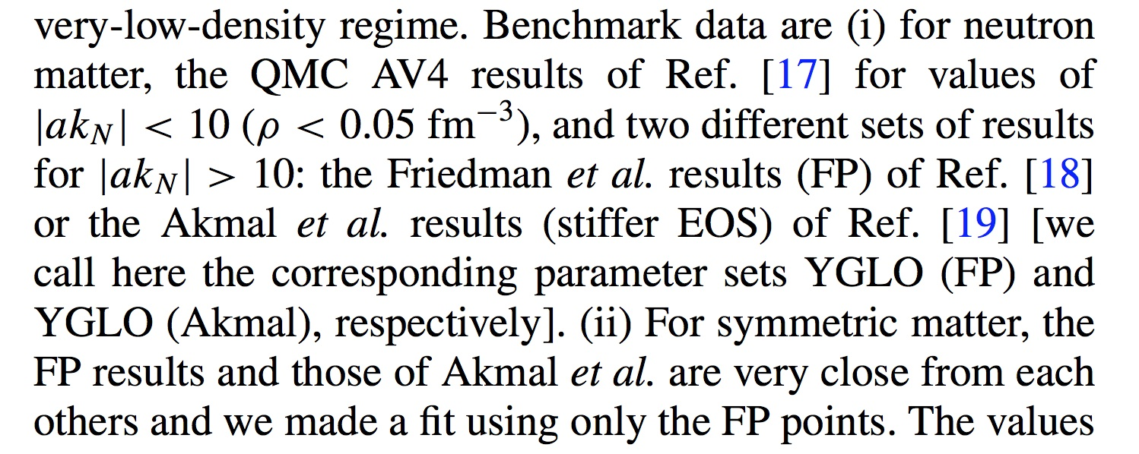
The other adjusted parameters

Slide 21
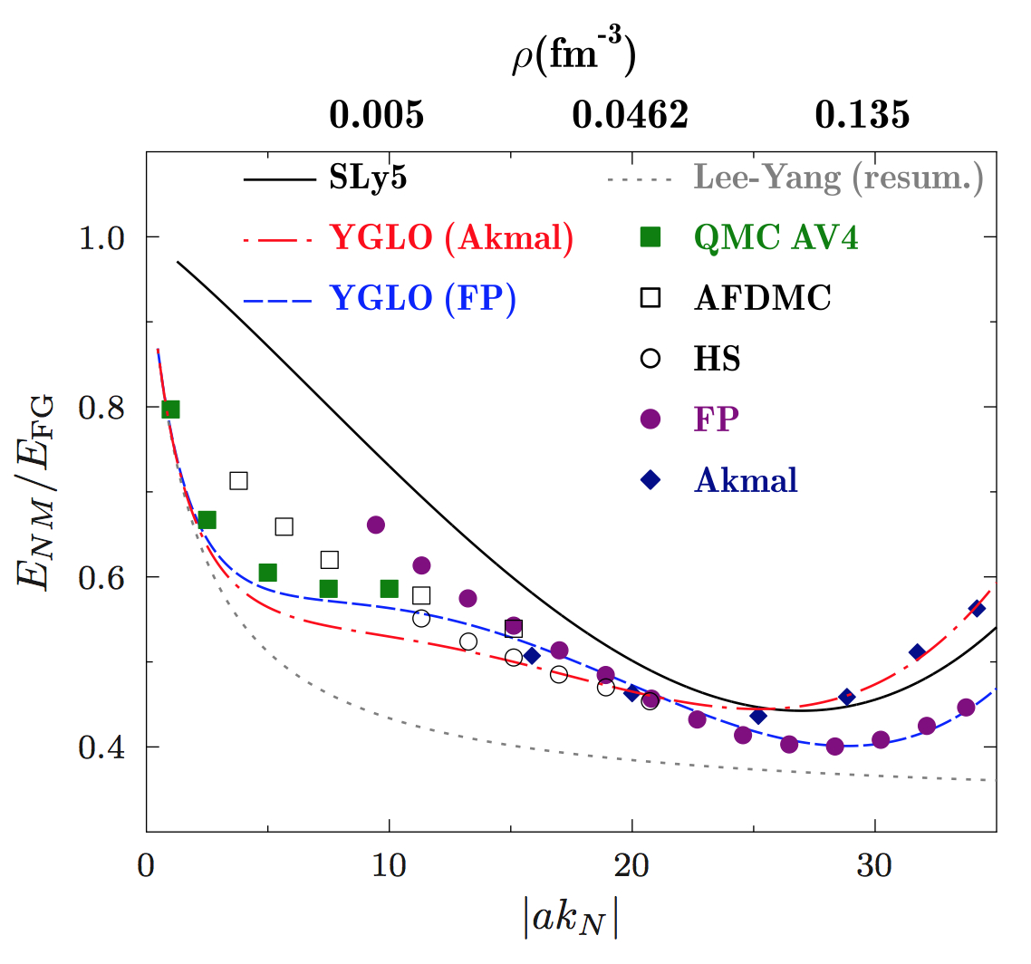
YGLO. Very low-density behavior of neutron matter
Energy divided by the free gas energy
Yang, Grasso, Lacroix, PRC 94, 031301(R) (2016)

Slide 22
Asymmetric matter
Parabolic approximation
Neutron
density
Proton
density

Slide 23
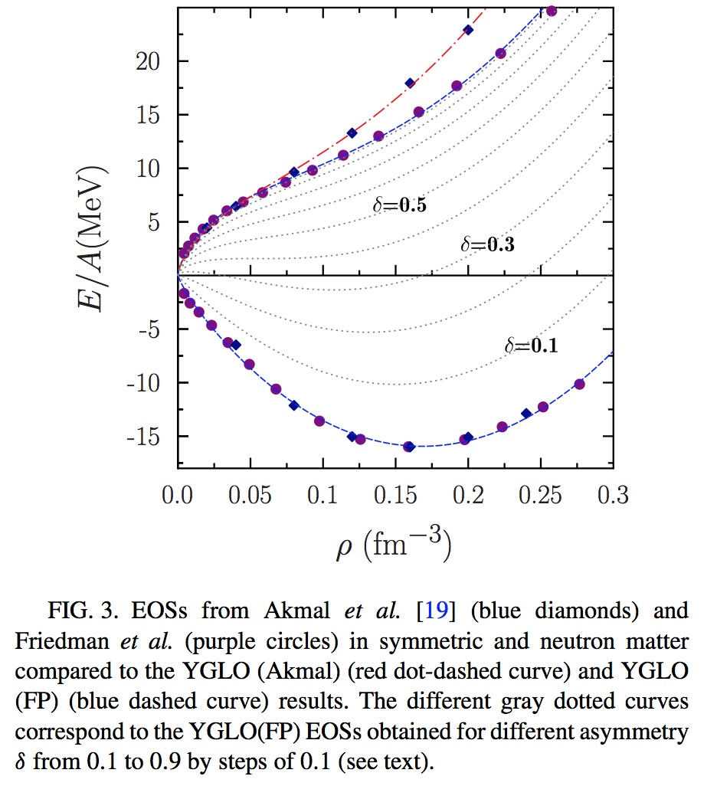
Asymmetric matter

Slide 24
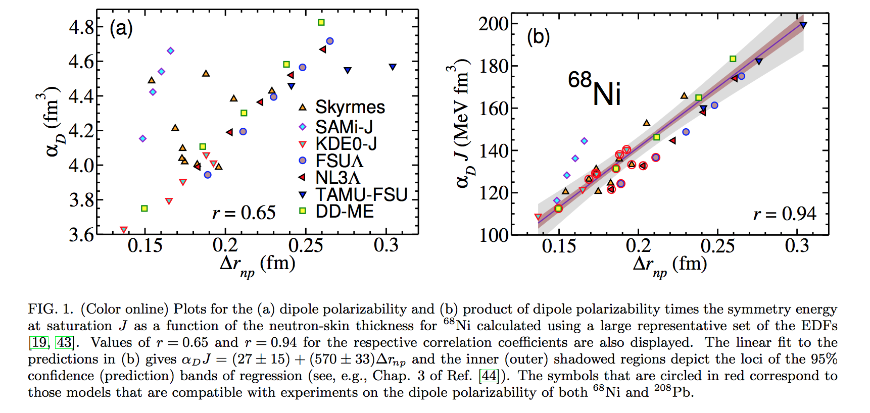
Neutron skin thickness (difference between rms radii of neutrons and protons)
Dipole polarizability times symmetry energy versus neutron skin thickness
Dipole polarizability versus neutron skin thickness
Roca-Maza et al, PRC 92, 064304 (2015)

Slide 25
Symmetry energy and its slope L=3ρ₀ (dS/dρ)_{ρ=ρ0}
Strong correlation observed between the neutron skin thickness and the slope L of the symmetry energy ( see for instance: Warda et al. PRC 80, 024316 (2009), Centelles et al. PRL 102, 122502 (2009) ->
This correlation is thus expected to exist between the electric dipole polarizability times the symmetry energy and the slope of the symmetry energy
Recent experimental determinations of the electric dipole polarizability:
²⁰⁸Pb (polarized proton inelastic scattering at forward angles, RCNP) (Tamii et al. PRL107, 062502 (2011)). Combining all available data: α_{D}=20.1 ± 0.6 fm³
- ¹²⁰Sn (polarized proton inelastic scattering at forward angles, RCNP) (Hashimoto et al. PRC 92, 031305 (2015)). Combining all available data: α_{D}=8.93 ± 0.36 fm³
⁶⁸Ni (Coulomb excitation in inverse kinematics and invariant mass in one- and two-neutron decay channels, GSI) (Wieland et al, PRL 102, 092502 (2009); Rossi et al. PRL 111, 242503 (2013)). α_{D}=3.40 ± 0.23 fm³

Slide 26
Using the experimental values of the electric dipole polarizability in the three nuclei
²⁰⁸Pb -> J=(24.5 ± 0.8)+(0.168 ± 0.007) L
⁶⁸Ni -> J=(24.9 ± 2.0)+(0.19 ± 0.02) L
¹²⁰Sn -> J=(25.4 ± 1.1)+(0.17 ± 0.01) L
Roca-Maza et al, PRC 92, 064304 (2015)

Slide 27
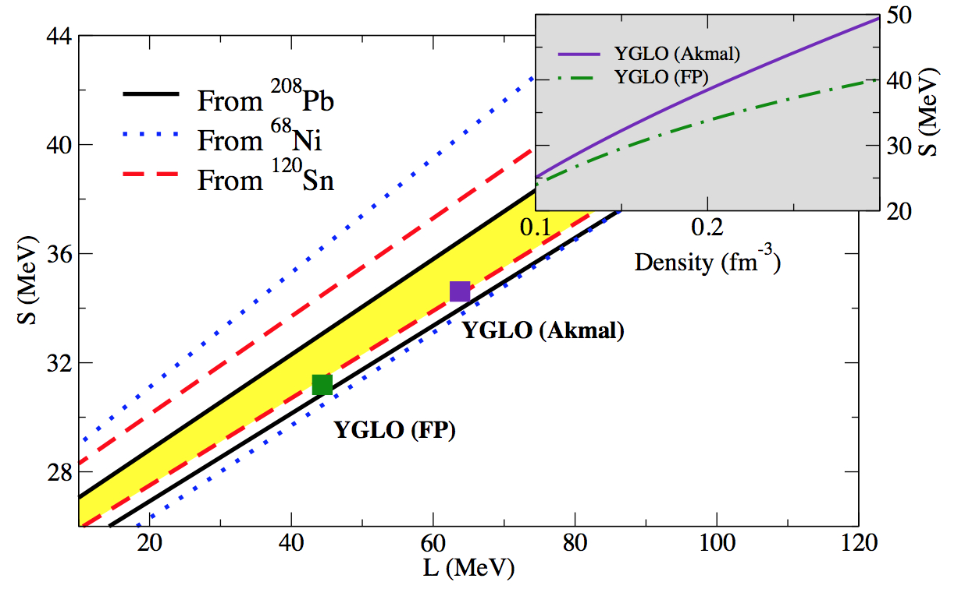
Symmetry energy and its slope
Lines delimit the phenomenological areas constrained by the exp. determination of the electric dipole polarizability
Yang, Grasso, Lacroix, PRC 94, 031301(R) (2016)

Slide 28
… Without resummation, how to handle the different density scales ?
… A Lee-Yang type expression for the EOS of neutron matter-> if the low-density regime is always satisfied
s-wave scattering length
Associated effective range
We choose to keep terms containing only the s-wave scattering length. The next term in the Lee-Yang expansion contains the p-wave scattering length
Grasso, Lacroix, Yang,Phys. Rev. C 95, 054327 (2017)

Slide 29
Neutron-neutron scattering length.
Low-density regime:
We impose a low-density constraint: - a k_{F}=1 ->
a =-18.9 fm up to a max momentum so that 18.9 k_{F}=1.
Beyond this value, we tune the scattering length so that –a = 1/k_{F}

Slide 30
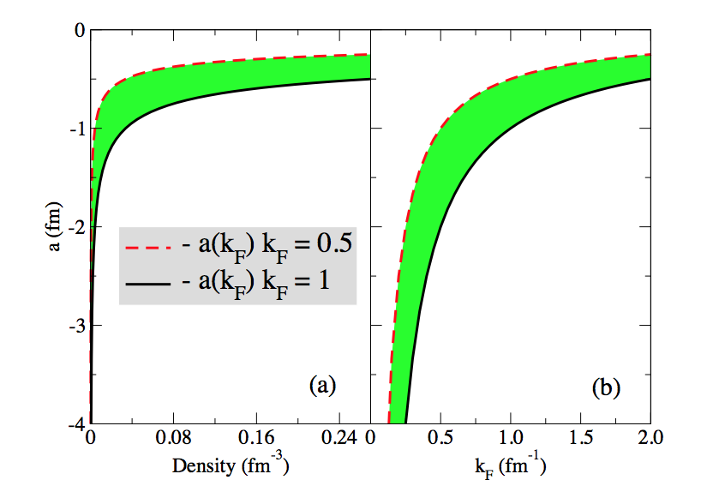
Neutron-neutron scattering length
Grasso, Lacroix, Yang, PRC 95, 054327 (2017).

Slide 31
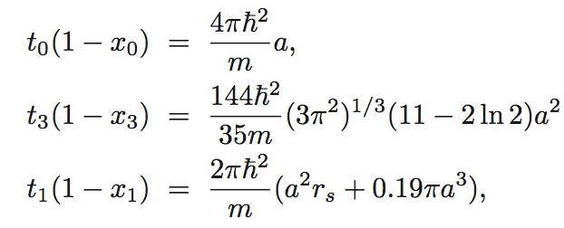
We introduce a Skyrme-type functional containing only s-wave terms and leading, at the mean-field level, to a neutron matter EOS given by the LY expression, with the relations :
The power of the density-dependent term is chosen equal to 1/3
Grasso, Lacroix, Yang, PRC 95, 054327 (2017).

Slide 32
We require that:
The functional correctly describes neutron matter at all density scales
The functional leads to a reasonable EOS for symmetric matter around the equilibrium point
This may be obtained by imposing a low-density regime everywhere (with a density-dependent neutron-neutron scattering length)

Slide 33
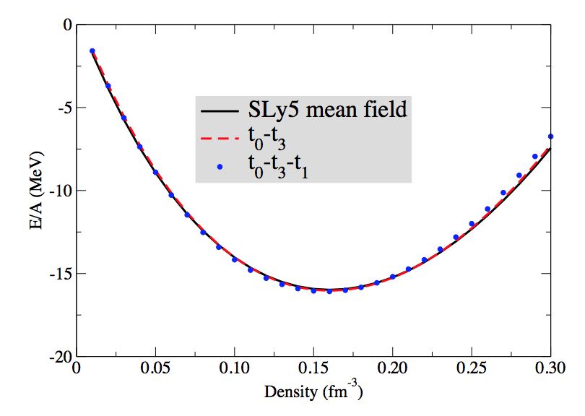
The parameters x_{i} do not enter in the EOS of symmetric matter.
We may thus adjust the parameters t_{i} to have a reasonable EOS of symmetric matter and tune the neutron-neutron scattering length by imposing, at each density scale, a low-density constraint
Symmetric matter, two cases
t₀-t₃
t₀-t₃-t₁
Grasso, Lacroix, Yang,Phys. Rev. C 95, 054327 (2017)

Slide 34
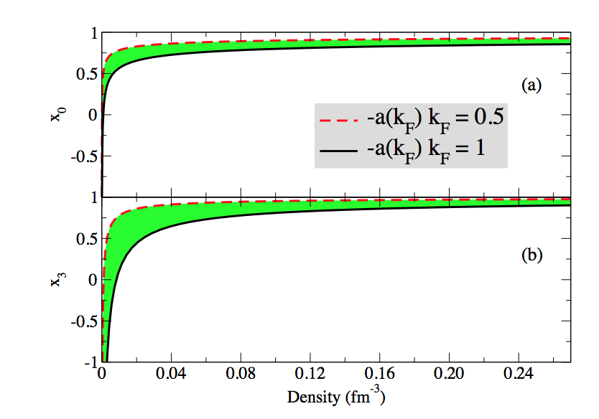
Density dependence of the parameters x₀ and x₃
Typical Skyrme values at densities around the saturation point
Grasso, Lacroix, Yang,Phys. Rev. C 95, 054327 (2017)

Slide 35
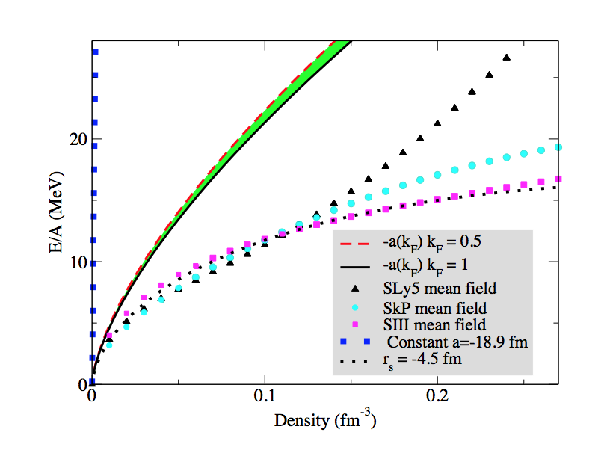
First two terms of the Lee-Yang expansion. EOS of neutron matter
LY with -18.9 fm
First two terms
SLy5 mean field
SkP mean field
Huge discrepancy
SIII mean field
Grasso, Lacroix, Yang,Phys. Rev. C 95, 054327 (2017)

Slide 36
Including the s-wave k_{F}⁵ terms and adjusting the effective range
Grasso, Lacroix, Yang, PRC 95, 054327 (2017).

Slide 37
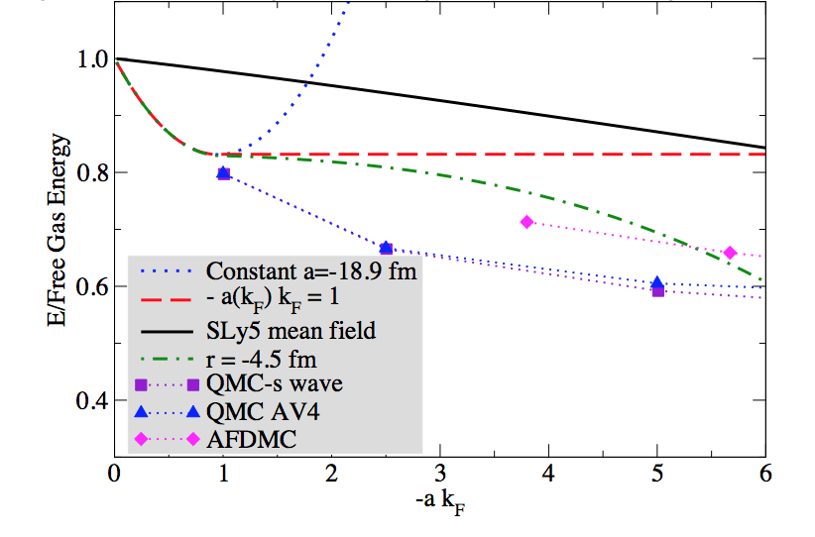
Low-density behavior
Grasso, Lacroix, Yang,Phys. Rev. C 95, 054327 (2017)

Slide 38
Conclusions
Beyond-mean-field tailored interactions -> second-order calculations for matter
New functionals valid at all density scales for neutron matter and at densities around saturation for symmetric matter
-> YGLO (resummation from EFT and good properties of Skyrme forces : a hybrid functional)
-> without resummation -> density-dependent neutron-neutron scattering length

