Slide 1
Le projet CALICE au LPSC-Grenoble
Activités 2017 et demande de budget 2018
Projet de R&D : -> calorimètrie EM Si/W
Équipe (2018)
Physiciens : 1
J-Y. Hostachy (DR 70%)
Ingénieurs de Recherche : 1
D. Grondin (IR 25%)
Ingénieurs (autres que IR) et techniciens :
J. Giraud (IE 20%) + L. Vivargent (AI 30%), atelier (10%)
Soit au TOTAL : 1,55
R&D mécanique :
Conception de la structure alvéolaire des bouchons EM (dessins et prototypes)
Système de refroidissement (thermalisation) de l’ensemble du calorimètre EM
Assemblage et positionnement de la totalité du calorimètre EM
Outillage et intégration des bouchons EM dans le détecteur ILD
Financement IN2P3 2017
Missions : 2850 €
AP : 1900 €

Slide 2
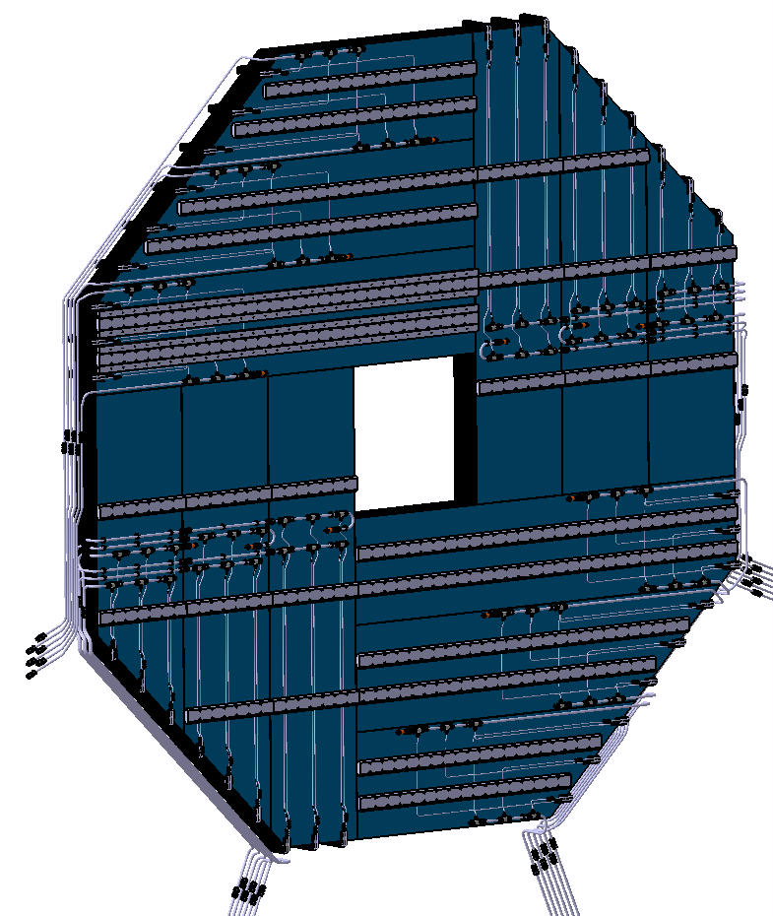
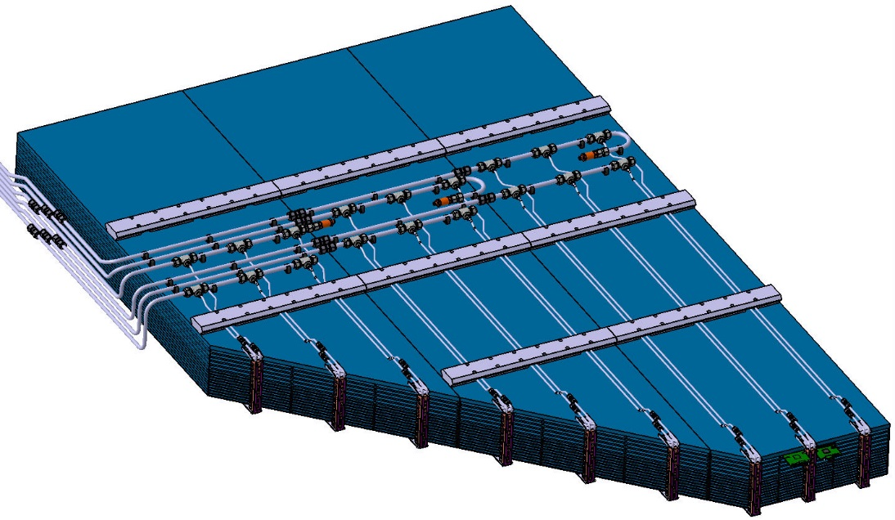
Conception des bouchons EM
End-Caps: 25,5 t - modular alveolar structure - composite W / Carbone HR
Each End-Cap is divided in 4 quarters composed of 3 modules each
There are 3 alveoli rows per module, each containing 15 alveoli to host Ecal layers
1683
M3
M2
M1
2492
185
Fastening rails on HCAL:
total thick.3cm
Leakless Cooling system
Detector slab (Si)
1 quadrant of 3 modules (~6,5 t)
Baseline ECAL End-cap D=4188 | Weight(kg)
 | 25208 +rails+services
1 Quadrant | 6302
Module 1 | 1585
Module 2 | 2164
Module 3 | 2553
25,5 t / EC
4 quadrants of 3 modules
12 modules
540 alveoli
2 x
Baseline ECAL End-cap D=4188
Rear face fully equipped with
rails and cooling pipes

Slide 3
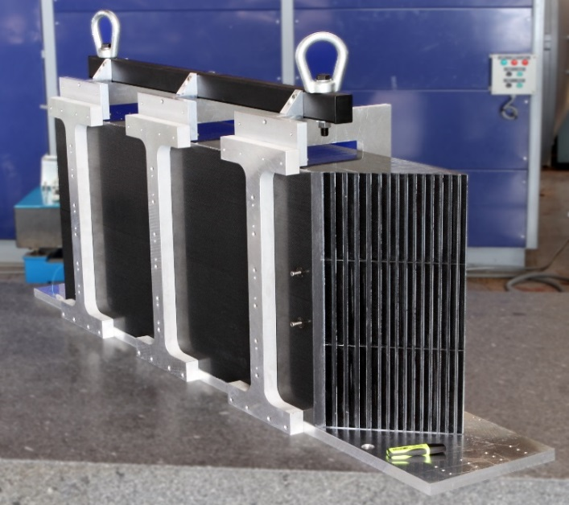
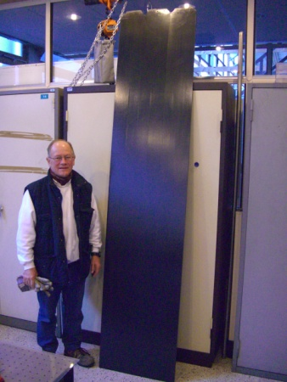
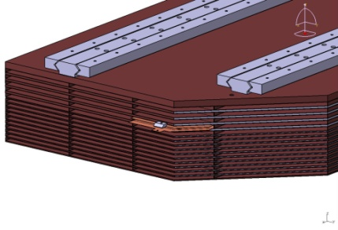

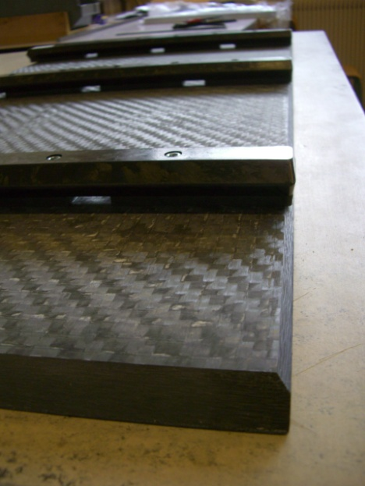
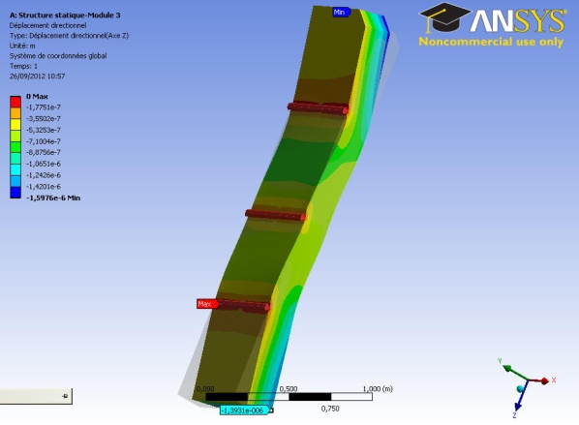
Bouchons EM Si/W & nouvelles technologies
CFRP (Carbone HR) components produced with several composite technologies
Fastening system on HCAL: thick.3cm
185 mm
Detector slab (Si)
Same concept / EUDET module for barrel (LLR)
bag molding & autoclave
but different shapes and length of alveoli
Moulding of one layer / 3 alveoli
L = 2.490 m wall thick. = 0.5mm
Construction of full size CFRP (Carbone HR) mechanical structures
  Up to 2,5m alveoli
  Interface to other detectors i.e. HCAL in ILD
Developments 2017
- Tests of rails and module deformation
- Optimization of deflection values / skin thickness
Composite simulation
Optimisation of rail localisation and module’ displacements
Thick Carbon HR plate Th. 13 mm ,
with inserts and composite rails done by thermocompression

Slide 4
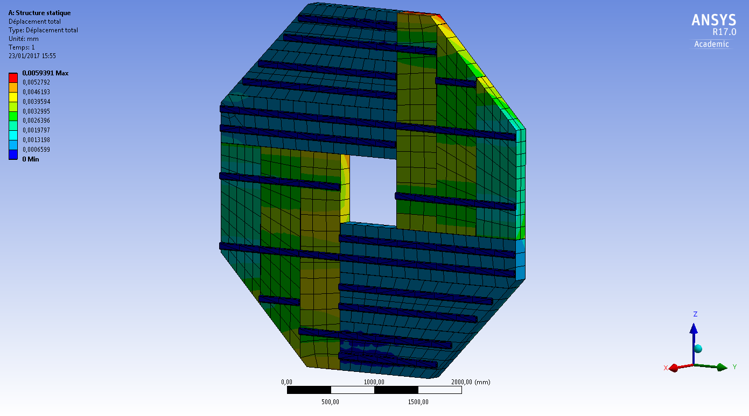
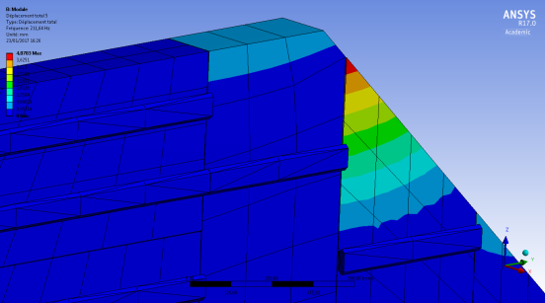
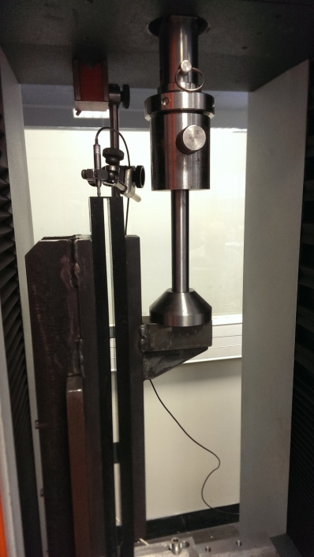
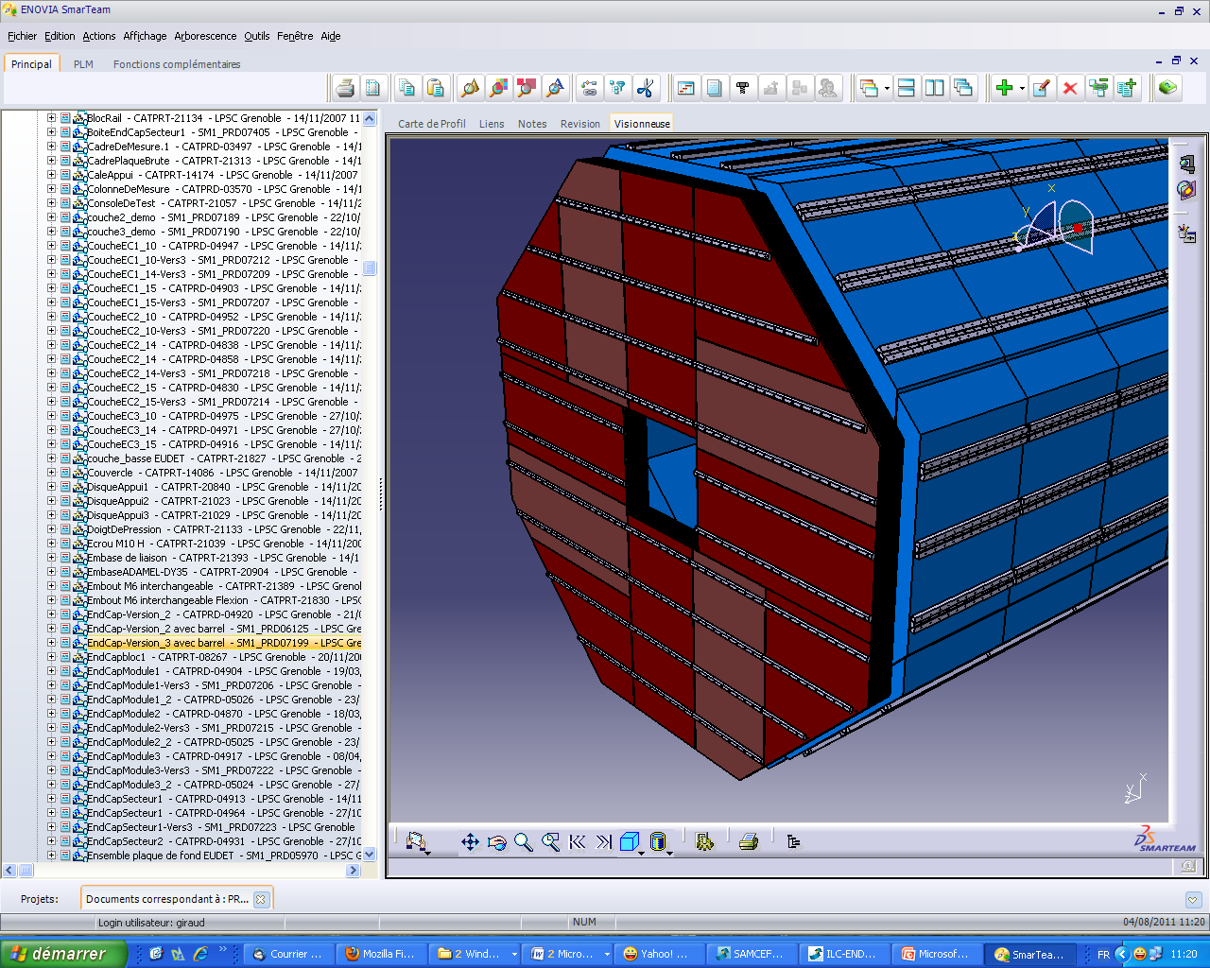
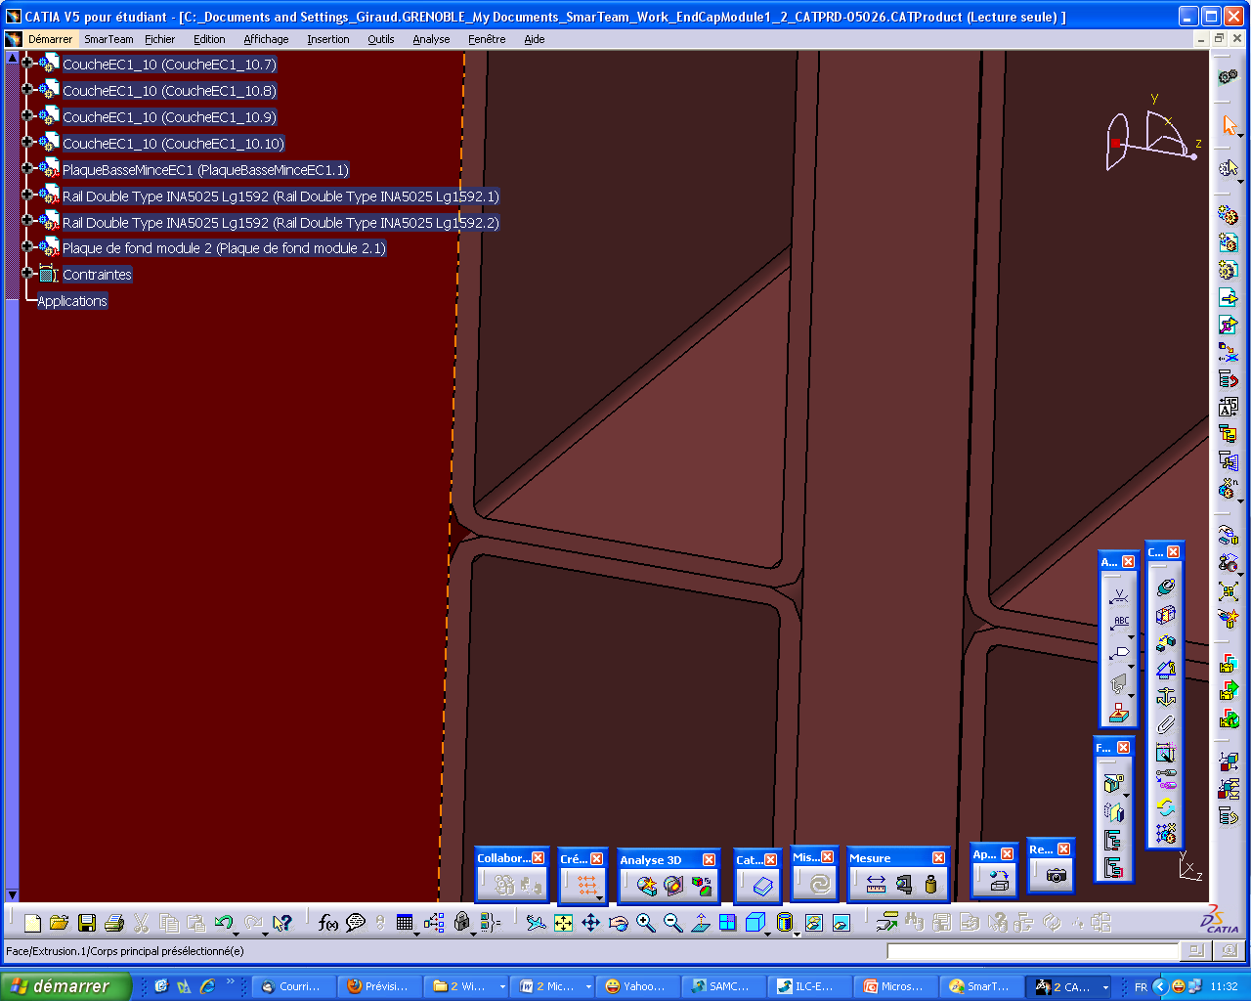
Structure composite & séisme
Optimisation on going / rails localisation/ on going
Rails fixed
Mode | Fréquence [Hz]
1, | 203,56
2, | 204,24
3, | 206,17
4, | 208,13
5, | 211,64
6, | 212,02
Total Displacement
Impact on ECAL dead zone
Problem of bending stress of alveoli skins:
influence / evolution of thickness of outer plies
w
Safety coefficient
Static: Sufficient / to the stress induced by weight of modules
just sufficient / seism (s =3.2 for Japan?)
/ risks during integration and transport
-> increase nb of ext. plies... Impact on ECAL dead zone=0,5mm= 1 extra external ply on modules
Carbone
g
Shearing tests
stress in the structure

Slide 5
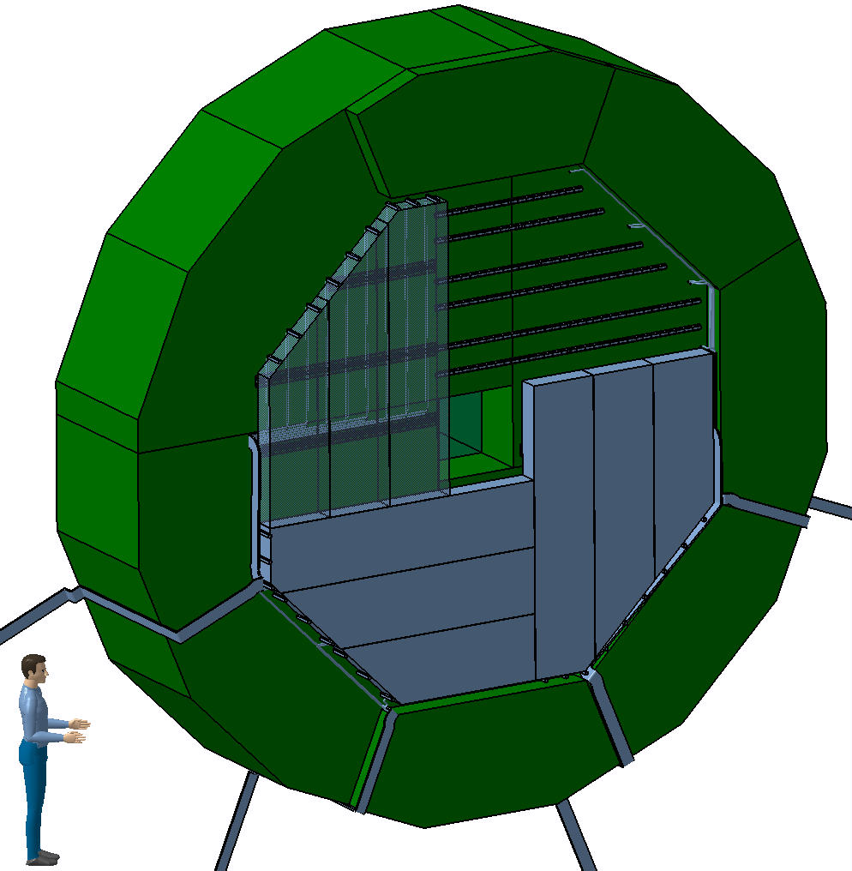
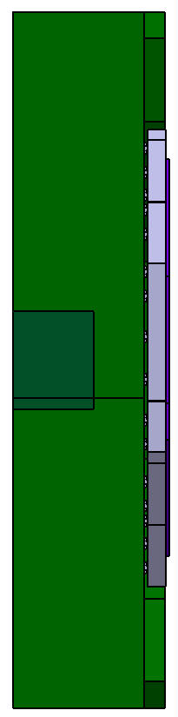
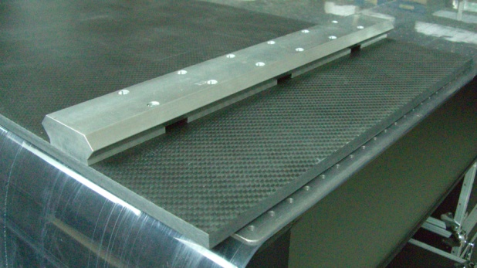
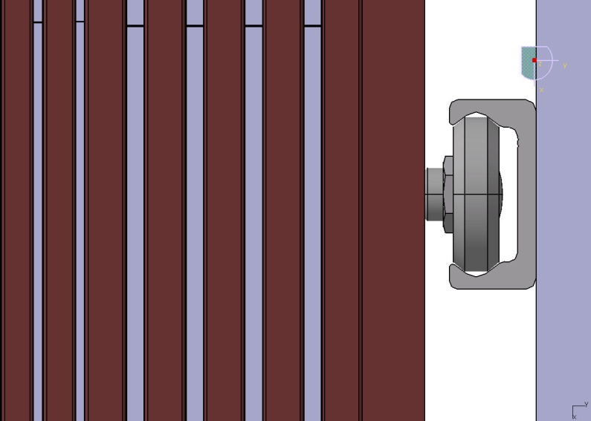
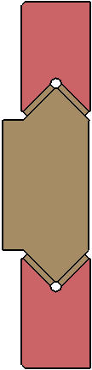
Système d’assemblage sur le HCAL
HCAL Ring
ECAL End-Cap
4188 mm -> 3453 mm
ECAL cooling
HCAL End-Cap
Double row sized rail on Module’ back
87 mm
4 quadrants subdivided into 3 modules each
Dendcap = 4192 mm
Weight of endcap ~ 25.5 t
Alveolar W-Carbon HR modules with
Rails for Fastening system on HCAL
Tests foreseen in 2017 for definition of interfaces (flatness/precision…)

Slide 6

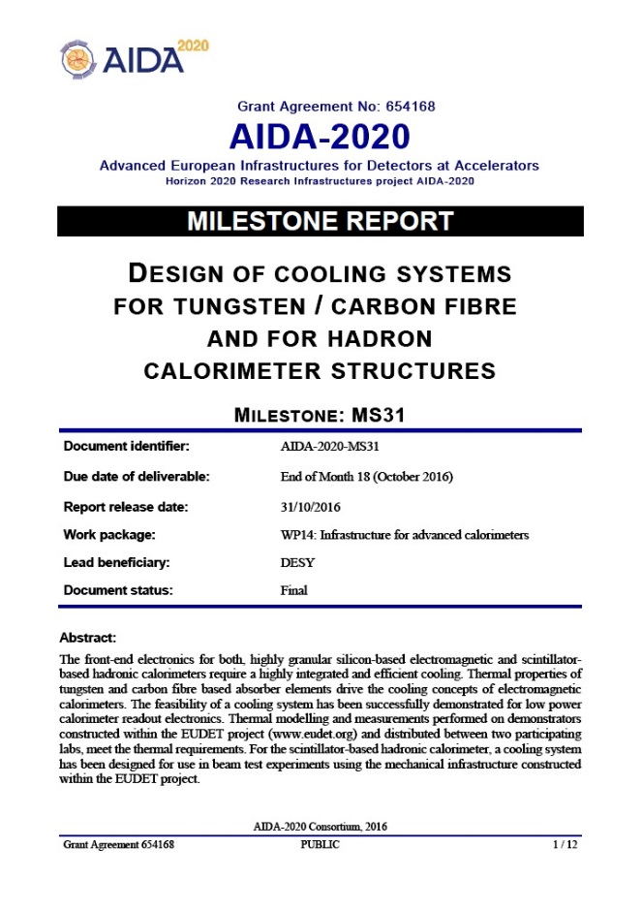

AIDA2020 : système de refroidissement
Takes part to AIDA2020 / WP14.5 - Task 2
Infrastructure to evaluate thermal properties of calorimeter structures
2.1 Cooling system to test thermal modelling of large CF (carbon fiber) structures (LPSC)
2.2 Cooling system for low power calorimeter readout electronics (DESY)
Report on the design of a leakless water cooling system for absorber structures for highly granular calorimeters
Compact and highly efficient Cooling Systems
  ECAL: Specification of local Cooling System
    Cooling system for large carbon fiber structures
    Preliminary thermal considerations
    Thermal Analysis of SLAB and modules
    CU shielding & thermal drain
      Design of Local heat exchangers
Deliverables [April 2018]
    GLOBAL COOLING System modelling
  THE leakless OPERATION MODE
      Develop and test a Global cooling True scale leak less loop
      for ECAL (13m, 10m, 9m) - demonstration and performance
Milestone 31 report has been uploaded on the AIDA-2020 report webpage by the 31/10/16.
This project has received funding from the European Union’s Horizon 2020 research and innovation programme under grant agreement No 654168.

Slide 7
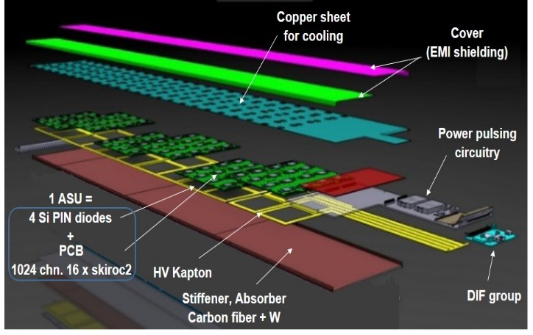
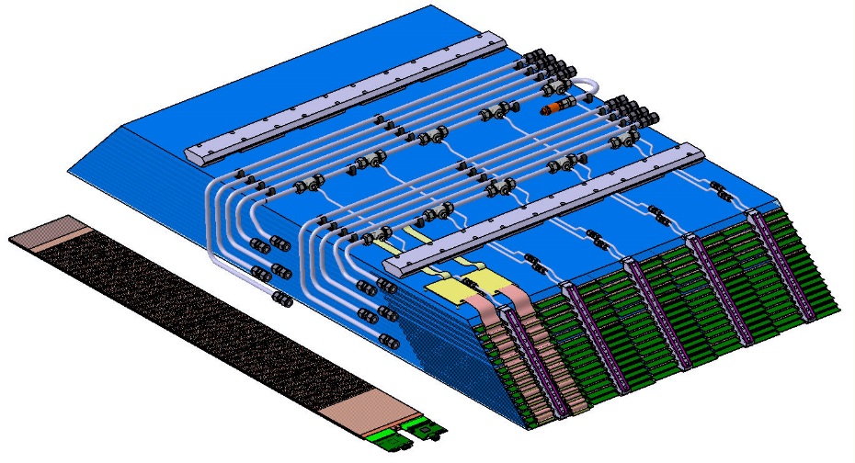
Système de refroidissement et contraintes
ECAL: Thermal modelling & local heat exchangers
Thermal modelling & local heat exchangers
It will feature 10 to 15 layers of double sided integrated detector elements (SLABs) in a Tunsgten-Carbon Fiber (W-CF) support
Alveolar structure
Pipes of
cooling system
Fastening system Rails
5 columns of cassettes with detection elements
Detector Slab
(15 / column)
Heat exchanger
Exploded view of half a long slab with 6 ASU
2 Electrical connections / Slab
Cooling needs for electronics and constraints :
An ECAL barrel alveolar module
  Maintaining temperature close to ambient
  Gradient accepted in SLAB detector 20°C (then, 20°C< T < 40°C maximum)
  Wide surface for exchange / low surfacic power
  Precision of cooling regulation +/- 2.5°C acceptable
  Service space between cooling and HCAL >1cm for cabling: DAQ + HV + GND
Leakless cooling system
  Cooling front–end
  Low water speed
  Low temperature gradient
  Risk of spray limited
  • Mechanical constraints due to electronic design (geometry of DIF card);
  • Space available: heat sources location;
  • Fastening system for cooling allowing fast connection/disconnection;
  • Heat power to dissipate, including (chips + DIF FPGA + interface components);
  • Hydraulic network, number of circuits;
  • Unfavourable environment (high radiation levels, magnetism, particles jets…) etc.…
Power per SLAB:
From current design of CALICE
  Final goal with power pulsing 1/100 s
  Ecal detector : 4.6 KW

Slide 8
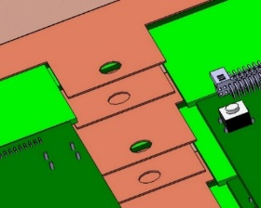
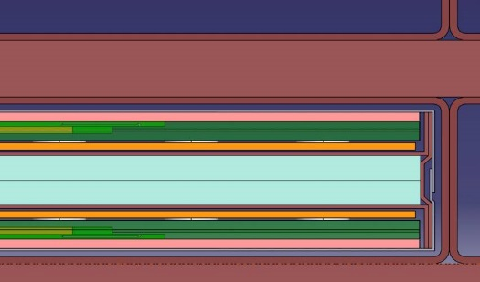
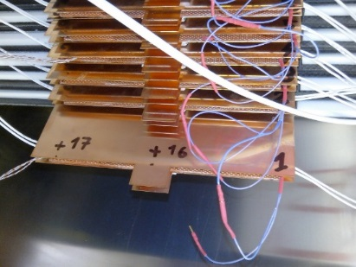
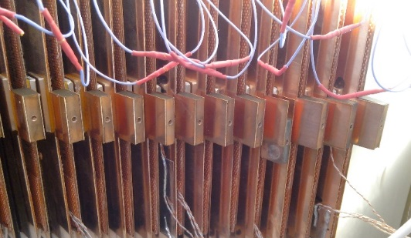
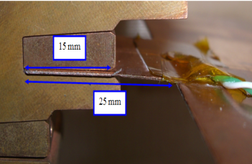
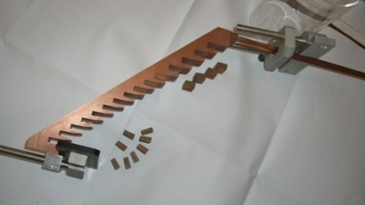
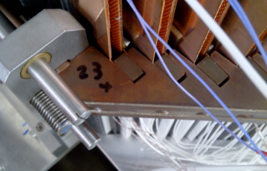
Système de refroidissement local
The cooling technology is active, using fluid circulation
design and construction of the heat exchanger
End Cap : (2.5m) 2,1m if R_{Endcap} ≈1726mm
Max T = 29 °C
ΔT = 6°C
Cooling trough
1 column
Max T < 25,5 °C & ΔT = 2,2°C
for Barrel : (1.5m)
Power : 30*0,356 = 10,68 W
Thermal gradient complient in SLAB detectors and modules
20
Heat shield: 500 µm (copper)
Ext. shield: 100 µm
(aluminium)
25
W _{Structure}
PCB : 1200 µm
(with FE embedded)
W _{Slab}
Glue : 75 µm
Wafer : 325 µm
2xCU drain 500µm
1 per slide of slab
Kapton film : 100 µm
Design of connection of heat exchangers- Schematic view of a slab with 2 copper drains
Copper drain extremities for one column as tested on EUDET module, with copper blocs to screw on heat exchanger
The connection of pipes to each slab is done by the way of cold copper blocs, brazed on pipes, inserted between the 2 copper sheets of the slab, in the free space let between the 2 DIF cards.
There is one cooling water exchanger in front of each column.
EUDET adaptation of Water heat exchanger
Copper plate / heat exchanger link
(Left) Design of connection of heat exchangers with one copper drain extremity (Middle) heat exchanger for 15 (x2) connections with Inlet and Outlet pipes on the upper side (Right) localisation of cooling system on one module

Slide 9

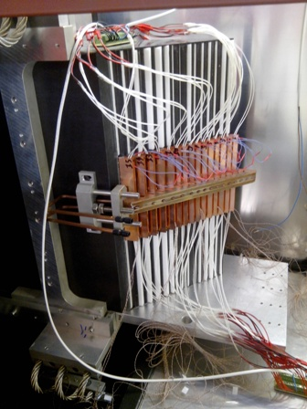
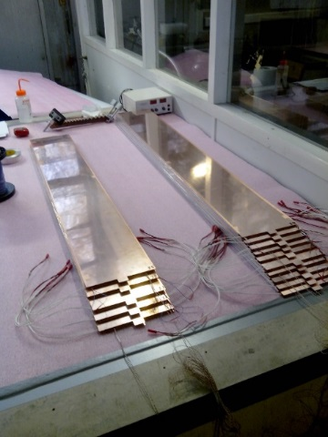
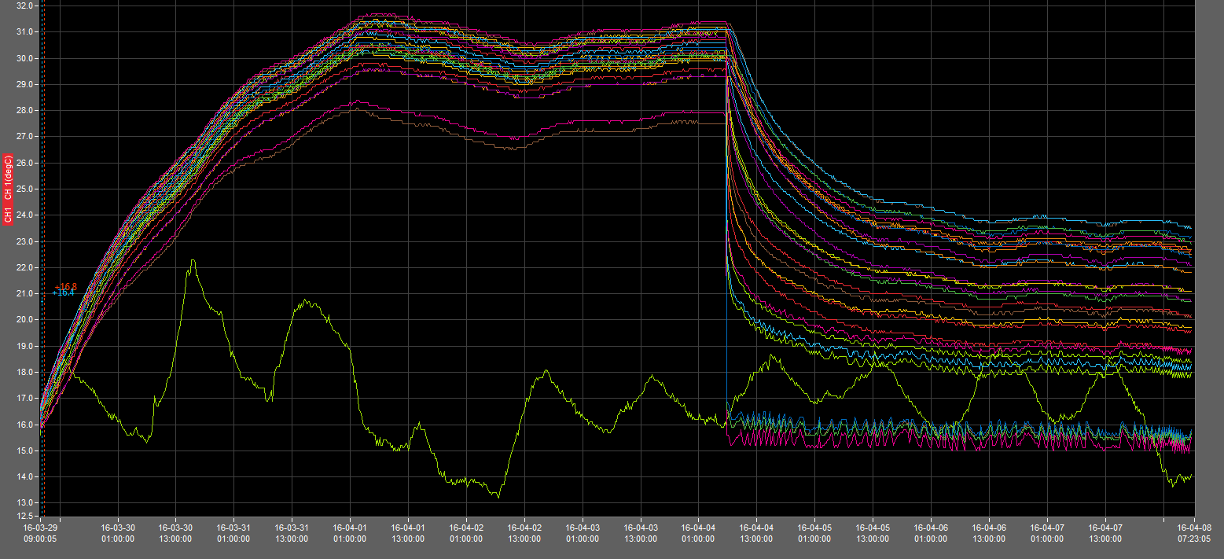
Tests et simulations (module EUDET)
Demonstration and performance of Thermal model
  Cooling tests: From detector to cooling station
  Realistic interface electronics for slabs
    Dummy ASU with representative power dissipation to simulate and DIF with localisation of hot spots
    Geometry, power distribution and representative materials + Cooling effect
              Local Heat exchanger with 15 connections
              Full module equipped / conductive materials
Adaptation of Water heat exchanger
Connection on slab
Dummy slab detector under construction for thermal tests on EUDET 15 slabs for 1 column
EUDET module (carbon structure) equipped with it’s heat exchanger 15 slab in EUDET module
Test 9
Test 10
First tests results in line with simulations
Requirements for 15W nominal
Gradient accepted in detector elements: 20°C
20°C < T < 40°C
Cooling ON
Cooling OFF
For ~30W tested with cooling
  -> T° rising in slab: ~up to 7°C
  -> maximum: 24°C
No cooling / Power ASU : 32 W/column => maximum temperature : 31°C
Cooling / ASU power : 31 W/column => maximum temperature : 24 °C

Slide 10
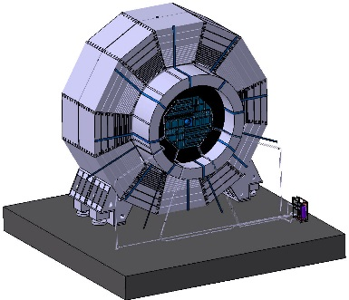
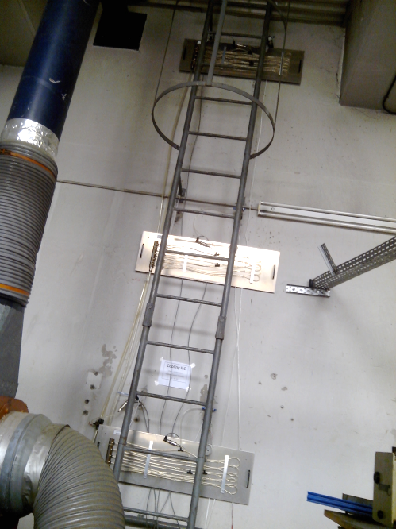
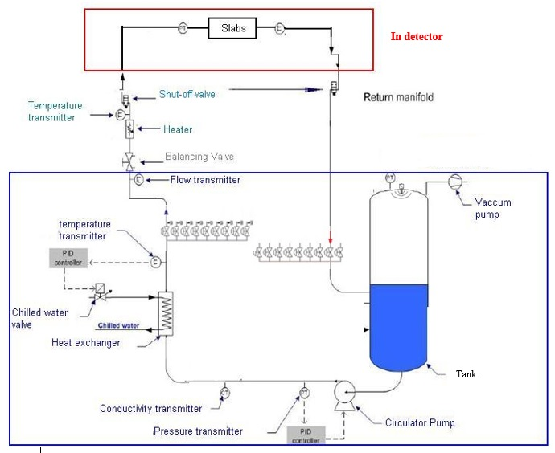
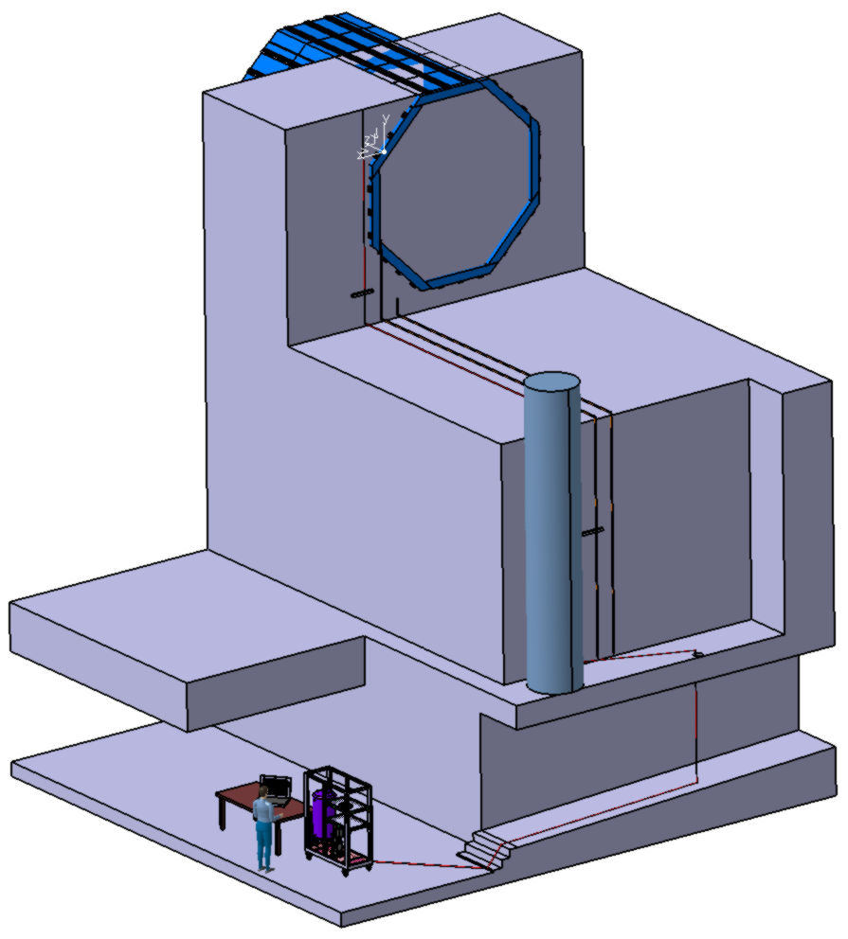
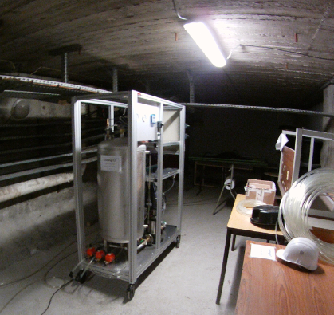
Système de refroidissement global
Principle of leak less:
Pressure distribution as a function of height,
depends on the pressure drop and altitude
Ongoing developments 2017
- Full scale leakless loop demonstrator Integration (3 levels 9-10 & 13m <1 atm)
Results in line with simulations
Detector location
13m
High Line
10 m
Medium Line
4.5 m
9 m
Low Line
5.1 m
cooling station
2.5 m
Cooling Station
Design of one leakless loop for ongoing tests
Rough estimate on fluid circulation:
Global flow rate : 150 l/min
Variation of fluid temperature: in-out => 3°C
Fluid speed < 2 m/s
Maximal pressure drop : 1.2 bar
Total heat to be removed: # 4.6 kW
LPSC cooling test area with a drop of 13 m
Cooling station

Slide 11
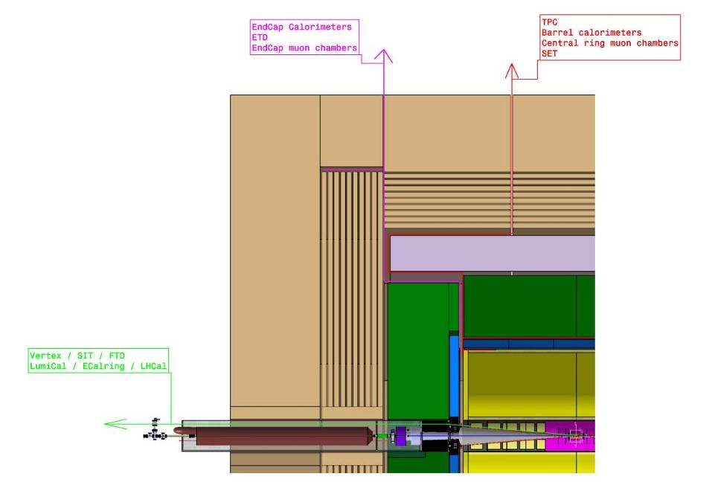
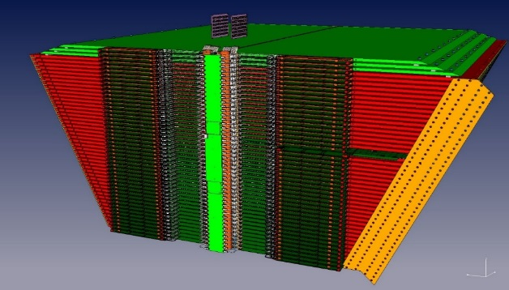

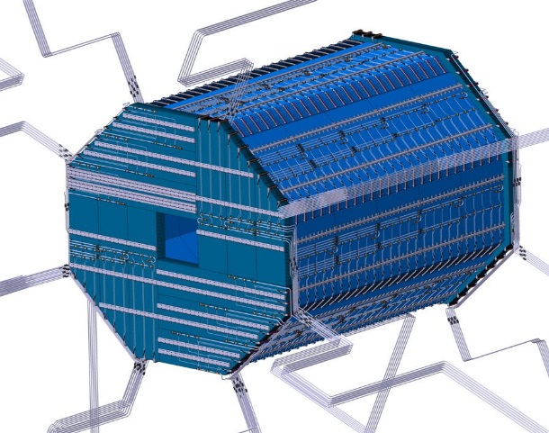
Système de refroidissement : intégration
detailed design of cooling pipes and cabling scalable to linear collider detector ongoing
Patch panels:
Space
Not far
Easy access
From barrel on barrel
From EC on EC
Cooling station on going
Sector connecting plate (10cm)
ECAL Cableshaft
HCAL= 50 cm²
16 way out ?
TPC = 10 cm²
8 way out ?
ECAL = 30 cm² ; 8 way out
Pathways of pipes between HCAL & ECAL Endcaps (limited space ≤30mm)
Cooling lines for ECAL End-cap and Barrel

Slide 12
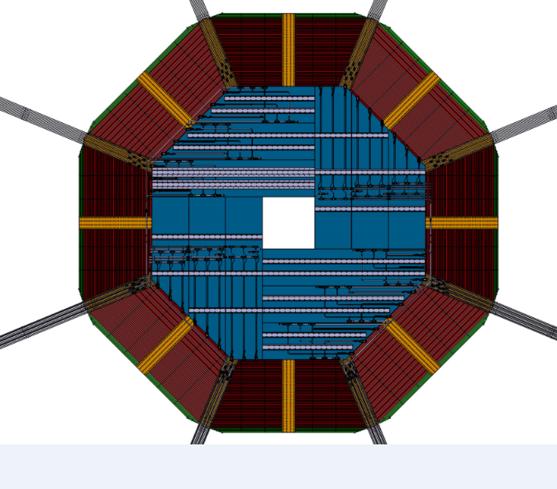
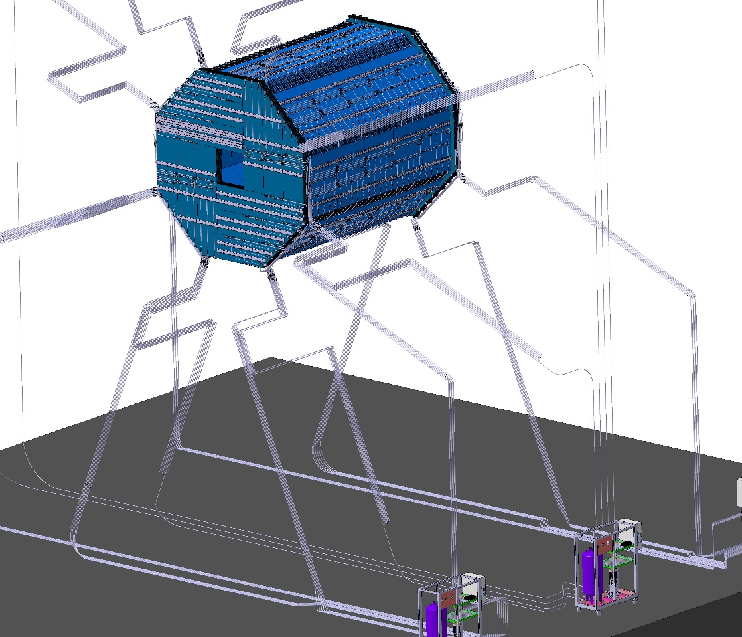
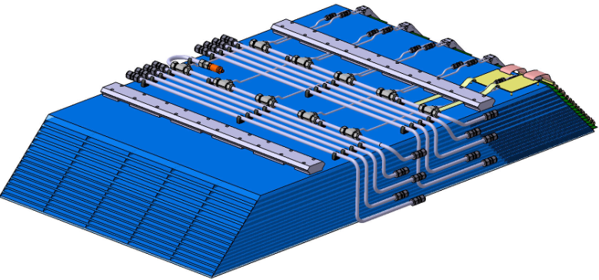

Système de refroidissement : intégration (suite)
Hydraulic network = Control by module
Conection of Endcap pipes
+ electronics constraints

Slide 13
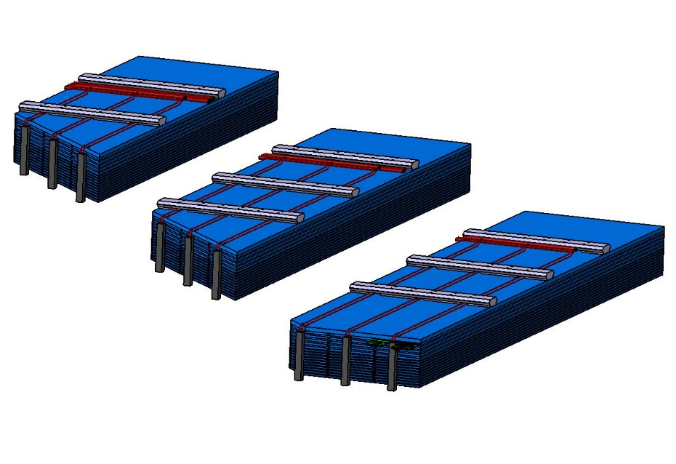
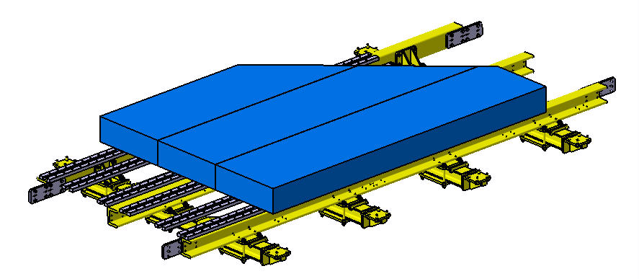
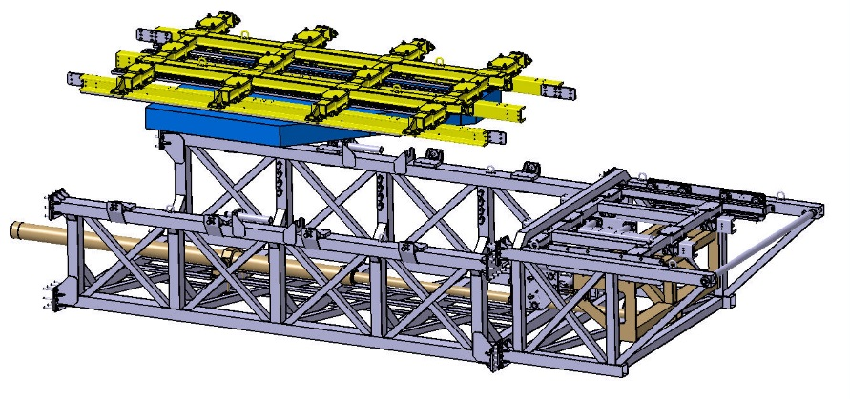
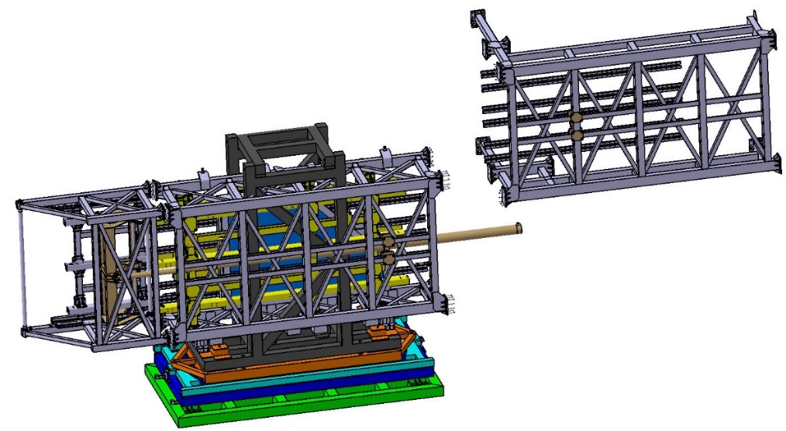
Intégration des bouchons EM
1 - Assembly and test of modules and quadrants
1-1. Modules equipment and test (24)
Dimensions
L,H,I: 2,8 x 0,6 x 0,7 m³ -> 2x40 m² Boxes: ~0,7 m² -> 50 m² with access Testing space: 50 m² Assembly area: 180 m² Weight per module: ~1.6 t to 2.6 t
ILC Campus – ECAL Hall
~1,6 T
~2,2 T
3 modules in each quadrant
~2,6 T
1-2. Quarters assembly (2x4) on cradles (2 in parallel)
Integration of one ECAL
quadrant ~6,5 T each
ILC Campus
Assembly hall
Dimensions
8 quarters (of 3 modules each): Assembly area: 50m² / quarter (quarters assembly 2 by 2) Assembly area: 100m² / total-2 quadrants Total weight : ~ 6,5 t / quadrant Testing-Storage area: 100m² / 2 quadrants

Slide 14
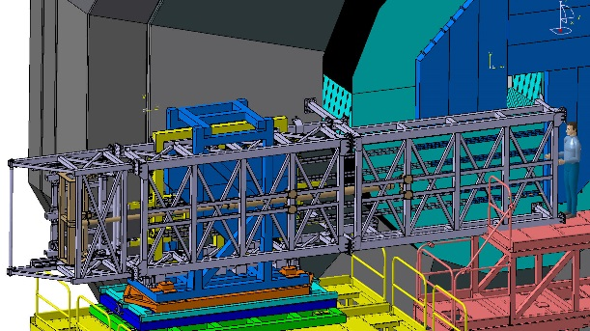
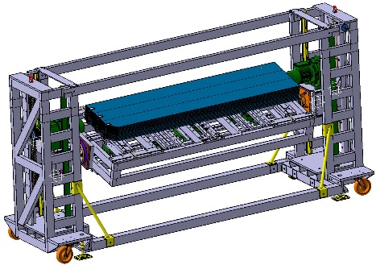
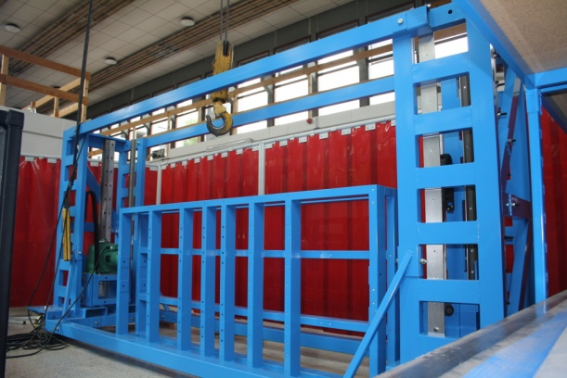
V.2 Intégration des bouchons EM (suite)
Assembly hall
2 - Assembly of quadrants on HCAL End-Cap
Quadrant Insertion tool (lateral) area: 120 m²
Minimum width = 7 m/beam line for integration
Assembly area: 25 m² / quadrant
Storage area : 1 quarter => 10 m² / 12 modules => 50 m²
Insertion on HCAL End-Cap on each side: per full quadrants
* Quadrant insertion tool
with orientation tuning, alignment
and fastening systems 10.4 x 2.3 x 2.3 m
* Module handling tool
for rails’ tests and module integration
4.2 x 1.2 x 2.1 m
3 ECAL End-Cap quadrants already fastened on HCAL
* Platform (Base Moving Frame ) or
* Mini-Vans (ATLAS Like @ CERN)
Module handling tool
on going
Sliding, tuning, alignment & fastening of the last ECAL quadrant on HCAL End-Cap

Slide 15
Intégration des bouchons EM (suite)
~ 7 months / EC
N° | Major Tasks Description for 1 End-Cap (Preliminary studies of the Ecal End-Cap assembly) | FTE | TIME | Ressource name
1 | ECAL End-Cap Base Moving Unit / Base Moving Frame / Quadrant Mounting Frame Insertion tool, transport , installation, alignment | 4 | ~ 1 month | crane 1 , crane 2
2 // | Rails: fixing (female parts) on the rear face of the HCAL End-Caps: Positioning / Alignment / Checking | 3 | ~ 1 month | Specific tooling TBD
3 | Quadrant 1 (3 modules) assembly in the ILC Campus, fully equipped, tested and aligned | 6 // | 4 weeks | quadrant support frame 1, crane 1
 | 3 Modules Equipment and test (assembly of 1 of the 3modules in the ILC Campus) | 2 | 1 week x 3
 | Tests ( electronic and signal) of the 3 constitutive modules | 2 // | 1 week x 3
 | Quadrant assembly on mounting support frame | 2 | 1 week
4 // | Quadrant 2 (3 modules) assembly in the ILC Campus, fully equipped, tested and aligned … | 6 // | 4 weeks | quadrant support frame 2, crane 1
5 | Quadrant 3 (3 modules) assembly in the ILC Campus, fully equipped, tested and aligned … | 6 // | 4 weeks | quadrant support frame 1, crane 1
6 // | Quadrant 4 (3 modules) assembly in the ILC Campus, fully equipped, tested and aligned … | 6 // | 4 weeks | quadrant support frame 2, crane 1
7 | Transportation of quadrant to IP (Assembly hall) | 4 | 2 days
8 | Integration of 1 Ecal End-Cap on HCAL End-Cap (space available for tooling approach on both sides of detector in assembly hall) | 4 | 1 month | crane 1 , crane 2 quadrant support&MF
 | Insertion of 4 Ecal End-Cap quadrants on HCAL End-Cap (quadrant on its support frame) Positioning of the quadrant on specific sliding tool / Pre-alignment operations / Insertion | 4 | 2 days x 4 | crane 1 , crane 2 quadrant support&MF
9 | 1 ECAL End-Cap general cooling integration | 4 | 2 weeks
10 | Remove ECAL End-Cap Mounting Frame / Base Moving Frame / Quadrant Mounting Frame… | 4 | 1 week | crane 1 , crane 2
ILC CAMPUS
Assembly Hall

Slide 16
Budget mécanique 2017
Allocation LPSC: totale 2017: 2,85 k€ (3k€ -5% = missions) 1,9 k€ (2k€ -5% = AP) Demande mécanique 2017: 10,4 k€ | S-total (prévisions) (10,4 k€) | Allocation 2017: 1,9 k€ Objectif réalisé … ou non
COOLING Fin de la construction d'une boucle test de circulation vraie grandeur pour valider le fonctionnement sous-atmosphérique. Tests d’un échangeur dédié en Faisceau Fabrication et brasage échangeur thermique sur géométrie BGA Boucle leakless complète Poursuite du montage de la boucle sous-atmosphérique Tests thermiques /simulations de variations de puissance (limites/pulsing) Fabrication et test échangeur thermique EUDET / géométrie BGA - Fabrication et brasage échangeur thermique sur géométrie BGA | 2.9 K€ 1 K€ 1 K€ 0.9 K€ | 1.6 k€ 1 k€ 0.6 k€ 0 k€ | OUI NON NON
COMPOSITE Réalisation d’un grand layer sur la nouvelle géométrie « Small Detector » pour un futur démonstrateur de module complet End-Cap et finalisation process fabrication grands layer End-Cap Stand-by / réductions budgétaires | 0.0 K€ 0.0 K€ | 0 | /
GUIDAGE / SUPPORTAGE Poursuite de la réalisation de l'équipement pour les tests de manutention (contraintes/structures composites) et d'installation des fluides sur tous les types de modules : sur budget AP et AIDA - Peinture + transport outillage lourd manutention modules - 2 Rails double rangée - Solde outillage lourd support modules | 2.5 K€ 1.3 K€ 0.7 K€ 0.5 K€ | 0.3 k€ 3.1 k€ 0 0.2 k€ | OUI NON NON

Slide 17
Demande de Budget 2018
1 – COOLING
Poursuite des tests d'une boucle de circulation vraie grandeur pour valider le fonctionnement sous-atmosphérique. Tests du circuit hydraulique complet d’un module.
  1.1 Thermique :
  Test boucle leakless complète et équipement hydraulique d’un module
  - Poursuite des tests de la boucle sous-atmosphérique : 0,7 k€
  - Fabrication et brasage échangeur thermique sur géométrie End-Cap : 0,9 k€
  - Circuit complet de connexion hydraulique et distribution d’un module 2,5 k€
TOTAL COOLING : 4,1 k€
2 - COMPOSITE
Réalisation d’un grand layer End-Cap pour validation process fabrication en 2,5m
  2.2 Moulage grand layer End-Cap :
  - Usinage reprise du moule + caule plate : 2,0 k€
  - Composite CC202-ET445 pour 3 alvéoles (20m²) + gabarits : 1,5 k€
  - Cuisson + transport : 2,3 k€
  TOTAL COMPOSITE : 5,8 k€
3 - GUIDAGE / SUPPORTAGE
Fin de montage de l'équipement pour les tests de manutention (contraintes/structures composites) et d'installation des fluides sur tous les types de modules.
  3.1 Tests sur outillage lourd manutention modules 1,5 k€
  3.2 Rails double rangée 0,7 k€
TOTAL OUTILLAGE : 2,2 k€
4 – MISSIONS
Budget dévolu aux missions du projet ILC-CALICE (TOTAL 7K€) : réunions CALICE, déplacements (LLR, CERN, pôle composite) etc..
TOTAL MISSIONS : 7 k€
TOTAL BUDGET 2018 : 19,1 k€

