Slide 1
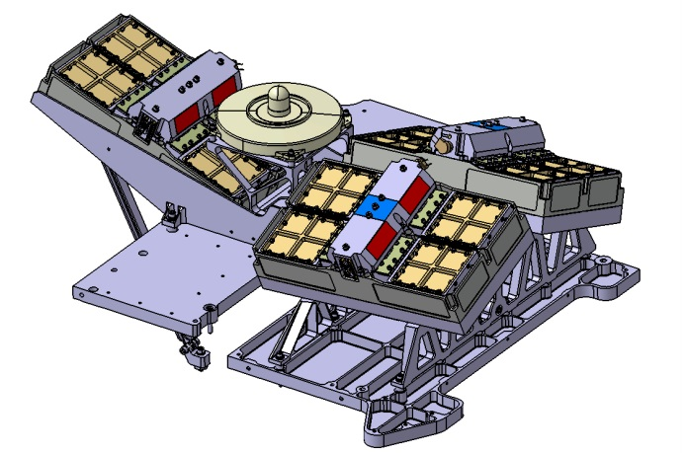
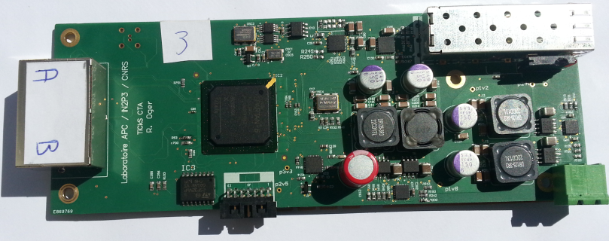
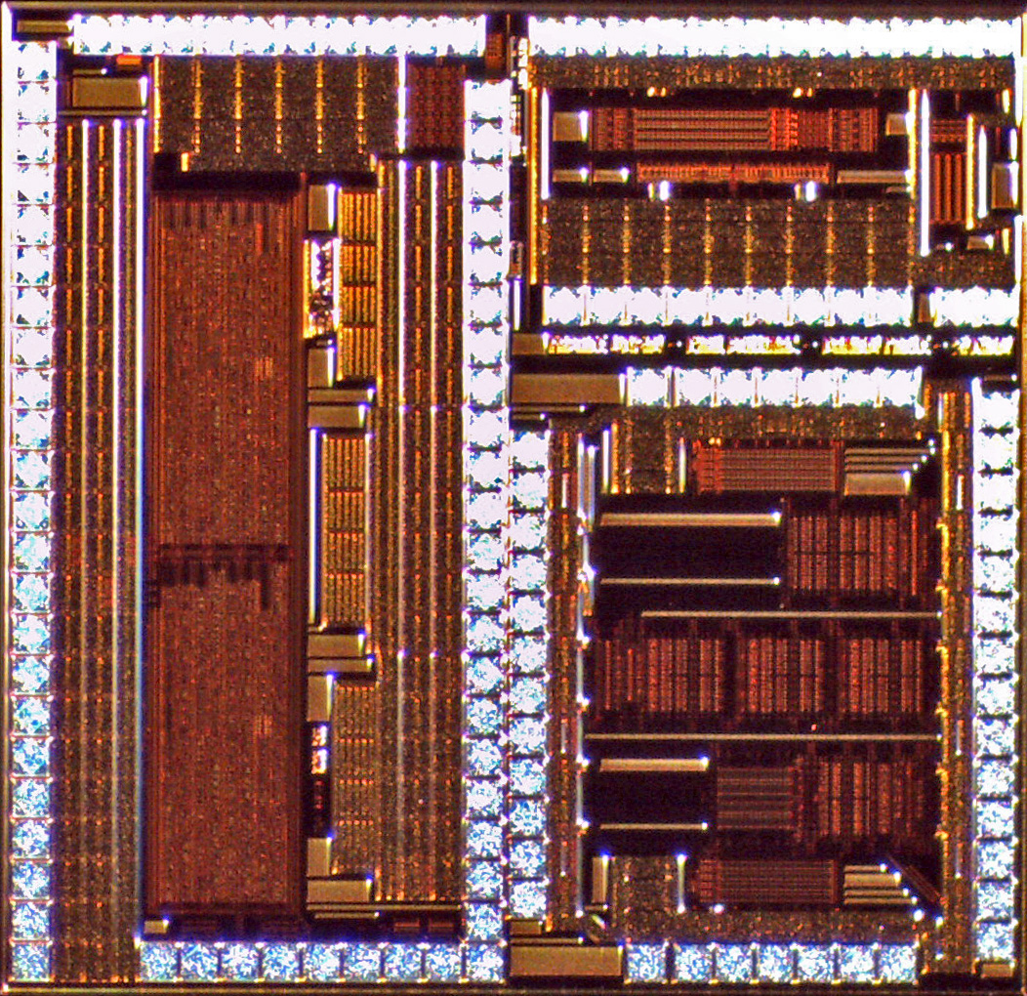
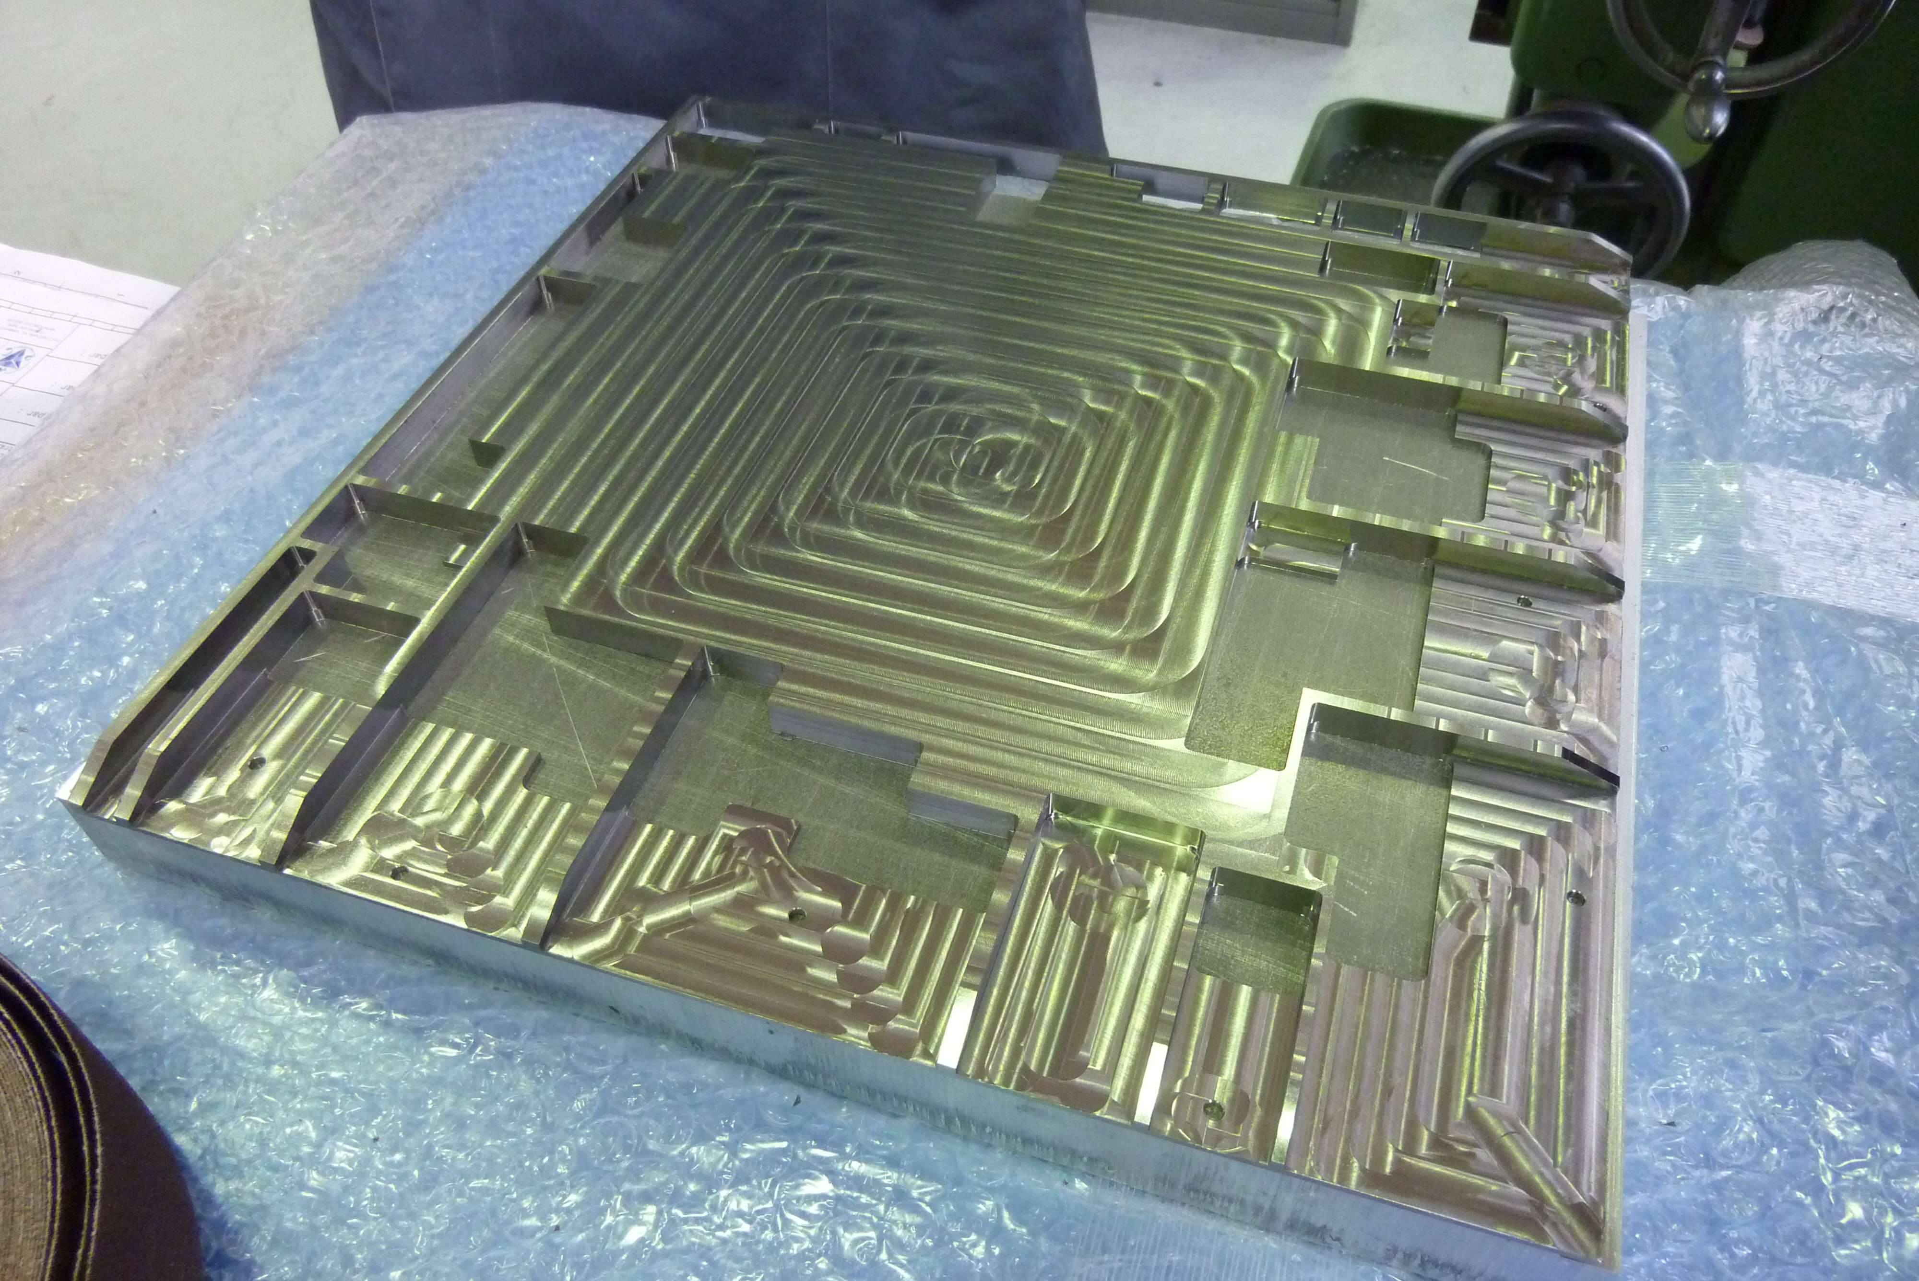
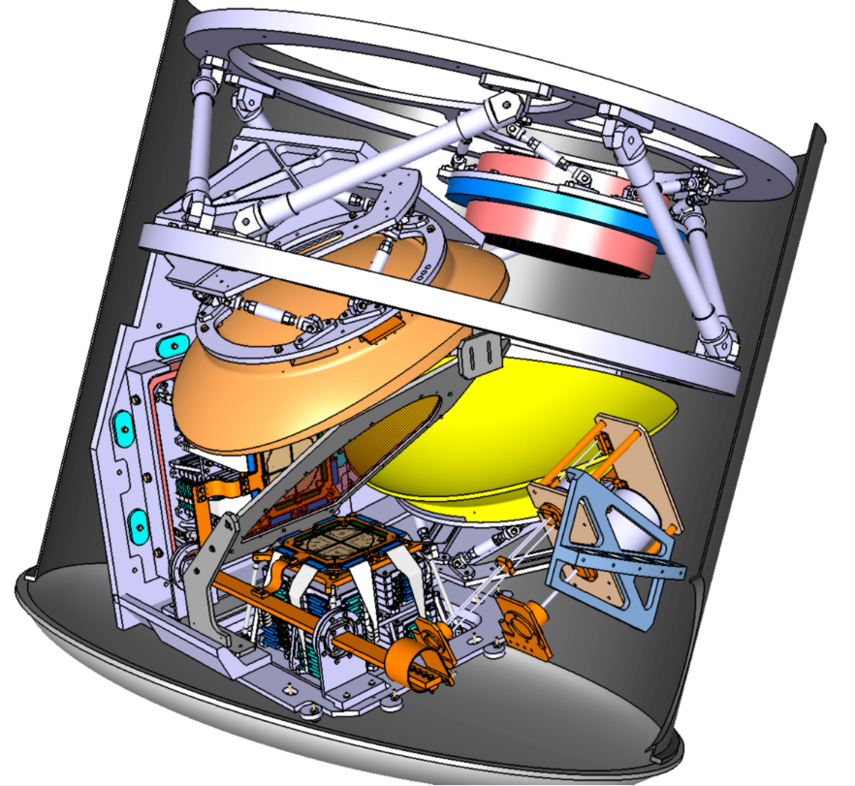
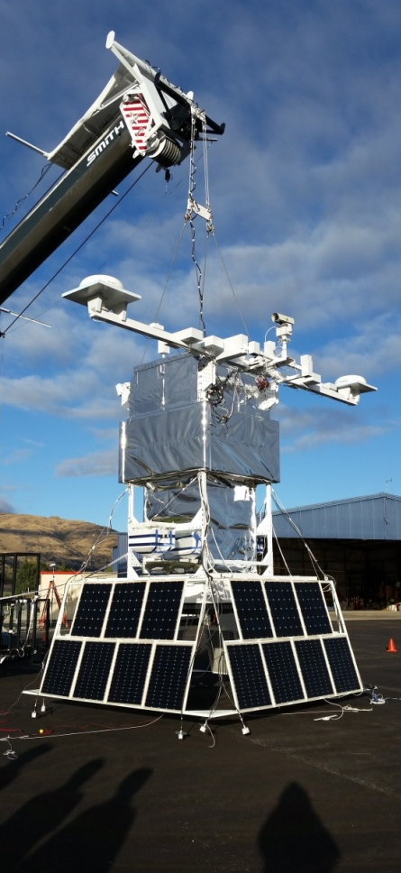
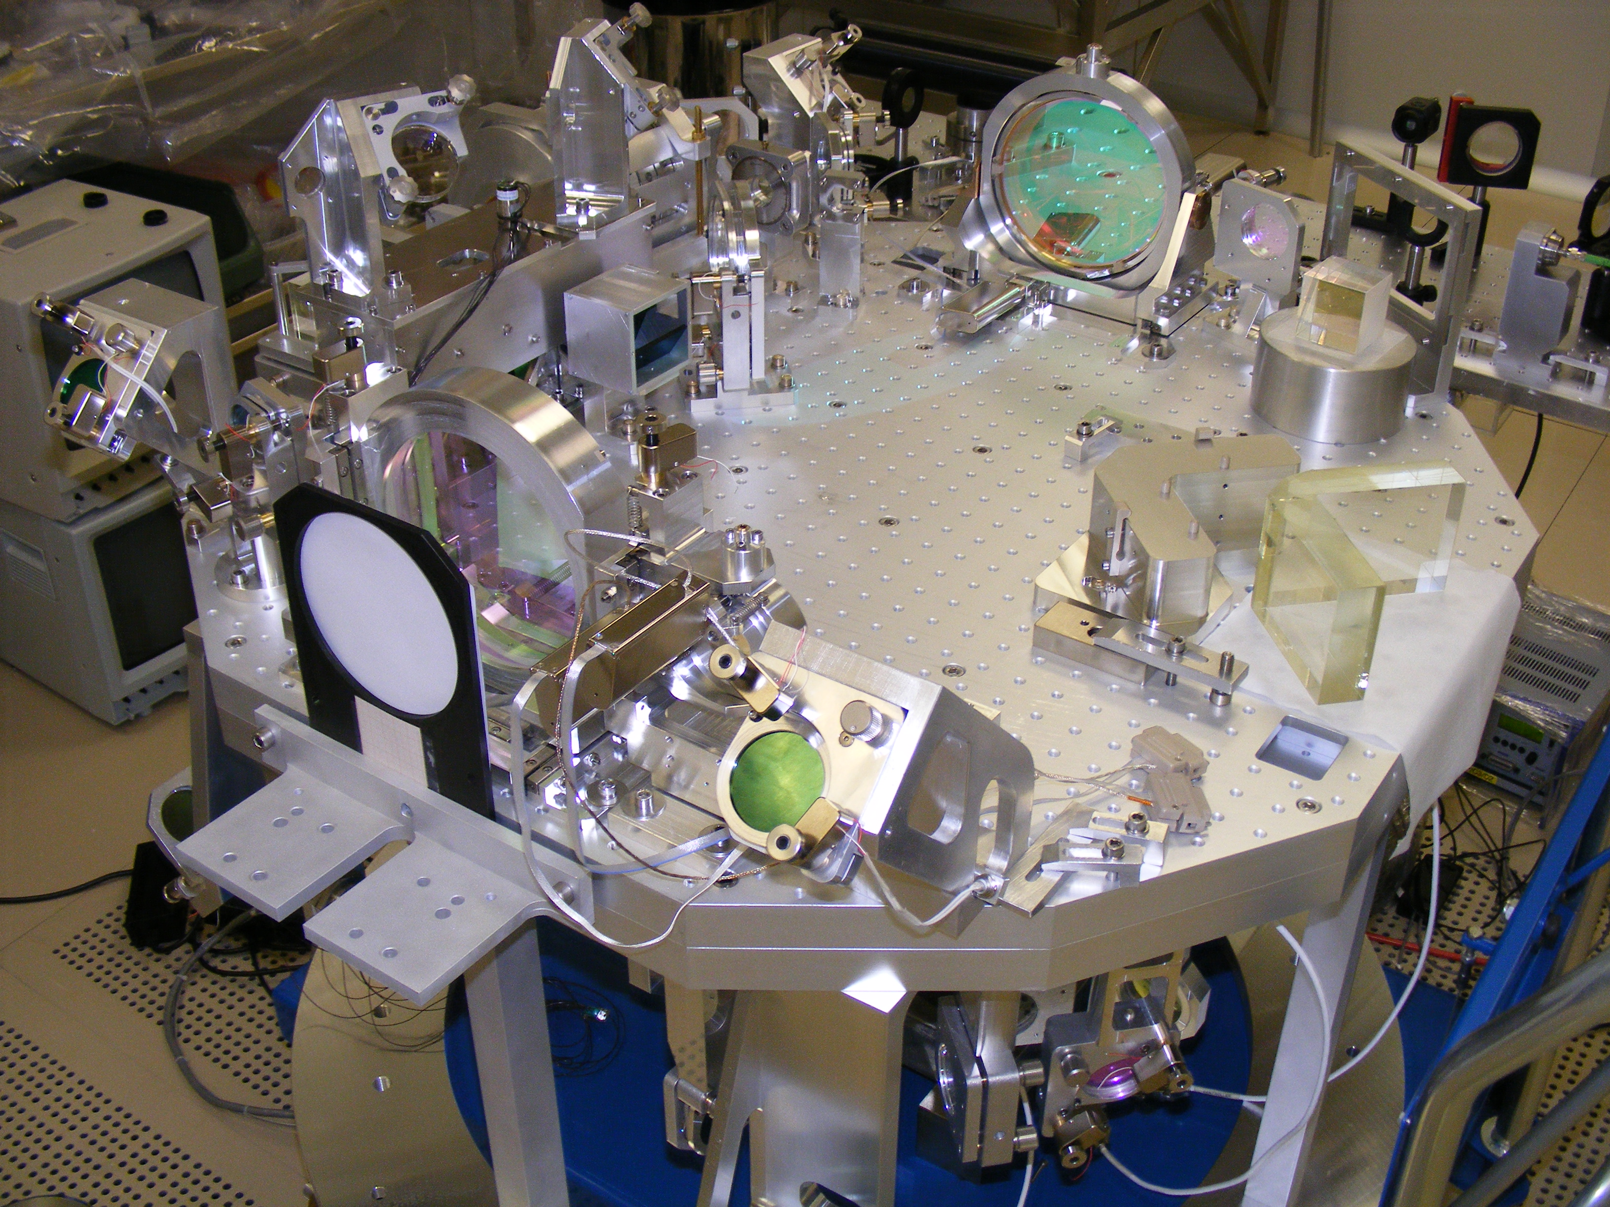
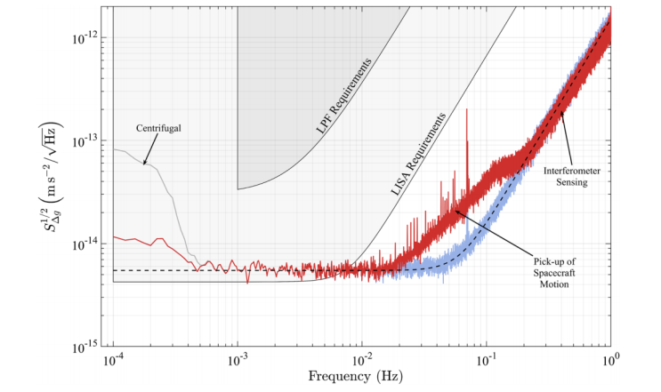
2012-2016 APC Laboratory
Technical Activities
T. Zerguerras
on behalf of the Technical Departments

Slide 2
Technical Departments
Organisation
Equipment, facilities and platform
Instrumentation Department (Techniques Expérimentales)
Electronics and Microelectronics Department
Mechanics Department
IT Department
Quality Unit
Analysis & Prospects

Slide 3
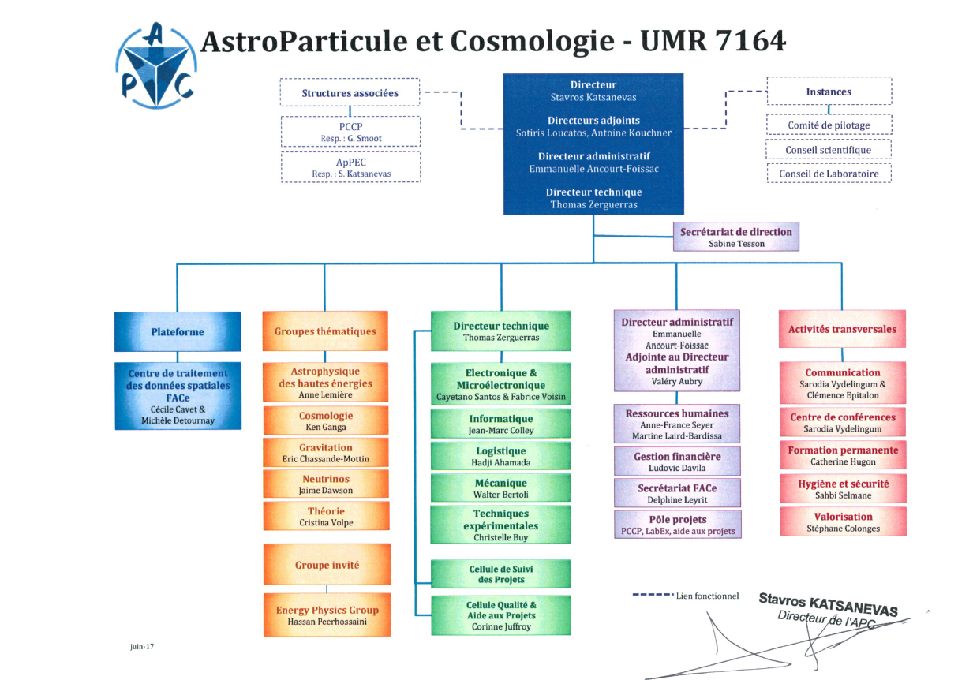
General organisation
5 technical departments + Quality Unit
+ the FACe platform
Building an instrument
=> combining skills

Slide 4
Organisation: structure
Matrix organisation structure: Project/Department (Assignment to a department, participation to projects)
One specific skill (Mechanics, Electronics/µelectronics, Instrumentation, IT, QA/PA)
Transverse activities of the Quality Unit
Supervision : Head of department
Project coordination: Project manager
Indicator Boards for activities and assignments monitoring
Project Monitoring Committee (Comité de Suivi de Projets CSP)
This organisation aims to create a bond of trust with funding and
tutelage agencies

Slide 5
Organisation: Role of the technical director
Missions officially defined by a CNRS/IN2P3 model of letter of mission
(ATRIUM -136477) since November 2016
@ APC:
Member of the direction board
Hierarchical: Supervision of the technical departments, management tasks
(annual evaluation interviews and career files of Technical Dpts heads …)
Organizationnal: operation following laboratory matrix structure ; needs of
quality in project and organisation of CSP project reviews (support of the
Quality Unit) ; survey of project management procedures and tools
(ex: CNRS/IN2P3 NSIP database, APC Indicator Boards …)
Strategic: analyzis and survey of technical implications in projects (skills,
workforce, infrastructures, consequences on other on-going projects) to
give recommandations and alerts to the laboratory director (final decision
maker); definition of the technical recruitment policy
Main contact with the CNRS/IN2P3 technical director, participation to
meetings and reviews organized by tutelage and funding agencies

Slide 6
Organisation: Technical staff evolution
On 31/12

Slide 7
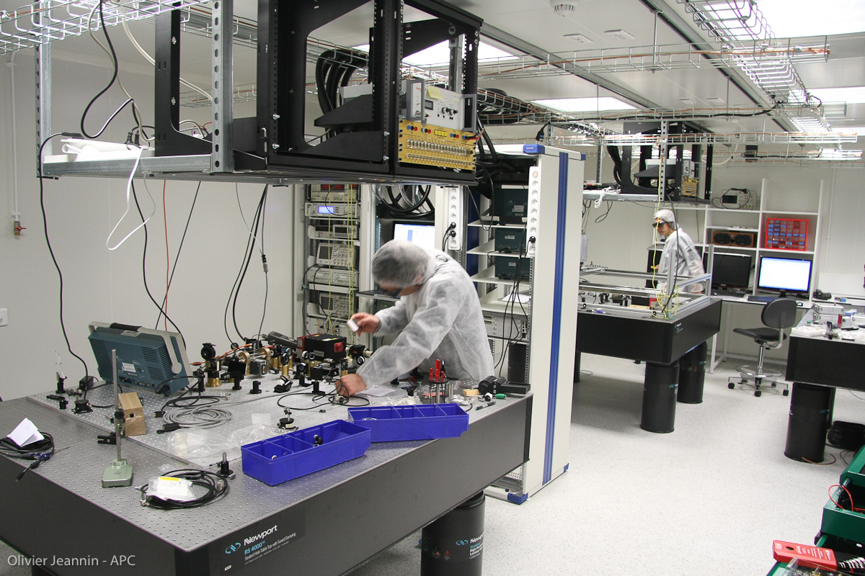
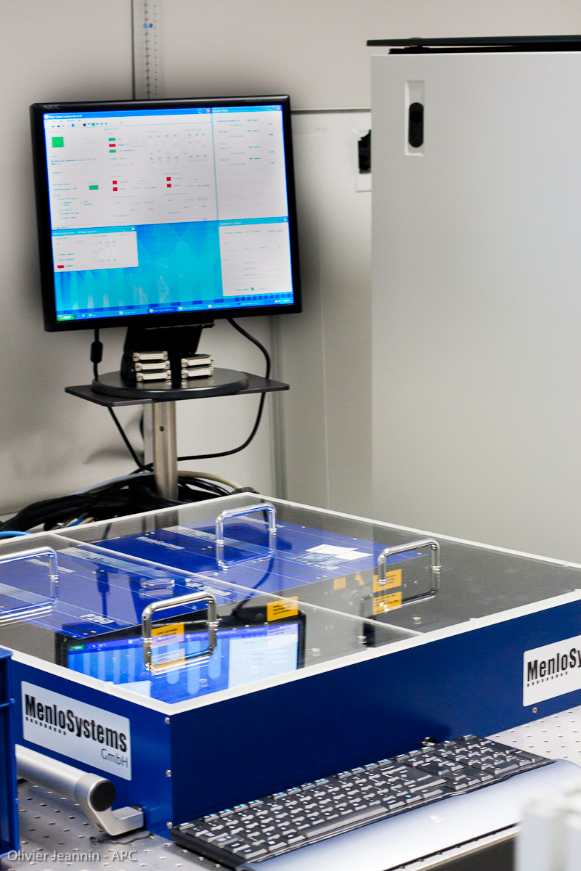
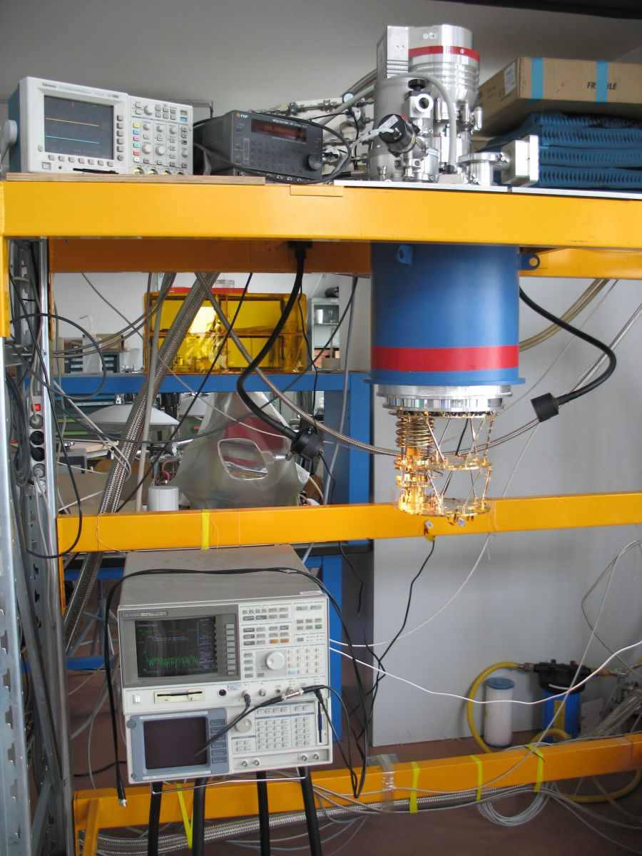
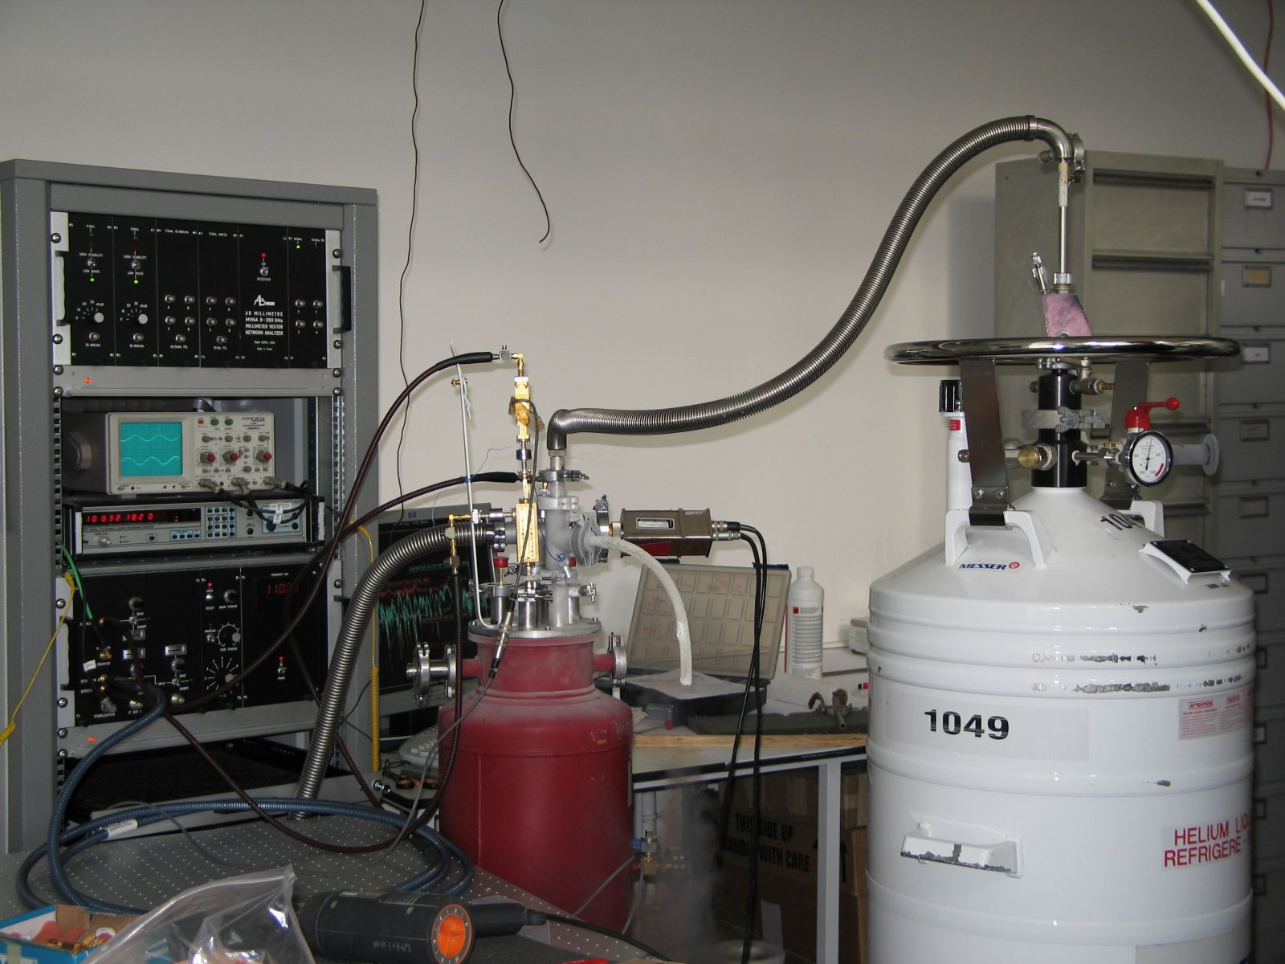
Equipment and facilities
ISO8 Cleanroom
(128m²):
Integration room
LISA room
VIRGO room
Frequency comb
generator
(Laser emission in a
spectral band from 1 to
2µm with a frequency
step of 250MHz)
Millimetric Laboratory:
100mK dilution-free cryostat
(Oxford Instrument)
(Cooling power :
160µW @100mK,
No cryogenic fluid)
Millimetric
Laboratory:
Vector network
analyzer
(characterization of
antenna and filters in
the frequency range
70-220GHz)

Slide 8
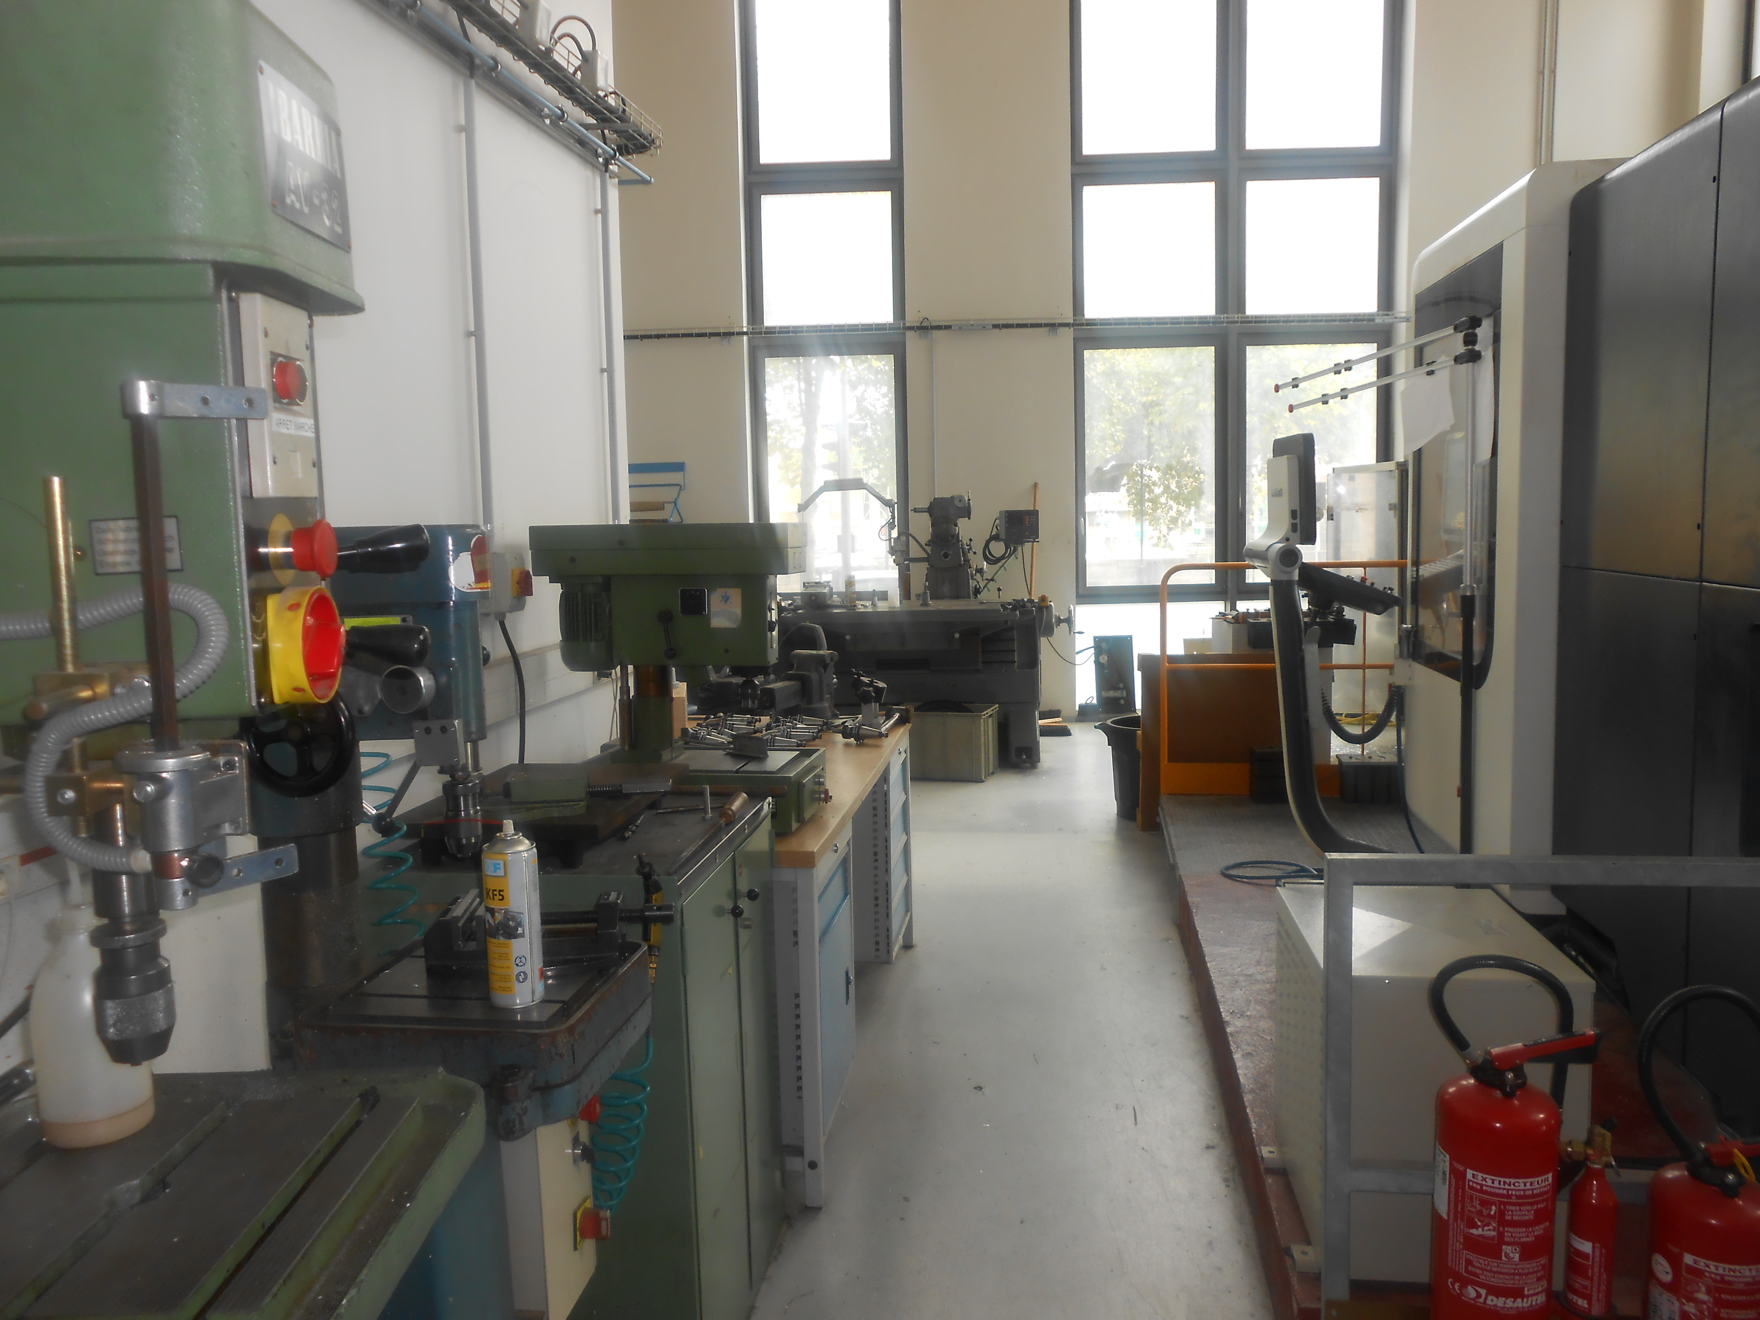
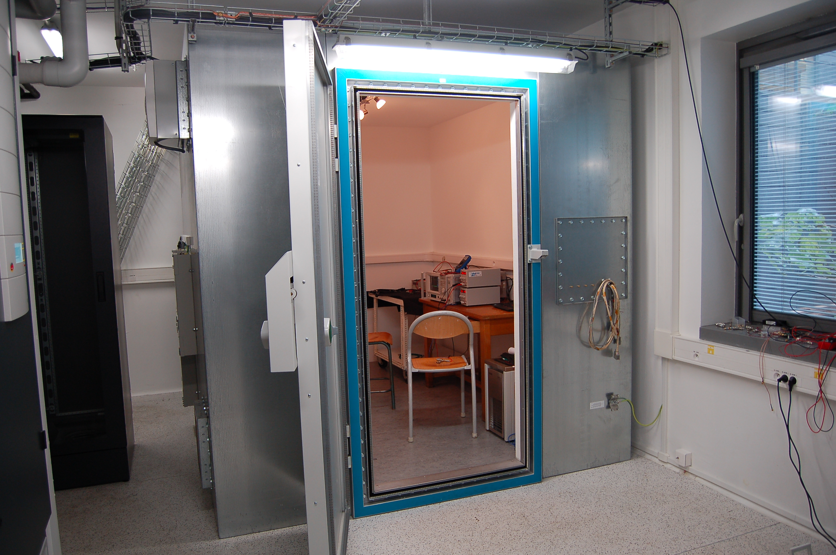
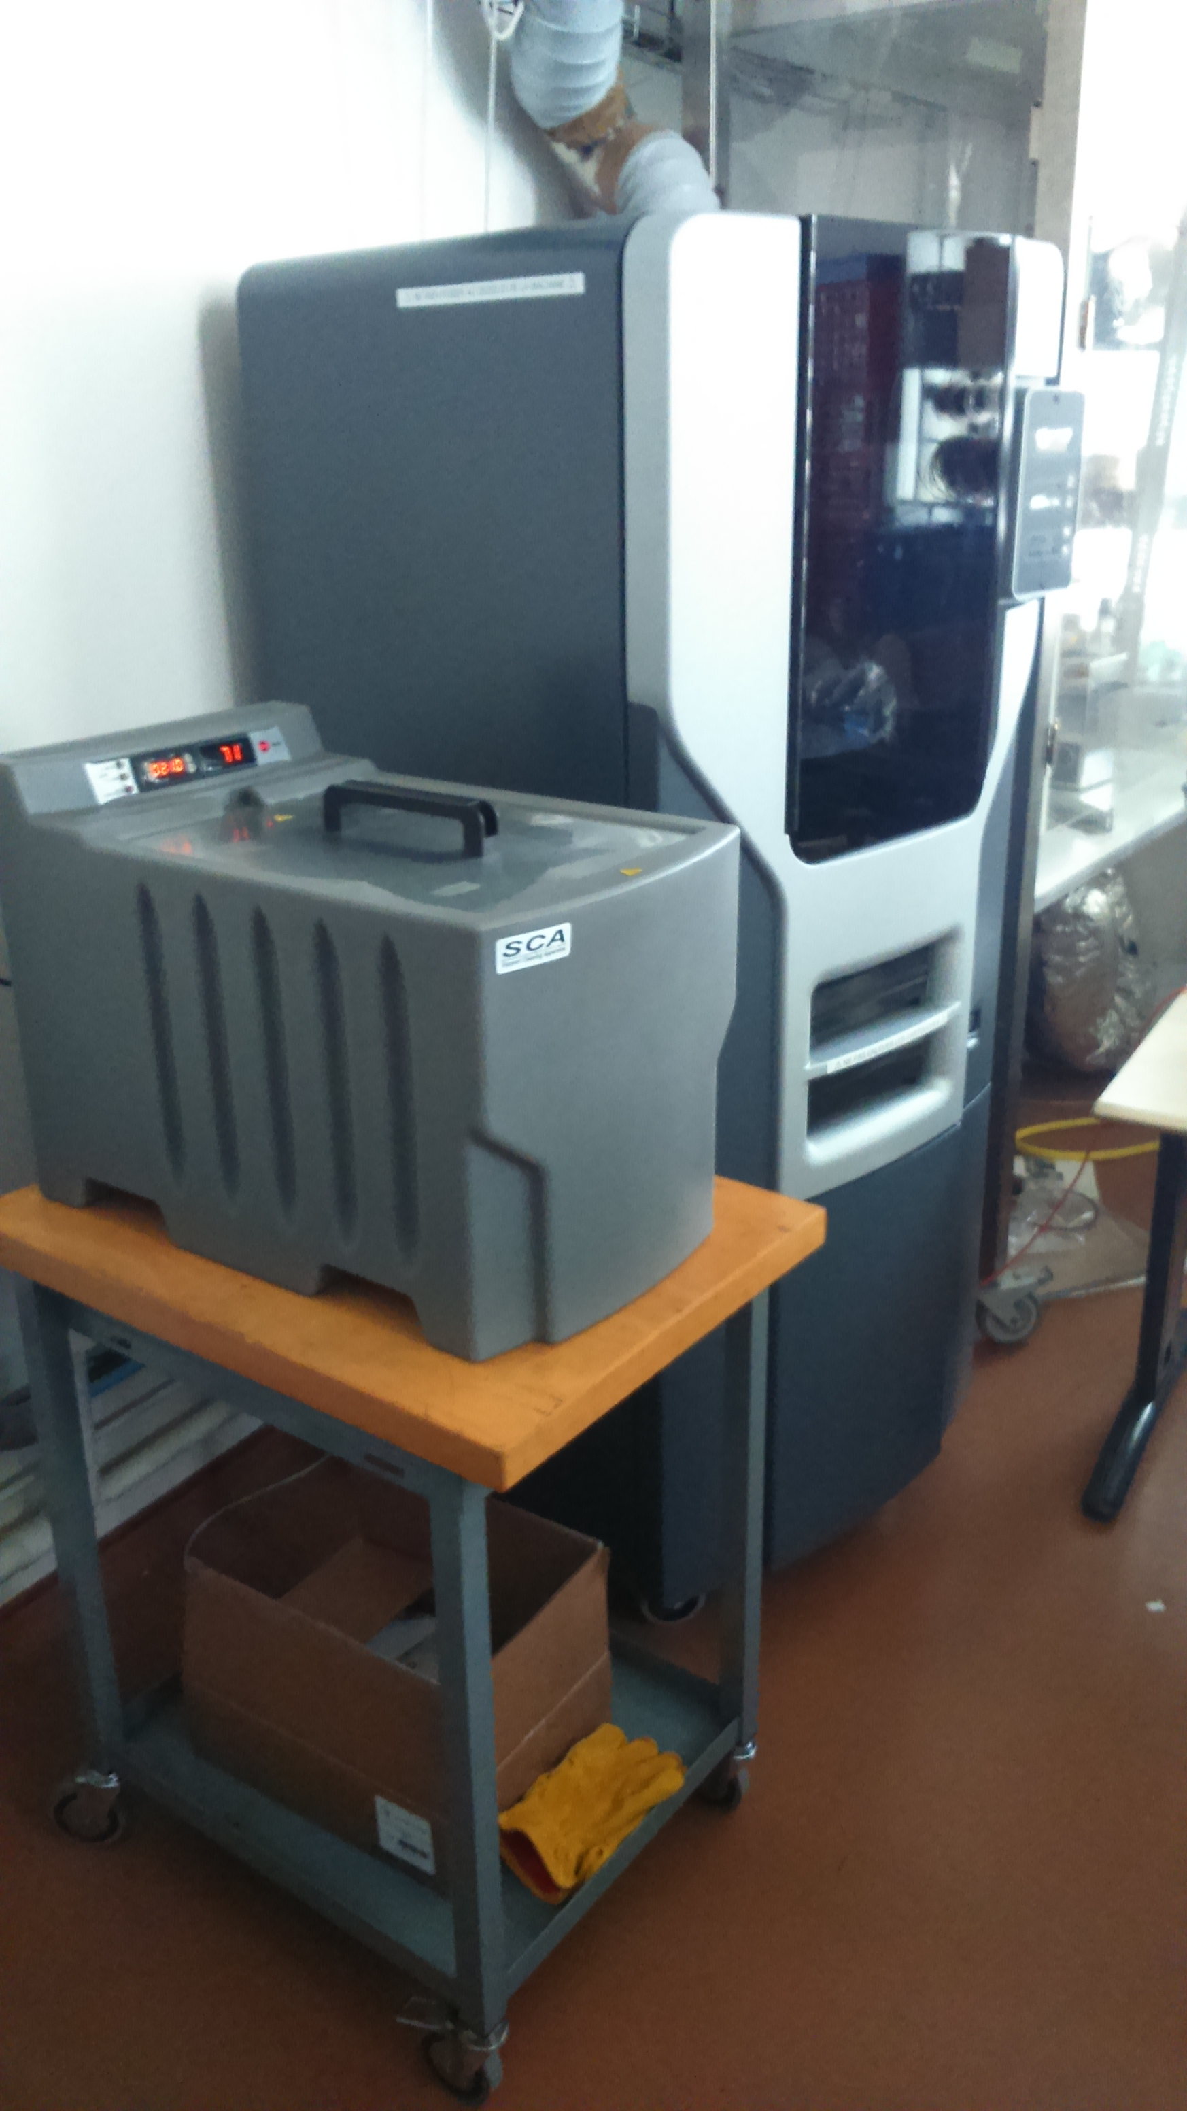
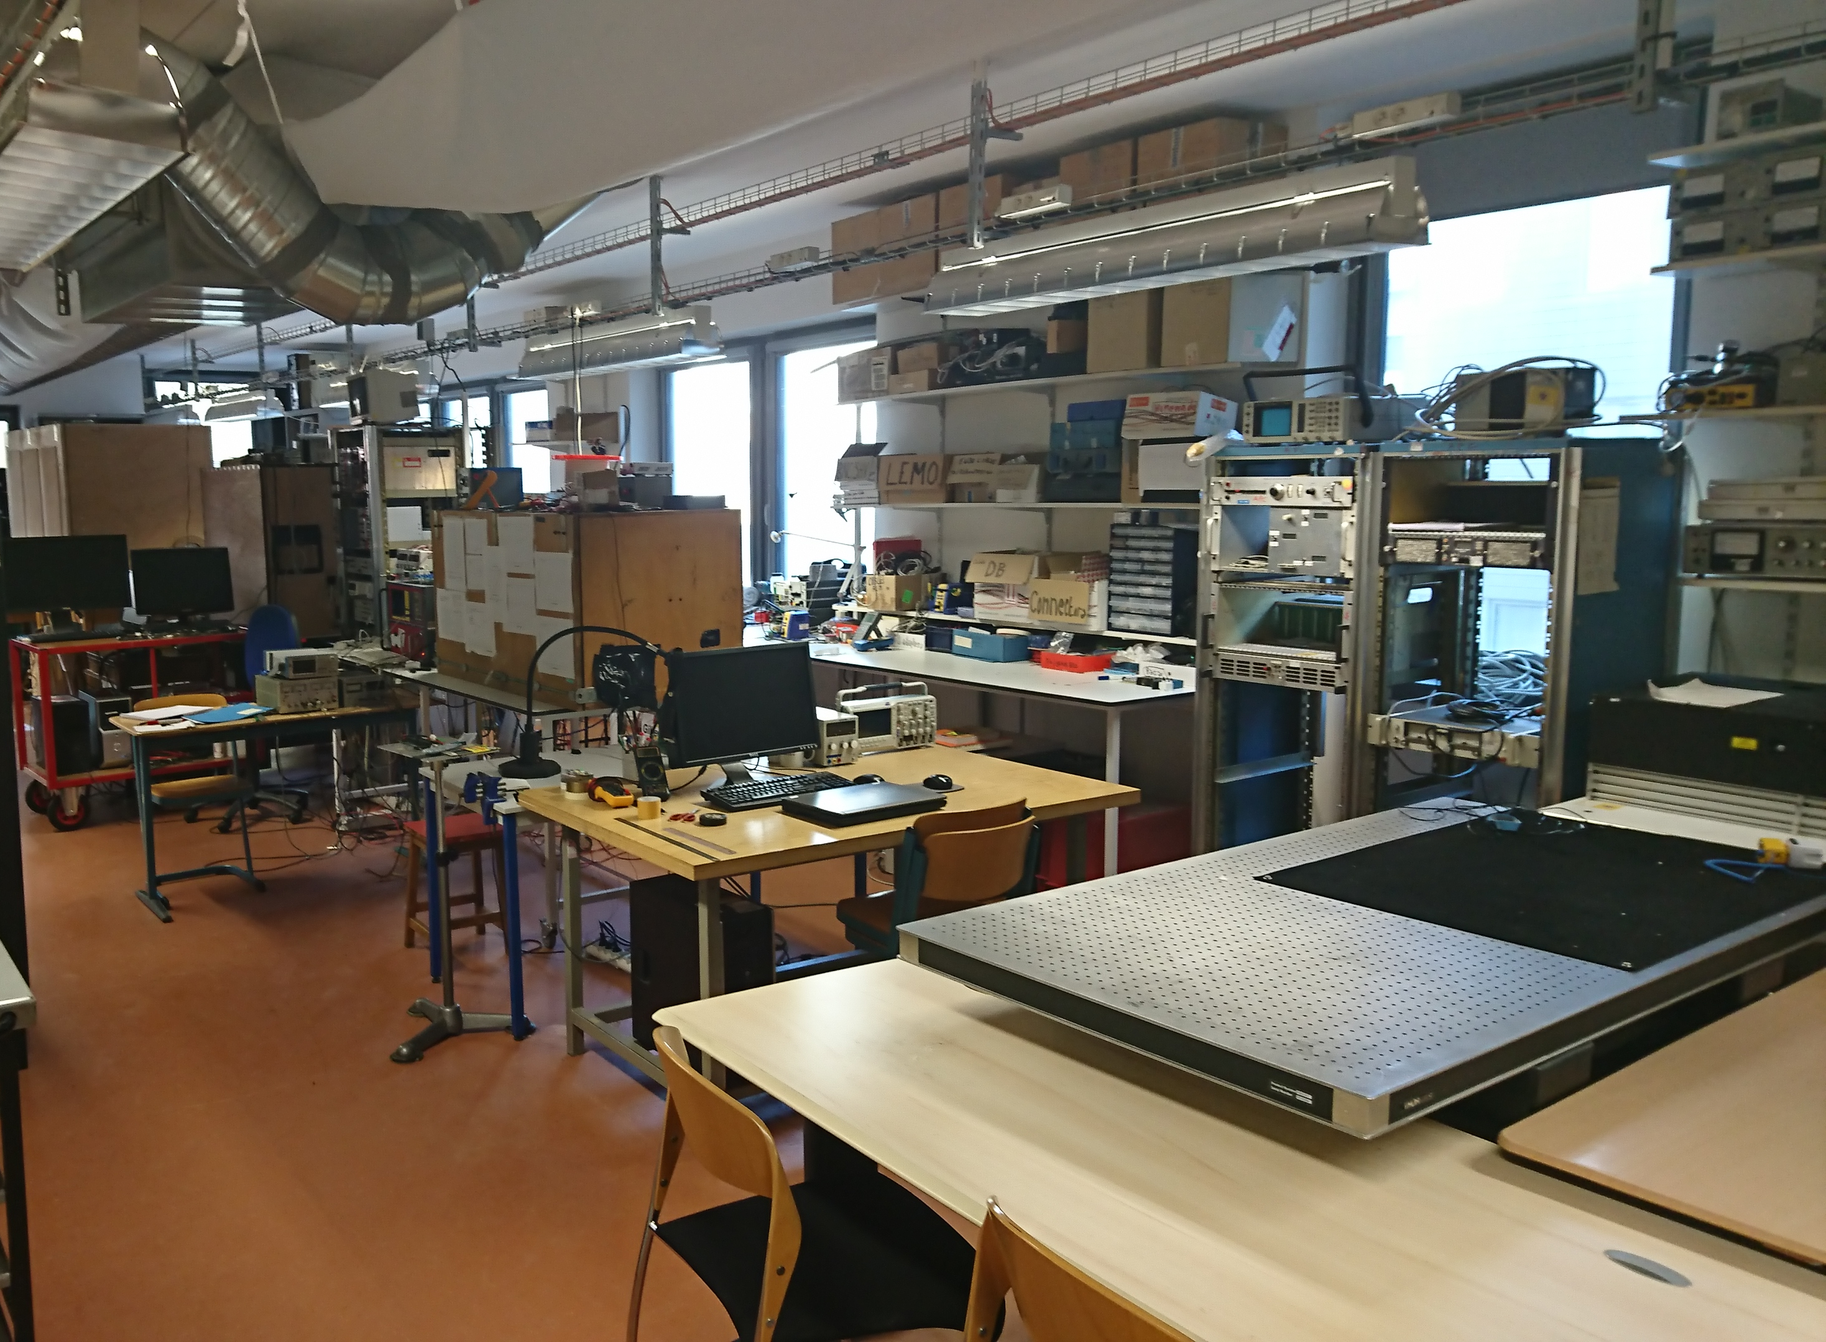
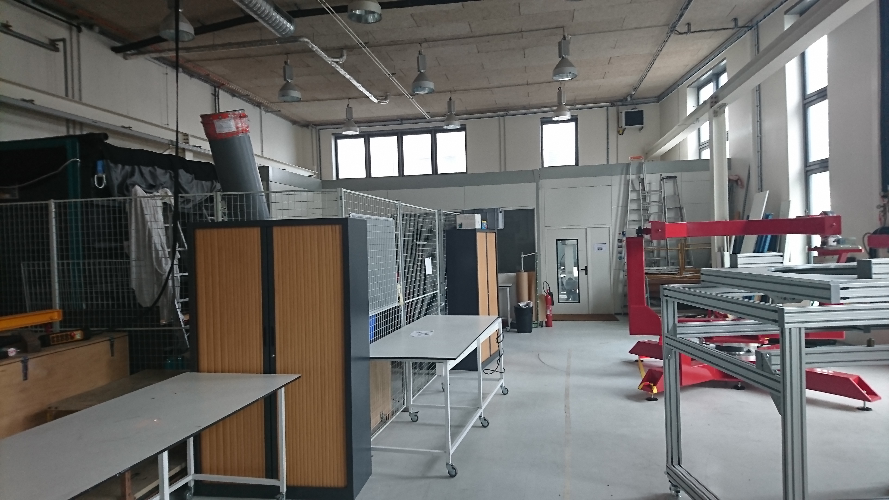
Equipment and facilities
Low electromagnetic noise test room (37,5m²) including a Faraday cage for components tests from 0.1mHz to 10Hz
Mechanics Workshop
3D Printing Stratasys Fortus FDM250mc
(ABS plastic)
Photodetection Laboratory
Mouting hall

Slide 9
Platform: FACe
Started in 2010, support of IPGP in the framework of the Paris-Diderot
University Space Campus – Application to the CNRS/IN2P3 Platform Label
Scientific Manager: Cécile Cavet (IT Department)
Technical Manager : Michèle Detournay (IT Department)
Missions:
Building and infrastructures management (electrical facilities, CDF, HVAC,
maintenance, subcontracting management)
Computing infrastructures management
Services to projects (data bases, web applications, development platform,
training and user support)
Equipment:
Computing parallel cluster: 652 cores et 42Tb storage
80 virtual servers for astroparticle and space projects (storage: 180Tb)
Concurrent Design Facility (CDF): design and operations (LISAPathfinder, LISA …)
Projects: PLANCK, INTEGRAL, CODEEN (EUCLID) …
Next:
FACe relocation in 2018
Contribution : LISA DPC, SVOM pipeline

Slide 10
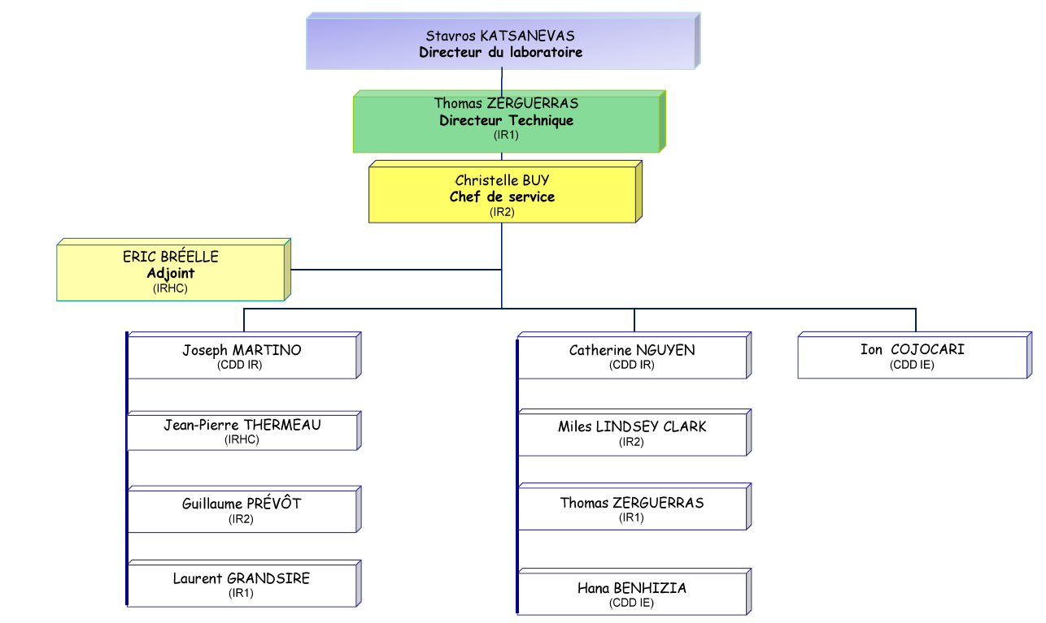
Instrumentation Department : Organisation
7 permanent, 4 fixed-term
IR with PhD: 4
Total : 11
Fixed term/Total: 36%
LISA, TARANIS
AdvVIRGO (PM),
LISA
TARANIS
LPF,
LISA
LISA
QUBIC,
IN2P3 Valorization
TARANIS (PM), KM3NeT (PM)
EUSO (PM),
Rad. protection
QUBIC (PM),
Cleanroom
IGOSAT (PM)
2012-2016: 10 departures, 11 arrivals
May 2017: end of fixed-term IE hiring
contract (QUBIC, EUCLID)
2017: 2 permanent CNRS/IN2P3 positions opened
(Instrumentation IE, System IR)

Slide 11
Instrumentation Department: Skills
Optics and interferometry
System engineering
AIT/AIV
Vacuum and cryogeny
Bolometer
Photodetection and spectroscopy
Simulations (Zemax, Fred, Matlab …)
Test benches design for detector characterization
Data acquisition (ex: Labview)
Data analysis (ex: Matlab)
Spatial and QA background (environment qualifications …)
Cleanroom
Project management

Slide 12
Instrumentation Department: AdvVIRGO and post-AdvVIRGO R&D
Telescopes for Advanced Virgo (2011-2015):
Adapting beam size from a few mm (laser bench) to 5 cm in cavities (and vice-versa)
Workpackages:
Optical simulations and design
Validation tests in the APC cleanroom
Definition of alignment procedures
Installation of 5 telescopes on site.
GW detection in coincidence with LIGO (August 2017)
Laguerre-Gauss modes
MAJOR EVENTS:
Production of higher-order LG modes : PRL 2010
Interferometry : first lock (2014)
Thermal compensation of aberrations : PRD 2015
Prospects:
Einstein Telescope: Third generation GW detector
(underground, cryogenic, …) : LG modes integration
Contribution: Mechanics Dpt

Slide 13
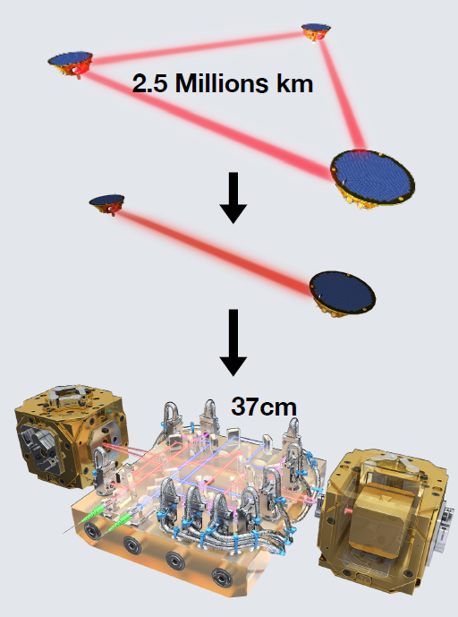
Instrumentation Department: LISAPathfinder
Successfully launched on 03/12/2015 (end : July 2017)
Validation of the technology for LISA:
measurement of the distance between two free-falling test masses by laser heterodyne interferometry
Major contribution of the APC to data analysis and interpretation (µ-thrusters, deglitch …)
Interferometer noise performances one order of magnitude better than LPF requirements
LISA selected as ESA L3 mission (launch: 2034)

Slide 14
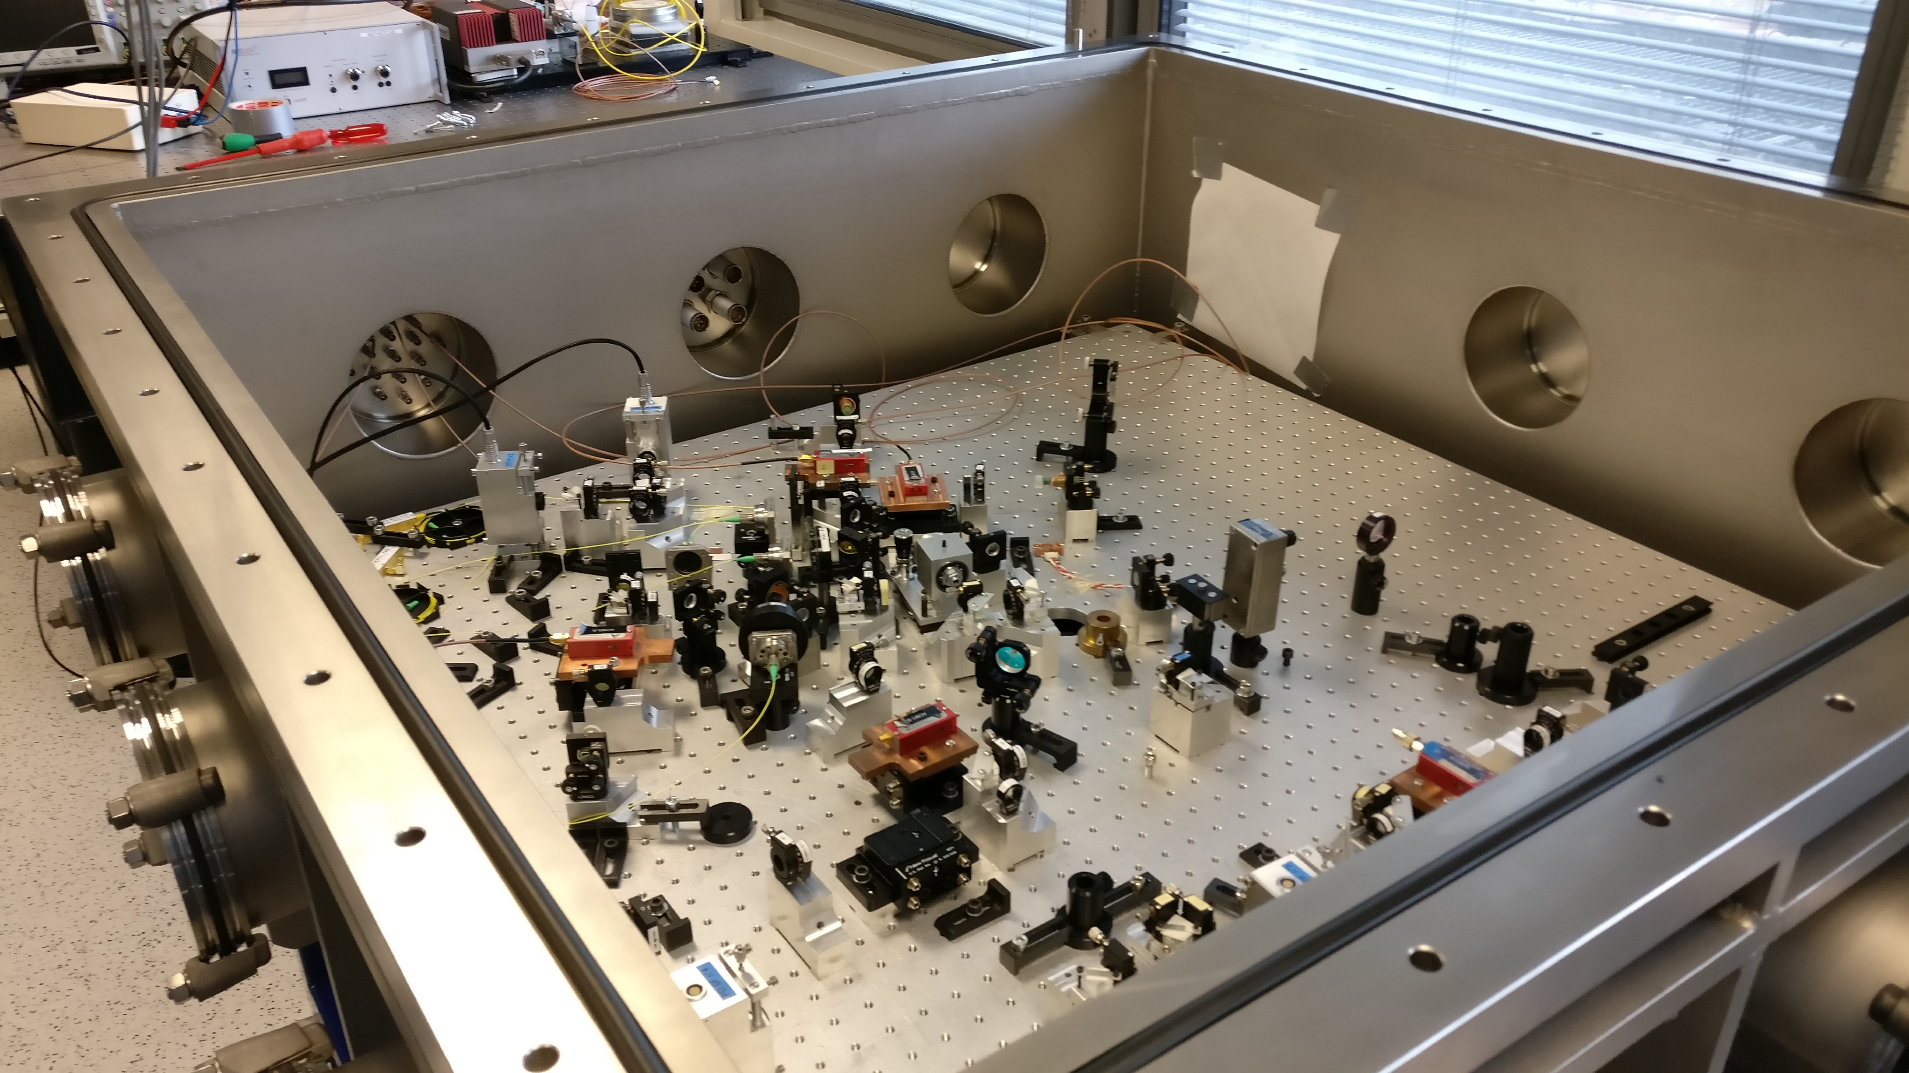
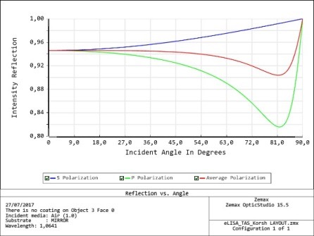
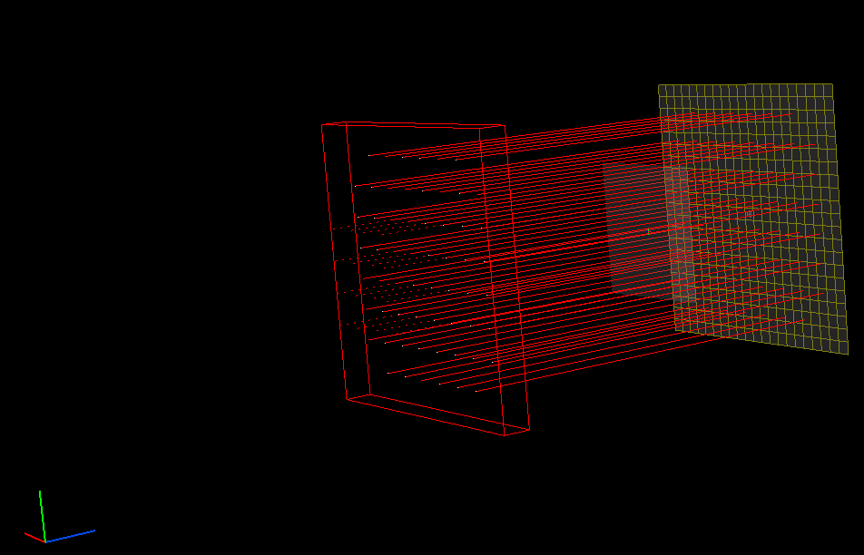
Instrumentation Department: LISA
AIT/AIV Phase 0 CNES and ESA
Straylight studies
Simulations to estimate the scattered light
from LISA telescopes:
Specifications on surface properties with
micro-roughness models ; cleanliness
Polarization of scattered lights
Funding: ESA ITT (collab: Thalès Alenia, APC,
ARTEMIS, LMA)
LISA On Table (LOT)
Hardware simulator of LISA to test in a
representative acquisition chain:
Noise reduction techniques
Instruments (photometers, phasemeter)
1st TDI (tested)
Preparation for vacuum operations (10⁻¹mbar)
Funding: R&T CNES

Slide 15
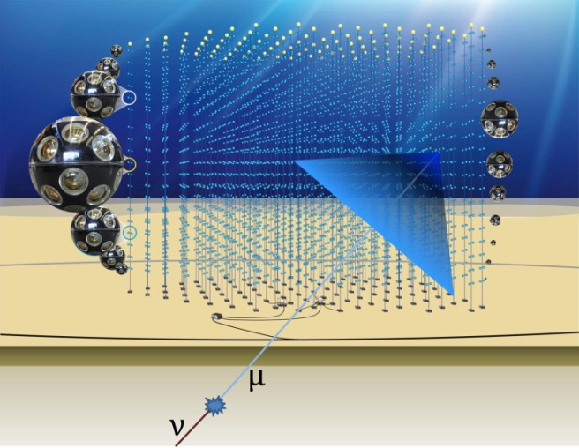
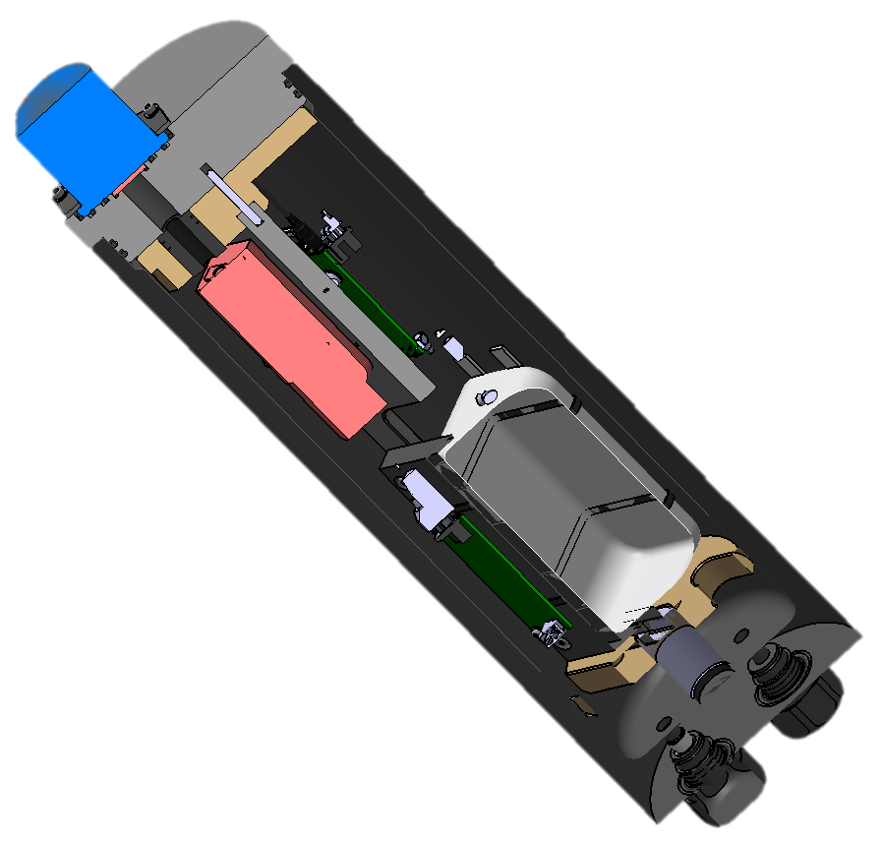
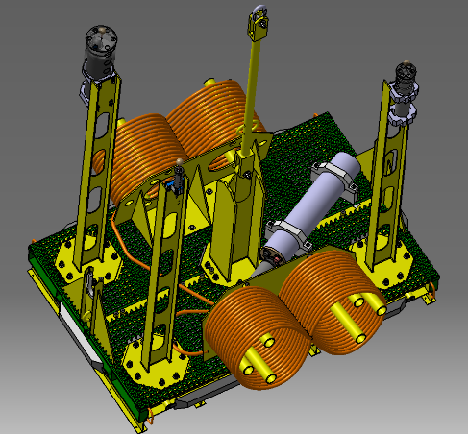
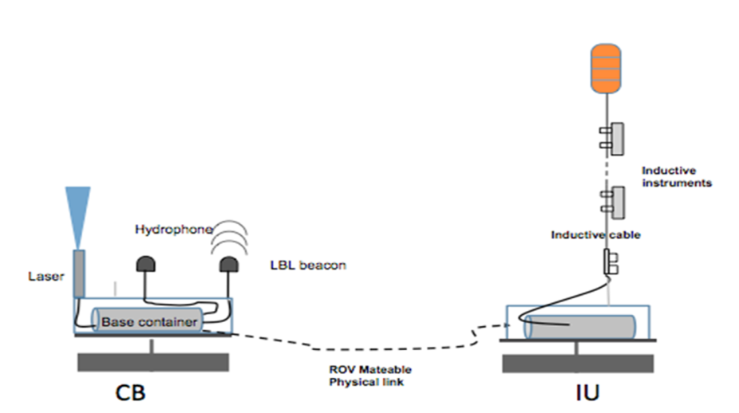
Instrumentation Department: KM3NeT
Project started @ APC in 2014
APC in charge of (CB+IU) project management
Design, integration, characterization and qualification of a new generation Laser Beacon for time calibration
Design, integration and deployment of a calibration unit for the KM3NeT ORCA detector
Collaboration with the CPPM (Marseille, France)
in charge of the instrumentation line
Funding FEDER + CNRS/IN2P3: 400 k€ (CB + IU)
Starting operation : mid-2019
Calibration test bench for DOM
@ APC Memphyno tank
Contributions:
Mechanics Dpt
Electronics Dpt
QA/PA
Notes:
Re çus: laser, carte de contrôle laser, mise en œuvre banc de test au laboratoire photodétection en cours

Slide 16
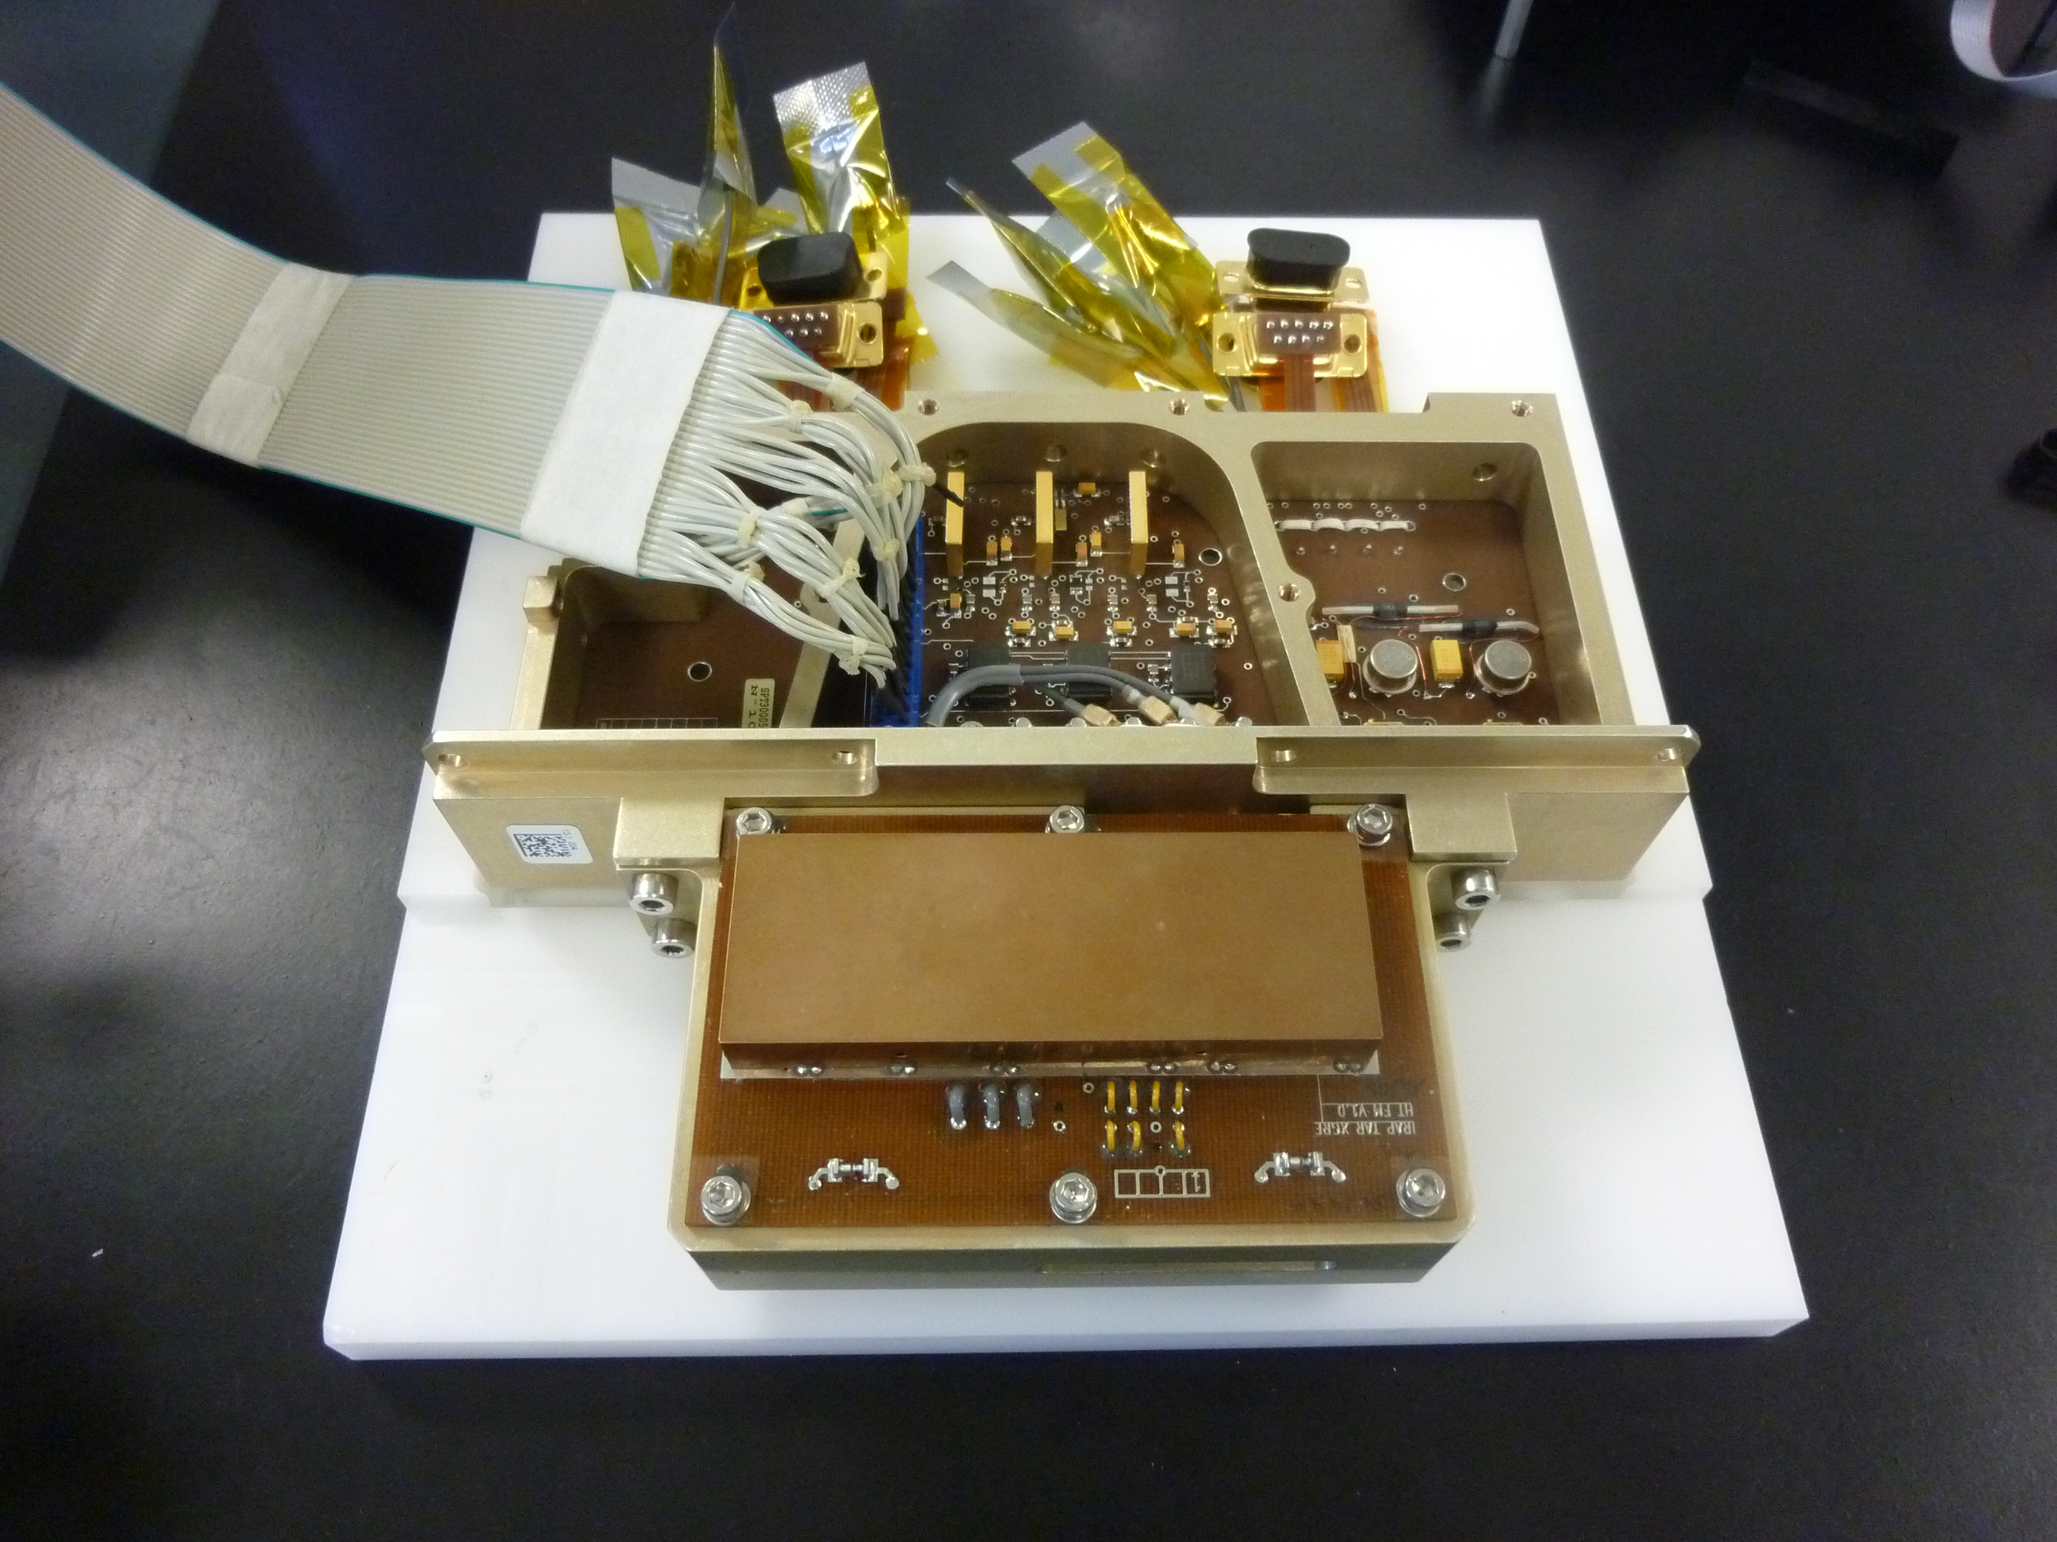
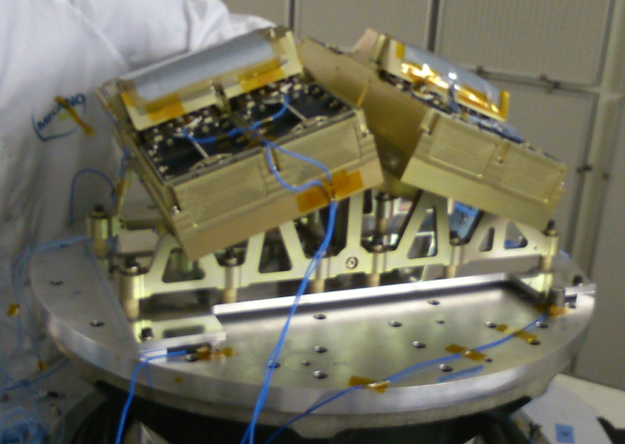
Instrumentation Department: TARANIS
CNES Microsatellite to study TLEs occuring during large storms
Design, production and validation of the XGRE
sensor (3 x 4 DU: LaBr3, plastic scintillators, PMT).
Instrumentation AIT/AIV (EGSE and MGSE
development, design and production of QM and FM,
environment tests implementation).
Production and validation of the XGRE QM sensors
(vibration and thermal vacuum tests) completed (August 2015)
Production and validation of the XGRE FM sensors
SM2 qualifications @ CNES (February 2016)
AIT FM sensors & vibration qualif. tests (March 2016)
Shock qualif. tests (April 2016)
Anomaly detected on LaBr3 (loss of performances)
-> Production process upgrade by St Gobain
-> June 2017: delivery of new LaBr3
(12 FM DUs + 4 QM DUs)
-> July 2018: delivery of FM DUs
-> End 2018- mid 2019: AIT on satellite and calibration
Contributions:
Mechanics Dpt
QA/PA
Electronics Dpt
NEXEYA (QA/PA and AIT/AIV)

Slide 17
Instrumentation Department: EUSO
Towards UHECR detection from space using UV light
Major facts / key milestones achieved
2012-2014: successful flight of the EUSO-Balloon mission
(12 countries, funding CNES+ Collaboration = 1,7 M€)
Project management + integration & calibration focal surf @ APC
→ Congratulations from CNES for the scientific return + funding for a second flight
Test campaigns in collaboration with the Telescope Array collaboration (USA+Japan) and in Turlab (Torino)
→ First UHECR detection using JEM-EUSO prototype
Funding from Europe (EuHIT), Campus Spatial (Paris Diderot) and CNES for second flight (Total for APC and LAL: 225 k€)
April 2017: EUSO-SPB (long duration balloon flight) by NASA :
Design, integration and calibration of the detector @ APC
Upcoming milestones
Dec. 2018: launch of the mini-EUSO mission towards ISS
Design, integration and calibration of PDM and HV system @ APC
Contributions:
Mechanics Dpt
Electronics Dpt
QA/PA
April 2020 : Second SPB flight, POEMMA prototype, selected
as NASA Probe studies program in 2017

Slide 18
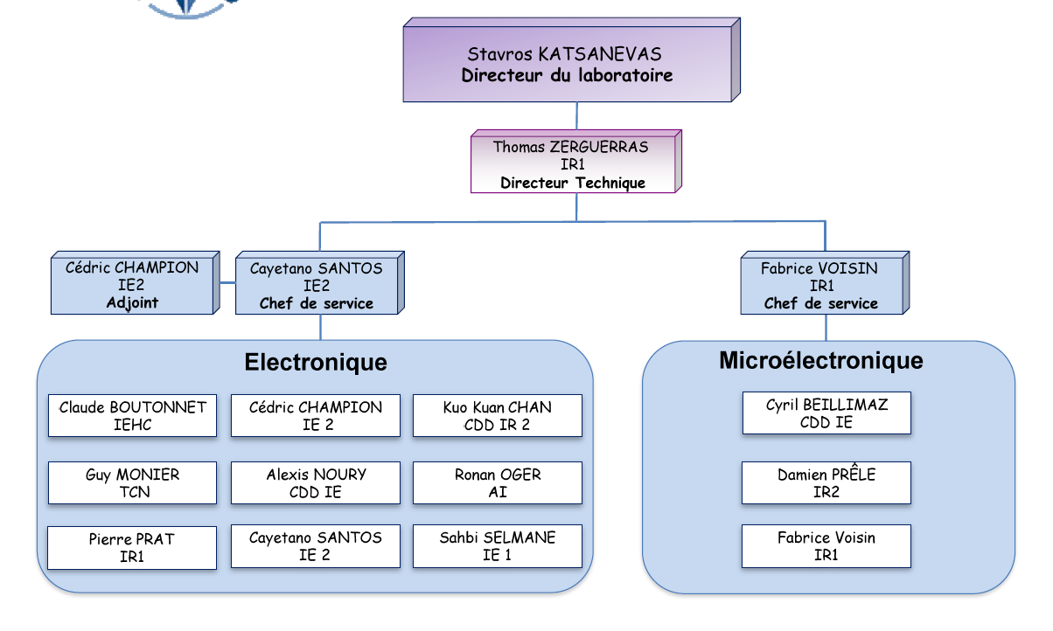
Electronics and Microelectronics Department : Organisation
Electronics:
7 permanent
2 fixed term
Total: 9
Fixed term/Total: 22 %
Microelectronics
(creation in 2016)
2 permanent
1 fixed term
IR with PhD: 2
Total: 3
Fixed term/Total: 33%
CTA, KM3NeT
CTA (PM), KM3NeT
ATHENA, TARANIS
ATHENA
Multi projects
TARANIS, JUNO, WA105
CTA, R&T Compton
ATHENA (PM),
GAMMACUBE
QUBIC
ATHENA,
QUBIC
LISA, LPF
JUNO (PM), LISA,
WA105 (PM)
EUSO, HSD
Electronics Dpt:
2 retirements in the next 5 years
End of the 2 fixed-term hiring contracts (31/12/2017 and 04/09/2018)
Microelectronics Dpt:
End of the fixed-term IE hiring contract in 2018
Need of a 3rd permanent IR

Slide 19
Electronics and Microelectronics Department : Skills
Analog/Digital electronics
Cryogenic microelectronics
ASICs definition, design, characterization and integration
FPGA programming (ALTERA, XILINX …)
PCB design & integration (CADENCE)
Timing and clock distribution systems (White Rabbit)
Simulations: ASICs (VIRTUOSO), VHDL, PCB (ALLEGRO)
Tests and characterization (ex: OMEGA ROC ASICs)
Spatial and QA backgrounds (RadHard qualifications …)
Project management

Slide 20
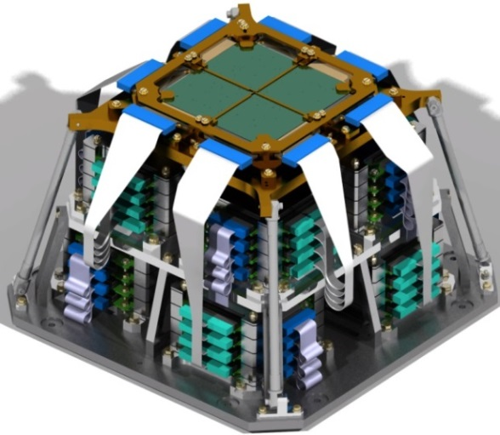
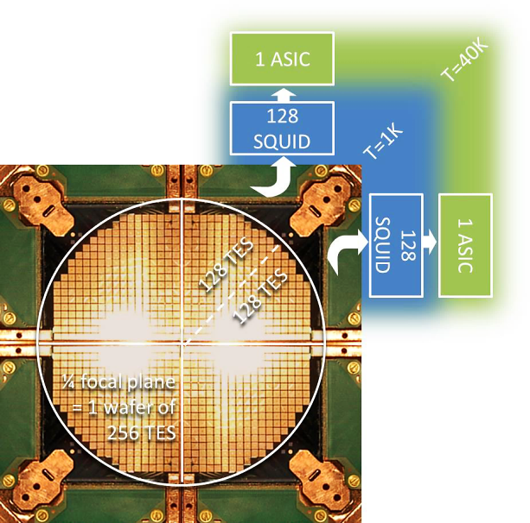
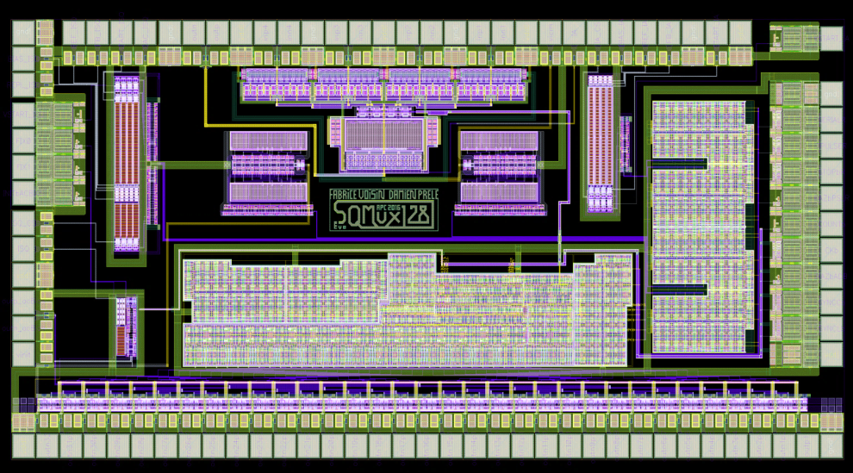
Microelectronics Department: QUBIC
Focal plane:
4 wafers made of 256 TES @300mK each
128 SQUID @ 1K + 1 ASIC @ 40 K for ⅛ focal plane
Readout: time multiplexing
SQMUX128 v2:
ASIC Cryo. AMS BiCMOS SiGe 0,35µm standard
Summer 2015: Integration and validation of ¼ focal plane @ APC
15/06/2016: ASIC v2 delivered - Successfull test in the dilution-free cryostat
September 2016: Starting QUBIC demonstrator integration (2x 1/4 focal planes, 512 channels)
Includes: LNA with multiplexed inputs (1:4)
Multiplexed current supply (1:32) for SQUIDs bias
Digital circuit for addressing and serial link
Contributions:
Mechanics Dpt
Instrumentation Dpt

Slide 21
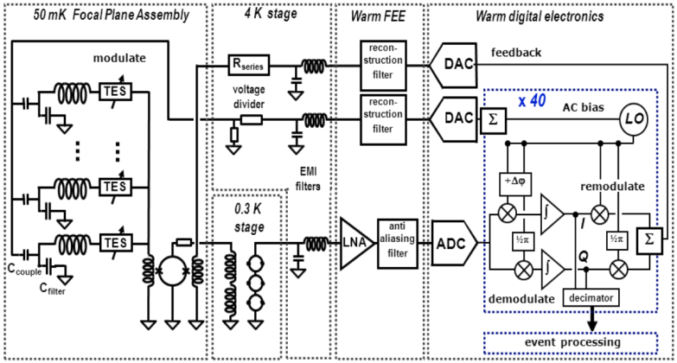
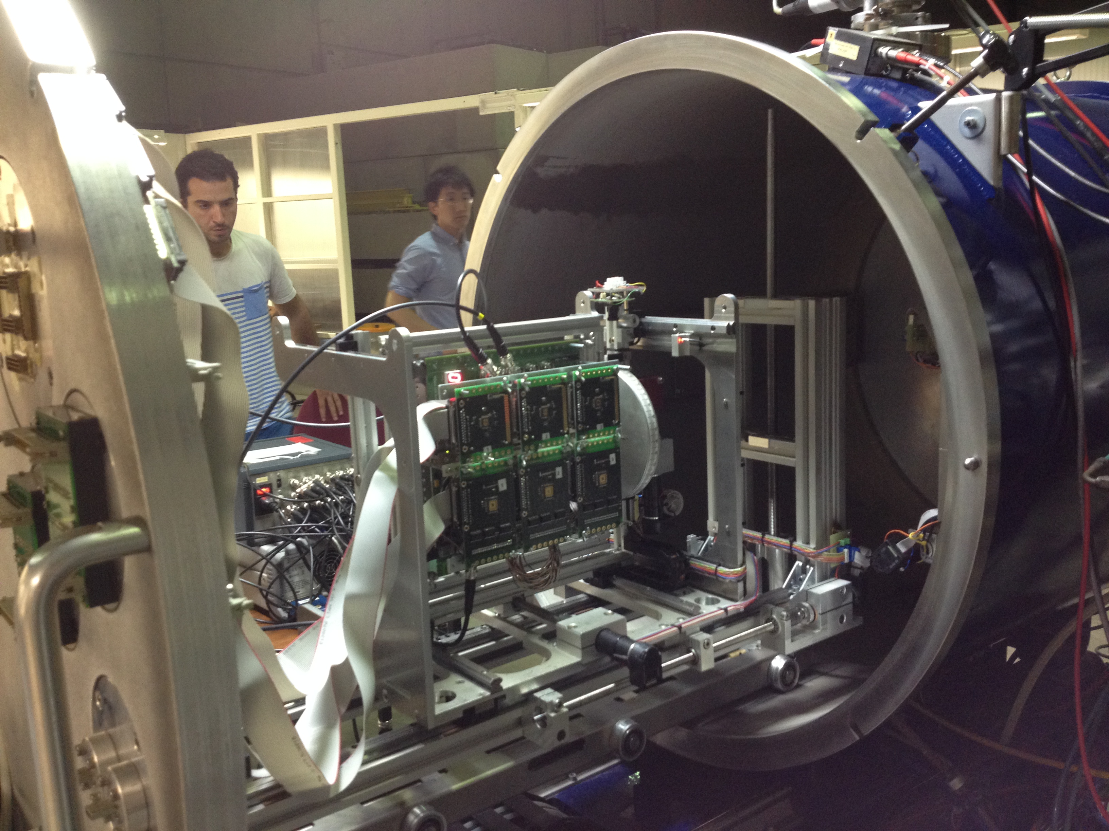
Microelectronics Department: ATHENA
Warm Front-End Electronic (FEE) for the X-IFU instrument
96 LNA (100V/V, 1-6MHz, 1nV/√Hz)
SQUIDs biasing
Bias regulation, HK, SQUID deflux
Box for cryostat + EMI filters
Phase A:
2015- 2019
ASIC production
+ RadHard qualif.
EGSE test benches
Mechanics integration
awaXe_v1:
ASIC AMS BiCMOS SiGe 0,35µm
Goals:
Test and characterization of several architectures
Validation of Rad Hard digital libraries
awaXe_v1 delivered on 01/08/2016.
Successful RadHard test campaign @ Cocase (high-intensity 60Co source) and latch-up tests @ Louvain-la-Neuve (heavy ions)
ASIC v2 in preparation

Slide 22
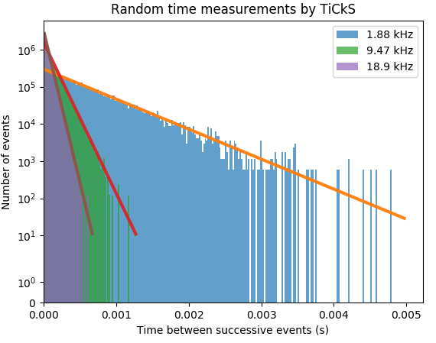
Electronics Department: TiCkS board for CTA
TiCkS board (Time and Clock Stamping) based on the White Rabbit (WR) SPEC node:
Providing ns-precision Time Stamps (TS) of input signals
Transmission of these TSs to a central collection point for use in any CTA camera
Modification in the Spartan-6 FPGA :
Addition of a 1ns precision TDC for the TSs (collab. CEA/IRFU)
UDP stack :
send TSs on WR fiber (No loss up to 320kHz @ fixed frequency )
Receive config & slow control commands on the same fiber
Send PPS and event counter
2 versions :
TiCkS –UCTS (FMC) soon available in the WR Open Hardware repository
TiCkS-CTA (2xRJ45)
C. Champion et al., Proc. ICALEPCS2017, Barcelona, Spain October 8-13 2017 (accepted)
2xRJ45
Clock
TS
Equivalent Dead time < 1ns
Next:
TiCkS on NectarCAM test bench: end of 2017
Network of 8 TiCkS: end Q1 2018
Contribution: QA/PA
12/06/2017
EAOM 2017
22

Slide 23
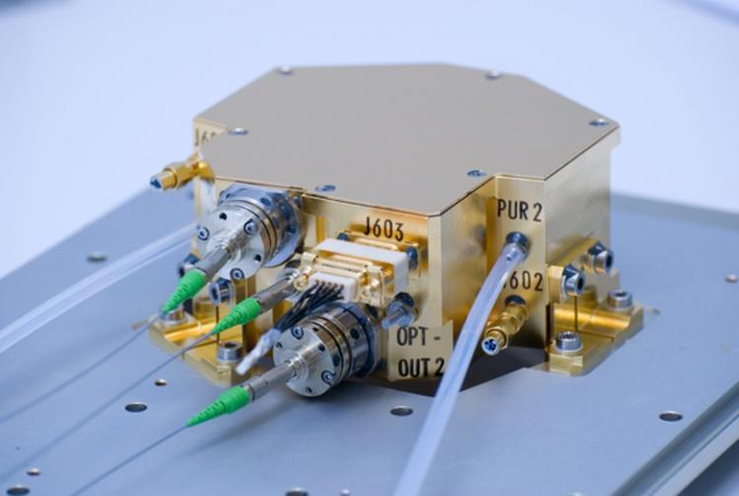
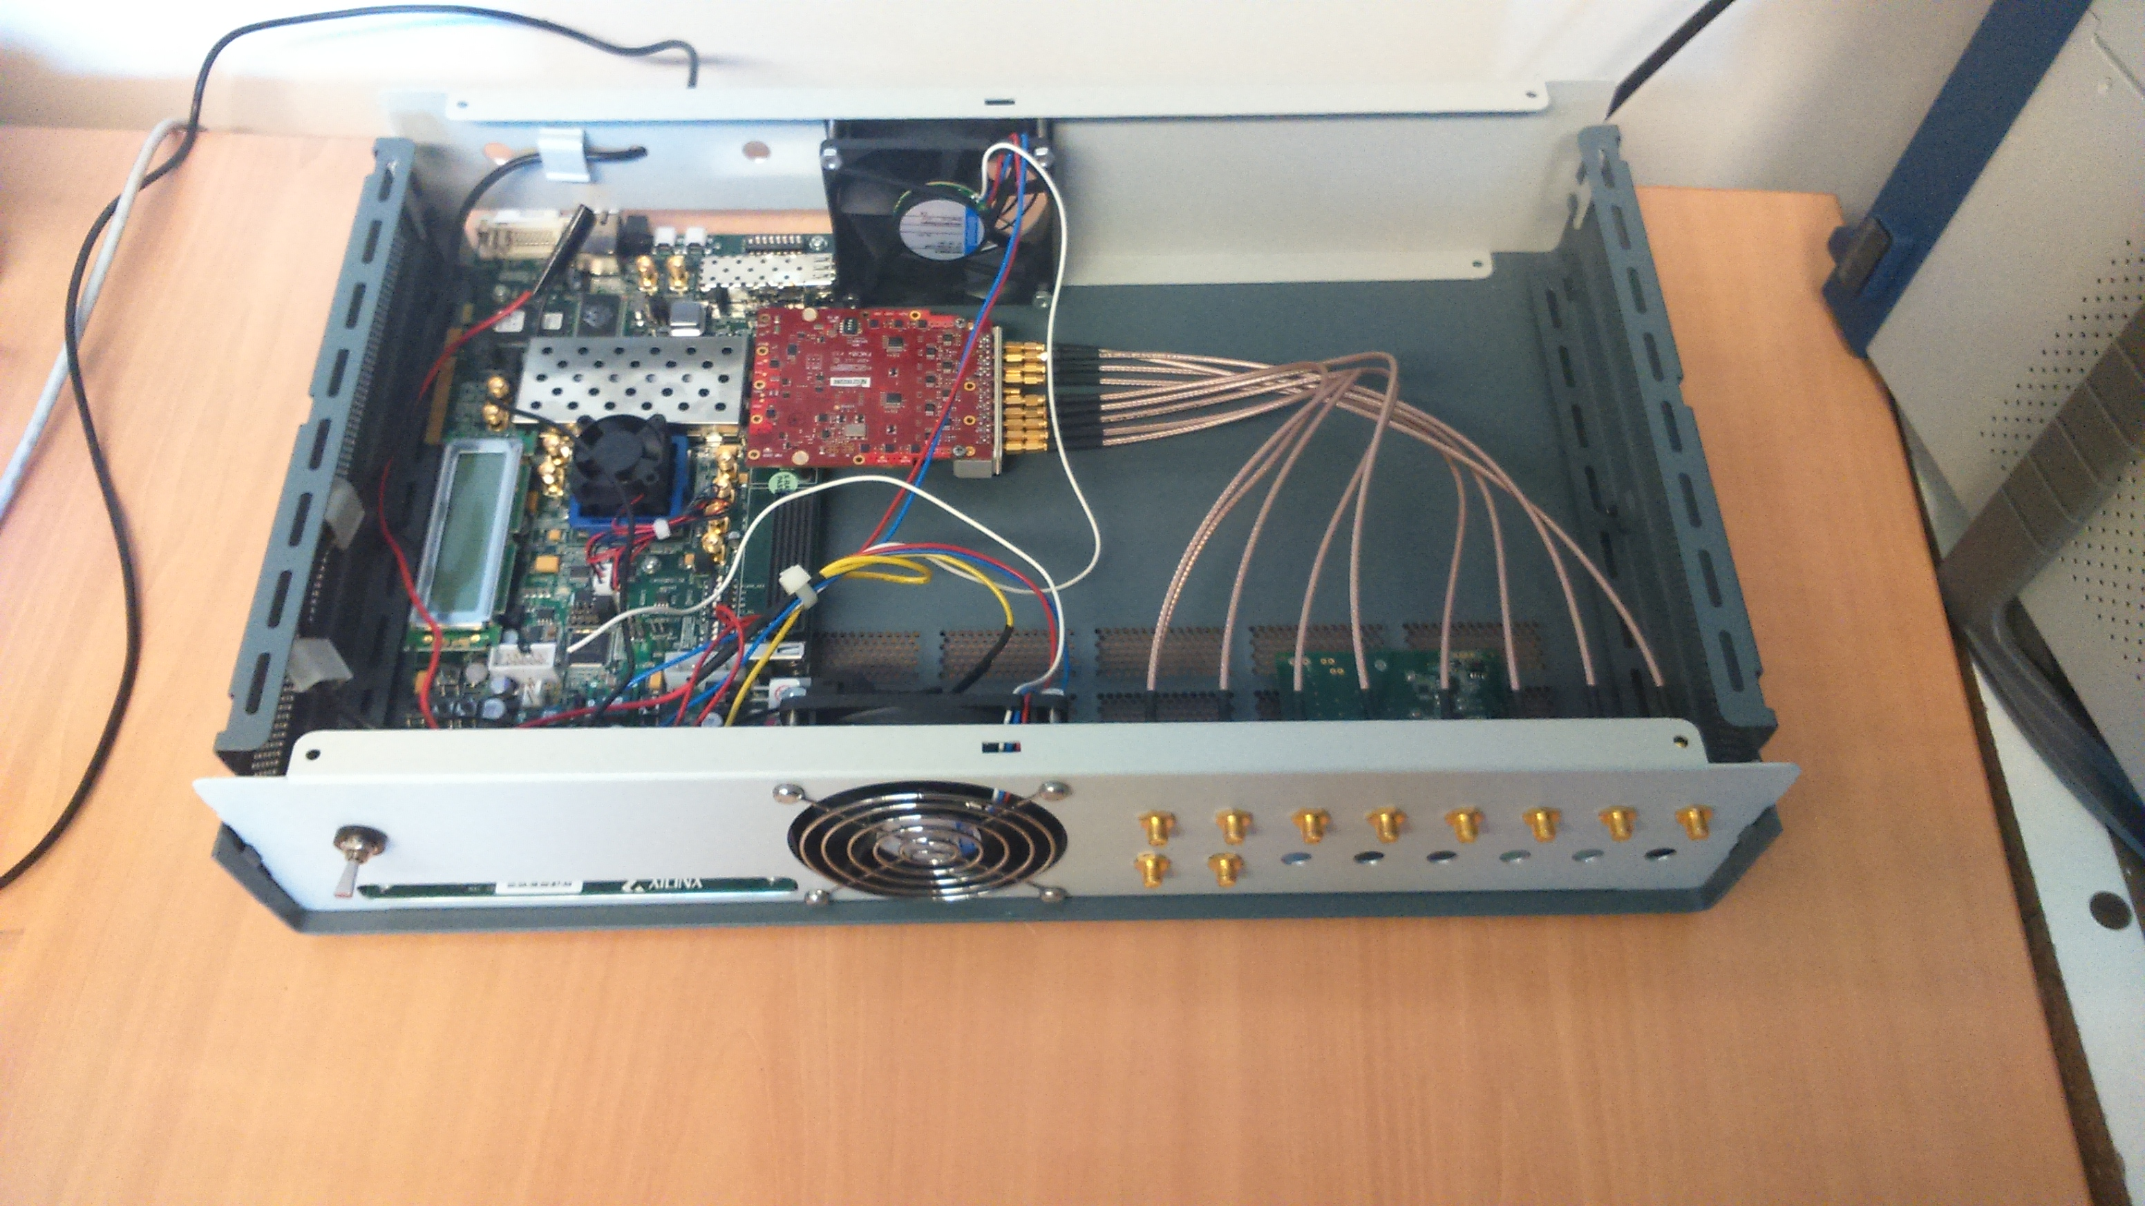
Electronics Department: LISAPathfinder and LISA
LISAPathfinder: LASER MODULATOR: beam splitter + 2 AOM + actuators
Validation of test procedures with the manufacturer
Monitoring during the mission
LISA R&T: Electronics development for the LISA On Table simulator
Servo electronics for laser amplitude and optical paths stabilization
Implementation and modification of a phasemeter developed at the AEI Hannover
building hardware for RF electronics
and DDS kits
external clock synchro + jitter correction
Upgrade to 14 bits @200MHz sampling
Low frequency noise measurements on
RF components and voltage references
REFIMEVE: Ultra-low phase noise sinusoidal signals synthesizer synchronized on the REFIMEVE
signals under development (Goals: LOT upgrade, LISA phasemeter characterization)

Slide 24
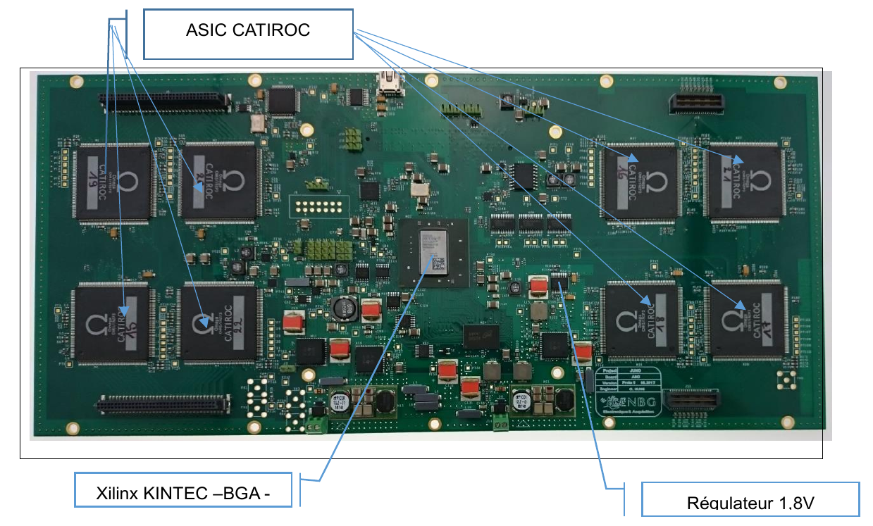
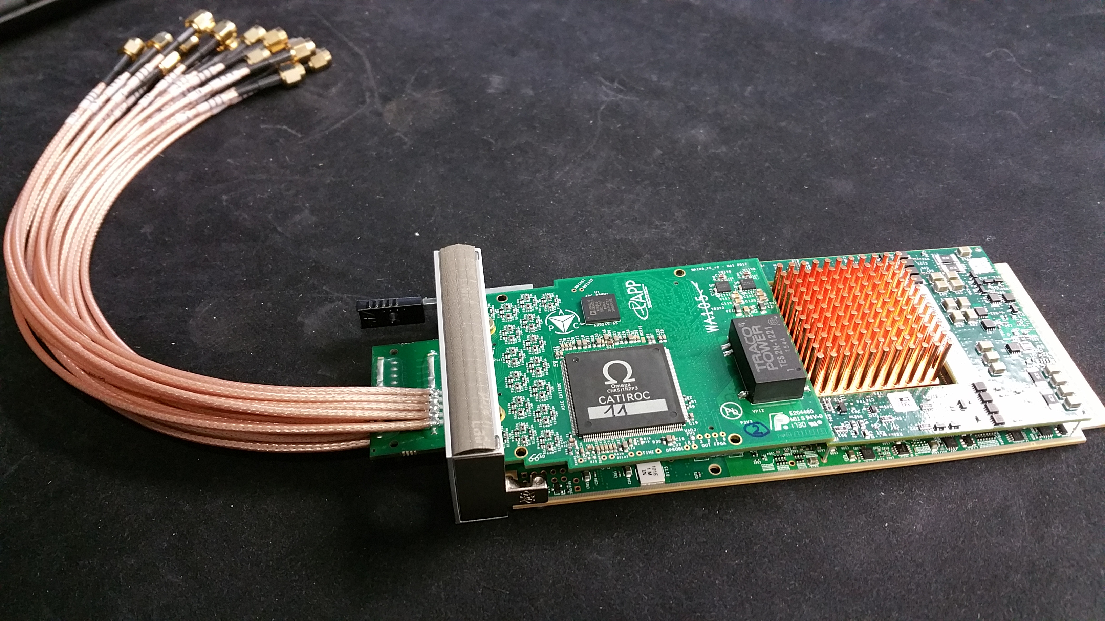
Electronics Department: Electronics readout for large PMTs assemblies
Card design, firmware and data acquisition
JUNO @ APC
Joint effort with CENBG and OMEGA – 1st version Mezzanine
128 channels
8x CATIROC ASICs
Kindex 7 FPGA
FMC connector
WA105 @ APC
Collaboration with IPNL, LAPP
and OMEGA
16 channels
1x CATIROC ASICs
65 Msps ADC
µTCA AMC
FMC connector

Slide 25
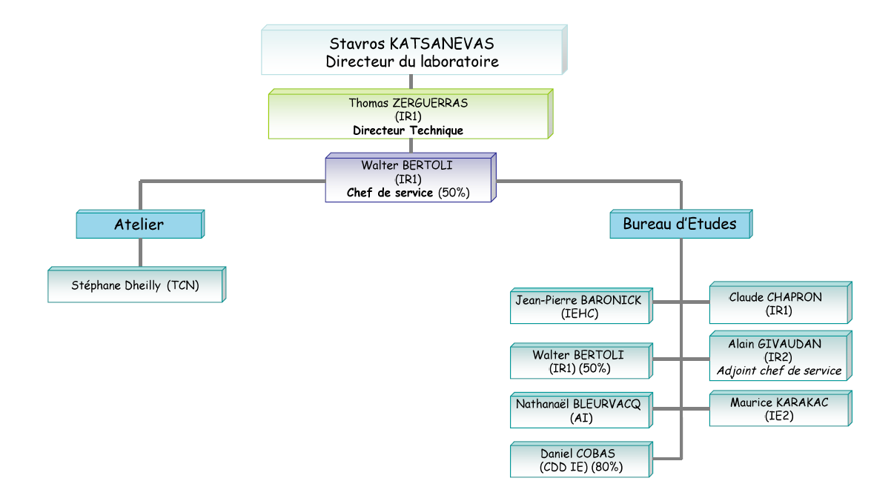
Mechanics Department: Organisation
7 permanent
1 fixed-term
Total: 8
Fixed Term/Total: 12,5%
AdvVIRGO
TARANIS,
ATHENA
QUBIC, SVOM
Multi-projects
Double Chooz
SVOM,
R&T Compton (PM)
Double
Chooz,
IGOSAT,
SVOM (PM)
Workshop
2018: 1 IE fixed-term contract
to extend
1 IE retirement in the next 5 years
AdvVIRGO,
EUCLID
EUSO, QUBIC
Double Chooz
SVOM
KM3NeT
Engineering office
2016: 1 permanent CNRS/IN2P3 IE hired

Slide 26
Mechanics Department: Skills
Mechanical design in specific environment (space, undersea, vacuum, cryogeny, high-level cleanliness)
CAD (CATIA)
Finite-element analysis (transition from Samcef to ANSYS): isotrope materials, mechanics, thermal management
Dimensionnal metrology (mechanics) + programmation
Spatial and QA background (environment qualifications …)
Project management, call of tenders for public contracts
Subcontracting monitoring
Workshop: CNC machine 2,5 axes (drilling)/assembly,
numerically controlled machining center.

Slide 27
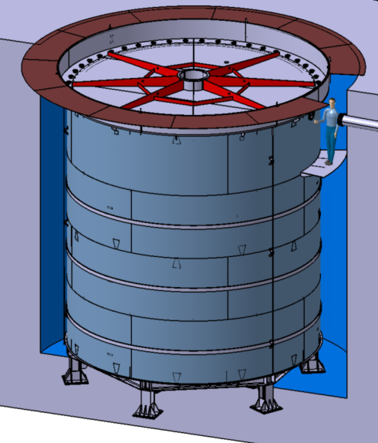
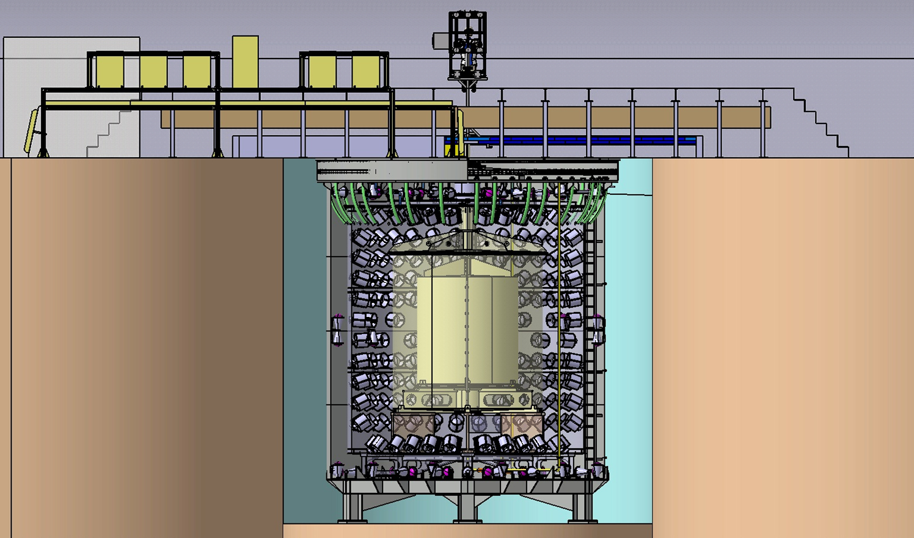
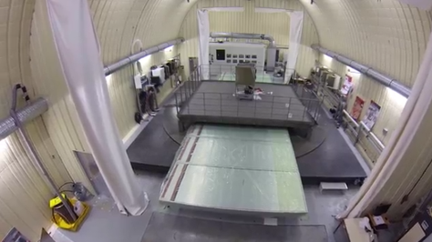
Mechanics Department: Double Chooz
Far Detector: Design, production and installation (2011)
Near Detector: Design, production and installation (2012-2014)
Shielding: 1m water (except steel on top)
Stainless steel tank on steel supports (outer vessel)
Support stiffness strenghtened to prevent any deflection > 1mm of
the bottom (45 tons thrust load)
Upper shielding (steel), platform and electronic hut
7.4 m
Electronic Hut
Plateform
Upper
Shielding

Slide 28
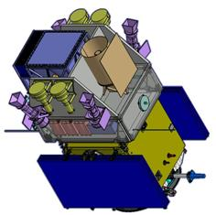
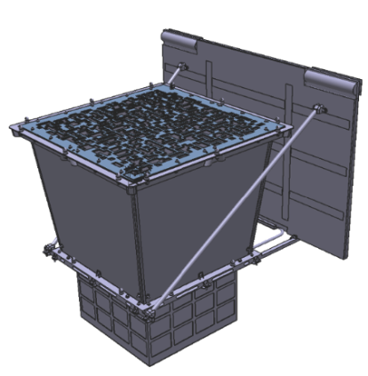
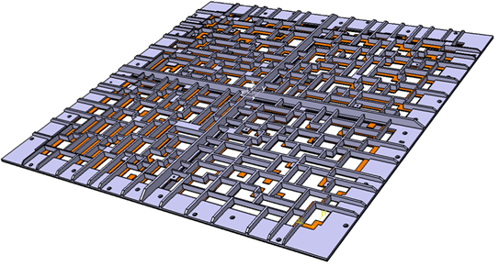
Mechanics Department: SVOM
French-Chinese Space Mission for detection of X and gamma bursts with a
4 keV threshold
APC workpackage: Design, production, test and validation of the
coded mask for the ECLAIRs instrument:
Pattern area 540x540mm² , 40% transparency, self-supporting mask
Initial design : pre-tensed foil made of allied Tantalum 0.6mm thick (4000 random holes)
CNES review (B phase) : September 2016
Currently: Phase C
Current design: new pattern with enlarged holes
→ sandwich Ti/Ta/Ti 33.6mm thick
Production of SM for further vibration test: End 2017
Structural Thermo Model delivery : May 2018
FM Mask: 2019
Launch : 2021

Slide 29
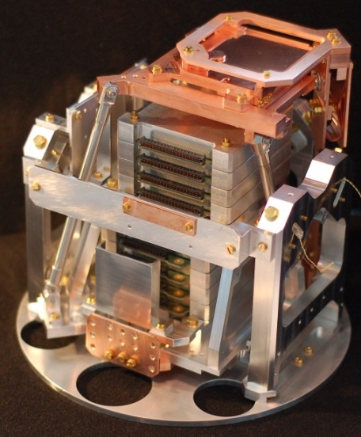
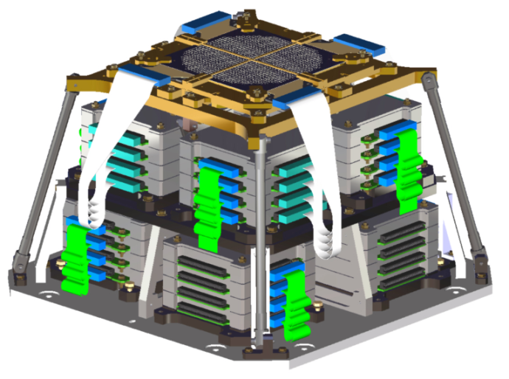
Mechanics Department: QUBIC
1.1m
APC mechanics workpackages :
Thermal & mech. design of focal plane towers
Therm. & mech. design of the instrument architecture inside vessel
Mech. design of the switches / R&D on horns manufacturing
Integration process of instrument inside vessel and tests
Technical challenges
Mass optimization
Keeping optics alignment when
instrument is cooled
EMC optimization
Many interfaces
Integration
Instrument mechanical.
architecture
Focal plane tower
Milestones:
Technical Demonstrator
design finalized
Production plan finalized
Production : laboratories for
small components (GEPI, LAL,
APC), subcontracting for the biggest
¼ Focal plane prototype
Contributions:
Microelectronics
Instrumentation

Slide 30
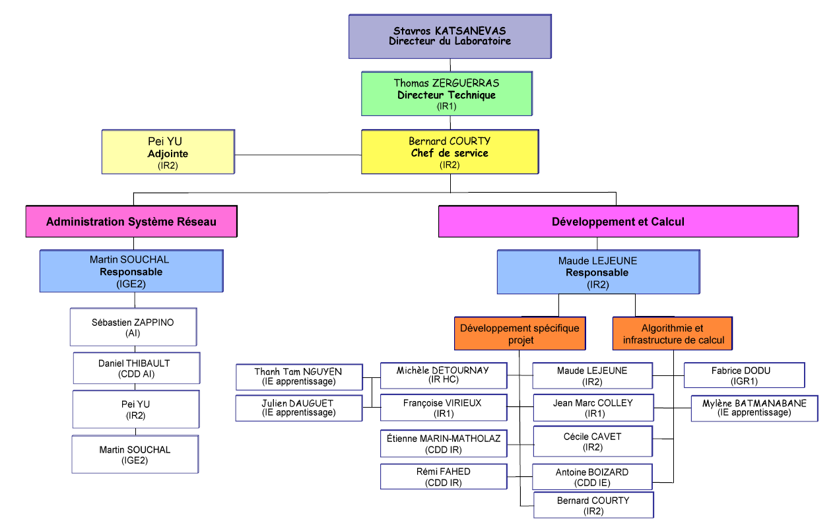
IT Department : Organisation
2 subdepartments:
Networks and systems administration
Development and calculation
Networks & systems
administration:
3 permanents
1 fixed-term
Total: 4
Fixed term/Total: 25%
Subcritical size
Development
& calculation:
7 permanent
3 fixed-term +
3 apprentice
IR with PhD: 3
Total: 13
(FT+Appr.)/Total: 46%
High ratio of
non-permanent members of staff
2016: 1 permanent IR hired
2018: Opening of a software engineering IR permanent position (LSST, LISA)

Slide 31
IT Department: Skills
Network & System Administration : network, storage, Unix account, databases,
identification system
Support: material (hard & soft) and users
APC Website management (Drupal)
Infrastructures for calculation and projects: parallel calculation cluster (~ 800 CPU),
APC cluster (~ 600 CPU), collaborative platforms, EGEE grid, cloud computing
(OpenStack) and Big-Data (Hadoop cluster)
Control & command, real-time: architecture of distributed applications, control and
monitoring of mechanical components (motor, presence detector, lock …), data
acquisition (PXI and USB bus), multi-threading and multi-processing architecture
Data analysis: data analysis chain development (ex: CMB cards), parallel and distributed
programming in shared distributed memory
Simulations: processes in astrophysics (plasma jets from black holes, accretion disk),
HPC, instrumental data (ex: EUCLID telescope)

Slide 32
IT Department: CTA PHP
Generalities : a web interface to manage proposals for scientific observations
Preparation
Submission
Evaluation
Follow-up
Admin
Planning
2015- Mid-2016: demonstrator dev. phase
Mid-2016- Mid-2018: Implementation
Mid- 2018: operationnal demonstrator version for the consortium
Mid-2020: First release to the observatory
Technical Team
Developper engineer: TT. Nguyen, J J. Dauguet
Project manager: M. Detournay

Slide 33
IT Department: LSST
JAVA development framework for the CCS camera: Monitoring and managing communications between subsystems (filters change, shutter, cooling, power supply management) and information flux between databases. Concept proposed by the APC laboratory and selected by the collaboration
FCS subsystem (filter changer) Control/Command: 6 filters
(motion control, exchange, positionning).
Critical (1 filter = 700k€)
Successfull reviews: Director NSF-DOE JSR (2016),
RSP IN2P3 (2017), FCS MRR (2017)
Scale 1 prototype under construction @ LPSC, CPPM and LPNHE
F. Virieux (PM), E. Marin-Matholaz

Slide 34
IT Department: DPC LISA
France in charge of the Data Processing Centre (DPC) :
CNES phase 0 : load peaks management
=> hybrid cluster (continuous load) / cloud (peak) system.
R&T CNES/ATOS : Docker containerization of applications
Objective: provide hardware and software tools to the consortium to host and process
LISA data analysis.
Context: APC + CNES leadership, relatively small data volume (1Tb/year) but some
processing tasks are CPU demanding
-> use distributed/on-demand CPU (~ 5000 cores/center, ~ 3 centers,
including the main French center)
-> develop luggable tools and services (virtualization, containers)
Ongoing activites: 1) APC provides the proto-DPC (continuous
Integration) + (due to end 2017) proto-database expected for the next
data challenge.
2) CNES, APC and the LISA consortium write the definition document
and specify workpackages.
M. Le Jeune, C. Cavet, E. Marin-Matholaz, M. Batmanabane

Slide 35
IT Department: EUCLID
Ground Segment : phase C2
CODEEN :
Continuous integration platform for software development
Administration and user support, migration on the OpenStack@CC-IN2P3 cloud in 2017
EXT/SIM :
Ground observatories data integration
Development of simulator and data analysis pipeline (démarrage EXT-generic starts in 2017, EXT-LSST in 2018 if Euclid/LSST
agreement)
SDC France scientific coordination (CC-IN2P3) :
Interface between the IN2P3 et the EUCLID project
Production infrastructure sizing and ressources allocation
C. Cavet (PM), A. Boizard, J.M. Colley, M. Detournay, R. Fahed, M. Le Jeune, M. Souchal

Slide 36
IT Department: Data analysis & Computing
Map-making for CMB data analysis
How to keep refined data analysis when
data volume is exploding ?
Number of detectors :
Polarbear I: 1200 -> Polarbear II: 7500
-> SIMONS array (2018): 22000
Size =n_t (10⁹) x n_pix (10⁷)
Unbiased mapmaking (iterative) to get full
map recovery at optimized CPU cost
High Performance Computing
Studies of disk instabilities around
black hole accretion disk
Support : FACe (7 nodes bought
by the HPC project team), CINES
Scientific library compilation,
optimization, installation
Visualization for very big data :
a new challenge
F. Dodu
M. Le Jeune

Slide 37
Quality Unit: Organization
3 permanent
1 apprentice
IR with PhD: 1
Total: 4 +
1 ext. consultant
CQAP
Corinne JUFFROY (IR1)
Quality Manager
Management
Quality Project
CNRS Quality in Research Network Steering Committee
IN2P3 and INSU Quality Networks
Stéphane COLONGES (IR2)
Product Assurance
Catherine HUGON (IE2)
Information Systems
Sebastien GAUCHERY
Apprentice Engineer
Ghania MEDJDOUB
Nexeya Consulting
Product Assurance
Electronics Product Assurance
Information
Systems
KM3Net
TARANIS
Valorisation Deputy
GTR FIDES
CNRS Electronics Network
Training Deputy
Démocrite Network
2012: 1 no-replaced IR departure
Multi-projects and transverse activities for the laboratory

Slide 38
Quality Unit:Skills
Quality Assurance Support:
Setting up quality and management procedures to continuously
improve scientist instruments produced by the laboratory
Includes:
Documentation management
Non-conformities management
Traceability process implementation
Control of assembly operations
Electronics Product Assurance:
Components qualification for commercial products or specific ASICs :
Radhard qualification process, studies of reliability and ITAR process for
space electronics components
Information and indicators management:
Electronics documentation management
Scientific bibliography
Database studies and development for laboratory management

Slide 39
Quality Unit: Involvement in projects
TARANIS
Quality Project + Electronic Product Assurance (the whole project)
Quality AIT/AIV
CTA / NectarCam
Reliability analysis of the MUTIN circuit Board and clock distribution.
RAMS activities for NectarCam : (RAMS = Reliability Availability Maintenability Safety)
KM3NeT
Reliability analysis of DOM (Digital Optic Module) and other subsystems
EUCLID
NISP sensor RadHard test campaigns for EUCLID focal plan
SVOM
Quality Project Documentation
ATHENA
Quality Project + RADHARD Qualification

Slide 40
Quality Unit: Achievements
Indicators Database Human Resources:
Information on Human Resources of the laboratory
for tutelage agencies, scientific and evaluation
committees
Project resources database:
Overview on human resources assigned to each
project for a better visibility
Production of indicators (statistics, charts, graphics)
Documentation:
Provision of documentation templates for
projects
Provision of an on-line documentation system
(ATRIUM) for centralisation and storage
Assistance to project reviews (CSP)
organisation and reports management
2012-2016: 37 internal reviews

Slide 41
Analysis & Prospects: Technical FTE

Slide 42
Analysis and prospects: Projects roadmap
 | Preparation |  |  | Projects |  |  | 2016 | 2017 | 2018 | 2019 | 2020 | 2021
 | Construction |  |  | Advanced VIRGO - Telescopes
 | Exploitation |  |  | ATHENA - WFEE
 | End |  |  | CTA - TiCkS
 |  |  |  | CTA - NECTARCAM- RAMS
 |  |  |  | CTA -GATE
 |  |  |  | CTA-PHP
 |  |  |  | COCOTE (R&T Compton)
 |  |  |  | DOUBLE CHOOZ
 |  |  |  | EUCLID-CODEEN
 |  |  |  | EUCLID-EXT
 |  |  |  | EUCLID-NISP Rad Hard
 |  |  |  | EUCLID-SIMULATIONS
 |  |  |  | mini-EUSO (ISS)
 |  |  |  | EUSO-SPB
 |  |  |  | EUSO-SPB 2
 |  |  |  | IGOSAT
 |  |  |  | JUNO - Electronics
 |  |  |  | KM3Net - Calibration Unit
 |  |  |  | LISA AIT/AIV
 |  |  |  | LISA-DPC
 |  |  |  | LISAPathfinder
 |  |  |  | LSST - CCS et FCS software
 |  |  |  | PLANCK
 |  |  |  | QUBIC- Demonstrator
 |  |  |  | QUBIC-FI
 |  |  |  | SVOM - ECLAIR coded mask
 |  |  |  | SVOM- Pipeline
 |  |  |  | TARANIS - XGRE
 |  |  |  | WA105 – Electronics
R&D Gammacube stopped in 2016

Slide 43
Analysis & Prospects: SWOT Analysis
Strengths | Weaknesses
Specific skills: optics, photodetection, cryogenic µelectronic, space AIT/AIV (mechanics & instrumentation), QA/PA, virtualization and cloud Skills in space and balloons projects managemement Recognition as a key actor in space projects by the CNES National and international visibility | Imbalance between projects needs and available technical HR High turn-over Risk of losing strategic skills (fixed-term contract, mobility, retirement …) Some permanent members of staff are the only ones with their skills (ex: optics, AIT/AIV, electronics PA, mechanics workshop technician) Strong commitment in projects limits involvement in generic R&D and general technologic surveys Logistics support reduced
Opportunities | Threats
Space and funding agencies, tutelage organisations, national and international collaborations calls of tender Long-term projects: EUCLID, CTA, KM3NeT, LSST, QUBIC, LISA, ATHENA … Multi-messenger astronomy rising | Financial cut from funding agencies and partners Time-consuming non-technical tasks increasing (ex: management, institutionnal consultancy, funding applications …) Specific skills difficult to find on the labor market Unfavorable change in tutelage agencies hiring policy More and more restrictive administrative regulating (ex: Sauvadet, GBCP)

Slide 44
A view for the future …
Technologies and skills:
ASICs for CMB instruments
Optics for on-ground and space GW detectors
Mechanical design and calculations in various environments (space, cryogeny, vacuum …)
AIT/AIV (on-ground, balloon and space projects)
Timing and clock distribution system (White Rabbit and beyond …)
Electronics readout for photodetection (partnership with the Omega Pole)
QA/PA (in particular Electronics PA)
Cloud and Big Data
Collaborative platforms for space projects
HPC and simulations (instruments, astrophysics …)
Long-term challenging technical projects in the frame of the
Multi-Messenger Astronomy:
Cosmo: EUCLID, LSST, QUBIC (demonstrator, FI ?), S4 (?), Litebird (?)
AHE: ATHENA, CTA, EUSO (?), SVOM
Neutrinos: KM3NeT, JUNO (?), WA105/DUNE (?)
Gravitation: AdvVIRGO and +, LISA
Lead a continuous effort to reach a balance between the technical
workforce and the scientific roadmap

Slide 45
Thank you for your attention !

