Slide 1
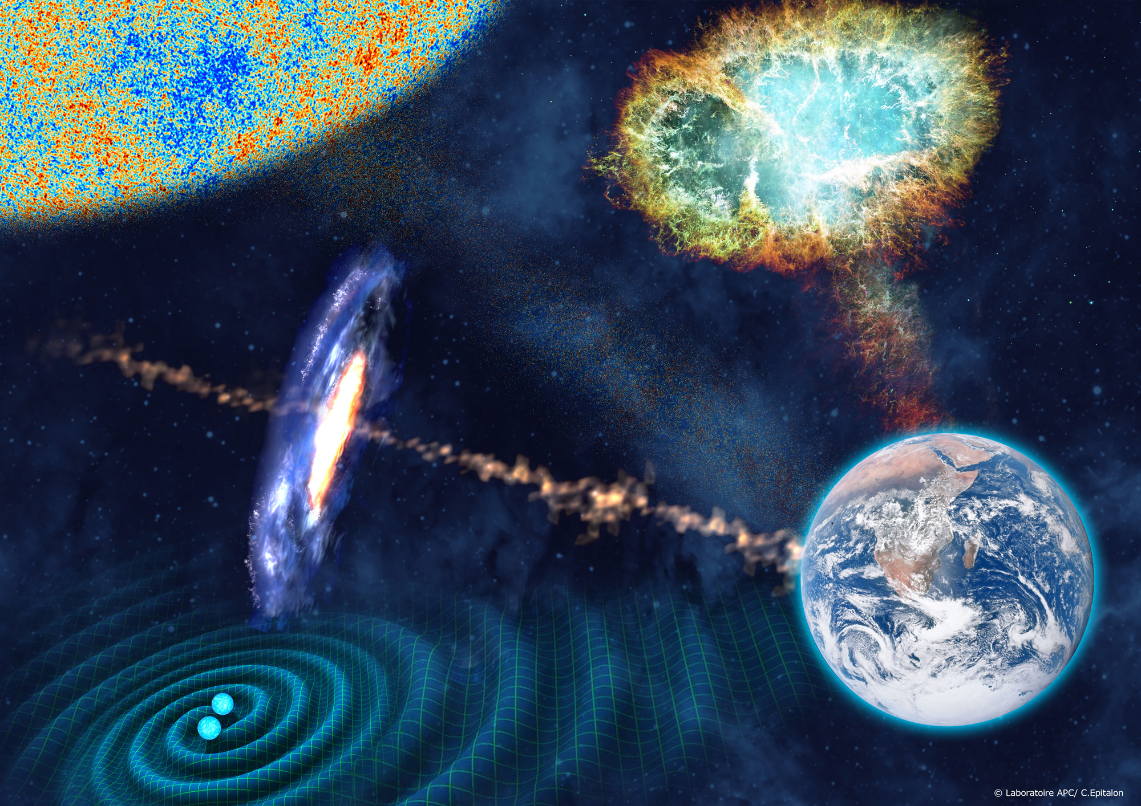
Laboratoire Astroparticule et Cosmologie (APC)
UMR 7164
IN2P3, Univ. Paris Diderot, CEA, Observatoire de Paris
Stavros Katsanevas
Created in 2005

Slide 2
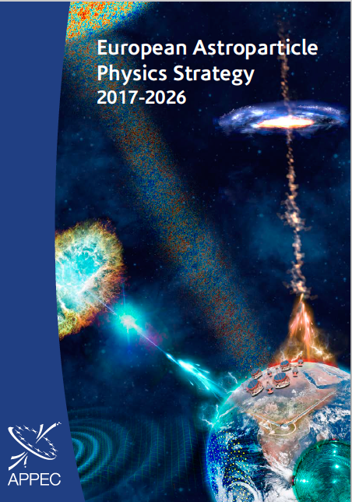
The two challenges of the present era for Astroparticle Physics and Cosmology
The Cosmic structures from the CMB to the present provides comparable constraints to the standard models of cosmology (inflation, dark energy) and particle physics (neutrino, dark matter?).
Multi-messenger astronomy involving photons of all frequencies, gravitational waves, neutrinos and high-energy charged particles provides a deeper understanding of violent phenomena regulating structure formation in the Universe as well as eventually hints for new laws of physics .

Slide 3
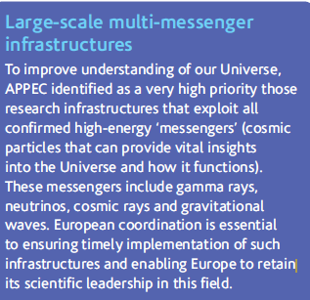
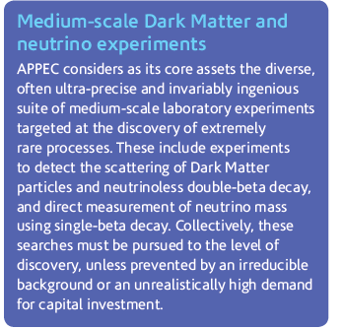
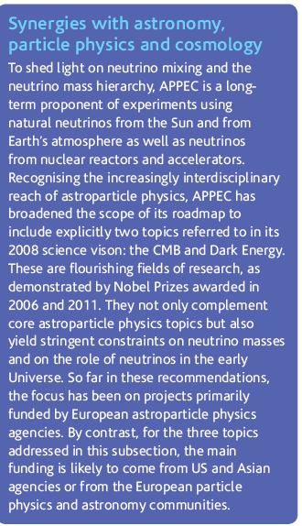
Q3: What connections are foreseen with the upcoming European Strategy for Particle Physics?
Large scale multi-messenger infrastructures:
  CTA, KM3Net, Virgo/Ligo/ET, LISA, UHECR (Auger+, Space)
Medium scale Dark Matter and neutrino experiments.
  A roadmap of underground science (multi-ton DM 2ν0β) priorities ca 2019-20
  Darkside ➔ DS-20k
Synergies with astronomy particle physics and cosmology
  Dark Energy: LSST, EUCLID
  Neutrino DUNE , JUNO, (HK)
  CMB roadmap: G4 on ground and space
Priorities and 2 roadmaps (CMB, underground science)
Key role of APC to the definition of the overall roadmap,
the neutrino and CMB global coordination and participation to the movement of global coordination of Liq. Ar DM infrastructures

Slide 4
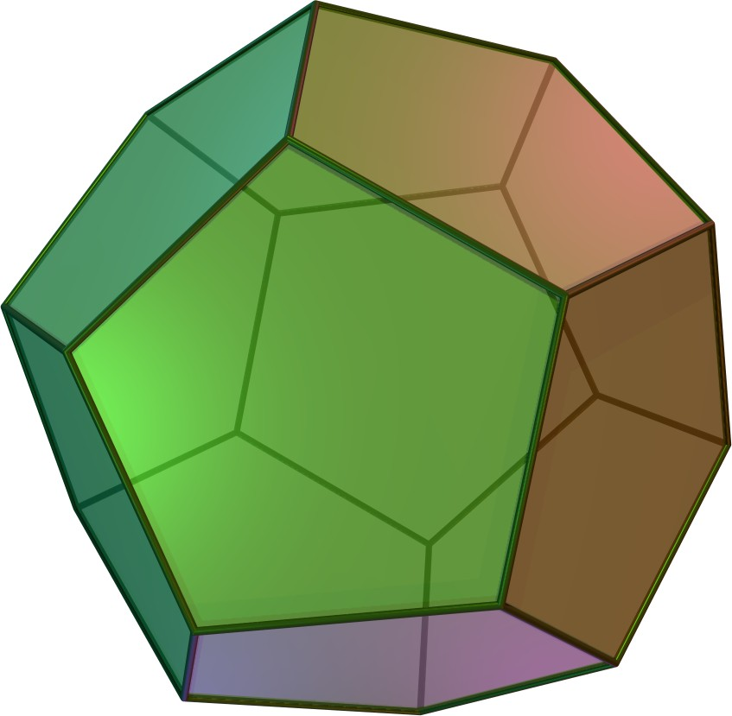

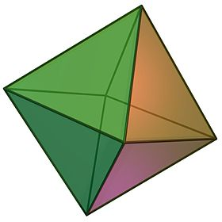
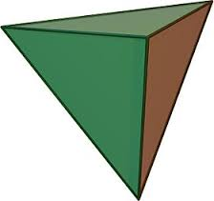
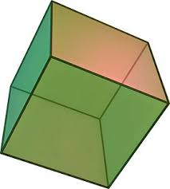
5 APC Groups
A « sudden » convergence
Cosmology
direct/indirect mesure
of ν mass
Feedback
Astrophysique Hautes Energies
PBH,Hubble
Phase Transitions
High Energy Astrophysics
Neutrino
Dark matter
Gravitation
PBH/DM/Snae
Multimessanger
Gravitation
Cosmologie
Theory
Cosmology/Gravitation/HEA
Ground-Space

Slide 5
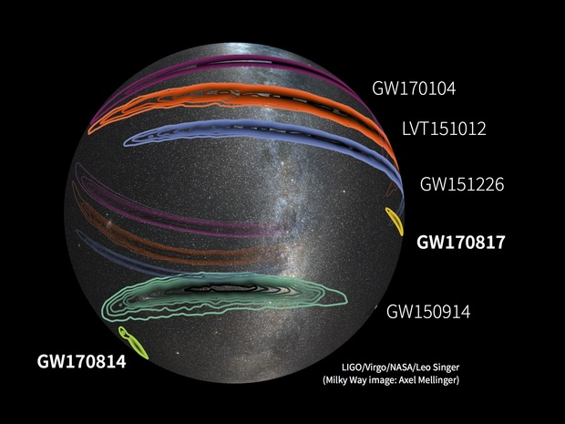
Gravitational Waves
Ground-Space complementarity @APC
LISA advVIRGO

Slide 6
Gravitational waves
A well defined APC roadmap : advVirgo+ and LISA
Highlights of APC contributions
  VIRGO: Beam adaptation telescopes
  VIRGO: Leadership in commissioning and analysis groups
  VIRGO: Organisation responsibility of many seminal papers since 2015
  LISA Introduction and leadership of French participation
  LISAPF: tests and data analysis
  Leadership of GDR Gravitation (C. Caprini)
  Interdisciplinarity with Geosciences
Future perspectives
  Sort term: O3 VIRGO and phase A LISA
  VIRGO: Analysis in multimessenger physics and Cosmology (ASTERICS)
  LISA: Responsibility of Data Processing Centre
  LISA: Participation in AIT/AIV
  R&D: Virgo (Laguerre-Gauss , FDS), LISA (scattered light, LOT)
  Interdisciplinary studies with Geoscience

Slide 7
Gravitational-wave astronomy: an emerging field...
The GW revolution a unifying theme
Cosmology
Measurement of cosmological parameters
Primordial Black Holes
CMB Polarisation
Cosmologial phase transitions
Theory
Gravitation
Modified Gravity tests
Cosmic strings,
mass of the graviton
primordial GW backgrounds
High-energy
astrophysics
& neutrinos
Multimessenger Astronomy
Understanding of Violent phenomena
Tests of fundamental laws

Slide 8
project | Chercheurs | IT | total
LISA | 3,2 | 6 | 9,2
VIRGO | 6,4 | 0,1 | 6,5
NANOSAT | 1,1 | 1,6 | 2,7
e-GRAAL | 0,9 | 0 | 0,9
SWOT
Gravitational Waves
FTE June 2017
autoevaluation document
Forces | Weaknesses
Ground-Space Complementarity High Visibility Role in LISA-France | Manpower VIRGO Loss of P.Binetruy
Opportunities | Threats
Start of Multimessenger Astronomy APC scientific environment Interdisciplinarity with Geosciences | Loss of FACe expertise for LISA

Slide 9
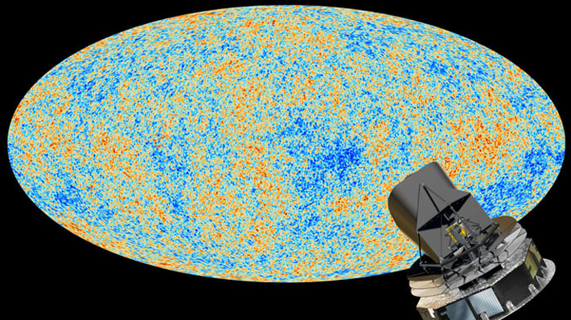
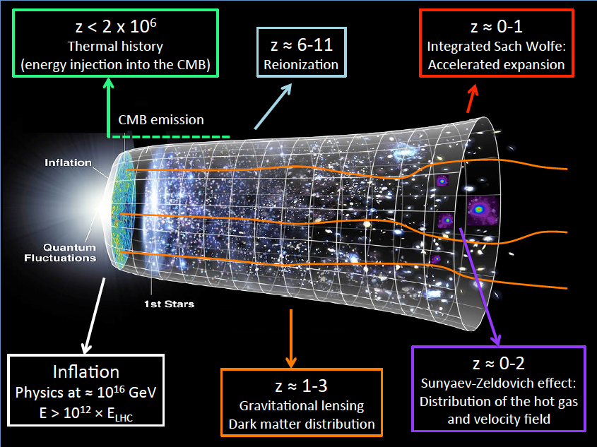
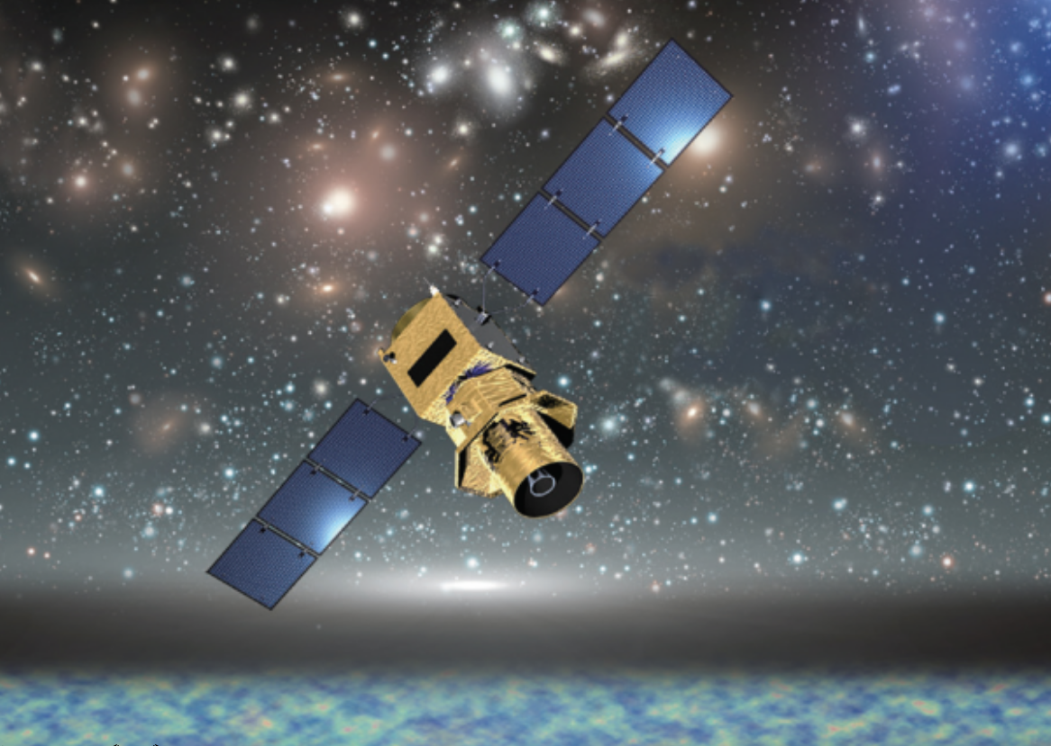
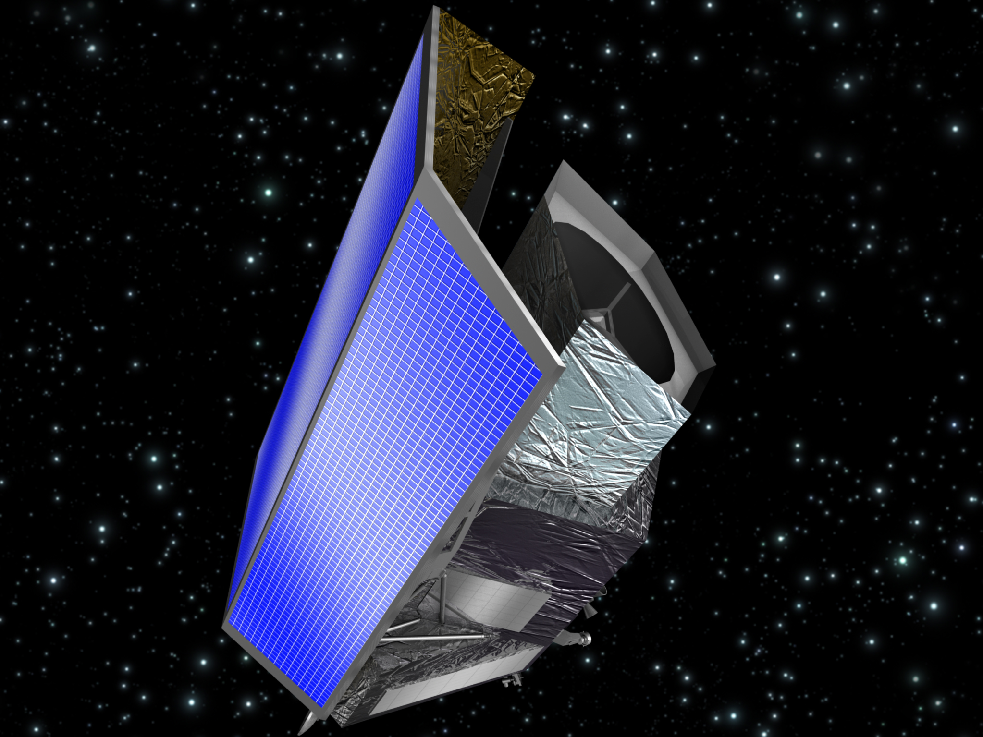
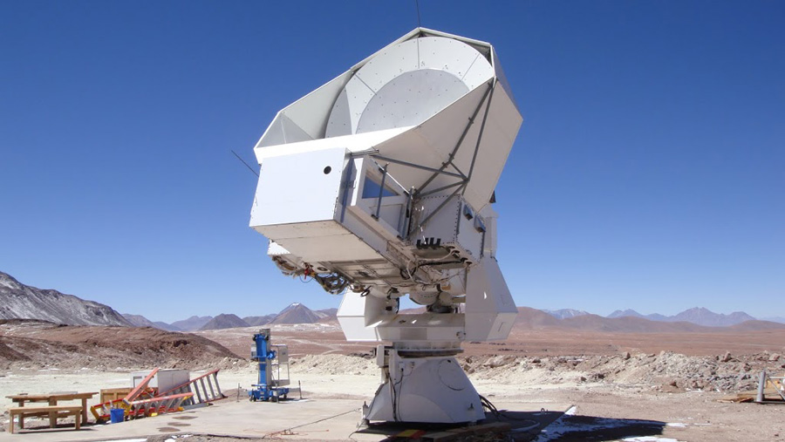
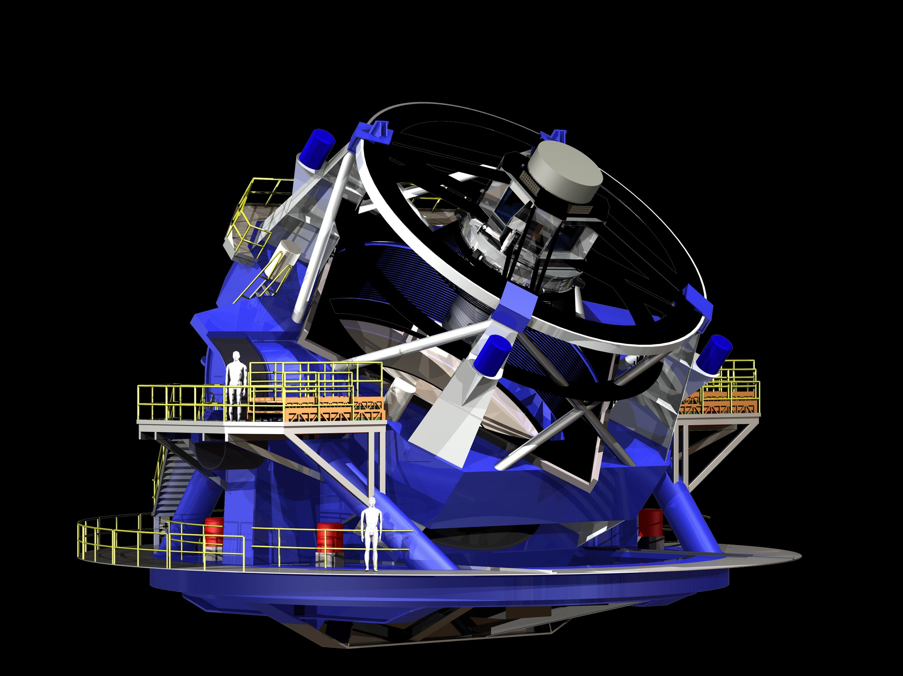
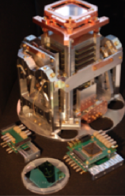
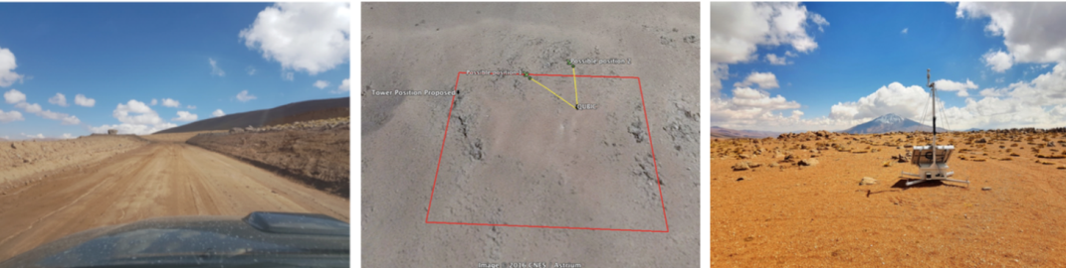
Cosmology
Ground-Space and « near »-« far » complementarity @APC
LiteBird
Euclid
Simons Array
QUBIC
LSST
A well defined roadmap for dark energy
Uncertainties in the European roadmap for CMB on ground and space (CMB-E4,CORE+)

Slide 10
Cosmology
Well defined roadmap for dark energy
Roadmap under construction for CMB
Highlights of APC contributions
  Planck: contributions to construction, leadership in seminal papers
  eBOSS,Polarbear : Leadership in seminal publications
  QUBIC: TES test readout and multiplexing ASIC
  QUBIC: New method of spectral analysis
  QUBIC: New site for cosmology in Argentina
  LSST Control and command soft
  EUCLID user platform CODEEN, responsibility of SGS
  LSST-EUCLID data exchange discussions
Future perspectives
  Short term: QUBIC: Technical demonstrator in 2018, deployment in Argentina in 2019 , LSST-EUCLID contributions by 2019
  QUBIC: analysis and stepping stone vs G3-G4
  G3-CMB Simons Array : analysis and eventual hardware contributions
  G4-CMB
      Ground: organisation of European CMB community (CMB-E4)
      Space: visible role of European post CORE process (ESA, LiteBird)
    LSST-EUCLID: Complementary analysis , formation of cosmic structures, ν

Slide 11
project | Chercheurs | IT | total
EUCLID | 3,2 | 3,9 | 7,1
QUBIC | 2,5 | 4,5 | 7
E4/CORE/LITEBIRD | 5,1 | 0,8 | 5,9
R&D SUBMM | 3,1 | 2 | 5,1
LSST | 1,8 | 1,8 | 3,6
eBOSS | 2,5 | 0 | 2,5
Simons Array | 2,5 | 0 | 2,5
SWOT
Cosmology
Forces | Weaknesses
CMB Detector and Readout expertise Data analysis expertise LSST Control and command EUCLID Pipeline software and SGS | DE analysis effort not yet at fulll speed although probably better than in other french labs CMB: recent losses of key instrumentalist personnel
Opportunities | Threats
Forthcoming LSST-Euclid agreement Large-survey– CMB complementarity Leadership in many European efforts High visibility in non-European efforts (Simons array, Litebird) | Not well defined status of QUBIC Not a clear European roadmap yet for CMB,

Slide 12
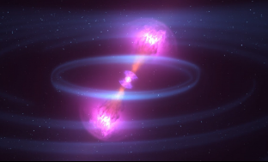
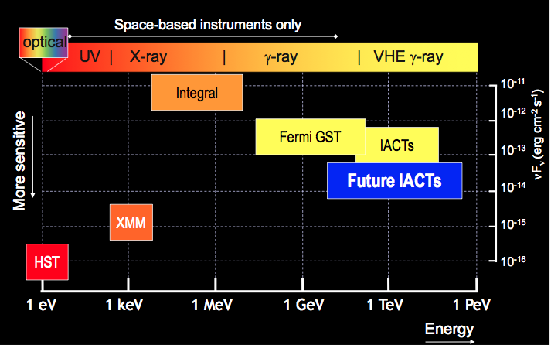
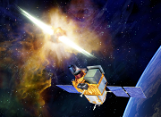
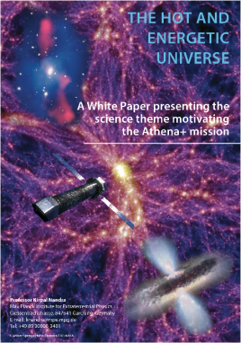
High Energy Astrophysics
UHECR
1 EeV 1 ZeV
CTA
SVOM
ATHENA
KM3Net
∂
∂

Slide 13
High energy Astrophysics
Space : A rich program (SVOM/ATHENA)
Ground : 2 large ESFRI infrastructures CTA/KM3NeT
Highlights of APC contributions
  HESS : Analysis on legacy, GC, Vela, link FERMI, multi-TeV
  INTEGRAL/ANTARES: Leadership of multi-messenger studies of GW
  ANTARES: Spokesperson, ICECUBE source hunting
  TARANIS: Leadership in XGRE integration
  SVOM : coded mask
  ATHENA: Responsibility of WFEE ASIC
  KM3NEt Calibration
  CTA : timing distribution and PHP software
  EUSO : PDM Integration , technical project manager SPB and mini-Euso
  AHE theoretical studies and simulation
  R&D Compton DSSSD detectors
Future perspectives and short term milestones
  Short term: TARANIS Deliver flight model in 2018
  Short term: SVOM flight model in 2019
  Short term: ATHENA ASIC WFEE @TRL6 , end of phase A in 2019
  CTA/KM3NEt: Tics, PHP demonstrators, calibration prototype, analysis
  EUSO mini-EUSO, SPB2, K-EUSO, POEMMA discussions and selection

Slide 14
project | Chercheurs | IT | total
HESS2/CTA | 7,4 | 2,5 | 9,9
antares/km3net | 7 | 2,7 | 9,7
ATHENA | 1,8 | 3,7 | 5,5
SIMULATION | 3,5 | 1 | 4,5
EUSO | 3,1 | 1,1 | 4,2
TARANIS | 1,3 | 2,7 | 4
SVOM | 1 | 2,7 | 3,7
R&D Compton | 1,2 | 1,1 | 2,3
Integral | 1,4 | 0 | 1,4
High Energy Astrophysics
SWOT
Strengths | Weaknesses
Ground-Space complementarity Space Quality procedures Large GW followup exeprtise | Unbalanced ratio of engineers and researchers (inverse on ground and space) Role of low energy γ , not yet well understood by our agencies
Opportunities | Threats
Multimessenger Astronomy | TARANIS construction uncertainties Full KM3NEt funding EUSO roadmap uncertainties

Slide 15
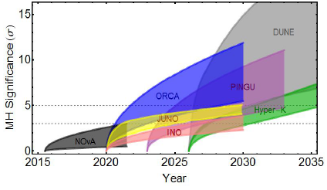
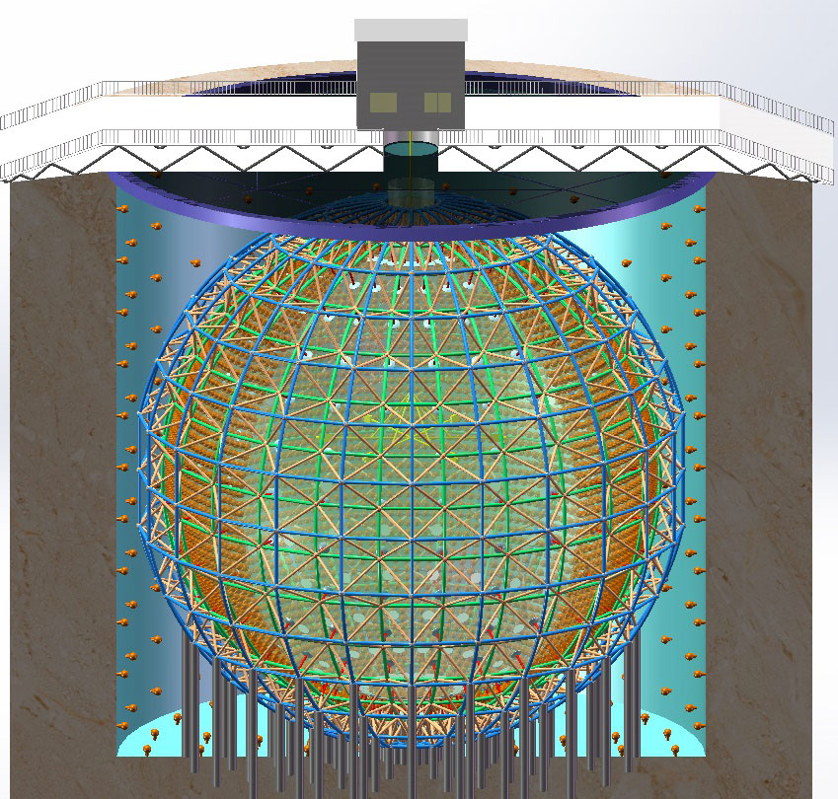
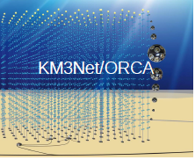
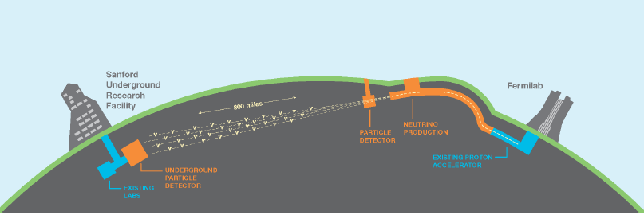
Neutrinos (invisibles I)
Reactor, accelerator and cosmic
10²⁴
10²⁰
CMB
10¹⁶
10¹²
solar
10⁸
Supernova
Flux (cm⁻² s⁻¹ MeV⁻¹)
Géological
10⁴
Reactors
10⁰
Atmospheric
10⁻⁴
10⁻⁸
Energy(eV)
Cosmic
10⁻¹²
DCHOOZ/JUNO
SOX
DUNE/ORCA
KM3NEt/ARCA
10⁻⁶
10⁻³
1
10³
10⁶
10⁹
10¹²
10¹⁵
10¹⁸
μeV meV eV keV MeV GeV TeV PeV EeV
3 techniques:H₂O/Liq Scint/Liq Ar

Slide 16
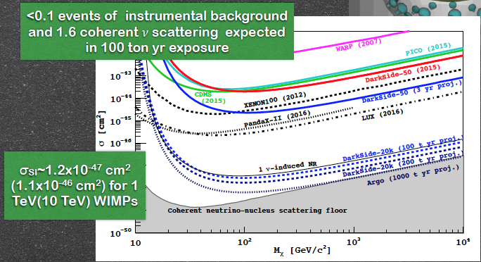
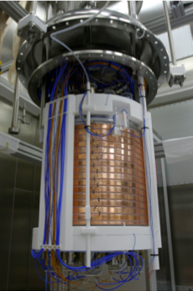
Dark matter (invisibles II)
Liq Argon: Dark-Side➔Ds-20k ➔Argo
Dark Side

Slide 17
Neutrinos and Dark matter
APC contributions and prospectives
Highlights of APC contributions
  DCHOOZ : Spokesperson, mechanics, analysis
  JUNO : The idea of multi-calorimetry, CATIROC card
  WA105/DUNE, Global convergence role, Physics coordination, CATIROC
  ORCA/KM3Net, NH/IH mass analysis,
  Borexino, SOX, DarkSide detailed simulation
  R&D Darkside directionality ARIS, LIQUIDO
  Interdisciplinarity
    Geoneutrinos, Muonic tomography
    Ocean Sea-Floor interdisciplinarity with Geosciences
Future perspectives and short term milestones
  DCHOOZ , final results and decomissioning in 2018
  WA105 Start of data taking in 2018-2019
  JUNO/WA105/DarkSide CATIROC electronics card in 2018-2019
  ORCA/JUNO/DUNE complementary Analysis
  R&D advances LIQUIDO, ARIS
  Interdisciplinarity. Deployment of ARCHE (muography), sea-floor instrumentation

Slide 18
project | Chercheurs | IT | total
DCHOOZ | 3,4 | 0,1 | 3,5
WA105/DUNE | 2,6 | 0,7 | 3,3
SOX | 2,9 | 0 | 2,9
JUNO/LIQUIDO | 1,7 | 0,9 | 2,6
Darkside | 1,7 | 0 | 1,7
Muography | 1 | 0 | 1
Neutrinos and dark matter
SWOT
Strengths | Weaknesses
Expertise Liquid scintillators Electronics card expertise Simulation Visible responsibilities | Small number of researchers per project Insufficient manpower in electronics engineers
Opportunities | Threats
Synergy of measurements of neutrino mass hierarchy in neutrino and with cosmology Good position in Argon Global collaboration for Dark matter Interdisciplinarity with Geosciences | Budget ORCA and DUNE Liquid Argon for DM not yet a national priority

Slide 19
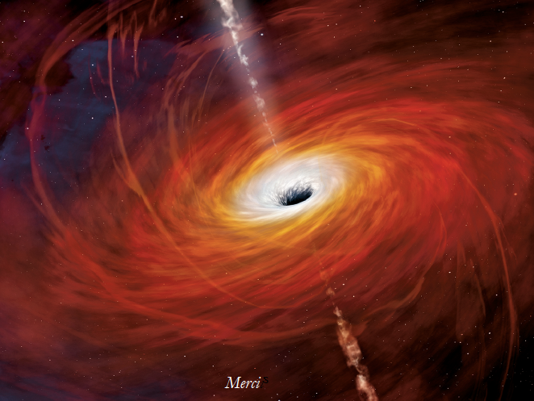
Theory
Cosmology, Gravity, String Theory (1ERC senior) :
- Inflation, dark energy and cosmological perturbations
- Topological defects
- General relativity, modified gravity theories
- Gravitational waves
- Duality, Holography
Astroparticle physics and neutrino:
- Neutrino physics and astrophysics
- MHD and propagation simulations
- Cosmic rays
Quantum Field Theory (QFT) :
- Non-abelian gauge theories and deconfinement,
- QFT in curved geometries,

Slide 20
project | Chercheurs | IT | total
Theory | 22,7 | 0 | 22,7
Theory
SWOT
Strengths | Weaknesses
Good internal organisation International Visibility APC very active meeting place, international insertion Among largest theory groups in IN2P3 | The phenomenological bridge although in good progress needs further strengthening given the opportunities
Opportunities | Threats
New environment after GW discovery Multi-messenger context | Not enough career opportunities of promotion for our Maitres de Conference

Slide 21
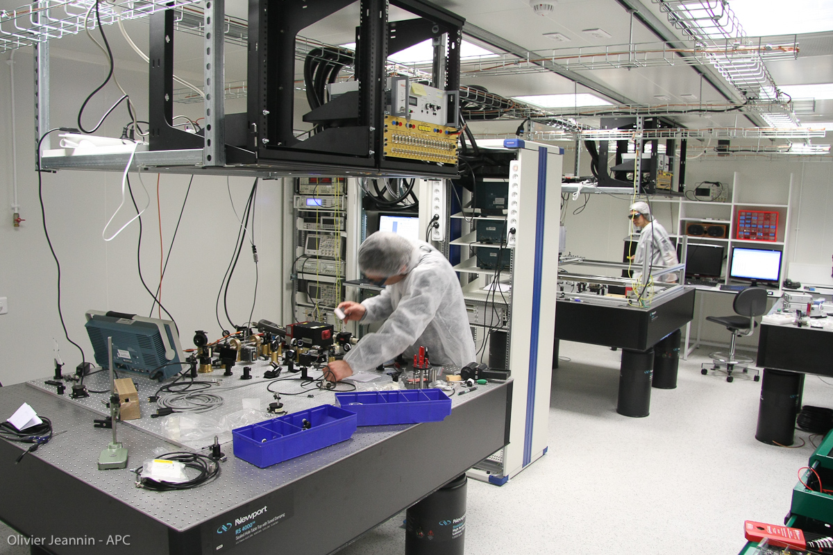
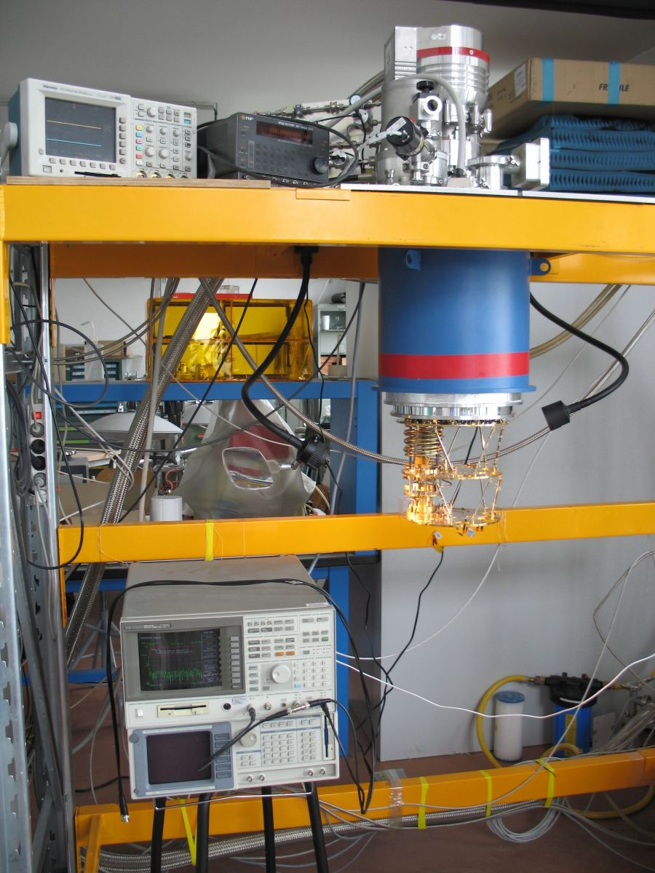
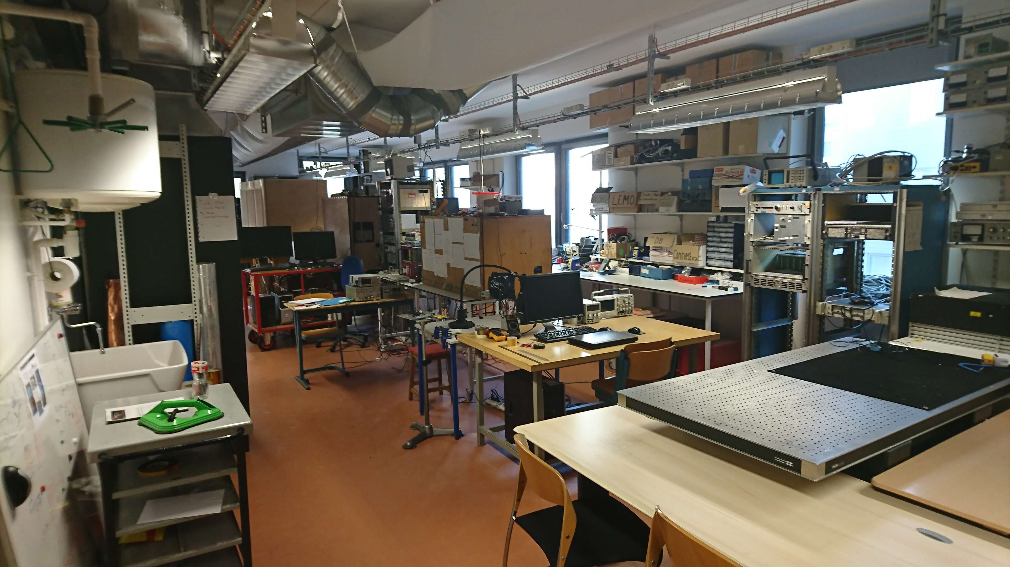
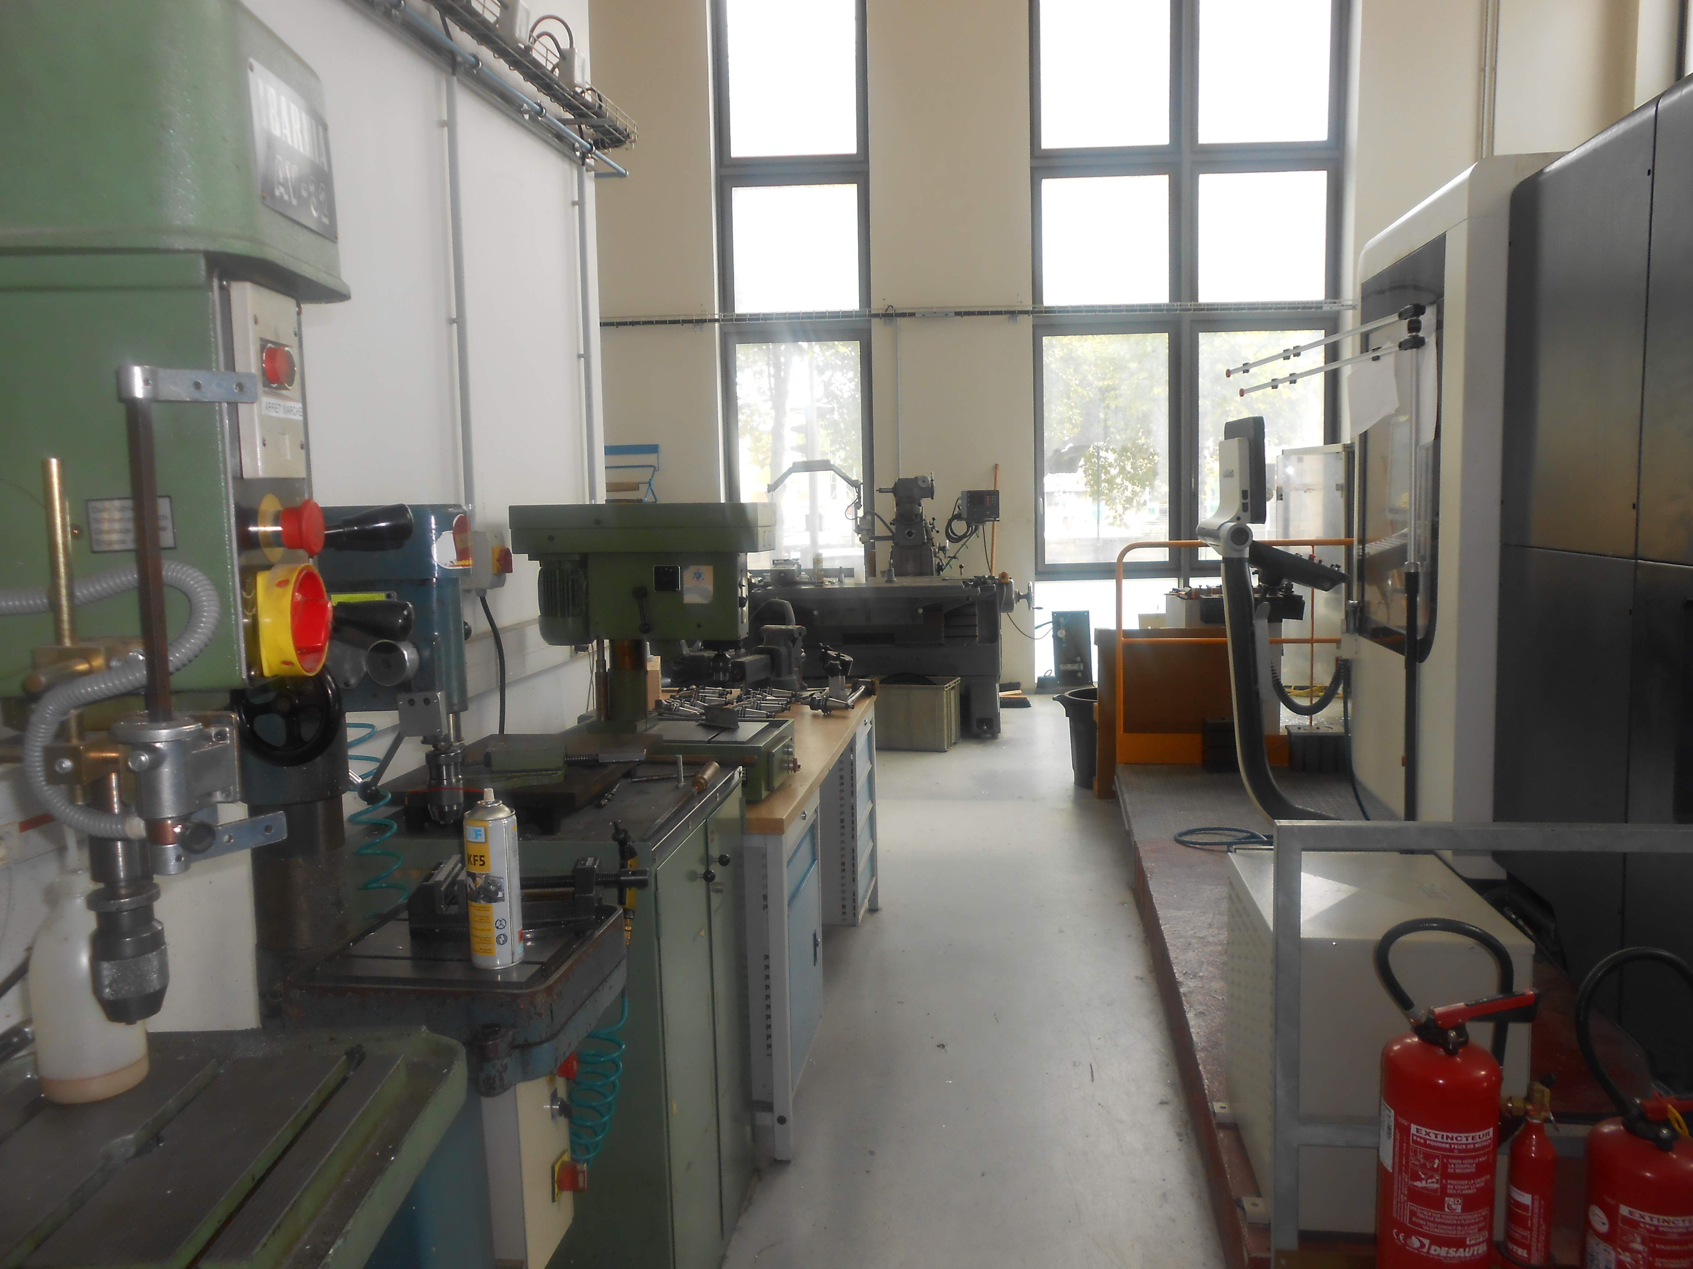
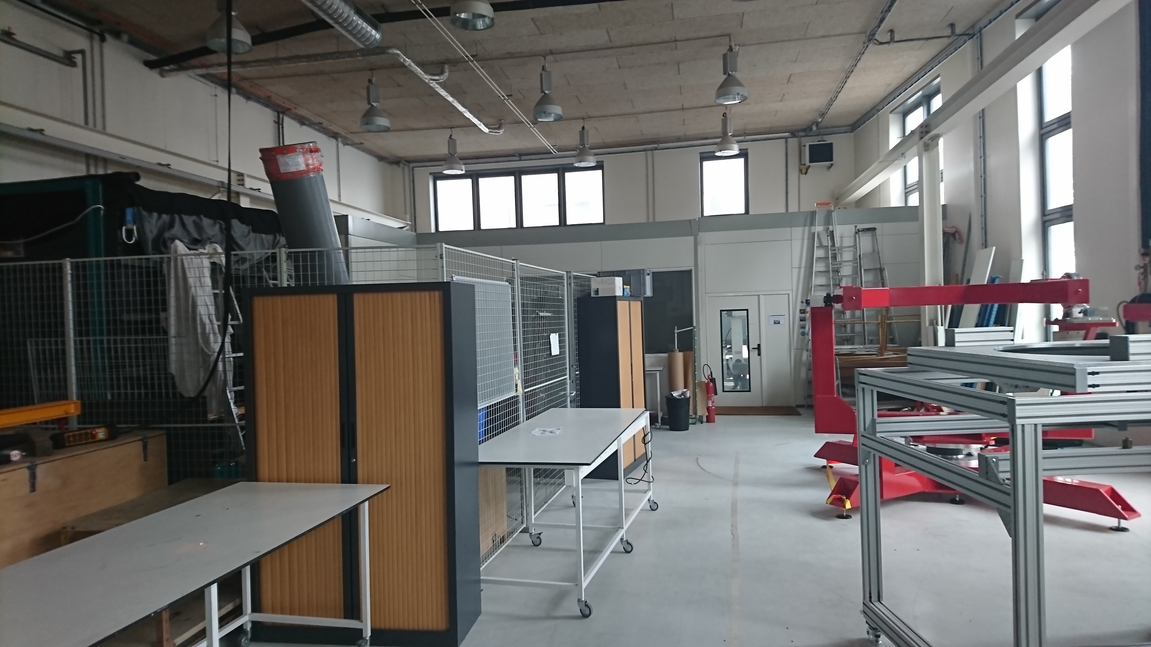
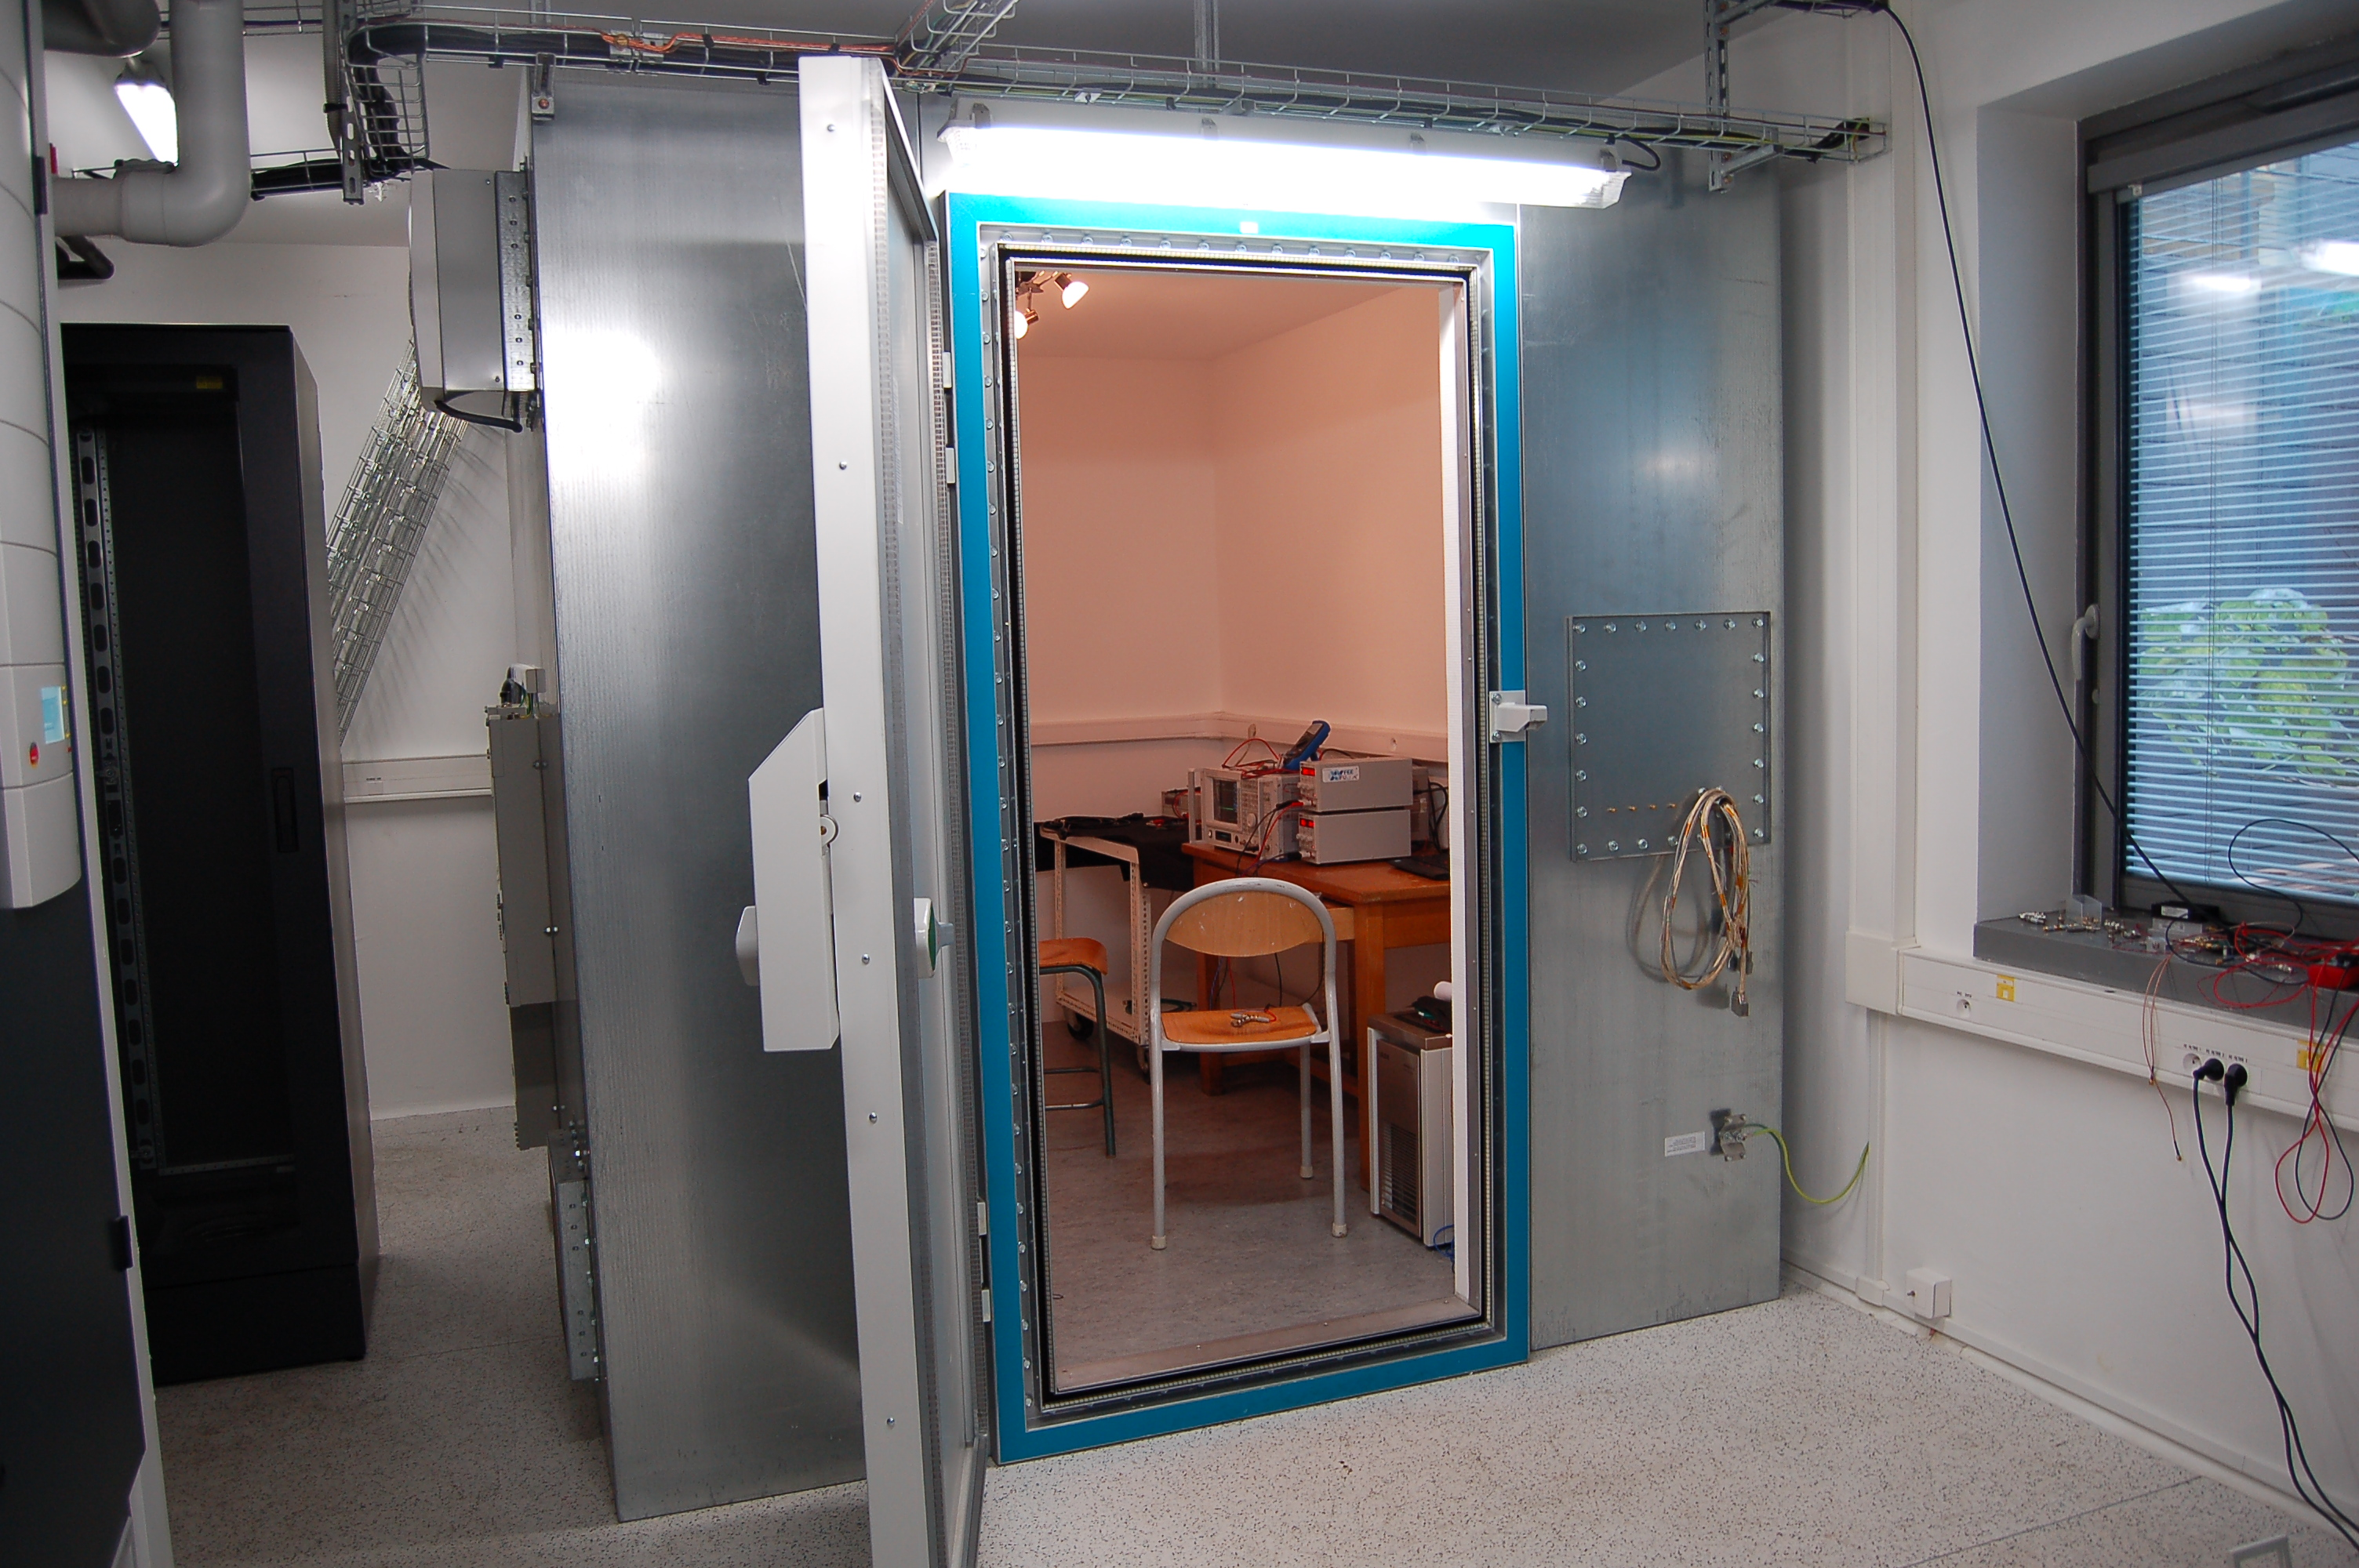
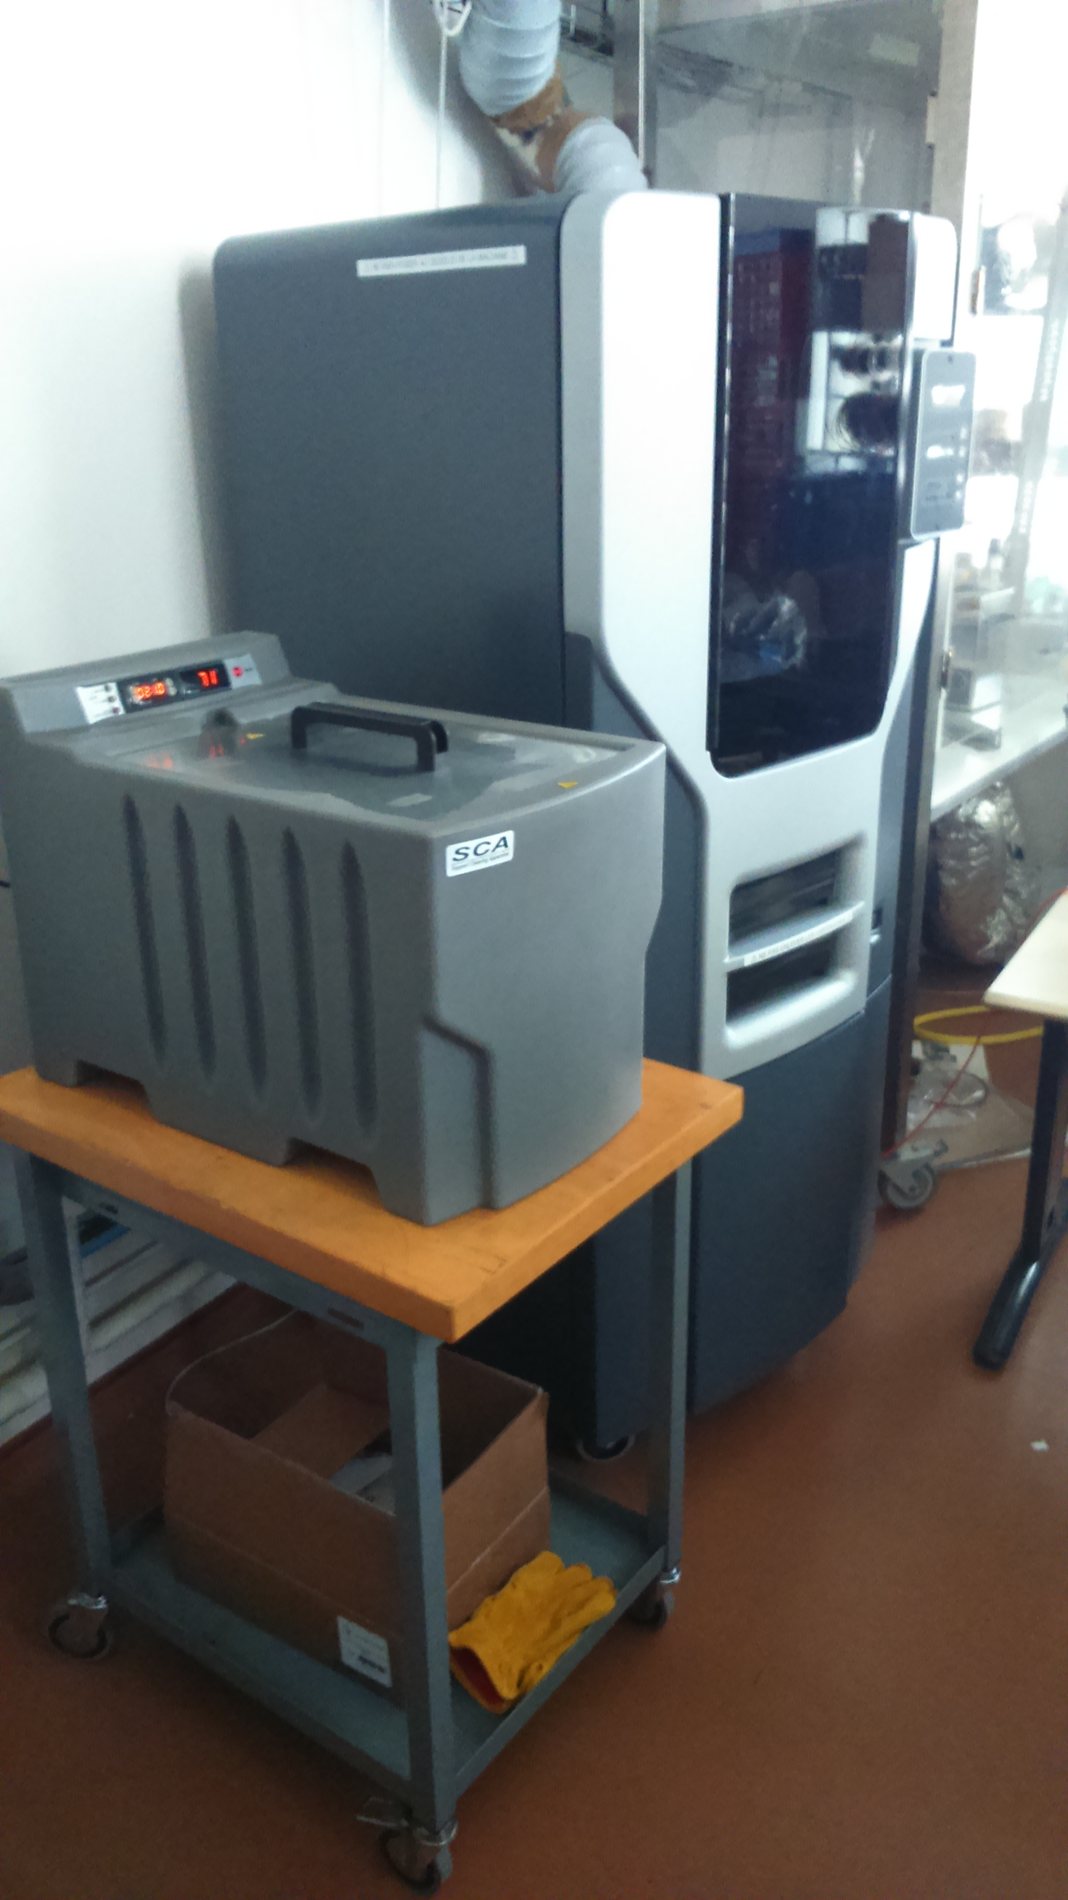
Technical Department Assets
Labo optique, Intégration spatial
Salle blanche , LISA, VIRGO
Laboratoire Millimétrique:
Cryostat à dilution 100mK
Laboratoire Photodétection
Hall de montage
Salle bas bruit (37,5 m²)
Atelier mécanique
Hall de montage
Imprimante 3D
See T. Zergeurras talk for details

Slide 22
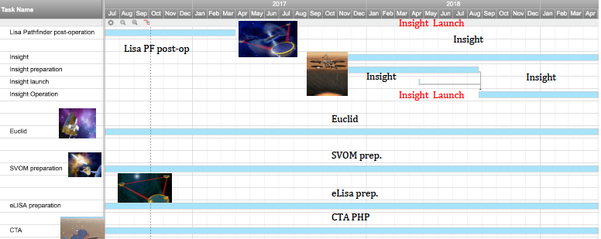
FACe (François Arago center)
Data Science Platform
APC data analysis center for space missions (since 2010).
  650 CPU, 40 TB, team of 10 agents
  Offices, meeting rooms, video-conference rooms, computing room, CDF.
  Location: Biopark but moving to Condorcet and IPGP in 2018
  Strong link with the CC-IN2P3.
Examples of achievements
PLANCK Sky model , QUBIC preparation
EUCLID Collaboration platform CODEEN, LSST Slow Control software
CTA Proposal Handling Platform
Mutimessenger studies
Future
LISA Data Processing Centre
EUCLID SGS activities
GW Multimessenger
CTA PHP
SVOM pipeline and quick look
ATHENA
MHD computing
Theory

Slide 23
Q4: FACe : The François Arago Center is presented as a platform to host DPC (Data Processing Centers) or DAC (Data Access Centers) for space missions or ground based projects with heavy computing needs. Please show how this platform is organized and the workforce needed to operate it. If the workforce is shared with the IT department, how is this managed?
FACe was created in 2010 as a centre of skills on data science, to concentrate and support the exchange of data methods on astroparticle physics and cosmology. It has an in-house support of a moderate scale (Tier-2) computing centre and strong links with CC-IN2P3. It accompanied the implication of APC on data analysis in Space (Planck, Integral, Euclid) and ground (QUBIC, CTA)
Its ambition was to operate with external resources after a few years. Although an “industrial” involvement was not obtained, it succeeded to seed of the order of 5 CDD per year by CNES, EU, regional (DIM_ACAV) and national (ANR) programs. It is also the centre of education of 3 apprentices.
It has a relative autonomy, having a scientific responsible (The first was V. Beckmann, Deputy Director for Data Science of IN2P3 since 2016, presently C. Cavet) and a technical responsible (M. Detournay), they report to the Direction of APC for matters of FACe, while they are partly under the authority of the Informatics Department on what concerns their career.
Further, there is an administrator of the premises (D. Leyrit) and an infrastructure expert (S. Zappino) both recruited by the University. Both under the authority of Administration and Informatics departments correspondingly. Of the order of 10 permanent engineers related to projects of APC (see above) , share their expertise through the centre.
The overall cost of the infrastructure (not counting the salaries of permanent personnel) is 700 KE of which 450 KE (source: 50% IN2P3/University, 50% external APC resources) concern the infrastructure and 250 KE the non-permanent personnel (100% external resources).

Slide 24
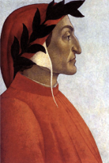
The Future: from FACe to DANTE
CNRS asked APC to move out from the building Biopark by the end of 2018
APC and IPGP obtained regional funding (350 KE) for the upgrade of their corresponding centres (FACe, S-CAPAD) under the project DANTE
  Concentrate the HPC/HTC computing/storage infrastructure in IPGP premises
  The Concurrent Design facility and Virtual Cluster in APC (Condorcet)
  Develop interdisciplinary expertise between Astroparticle sciences and Geosciences and data science more generally
DANTE could become key centre of P2IDS (Paris Interdisciplinary Institute for Data Sciences) in the context of the Target University
FACe team develops also autonomous expertise on APC subjects and also moves at Condorcet building
This is a key infrastructure challenge of 2018 for APC
  2 main tasks:
  Machine upgrade : 210 KE (100 KE region, rest RP)
  Movement of personnel and CDF to Condorcet. Budget of restitution of offices : 309 k€

Slide 25
Q1: How can you tell if a group is spread too thin to be effective, and how are priorities set and accepted? Can you please give examples of activities that groups decided not to pursue and how that worked?
Evolution from APC contributions “en amont et en aval” or “R&D and analysis” to key infrastructure contributions , in particular w.r.t to space program. Space in particular was a key attractor of resources and had a profound influence on APC distribution of technical forces, quality procedures, precise FTE followup. It also has impact on ground program when delays etc encountered;
We have 2 Evaluation Instruments. A “High level” one: the Scientific Council and the Project Follow-up Cell or “Cellule de Suivi des Projets” (CSP) attentive to keep the unitarity w.r.t technical FTE.
  Too close and too far? At the 2017 biennale, we decided that need an intermediate instance, but not multiply committees. We decided to give the task to the current body of group and department responsibles to evaluate the resources of the program every 3-4 months, including new proposals. Also recommended by our SC.
  During the first Biennale of APC there were complaints that our FTE did not previously conserve unitarity, this is clearly not the case anymore.
6 Projects stopped or downscaled (since 2014).
  SKA and PTA, (lead to discontent of key researchers) , Xshooter, Borexino, R&D Gamma-cube (despite funds from InnovSATT), and eBOSS participation (lead to loss of a key researcher)
3 New projects since 2014 (in fact continuation of our expertise in new context):
  ATHENA (follow-up of our expertise in readout ASICs),
  Dark Side (Borexino expertise)
  JUNO (continuation of DCHOOZ expertise)
1 R&D project in CSP process: LIQUIDO

Slide 26
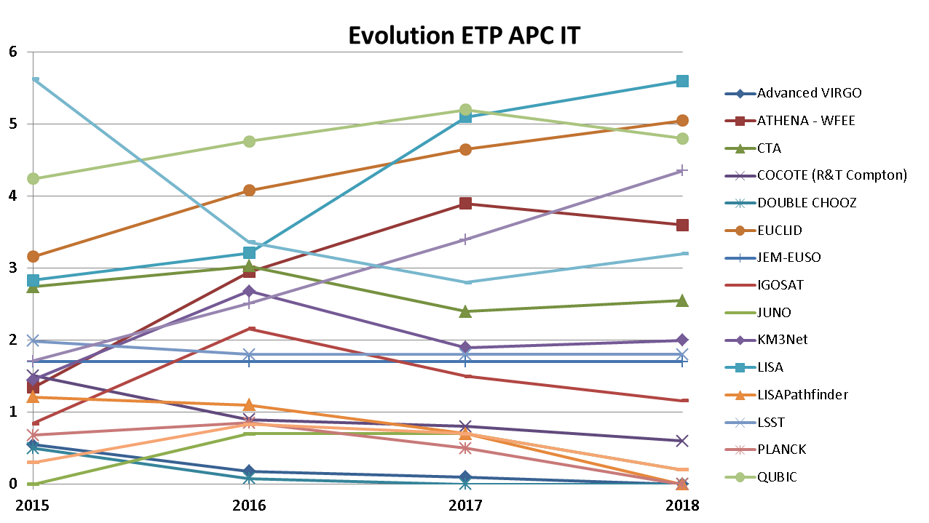
A precise evolution of technical forces
CSP and CQP (see presentation TZ)

Slide 27
∂
Roadmap
Projet | 2017 | 2018 |  | 2019 | 2020 | 2021 | 2022
Planck
LPF
Antares
DCHOOZ
Integral |  | End? |  |  | End?
eBOSS
EUSOO SPB2/mini-EUSO
Taranis
QUBIC
VIRGO | Analysis/upgrade
HESS/CTA | Analysis/construction
Simons Array/observatory | Analysis/construction
KM3NEt
EUCLID
LSST
SVOM
JUNO
Darkside/DS-20k
WA105/DUNE
ATHENA
LISA
CMB/Ground-space | CMB-E4/Litebird/CORE++
UHECR-space | K-EUSO/POEMMA
2017 21 projects of which 9 in analysis
2020 13 projects of which 9 in analysis
+2 other possibilities

Slide 28
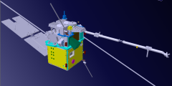
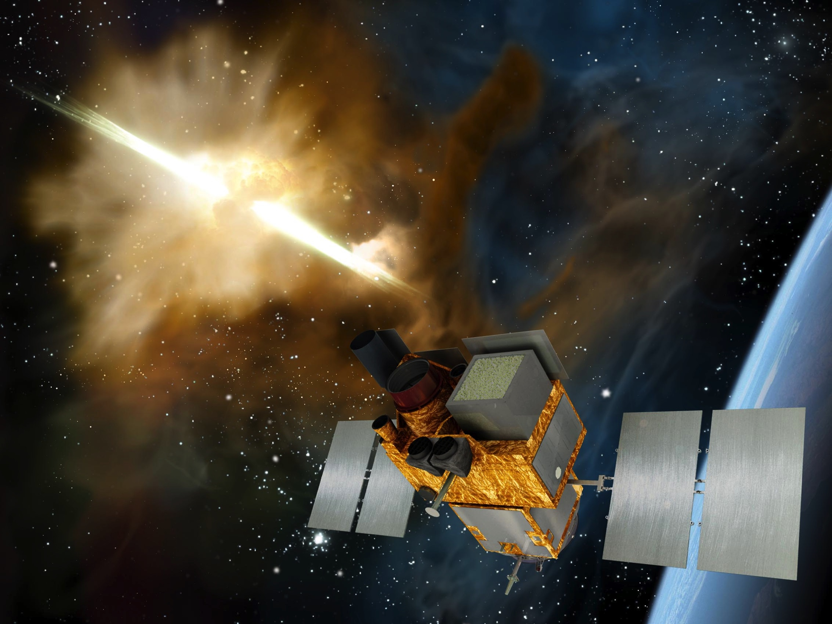
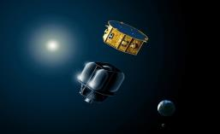
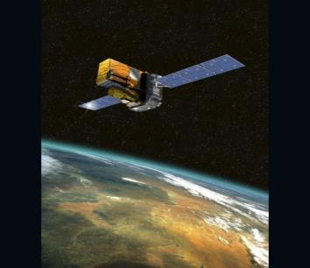
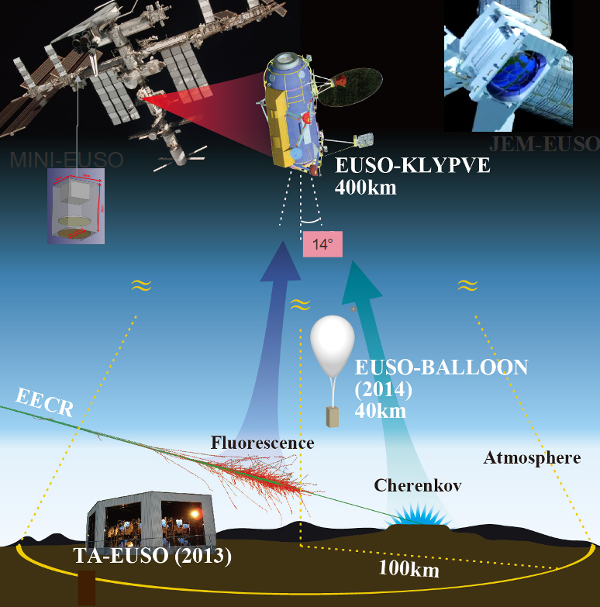
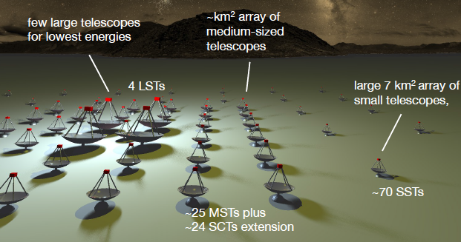
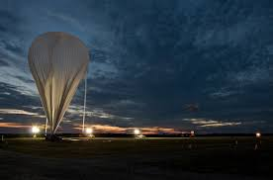
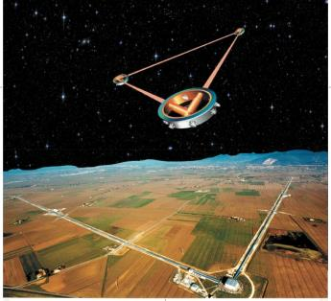
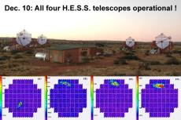
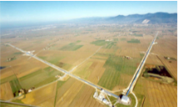
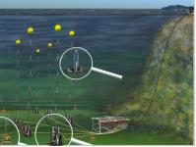
Multi-messenger
Universe
LISAPF
TARANIS
SVOM
ATHENA
INTEGRAL
CTA
EUSO ballon
EUSO SPB2-ISS
LISA
KMN3NEt
HESS
advVIRGO
ANTARES
2018
2020
2022
2024
2026
2030
2032
2034

Slide 29



Mesure of the Universe
(Cosmology, DM,neutrinos)
EUCLID
PolarBear/Simons Array
LiteBird
Planck
LSST
QUBIC
DUNE
DoubleChooz
Dark Side
JUNO
2018
2019
2020
2021
2022
2023
2024
2025

Slide 30
Three key associated structures
Labex
Univearths
Paris Centre for Cosmological Physics
Interdisciplinarity with Geosciences
Educationand R&D
European Roadmap
APPEC

Slide 31
Astro-geo science emerging synergy
(or revival of an older alliance)
The geosphere, a direct object of study of the geosciences, is both the target and the detecting medium for astroparticle observatories,
They both deal with complex natural systems at a much larger scale than the human, deploy large sensor networks in sometimes hostile environments (sea, desert, underground, space);
Use long series of precise observations acquired over a range of time scales;
Extreme dating is a discovery instrument;
They finally use advanced sensors and a large data manipulation and worldwide networking, including the distribution of alerts.
Seismology
    Seismic precursors using gravitational wave technology
    Ocean floor seismology (standard, acoustic)
Muon Imaging
    Volcano muon tomography
    Archaeology, prospection
Neutrino Imaging
    Geoneutrinos
    Earth Neutrino radiography
Deep ocean
    Parameter monitoring and bioimaging
  Space
    Space weather (Nano satellites, Taranis, EUSO)
APPEC-APC centre organises a pan-European meeting
of agencies and Pis by mid-2018

Slide 32

A strategic alliance
The interdisciplinarity with Geosciences Labex Univearths+
EUR EPU (AIM,APC,IPGP) Not retained
Data Plateforme DANTE (APC, IPGP) retained (see above)

Slide 33



∂
Paris Center for Cosmological Physics
APC ,GEPI, LPNHE, LPTENS, LuTH
Foundation « Physics of the Universe »
Chair G. Smoot, Interim Director S. Katsanevas (replacing P. Binetruy)
Education and Outreach
  « Teaching the Universe »
  MOOC Gravity (P. Binetry + G. Smoot, subscription 100.000 followers)
  PW@APC
  A conference program
  Art and Science Univers 2.0 (Foundation Carasso)
A fellows program (Recently 4 of which V. Domcke L’Oreal Prize for Women)
Current focus: R&D on submm detectors: TES/KID)
International Donators (Energetic Cosmos Laboratory Nazarbayev University, Kazhakstan) on extension of TES/KIDS sensitivity to the visible and near-IR

Slide 34
∂
Paris Center for Cosmological Physics
APC ,GEPI, LPNHE, LPTENS, LuTH
Q5: PCCP: What are the organizational and financial relations between The Paris Center for Cosmological Physics (PCCP) and APC? Is there coordination between the PCCP scientific program and the APC physics group (Cosmology, Theory …)?
On the financial level, there is complete separation and autonomy, since PCCP is supported by a Foundation (RFPU) , with an executive director a president, and an independent council. Audited every year.
On the scientific side there is complete coordination in the cosmology and gravitation sector with APC groups
Lately the shift of the focus on detectors has permitted , with the help of DIM-ACAV (region), Univearths and international donators, in collaboration with GEPI to start an activity on TES/KIDS detectors, extending their reach to the visible and near-IR with applications extending from Earth, Planetary and Cosmology to medicine.
The hiring policy has shifted to this domain, and this work is done in complete synergy with the millimetric lab responsibles (M. Piat et al)

Slide 35

APPEC functional centre
  Mandate of APC Functional centre
Strategy
Interdisciplinary issues
Recent Highlights
Global Neutrino Meetings (2014,2015,2016)
European Coordination CMB (2015,2016, 2017)
Organization of Scientific Advisory Committee
April 2016 Roadmap APPEC town meeting
S.K among editors of the European Roadmap
Planned in 2018
Interdisciplinary coordination with Geosciences
Loss of European responsibile I. Agrafioti by promotion to a very high position at ERC during 2015 difficult to replace, nevertheless we continued to be very active in the organization of the community after her departure

Slide 36

International Insertion
U. Of Chicago
UHECR
A new brother institution
Astrocent in Warsaw
UMI Paris- Bay-Area
G. Smoot, S. Perlmutter
Cosmology (CMB-DE)
Director from APC
APC Director
LIA, KAVLI-IPMU
Cosmology, Gravitation
KITP Helmholz Allianz
AHE
APC-Hambourg-Oxford
Solvay Institute
Theory
APC Director
LIA Argentina
QUBIC…
Q2: The agreements and connections with international groups are admirable and impressive. Could you please list some specific results or opportunities that are a consequence of these ?

Slide 37
A new brother-Institution in Warsaw
AstroCeNT:
Particle Astrophysics Science and Technology Centre
The prime objective of AstroCeNT will be to develop a future oriented research and development (R&D) programme in science and technology in the area of ultra-sensitive detectors and sensors as well as large data set collection and analysis tools
The international strategic partner of AstroCeNT will be the Laboratory of Astroparticle and Cosmology (APC) — a world-class scientific institute based in Paris.. APC key element to the acceptance of the funding (a few M€/year)
The main scientific field of the Agenda will initially be focused on two areas:
  Gravitational wave astronomy and
  Dark matter
The main three science-driven technological themes initially proposed for AstroCeNT are:
  Silicon Photo Multiplier based systems;
  seismic sensors;
  data acquisition and large data set processing

Slide 38
Institutional insertion
Target University
P5-P7-IPGP
Federation (IN2P3)
APC-LLR-LPNHE
University evolution
Disciplinary federation
Regional federation
APC considered a key asset of P7 and Target University
S.K
Coordinator of pole Exact sciences and Technology and
Coordinator of the project Paris Interdisciplinary Institute of Data Sciences
Dim-ACAV
Astrophysics
Coordination OdP

Slide 39
Education I
Deputy director responsible: A. Kouchner
2 recruitments
next year
1Pr (46.1)
1MCF
About one third of the researchers (permanent positions) at APC are Faculty members
APC members actively participate to the administrative boards of Paris-Diderot University the Department Council (5) the Scientific Council (5), the Teaching Council (4).
50-60 internships/year, including IGOSAT nano-satellite program
Project Graduate School Earth Planets Universe, not retained we will resubmit

Slide 40




Education II
Followup 2013-2016

Slide 41
Q6: The Energy Physics Group has recently joined the laboratory. The scientific activity of this is clearly of high level and with high societal impact. However, It is not a priori obvious that APC would offer the best development environment to this research activity. In addition, many of the research themes of this group are rather managed by departments of the CNRS (or CEA) which are not the ones which are the “tutelle” of APC. Would you please further explain the strategy for welcoming this new group at APC?
The Energy Physics Group is composed of 4 senior researchers (1 professor, 2 associate professors (research affiliates) and 1 CNRS research engineer) as well as 3 PhD candidates.
Indeed the goal of the Enregy group : “Search for novel sources of energy for tomorrow. Interdisciplinary focused on the observation and understanding of basic mechanisms underlying physical phenomena, their modeling and eventually applications in novo energy systems. At the interface of physics, biology and chemistry this cross-disciplinary research includes also socio-economics aspect.” is not directly related to the other APC groups
It is clearly an excellent group with a very high level of visibility both inside the University and beyond
APC agreed to host the group due to academic difficulties within laboratories that would be more natural loci of the activity. With the explicit agreement that the link would be mostly administrative, and no ambition would develop either to extend the APC activity to the Energy group domains, or profit from any possible assets (offices etc) since this would also create conflicts with neighbouring laboratories.
Nevertheless some synergies recently appeared between the ocean biology activity and KM3NEt interdisciplinary goals. They will be explored in the near future.

Slide 42
Organisational issues

Slide 43

UnivEarths
M. Chaussidon, S.Katsanevas

Slide 44
Laboratory composition (187 agents the 01/06/2017))
5 groups | 5 groups | 96 | 39,9 | 135,9
Other Research | Other | 8,7 | 0 | 8,7
Teaching |  | 10,7 | 0,1 | 10,8
Admin/management | Support | 1,8 | 20 | 21,8
Engineering | Support | 0 | 5,4 | 5,4
Total |  | 117,2 | 65,4 | 182,6

Slide 45
The smallest ratio of engineers to researchers in permanent stuff
And the highest ratio of non-permanent to permanent in IN2P3

Slide 46
Permanent personnel: stability
+2 IT +2 Ch CNRS In November
+ 2 Univ. Pos + 3 new ITA For 2018

Slide 47
Non-Permanent personnel
+2 IT
+2 Ch
In November
+ 2 Univ. Pos
+ 3 new ITA
For 2018

Slide 48
A large fraction of non-permanent personnel since 2010
+4 new permanent in November

Slide 49

A very large annual turnover 1/3 of the personnel

Slide 50
Budget evolution (managed at APC and not centrally)
A large variety of sources
Furthermore, as an example of the diversity of sources of funding we show the percentage of resources obtained in 2016(excluding permanent and non-permanent CNRS, University and CEA salaries). The “proper resources” are 91% in 2016 (although this presentation is biased from the fact that in the GBCP budgeting mode the multiannual budget is notified in the first year, so the budget is “forward loaded”). If one includes the salaries of the permanent and non-permanent salaries of CNRS agents this percentage becomes 47% (of a total of 13.7 M€).

Slide 51
SWOT, Administration
Forces | Weaknesses
Organisation on the basis of structure projects Professonalisation of different functions (Europe, PCCP, ..)Very proactive researchers and engineers Adaptation to a new funding environment | Large turnover of permanent personnel resulting in a permanent fragility Multiplicity of funding sources with different rules Frequent changes of software environment, Transitions between administrative authorities Use of CDD , constant formation and loss of expertise
Opportunities | Threats
Dynamic laboratory leading to a constant renewal of expertise | Mobility turnover nearly 1-2 /year
AQ1: Is the admin support sufficient?

Slide 52



Gender issues
GENERA:
implementation at APC
Actions towards students, role models
  Masterclass on UN day of women in science (11/02/2016)
  Intervention at Summer School for undergraduate students (16/07/2017)
  Discussion session at High School Teachers’ school EPhyD (31/08/2017)
  Exhibit ”Physique de femmes” at Fête de la Science 2017
2) Encourage women to apply
  L’Oréal-Unesco Prize (E. Capocasa and V. Domcke, 2016)
  Nominations of group and service leaders
  ➔ 50% Women of group/srevice leaders at APC
EU funded in the frame of H2020-GERI-2014-1
2015-2018, 3.34 Mio Euro funding
14 beneficiaries from 11 countries
Objectives: assess the status of gender issues and GEPs, support organisations in implementing
Shall establish a long-term perspective beyond project lifetime (network, monitoring)

Slide 53






Communication
Communication Art , Science and Society
A new web site , videos
Squaring the circle A. Csorgo, Fondation de France
PW@APC
Fete de la Science
Univers 2.0
B. Barish and GW August 2017
Science and Society S. Perlmutter

Slide 54
Additional questions
AQ2: Why only half of the lab participates in the “biennale”?
We always doodle. But it is difficult to find a timeslot when 200 people are available. Also difficulties with the academic personnel, due to teaching
AQ3: The recent jump up to 50% female post-docs in 2017 (whole lab) is very impressive and positive. Is it understood -- was this the result of a particular effort – or is it a fluctuation? There appeared to be a small jump downward in female PhDs around the same time. Is that understood, or is it a fluctuation?
We have 25% women overall, and 50% female responsibles in groupe and department responsibles. We also have a specific Gender program. See next slide. Too early to see here a causal effect. APC
AQ4: It seems that the plots of fig4 a and 4c showing the evolution of the staff are not consistent. Which of them is the right one ? What happened in 2013 (increase then decrease of the staff) ?the plot 4a is wrong, plot 4c is the correct one.
The plot 4a contains also non permanent personnel, thus it is confusing, we will replace it , the plot 4c is the correct one.

Slide 55
SWOT, APC
Forces | Weaknesses
Very proactive researchers and engineers Leadership in IN2P3 in search of new resources (from ANR to EU) Source of high level personnel for IN2P3 (recently the DAT and the DAC) Adaptation to a new funding environment Recognition as a space laboratory Technical and data-science expertise High Visibility in the University enironment International recognition | Differential ratios researchers/engineers per project, in general lack of technical forces (among the smallest IN2P3 ratios of engineers/researchers) Administration HR fragility, given the multiplicity of the funding sources Large CDD turnover Not anymore dedicated European project manager, communication officer
Opportunities | Threats
Start of GW and Multi-messenger Astronomy Unique APC group structure in the current scientific context Interdisciplinarity with Geosciences | Tight schedule for FACe relocation Fragility to loss of key expertise

Slide 56
In conclusion APC (current directors view)
Consists of very proactive researchers and engineers with high visibility
Has a program well embedded in national, European and global priorities, in fact it leads some of key efforts of coordination in Europe
Is a unique environment for the emergence of multi-messenger science and cosmology boosted by the recent discoveries
Develops key expertise in data science and interdisciplinary strategic links with Geosciences
Is has major and innovative activities in education and visible implication in outreach, communication and gender efforts
Moved from “R&D and analysis” to major instrumental contributions to the programs it participates. It became thus a major IN2P3 lab with space implication.
Proactively adapted to the “millefeuille” funding environment, and in fact it used it as an opportunity to palliate its chronic insufficiency in technical personnel
The change of funding models, the multiplicities of funding agencies, and the transition from R&D/analysis to major contributions, in particular in space mission created tensions in the deployment of technical forces. These will hopefully be resorbed in 2 years time, provided new projects are examined with sufficient caution
The administrative department has adapted to the new institutional environment with success, but a fragility and certain lack of human resources remains and has to be monitored carefully.

Slide 57
In the next 5 years , APC should
Increase her key implication in VIRGO (including R&D on advVIRGO+) and LISA while also developing the multi-messenger opportunities in APC
Realise the deployment of the first module of QUBIC in Argentina.
Increase its participation in the analysis of EUCLID and LSST,
Participate in the roadmap definition of CMB in Europe (CMB-E4 and post CORE+) and in the world (Simons Array, LiteBird)
Concentrate in the construction and deployment of the 2 key ESFRI infrastructures CTA and KM3NeT
Finish the constructions and participate in the analysis of SVOM and ATHENA, while also capitalising on its experience of long flight ballooning in the context of EUSO.
Finish her constructions in JUNO and WA105/DUNE, continue its implication in their analysis
Participate in the definition of global roadmap on underground science, supporting the DM-20k option in particular.
Strengthen further the links between theory and experiment
Promote the strategic links with Geosciences in the context of Univearths and at the European level and the synergy with PCCP.

