Slide 1
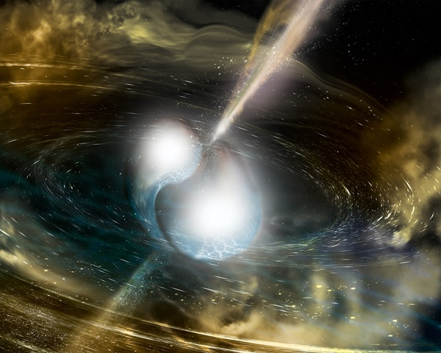
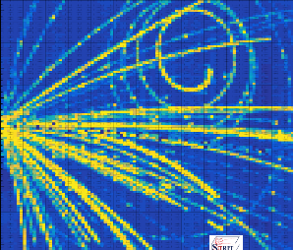
Highlights of SπRIT TPC – designed to investigate physics from neutron-star merger to nucleus-nucleus collisions
LIGO Detects a Neutron Star Merger
¹³²Sn+¹²⁴Sn @ E/A=270 MeV
Betty Tsang, NSCL/FRIB
Michigan State University
AT-TPC Workshop, Jan 17-19, 2018 Santiago de Compostella, Spain

Slide 2
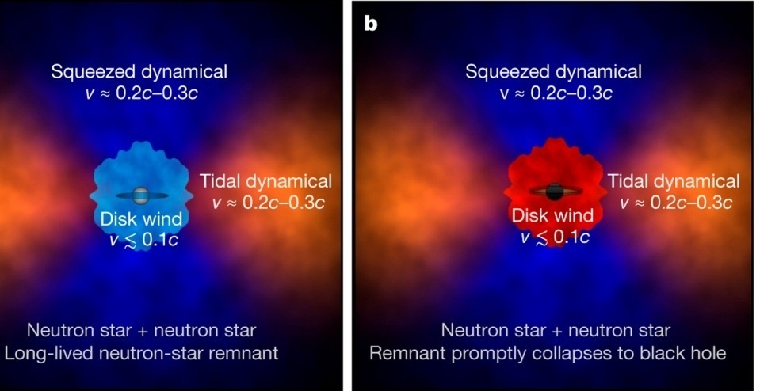
Nuclear Equation of State determines properties of neutron stars and the fate of merger of Neutron Stars
Pion spectral ratios
D Kasen et al. Nature 551, 80–84 (2017) doi:10.1038/nature24453
Laboratory Experiments
conceived ~ 2007.
Phys. Rev. C 95, 044614 (2017)

Slide 3
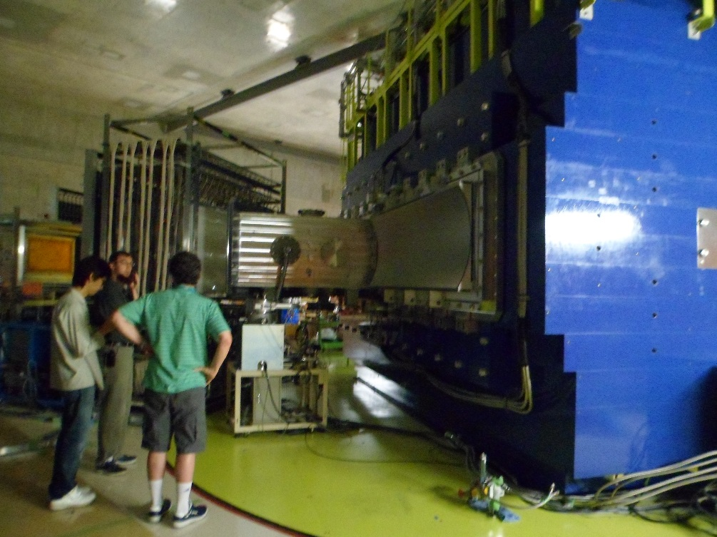
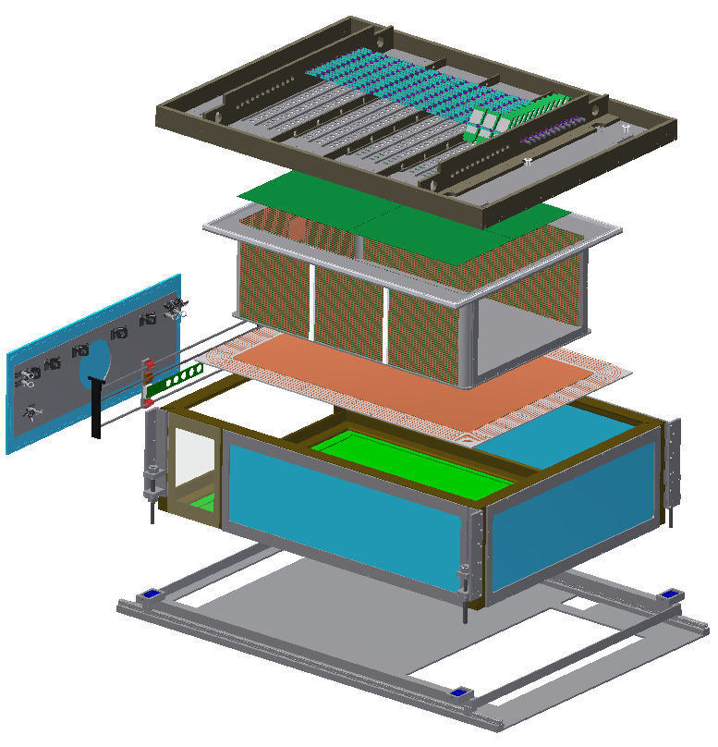
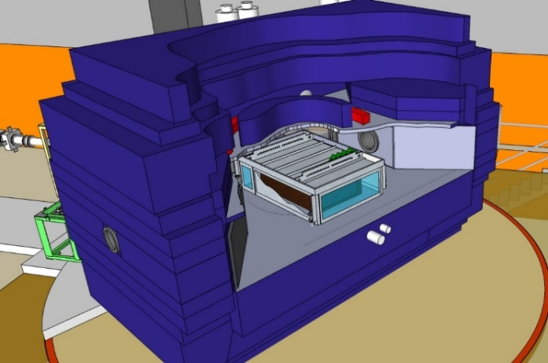
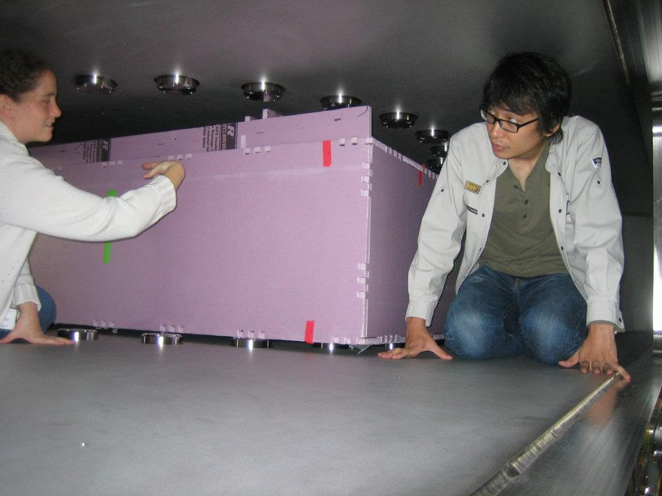
SAMURAI Spectrometer
Will it fit?
Yes!
Acknowledgement: Jon Barney for some of the interesting graphics in this talk
Summer, 2011
Barney, Justin, Chan

Slide 4



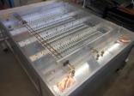

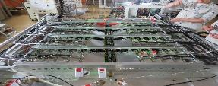
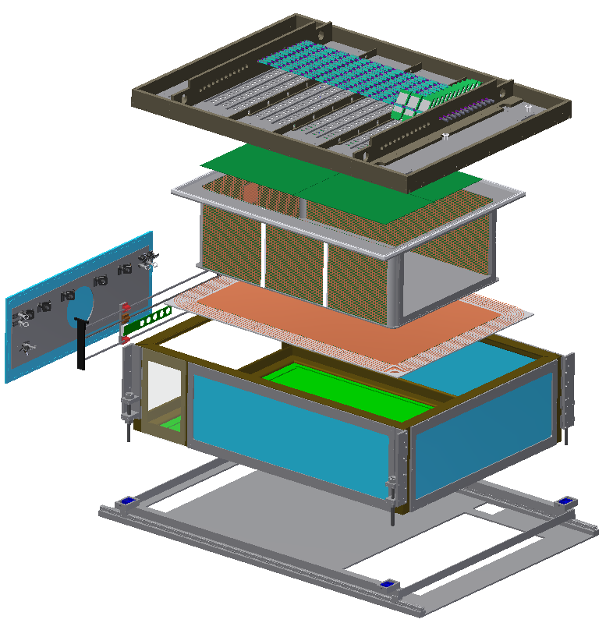
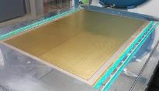
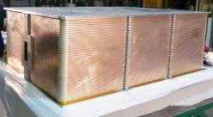
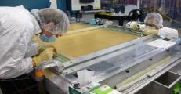
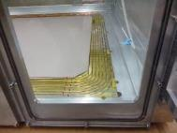
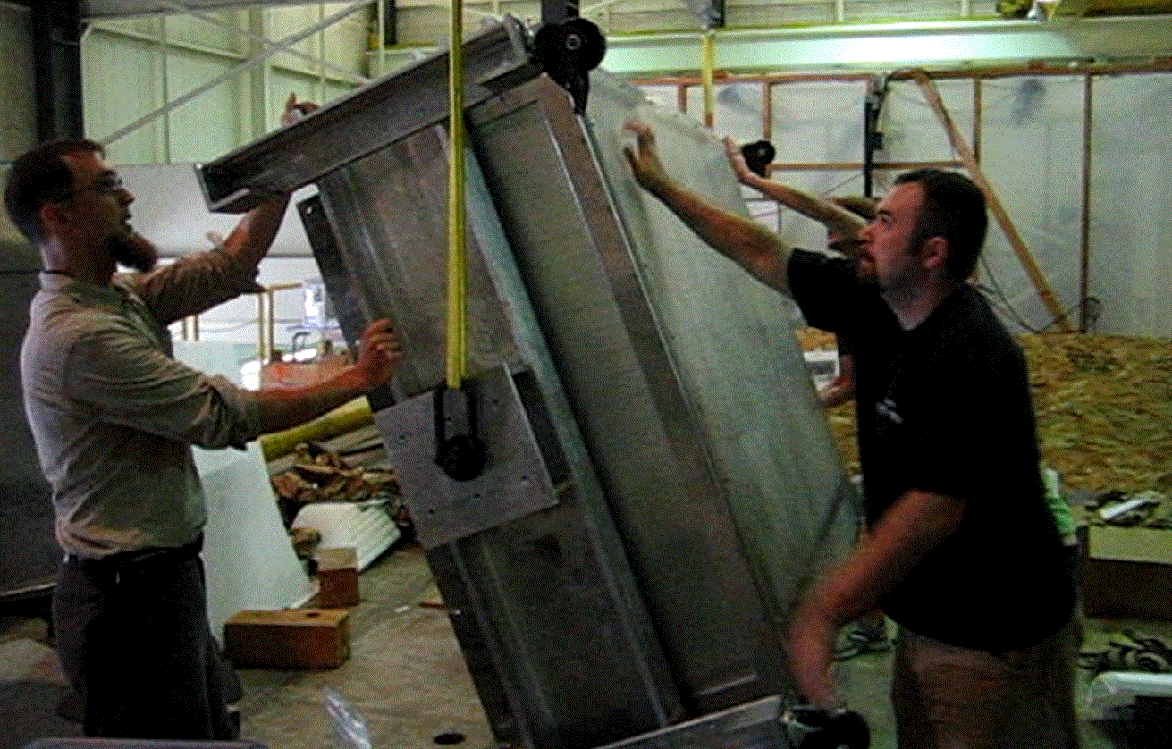
Rigid Top Plate
Primary structural member,
reinforced with ribs.
Holds pad plane and wire planes.
Front End Electronics
STAR FEE for testing,
ultimately use GET
2011-2013
joined by Korea, China, Poland, Germany
Pad Plane (12096 pads)
Mounted to bottom of
top plate. Used to measure particle ionization tracks
Joint US(DOE) + Japan (MEXT) project
Field Cage
Defines uniform electric field.
Contains detector gas.
Wire Planes (e- mult)
Mounted below pad plane.
Provide signal multiplication and gate for unwanted events
Beam
1.5m
0.5m
1m
Calibration Laser Optics
Target Mechanism
Voltage Step-Down
Prevent sparking from cathode (20kV) to ground
Thin-Walled Enclosure
Protects internal
components, seals
insulation gas volume, and supports pad plane while allowing particles to continue on to ancillary detectors.
NIMA784, 513-517 (2015)
Rails
For inserting TPC into SAMURAI vacuum chamber

Slide 5

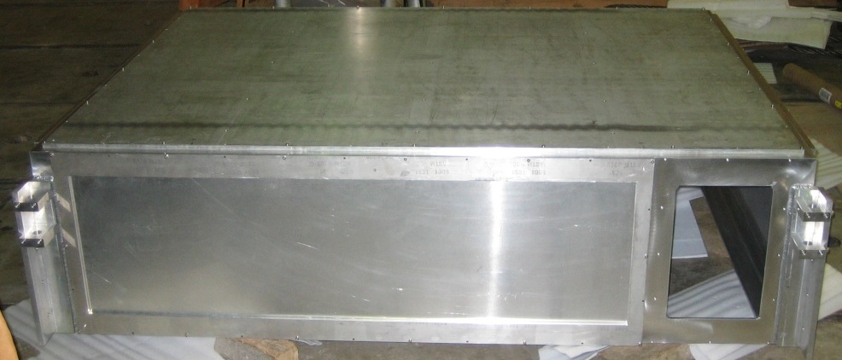
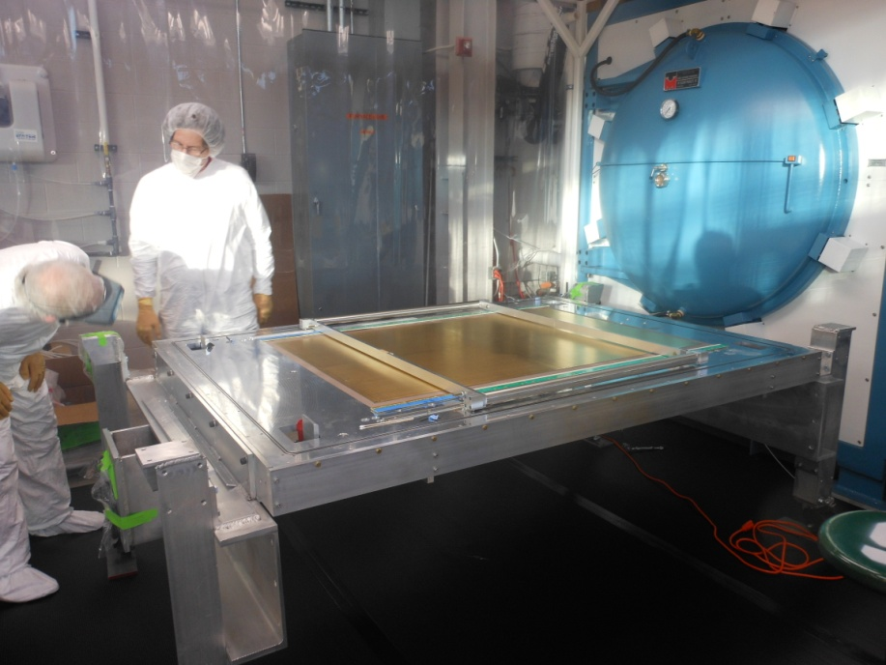
Enclosure
A. McIntosh, Texas A&M
Aluminum, plus Lexan windows
Skeleton: Angle bar, welded and polished for sealing.
Sides & Downstream Walls: framed aluminum sheet, to minimize neutron scattering
Bottom Plate: Solid, to support voltage step-down
Upstream Plate: Solid, ready for beamline coupling hole to be machined

Slide 6
SAMURAI TPC: Exploded View
Rigid Top Plate
Primary structural member,
reinforced with ribs.
Holds pad plane and wire planes.
Front End Electronics
Liquid Cooled
Field Cage
Defines uniform electric field.
Contains detector gas.
Pad Plane (108x112)
Used to measure particle ionization tracks
beam
Voltage Step-Down
Prevent sparking from cathode (20kV) to ground
Calibration Laser Optics
Thin-Walled Enclosure
Protects internal components,
seals insulation gas volume,
Supports pad pan while allowing particles to continue on to ancillary detectors.
Target Mechanism
Rails
Inserting TPC into SAMURAI vacuum chamber

Slide 7
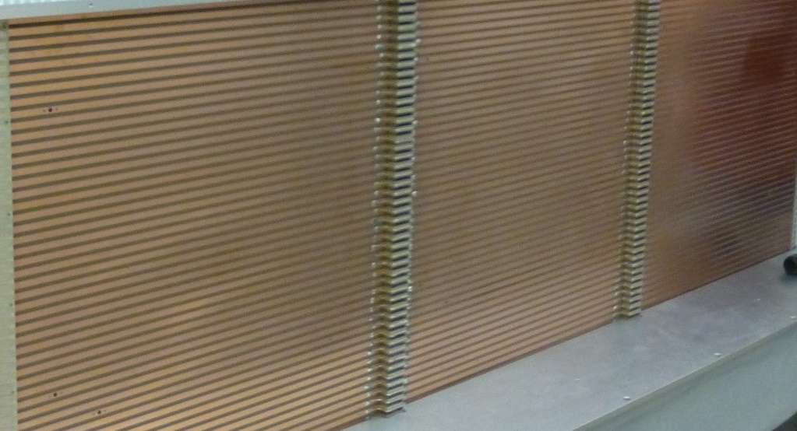
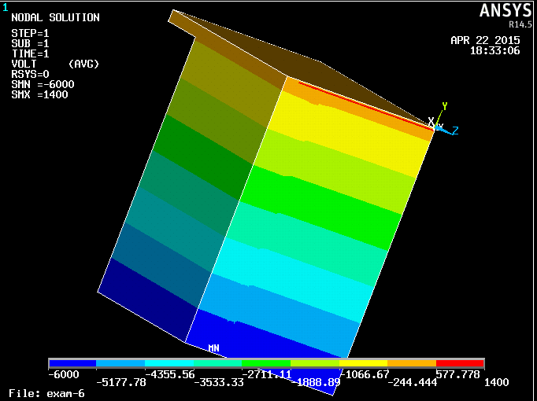
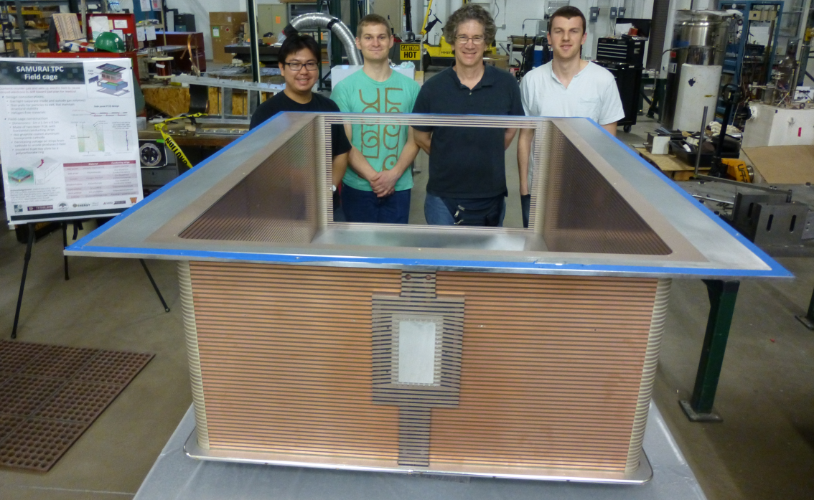


Field cage
Thin walls for particles to exit
Gas tight (separate gas volumes)
Electric field equipotential distribution with ANSYS
z
30
cm
Top plate
50
cm
avalanche area
y
Made of two layer PCB’s
Field cage wall
drift area
0.035 mm Cu
1.59 mm G10
50
cm
x
Y.F Zhang, BNU
Justin Estee
exit window electrodes will be evaporated on large Kapton foil
Notes:
Field non-uniformities cause electron drift lines to bend (worsens spatial resolution)
Thin walls allow particles to exit
Gas-tight to allow different gases in FC and in rest of enclosure
Prevent sparking, AT mode

Slide 8
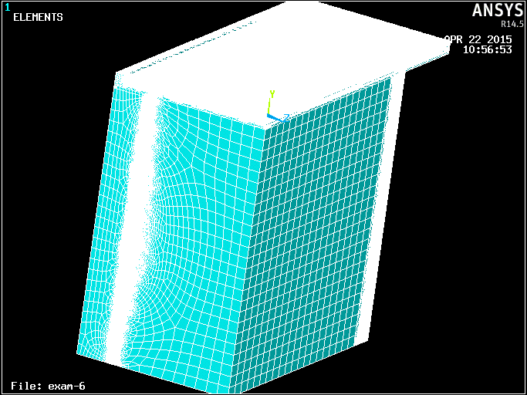
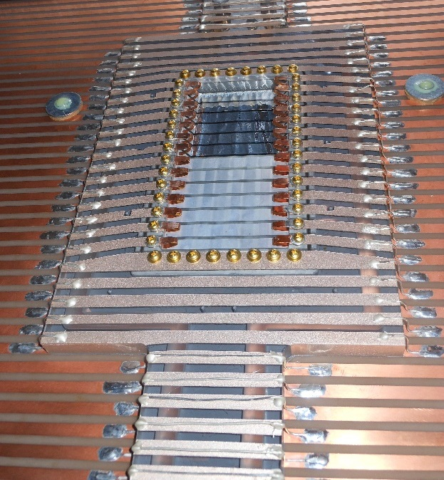
Window modeled by 3D ANSYS
Aluminum entrance window electrodes evaporated on PPTA
Pad plane & wire regions
Region of rear strips
Window frame
Region of strips
Y.F Zhang, BNU

Slide 9
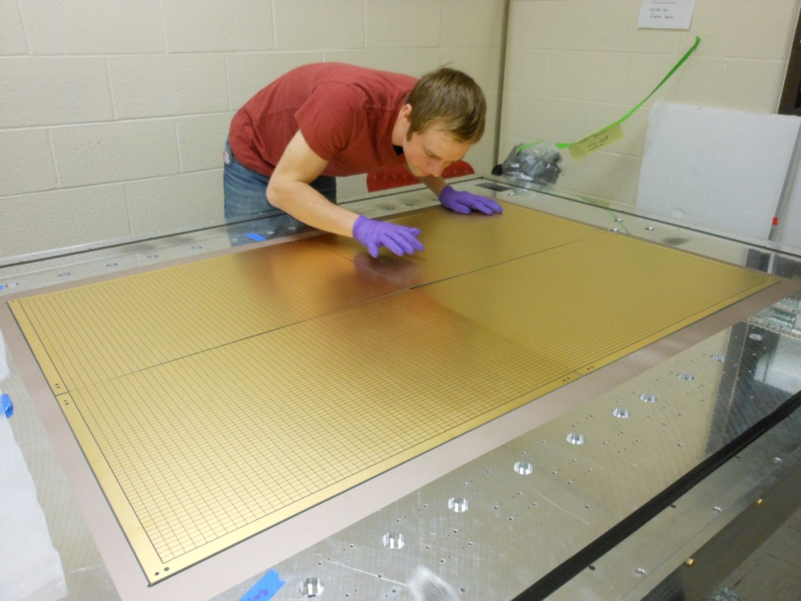
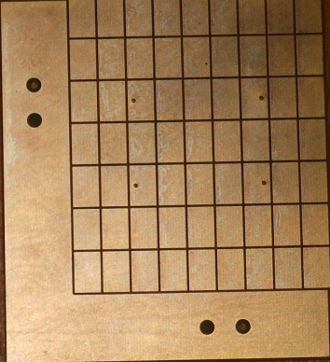
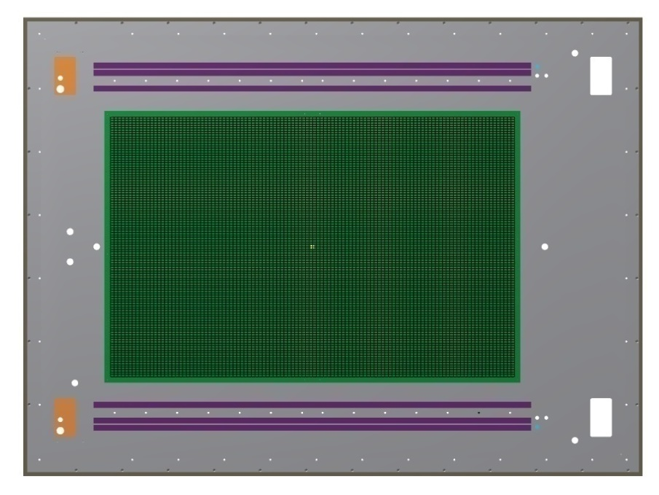
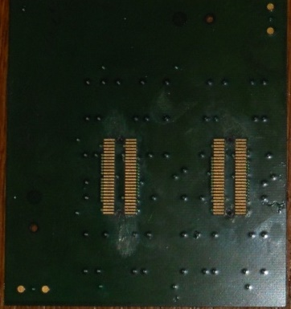

Pad plane layout for 12,096 pads=112(12mm) x108(8mm)
16x12 units
1 unit= 63 (7x9) pads
Jon Barney on xcel sheet
Unit cell = 32+31 + 1(empty) channels

Slide 10
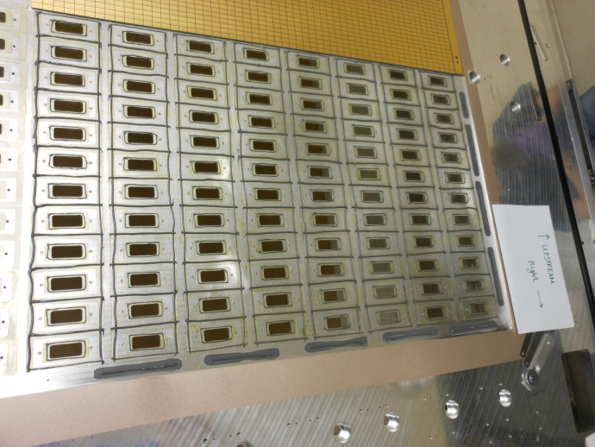
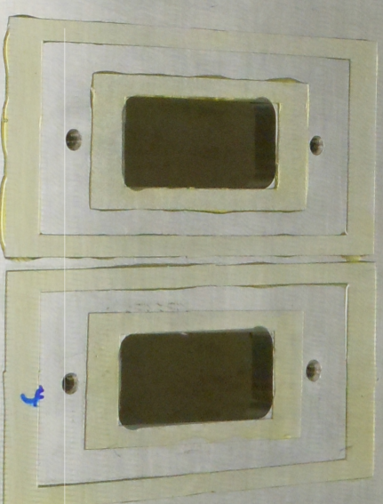
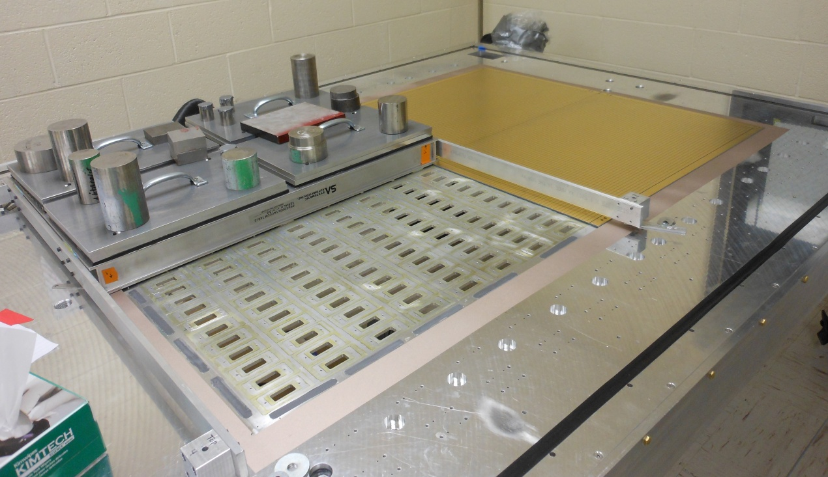
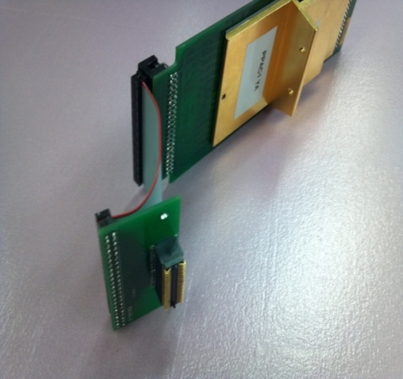
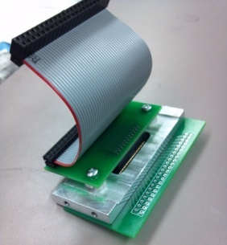
Gluing and Assembly of pad planes
Bec Shane
Jon Barney
Justin Estee
R Showalter
Cable connection to STAR FEE card
Mock up of lid and pad plane
Choice of
Samtec connector
reduces risks
of connector failure
Spring loaded connection to pad plane through lid

Slide 11
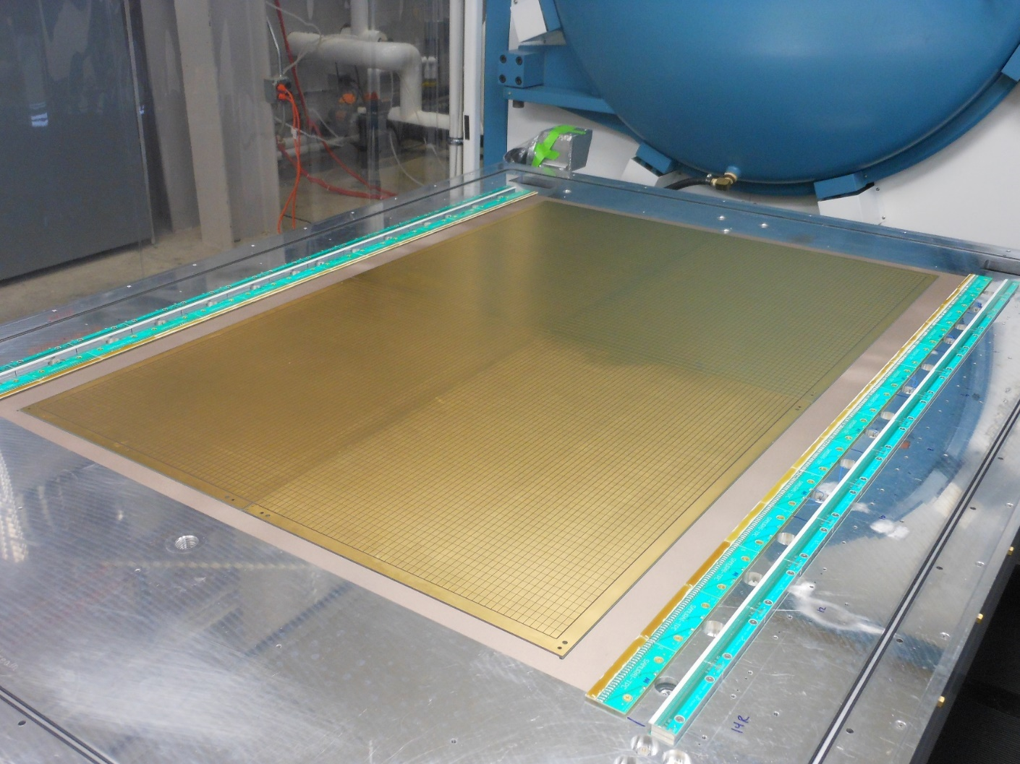
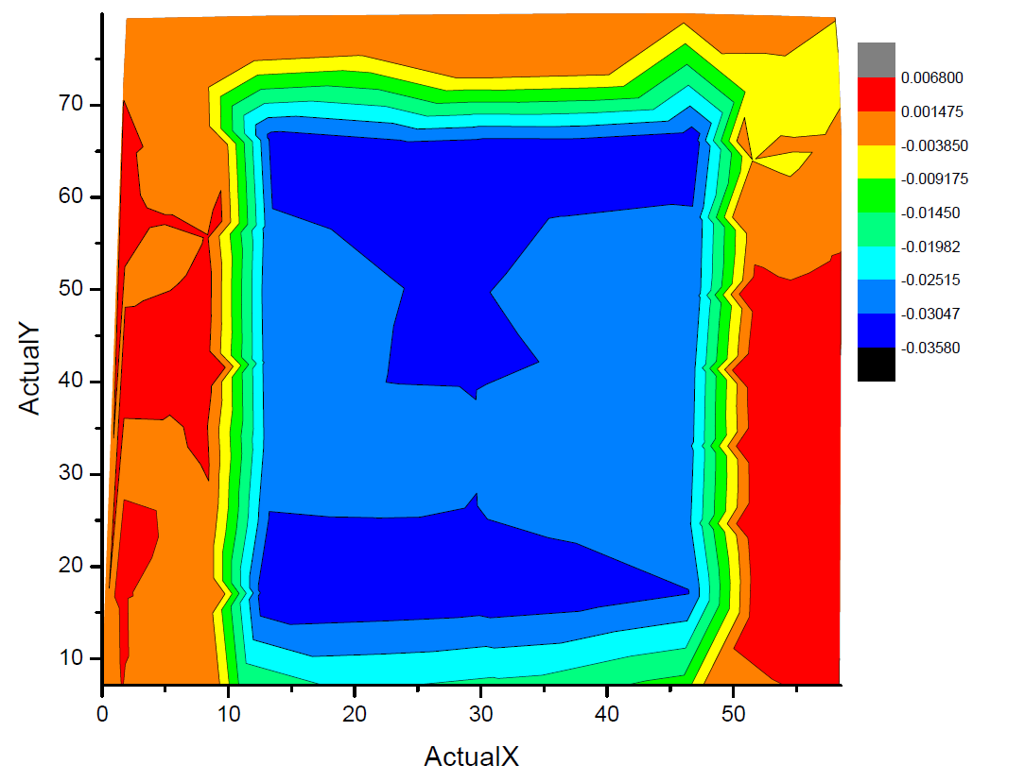
Leveling of top plate with laser
Y(in)
+.010”
.000”
-.020”
20 40 60
-.040”
0 20 40 X(in)
Flat to within about o.127 mm.
we adjusted pad-plane–anode wire heights to be within 0.05 mm

Slide 12
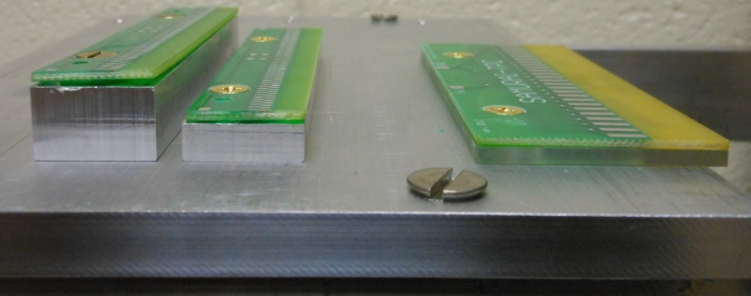
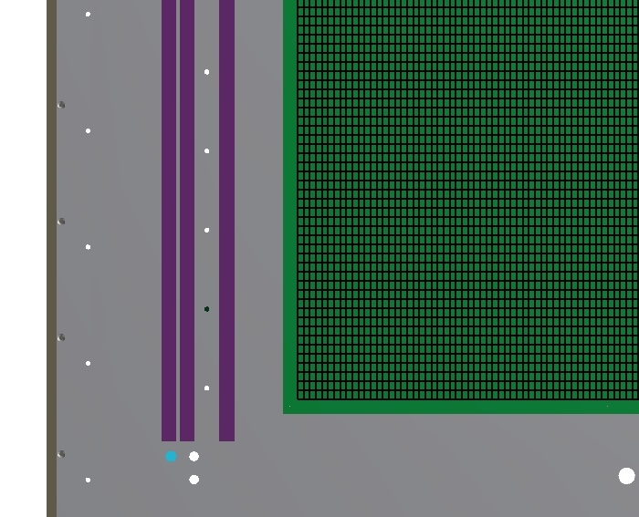
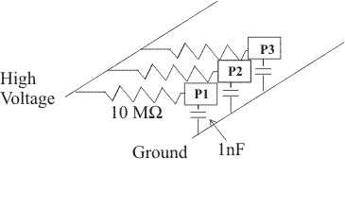
Wire planes
Gating grid (14mm)
Plane | Height (mm) | Pitch (mm) | diameter(μm)
anode | 4.05 | 4 | 20
ground | 8.1 | 1 | 75
Gating grid | 14 | 1 | 75
Ground (8mm)
Anode (4mm)
[Side view of test setup]
Boards fabricated from Rogers 4003.
Strength of glue bond to wires exceeds twice the required strength.
Ground of Pad plane goes to BNC connector, allowing switch between self triggering, and pulsing or shorting, from the outside of TPC.
Bottom view of lid
Anode board circuit
Notes:
Field non-uniformities cause electron drift lines to bend (worsens spatial resolution)
Thin walls allow particles to exit
Gas-tight to allow different gases in FC and in rest of enclosure
Prevent sparking, AT mode

Slide 13
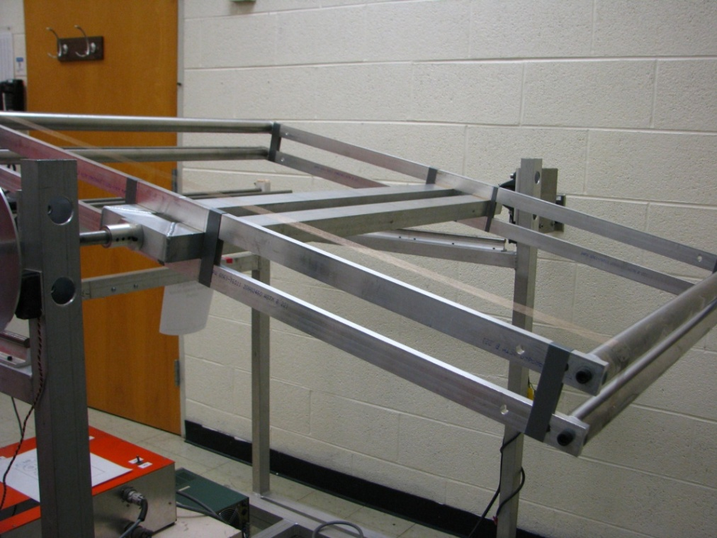
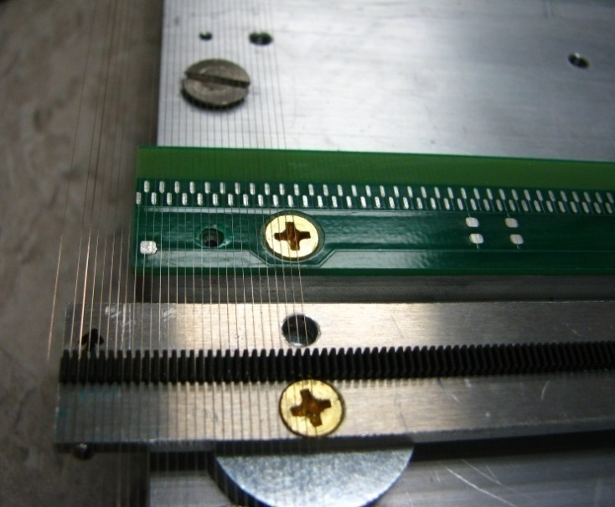
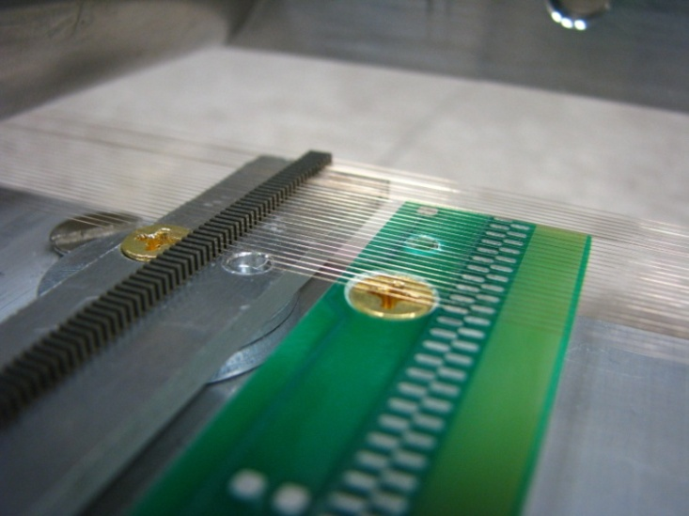
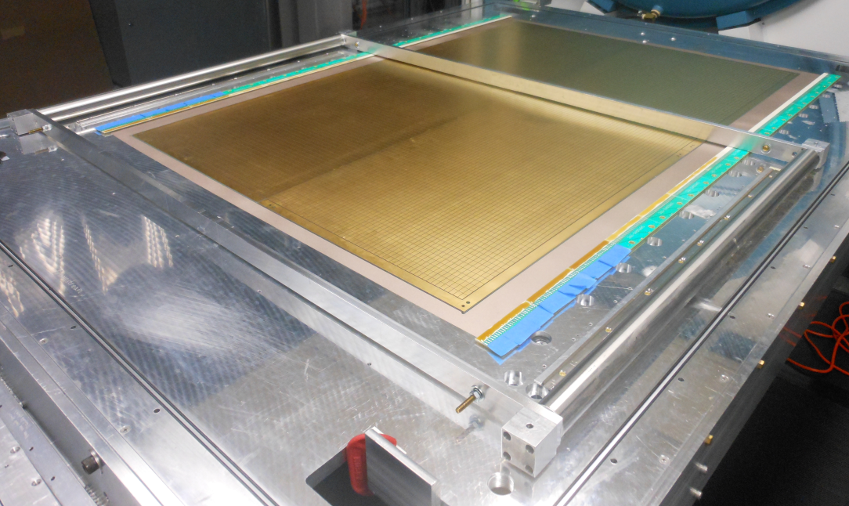
Wire planes –
Over 3000 tiny wires to solder
Shane
Powell
HiRA
comb
frame
comb
circuit board with solder pads
Notes:
Field non-uniformities cause electron drift lines to bend (worsens spatial resolution)
Thin walls allow particles to exit
Gas-tight to allow different gases in FC and in rest of enclosure
Prevent sparking, AT mode

Slide 14
open: Vgg=-115; Voff=0
Closed: Vgg=-115; Voff=35
Pads
anode wires
Ground wires
Gating grid wires
Electron Drift Lines
Electron Drift Lines
Particle Track
Particle Track
Illustration by S. Tangwancharoen

Slide 15
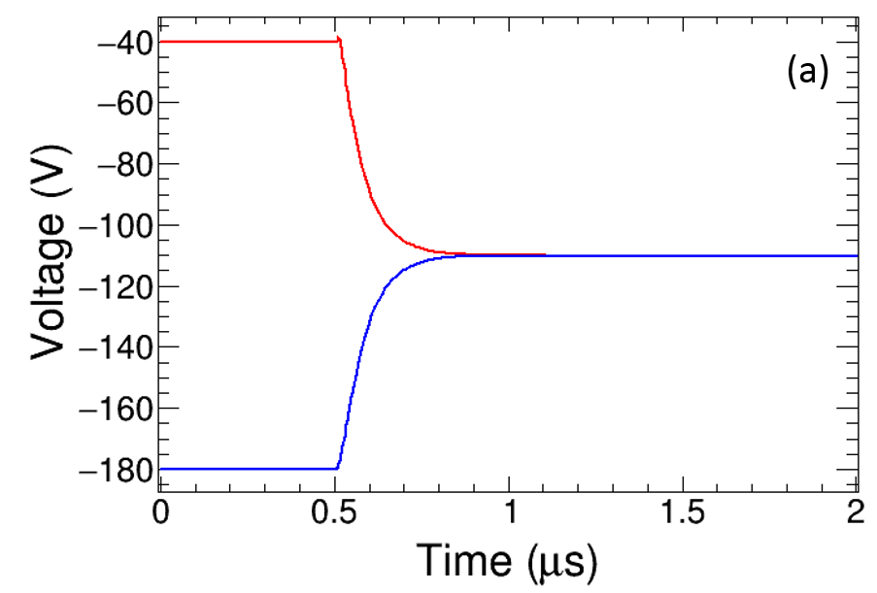
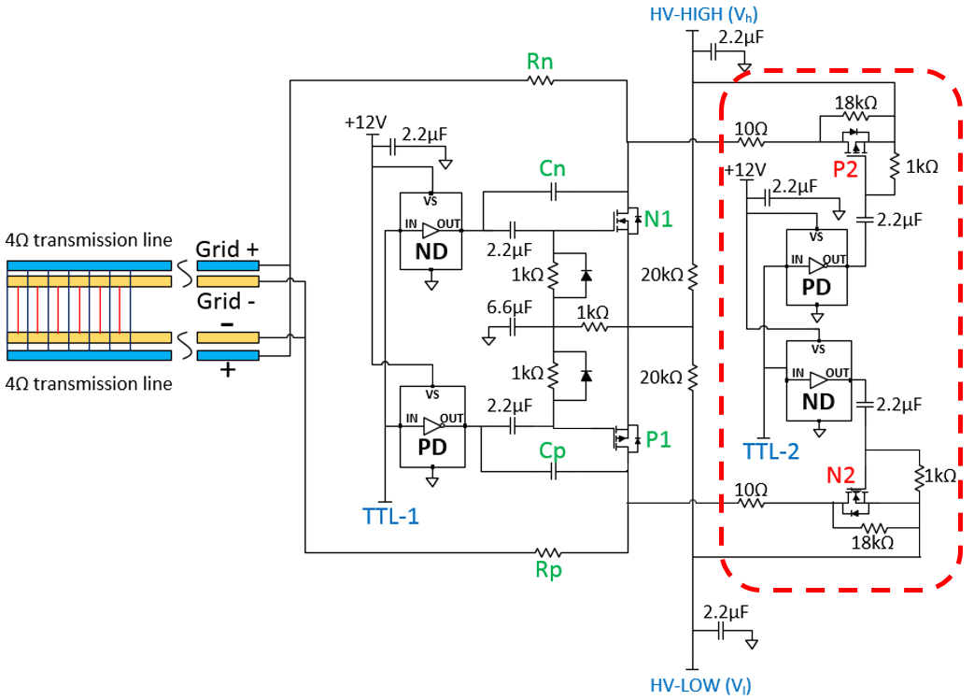
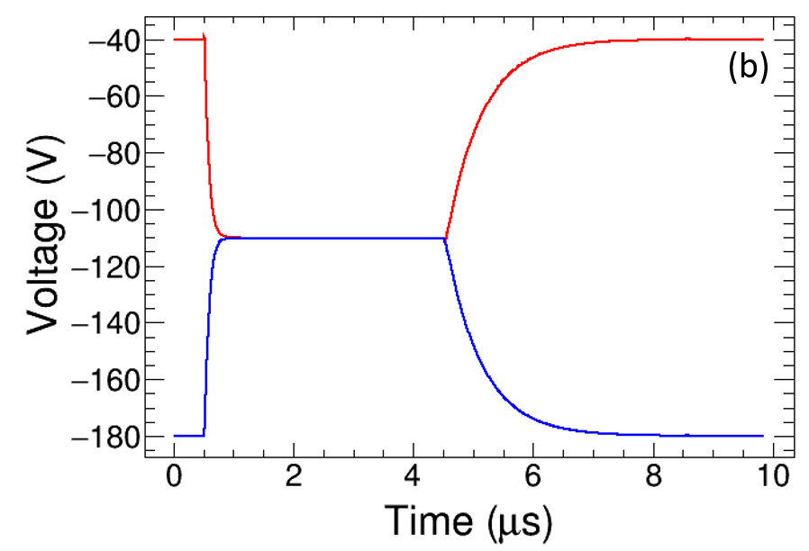
Tangwancharoen et al., NIMA 853 (2017) p.44-52
Open the gating grid in less than 0.35 µs
Close the gating grid ~3 µs

Slide 16

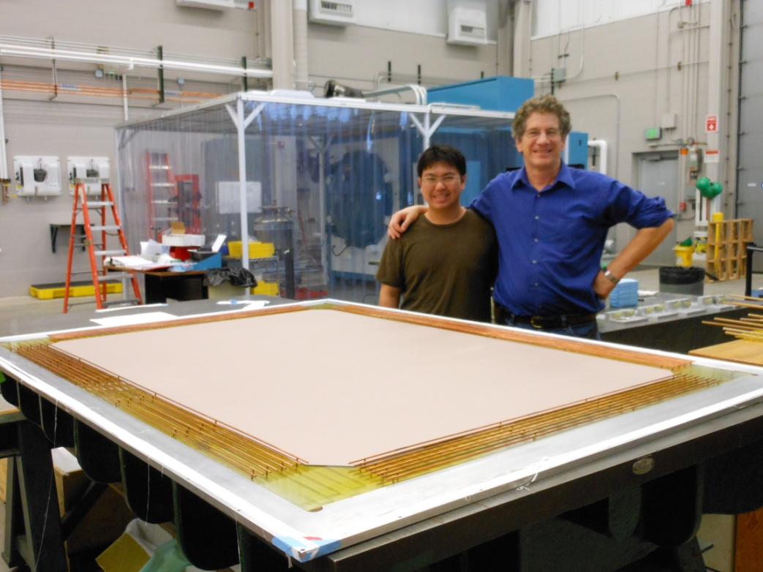
Cathode & Voltage step down
Situated about 6 mm below the cathode
Polycarbonate (6 mm) epoxied to bottom plate of enclosure.
Copper-silver epoxy electrode surface below cathode is biased to the cathode voltage.
Eight concentric copper rings step the voltage down from cathode HV to ground. This has been tested to 20 kV.

Slide 17
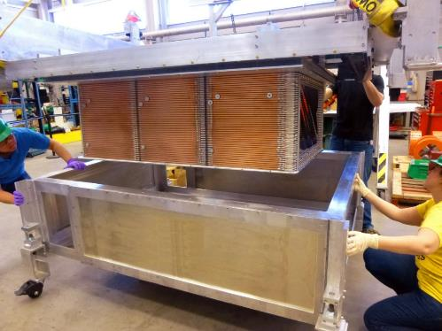

May, 2013
HiRA group
March, 2016

Slide 18
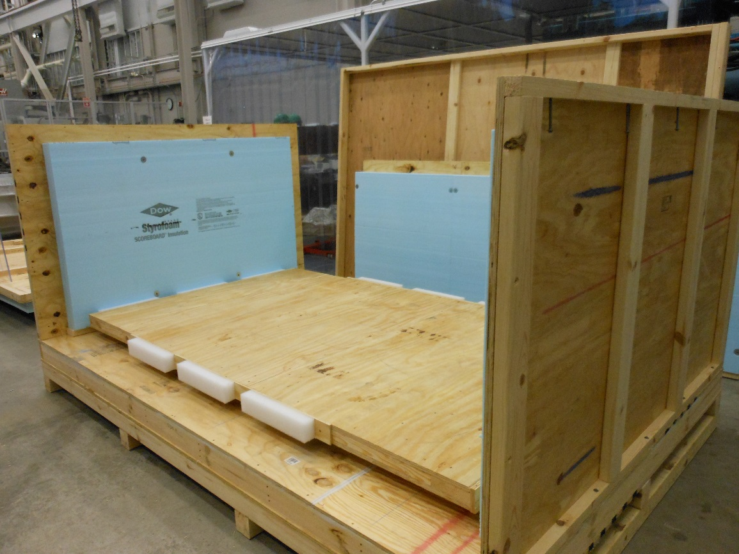
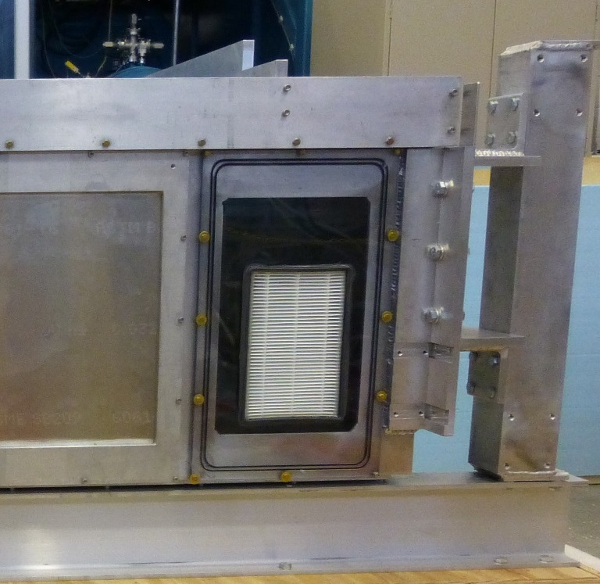
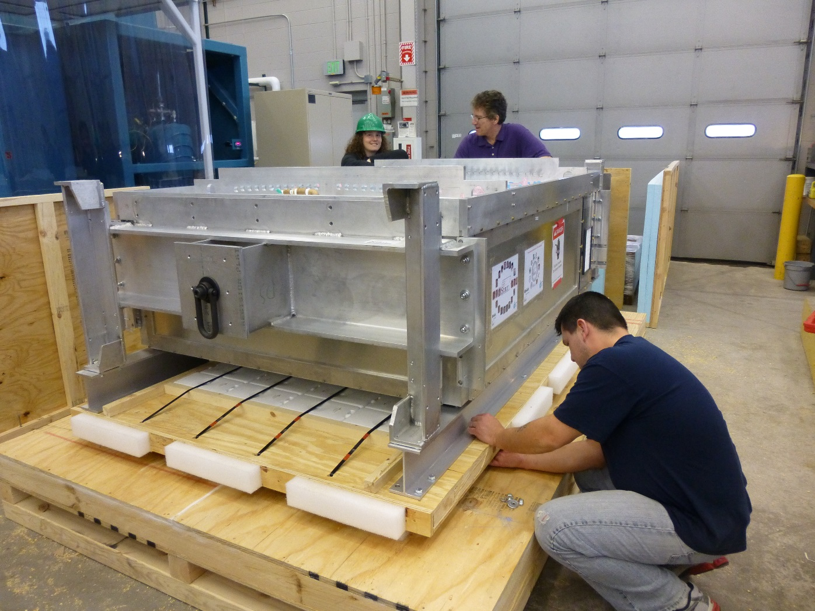

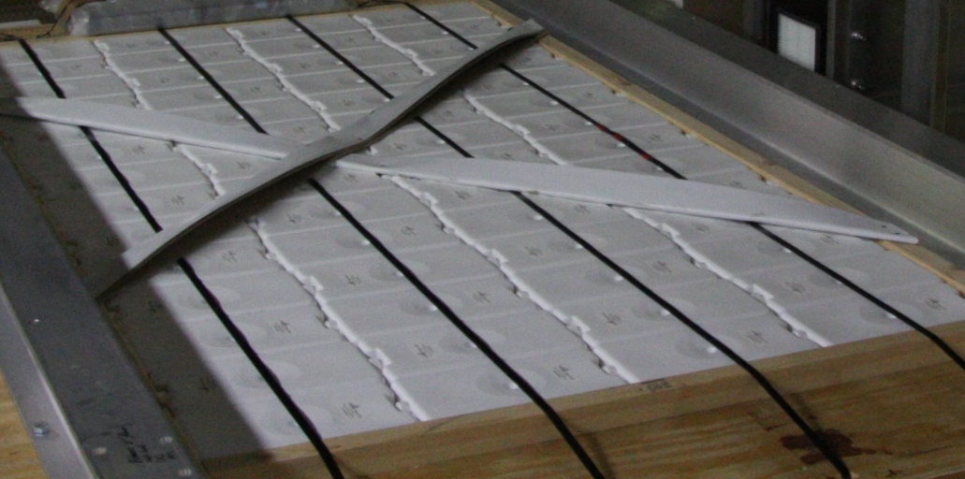
Packing to ship
–MSU packaging department
Damp out vibrations
Equilibrium pressure
in and out during flight
Constant temp ~23 deg
“Phase-change” material

Slide 19
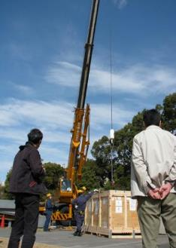






May, 2013
Feb, 2014
July, 2014
Feb, 2014
August, 2015
March, 2016

Slide 20


Katana Veto and trigger wall
Scintillator Trigger Array
Notes:
This is the day one experimental setup. THe trigger scintillaroto sits int he magnitic field, so we use MPPC’s Seems to work wel. our open geomety allos us to detector neutrons and charged particle downstream in scintillator arrays.

Slide 21


Slide 22


Jacob Crosby showing Paul Gueye cosmic shower with Google Cardboard VR.
Shane et al., NIMA 784 (2015) 513
J. Crosby

Slide 23


Experimental Setup
Primary | Beam | Target | E_{beam}/A | δ_{sys} | evt(M) | 2016
¹²⁴Xe | ¹⁰⁸Sn | ¹¹²Sn | 269 | 0.09 | 8 | 4/30-5/4
 | ¹¹²Sn | ¹²⁴Sn | 270 | 0.15 | 5 | 5/4-5/6
²³⁸Ｕ | ¹³²Sn | ¹²⁴Sn | 269 | 0.22 | 9 | 5/25-5/29
 | ¹²⁴Sn | ¹¹²Sn | 270 | 0.15 | 5 | 5/30-6/1
Z=1,2,3 |  | 100, 200 |  | 0.6 | 6/1
Easiest thing is spectrometer for pions

Slide 24



Types of events (top views: x vs. z)
Reaction on target: good event
Target
Reaction upstream: before target
Beam pipe
reaction with gas inside TPC:
Active target events;
Active Veto
x(mm)
z(mm)

Slide 25

Particle ID spectra
¹³²Sn+¹²⁴ Sn
³He
⁴He
p
d
t
π⁻
π⁺

Slide 26



Postdoc position available
On Site Experimenters
J. Barney (MSU)
G. Cerizza (MSU)
J. Estee (MSU)
B. Hong (Korea U)
T. Isobe (RIKEN)*
G. Jhang (Korea U)
M. Kaneko (Kyoto U)
M. Kurata-Nishimura (RIKEN)
P. Lasko (IFN, Krakow)
H. Lee (RISP)
J. Lee (Korea U)
J. Lukasik (IFN, Krakow)
W. Lynch (MSU)*
A. McIntosh (TAMU)
P. Morfouace (MSU)
T. Murakami (Kyoto U)*
S. Nishimura (RIKEN)
P. Pawlowski (IFN, Krakow)
C. Santamaria (MSU)
R. Shane (MSU)
D. Suzuki (RIKEN)
B. Tsang (MSU)*
Y. Zhang (Tsinghua U)
*spokespersons
collaboration
Other Participants: H. Baba, Chica, Ichihara, Kondo, T. Nakamura, H. Otsu, Saito, Togano
NeuLAND Collaboration: Leyla Atar, Tom Aumann, Igor Gasparic, A. Horvat, H. Scheit

Slide 27

































Thank you
construction

