Slide 1
Performance of SPiRIT-TPC with GET readout system for heavy ion collision experiment
RIKEN Nishina Center
Tadaaki Isobe for the SπRIT Collaboration
Workshop on Active Targets and Time Projection Chambers for High-intensity and Heavy-ion beams in Nuclear Physics
in Santiago de Compostela, Jan. 17th 2018
Notes:
アニョハセヨ
ネイ、イレムン、イソベイブニダ
36min

Slide 2
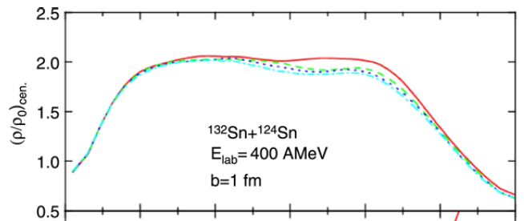
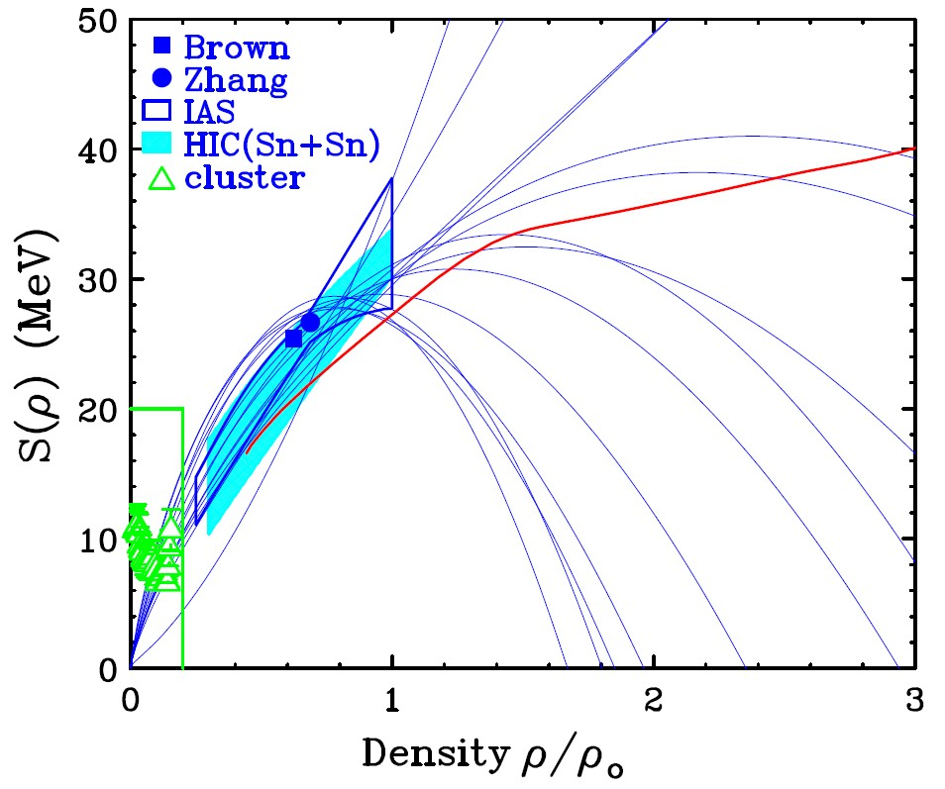

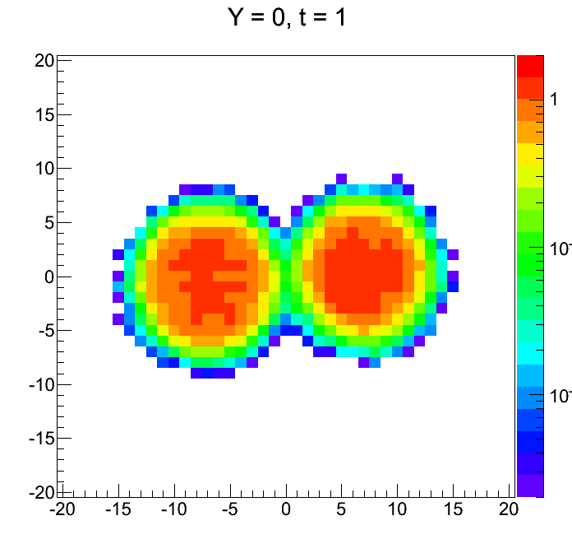
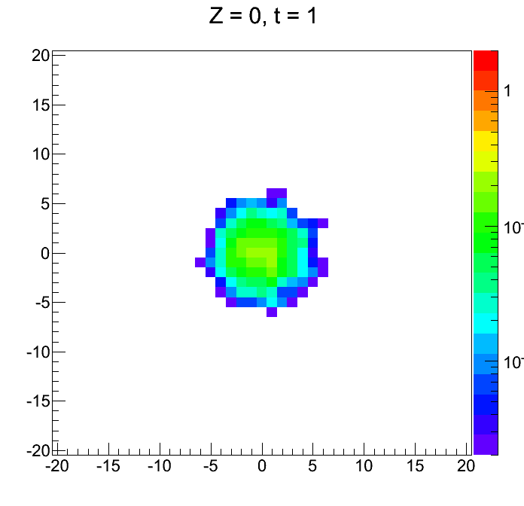
Heavy Ion Collision Exp. w/ TPC to study the density dependent symmetry energy
PRC71 (2005) 0146a08
?
?
?
IBUU by Bao
EOS of pure neutron matter
Large uncertainty on nuclear symmetry energy at ρ≫ρ₀ compared with that for ρ≦ρ₀ region.
Heavy ion collision is currently unique way to produce high dense matter in the laboratory.
New experimental project at RIBF for the study of density dependent symmetry energy. ρ~2ρ₀ nuclear matter at RIBF energy HIC.

Slide 3
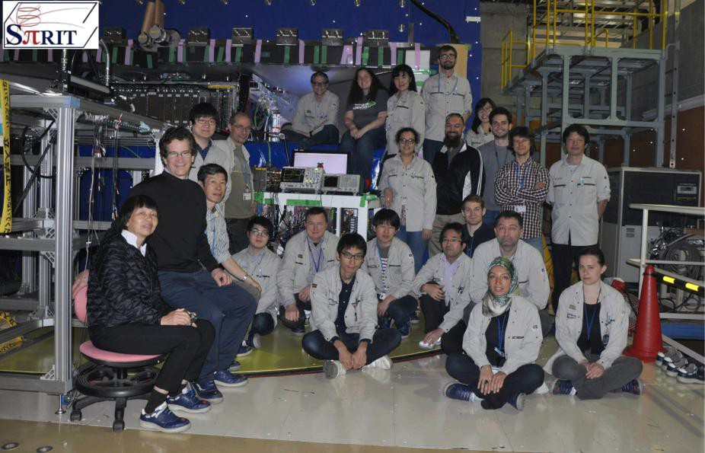
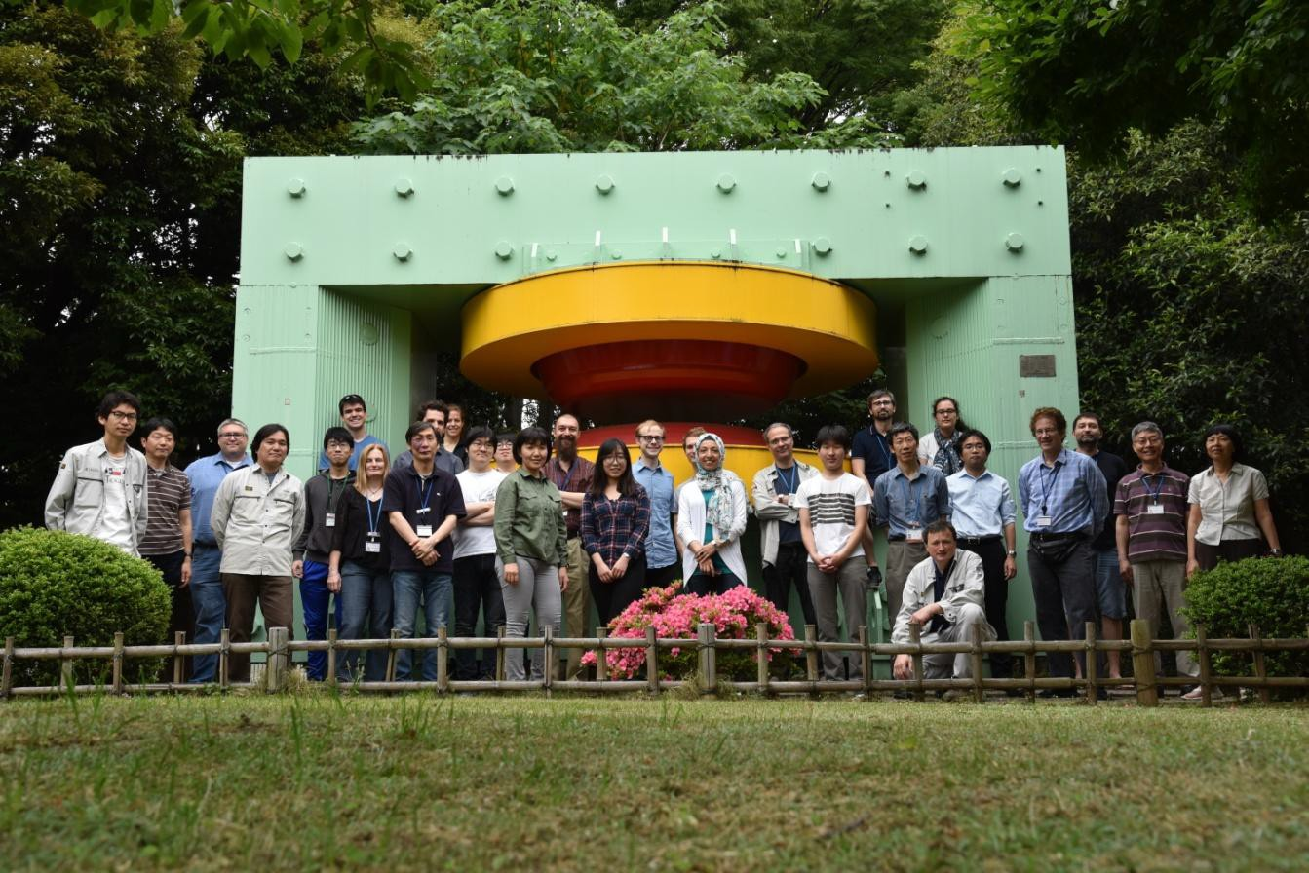


Collaboration for New Device at RIBF: SPiRIT
SAMURAI Pion Reconstruction and Ion Tracker
International Collaboration aiming to study
density dependent symmetry energy through Heavy RI Collision experiments.

Slide 4
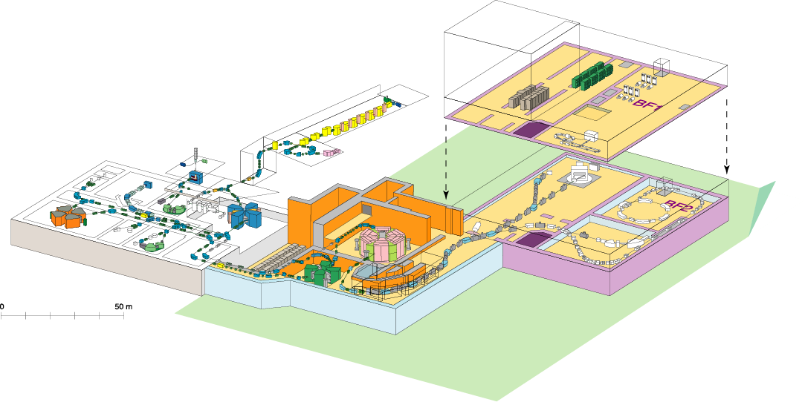
RIKEN RI Beam Factory (RIBF)
Experiment facility
Old facility
SHE
Z=113
Accelerator
RIPS
GARIS
60~100 MeV/nucleon
SCRIT
~5 MeV/nucleon
RILAC
AVF
ZeroDegree
SAMURAI
fRC
RRC
SRC
SLOWRI
IRC
RI-ring
CRIB (CNS)
SHARAQ (CNS)
BigRIPS
<10 MeV/nucleon
350-400 MeV/nucleon
New facility
  Intense (80 kW max.) H.I. beams (up to U) of 345AMeV at SRC
  Fast RI beams by projectile fragmentation and U-fission at BigRIPS
  Operation since 2007

Slide 5
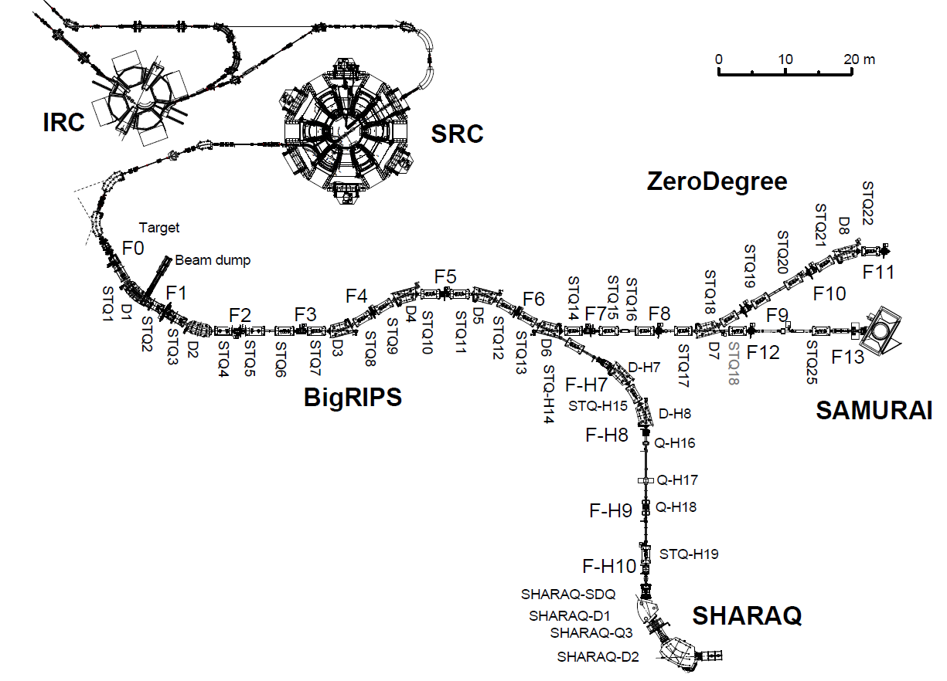
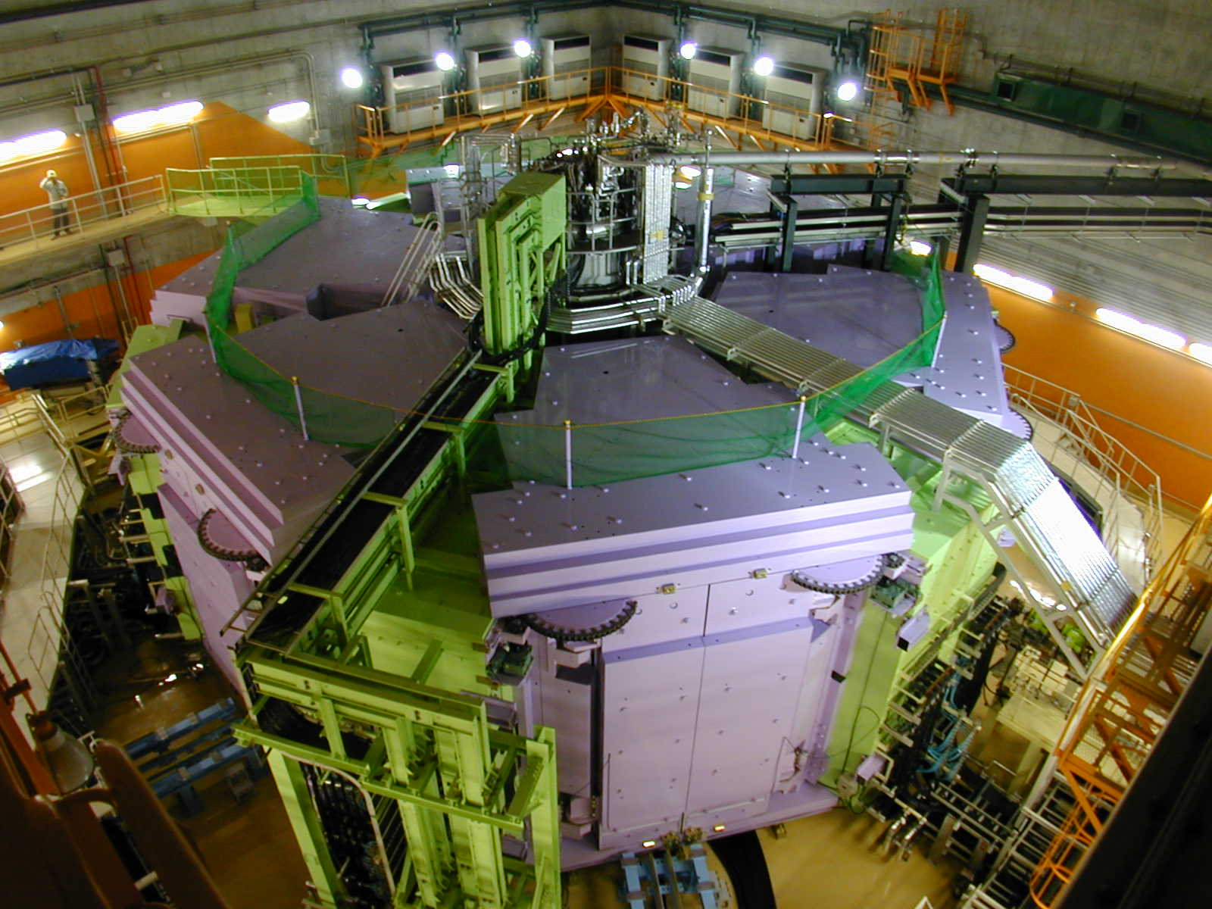
Super Ring Cyclotron
To accelerate Uranium ion to 345 AMeV.

Slide 6
F0-F11: 125.983m
ZeroDegree
BigRIPS
Max. rigidity = 9Tm
SAMURAI
Field integral =7Tm
RI beam production
High-resolution
beam line
SHARAQ by U. of Tokyo
Max. rigidity
=6.8Tm max.

Slide 7
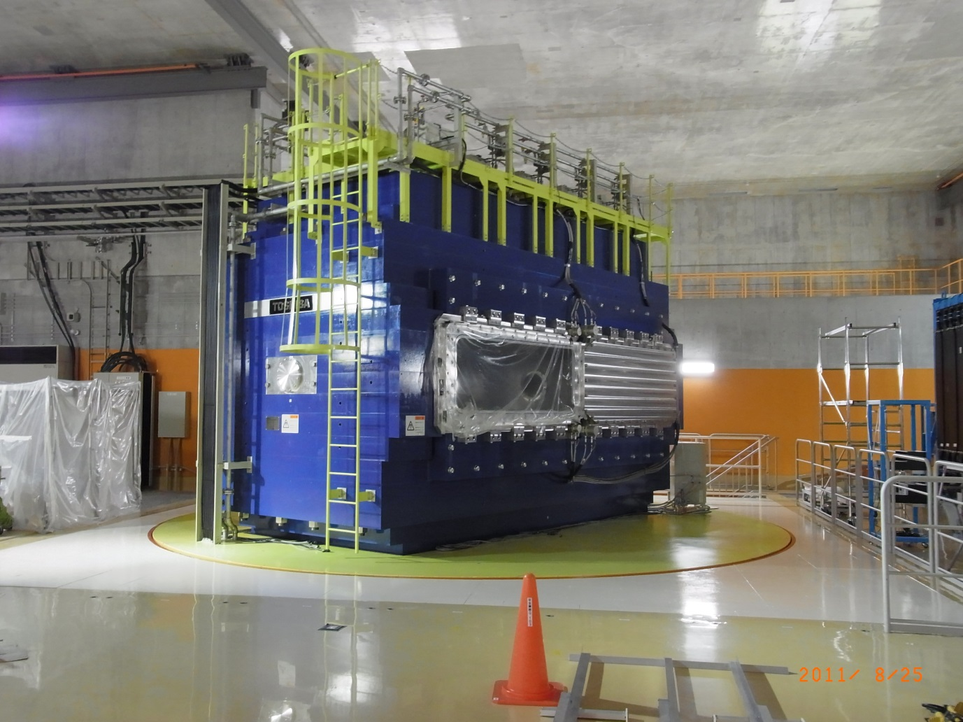
SAMURAI Spectrometer
Superconducting Analyzer for Multi particles from Radio Isotope Beams
F0-F11: 125.983m
ZeroDegree
BigRIPS
Max. rigidity = 9Tm
SAMURAI
Field integral =7Tm
High-resolution
beam line
B<3T
R: 1m
Gap: 80cm
SHARAQ by U. of Tokyo
Max. rigidity
=6.8Tm max.

Slide 8
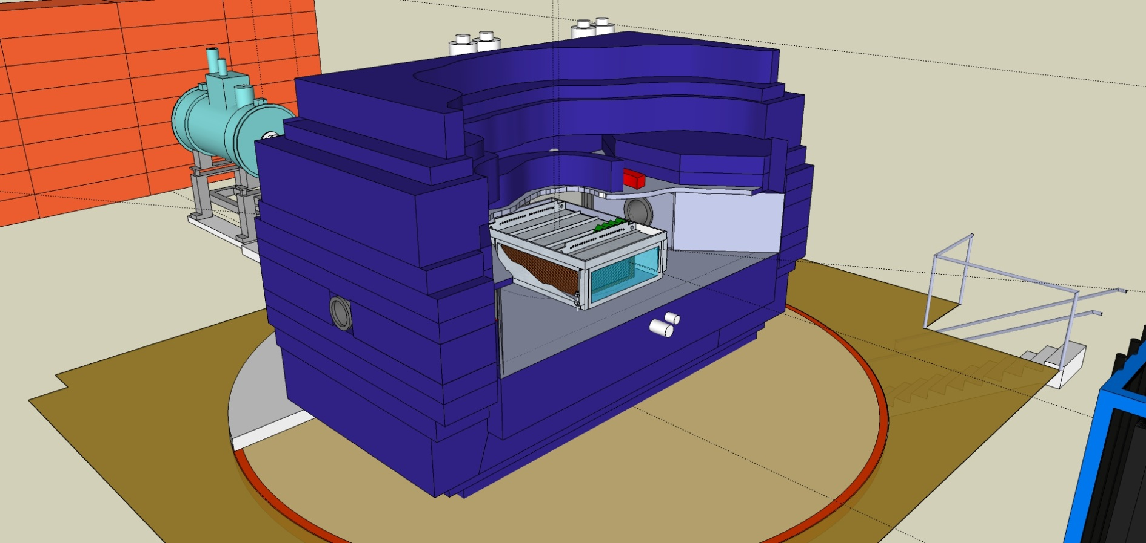
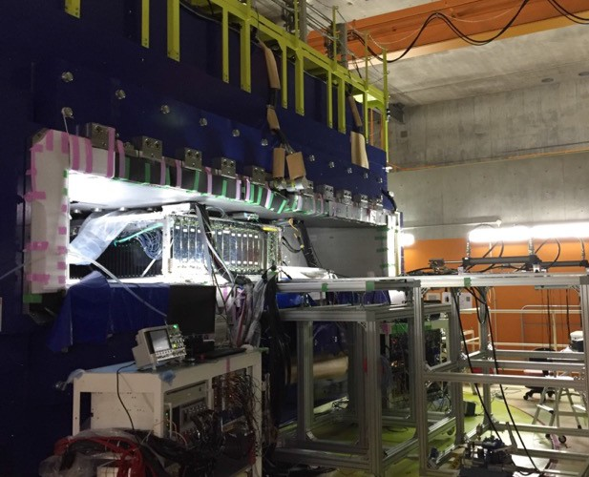

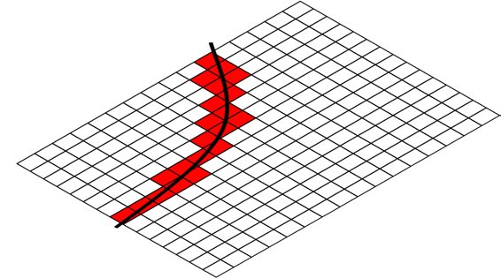
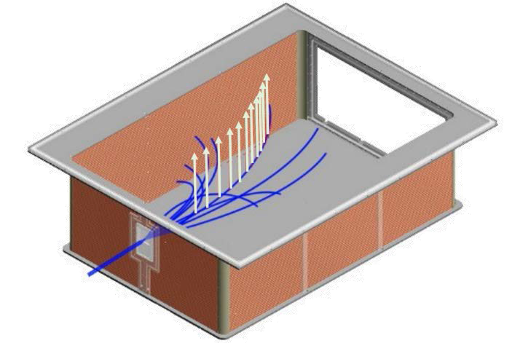
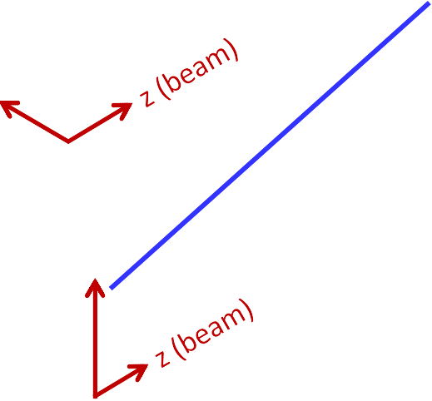

SPiRIT-Time Projection Chamber
for the measurement of charged particles in HIC
NIMA 784 (2015) 513
SAMURAI dipole magnet
80cm
B field
dE/dX – Bρ particle identification.
Readout with ~12000 pads.
Operation under B~0.5T
53cm
E field
x
y

Slide 9
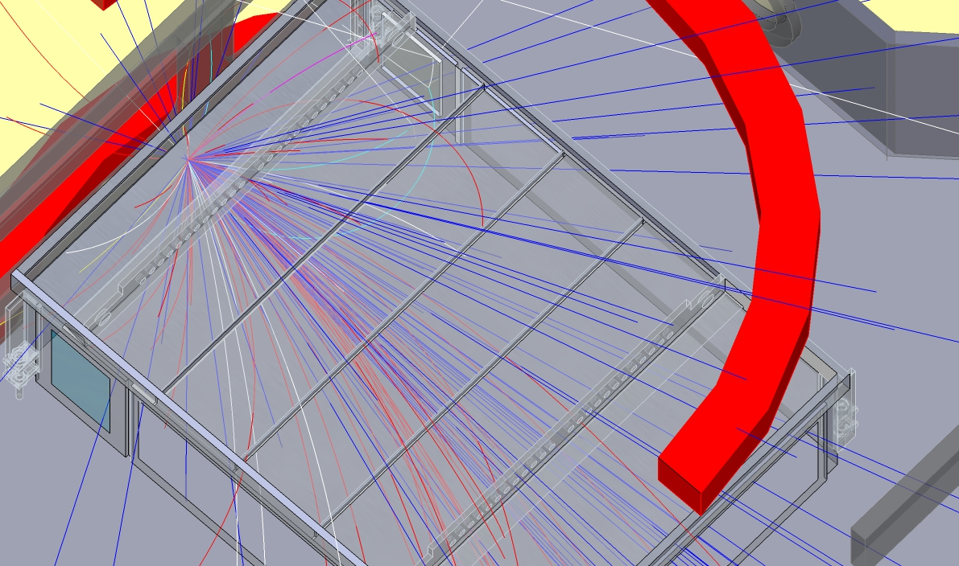
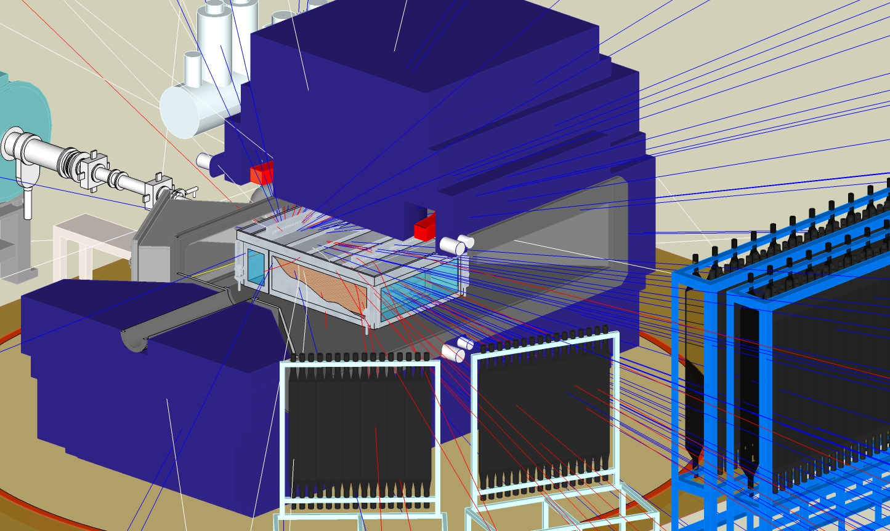
HIC Simulation
π⁻
π⁺
b~3fm

Slide 10
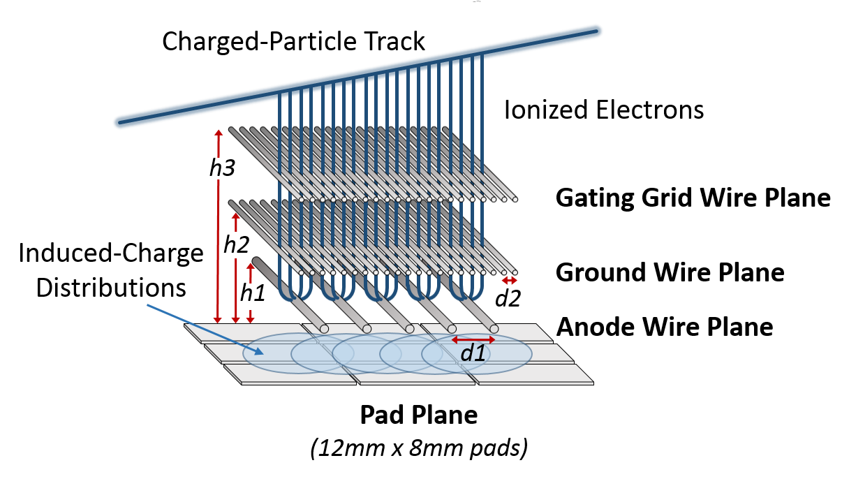
Basic design of TPC stable operation is most important
Z: beam
Based on Bevalac EOS TPC.
Wire amplification with P10 gas (1atm).
Target at the entrance of chamber.
~12000 readout pads.
Multiplicity: 10~100.
Beam passes through chamber as well.
12mm
X: wire
8mm
Y: drift
B,E
112pads (1344mm)
108pads
(864mm)
beam
53cm
drift

Slide 11

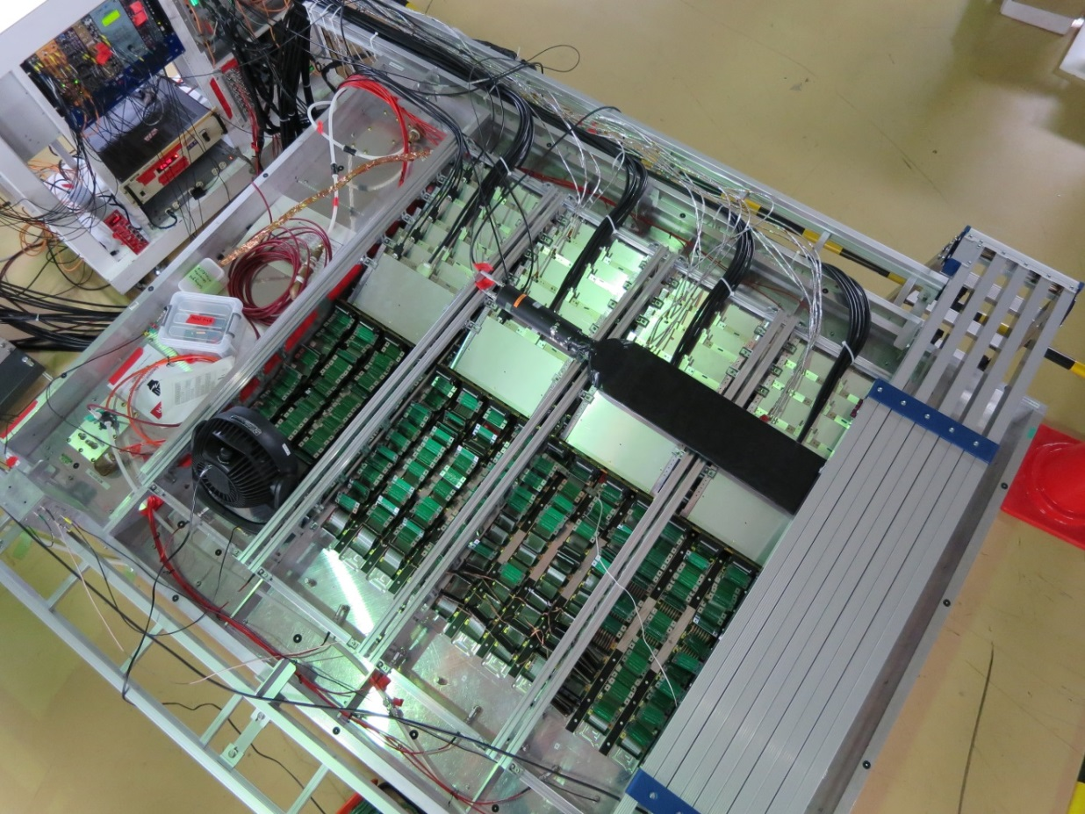
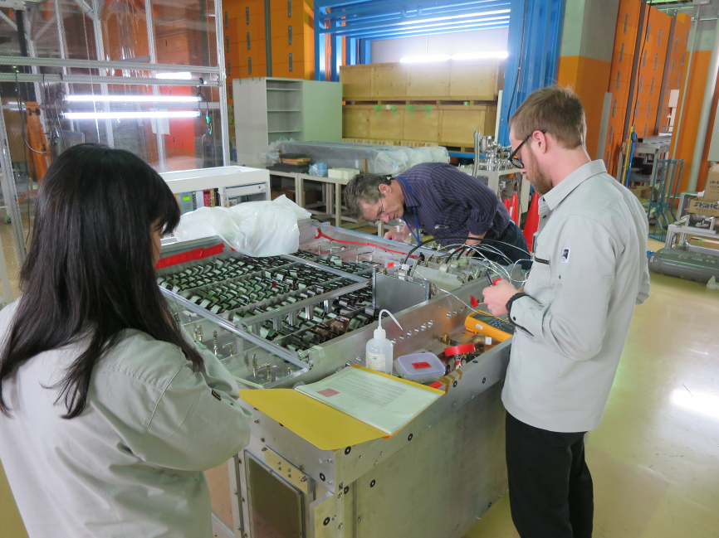
Readout Electronics for TPC: GET
GET: state-of-art general electronics for TPC
  Integrated system from Frontend to DAQ.
Configurable even after the installation
Ch. by ch. hit registering
  Selective digitization
Checking the connection one board by one board.
Half of electronics on TPC

Slide 12
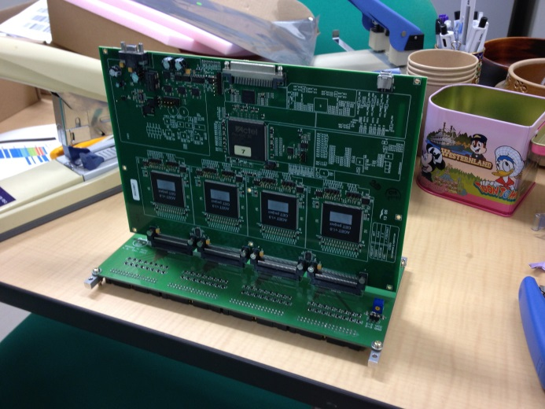
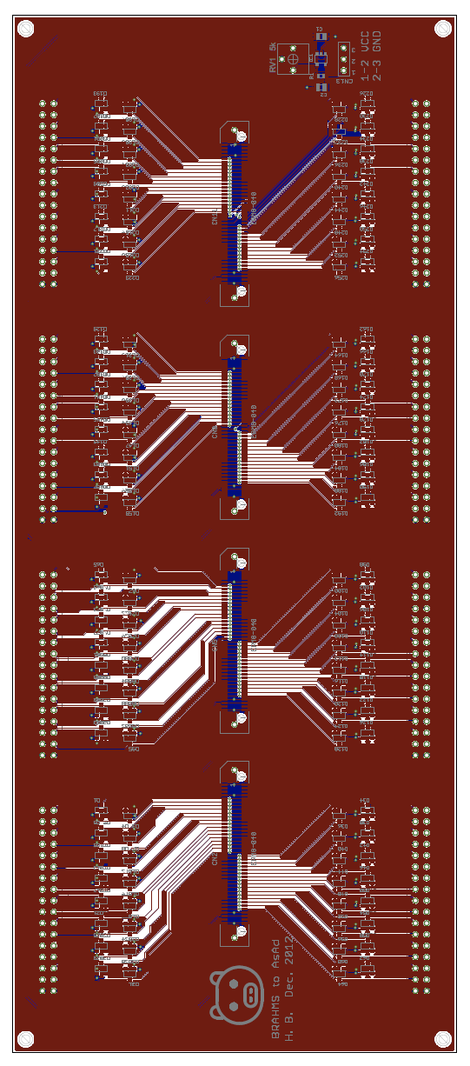
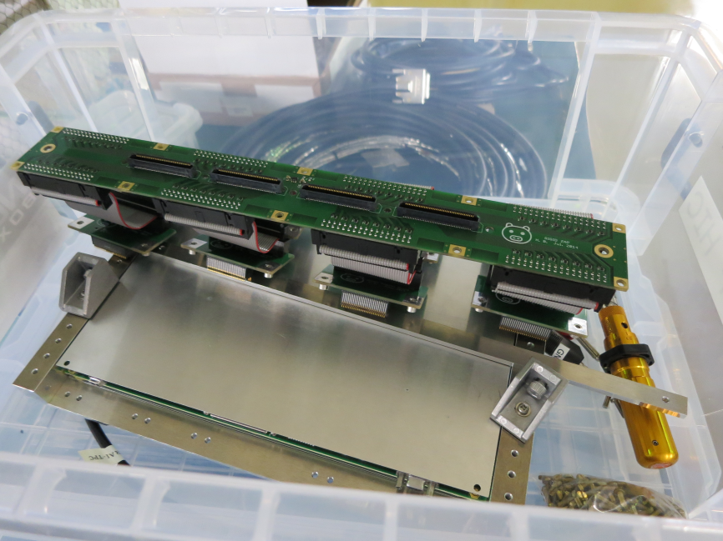
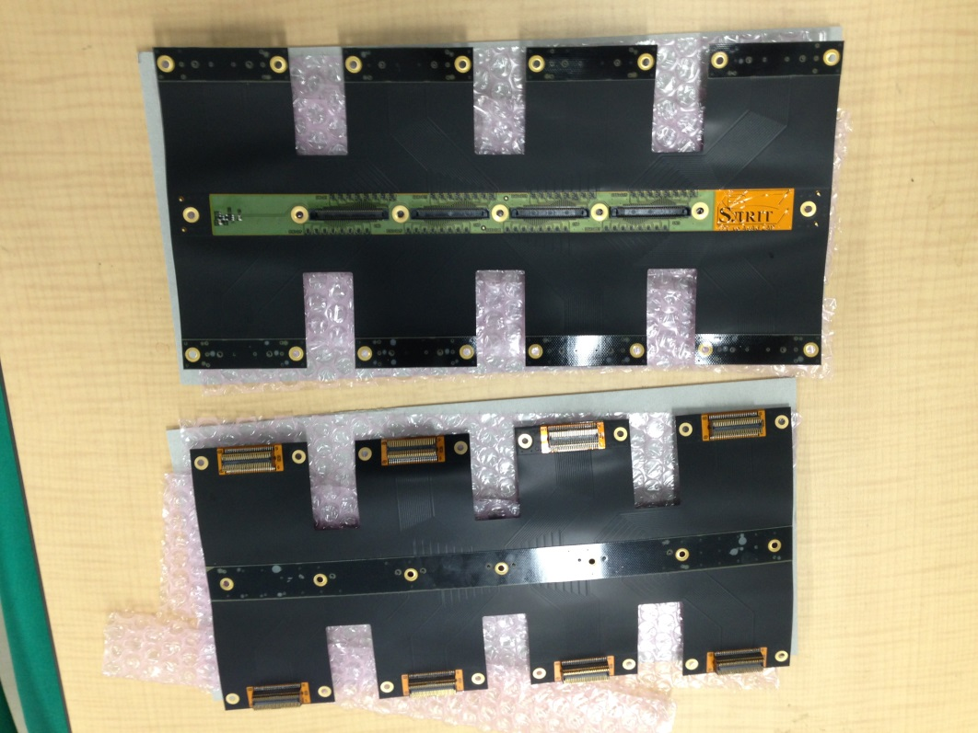
Development of interface board: ZAP
3 Interface boards were made as prototype
Three issues addressed in terms of the development.
  Space issue: all in 17cm
  Noise level
  Transfer function (i.e. Gain)
3rd: final one
4x31 cm2
1st
2nd
Flexible board
Designed/Made by H. Baba

Slide 13
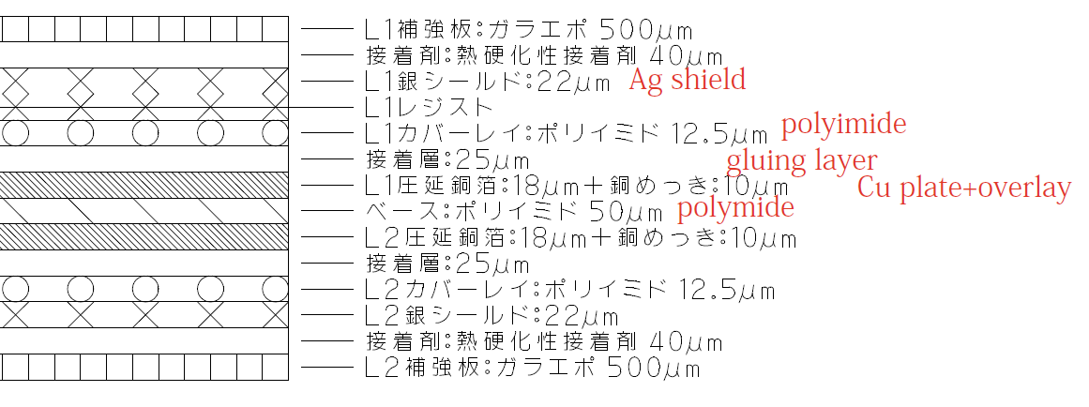
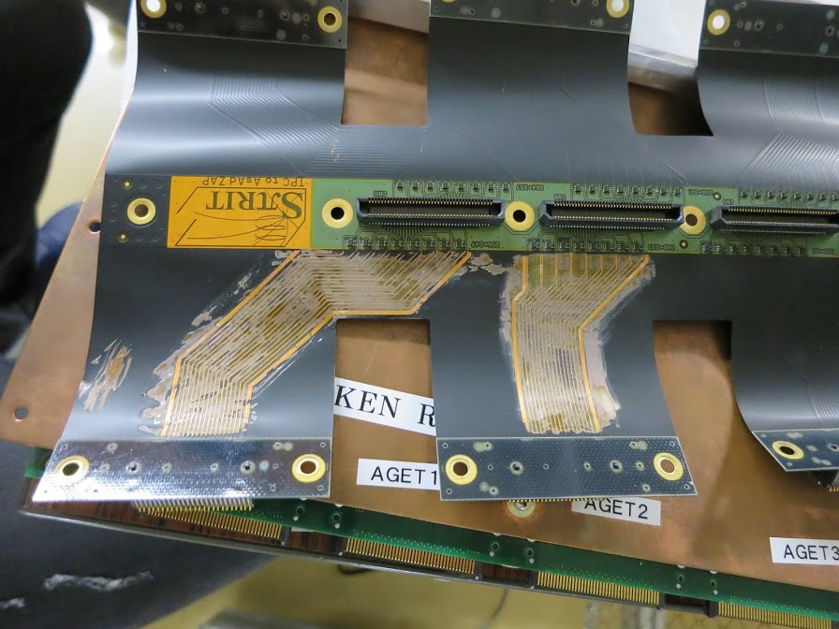
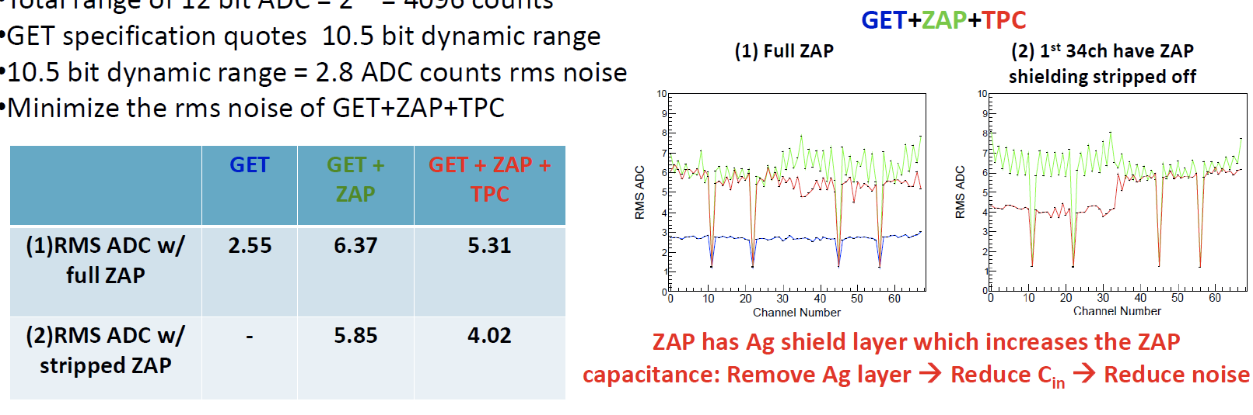
Noise shield made large noise
120fC, 233nsec
Courtesy of W. Powell

Slide 14
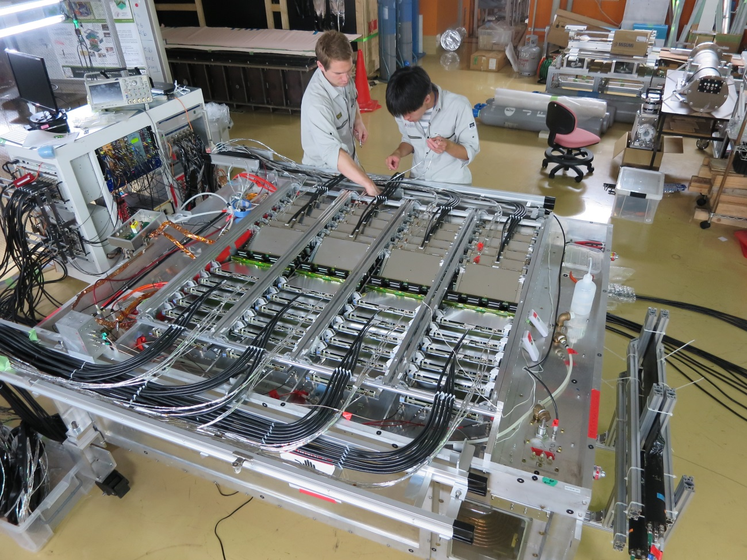
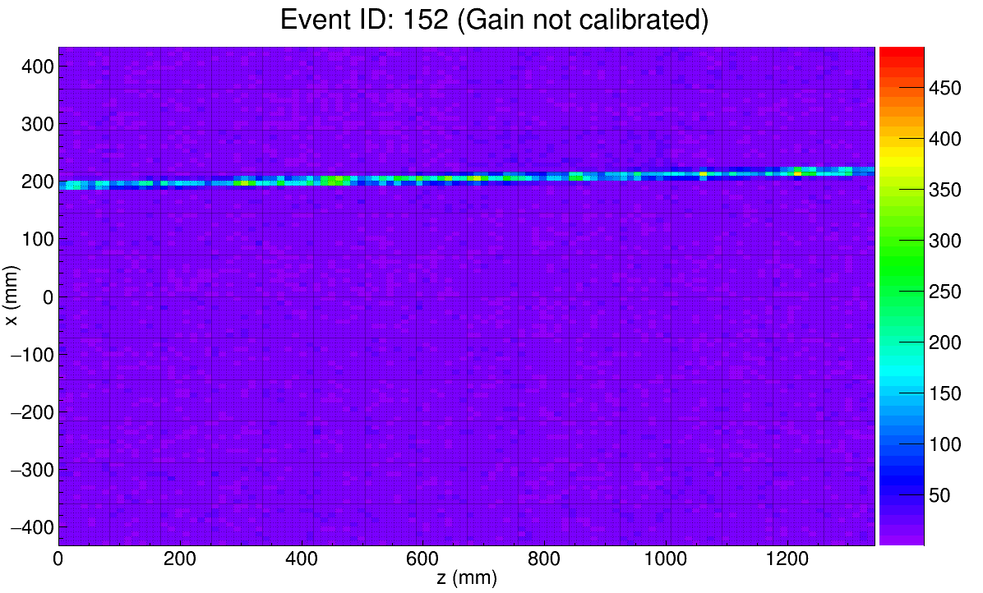
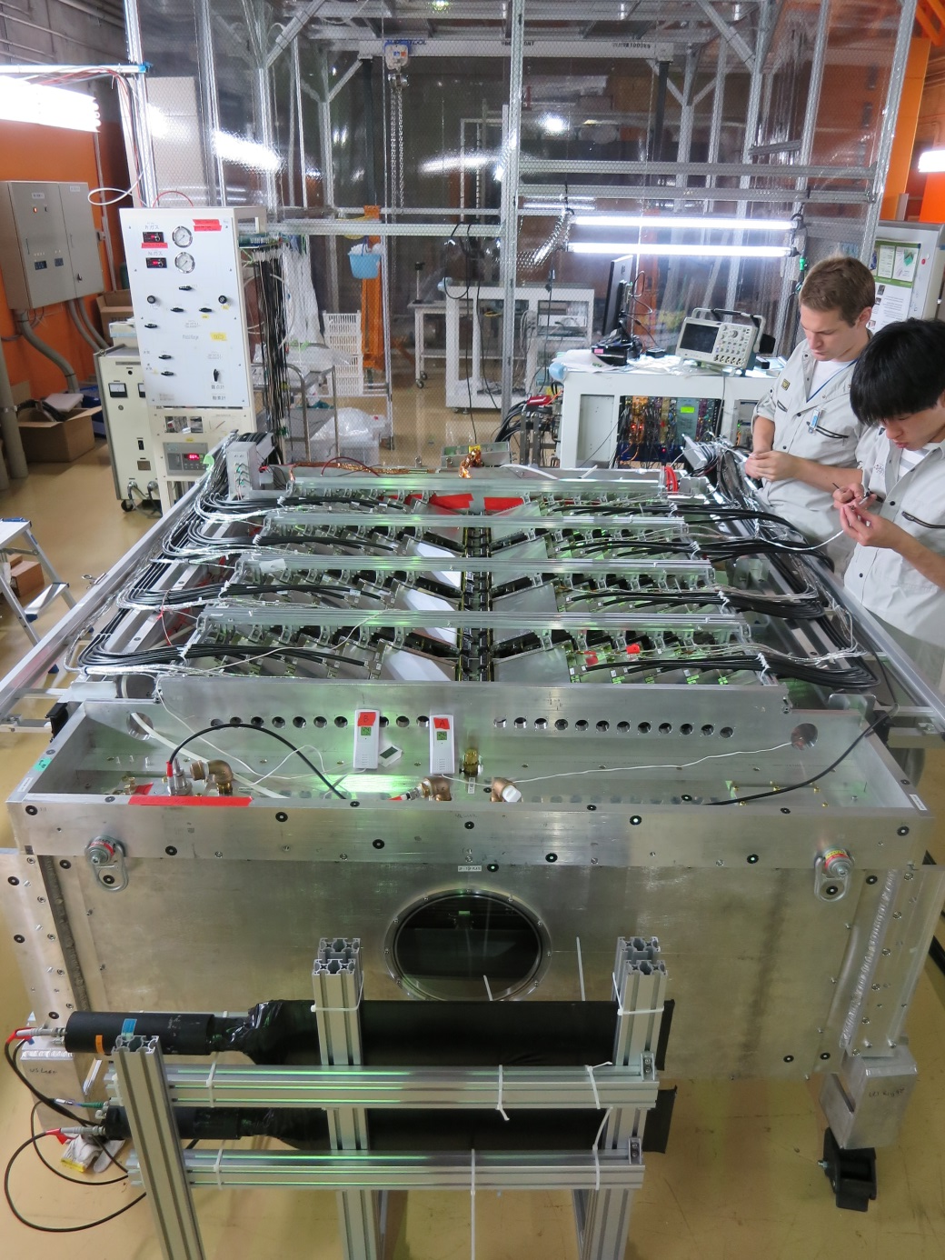
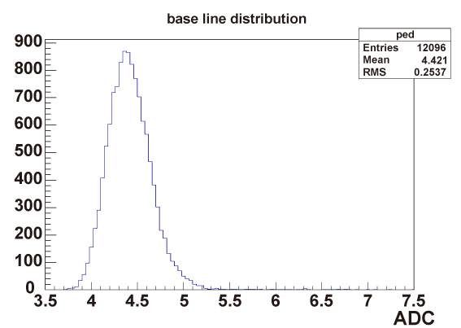
2015 Aug.: Installation of electronics finished
Pedestal
RMS for all of pads

Slide 15
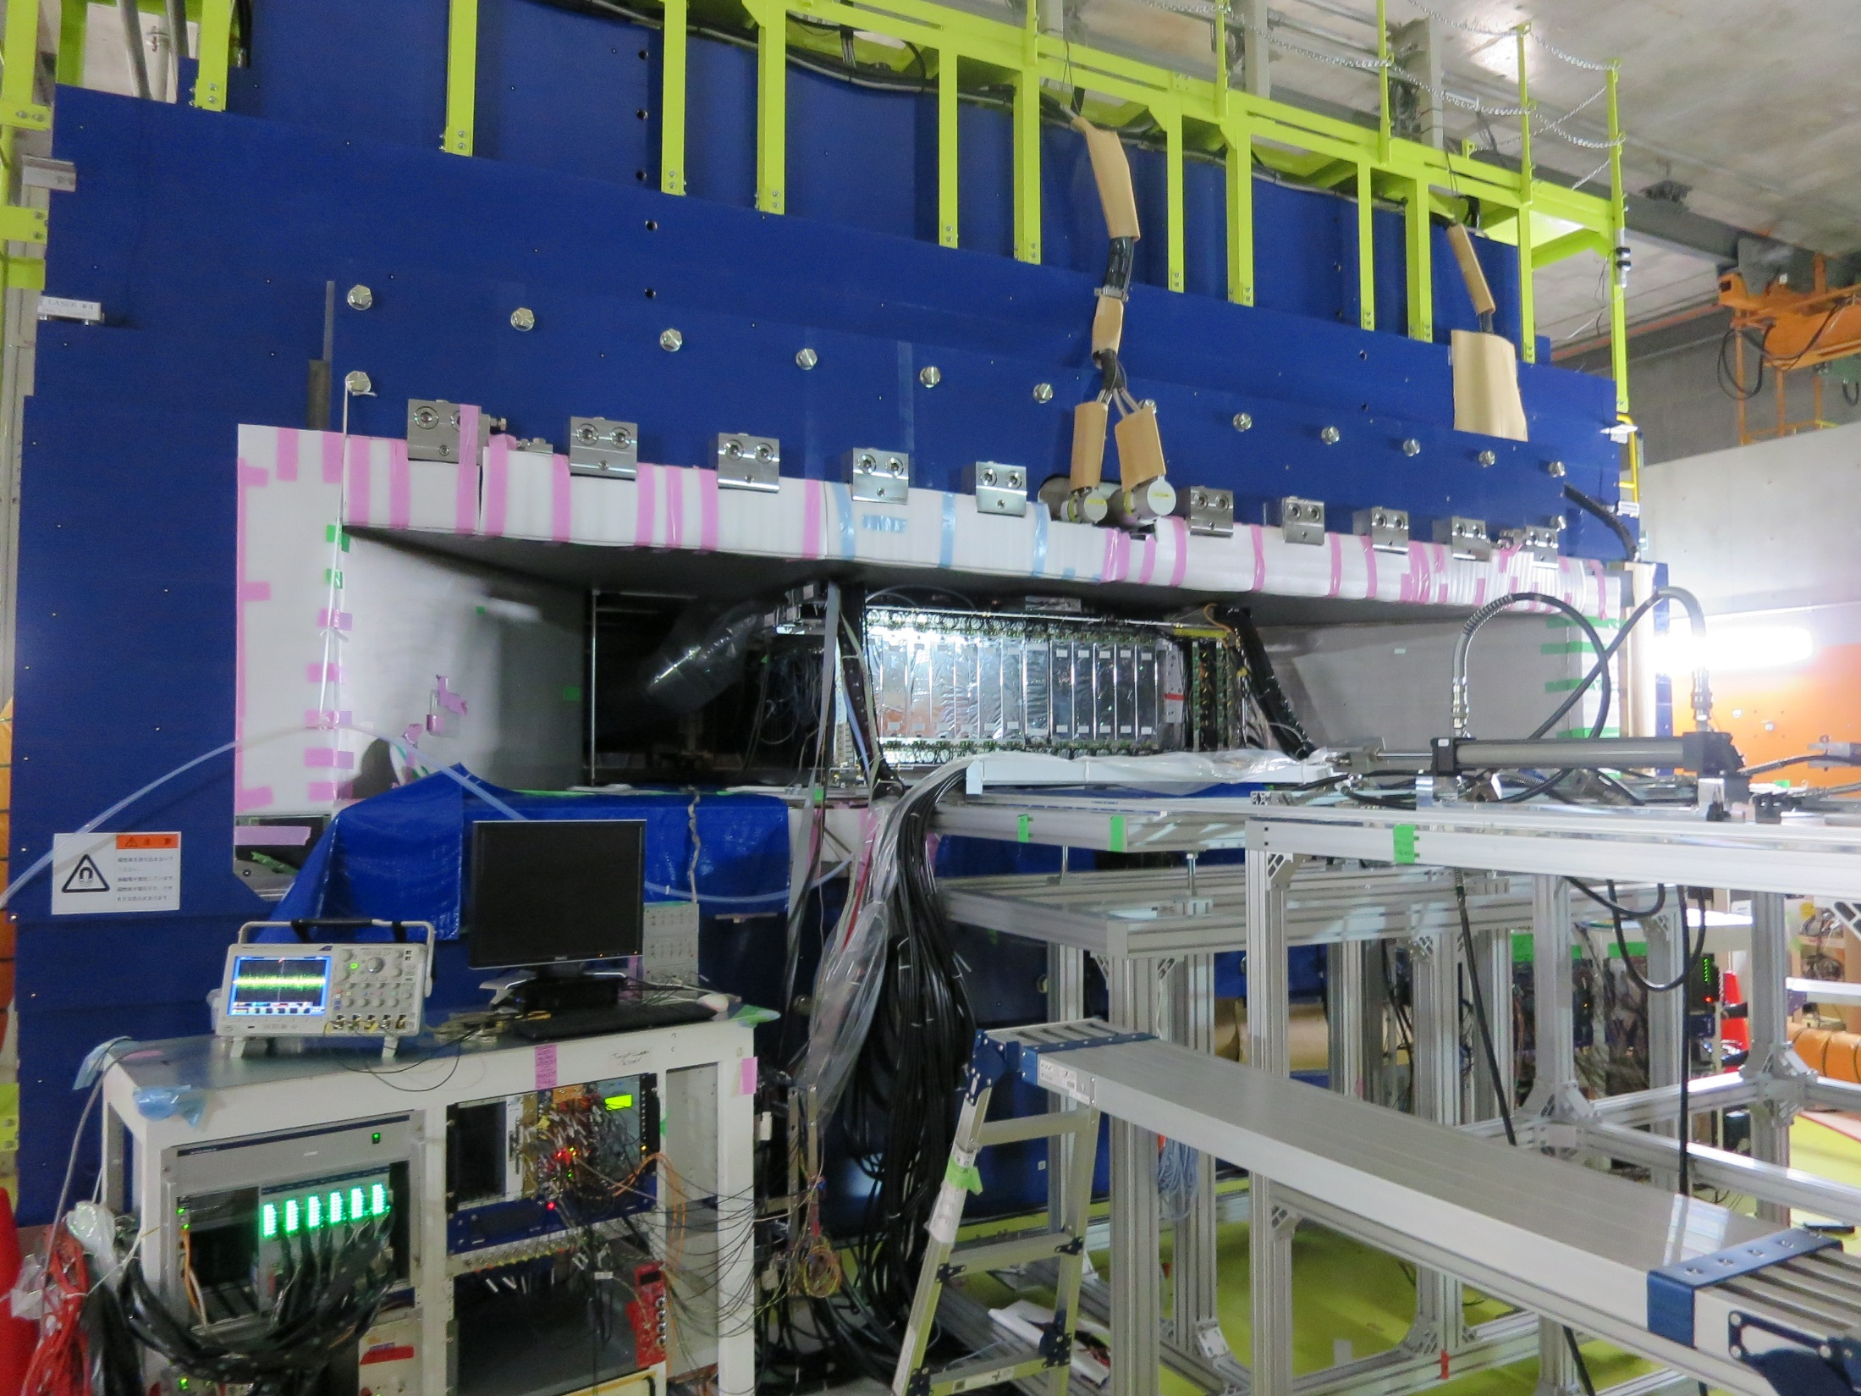

Slide 16
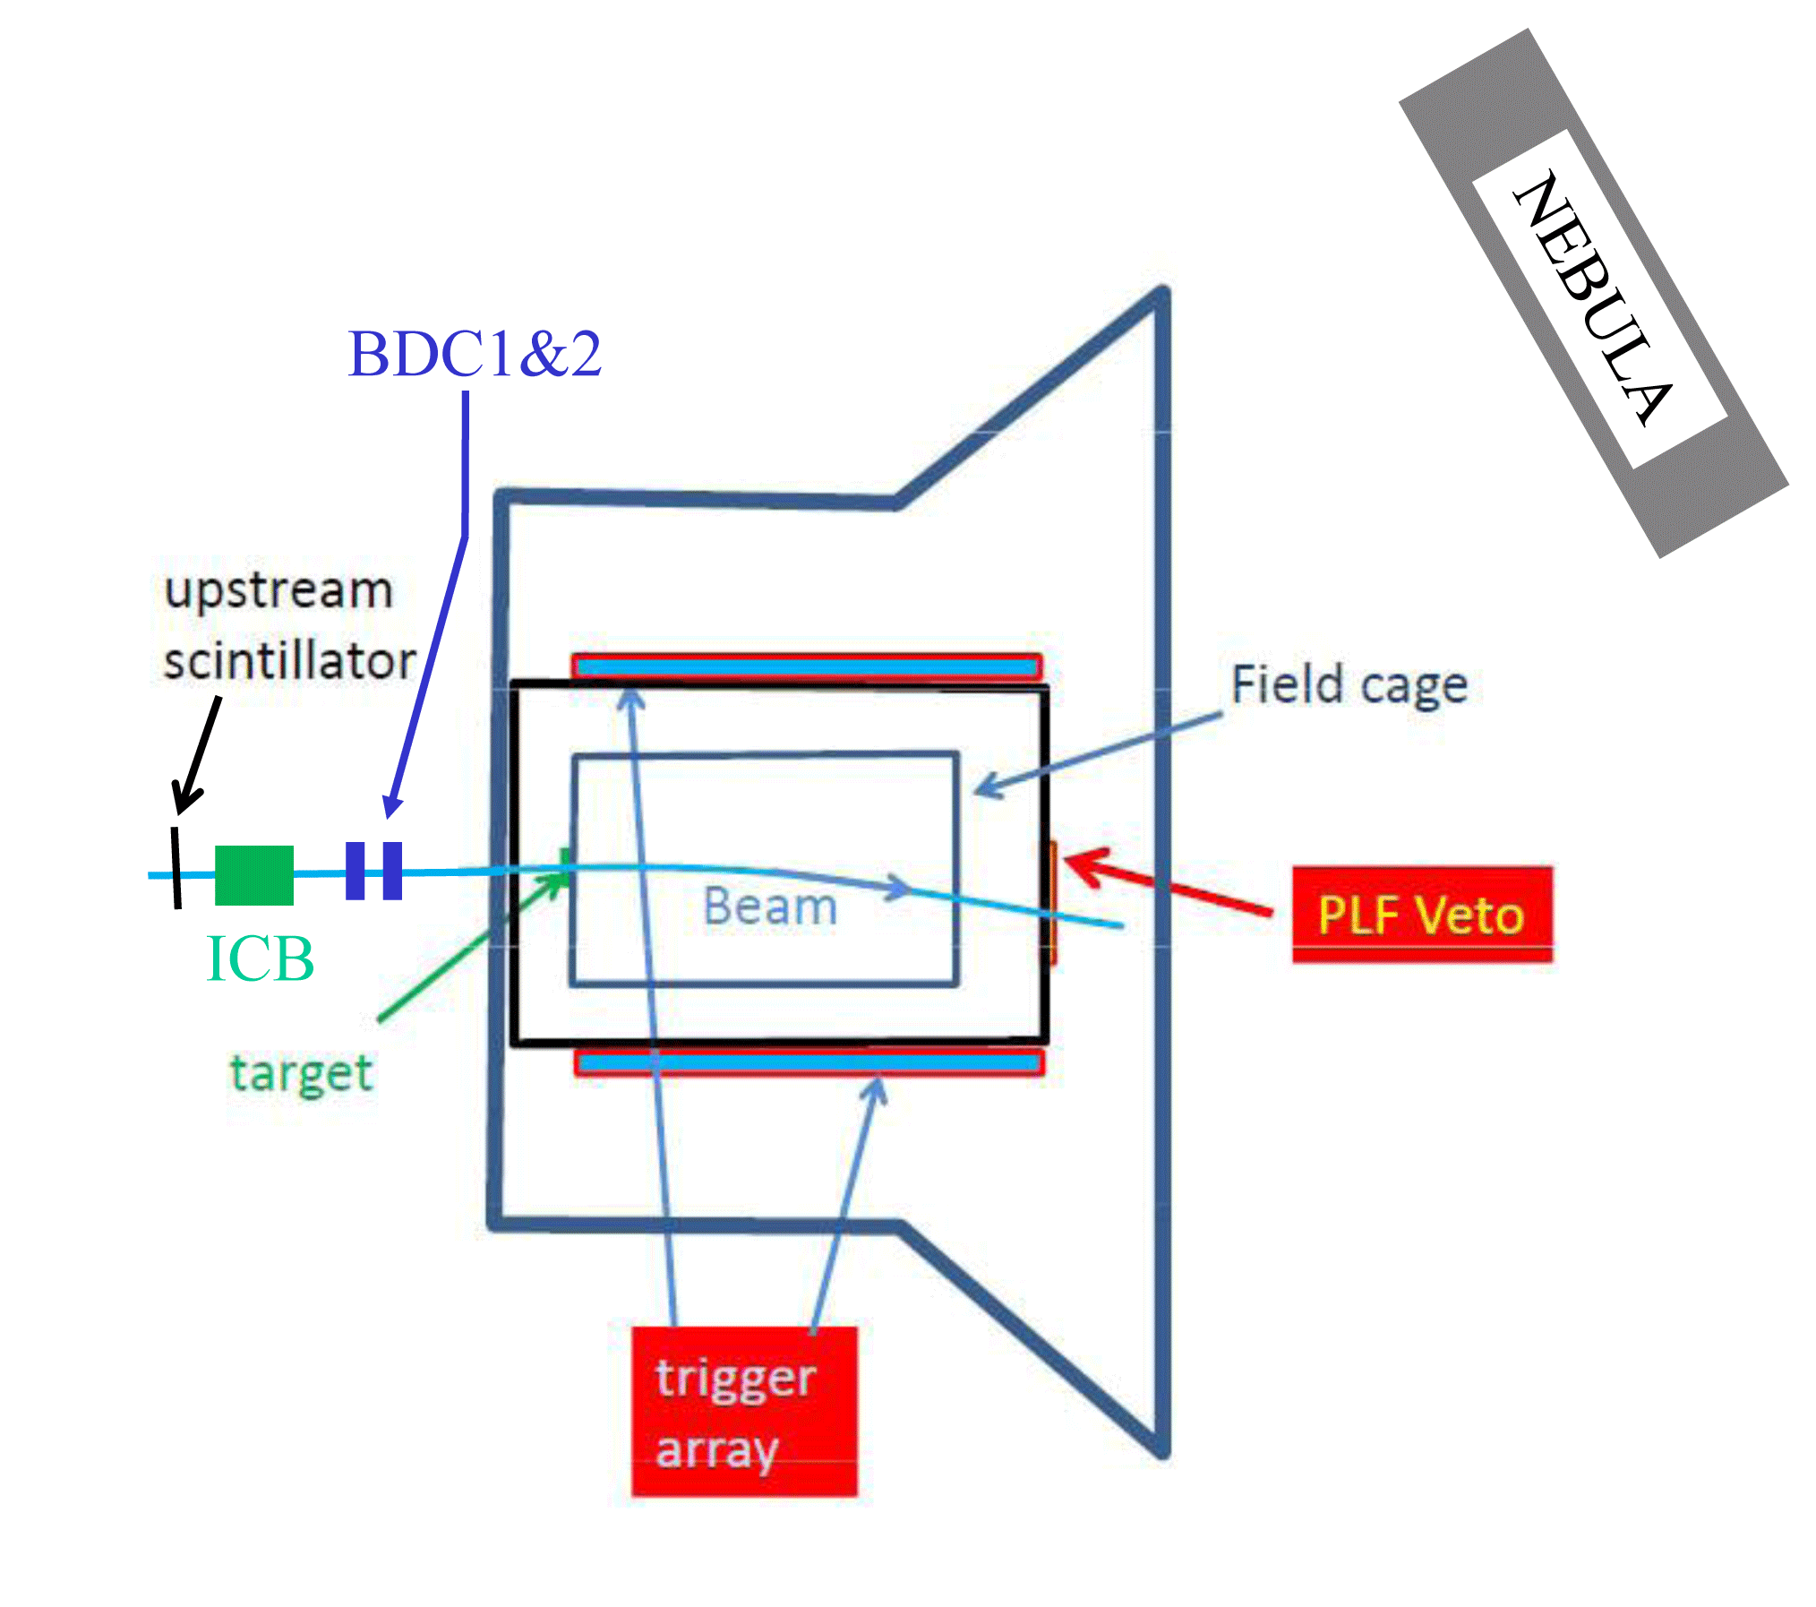



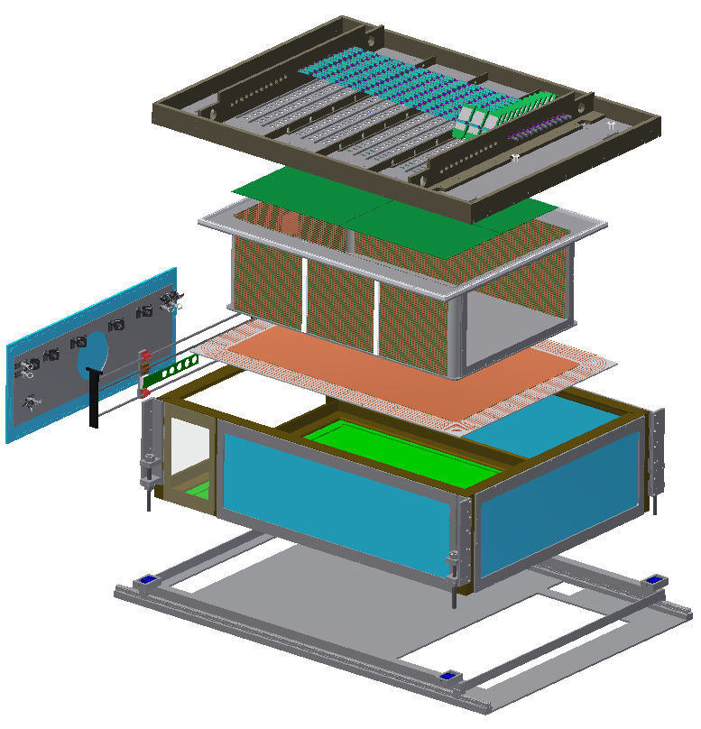
2016 Spring Heavy RI collision experimental setup
Chamber in SAMURAI magnet B=0.5T
NeuLAND
Beam Tracker
¹³²Sn
STQ
External trigger with scintillator paddles + MPPC
MWPC type
Time Proj.
Chamber
12k channel
Measure (π⁺ & π⁻), (p & n), (³H & ³He) in heavy RI collisions

Slide 17


SπRIT TPC
beam
AsAd
AsAd
AsAd
AsAd
4 AsAds for each CoBo:
48 AsAds in total
・・・・・・・・・
・・・・・・・・・
AGET
AGET
AGET
AGET
AGET
AGET
AGET
AGET
AGET
AGET
AGET
AGET
AGET
AGET
AGET
AGET
CoBo
CoBo
CoBo
・・・・・・・・・
CoBo
12 CoBo
10Gb network
DAQ
DAQ
Semi-online
Analysis
Disk
Disk
xrootd
RIKEN HPC

Slide 18
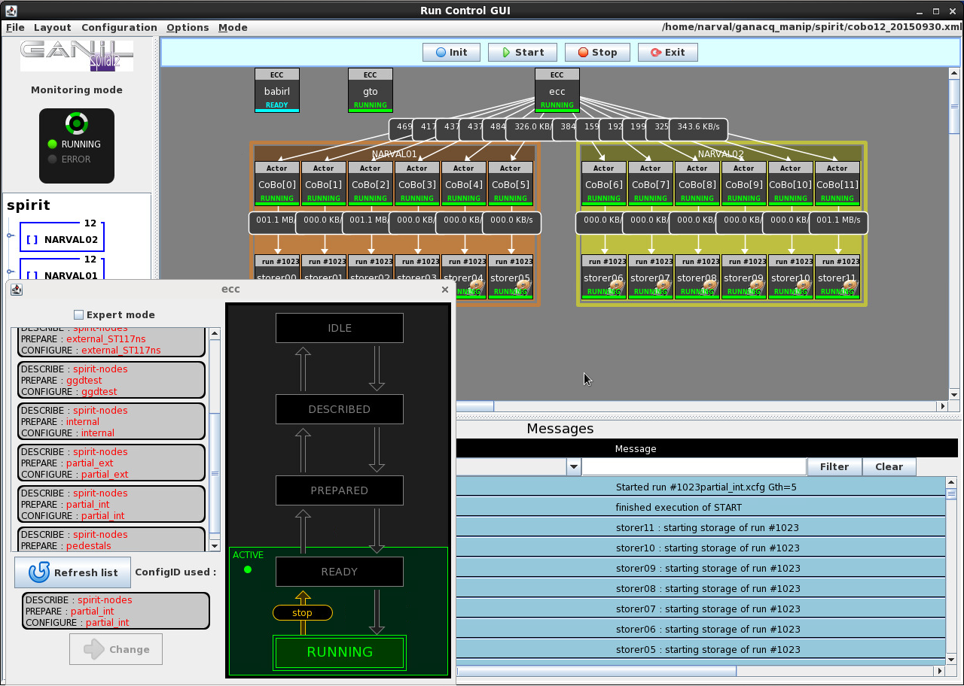
Control UI : GANIL RC
SOAP Server to control GTO
SOAP Server to control GET
SOAP Server to control other DAQ
DAQ benckmark:
100MByte/sec/CoBo
1.2GByte/sec at most
(writing data on disk)

Slide 19
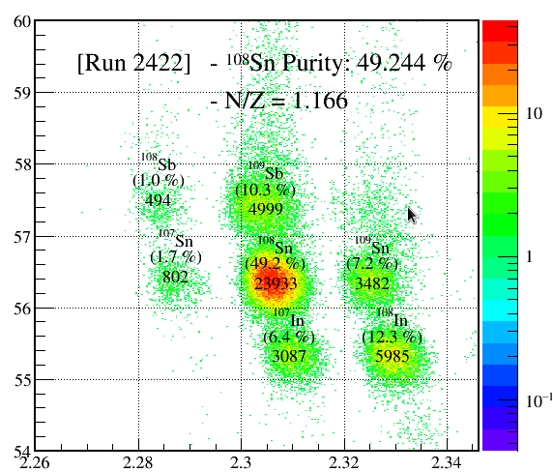
Dayone Heavy RI Collision experiment
Systematic measurements of multiple observables in heavy RI collisions in same Z (Z=50) but different N system were realized with heavy RI beam.
  Charged pion is main observable.
  Control the Coulomb interaction
Successfully finished. 2016 Apr. – Jun.
  Beam rate: 10kHz, trig. rate: 70Hz
  30M Events: 60Hz, 5MB/eve →300MB/sec
  250TB/2week
Beam PID
Primary | Beam | Target | E_{beam}/A | (N-Z/A)_{sys}
²³⁸U | ¹³²Sn | ¹²⁴Sn | 270 | 0.22
 | ¹²⁴Sn | ¹¹²Sn | 270 | 0.15
¹²⁴Xe | ¹⁰⁸Sn | ¹¹²Sn | 270 | 0.09
 | ¹¹²Sn | ¹²⁴Sn | 270 | 0.15
Z(A.U.)
A/Q(A.U.)

Slide 20
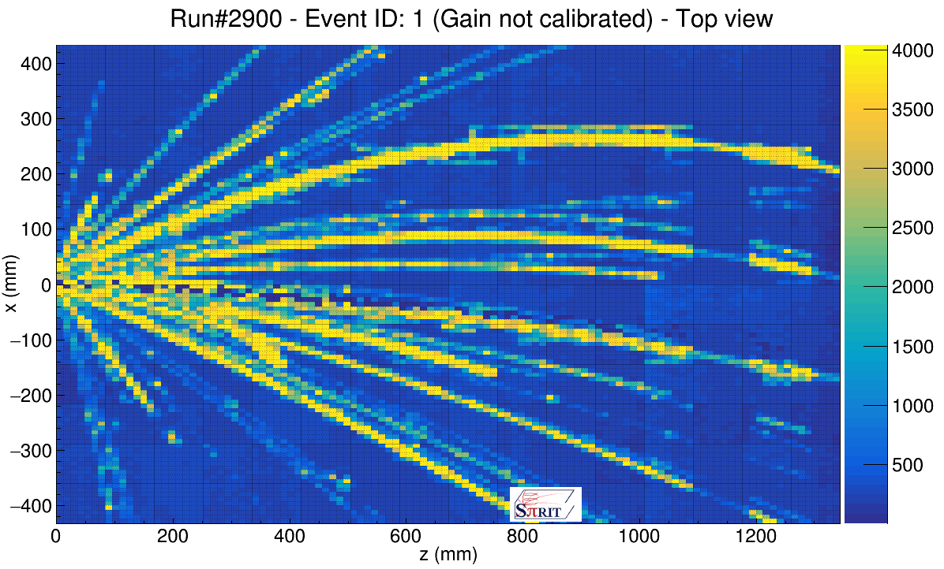
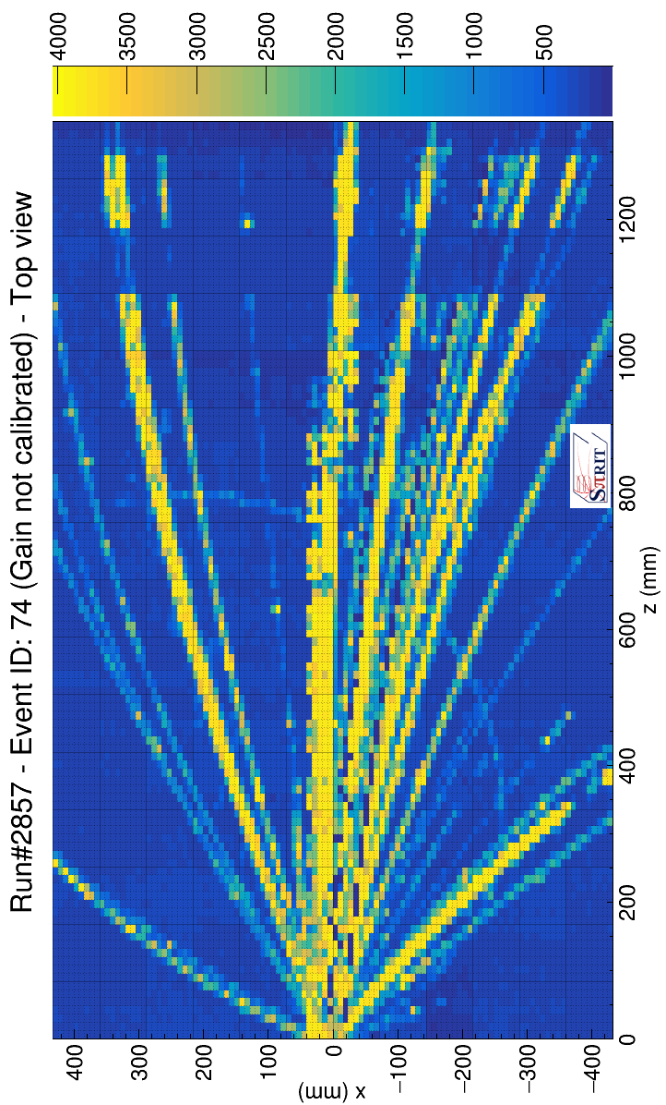
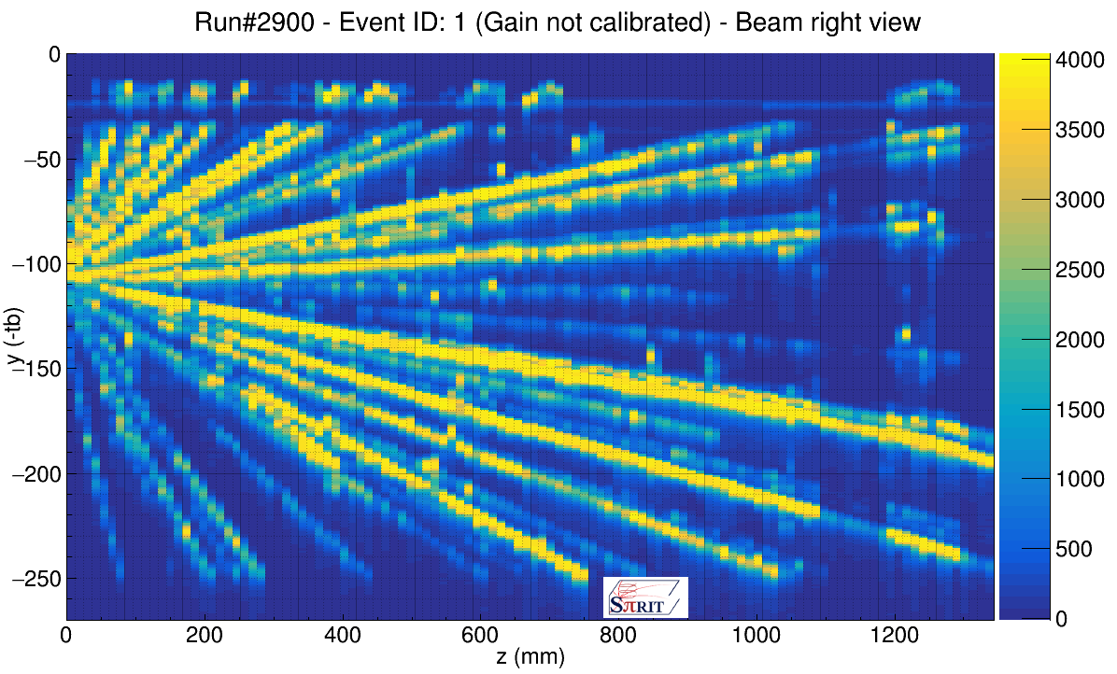
Example of HIC events seen by TPC
Top view
π⁻??
Side view

Slide 21
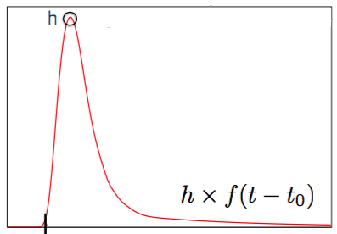
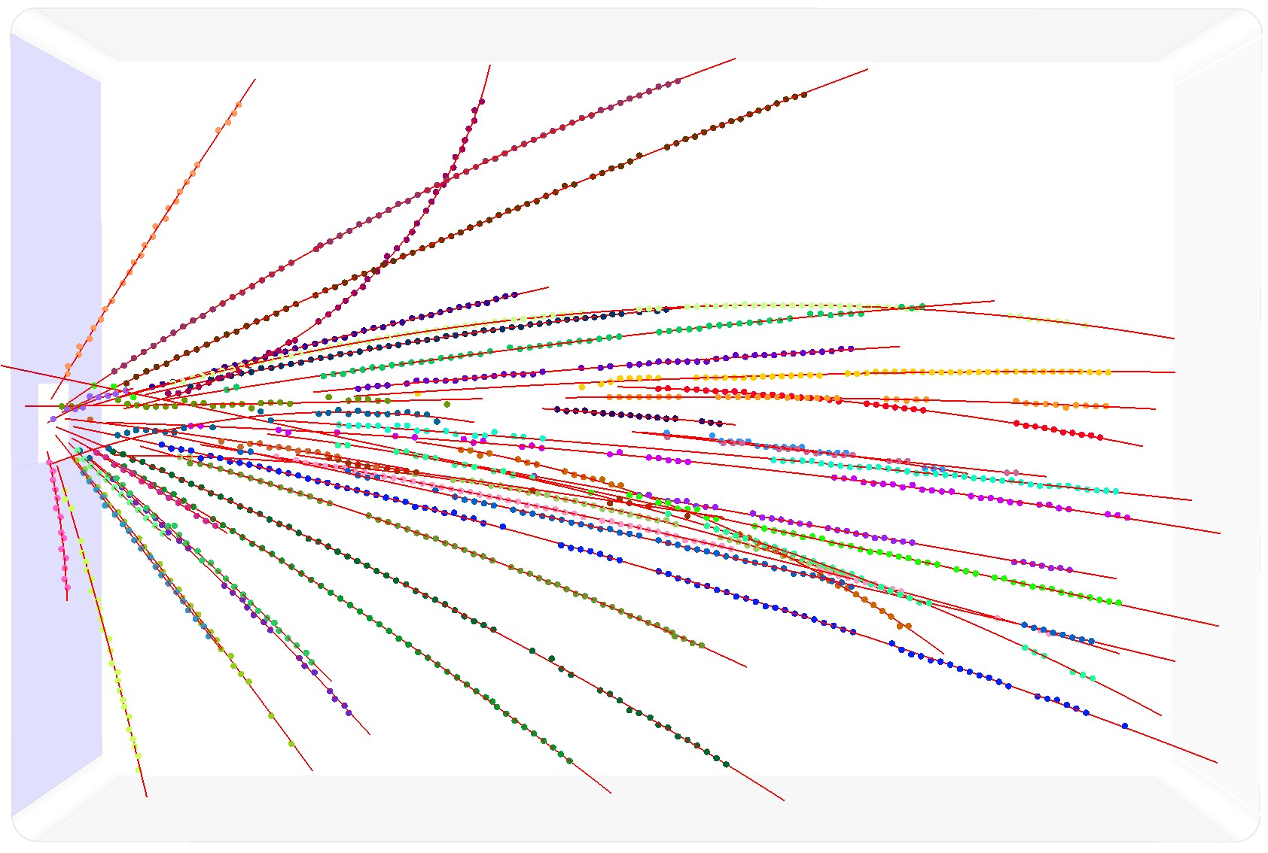
Offline analysis: Charged particle tracking
Pulse Shape Analysis
Helix tracking: 3D momentum
  Track separation
  Riemann fit: 2D
  Helix fit: 3D
  Clustering
  Initialize GENFIT parameters
GENFIT: precise fitting (Parameterization, extrapolation)
RAVE(Reconstruction vertices)
f: Fixed shape
t₀: time at 5% of h
Courtesy of J.W. Lee, G. Jhang, G. Cerizza

Slide 22
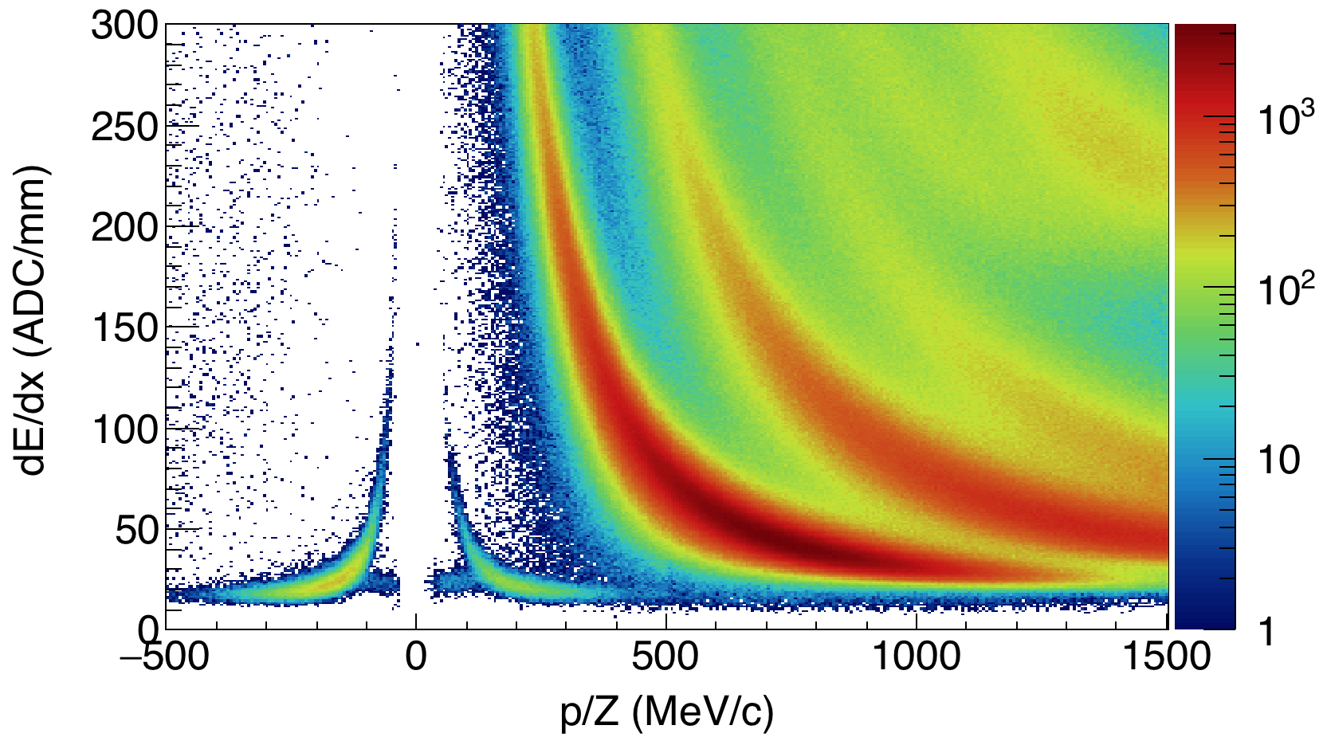
Particle identification by TPC
¹³²Sn + ¹²⁴Sn E_{beam}=270 AMeV
t
⁴He
p
d
⁴He
π⁻
π⁺
e⁻
e⁺

Slide 23
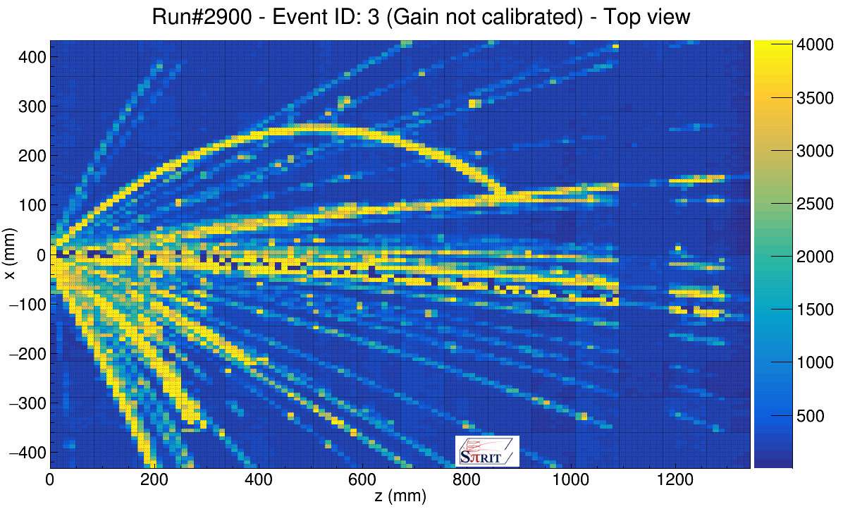
Dead channels along beam trajectory
What is these pads? Black means dead.
Seen along beam trajectory → due to δ-ray?
→ but δ-ray is supposed to be suppressed with B-field.
Could not be seen in the case of cosmic
Varies event by event

Slide 24
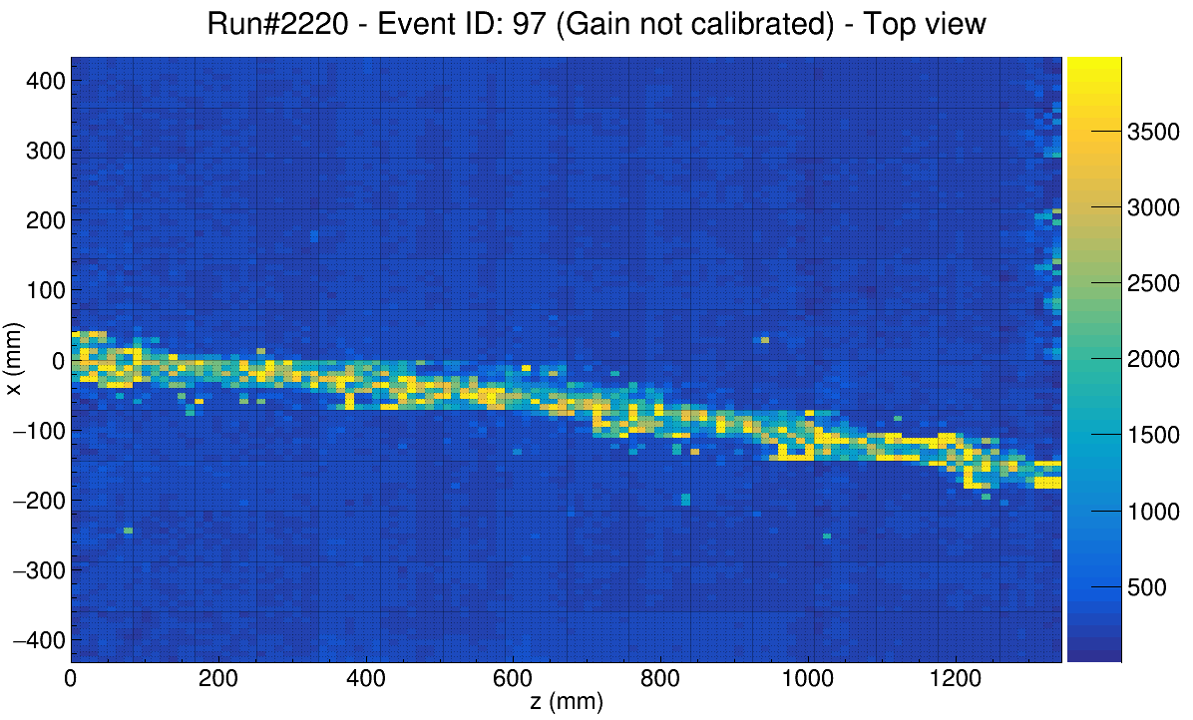
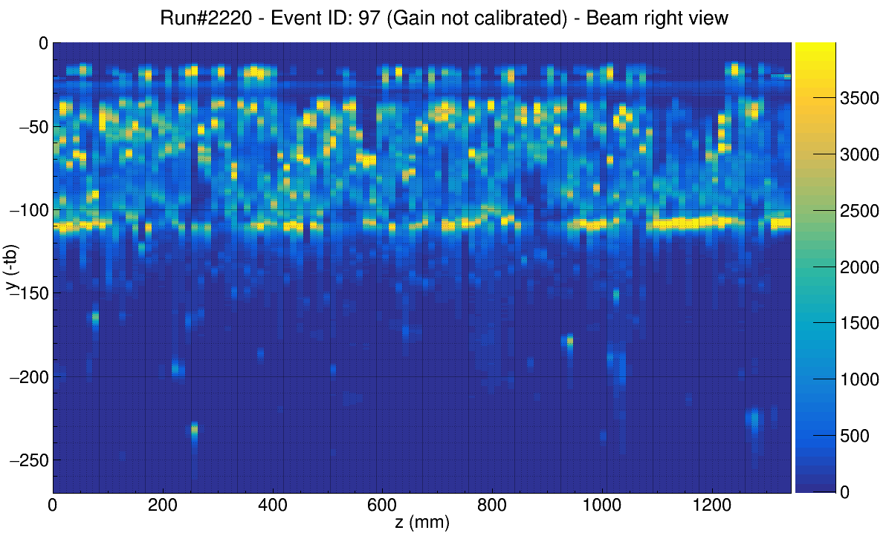
How signal from heavy ion would be seen with high gain for the measurement of protons
δ-rays passing GG wires
GG can not block these δ-rays
Top view
Side view
GG
Drift direction
Spread over neighboring pads
through C between the pads.
Beam signal is not seem.

Slide 25
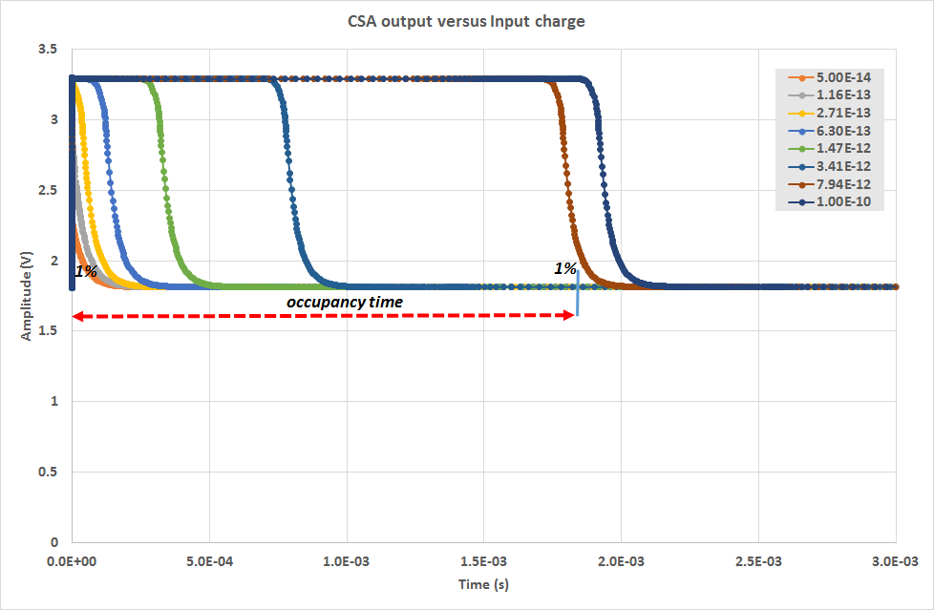
Preamp becomes dead for a certain time due to huge signal
CSA output(V)
SPICE simulation
Courtesy of P. Baron
Time (s)
3ms
Output of CSA is kept to be saturated in the case of huge signal
As long as output is saturated, no signal comes out from following shaper →behaves as dead
Dead for 2 msec in the case of 10pC charge input
10pC corresponds to the charge from Z~35 nuclei

Slide 26
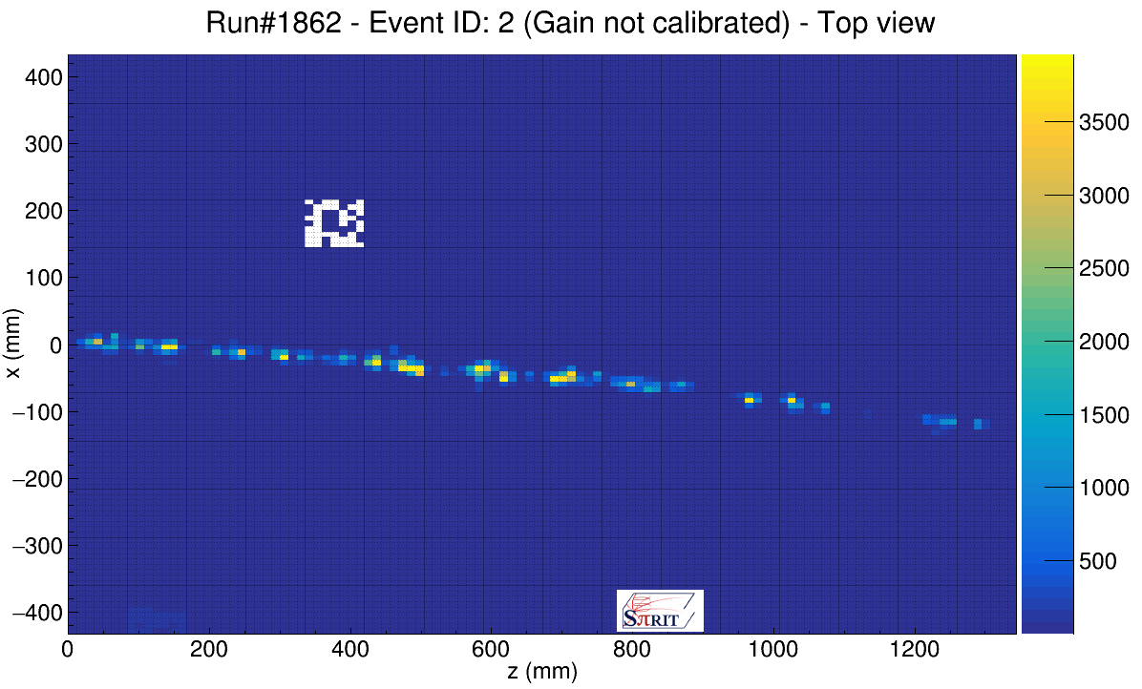
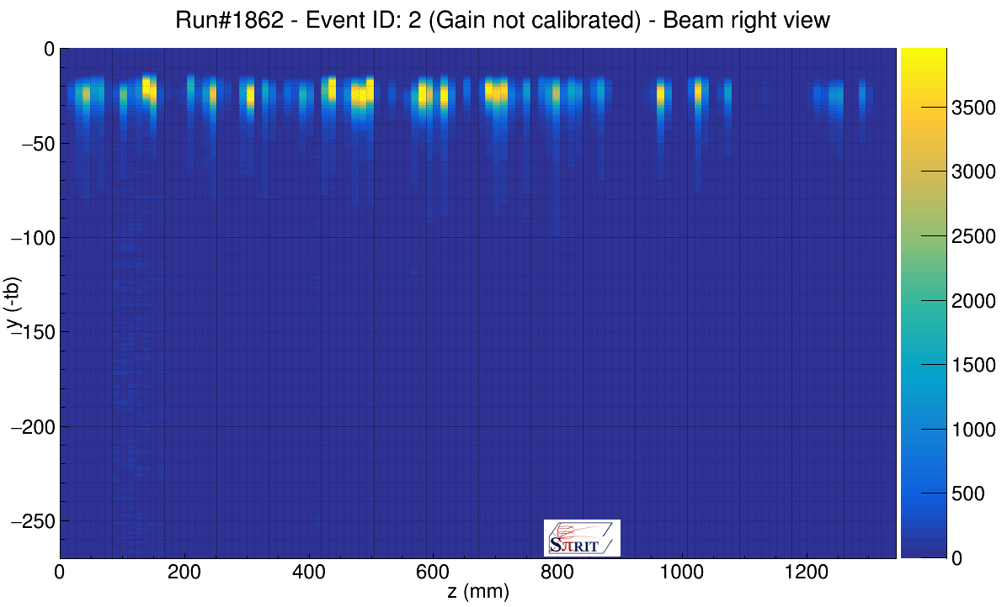
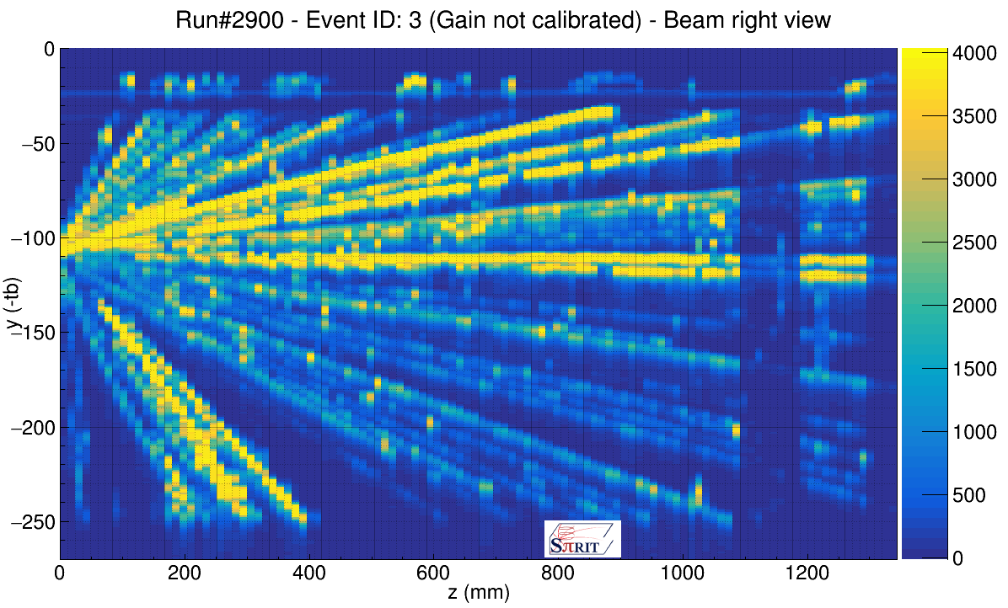
δ-ray which cannot be blocked with GG
Top view
Top view
10kHz beam rate: 1beam per 100μsec
Part of δ-ray coming from beam passes through GG
→ Make a dead time on the pad
Independent from trigger rate, probability of dead pads increase depending on beam rate
Acceptable beam rate of pads along beam line is limited due to this effect
GG
Side view
Side view
Beam event
Reaction event

Slide 27
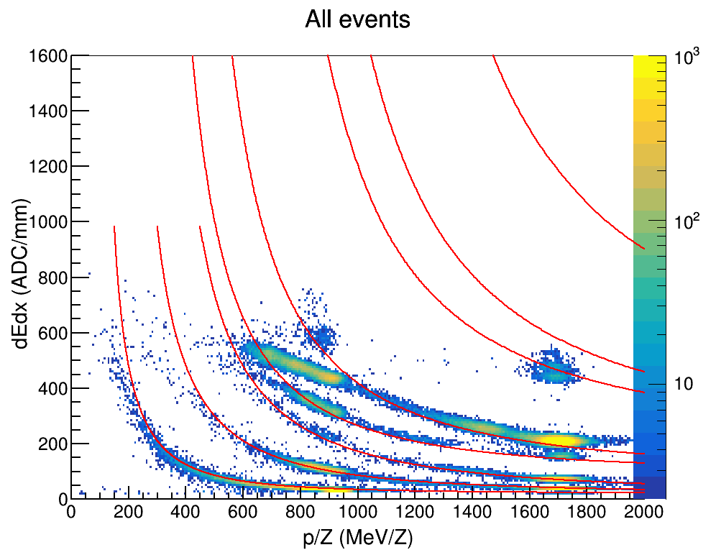
Limitation of dynamic range: offline analysis to increase the range?
³He
⁴He
Calibration run by using Z:1~3 cocktail beam.
p
t
d
⁷Li
⁶Li
Pulse height information as energy loss of charged particle.
→ linearity kept up to Z~1
Other method to increase the range of dE/dX linearity.
1. Pad desaturation by using PRF. → discussed by Estee tomorrow.
2. Signal slope information instead of signal height.

Slide 28


Signal slope value as deposited charge information
Scan for steepest bin of a signal.
Slope of signal shows linearity for higher pulser voltage.
According to SPICE simulation, linearity can be kept up to 240fC input.
  i.e. ~2 times wider
120fC D.R.
117 ns Shaping time
Pulser voltage on TPC ground wire

Slide 29
Summary
New experimental program of SPiRIT to constrain the density dependent symmetry energy has started.
SPiRIT-TPC as main device for the measurement of multi-particle trajectory.
State-of-art readout system of GET is integrated to maximize the TPC performance.
First experiment campaign by using Sn isotopes was successfully finished.
  ¹³²Sn+¹²⁴Sn, ¹⁰⁸Sn+¹¹²Sn, … @E/A=270MeV
Preliminary analysis shows the measurement of charged pion is promising.
Part of pads along beam trajectory can be dead due to δ-ray from high intense beam.
Dynamic range of electronics can be gained by using slope information instead of height of signal.

Slide 30


































Thank you!

