Slide 1

OpenGATE Meeting
Recent activities of Athens group,
using GATE
Panagiotis Papadimitroulas & George Loudos
Nov.-Dec. 2017, Marseille, France

Slide 2
Activities in Summary
QSPECT software tool for reconstructing SPECT GATE data
S-values calculation for pediatric NM
Brachytherapy validation for a list of 6 sources
G4-DNA model of a DSB dosimeter from Texas University
X-ray preclinical imaging using Gold Nano Particles
Access in the national HPC-ARIS infrastructure

Slide 3

QSPECT software tool
Image Reconstruction application with graphical user interface, which visualizes images from SPECT data
Integrates image reconstruction by using the Maximum Likelihood Expectation Maximization – MLEM iterative algorithm
Completed with a user manual and an associate script for converting root files to projection txt images.
QSPECT’s main menu on Windows distribution

Slide 4

ERROR project:
H2020 marie curie rise 2015-2019
“A pEdiatric dosimetRy peRsonalized platfOrm based on computational anthropomoRphic phantoms”
Goal:
The development of a new software tool, which will offer to the clinician the possibility to assess imaging and therapeutic protocols predicting the absorbed dose per organ. This tool will be implemented and evaluated for pediatric applications, since this is a rather sensitive target group.
The project is in progress 2 years now (https://error.upatras.gr)
Main activities in ERROR so far, using GATE:
Validation of S-values for pediatric applications and calculation of Specific Absorbed Dose Rates (SADRs).
Brachytherapy validation for a list of 6 sources
Validation of Brightspeed lite 16 CT scanner

Slide 5
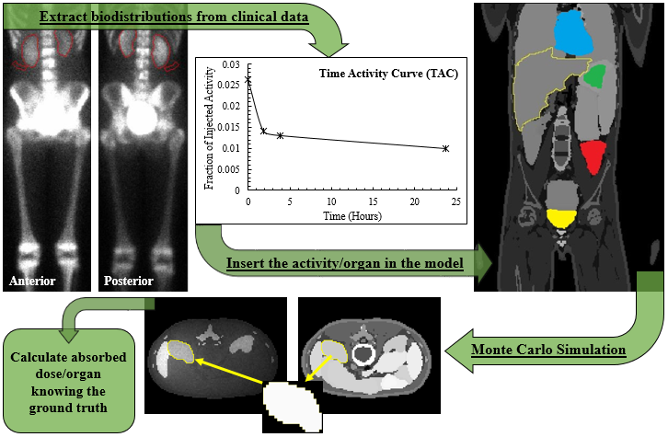
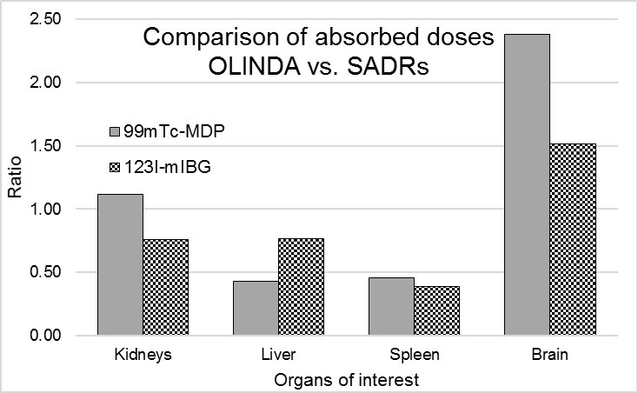
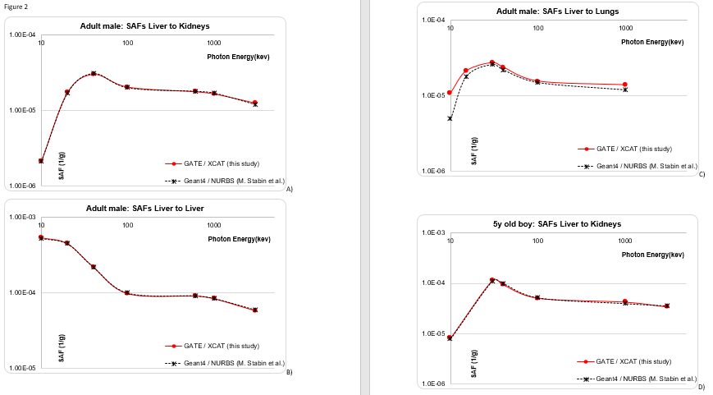
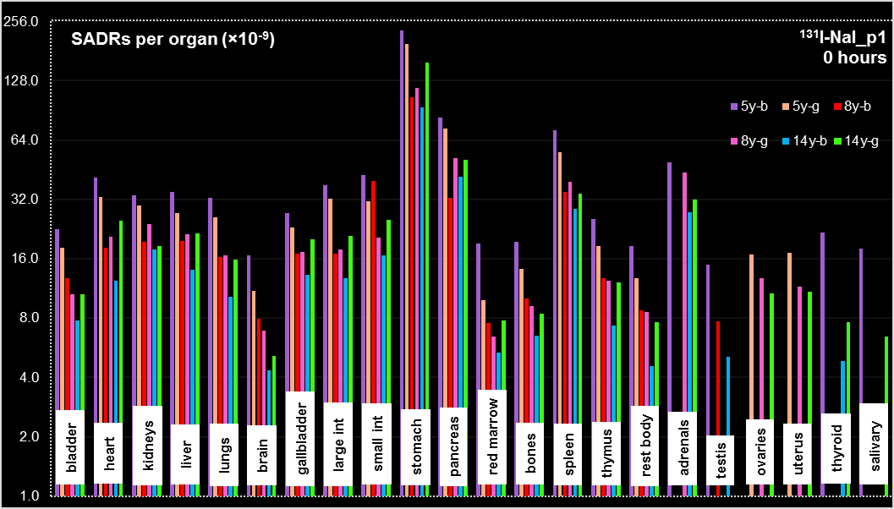
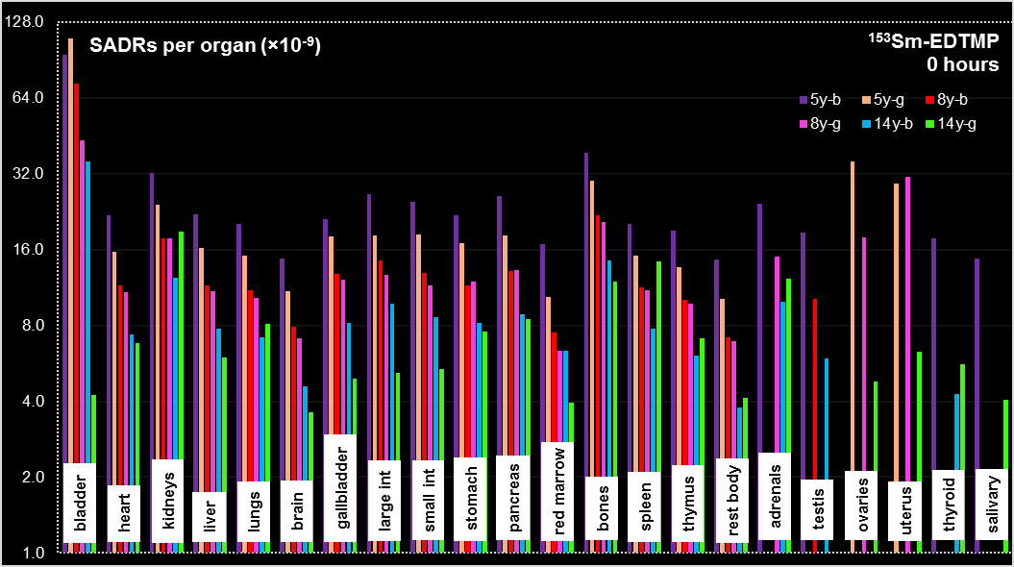
Pediatric SADRS calculation
The results submitted in Medical Physics, and the paper is under review process.

Slide 6
Brachytherapy validation
Full Brachytherapy Validation in GATE
(Radial Dose Function, Anisotropy Function, Dose Rate Constant)
A list of commercial brachy sources are validated:
¹⁹²Ir Nucletron mHDR-v1
¹⁹²Ir Nucletron mPDR-v2
¹⁹²Ir Varian VS2000 HDR
A GUI is designed in order to make available:
.mac files of the sources
Visual description of the seeds (geometrical characteristics)
PhaseSpace files from the sources to be used directly on brachy simulations
Validation report for each source (comparison of GATE vs. TG-43 protocol)
¹⁹²Ir M-19 HDR
¹²⁵I Amersham Health 6711
¹²⁵I Bebig Theragenics I25.S06

Slide 7
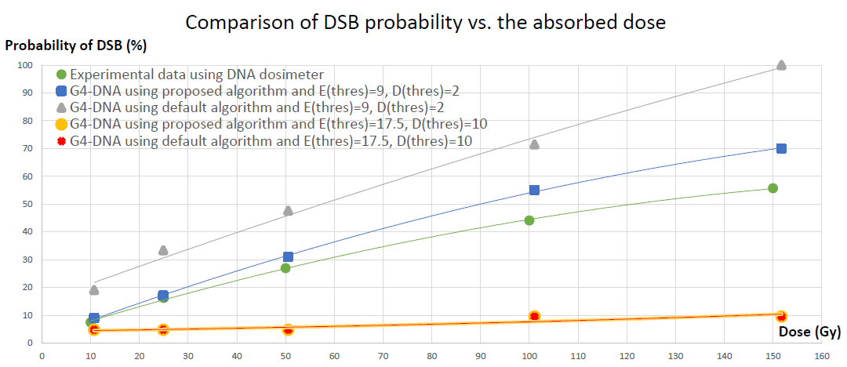
G4-DNA model of a DSB dosimeter
PhD thesis of Mr. K. Chatzipapas
Geometrical characteristics of a micro dosimeter for the quantification of DNA-DSB after irradiation (Univ. of Texas – Health and Science Center)
Evaluation of the model with G4-DNA – comparison of experimental and simulated data.
Preliminary results, presented in the MCMA-2017, 15-18 Oct. in Napoli, Italy

Slide 8
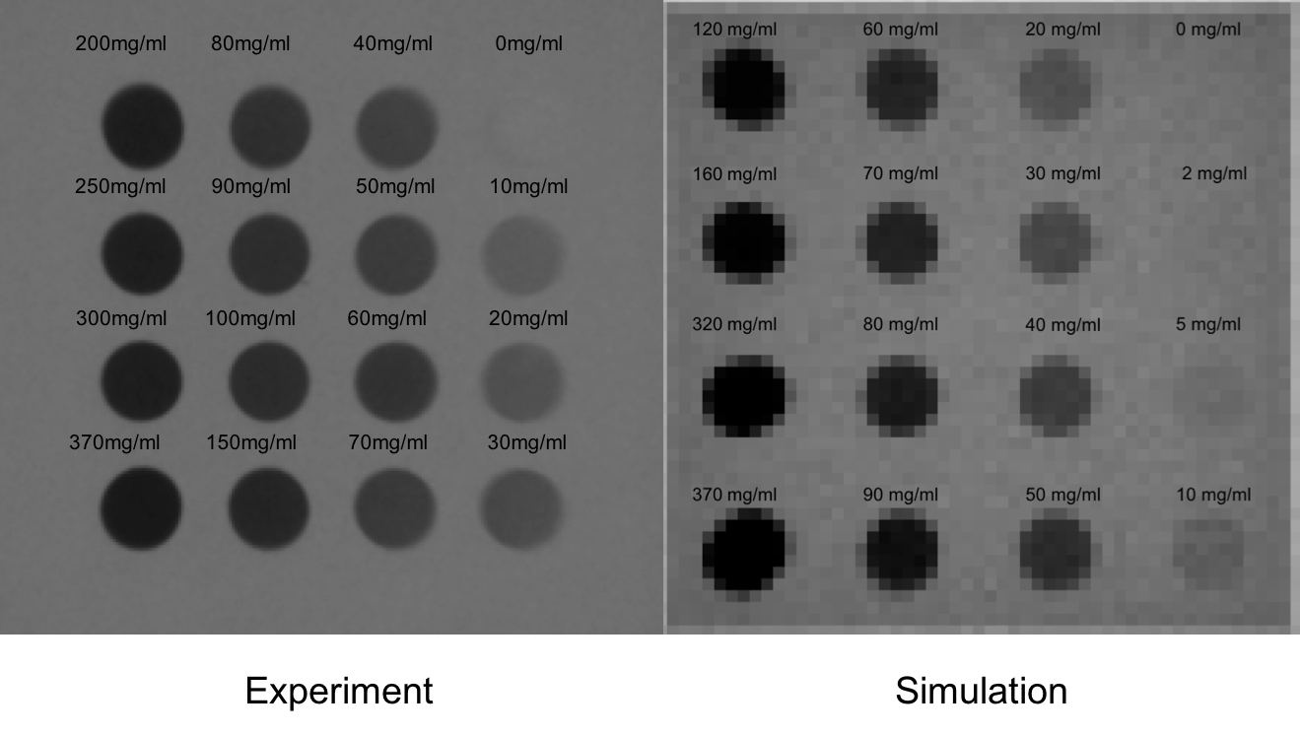
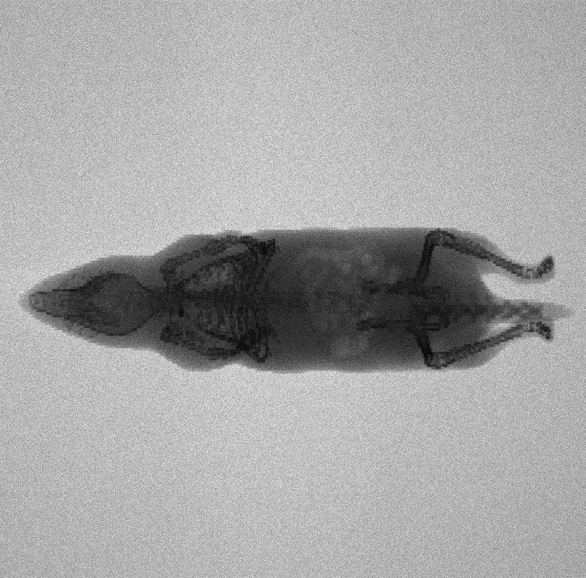
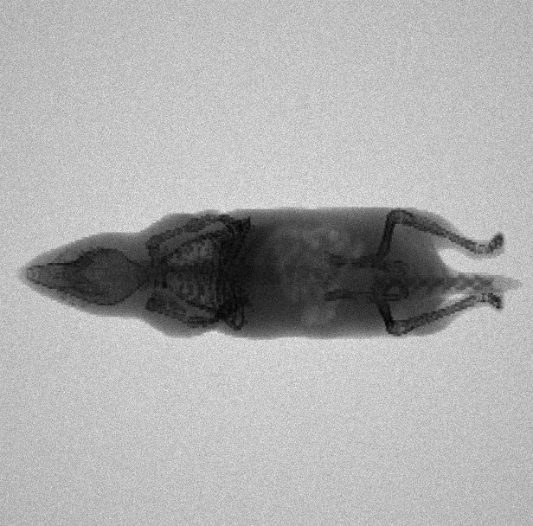
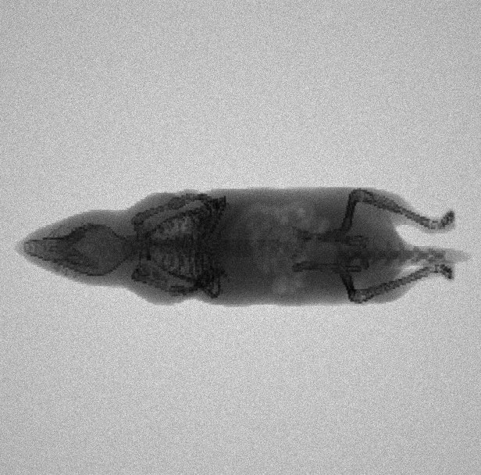
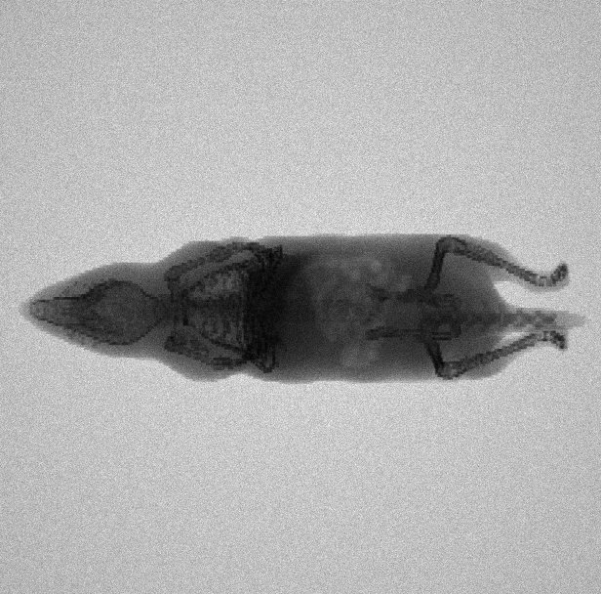
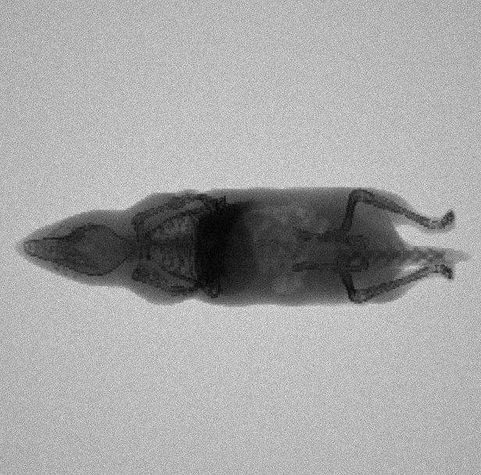
X-ray preclinical imaging with GNP
Visualize with GATE Gold Nanoparticles (GNPs) through X-Ray and CT imaging
Different concentrations of GNPs were studied and applied in MOBY mouse model
No NPs
5mgAu in liver
0.2% PW
10mgAu in liver
0.4% PW
20mgAu in liver
0.8% PW
40mgAu in liver
1.64% PW
Experimental Simulated

Slide 9
OTHER activities
Access in the national HPC-ARIS infrastructure (https://hpc.grnet.gr/en/)
GATE is installed
We gained access for 6 months – 100,000 core hours to create a pediatric database and we are going to apply again such an application.
Applications are open for user access every 6 months.
Training Activities
A 2 days “GATE hands on” will be done in the Master of Medical Physics in University of Patras in spring 2018.

Slide 10
OpenGATE Meeting
Recent activities of Athens group,
using GATE
Panagiotis Papadimitroulas & George Loudos
Nov.-Dec. 2017, Marseille, France

