Slide 1
Cadence for supernovae in LSST
Ph.Gris¹, N.Regnault²
LSST@Europe3
LSST Science: Supernova/Transients/variable stars
1 Laboratoire de Physique de Clermont IN2P3/CNRS
2 Laboratoire de Physique des Hautes Energies IN2P3/CNRS

Slide 2
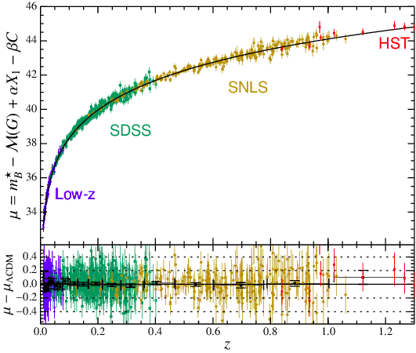
Supernovae and Dark Energy
Hubble diagram
Distance modulus
M. Betoule et al. A&A, Vol. 568,id.A122
Redshift

Slide 3
Supernovae and Dark Energy
Hubble diagram
Cosmology (fit)
-> Dark Energy constraints
Distance modulus
M. Betoule et al. A&A, Vol. 568,id.A122
~ 740 Supernovae
Redshift

Slide 4
Supernovae and Dark Energy
Hubble diagram
Cosmology (fit)
-> Dark Energy constraints
Distance modulus
M. Betoule et al. A&A, Vol. 568,id.A122
~ 740 Supernovae
LSST : type Ia Supernovae for Hubble diagram
large sample (x few 100)
well calibrated (photometry) well measured
with minimal bias (ie high redshift completeness)
Redshift

Slide 5
Supernovae and Dark Energy
Hubble diagram
Space Obs.
(EUCLID , WFIRST)
LSST compl.
Distance modulus
LSST
WFD
LSST
DDF
M. Betoule et al. A&A, Vol. 568,id.A122
Redshift

Slide 6
Supernovae and Dark Energy
Hubble diagram
Space Obs.
(EUCLID , WFIRST)
LSST compl.
Distance modulus
LSST
WFD
LSST
DDF
M. Betoule et al. A&A, Vol. 568,id.A122
Redshift

Slide 7
Supernovae and Dark Energy
Distance modulus

Slide 8
Supernovae and Dark Energy
Distance modulus
Supernova parameters
B-band magnitude (max)
Stretch (intrinsic)
Color (extinction host - extrinsic)
Estimated from light curves
(SALT2 fit)

Slide 9
Supernovae and Dark Energy
Estimated from (Hubble diagram) fit (with cosmological parameters)
α ≈ 0.14
β ≈ 3.1
Distance modulus
→ error on distance modulus dominated by σ_{C}
→ high quality supernovae : σ_{C} ≤ 0.04 ( σ_{μ}≤ 0.1)
Extracted from light curves
Observing strategy

Slide 10
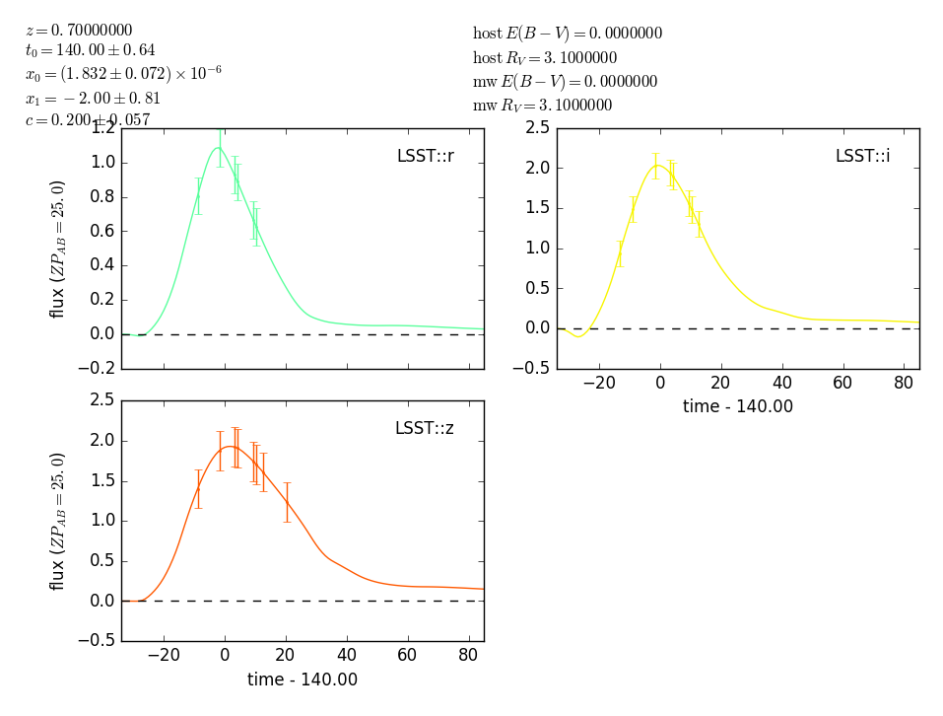
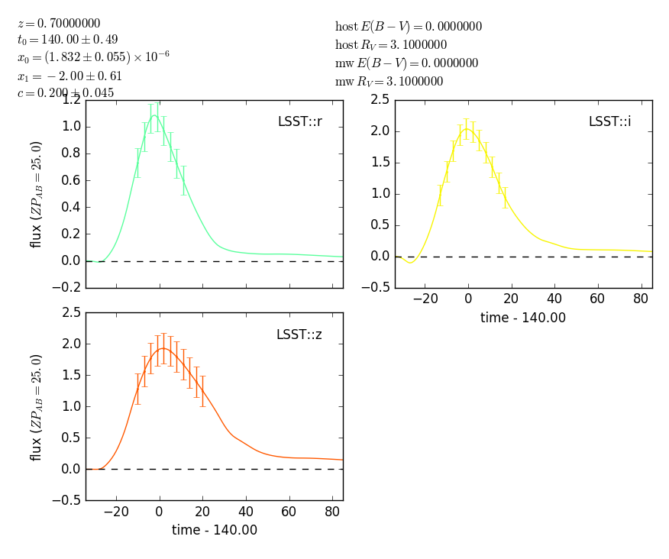
Main parameters driving SN science
Parameter | Impact | Typical value
cadence +multiband observations | Light curve quality (SN parameters estimation) | median: 3 days-1 with limited variations
season length | Number of SN collected | 170-180 days
depth | High z detection | 5-σ depth ~ 26.5, 26.2, 25.6, 24.7 for r, i, z, y bands (DDF)
The goal : collect a large and unbiased (z ≤ 0.8 DDF) sample of well measured (σ_{C} ≤ 0.04) type Ia supernovae.

Slide 11
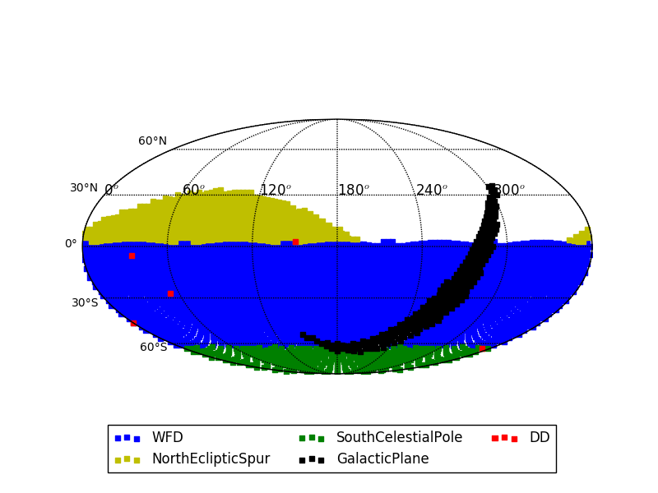
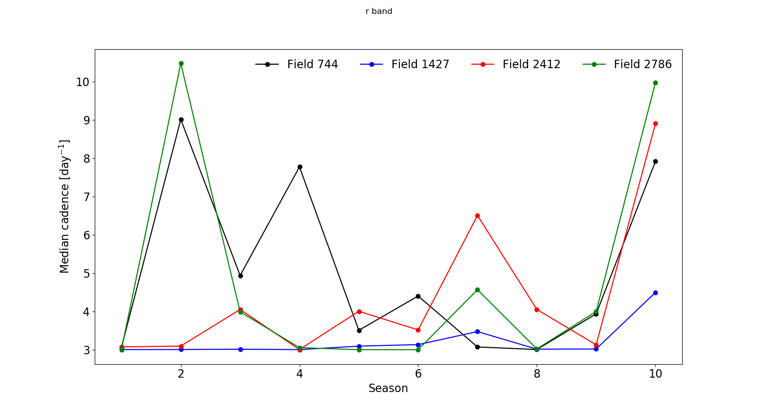
Cadence for SN in LSST
Observing strategy : current baseline minion_1016
Total number of visits : 2,448,282
(1 visit = 2 exposures of 15s)
3 types of surveys:
universal (WFD) ~ 90% -> Supernovae
mini-surveys : ~5%
Deep (DDF) : ~5% -> Supernovae
Median cadence [day-1]
Season

Slide 12
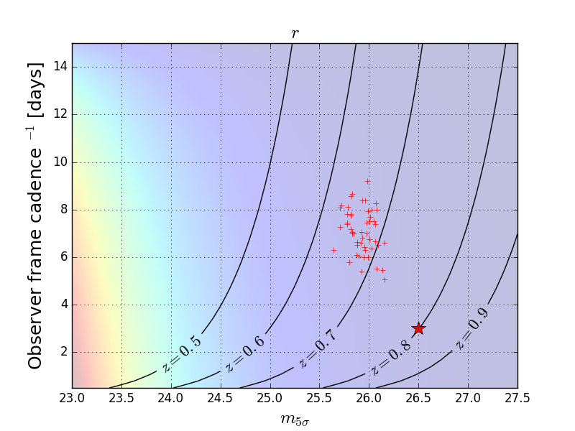
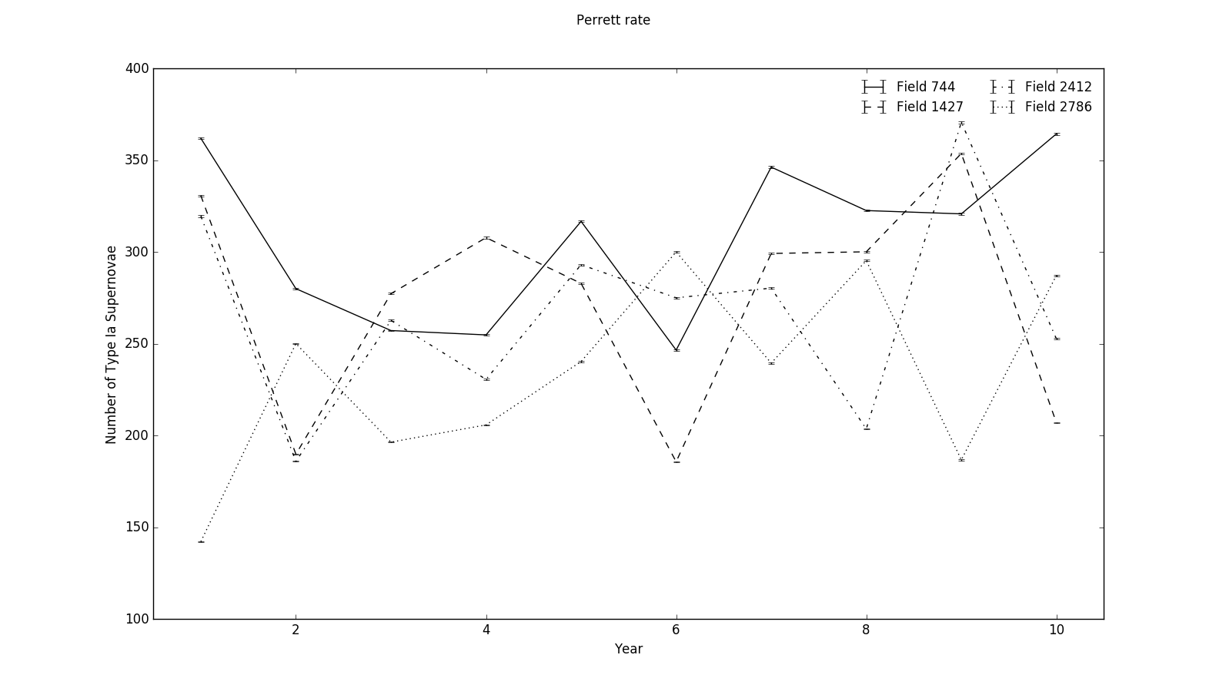
Cadence for SN in LSST – DDF minion_1016
Cadence metric
Number of Supernovae
MC simulations
Parameters : DayMax, X1, c, z
LC curve fits
SN rate production
→ get a reliable estimation of the number of well-measured SN after ten years.
cadence [day-1]
N (SN Ia)
250
4 DDF – ten years – N(SN Ia) ~ 11000
5-σ depth
year

Slide 13
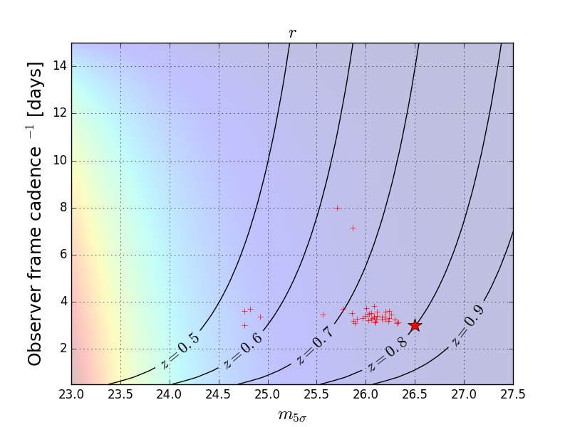
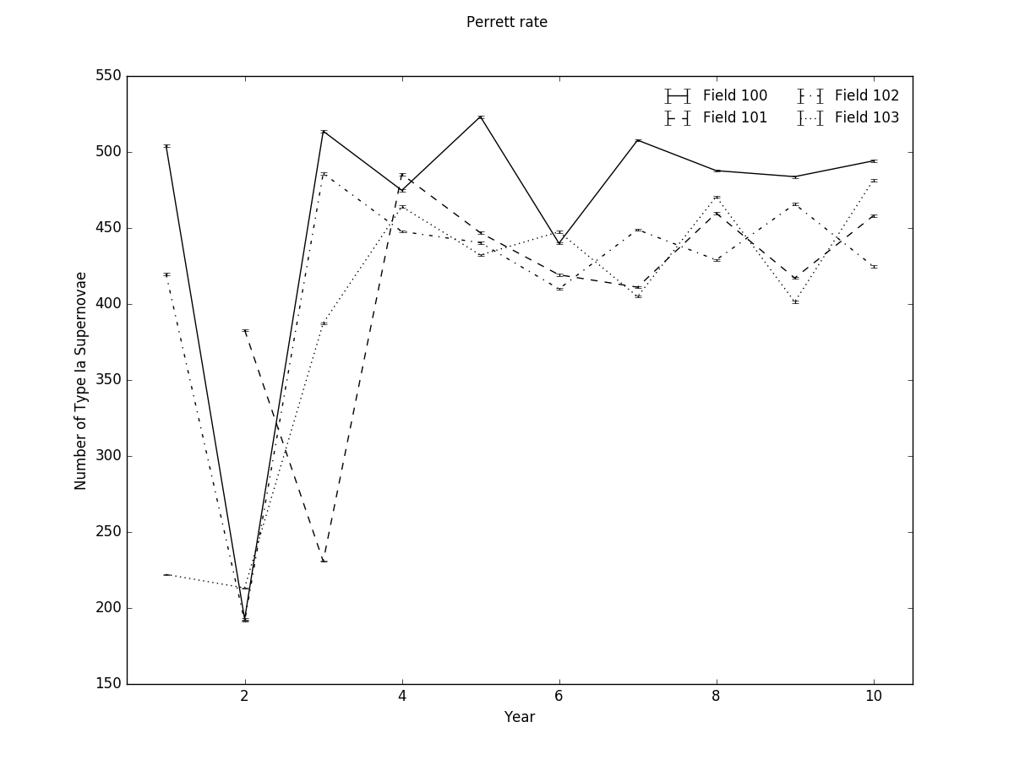
Cadence for SN in LSST – improving the cadence - DDF
New simulation : feature_baseline_10yrs : better cadence (regular 3 days-1) – same depth + improved sky model+ season length increased
Cadence metric
Number of Supernovae
minion_1016
cadence [day-1]
N (SN Ia)
250
4 DDF – ten years – N(SN Ia) ~ 11000
preliminary
feature_baseline
5-σ depth
year
450
cadence [day-1]
N (SN Ia)
4 DDF – ten years – N(SN Ia) ~ 16400
(without « bad » year 2 → 18000)
5-σ depth
year

Slide 14
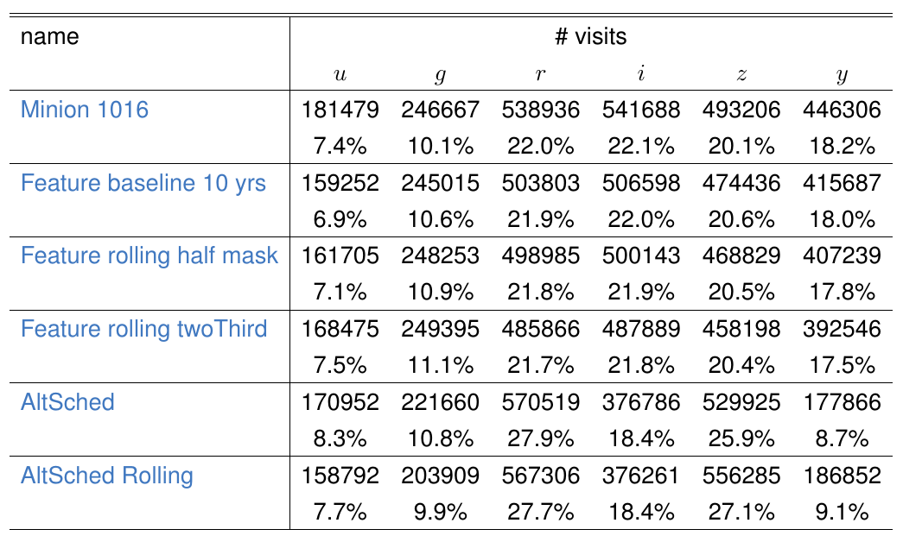
Cadence for SN in LSST – WFD
Minion_1016 and alternative scenarios (rolling cadence) being studied.

Slide 15
Cadence for SN in LSST – WFD
Minion_1016 and alternative scenarios (rolling cadence) being studied.
Of interest for SN science measurements

Slide 16
Cadence for SN in LSST – WFD
Minion_1016 and alternative scenarios (rolling cadence) being studied.
Rolling cadences
Altsched rolling vs feature ½ : g: -21% r : +14% i: -32% z: + 16%

Slide 17
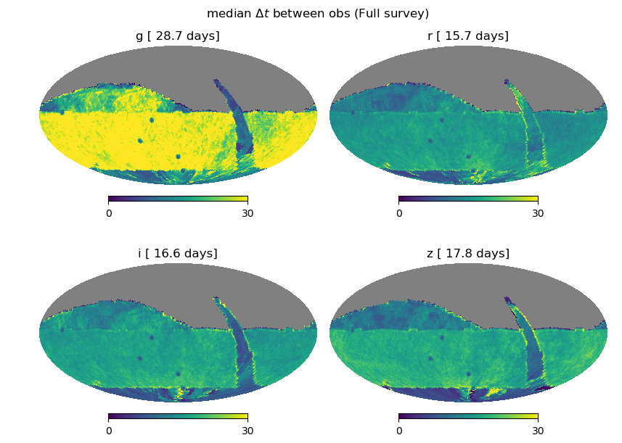
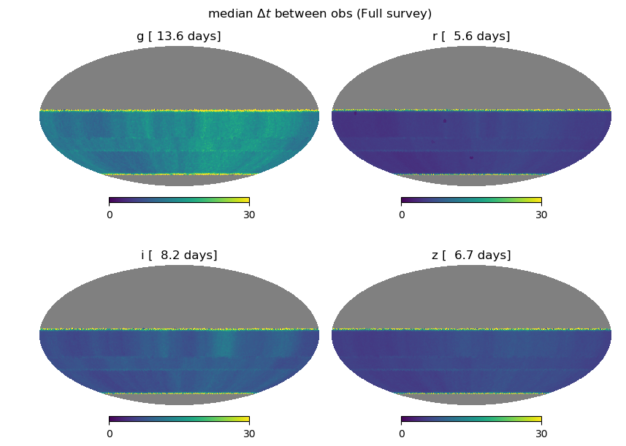
Cadence for SN in LSST – WFD
Average cadence
minion_1016
altsched

Slide 18
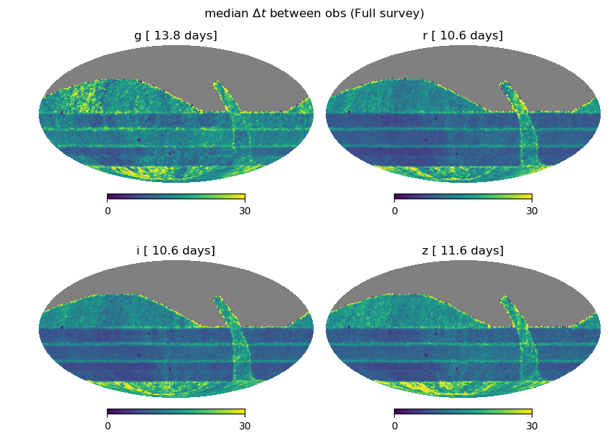
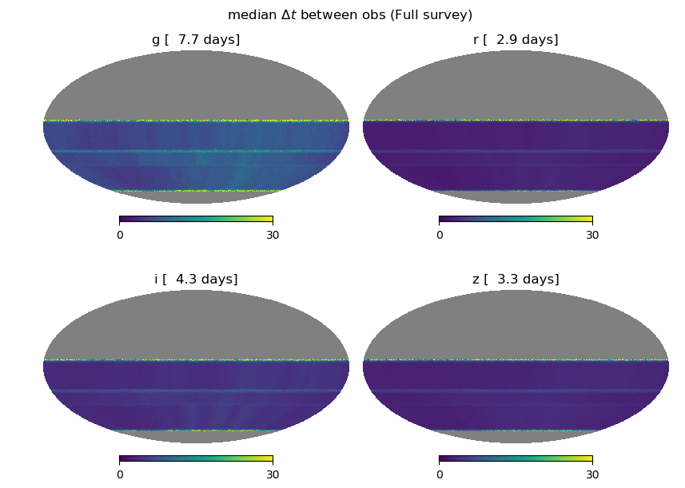
Cadence for SN in LSST – WFD
Average cadence
Feature rolling 2/3
altsched_rolling

Slide 19
Cadence for SN in LSST – WFD - Number of SNe
altsched_rolling
feature_baseline
http://supernovae.in2p3.fr/~nrl/lsst_sn_cadence/FullSample/

Slide 20
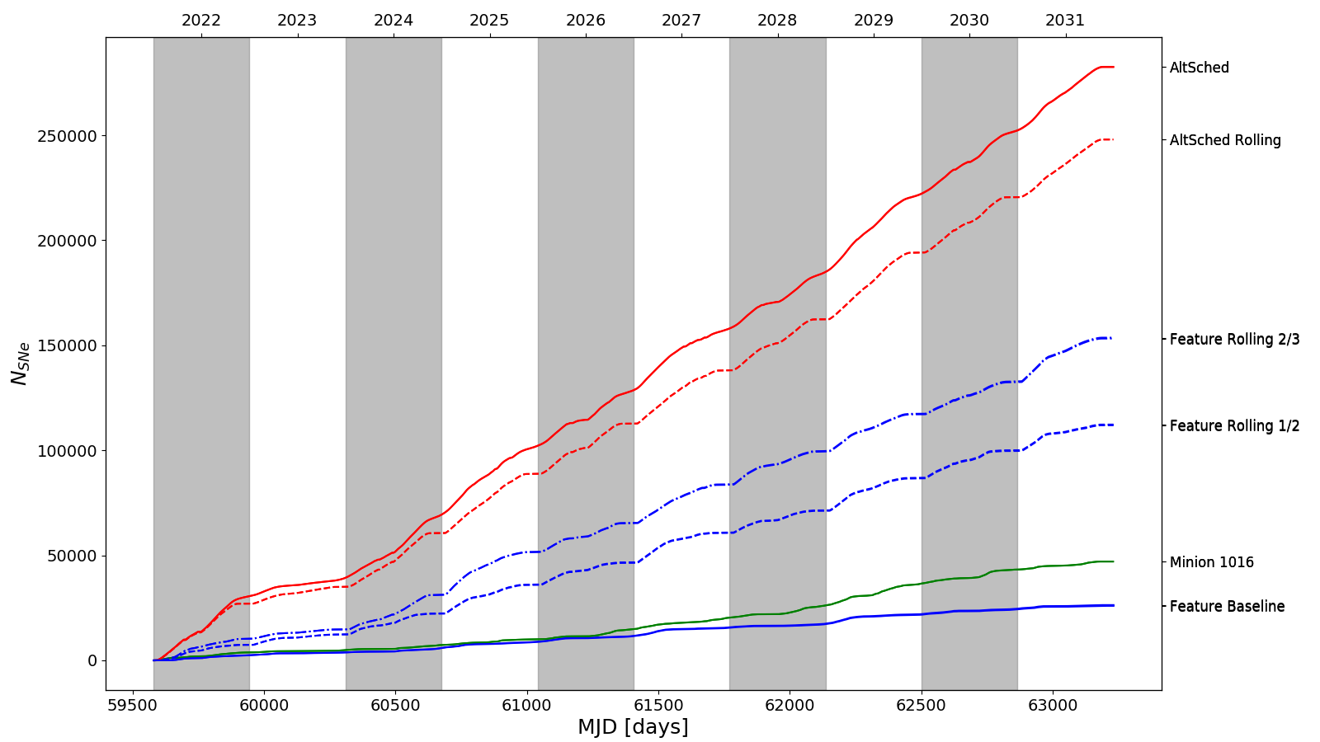
Cadence for SN in LSST
Summary
A large sample of well measured of type Ia supernovae is mandatory to set tight constraints on the nature of Dark Energy
A suitable observing strategy is crucial to collect this sample:
Cadence + multi-band observations
Depth
Season length
Proposed strategies lead to the following conclusions (10 years):
DDF : 4 fields - between 11000 to 18000 Sne Ia ; completeness z ~ 0.7
Altsched
250,000
Altsched rolling
WFD
preliminary
N (SN Ia)
feature rolling 2/3
150,000
feature rolling 1/2
50,000
minion
feature baseline
MJD [days]

Slide 21
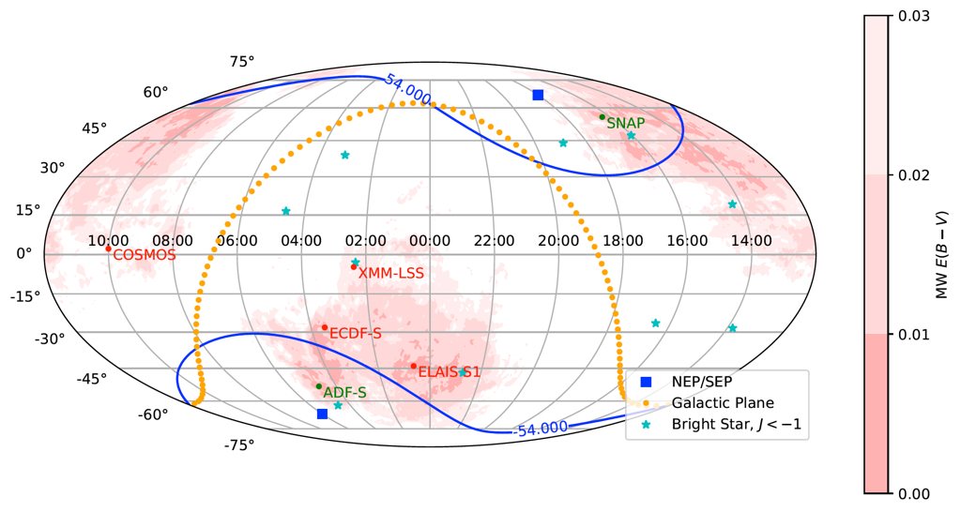
Cadence for SN in LSST
Summary
WFIRST CVZ
Possible improvements of cadence (wrt SN science):
DDF
Increase the number (up to 8 ? ):
Dark Energy anisotropies (w0,w1)
Synergy with space obs.
Increase z_{limit} ?
Increase season lengths ?
Ultra Deep fields (2x DDF depth)?
WFD
Huge variations seen between simulators
Rolling cadence strategy tend to lead to highest z_{limit} values
Better cadence in g would help
A call for white papers on LSST cadence optimization will be made soon. We will use the tools developed (and probably many more) up to now to estimate the best observing strategy from the SN science point of view.

