Slide 1
Evolution of matter from the interstellar medium to exoplanets with the JWST
Etat d’avancement au 15 novembre 2017
Alain Abergel (IAS)
CSNSM: C. Engrand J. Duprat M. Godard
L. Delauche L. Delbecq D. Le Du J. Bourcois C. Baumier C. Bachelet F. Fortuna
IAS: A.Abergel A. Aleon R. Brunetto E. Dartois E. Habart A. Jones
M.-A. Miville-Deschênes M. Olivier L. Verstraete N. Ysard Z. Djouadi
O. Mivumbi P. Duret K. Dassas C. Cossou
IPNO: M. Chabot G. Martinet S.Bouneau N. De Sereville F. Hamache
+ technical staff
SAp/AIM: P. Bouchet D. Dicken S. Fromang P.-O. Lagage E. Pantin P. Tremblin
A. Coulais R. Gastaud
Also: Maison de la Simulation, Soleil, ISMO

Slide 2
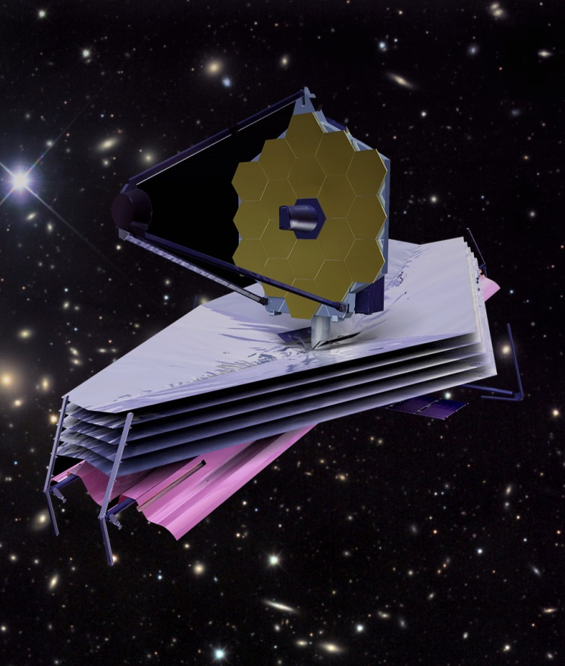
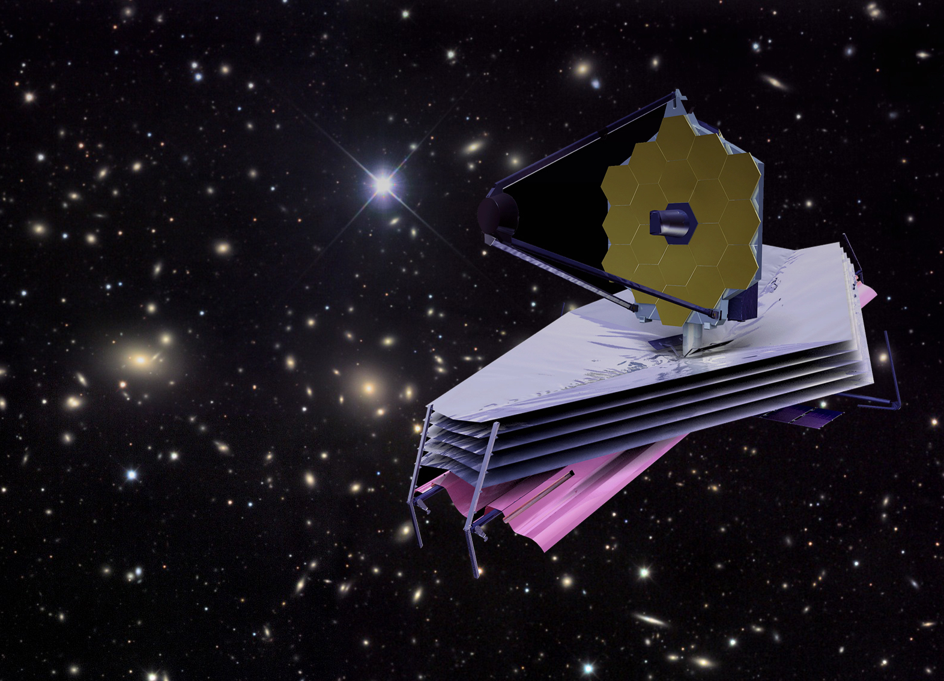
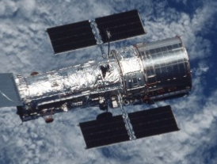

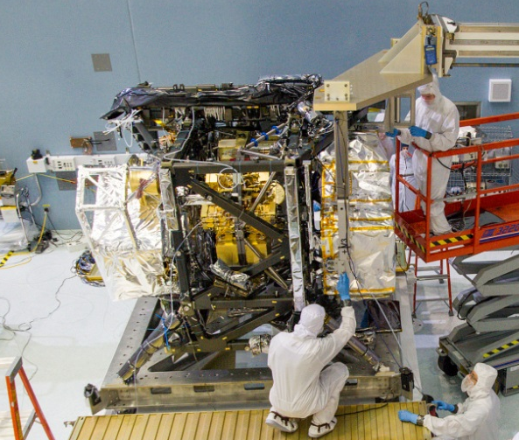
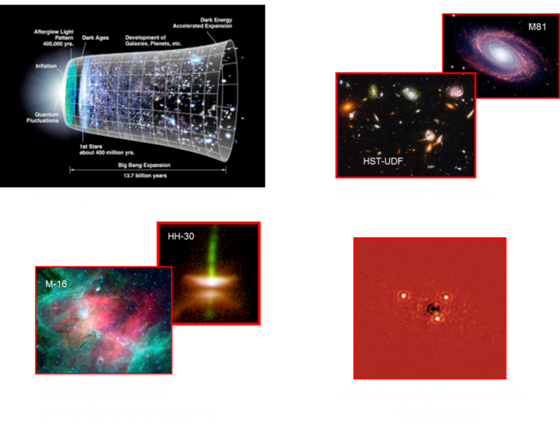
The JWST successor of the HST, :
a 6.5 meter InfraRed telescope in Space
Optimized in the IR
Launched: oct 2018 Spring 2019
In operation for 5 to 10 years (2019→2029)
JWST: flagship mission from NASA
with participation of Europe and Canada
Four IR Instruments:
NIRIS (0.6-5 μm) (Canada)
NIRCAM (1-5 μm) (US)
NIRSPEC (1-5 μm) (ESA)
MIRI : (5-28 μm) (Europe – US)
Four Scientific Themes:
First light and the reionisation
Assembly of galaxies
Birth of stars and proto-planetary systems
Planetary systems and the origin of life
Notes:
Biggest, most powerful, space-based observatory ever launched. The HST was optimised for visible light. The JWST is optimised for the IR, which will allow us to see back in time, to study the colder Universe, especially, and this is related to our project to analyse the regions where stars and planets are forming and also to study exoplanets. The JWST brings four scientific instruments, which combine imaging and spectroscopic capabilities. MIRI is a key instrument since it works at longer wavelenghts.

Slide 5
Goals of our project
  Cycle of dust particles in Galaxies :
Notes:
In order to introduce the goal of our project, I present the cycle of dust particles in Galaxies. After their formation, dust particles evolve, due to cosmic rays, radiation, schocks & interaction with the gas. Stars form in the densest regions, Disks as a by-product of star formation. Planetary systems form in disks. And finally the central stars become an evolved star.

Slide 6
Goals of our project
  Understanding physical processes which are acting on the matter in the evolutionary sequence from the interstellar medium to the formation of planets

Slide 7
Organisation: 4 work-packages
  WP1 Scientific coordination: Alain Abergel (IAS)
  WP2 Preparation of JWST observations: P.-O. Lagage (SAp/AIM)
  WP3 Modeling and simulations : E. Habart (IAS)
  WP4 Laboratory experiments : C. Engrand (CSNSM) & A. Aléon-Toppani (IAS)

Slide 8
WP2 : Preparation of the JWST observations
Prior to launch (2016-2018)
Task 1: Simulations of JWST observations,
Tasks 2 & 3: Keep on acquiring expertise (Optics, Detector, etc)
Data reduction pipeline: Implementation, use, improvement
Participation in the data challenges (planned for exoplanets)
After launch (2019 - …)
As soon as data are available (great advantage : access to the commissionning data)
run the data reduction pipeline, assess the uncertainties
→ to be rapidly in a position to interpret the data
Participation to (and support from) the French Center of Expertise for MIRI located at Paris-Saclay

Slide 9
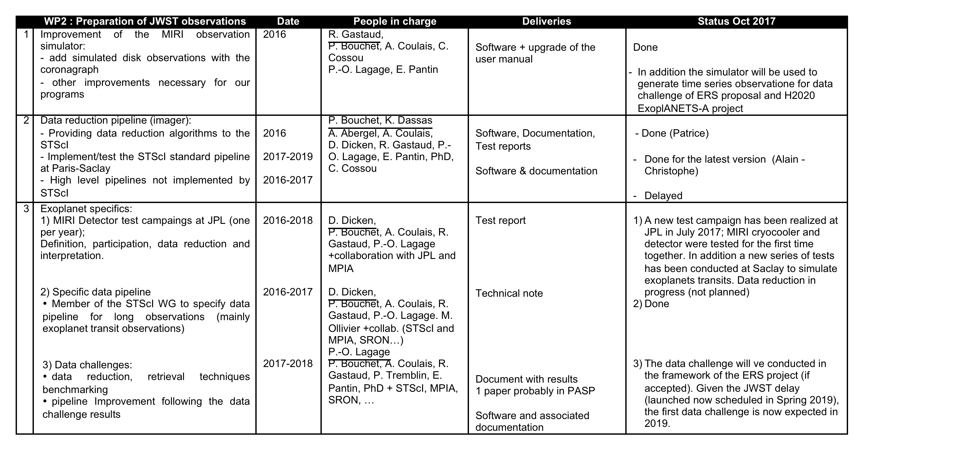
WP2 : Preparation of the JWST observations
1 PhD Marine Martin-Lagarde (2017-2020):
    Exoplanet atmosphere characterization with the JWST
    Observing programs, data challenge

Slide 10
Preparation of JWST observing programs
Participation to the MIRI consortium for the definition of Guaranteed Time Observations (GTO) :
  Exoplanets (115 hours)
    Disks (105 hours)
    Photodissociation Regions (42 hours)
    → Final submission November 30, 2017
Coordination with the community (national and international workshops) for the preparation of observing programs, especially for Eearly Released Science (observations during the first 5 months). 106 submitted proposals → 13 accepted (460 hours)
  Exoplanets: Transit (78 hours)
    Exoplanets: Direct imaging (38 hours)
    Radiative Feedback from Massive Stars (28.5 hours).
    → Final submission December 12, 2017
Next step: General Observations. Cycle 1. 30 November 2017 → 2 March 2018

Slide 11
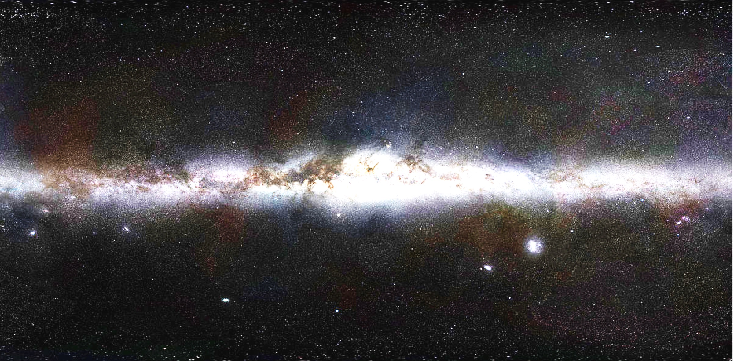
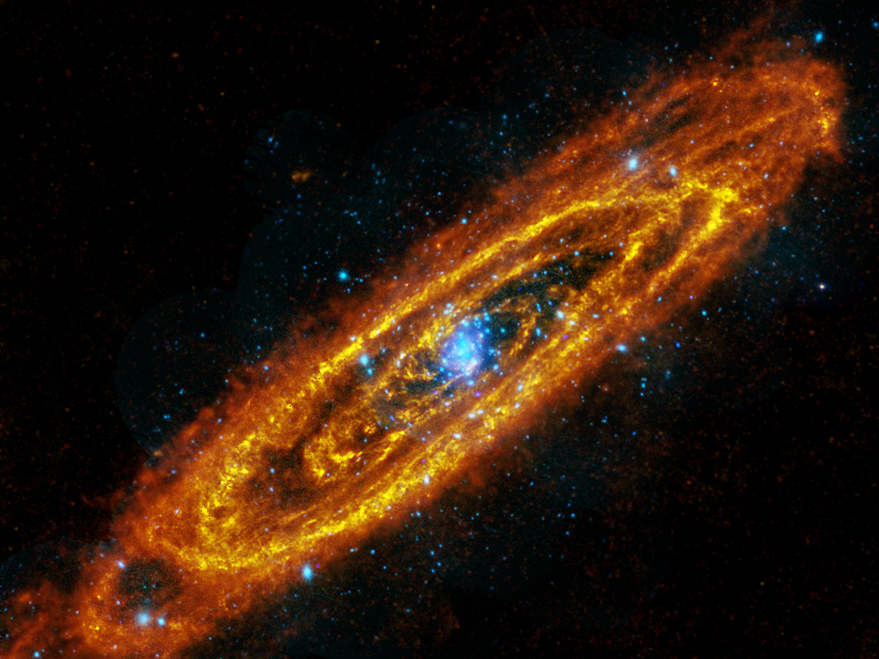
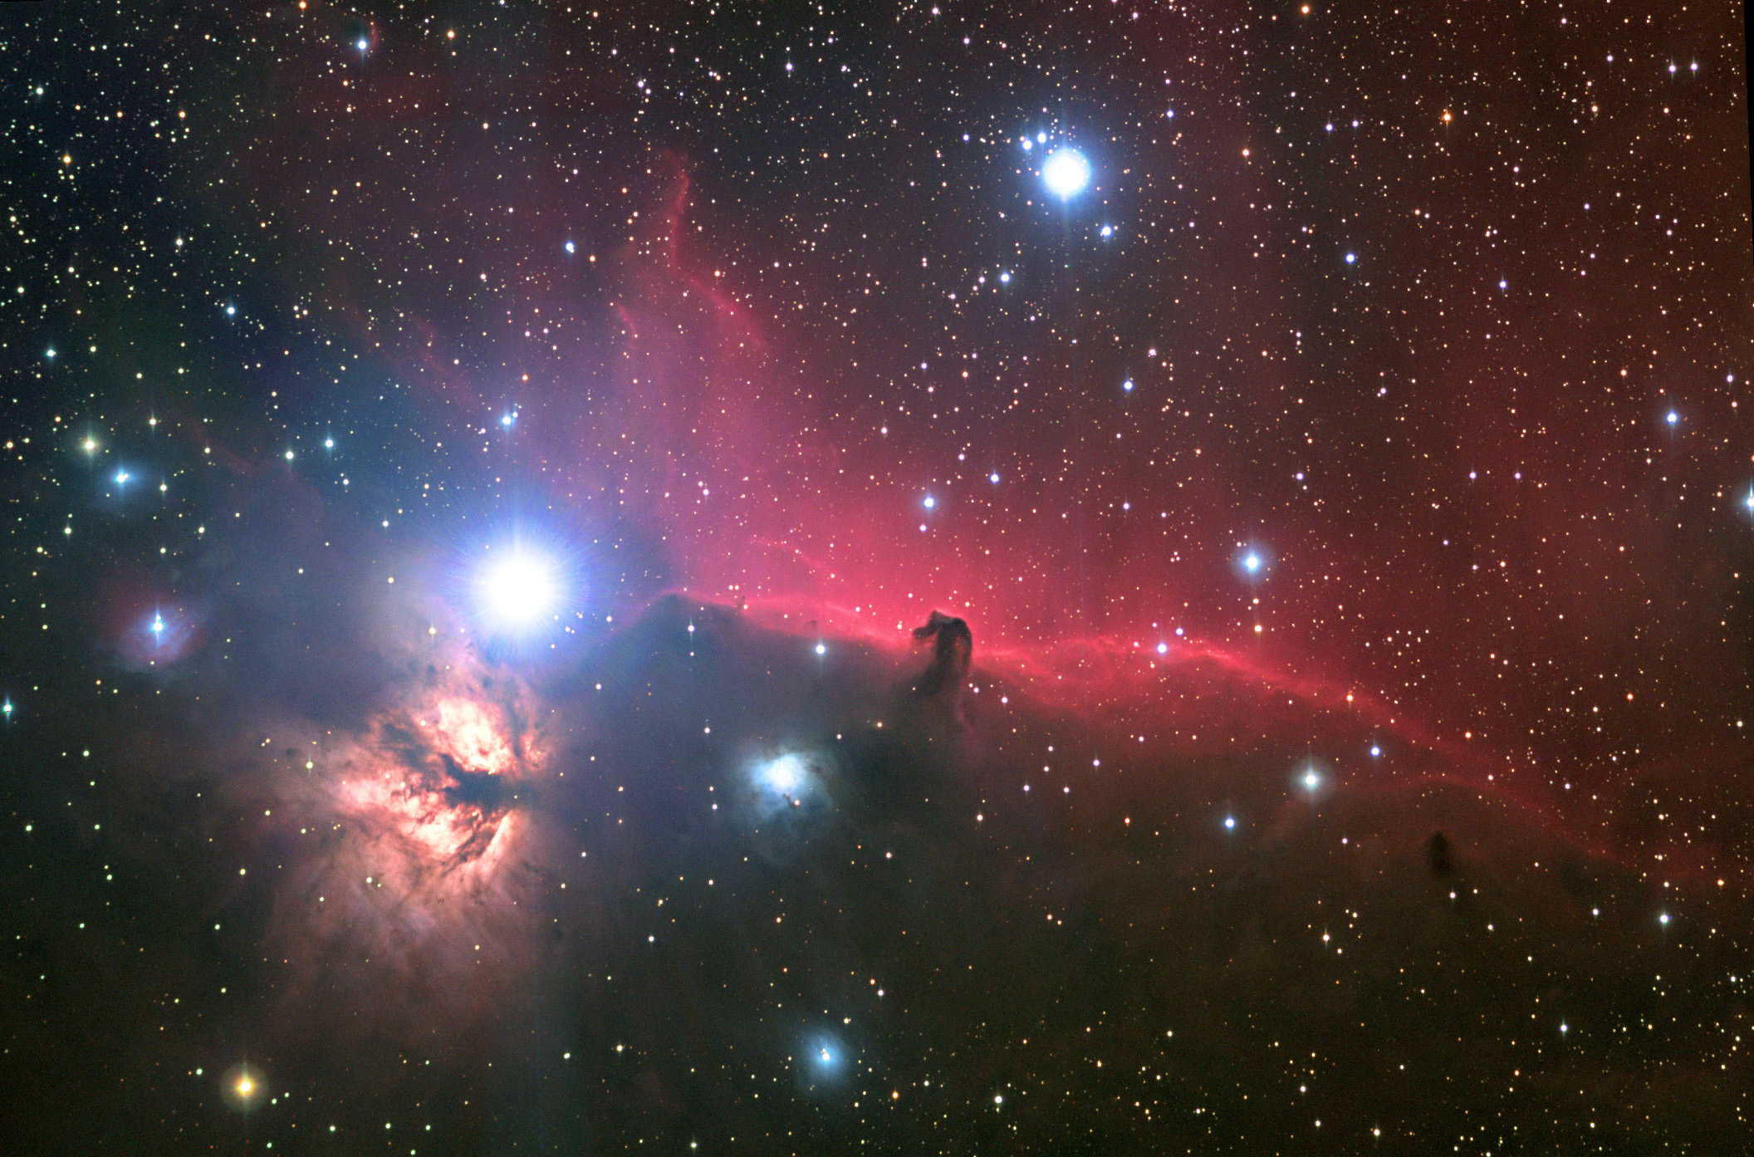
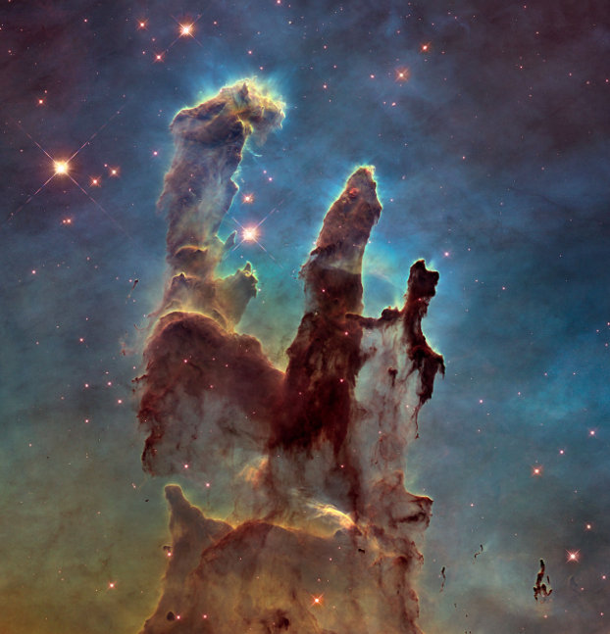
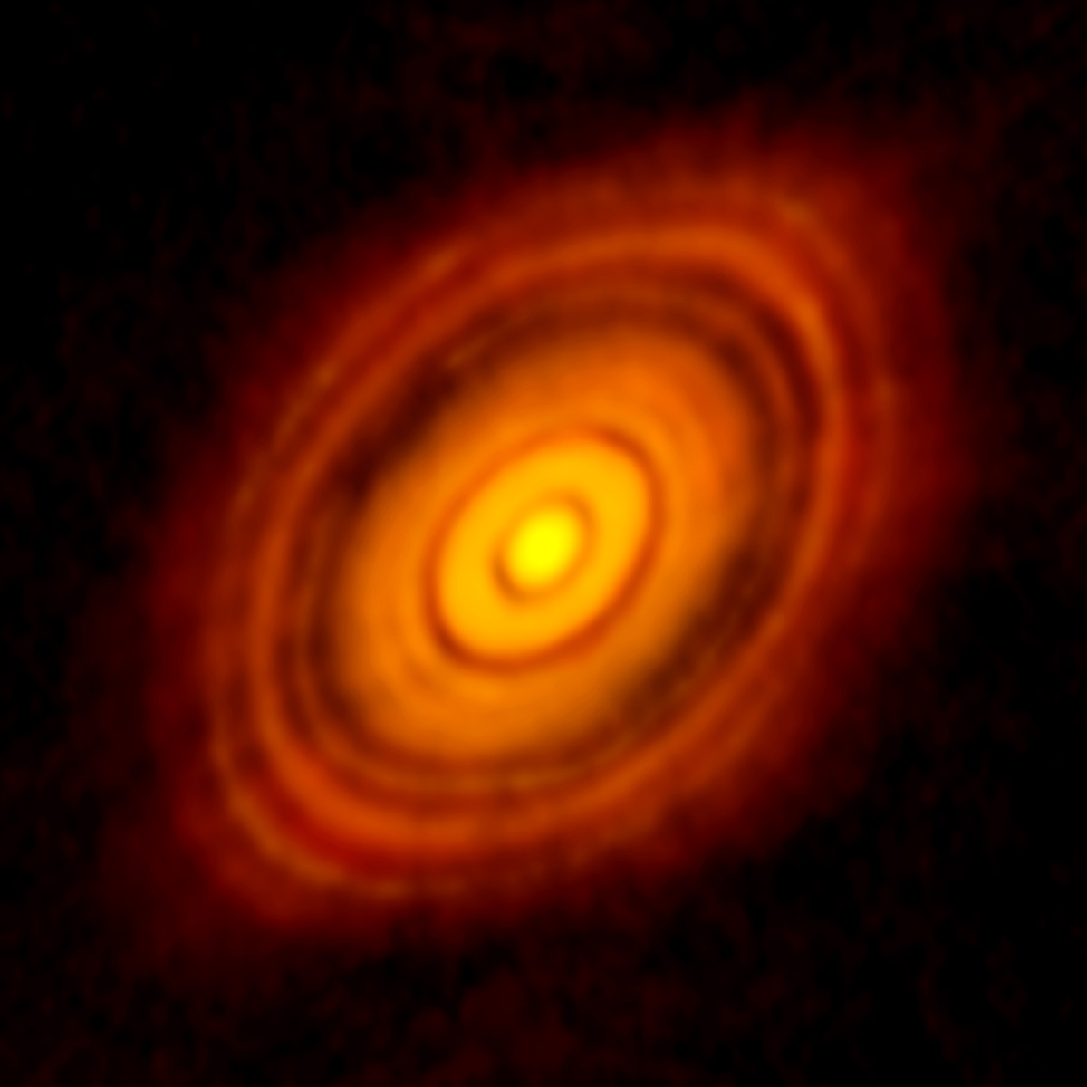
Interstellar dust-of-the-art : Interstellar dust
Everywhere
UV-visible → IR-submm
Visible (ESO/S. Brunier)
Planck HFI (thermal dust)
Key actor of matter evolution (gas heating, formation/protection of molecules)
at all angular scales :
2” , 280 AU
Herschel, FIR, M31
ALMA 1 mm, HL Tau
HST visible, M16
NRAO, visible in Orion
Notes:
Un aspect essentiel de notre project concerne les poussières interstellaires.
Observé par Planck sur le ciel entier (avant-plan). Présentes partout dans dans les galaxies. Redistribue le rayonnement UV-visible stellaire dans l’IR et le sub-mm.

Slide 12
Dust Emission spectrum (diffuse ISM)
JWST Herschel Planck
Jones et al. 2013 + DUSTEM
- ‘’Big Grains’’ (but size < 1 μm): Thermal equilibrium → Herschel & Planck
- ‘’Very small dust particles’’ (nanometric size): Stochastically heated → JWST
Most that half the total grain surface
→ Strongly coupled to the gas (Dynamics, Heating, Molecular formation)
→ Major role in the matter evolution
Key question: evolution with the local conditions (star forming regions, protoplanetary disks, …)
12
Notes:
Very small grains: Couplage dynamique. Et rapport S/V= 1/Rayon. Typiquement 2/3 de la surface des grains.
Rôle clé formation de H2, chauffage.

Slide 13
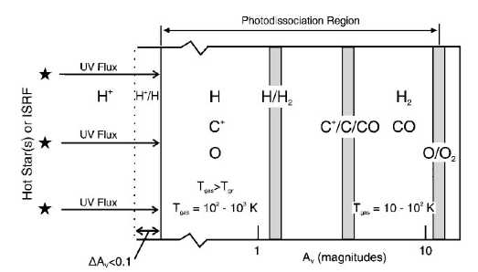
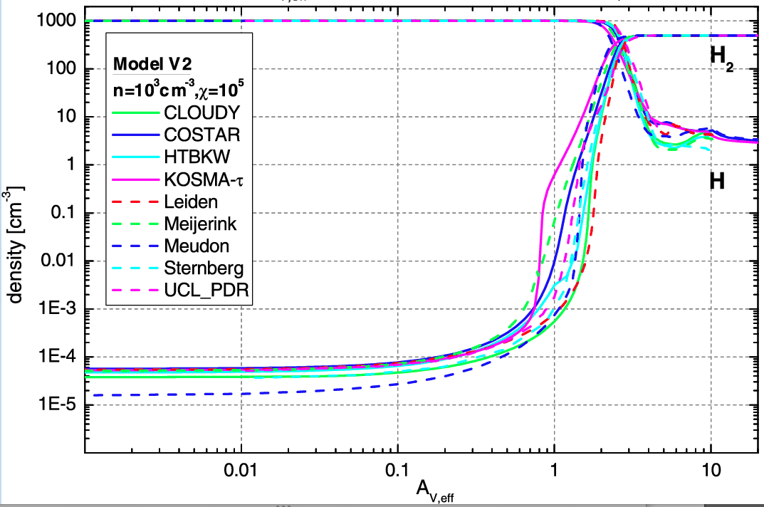
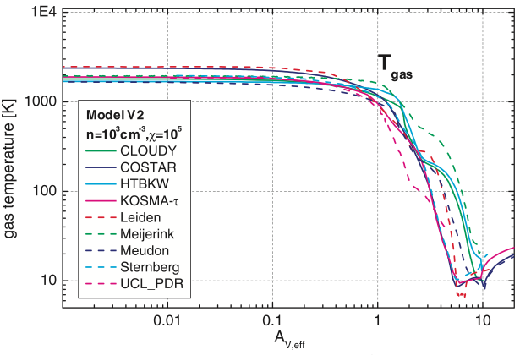
Photo-dominated regions (PDRs)
Laboratories to study radiation-dominated processes in galaxies
and the evolution of the dust and gas with the density
Visible
Röllig et al. 2007

Slide 14
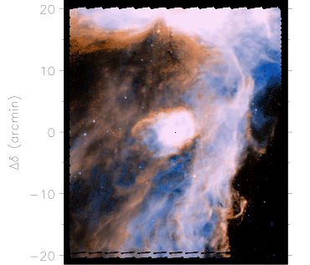
Dust evolution : photo-dominated regions (PDRs)
Aromatic 5-8 μm
Continuum at 15 μm
Visible IR emission:
In PDRs
1-2 μm
10’’
10’’
HST
NRAO ISO (Abergel et al. 2002, telescope diameter: 60 cm)
  JWST : How dust properties change at the interfaces ?
  The JWST has the angular resolution (0.1’’-1’’) to resolve the interfaces in the IR
  Dust evolution : growing, accretion, fragmentation, charge state, …
Notes:
These interfaces are resolved with the HST but only in the very near IR, and we do not see the emission of very small particles but here mainly the scattering of the incident light by the large dust particles.
Only the JWST will bring the angular resolution in the IR.

Slide 15
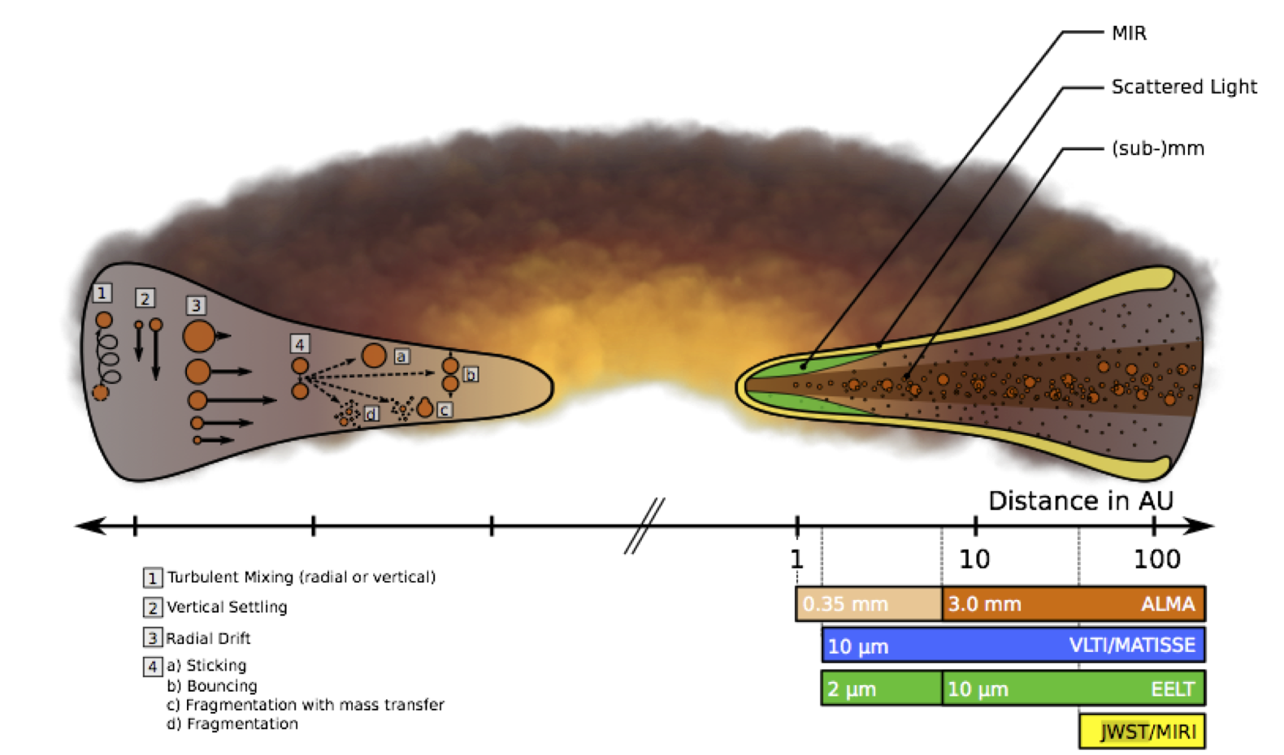
Dust evolution in protoplanetary disks
infall
IRAS 04302
(gas + dust)
< 1’’
By-product of the gravitational collapse to form young stars
Solid matter : Submicronic size → cm size → Planets
Flared shape :
  Stellar radiation and stellar winds,
  Turbulence
  Sedimentation towards the plane of the disk.
Observations → Angular Resolution & Sensitivity at long wavelengths are mandatory…
Notes:
Protoplanetary disks are by-product of the gravitational collapse to form young stars.
Disks : place where the solid matter growths from submicronic to planetary sizes.
The disks generaly have a flared shape due to combination of radiation and stellar winds, turbulence, sedimentation towards the plane of the disk.

Slide 16
Dust evolution in protoplanetary disks
infall
IRAS 04302
(gas + dust)
< 1’’
  JWST : How dust properties change at the upper layers of the disks ?
  Spatially & spectrally-resolved dust emission and scattering with a unique sensitivity
  Only JWST can give the warm gas and dust inventory as a function of the local conditions.
  Unique access to large distance from the star (30-500 AU) and T Tauri stars (< 2 M⌾)
  Dust evolution at the upper layers → Impacts on the growing processes
Notes:
Protoplanetary disks are by-product of the gravitational collapse to form young stars.
Disks : place where the solid matter growths from submicronic to planetary sizes.
The disks generaly have a flared shape due to combination of radiation and stellar winds, turbulence, sedimentation towards the plane of the disk.

Slide 17
WP3 (Modeling & Simulations) : PDRs & Disks
  The modeling is the key to analyse the data
  Disks: JWST signatures mainly from upper layers → Diagnostics comparable to PDRs
UV
Task 1: Dust properties modeling
Task 2: Analysis of pre-JWST data
Task 3: Simulation of JWST observations
Task 4: Analysis of JWST observations
Strong interactions with laboratory experiments
Photon-Dominated layers
JWST
UV
  Objectives:
  Realistic dust model in disks based on pre-JWST & JWST data, laboratory experiments Model calculations: dust (with adaptable properties) & radiative transfer,
  Survival and interaction of nano-grains with UV photons at the illuminated edges
  First coagulation of aggregates and settling phases
  Constrain PDR/disk structures, which is essential for the study of the dynamics & chemistry
2 PhD : 1 for disks (2016-2019) and 1 for PDRs (2017-2020)
1 postDoc (disks 2017-2019)
Notes:
Insister sur le lien PDRs-Disques
Collaboration avec Radiative transfer codes MCFOST
Simulations MHD: S. Fromang

Slide 18
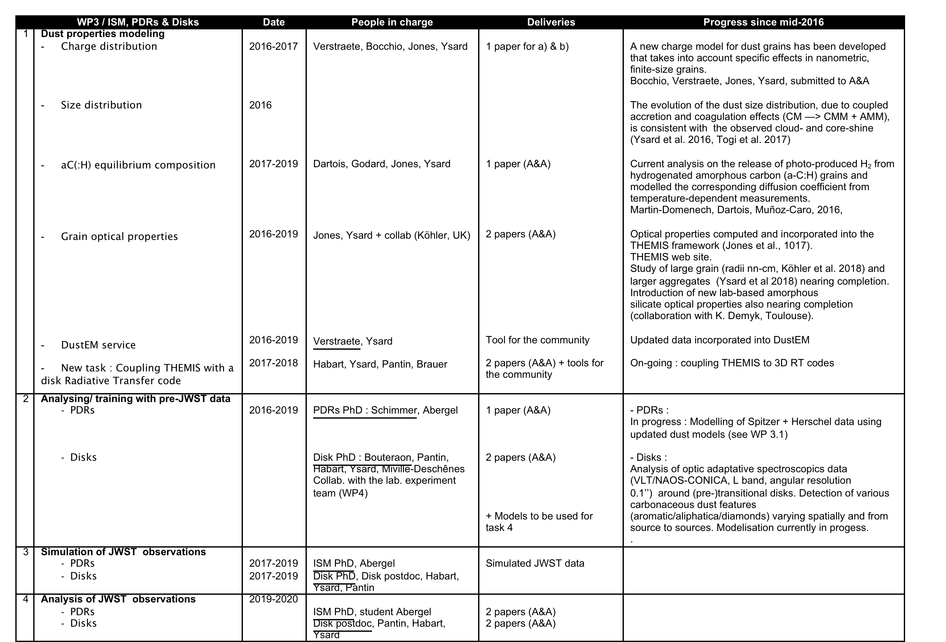
WP3 (Modeling & Simulations) : PDRs & Disks
Notes:
Insister sur le lien PDRs-Disques
Collaboration avec Radiative transfer codes MCFOST
Simulations MHD: S. Fromang

Slide 19
WP3 (Modeling & Simulations) : PDRs & Disks

Slide 20
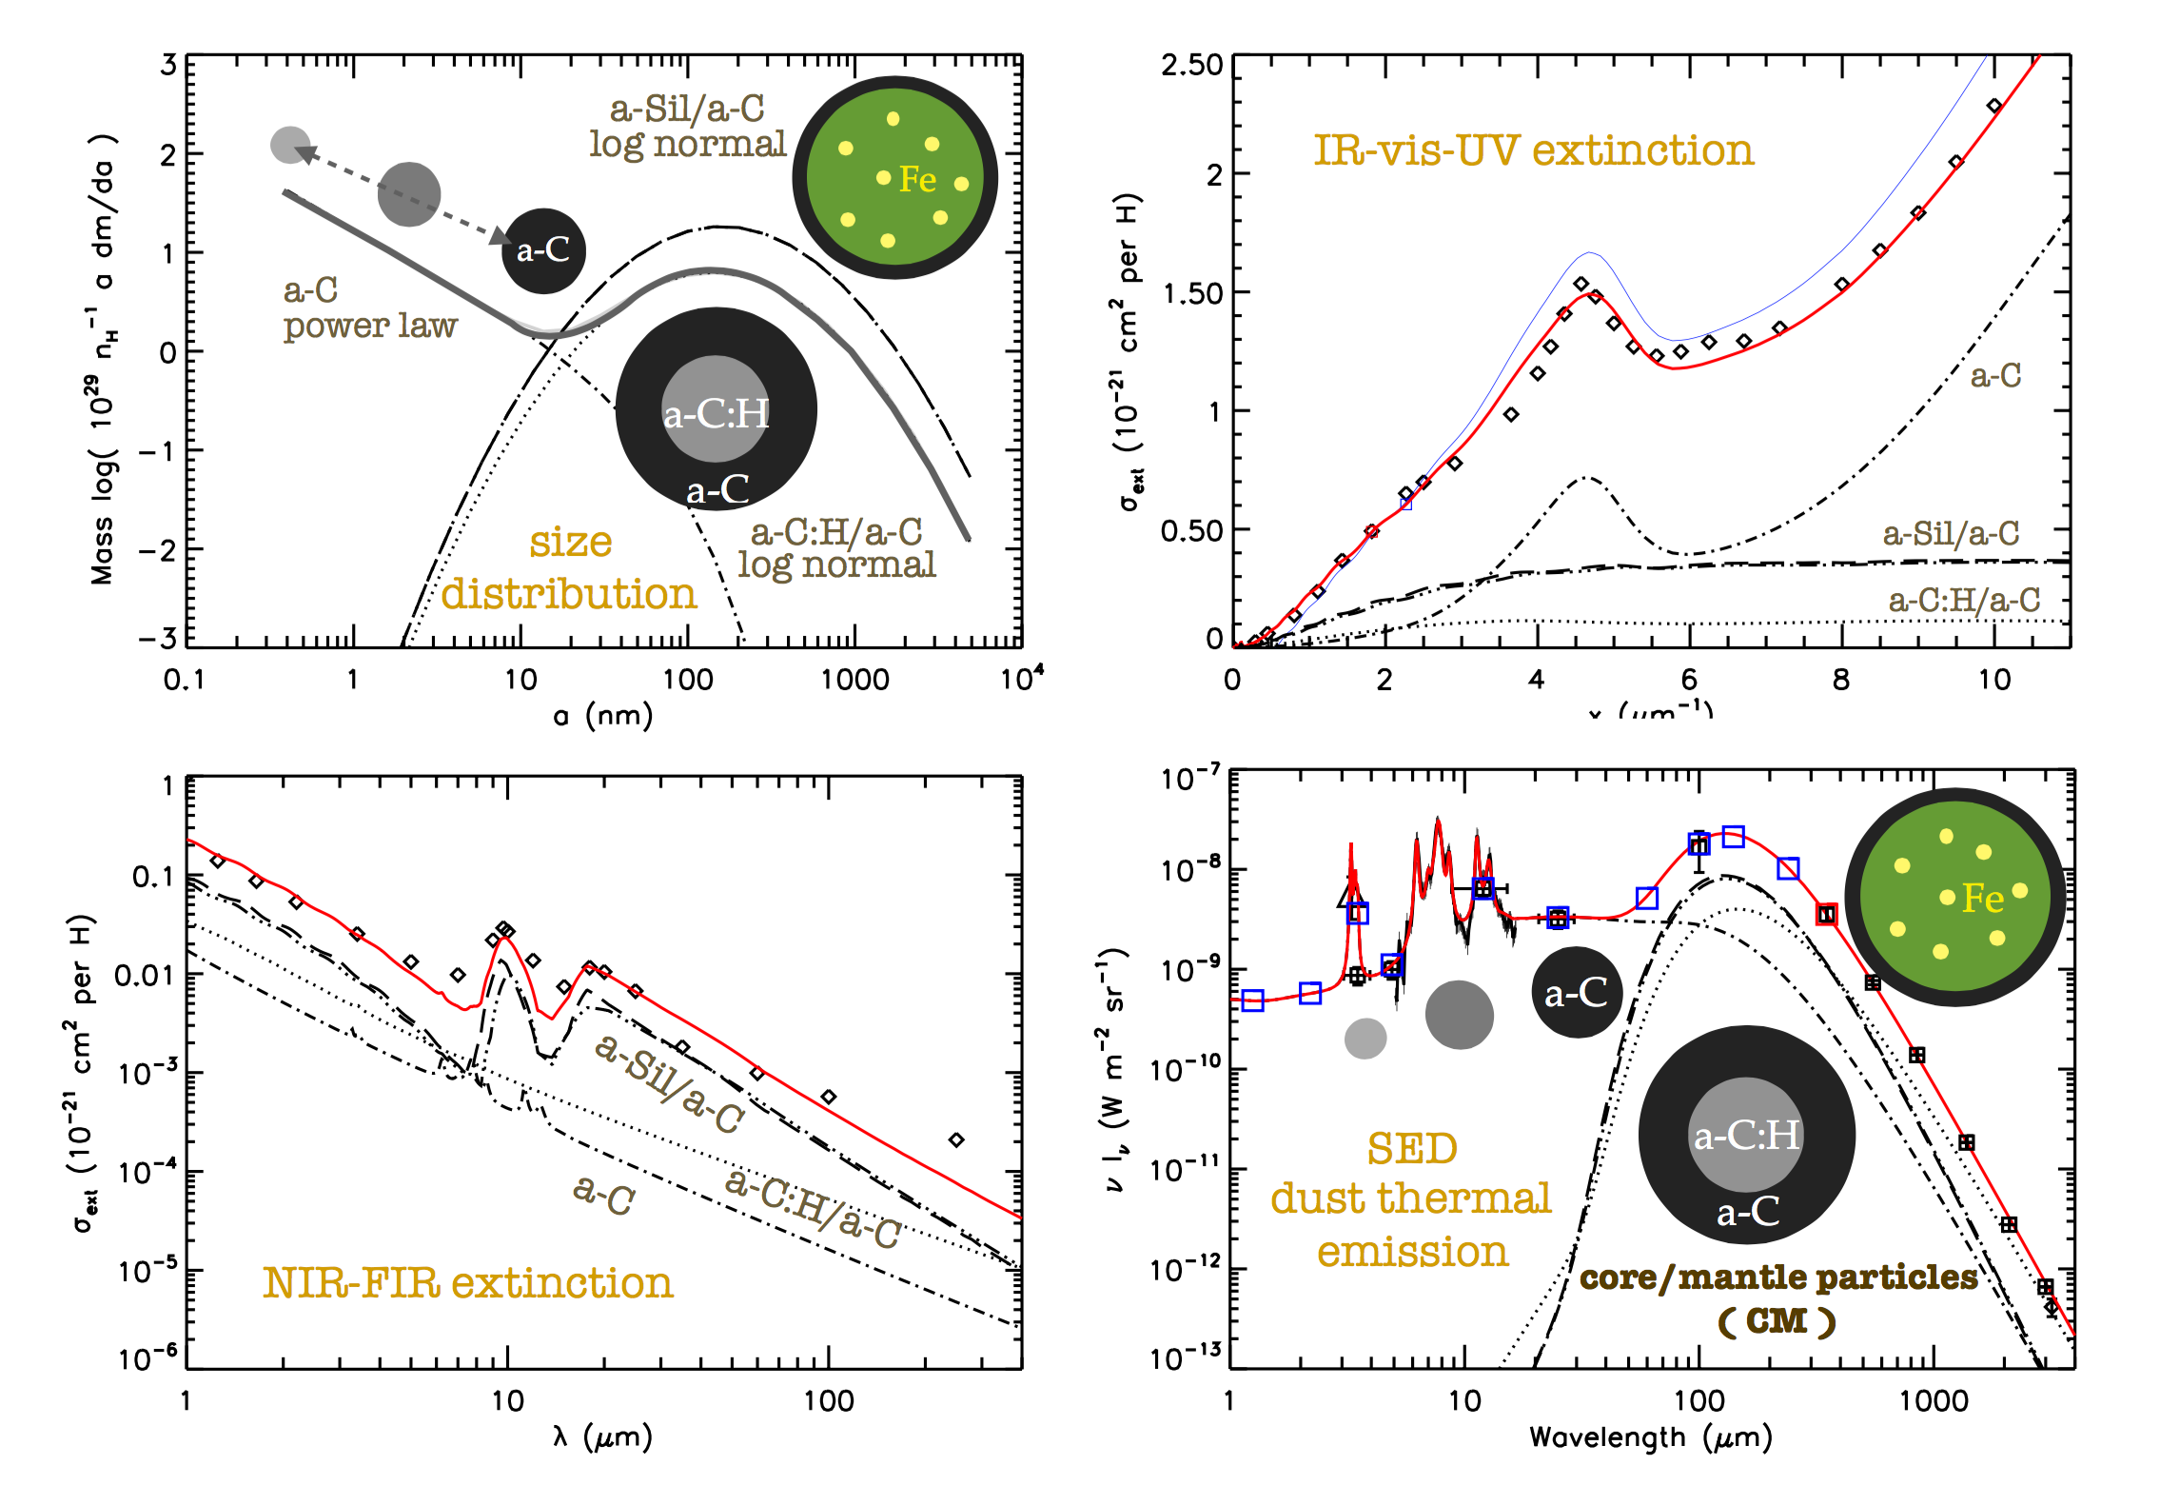
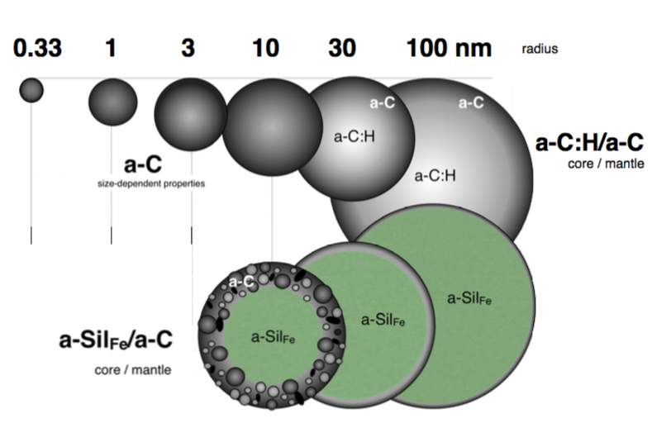
Ant Jones, Nathalie Ysard, Melanie Köhler, Laurent Verstraete, Marco Bocchio
Jones et al. 2013, 2016, 2017, Koehler et al. 2015, Ysard et al. 2015, 2016, 2018
WP 3.1 Dust model (including evolution) THEMIS
Black: aromatic-rich a-C(:H)
Grey: aliphatic-rich a-C(:H)
Green: a-Sil
Core/mantel dust model
2 materials :
- amorphous hydrocarbon materials, a-C(:H), with variable H content
- amorphous silicate (with iron inclusions)
3 populations : - Small particles (0.4-100 nm) of a-C(:H)
- BGs (around 200 nm) of a-C(:H)
- BGs (around 200 nm) of amorphous silicate with mantle of a-C(:H)
Carbonaceous surfaces are aromatised in the diffuse ISM → smaller grains are aromatics
20

Slide 21
WP 3.1 Actual and future developments
Grain charge & photoelectric heating
Larger aggregate optical properties
Lab-based silicate n & k optical properties (coming soon)
A global view of dust evolution - nanoparticle-driven chemistry, ...

Slide 22
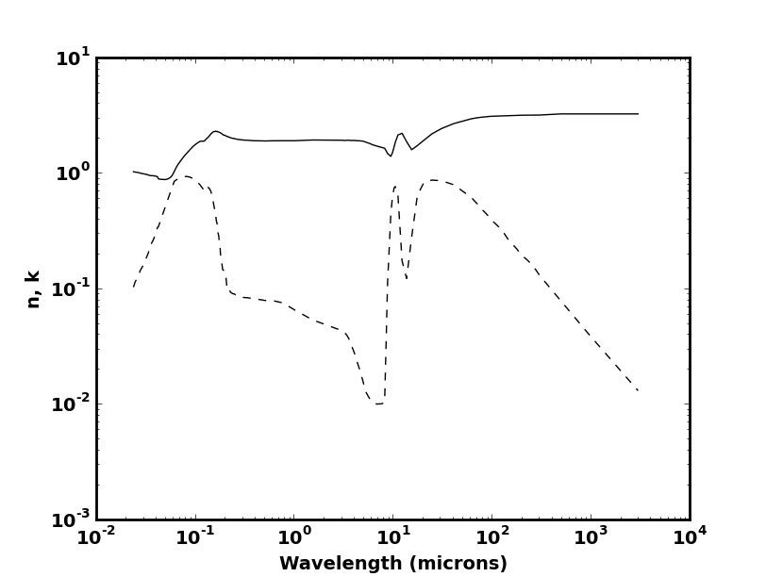
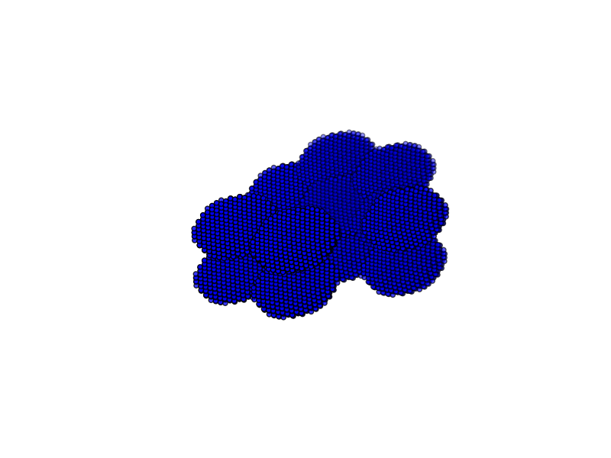
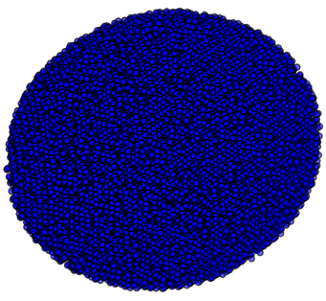
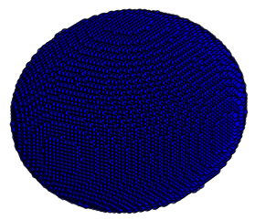
WP 3.1 Grain growth effects on optical properties
Example of silicate grains with complex structures
Ysard et al. in prep
n
aggregate of compact spheres
k
+ size
+ porosity
+ spheroids
+ aggregation
+ size/shape/structure/number
+ of monomers in aggregates
+ composition
porous sphere
compact sphere

Slide 23
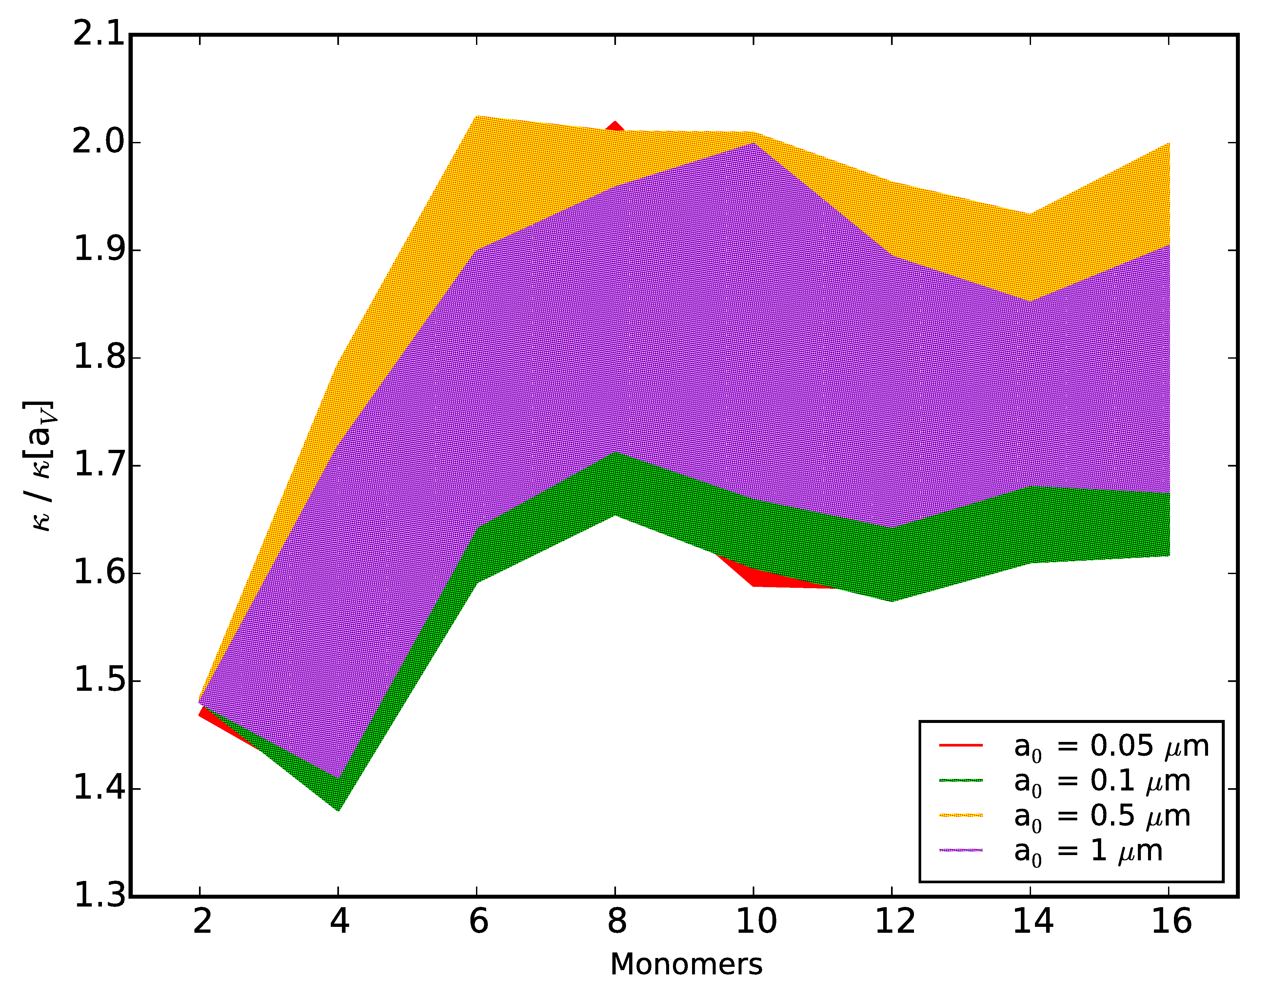

WP 3.1 Grain growth effects on optical properties
Example of aggregates of compact spheres
Ysard et al. in prep
Dust mass opacity κ of aggregates made of compact spheres normalized to κ of the compact spheres of same masses

Slide 24
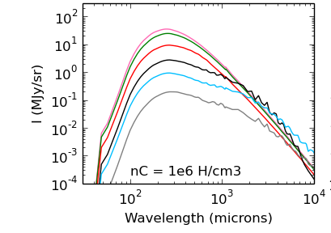
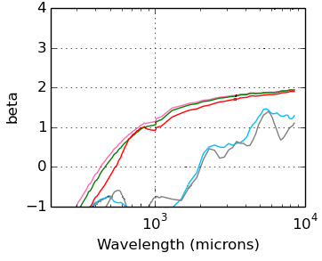
WP 3.1 Grain growth effects on optical properties
Example of compact spheres of silicate up to 10 cm in radius
Ysard et al. in prep
a = 0.01 µm, 0.1 µm, 1 µm, 10 µm, 100 µm, 1 mm, 1cm, 10cm

Slide 25
WP3 (Modeling & Simulations) : PDRs & Disks
Notes:
Insister sur le lien PDRs-Disques
Collaboration avec Radiative transfer codes MCFOST Grenoble, RADMC3D Dullemend Heidelberg
SKIRT Gand
Simulations MHD: S. Fromang

Slide 26
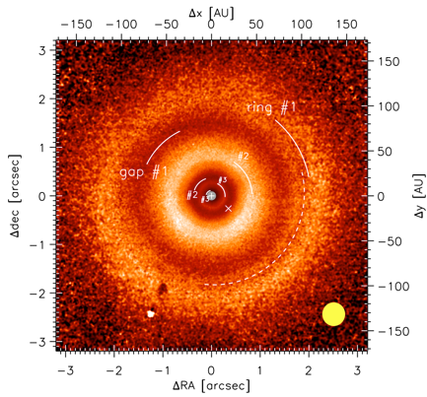
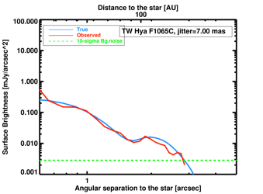
WP 3.3 Simulation of JWST observations: Protoplanetary disks
R. Brauer, post-doc (2017-2019)
/VLTSPHERE DPI H
VLT/SPHERE DPI H
R. Brauer currently being trained on THEMIS-DustEm
Then coupling with a radiative transfert code (MCFOST)
Model adjusted on current observations, used to compute simulations of JWST observations
JWST/MIRIM-4QPM coronagraphs data end-to-end simulator fully functional
Test-case on GTO TW Hya forthcoming observations
demonstrates the ability to detect gaps in PP disk using MIRI
van Boekel+17
TW Hya image obtained by VLT/SPHERE instrument. Gaps seen in this image are used as inputs for JWST observations modeling
True (blue) and observed profiles (red) using JWST/MIRI of TW Hya PP disk at 10.65 um

Slide 27
WP3 (Modeling & Simulations) : PDRs & Disks
Notes:
Insister sur le lien PDRs-Disques
Collaboration avec Radiative transfer codes MCFOST Grenoble, RADMC3D Dullemend Heidelberg
SKIRT Gand
Simulations MHD: S. Fromang

Slide 28
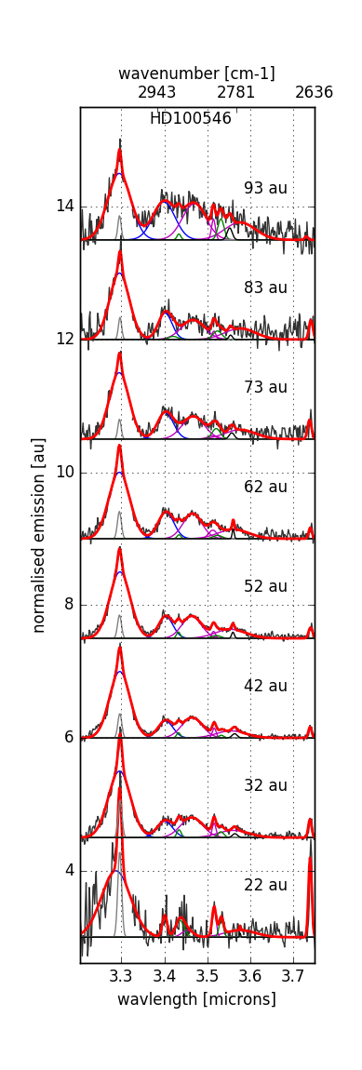
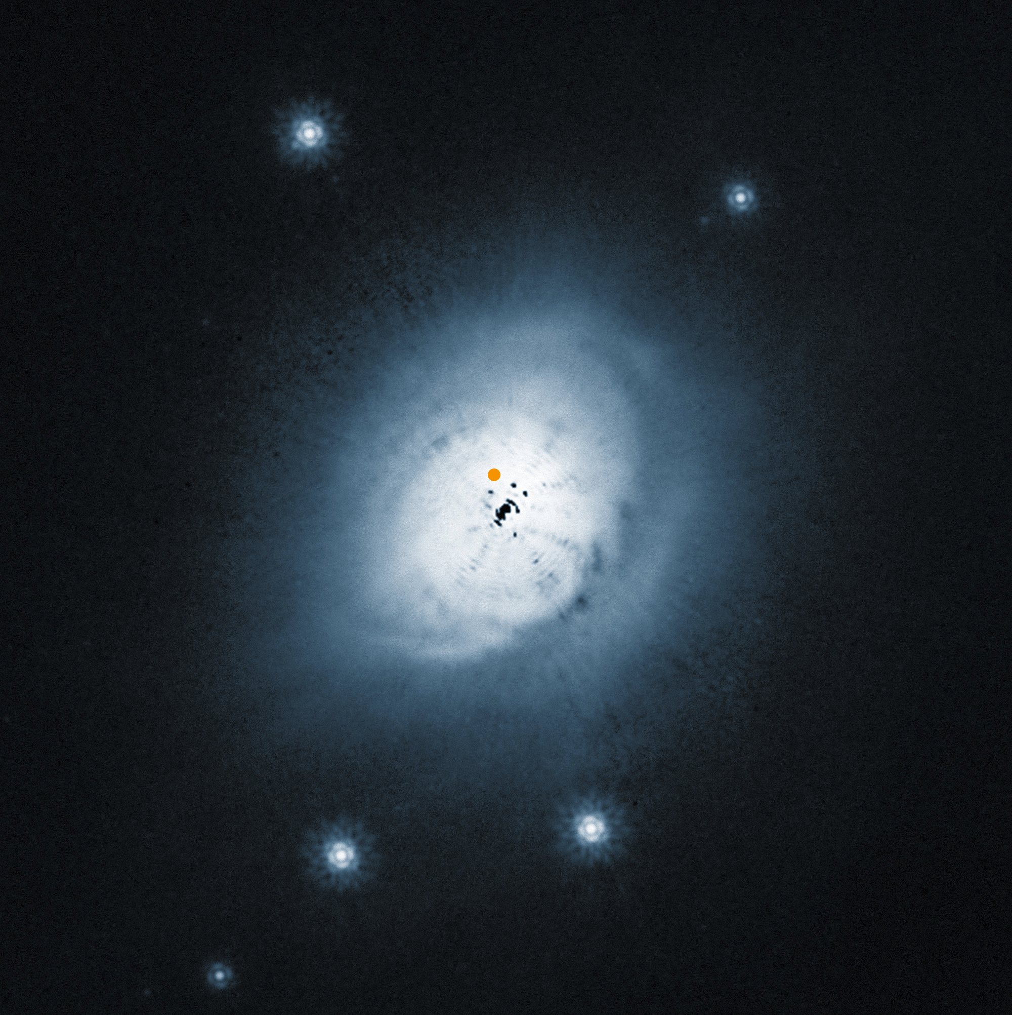
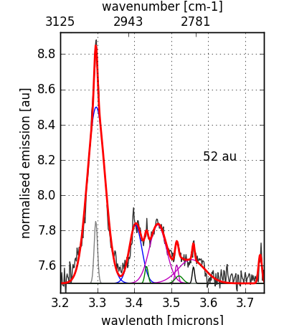
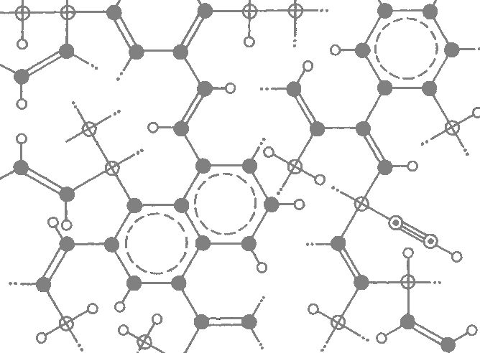
WP 3.2 Spatially resolved spectroscopic emission in the mid infrared range of protoplanetary disks with VLT/NACO, Thomas Boutéraron, PhD 2016-19
HD 100546
Covered area by moving the slit
Mean spectra over the distance
H recombination line
Aromatics
Aliphatics
+ Heteroatom ?
HST/ACS
> Identification of several bands related to vibrational modes
of carbonaceous nanograins at different positions in the disk
> Evidences for aromatic and aliphatic materials
Aliphatics
Olefinics
Aromatics

Slide 29
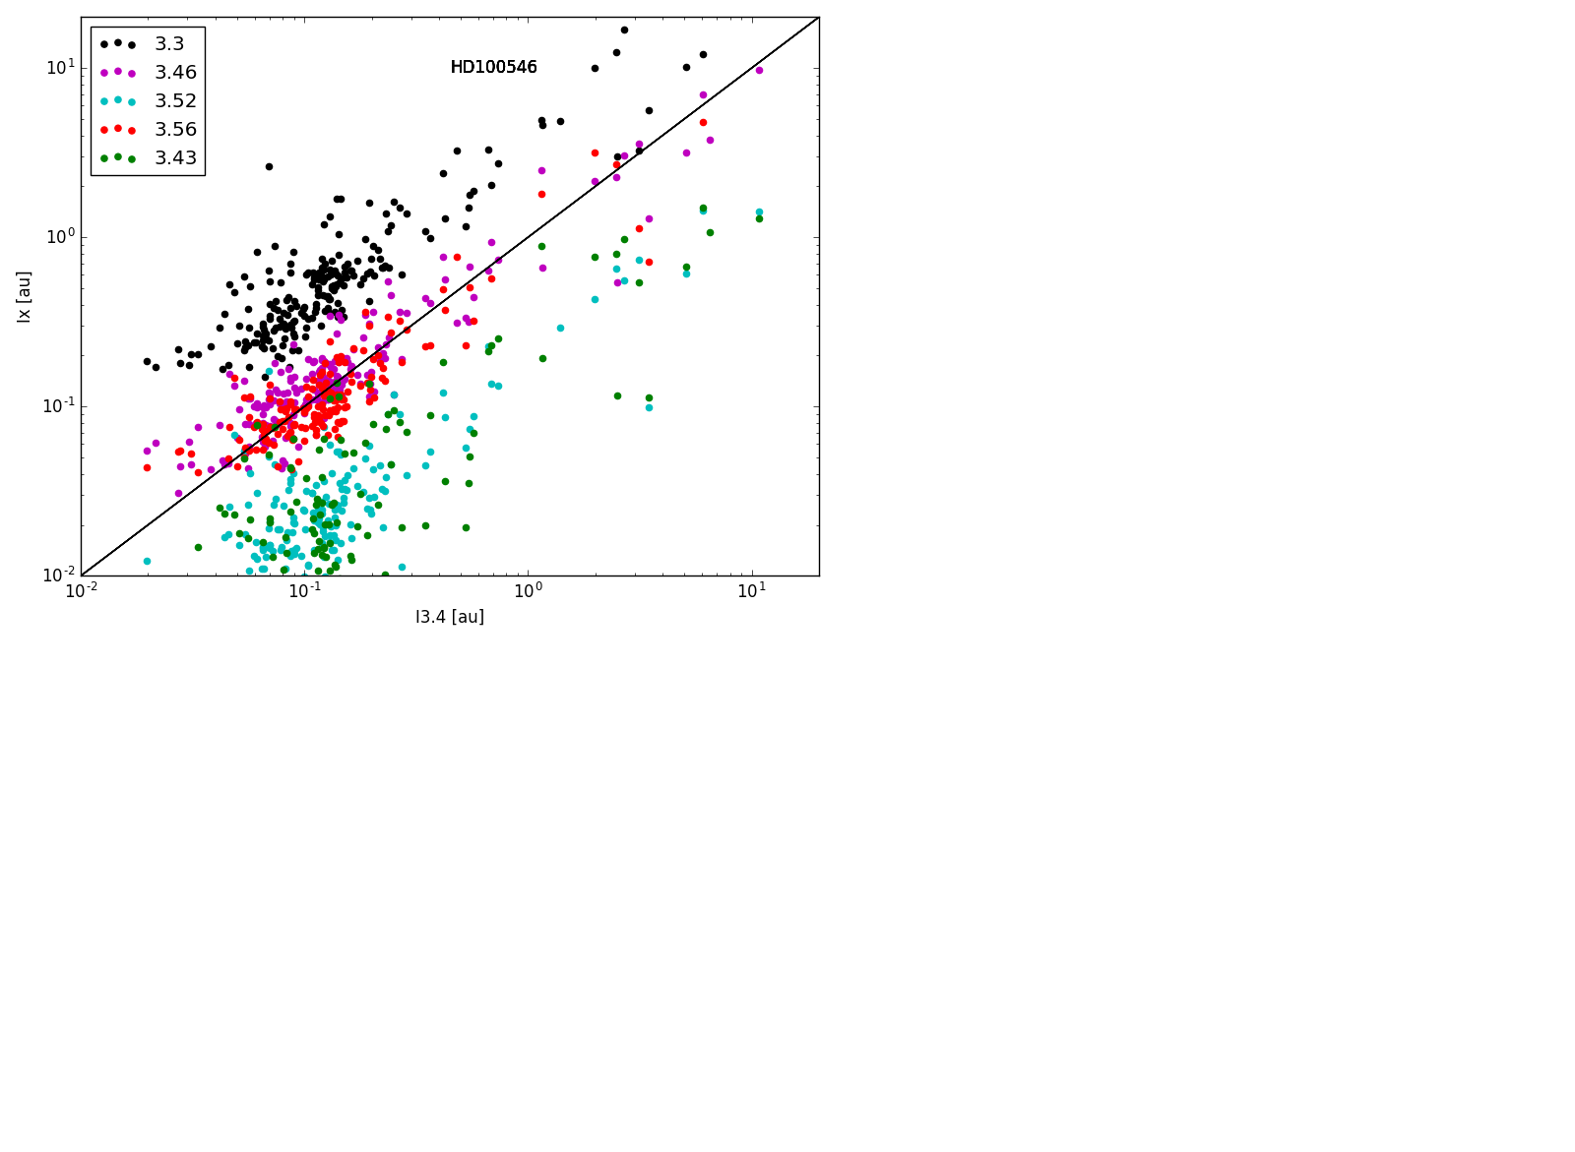
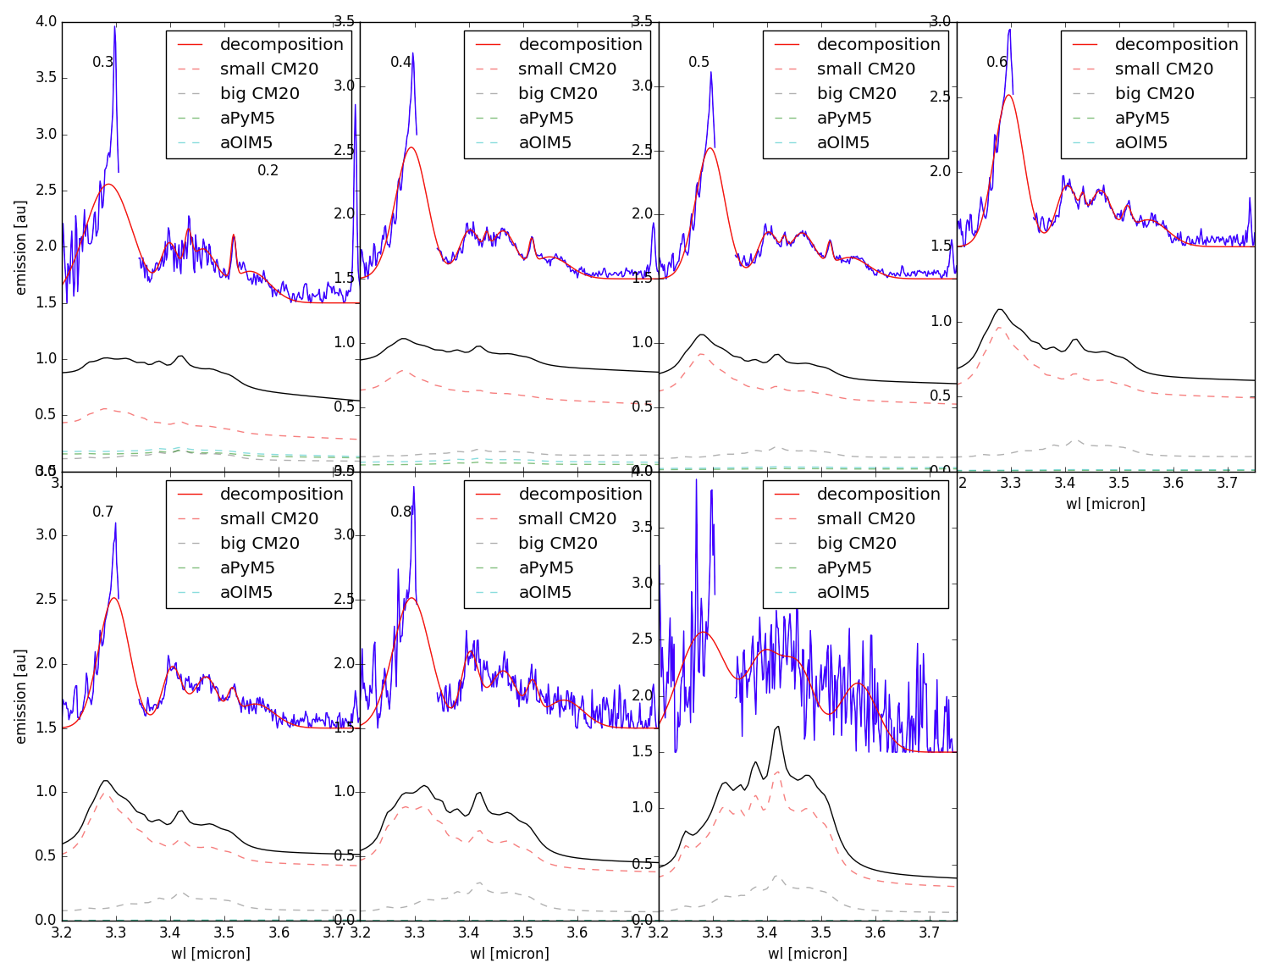
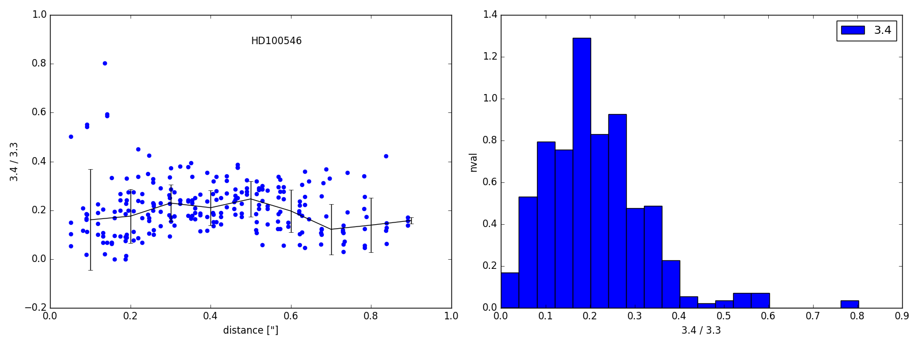
Correlations, Band ratio, Modeling (Boutéraon et al, in prep.)
0.2 ’’
0.3 ’’
0.4 ’’
0.5 ’’
Integrale in x band [arbitrary units]
Integrale in 3.4 band [arbitrary units]
0.6 ’’
0.7 ’’
0.8 ’’
3.4 / 3.3
Distance [‘’]
Wavelength [µm]
> Emission bands spatially extended and correlated over 10-100 AU due to stochastically heating of nanograins at the disk surfaces
> No strong variations in the band ratio according to the distance to the star compatible with similar carriers and a constant renewal of a-C:H material at the disk surfaces
> Preliminary modeling with THEMIS : need to include dust evolution in response to local physical (UV field and density)

Slide 30
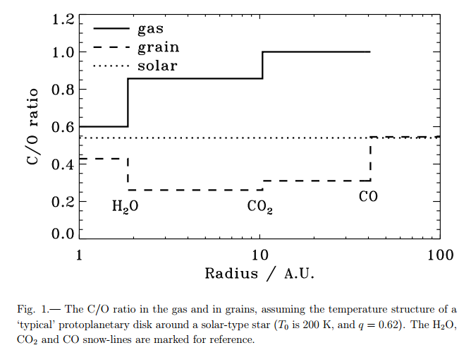
WP3 (Modeling & Simulations) : Exoplanet atmospheres
→ Test of atmospheric models, circulation models, climate models in new regimes
→ Link Protoplanetary disks – Atmosphere of giant planets
Planetary formation starts with the coagulation of icy grains,
C/O ratio = ‘’ f ‘’(place where the exoplanet forms in the disk)
(due to different T_{condensation} for H₂O, CO₂ & CO)
Comparison with the C/O value of the central star
→ discreminate between different formation models
C/O ratio in disks
To retrieve the C/O ratio from IR JWST spectra
Need models (with radiative transfer, opacities…)
1D exoplanet atmospheric model of Paris-Saclay (ATMO), one of the best models at the international level
Task 1: Benchmarking of atmospheric exoplanet models
Task 2: Effect of composition variations
Task 3: Include dust clouds (relation with the dust expertise from WPs 3 & 4)
Task 4: 3D models to assess the uncertainties when using 1D model
Task 5: Analyse first JWST observations
Notes:
Différentes températures de condensation H20 135K, CO2 47 K, CO 20K
Planètes géantes, atmosphères pas altérée par des échanges avec la surface comme dans les planetes telluriques
Diametre des grains tres différents : forcément pas les memes modèles.

Slide 31
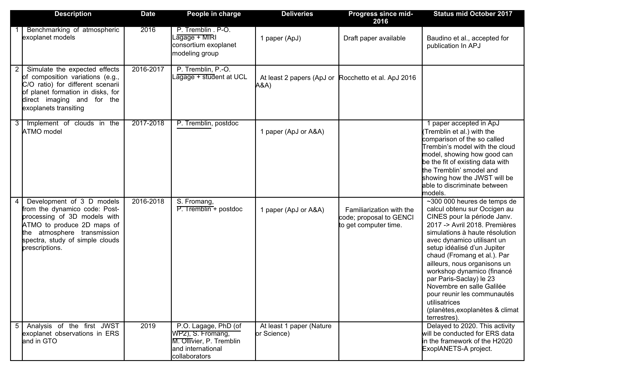
WP3 (Modeling & Simulations) : Exoplanet atmospheres
1st oct. 2017 : new PhD student, Marine Martin-Lagarde (½ CNES, ½ ED STEPUp P7)
1st nov. 2017 : new post-doc P2IO Giuseppe Morello tasks 3.3 and 3.4

Slide 32
WP3 (Modeling & Simulations) : Exoplanet atmospheres
1st oct. 2017 : new PhD student, Marine Martin-Lagarde (½ CNES, ½ ED STEPUp P7)
1st nov. 2017 : new post-doc P2IO Giuseppe Morello tasks 3.3 and 3.4

Slide 33
WP3 modelling & simulations: Exoplanets
3.1 Benchmarking atmospheric exoplanet models
Baudino et al. (accepted in ApJ)
Structure of the atmosphere (T and P profiles)
Emission transmission spectra
Atmospheric composition
Solve the stationary conservation laws
(Hydrostatic balance and Energy conservation)
Radiative transfer
Chemistry

Slide 34
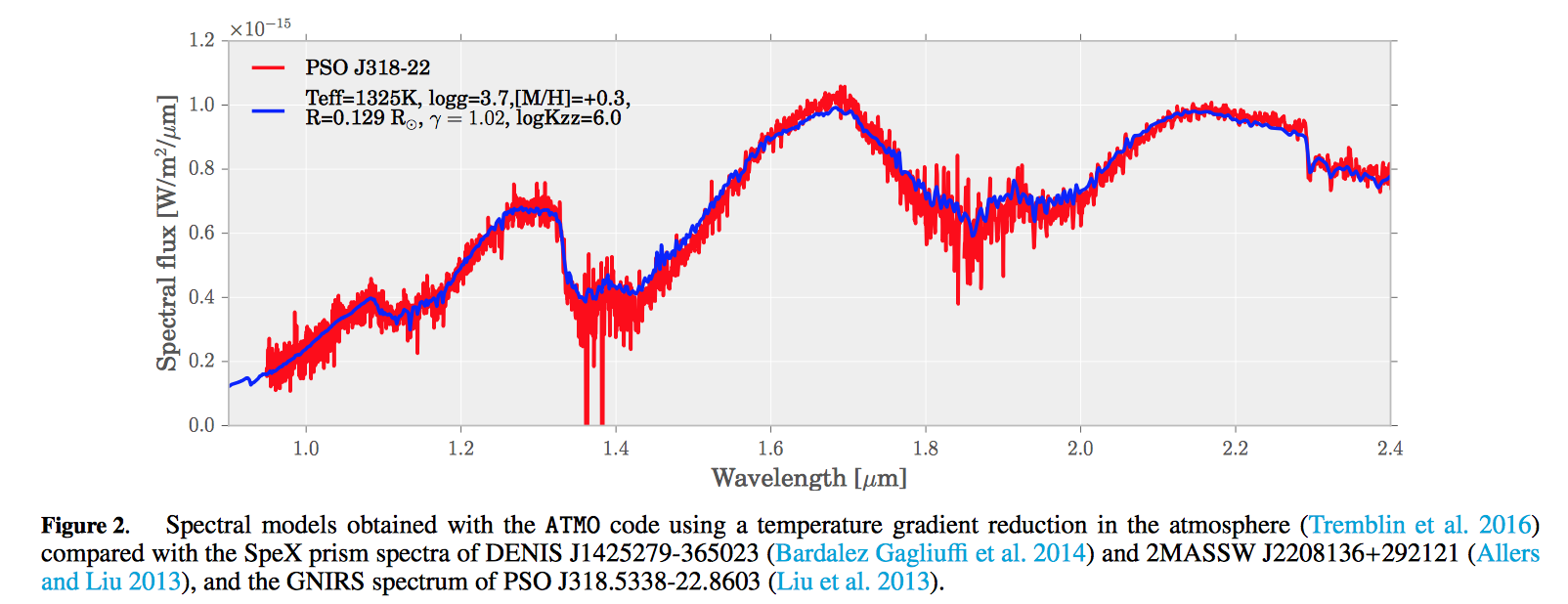
WP3 modelling & simulations: Exoplanets
3.3 Implementation of clouds in the ATMO model
Prior the implementation of cloud models in ATMO to explain the 10 um silicate features:
Cloudless atmospheric models (blue) for young low-gravity explanets/brown dwarfs that reproduce very well the observed near infrared (NIR) spectra (red).
Trembin et al. ApJ 2017
These Cloudless models use a temperature gradient reduction that would be the signature of a chemical instability when CO is converted into CH4
Notes:
Pour l’instant, un modèle sans nuage permet de reproduire les observations, mais le JWST devrait permettre de trancher la question, en particulier concernant la présence de nuages à haute altitude dont la présence devrait être révélée par la bande d’absorption des silicates à 10 microns.

Slide 35
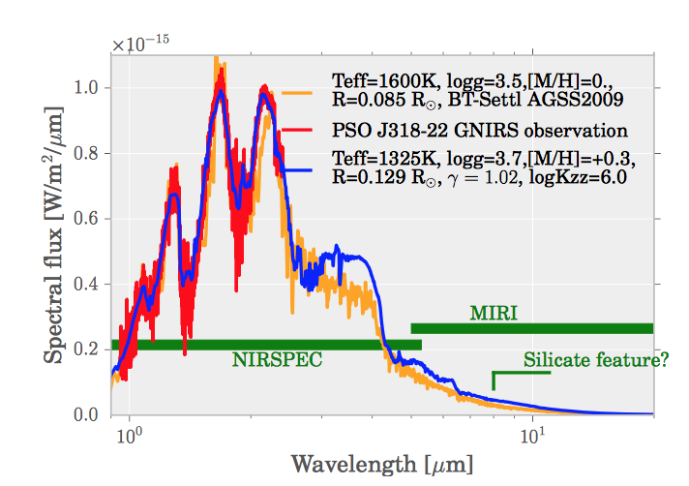
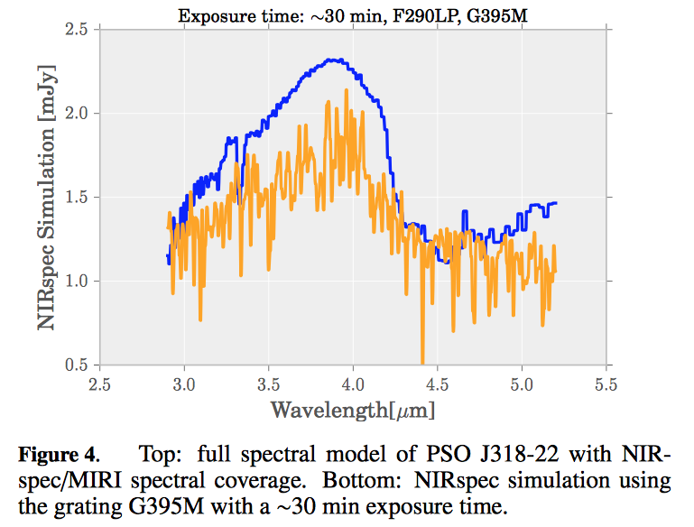
WP3 modelling & simulations: Exoplanets
3.3 Implementation of clouds in the ATMO model
Prior the implementation of cloud models in ATMO to explain the 10 um silicate features:
Prediction of the differences (observable with NIRSPEC/MIRI on JWST) between these cloudless models (blue) and standard cloud models used in the literature (yellow).
Motivate the need of a revision of standard cloud models to explain the 10 um silicate feature instead of the shape of the NIR spectrum
Notes:
Pour l’instant, un modèle sans nuage permet de reproduire les observations, mais le JWST devrait permettre de trancher la question, en particulier concernant la présence de nuages à haute altitude dont la présence devrait être révélée par la bande d’absorption des silicates à 10 microns.

Slide 36
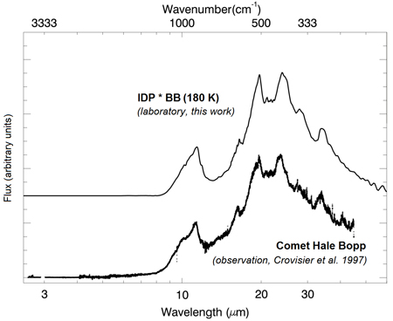
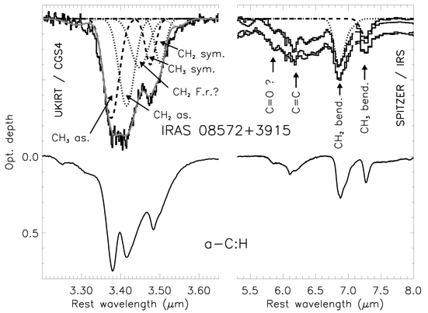
Laboratory experiments : why ?
Nature of interstellar grains ? Complexity of astrophysical IR spectra
IDP (NASA/JPL) Analogues IDP
Dartois et al. 2007 Brunetto et al. 2011
Laboratory experiments are essential:
for direct comparison with observational data
to provide experimental data for modeling
to understand the nature and the effects of radiative processes

Slide 37
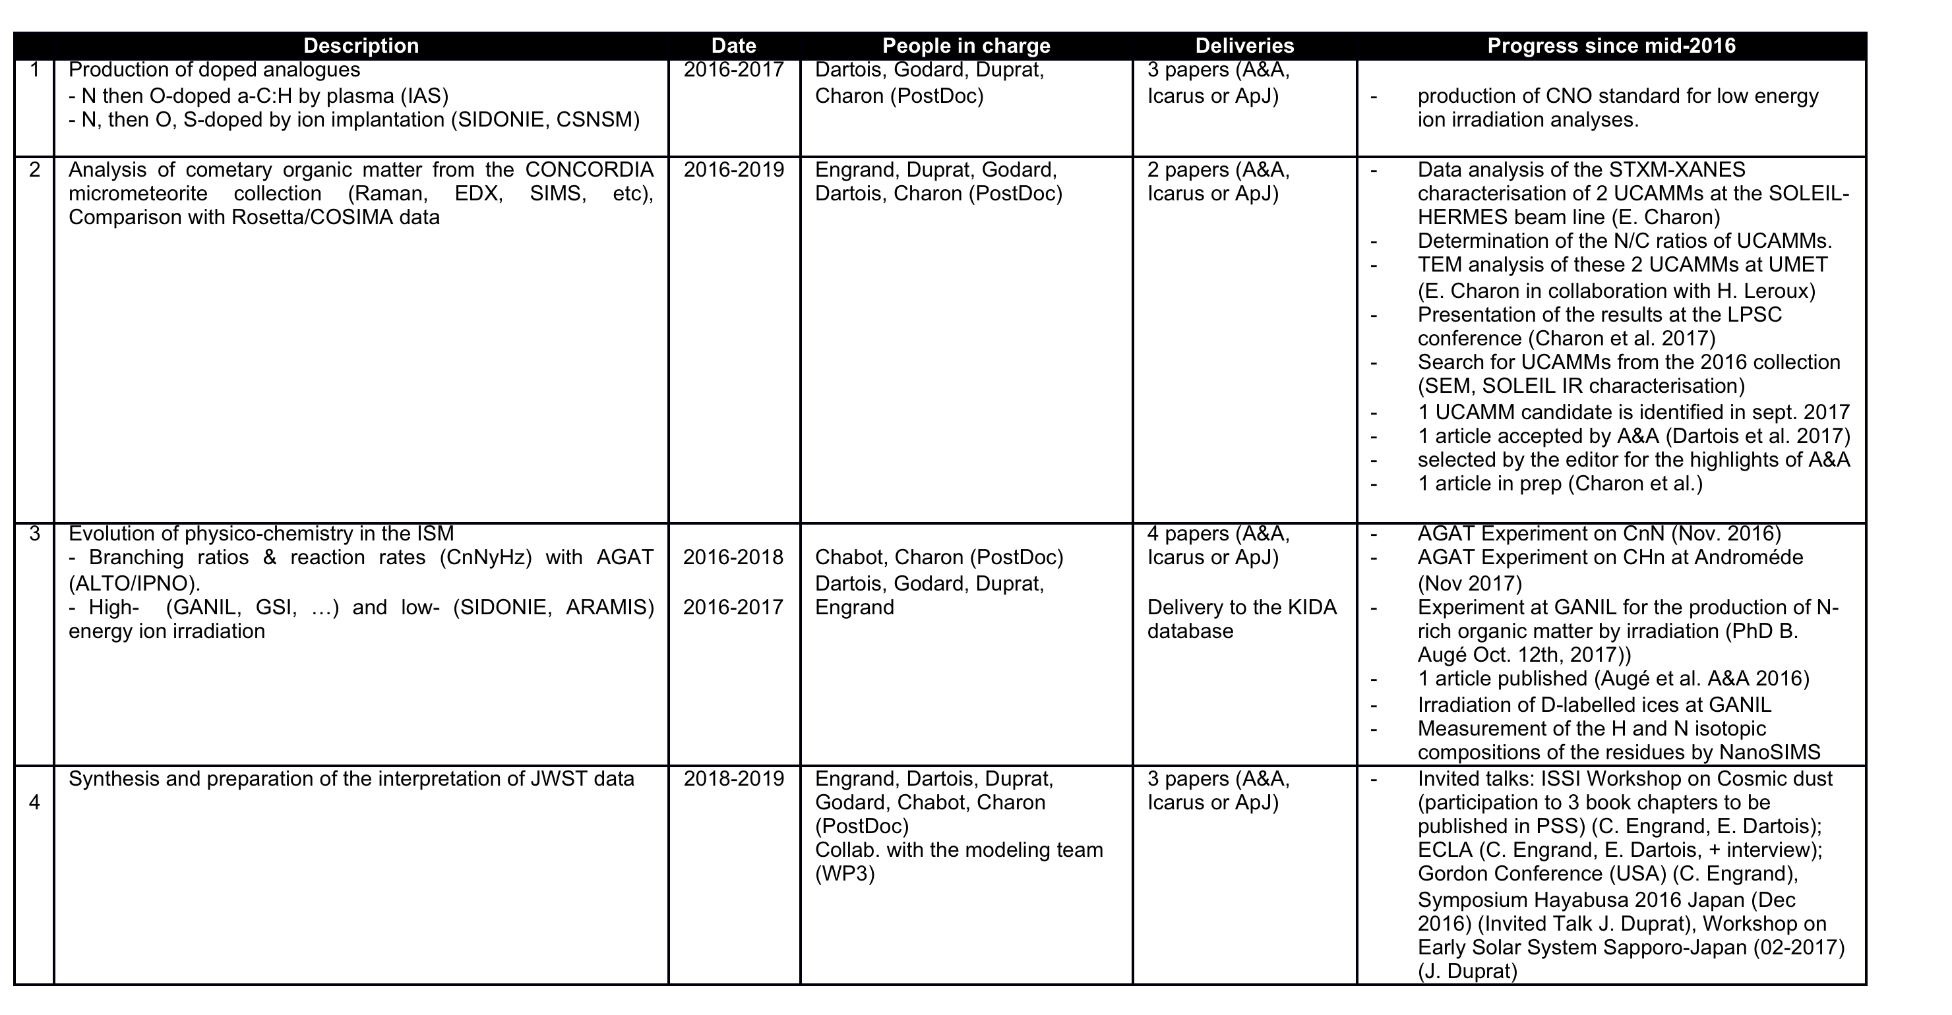
WP4 Laboratory experiments: Organic Matter

Slide 38
WP4 Laboratory experiments: Organic Matter

Slide 39
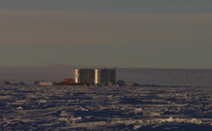


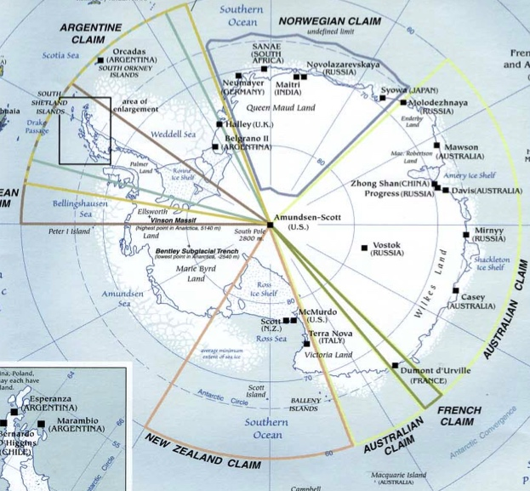
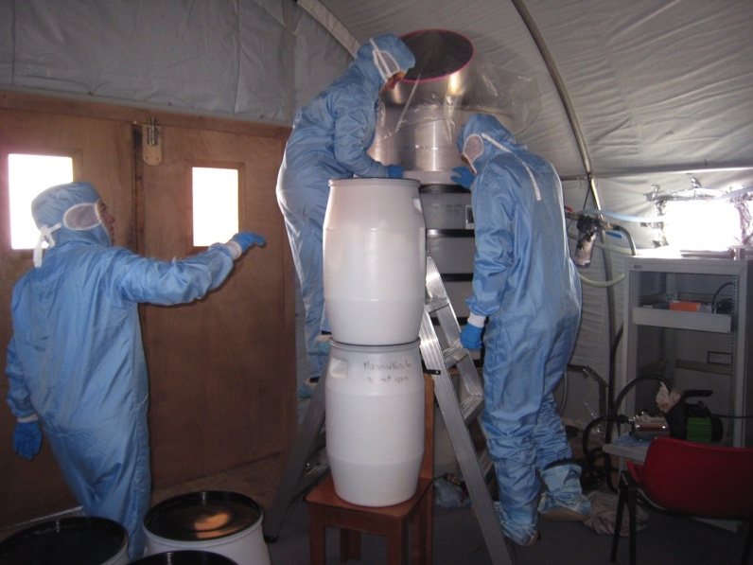
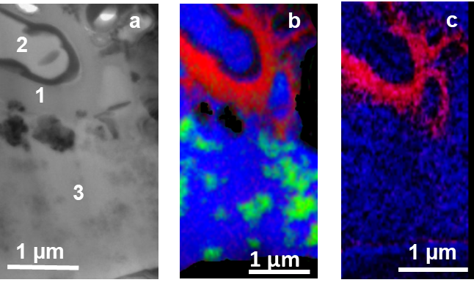
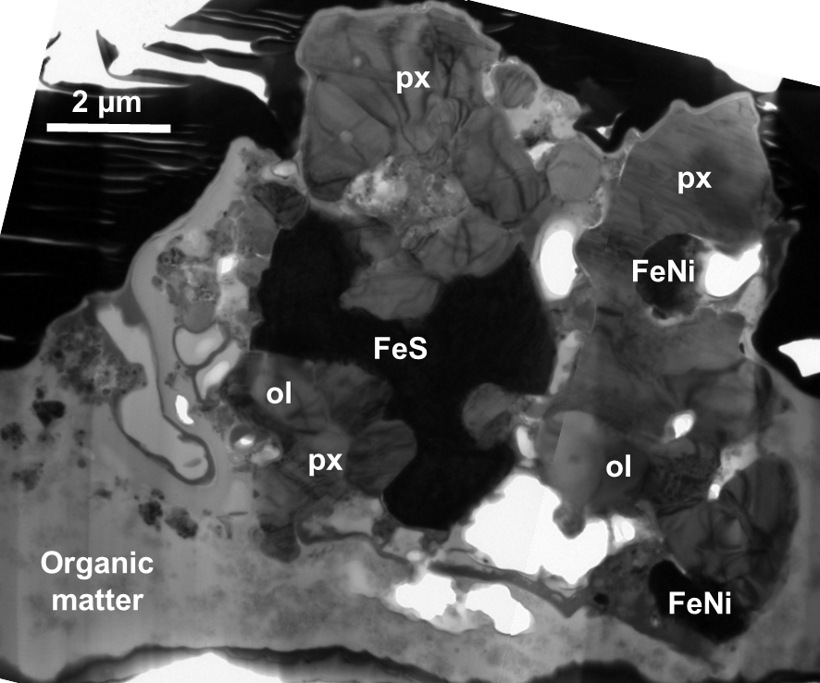
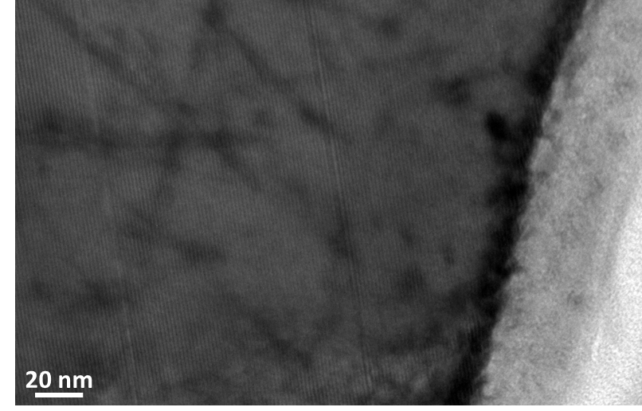
WP 4.2 Ultracarbonaceous Antarctic Micrometeorites (UCAMMs)
Charon (P2IO post-doc) et al.
  unique opportunity to study the association of low and high temperature phases in dust coming from the most remote regions of the solar system.
  uttermost interest for the input of prebiotic matter in the early Earth
CONCORDIA Station, January 2016
STXM C-and N-XANES analyses performed on new UCAMM : presence of small minerals associated with at least three organic phases with different nitrogen concentrations (using STXM at the SOLEIL HERMES beamline).
This sample was analysed by transmission electron microscopy (TEM) : nature of the minerals present in the UCAMMs (using Tecnaï FEI TEM at UMET in university Lille 1).
Observation of irradiation damages in silicates : disordered rim and tracks. Calculation of an upper limit of irradiation time in inner solar system equal to a few hundred thousand years.
Notes:
Ultracarnonacous Micrométéorites are knwon to arise from the outer parts of the solar system: trace past formation and evolution in the outer solar system.
Different techniques of analysis to study :
the mineralogy : complexity (assemblage processed at high T in the inner part of the solar system), 3 different phases of organic matter, 1 smooth N-rich, 2 smooth N-poor, 3 patchy and N-poor
Effect of irradiation
X-ray absorption near edge structure (XANES) spectroscopy analyses at the C and N K- edges, synchrotron-based scanning transmission X-ray microscopy (STXM)
transmission electron microscopy (TEM)

Slide 40
WP 4.2 UCAMMs. IR & Raman fingerprints
Notes:
Microspectroscopy and microRaman observations have been performed at SOLEIL for 8 UCAMMs.
Main result: the high Carbon over siliicon ratio well above IDP and ISM values and is correlated with a Nitrigen enrichment. UCAMMs reveal material not directy incorporated from the ISM, formed behind the Nitrogen snow line, and submitted to physicochemical evolution.

Slide 41
WP4 Laboratory experiments: Organic Matter

Slide 42
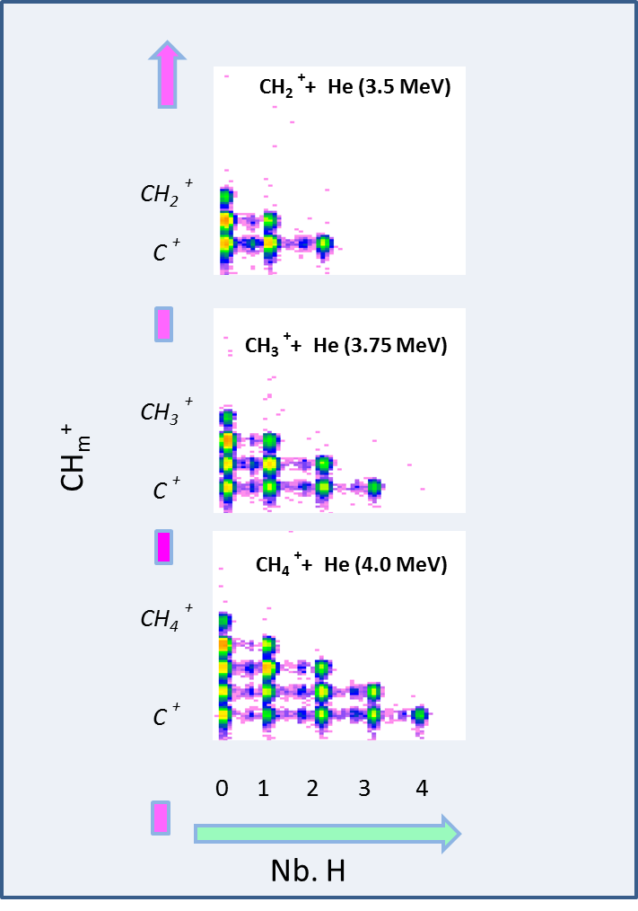



WP4.3 - datas for astrochemistry
AGAT@ANDROMEDE
Example of Mass spectra
Multi-detector to study AGrégat-ATom collisions at high speed
May 2017 : CH,CH₂,CH₃,CH₄ Analysis on-going
AGAT at ANDROMEDE (Nov 2016 – April 2017)
Notes:
Simulation of the release of gas phase species from the solid phases. First measurements has been performed with AGAT at ANDROMEDE.

Slide 43




WP 4.3 Cosmic rays irradiation of interstellar dust analogues
E. Dartois, M. Chabot, T.Pino, K. Béroff, M. Godard, D. Severin, M. Bender and C. Trautmann, A&A 2017
IPN, CSNSM, IAS, ISMO, GSI and TU Darmstadt
Cosmic Rays simulated at GSI
a-C:H analogues in laboratory
Production of small hydrocarbons by CR is negligible as compared to UV in diffuse medium but not in dense cloud.

Slide 44
WP4 Laboratory experiments: Silicate Matter
P2IO funding: Purchase of the optical microscope is under progress.
M2 student in 2017 spring to develop the VIS-NIS spectroscopy of IDPs. The development was not completed and is under progress.
Zélia Dionnet (PhD, third year) : IR mapping, X and IR tomography experiments.
PhD to be started in 2018

Slide 45





WP 4.1 Sample preparation
20 IDPs given by NASA
Development of the VIS-NIR spectroscopy of 10 µm particles in clean room under progress
New microscope to perform micromanipulation, observation of 10 µm particles and VIS-NIS spectroscopy to be delivered at the beginning of 2018
Development of multi-analyses on 10 µm grains
5 microns
1 µm slice for IR and Raman spectroscopy
3 µm slice for nanosims
100 nm slice for TEM
10*20 µm particle for X- & IR-tomography
Aleon-Toppani et al., in prep

Slide 46

WP 4.2 IR spectroscopy of micron-sized subunits
FPA mapping on Paris meteorite, towards a better understanding of the organic and minerals interactions
Dionnet et al., to be submitted

Slide 47


WP 4.3 Porosity of IDPs and meteorite matrix
FTIR Micro-tomography : CH band reconstruction of the Paris meteorite: Dionnet et al., in prep
+ micro-tomography X on Psiche/SOLEIL
= porosity of the primitive Paris meteorite
Notes:
Brunetto:
Position bande des solicate= f(irradiation)

Slide 48

WP 4.4 Evolution of the primitive extraterrestrial dust under irradiation
« Hyperspectral FTIR imaging of irradiated carbonaceous meteorites »
Brunetto et al., submitted to PSS
Notes:
Brunetto:
Position bande des solicate= f(irradiation)

Slide 49
Conclusions
  Put together the strong expertises in several P2IO (IAS, SAp/AIM, CSNSM, IPNO) to prepare the scientific exploitation of the JWST
  Strong connections with the community:
    3 GTO programs + 3 ERS proposals
    French MIRI center of expertise
    Associated to the organisation of the Ψ2 Core to Disk program at the Paris-Saclay University (14th May → 22th June 2018, https://www.ias.u-psud.fr/core2disk/index.html)
  Prepare young astrophysicists to work on JWST data
    3 two year post-doc:
      1 cometary matter (P2IO but not the flagship project): 2016-2017
      1 disks 2017-2019 (P2IO)
      1 exoplanets 2017-2019 (P2IO)
    4 PhD in the initial project (only 2 ½ PhD founded by P2IO)
      1 Disks (½ P2IO - ½ Paris-Sud) from oct. 2016
      1 exoplanets (½ CNES et ½ P7) from oct. 2017
      1 PDRs (½ CNES et ½ P2IO) from oct. 2017
      1 Silicate Matter not started in 2017, expected from oct 2018
      + 1 IR and X micro-tomography (IDEX Paris-Saclay), 2015-2018

Slide 51
Organisation chart
JWST data (from mid- 2019)
JWST proposals
Pre-JWST data
Extraterrestrial material / analogues
Data processing
Laboratory experiments
Simulation of exoplanetary atmospheres
Data analysisN
Laboratory data
Simulations of JWST observations
Dust modeling
Radiative transfer codes
Geometry and chemical structure of PDR & disks
JWST simulated data processing
WP2
WP3
WP4

Slide 52
PhD and post-doc
  3 two year post-doc:
    1 cometary matter (P2IO but not the flagship project): 2016-2017
    1 disks 2017-2019 (P2IO)
    1 exoplanets 2017-2019 (P2IO)
  4 PhD in the initial project (only 2 ½ PhD founded by P2IO)
    1 Disks (½ P2IO - ½ Paris-Sud) from oct. 2016
    1 exoplanets (½ CNES et ½ P7) from oct. 2017
    1 PDRs (½ CNES et ½ P2IO) from oct. 2017
    1 Silicate Matter not started in 2017, expected from oct 2018
    + 1 IR and X micro-tomography (IDEX Paris-Saclay), 2015-2018

Slide 53
Budget

Slide 54
ERS program on PDRs
(PI Olivier Berné & Emilie Habart, Co-I Alain Abergel & Emmanuel Dartois
Large international and interdisciplinary team of 138 scientists: astronomers interested a wide variety of targets, (astro)physicists, (astro)chemists, experimentalists, theoreticians
Provide template datasets to guide the preparation of GO Cycle 2 proposals on star-forming regions in our Galaxy and beyond, as well as, several science-enabling products (e.g., data analysis tools) for the community
=> Spectral richness that JWST will observe

Slide 55
Target and observing modes
Obtain an extensive data set using four of the JWST instruments on a single source to limit the overhead time, and simplify scheduling in the ERS window
Select a massive star-forming region that i) is located within 2 kpc in order to resolve the PDR, ii) shows a clear, well-defined (almost edge-on) interface between a molecular cloud and the H ii region
Exemple of selected fields of view of NIRCam and MIRI imaging, NIRSPEC and MIRI IFU

Slide 56

Dust evolution in protoplanetary disks
infall
(gas + dust)
ALMA (1 mm)
HL Tau
ALMA Patnership et al. 2015
0.1’’=14 AU
Notes:
The radio interferometer ALMA has observed the internal parts of the disks, where planets are suspected to be forming.
The HST the scattered light coming from the liluminated edges of the disks.
The IR emission is also coming from illuminated edges.
We have very few IR images and spectra due to the lack of sensitiviy and angular resolution.

Slide 57

Dust evolution in protoplanetary disks
HST (1-2 μm)
infall
IRAS 04302
(gas + dust)
3.7’’=500 AU
ALMA (1 mm)
HL Tau
ALMA Patnership et al. 2015
0.1’’=14 AU
Notes:
The radio interferometer ALMA has observed the internal parts of the disks, where planets are suspected to be forming.
The HST the scattered light coming from the liluminated edges of the disks.
The IR emission is also coming from illuminated edges.
We have very few IR images and spectra due to the lack of sensitiviy and angular resolution.

Slide 58
Dust evolution in protoplanetary disks
HST (1-2 μm)
infall
IRAS 04302
(gas + dust)
IR (VLT, ISO/Spitzer)
^{stochastically heated}
3.7’’=500 AU
Continnum
Aromatic band (8.6 μm)
ALMA (1 mm)
Lagage et al. 2006
HL Tau
HD 97048
ALMA Patnership et al. 2015
0.3’’=50 AU
Van Kerckoven et al.2002
Bouwman et al. 2003
Habart et al. 2004, 2006
Aromatic
Diamonds
F_{ν} / max(F_{ν})
Aliphatic
Amorphous/Crystalline
Silicates
0.1’’=14 AU
___ HD 97048
___ HD 100546
10
λ (μm)
Notes:
The radio interferometer ALMA has observed the internal parts of the disks, where planets are suspected to be forming.
The HST the scattered light coming from the liluminated edges of the disks.
The IR emission is also coming from illuminated edges.
We have very few IR images and spectra due to the lack of sensitiviy and angular resolution.

