Slide 1
Input transistor noise simulation
Input transistor (nmos1v) varied from 100/0.2 to 10 000/0.2
Id=1 mA
100/0.2 gm=16 mA/V en=0.7 nV/sqrt(Hz) expect sqrt(4kT/2gm)=0.72
1000/0.2 gm=23 mA/V en=0.4 nV/sqrt(Hz), expect 0.60
10000/0.2 gm=27 mA/V en=0,3 nV, expect 0.55, almost factor 2 !

Slide 2
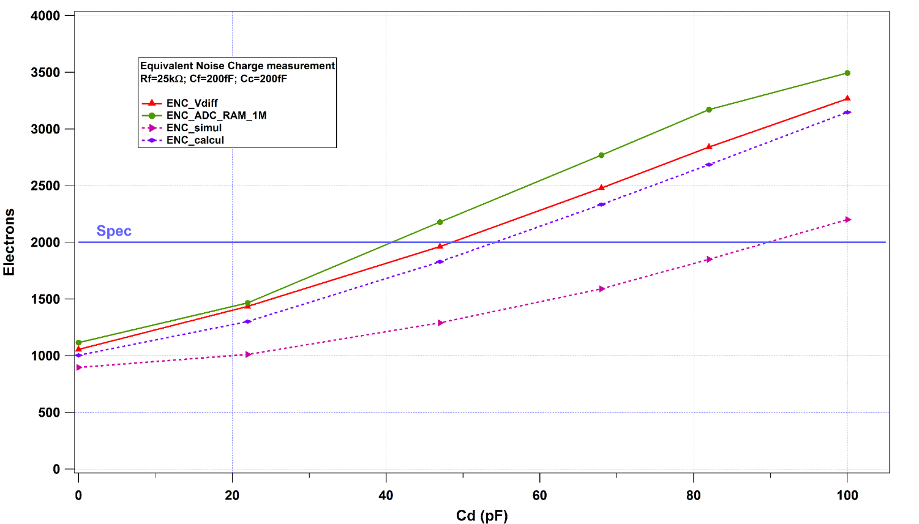
TV2: Noise measurements [CMS HGCAL]

Slide 3
Series noise input transistor [ATLAS LAUROC]
Measured and calculated for 3000/0.26

