Slide 1
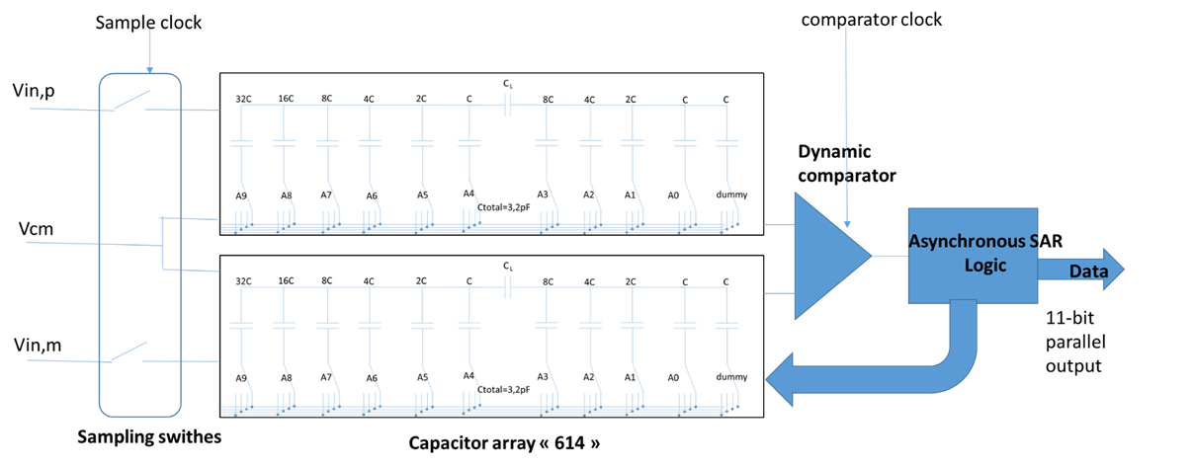
TV2: 10/11b 20MHz SAR ADC
Requirement for CMS HGCAL: 11 bit ADC/40MHz; low noise <1mW
TV2 submitted in January 2017
20MHz sampling Clock
2 types of ADC submitted : Synchronous/Asynchronous conversion logic (tunable settling delay)
Architecture based on a Split 6b/4b capacitor array DAC
MSB given by the input signal sign

Slide 2
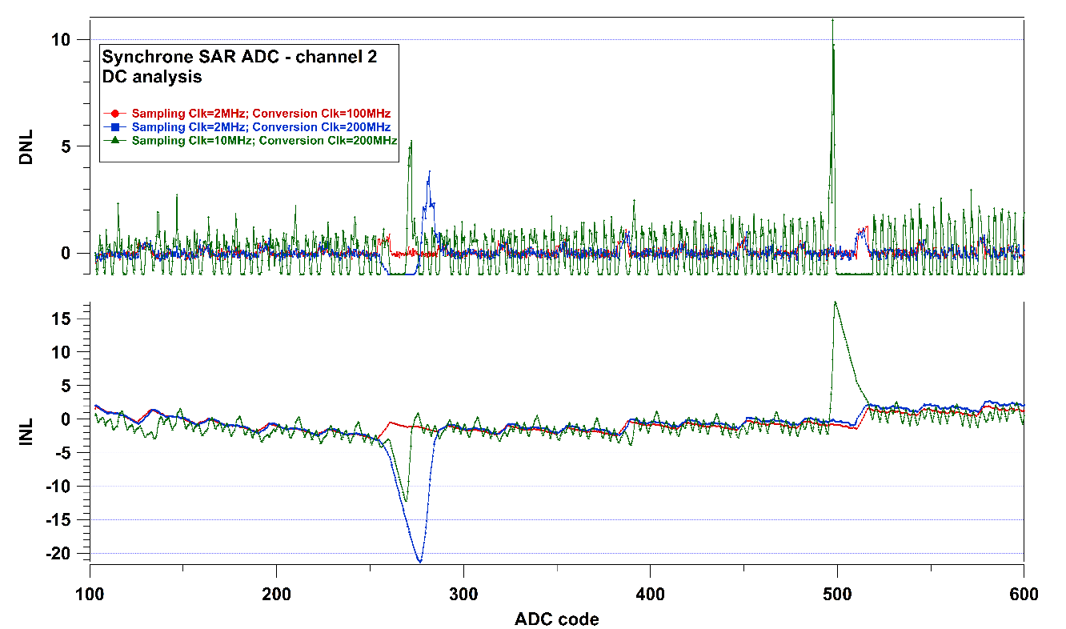
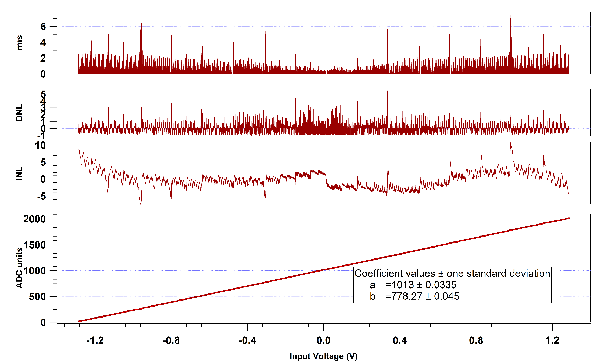
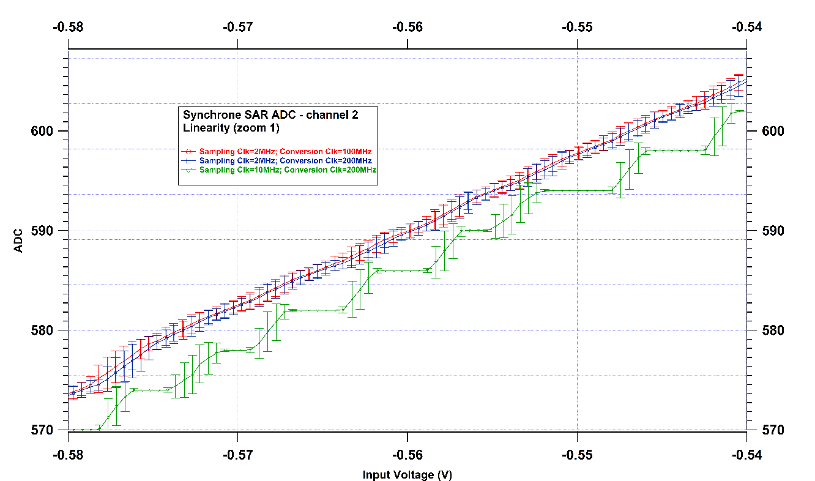
TV2: SAR ADC tests
Maximum sampling frequency: 15MHz, but 10MHz achieve better results
DC characterization: INL, DNL, capa network
Many parameters to be explored: delay, reference voltages, dynamic performance…
Channel 1, async version, no bootstrap, @ 10 MHz

Slide 3
HGROC: 11-bit SAR ADC
HGROC chip for CMOS HGCAL
Submitted in July 2017
Based on TV2 architecture
Improved digital
40MHz sampling Clock expected
Asynchronous logic
2 capacitor array architectures

Slide 4
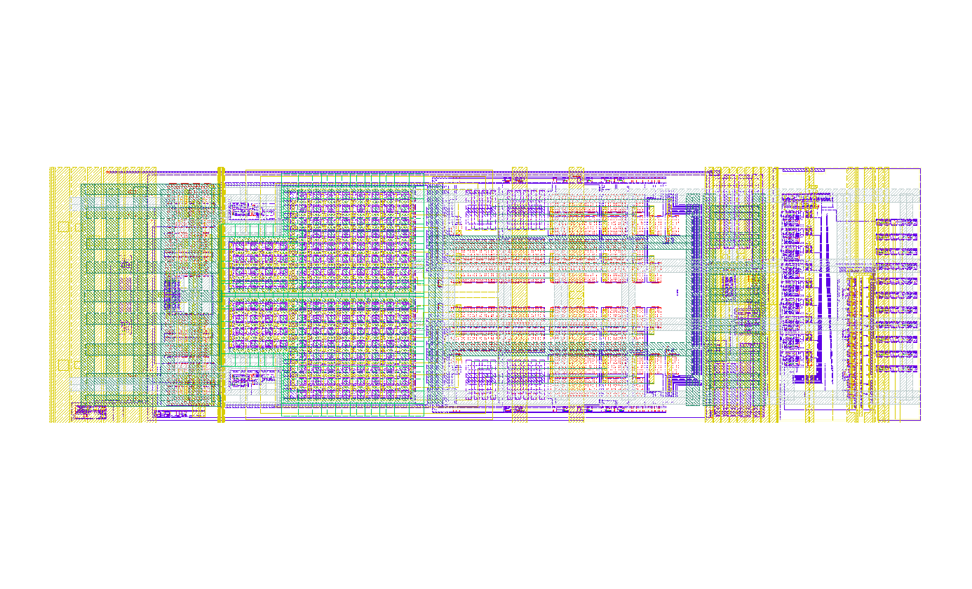
600um
175um

Slide 5
PLL
320MHz clock input (LpGBT fast command clock, adjustable phase)
1,28GHz VCO frequency
“CLPS” receiver
- Submitted and used, not really tested apart
“CLPS” driver
Driving current: 0,5 to 4 mA, step 0,5mA
Pre-emphasis: 0,5 to 4 mA, step 0,5 mA, pulse width 200, 300, 400 ps
Submitted, reception by November
Specification description | Value
Vcm (common voltage) | 0,6 V
Vdiff (differential voltage) | 100 to 200 mV
Pre-emphasis current | 0,5 to 4 mA
Termination load | 100 Ω

Slide 6
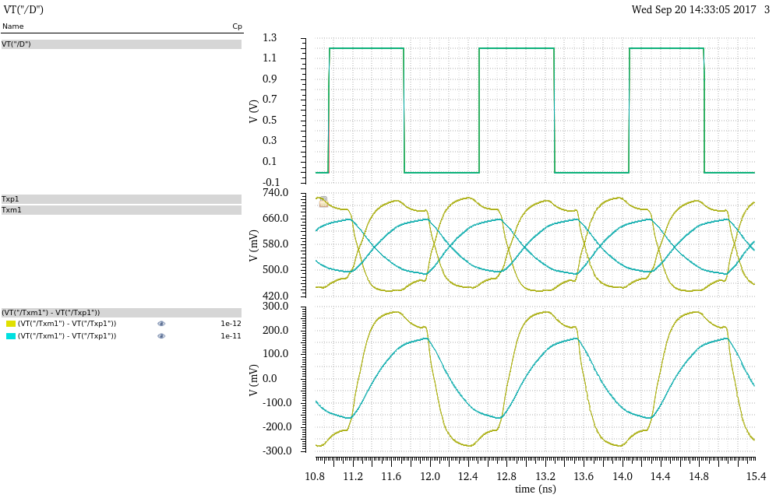
Clk=640MHz; Cp=0 1p 5p 10p; driver strength=2mA; Pre-Emphasis strength=1mA, pulse width=20%

Slide 7
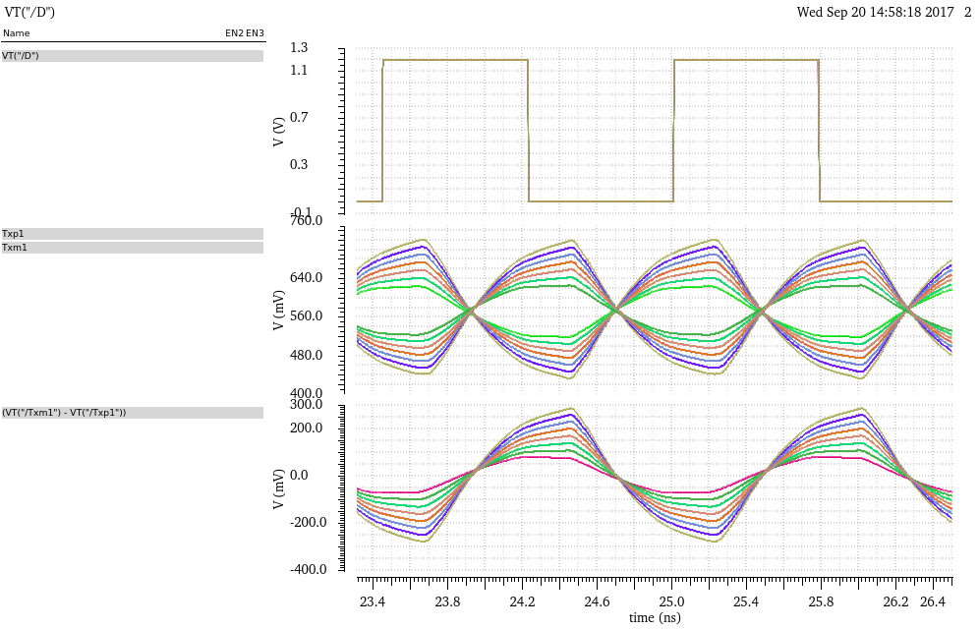
Clk=640MHz; Cp=10p; driver strength=2mA; Pre-Emphasis strength=0,5 to 4mA, pulse width=20%

