Slide 1
SVOM
ToO-Multi_Messenger Programming
Principles and Simulation Overview
J. JAUBERT (CNES) – V. DEBOUT (CS for CNES)
N. LEROY – J.G. DUCOIN (LAL)

Slide 2
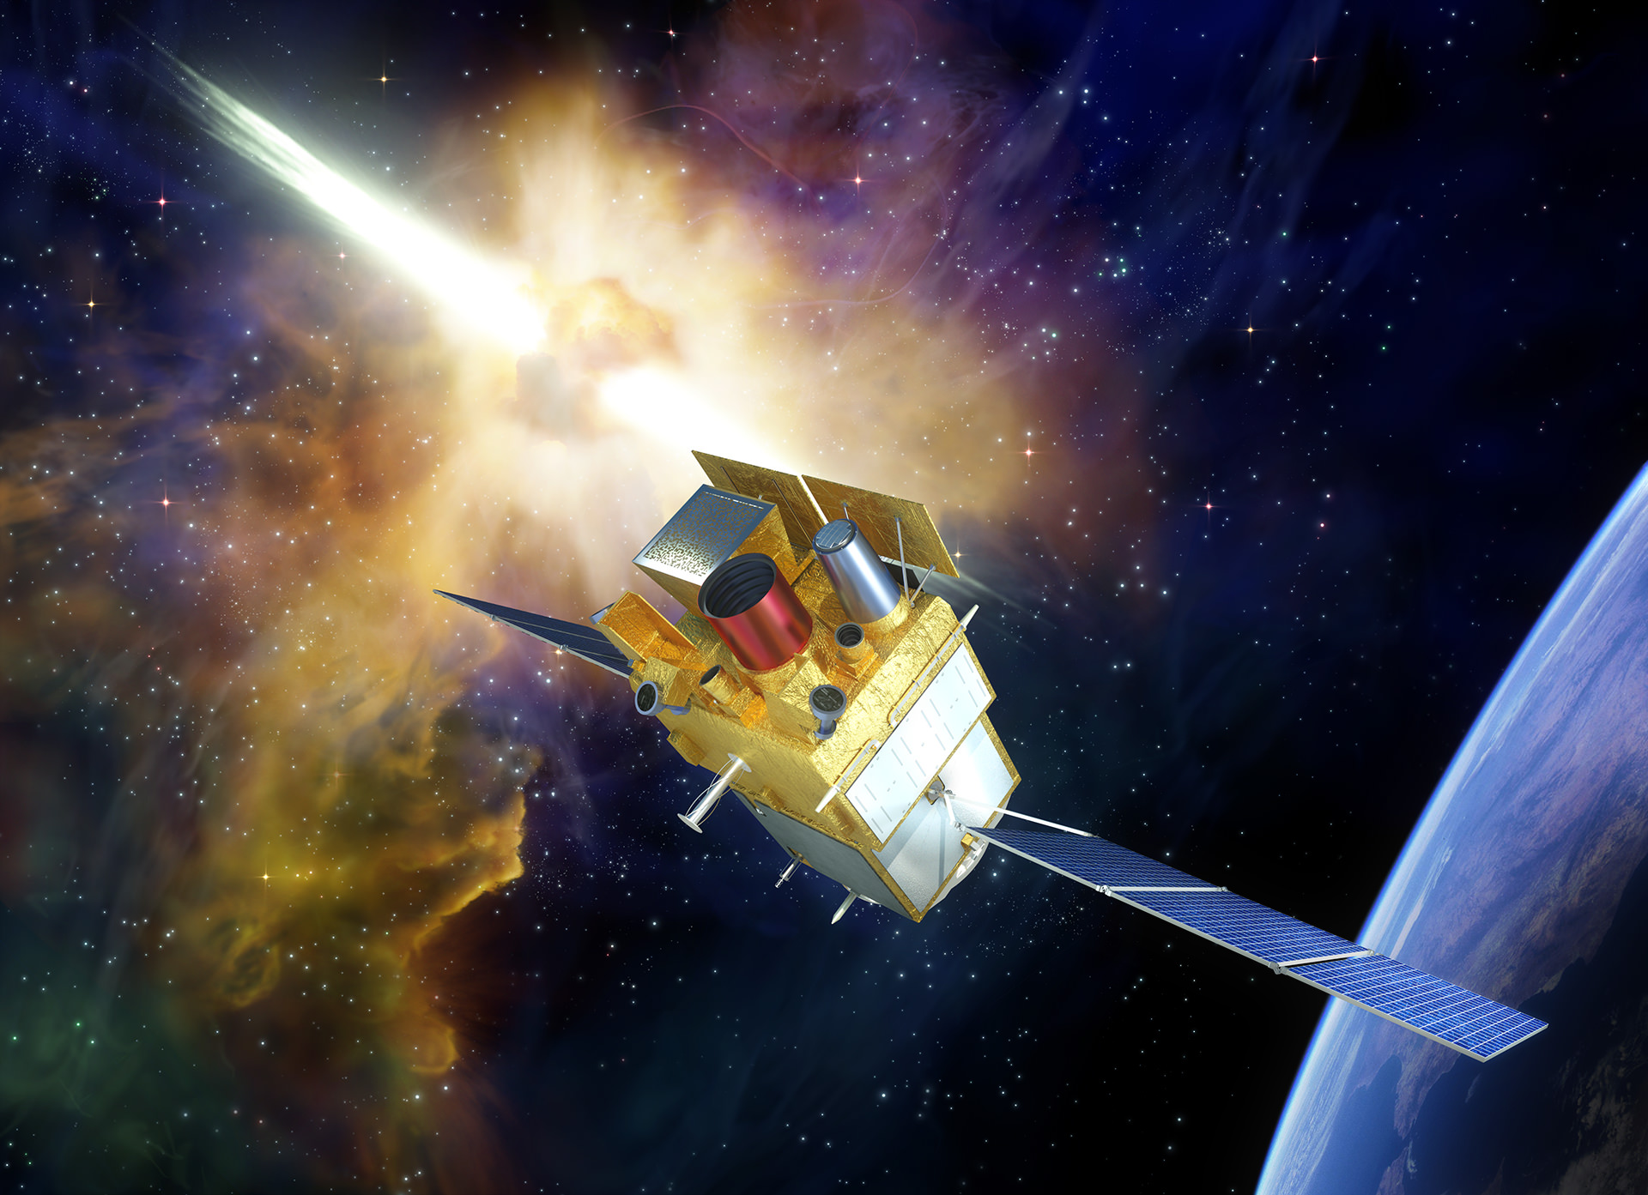
AGENDA
Reminders of ToO-MM scope and programming principles
Prototype for tiles sequencing
Examples of scenarios and results
Conclusion and Further Prospects

Slide 3
ToO-Multi Messengers scope
SVOM Tiles Programming – Principles and Simulation Overview
  Definition for the system :
    Like all Target of Opportunity, unplanned observation requests decided from ground
    Supplement ToO-Exceptional subset
    To be performed within short delays / as soon as possible
    Need a tiling of a sky area (e g, error box linked to GW detection), with for each tile :
      Pointing direction
      Effective observing duration
      Priority

Slide 4
ToO-MM main requirements for tiles programming
SVOM Tiles Programming – Principles and Simulation Overview
  Current requirements from MRR + SRD documents :
    1 ToO-MM / month (→ goal : 1 ToO-MM / week)
    Observation start (1rst tile) < 12h from ToO-MM alert acceptance
    ToO-MM : from 4 up to 25 tiles with effective observation duration ~ 10mn / tile
    Max 14 orbits (~1 day)
    Max 3 tiles / orbit (→ goal : 5 tiles / orbit)
    Tiles ⊂ (5°x5°) in each orbit
    Implicit : Tiles observed out of Earth occultation and South-Atlantic Anomaly (SAA) crossings, Sun and Moon constraints for MXT & VT applicable
    MXT photons and VT attitude charts sent to ground via VHF network (for each tile)

Slide 5
ToO-MM main requirements for tiles programming
SVOM Tiles Programming – Principles and Simulation Overview
  Additional requirements for tiles programming process :
    Tiles have priority levels assigned by scientific users (tiling definition process)
    Slews (i.e. attitude maneuvers) > 5° performed during Earth occultations or SAA crossings (not mandatory, as much as possible)
    Tiles possible sequencing criteria :
    Priority levels (Nominal)
    Minimization of whole sequence duration (Alternative TBC)
    Minimization of sum of slews amplitudes or amplitude of largest slew (Alternative TBC)

Slide 6
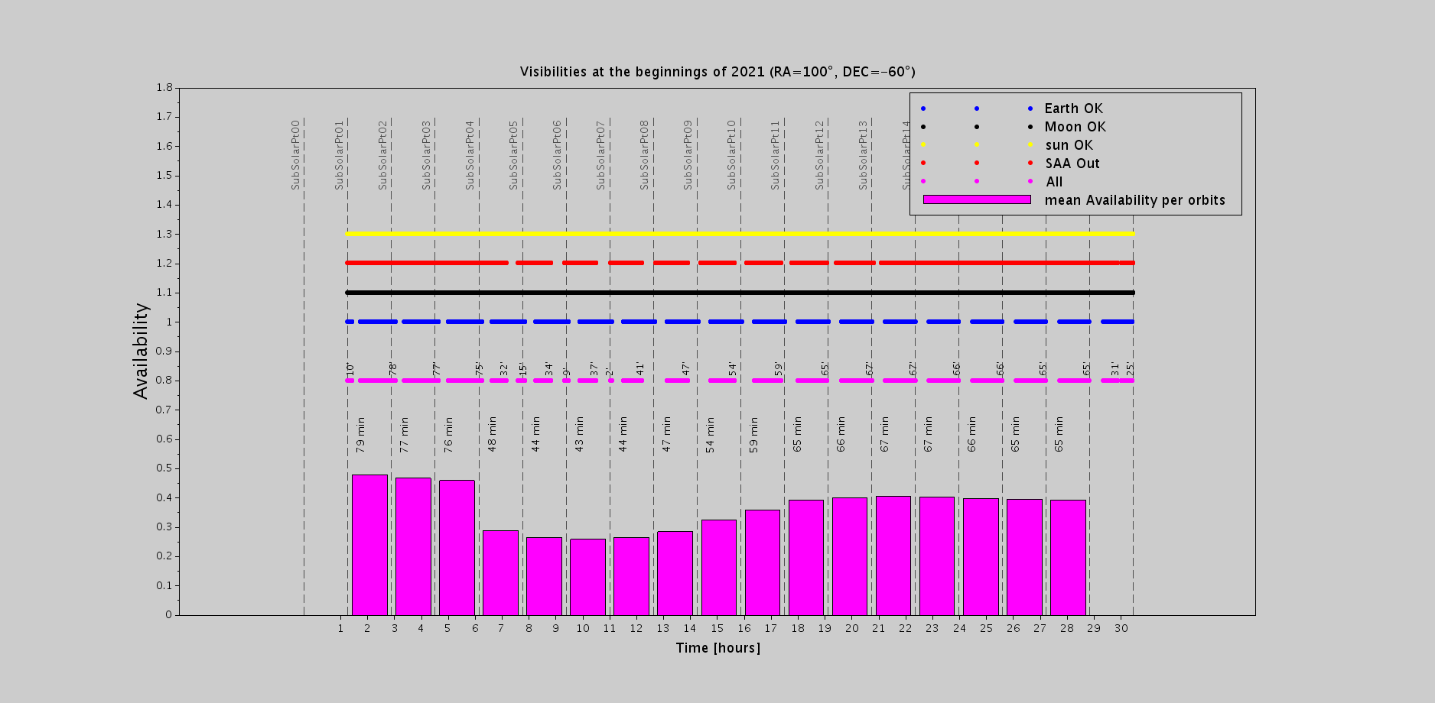
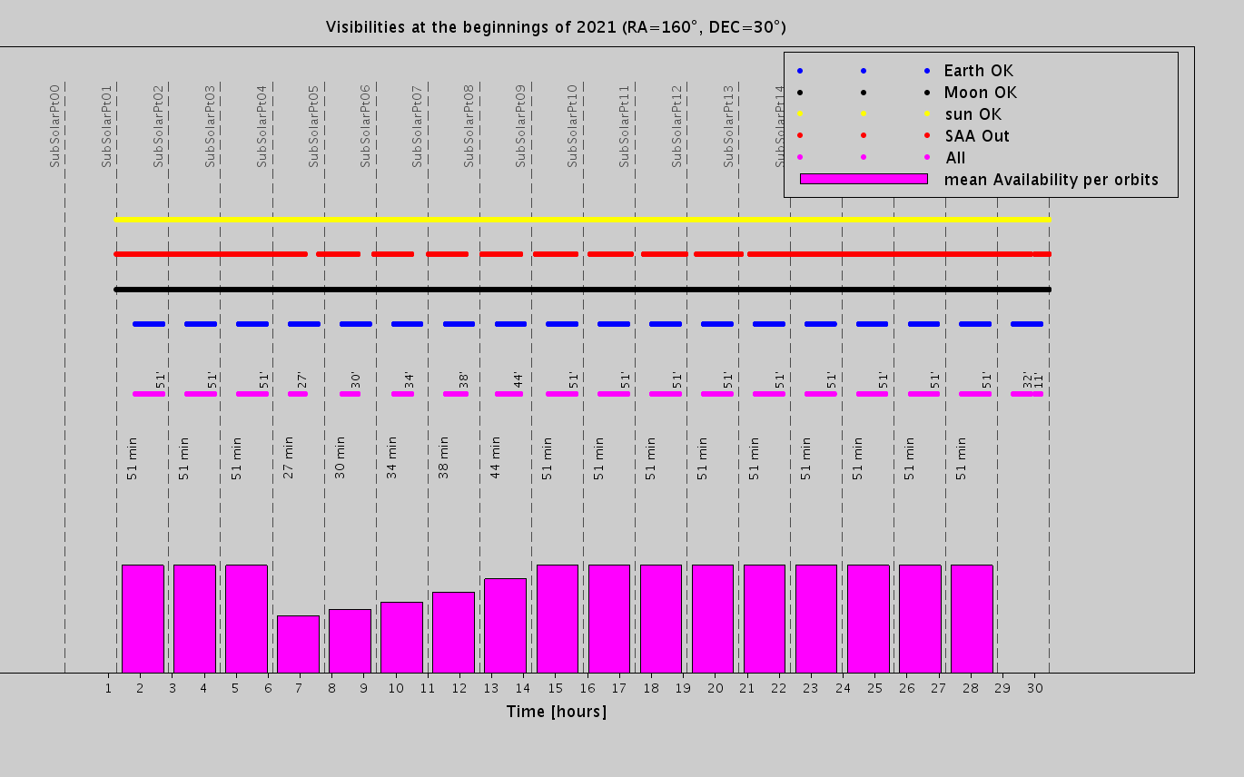
Main Constraint : Available observing duration per orbit
SVOM Tiles Programming – Principles and Simulation Overview
For specific target directions, accessibility periods can vary a lot from one orbit to the next one due to Earth occultations and South-Atlantic Anomaly (SAA) crossings combining together :
Min = 27 mn – Max = 79 mn
Tiles Programming and Duration of whole ToO-MM sequence can vary a lot depending on the start date

Slide 7
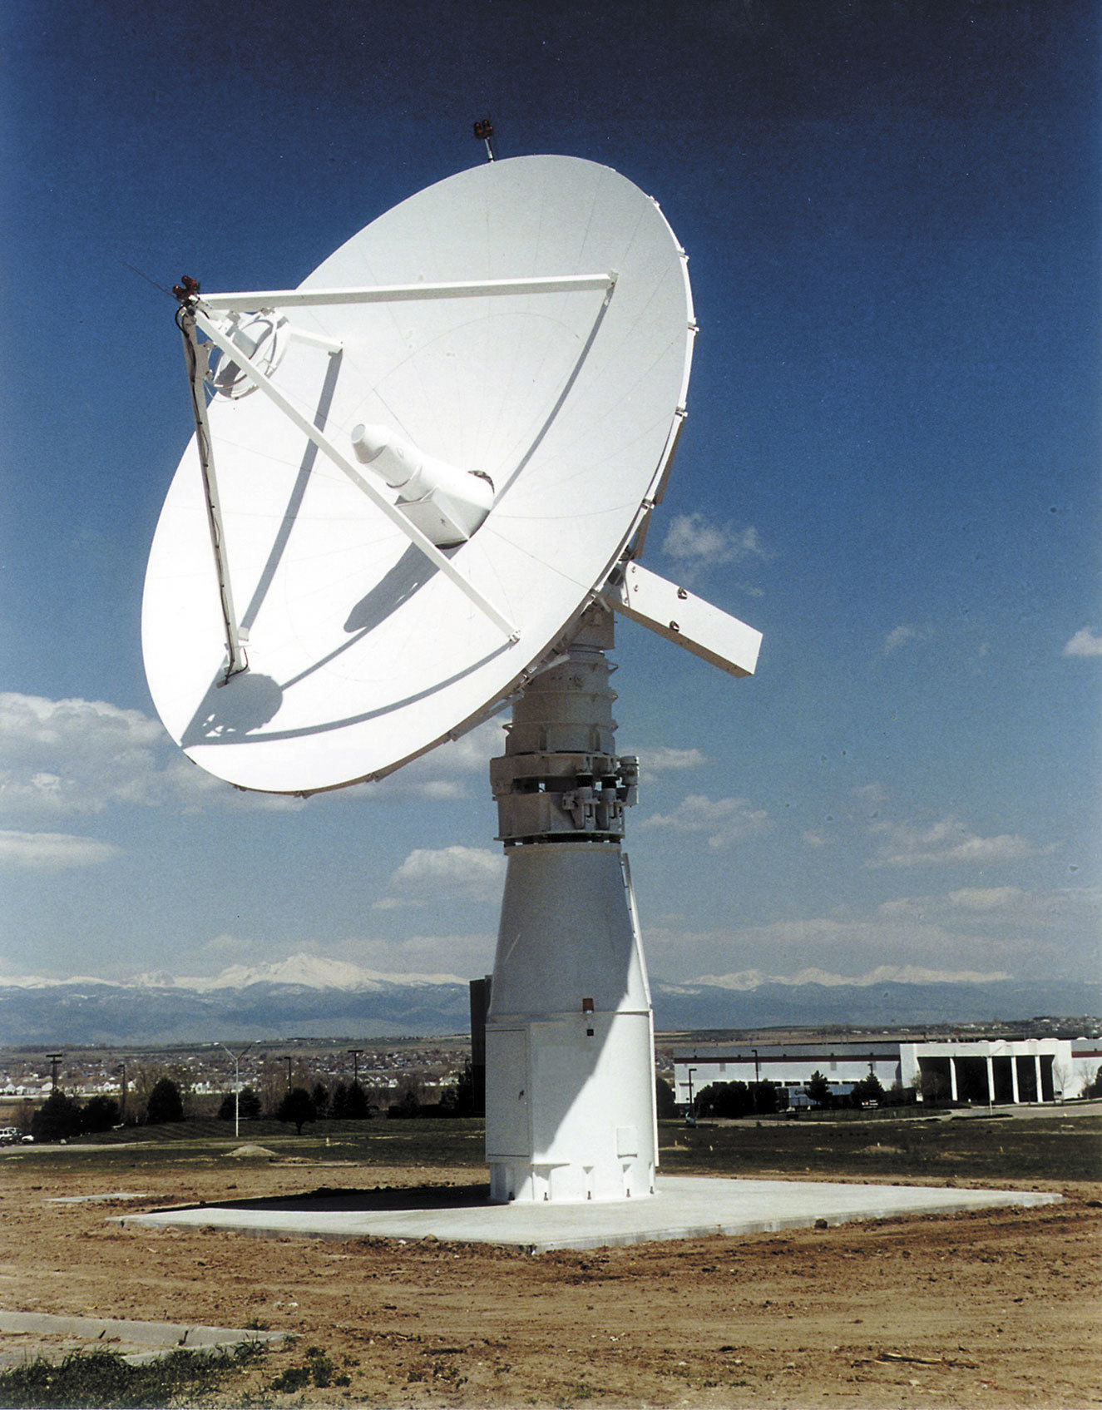
SVOM Tiles Programming – Principles and Simulation Overview
MM Alert
ToO MM Alert trigger
S-band pass selection process
(e.g. Pass N+3 selected)
at Chinese Control Center
CCC
S-band station
Alert Validation
at Science Center
Verification of accessibility
vs Sun/Moon and ToO MM constraints (error box, etc…)
S-band pass selected
e.g.
Pass N+3
TC
Tiling scenario implementation picked up at the date for WP elaboration at the latest
Work Plan elaboration
TC plan generation process
TC plan Upload
OCG
ToO-MM Tiling Process
providing scenarios updated along time
Tiling Scenario
Science Center
Mission Center
CCC
Mission Center computes the absolute times of observing slots for each tile of the sequence from scenario available at Science Center at the date at the latest for workplan elaboration depending on S-band pass selected by CCC (CLTC) and considering :
Orbit, Earth occultations & SAA crossings prediction
Tiles sequencing criterion (e g, priorities assigned)
Iterative
update

Slide 8
AGENDA
Reminders of ToO-MM scope and programming principles
Prototype for tiles sequencing
Examples of scenarios and results
Conclusion and Further Prospects

Slide 9
ToO-Multi-Messenger Prototype
SVOM Mission Planning – Status report of activities – 03/05/2018
A first version of a prototype is implemented to program all the tiles of a ToO-MM request considering :
  The definition of the tiles (number, pointing directions, observing duration, priorities)
  The S-band pass selected for TC upload (→ earliest start date)
  The available observing duration on following orbits (Earth occultations, SAA crossings)
  The instruments constraints (MXT, VT) wrt Sun & Moon
  The slew speed (4 deg / mn) with random draw for the current pointing preceding ToO-MM start date
  The system constraints with some possible relaxation to assess results and impacts :
    Total number of tiles (can be more than 25),
    Sequence duration (can be longer than 14 orbits),
    Number of tiles / orbit (can be more than 3 tiles / orbit),
    Slews > 5° during occultation or not, tiles of one given orbit in (5°x5°) or not
    Criteria for sequencing (tiles priority is the nominal, alternatives for sequence duration or slews minimization)
Consideration of all S-band passes over a time span (part of year when Sun constraint is ok)
→ Statistics on tiling sequences (sequence duration, tiles distribution, slews, …)

Slide 10
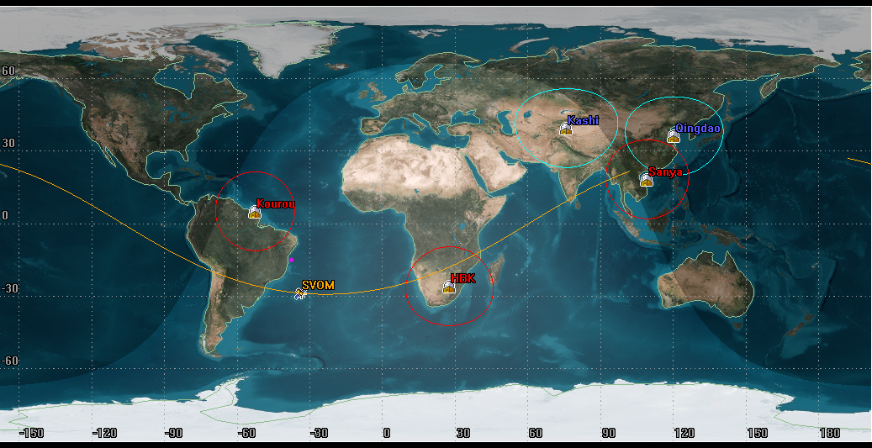
ToO-Multi-Messenger Prototype
SVOM Mission Planning – Status report of activities – 03/05/2018
S-Band
S+X-Band

Slide 11
SVOM Tiles Programming – Principles and Simulation Overview
Science Center / Scenario N
Mission Center
Tile 1 (α1,δ1),d1,p1
ToO MM alert trigger
Tile 2 (α2,δ2),d2,p2
Tstart
Tend
S-band 1
S-band 2
S-band 3
S-band 4
Tile 3 (α3,δ3),d3,p3
Tile N (αn,δn),dn,pn
Tiling sequence after S-band 2
Tstart
Tend
SAA
SAA
SAA
Earth Occ.
Earth Occ.
Earth Occ.
Earth Occ.
Earth Occ.
Available slots for observing
d5
d2
d4
Σ= d7
d1
dn
Pointings programming
Tile 5
Ti 2
Tile4
Tile7
Tile1
Tile N
(priority ranking)
First slew
Slew <5°
Slew > 5°
Slew <5°
Slew <5°

Slide 12
AGENDA
Reminders of ToO-MM scope and programming principles
Prototype for tiles sequencing
Examples of scenarios and results
  Tiles definition process
  Tiles programming
Conclusion and Further Prospects

Slide 13
ToO-Multi-Messenger Prototype
SVOM Mission Planning – Status report of activities – 03/05/2018
Representative scenarios of ToO-MM requests delivered by LAL (N. Leroy / JG Ducoin) :
  2 scenarios :
    GW170814 : 42 tiles / 10 mn obs per tile
    GW170817 : 36 tiles / 10 mn obs per tile
  ~ 3500 useful passes over 1 year (when Sun constraint ok)

Slide 14
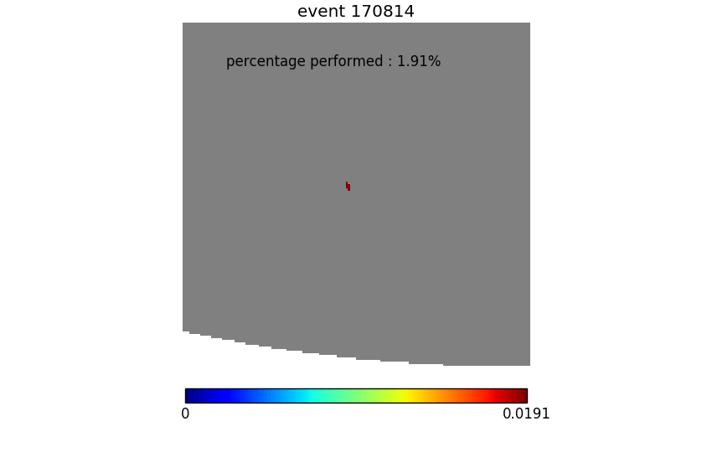
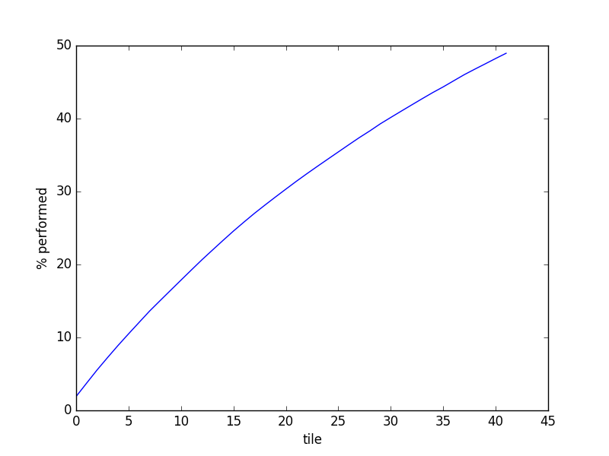
Scheduling by probability
Prioritizing tiles by probability inside each tile - Improve search with 3 tiles per orbit
BBH Exemple : 170814
Probability performed for 42 tiles : 48,96 %

Slide 15
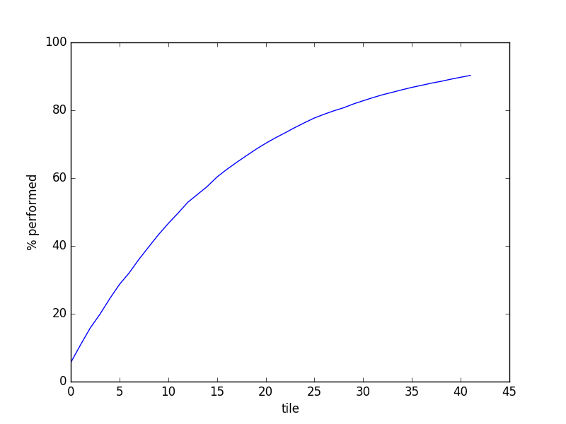
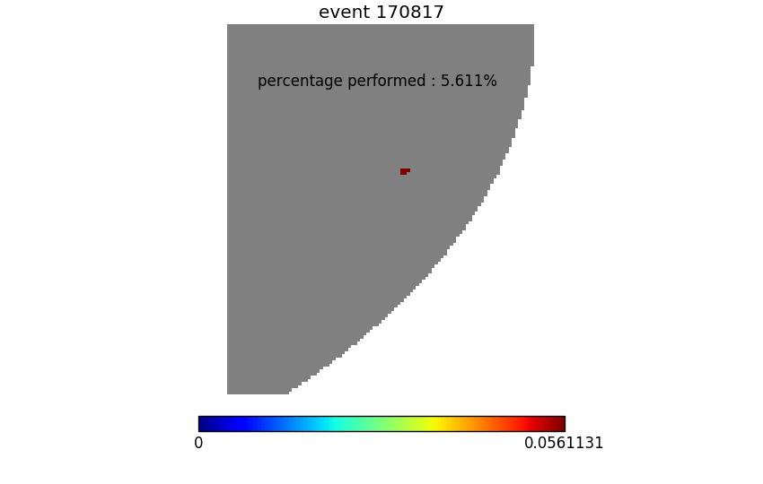
Scheduling by probability
Prioritizing tiles by probability inside each tile
BNS Exemple : 170817
Probability performed for 42 tiles : 90,27 %

Slide 16
Galaxies targeting
Hypothesis
Researched events happened in a galaxy
Catalog selection → First example with GLADE
  constructed from four existing galaxies catalogs : GWGC, 2MPZ, 2MASS XSC and HyperLEDA.
  GLADE contains 3,262,883 objects. (http://aquarius.elte.hu/glade/)
Selection of galaxies inside the 3D volume RA, Dec, distance (using 3 sigma error for the latest)
Priorisation of tiles using the number of galaxies inside each of them

Slide 17
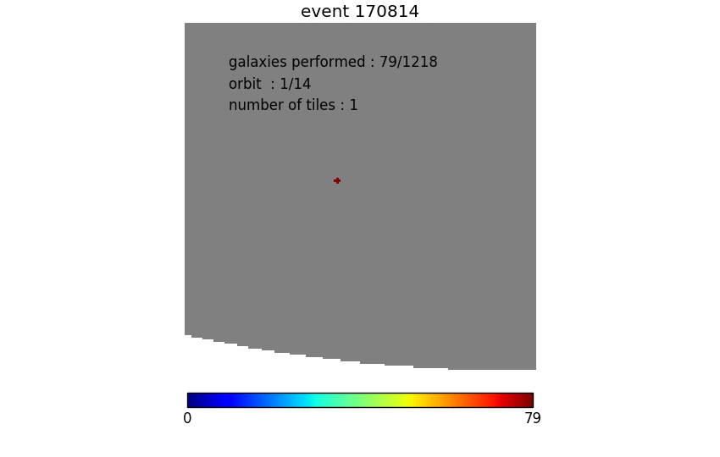
Galaxies targeting
Limitation of 14 orbits and 3 tiles per orbit
 | Galaxies performed | Orbit (max 14) | Number of tile (max 42)
50 % | 1197/1218 | 14 | 42
90 % | 4493/9914 | 14 | 42
BBH CASE : GW 170814

Slide 18
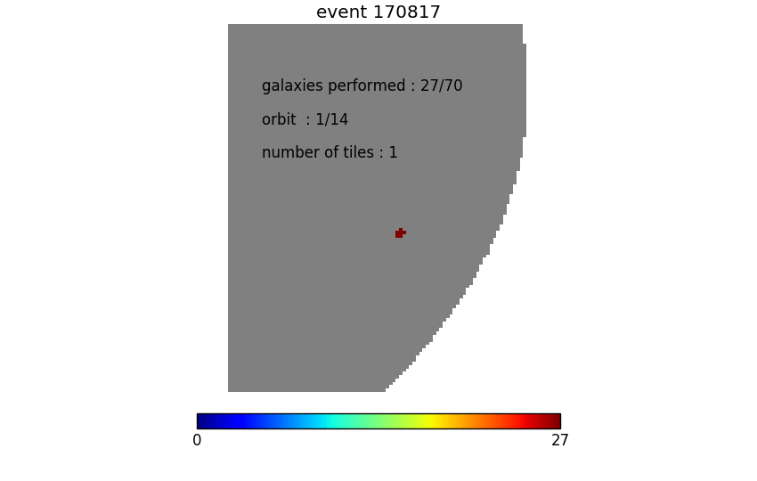
Galaxies targeting
BNS CASE : GW 170817
Limitation of 14 orbits and 3 tiles per orbit
 | Galaxies performed | Orbit (max 14) | Number of tile (max 42)
50 % | 70/70 | 4 | 11
90 % | 185/185 | 13 | 36

Slide 19
Galaxies targeting
Ongoing :
- Study different catalogs : completness issue, distance computation, …
- Include type of galaxy ?
- More tests are performed with :
~200 simulated 02 skymaps triple coincidence
Distance between 5 and 270 Mpc
Error region spanning from 1.2 and 3000 deg2

Slide 20
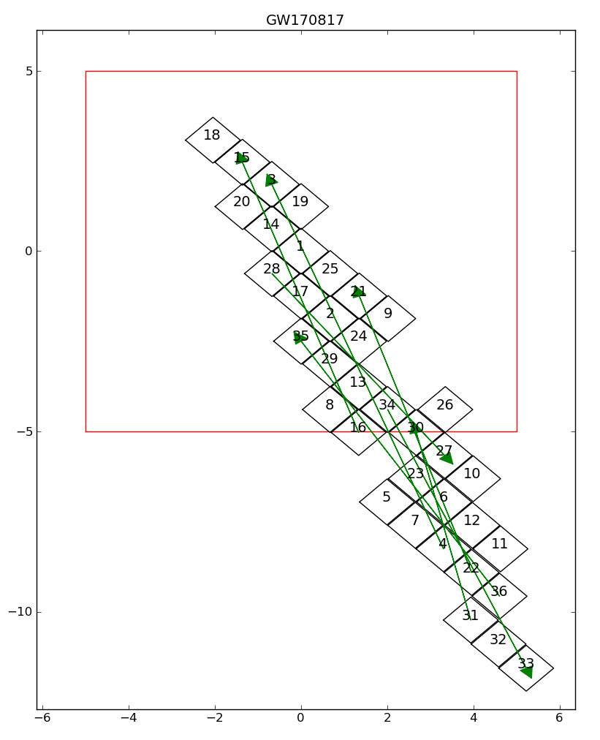
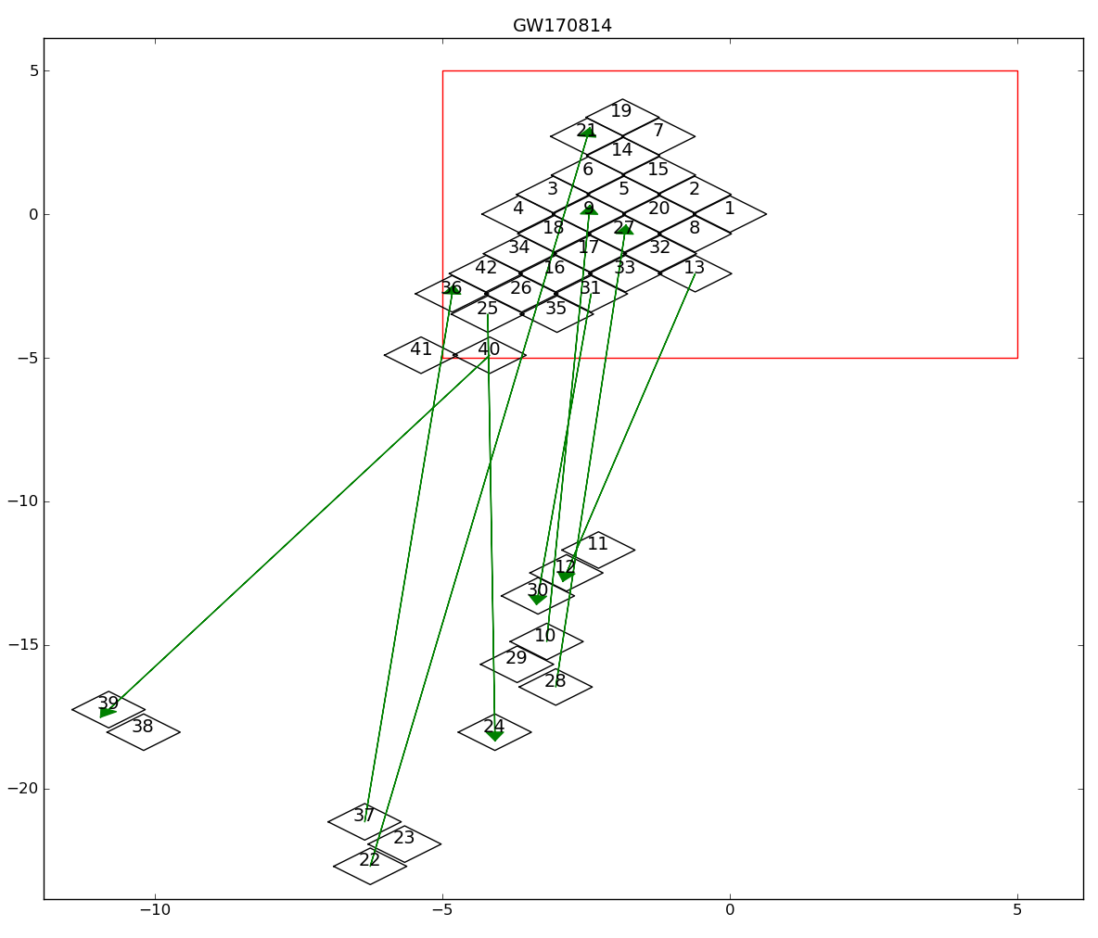
ToO-Multi-Messenger Prototype
SVOM Tiles Programming – Principles and Simulation Overview
GW170814 : 42 tiles
GW170817 : 36 tiles
Simplified representation of tiles centered on tiles n°1
Slews > 5°
8 slews >> 5°
Max ~ 25°
7 slews > 5°
Max ~ 11°
deg
Note : Tiling built to insert slews > 5° every 3 tiles
deg

Slide 21
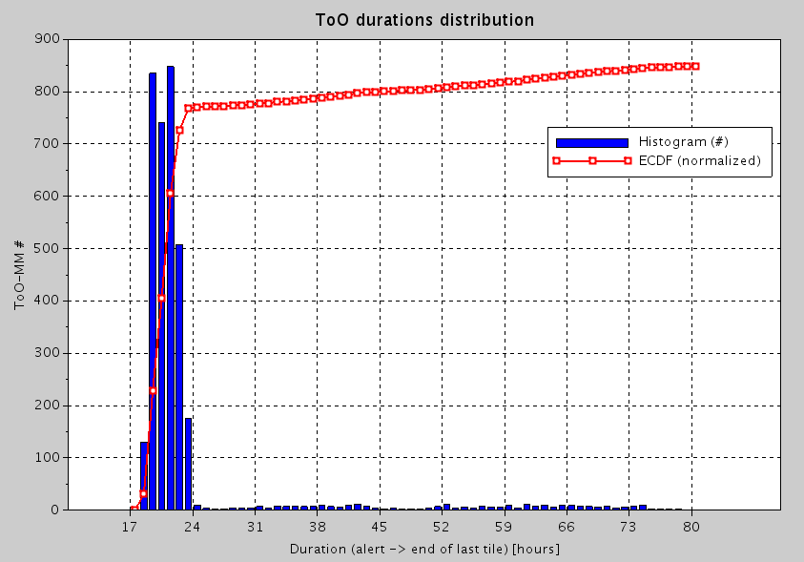
ToO-Multi-Messenger Prototype
SVOM Tiles Programming – Principles and Simulation Overview
GW170817 : 36 tiles, 10 mn / tile, limited 3 tiles / orb
Slews > 5° not constrained
Histogram and cumulative distribution of whole sequence duration for all S-band passes over 1 year
(sequencing with tiles priorities)
☞ T₀ = Start S-band slot
Min = 18 h
Max = 25 h / 79 h (Moon)
Aver. = 22 h
Moon disturbance
T₀ → End last tile (hours)

Slide 22
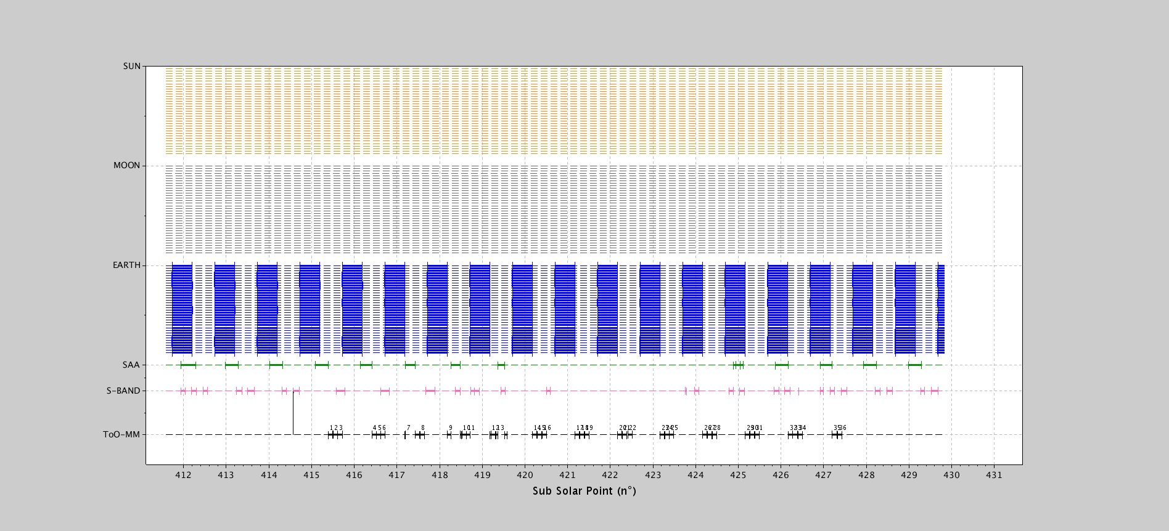
ToO-Multi-Messenger Prototype
SVOM Tiles Programming – Principles and Simulation Overview
GW170817 : 36 tiles, 10 mn / tile, limited 3 tiles / orb

Slide 23
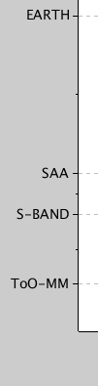
ToO-Multi-Messenger Prototype
SVOM Tiles Programming – Principles and Simulation Overview
GW170817 : 36 tiles, 10 mn / tile, limited 3 tiles / orb

Slide 24
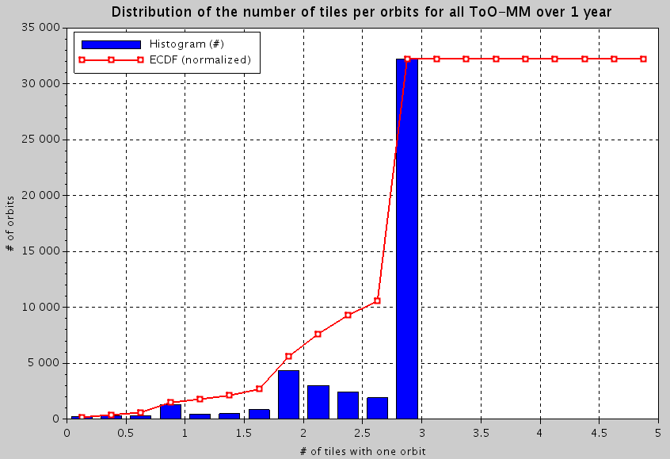
ToO-Multi-Messenger Prototype
SVOM Tiles Programming – Principles and Simulation Overview
GW170817 : 36 tiles, 10 mn / tile, limited 3 tiles / orb
Slews > 5° not constrained
Histogram and cumulative distribution of numbers of tiles per orbit over all sequences for all
S-band passes
over 1 year
(sequencing with tiles priorities)
Most of orbits with 3 tiles
Nb tiles / orbit
Orbits begin/end at subsolar point

Slide 25
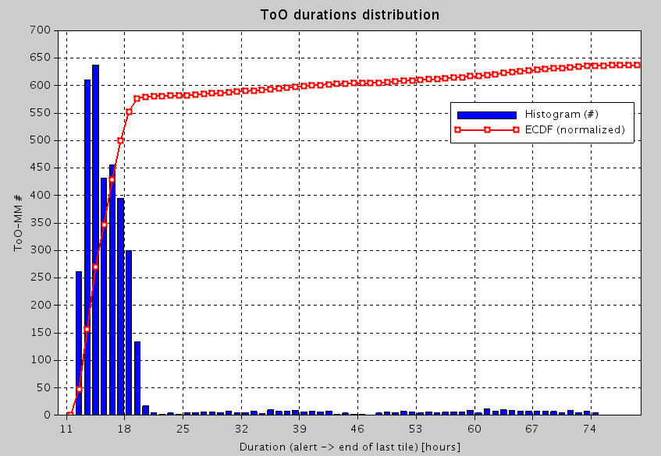
ToO-Multi-Messenger Prototype
SVOM Tiles Programming – Principles and Simulation Overview
GW170817 : 36 tiles, 10 mn / tile, tiles / orb not limited
Slews > 5° not constrained
Histogram and cumulative distribution of whole sequence duration for all S-band passes over 1 year
(sequencing with tiles priorities)
☞ T₀ = Start S-band slot
Min = 12 h
Max = 21 h / 75 h (Moon)
Aver. = 15 h
Moon disturbance
Min = 18 h
Max = 25 h / 79 h (Moon)
Aver. = 22 h
T₀ → End last tile (hours)
Limited 3 tiles / orb

Slide 26
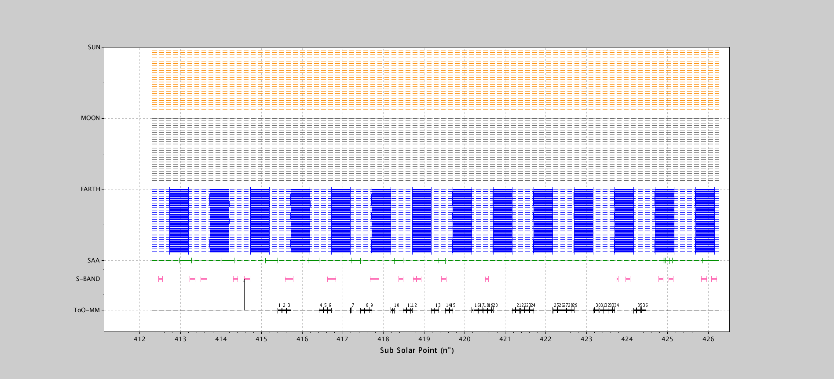
ToO-Multi-Messenger Prototype
SVOM Tiles Programming – Principles and Simulation Overview
GW170817 : 36 tiles, 10 mn / tile, tiles / orb not limited

Slide 27
ToO-Multi-Messenger Prototype
SVOM Tiles Programming – Principles and Simulation Overview
GW170817 : 36 tiles, 10 mn / tile, tiles / orb not limited

Slide 28
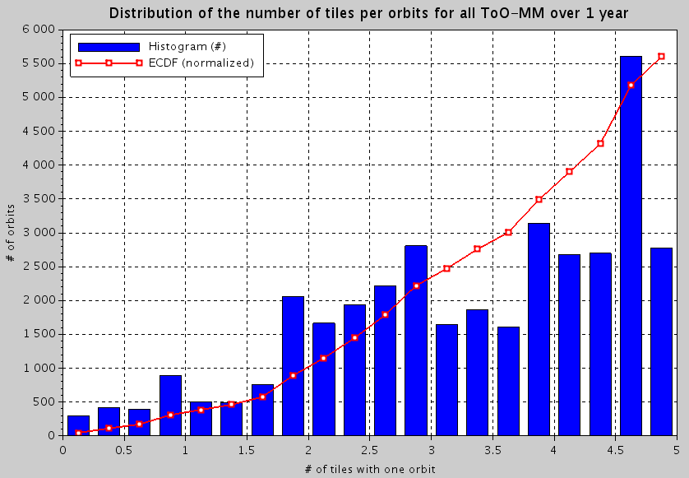
ToO-Multi-Messenger Prototype
SVOM Tiles Programming – Principles and Simulation Overview
GW170817 : 36 tiles, 10 mn / tile, tiles / orb not limited
Slews > 5° not constrained
Histogram and cumulative distribution of numbers of tiles per orbit over all sequences for all
S-band passes
over 1 year
(sequencing with tiles priorities)
Up to 5 tiles / orbit useful
if feasible
Nb tiles / orbit
Orbits begin/end at subsolar point

Slide 29
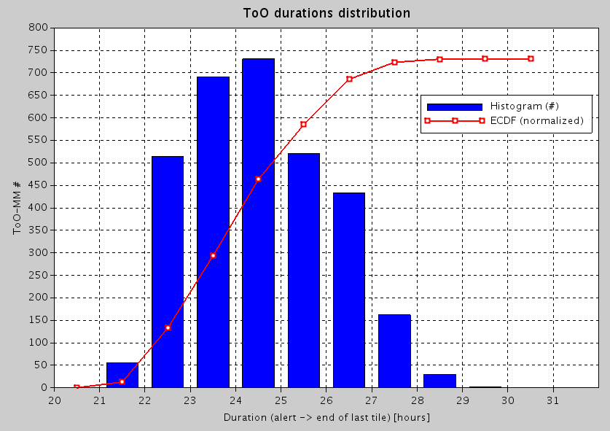
ToO-Multi-Messenger Prototype
SVOM Tiles Programming – Principles and Simulation Overview
GW170814 : 42 tiles, 10 mn / tile, limited 3 tiles / orb
Slews > 5° not constrained
Histogram and cumulative distribution of whole sequence duration for all S-band passes over 1 year
(sequencing with tiles priorities)
☞ T₀ = Start S-band slot
Min = 22 h
Max = 29 h
Aver. = 25 h
T₀ → End last tile (hours)

Slide 30
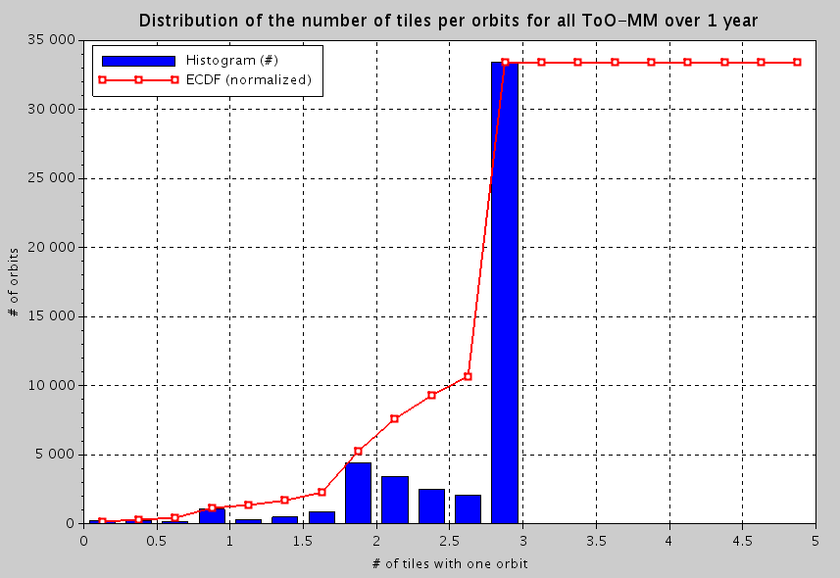
ToO-Multi-Messenger Prototype
SVOM Tiles Programming – Principles and Simulation Overview
GW170814 : 42 tiles, 10 mn / tile, limited 3 tiles / orb
Slews > 5° not constrained
Histogram and cumulative distribution of numbers of tiles per orbit over all sequences for all
S-band passes
over 1 year
(sequencing with tiles priorities)
Most of orbits with 3 tiles
Nb tiles / orbit
Orbits begin/end at subsolar point

Slide 31
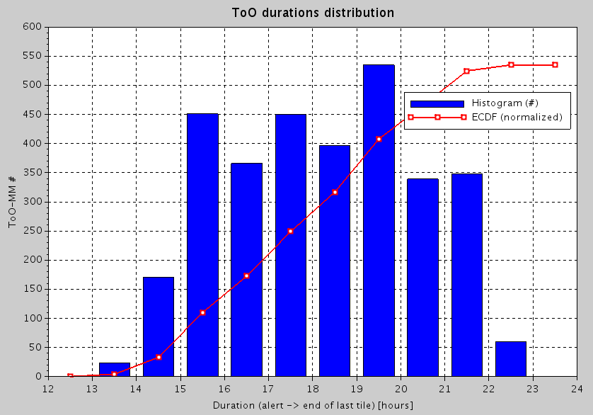
ToO-Multi-Messenger Prototype
SVOM Tiles Programming – Principles and Simulation Overview
GW170814 : 42 tiles, 10 mn / tile, tiles / orb not limited
Slews > 5° not constrained
Histogram and cumulative distribution of whole sequence duration for all S-band passes over 1 year
(sequencing with tiles priorities)
☞ T₀ = Start S-band slot
Min = 14 h
Max = 23 h
Aver. = 19 h
Min = 22 h
Max = 29 h
Aver. = 25 h
T₀ → End last tile (hours)
Limited 3 tiles / orb

Slide 32
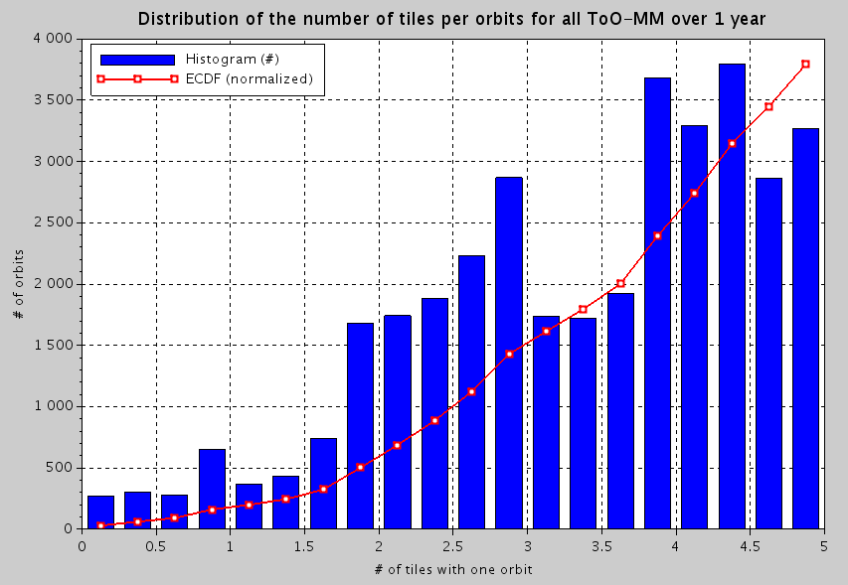
ToO-Multi-Messenger Prototype
SVOM Tiles Programming – Principles and Simulation Overview
GW170814 : 42 tiles, 10 mn / tile, tiles / orb not limited
Slews > 5° not constrained
Histogram and cumulative distribution of numbers of tiles per orbit over all sequences for all
S-band passes
over 1 year
(sequencing with tiles priorities)
Up to 5 tiles / orbit useful
if feasible
Nb tiles / orbit
Orbits begin/end at subsolar point

Slide 33
AGENDA
Reminders of ToO-MM scope and programming principles
Prototype for tiles sequencing
Examples of scenarios and results
Conclusion and Further Prospects

Slide 34
Conclusions and further prospects
SVOM Mission Planning – Status report of activities – 03/05/2018
The prototype implemented currently allows for statistically assessing the duration of whole sequences of tiling relating to ToO-MM scenarios with possible variations for constraints
Refine consideration of constraints (slew constraints / occultation periods if needed)
Implement model for ground delays from MM alert up to S-band TC upload
→ Total response time for ToO-MM requests
Simulations to be performed with additional scenarios of ToO-MM requests delivered by LAL :
  ~200 new scenarios simulated from skymaps

Slide 35
SVOM Mission Planning and Programming Overview
谢谢
Thank You

