Slide 1
Engine-powered optical transients
Lingjun Wang
IHEP, CAS
2018/05/17@Les Houches

Slide 2
Contents
Magnetar spin-down powered transients
Supernovae
GRB afterglows
Accretion (onto black holes or magnetars) powered transients
Supernovae
GRB afterglows

Slide 3
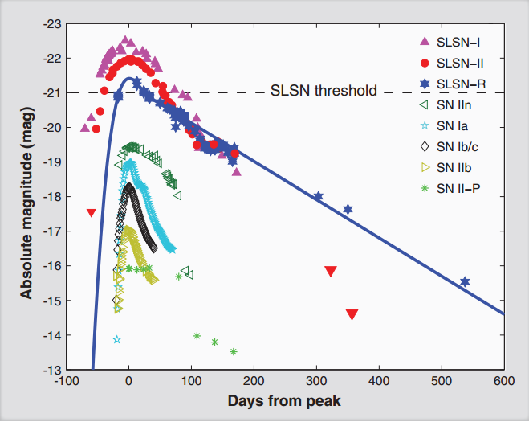
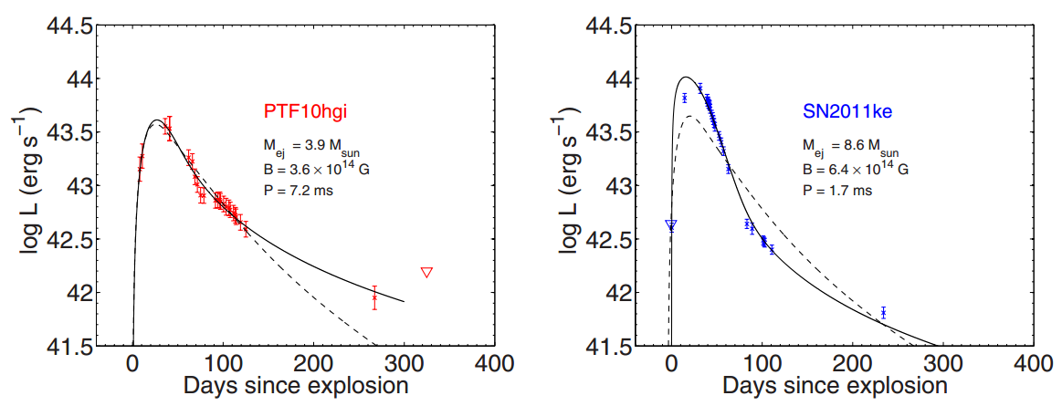
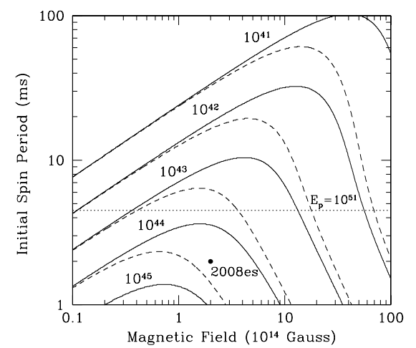
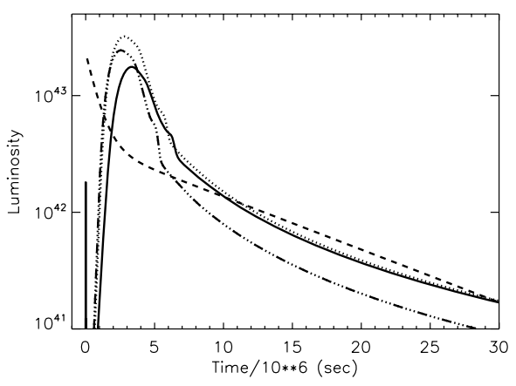
Superluminous supernovae
It is suggested that SLSNe I are powered by magnetars.
Inserra+ 2013
Gal-Yam (2012)
Kasen & Bildsten (2010)
Woosley (2010)

Slide 4
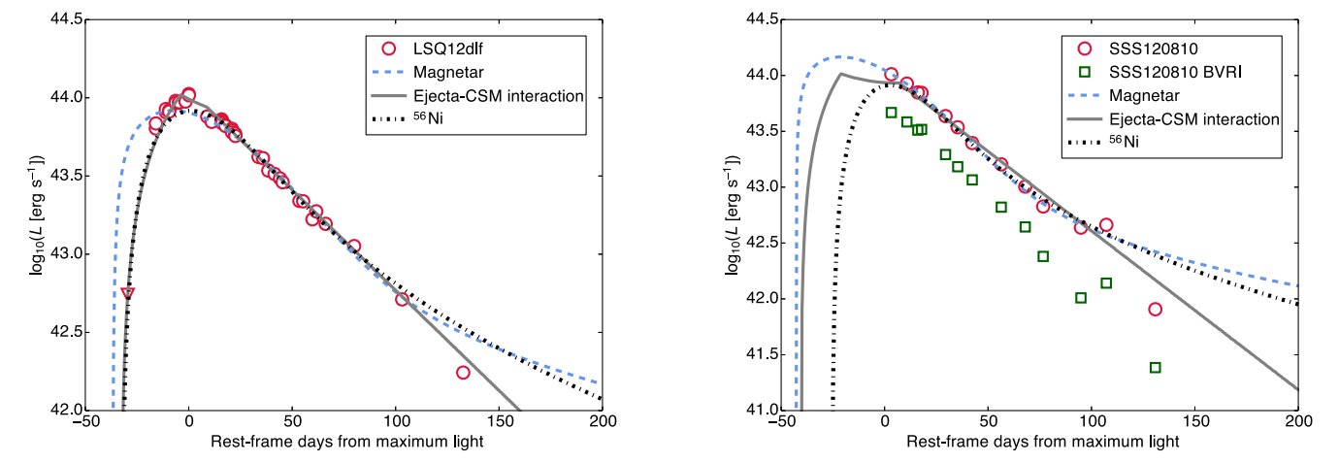
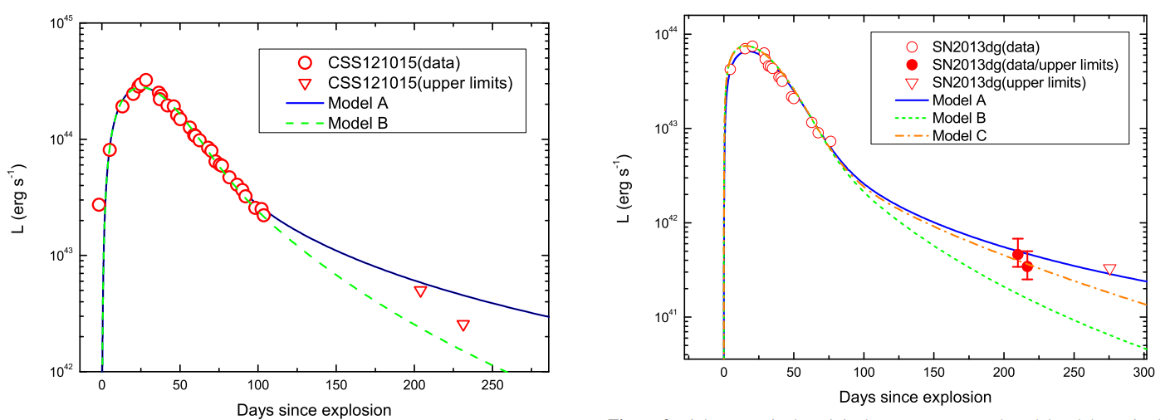
SLSNe: Hard emission leakage
The late-time low luminosity is suggested to be caused by hard emission leakage.
Nicholl + 2014
Wang + 2015, ApJ, 799, 107

Slide 5
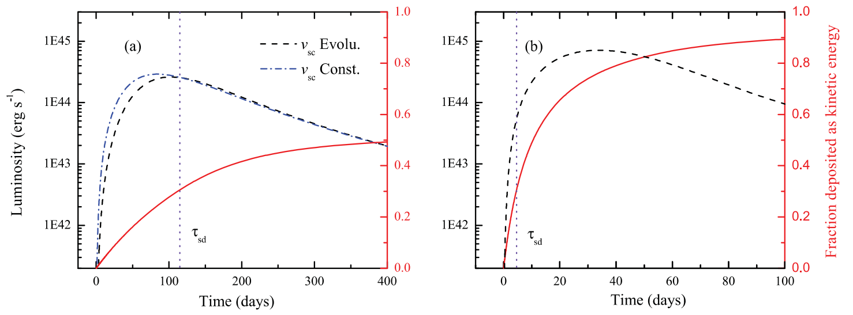
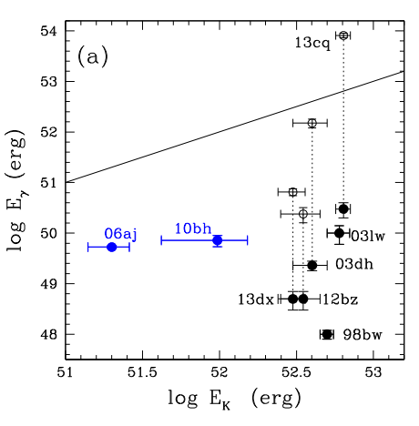
Ejecta acceleration by magnetar spin-down
The acceleration of ejecta by magnetar spin-down is quantitatively calculated.
->
A possible way to provide SNe Ic-BL with large kinetic energy.
Wang + 2016, ApJ, 821, 22
Mazzali+2014
GRBs/SNe (broad-lined type Ic SNe, SNe Ic-BL) are powered by magnetars?

Slide 6
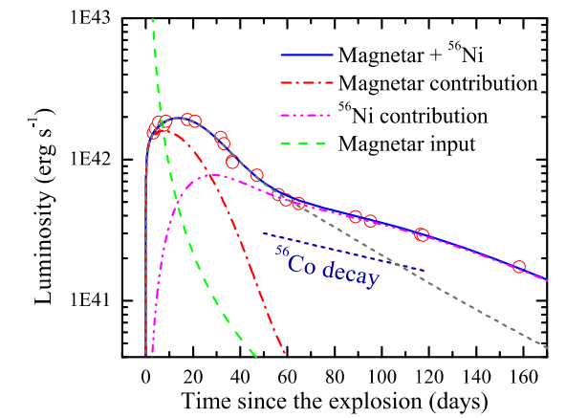
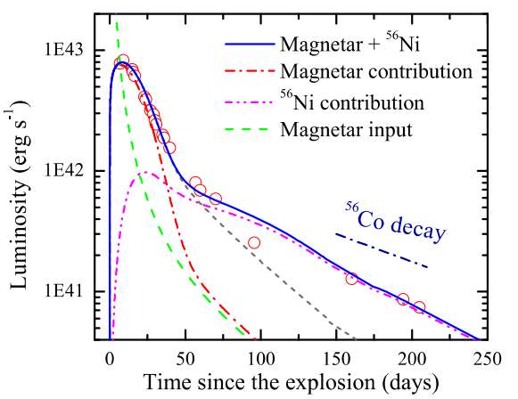
Broad-lined SNe Ic (SNe Ic-BL)
The ⁵⁶Ni problem of magnetar-powered SNe Ic-BL can be solved.
The peaks in the lights curve of SNe Ic-BL are powered by magnetars, while the exponential decay is powered by ⁵⁶Ni cascade decay.
The magnetar can contribute significantly to the kinetic energy of SNe Ic-BL.
Wang + 2016, ApJ, 831, 41

Slide 7
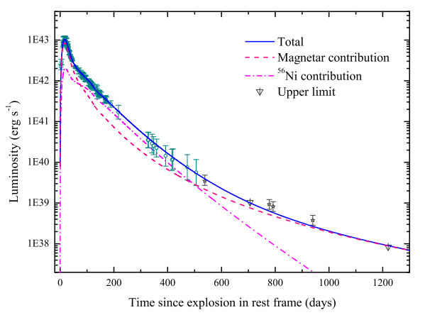
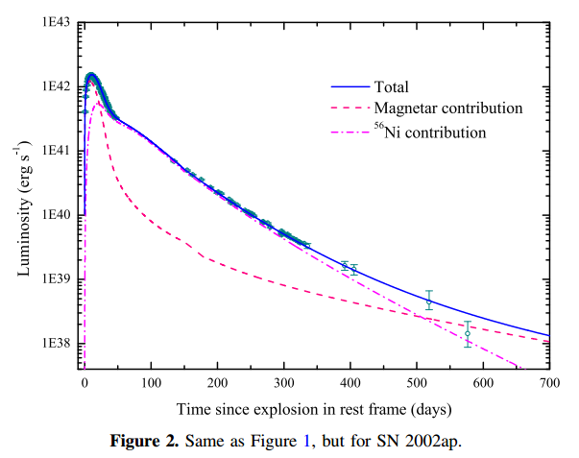
SNe Ic-BL 1998bw and 2002ap
SN 1998bw was associated with GRB980425.
Evidence for magnetar-powered GRB-SNe.
See also Wang+2017, ApJ, 851, 54
Wang + 2017, ApJ, 837, 128

Slide 8
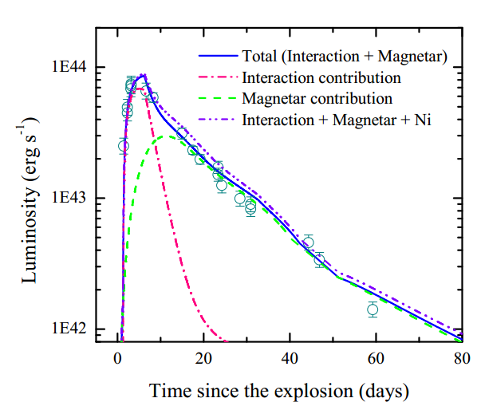
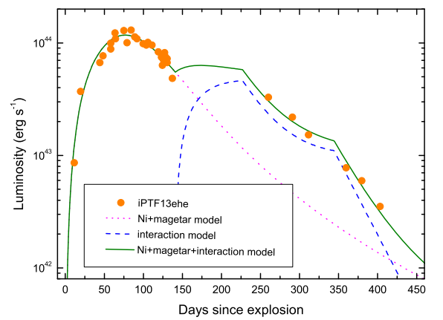
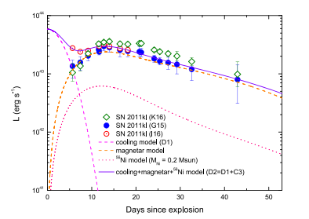
Other energy sources (interaction & cooling)
Sometimes magnetar+⁵⁶Ni cannot account for the light curves, other energy sources should be included, for example, CSM-ejecta interaction (iPTF13ehe, Wang+2016, 828, 87; iPTF16asu, Wang+2017, 1712.07359), shock cooling (2011kl, Wang+2017, 850, 148).
Wang + 2016, ApJ, 828, 87
Wang + 2017, 1712.07359
Wang + 2017, ApJ, 850, 148

Slide 9
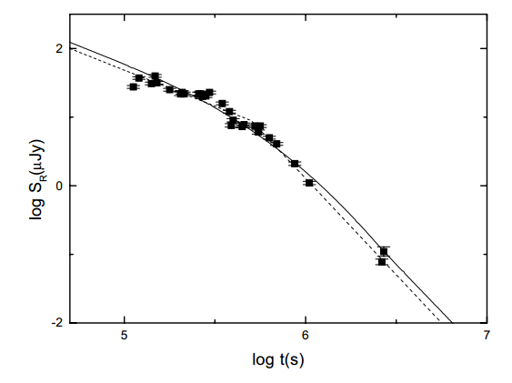
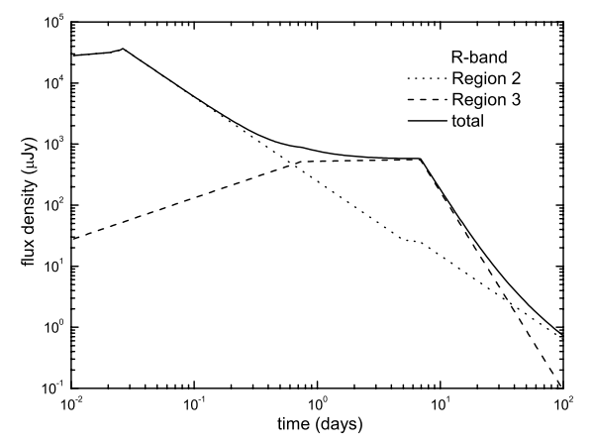
Magnetar-powered GRB afterglows
Usov (1992) proposed magnetar model for long GRBs.
Dai & Lu (1998a, 1998b) proposed that the double neutron star mergers may result in stable magnetars.
A shallow decay in the afterglow of GRBs.
Dai & Lu 2001
Dai 2004

Slide 10
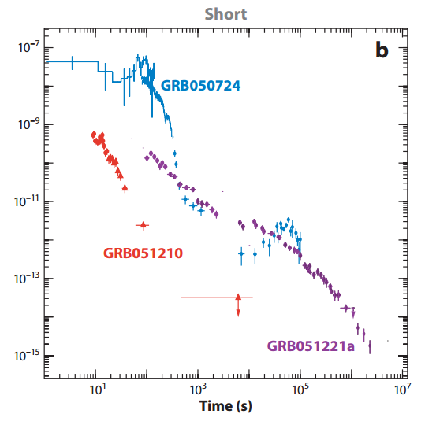
Magnetar-powered GRB afterglows
X-ray flares discovered by swift.
Dai+2006 put forward a magnetic amplification model to account for X-ray flares by assuming the formation of stable magnetars following double neutron star mergers.

Slide 11
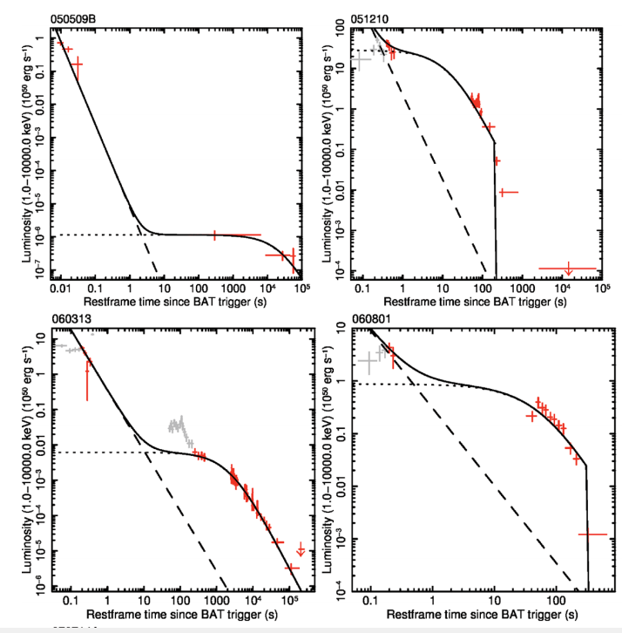
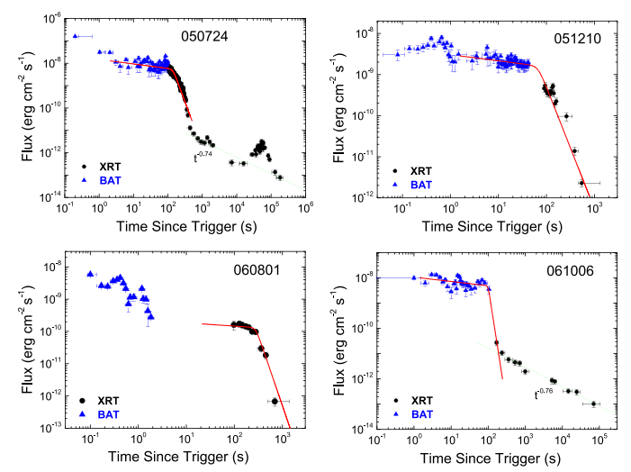
Magnetar-powered GRB afterglows
Evidence for magnetar central engine for short GRBs (Rowlinson+ 2010, 2013, Lü+2015)

Slide 12
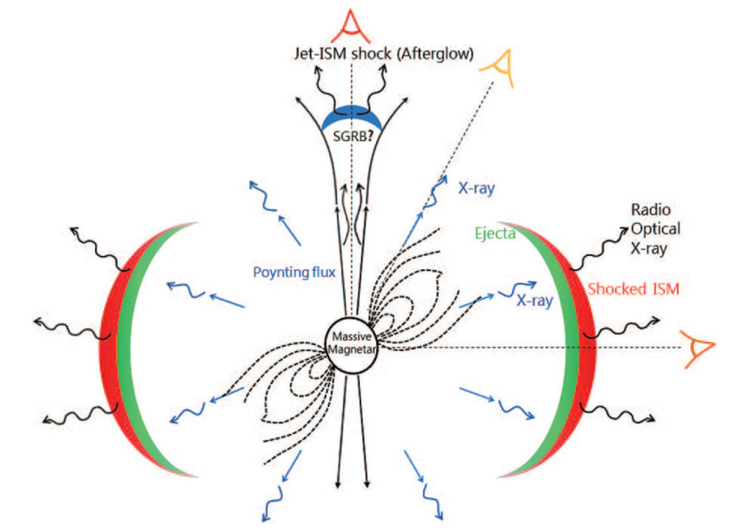
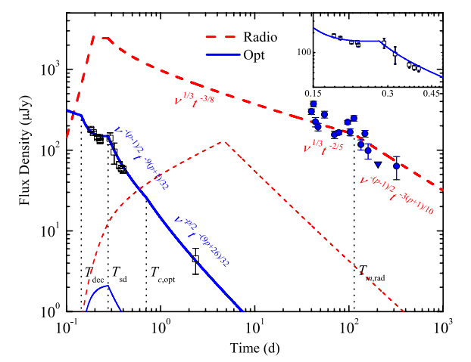
Magnetar-powered GRB afterglows
Bright multi-band emission powered by magnetars following neutron star mergers (Gao+2013).
PTF11agg might be the afterglow of a short GRB powered by a magnetar (Wang & Dai 2013).
Gao+2013
Wang & Dai 2013

Slide 13
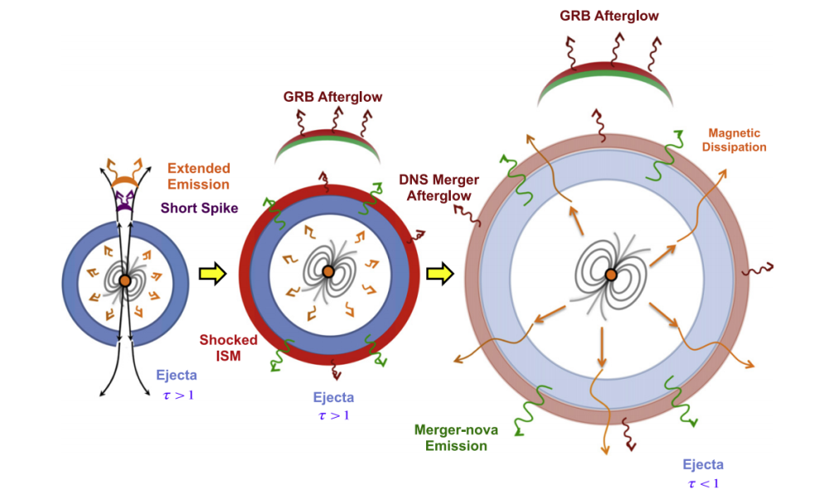
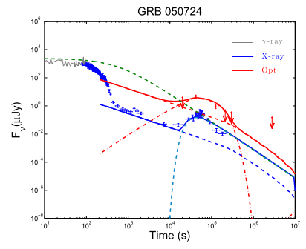
Magnetar-powered GRB afterglows
The X-ray flare and optical bump in the afterglow of GRB 050724 may be the signature of a long-lived magnetar.
Gao+2015, 2017

Slide 14
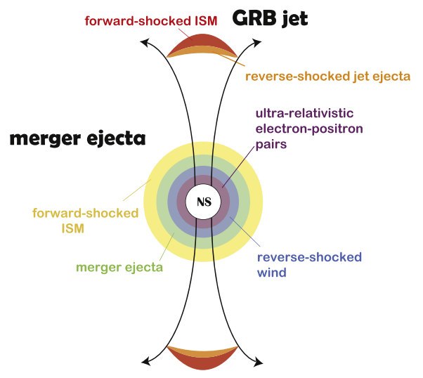
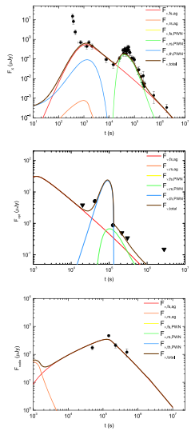
The pulsar wind nebula (PWN) model
Lin+2018
The X-ray flare and optical bump in the afterglow of GRB 050724 may be the signature of a magnetar.
A bare PWN without surrounding SN ejecta might be the source of repeating fast radio bursts (Dai+2017).

Slide 15
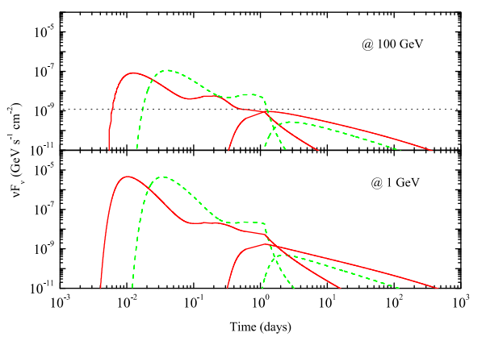
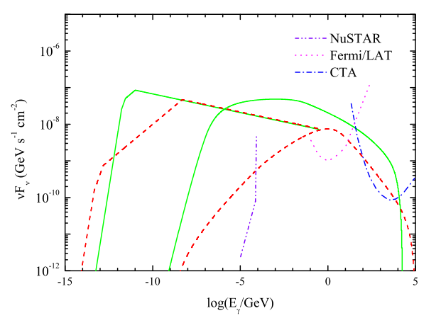
High energy emission as a signature of mag
Light curves @ 1GeV and 100GeV
Spectral energy distribution
Wang+2015, ApJ, 800, 79
Wang+2016, ApJ, 823, 15
High energy emission as a signature of magnetars caused by IC scattering.

Slide 16
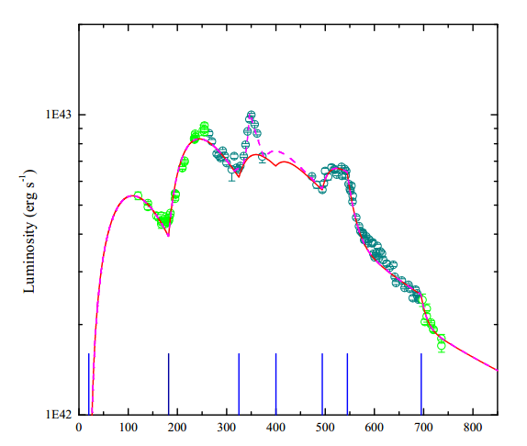
Accretion-powered supernovae
Fallback accretion-powered supernovae.
Disk instability could result in intermittent accretion and multi-peaked supernovae, like iPTF14hls (Wang+2018).
Wang+2018

Slide 17
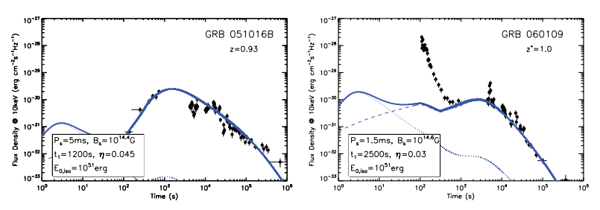
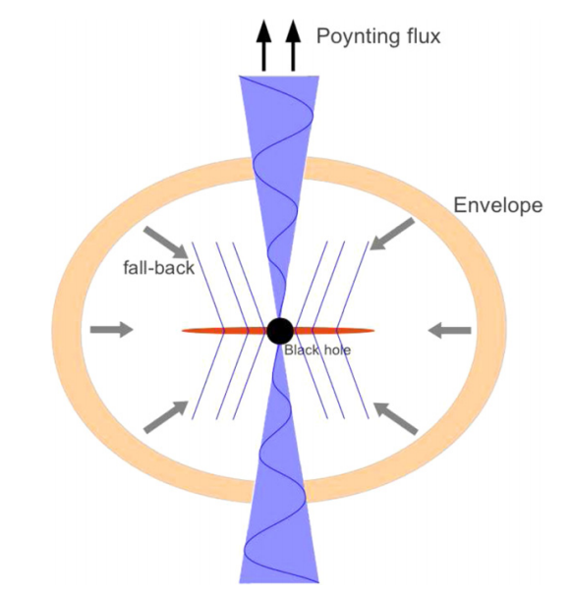
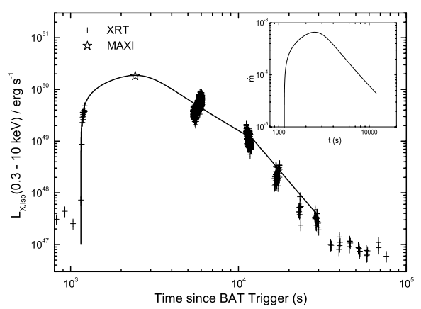
Accretion-powered GRB afterglows
Rebrightening because of the propeller effect of magnetar hyperaccretion (Dai & Liu 2012).
Giant X-ray bump caused by fallback onto black holes (Wu+2013).
Dai & Liu 2012
Wu+2013

Slide 18
Thank you!
merci

